Slide 1
Section 13.4
Determining Limits of Functions

Slide 2
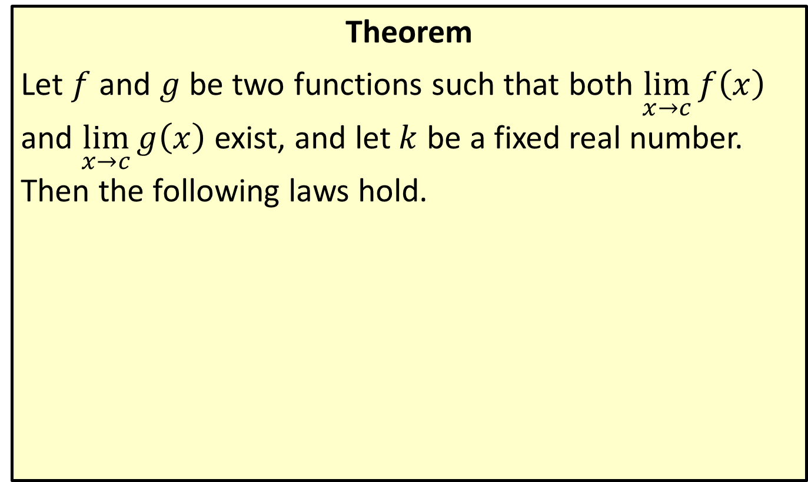
Basic Limit Laws
Theorem
Let $f$ and $g$ be two functions such that both $\lim_{x→c}⁡f\left(x\right)$ and $\lim_{x→c}⁡g\left(x\right)$ exist, and let $k$ be a fixed real number. Then the following laws hold.

Slide 3
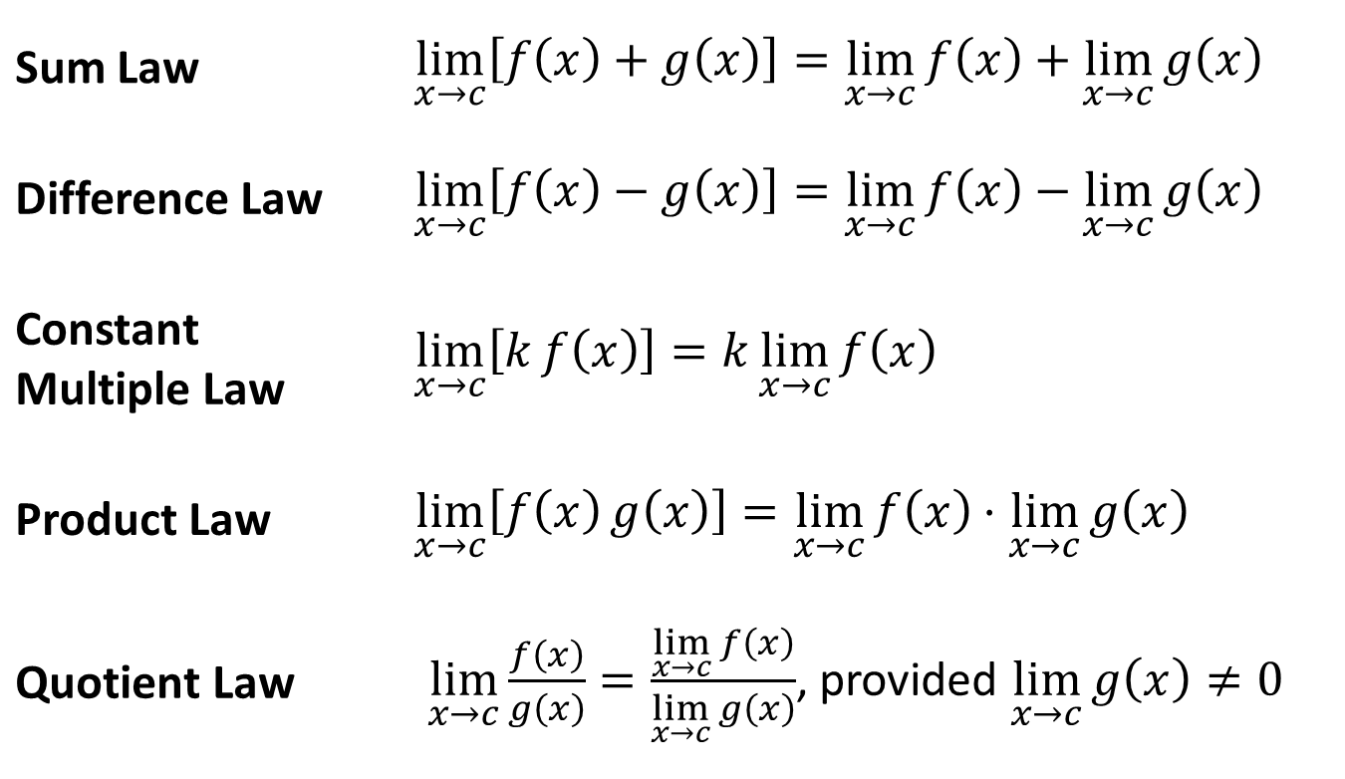
Basic Limit Laws (cont.)
Sum Law | $\lim_{x→c}\left[f\left(x\right)+g\left(x\right)\right]=\lim_{x→c}{f\left(x\right)}+\lim_{x→c}{g\left(x\right)}$
Difference Law | $\lim_{x→c}\left[f\left(x\right)−g\left(x\right)\right]=\lim_{x→c}{f\left(x\right)}−\lim_{x→c}{g\left(x\right)}$
Constant Multiple Law | $\lim_{x→c}\left[kf\left(x\right)\right]=k\lim_{x→c}{f\left(x\right)}$
Product Law | $\lim_{x→c}\left[f\left(x\right)g\left(x\right)\right]=\lim_{x→c}{f\left(x\right)}⋅\lim_{x→c}{g\left(x\right)}$
Quotient Law | $\lim_{x→c}{\frac{f\left(x\right)}{g\left(x\right)}}=\frac{\lim_{x→c}{f\left(x\right)}}{\lim_{x→c}{g\left(x\right)}}$, provided $\lim_{x→c}{g\left(x\right)}≠0$

Slide 4
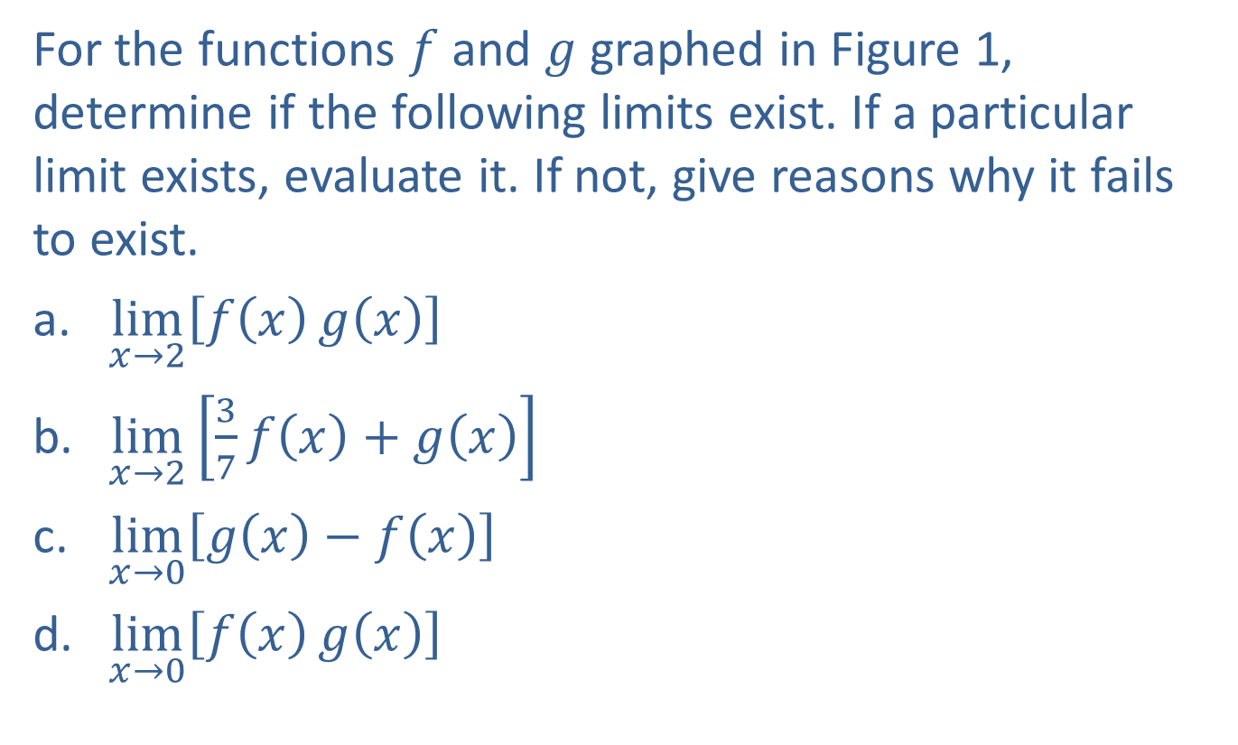
Example 1: Using Graphs and Limit Laws to Determine Limits
For the functions $f$ and $g$ graphed in Figure 1, determine if the following limits exist. If a particular limit exists, evaluate it. If not, give reasons why it fails to exist.
​$\lim_{x→2}⁡\left[f\left(x\right)g\left(x\right)\right]$
​$\lim_{x→2}⁡\left[\frac{3}{7}f\left(x\right)+g\left(x\right)\right]$
​$\lim_{x→0}⁡\left[g\left(x\right)−f\left(x\right)\right]$
​$\lim_{x→0}⁡\left[f\left(x\right)g\left(x\right)\right]$

Slide 5
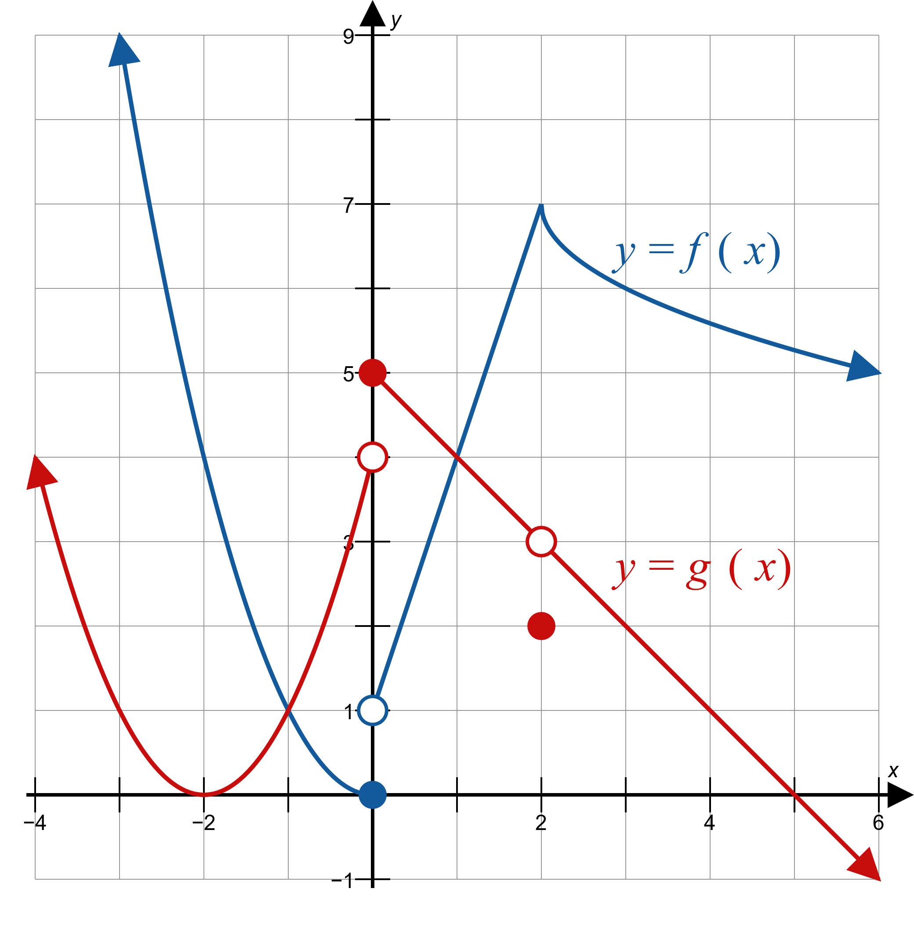
Example 1: Using Graphs and Limit Laws to Determine Limits (cont.)
Figure 1

Slide 6
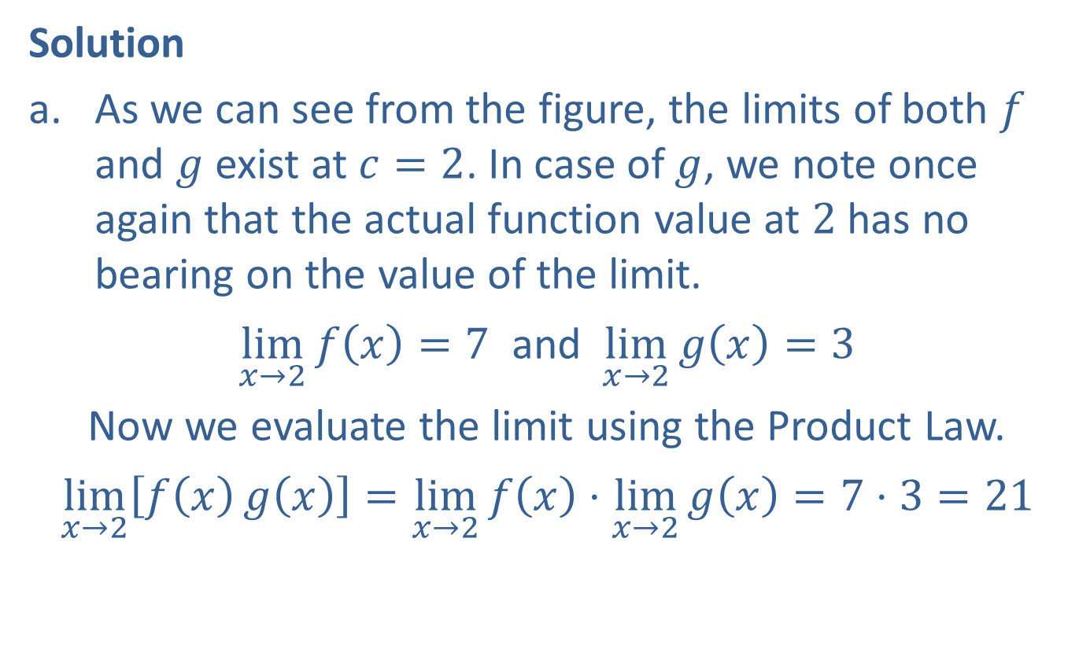
Example 1: Using Graphs and Limit Laws to Determine Limits (cont.)
Solution
​As we can see from the figure, the limits of both $f$ and $g$ exist at $c=2$. In case of $g$, we note once again that the actual function value at 2 has no bearing on the value of the limit.
​$\lim_{x→2}{f\left(x\right)}=7$ and $\lim_{x→2}{g\left(x\right)}=3$
  Now we evaluate the limit using the Product Law.
​$\lim_{x→2}\left[f\left(x\right)g\left(x\right)\right]=\lim_{x→2}{f\left(x\right)}⋅\lim_{x→2}{g\left(x\right)}=7⋅3=21$

Slide 7
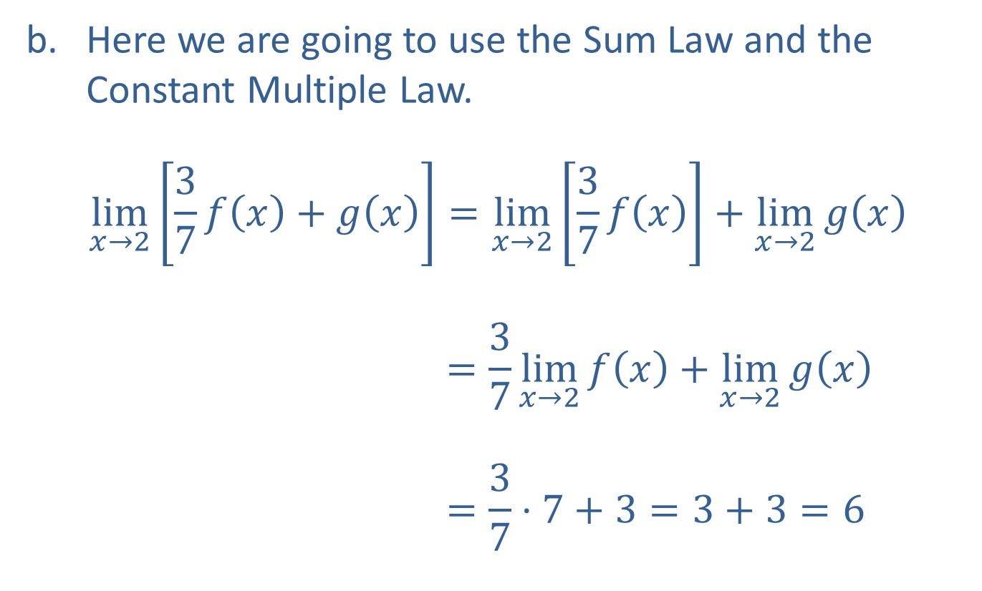
Example 1: Using Graphs and Limit Laws to Determine Limits (cont.)
​Here we are going to use the Sum Law and the Constant Multiple Law.
$$\lim_{x→2}\left[\frac{3}{7}f\left(x\right)+g\left(x\right)\right]=\lim_{x→2}\left[\frac{3}{7}f\left(x\right)\right]+\lim_{x→2}{g\left(x\right)} \\ =\frac{3}{7}\lim_{x→2}{f\left(x\right)}+\lim_{x→2}{g\left(x\right)} \\ =\frac{3}{7}⋅7+3=3+3=6$$

Slide 8
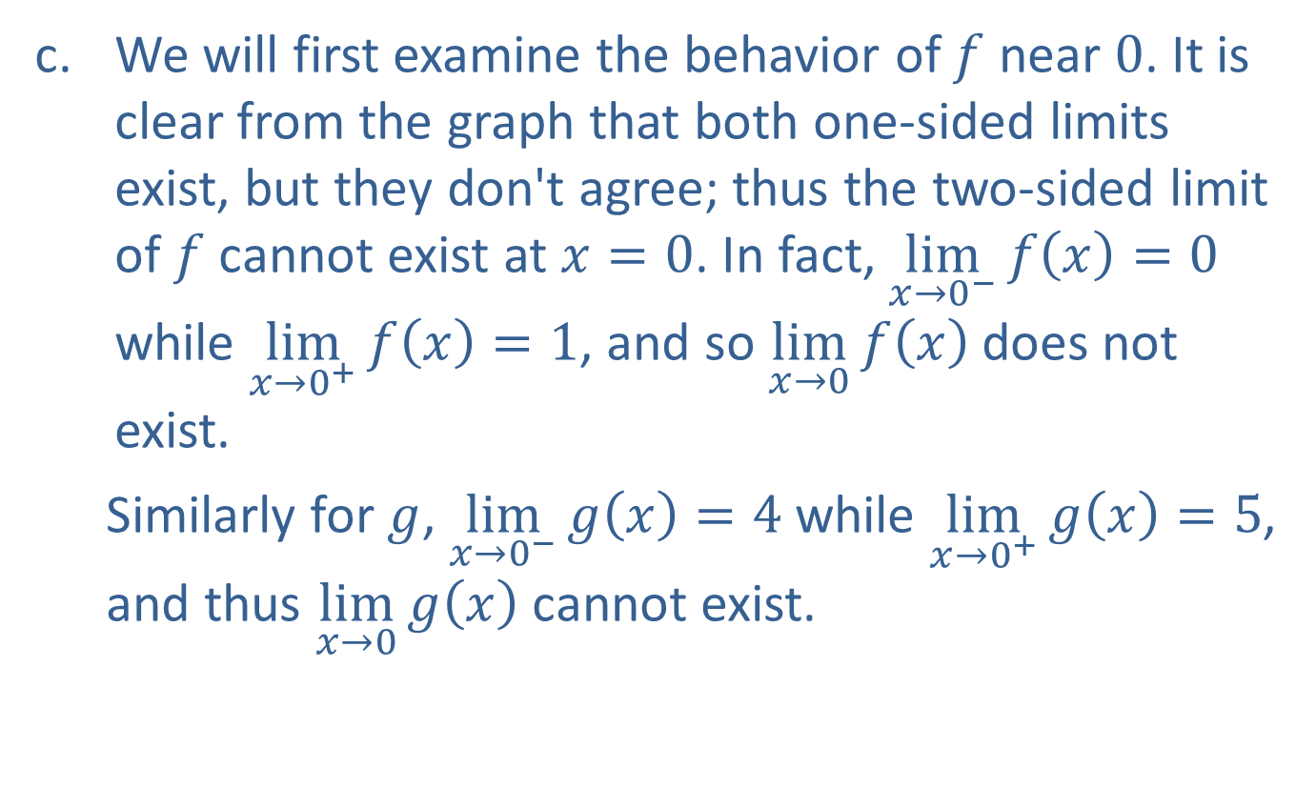
Example 1: Using Graphs and Limit Laws to Determine Limits (cont.)
​We will first examine the behavior of $f$ near 0. It is clear from the graph that both one-sided limits exist, but they don't agree; thus the two-sided limit of $f$ cannot exist at $x=0$. In fact, $\lim_{x→0^{−}}{f\left(x\right)}=0$ while $\lim_{x→0^{+}}{f\left(x\right)}=1$, and so $\lim_{x→0}⁡f\left(x\right)$ does not exist.
  Similarly for $g$, $\lim_{x→0^{−}}{g\left(x\right)}=4$ while $\lim_{x→0^{+}}{g\left(x\right)}=5$, and thus $\lim_{x→0}⁡g\left(x\right)$ cannot exist.
​

Slide 9
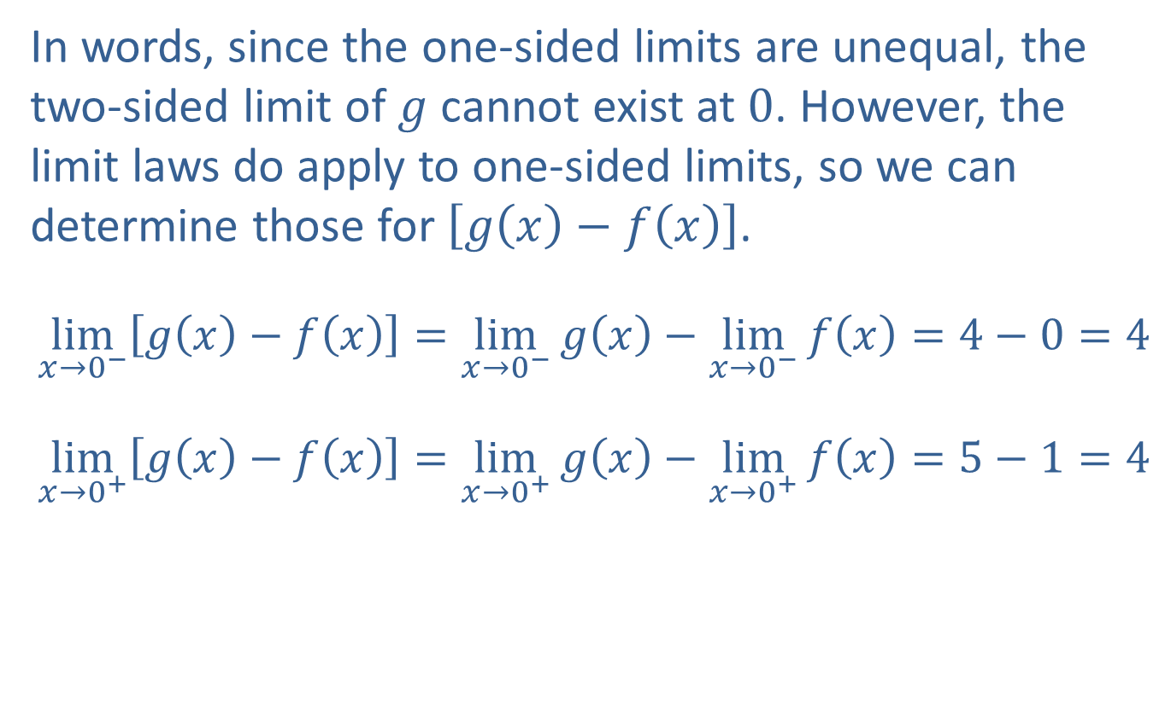
Example 1: Using Graphs and Limit Laws to Determine Limits (cont.)
​In words, since the one-sided limits are unequal, the two-sided limit of $g$ cannot exist at 0. However, the limit laws do apply to one-sided limits, so we can determine those for $\left[g\left(x\right)−f\left(x\right)\right]$.
​$\lim_{x→0^{−}}\left[g\left(x\right)−f\left(x\right)\right]=\lim_{x→0^{−}}{g\left(x\right)}−\lim_{x→0^{−}}{f\left(x\right)}=4−0=4$
​$\lim_{x→0^{+}}\left[g\left(x\right)−f\left(x\right)\right]=\lim_{x→0^{+}}{g\left(x\right)}−\lim_{x→0^{+}}{f\left(x\right)}=5−1=4$
​

Slide 10
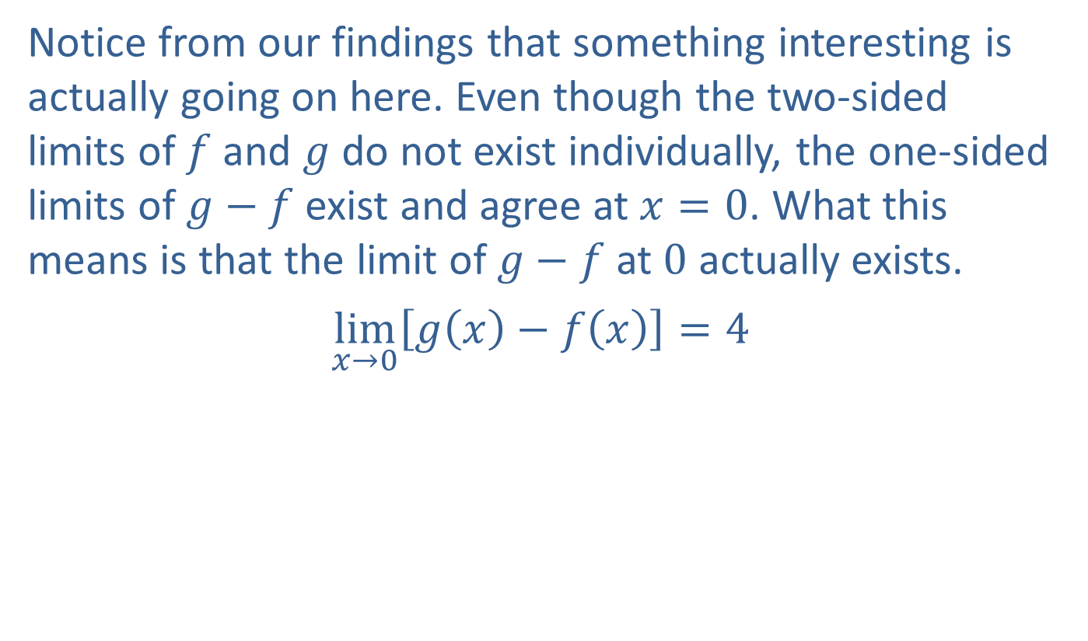
Example 1: Using Graphs and Limit Laws to Determine Limits (cont.)
​​Notice from our findings that something interesting is actually going on here. Even though the two-sided limits of $f$ and $g$ do not exist individually, the one-sided limits of $g−f$ exist and agree at $x=0$. What this means is that the limit of $g−f$ at 0 actually exists.
​$\lim_{x→0}\left[g\left(x\right)−f\left(x\right)\right]=4$

Slide 11
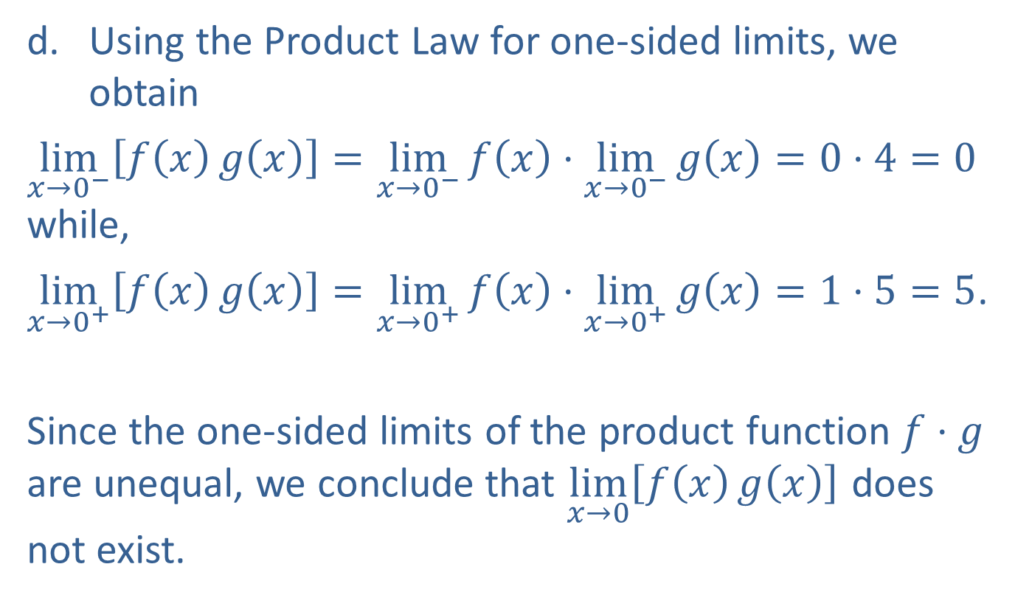
Example 1: Using Graphs and Limit Laws to Determine Limits (cont.)
​Using the Product Law for one-sided limits, we obtain
​$\lim_{x→0^{−}}\left[f\left(x\right)g\left(x\right)\right]=\lim_{x→0^{−}}{f\left(x\right)}⋅\lim_{x→0^{−}}{g\left(x\right)}=0⋅4=0$ while,
​$\lim_{x→0^{+}}\left[f\left(x\right)g\left(x\right)\right]=\lim_{x→0^{+}}{f\left(x\right)}⋅\lim_{x→0^{+}}{g\left(x\right)}=1⋅5=5$.​
Since the one-sided limits of the product function $f⋅g$ are unequal, we conclude that $\lim_{x→0}⁡\left[f\left(x\right)g\left(x\right)\right]$ does not exist.

Slide 12

Example 2: Using Limit Laws to Determine Limits
Let $f\left(x\right)=\left\{\begin{aligned}\frac{\left|x\right|}{x} \text{if} x≠0 \\ 0 if x=0\end{aligned}\right.$ and $g\left(x\right)=\cos{x}$.
Determine whether $\lim_{x→0}⁡\left[f\left(x\right)g\left(x\right)\right]$ exists.

Slide 13
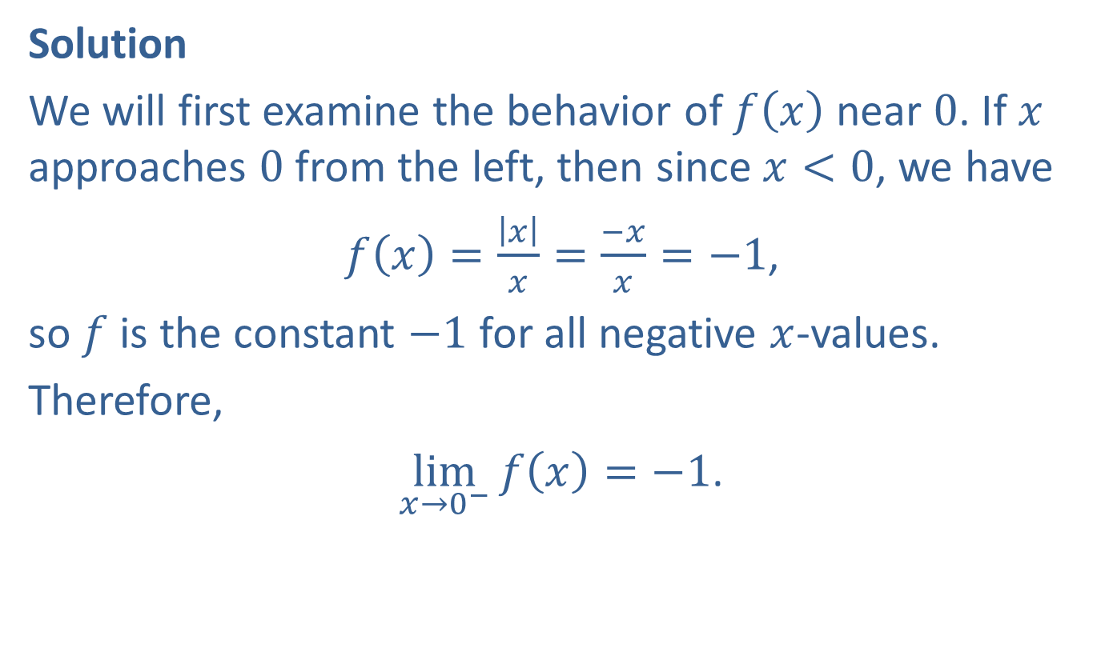
Example 2: Using Limit Laws to Determine Limits (cont.)
Solution
We will first examine the behavior of $f⁡\left(x\right)$ near 0. If $x$ approaches 0 from the left, then since $x<0$, we have
$f\left(x\right)=\frac{\left|x\right|}{x}=\frac{−x}{x}=−1$,
so $f$ is the constant $−1$ for all negative $x$-values.
Therefore,
$\lim_{x→0^{−}}{f\left(x\right)}=−1$.

Slide 14
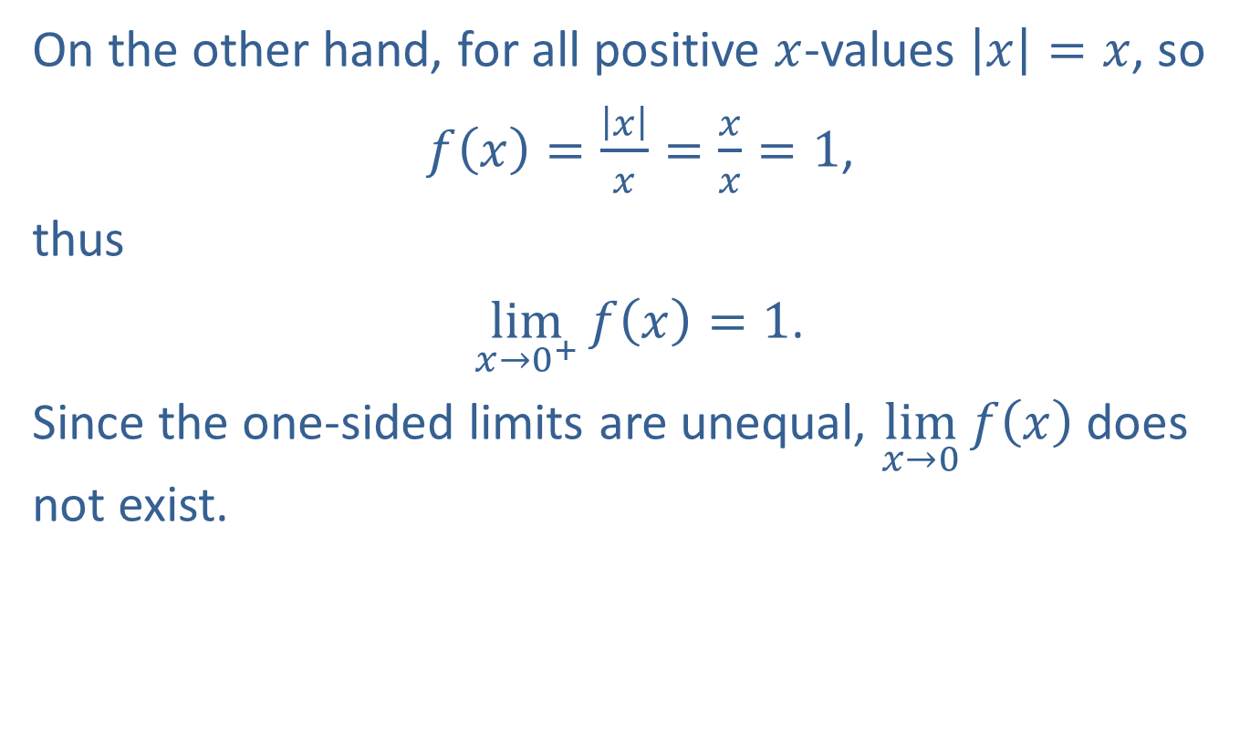
Example 2: Using Limit Laws to Determine Limits (cont.)
On the other hand, for all positive $x$-values $\left|x\right|=x$, so
$f\left(x\right)=\frac{\left|x\right|}{x}=\frac{x}{x}=1$,
thus
$\lim_{x→0^{+}}{f\left(x\right)}=1$.
Since the one-sided limits are unequal, $\lim_{x→0}⁡f\left(x\right)$ does not exist.

Slide 15
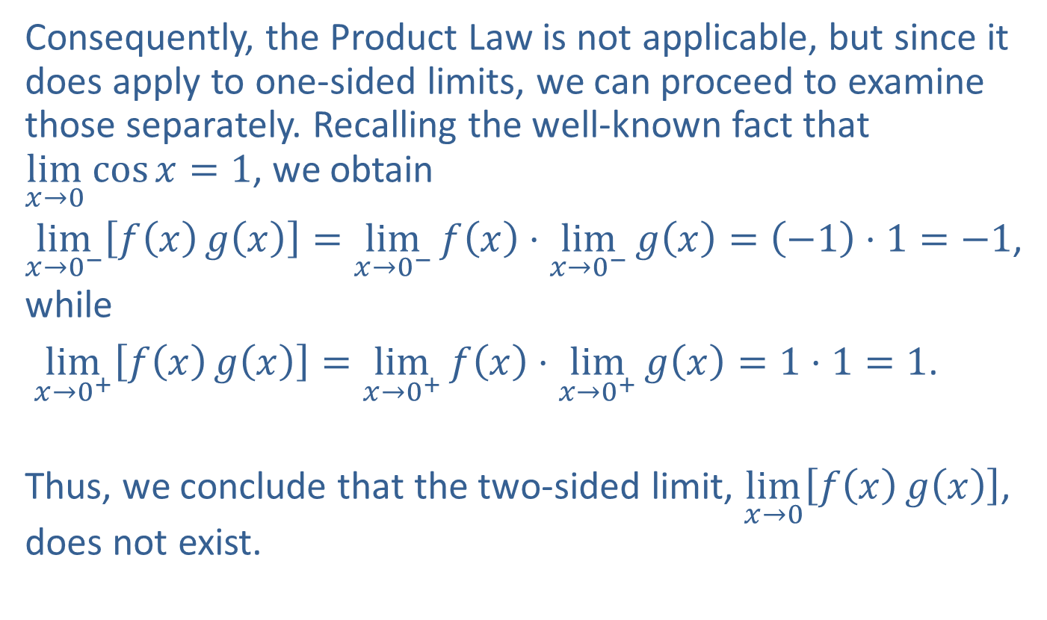
Example 2: Using Limit Laws to Determine Limits (cont.)
Consequently, the Product Law is not applicable, but since it does apply to one-sided limits, we can proceed to examine those separately. Recalling the well-known fact that $\lim_{x→0}{\cos{x}}=1$, we obtain
$\lim_{x→0^{−}}\left[f\left(x\right)g\left(x\right)\right]=\lim_{x→0^{−}}{f\left(x\right)}⋅\lim_{x→0^{−}}{g\left(x\right)}=\left(−1\right)⋅1=−1$,
while
$\lim_{x→0^{+}}\left[f\left(x\right)g\left(x\right)\right]=\lim_{x→0^{+}}{f\left(x\right)}⋅\lim_{x→0^{+}}{g\left(x\right)}=1⋅1=1$.
Thus, we conclude that the two-sided limit, $\lim_{x→0}⁡\left[f\left(x\right)g\left(x\right)\right]$, does not exist.

Slide 16
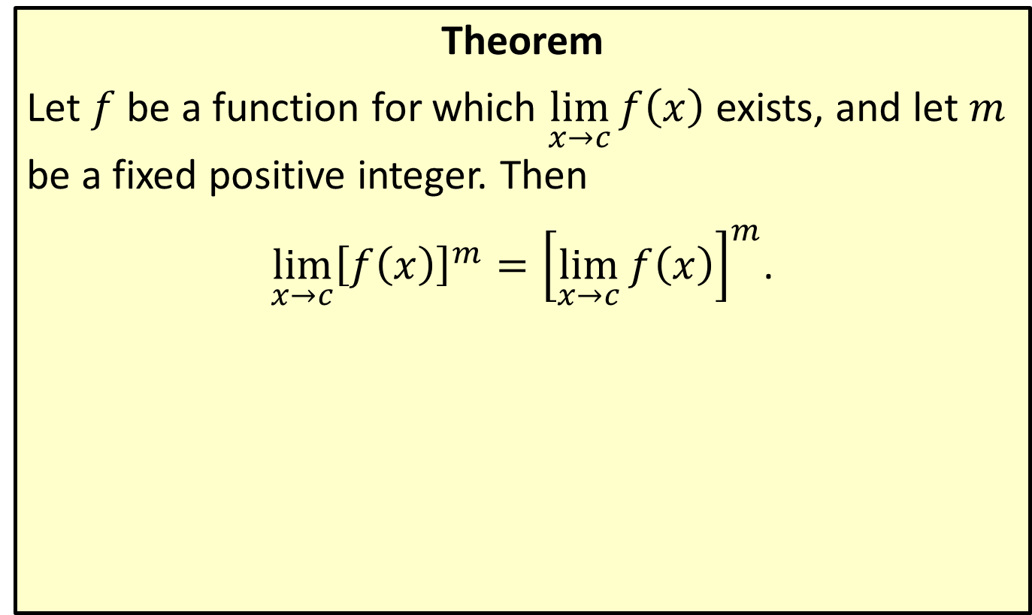
Positive Integer Power Law
Theorem
Let $f$ be a function for which $\lim_{x→c}⁡f\left(x\right)$ exists, and let $m$ be a fixed positive integer. Then
$\lim_{x→c}{{\left[f\left(x\right)\right]}^{m}}={\left[\lim_{x→c}{f\left(x\right)}\right]}^{m}$.

Slide 17
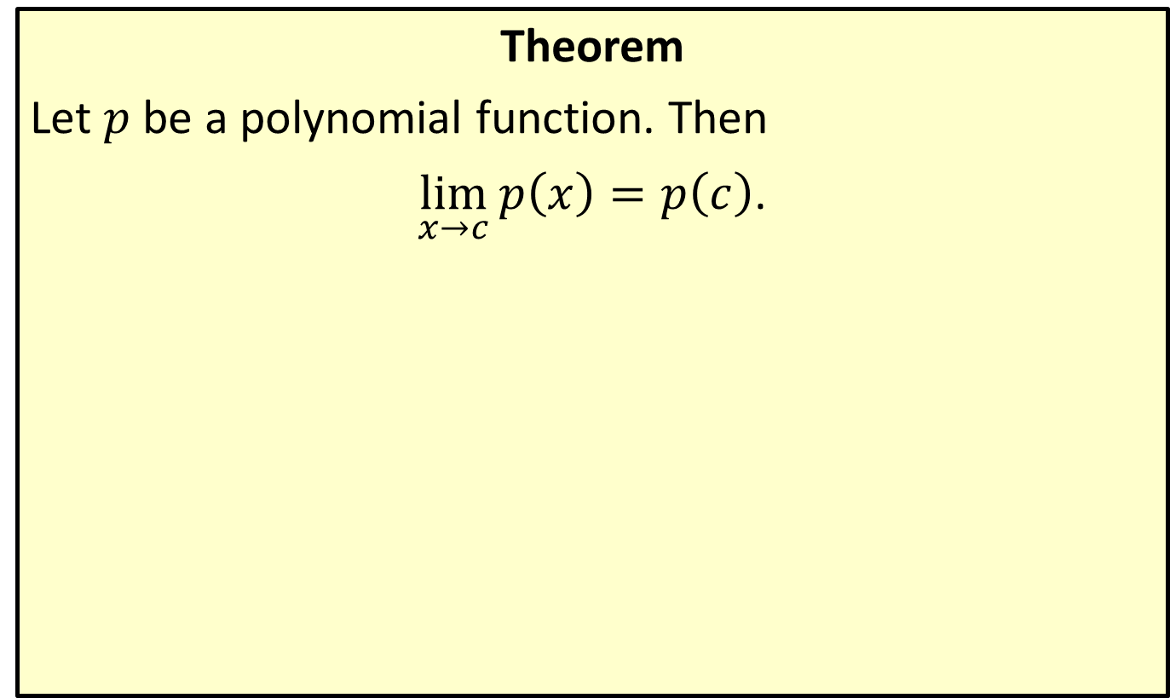
Polynomial Substitution Law
Theorem
Let $p$ be a polynomial function. Then
$\lim_{x→c}{p\left(x\right)}=p\left(c\right)$.

Slide 18
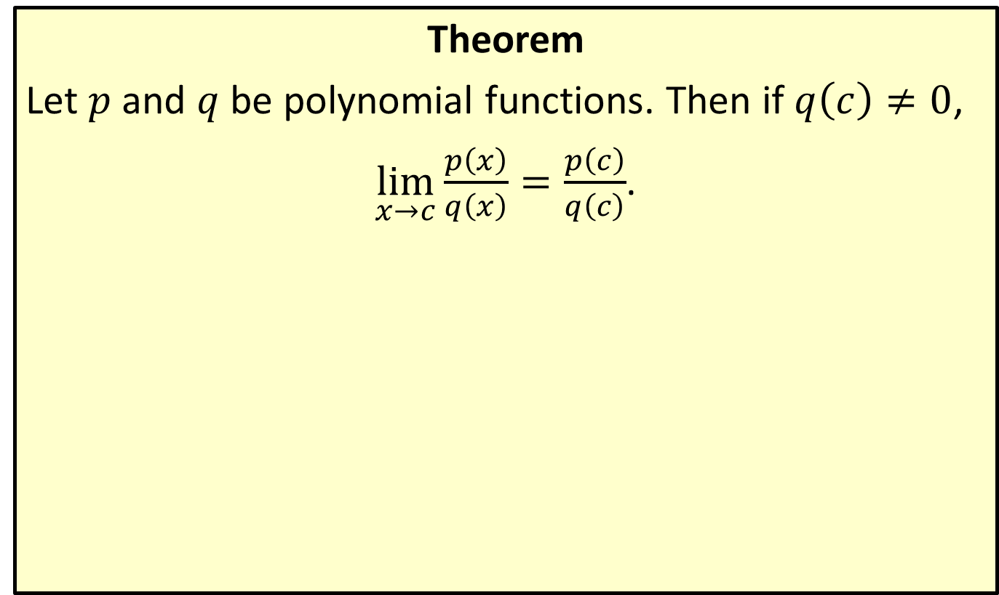
Rational Function Substitution Law
Theorem
Let $p$ and $q$ be polynomial functions. Then if $q\left(c\right)≠0$,
$\lim_{x→c}{\frac{p\left(x\right)}{q\left(x\right)}}=\frac{p\left(c\right)}{q\left(c\right)}$.

Slide 19

Example 3: Using Limit Laws to Determine Limits
Find the following limits.
​$\lim_{x→2}⁡\left(4x^{3}−5x^{2}+1\right)$
​$\lim_{x→−1}⁡\left(2x^{4}+x^{3}−3x^{2}+7.5\right)$
​$\lim_{x→3}⁡\left(\frac{x^{2}+2}{3x−1}\right)$
​$\lim_{x→1}⁡\left(\frac{2x^{3}−5x+1}{2x−x^{2}}\right)$

Slide 20
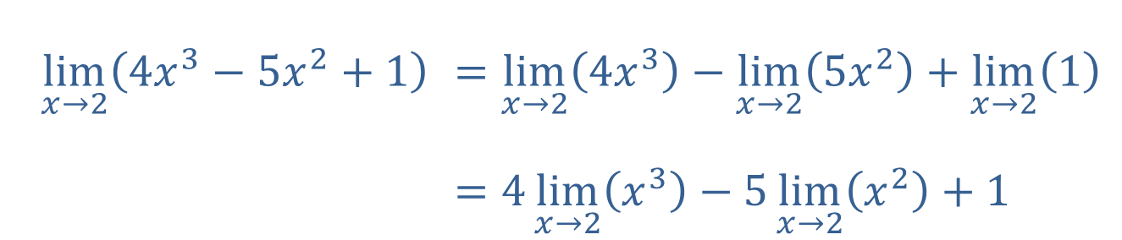
Example 3: Using Limit Laws to Determine Limits (cont.)
Solution
​First using the Sum and Difference Laws, we obtain
  where in the last step we used the Constant Multiple Law.
$$\lim_{x→2}\left(4x^{3}−5x^{2}+1\right)$$ | $=\lim_{x→2}\left(4x^{3}\right)−\lim_{x→2}\left(5x^{2}\right)+\lim_{x→2}\left(1\right)$
 | $=4\lim_{x→2}\left(x^{3}\right)−5\lim_{x→2}\left(x^{2}\right)+1$

Slide 21
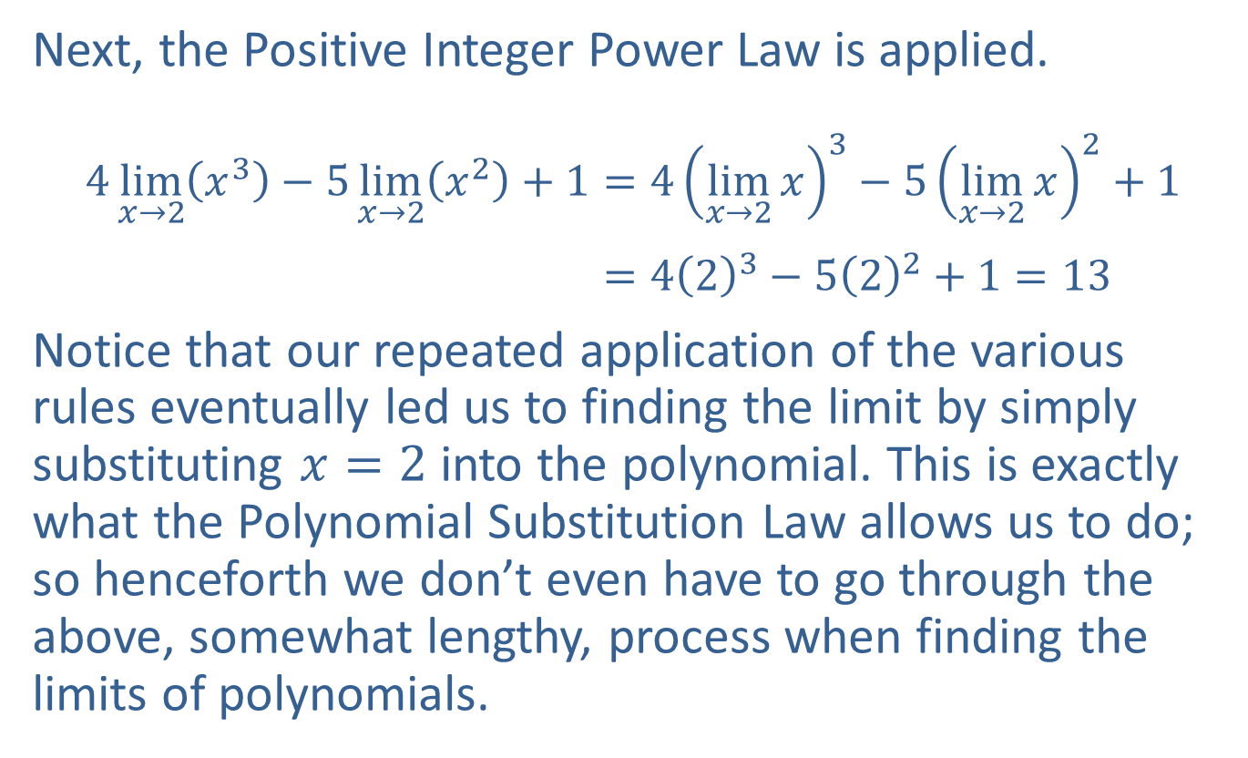
Example 3: Using Limit Laws to Determine Limits (cont.)
Next, the Positive Integer Power Law is applied.
​$4\lim_{x→2}\left(x^{3}\right)−5\lim_{x→2}\left(x^{2}\right)+1=4{\left(\lim_{x→2}{x}\right)}^{3}−5{\left(\lim_{x→2}{x}\right)}^{2}+1$
$=4{\left(2\right)}^{3}−5{\left(2\right)}^{2}+1=13$
​Notice that our repeated application of the various rules eventually led us to finding the limit by simply substituting $x=2$ into the polynomial. This is exactly what the Polynomial Substitution Law allows us to do; so henceforth we don’t even have to go through the above, somewhat lengthy, process when finding the limits of polynomials.

Slide 22

Example 3: Using Limit Laws to Determine Limits (cont.)
​In this case, we will simply use the Polynomial Substitution Law.
​$\lim_{x→−1}\left(2x^{4}+x^{3}−3x^{2}+7.5\right)$
$$=2{\left(−1\right)}^{4}+{\left(−1\right)}^{3}−3{\left(−1\right)}^{2}+7.5=5.5$$

Slide 23
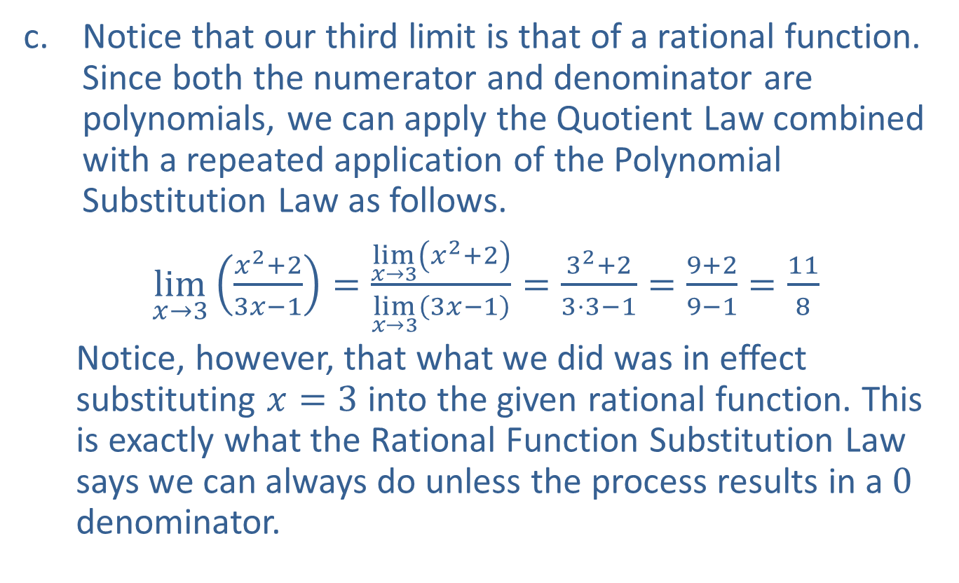
Example 3: Using Limit Laws to Determine Limits (cont.)
​Notice that our third limit is that of a rational function. Since both the numerator and denominator are polynomials, we can apply the Quotient Law combined with a repeated application of the Polynomial Substitution Law as follows.
​$\lim_{x→3}\left(\frac{x^{2}+2}{3x−1}\right)=\frac{\lim_{x→3}\left(x^{2}+2\right)}{\lim_{x→3}\left(3x−1\right)}=\frac{3^{2}+2}{3⋅3−1}=\frac{9+2}{9−1}=\frac{11}{8}$
  Notice, however, that what we did was in effect substituting $x=3$ into the given rational function. This is exactly what the Rational Function Substitution Law says we can always do unless the process results in a 0 denominator.

Slide 24
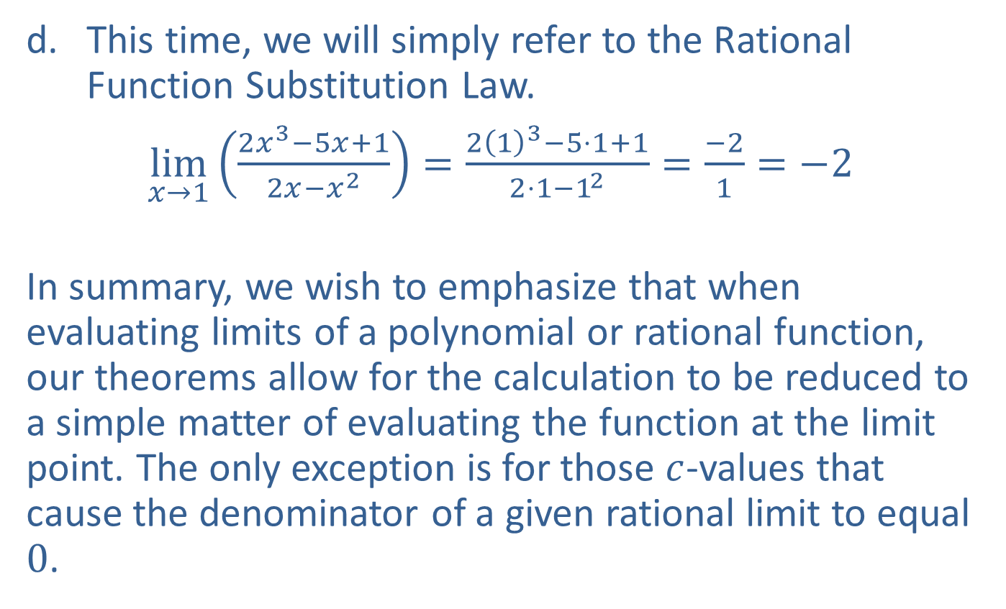
Example 3: Using Limit Laws to Determine Limits (cont.)
​This time, we will simply refer to the Rational Function Substitution Law.
​$\lim_{x→1}\left(\frac{2x^{3}−5x+1}{2x−x^{2}}\right)=\frac{2{\left(1\right)}^{3}−5⋅1+1}{2⋅1−1^{2}}=\frac{−2}{1}=−2$
​
In summary, we wish to emphasize that when evaluating limits of a polynomial or rational function, our theorems allow for the calculation to be reduced to a simple matter of evaluating the function at the limit point. The only exception is for those $c$-values that cause the denominator of a given rational limit to equal 0.

Slide 25
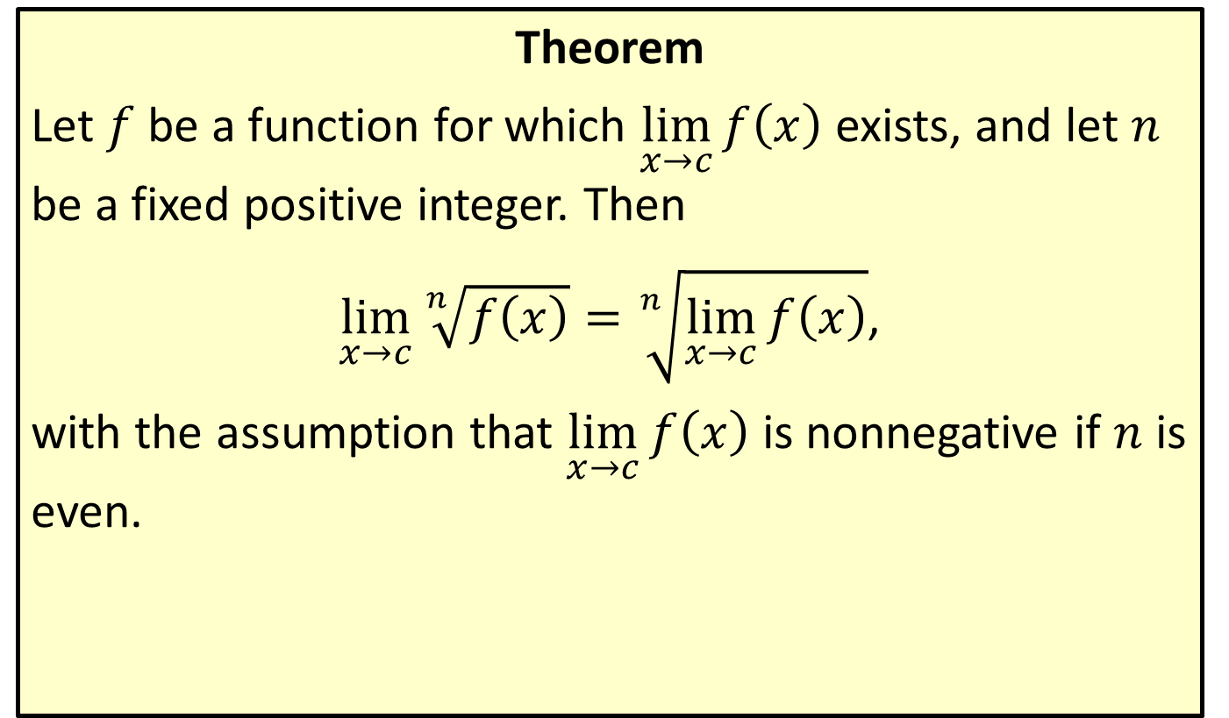
Positive Integer Root Law
Theorem
Let $f$ be a function for which $\lim_{x→c}⁡f\left(x\right)$ exists, and let $n$ be a fixed positive integer. Then
$\lim_{x→c}{\sqrt[n]{f\left(x\right)}}=\sqrt[n]{\lim_{x→c}{f\left(x\right)}}$,
with the assumption that $\lim_{x→c}⁡f\left(x\right)$ is nonnegative if $n$ is even.

Slide 26
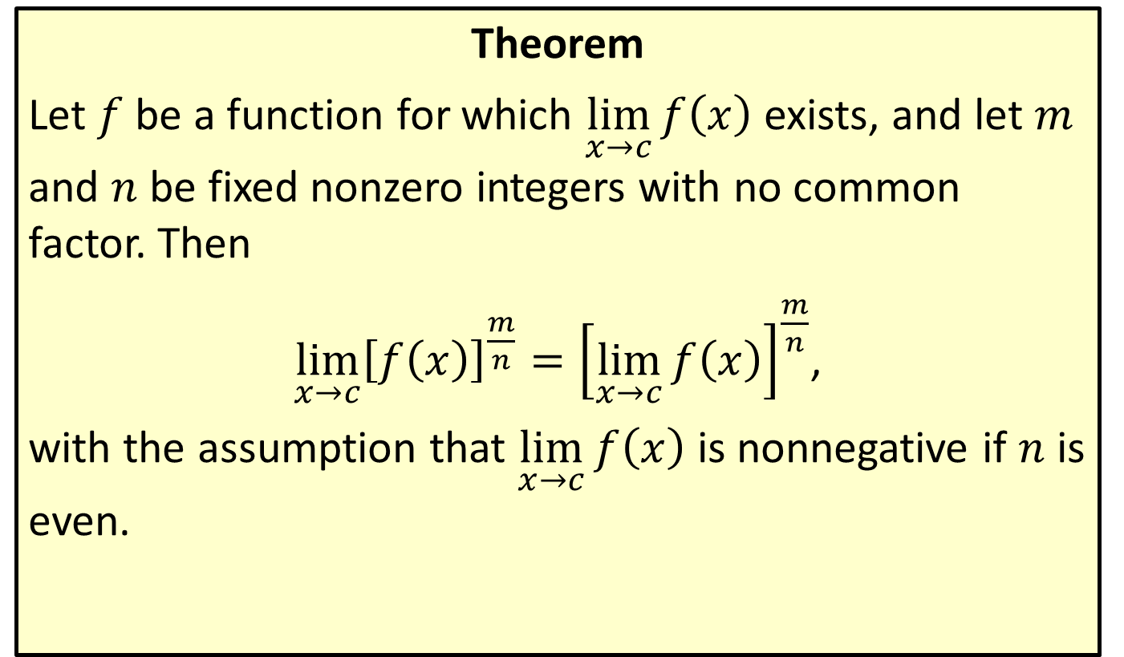
Rational Power Law
Theorem
Let $f$ be a function for which $\lim_{x→c}⁡f\left(x\right)$ exists, and let $m$ and $n$ be fixed nonzero integers with no common factor. Then
$\lim_{x→c}{{\left[f\left(x\right)\right]}^{\frac{m}{n}}}={\left[\lim_{x→c}{f\left(x\right)}\right]}^{\frac{m}{n}}$,
with the assumption that $\lim_{x→c}⁡f\left(x\right)$ is nonnegative if $n$ is even.

Slide 27
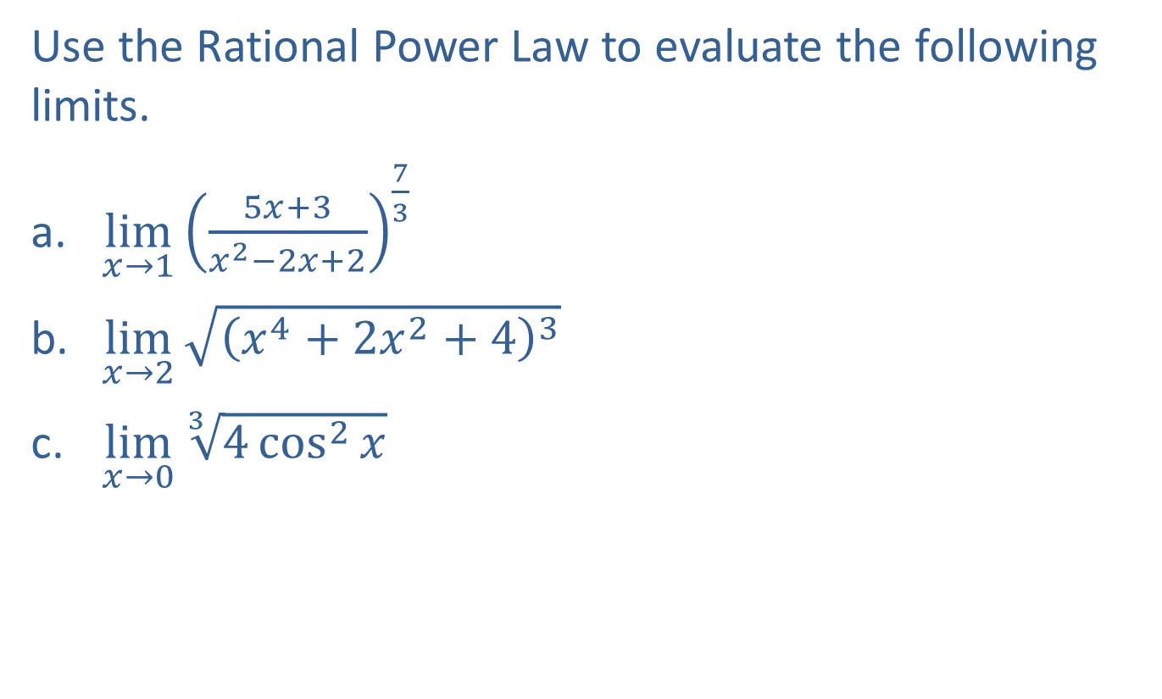
Example 4: Using Limit Laws to Determine Limits
Use the Rational Power Law to evaluate the following limits.
​$\lim_{x→1}⁡{\left(\frac{5x+3}{x^{2}−2x+2}\right)}^{\frac{7}{3}}$
​$\lim_{x→2}⁡\sqrt{{\left(x^{4}+2x^{2}+4\right)}^{3}}$
​$\lim_{x→0}⁡\sqrt[3]{4\cos^{2}{x}}$

Slide 28
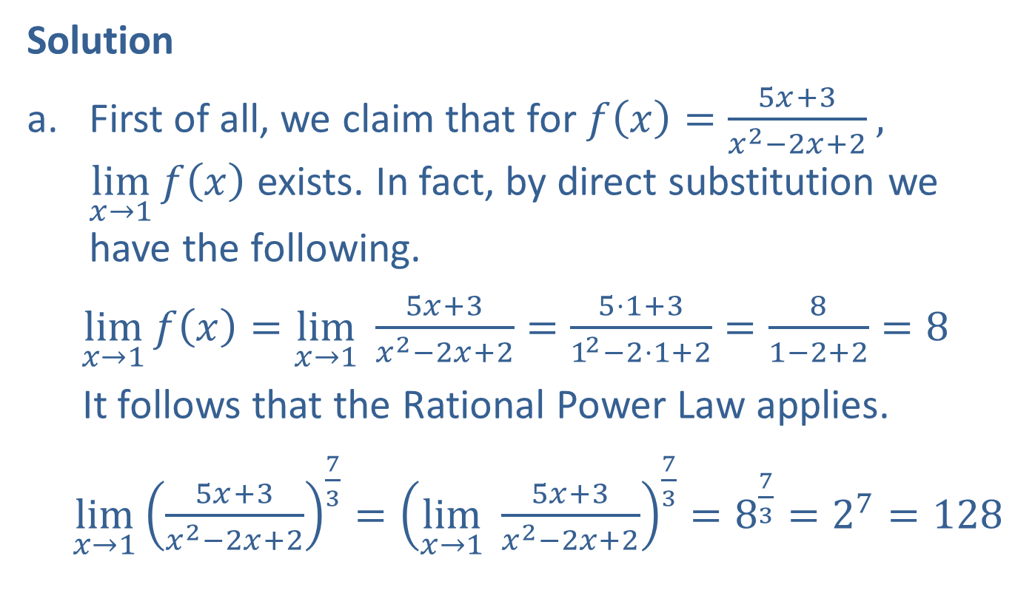
Example 4: Using Limit Laws to Determine Limits (cont.)
Solution
​First of all, we claim that for $f\left(x\right)=\frac{5x+3}{x^{2}−2x+2}$,
$\lim_{x→1}⁡f\left(x\right)$ exists. In fact, by direct substitution we have the following.
​$\lim_{x→1}{f\left(x\right)}=\lim_{x→1}{ \frac{5x+3}{x^{2}−2x+2}}=\frac{5⋅1+3}{1^{2}−2⋅1+2}=\frac{8}{1−2+2}=8$
  It follows that the Rational Power Law applies.
​$\lim_{x→1}{{\left(\frac{5x+3}{x^{2}−2x+2}\right)}^{\frac{7}{3}}}={\left(\lim_{x→1}{ \frac{5x+3}{x^{2}−2x+2}}\right)}^{\frac{7}{3}}=8^{\frac{7}{3}}=2^{7}=128$

Slide 29
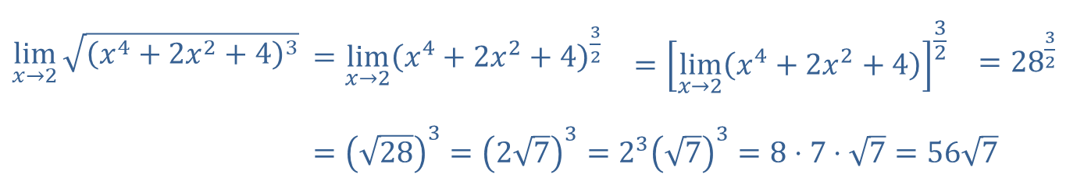
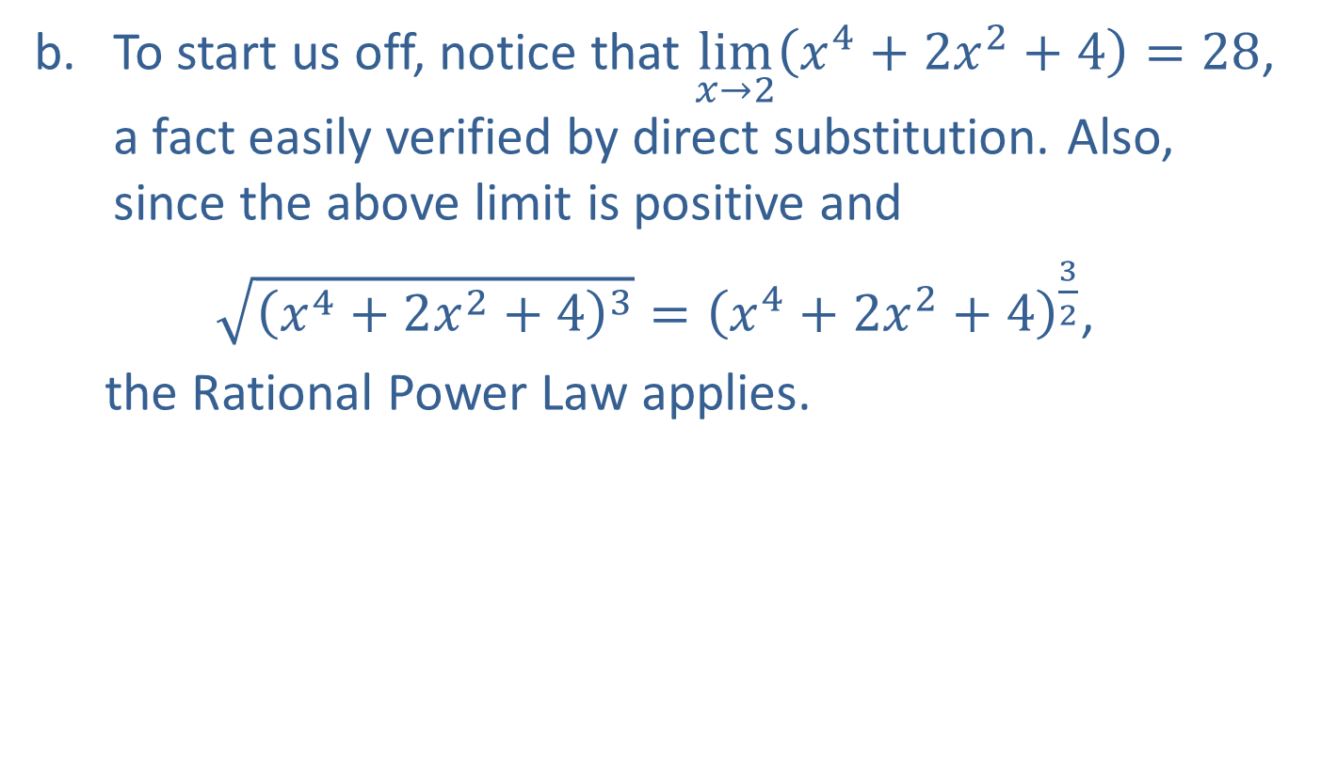
Example 4: Using Limit Laws to Determine Limits (cont.)
​To start us off, notice that $\lim_{x→2}\left(x^{4}+2x^{2}+4\right)=28$, a fact easily verified by direct substitution. Also, since the above limit is positive and
​$\sqrt{{\left(x^{4}+2x^{2}+4\right)}^{3}}={\left(x^{4}+2x^{2}+4\right)}^{\frac{3}{2}}$,
  the Rational Power Law applies.
$$\lim_{x→2}{\sqrt{{\left(x^{4}+2x^{2}+4\right)}^{3}}}$$ | $=\lim_{x→2}{{\left(x^{4}+2x^{2}+4\right)}^{\frac{3}{2}}}$ | $$={\left[\lim_{x→2}\left(x^{4}+2x^{2}+4\right)\right]}^{\frac{3}{2}}$$ | $={28}^{\frac{3}{2}}$
 | $={\left(\sqrt{28}\right)}^{3}={\left(2\sqrt{7}\right)}^{3}=2^{3}{\left(\sqrt{7}\right)}^{3}=8⋅7⋅\sqrt{7}=56\sqrt{7}$

Slide 30

Example 4: Using Limit Laws to Determine Limits (cont.)
​Since $4\cos^{2}{x}={\left(2\cos{x}\right)}^{2}$, and since
$\lim_{x→0}\left(2\cos{x}\right)=2$, the Rational Power Law once again applies.
​$\lim_{x→0}{\sqrt[3]{4\cos^{2}{x}}}=\lim_{x→0}{{\left(2\cos{x}\right)}^{\frac{2}{3}}}={\left[\lim_{x→0}\left(2\cos{x}\right)\right]}^{\frac{2}{3}}=2^{\frac{2}{3}}=\sqrt[3]{4}$

Slide 31

Example 5: Using Algebraic Techniques to Determine Limits
Find $\lim_{x→−3}⁡\frac{x^{2}−9}{x+3}$.

Slide 32
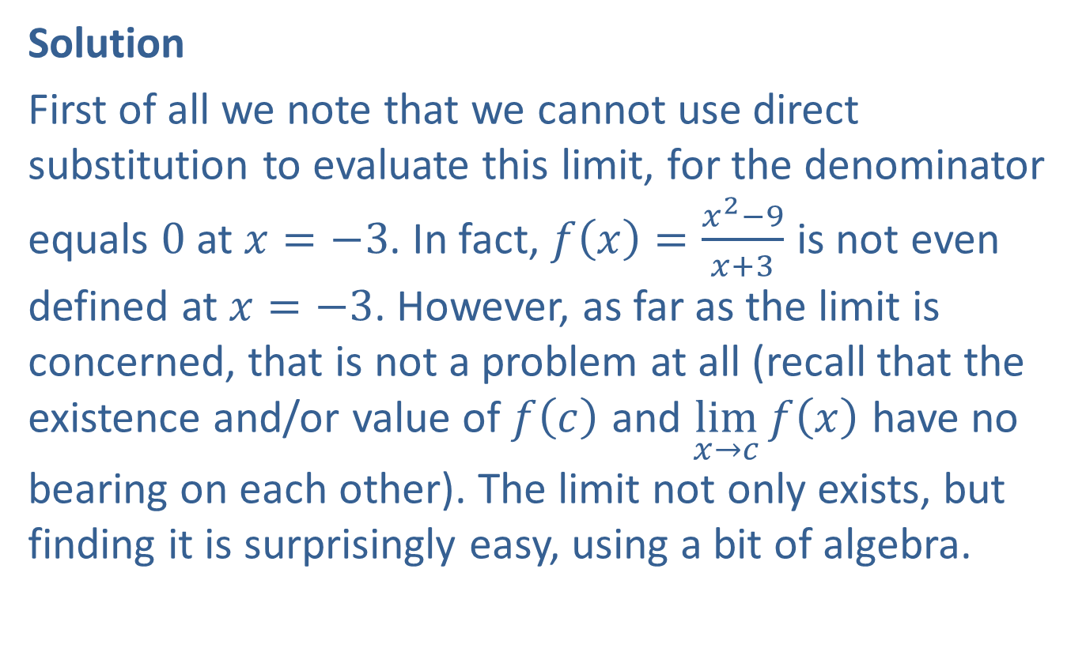
Example 5: Using Algebraic Techniques to Determine Limits (cont.)
Solution
First of all we note that we cannot use direct substitution to evaluate this limit, for the denominator equals 0 at $x=−3$. In fact, $f\left(x\right)=\frac{x^{2}−9}{x+3}$ is not even defined at $x=−3$. However, as far as the limit is concerned, that is not a problem at all (recall that the existence and/or value of $f⁡\left(c\right)$ and $\lim_{x→c}⁡f\left(x\right)$ have no bearing on each other). The limit not only exists, but finding it is surprisingly easy, using a bit of algebra.

Slide 33
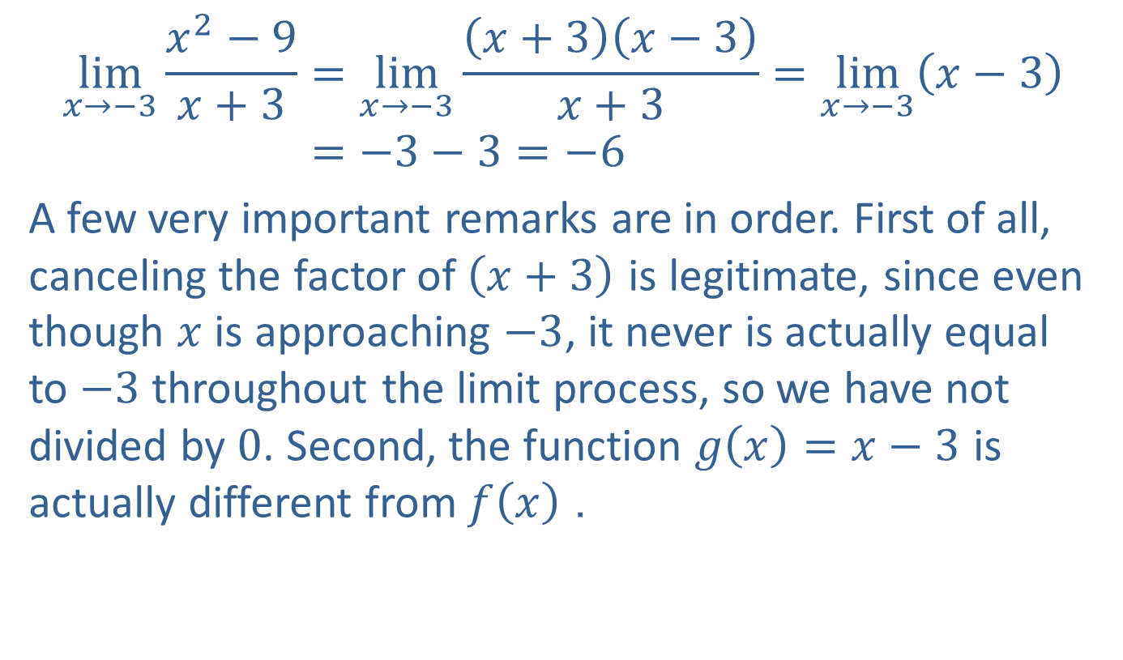
Example 5: Using Algebraic Techniques to Determine Limits (cont.)
$$\lim_{x→−3}{\frac{x^{2}−9}{x+3}}=\lim_{x→−3}{\frac{\left(x+3\right)\left(x−3\right)}{x+3}}=\lim_{x→−3}\left(x−3\right) \\ =−3−3=−6$$
A few very important remarks are in order. First of all, canceling the factor of $\left(x+3\right)$ is legitimate, since even though $x$ is approaching $−3$, it never is actually equal to $−3$ throughout the limit process, so we have not divided by 0. Second, the function $g\left(x\right)=x−3$ is actually different from $f⁡\left(x\right)$.

Slide 34
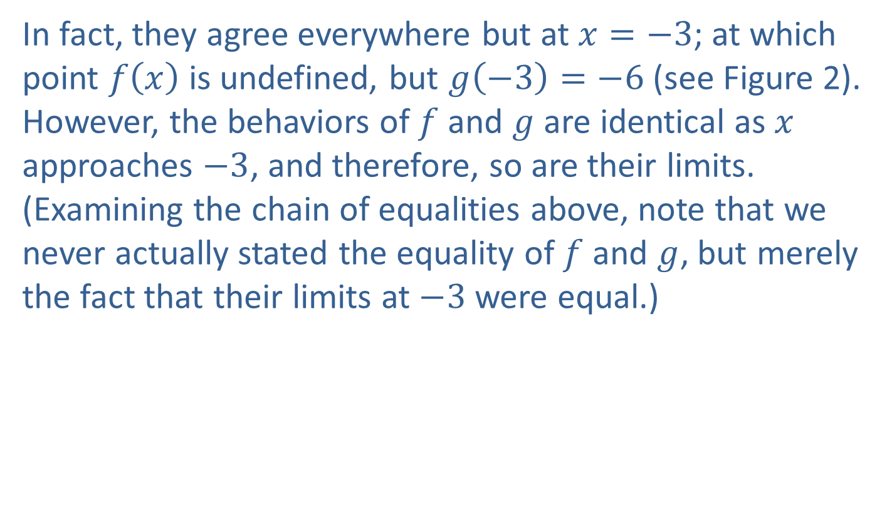
Example 5: Using Algebraic Techniques to Determine Limits (cont.)
In fact, they agree everywhere but at $x=−3$; at which point $f⁡\left(x\right)$ is undefined, but $g\left(−3\right)=−6$ (see Figure 2). However, the behaviors of $f$ and $g$ are identical as $x$ approaches $−3$, and therefore, so are their limits. (Examining the chain of equalities above, note that we never actually stated the equality of $f$ and $g$, but merely the fact that their limits at $−3$ were equal.)

Slide 35
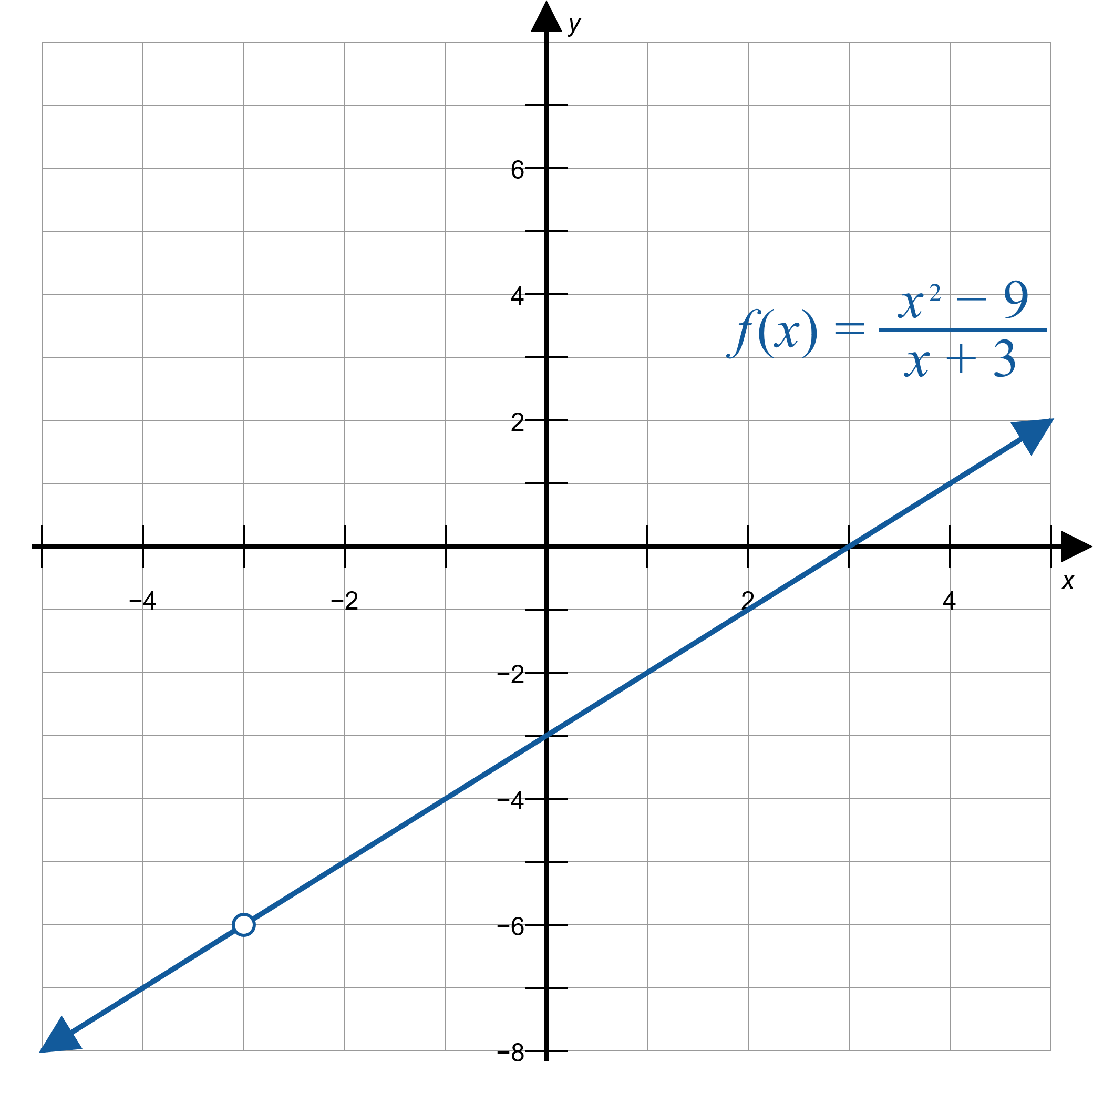
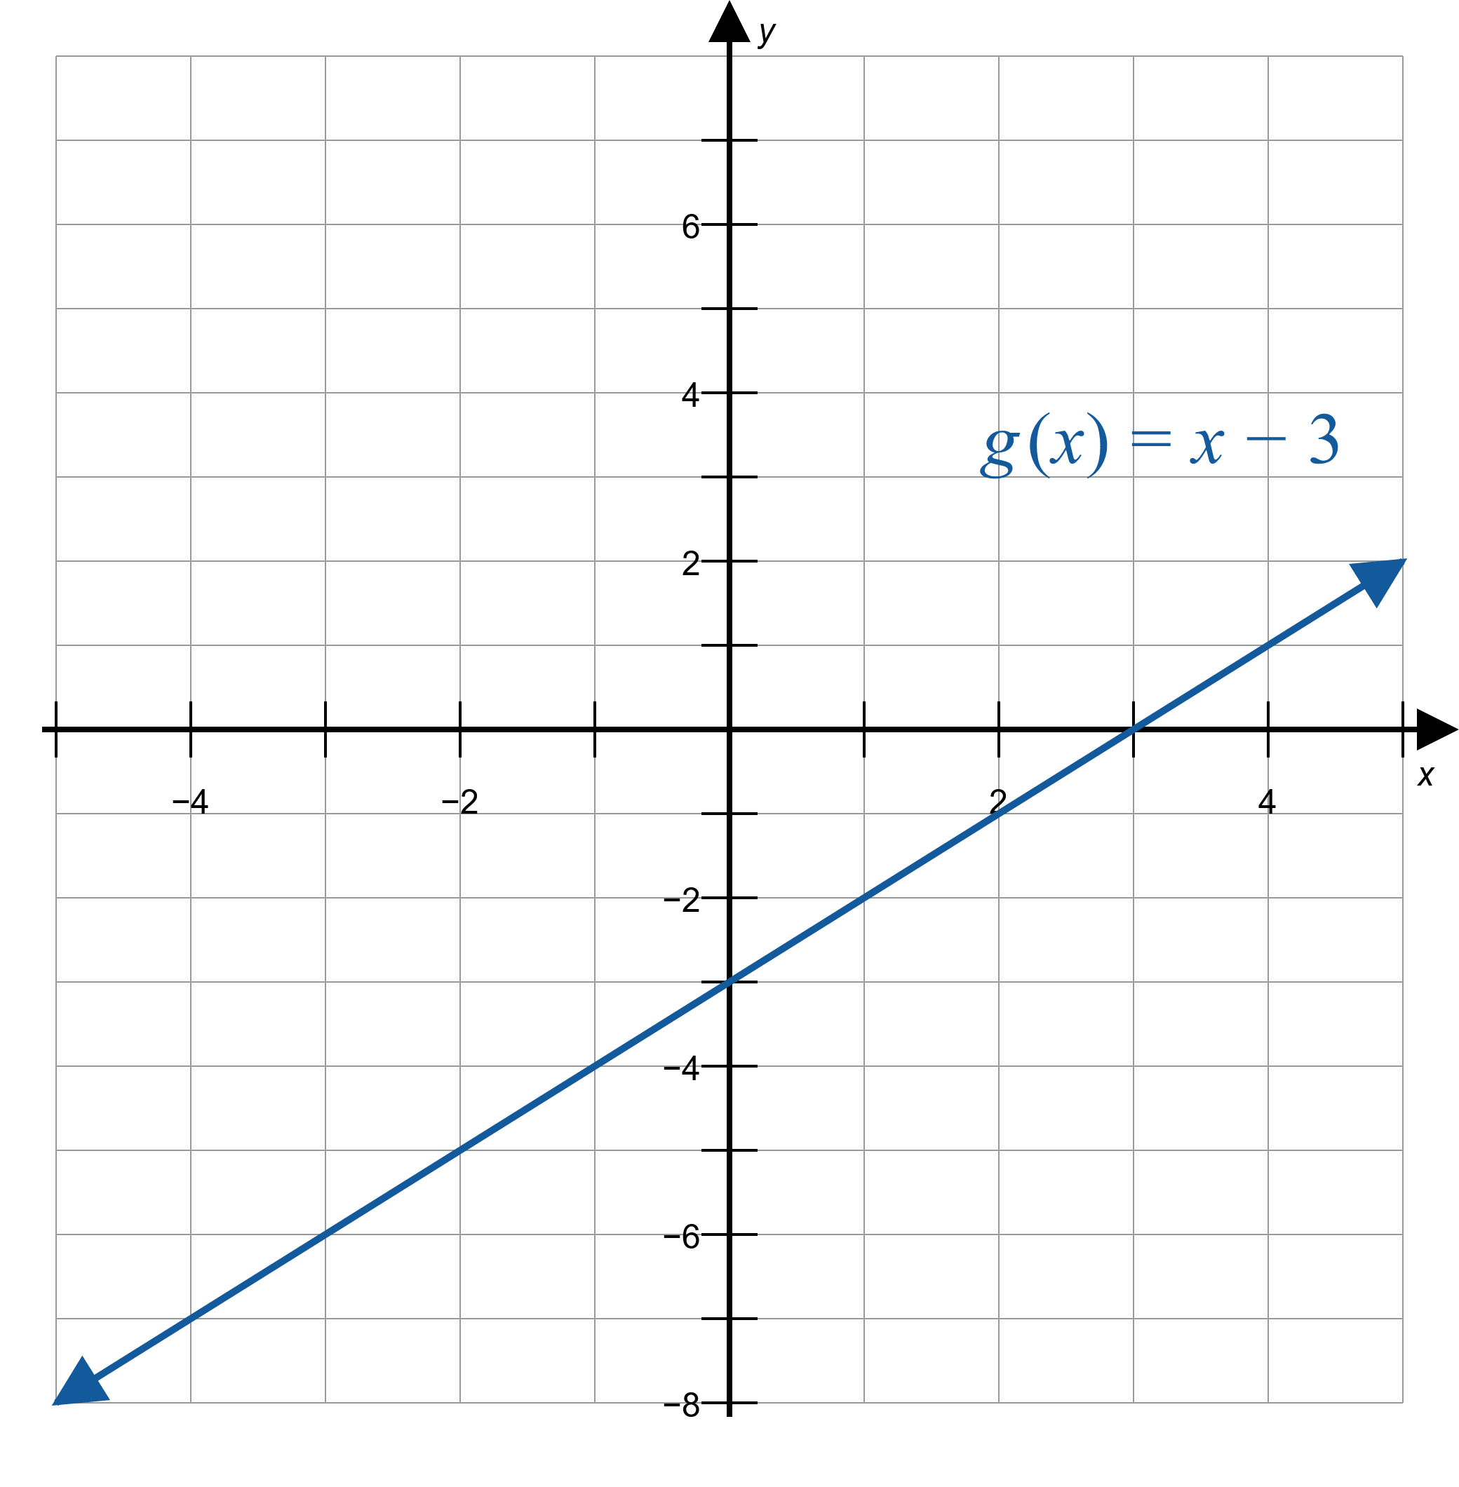
Example 5: Using Algebraic Techniques to Determine Limits (cont.)
Figure 2

Slide 36

Example 6: Using Algebraic Techniques to Determine Limits
Use algebra to evaluate $\lim_{x→1}⁡\frac{\sqrt{x+3}−2}{x−1}$.

Slide 37
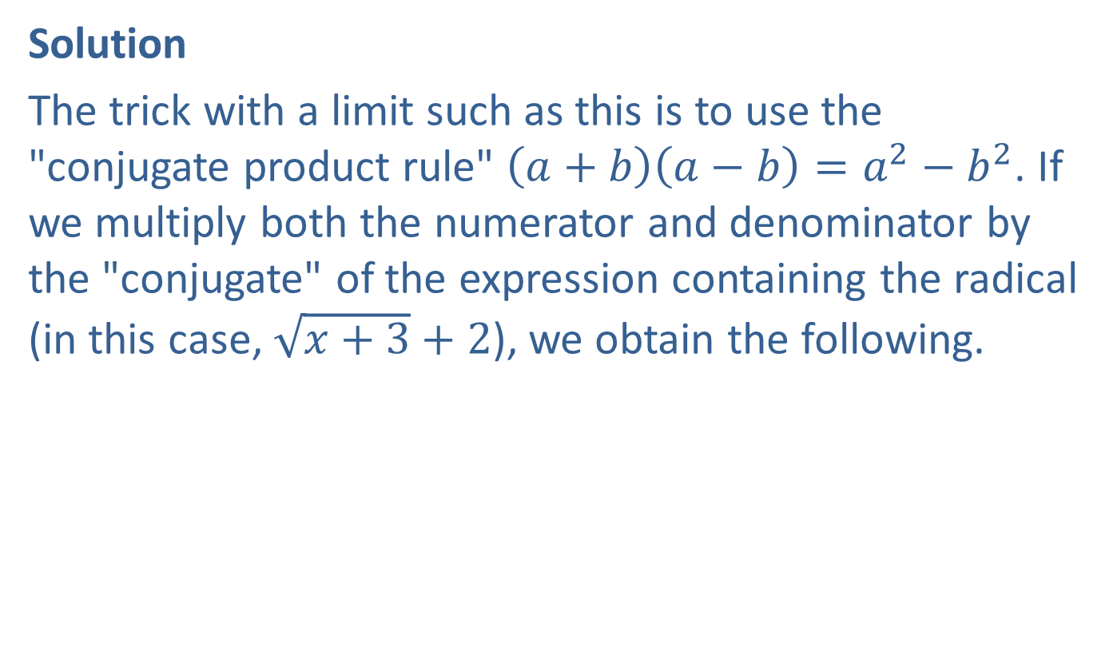
Example 6: Using Algebraic Techniques to Determine Limits (cont.)
Solution
The trick with a limit such as this is to use the "conjugate product rule" $\left(a+b\right)\left(a−b\right)=a^{2}−b^{2}$. If we multiply both the numerator and denominator by the "conjugate" of the expression containing the radical (in this case, $\sqrt{x+3}+2$), we obtain the following.

Slide 38
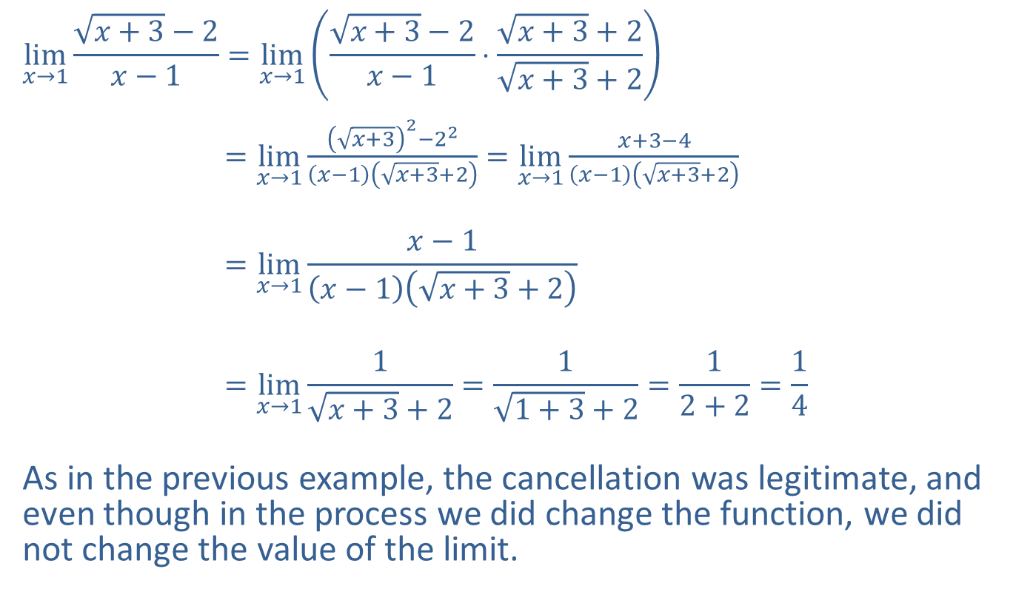
Example 6: Using Algebraic Techniques to Determine Limits (cont.)
$$\lim_{x→1}{\frac{\sqrt{x+3}−2}{x−1}}=\lim_{x→1}\left(\frac{\sqrt{x+3}−2}{x−1}⋅\frac{\sqrt{x+3}+2}{\sqrt{x+3}+2}\right)$$
$=\lim_{x→1}{\frac{{\left(\sqrt{x+3}\right)}^{2}−2^{2}}{\left(x−1\right)\left(\sqrt{x+3}+2\right)}}=\lim_{x→1}{\frac{x+3−4}{\left(x−1\right)\left(\sqrt{x+3}+2\right)}}$
$$=\lim_{x→1}{\frac{x−1}{\left(x−1\right)\left(\sqrt{x+3}+2\right)}}$$
$$=\lim_{x→1}{\frac{1}{\sqrt{x+3}+2}}=\frac{1}{\sqrt{1+3}+2}=\frac{1}{2+2}=\frac{1}{4}$$
As in the previous example, the cancellation was legitimate, and even though in the process we did change the function, we did not change the value of the limit.

Slide 39

Example 7: Using Algebraic Techniques to Determine Limits
Find $\lim_{h→0}⁡\frac{{\left(h+2\right)}^{2}−4}{h}$.

Slide 40
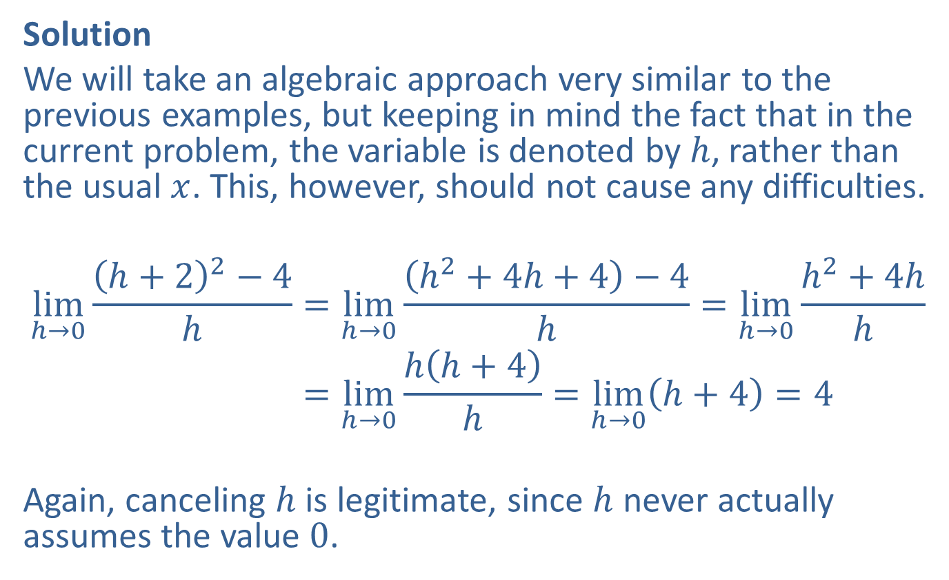
Example 7: Using Algebraic Techniques to Determine Limits (cont.)
Solution
We will take an algebraic approach very similar to the previous examples, but keeping in mind the fact that in the current problem, the variable is denoted by $h$, rather than the usual $x$. This, however, should not cause any difficulties.
limh→0h+22−4h=limh→0h2+4h+4−4h=limh→0h2+4hhlimh→0⁡h+22−4h=limh→0hh+4h=limh→0h+4=4
Again, canceling $h$ is legitimate, since $h$ never actually assumes the value 0.

Slide 41
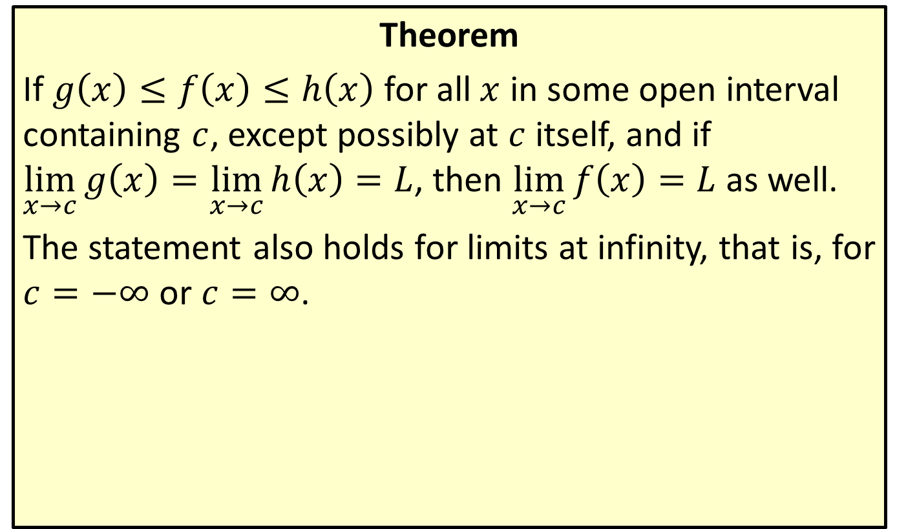
The Squeeze Theorem
Theorem
If $g\left(x\right)≤f\left(x\right)≤h\left(x\right)$ for all $x$ in some open interval containing $c$, except possibly at $c$ itself, and if
$\lim_{x→c}{g\left(x\right)}=\lim_{x→c}{h\left(x\right)}=L$, then $\lim_{x→c}{f\left(x\right)}=L$ as well.
The statement also holds for limits at infinity, that is, for $c=−∞$ or $c=∞$.

Slide 42

Example 8: Using the Squeeze Theorem to Determine Limits
Use the Squeeze Theorem to prove $\lim_{x→0}\left(x\sin\left(\frac{1}{x}\right)\right)=0$.

Slide 43
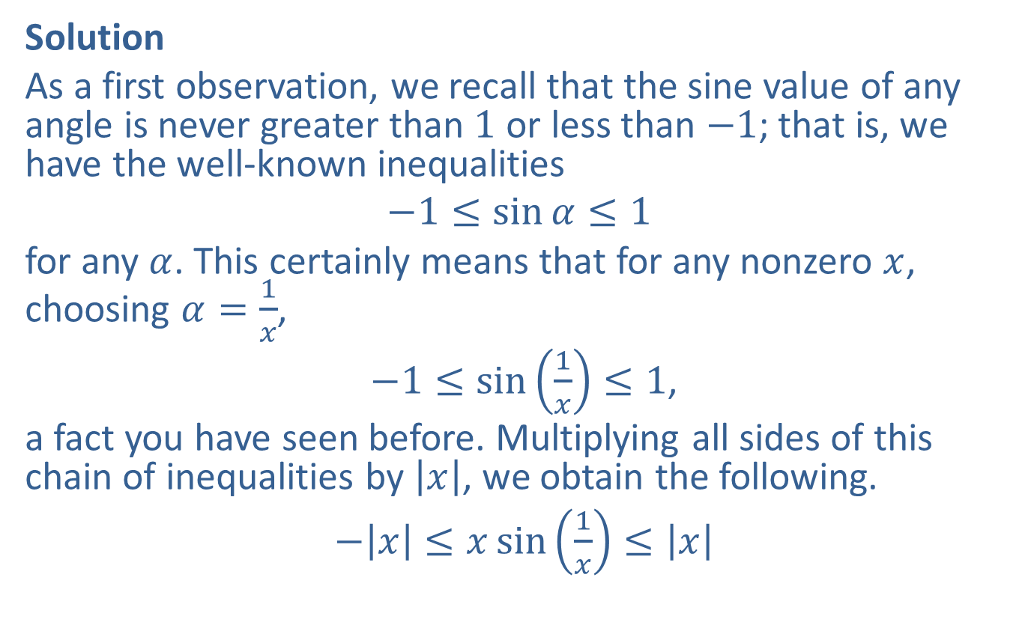
Example 8: Using the Squeeze Theorem to Determine Limits (cont.)
Solution
As a first observation, we recall that the sine value of any angle is never greater than 1 or less than $−1$; that is, we have the well-known inequalities
$$−1≤\sin{α}≤1$$
for any $α$. This certainly means that for any nonzero $x$, choosing $α=\frac{1}{x}$,
$−1≤\sin\left(\frac{1}{x}\right)≤1$,
a fact you have seen before. Multiplying all sides of this chain of inequalities by $\left|x\right|$, we obtain the following.
$−\left|x\right|≤x\sin\left(\frac{1}{x}\right)≤\left|x\right|$

Slide 44
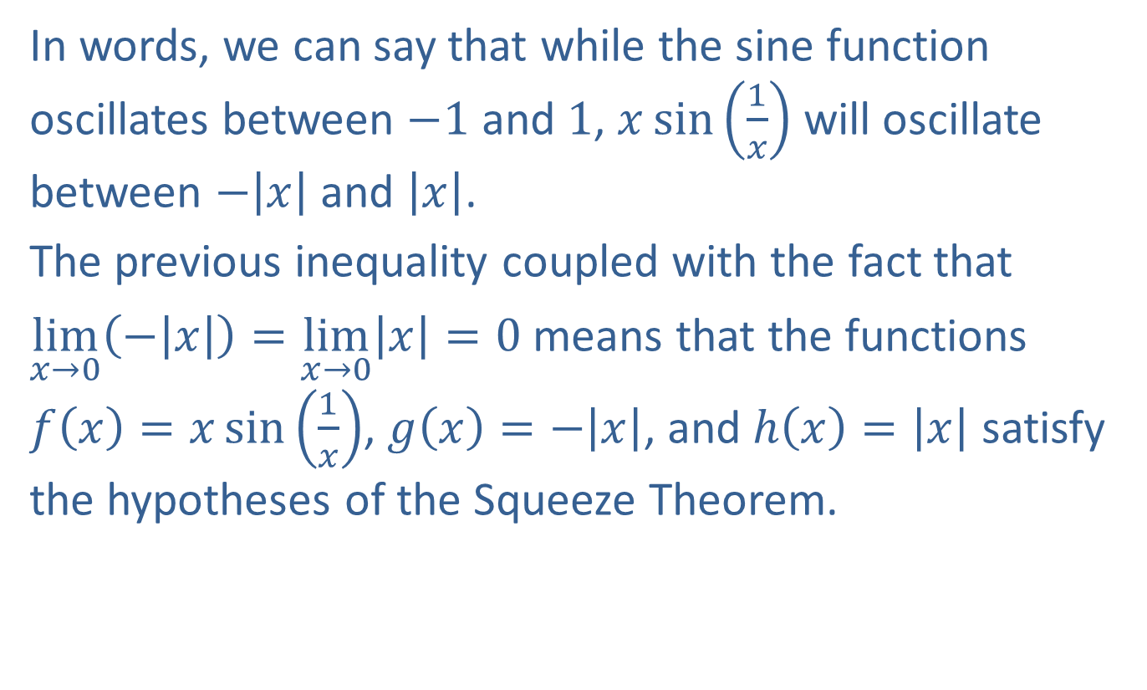
Example 8: Using the Squeeze Theorem to Determine Limits (cont.)
In words, we can say that while the sine function oscillates between $−1$ and 1, $x\sin\left(\frac{1}{x}\right)$ will oscillate between $−\left|x\right|$ and $\left|x\right|$.
The previous inequality coupled with the fact that
$\lim_{x→0}\left(−\left|x\right|\right)=\lim_{x→0}\left|x\right|=0$ means that the functions
$f\left(x\right)=x\sin\left(\frac{1}{x}\right)$, $g\left(x\right)=−\left|x\right|$, and $h\left(x\right)=\left|x\right|$ satisfy the hypotheses of the Squeeze Theorem.

Slide 45
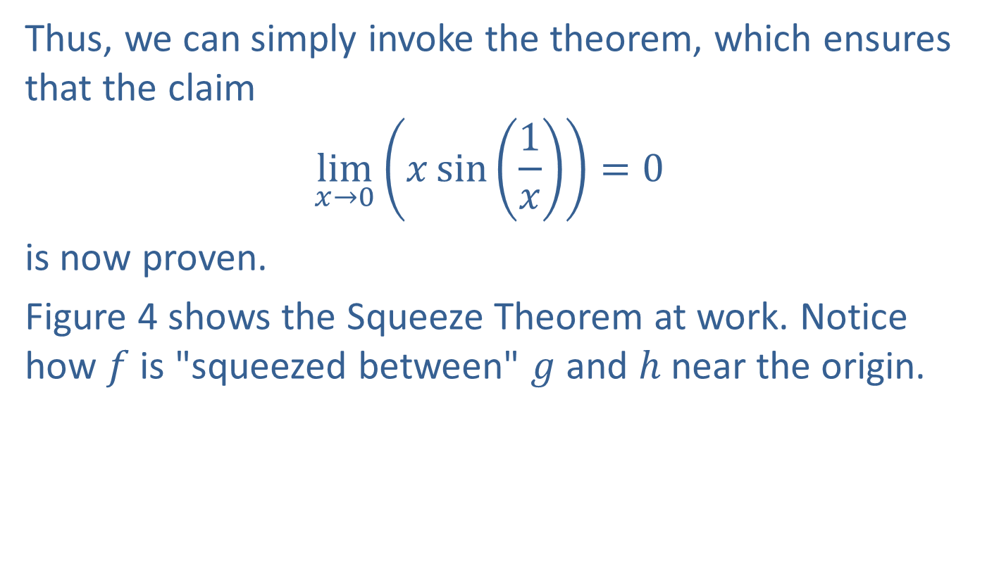
Example 8: Using the Squeeze Theorem to Determine Limits (cont.)
Thus, we can simply invoke the theorem, which ensures that the claim
$$\lim_{x→0}\left(x\sin\left(\frac{1}{x}\right)\right)=0$$
is now proven.
Figure 4 shows the Squeeze Theorem at work. Notice how $f$ is "squeezed between" $g$ and $h$ near the origin.

Slide 46
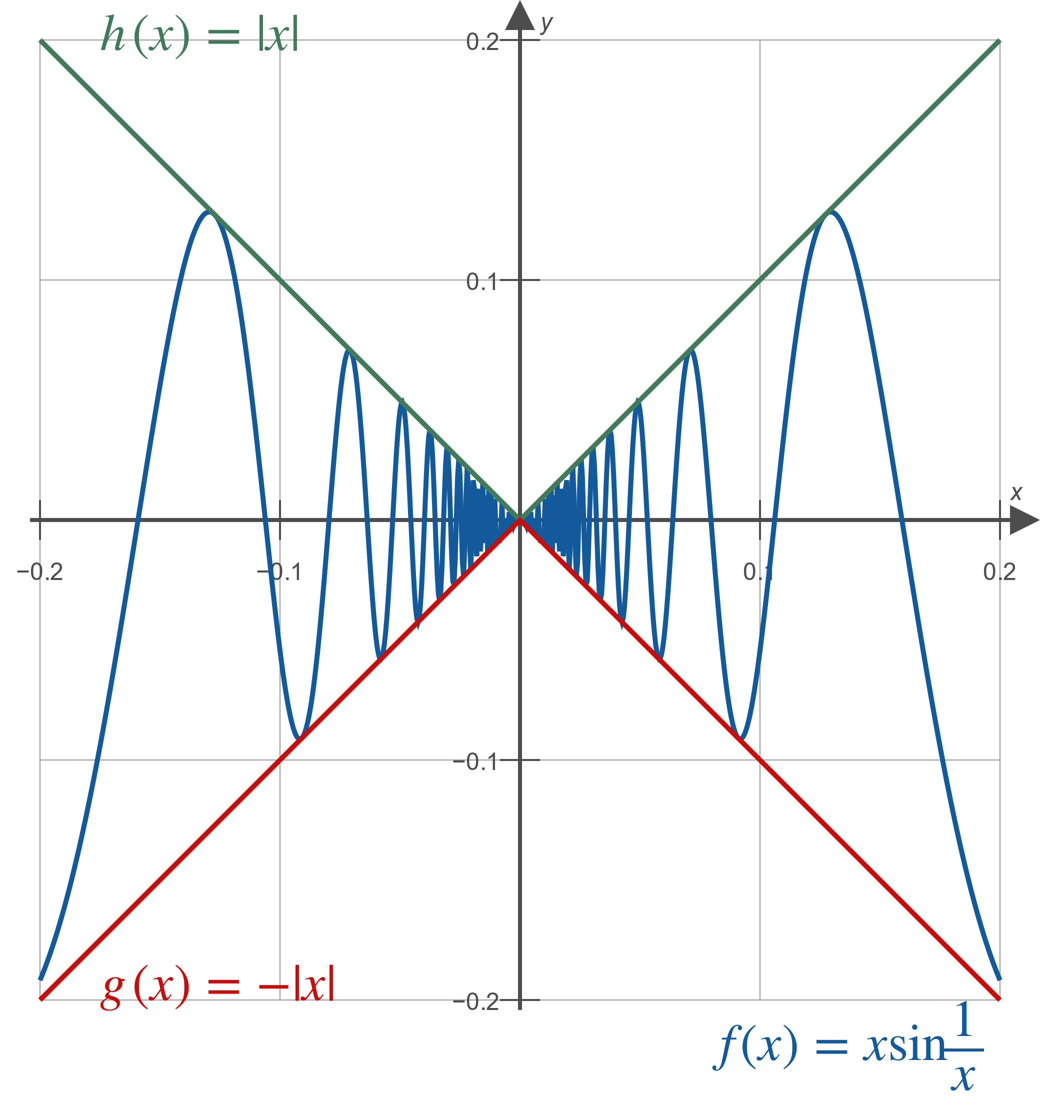
Example 8: Using the Squeeze Theorem to Determine Limits (cont.)
Figure 4

Slide 47
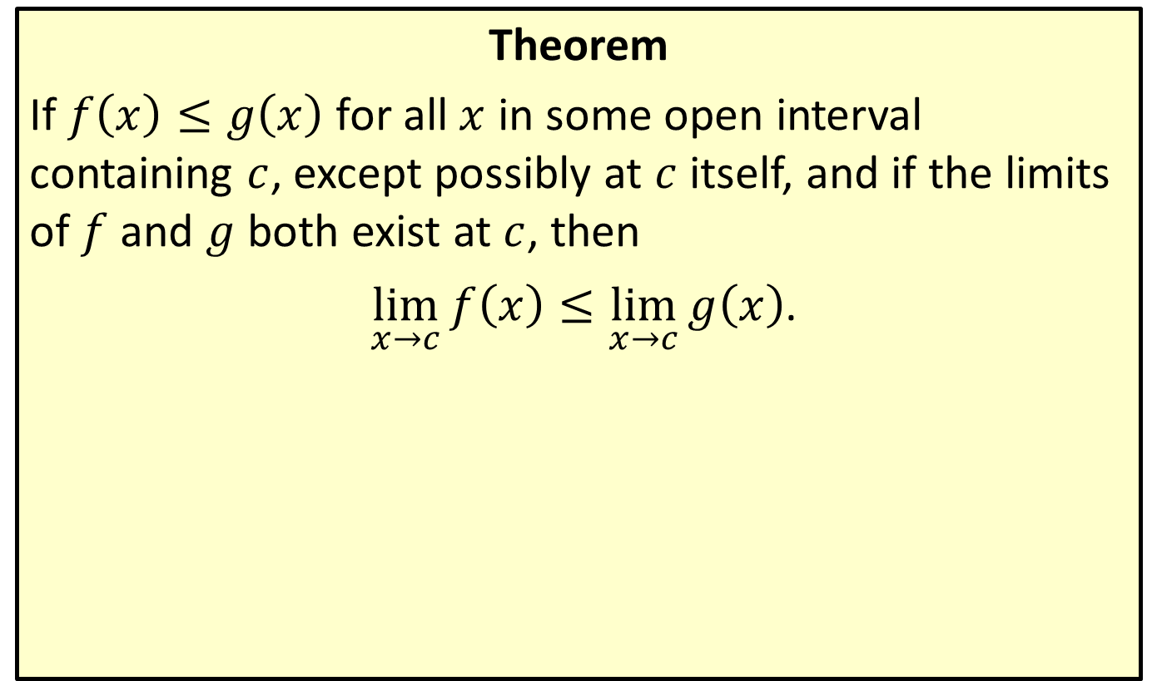
Upper Bound Theorem
Theorem
If $f\left(x\right)≤g\left(x\right)$ for all $x$ in some open interval containing $c$, except possibly at $c$ itself, and if the limits of $f$ and $g$ both exist at $c$, then
$\lim_{x→c}{f\left(x\right)}≤\lim_{x→c}{g\left(x\right)}$.

