Slide 1
Section 13.5
Continuity

Slide 2
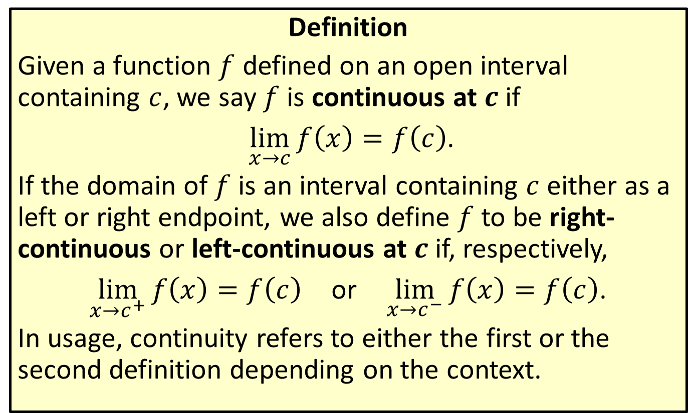
Continuity at a Point
Definition
Given a function $f$ defined on an open interval containing $c$, we say $f$ is continuous at $c$ if
$\lim_{x→c}{f\left(x\right)}=f\left(c\right)$.
If the domain of $f$ is an interval containing $c$ either as a left or right endpoint, we also define $f$ to be right-continuous or left-continuous at $c$ if, respectively,
$\lim_{x→c^{+}}{f\left(x\right)}=f\left(c\right)$ or $\lim_{x→c^{−}}{f\left(x\right)}=f\left(c\right)$.
In usage, continuity refers to either the first or the second definition depending on the context.

Slide 3
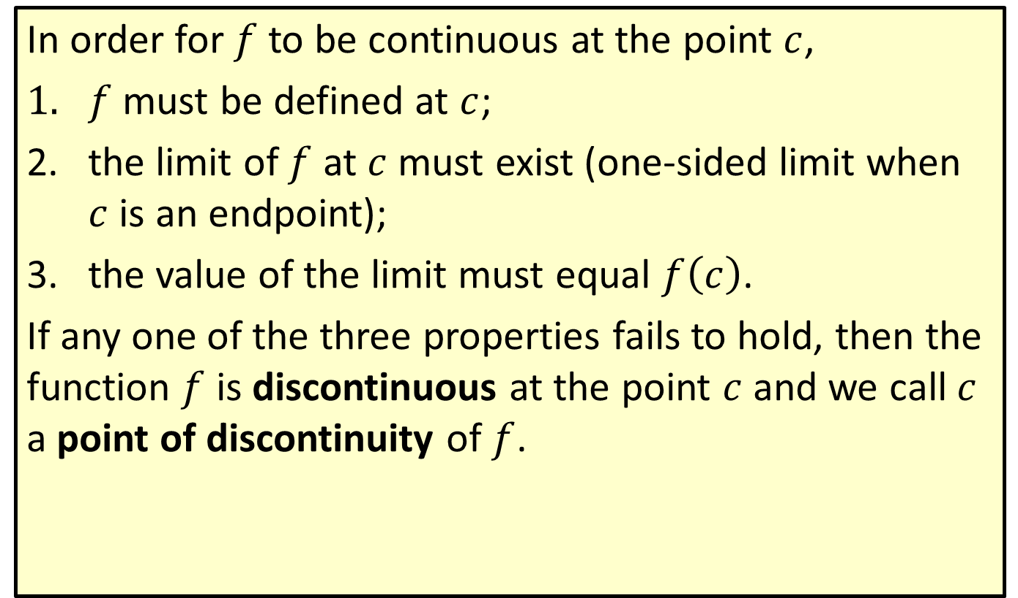
Continuity at a Point (cont.)
In order for $f$ to be continuous at the point $c$,
$f$ must be defined at $c$;
the limit of $f$ at $c$ must exist (one‑sided limit when $c$ is an endpoint);
the value of the limit must equal $f\left(c\right)$.
If any one of the three properties fails to hold, then the function $f$ is discontinuous at the point $c$ and we call $c$ a point of discontinuity of $f$.

Slide 4

Example 1: Finding Points of Continuity and Discontinuity
Find all points of continuity as well as all points of discontinuity for the function $f⁡\left(x\right)$ given by its graph in Figure 1. For any discontinuities, identify those from the three properties of continuity that fail to hold.

Slide 5
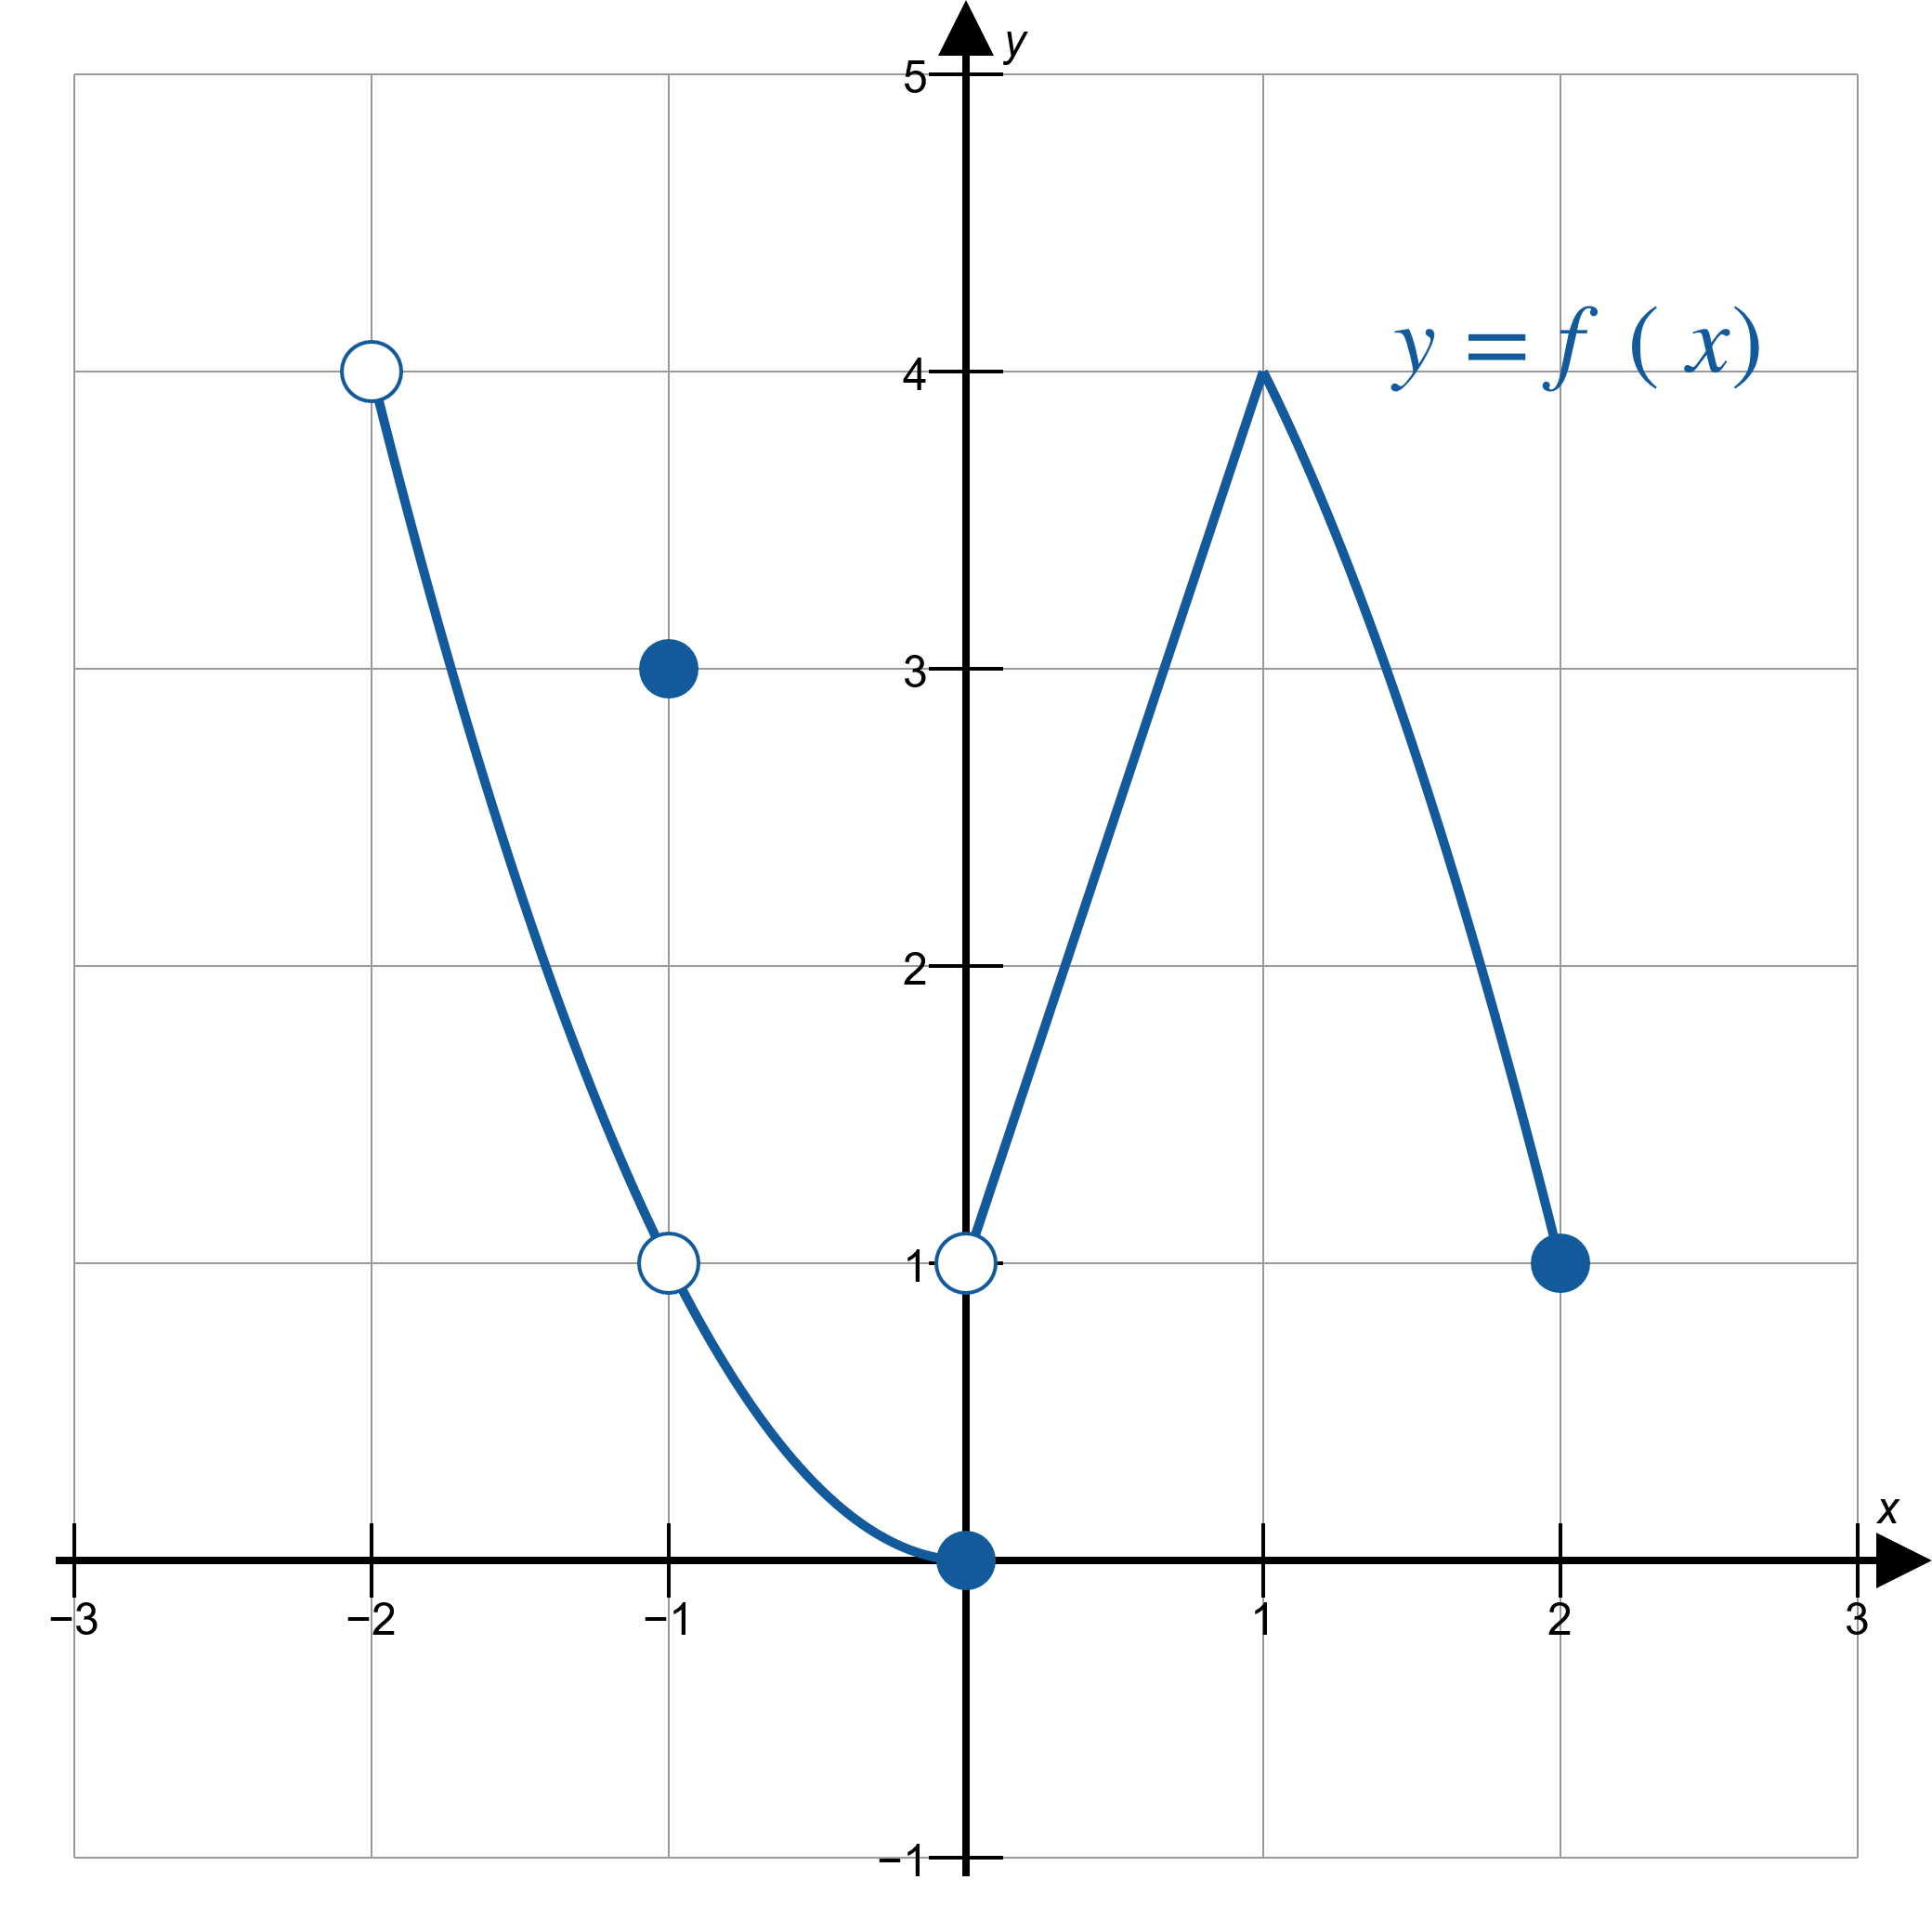
Example 1: Finding Points of Continuity and Discontinuity (cont.)
Figure 1

Slide 6
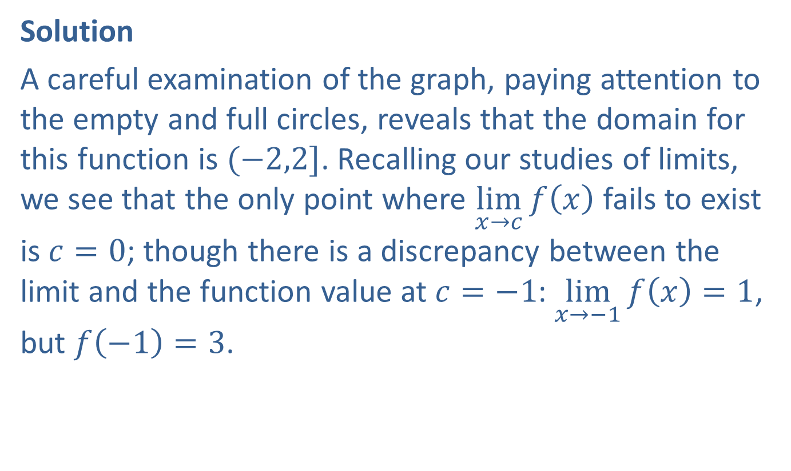
Example 1: Finding Points of Continuity and Discontinuity (cont.)
Solution
A careful examination of the graph, paying attention to the empty and full circles, reveals that the domain for this function is $(−2,2]$. Recalling our studies of limits, we see that the only point where $\lim_{x→c}⁡f\left(x\right)$ fails to exist is $c=0$; though there is a discrepancy between the limit and the function value at $c=−1$: $\lim_{x→−1}{f\left(x\right)}=1$, but $f\left(−1\right)=3$.

Slide 7
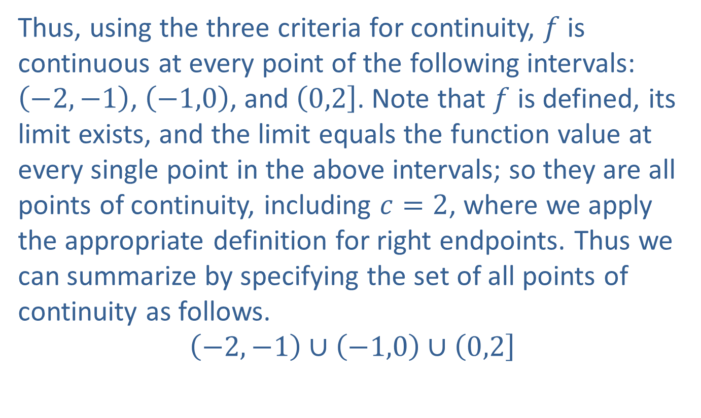
Example 1: Finding Points of Continuity and Discontinuity (cont.)
Thus, using the three criteria for continuity, $f$ is continuous at every point of the following intervals: $\left(−2,−1\right)$, $\left(−1,0\right)$, and $\left(0,2\right]$. Note that $f$ is defined, its limit exists, and the limit equals the function value at every single point in the above intervals; so they are all points of continuity, including $c=2$, where we apply the appropriate definition for right endpoints. Thus we can summarize by specifying the set of all points of continuity as follows.
$$\left(−2,−1\right)∪\left(−1,0\right)∪\left(0,2\right]$$

Slide 8
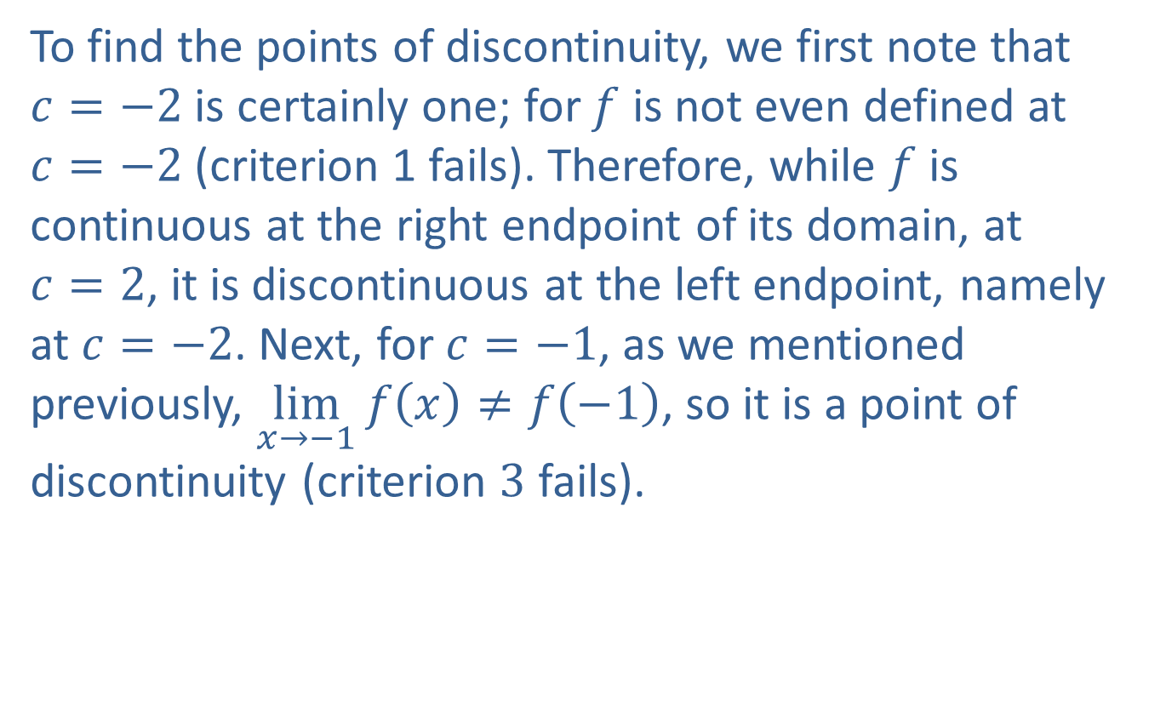
Example 1: Finding Points of Continuity and Discontinuity (cont.)
To find the points of discontinuity, we first note that $c=−2$ is certainly one; for $f$ is not even defined at $c=−2$ (criterion 1 fails). Therefore, while $f$ is continuous at the right endpoint of its domain, at $c=2$, it is discontinuous at the left endpoint, namely at $c=−2$. Next, for $c=−1$, as we mentioned previously, $\lim_{x→−1}{f\left(x\right)}≠f\left(−1\right)$, so it is a point of discontinuity (criterion 3 fails).

Slide 9
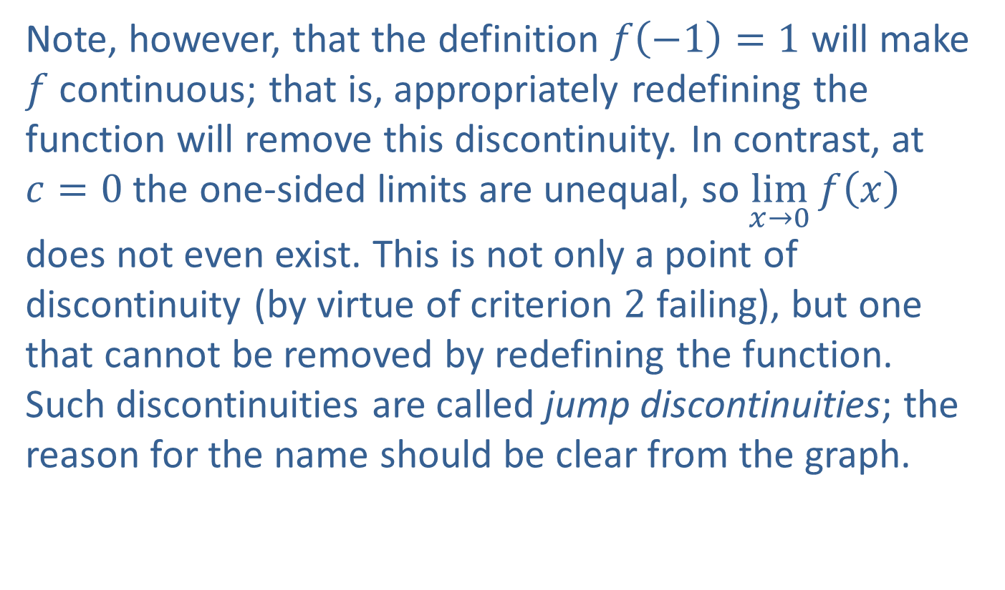
Example 1: Finding Points of Continuity and Discontinuity (cont.)
Note, however, that the definition $f\left(−1\right)=1$ will make $f$ continuous; that is, appropriately redefining the function will remove this discontinuity. In contrast, at $c=0$ the one-sided limits are unequal, so $\lim_{x→0}⁡f\left(x\right)$ does not even exist. This is not only a point of discontinuity (by virtue of criterion 2 failing), but one that cannot be removed by redefining the function. Such discontinuities are called jump discontinuities; the reason for the name should be clear from the graph.

Slide 10
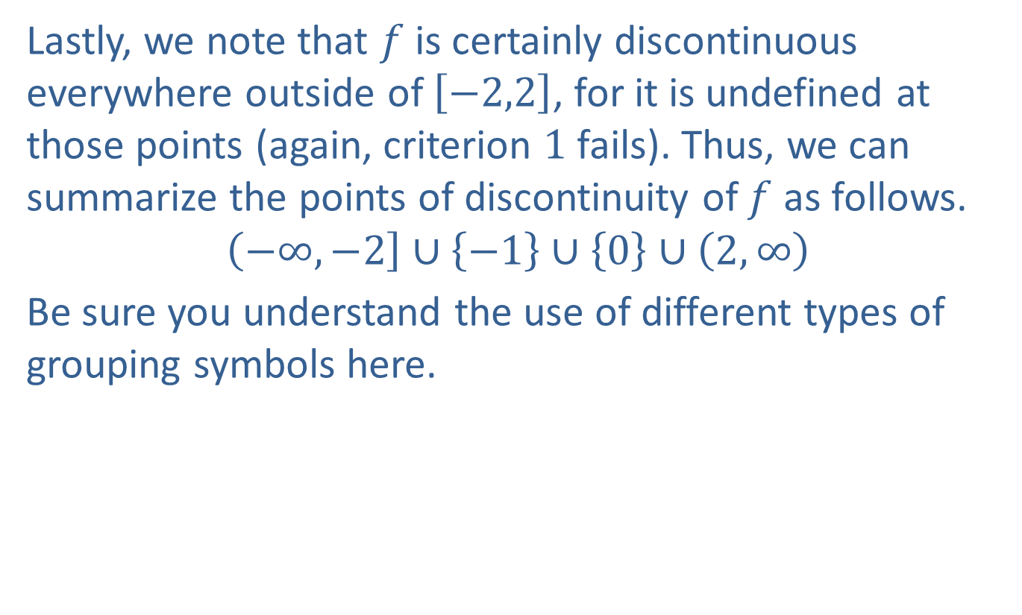
Example 1: Finding Points of Continuity and Discontinuity (cont.)
Lastly, we note that $f$ is certainly discontinuous everywhere outside of $\left[−2,2\right]$, for it is undefined at those points (again, criterion 1 fails). Thus, we can summarize the points of discontinuity of $f$ as follows.
$$\left(−∞,−2\right]∪\left\{−1\right\}∪\left\{0\right\}∪\left(2,∞\right)$$
Be sure you understand the use of different types of grouping symbols here.

Slide 11

Example 2: Finding Points of Discontinuity
Identify and examine the discontinuities of the following functions.
​$f\left(x\right)=\frac{x^{2}+x}{x}$
​$g\left(x\right)=\frac{1}{x^{2}}$
​$h\left(x\right)=\sin\left(\frac{1}{x}\right)$

Slide 12
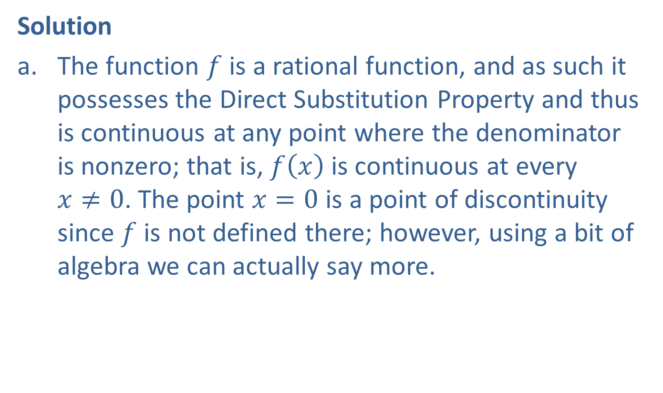
Example 2: Finding Points of Discontinuity (cont.)
Solution
​The function $f$ is a rational function, and as such it possesses the Direct Substitution Property and thus is continuous at any point where the denominator is nonzero; that is, $f⁡\left(x\right)$ is continuous at every $x≠0$. The point $x=0$ is a point of discontinuity since $f$ is not defined there; however, using a bit of algebra we can actually say more. ​

Slide 13
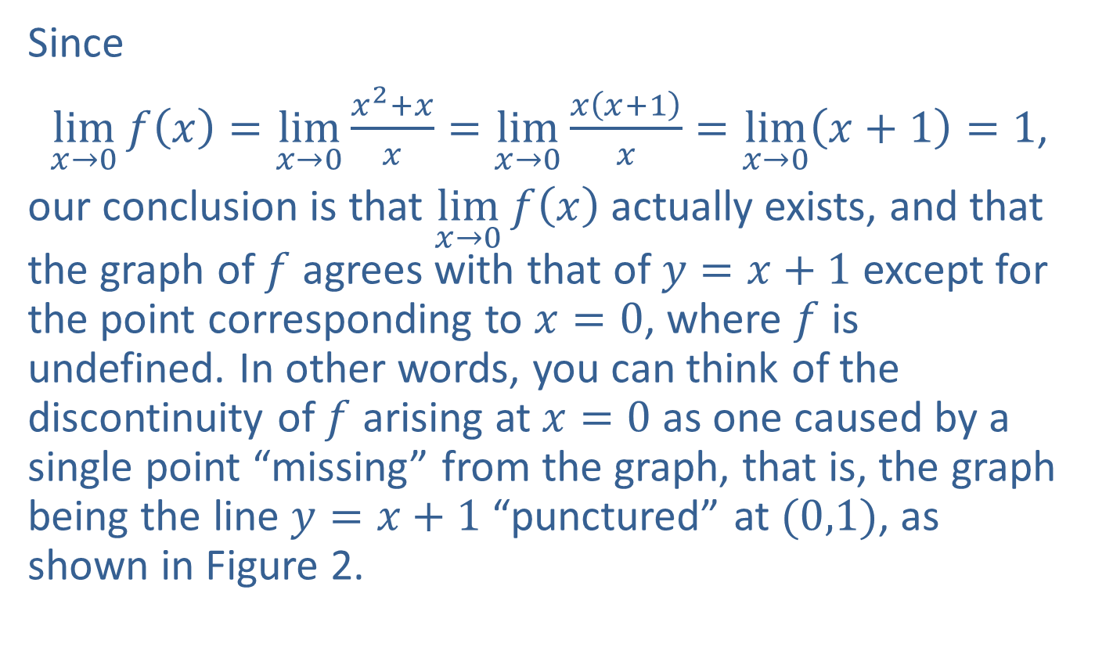
Example 2: Finding Points of Discontinuity (cont.)
Since
​ $\lim_{x→0}{f\left(x\right)}=\lim_{x→0}{\frac{x^{2}+x}{x}}=\lim_{x→0}{\frac{x\left(x+1\right)}{x}}=\lim_{x→0}\left(x+1\right)=1$,
​our conclusion is that $\lim_{x→0}⁡f\left(x\right)$ actually exists, and that the graph of $f$ agrees with that of $y=x+1$ except for the point corresponding to $x=0$, where $f$ is undefined. In other words, you can think of the discontinuity of $f$ arising at $x=0$ as one caused by a single point “missing” from the graph, that is, the graph being the line $y=x+1$ “punctured” at $(0,1)$, as shown in Figure 2.

Slide 14
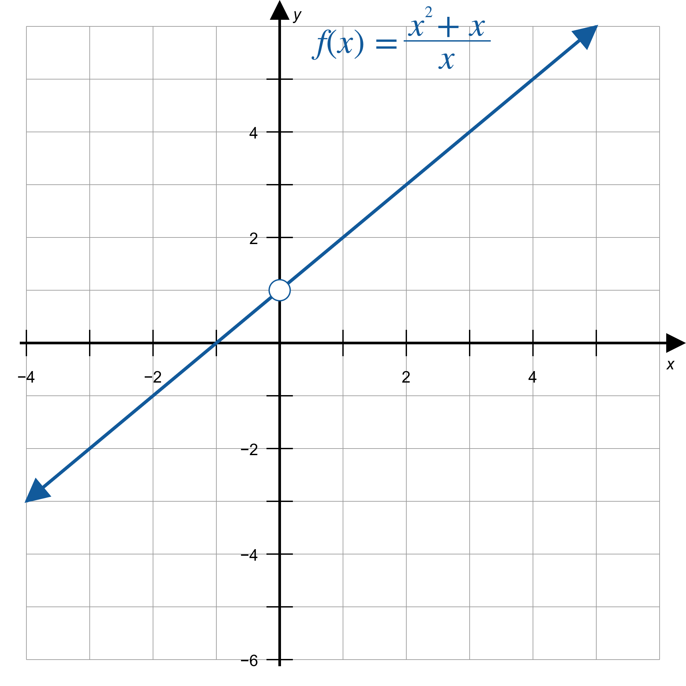
Example 2: Finding Points of Discontinuity (cont.)
Figure 2

Slide 15

Example 2: Finding Points of Discontinuity (cont.)
​This is another example of a discontinuity that can be removed; the definition $f\left(0\right)=1$ will make $f$ continuous at $x=0$.

Slide 16
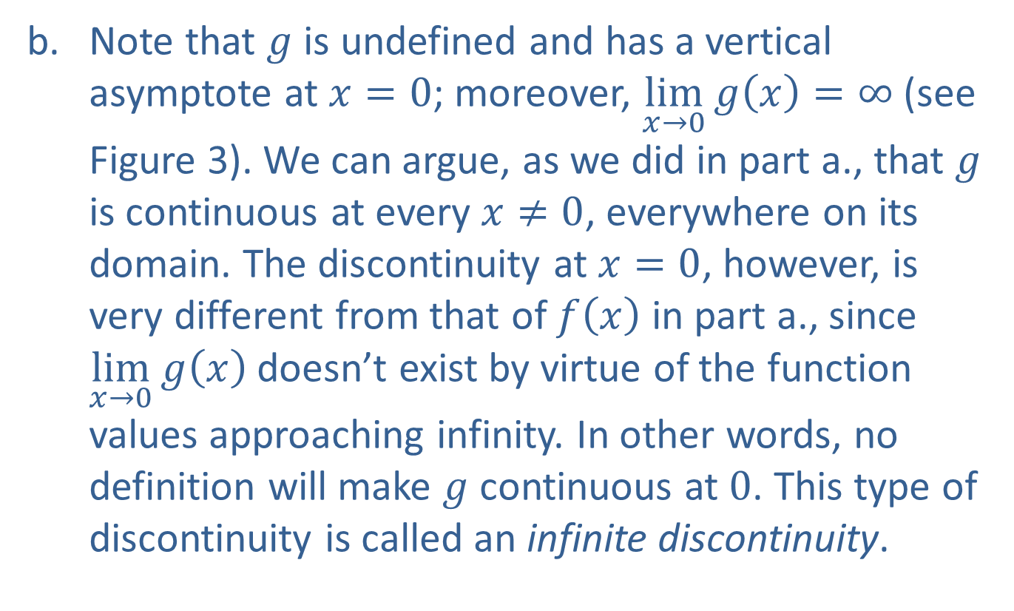
Example 2: Finding Points of Discontinuity (cont.)
​Note that $g$ is undefined and has a vertical asymptote at $x=0$; moreover, $\lim_{x→0}{g\left(x\right)}=∞$ (see Figure 3). We can argue, as we did in part a., that $g$ is continuous at every $x≠0$, everywhere on its domain. The discontinuity at $x=0$, however, is very different from that of $f⁡\left(x\right)$ in part a., since $\lim_{x→0}⁡g\left(x\right)$ doesn’t exist by virtue of the function values approaching infinity. In other words, no definition will make $g$ continuous at 0. This type of discontinuity is called an infinite discontinuity.

Slide 17
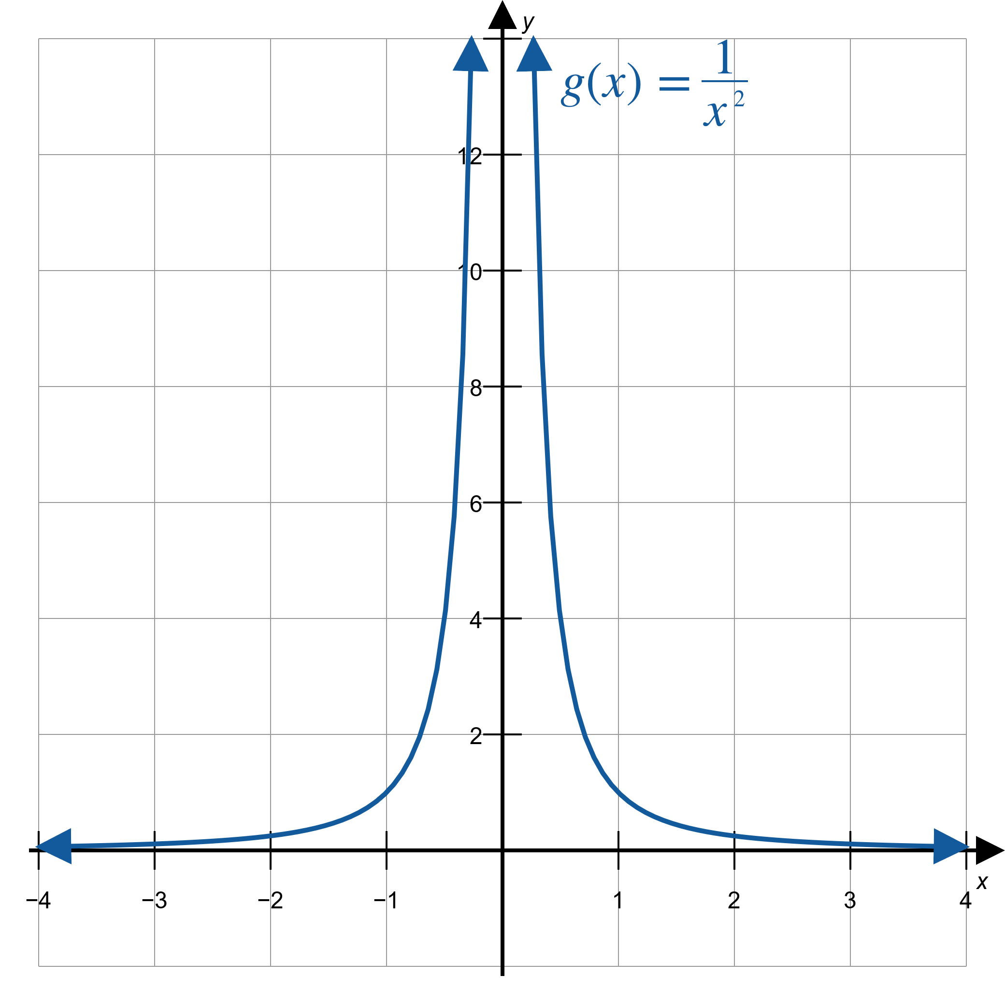
Example 2: Finding Points of Discontinuity (cont.)
Figure 3

Slide 18
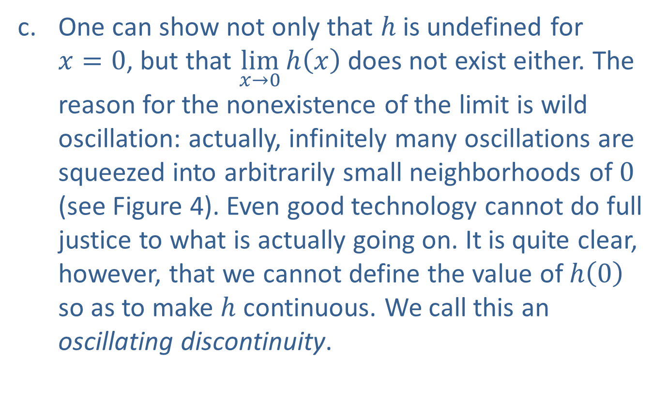
Example 2: Finding Points of Discontinuity (cont.)
​One can show not only that $h$ is undefined for $x=0$, but that $\lim_{x→0}⁡h\left(x\right)$ does not exist either. The reason for the nonexistence of the limit is wild oscillation: actually, infinitely many oscillations are squeezed into arbitrarily small neighborhoods of 0 (see Figure 4). Even good technology cannot do full justice to what is actually going on. It is quite clear, however, that we cannot define the value of $h⁡\left(0\right)$ so as to make $h$ continuous. We call this an oscillating discontinuity.

Slide 19
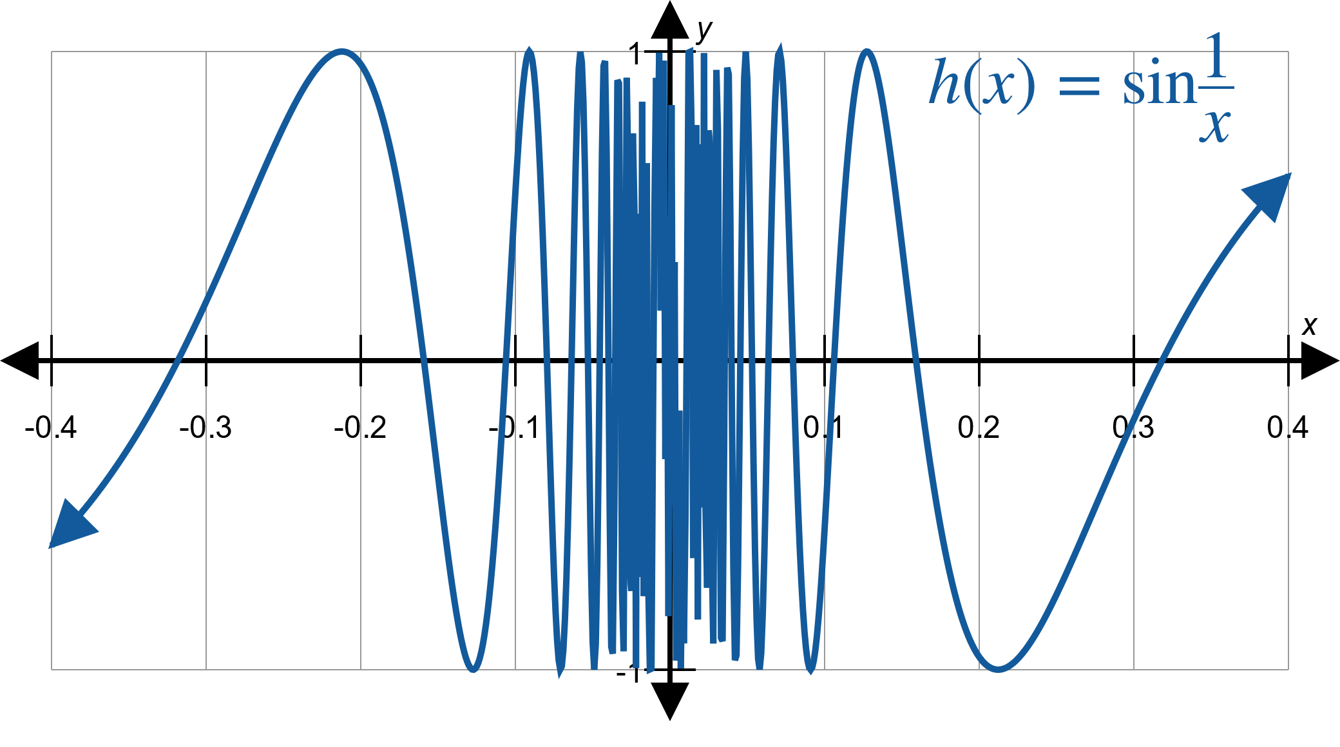
Example 2: Finding Points of Discontinuity (cont.)
Figure 4

Slide 20
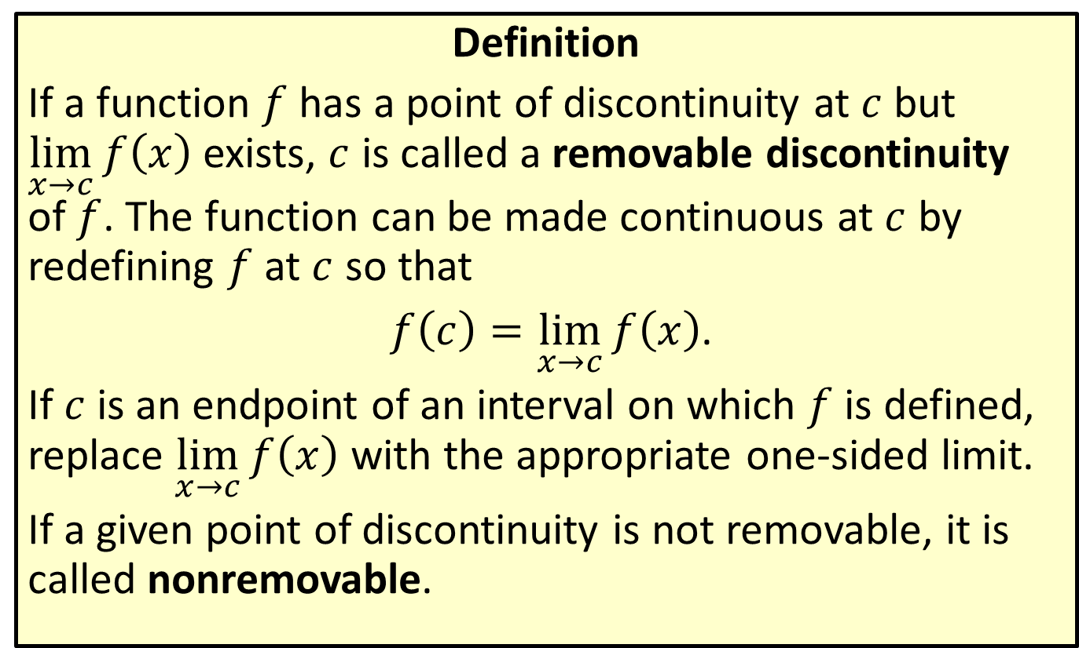
Removable Discontinuity
Definition
If a function $f$ has a point of discontinuity at $c$ but $\lim_{x→c}⁡f\left(x\right)$ exists, $c$ is called a removable discontinuity of $f$. The function can be made continuous at $c$ by redefining $f$ at $c$ so that
$f\left(c\right)=\lim_{x→c}{f\left(x\right)}$.
If $c$ is an endpoint of an interval on which $f$ is defined, replace $\lim_{x→c}⁡f\left(x\right)$ with the appropriate one-sided limit.
If a given point of discontinuity is not removable, it is called nonremovable.

Slide 21
Example 3: Classifying Removable and Nonremovable Points of Discontinuity
Identify the discontinuities in Examples 1 and 2 as removable or nonremovable.

Slide 22
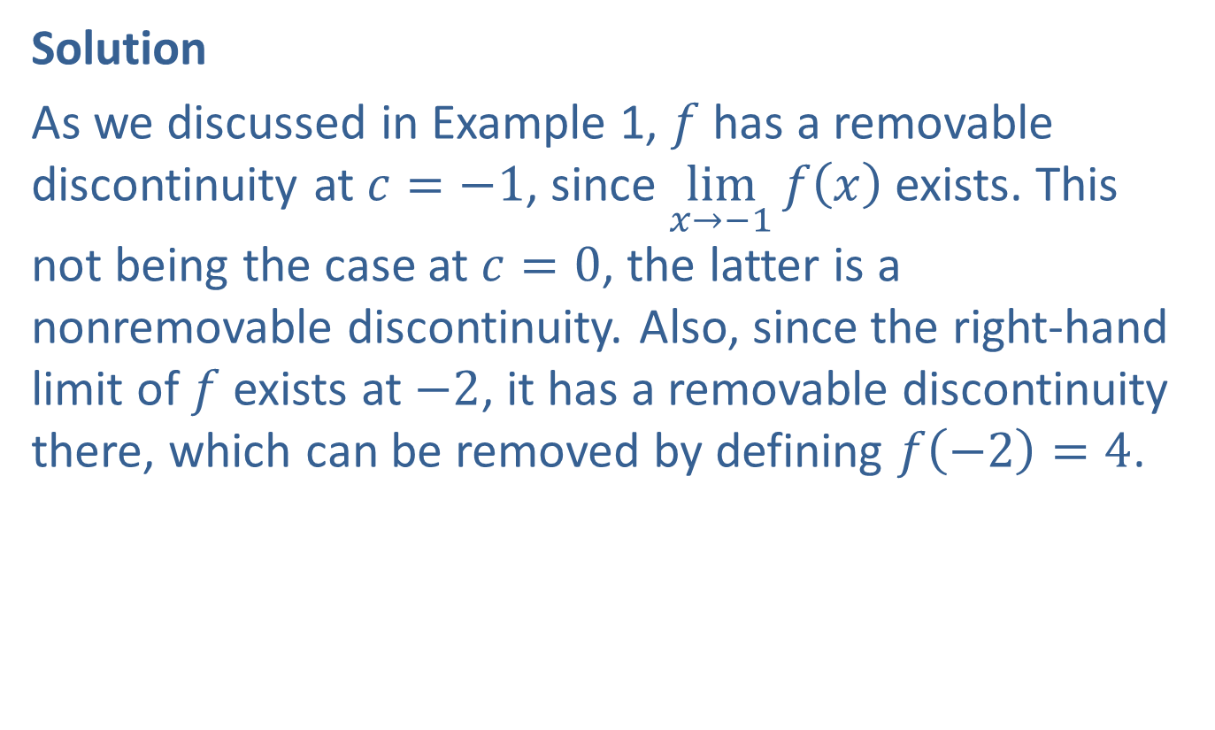
Example 3: Classifying Removable and Nonremovable Points of Discontinuity (cont.)
Solution
As we discussed in Example 1, $f$ has a removable discontinuity at $c=−1$, since $\lim_{x→−1}⁡f\left(x\right)$ exists. This not being the case at $c=0$, the latter is a nonremovable discontinuity. Also, since the right-hand limit of $f$ exists at $−2$, it has a removable discontinuity there, which can be removed by defining $f\left(−2\right)=4$.

Slide 23
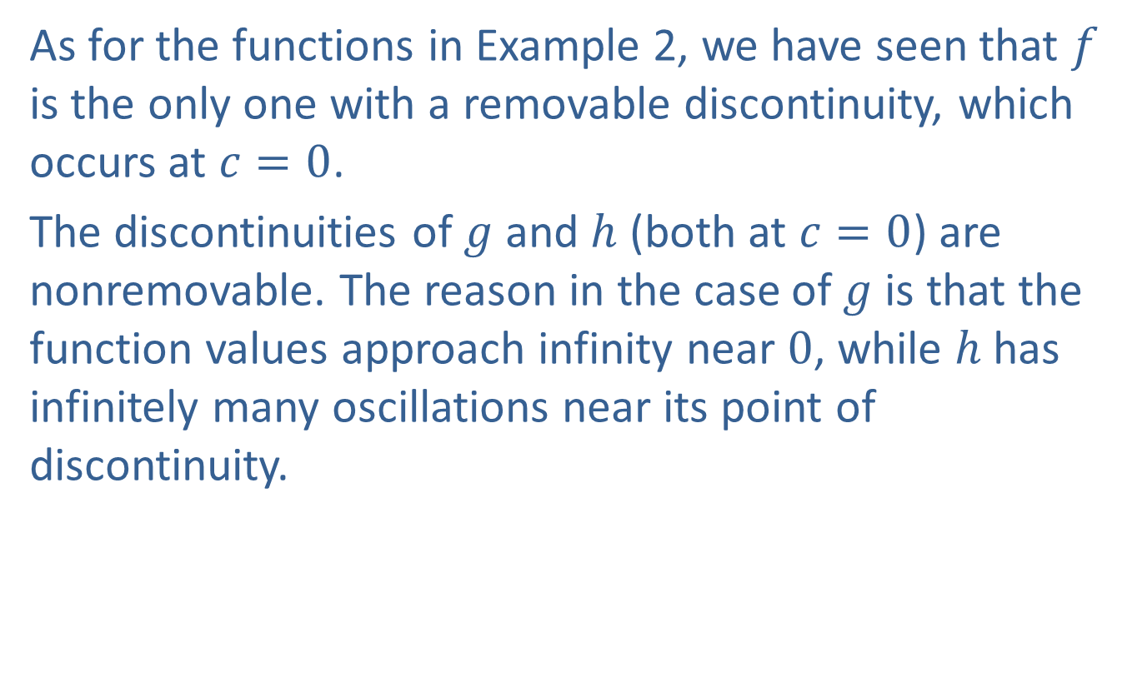
Example 3: Classifying Removable and Nonremovable Points of Discontinuity (cont.)
As for the functions in Example 2, we have seen that $f$ is the only one with a removable discontinuity, which occurs at $c=0$.
The discontinuities of $g$ and $h$ (both at $c=0$) are nonremovable. The reason in the case of $g$ is that the function values approach infinity near 0, while $h$ has infinitely many oscillations near its point of discontinuity.

Slide 24
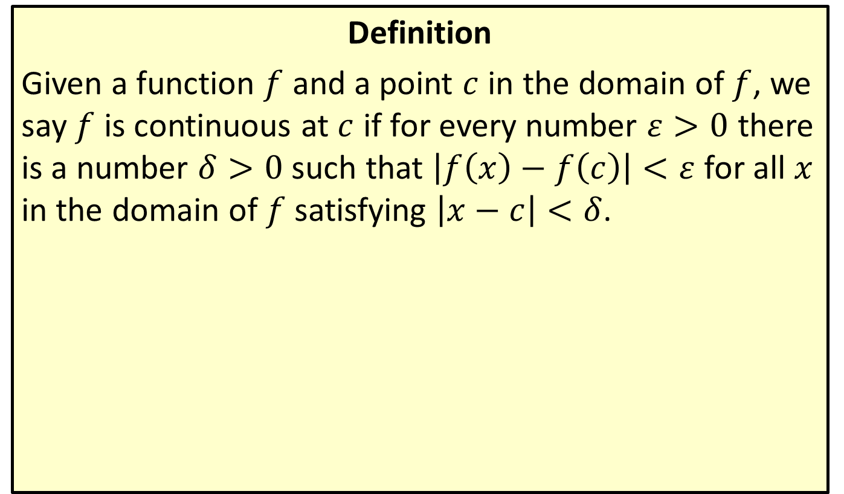
Epsilon-Delta Continuity at a Point
Definition
Given a function $f$ and a point $c$ in the domain of $f$, we say $f$ is continuous at $c$ if for every number $ε>0$ there is a number $δ>0$ such that $\left|f\left(x\right)−f\left(c\right)\right|<ε$ for all $x$ in the domain of $f$ satisfying $\left|x−c\right|<δ$.

Slide 25
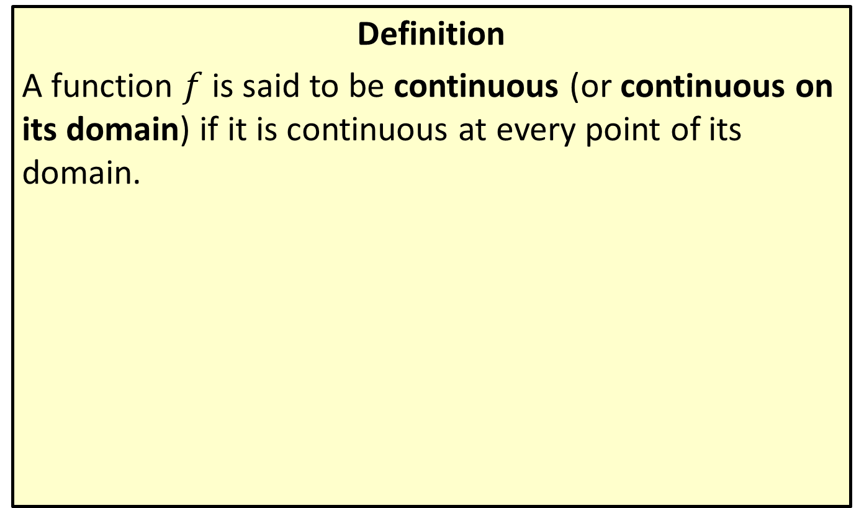
Continuity of a Function
Definition
A function $f$ is said to be continuous (or continuous on its domain) if it is continuous at every point of its domain.

Slide 26

Example 4: Finding Points of Continuity and Discontinuity
Discuss the continuity of $f\left(x\right)=\frac{x^{2}−1}{x−1}$. If applicable, identify all points of discontinuity.

Slide 27
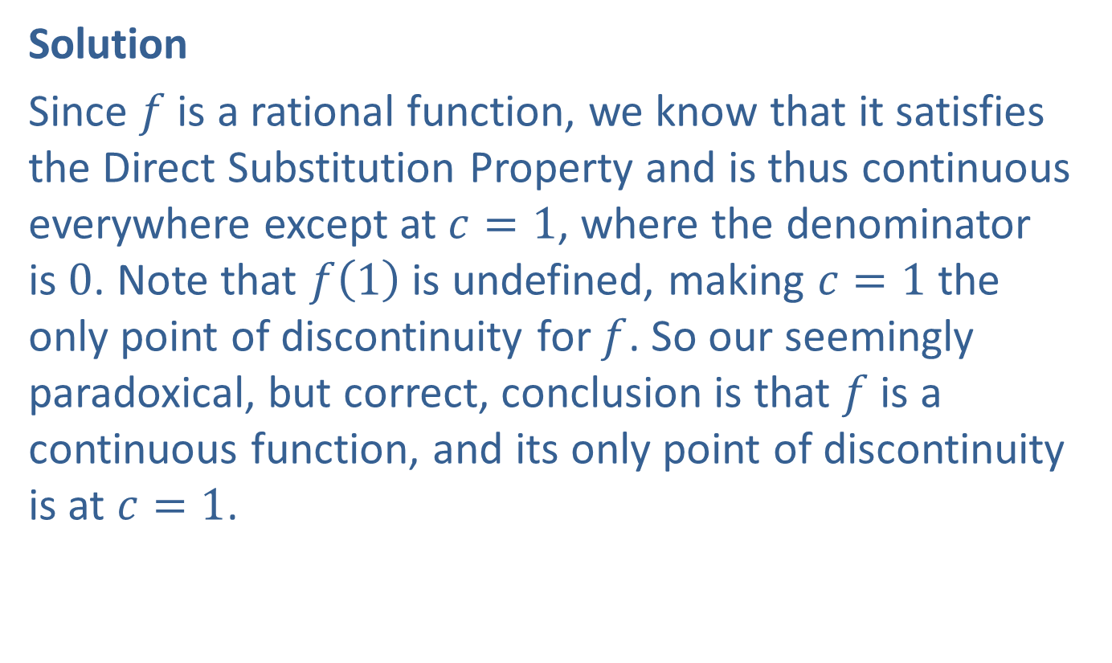
Example 4: Finding Points of Continuity and Discontinuity (cont.)
Solution
Since $f$ is a rational function, we know that it satisfies the Direct Substitution Property and is thus continuous everywhere except at $c=1$, where the denominator is 0. Note that $f⁡\left(1\right)$ is undefined, making $c=1$ the only point of discontinuity for $f$. So our seemingly paradoxical, but correct, conclusion is that $f$ is a continuous function, and its only point of discontinuity is at $c=1$.

Slide 28
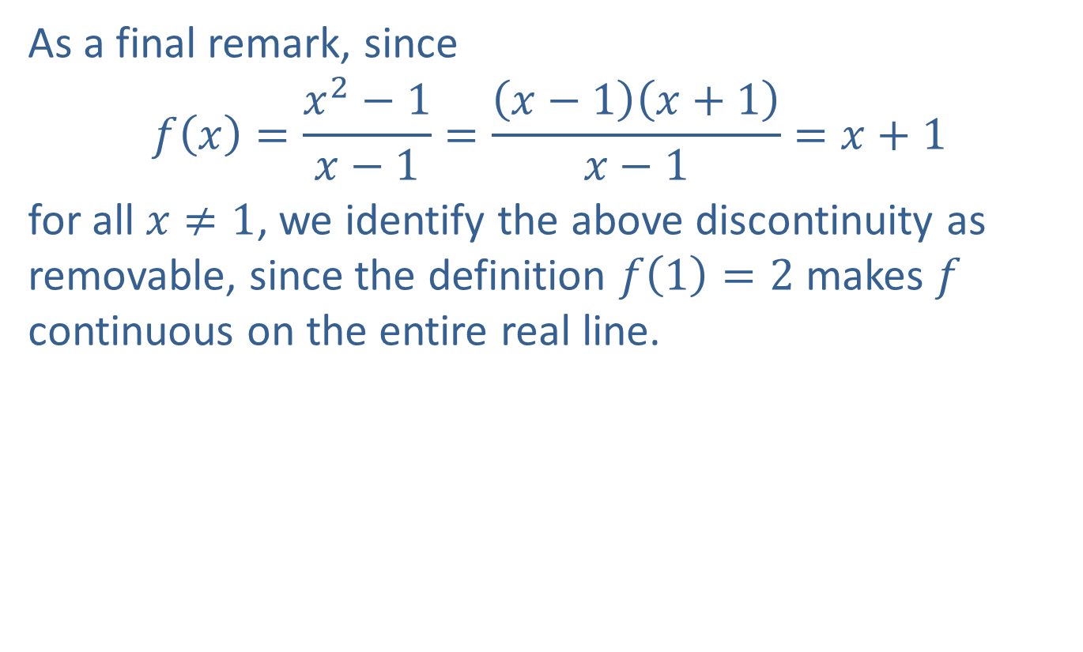
Example 4: Finding Points of Continuity and Discontinuity (cont.)
As a final remark, since
$$f\left(x\right)=\frac{x^{2}−1}{x−1}=\frac{\left(x−1\right)\left(x+1\right)}{x−1}=x+1$$
for all $x≠1$, we identify the above discontinuity as removable, since the definition $f\left(1\right)=2$ makes $f$ continuous on the entire real line.

Slide 29

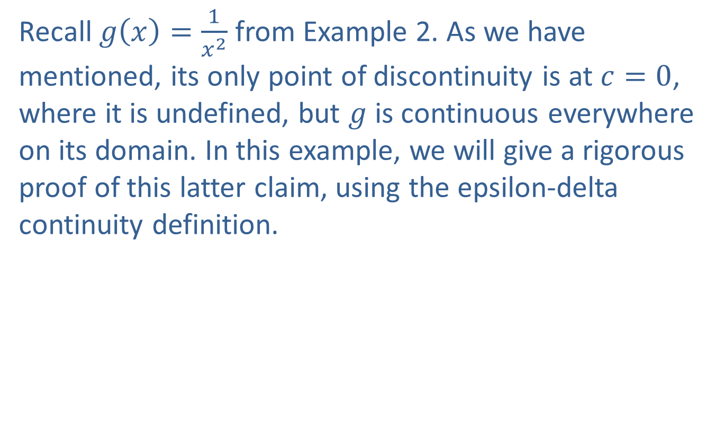
Example 5: Using the $ε$-$δ$ Definition of Continuity
Recall $g\left(x\right)=\frac{1}{x^{2}}$ from Example 2. As we have mentioned, its only point of discontinuity is at $c=0$, where it is undefined, but $g$ is continuous everywhere on its domain. In this example, we will give a rigorous proof of this latter claim, using the epsilon-delta continuity definition.

Slide 30

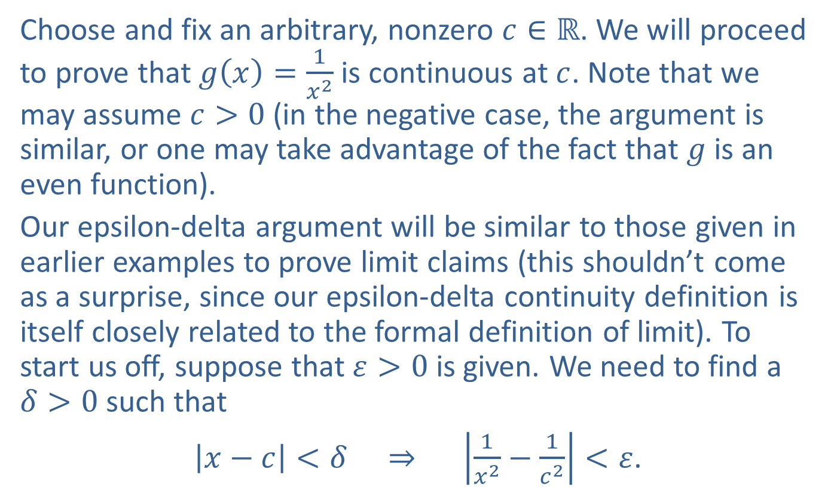
Example 5: Using the $ε$-$δ$ Definition of Continuity (cont.)
Choose and fix an arbitrary, nonzero $c∈ℝ$. We will proceed to prove that $g\left(x\right)=\frac{1}{x^{2}}$ is continuous at $c$. Note that we may assume $c>0$ (in the negative case, the argument is similar, or one may take advantage of the fact that $g$ is an even function).
Our epsilon-delta argument will be similar to those given in earlier examples to prove limit claims (this shouldn’t come as a surprise, since our epsilon-delta continuity definition is itself closely related to the formal definition of limit). To start us off, suppose that $ε>0$ is given. We need to find a $δ>0$ such that
$\left|x−c\right|<δ ⇒ \left|\frac{1}{x^{2}}−\frac{1}{c^{2}}\right|<ε$.

Slide 31
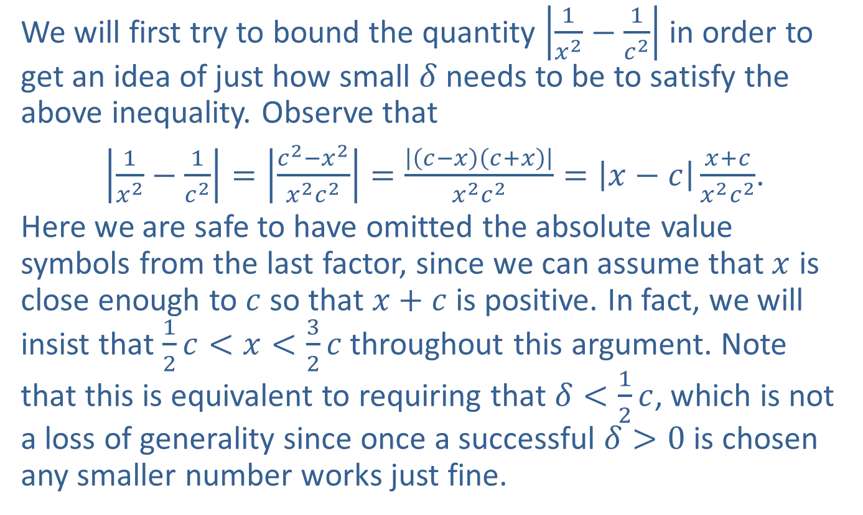
Example 5: Using the $ε$-$δ$ Definition of Continuity (cont.)
We will first try to bound the quantity $\left|\frac{1}{x^{2}}−\frac{1}{c^{2}}\right|$ in order to get an idea of just how small $δ$ needs to be to satisfy the above inequality. Observe that
$\left|\frac{1}{x^{2}}−\frac{1}{c^{2}}\right|=\left|\frac{c^{2}−x^{2}}{x^{2}c^{2}}\right|=\frac{\left|\left(c−x\right)\left(c+x\right)\right|}{x^{2}c^{2}}=\left|x−c\right|\frac{x+c}{x^{2}c^{2}}$.
Here we are safe to have omitted the absolute value symbols from the last factor, since we can assume that $x$ is close enough to $c$ so that $x+c$ is positive. In fact, we will insist that $\frac{1}{2}c<x<\frac{3}{2}c$ throughout this argument. Note that this is equivalent to requiring that $δ<\frac{1}{2}c$, which is not a loss of generality since once a successful $δ>0$ is chosen any smaller number works just fine.

Slide 32
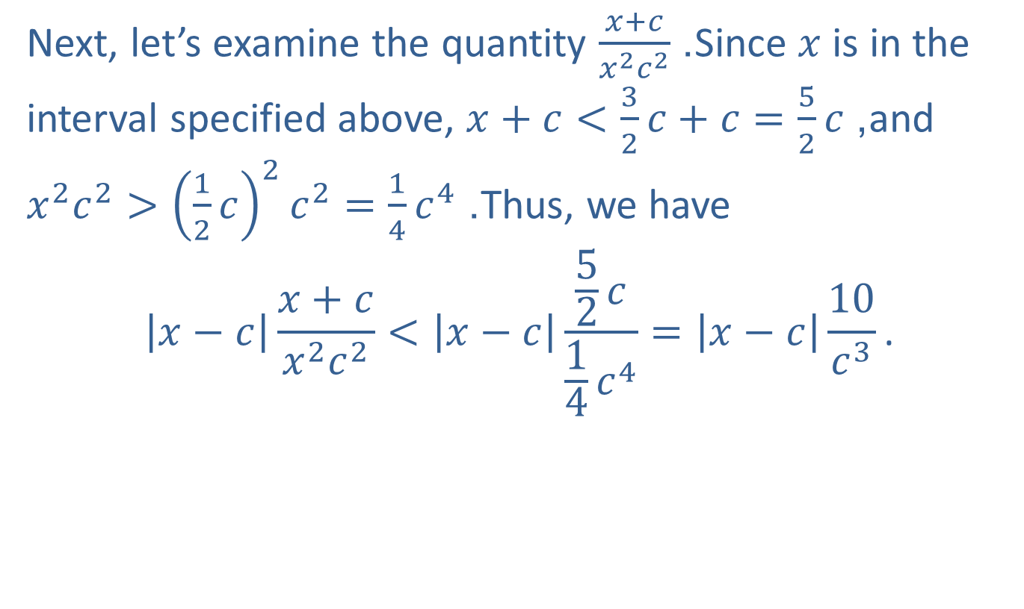
Example 5: Using the $ε$-$δ$ Definition of Continuity (cont.)
Next, let’s examine the quantity $\frac{x+c}{x^{2}c^{2}}$. Since $x$ is in the interval specified above, $x+c<\frac{3}{2}c+c=\frac{5}{2}c$, and $x^{2}c^{2}>{\left(\frac{1}{2}c\right)}^{2}c^{2}=\frac{1}{4}c^{4}$. Thus, we have
$$\left|x−c\right|\frac{x+c}{x^{2}c^{2}}<\left|x−c\right|\frac{\frac{5}{2}c}{\frac{1}{4}c^{4}}=\left|x−c\right|\frac{10}{c^{3}}\text{.}$$

Slide 33
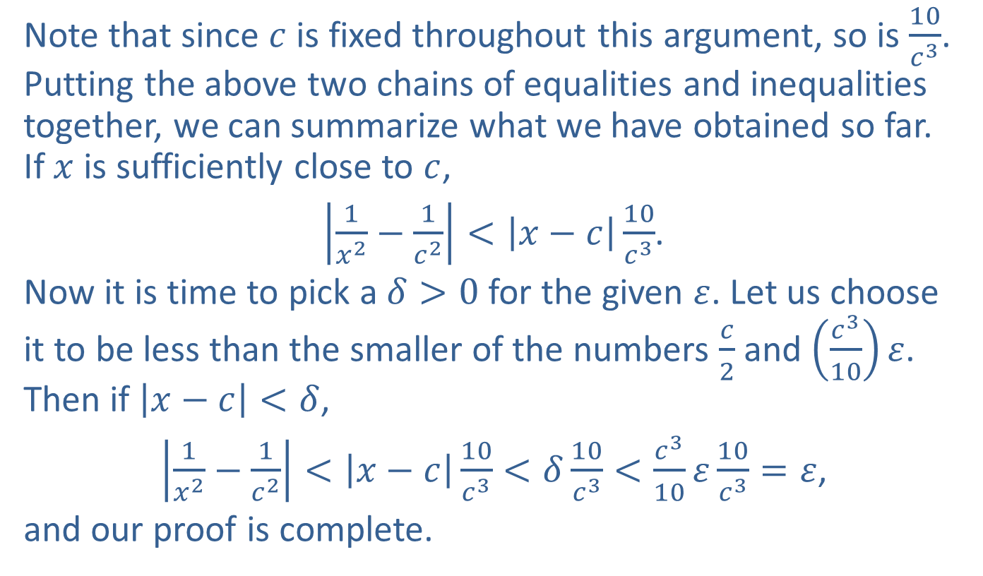
Example 5: Using the $ε$-$δ$ Definition of Continuity (cont.)
Note that since $c$ is fixed throughout this argument, so is $\frac{10}{c^{3}}$. Putting the above two chains of equalities and inequalities together, we can summarize what we have obtained so far. If $x$ is sufficiently close to $c$,
$\left|\frac{1}{x^{2}}−\frac{1}{c^{2}}\right|<\left|x−c\right|\frac{10}{c^{3}}$.
Now it is time to pick a $δ>0$ for the given $ε$. Let us choose it to be less than the smaller of the numbers $\frac{c}{2}$ and $\left(\frac{c^{3}}{10}\right)ε$. Then if $\left|x−c\right|<δ$,
$\left|\frac{1}{x^{2}}−\frac{1}{c^{2}}\right|<\left|x−c\right|\frac{10}{c^{3}}<δ\frac{10}{c^{3}}<\frac{c^{3}}{10}ε\frac{10}{c^{3}}=ε$,
and our proof is complete.

Slide 34

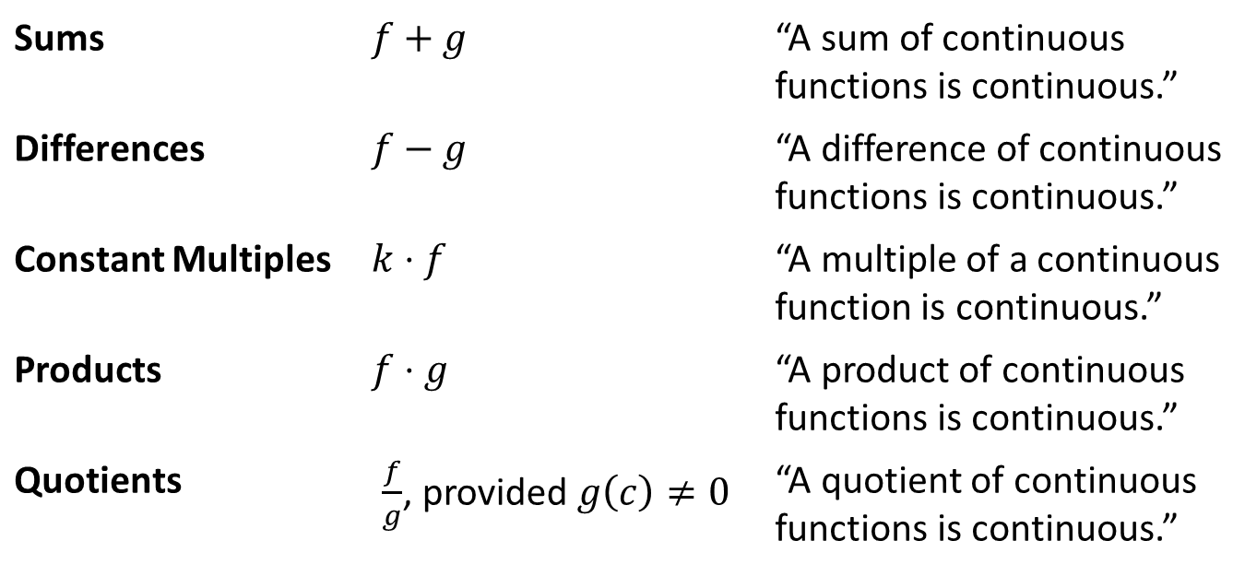
Properties of Continuous Functions
Theorem
Let $f$ and $g$ be two functions both continuous at the point $c$, and let $k$ be a fixed real number. Then the following combinations of $f$ and $g$ are also continuous at $c$.
Sums | $f+g$ | “A sum of continuous functions is continuous.”
Differences | $f−g$ | “A difference of continuous functions is continuous.”
Constant Multiples | $k⋅f$ | “A multiple of a continuous function is continuous.”
Products | $f⋅g$ | “A product of continuous functions is continuous.”
Quotients | $\frac{f}{g}$, provided $g\left(c\right)≠0$ | “A quotient of continuous functions is continuous.”

Slide 35
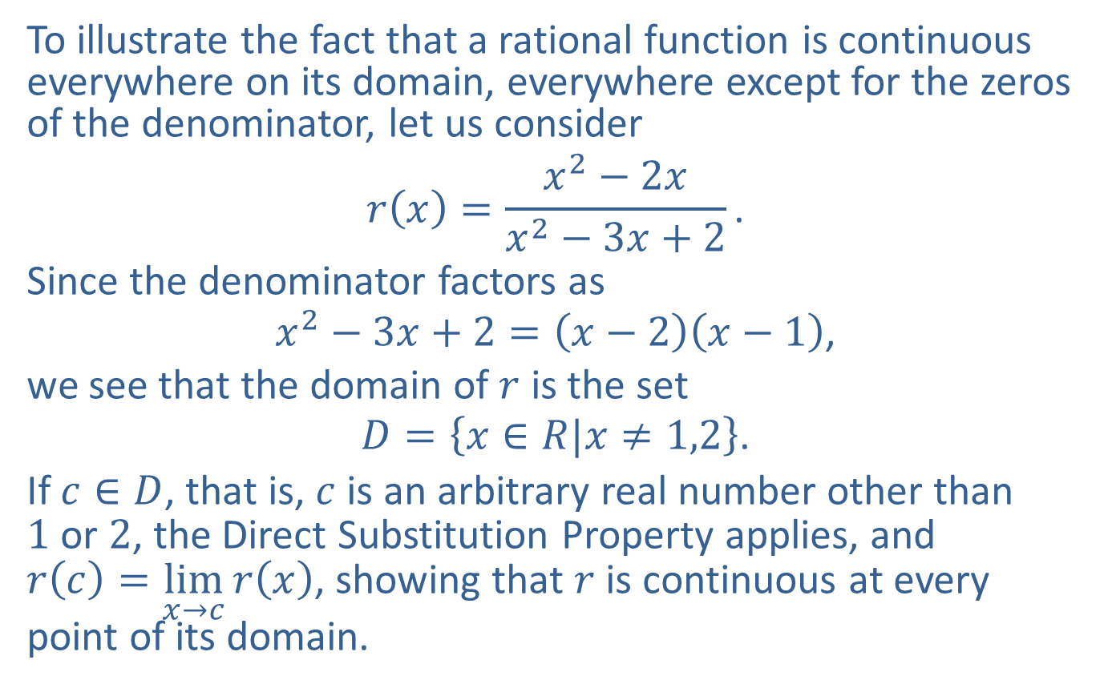
Example 6: Understanding Rational Functions and Continuity
To illustrate the fact that a rational function is continuous everywhere on its domain, everywhere except for the zeros of the denominator, let us consider
$$r\left(x\right)=\frac{x^{2}−2x}{x^{2}−3x+2}\text{.}$$
Since the denominator factors as
$$x^{2}−3x+2=\left(x−2\right)\left(x−1\right)\text{,}$$
we see that the domain of $r$ is the set
$$D=\left\{x∈R|x≠1,2\right\}\text{.}$$
If $c∈D$, that is, $c$ is an arbitrary real number other than 1 or 2, the Direct Substitution Property applies, and $r\left(c\right)=\lim_{x→c}{r\left(x\right)}$, showing that $r$ is continuous at every point of its domain.

Slide 36
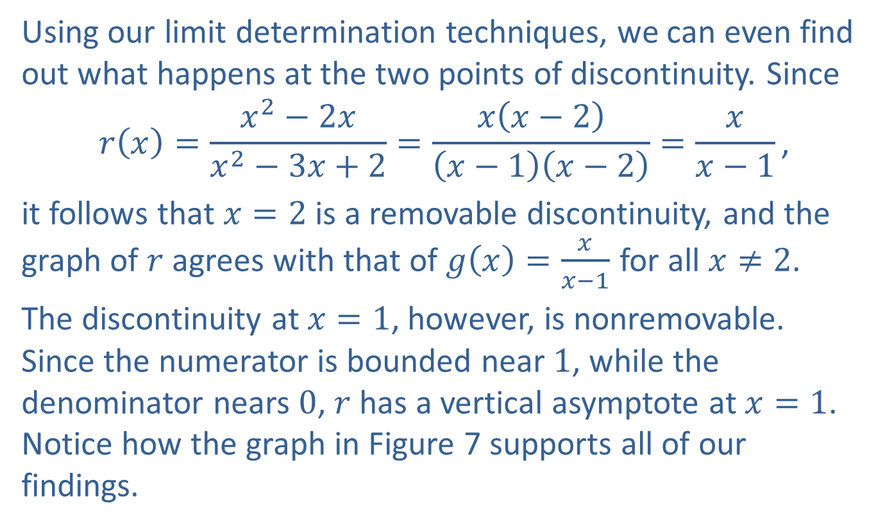
Example 6: Understanding Rational Functions and Continuity (cont.)
Using our limit determination techniques, we can even find out what happens at the two points of discontinuity. Since
$$r\left(x\right)=\frac{x^{2}−2x}{x^{2}−3x+2}=\frac{x\left(x−2\right)}{\left(x−1\right)\left(x−2\right)}=\frac{x}{x−1}\text{,}$$
it follows that $x=2$ is a removable discontinuity, and the graph of $r$ agrees with that of $g\left(x\right)=\frac{x}{x−1}$ for all $x≠2$.
The discontinuity at $x=1$, however, is nonremovable. Since the numerator is bounded near 1, while the denominator nears 0, $r$ has a vertical asymptote at $x=1$. Notice how the graph in Figure 7 supports all of our findings.

Slide 37
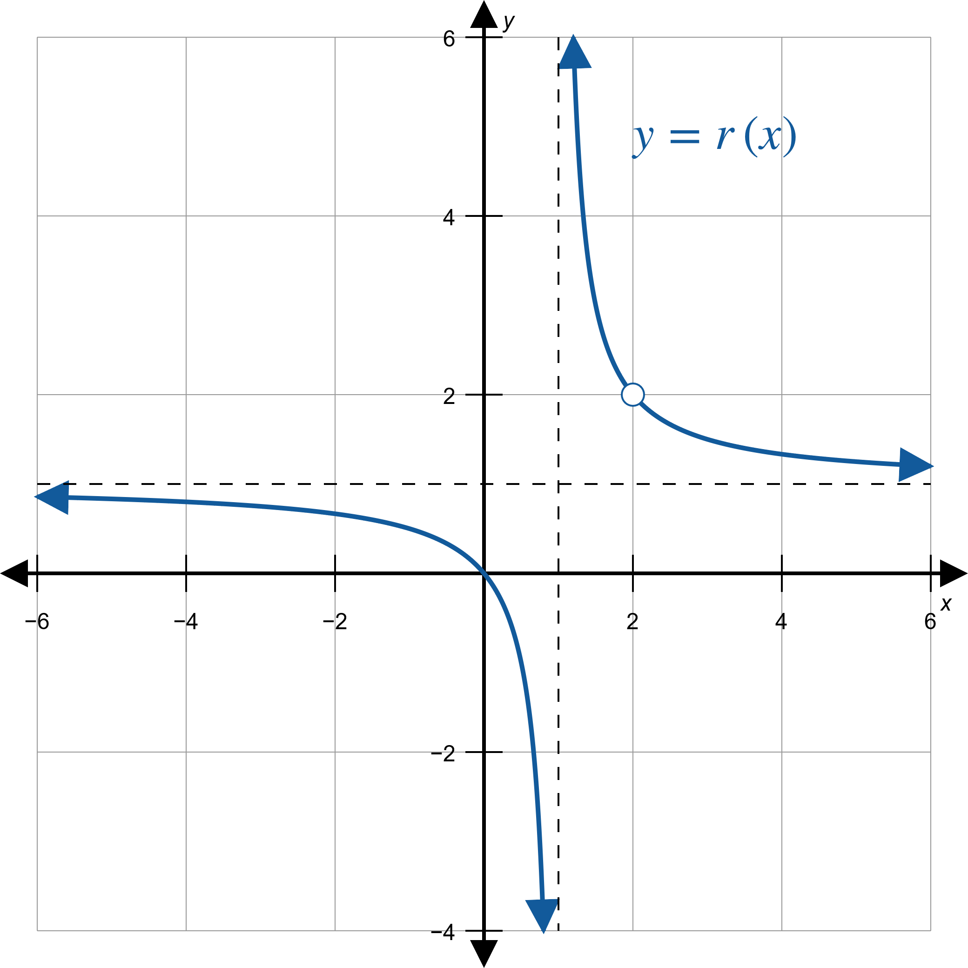
Example 6: Understanding Rational Functions and Continuity (cont.)
Figure 7

Slide 38
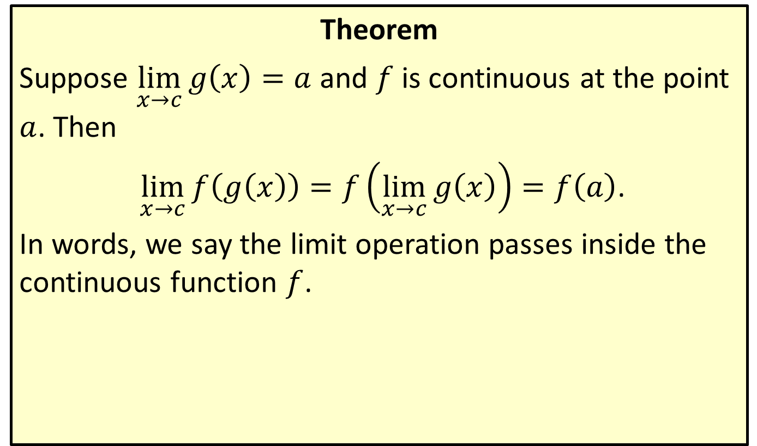
“Limits Pass through a Continuous Function”
Theorem
Suppose $\lim_{x→c}{g\left(x\right)}=a$ and $f$ is continuous at the point $a$. Then
$\lim_{x→c}{f\left(g\left(x\right)\right)}=f\left(\lim_{x→c}{g\left(x\right)}\right)=f\left(a\right)$.
In words, we say the limit operation passes inside the continuous function $f$.

Slide 39
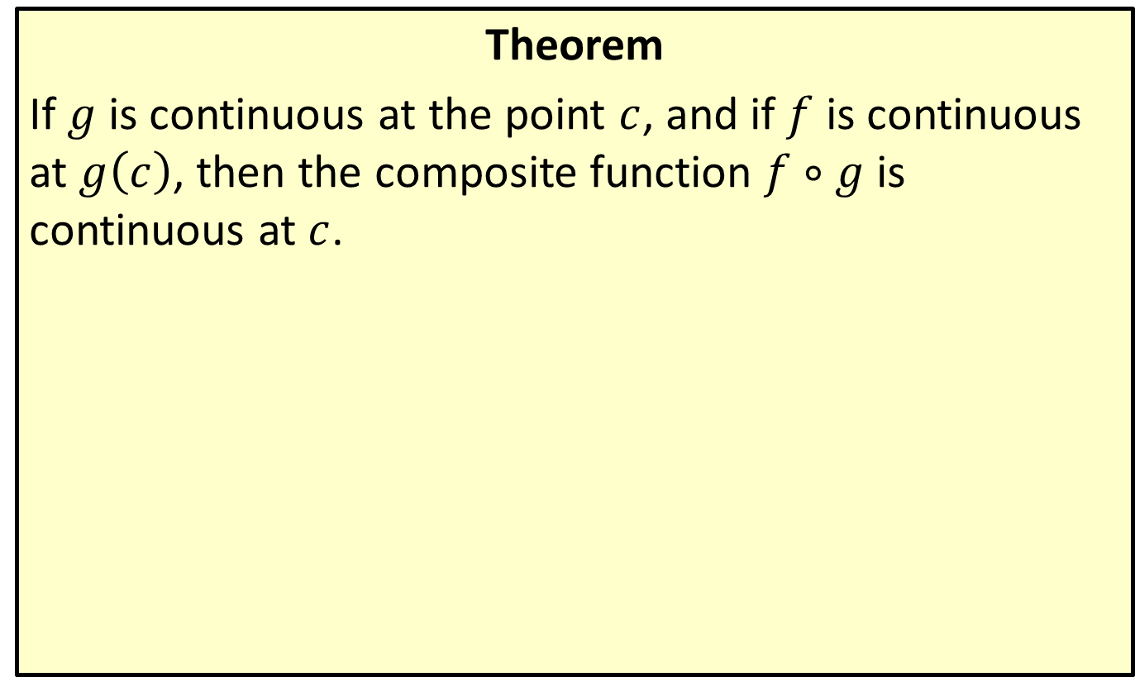
“A Composition of Continuous Functions Is Continuous”
Theorem
If $g$ is continuous at the point $c$, and if $f$ is continuous at $g⁡\left(c\right)$, then the composite function $f∘g$ is continuous at $c$.

Slide 40
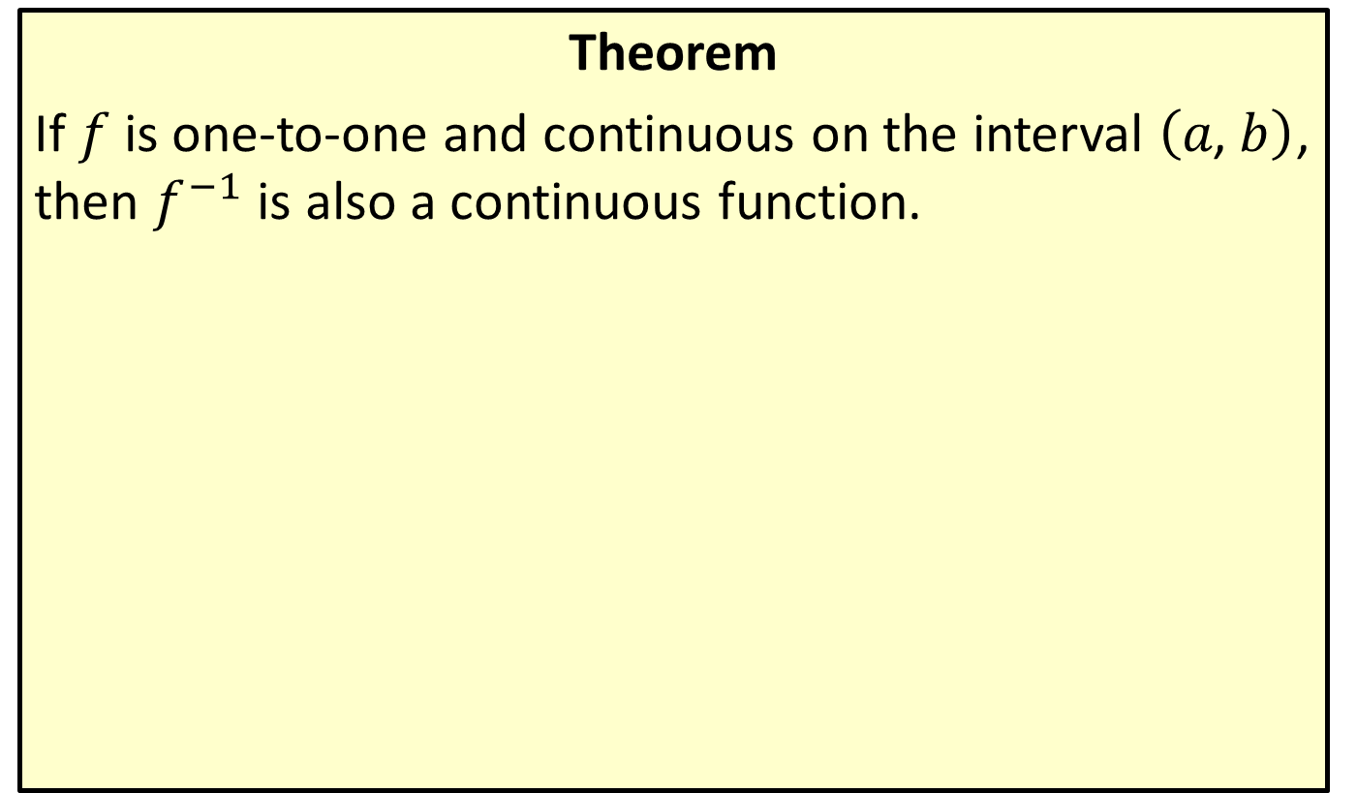
“The Inverse of a Continuous Function Is Continuous”
Theorem
If $f$ is one-to-one and continuous on the interval $\left(a\text{, }b\right)$, then $f^{−1}$ is also a continuous function.

Slide 41
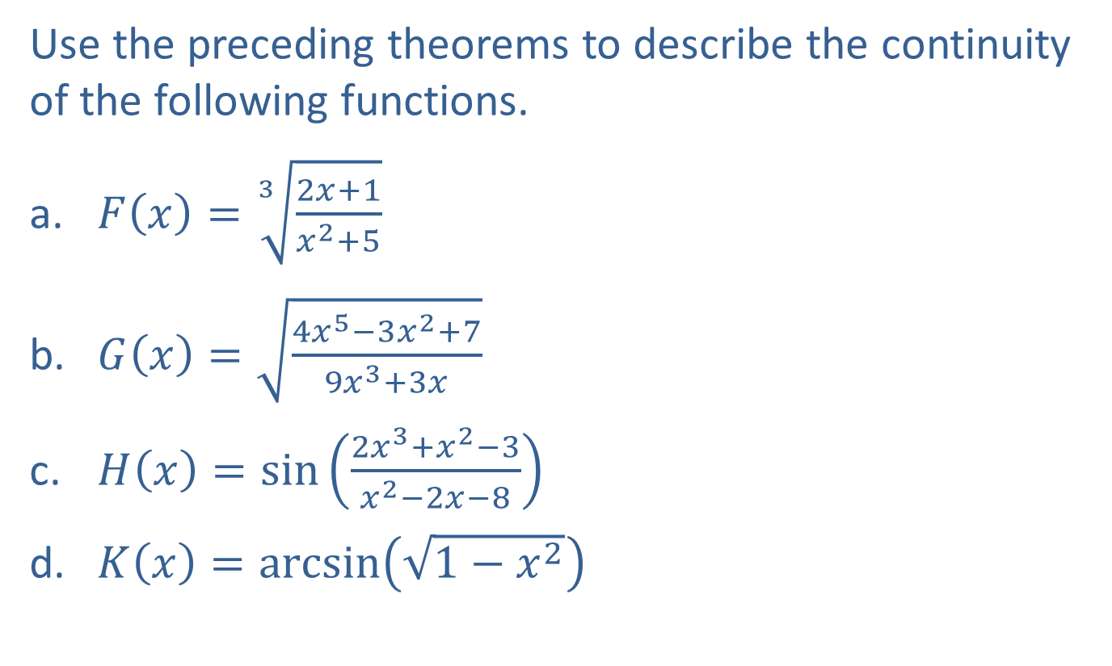
Example 7: Using Theorems to Determine Continuity of Functions
Use the preceding theorems to describe the continuity of the following functions.
​$F\left(x\right)=\sqrt[3]{\frac{2x+1}{x^{2}+5}}$
​$G\left(x\right)=\sqrt{\frac{4x^{5}−3x^{2}+7}{9x^{3}+3x}}$
​$H\left(x\right)=\sin\left(\frac{2x^{3}+x^{2}−3}{x^{2}−2x−8}\right)$
​$K\left(x\right)=\arcsin\left(\sqrt{1−x^{2}}\right)$

Slide 42
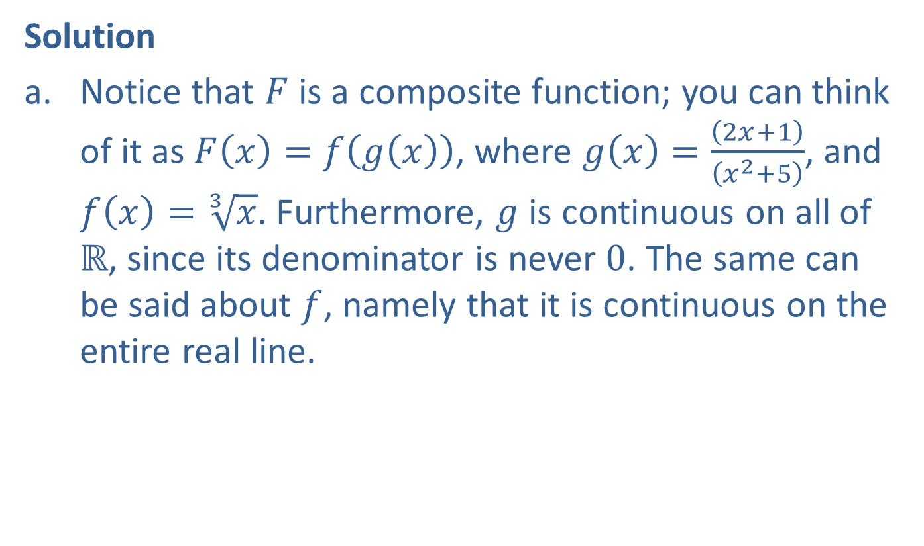
Example 7: Using Theorems to Determine Continuity of Functions (cont.)
Solution
​Notice that $F$ is a composite function; you can think of it as $F\left(x\right)=f\left(g\left(x\right)\right)$, where $g\left(x\right)=\frac{\left(2x+1\right)}{\left(x^{2}+5\right)}$, and $f\left(x\right)=\sqrt[3]{x}$. Furthermore, $g$ is continuous on all of $ℝ$, since its denominator is never 0. The same can be said about $f$, namely that it is continuous on the entire real line.

Slide 43
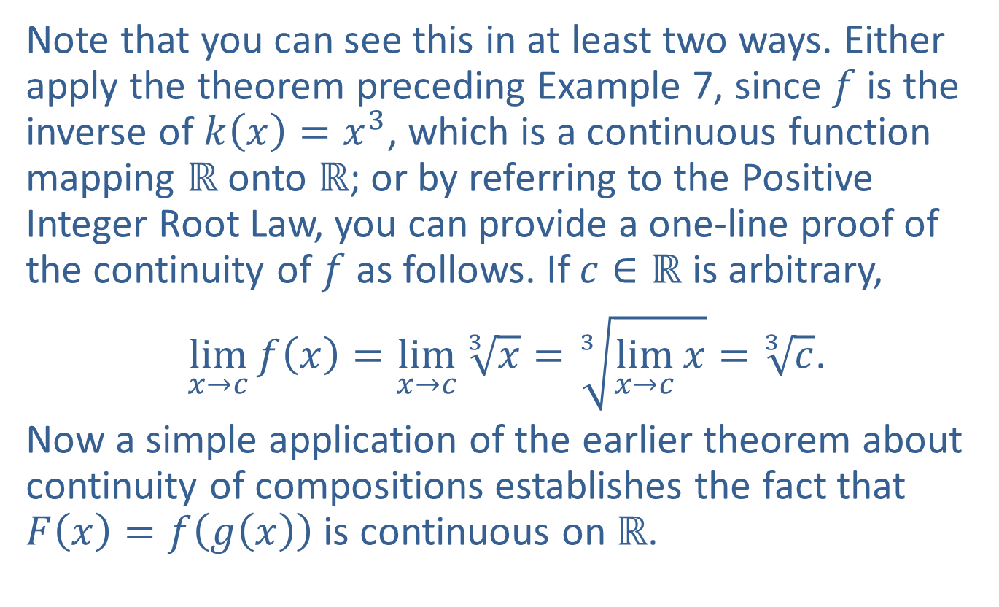
Example 7: Using Theorems to Determine Continuity of Functions (cont.)
Note that you can see this in at least two ways. Either apply the theorem preceding Example 7, since $f$ is the inverse of $k\left(x\right)=x^{3}$, which is a continuous function mapping $ℝ$ onto $ℝ$; or by referring to the Positive Integer Root Law, you can provide a one-line proof of the continuity of $f$ as follows. If $c∈ℝ$ is arbitrary,
$\lim_{x→c}{f\left(x\right)}=\lim_{x→c}{\sqrt[3]{x}}=\sqrt[3]{\lim_{x→c}{x}}=\sqrt[3]{c}$.
​Now a simple application of the earlier theorem about continuity of compositions establishes the fact that $F\left(x\right)=f\left(g\left(x\right)\right)$ is continuous on $ℝ$.

Slide 44
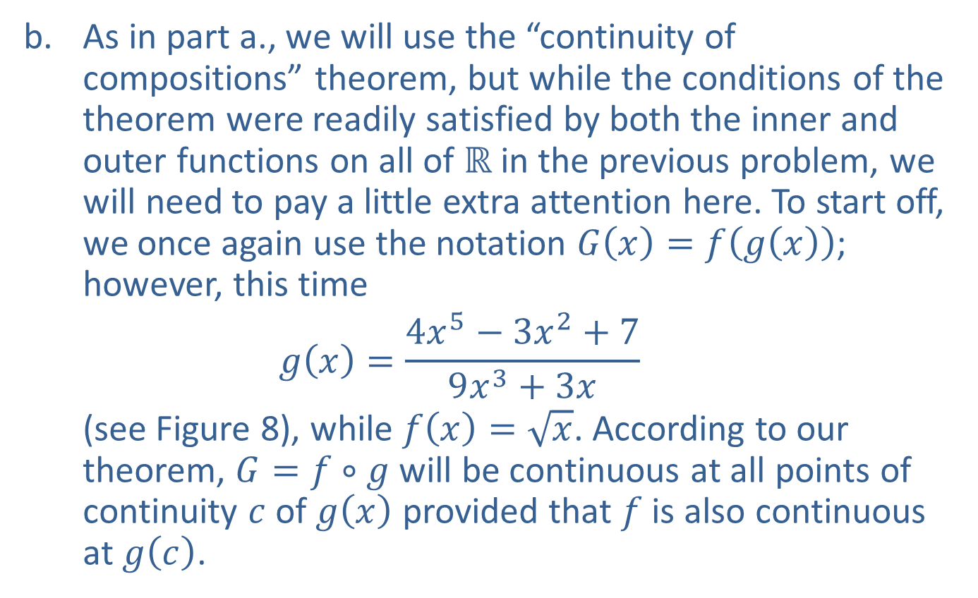
Example 7: Using Theorems to Determine Continuity of Functions (cont.)
​As in part a., we will use the “continuity of compositions” theorem, but while the conditions of the theorem were readily satisfied by both the inner and outer functions on all of $ℝ$ in the previous problem, we will need to pay a little extra attention here. To start off, we once again use the notation $G\left(x\right)=f\left(g\left(x\right)\right)$; however, this time
$$g\left(x\right)=\frac{4x^{5}−3x^{2}+7}{9x^{3}+3x}$$
(see Figure 8), while $f\left(x\right)=\sqrt{x}$. According to our theorem, $G=f∘g$ will be continuous at all points of continuity $c$ of $g⁡\left(x\right)$ provided that $f$ is also continuous at $g⁡\left(c\right)$.

Slide 45
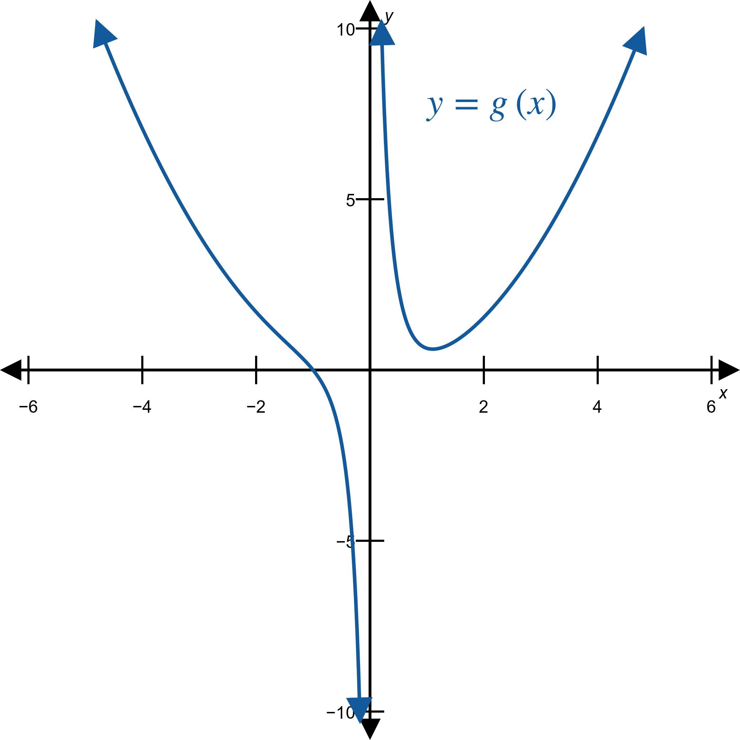
Example 7: Using Theorems to Determine Continuity of Functions (cont.)
Figure 8

Slide 46
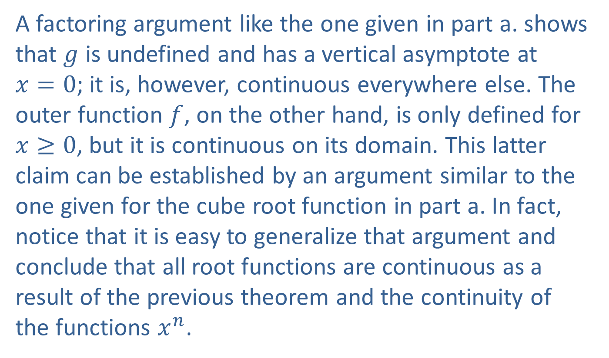
Example 7: Using Theorems to Determine Continuity of Functions (cont.)
A factoring argument like the one given in part a. shows that $g$ is undefined and has a vertical asymptote at $x=0$; it is, however, continuous everywhere else. The outer function $f$, on the other hand, is only defined for $x≥0$, but it is continuous on its domain. This latter claim can be established by an argument similar to the one given for the cube root function in part a. In fact, notice that it is easy to generalize that argument and conclude that all root functions are continuous as a result of the previous theorem and the continuity of the functions $x^{n}$.

Slide 47
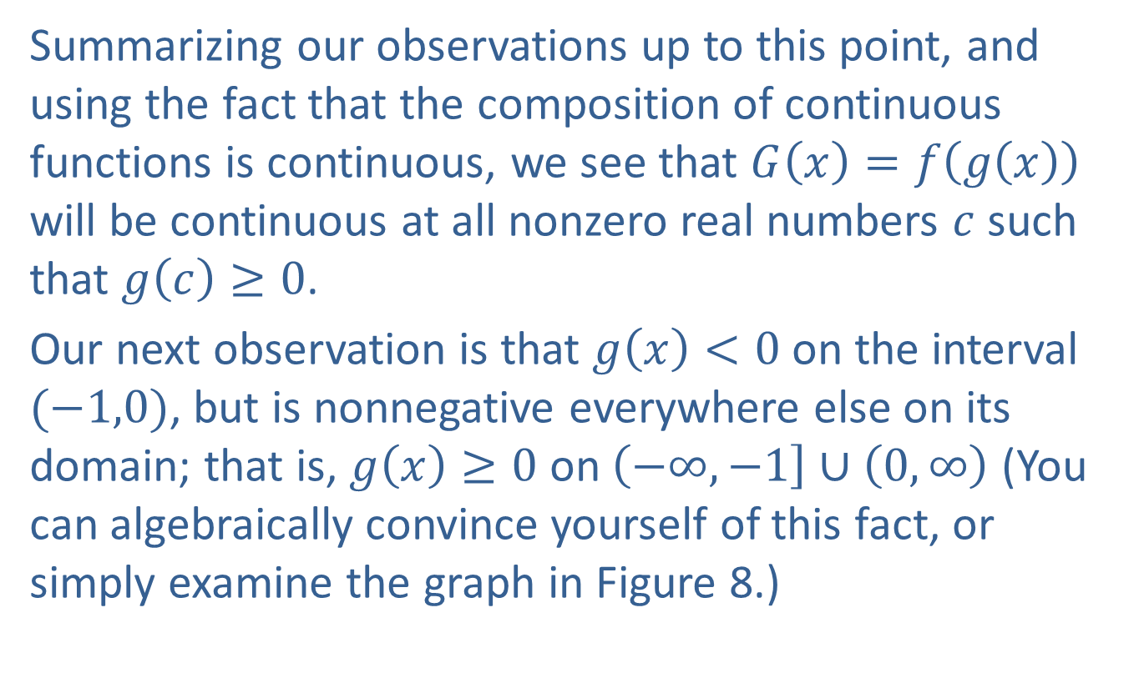
Example 7: Using Theorems to Determine Continuity of Functions (cont.)
​Summarizing our observations up to this point, and using the fact that the composition of continuous functions is continuous, we see that $G\left(x\right)=f\left(g\left(x\right)\right)$ will be continuous at all nonzero real numbers $c$ such that $g\left(c\right)≥0$.
​Our next observation is that $g⁡\left(x\right)<0$ on the interval $(−1,0)$, but is nonnegative everywhere else on its domain; that is, $g\left(x\right)≥0$ on $\left(−∞,−1\right]∪\left(0,∞\right)$ (You can algebraically convince yourself of this fact, or simply examine the graph in Figure 8.)​

Slide 48

Example 7: Using Theorems to Determine Continuity of Functions (cont.)
​Therefore, we conclude that $G\left(x\right)=f\left(g\left(x\right)\right)$ is continuous on the set $\left(−∞,−1\right]∪\left(0,∞\right)$ The graph of $G$ supports our conclusion (see Figure 9).
​

Slide 49
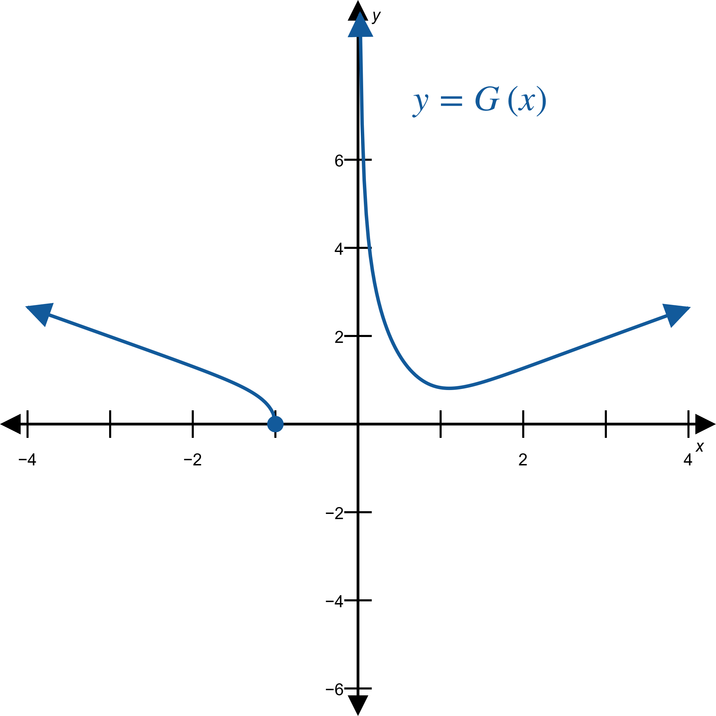
Example 7: Using Theorems to Determine Continuity of Functions (cont.)
Figure 9

Slide 50
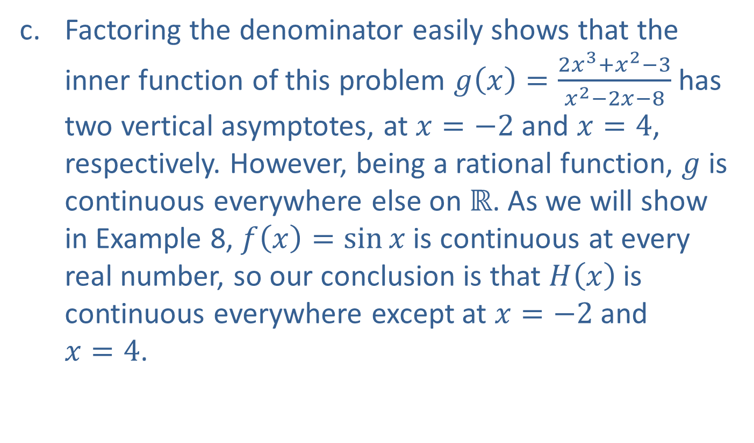
Example 7: Using Theorems to Determine Continuity of Functions (cont.)
​Factoring the denominator easily shows that the inner function of this problem $g\left(x\right)=\frac{2x^{3}+x^{2}−3}{x^{2}−2x−8}$ has two vertical asymptotes, at $x=−2$ and $x=4$, respectively. However, being a rational function, $g$ is continuous everywhere else on $ℝ$. As we will show in Example 8, $f\left(x\right)=\sin{x}$ is continuous at every real number, so our conclusion is that $H⁡\left(x\right)$ is continuous everywhere except at $x=−2$ and $x=4$.

Slide 51
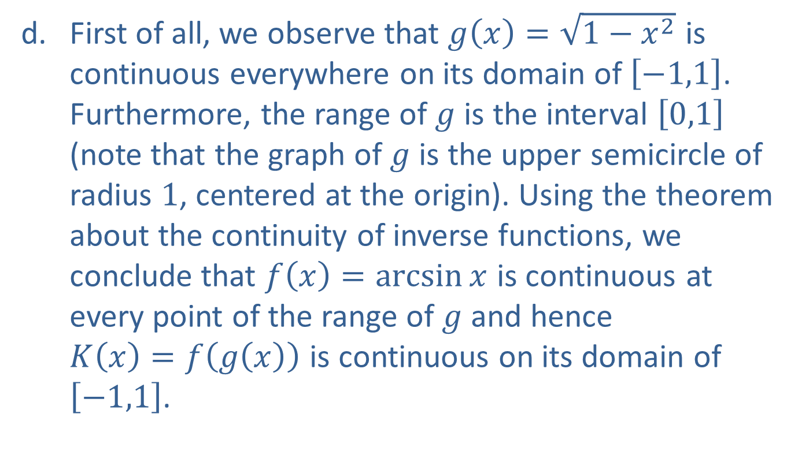
Example 7: Using Theorems to Determine Continuity of Functions (cont.)
​First of all, we observe that $g\left(x\right)=\sqrt{1−x^{2}}$ is continuous everywhere on its domain of $\left[−1,1\right]$. Furthermore, the range of $g$ is the interval $\left[0,1\right]$ (note that the graph of $g$ is the upper semicircle of radius 1, centered at the origin). Using the theorem about the continuity of inverse functions, we conclude that $f\left(x\right)=\arcsin{x}$ is continuous at every point of the range of $g$ and hence $K\left(x\right)=f\left(g\left(x\right)\right)$ is continuous on its domain of $\left[−1,1\right]$.

Slide 52

Example 8: Using Alternate Formulations to Prove Functions Are Continuous
Use the alternate formulation of continuity to prove that $f\left(x\right)=\sin{x}$ is continuous on $ℝ$.

Slide 53

Example 8: Using Alternate Formulations to Prove Functions Are Continuous (cont.)
Solution
Our goal is to show that for any fixed real number $c$, $\lim_{h→0}{\sin\left(c+h\right)}=\sin{c}$.
Using the appropriate sum identity known from trigonometry along with the relevant limit laws,
limh→0sin𝑐+h=limh→0sin𝑐cosh+cos𝑐sinhlimh→0⁡sin𝑐+h=limh→0sin𝑐cosh+limh→0cos𝑐sinhlimh→0⁡sin𝑐+h=sin𝑐limh→0cosh+cos𝑐limh→0sinh,
where we also used the fact that during the limit process $sin⁡c$ and $cos⁡c$ are constants, so the Constant Multiple Law applies.

Slide 54

Example 8: Using Alternate Formulations to Prove Functions Are Continuous (cont.)
Our next step is to recall that as $h$ approaches 0, $\lim_{h→0}{\cos{h}}=1$ and $\lim_{h→0}{\sin{h}}=0$. (You may recall these facts from the unit-circle definition of sine and cosine for small angles, or simply from the graphs of the sine and cosine functions.) Using these latter two limits we obtain
$$\sin{c}\lim_{h→0}{\cos{h}}+\cos{c}\lim_{h→0}{\sin{h}}=\sin{c}⋅1+\cos{c}⋅0$$
$$=\sin{c}\text{,}$$
which is what we needed to prove.

Slide 55

Example 8: Using Alternate Formulations to Prove Functions Are Continuous (cont.)
Finally, we note that the continuity of $cos⁡x$ can be established by a similar argument, or by using the continuity of the sine function along with the identity $\cos{x}=\sin\left(\left(\frac{π}{2}\right)−x\right)$. Then using the properties of continuous functions, the continuity of the remaining four trigonometric functions $tan⁡x$, $cot⁡x$, $sec⁡x$, and $csc⁡x$ will follow.

Slide 56

Example 9: Using Theorems to Determine Continuity of Functions
Use the preceding theorems to identify where the following functions are continuous.
​$f\left(x\right)=\frac{\arctan\left(\ln{x}\right)}{x^{2}+1}$
​$g\left(x\right)=\frac{xe^{\cos{x}}}{\sqrt{x^{2}−1}−3}$
​$h\left(x\right)=\frac{\ln{x}−\sin^{−1}{x}}{x^{2}+x−2}$

Slide 57

Example 9: Using Theorems to Determine Continuity of Functions (cont.)
Solution
​Being the inverses of continuous functions, $ln⁡x$ is continuous on $\left(0,∞\right)$, and $arctan⁡x$ is continuous on the entire real line. Thus the composition $arctan⁡\left(\ln{x}\right)$ is continuous on $\left(0,∞\right)$ Since the denominator of $f$, $x^{2}+1$, is never 0 on $ℝ$ (check this), it follows that the quotient $f⁡\left(x\right)$ is continuous on $\left(0,∞\right)$.

Slide 58

Example 9: Using Theorems to Determine Continuity of Functions (cont.)
​Since all three functions $cos⁡x$, $e^{x}$, and $x$ are continuous on the entire real line, it follows from our theorems that both the composition $e^{\cos{x}}$ and the product $xe^{\cos{x}}$ will be continuous on all of $ℝ$. Next, just as we did in Example 6, we would like to use the theorem stating the continuity of the quotient of continuous functions, but we need to carefully check the continuity of the denominator of $g$.

Slide 59

Example 9: Using Theorems to Determine Continuity of Functions (cont.)
First, the square root function requires that the inequality $x^{2}−1≥0$ be true for $x$. This means we need $x^{2}≥1$ to hold; that is, $x≥1$ or $x≤−1$. Since the composition of continuous functions is continuous, we conclude that $\sqrt{x^{2}−1}$ is continuous on $\left(−∞,−1\right]∪\left[1,∞\right)$.

Slide 60

Example 9: Using Theorems to Determine Continuity of Functions (cont.)
Last, but not least, in order for $g$ to be continuous, its denominator cannot be 0, so we have to exclude the solutions of the equation $\sqrt{x^{2}−1}=3$. By squaring both sides and adding 1 we obtain $x^{2}=10$; that is, the points $x=±\sqrt{10}$ have to be excluded from the domain.
​Summarizing our findings, we conclude that $g⁡\left(x\right)$ is continuous on the following set.
​$\left(−∞,−\sqrt{10}\right)∪\left(−\sqrt{10},−1\right]∪\left[1,\sqrt{10}\right)∪\left(\sqrt{10},∞\right)$

Slide 61

Example 9: Using Theorems to Determine Continuity of Functions (cont.)
​Arguing as we did in part a., $ln⁡x$ and $\sin^{−1}⁡x$ are continuous since they are inverses of continuous functions. The domain of $ln⁡x$ is $\left(0,∞\right)$, while $\sin^{−1}⁡x$ is only defined on $\left[−1,1\right]$. However, notice that $x=1$ is a zero of the denominator, so by the properties of continuous functions, we conclude that $h⁡\left(x\right)$ is continuous on the open interval $\left(0,1\right)$.

Slide 62

Example 10: Defining Continuous Extensions of Functions
Identify the removable discontinuities and define the continuous extension of $r\left(x\right)=\frac{x^{2}−5x}{x^{3}−3x^{2}−10x}$.

Slide 63

Example 10: Defining Continuous Extensions of Functions (cont.)
Solution
Factoring and canceling yields
$r\left(x\right)=\frac{x^{2}−5x}{x^{3}−3x^{2}−10x}=\frac{x\left(x−5\right)}{x\left(x−5\right)\left(x+2\right)}=\frac{1}{x+2}$,
where the previous equality holds for all $x$ except for $x=0$ and $x=5$. However, both $\lim_{x→0}⁡r\left(x\right)$ and $\lim_{x→5}⁡r\left(x\right)$ still exist.
$\lim_{x→0}{r\left(x\right)}=\frac{1}{0+2}=\frac{1}{2}$, while $\lim_{x→5}{r\left(x\right)}=\frac{1}{5+2}=\frac{1}{7}$

Slide 64

Example 10: Defining Continuous Extensions of Functions (cont.)
Therefore, $r$ has two removable discontinuities, at $x=0$ and $x=5$. Now we can define $\tilde{r}⁡\left(x\right)$, the continuous extension of $r$, as follows.
$$\tilde{r}\left(x\right)=\left\{\begin{aligned}\frac{x^{2}−5x}{x^{3}−3x^{2}−10x} \text{if} x≠0 \text{or} 5 \\ \frac{1}{2} \text{if} x=0 \\ \frac{1}{7} \text{if} x=5\end{aligned}\right.$$

Slide 65

Example 10: Defining Continuous Extensions of Functions (cont.)
Let us note, however, that although correct and instructive, it is not necessary in this case to use a piecewise-defined function to define the continuous extension of $r$. Alternatively, it is much shorter to define it simply as $\tilde{r}\left(x\right)=\frac{1}{x+2}$. Note that this is equivalent to our piecewise definition. Note also that both $r$ and its continuous extension have nonremovable discontinuities at $x=−2$.

Slide 66

The Intermediate Value Theorem
Theorem
If $f$ is a continuous function defined on the closed interval $\left[a,b\right]$, then $f$ takes on every value between $f⁡\left(a\right)$ and $f⁡\left(b\right)$. That is, if $L$ is a real number between $f⁡\left(a\right)$ and $f⁡\left(b\right)$, then there is a $c$ in the interval $\left[a,b\right]$ such that $f\left(c\right)=L$.

Slide 67

Example 11: Using the Intermediate Value Theorem
Use the Intermediate Value Theorem to show that the equation $x^{5}+9x−4=0$ has a solution between 0 and 1.

Slide 68

Example 11: Using the Intermediate Value Theorem (cont.)
Solution
Introducing the notation $f\left(x\right)=x^{5}+9x−4$, notice that we are attempting to prove the existence of a solution, or root, of the equation $f\left(x\right)=0$ on the interval $\left[0,1\right]$. The existence of such root $c$ would mean that $f$ takes on the value $L=0$ for some $c$ in $\left[0,1\right]$. Does the Intermediate Value Theorem guarantee that? Notice first of all that $f$ is certainly continuous on the closed interval $\left[0,1\right]$ (actually, it is continuous on the entire real line, but for the purposes of this problem we can safely ignore what happens outside of $\left[0,1\right]$).

Slide 69


Example 11: Using the Intermediate Value Theorem (cont.)
Next, since 0 and 1 play the roles of $a$ and $b$ in the theorem, respectively, we proceed to examine the values $f⁡\left(0\right)$ and $f⁡\left(1\right)$.
In other words, a change of sign occurs on $\left[0,1\right]$; that is, $f$ goes from negative to positive on $\left[0,1\right]$. The statement of the Intermediate Value Theorem is precisely the fact that a continuous function cannot do this and avoid intersecting the horizontal line $y=0$ (the $x$-axis).
​$f⁡\left(0\right)$ | ​$=0^{5}+9⋅0−4=−4<0$
​$f⁡\left(1\right)$ | ​$=1^{5}+9⋅1−4=6>0$

Slide 70

Example 11: Using the Intermediate Value Theorem (cont.)
More precisely, since $L=0$ we have $−4<L<6$; that is, since 0 is a real number between $f\left(0\right)=−4$ and $f\left(1\right)=6$, by the Intermediate Value Theorem there is a $c$ in $\left[0,1\right]$ such that $f\left(c\right)=L=0$. In other words, we have
$c^{5}+9c−4=0$.
Thus we proved the existence of a root between 0 and 1 for the given equation.

Slide 71
Note:
The Intermediate Value Theorem is an existence theorem; in other words, we proved the existence of a solution between 0 and 1 without actually specifying what it is.

