Slide 1
Section 13.6
The Derivative

Slide 2
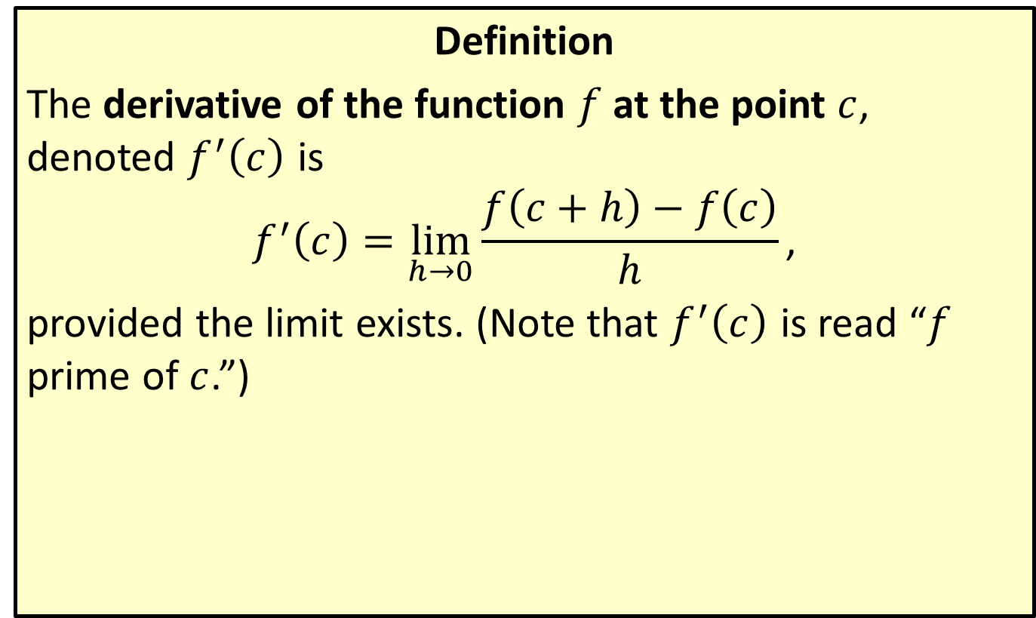
The Derivative at a Point
Definition
The derivative of the function $f$ at the point $c$, denoted $f^{′}⁡\left(c\right)$ is
$$f^{′}\left(c\right)=\lim_{h→0}{\frac{f\left(c+h\right)−f\left(c\right)}{h}}\text{,}$$
provided the limit exists. (Note that $f^{′}⁡\left(c\right)$ is read “$f$ prime of $c$.”)

Slide 3

Example 1: Finding the Equation of a Tangent Line
Find the slope of the line tangent to the graph of $f\left(x\right)=x^{2}−1$ at the point $\left(2,3\right)$. Then use this information to derive the equation of the tangent line.

Slide 4
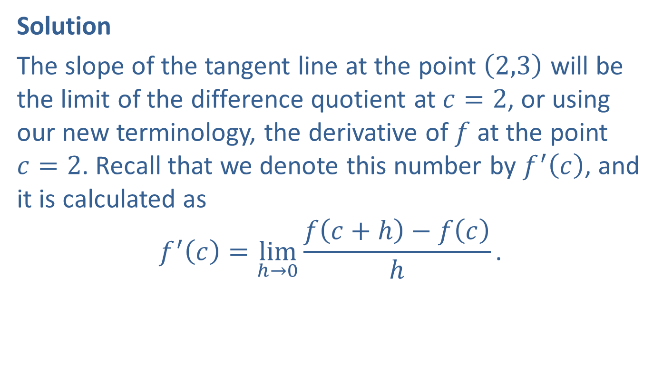
Example 1: Finding the Equation of a Tangent Line (cont.)
Solution
The slope of the tangent line at the point $\left(2,3\right)$ will be the limit of the difference quotient at $c=2$, or using our new terminology, the derivative of $f$ at the point $c=2$. Recall that we denote this number by $f^{′}⁡\left(c\right)$, and it is calculated as
$$f^{′}\left(c\right)=\lim_{h→0}{\frac{f\left(c+h\right)−f\left(c\right)}{h}}\text{.}$$

Slide 5
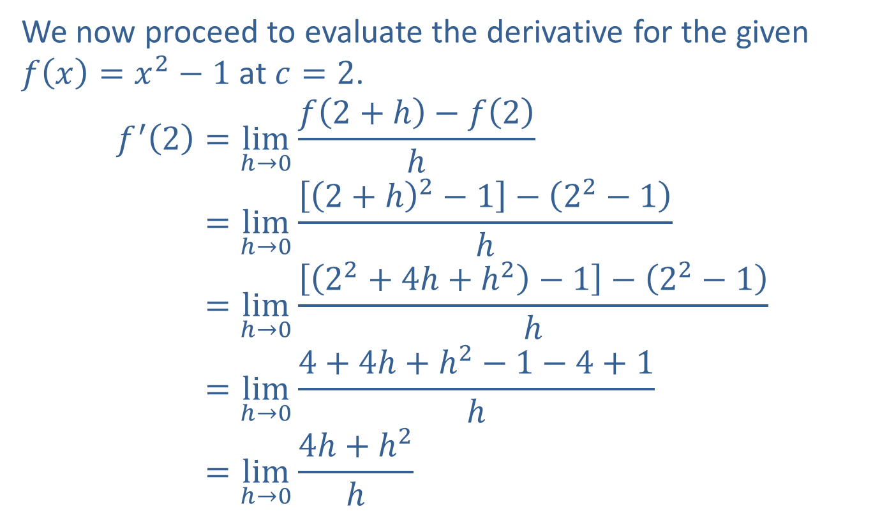
Example 1: Finding the Equation of a Tangent Line (cont.)
We now proceed to evaluate the derivative for the given $f\left(x\right)=x^{2}−1$ at $c=2$.
𝑓′2=limh→0⁡𝑓2+h−𝑓2h𝑓′⁡2=limh→0⁡2+h2−1−22−1h𝑓′⁡2=limh→0⁡22+4h+h2−1−22−1h𝑓′⁡2=limh→0⁡4+4h+h2−1−4+1h𝑓′⁡2=limh→0⁡4h+h2h

Slide 6
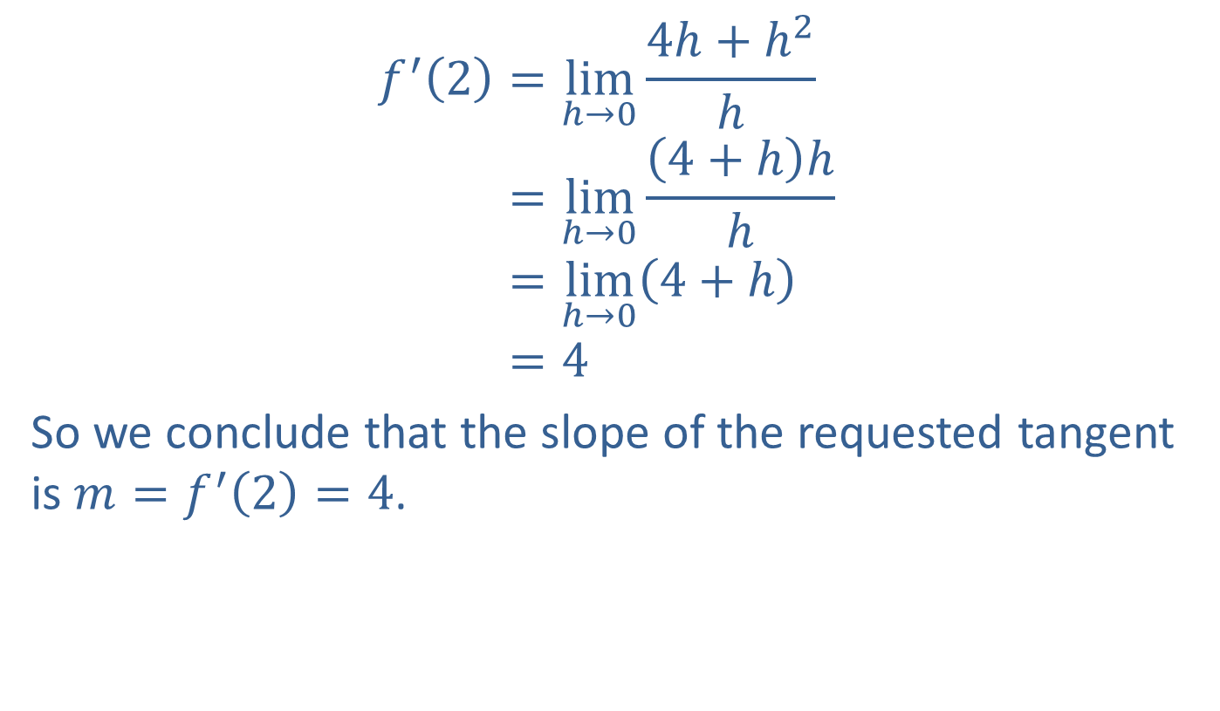
Example 1: Finding the Equation of a Tangent Line (cont.)
𝑓′2=limh→0⁡4h+h2h𝑓′⁡2=limh→0⁡4+hhh𝑓′⁡2=limh→04+h𝑓′⁡2=4
So we conclude that the slope of the requested tangent is $m=f^{′}\left(2\right)=4$.

Slide 7
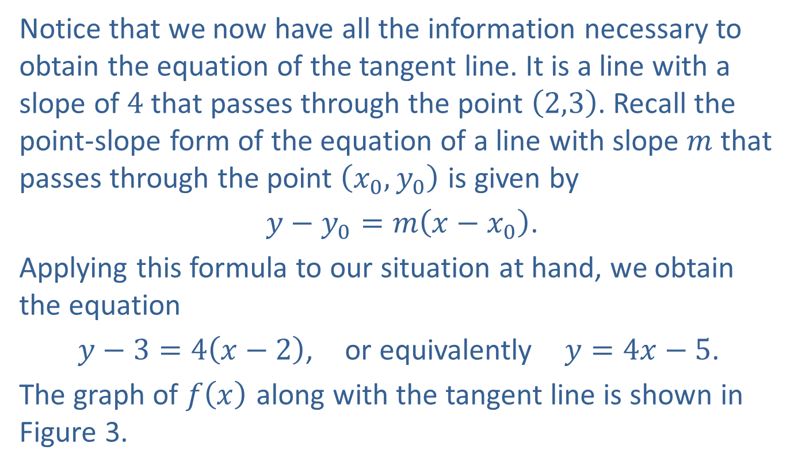
Example 1: Finding the Equation of a Tangent Line (cont.)
Notice that we now have all the information necessary to obtain the equation of the tangent line. It is a line with a slope of 4 that passes through the point $\left(2,3\right)$. Recall the point-slope form of the equation of a line with slope $m$ that passes through the point $\left(x_{0},y_{0}\right)$ is given by
$y−y_{0}=m\left(x−x_{0}\right)$.
Applying this formula to our situation at hand, we obtain the equation
$y−3=4\left(x−2\right)$, or equivalently $y=4x−5$.
The graph of $f⁡\left(x\right)$ along with the tangent line is shown in Figure 3.

Slide 8
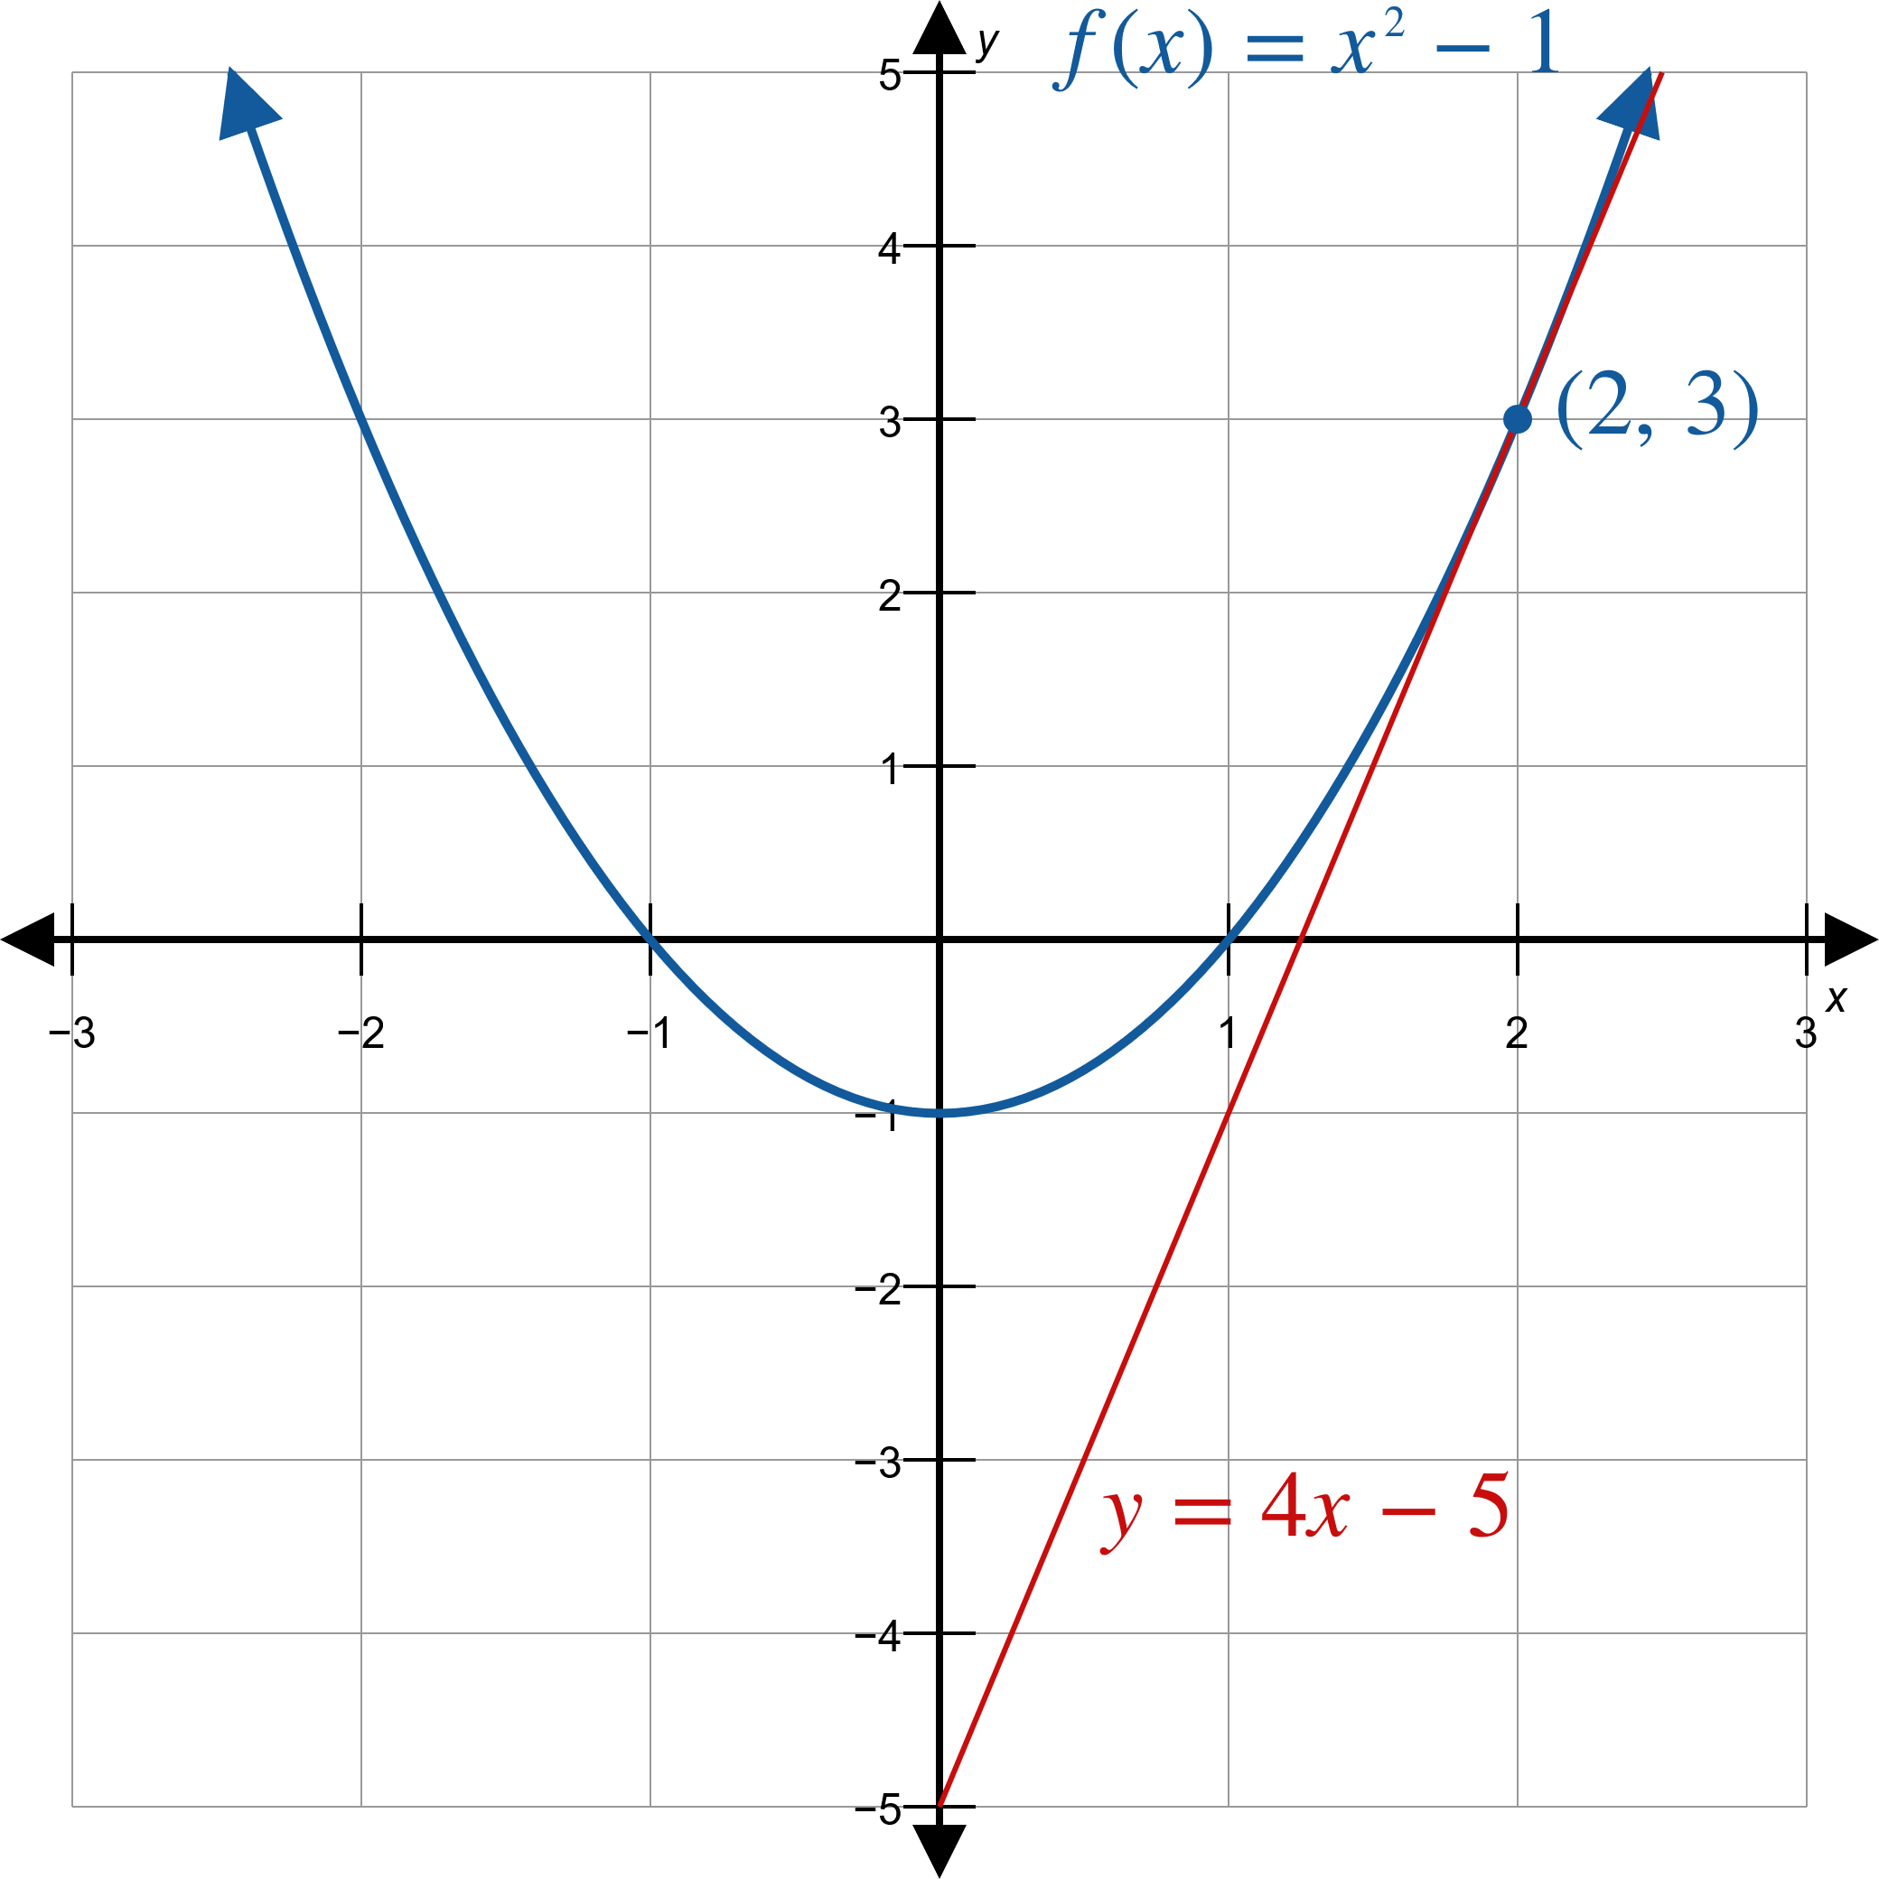
Example 1: Finding the Equation of a Tangent Line (cont.)
Figure 3

Slide 9

Example 2: Finding Instantaneous Velocity
A particle is moving along a straight line so that its distance from the start is given by $d\left(t\right)=5t−\frac{1}{2}t^{2}$, where $d$ is measured in feet and $t$ in seconds. What is the particle’s instantaneous velocity at $t=2$ seconds?

Slide 10
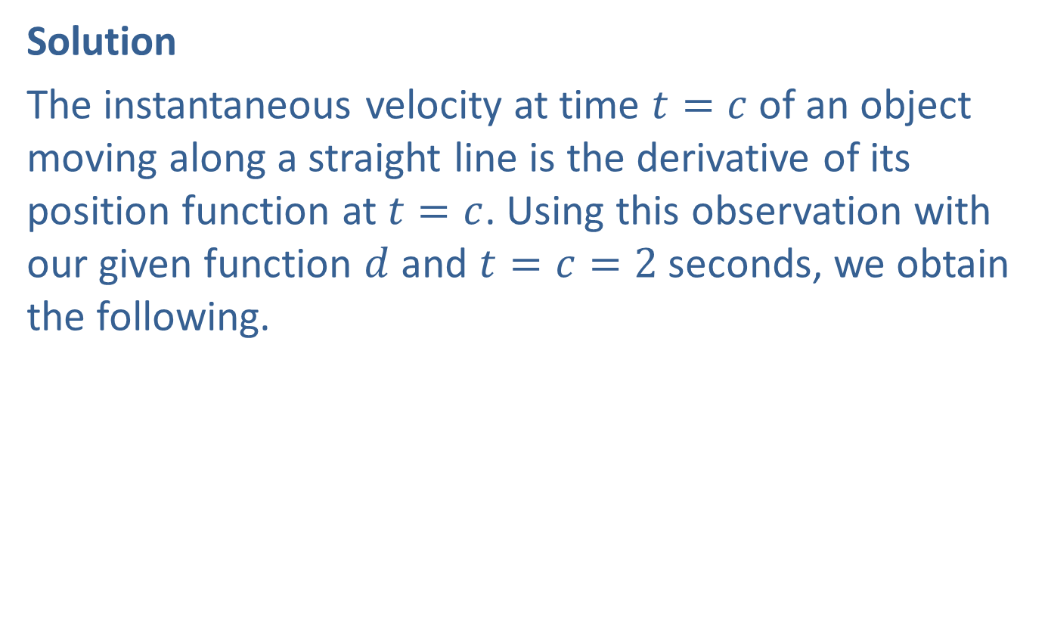
Example 2: Finding Instantaneous Velocity (cont.)
Solution
The instantaneous velocity at time $t=c$ of an object moving along a straight line is the derivative of its position function at $t=c$. Using this observation with our given function $d$ and $t=c=2$ seconds, we obtain the following.

Slide 11
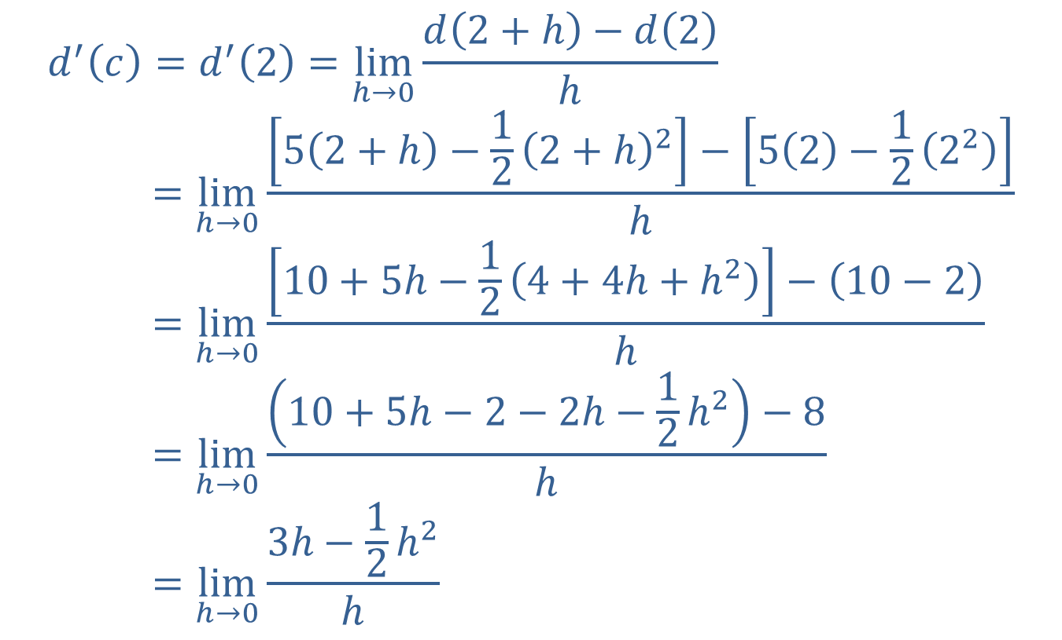
Example 2: Finding Instantaneous Velocity (cont.)
𝑑′𝑐=𝑑′2=limh→0⁡𝑑2+h−𝑑2h𝑑′𝑐=limh→0⁡52+h−122+h2−52−1222h𝑑′𝑐=limh→0⁡10+5h−124+4h+h2−10−2h𝑑′𝑐=limh→0⁡10+5h−2−2h−12h2−8h𝑑′𝑐=limh→0⁡3h−12h2h

Slide 12
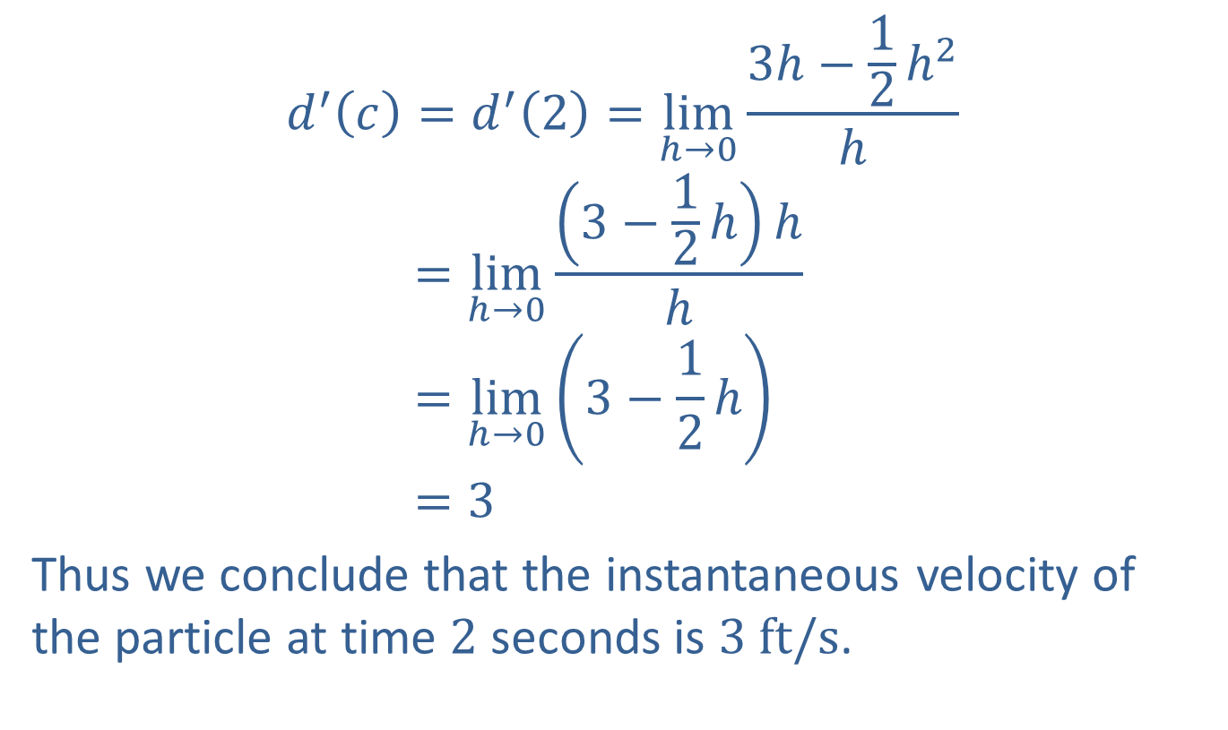
Example 2: Finding Instantaneous Velocity (cont.)
𝑑′𝑐=𝑑′2=limh→0⁡3h−12h2h𝑑′𝑐=limh→0⁡3−12hhh𝑑′𝑐=limh→03−12h𝑑′𝑐=3
Thus we conclude that the instantaneous velocity of the particle at time 2 seconds is $3 ft/s$.

Slide 13
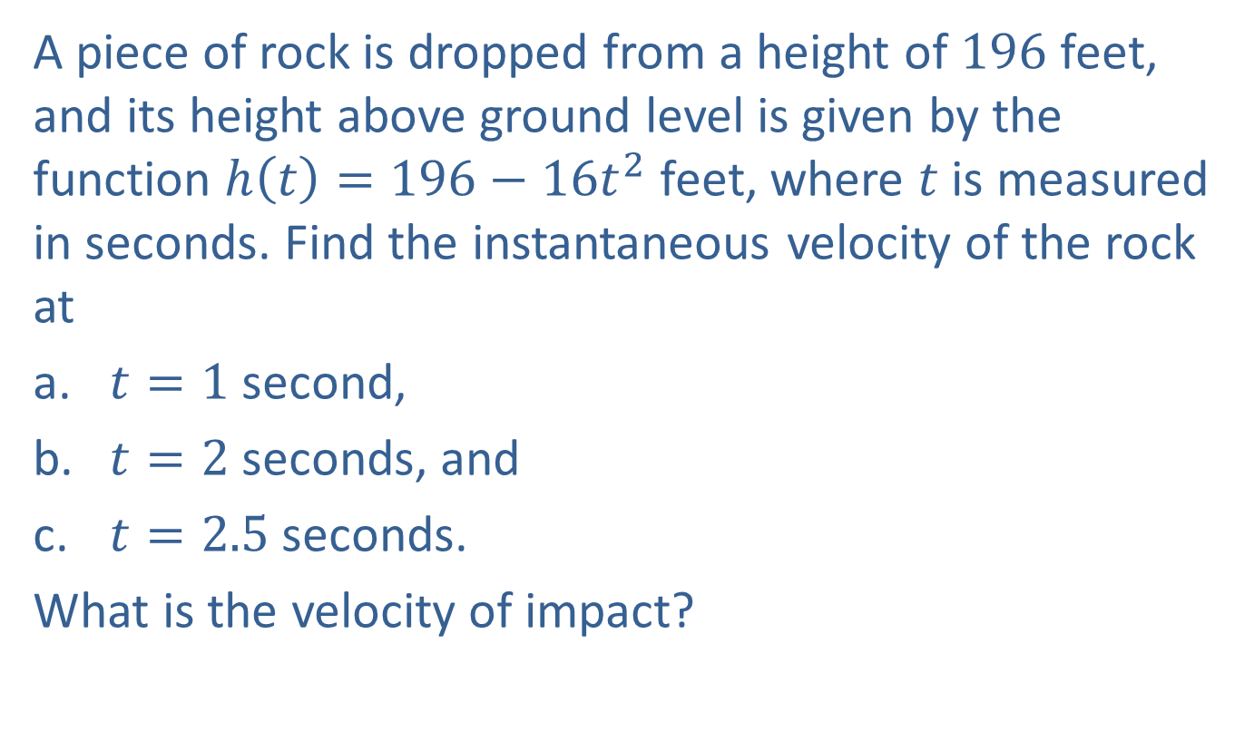
Example 3: Finding Instantaneous Velocity
A piece of rock is dropped from a height of 196 feet, and its height above ground level is given by the function $h\left(t\right)=196−16t^{2}$ feet, where $t$ is measured in seconds. Find the instantaneous velocity of the rock at
​$t=1$ second,
​$t=2$ seconds, and
​$t=2.5$ seconds.
What is the velocity of impact?

Slide 14
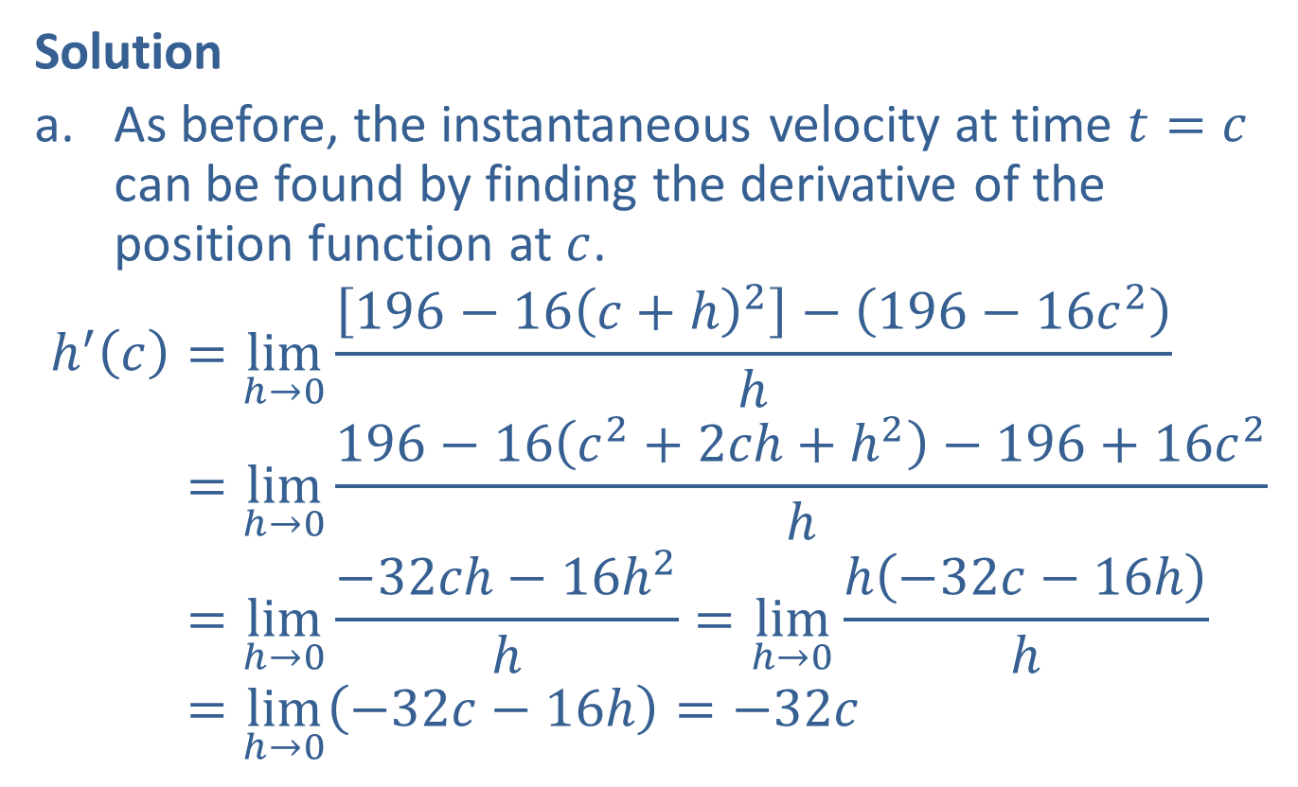
Example 3: Finding Instantaneous Velocity (cont.)
Solution
​As before, the instantaneous velocity at time $t=c$ can be found by finding the derivative of the position function at $c$.
h′𝑐=limh→0⁡196−16𝑐+h2−196−16𝑐2hh′⁡𝑐=limh→0⁡196−16𝑐2+2𝑐h+h2−196+16𝑐2hh′⁡𝑐=limh→0⁡−32𝑐h−16h2h=limh→0⁡h−32𝑐−16hhh′⁡𝑐=limh→0−32𝑐−16h=−32𝑐

Slide 15
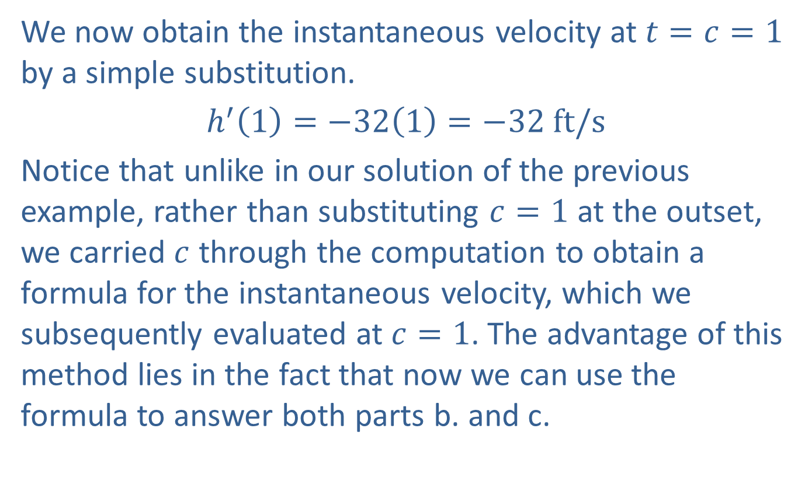
Example 3: Finding Instantaneous Velocity (cont.)
​We now obtain the instantaneous velocity at $t=c=1$ by a simple substitution.
​$h^{′}\left(1\right)=−32\left(1\right)=−32 ft/s$
​Notice that unlike in our solution of the previous example, rather than substituting $c=1$ at the outset, we carried $c$ through the computation to obtain a formula for the instantaneous velocity, which we subsequently evaluated at $c=1$. The advantage of this method lies in the fact that now we can use the formula to answer both parts b. and c.

Slide 16
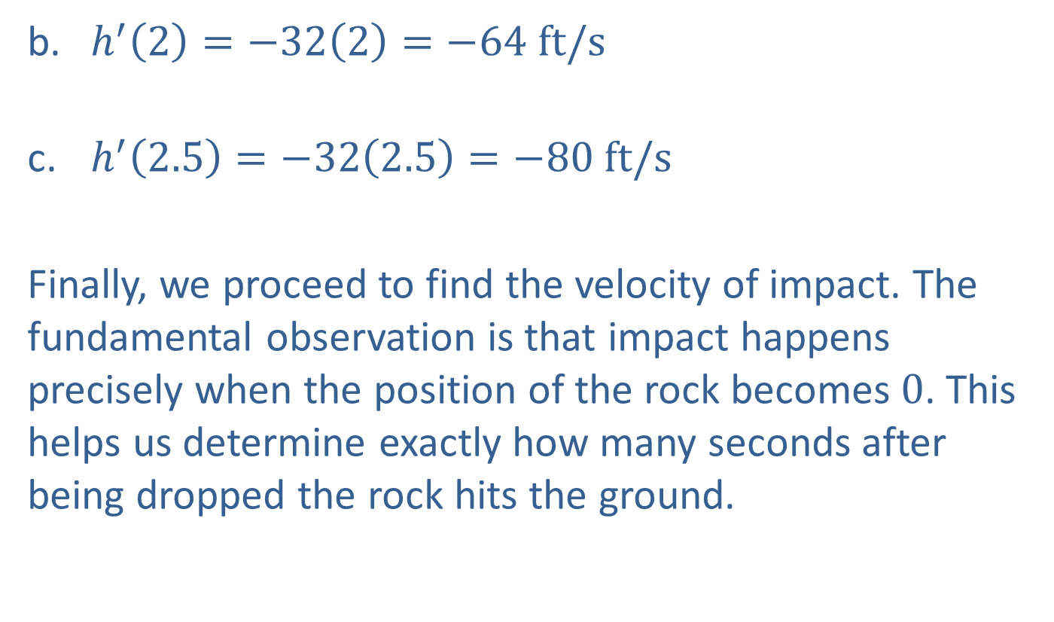
Example 3: Finding Instantaneous Velocity (cont.)
​$h^{′}\left(2\right)=−32\left(2\right)=−64 ft/s$
​$h^{′}\left(2.5\right)=−32\left(2.5\right)=−80 ft/s$
Finally, we proceed to find the velocity of impact. The fundamental observation is that impact happens precisely when the position of the rock becomes 0. This helps us determine exactly how many seconds after being dropped the rock hits the ground.

Slide 17
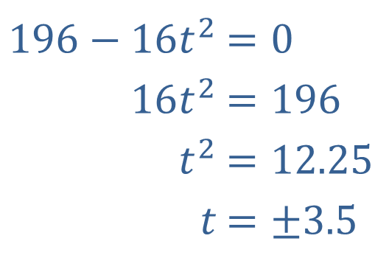

Example 3: Finding Instantaneous Velocity (cont.)
​Thus we solve the equation $h\left(t\right)=0$​.
Since time is always positive, we will only consider the solution $t=3.5 s$.
​$196−16t^{2}$ | ​$=0$
​$16t^{2}$ | ​$=196$
​$t^{2}$ | ​$=12.25$
​$t$ | ​$=±3.5$

Slide 18
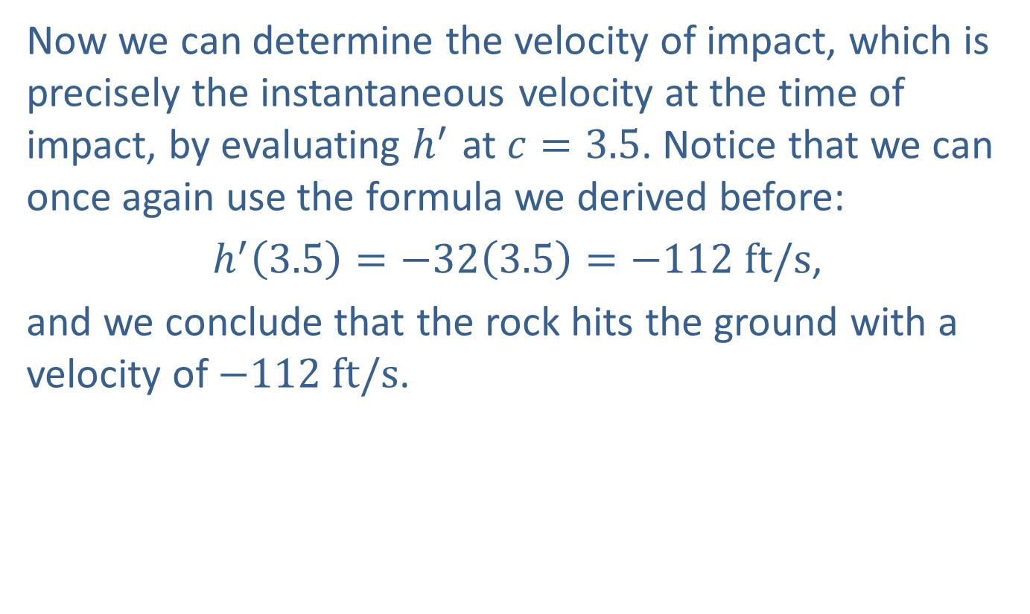
Example 3: Finding Instantaneous Velocity (cont.)
​Now we can determine the velocity of impact, which is precisely the instantaneous velocity at the time of impact, by evaluating $h^{′}$ at $c=3.5$. Notice that we can once again use the formula we derived before:
$h^{′}\left(3.5\right)=−32\left(3.5\right)=−112 ft/s$,
​and we conclude that the rock hits the ground with a velocity of $−112 ft/s$.

Slide 19
Example 3: Finding Instantaneous Velocity (cont.)
​In conclusion, we note that the negative signs in the answers mean that the direction of velocity is pointing downward throughout the motion. Also, while our answer is close to what we would measure in an actual experiment, it is important to remember that we ignored air resistance in this problem.

Slide 20
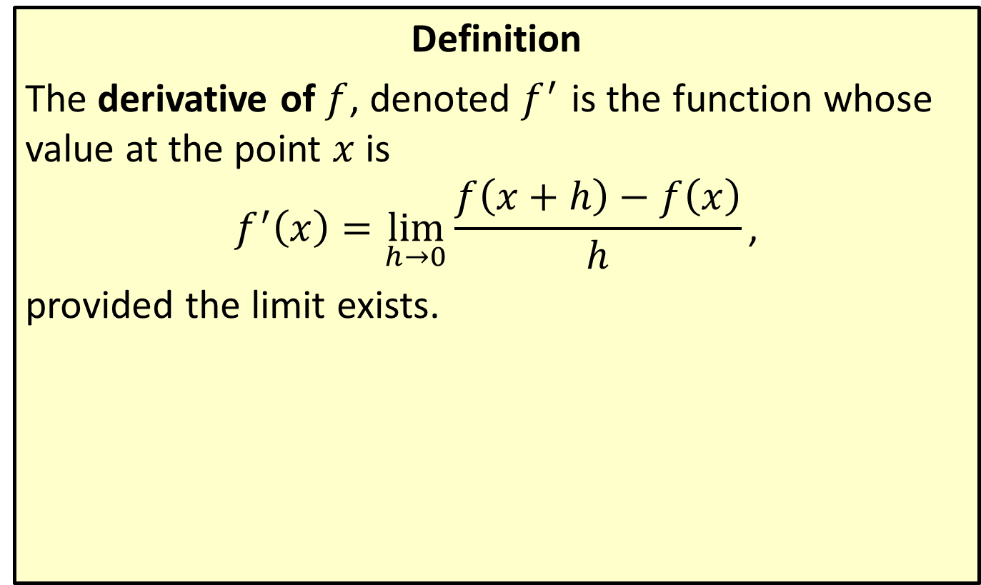
The Derivative of a Function
Definition
The derivative of $f$, denoted $f^{′}$ is the function whose value at the point $x$ is
$$f^{′}\left(x\right)=\lim_{h→0}{\frac{f\left(x+h\right)−f\left(x\right)}{h}}\text{,}$$
provided the limit exists.

Slide 21
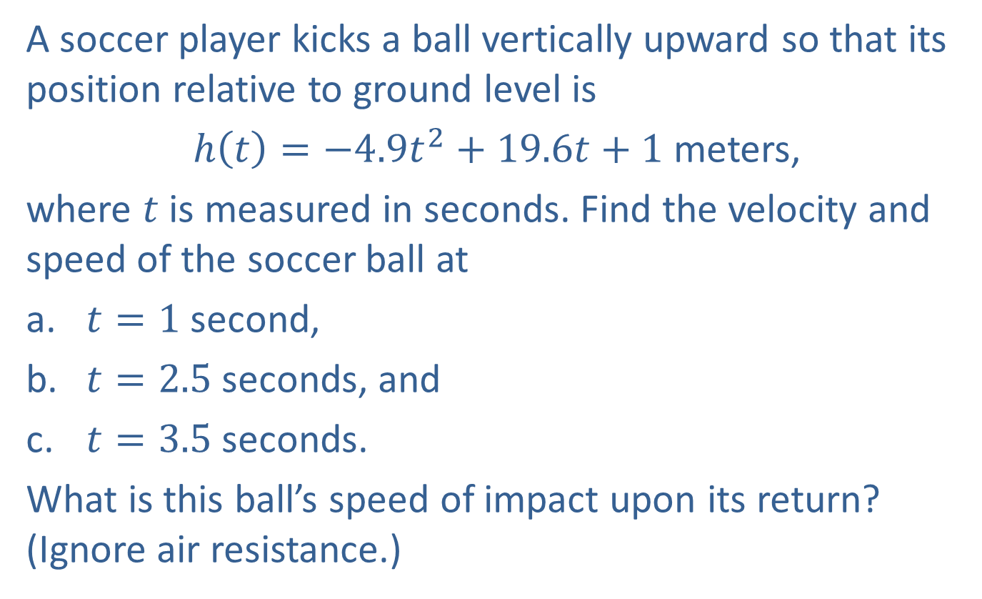
Example 4: Finding Speed
A soccer player kicks a ball vertically upward so that its position relative to ground level is
$h\left(t\right)=−4.9t^{2}+19.6t+1$ meters,
where $t$ is measured in seconds. Find the velocity and speed of the soccer ball at
​$t=1$ second,
​$t=2.5$ seconds, and
​$t=3.5$ seconds.
What is this ball’s speed of impact upon its return? (Ignore air resistance.)

Slide 22
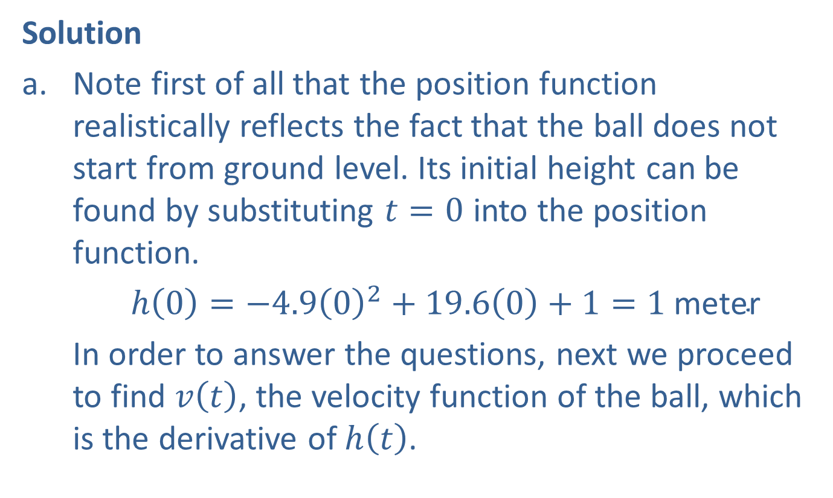
Example 4: Finding Speed (cont.)
Solution
​Note first of all that the position function realistically reflects the fact that the ball does not start from ground level. Its initial height can be found by substituting $t=0$ into the position function.
​$h\left(0\right)=−4.9{\left(0\right)}^{2}+19.6\left(0\right)+1=1 \text{meter}$
​In order to answer the questions, next we proceed to find $v⁡\left(t\right)$, the velocity function of the ball, which is the derivative of $h⁡\left(t\right)$.

Slide 23
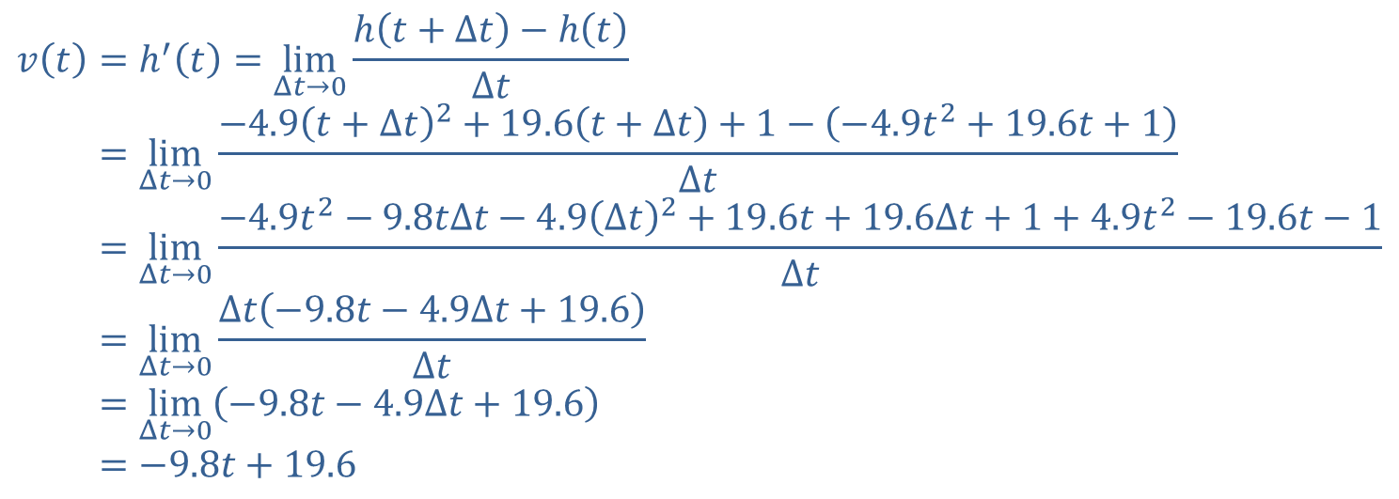

Example 4: Finding Speed (cont.)
Notice that we are using the alternate notation of $Δt$ instead of $h$ for the increment, so as not to cause confusion with the name of the position function.
𝑣𝑡=h′𝑡=limΔ𝑡→0⁡h𝑡+Δ𝑡−h𝑡Δ𝑡𝑣⁡𝑡=limΔ𝑡→0⁡−4.9𝑡+Δ𝑡2+19.6𝑡+Δ𝑡+1−−4.9𝑡2+19.6𝑡+1Δ𝑡𝑣⁡𝑡=limΔ𝑡→0⁡−4.9𝑡2−9.8𝑡Δ𝑡−4.9Δ𝑡2+19.6𝑡+19.6Δ𝑡+1+4.9𝑡2−19.6𝑡−1Δ𝑡𝑣⁡𝑡=limΔ𝑡→0⁡Δ𝑡−9.8𝑡−4.9Δ𝑡+19.6Δ𝑡𝑣⁡𝑡=limΔ𝑡→0−9.8𝑡−4.9Δ𝑡+19.6𝑣𝑡=−9.8𝑡+19.6

Slide 24
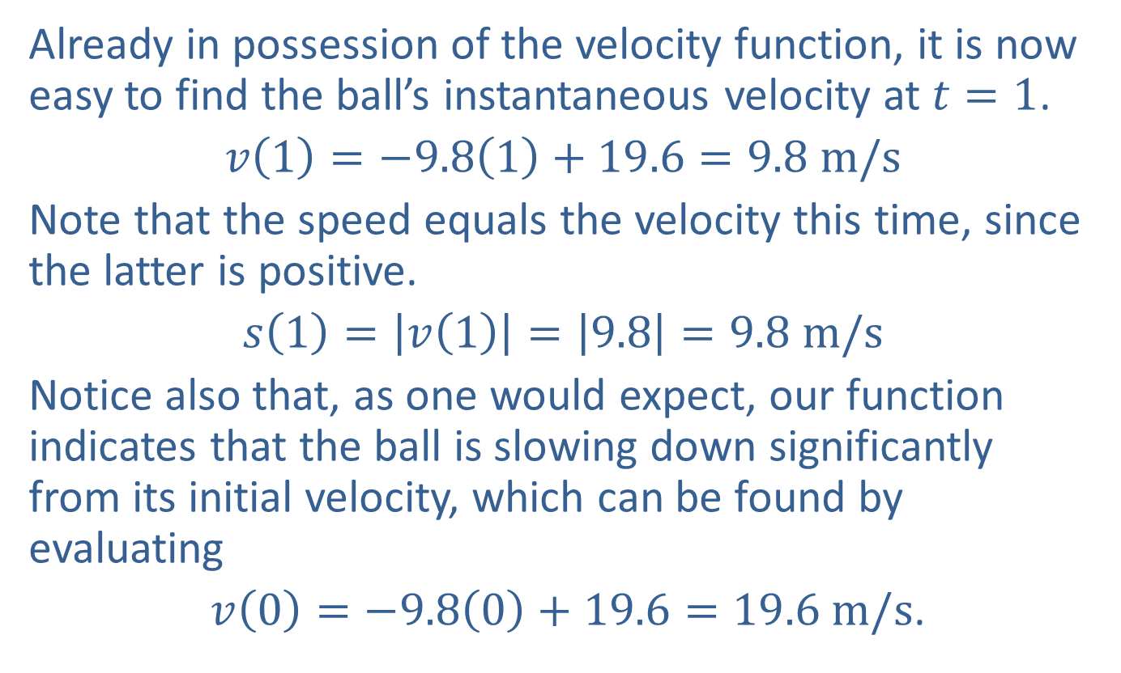
Example 4: Finding Speed (cont.)
​Already in possession of the velocity function, it is now easy to find the ball’s instantaneous velocity at $t=1$.
​$v\left(1\right)=−9.8\left(1\right)+19.6=9.8 m/s$
​Note that the speed equals the velocity this time, since the latter is positive.
​$s\left(1\right)=\left|v\left(1\right)\right|=\left|9.8\right|=9.8 m/s$
​Notice also that, as one would expect, our function indicates that the ball is slowing down significantly from its initial velocity, which can be found by evaluating
​ $v\left(0\right)=−9.8\left(0\right)+19.6=19.6 m/s$.

Slide 25
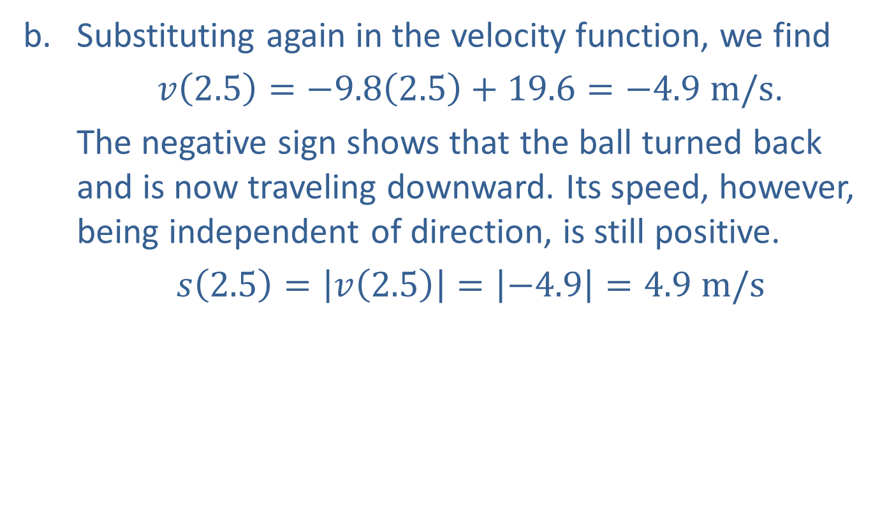
Example 4: Finding Speed (cont.)
​Substituting again in the velocity function, we find
$v\left(2.5\right)=−9.8\left(2.5\right)+19.6=−4.9 m/s$.
​The negative sign shows that the ball turned back and is now traveling downward. Its speed, however, being independent of direction, is still positive.
​$s\left(2.5\right)=\left|v\left(2.5\right)\right|=\left|−4.9\right|=4.9 m/s$

Slide 26
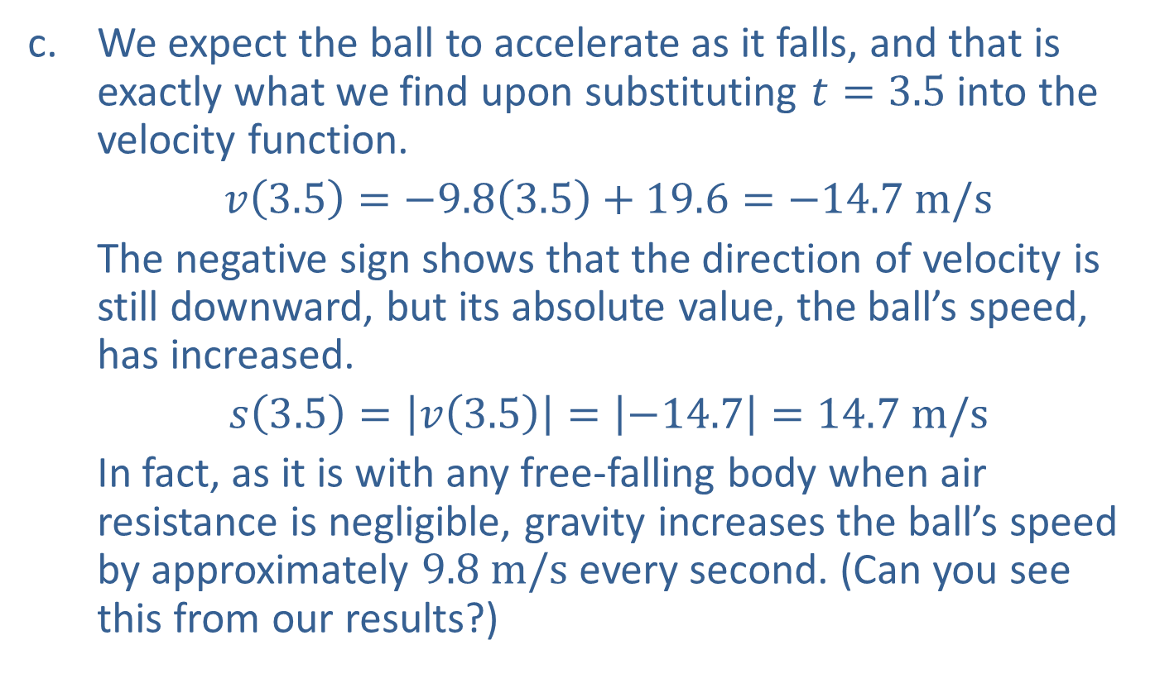
Example 4: Finding Speed (cont.)
​We expect the ball to accelerate as it falls, and that is exactly what we find upon substituting $t=3.5$ into the velocity function.
​$v\left(3.5\right)=−9.8\left(3.5\right)+19.6=−14.7 m/s$
​The negative sign shows that the direction of velocity is still downward, but its absolute value, the ball’s speed, has increased.
​$s\left(3.5\right)=\left|v\left(3.5\right)\right|=\left|−14.7\right|=14.7 m/s$
In fact, as it is with any free-falling body when air resistance is negligible, gravity increases the ball’s speed by approximately $9.8 m/s$ every second. (Can you see this from our results?)

Slide 27
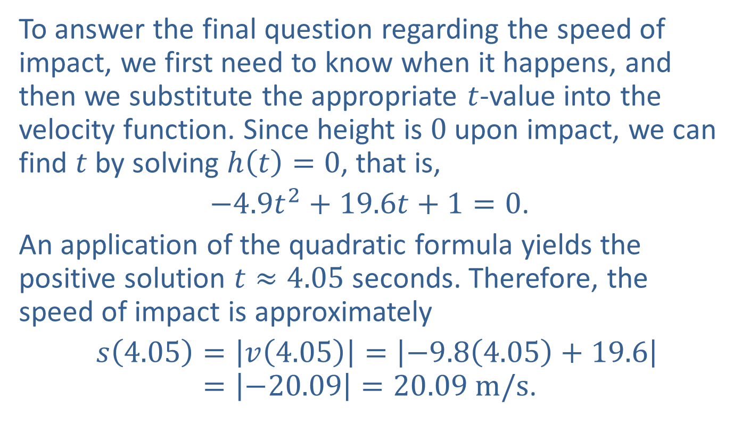
Example 4: Finding Speed (cont.)
​​To answer the final question regarding the speed of impact, we first need to know when it happens, and then we substitute the appropriate $t$-value into the velocity function. Since height is 0 upon impact, we can find $t$ by solving $h\left(t\right)=0$, that is,
$−4.9t^{2}+19.6t+1=0$.
An application of the quadratic formula yields the positive solution $t≈4.05$ seconds. Therefore, the speed of impact is approximately
$s\left(4.05\right)=\left|v\left(4.05\right)\right|=\left|−9.8\left(4.05\right)+19.6\right|=\left|−20.09\right|=20.09 m/s$.

Slide 28

Example 5: Finding Derivatives and Tangent Lines to Graphs
Find the derivative of $f\left(x\right)=\sqrt{x}$, and use it to determine equations of the tangent lines to the graph of $f$ at the points $\left(1,1\right)$ and $\left(2,\sqrt{2}\right)$.

Slide 29
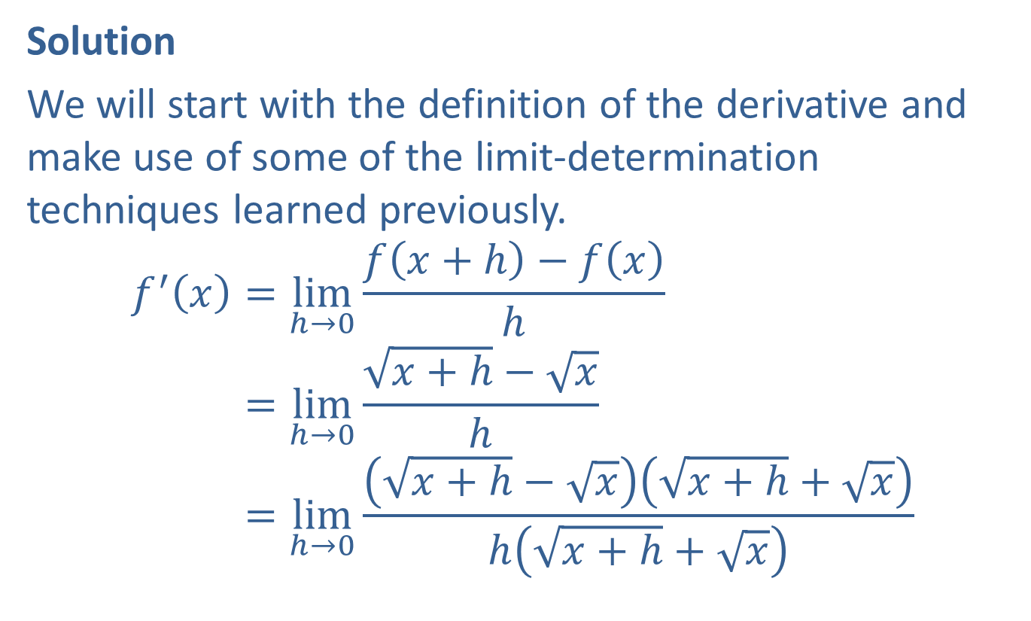
Example 5: Finding Derivatives and Tangent Lines to Graphs (cont.)
Solution
We will start with the definition of the derivative and make use of some of the limit-determination techniques learned previously.
𝑓′𝑥=limh→0⁡𝑓𝑥+h−𝑓𝑥h𝑓′⁡𝑥=limh→0⁡𝑥+h−𝑥h𝑓′⁡𝑥=limh→0⁡𝑥+h−𝑥𝑥+h+𝑥h𝑥+h+𝑥

Slide 30
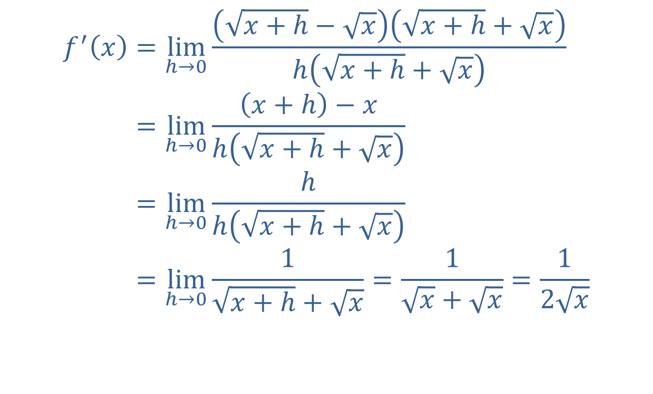
Example 5: Finding Derivatives and Tangent Lines to Graphs (cont.)
𝑓′𝑥=limh→0⁡𝑥+h−𝑥𝑥+h+𝑥h𝑥+h+𝑥𝑓′𝑥=limh→0⁡𝑥+h−𝑥h𝑥+h+𝑥𝑓′⁡𝑥=limh→0⁡hh𝑥+h+𝑥𝑓′⁡𝑥=limh→0⁡1𝑥+h+𝑥=1𝑥+𝑥=12𝑥

Slide 31
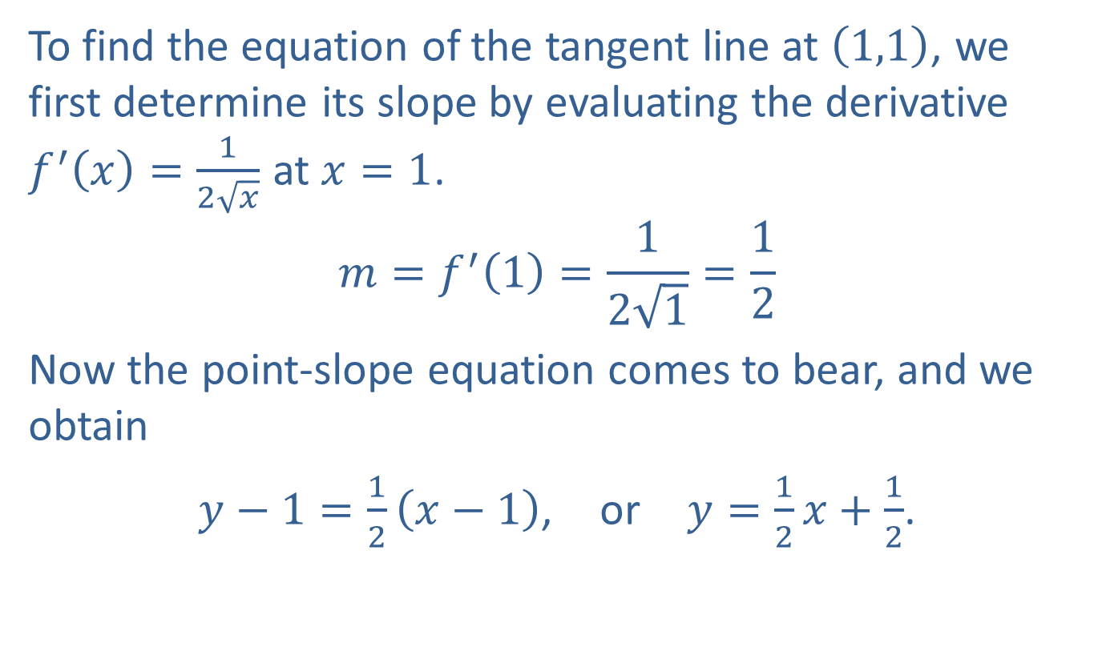
Example 5: Finding Derivatives and Tangent Lines to Graphs (cont.)
To find the equation of the tangent line at $\left(1,1\right)$, we first determine its slope by evaluating the derivative $f^{′}\left(x\right)=\frac{1}{2\sqrt{x}}$ at $x=1$.
$$m=f^{′}\left(1\right)=\frac{1}{2\sqrt{1}}=\frac{1}{2}$$
Now the point-slope equation comes to bear, and we obtain
$y−1=\frac{1}{2}\left(x−1\right)$, or $y=\frac{1}{2}x+\frac{1}{2}$.

Slide 32
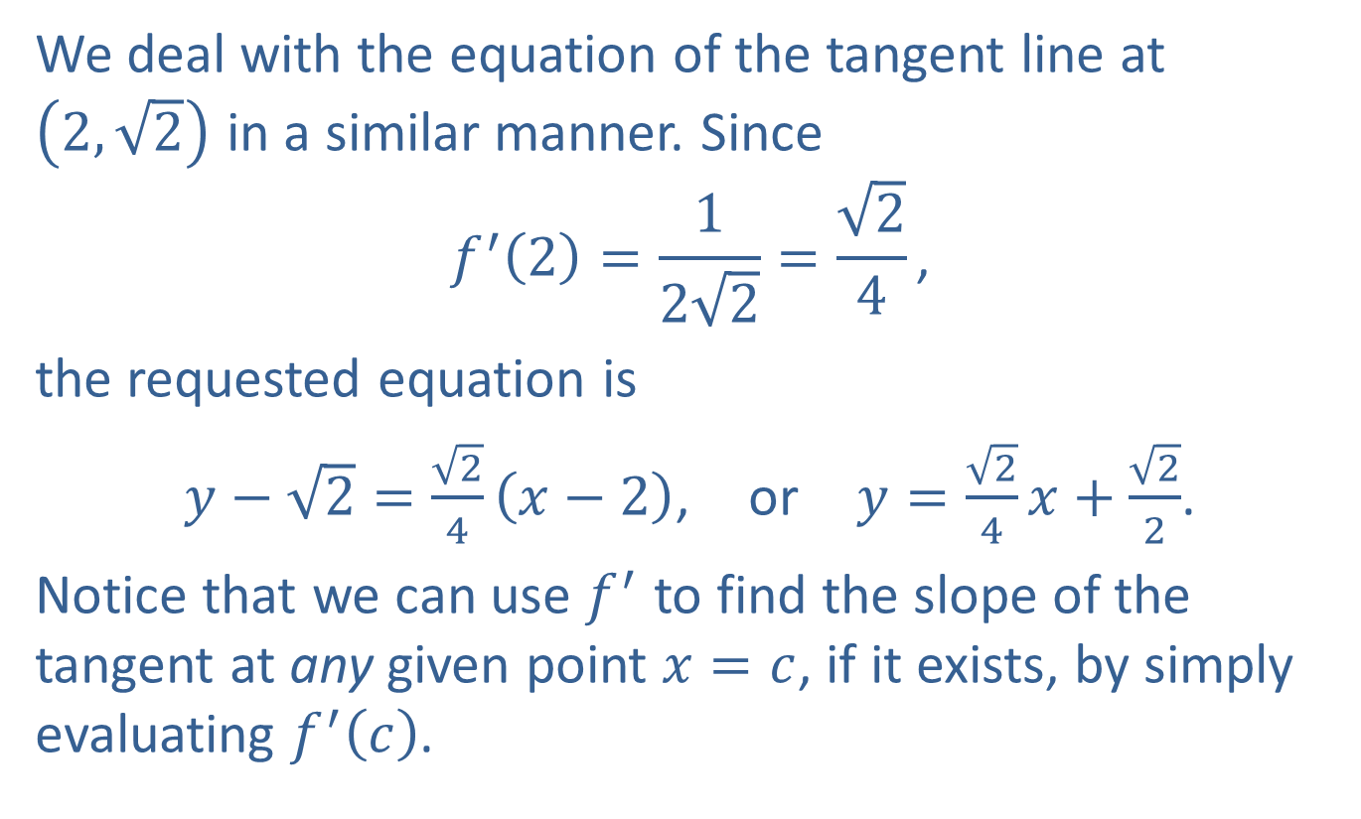
Example 5: Finding Derivatives and Tangent Lines to Graphs (cont.)
We deal with the equation of the tangent line at $\left(2,\sqrt{2}\right)$ in a similar manner. Since
$$f^{′}\left(2\right)=\frac{1}{2\sqrt{2}}=\frac{\sqrt{2}}{4}\text{,}$$
the requested equation is
$y−\sqrt{2}=\frac{\sqrt{2}}{4}\left(x−2\right)$, or $y=\frac{\sqrt{2}}{4}x+\frac{\sqrt{2}}{2}$.
Notice that we can use $f^{′}$ to find the slope of the tangent at any given point $x=c$, if it exists, by simply evaluating $f^{′}⁡\left(c\right)$.

Slide 33
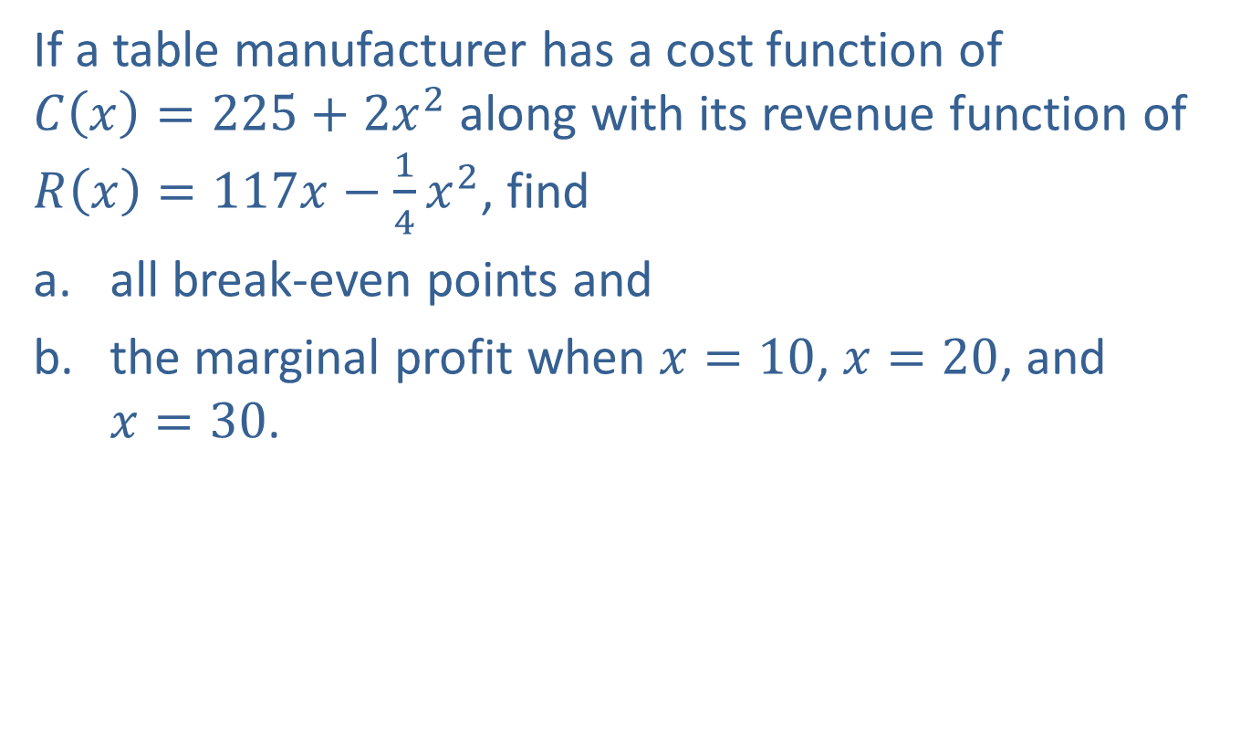
Example 6: Finding Break-Even Points and Marginal Profit
If a table manufacturer has a cost function of $C\left(x\right)=225+2x^{2}$ along with its revenue function of $R\left(x\right)=117x−\frac{1}{4}x^{2}$, find
​all break-even points and
​the marginal profit when $x=10$, $x=20$, and $x=30$.

Slide 34
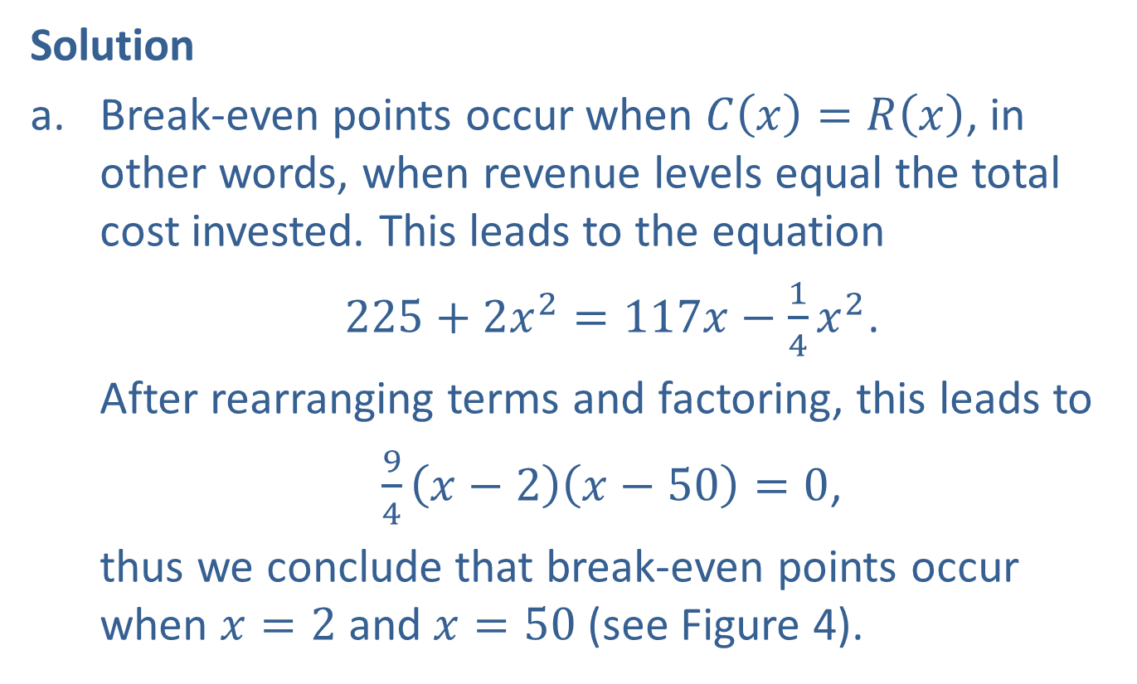
Example 6: Finding Break-Even Points and Marginal Profit (cont.)
Solution
​Break-even points occur when $C\left(x\right)=R\left(x\right)$, in other words, when revenue levels equal the total cost invested. This leads to the equation
$225+2x^{2}=117x−\frac{1}{4}x^{2}$.
​After rearranging terms and factoring, this leads to
​$\frac{9}{4}\left(x−2\right)\left(x−50\right)=0$,
​thus we conclude that break-even points occur when $x=2$ and $x=50$ (see Figure 4).

Slide 35
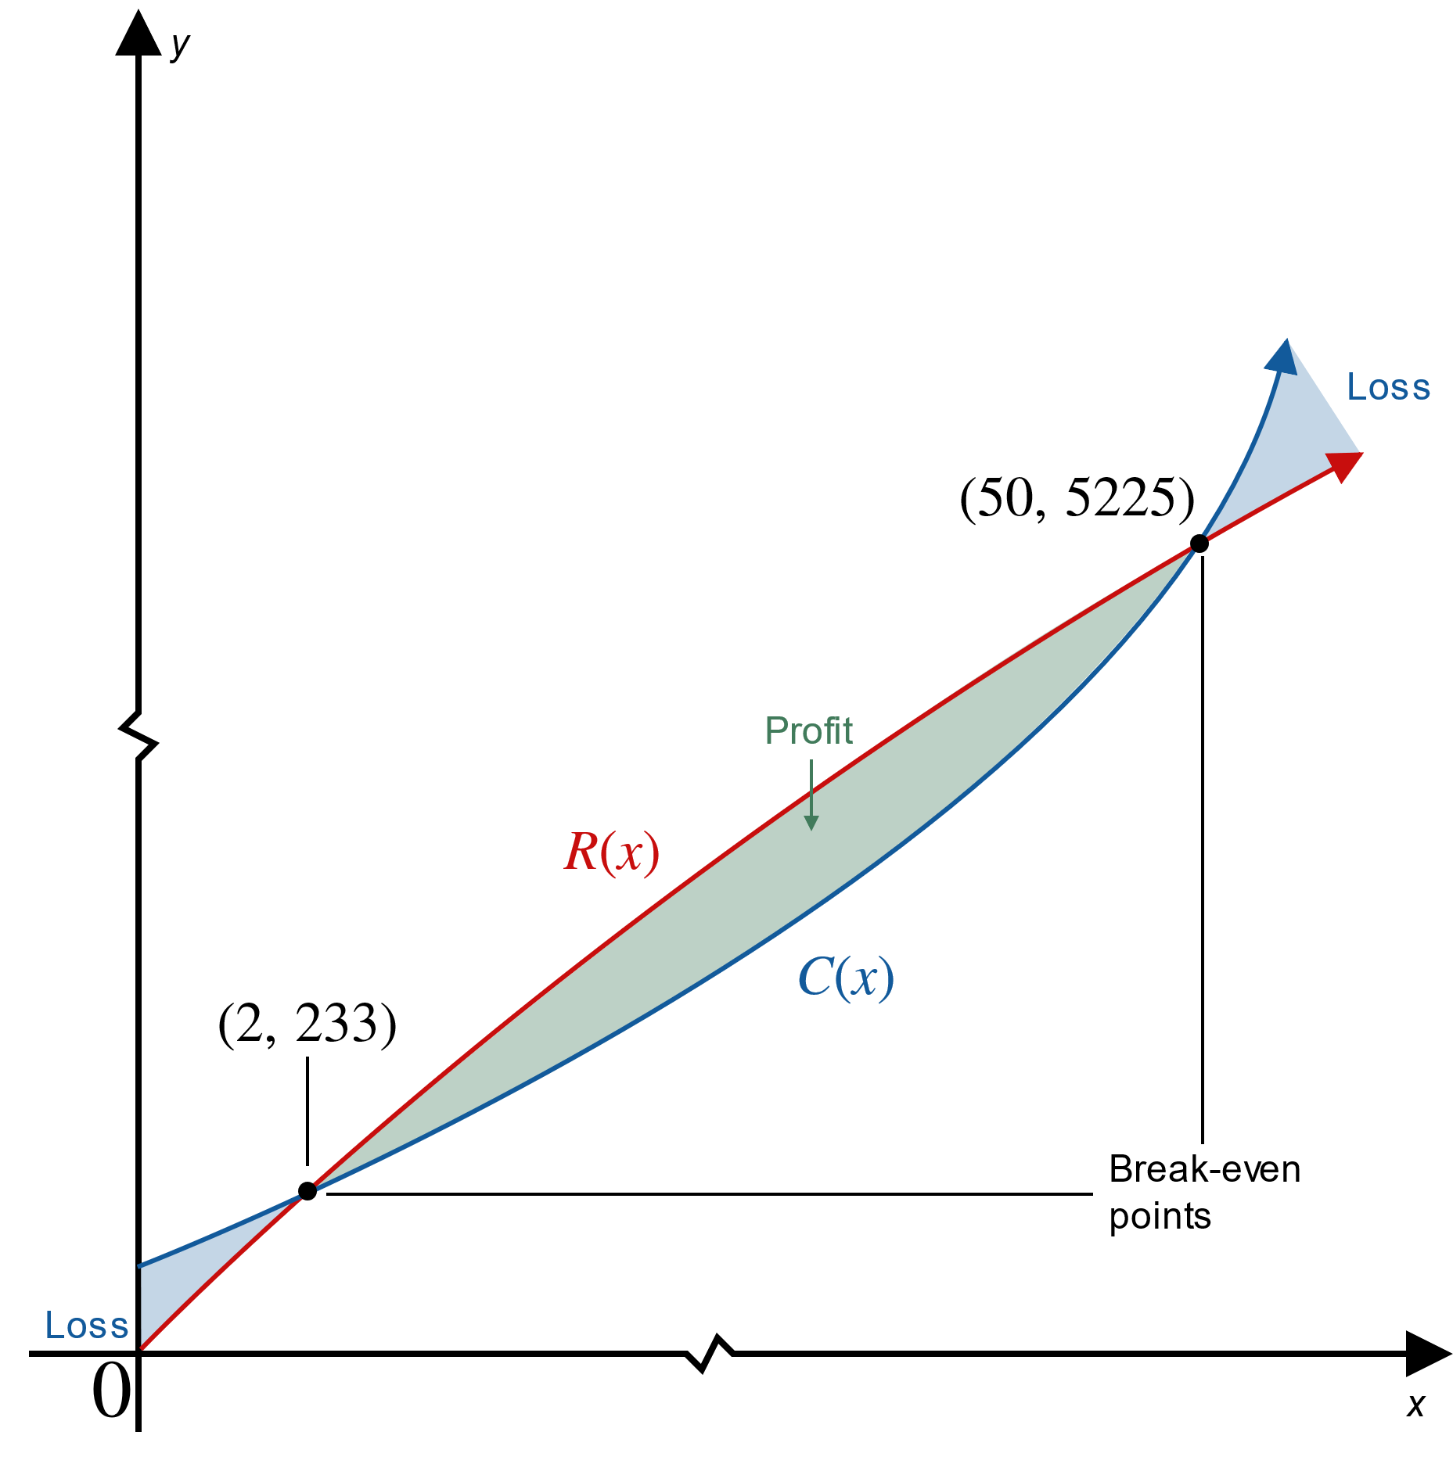
Example 6: Finding Break-Even Points and Marginal Profit (cont.)
Figure 4

Slide 36
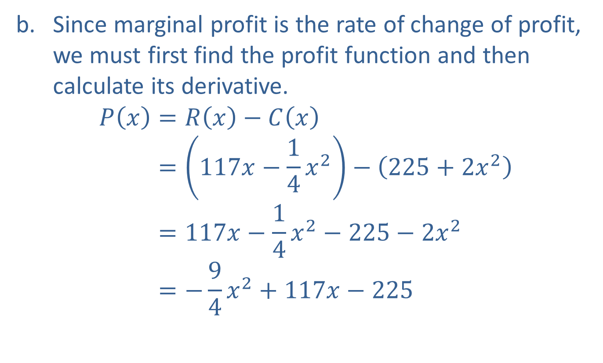
Example 6: Finding Break-Even Points and Marginal Profit (cont.)
​Since marginal profit is the rate of change of profit, we must first find the profit function and then calculate its derivative.
𝑃𝑥=𝑅𝑥−𝐶𝑥𝑃⁡𝑥=117𝑥−14𝑥2−225+2𝑥2𝑃⁡𝑥=117𝑥−14𝑥2−225−2𝑥2𝑃⁡𝑥=−94𝑥2+117𝑥−225

Slide 37
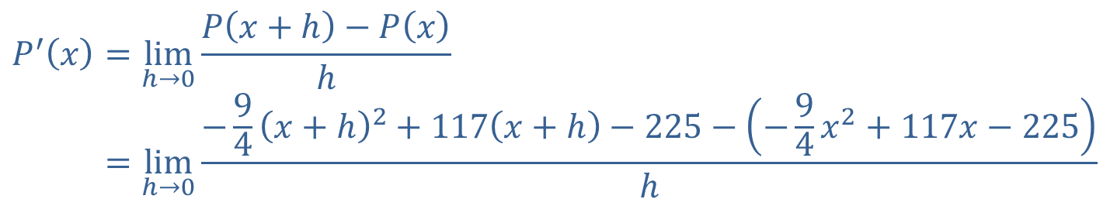
Example 6: Finding Break-Even Points and Marginal Profit (cont.)
​Next, we will use the definition of the derivative to obtain the marginal profit function.
𝑃′𝑥=limh→0⁡𝑃𝑥+h−𝑃𝑥h𝑃′⁡𝑥=limh→0⁡−94𝑥+h2+117𝑥+h−225−−94𝑥2+117𝑥−225h

Slide 38
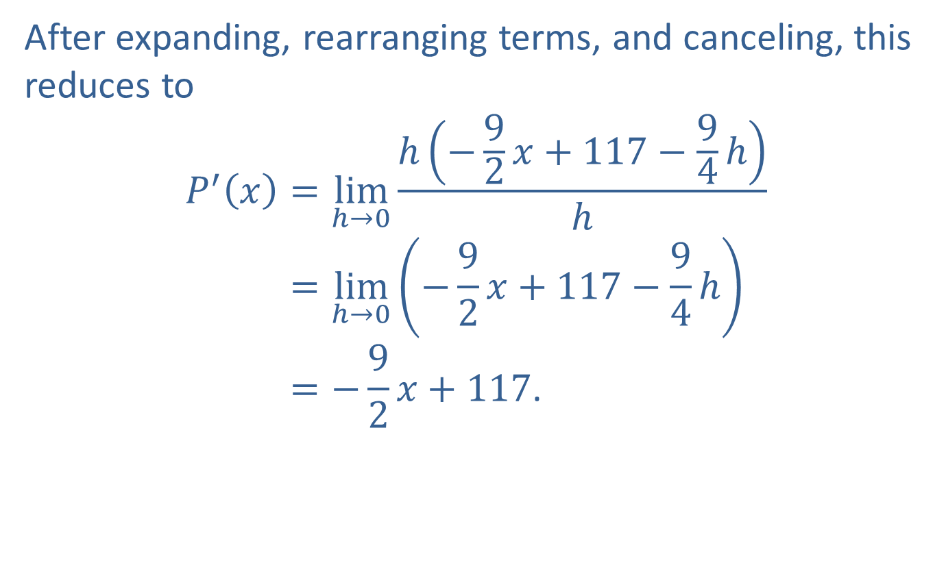
Example 6: Finding Break-Even Points and Marginal Profit (cont.)
​​After expanding, rearranging terms, and canceling, this reduces to
𝑃′𝑥=limh→0⁡h−92𝑥+117−94hh𝑃′⁡𝑥=limh→0−92𝑥+117−94h𝑃′⁡𝑥=−92𝑥+117.

Slide 39
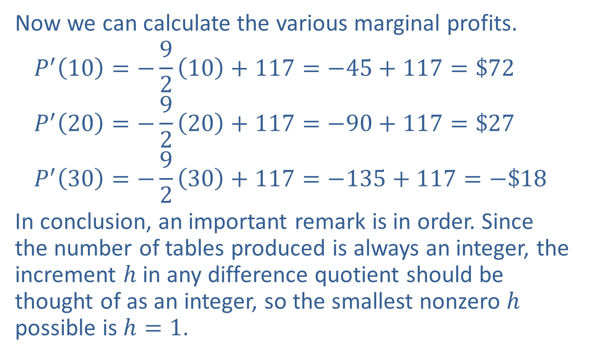
Example 6: Finding Break-Even Points and Marginal Profit (cont.)
​Now we can calculate the various marginal profits.
$$P^{′}\left(10\right)=−\frac{9}{2}\left(10\right)+117=−45+117=\$72$$
$$P^{′}\left(20\right)=−\frac{9}{2}\left(20\right)+117=−90+117=\$27$$
$$P^{′}\left(30\right)=−\frac{9}{2}\left(30\right)+117=−135+117=−\$18$$
​In conclusion, an important remark is in order. Since the number of tables produced is always an integer, the increment $h$ in any difference quotient should be thought of as an integer, so the smallest nonzero $h$ possible is $h=1$.

Slide 40
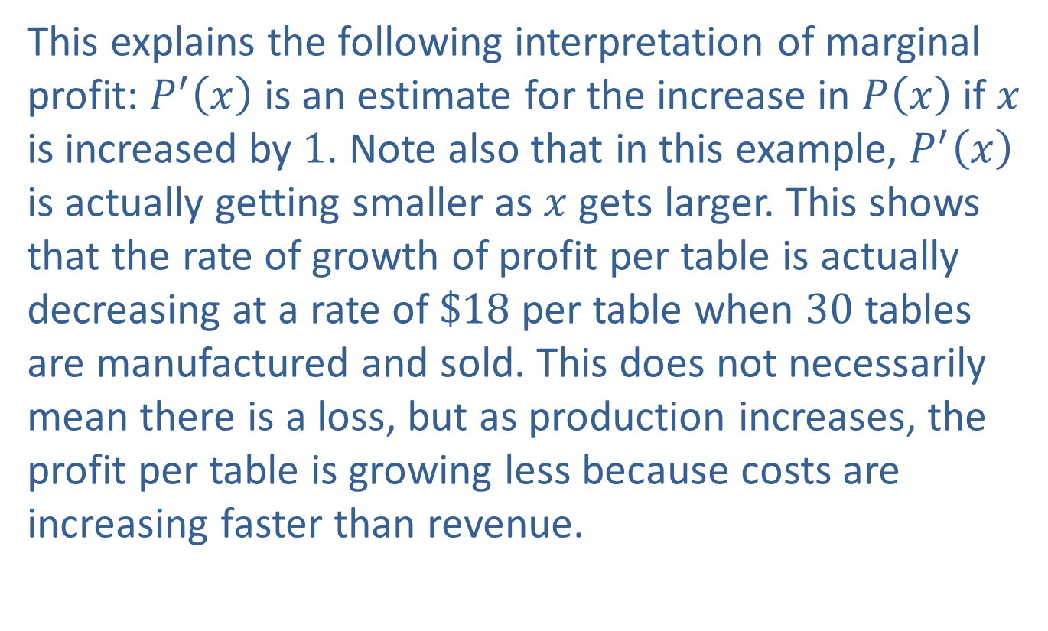
Example 6: Finding Break-Even Points and Marginal Profit (cont.)
​This explains the following interpretation of marginal profit: $P^{′}⁡\left(x\right)$ is an estimate for the increase in $P⁡\left(x\right)$ if $x$ is increased by 1. Note also that in this example, $P^{′}⁡\left(x\right)$ is actually getting smaller as $x$ gets larger. This shows that the rate of growth of profit per table is actually decreasing at a rate of $\$18$ per table when 30 tables are manufactured and sold. This does not necessarily mean there is a loss, but as production increases, the profit per table is growing less because costs are increasing faster than revenue.

