Slide 1
Section 2.6
Linear Inequalities in Two Variables

Slide 2
Solving Linear Inequalities in Two Variables
Procedure
Step 1: | Graph the line that results from replacing the inequality symbol with =.
Step 2: | Make the line solid if the inequality symbol is ≤ or ≥ (not strict) and dashed if the symbol is < or > (strict). A solid line indicates that points on the line are included in the solution set while a dashed line indicates that points on the line are excluded from the solution set.
Step 3: | Determine which of the half-planes defined by the boundary line solves the inequality by substituting a test point from one of the two half-planes into the inequality. If the resulting numerical statement is true, all the points in the same half-plane as the test point solve the inequality. Otherwise, the points in the other half-plane solve the inequality. Shade in the half-plane that solves the inequality.

Slide 3

Example 1: Solving Linear Inequalities
Solve the following linear inequalities by graphing their solution sets.
​$3x+2y<12$
​$x−y≤0$
​$x>3$

Slide 4
Note:
Whenever possible, use the origin as a test point, since it makes for a very simple calculation.

Slide 5
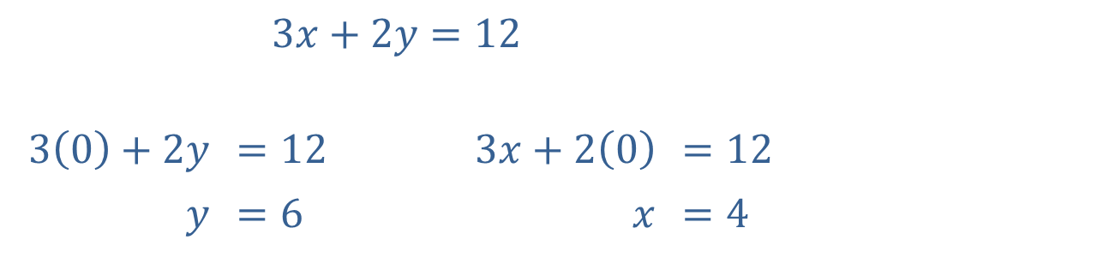

Example 1: Solving Linear Inequalities (cont.)
Solution
​To graph the boundary line, replace the inequality symbol with an equal sign, then find the $x$- and
$y$-intercepts.
​$3x+2y=12$
​$3\left(0\right)+2y$ | ​$=12$ | ​$3x+2\left(0\right)$ | ​$=12$
$$y$$ | ​$=6$ | $$x$$ | ​$=4$

Slide 6
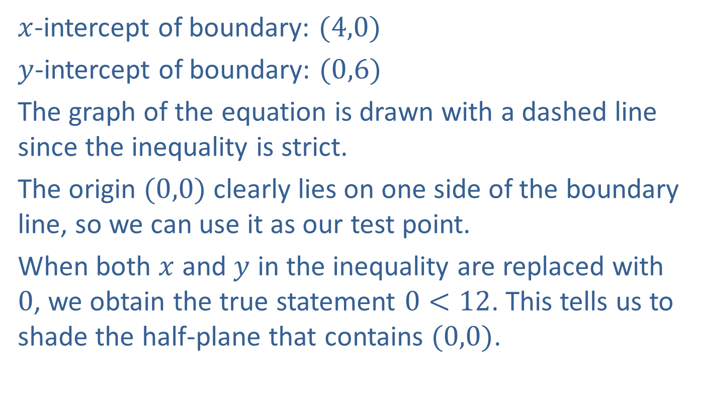
Example 1: Solving Linear Inequalities (cont.)
​$x$-intercept of boundary: $(4,0)$
​$y$-intercept of boundary: $(0,6)$
​The graph of the equation is drawn with a dashed line since the inequality is strict.
​The origin $(0,0)$ clearly lies on one side of the boundary line, so we can use it as our test point.
​When both $x$ and $y$ in the inequality are replaced with 0, we obtain the true statement $0<12$. This tells us to shade the half-plane that contains $(0,0)$.
​

Slide 7
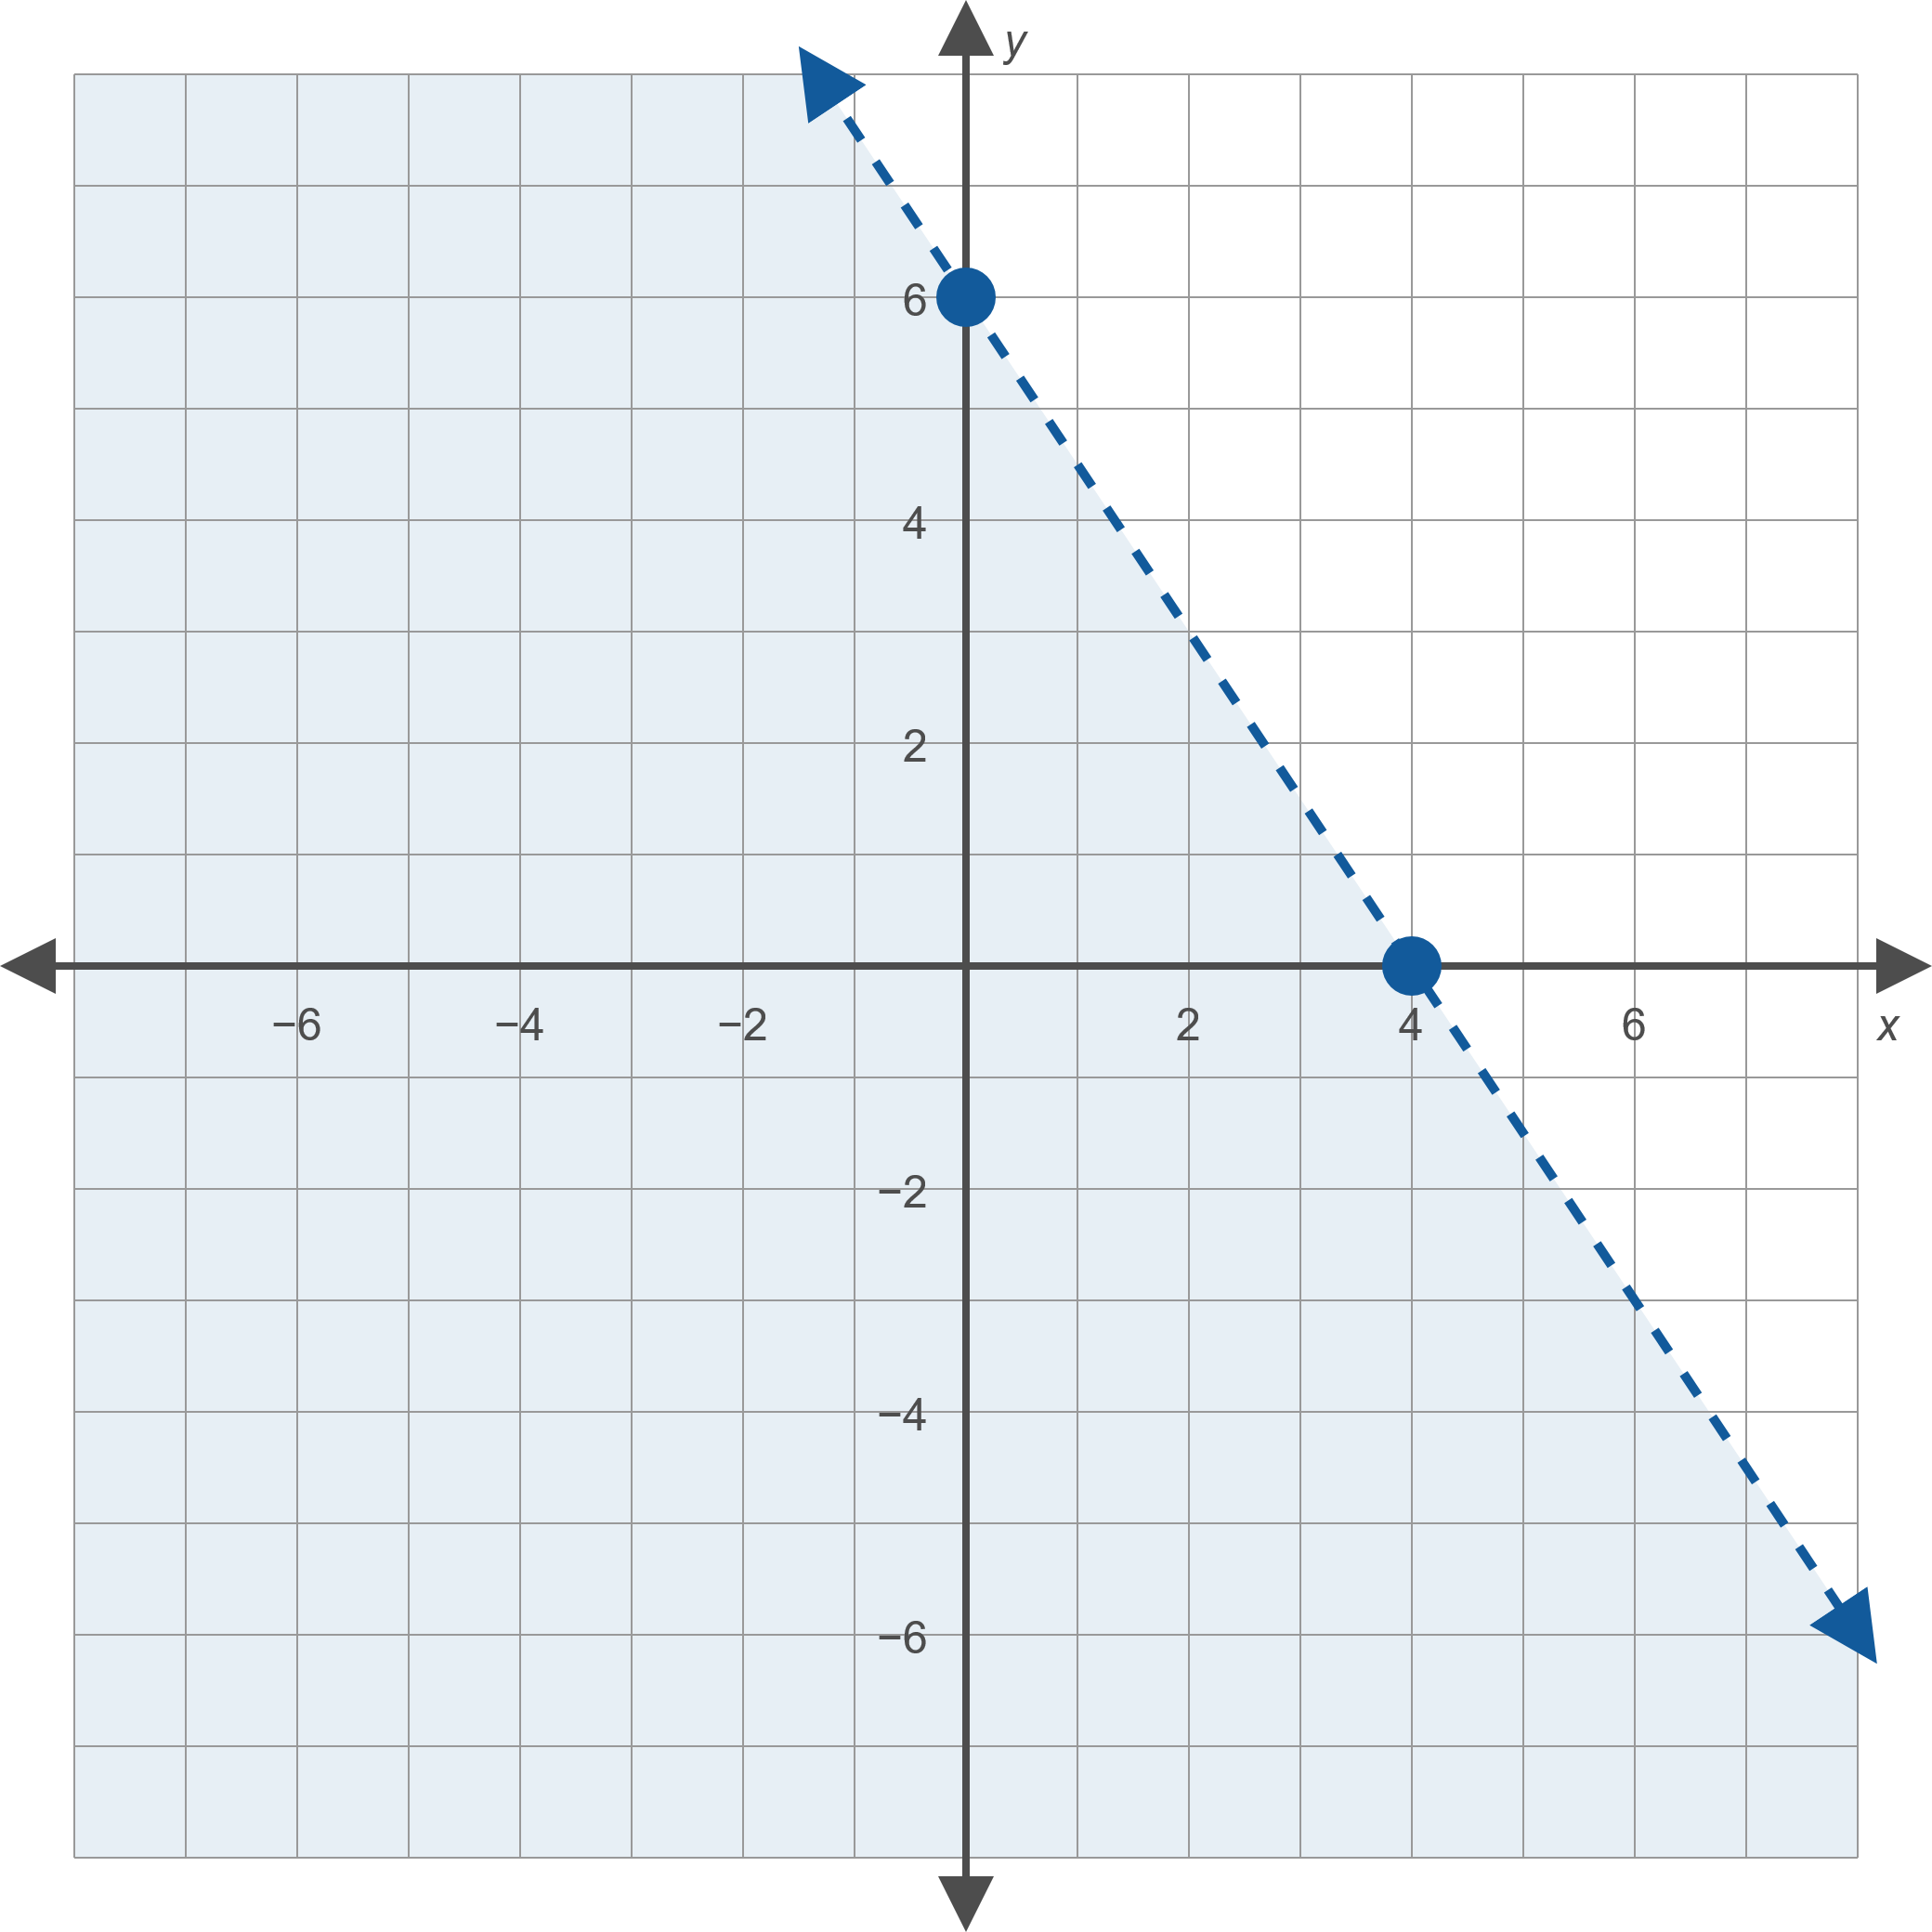
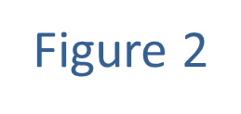
Example 1: Solving Linear Inequalities (cont.)

Slide 8
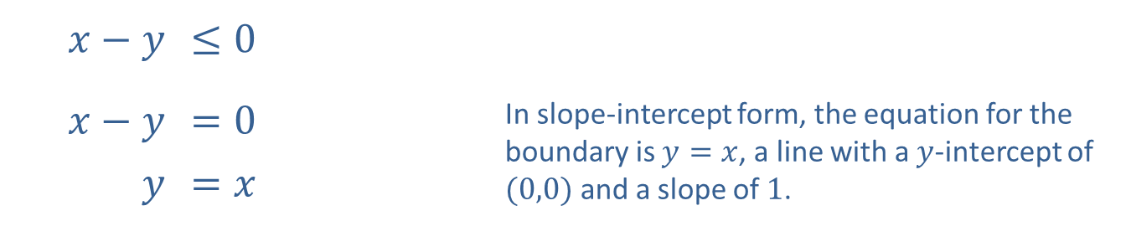
Example 1: Solving Linear Inequalities (cont.)
​
​$x−y$ | ​$≤0$
​$x−y$ | ​$=0$ | In slope-intercept form, the equation for the boundary is $y=x$, a line with a $y$-intercept of $(0,0)$ and a slope of 1.
$$y$$ | ​$=x$

Slide 9
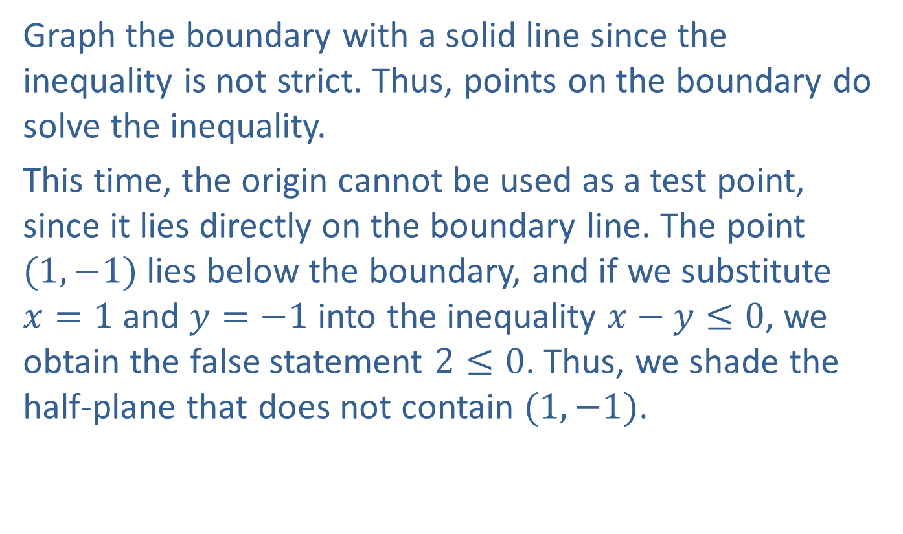
Example 1: Solving Linear Inequalities (cont.)
​Graph the boundary with a solid line since the inequality is not strict. Thus, points on the boundary do solve the inequality.
​This time, the origin cannot be used as a test point, since it lies directly on the boundary line. The point $(1,−1)$ lies below the boundary, and if we substitute $x=1$ and $y=−1$ into the inequality $x−y≤0$, we obtain the false statement $2≤0$. Thus, we shade the half-plane that does not contain $(1,−1)$. ​

Slide 10
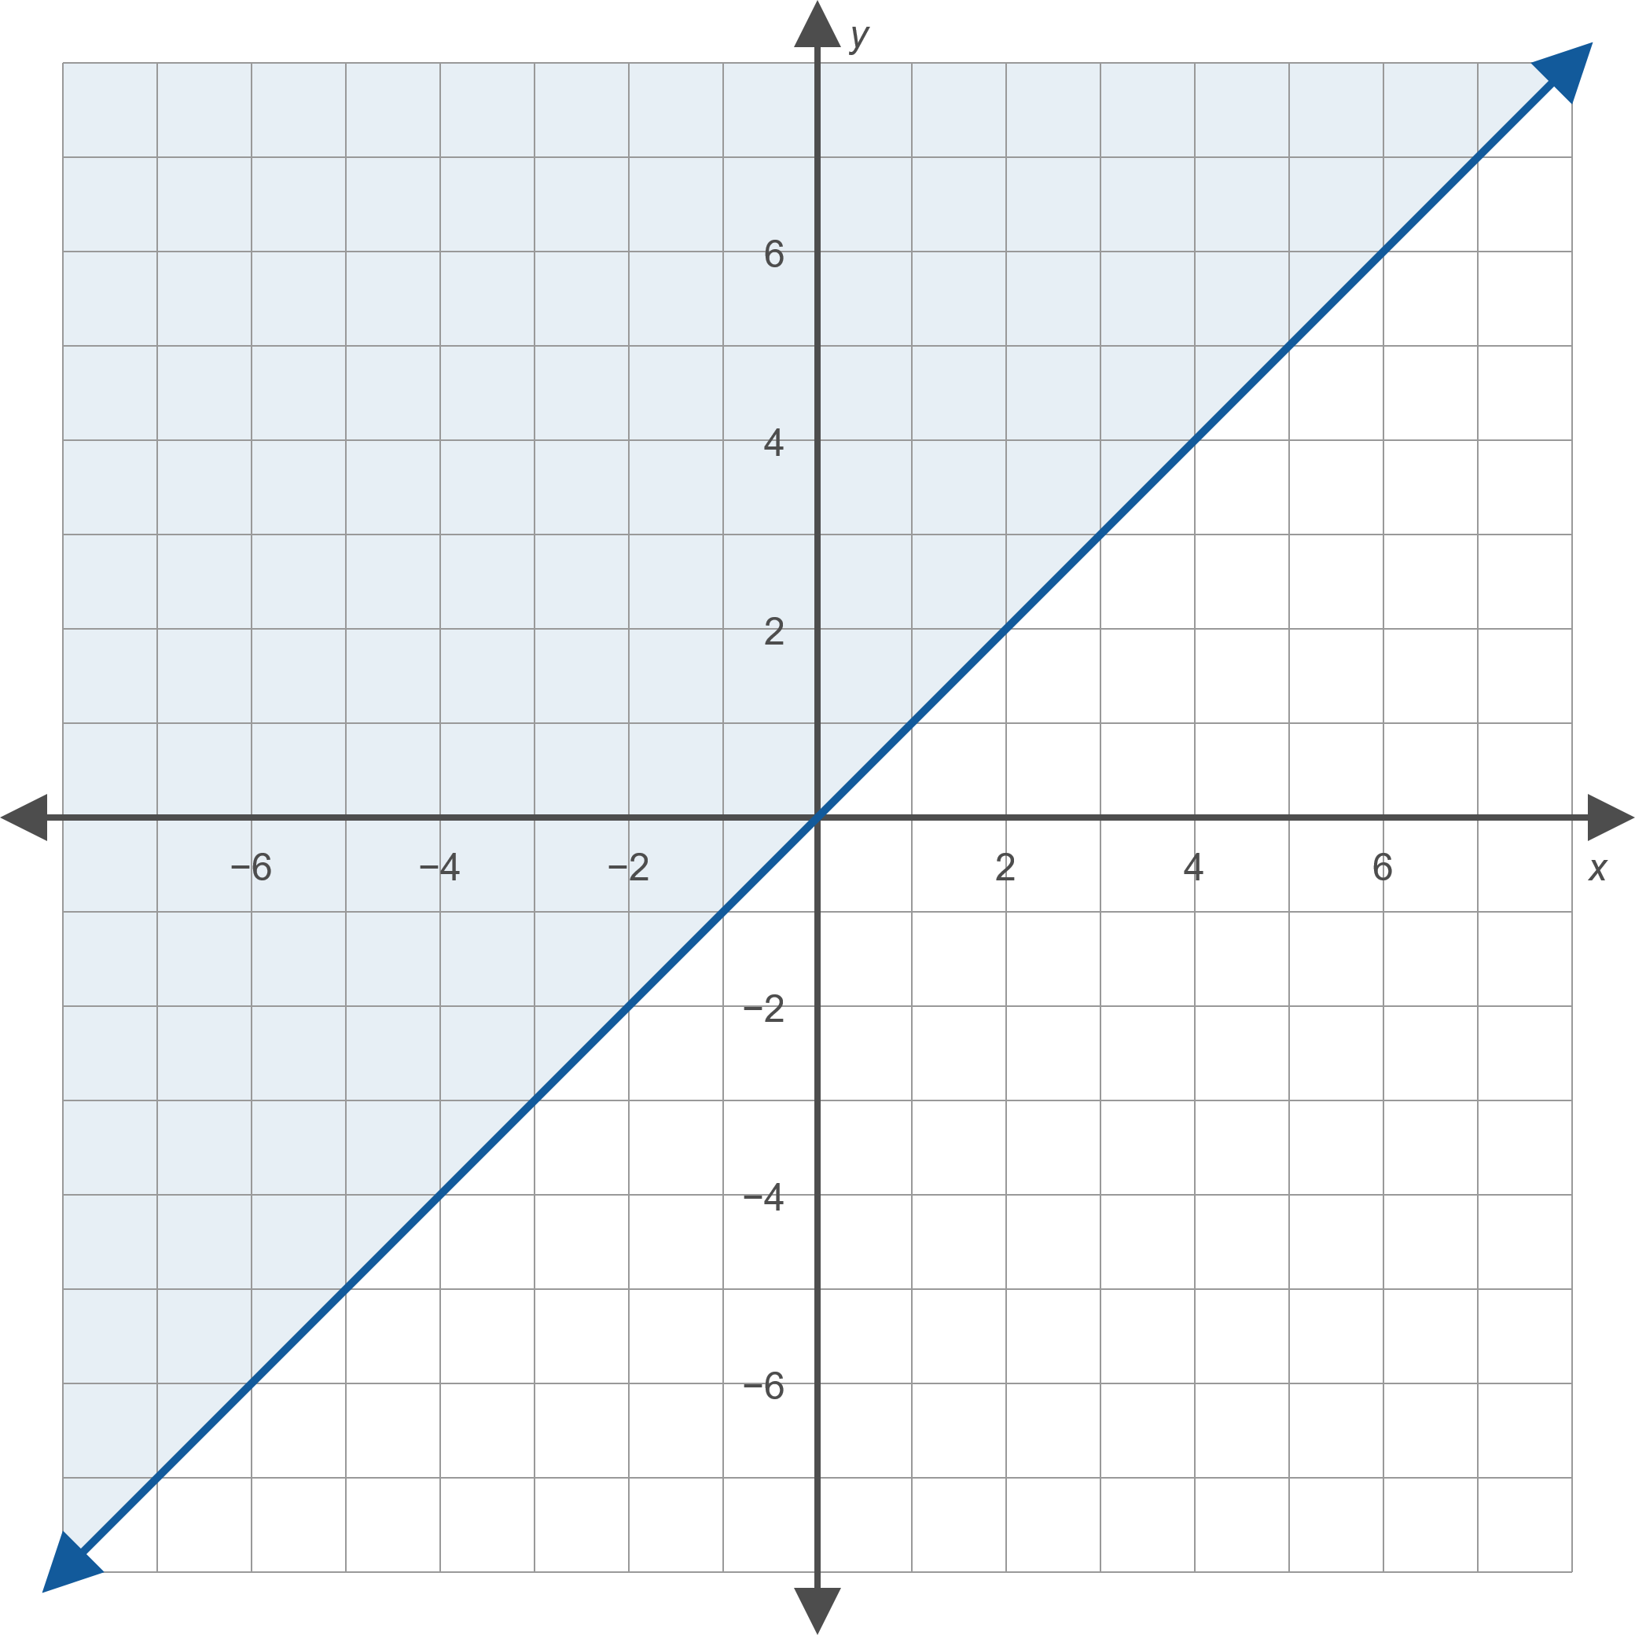
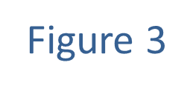
Example 1: Solving Linear Inequalities (cont.)

Slide 11
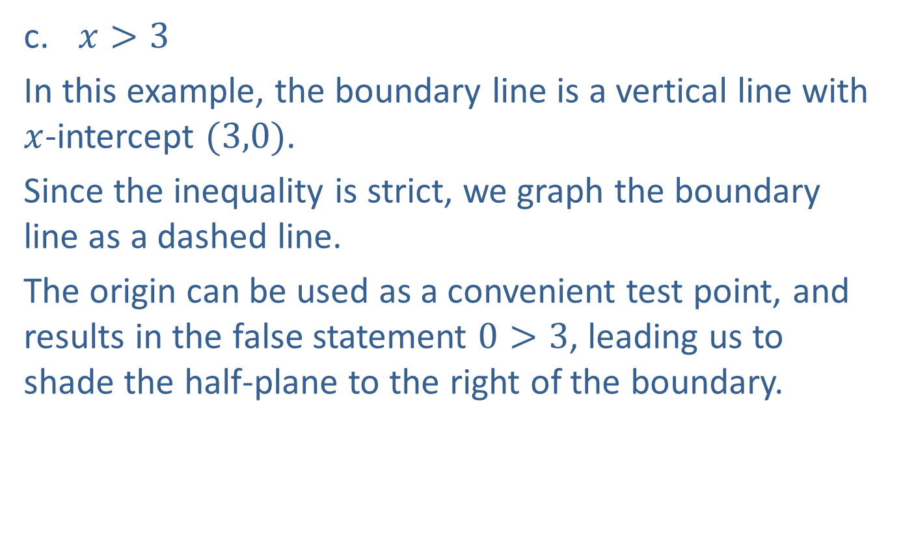
Example 1: Solving Linear Inequalities (cont.)
​$x>3$
​In this example, the boundary line is a vertical line with $x$-intercept $(3,0)$.
​Since the inequality is strict, we graph the boundary line as a dashed line.
​The origin can be used as a convenient test point, and results in the false statement $0>3$, leading us to shade the half-plane to the right of the boundary. ​

Slide 12
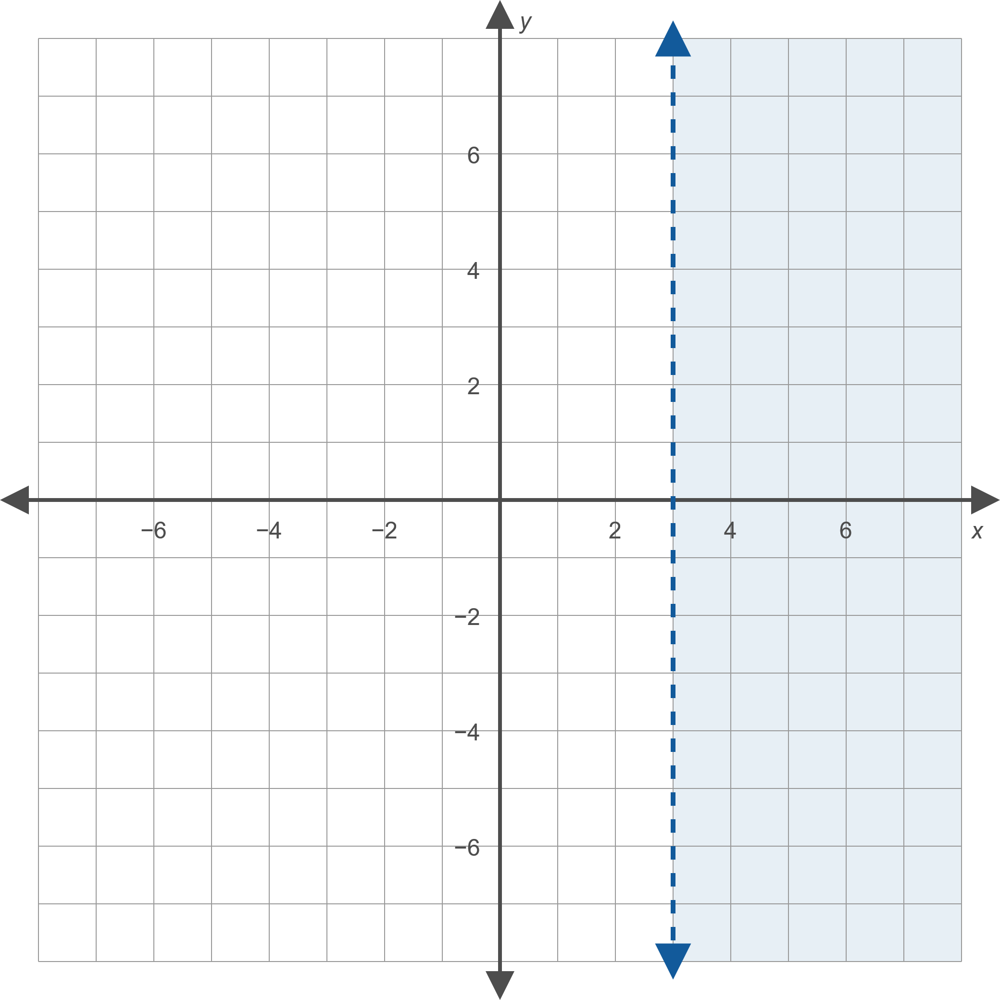
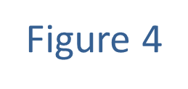
Example 1: Solving Linear Inequalities (cont.)

Slide 13

Example 2: Solving Linear Inequalities
Graph the solution sets that satisfy the following inequalities.
​$5x−2y<10$ and $y≤x$
​$x+y<4$ or $x≥4$

Slide 14
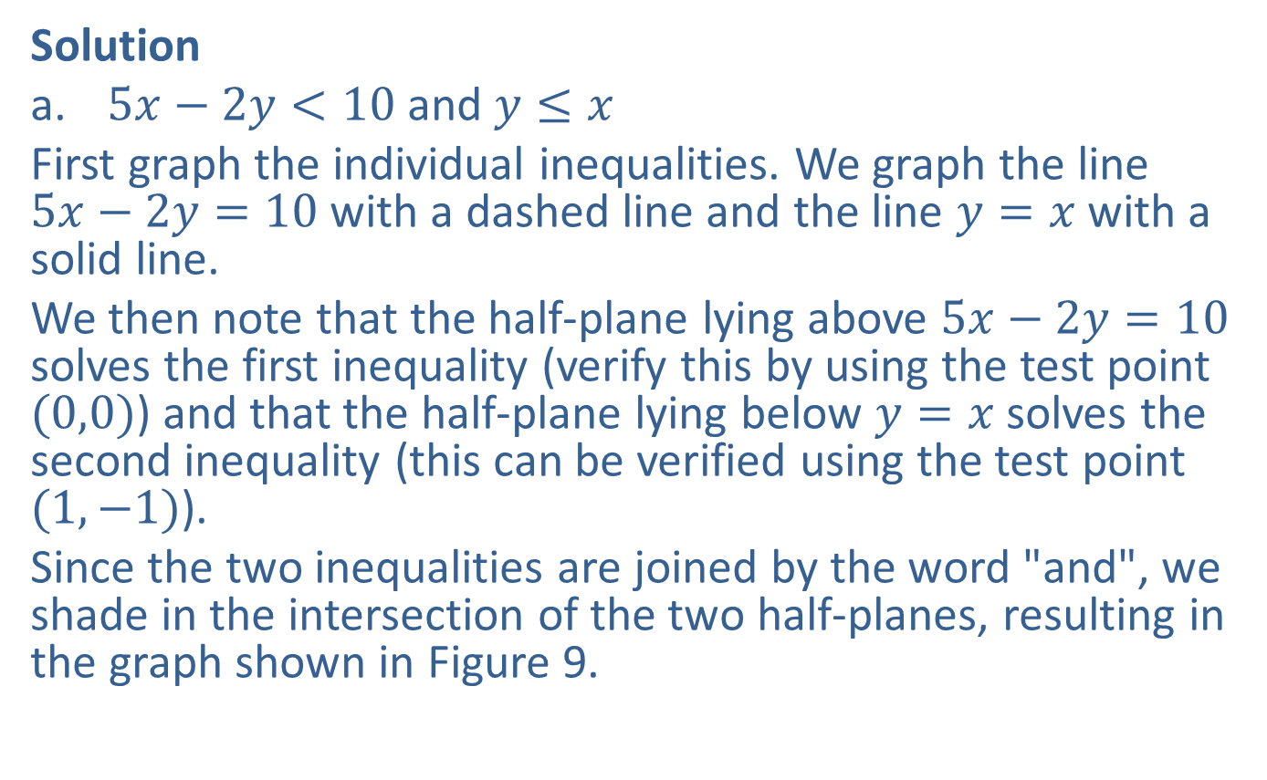
Example 2: Solving Linear Inequalities (cont.)
Solution
​$5x−2y<10$ and $y≤x$
​First graph the individual inequalities. We graph the line $5x−2y=10$ with a dashed line and the line $y=x$ with a solid line.
​We then note that the half-plane lying above $5x−2y=10$ solves the first inequality (verify this by using the test point $(0,0)$) and that the half-plane lying below $y=x$ solves the second inequality (this can be verified using the test point $(1,−1)$).
​Since the two inequalities are joined by the word "and", we shade in the intersection of the two half-planes, resulting in the graph shown in Figure 9.
​

Slide 15
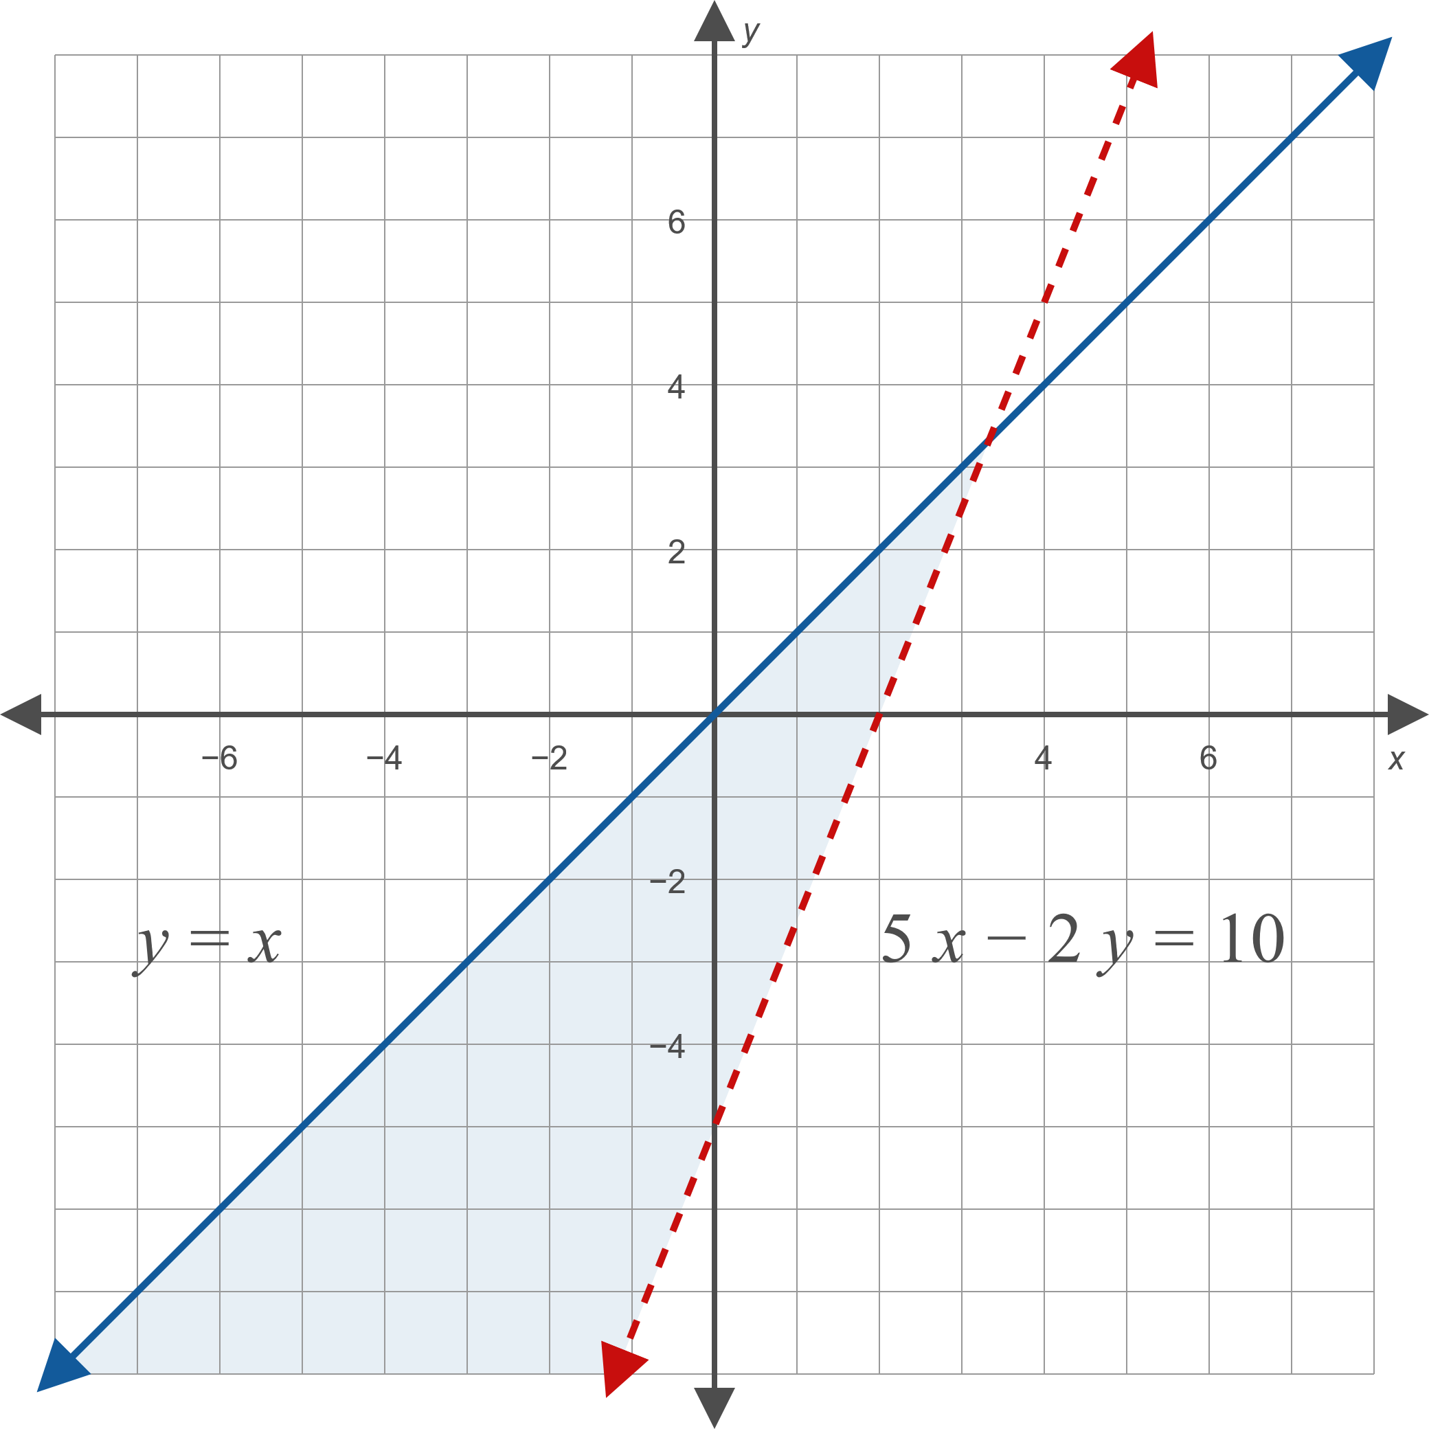
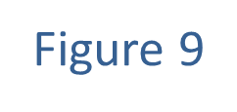
Example 2: Solving Linear Inequalities (cont.)

Slide 16
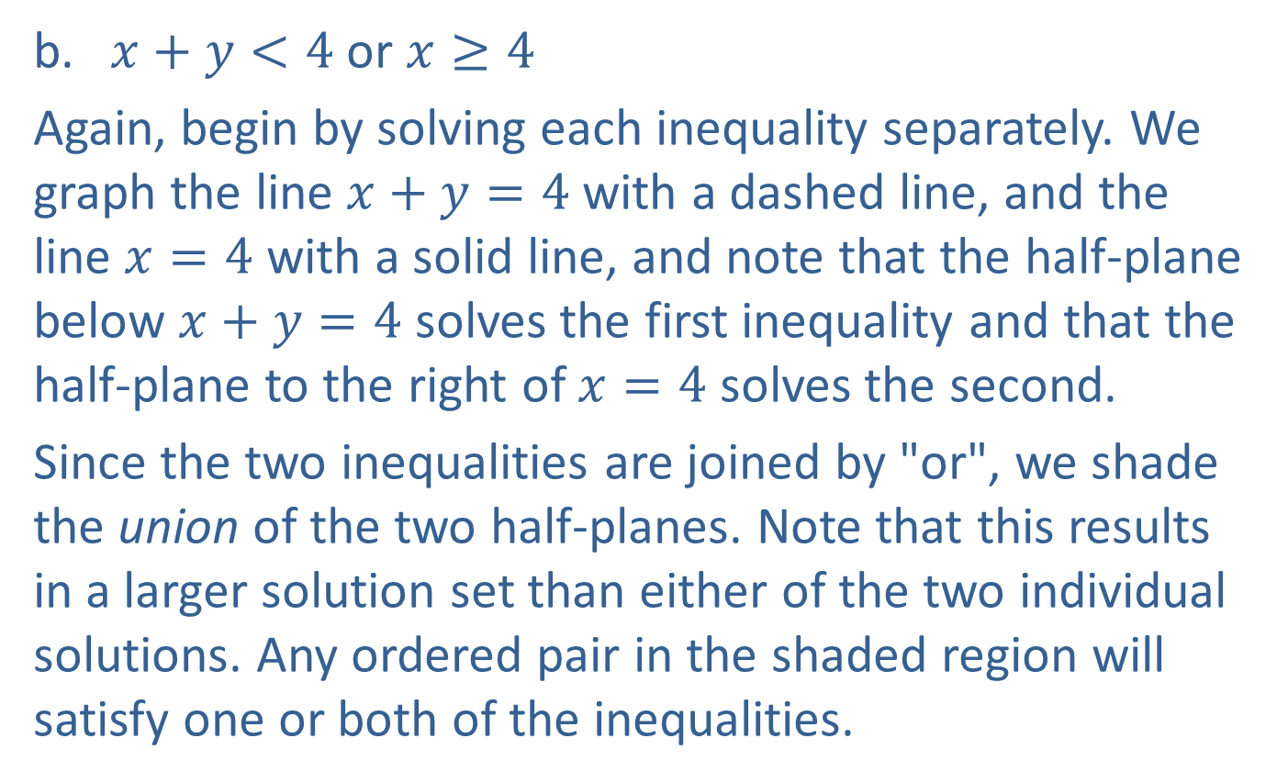
Example 2: Solving Linear Inequalities (cont.)
​$x+y<4$ or $x≥4$
​Again, begin by solving each inequality separately. We graph the line $x+y=4$ with a dashed line, and the line $x=4$ with a solid line, and note that the half-plane below $x+y=4$ solves the first inequality and that the half-plane to the right of $x=4$ solves the second.
​Since the two inequalities are joined by "or", we shade the union of the two half-planes. Note that this results in a larger solution set than either of the two individual solutions. Any ordered pair in the shaded region will satisfy one or both of the inequalities. ​

Slide 17
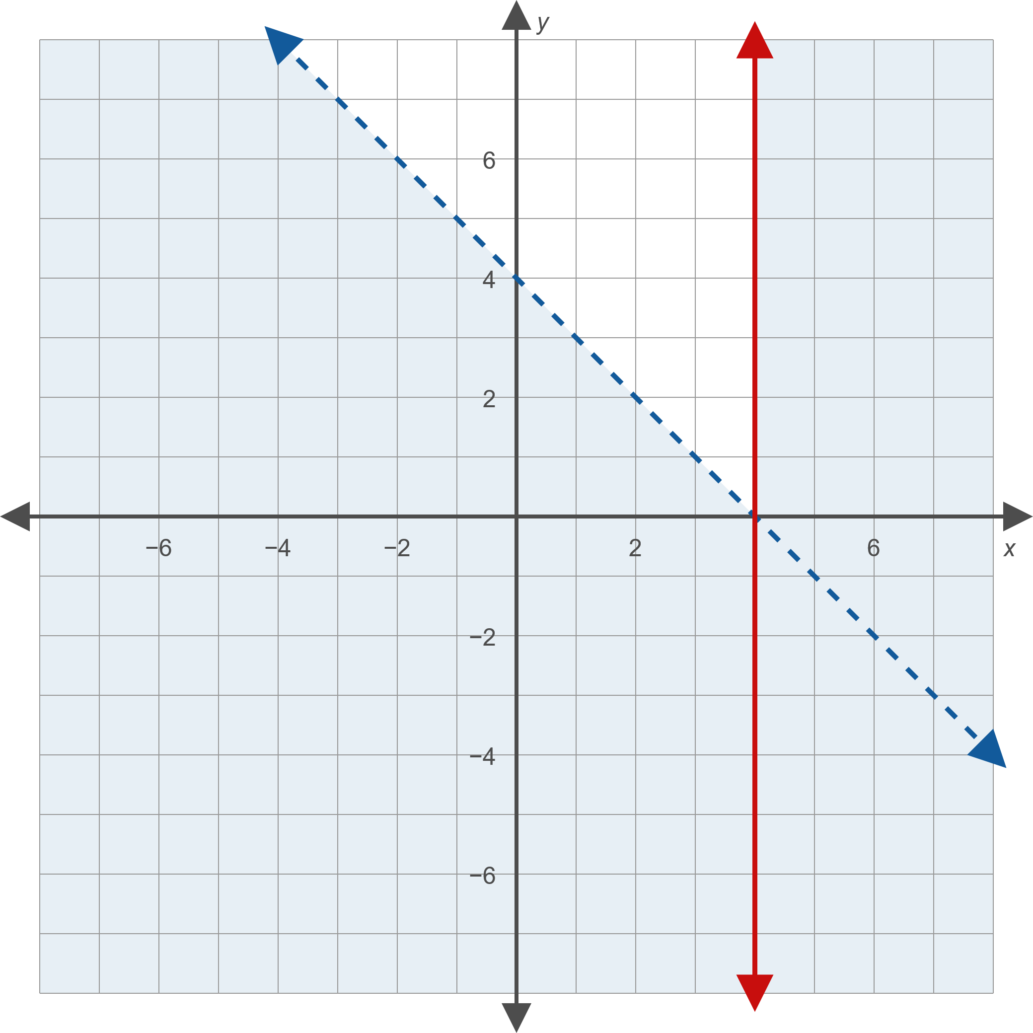
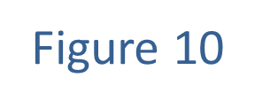
Example 2: Solving Linear Inequalities (cont.)

Slide 18

Example 3: Solving Absolute Value Linear Inequalities
Graph the solution set in $ℝ^{2}$ that satisfies the joint conditions $\left|x−3\right|>1$ and $\left|y−2\right|≤3$.

Slide 19
Example 3: Solving Absolute Value Linear Inequalities (cont.)
Solution
First, we need to find the solution to each individual inequality.

Slide 20
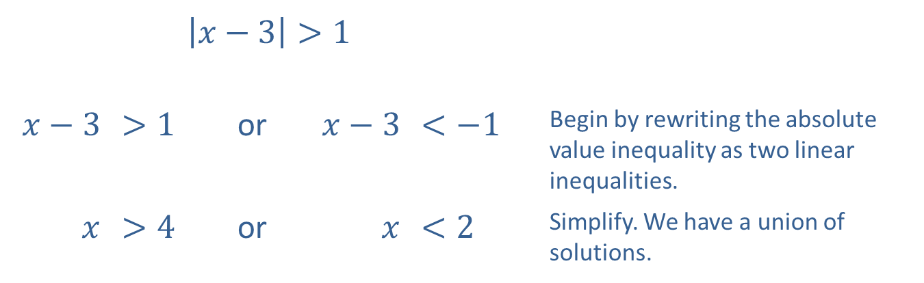
Example 3: Solving Absolute Value Linear Inequalities (cont.)
​$\left|x−3\right|>1$
​$x−3$ | ​$>1$ | or | ​$x−3$ | ​$<−1$ | Begin by rewriting the absolute value inequality as two linear inequalities.
$$x$$ | ​$>4$ | or | $$x$$ | ​$<2$ | Simplify. We have a union of solutions.

Slide 21
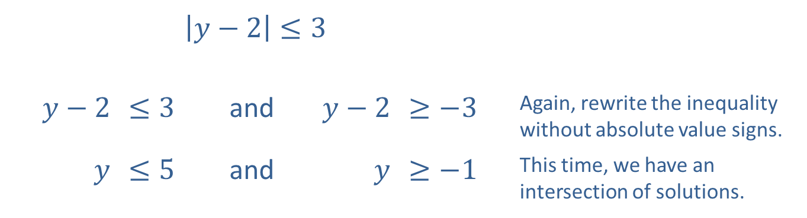
Example 3: Solving Absolute Value Linear Inequalities (cont.)
​$\left|y−2\right|≤3$
​$y−2$ | ​$≤3$ | and | ​$y−2$ | ​$≥−3$ | Again, rewrite the inequality without absolute value signs.
$$y$$ | ​$≤5$ | and | $$y$$ | ​$≥−1$ | This time, we have an intersection of solutions.

Slide 22
Example 3: Solving Absolute Value Linear Inequalities (cont.)
Now we can graph the solutions to the individual conditions.

Slide 23
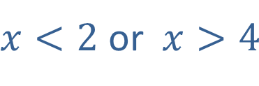
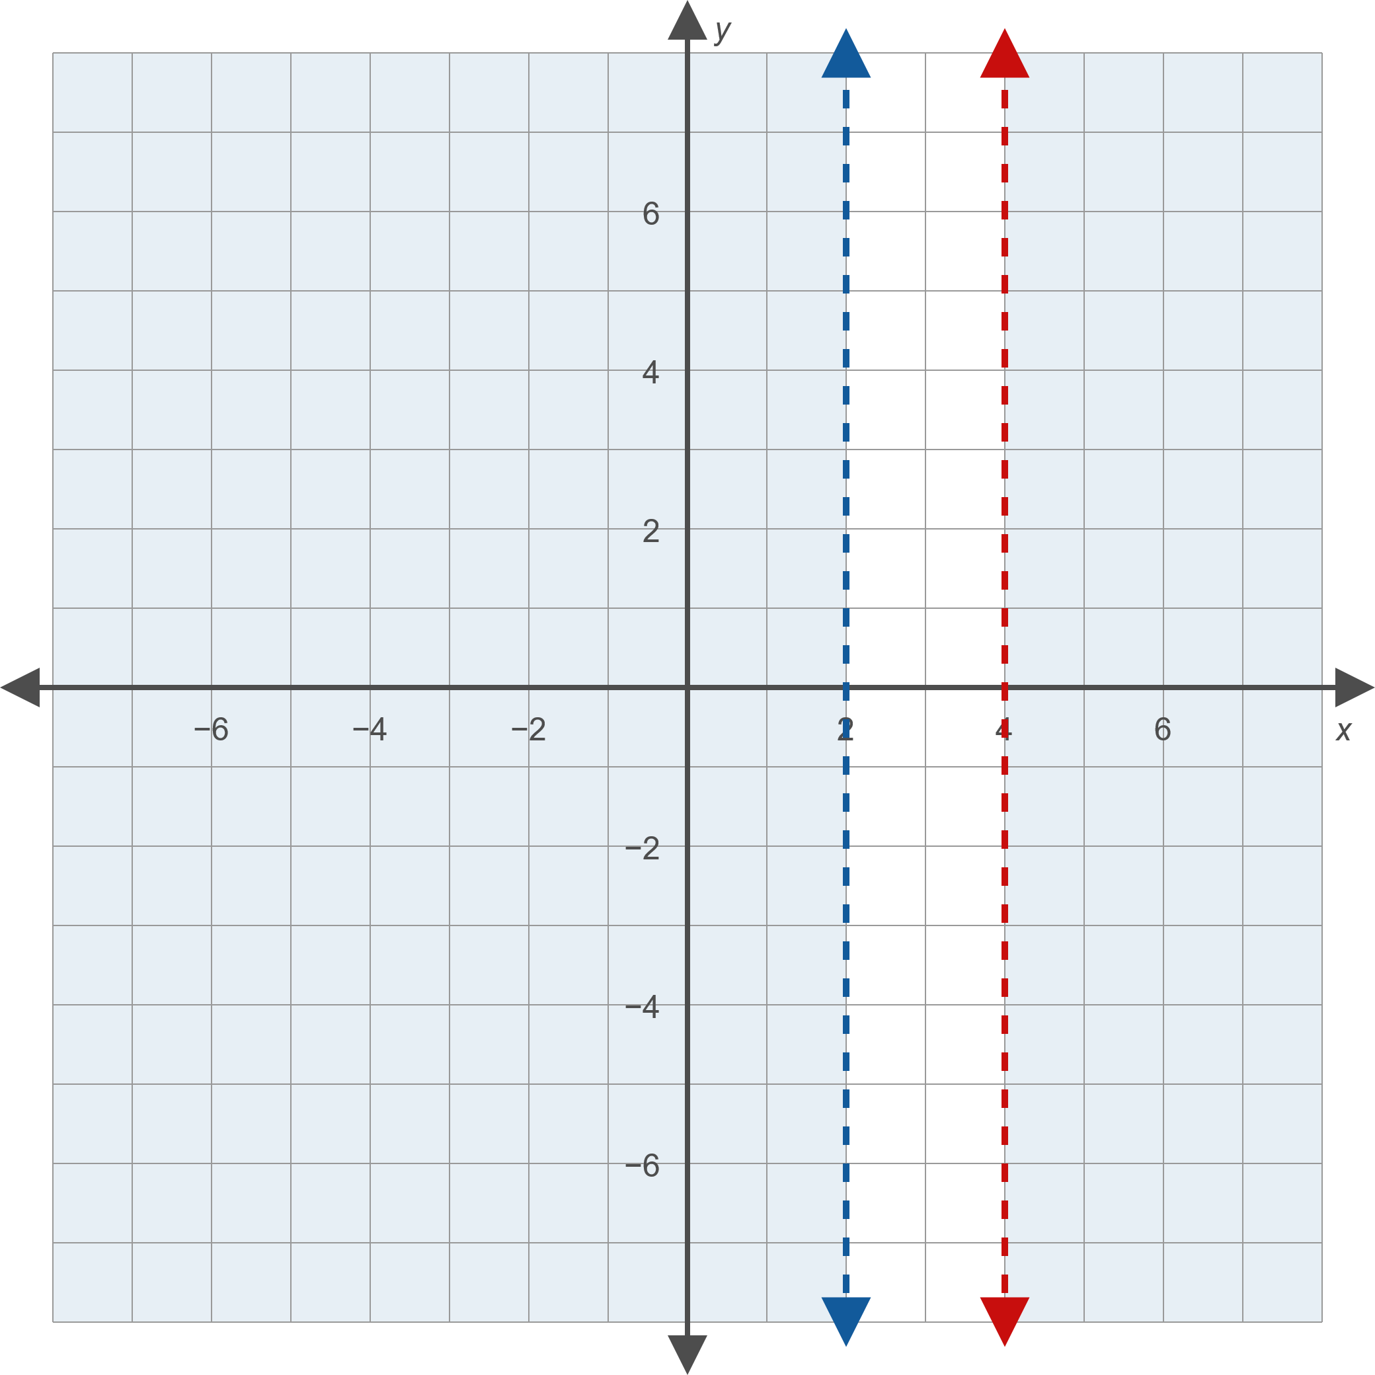
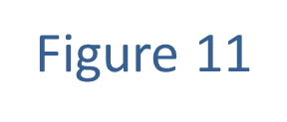
Example 3: Solving Absolute Value Linear Inequalities (cont.)

Slide 24
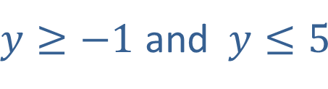
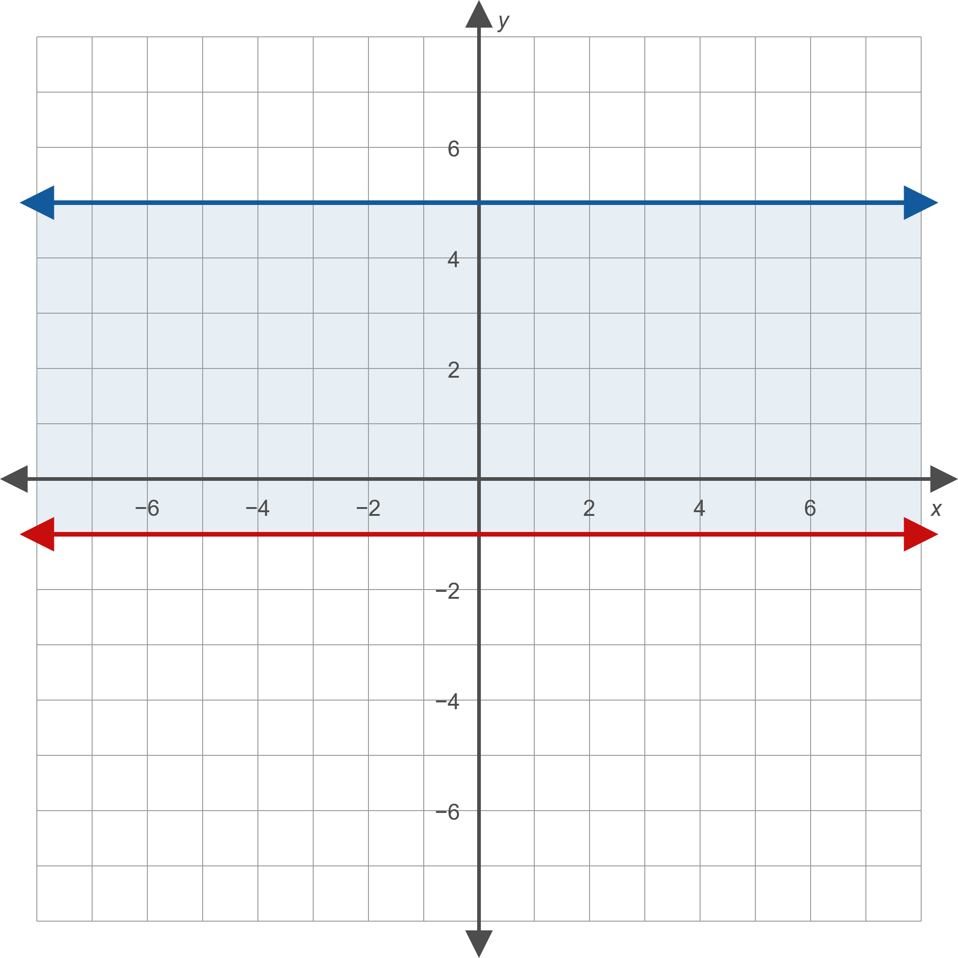
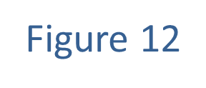
Example 3: Solving Absolute Value Linear Inequalities (cont.)

Slide 25

Example 3: Solving Absolute Value Linear Inequalities (cont.)
We now intersect the solution sets to obtain the final answer: $\left|x−3\right|>1$ and $\left|y−2\right|≤3$

Slide 26
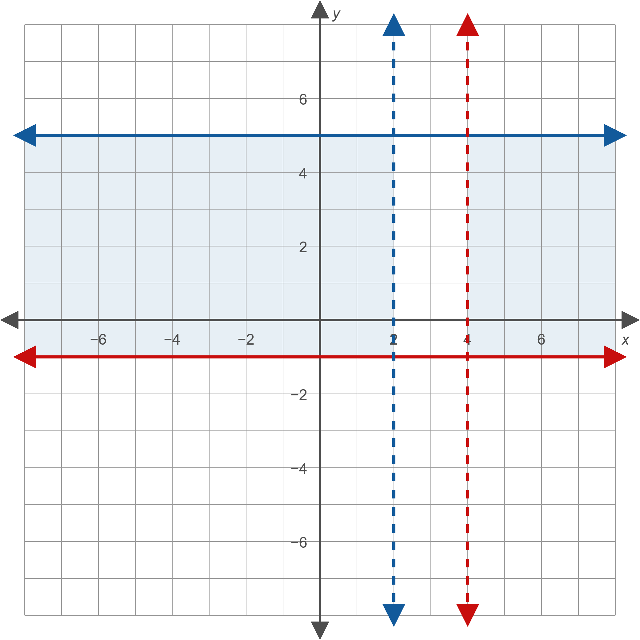
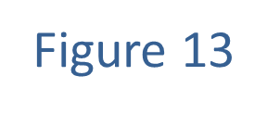
Example 3: Solving Absolute Value Linear Inequalities (cont.)

