Slide 1
Section 3.1
Relations and Functions

Slide 2
Relations, Domain, and Range
Definition
A relation is a set of ordered pairs. Any set of ordered pairs automatically relates the set of first coordinates to the set of second coordinates, and these sets have special names. The domain of a relation is the set of all the first coordinates, and the range of a relation is the set of all second coordinates.

Slide 3
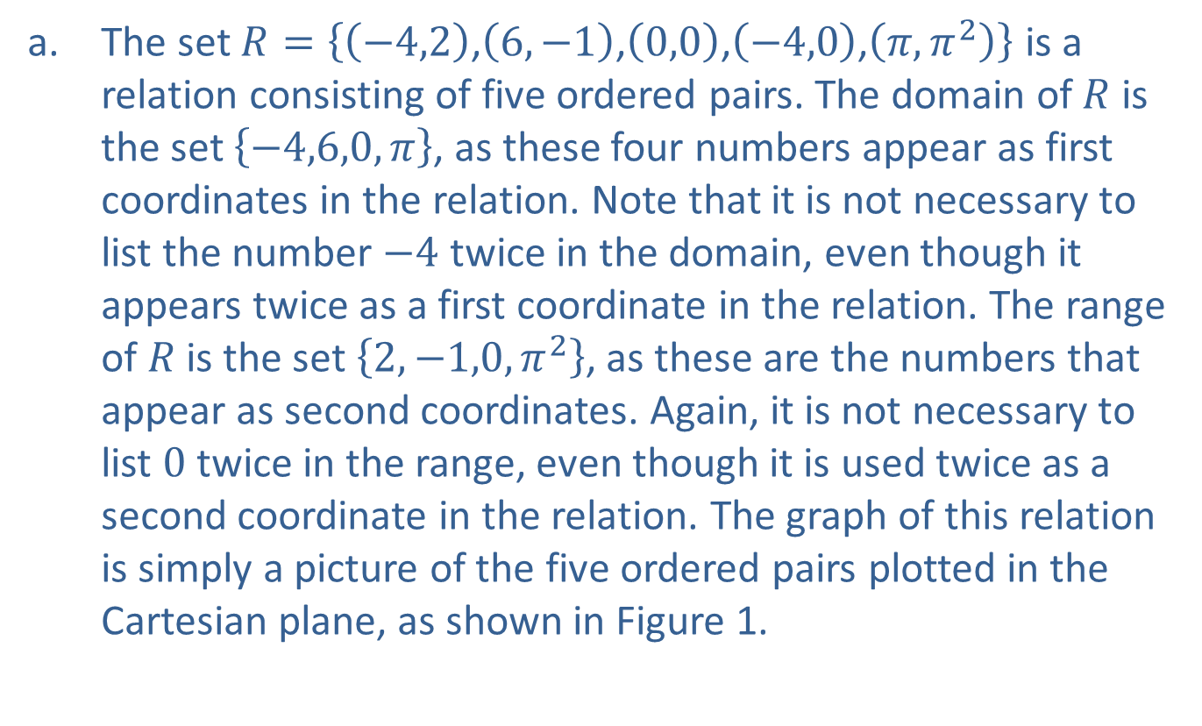
Example 1: Relations, Domain, and Range
​The set $R=\left\{\left(−4,2\right)\text{,}\left(6,−1\right)\text{,}\left(0,0\right)\text{,}\left(−4,0\right)\text{,}\left(π,π^{2}\right)\right\}$ is a relation consisting of five ordered pairs. The domain of $R$ is the set $\left\{−4,6,0,π\right\}$, as these four numbers appear as first coordinates in the relation. Note that it is not necessary to list the number $−4$ twice in the domain, even though it appears twice as a first coordinate in the relation. The range of $R$ is the set $\left\{2,−1,0,π^{2}\right\}$, as these are the numbers that appear as second coordinates. Again, it is not necessary to list 0 twice in the range, even though it is used twice as a second coordinate in the relation. The graph of this relation is simply a picture of the five ordered pairs plotted in the Cartesian plane, as shown in Figure 1.
​

Slide 4
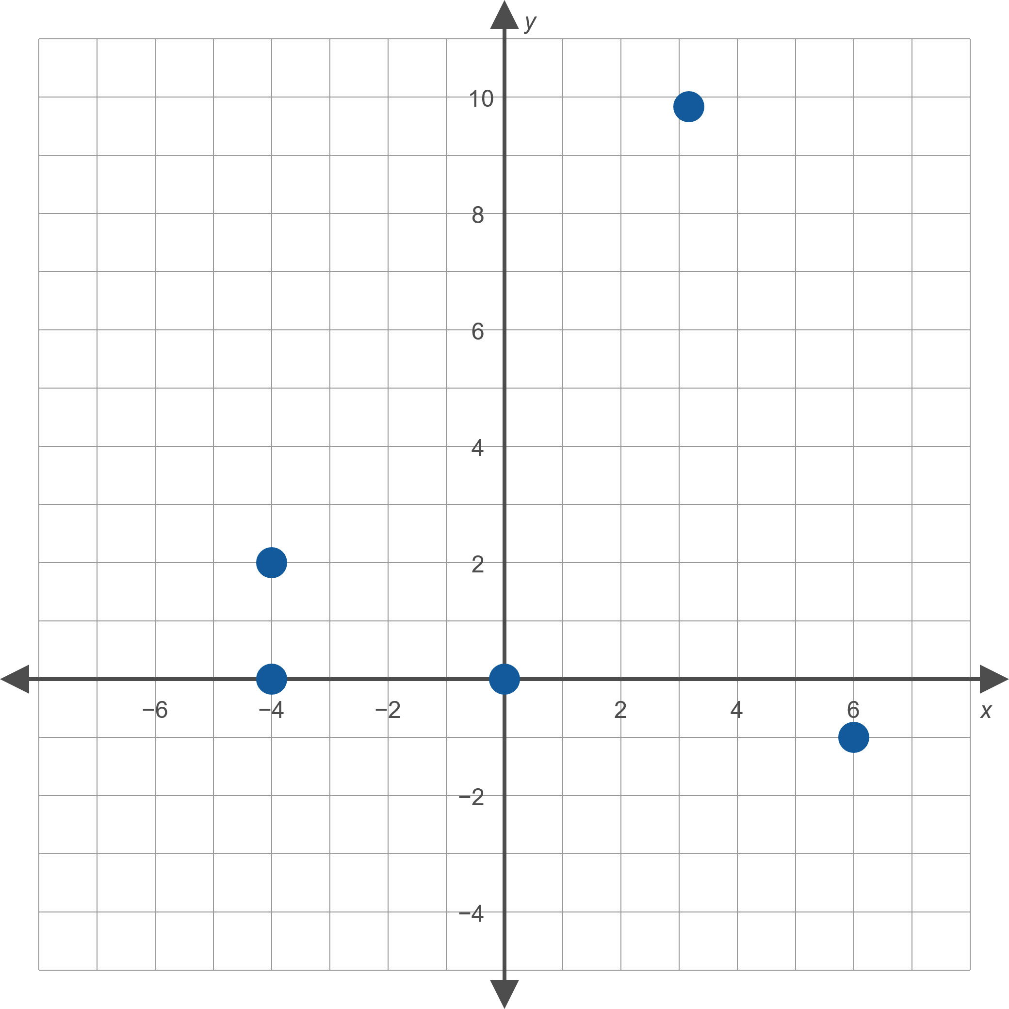
Example 1: Relations, Domain, and Range (cont.)
Figure 1

Slide 5
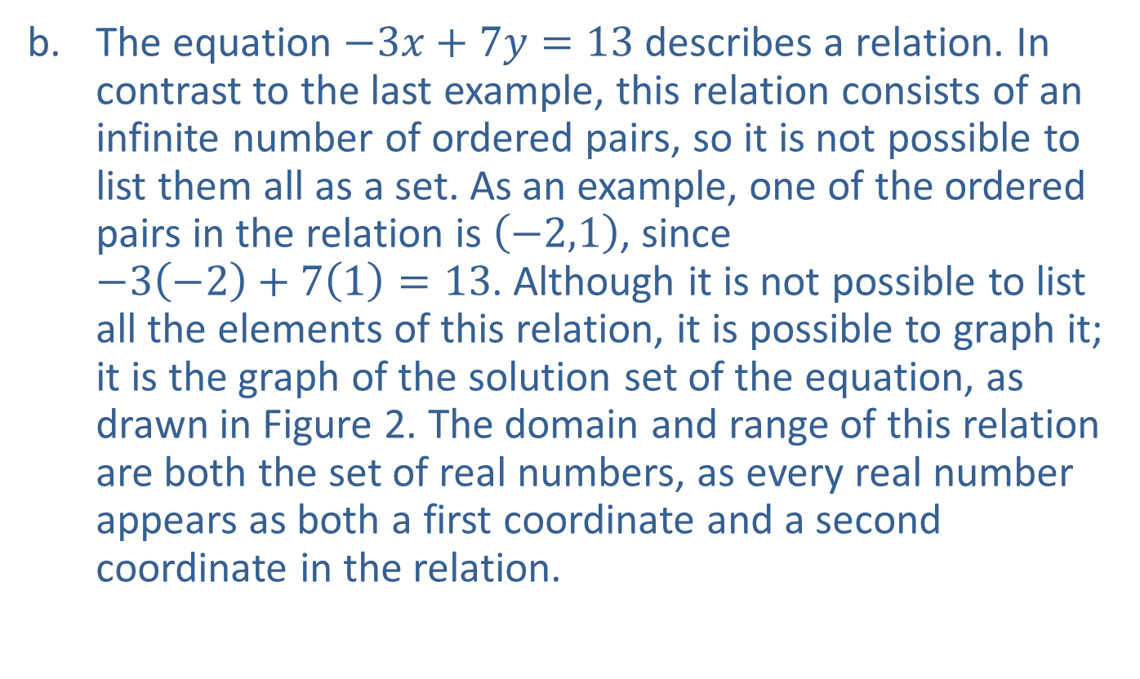
Example 1: Relations, Domain, and Range (cont.)
​The equation $−3x+7y=13$ describes a relation. In contrast to the last example, this relation consists of an infinite number of ordered pairs, so it is not possible to list them all as a set. As an example, one of the ordered pairs in the relation is $\left(−2,1\right)$, since
$−3\left(−2\right)+7\left(1\right)=13$. Although it is not possible to list all the elements of this relation, it is possible to graph it; it is the graph of the solution set of the equation, as drawn in Figure 2. The domain and range of this relation are both the set of real numbers, as every real number appears as both a first coordinate and a second coordinate in the relation.
​

Slide 6
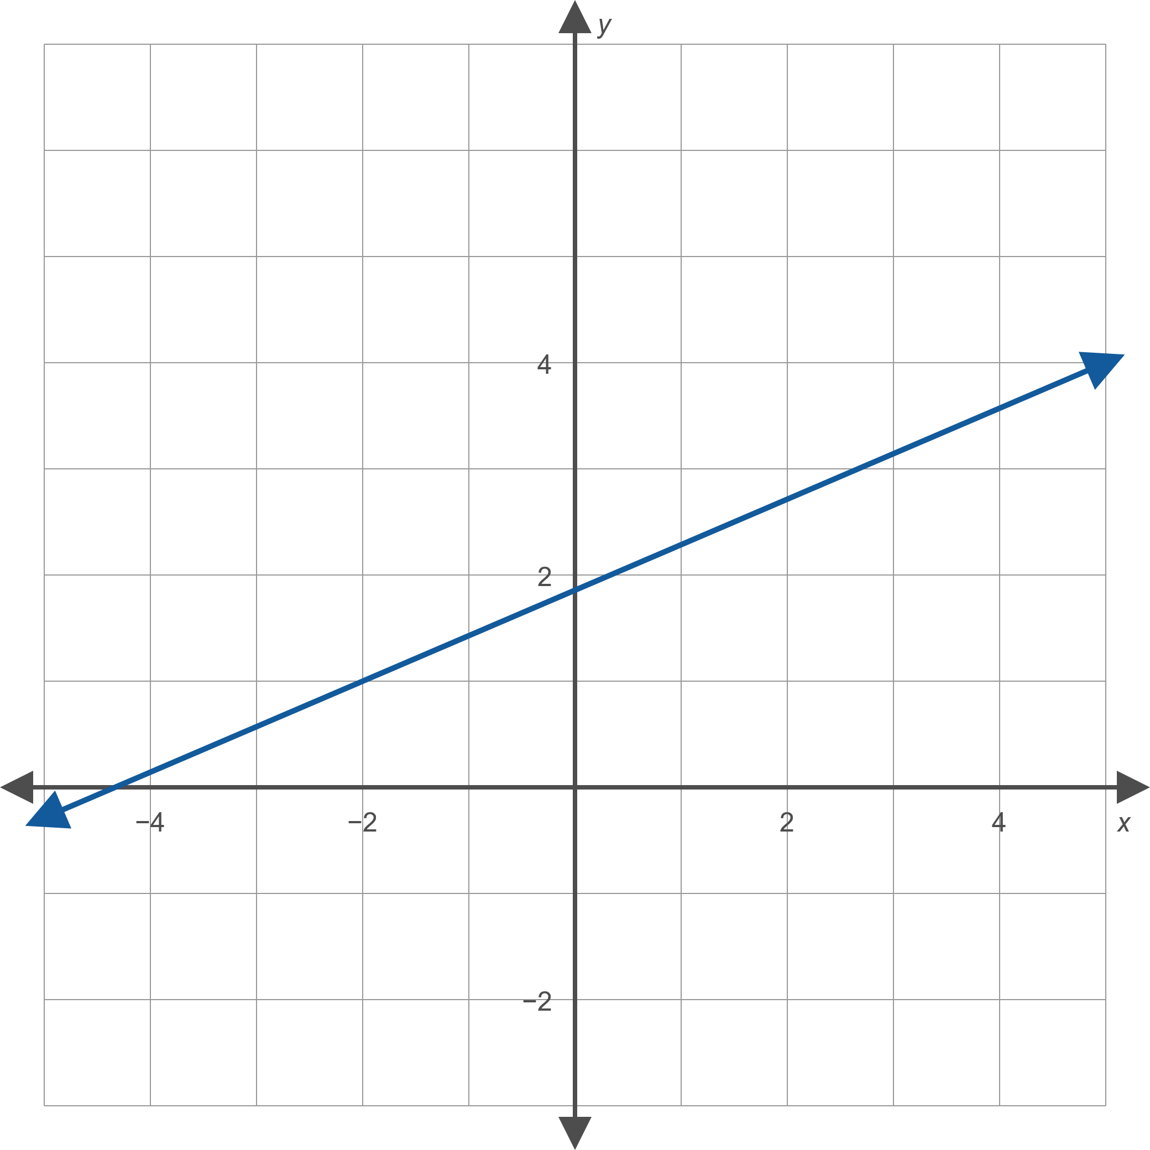
Example 1: Relations, Domain, and Range (cont.)
Figure 2

Slide 7
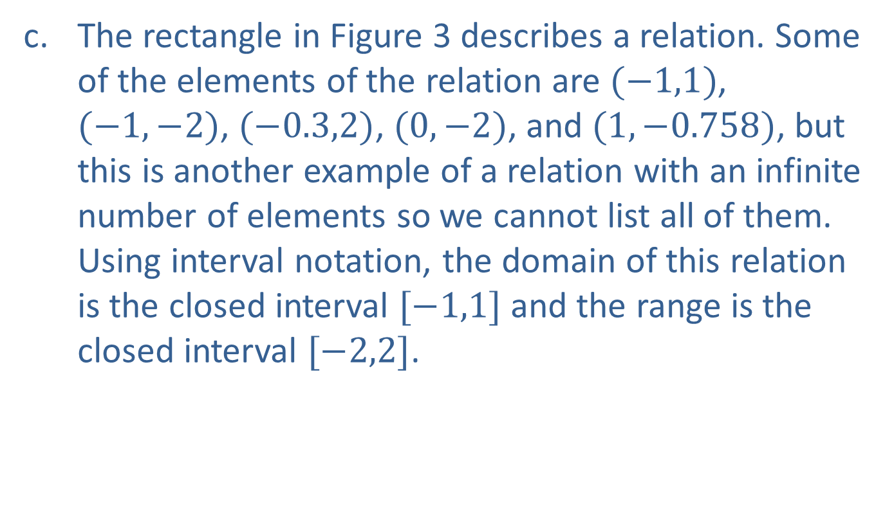
Example 1: Relations, Domain, and Range (cont.)
​The rectangle in Figure 3 describes a relation. Some of the elements of the relation are $(−1,1)$, $(−1,−2)$, $(−0.3,2)$, $(0,−2)$, and $(1,−0.758)$, but this is another example of a relation with an infinite number of elements so we cannot list all of them. Using interval notation, the domain of this relation is the closed interval $[−1,1]$ and the range is the closed interval $[−2,2]$.
​

Slide 8
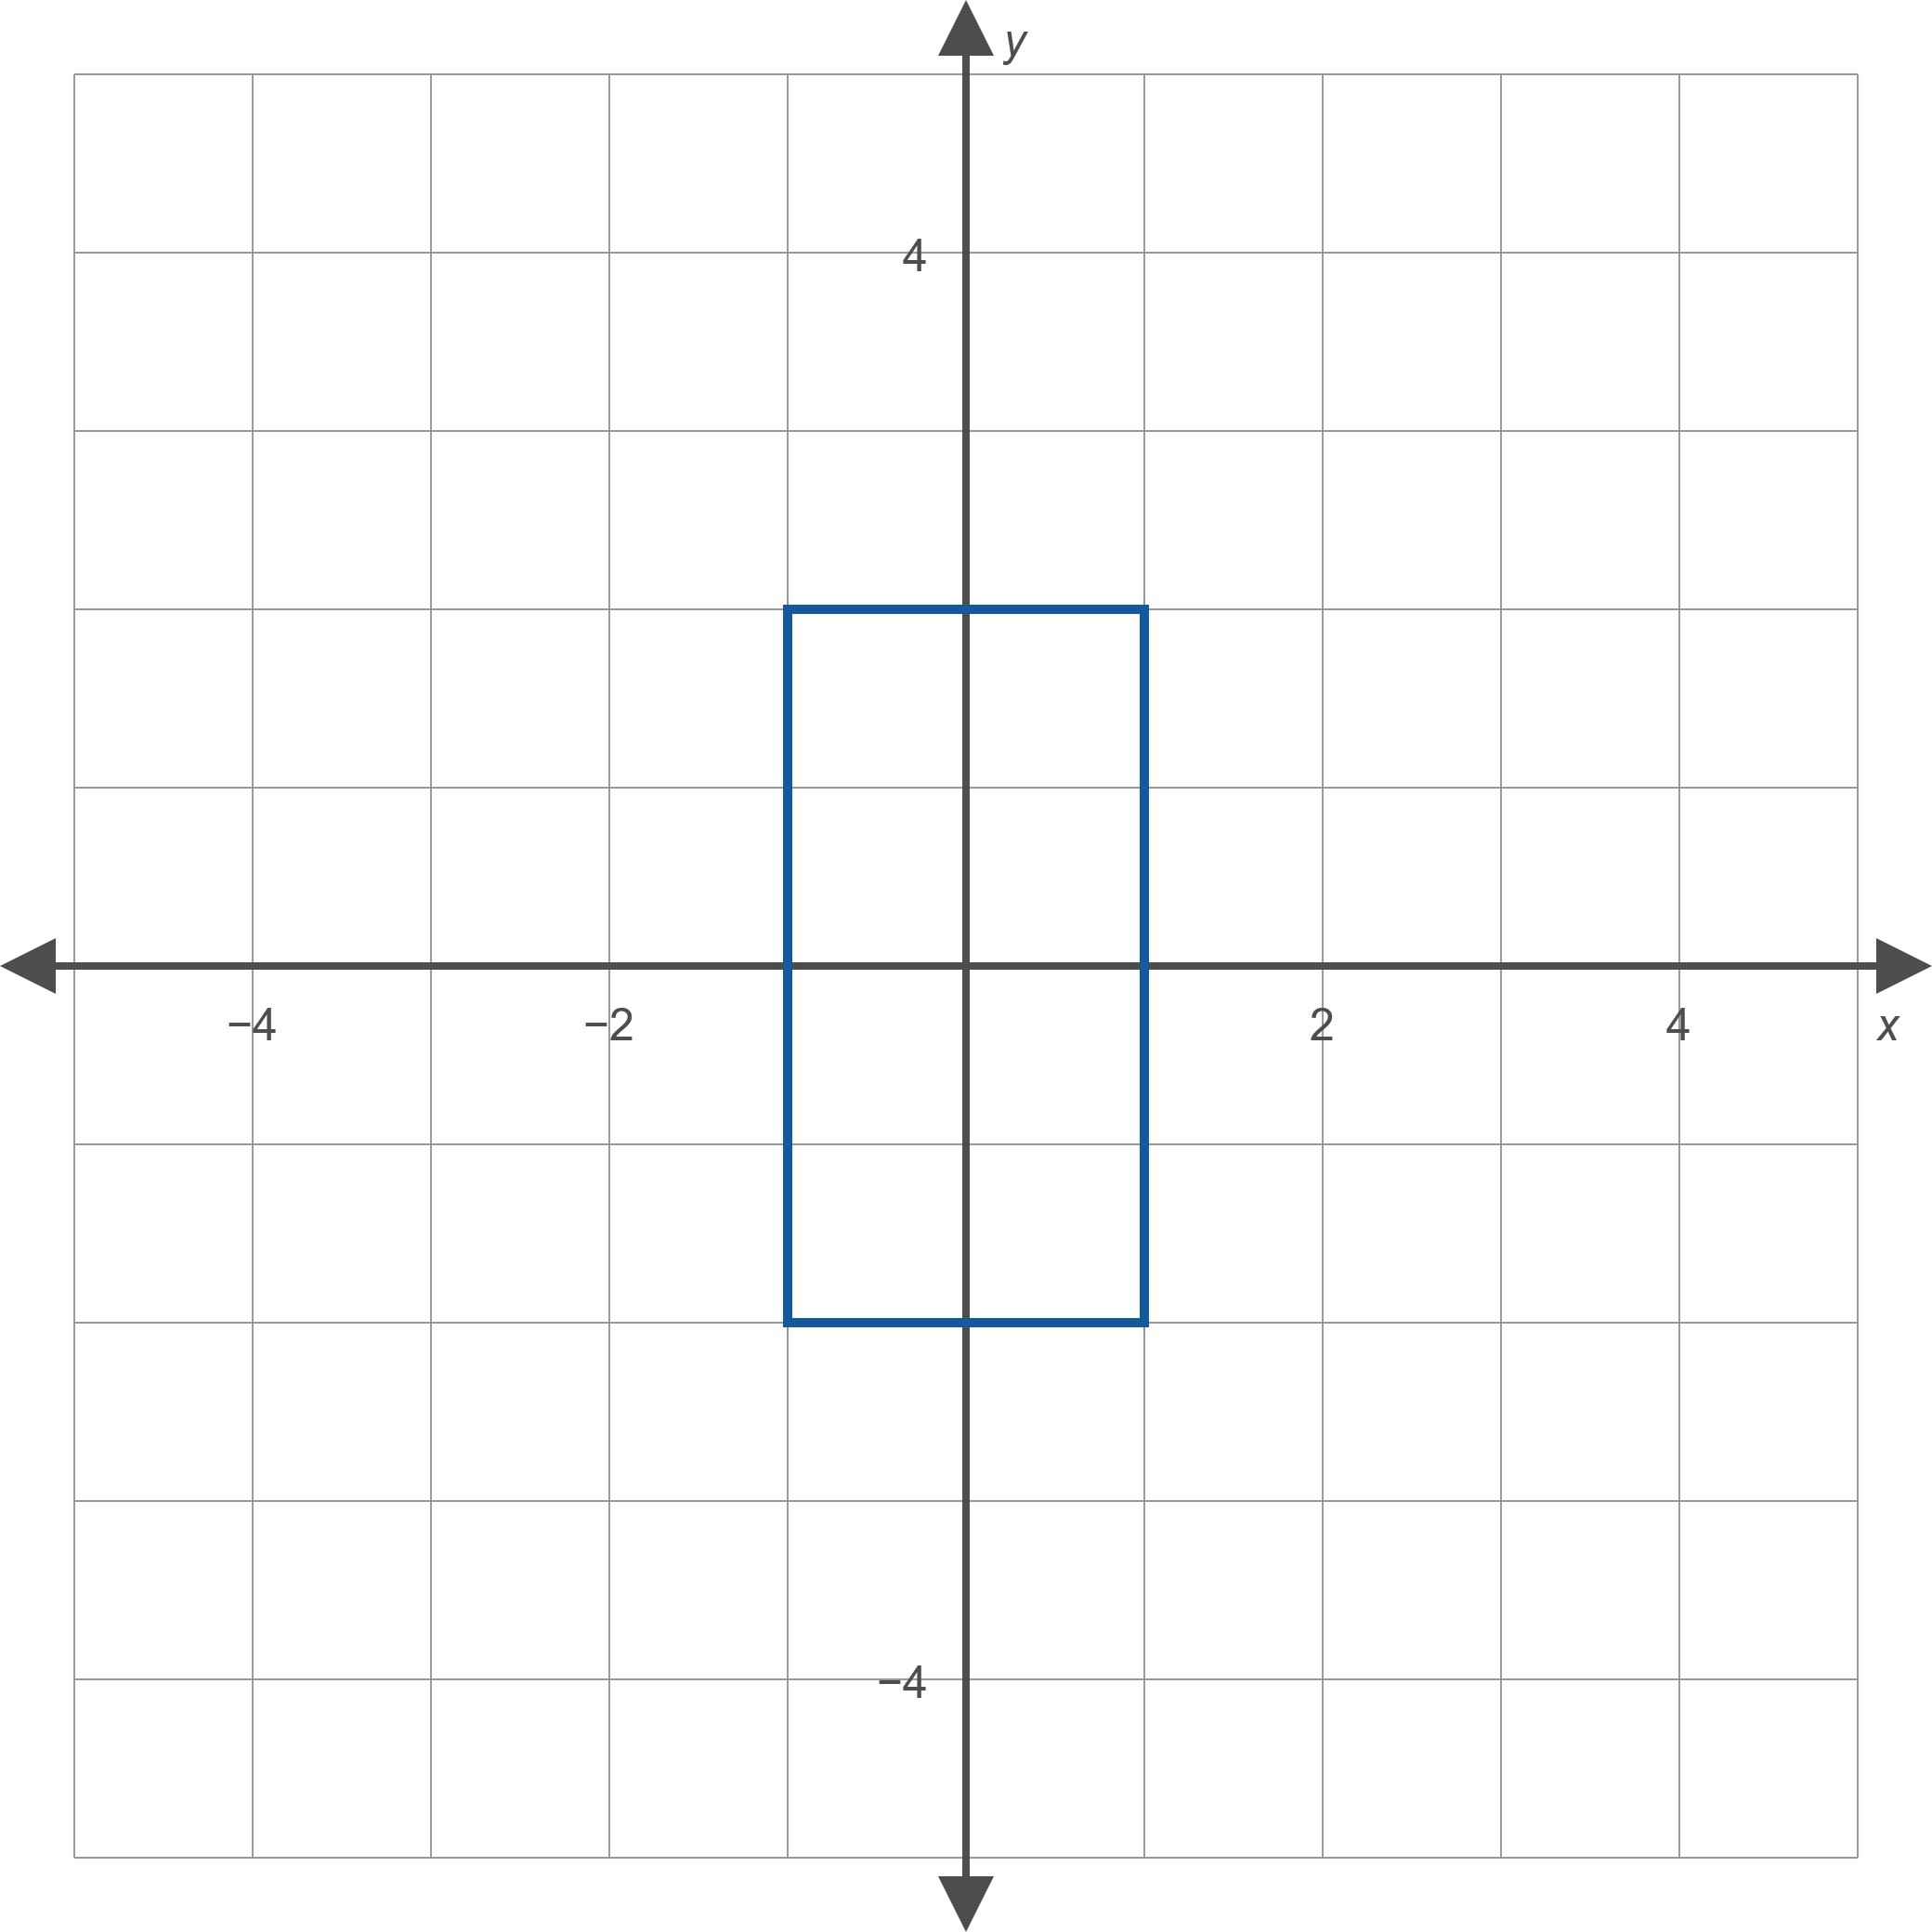
Example 1: Relations, Domain, and Range (cont.)
Figure 3

Slide 9
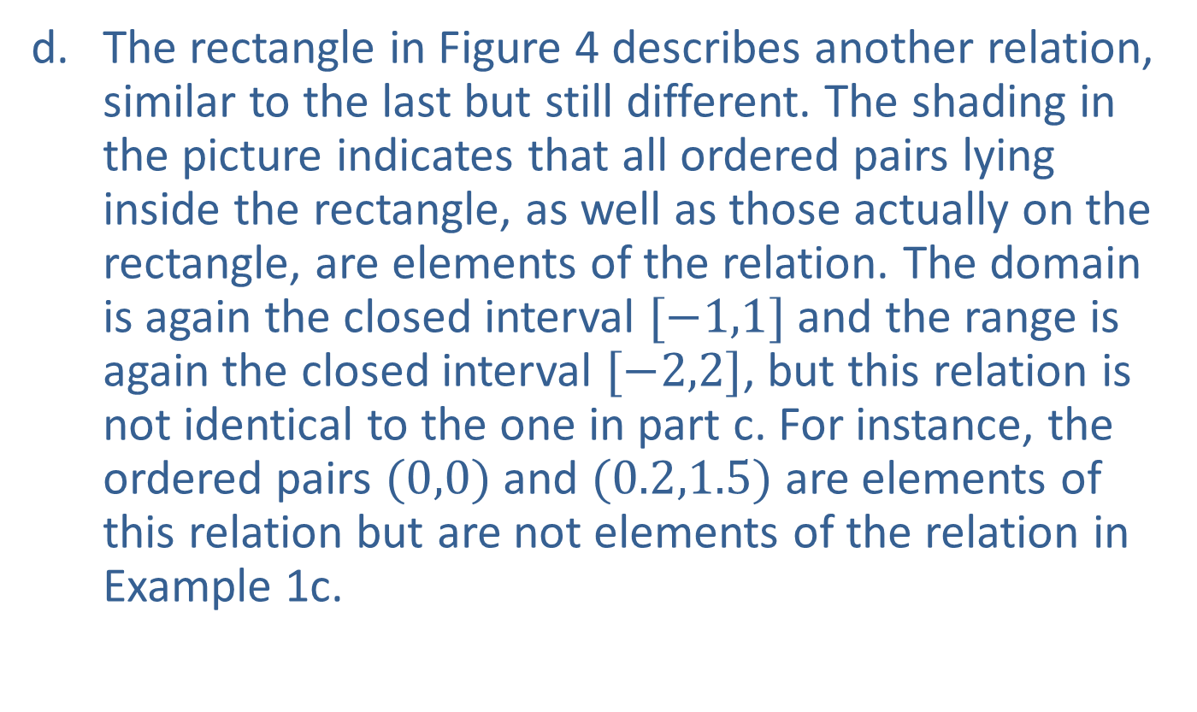
Example 1: Relations, Domain, and Range (cont.)
​The rectangle in Figure 4 describes another relation, similar to the last but still different. The shading in the picture indicates that all ordered pairs lying inside the rectangle, as well as those actually on the rectangle, are elements of the relation. The domain is again the closed interval $[−1,1]$ and the range is again the closed interval $[−2,2]$, but this relation is not identical to the one in part c. For instance, the ordered pairs $(0,0)$ and $(0.2,1.5)$ are elements of this relation but are not elements of the relation in Example 1c.
​

Slide 10
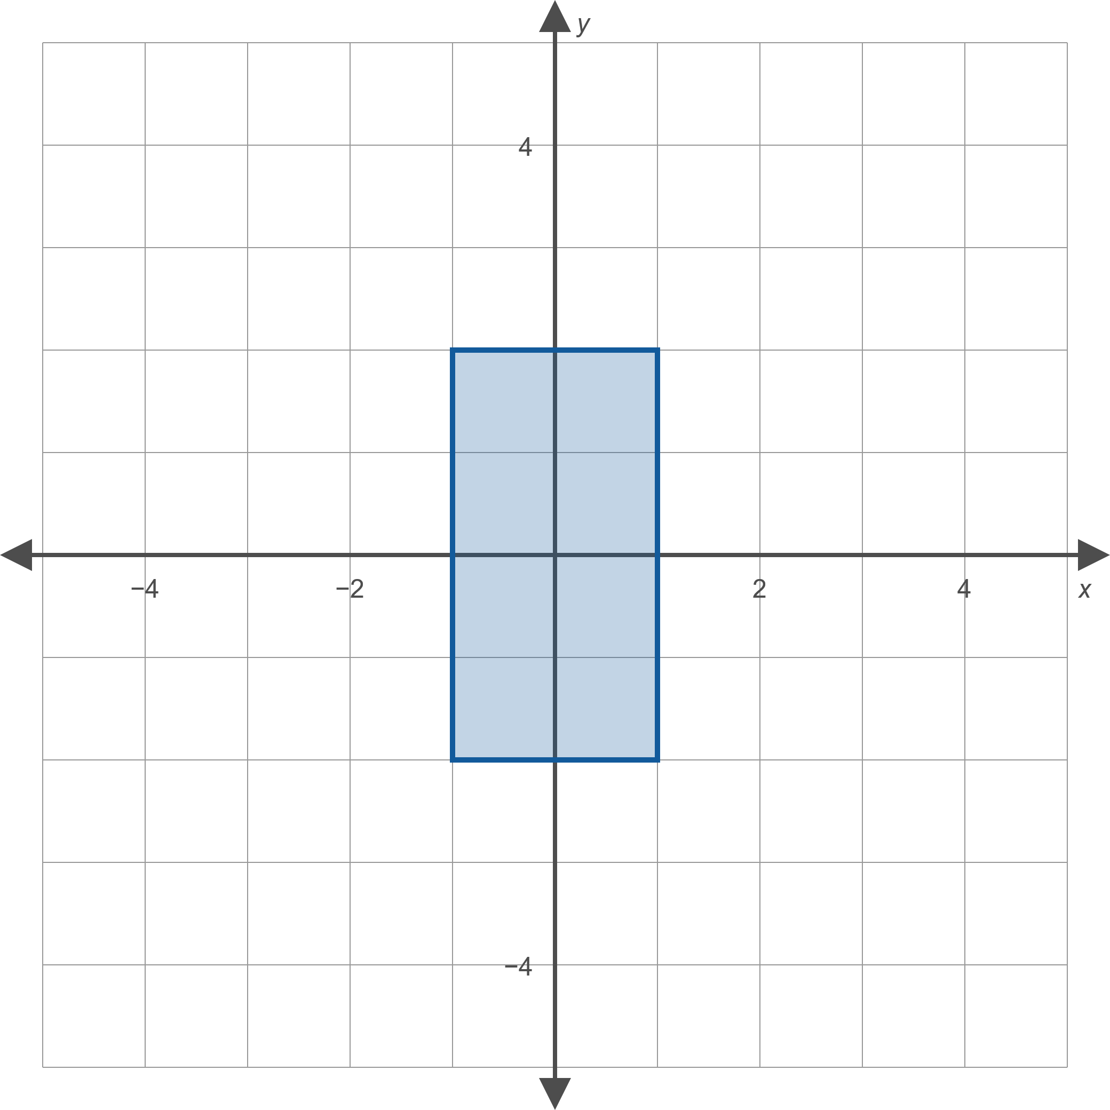
Example 1: Relations, Domain, and Range (cont.)
Figure 4

Slide 11
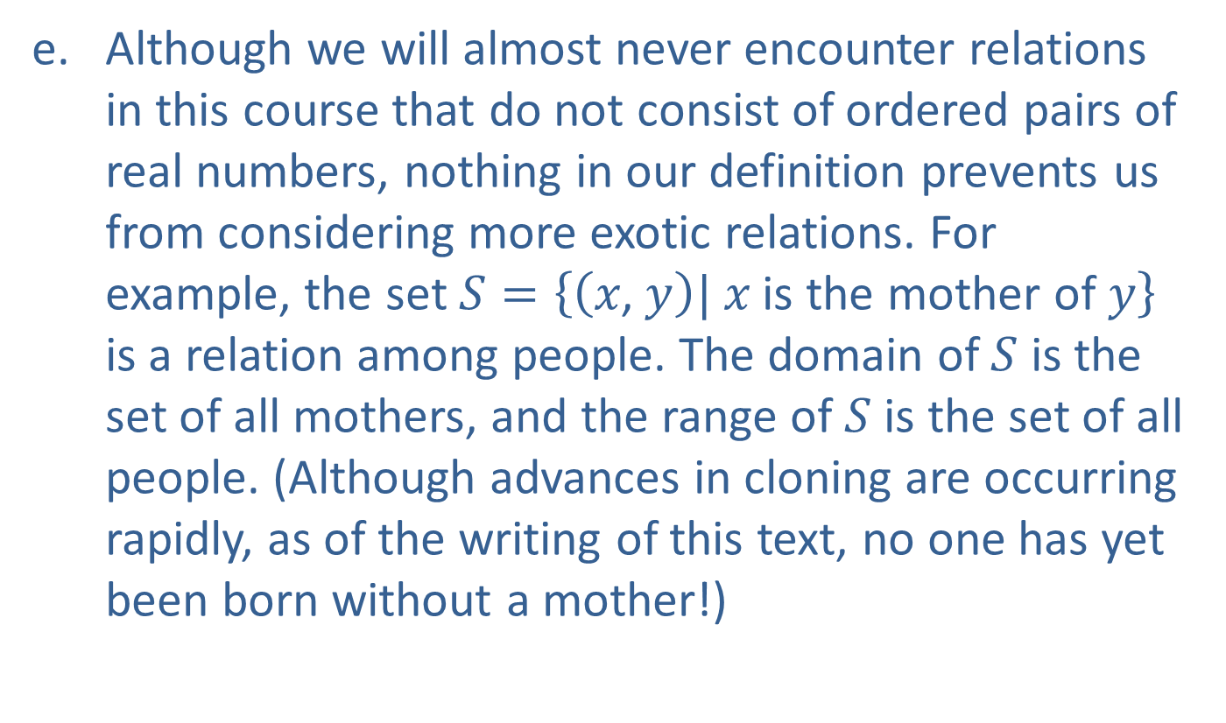
Example 1: Relations, Domain, and Range (cont.)
​Although we will almost never encounter relations in this course that do not consist of ordered pairs of real numbers, nothing in our definition prevents us from considering more exotic relations. For example, the set $S=\left\{\left(x\text{, }y\right)\text{|} x \text{is} \text{the} \text{mother} \text{of} y\right\}$ is a relation among people. The domain of $S$ is the set of all mothers, and the range of $S$ is the set of all people. (Although advances in cloning are occurring rapidly, as of the writing of this text, no one has yet been born without a mother!)

Slide 12
Function
Definition
A function is a relation in which every element of the domain is paired with exactly one element of the range. Equivalently, a function is a relation in which no two distinct ordered pairs have the same first coordinate.

Slide 13
Example 2: Is the Relation a Function?
For each relation in Example 1, identify whether the relation is also a function.

Slide 14
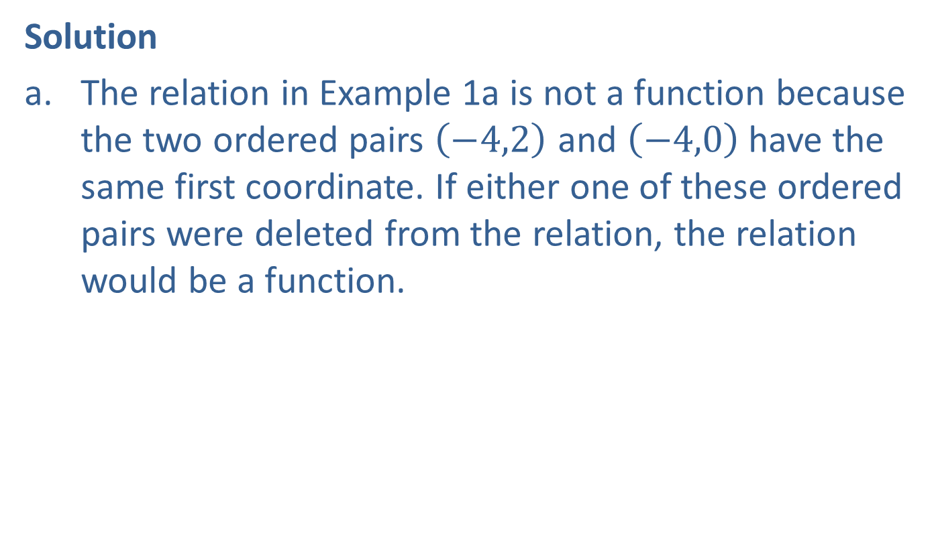
Example 2: Is the Relation a Function? (cont.)
Solution
​The relation in Example 1a is not a function because the two ordered pairs $\left(−4,2\right)$ and $\left(−4,0\right)$ have the same first coordinate. If either one of these ordered pairs were deleted from the relation, the relation would be a function.
​

Slide 15
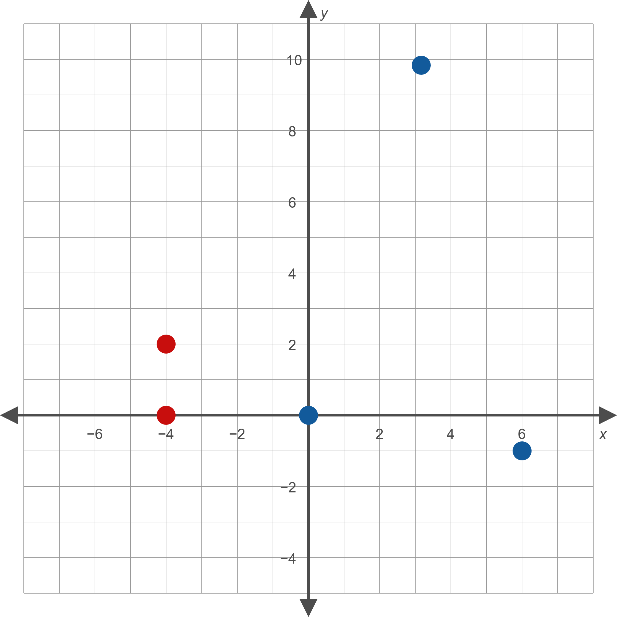
Example 2: Is the Relation a Function? (cont.)
Figure 6

Slide 16
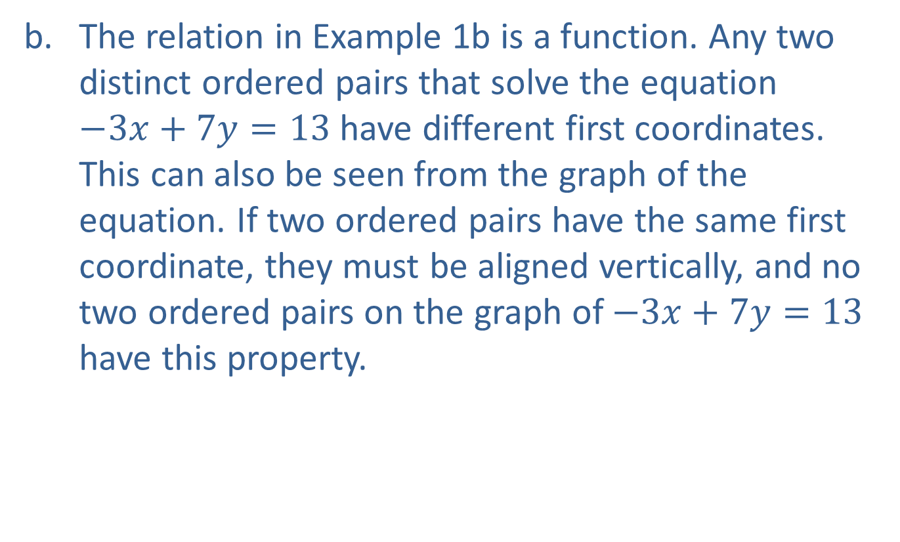
Example 2: Is the Relation a Function? (cont.)
​The relation in Example 1b is a function. Any two distinct ordered pairs that solve the equation
$−3x+7y=13$ have different first coordinates. This can also be seen from the graph of the equation. If two ordered pairs have the same first coordinate, they must be aligned vertically, and no two ordered pairs on the graph of $−3x+7y=13$ have this property.
​

Slide 17
Example 2: Is the Relation a Function? (cont.)
Figure 7

Slide 18

Example 2: Is the Relation a Function? (cont.)
​The relation in Example 1c is not a function. To prove that a relation is not a function, it is only necessary to find two ordered pairs with the same first coordinate, and the pairs $\left(0,2\right)$ and $\left(0,−2\right)$ show that this relation fails to be a function.
​

Slide 19

Example 2: Is the Relation a Function? (cont.)
Figure 8

Slide 20
Example 2: Is the Relation a Function? (cont.)
​The relation in Example 1d is also not a function. In fact, we can use the same two ordered pairs as in the previous part to prove this fact.
​Finally, the relation in Example 1e also fails to be a function. Think of two people who have the same mother; this gives us two ordered pairs with the same first coordinate: (mother, child 1) and (mother, child 2). Thus, the relation is not a function.

Slide 21
The Vertical Line Test
Theorem
If a relation can be graphed in the Cartesian plane, the relation is a function if and only if no vertical line passes through the graph more than once. If even one vertical line intersects the graph of the relation two or more times, the relation fails to be a function.

Slide 22
CAUTION!
Note that vertical lines that miss the graph of a relation entirely don’t prevent the relation from being a function; it is only the presence of a vertical line that hits the graph two or more times that indicates the relation isn’t a function.

Slide 23

Example 3: Functions and the Vertical Line Test
​The relation
$R=\left\{\left(−3,2 )\text{,}(−1,0)\text{,}(0,2)\text{,}(2,−4)\text{,}(4,0\right)\right\}$,
graphed in Figure 9, is a function. Any given vertical line in the plane either intersects the graph once or not at all.
​

Slide 24
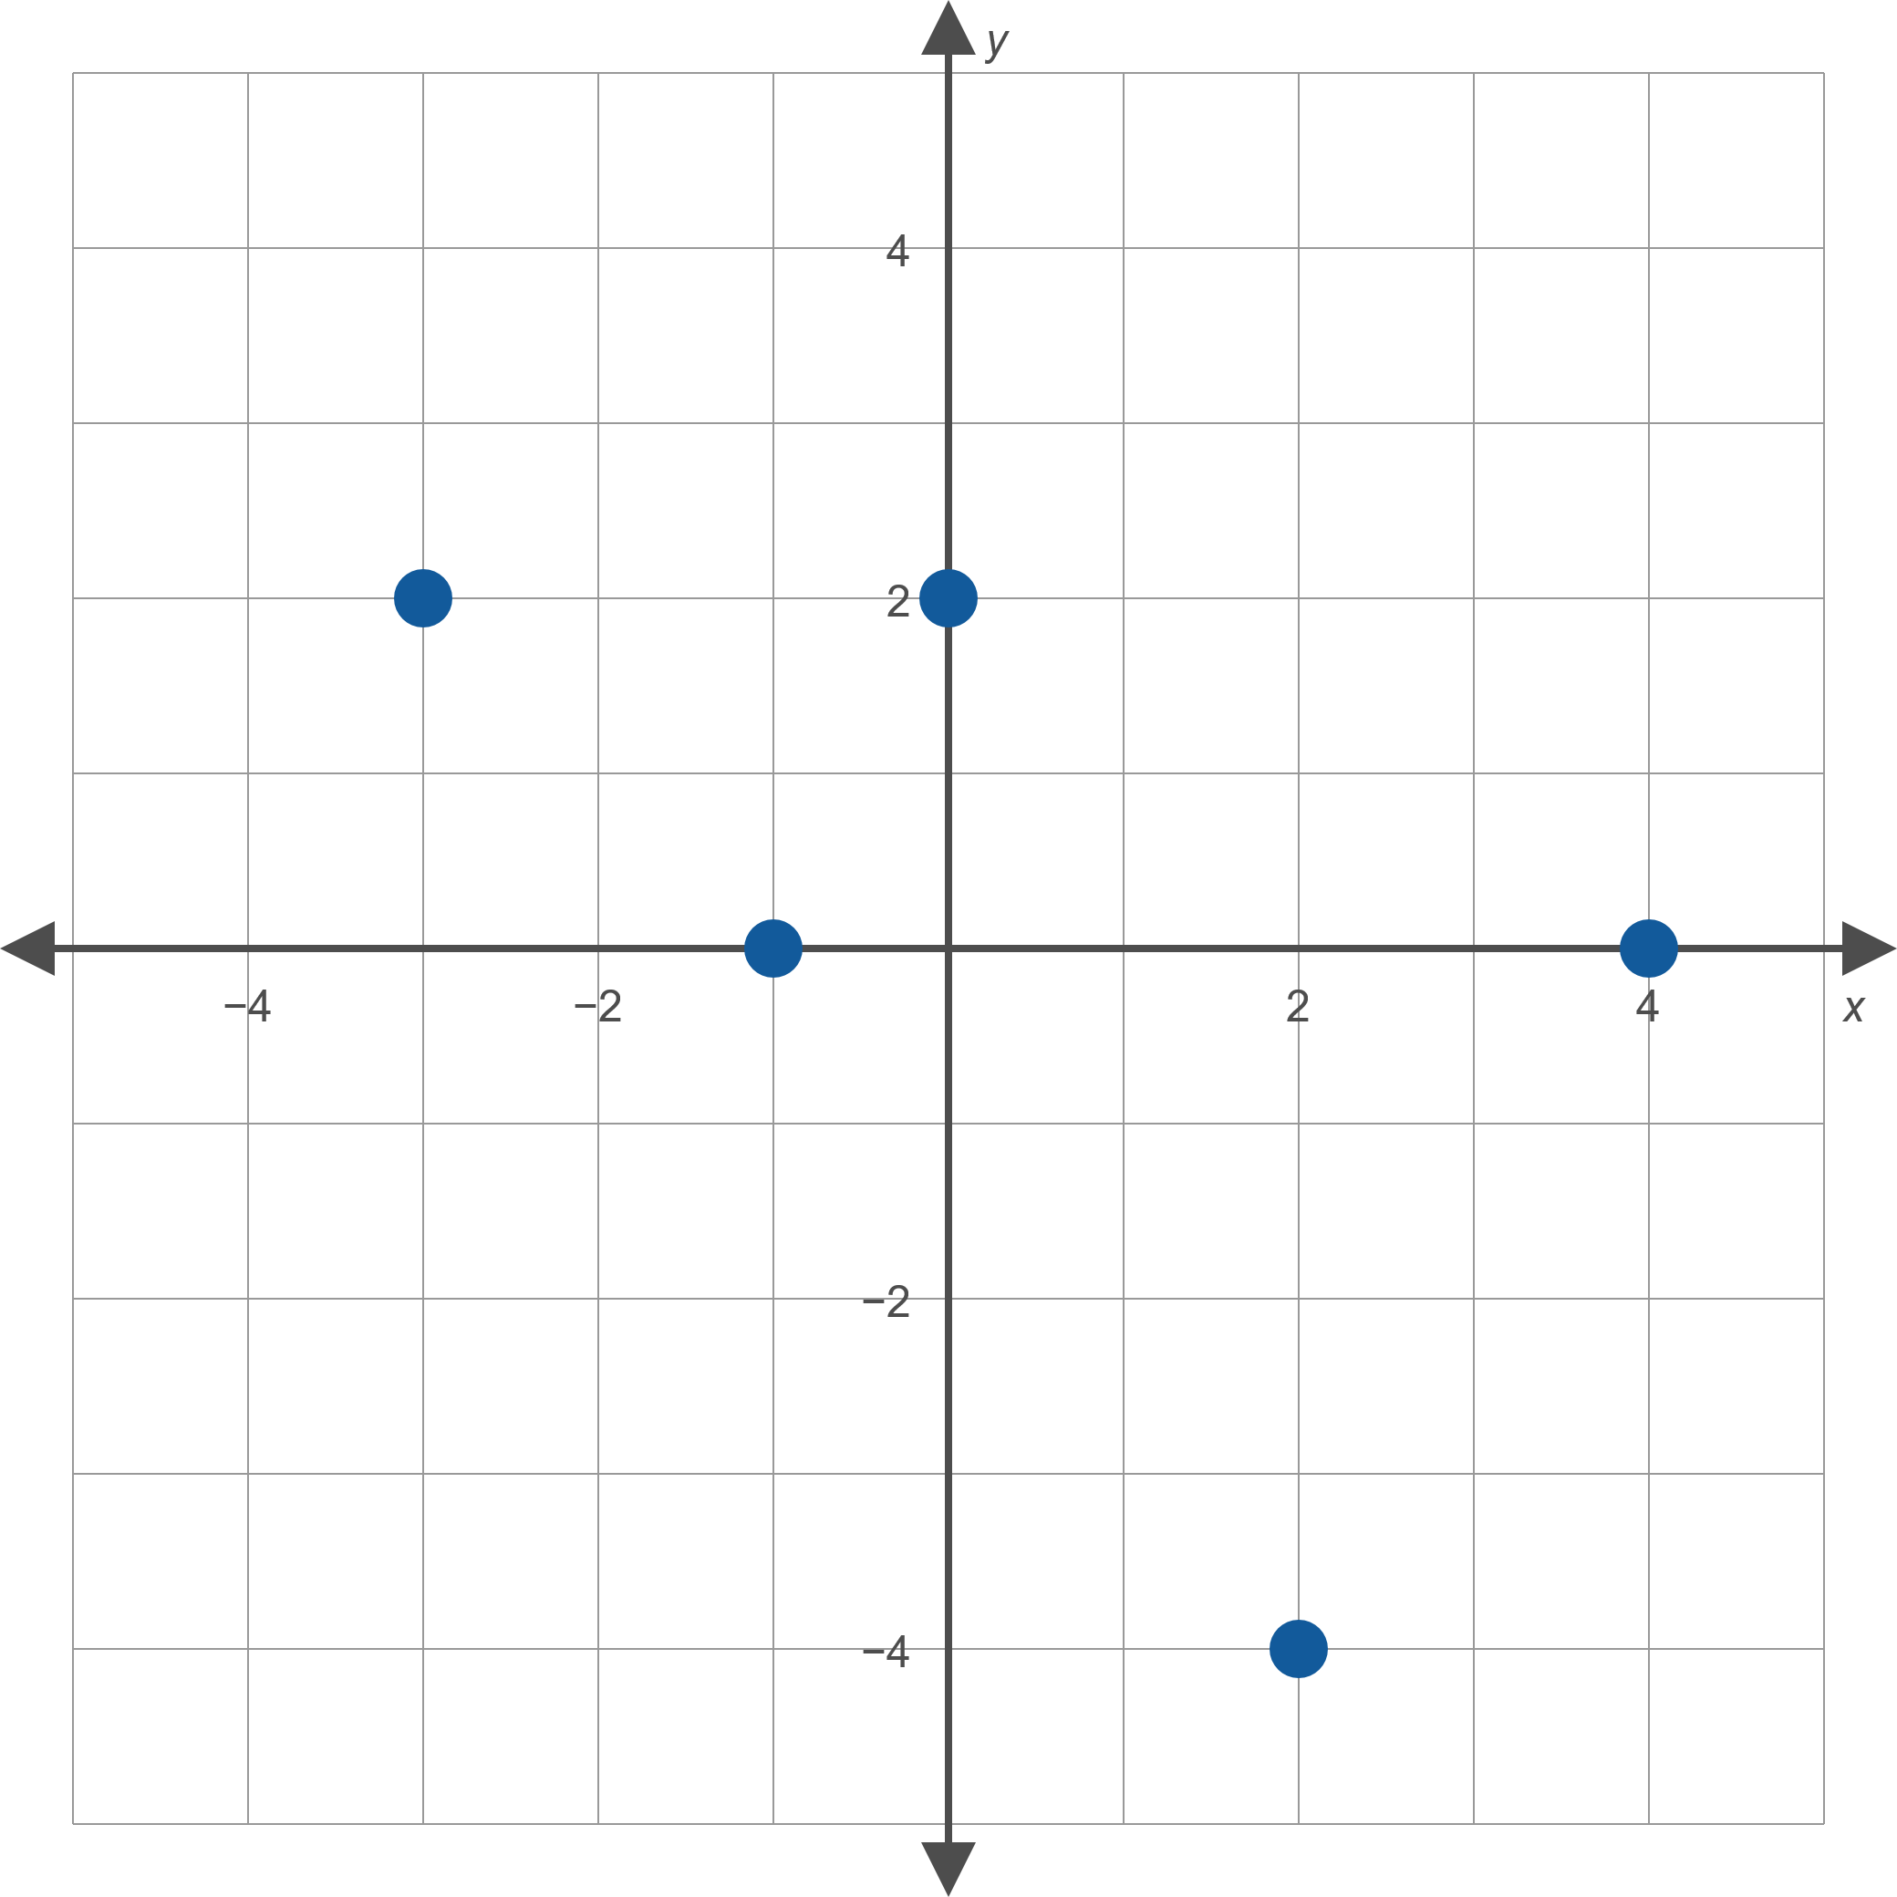
Example 3: Functions and the Vertical Line Test (cont.)
Figure 9

Slide 25
Example 3: Functions and the Vertical Line Test (cont.)
​The relation graphed in Figure 10 is not a function, as there are many vertical lines that intersect the graph more than once. The dashed line is one such vertical line.
​

Slide 26
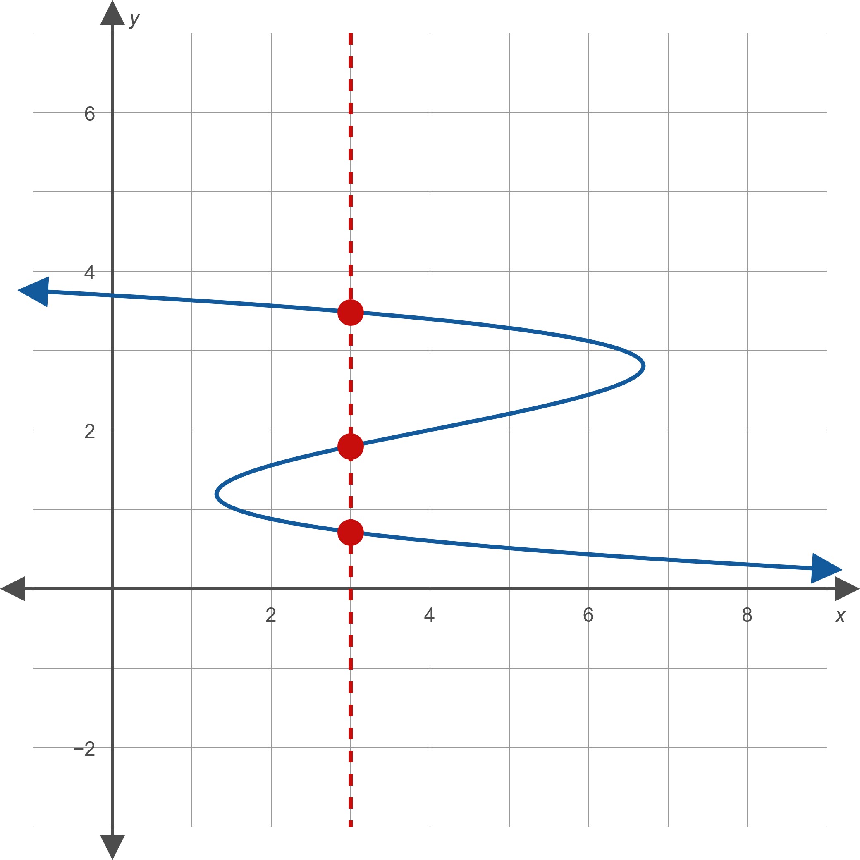
Example 3: Functions and the Vertical Line Test (cont.)
Figure 10

Slide 27
Example 3: Functions and the Vertical Line Test (cont.)
​The relation graphed in Figure 11 is a function. In this case, every vertical line in the plane intersects the graph exactly once.
​

Slide 28
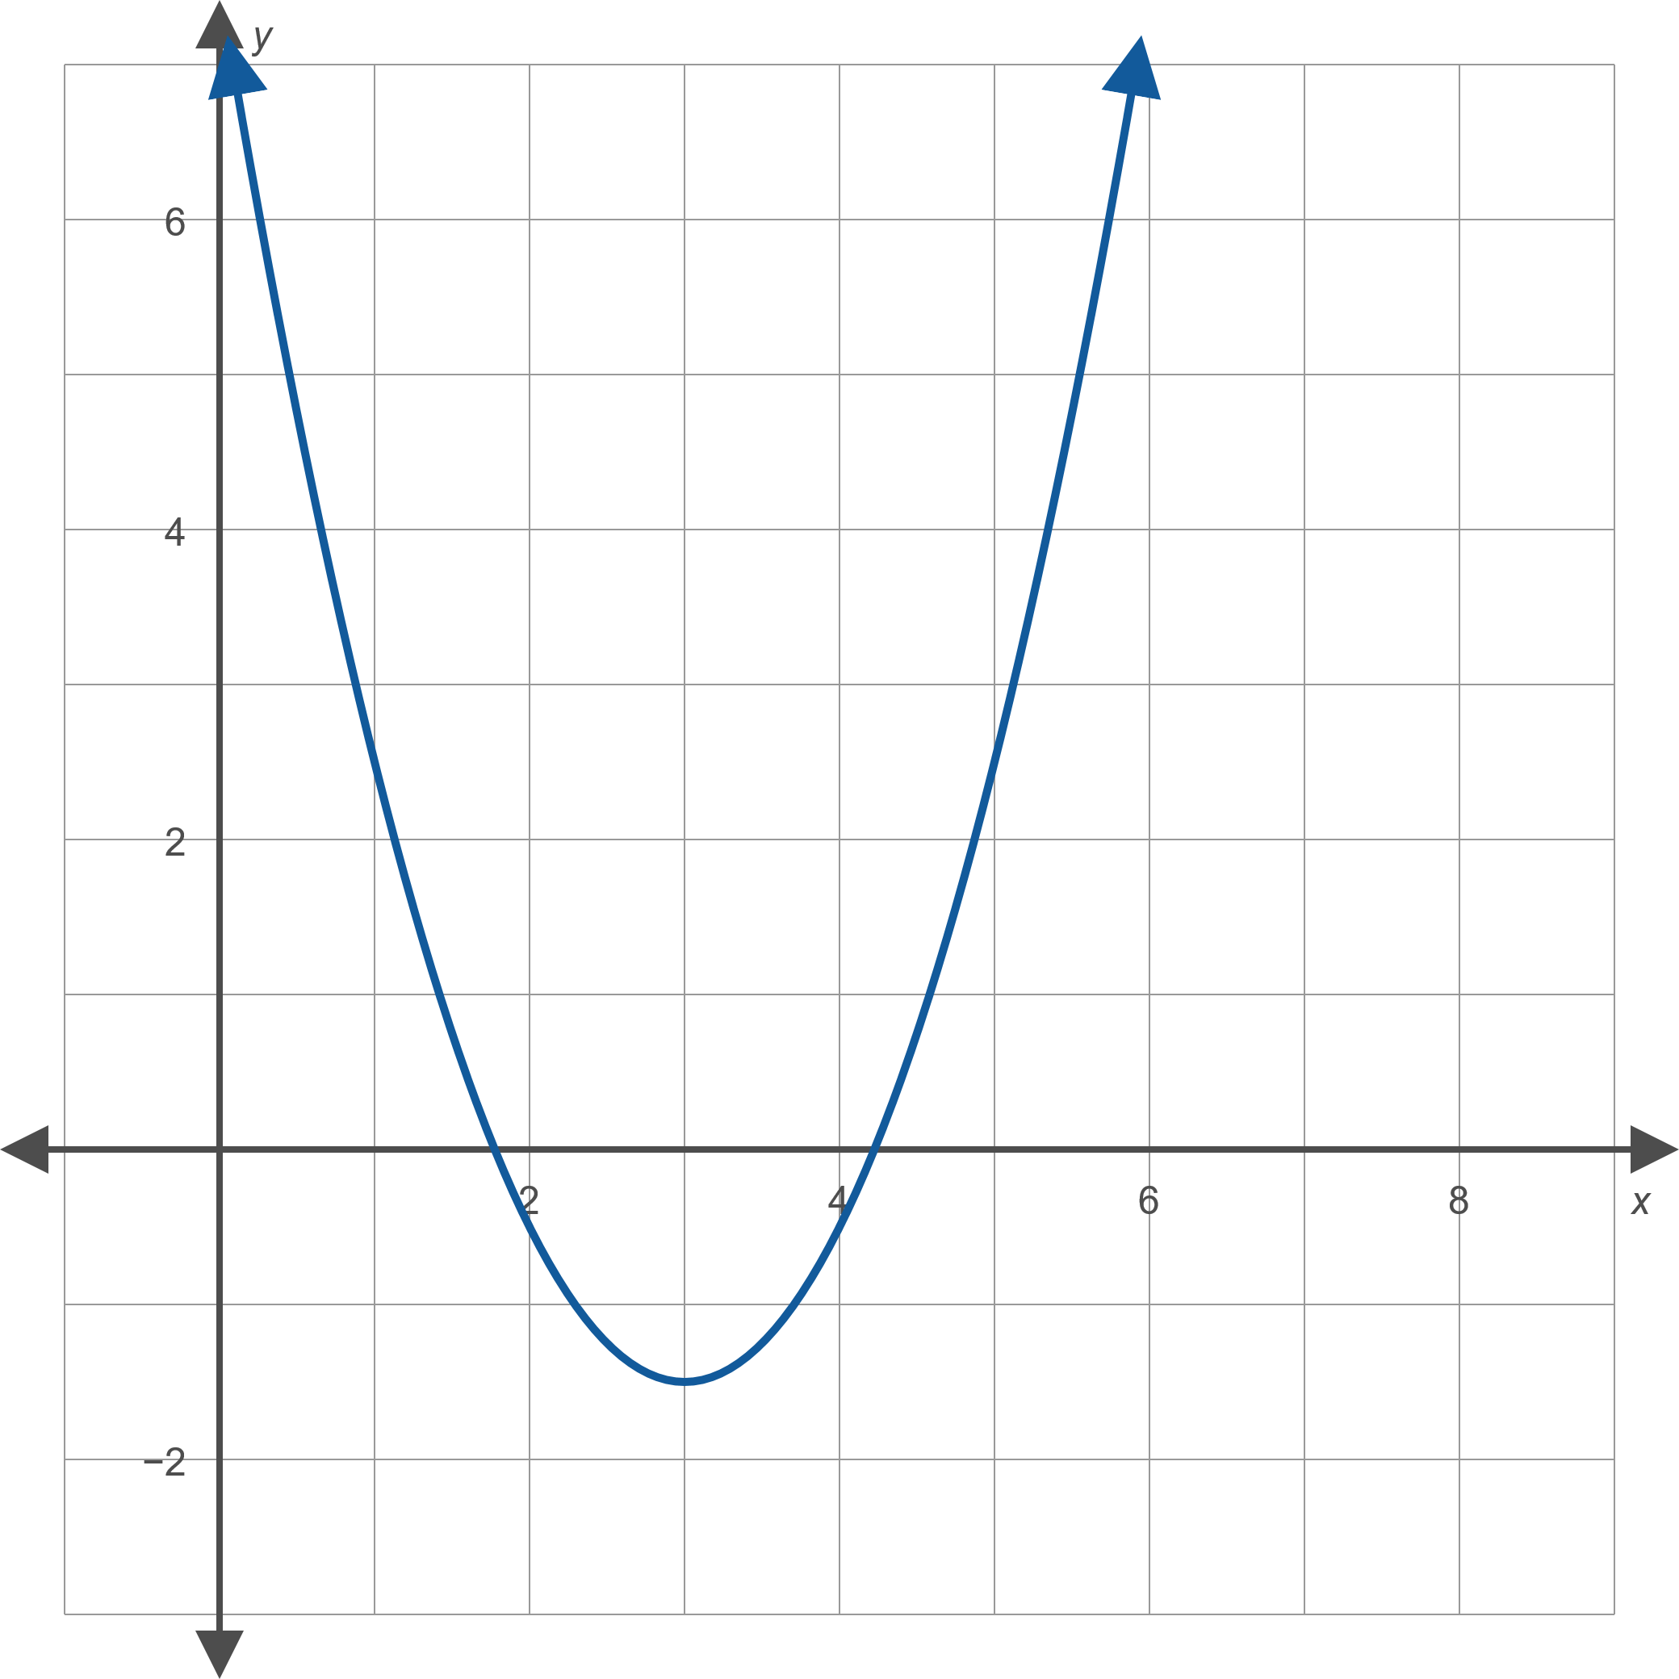
Example 3: Functions and the Vertical Line Test (cont.)
Figure 11

Slide 29
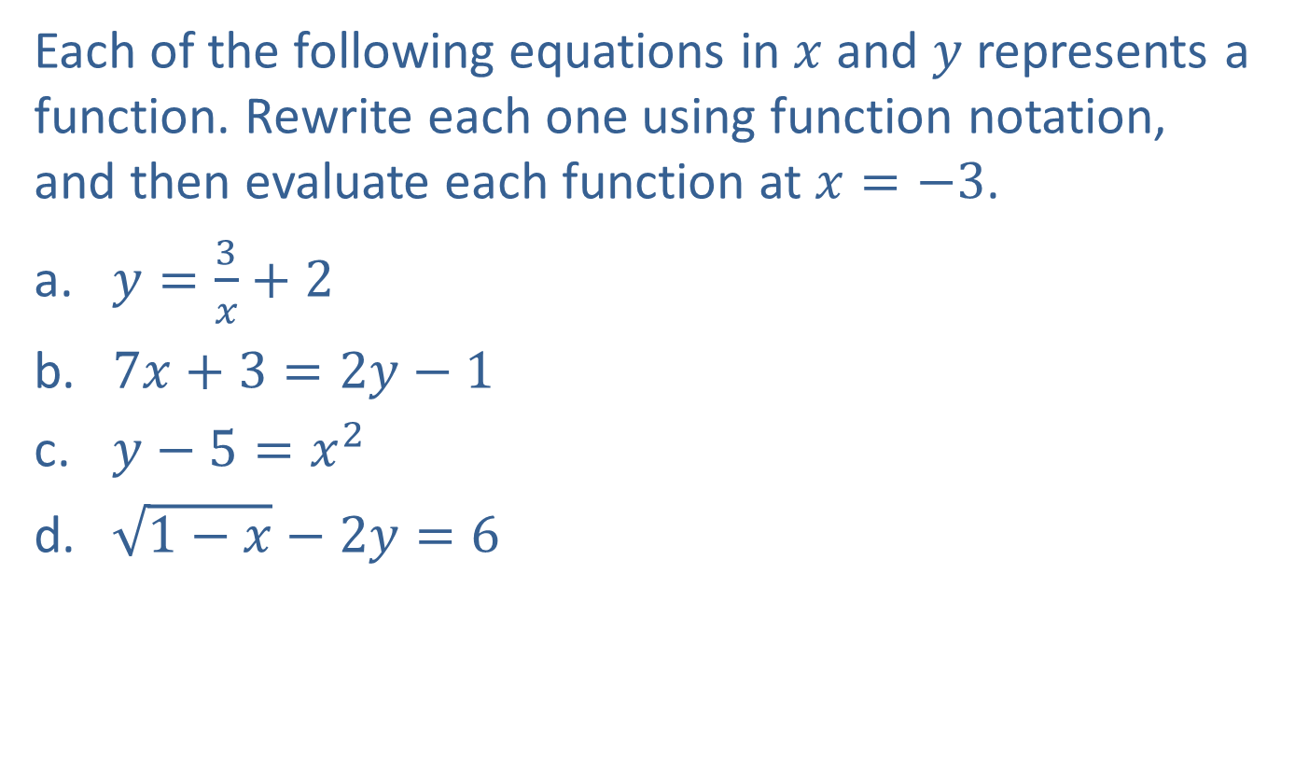
Example 4: Function Notation
Each of the following equations in $x$ and $y$ represents a function. Rewrite each one using function notation, and then evaluate each function at $x=−3$.
​$y=\frac{3}{x}+2$
​$7x+3=2y−1$
​$y−5=x^{2}$
​$\sqrt{1−x}−2y=6$

Slide 30
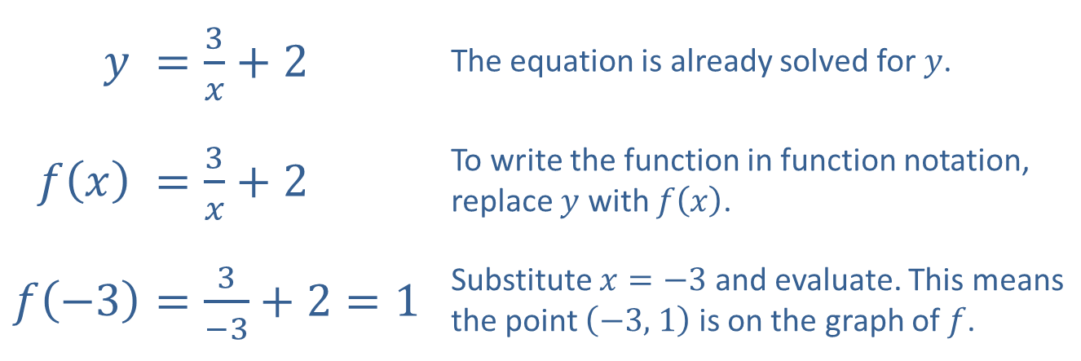
Example 4: Function Notation (cont.)
Solution
​
$$y$$ | ​$=\frac{3}{x}+2$ | The equation is already solved for $y$.
​$f⁡\left(x\right)$ | ​$=\frac{3}{x}+2$ | To write the function in function notation, replace $y$ with $f⁡\left(x\right)$.
$$f⁡\left(−3\right)$$ | ​$=\frac{3}{−3}+2=1$ | Substitute $x=−3$ and evaluate. This means the point $\left(−3\text{, }1\right)$ is on the graph of $f$.

Slide 31
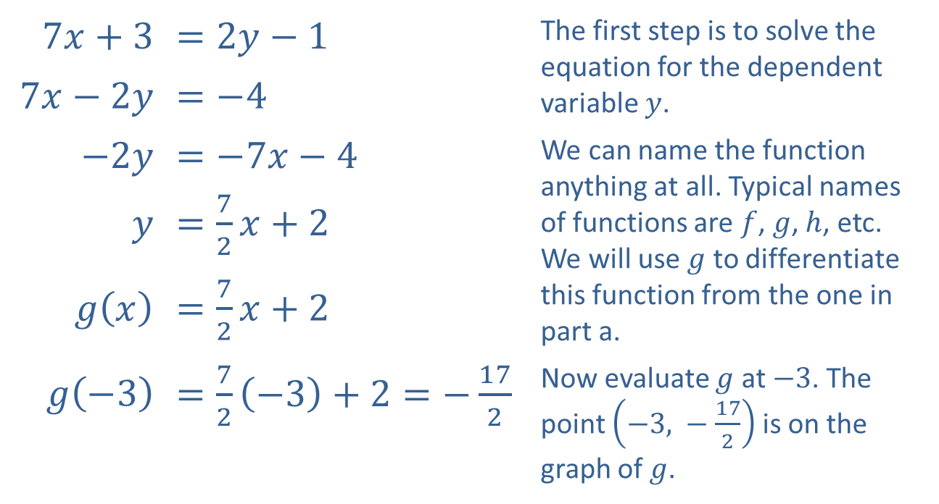
Example 4: Function Notation (cont.)
​
​$7x+3$ | ​$=2y−1$ | The first step is to solve the equation for the dependent variable $y$.
​$7x−2y$ | ​$=−4$
​$−2y$ | ​$=−7x−4$ | We can name the function anything at all. Typical names of functions are $f$, $g$, $h$, etc. We will use $g$ to differentiate this function from the one in part a.
$y$ | ​$=\frac{7}{2}x+2$
​$g⁡\left(x\right)$ | ​$=\frac{7}{2}x+2$
​$g⁡\left(−3\right)$ | ​$=\frac{7}{2}\left(−3\right)+2=−\frac{17}{2}$ | Now evaluate $g$ at $−3$. The point $\left(−3\text{, }−\frac{17}{2}\right)$ is on the graph of $g$.

Slide 32
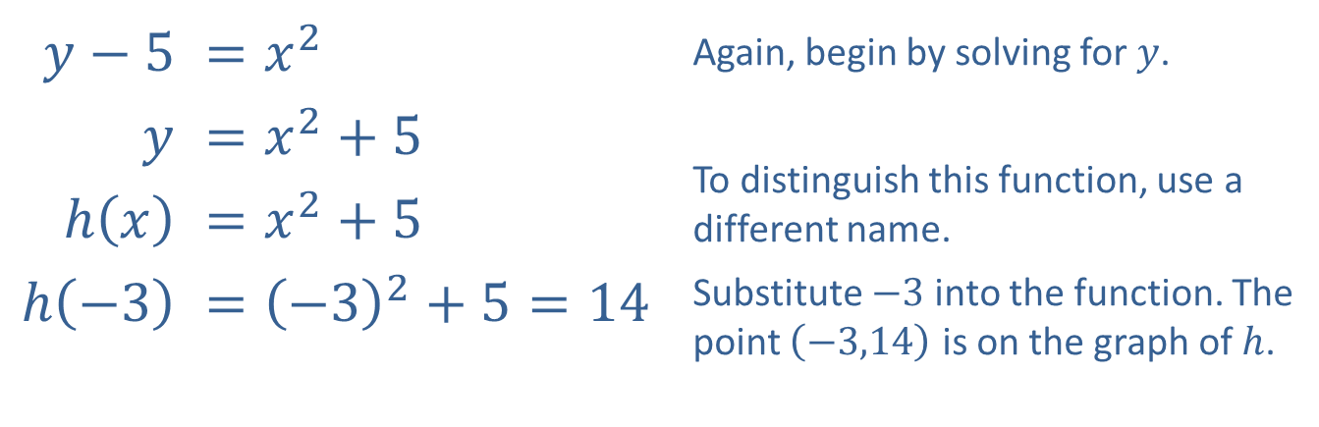
Example 4: Function Notation (cont.)
​
​$y−5$ | ​$=x^{2}$ | Again, begin by solving for $y$.
$y$ | ​$=x^{2}+5$ | To distinguish this function, use a different name.
​$h⁡\left(x\right)$ | ​$=x^{2}+5$
​$h⁡\left(−3\right)$ | ​$={\left(−3\right)}^{2}+5=14$ | Substitute $−3$ into the function. The point $\left(−3\text{,}14\right)$ is on the graph of $h$.

Slide 33
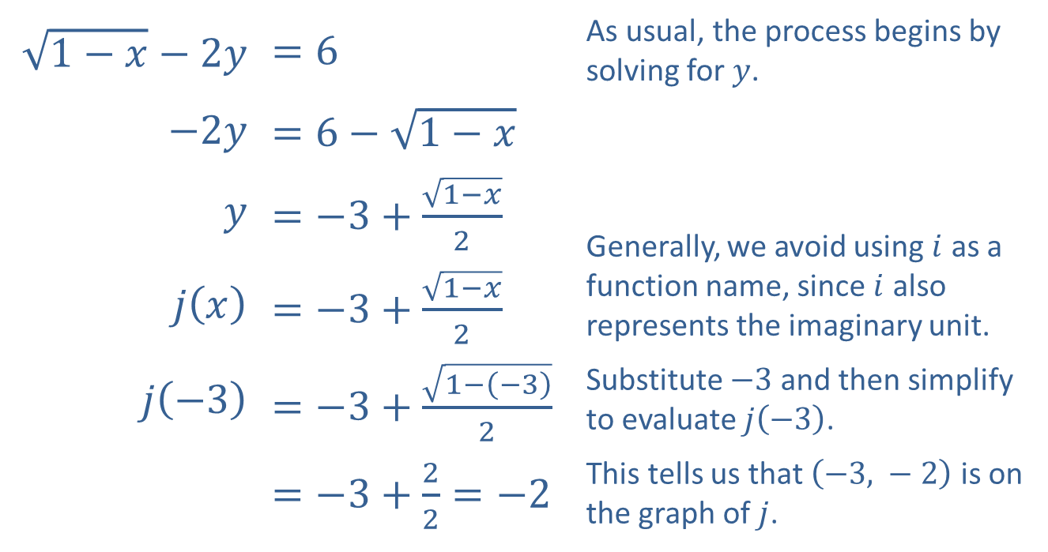
Example 4: Function Notation (cont.)
​$\sqrt{1−x}−2y$ | ​$=6$ | As usual, the process begins by solving for $y$.
​$−2y$ | ​$=6−\sqrt{1−x}$
$y$ | ​$=−3+\frac{\sqrt{1−x}}{2}$ | Generally, we avoid using $i$ as a function name, since $i$ also represents the imaginary unit.
​$j⁡\left(x\right)$ | ​$=−3+\frac{\sqrt{1−x}}{2}$
​$j⁡\left(−3\right)$ | ​$=−3+\frac{\sqrt{1−\left(−3\right)}}{2}$ | Substitute $−3$ and then simplify to evaluate $j⁡\left(−3\right)$.
​ | ​$=−3+\frac{2}{2}=−2$ | This tells us that $\left(−3\text{, }−2\right)$ is on the graph of $j$.
​

Slide 34

Example 5: Interpreting Function Values from a Graph
Use the graph of the function $f$ in Figure 14 to answer the following questions.
​What is the value of $f⁡\left(0\right)$?
​What is the value of $f⁡\left(2\right)$?
​For what integer values of $x$ is $f\left(x\right)=2$?

Slide 35
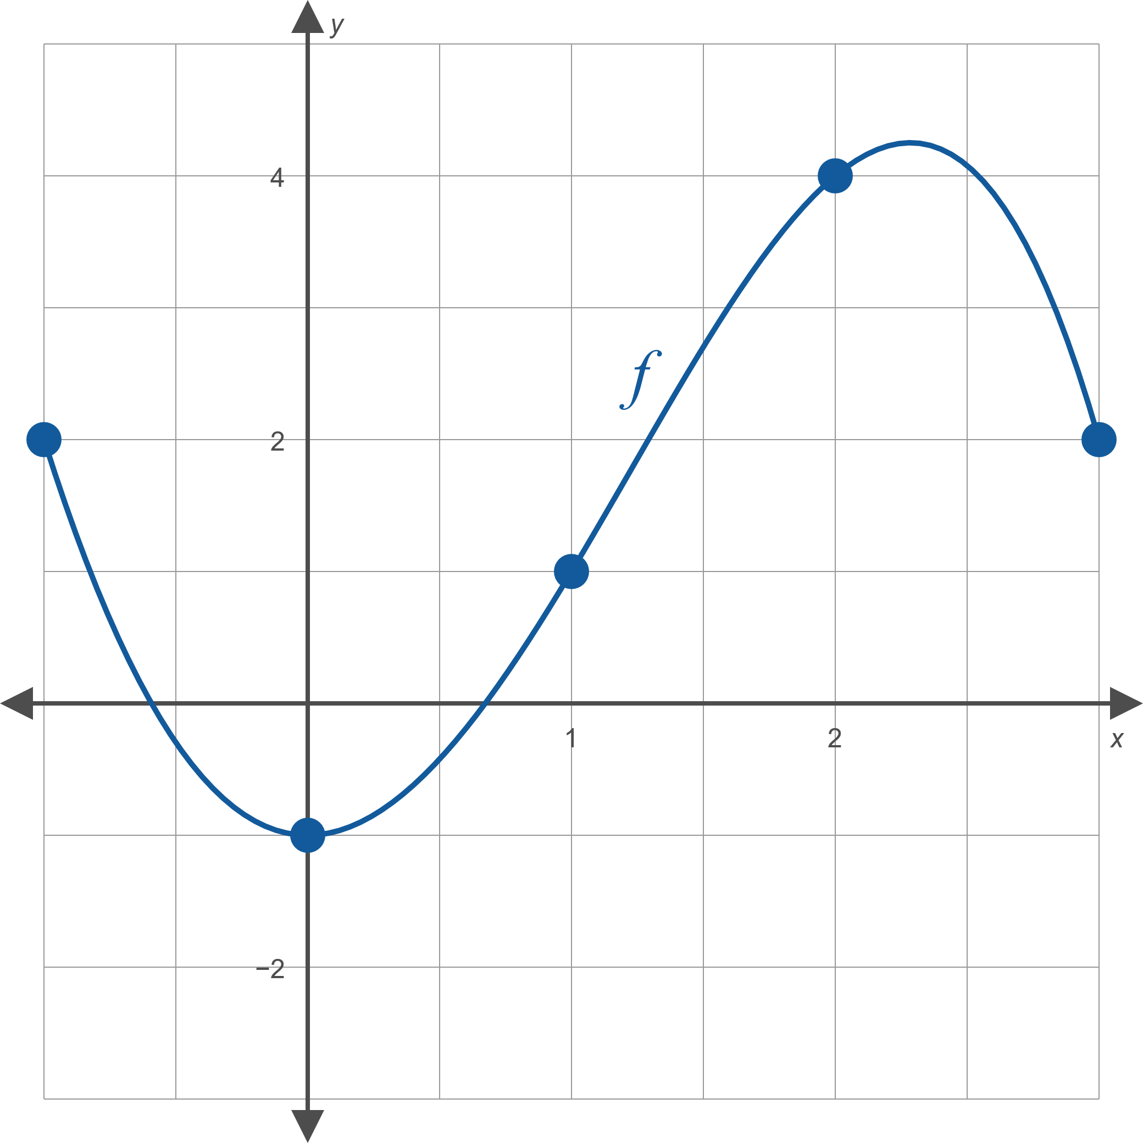
Example 5: Interpreting Function Values from a Graph (cont.)
Figure 14

Slide 36
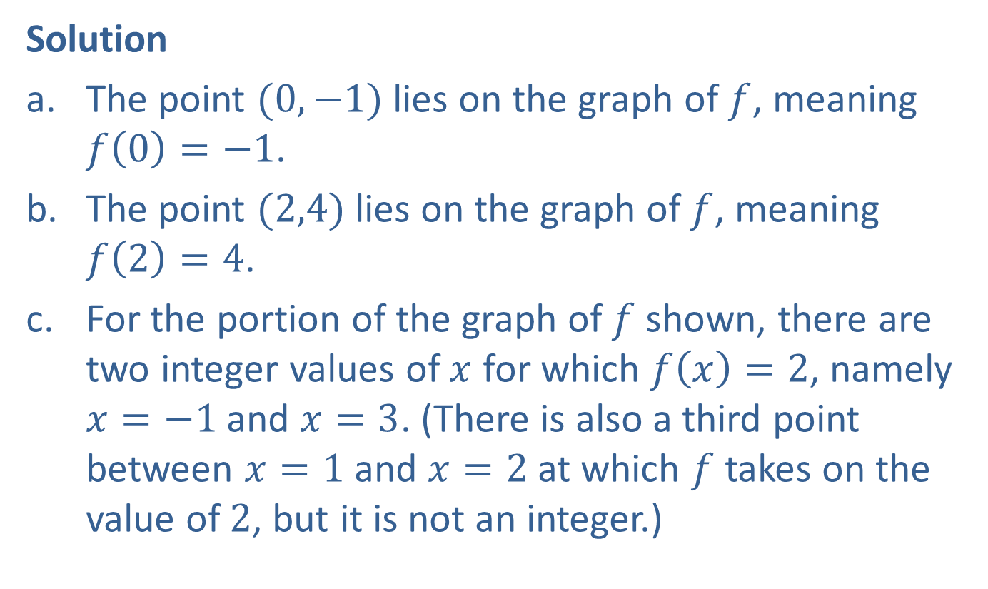
Example 5: Interpreting Function Values from a Graph (cont.)
Solution
​The point $(0,−1)$ lies on the graph of $f$, meaning $f\left(0\right)=−1$.
​The point $(2,4)$ lies on the graph of $f$, meaning $f\left(2\right)=4$.
​For the portion of the graph of $f$ shown, there are two integer values of $x$ for which $f\left(x\right)=2$, namely $x=−1$ and $x=3$. (There is also a third point between $x=1$ and $x=2$ at which $f$ takes on the value of 2, but it is not an integer.)

Slide 37
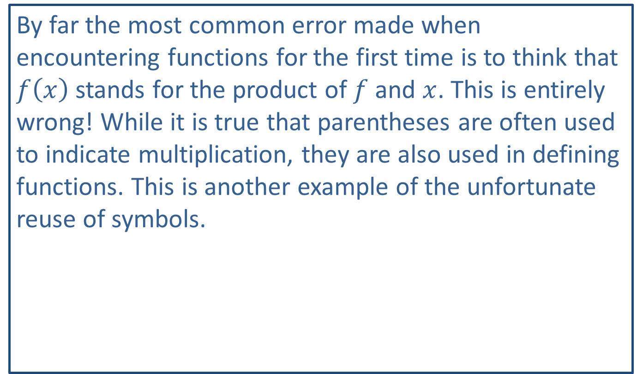
CAUTION!
By far the most common error made when encountering functions for the first time is to think that $f⁡\left(x\right)$ stands for the product of $f$ and $x$. This is entirely wrong! While it is true that parentheses are often used to indicate multiplication, they are also used in defining functions. This is another example of the unfortunate reuse of symbols.

Slide 38

Example 6: Evaluating Functions
Given the function $f⁡\left(x\right)=3x^{2}−2$, evaluate the following.
​$f⁡\left(a\right)$
​$f⁡\left(x+h\right)$
​$\frac{f⁡\left(x+h\right)−f⁡\left(x\right)}{h}$

Slide 39
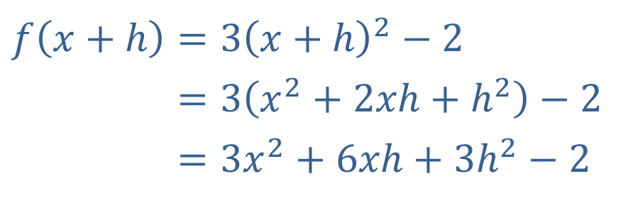

Example 6: Evaluating Functions (cont.)
​Solution
This is just a matter of replacing $x$ with $a$.
$$f⁡\left(a\right)=3a^{2}−2$$
Here we replace $x$ with $x+h$ and simplify the result.
​$f\left(x+h\right)=3{\left(x+h\right)}^{2}−2$
​𝑓⁡𝑥+h=3𝑥2+2𝑥h+h2−2
​𝑓⁡𝑥+h=3𝑥2+6𝑥h+3h2−2

Slide 40
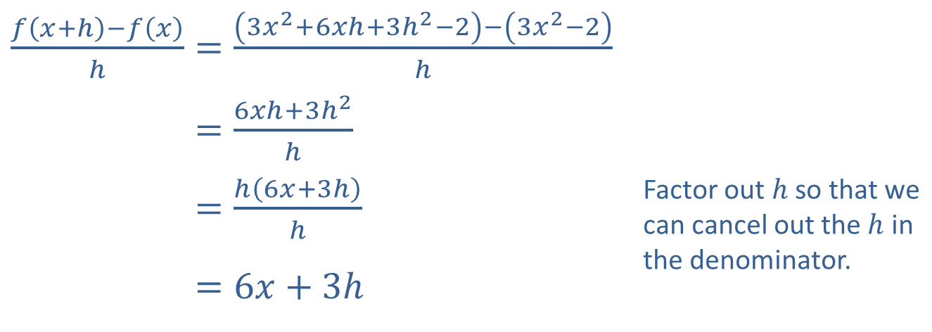
Example 6: Evaluating Functions (cont.)
​We can use the result from part b. in simplifying this expression.
​$\frac{f⁡\left(x+h\right)−f⁡\left(x\right)}{h}=\frac{\left(3x^{2}+6xh+3h^{2}−2\right)−\left(3x^{2}−2\right)}{h}$
​𝑓⁡𝑥+h−𝑓⁡𝑥h=6𝑥h+3h2h
​𝑓⁡𝑥+h−𝑓⁡𝑥h=h6𝑥+3hh | Factor out $h$ so that we can cancel out the $h$ in the denominator.
​𝑓⁡𝑥+h−𝑓⁡𝑥h=6𝑥+3h

Slide 41
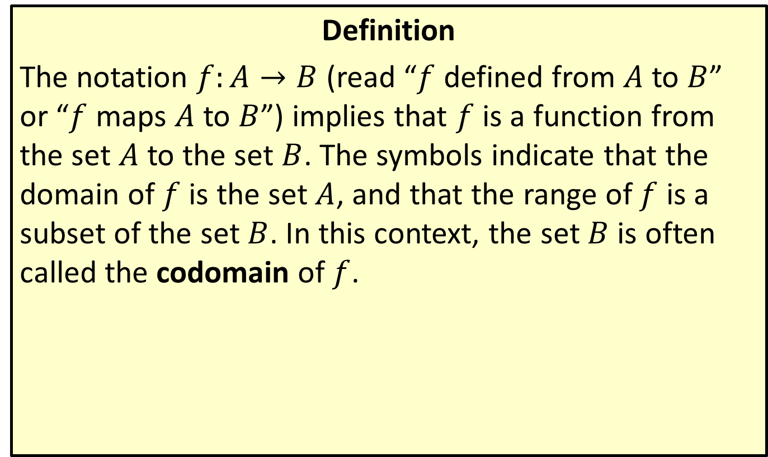
Domain and Codomain Notation
Definition
The notation $f:A→B$ (read “$f$ defined from $A$ to $B$” or “$f$ maps $A$ to $B$”) implies that $f$ is a function from the set $A$ to the set $B$. The symbols indicate that the domain of $f$ is the set $A$, and that the range of $f$ is a subset of the set $B$. In this context, the set $B$ is often called the codomain of $f$.

Slide 42
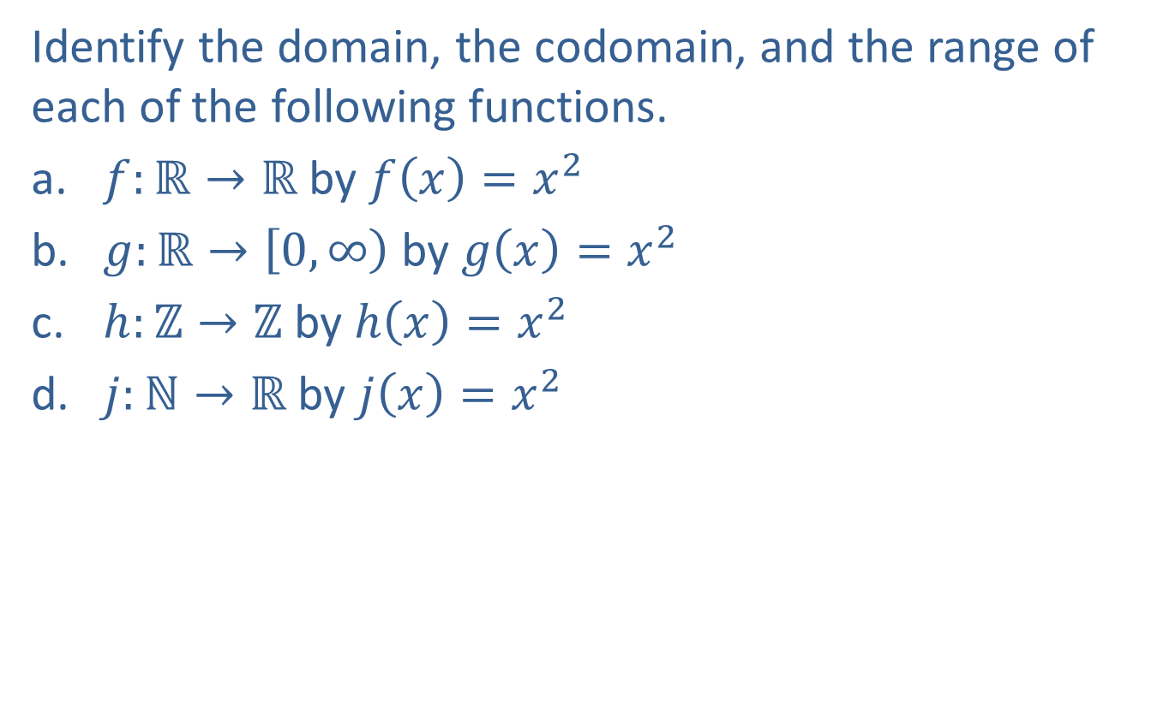
Example 7: Domain, Codomain, and Range
Identify the domain, the codomain, and the range of each of the following functions.
​$f:ℝ→ℝ$ by $f\left(x\right)=x^{2}$
​$g:ℝ→\left[0,∞\right)$ by $g\left(x\right)=x^{2}$
​$h:ℤ→ℤ$ by $h\left(x\right)=x^{2}$
​$j:ℕ→ℝ$ by $j\left(x\right)=x^{2}$

Slide 43
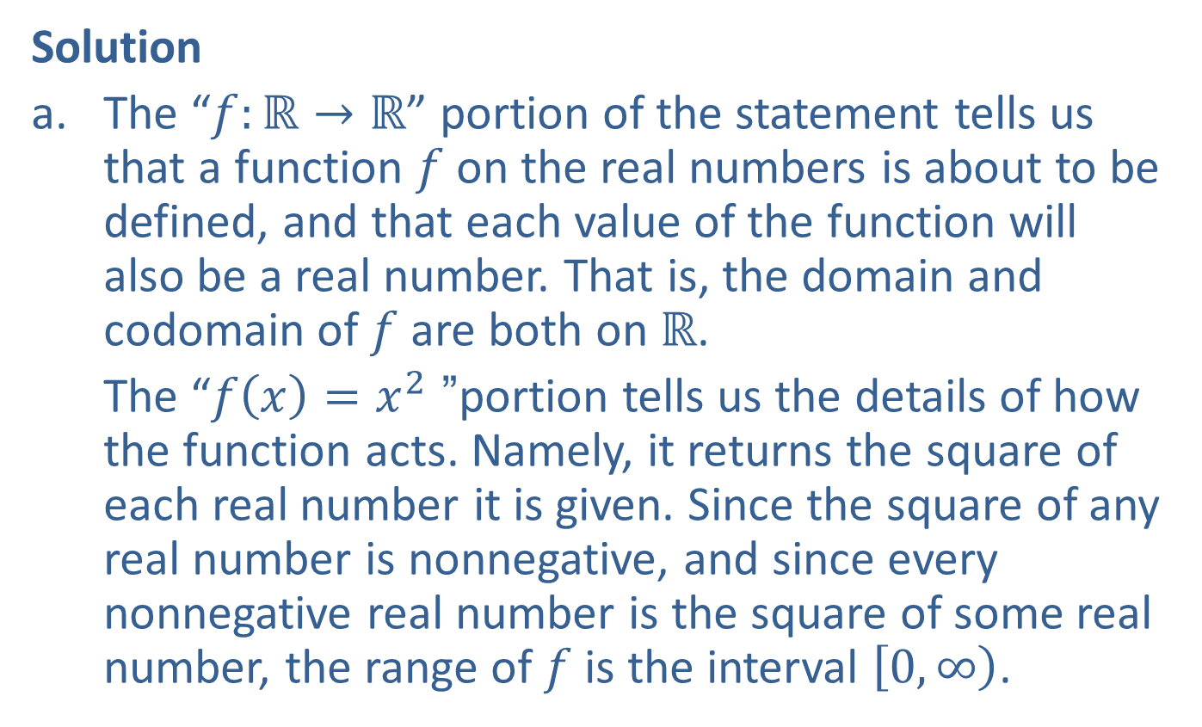
Example 7: Domain, Codomain, and Range (cont.)
Solution
​The “$f:ℝ→ℝ$” portion of the statement tells us that a function $f$ on the real numbers is about to be defined, and that each value of the function will also be a real number. That is, the domain and codomain of $f$ are both on $ℝ$.
​The “$f\left(x\right)=x^{2}$” portion tells us the details of how the function acts. Namely, it returns the square of each real number it is given. Since the square of any real number is nonnegative, and since every nonnegative real number is the square of some real number, the range of $f$ is the interval $\left[0,∞\right)$.

Slide 44
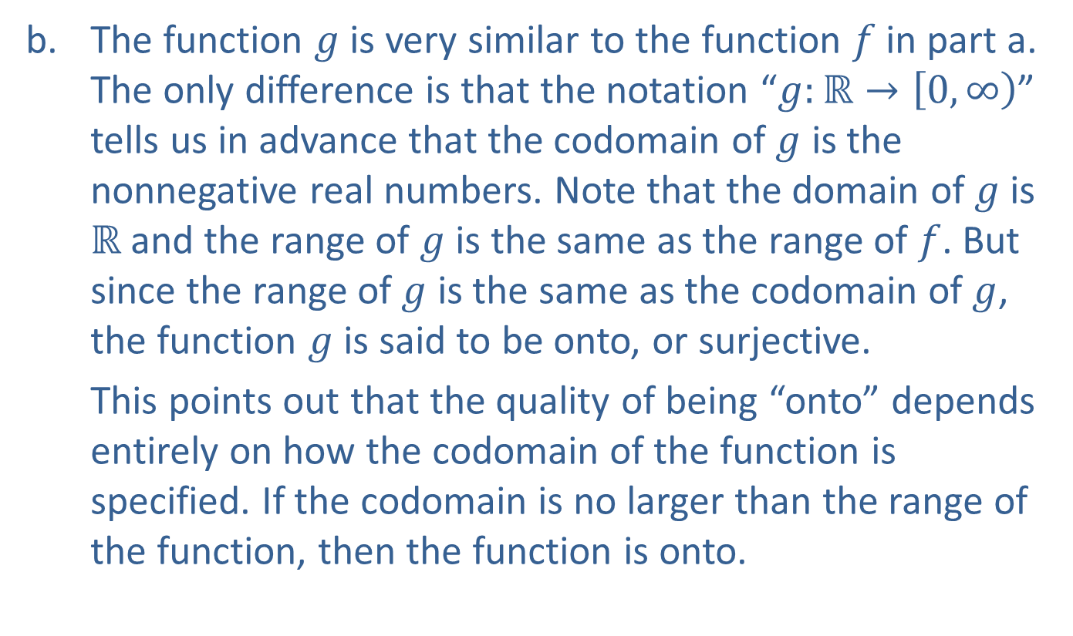
Example 7: Domain, Codomain, and Range (cont.)
​The function $g$ is very similar to the function $f$ in part a. The only difference is that the notation “$g:ℝ→\left[0,∞\right)$” tells us in advance that the codomain of $g$ is the nonnegative real numbers. Note that the domain of $g$ is $ℝ$ and the range of $g$ is the same as the range of $f$. But since the range of $g$ is the same as the codomain of $g$, the function $g$ is said to be onto, or surjective.
​This points out that the quality of being “onto” depends entirely on how the codomain of the function is specified. If the codomain is no larger than the range of the function, then the function is onto.

Slide 45
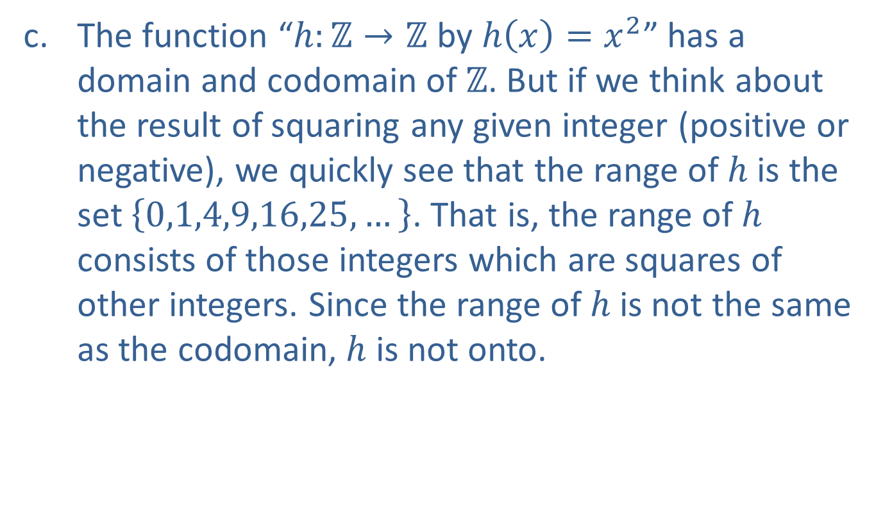
Example 7: Domain, Codomain, and Range (cont.)
​The function “$h:ℤ→ℤ$ by $h\left(x\right)=x^{2}$” has a domain and codomain of $ℤ$. But if we think about the result of squaring any given integer (positive or negative), we quickly see that the range of $h$ is the set $\left\{0,1,4,9,16,25,…\right\}$. That is, the range of $h$ consists of those integers which are squares of other integers. Since the range of $h$ is not the same as the codomain, $h$ is not onto.

Slide 46
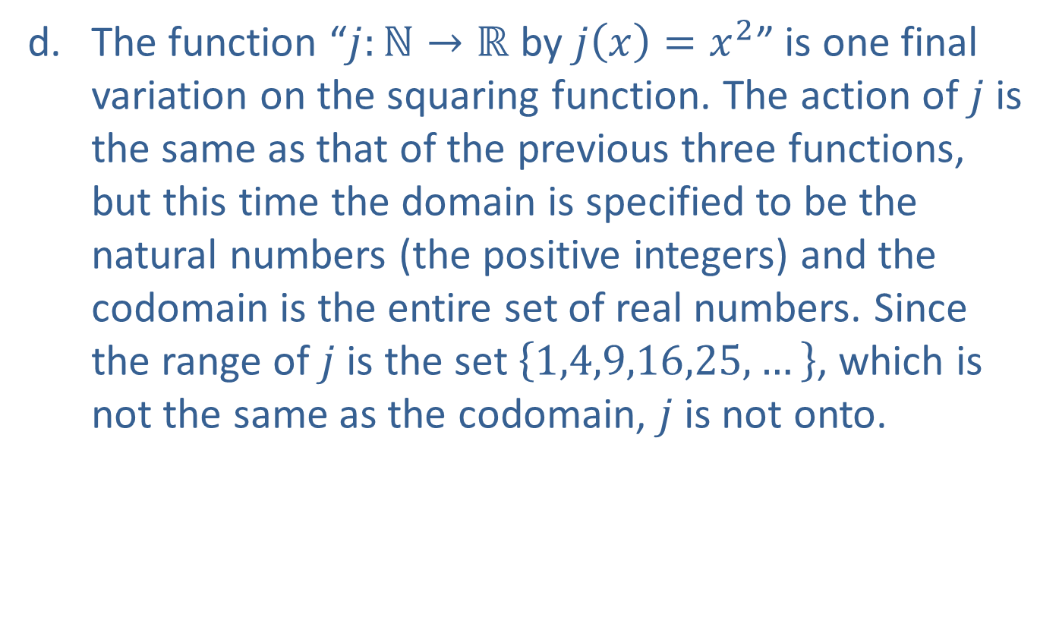
Example 7: Domain, Codomain, and Range (cont.)
​The function “$j:ℕ→ℝ$ by $j\left(x\right)=x^{2}$” is one final variation on the squaring function. The action of $j$ is the same as that of the previous three functions, but this time the domain is specified to be the natural numbers (the positive integers) and the codomain is the entire set of real numbers. Since the range of $j$ is the set $\left\{1,4,9,16,25,…\right\}$, which is not the same as the codomain, $j$ is not onto.

Slide 47

Example 8: Implied Domain of a Function
Determine the implied domain of each of the following functions.
​$f⁡\left(x\right)=5x−\sqrt{3−x}$
​$g⁡\left(x\right)=\frac{x−3}{x^{2}−1}$

Slide 48
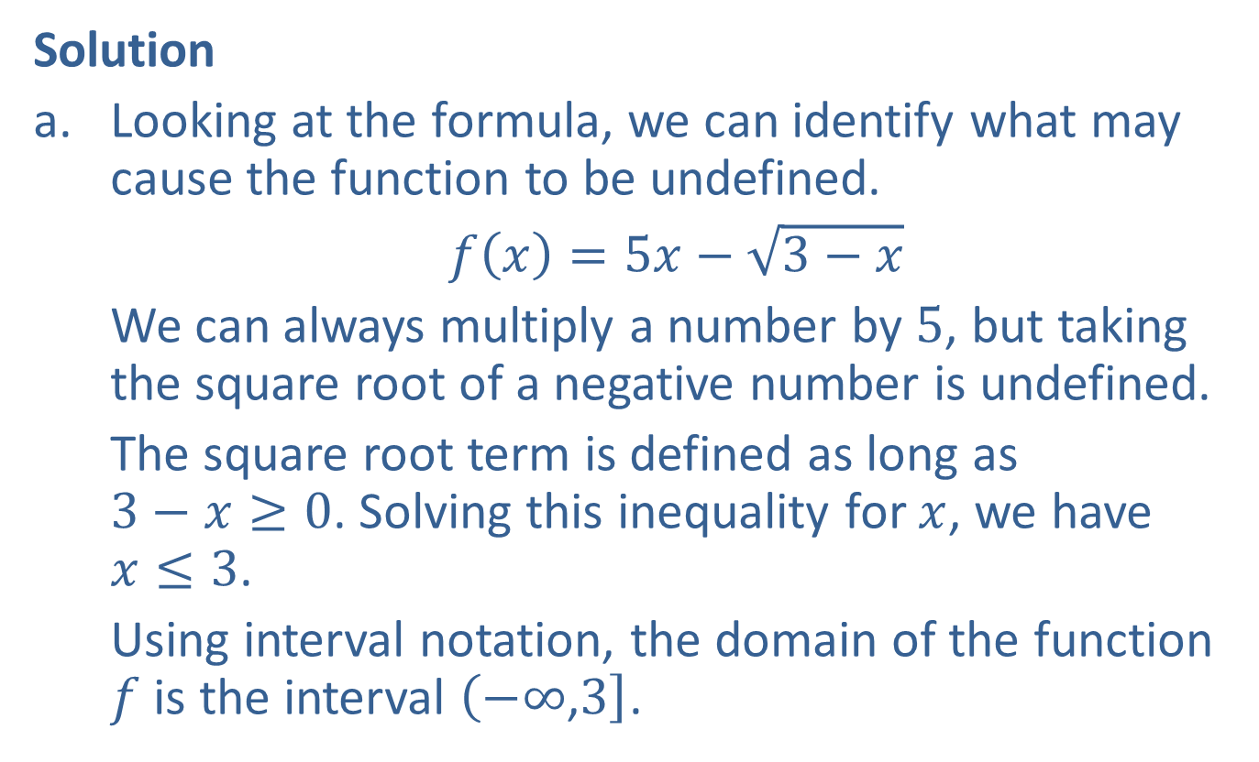
Example 8: Implied Domain of a Function (cont.)
Solution
​Looking at the formula, we can identify what may cause the function to be undefined.
​$f⁡\left(x\right)=5x−\sqrt{3−x}$
We can always multiply a number by 5, but taking the square root of a negative number is undefined.
​The square root term is defined as long as
$3−x≥0$. Solving this inequality for $x$, we have
$x≤3$.
​Using interval notation, the domain of the function $f$ is the interval $\left(−∞\text{,}3\right]$.

Slide 49
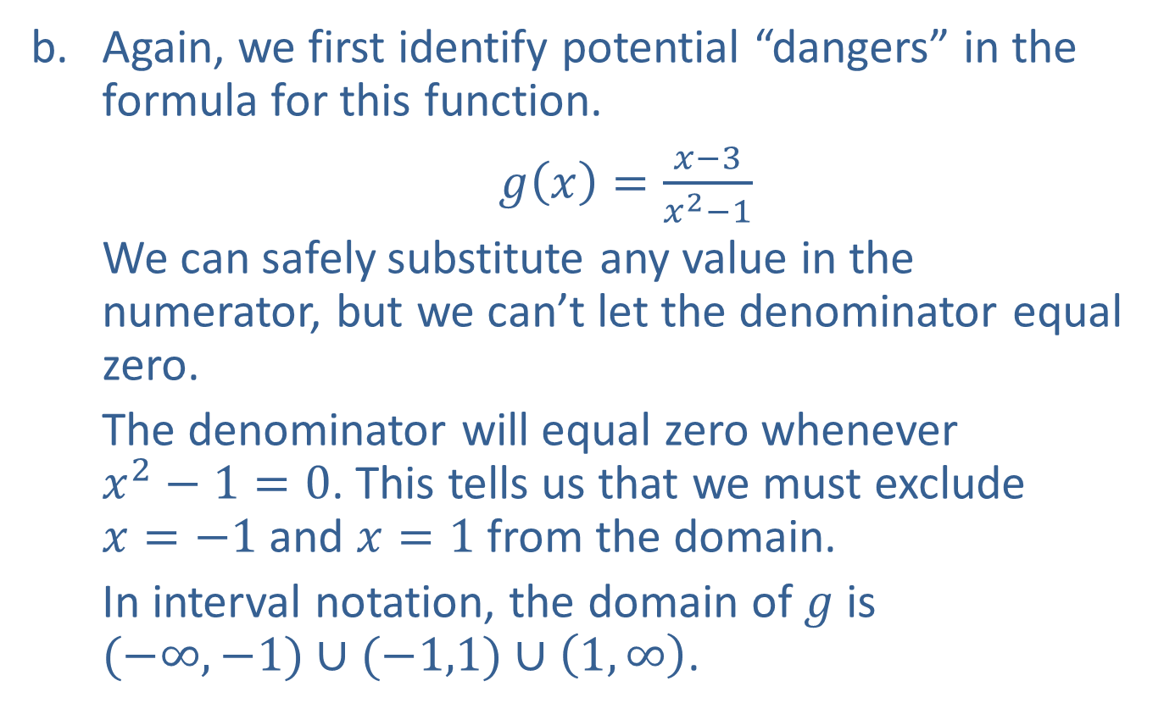
Example 8: Implied Domain of a Function (cont.)
​Again, we first identify potential “dangers” in the formula for this function.
​$g⁡\left(x\right)=\frac{x−3}{x^{2}−1}$
​We can safely substitute any value in the numerator, but we can’t let the denominator equal zero.
The denominator will equal zero whenever
$x^{2}−1=0$. This tells us that we must exclude
$x=−1$ and $x=1$ from the domain.
​In interval notation, the domain of $g$ is
$(−∞,−1)∪(−1,1)∪\left(1,∞\right)$.

