Slide 1
Section 3.3
Quadratic Functions

Slide 2
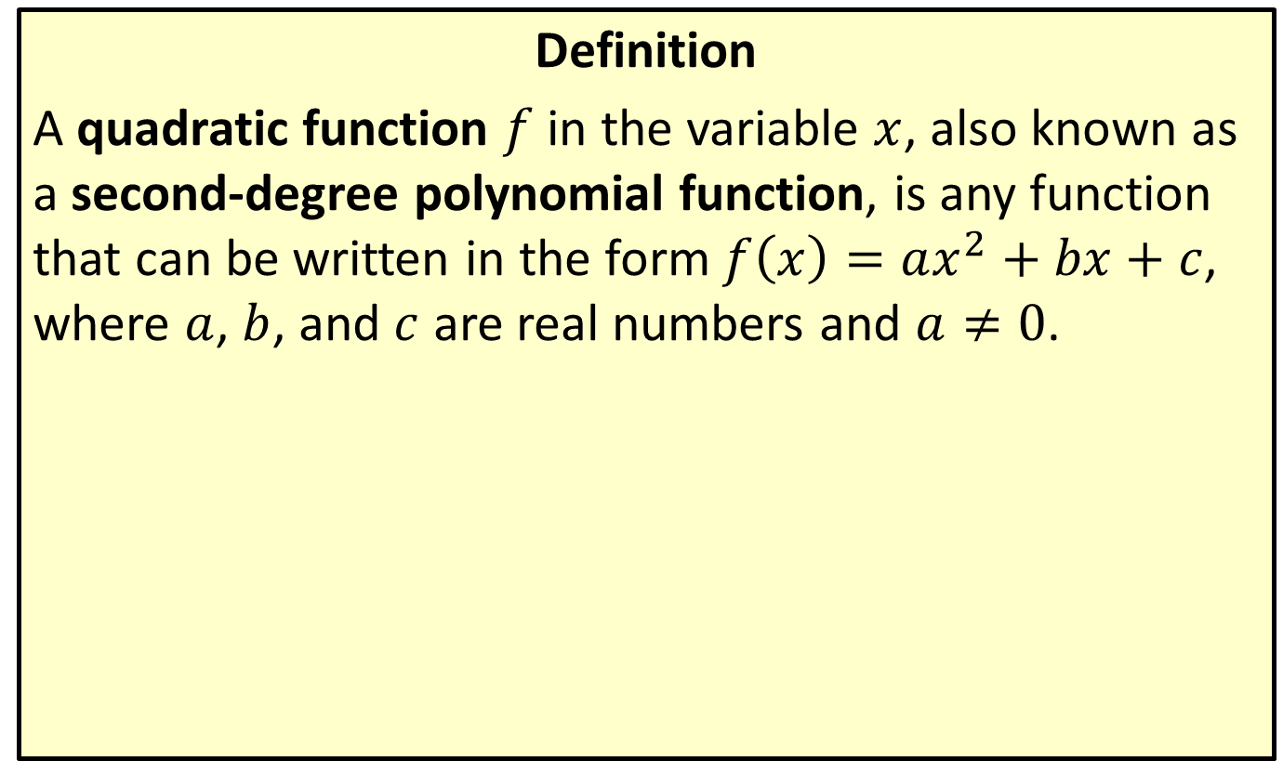
Quadratic Functions
Definition
A quadratic function $f$ in the variable $x$, also known as a second-degree polynomial function, is any function that can be written in the form $f\left(x\right)=ax^{2}+bx+c$, where $a$, $b$, and $c$ are real numbers and $a≠0$.

Slide 3
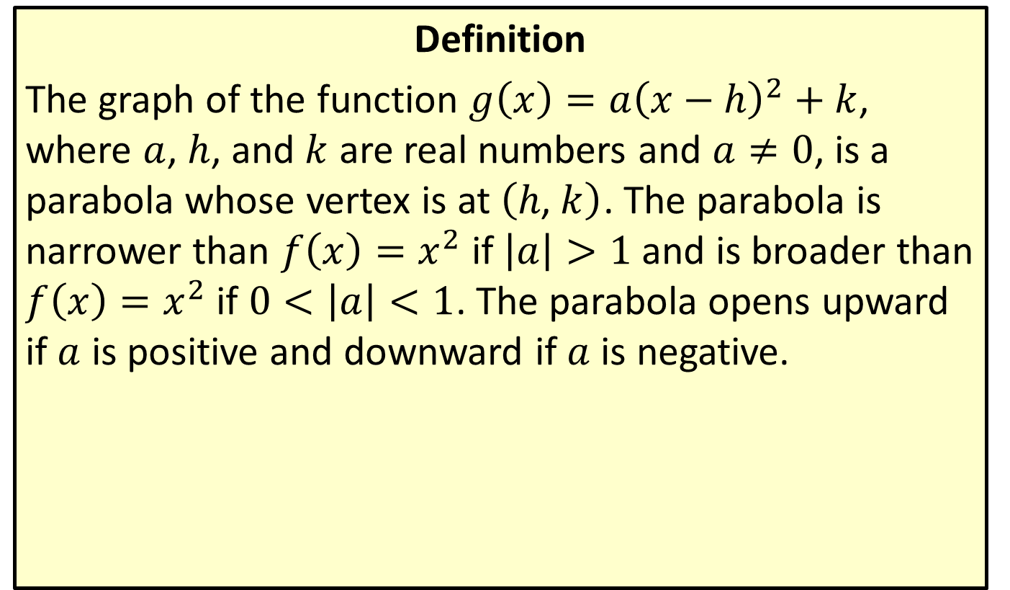
Vertex Form of a Quadratic Function
Definition
The graph of the function $g\left(x\right)=a{\left(x−h\right)}^{2}+k$, where $a$, $h$, and $k$ are real numbers and $a≠0$, is a parabola whose vertex is at $\left(h\text{, }k\right)$. The parabola is narrower than $f\left(x\right)=x^{2}$ if $\left|a\right|>1$ and is broader than $f\left(x\right)=x^{2}$ if $0<\left|a\right|<1$. The parabola opens upward if $a$ is positive and downward if $a$ is negative.

Slide 4

Example 1: Graphing Quadratic Functions
Sketch the graph of the function
$f\left(x\right)=−x^{2}−2x+3$.
Locate the vertex and the $x$-intercepts.

Slide 5
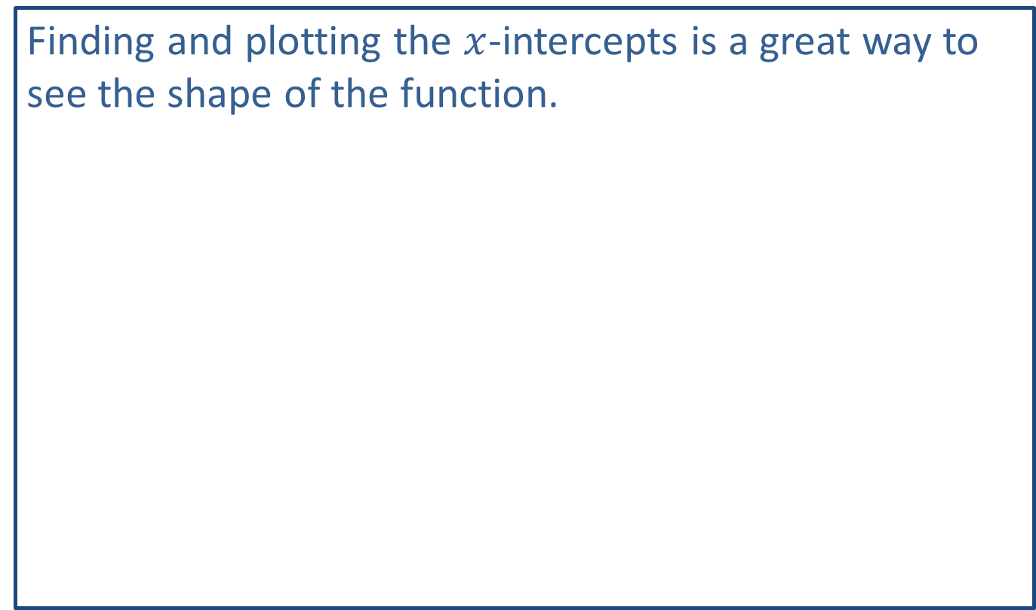
Note:
Finding and plotting the $x$-intercepts is a great way to see the shape of the function.

Slide 6
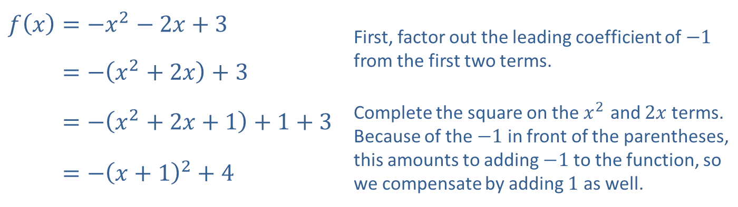

Example 1: Graphing Quadratic Functions (cont.)
Solution
First, identify the vertex of the function by completing the square as follows.
Completing the square places the equation in vertex form, and we rewrite the expression $−{\left(x+1\right)}^{2}+4$ as $−{\left(x−\left(−1\right)\right)}^{2}+4$, so the vertex is $\left(−1\text{,}4\right)$.
​$f\left(x\right)=−x^{2}−2x+3$ | First, factor out the leading coefficient of $−1$ from the first two terms.
​𝑓⁡𝑥=−𝑥2+2𝑥+3
​𝑓⁡𝑥=−𝑥2+2𝑥+1+1+3 | Complete the square on the $x^{2}$ and $2x$ terms. Because of the $−1$ in front of the parentheses, this amounts to adding $−1$ to the function, so we compensate by adding 1 as well.
​𝑓⁡𝑥=−𝑥+12+4

Slide 7
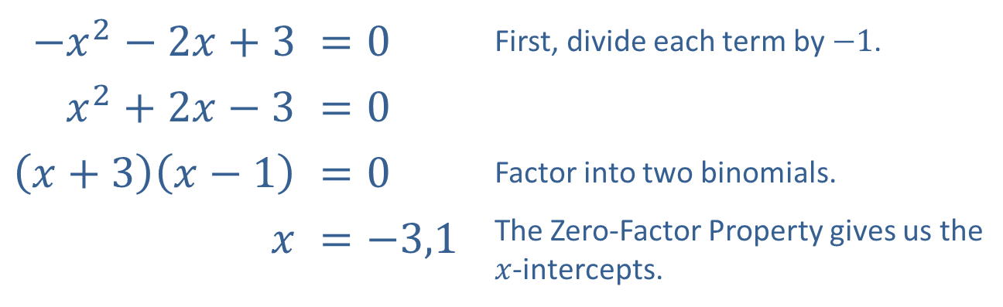

Example 1: Graphing Quadratic Functions (cont.)
The instructions also ask us to identify the $x$-intercepts. An $x$-intercept of the function $f$ is any point on the $x$-axis where $f\left(x\right)=0$, so we need to solve the equation $−x^{2}−2x+3=0$. This can be done by factoring.
Therefore, the $x$-intercepts are located at $\left(−3\text{,}0\right)$ and $\left(1\text{,}0\right)$.
​$−x^{2}−2x+3$ | $$=0$$ | First, divide each term by $−1$.
​$x^{2}+2x−3$ | $$=0$$
​$\left(x+3\right)\left(x−1\right)$ | $$=0$$ | Factor into two binomials.
​$x$ | $$=−3,1$$ | The Zero-Factor Property gives us the $x$-intercepts.

Slide 8
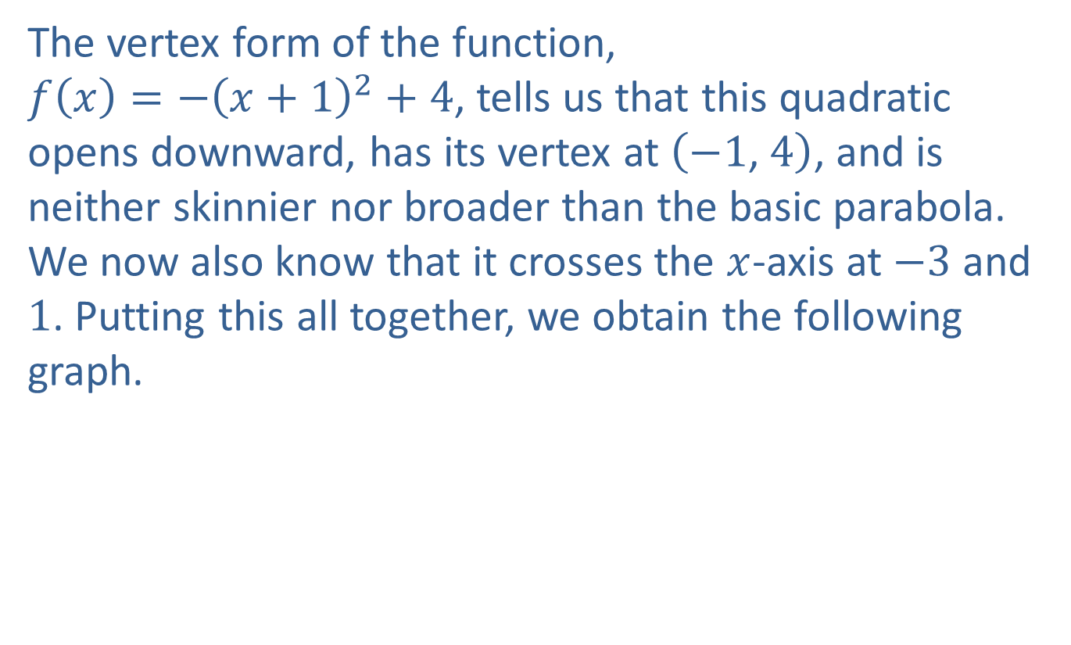
Example 1: Graphing Quadratic Functions (cont.)
The vertex form of the function, $f\left(x\right)=−{\left(x+1\right)}^{2}+4$, tells us that this quadratic opens downward, has its vertex at $\left(−1\text{, }4\right)$, and is neither skinnier nor broader than the basic parabola. We now also know that it crosses the $x$-axis at $−3$ and 1. Putting this all together, we obtain the following graph.

Slide 9
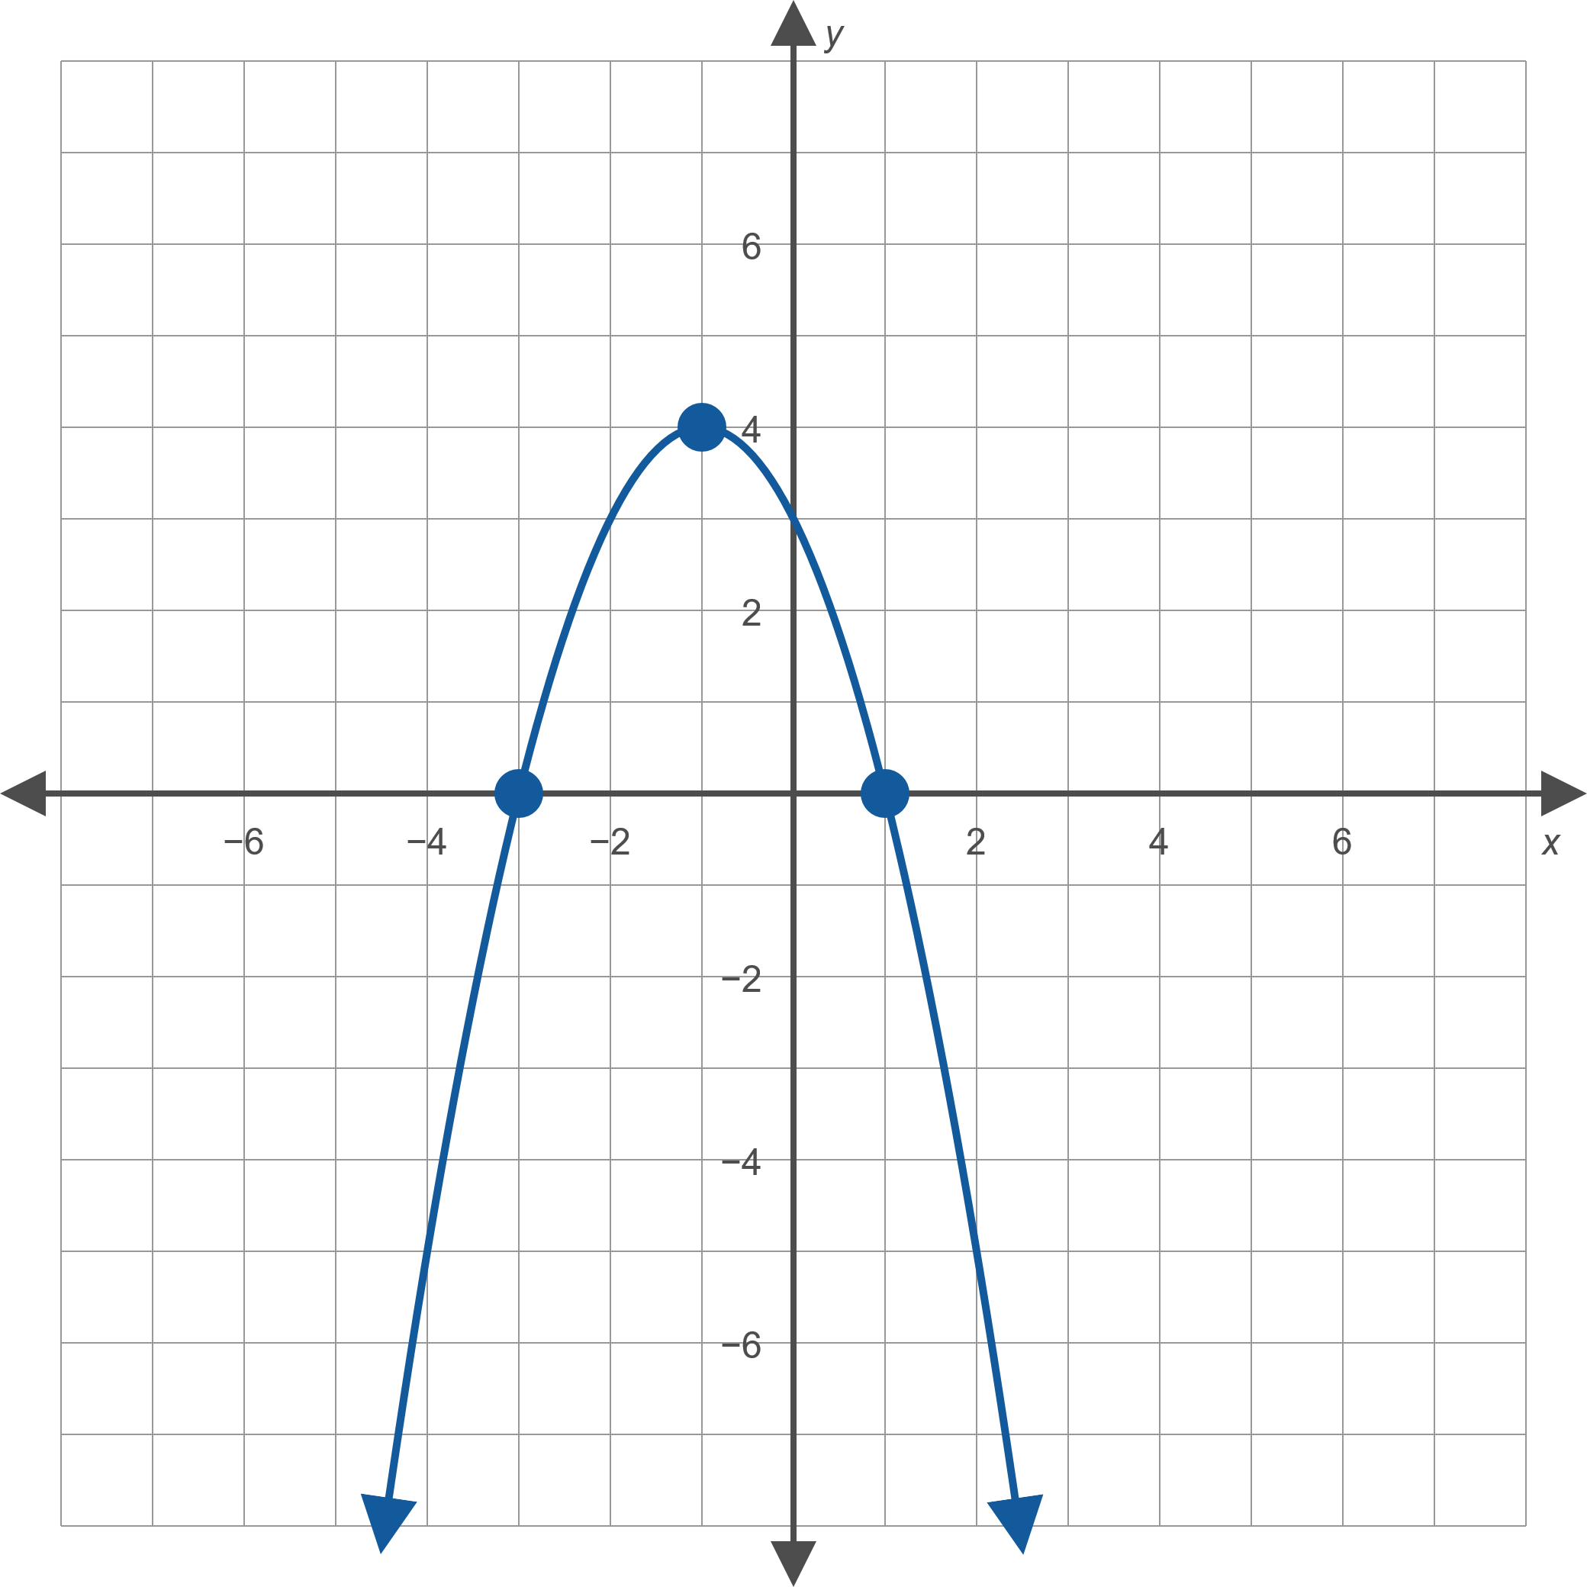
Example 1: Graphing Quadratic Functions (cont.)
Figure 6: $f\left(x\right)=−x^{2}−2x+3$

Slide 10
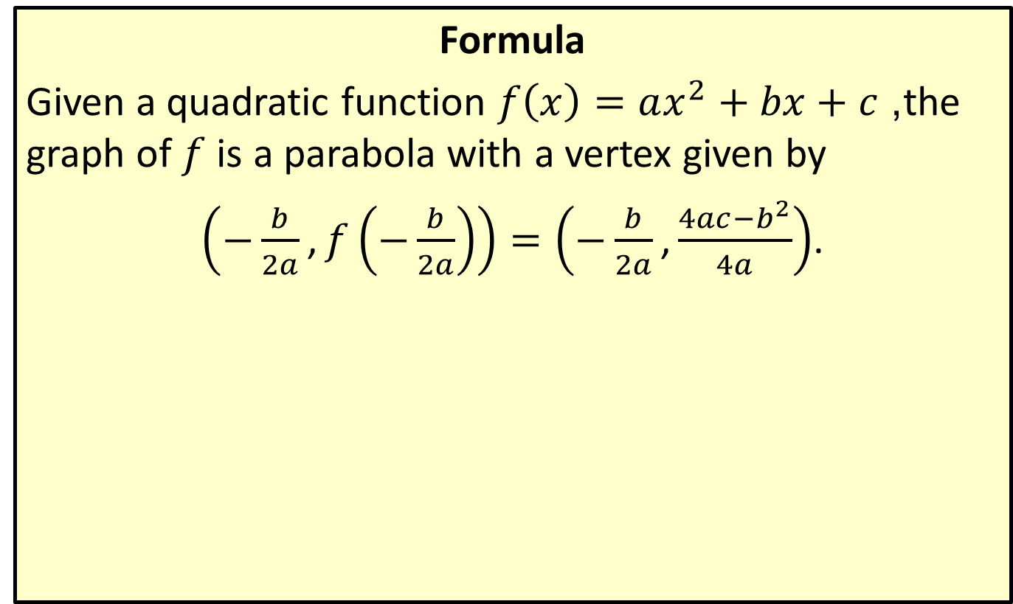
Vertex of a Quadratic Function
Formula
Given a quadratic function $f\left(x\right)=ax^{2}+bx+c$, the graph of $f$ is a parabola with a vertex given by
$\left(−\frac{b}{2a}\text{,}f\left(−\frac{b}{2a}\right)\right)=\left(−\frac{b}{2a}\text{,}\frac{4ac−b^{2}}{4a}\right)$.

Slide 11

Example 2: Using the Vertex Formula
Find the vertex of the following quadratic functions using the vertex formula.
​$f\left(x\right)=x^{2}−4x+8$
​$g\left(x\right)=3x^{2}+5x−1$

Slide 12
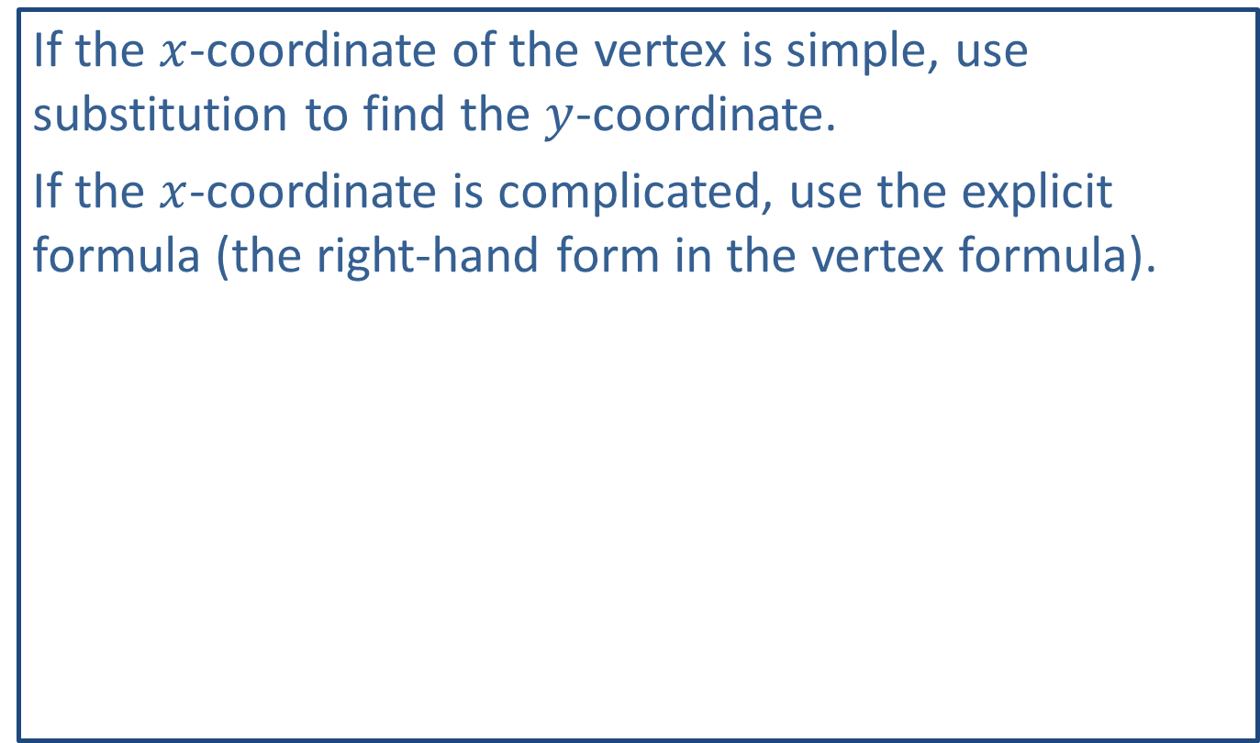
Note:
If the $x$-coordinate of the vertex is simple, use substitution to find the $y$-coordinate.
If the $x$-coordinate is complicated, use the explicit formula (the right-hand form in the vertex formula).

Slide 13
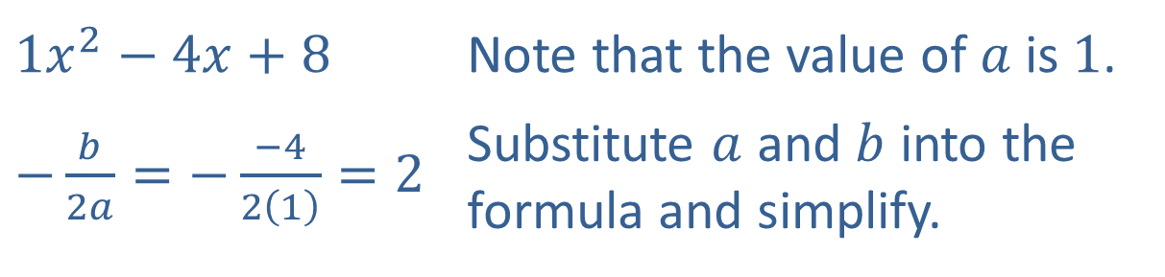

Example 2: Using the Vertex Formula (cont.)
Solution
​Begin by using the formula to find the $x$-coordinate of the vertex.
​
​$1x^{2}−4x+8$ | Note that the value of $a$ is 1.
​$−\frac{b}{2a}=−\frac{−4}{2\left(1\right)}=2$ | Substitute $a$ and $b$ into the formula and simplify.

Slide 14
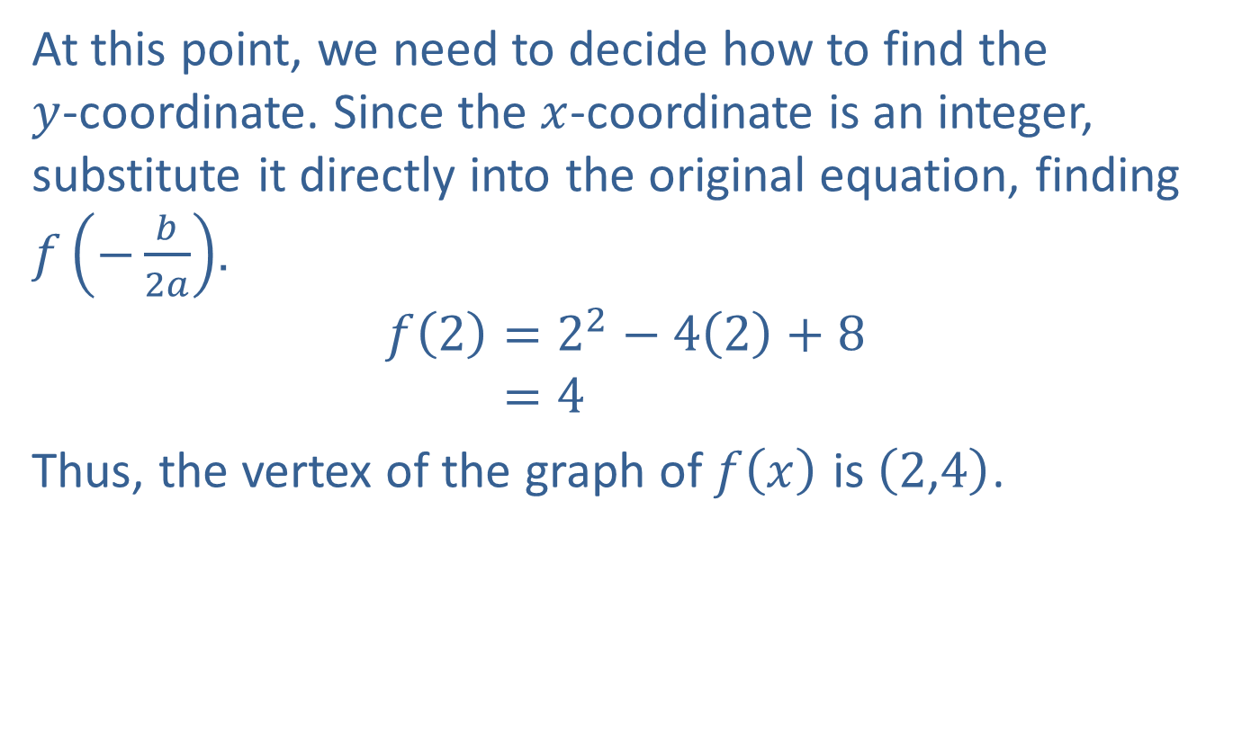
Example 2: Using the Vertex Formula (cont.)
​At this point, we need to decide how to find the $y$-coordinate. Since the $x$-coordinate is an integer, substitute it directly into the original equation, finding $f⁡\left(−\frac{b}{2a}\right)$.
𝑓2=22−42+8𝑓⁡2=4
​Thus, the vertex of the graph of $f⁡\left(x\right)$ is $\left(2\text{,}4\right)$.

Slide 15
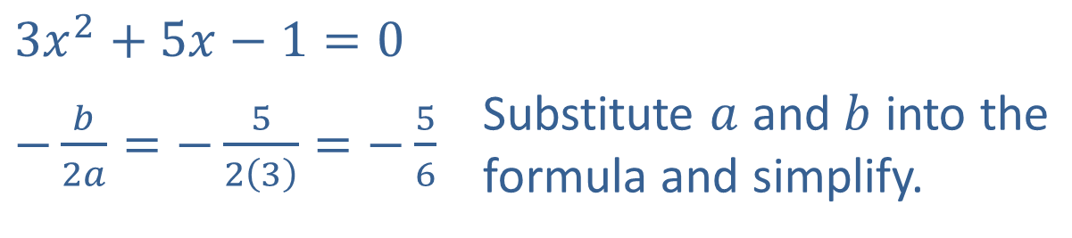

Example 2: Using the Vertex Formula (cont.)
​Again, begin by finding the $x$-coordinate of the vertex.
​
​$3x^{2}+5x−1=0$ | Substitute $a$ and $b$ into the formula and simplify.
​$−\frac{b}{2a}=−\frac{5}{2\left(3\right)}=−\frac{5}{6}$

Slide 16
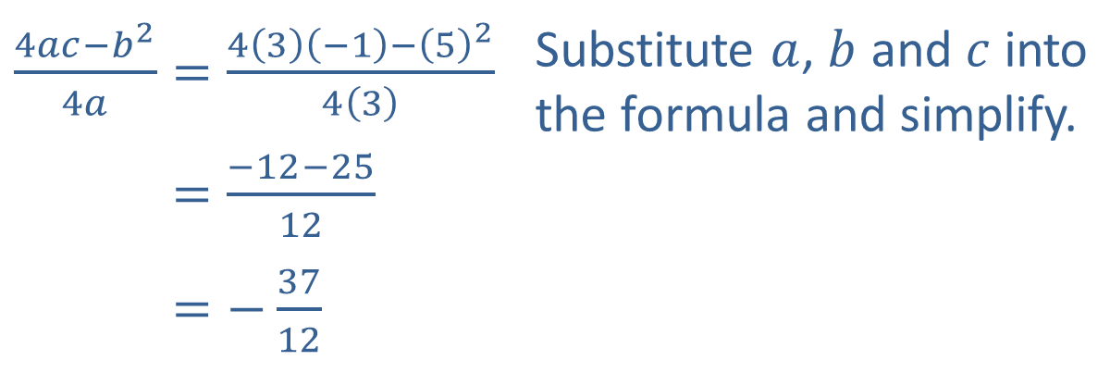

Example 2: Using the Vertex Formula (cont.)
​Here, the $x$-coordinate is a fraction, so substituting it into the original equation leads to messy calculations. Instead, use the explicit formula to find the $y$-coordinate.
​
Thus, the vertex of the graph of $g⁡\left(x\right)$ is $\left(−\frac{5}{6},−\frac{37}{12}\right)$.
​$\frac{4ac−b^{2}}{4a}=\frac{4\left(3\right)\left(−1\right)−{\left(5\right)}^{2}}{4\left(3\right)}$ | Substitute $a$, $b$ and $c$ into the formula and simplify.
​4𝑎𝑐−𝑏24𝑎=−12−2512
​4𝑎𝑐−𝑏24𝑎=−3712

Slide 17
Example 3: Finding a Quadratic Function Given Its Graph
​Find a formula for the quadratic function whose graph is given in Figure 7.
​Use the formula to determine the coordinates of the parabola’s vertex.

Slide 18
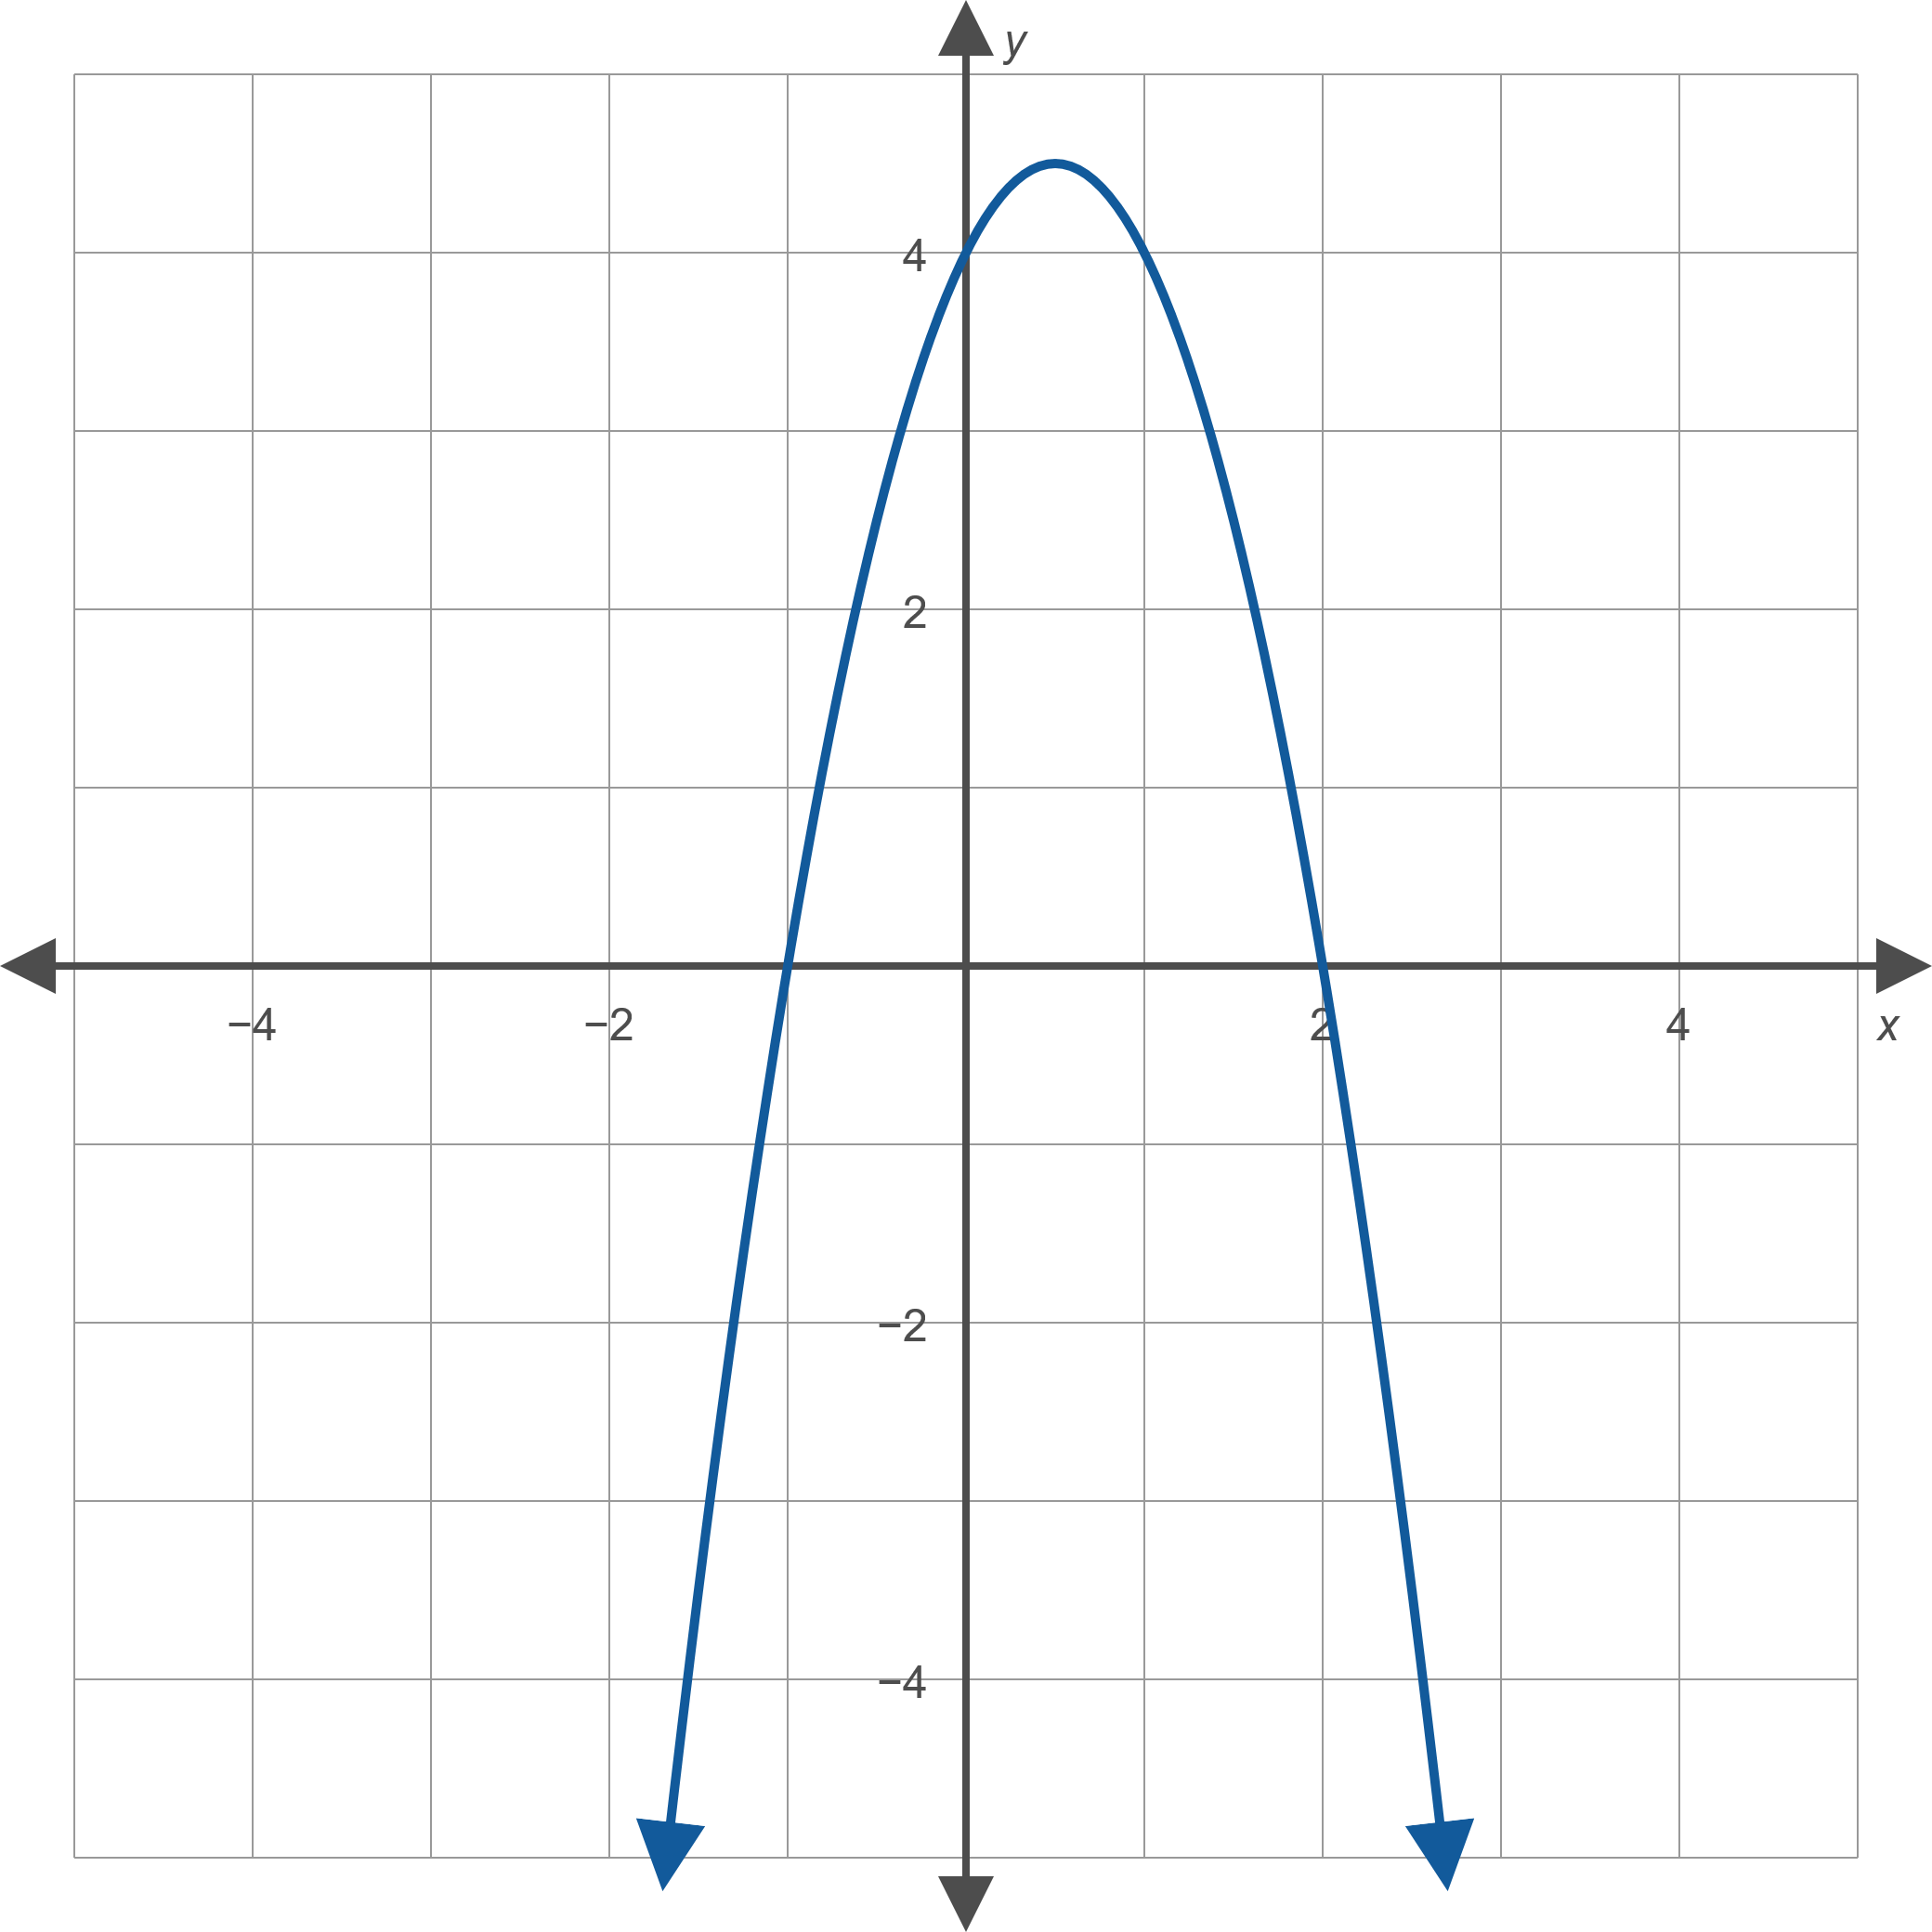
Example 3: Finding a Quadratic Function Given Its Graph (cont.)
Figure 7

Slide 19
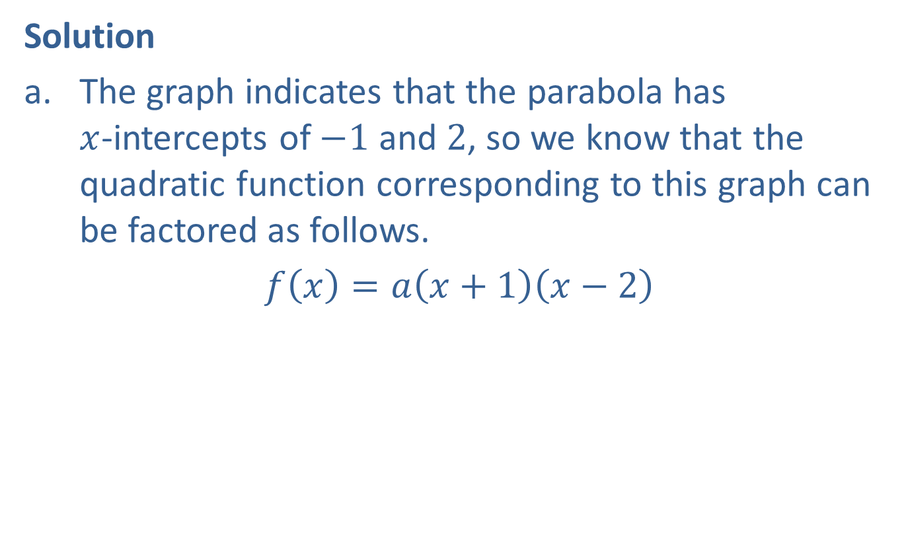
Example 3: Finding a Quadratic Function Given Its Graph (cont.)
Solution
​The graph indicates that the parabola has $x$-intercepts of $−1$ and 2, so we know that the quadratic function corresponding to this graph can be factored as follows.
​$f\left(x\right)=a\left(x+1\right)\left(x−2\right)$

Slide 20
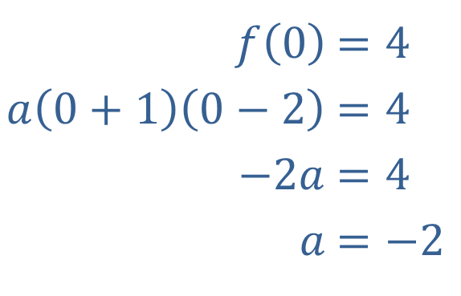
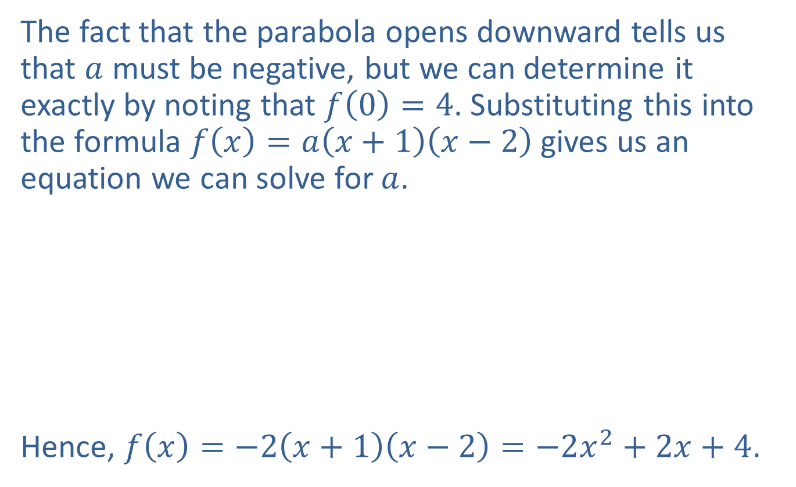
Example 3: Finding a Quadratic Function Given Its Graph (cont.)
​The fact that the parabola opens downward tells us that $a$ must be negative, but we can determine it exactly by noting that $f\left(0\right)=4$. Substituting this into the formula $f\left(x\right)=a\left(x+1\right)\left(x−2\right)$gives us an equation we can solve for $a$.
​
​Hence, $f\left(x\right)=−2\left(x+1\right)\left(x−2\right)=−2x^{2}+2x+4$.
​$f⁡\left(0\right)$ | ​$=4$
​$a\left(0+1\right)\left(0−2\right)$ | ​$=4$
​$−2a$ | ​$=4$
​$a$ | ​$=−2$

Slide 21
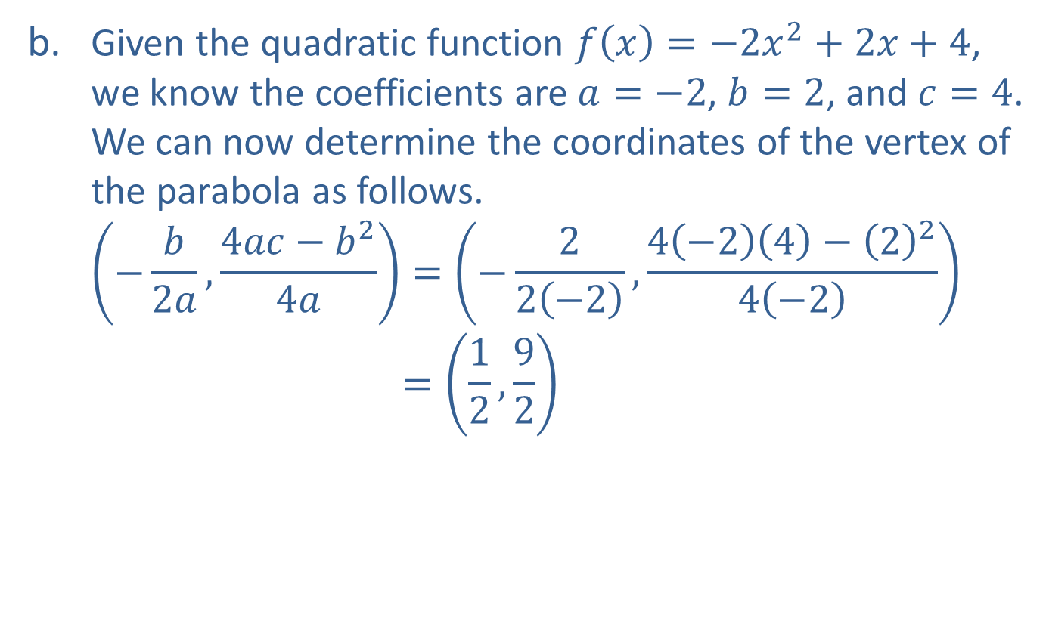
Example 3: Finding a Quadratic Function Given its Graph (cont.)
​Given the quadratic function $f\left(x\right)=−2x^{2}+2x+4$, we know the coefficients are $a=−2$, $b=2$, and $c=4$. We can now determine the coordinates of the vertex of the parabola as follows.
−𝑏2𝑎,4𝑎𝑐−𝑏24𝑎=−22−2,4−24−224−2(−𝑏2𝑎,4𝑎𝑎−𝑏24𝑎)=12,92

Slide 22
Example 4: Quadratic Regression
Given the points graphed in Figure 8, use quadratic regression to find and graph the quadratic function of best fit.

Slide 23
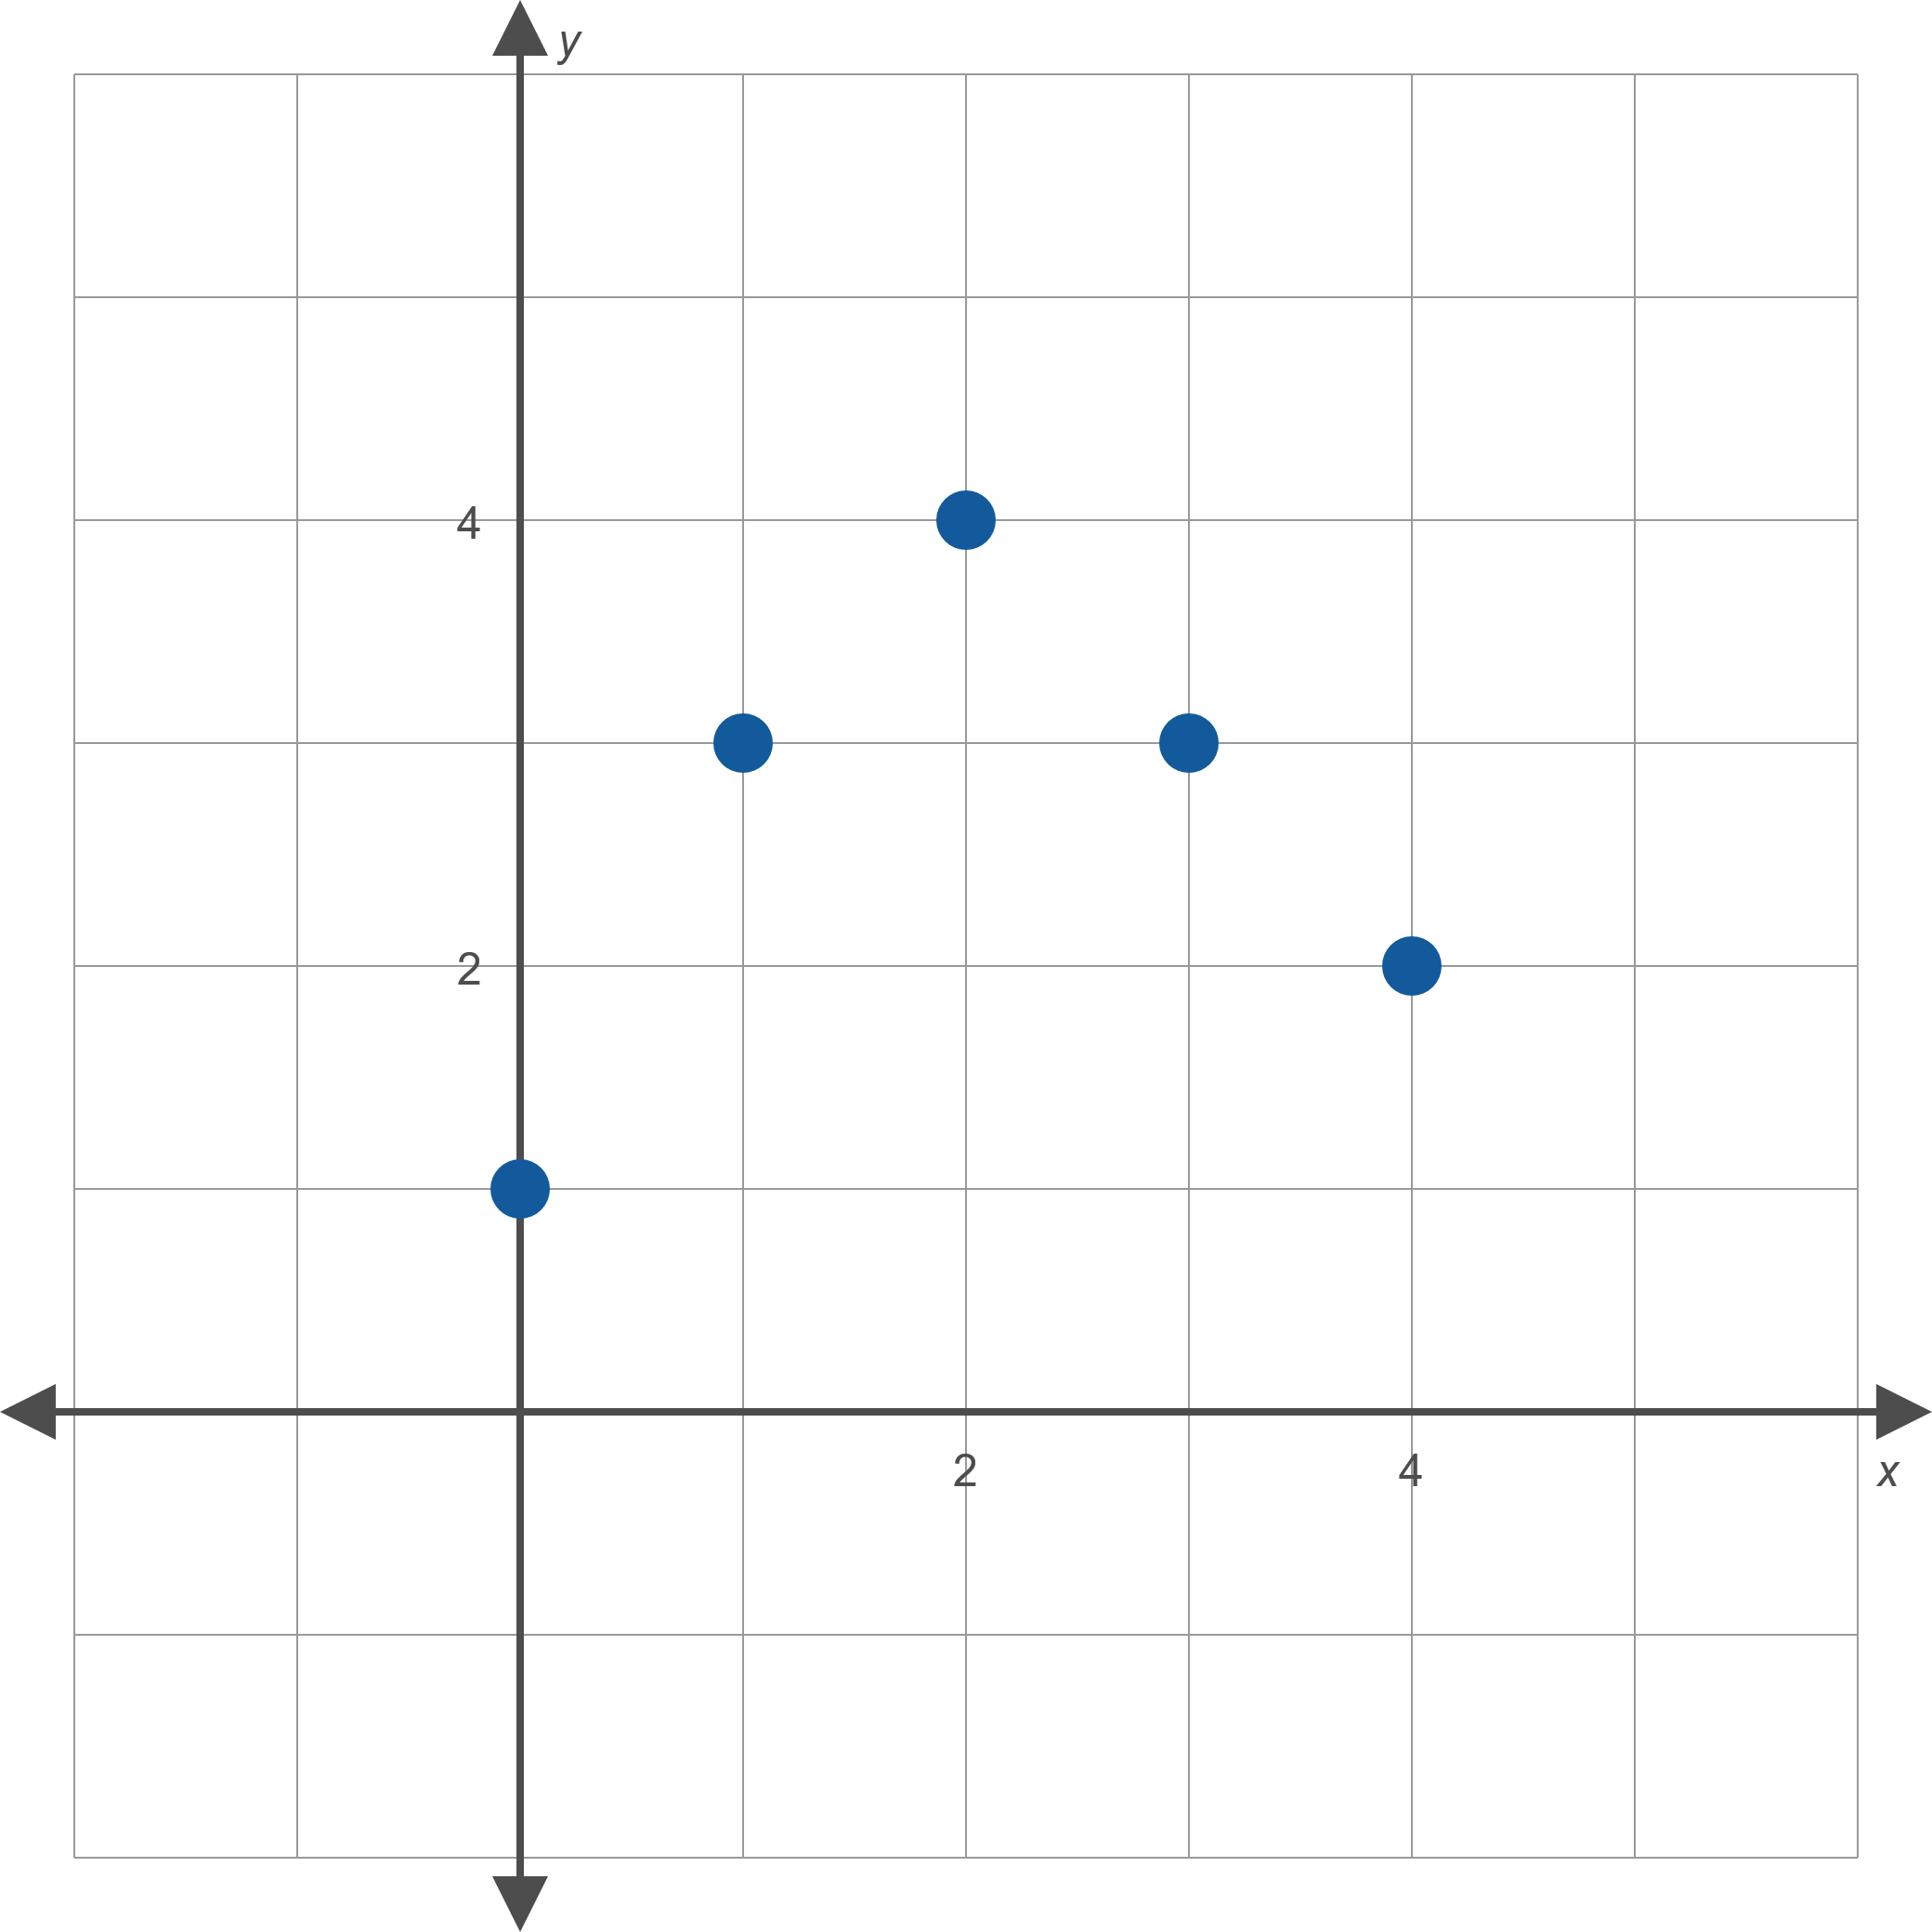
Example 4: Quadratic Regression (cont.)
Figure 8

Slide 24
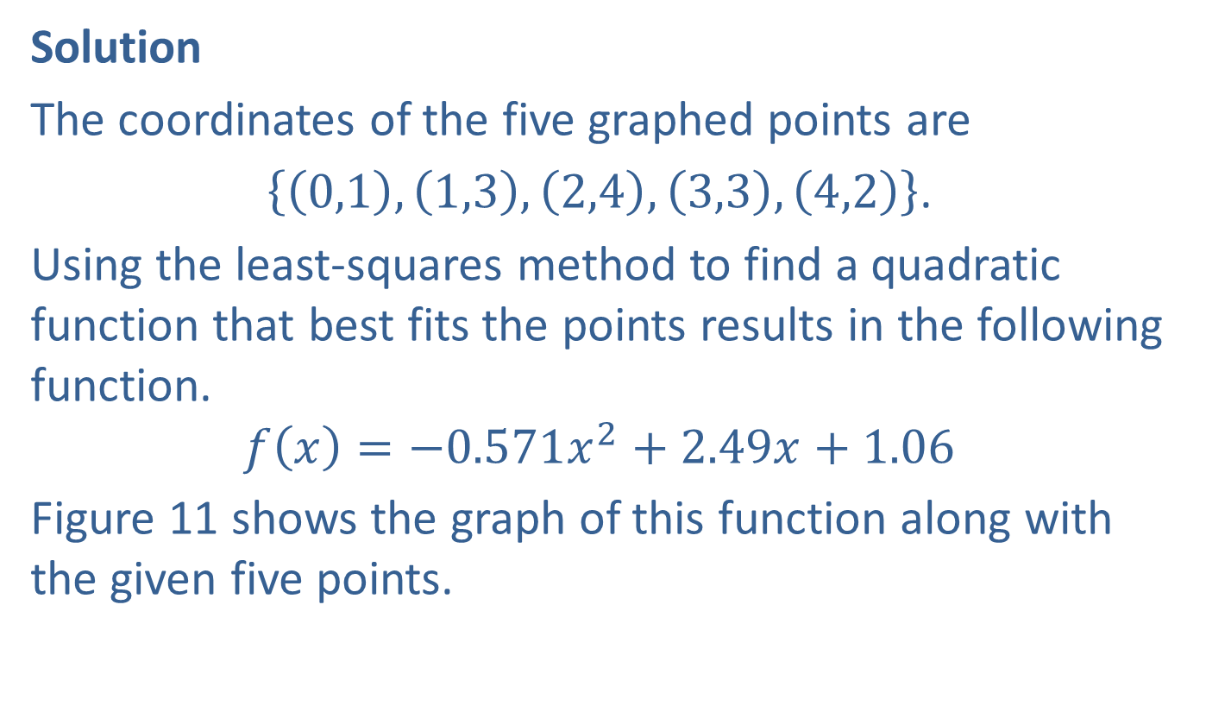
Example 4: Quadratic Regression (cont.)
Solution
The coordinates of the five graphed points are
$\left\{\left(0,1\right),\left(1,3\right),\left(2,4\right),\left(3,3\right),\left(4,2\right)\right\}$.
Using the least-squares method to find a quadratic function that best fits the points results in the following function.
$$f\left(x\right)=−0.571x^{2}+2.49x+1.06$$
Figure 11 shows the graph of this function along with the given five points.

Slide 25
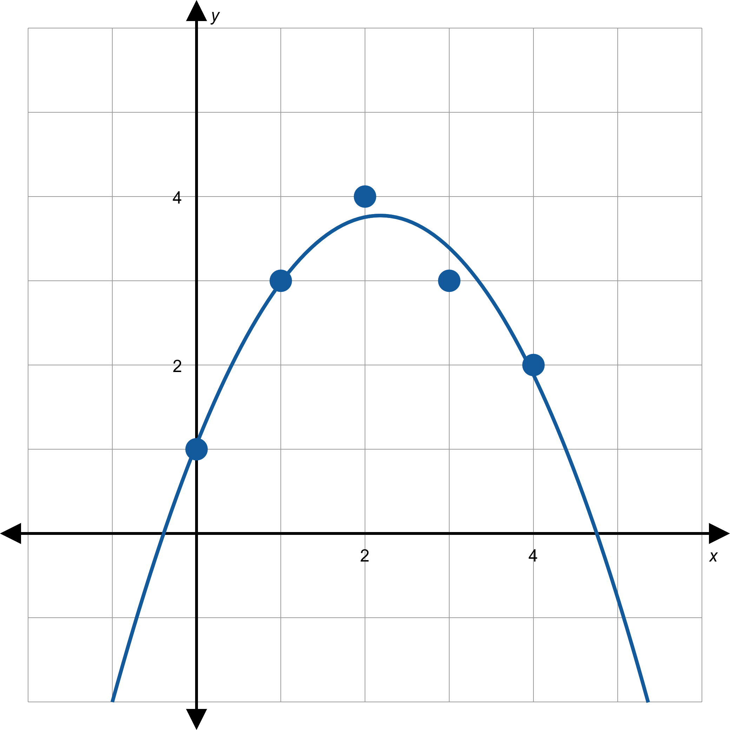
Example 4: Quadratic Regression (cont.)
Figure 11

Slide 26
Example 5: Quadratic Regression
​Find the quadratic function that best fits the points shown in Figure 12.
​Use your result to determine the coordinates of the vertex of the best-fitting parabola.

Slide 27
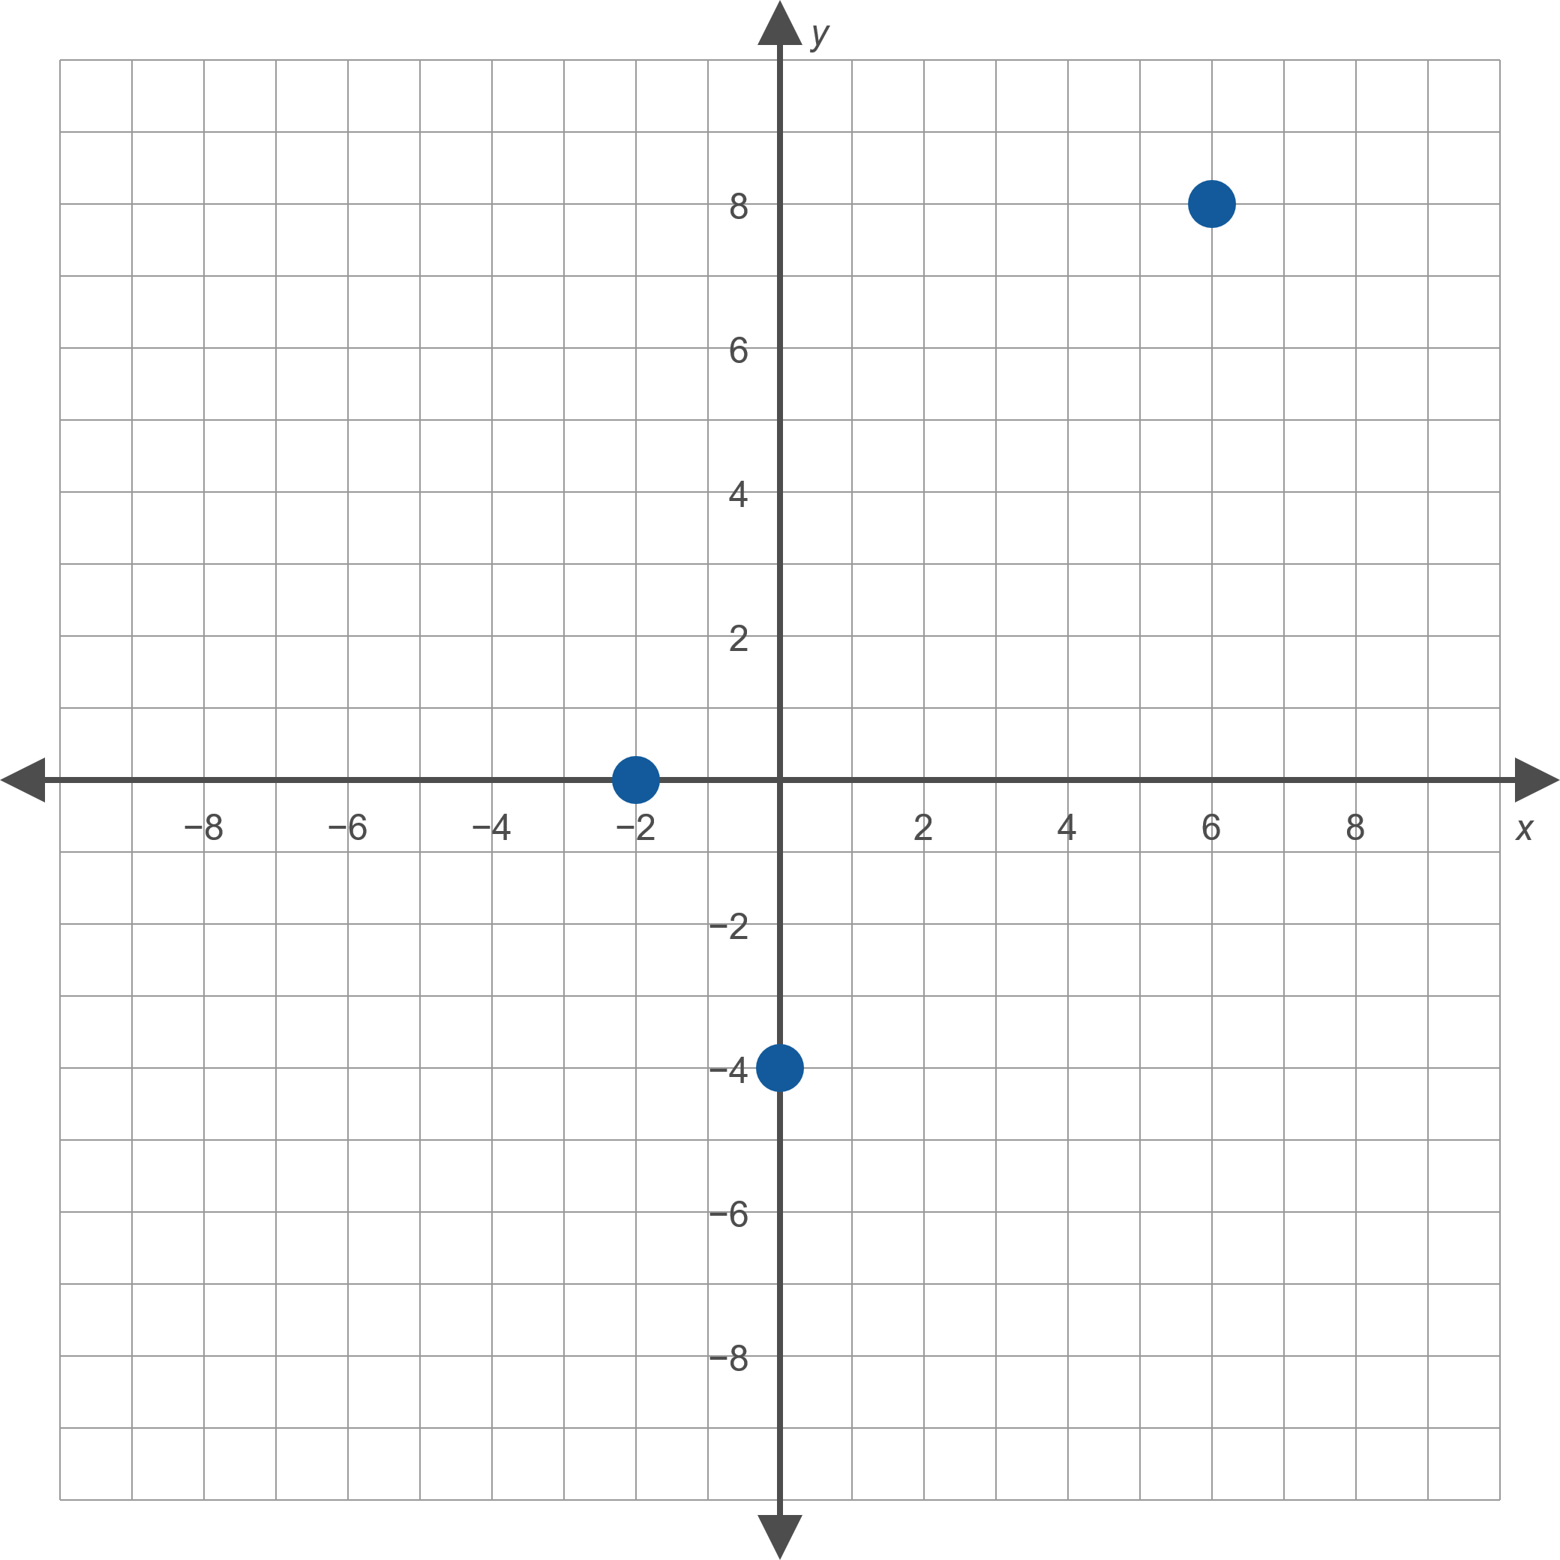
Example 5: Quadratic Regression (cont.)
Figure 12

Slide 28
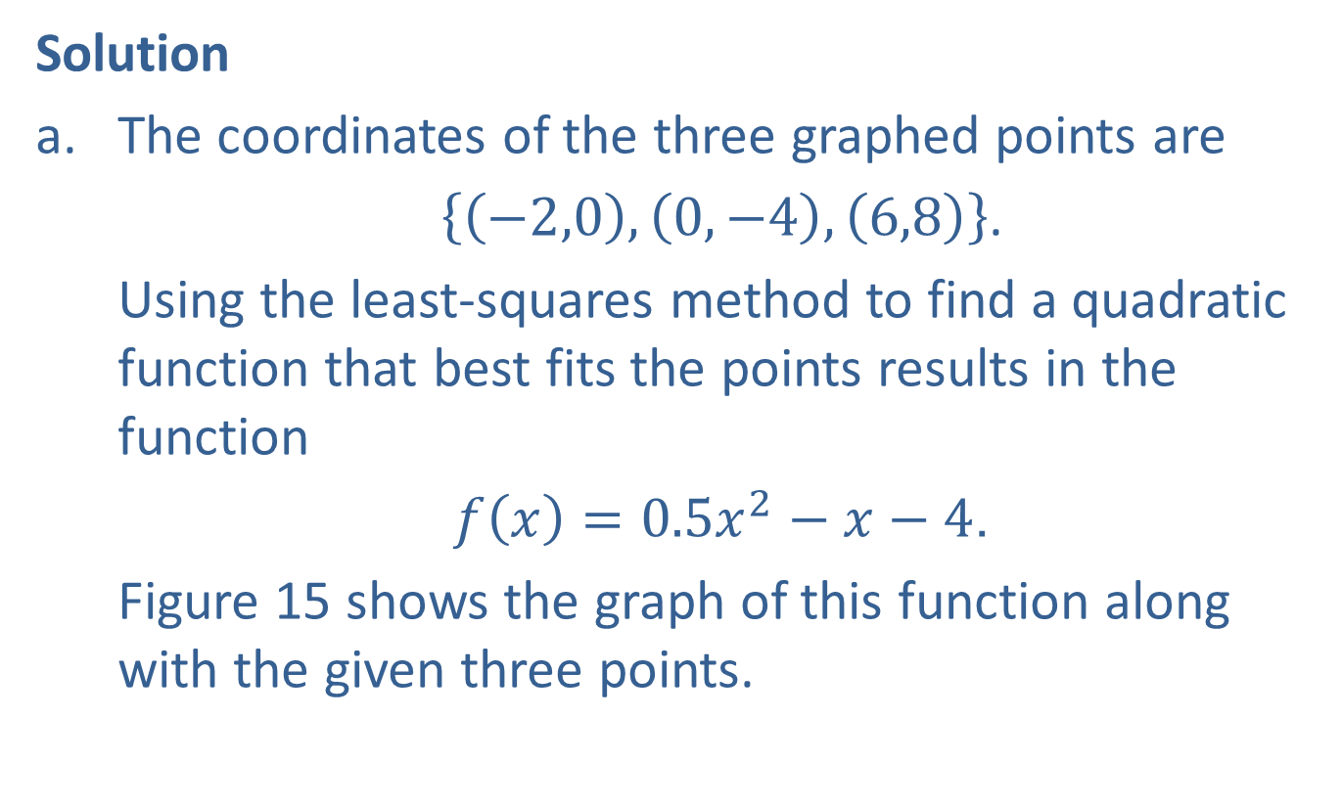
Example 5: Quadratic Regression (cont.)
Solution
​The coordinates of the three graphed points are
​$\left\{\left(−2,0\right),\left(0,−4\right),\left(6,8\right)\right\}$.
​Using the least-squares method to find a quadratic function that best fits the points results in the function
​$f\left(x\right)=0.5x^{2}−x−4$.
​Figure 15 shows the graph of this function along with the given three points.

Slide 29
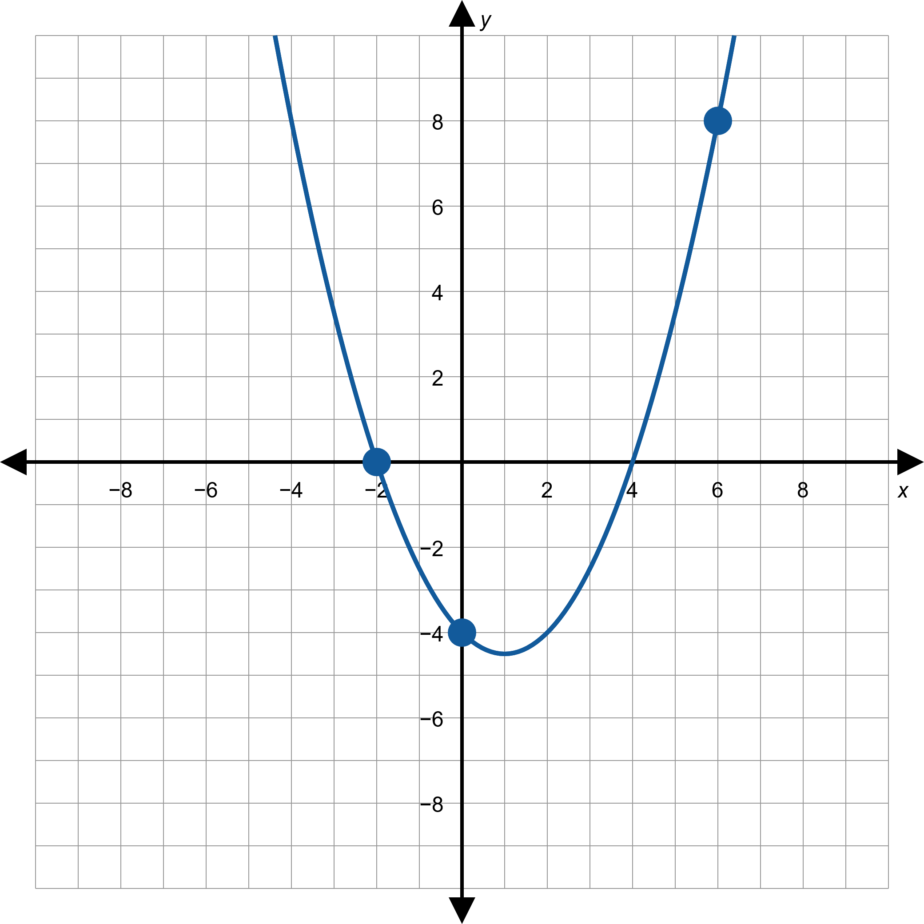
Example 5: Quadratic Regression (cont.)
Figure 15

Slide 30
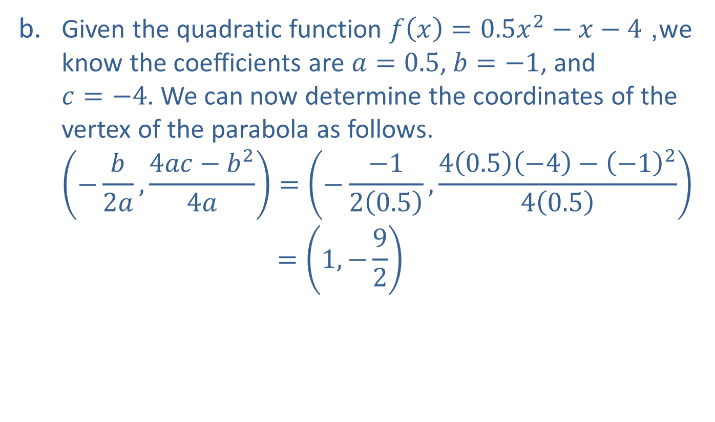
Example 5: Quadratic Regression (cont.)
​Given the quadratic function $f\left(x\right)=0.5x^{2}−x−4$, we know the coefficients are $a=0.5$, $b=−1$, and $c=−4$. We can now determine the coordinates of the vertex of the parabola as follows.
−𝑏2𝑎,4𝑎𝑐−𝑏24𝑎=−−120.5,40.5−4−−1240.5(−𝑏2𝑎,4𝑎𝑐−𝑏24𝑎 =1,−92

Slide 31
Example 6: Fencing a Garden
A farmer plans to use 100 feet of spare fencing material to form a rectangular garden plot against the side of a long barn, using the barn as one side of the plot. How should he split up the fencing among the other three sides in order to maximize the area of the garden plot?

Slide 32
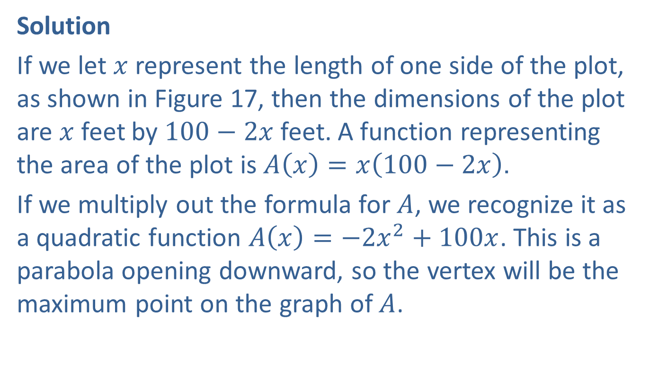
Example 6: Fencing a Garden (cont.)
Solution
If we let $x$ represent the length of one side of the plot, as shown in Figure 17, then the dimensions of the plot are $x$ feet by $100−2x$ feet. A function representing the area of the plot is $A\left(x\right)=x\left(100−2x\right)$.
If we multiply out the formula for $A$, we recognize it as a quadratic function $A\left(x\right)=−2x^{2}+100x$. This is a parabola opening downward, so the vertex will be the maximum point on the graph of $A$.

Slide 33
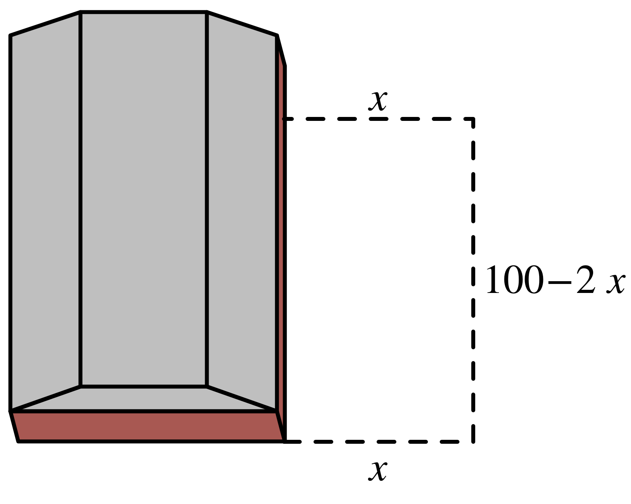
Example 6: Fencing a Garden (cont.)
Figure 17

Slide 34
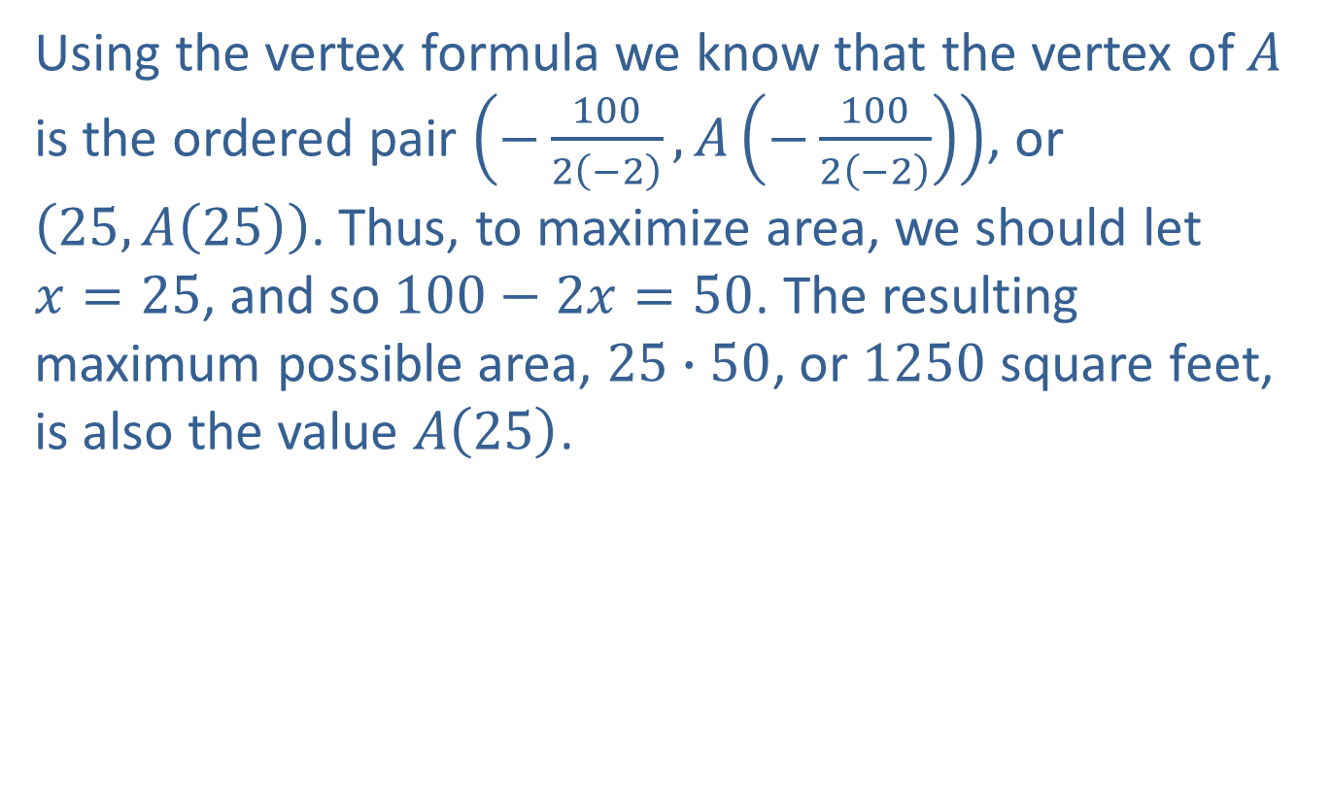
Example 6: Fencing a Garden (cont.)
Using the vertex formula we know that the vertex of $A$ is the ordered pair $\left(−\frac{100}{2\left(−2\right)},A\left(−\frac{100}{2\left(−2\right)}\right)\right)$, or $\left(25,A\left(25\right)\right)$. Thus, to maximize area, we should let $x=25$, and so $100−2x=50$. The resulting maximum possible area, $25∙50$, or 1250 square feet, is also the value $A\left(25\right)$.

Slide 35
Example 7: Quadratic Regression and Maximization
Suzanne occasionally plays guitar in a coffee shop and sells CDs of her music when she does. She’s been experimenting with the price to charge per CD and has noted the relationship between price and number of CDs sold shown in Table 1, where the corresponding revenue (the product of price and number sold) is also shown. If she assumes the dependence of revenue on number of CDs sold is quadratic in nature, what number of CDs sold will maximize her revenue? What is the corresponding price per CD?

Slide 36
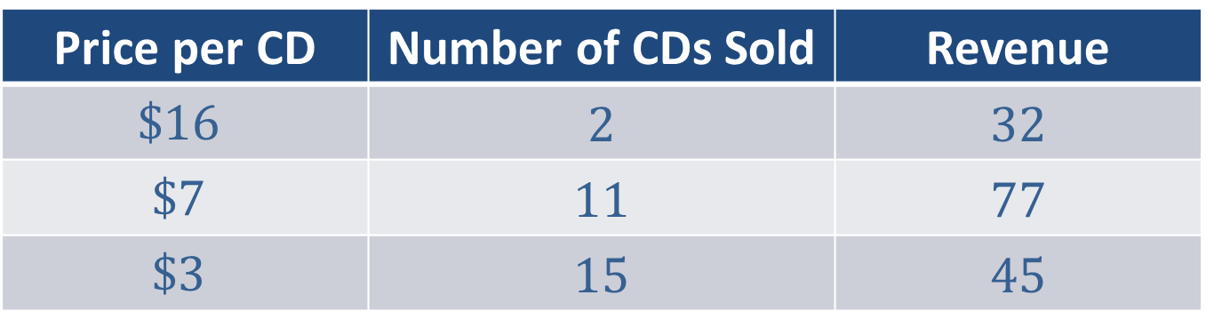
Example 7: Quadratic Regression and Maximization (cont.)
Price per CD | Number of CDs Sold | Revenue
$$\$16$$ | 2 | 32
$$\$7$$ | 11 | 77
$$\$3$$ | 15 | 45
Table 1

Slide 37
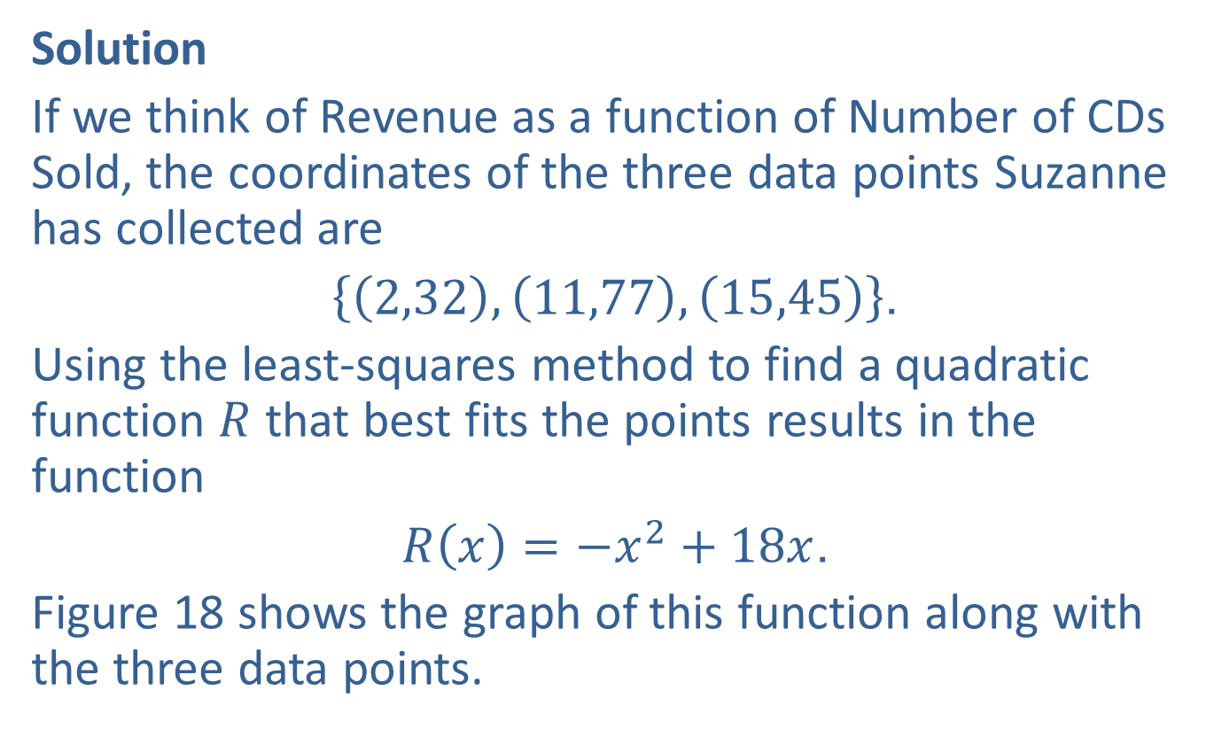
Example 7: Quadratic Regression and Maximization (cont.)
Solution
If we think of Revenue as a function of Number of CDs Sold, the coordinates of the three data points Suzanne has collected are
$\left\{\left(2,32\right),\left(11,77\right),\left(15,45\right)\right\}$.
Using the least-squares method to find a quadratic function $R$ that best fits the points results in the function
$R\left(x\right)=−x^{2}+18x$.
Figure 18 shows the graph of this function along with the three data points.

Slide 38
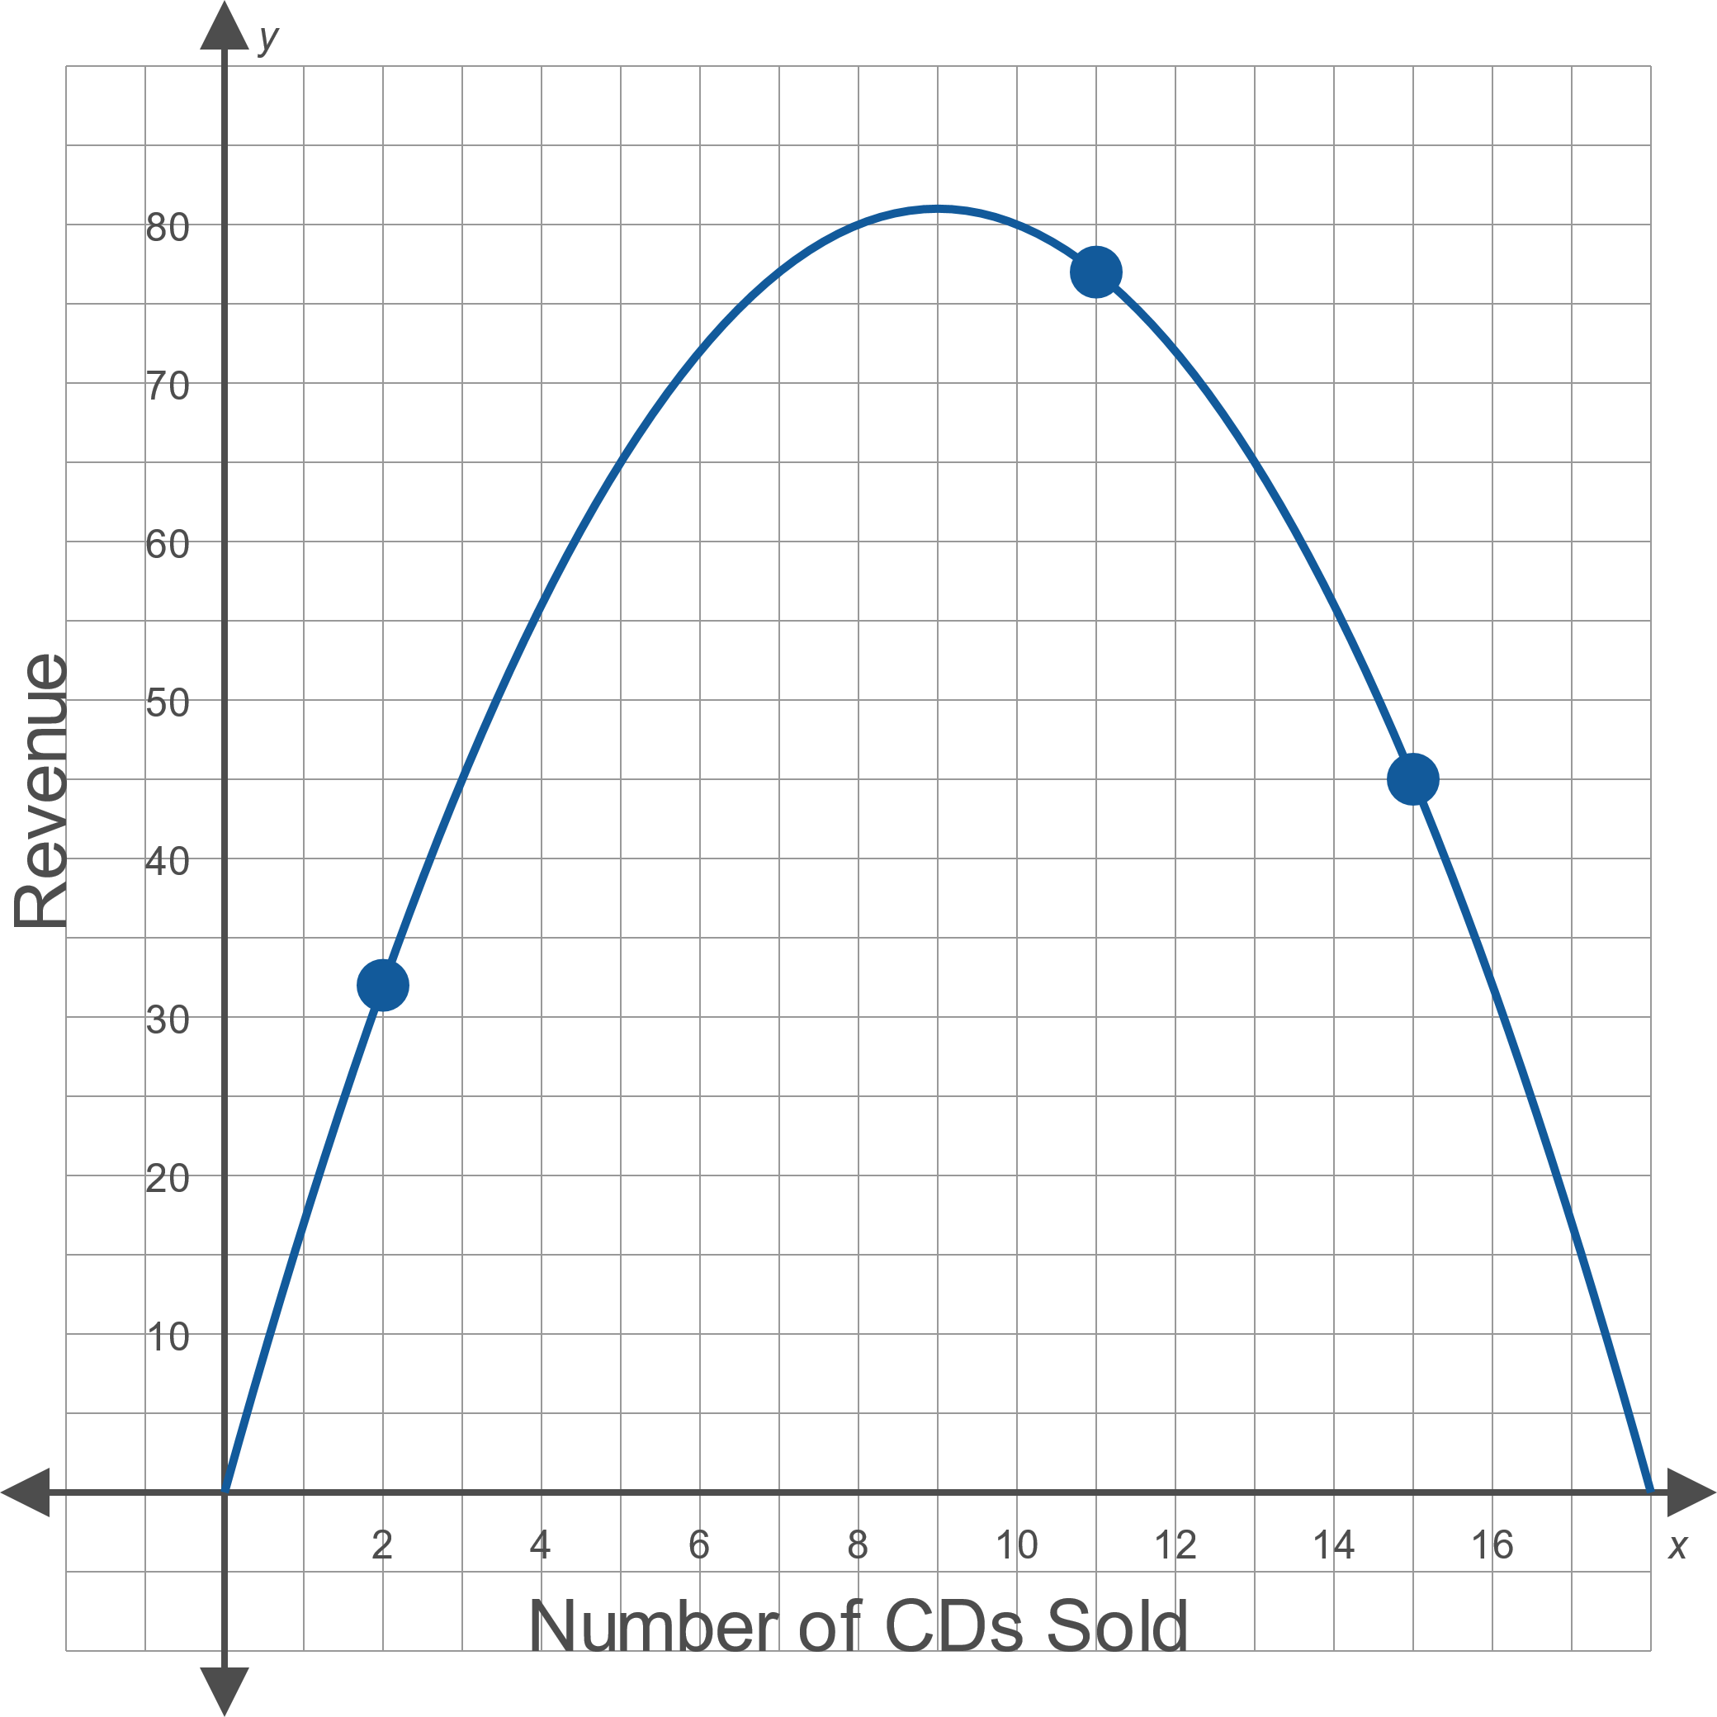
Example 7: Quadratic Regression and Maximization (cont.)
Figure 18

Slide 39
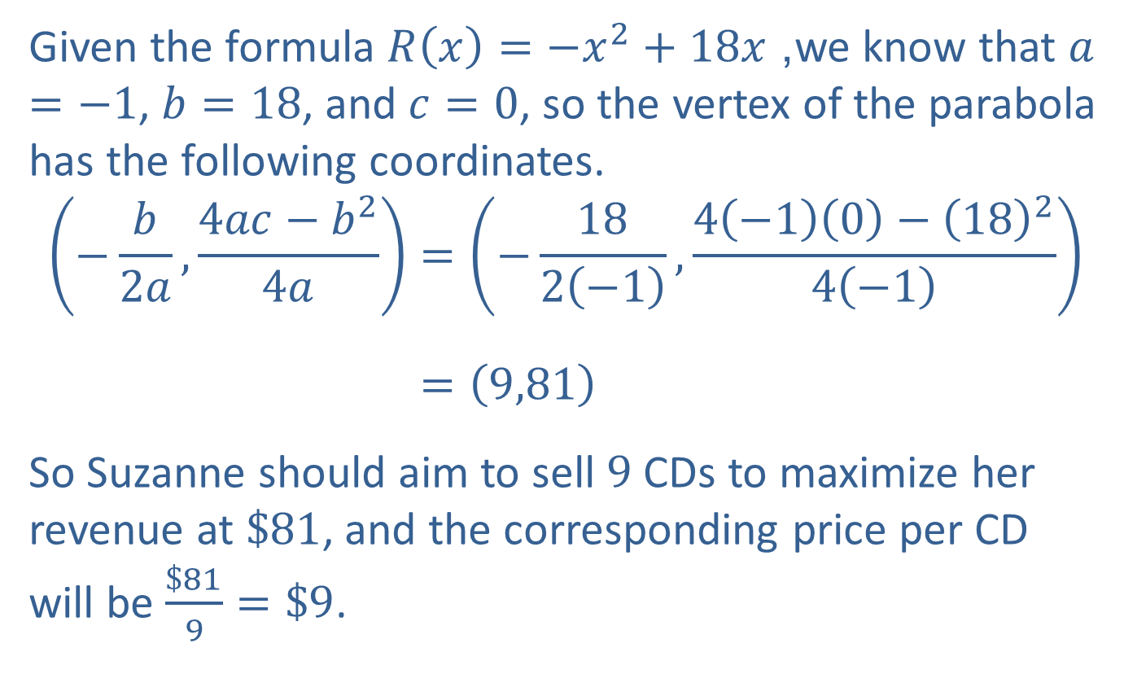
Example 7: Quadratic Regression and Maximization (cont.)
Given the formula $R\left(x\right)=−x^{2}+18x$, we know that $a=−1$, $b=18$, and $c=0$, so the vertex of the parabola has the following coordinates.
−𝑏2𝑎,4𝑎𝑐−𝑏24𝑎=−182−1,4−10−1824−1(−𝑏2𝑎,4𝑎𝑐−𝑏24𝑎)=9,81
So Suzanne should aim to sell 9 CDs to maximize her revenue at $\$81$, and the corresponding price per CD will be $\frac{\$81}{9}=\$9$.

