Slide 1
Section 6.2
Exponential Models

Slide 2
Example 1: Population Growth
A biologist is culturing bacteria in a large Petri dish. She begins with 1000 bacteria, and supplies sufficient food so that for the first five hours the bacteria population grows exponentially, doubling every hour.
​Find a function that models the population growth of this bacteria culture.
​Determine when the population reaches 16,000 bacteria.
​Calculate the population two and a half hours after the scientist begins.

Slide 3
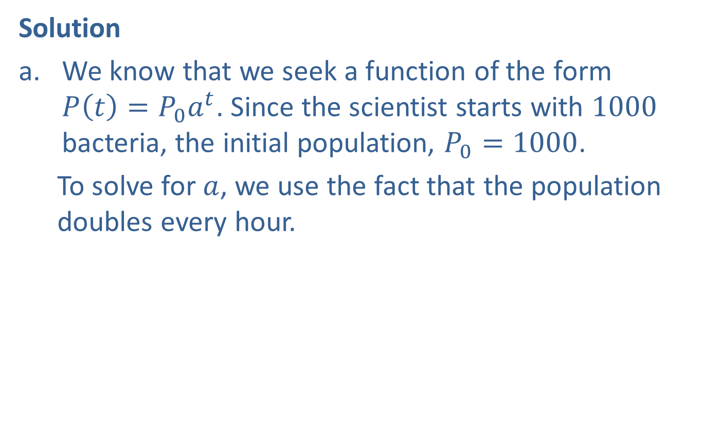
Example 1: Population Growth (cont.)
Solution
​We know that we seek a function of the form
$P\left(t\right)=P_{0}a^{t}$. Since the scientist starts with 1000 bacteria, the initial population, $P_{0}=1000$.
  To solve for $a$, we use the fact that the population doubles every hour.
​

Slide 4
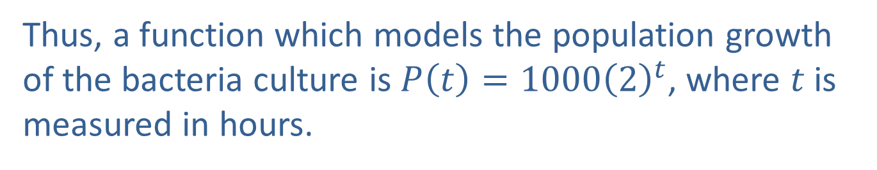
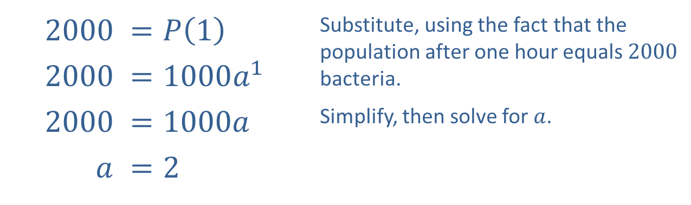
Example 1: Population Growth (cont.)
​2000 | ​=𝑃10. | Substitute, using the fact that the population after one hour equals 2000 bacteria.
​2000 | ​$=1000a^{1}$
​2000 | ​=1000𝑎0 | Simplify, then solve for $a$.
​$a$ | ​$=2$
​Thus, a function which models the population growth of the bacteria culture is $P\left(t\right)=1000{\left(2\right)}^{t}$, where $t$ is measured in hours.

Slide 5
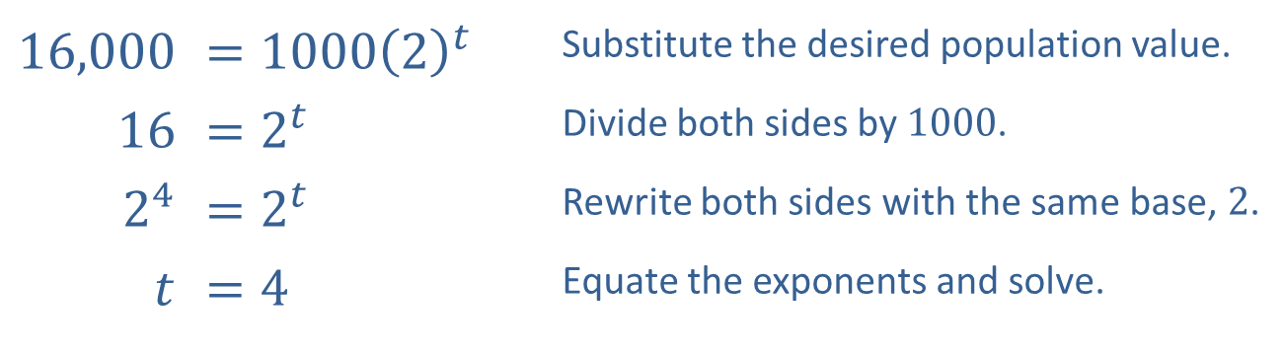

Example 1: Population Growth (cont.)
​We wish to find the time $t$ for which
$P\left(t\right)=16,000$.
​
​16,000 | ​$=1000{\left(2\right)}^{t}$ | Substitute the desired population value.
​16 | ​$=2^{t}$ | Divide both sides by 1000.
​$2^{4}$ | ​$=2^{t}$ | Rewrite both sides with the same base, 2.
​$t$ | ​$=4$ | Equate the exponents and solve.
  Thus, the bacteria culture reaches a population of 16,000 in 4 hours.

Slide 6
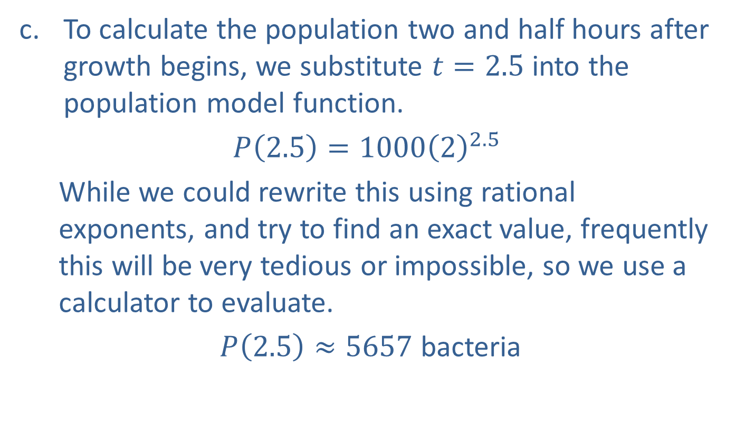
Example 1: Population Growth (cont.)
​To calculate the population two and half hours after growth begins, we substitute $t=2.5$ into the population model function.
​$P\left(2.5\right)=1000{\left(2\right)}^{2.5}$
  While we could rewrite this using rational exponents, and try to find an exact value, frequently this will be very tedious or impossible, so we use a calculator to evaluate.
​ $P\left(2.5\right)≈5657$ bacteria

Slide 7

Example 2: Radioactive Decay
Determine the base $a$ so that the function $A\left(t\right)=A_{0}a^{t}$ accurately describes the decay of carbon-14 as a function of $t$ years.

Slide 8
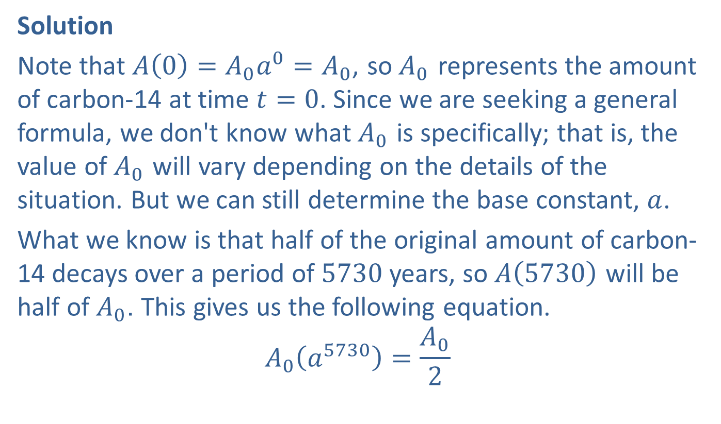
Example 2: Radioactive Decay (cont.)
Solution
Note that $A\left(0\right)=A_{0}a^{0}=A_{0}$, so $A_{0}$ represents the amount of carbon-14 at time $t=0$. Since we are seeking a general formula, we don't know what $A_{0}$ is specifically; that is, the value of $A_{0}$ will vary depending on the details of the situation. But we can still determine the base constant, $a$.
What we know is that half of the original amount of carbon-14 decays over a period of 5730 years, so $A⁡\left(5730\right)$ will be half of $A_{0}$. This gives us the following equation.
$$A_{0}\left(a^{5730}\right)=\frac{A_{0}}{2}$$

Slide 9
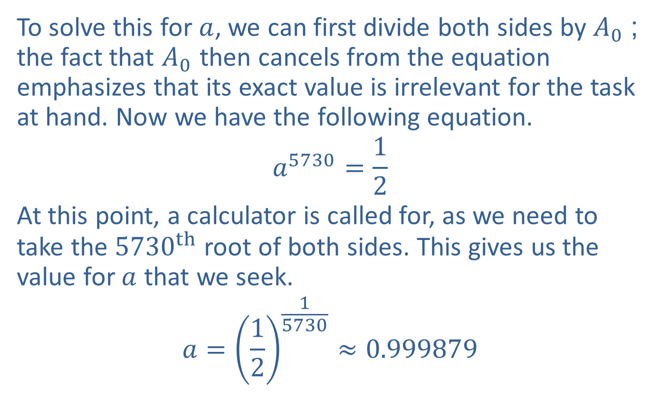
Example 2: Radioactive Decay (cont.)
To solve this for $a$, we can first divide both sides by $A_{0}$; the fact that $A_{0}$ then cancels from the equation emphasizes that its exact value is irrelevant for the task at hand. Now we have the following equation.
$$a^{5730}=\frac{1}{2}$$
At this point, a calculator is called for, as we need to take the ${5730}^{th}$ root of both sides. This gives us the value for $a$ that we seek.
$$a={\left(\frac{1}{2}\right)}^{\frac{1}{5730}}≈0.999879$$

Slide 10
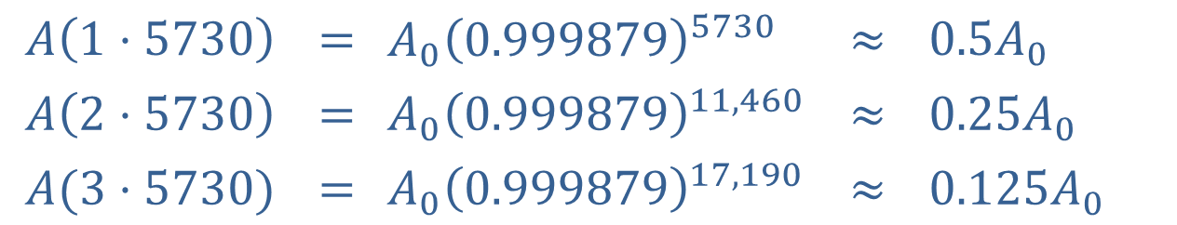

Example 2: Radioactive Decay (cont.)
The function is thus $A\left(t\right)=A_{0}{\left(0.999879\right)}^{t}$ (using our approximate value for $a$). We can now verify that the function behaves as expected by evaluating $A$ at various multiples of the half-life for carbon-14, as shown.
$$A\left(1⋅5730\right)$$ | $$=$$ | $$A_{0}{{\left(0.999879\right)}^{5730}}$$ | $$≈$$ | $0.5A_{0}$
$$A\left(2⋅5730\right)$$ | $$=$$ | $$A_{0}{{\left(0.999879\right)}^{11,460}}$$ | $$≈$$ | $0.25A_{0}$
$$A{(3⋅5730)}$$ | $$=$$ | $$A_{0}{\left(0.999879\right)}^{17,190}$$ | $$≈$$ | $0.125A_{0}$

Slide 11
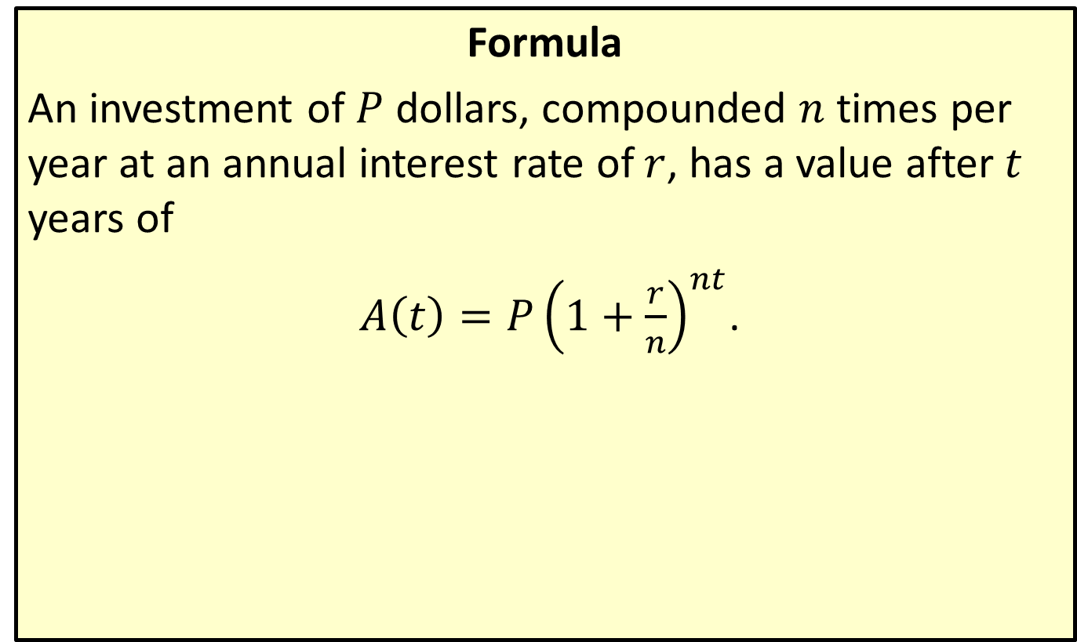
Compound Interest Formula
Formula
An investment of $P$ dollars, compounded $n$ times per year at an annual interest rate of $r$, has a value after $t$ years of
$A\left(t\right)=P{\left(1+\frac{r}{n}\right)}^{nt}$.

Slide 12

Example 3: Compound Interest Formula
Sandy invests $\$10,000$ in a savings account earning $4.5\%$ annual interest compounded quarterly. What is the value of her investment after three and a half years?

Slide 13
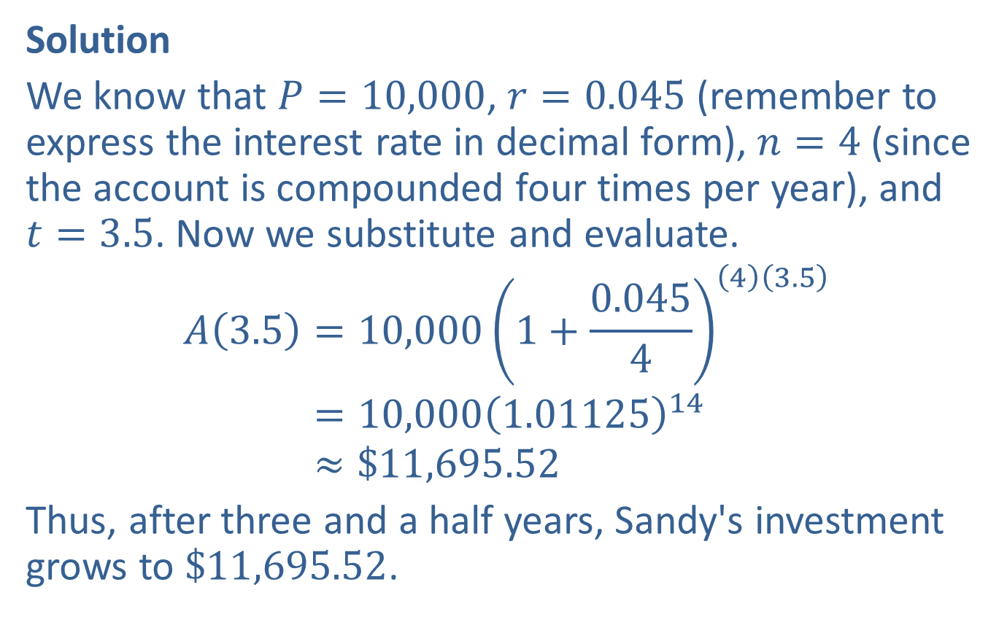
Example 3: Compound Interest Formula (cont.)
Solution
We know that $P=10,000$, $r=0.045$ (remember to express the interest rate in decimal form), $n=4$ (since the account is compounded four times per year), and
$t=3.5$. Now we substitute and evaluate.
𝐴3.5=10,0001+0.045443.5𝐴⁡3.5=10,0001.0112514𝐴⁡3.5≈$11,695.52
Thus, after three and a half years, Sandy's investment grows to $\$11,695.52$.

Slide 14
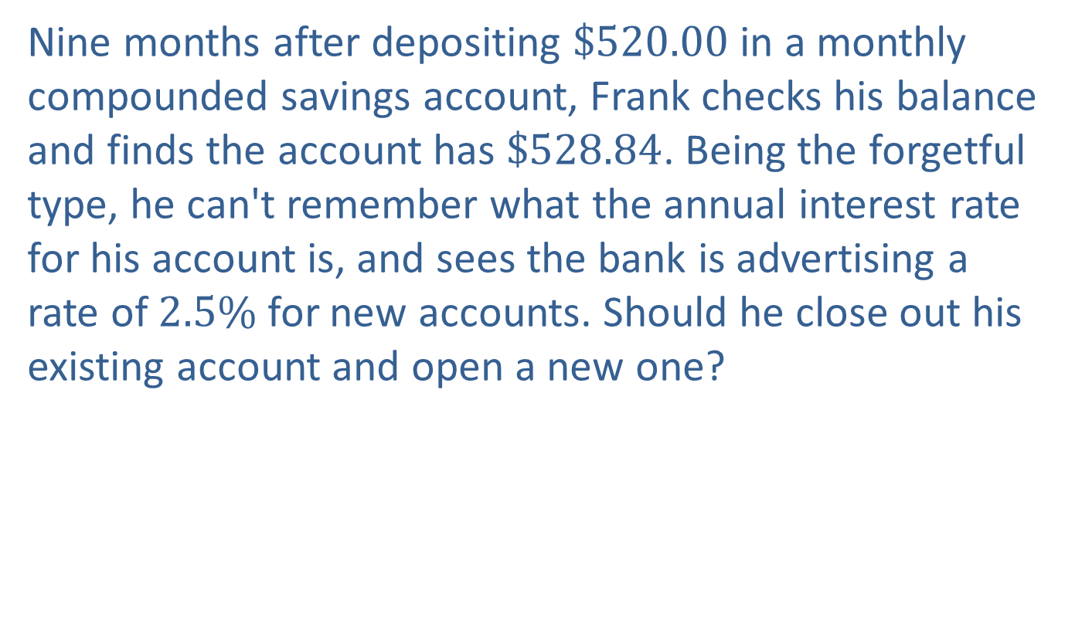
Example 4: Compound Interest Formula
Nine months after depositing $\$520.00$ in a monthly compounded savings account, Frank checks his balance and finds the account has $\$528.84$. Being the forgetful type, he can't remember what the annual interest rate for his account is, and sees the bank is advertising a rate of $2.5\%$ for new accounts. Should he close out his existing account and open a new one?

Slide 15
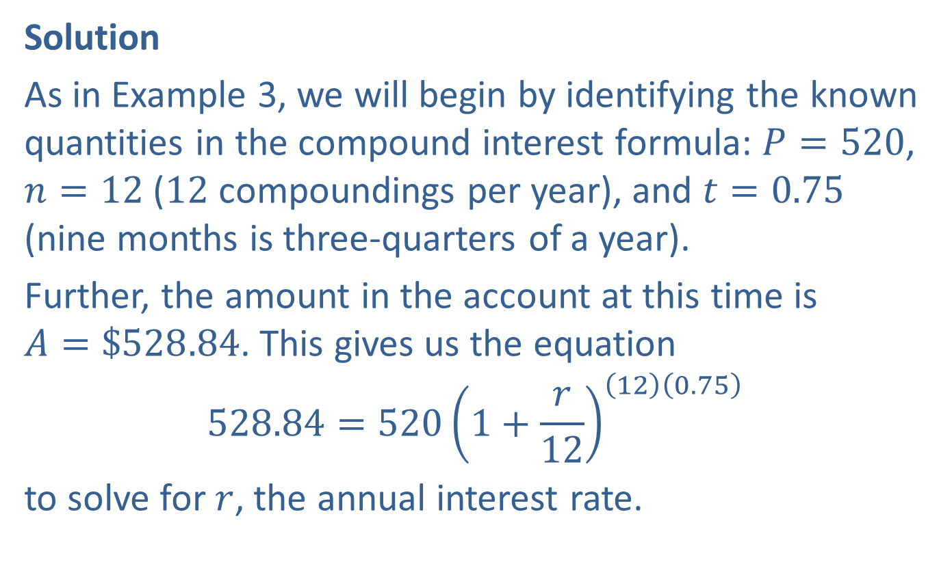
Example 4: Compound Interest Formula (cont.)
Solution
As in Example 3, we will begin by identifying the known quantities in the compound interest formula: $P=520$, $n=12$ (12 compoundings per year), and $t=0.75$ (nine months is three-quarters of a year).
Further, the amount in the account at this time is
$A=\$528.84$. This gives us the equation
$$528.84=520{\left(1+\frac{r}{12}\right)}^{\left(12\right)\left(0.75\right)}$$
to solve for $r$, the annual interest rate.

Slide 16

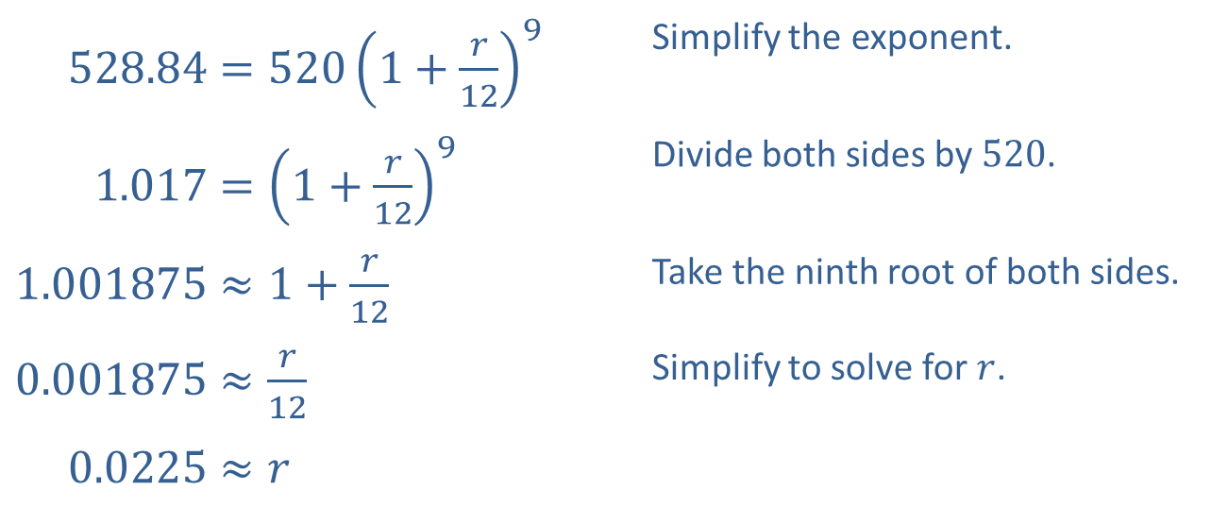
Example 4: Compound Interest Formula (cont.)
​00528.84=5201+𝑟129 | Simplify the exponent.
​0001.017=1+𝑟129 | Divide both sides by 520.
​$1.001875≈1+\frac{r}{12}$ | Take the ninth root of both sides.
​$0.001875≈\frac{r}{12}$ | Simplify to solve for $r$.
​000.0225≈𝑟
Thus, Frank's current savings account is paying an annual interest rate of $2.25\%$, so he would gain a slight advantage by switching to a new account.

Slide 17
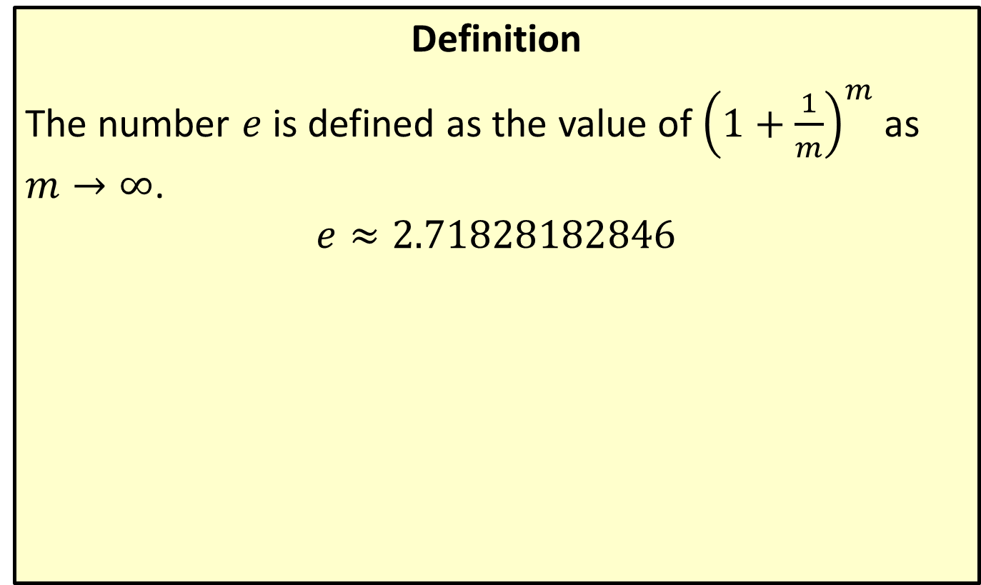

The Number $e$
Definition
The number $e$ is defined as the value of ${\left(1+\frac{1}{m}\right)}^{m}$ as
$m→∞$.
$$e≈2.71828182846$$

Slide 18
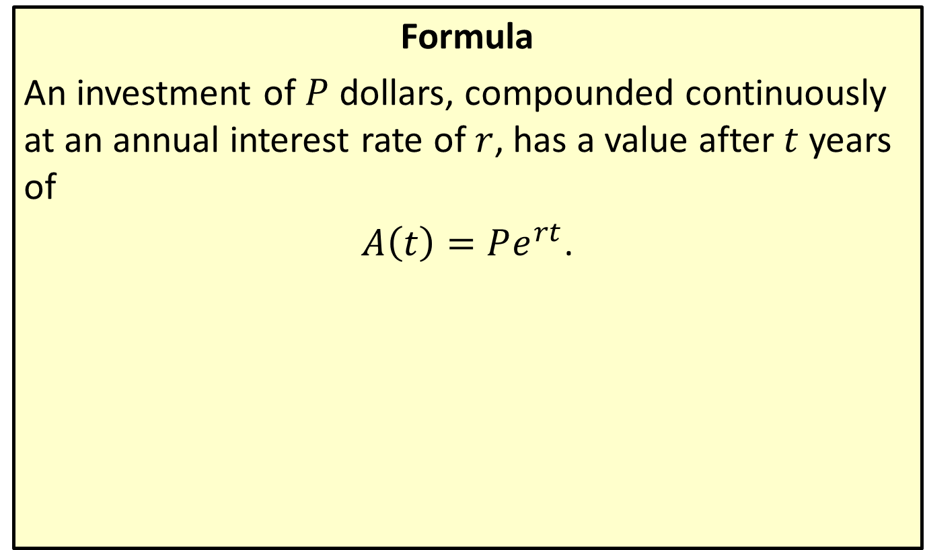
Continuous Compounding Formula
Formula
An investment of $P$ dollars, compounded continuously at an annual interest rate of $r$, has a value after $t$ years of
$A\left(t\right)=Pe^{rt}$.

Slide 19

Example 5: Continuous Compounding Formula
If Sandy (last seen in Example 3) has the option of investing her $\$10,000$ in a continuously compounded account earning $4.5\%$ annual interest, what will be the value of her account in three and a half years?

Slide 20
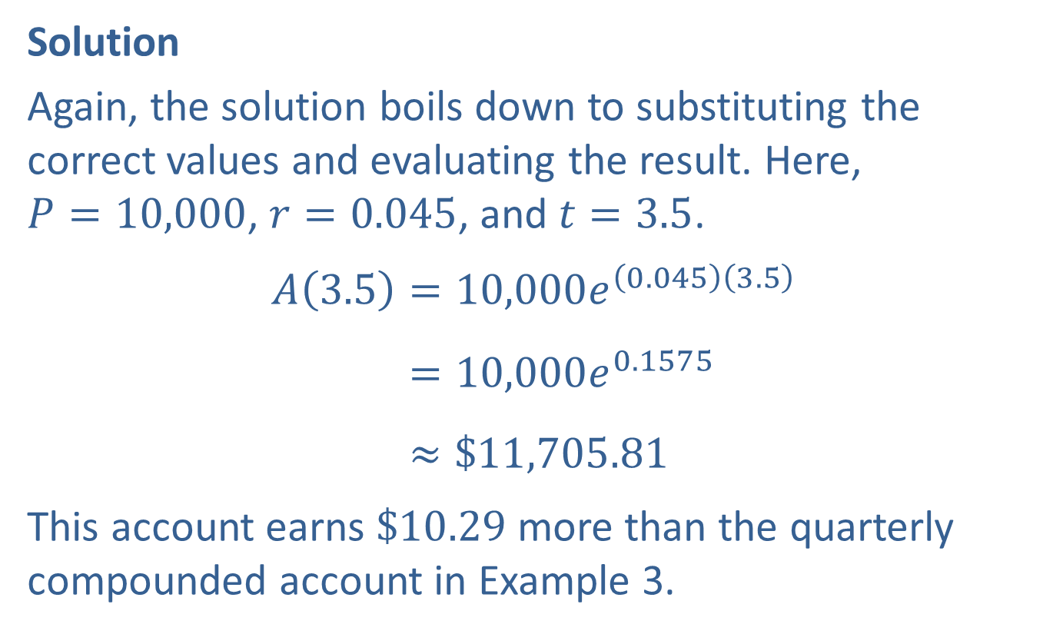
Example 5: Continuous Compounding Formula (cont.)
Solution
Again, the solution boils down to substituting the correct values and evaluating the result. Here,
$P=10,000$, $r=0.045$, and $t=3.5$.
𝐴3.5=10,000𝑒0.0453.5𝐴⁡3.5=10,000𝑒0.1575𝐴⁡3.5≈$11,705.81
This account earns $\$10.29$ more than the quarterly compounded account in Example 3.

Slide 21
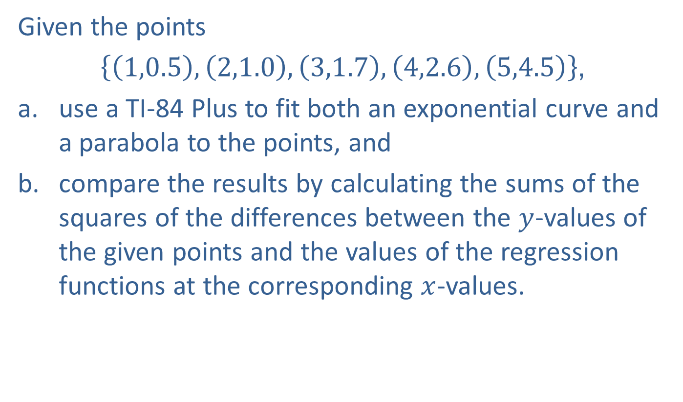
Example 6: Exponential Regression
Given the points
$\left\{\left(1,0.5\right),\left(2,1.0\right),\left(3,1.7\right),\left(4,2.6\right),\left(5,4.5\right)\right\}$,
​use a TI-84 Plus to fit both an exponential curve and a parabola to the points, and
​compare the results by calculating the sums of the squares of the differences between the $y$-values of the given points and the values of the regression functions at the corresponding $x$-values.

Slide 22

Example 6: Exponential Regression (cont.)
Solution
​For the given five points in this example, a TI-84 Plus returns the following exponential function of best fit as shown in Figure 1.
​$f\left(x\right)=0.3180{\left(1.707\right)}^{x}$
​

Slide 23
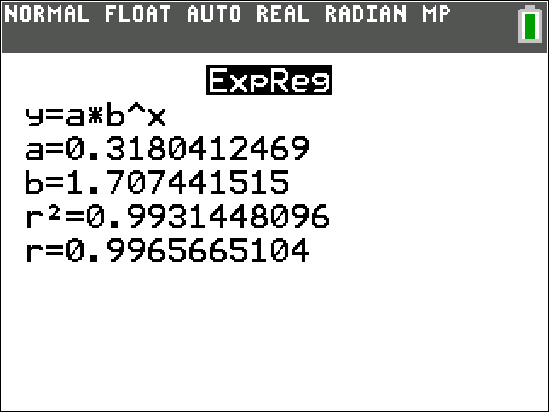
Example 6: Exponential Regression (cont.)
Figure 1

Slide 24

Example 6: Exponential Regression (cont.)
​A graph of $f$ along with the given points is shown in Figure 2.
​

Slide 25
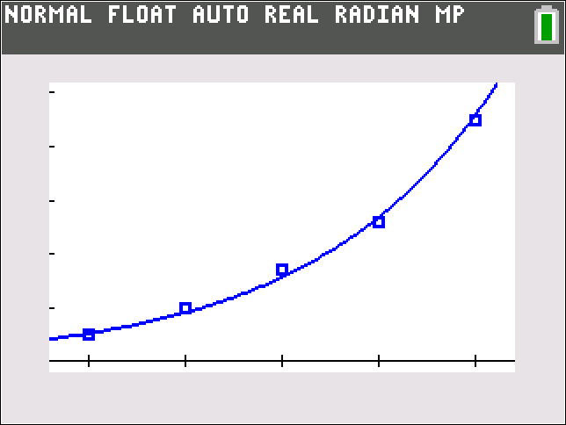
Example 6: Exponential Regression (cont.)
Figure 2

Slide 26

Example 6: Exponential Regression (cont.)
​​A graphing utility can also be used to find a quadratic function that best fits a given set of points. In this case, the equation of the best-fitting parabola, as shown in Figure 3, is the function
​ $g\left(x\right)=0.2143x^{2}−0.3257x+0.6800$.
​​

Slide 27
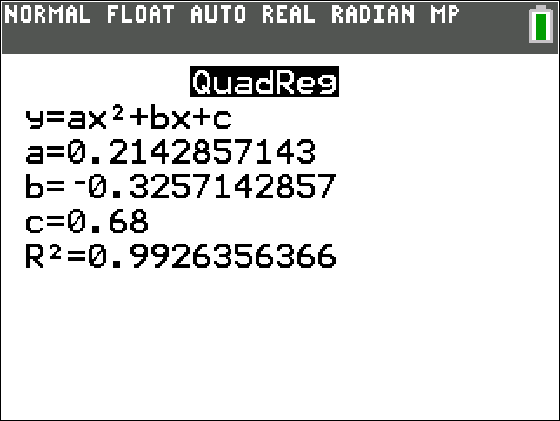
Example 6: Exponential Regression (cont.)
Figure 3

Slide 28

Example 6: Exponential Regression (cont.)
​And a graph of $g$ with the given points appears in Figure 4.
​

Slide 29

Example 6: Exponential Regression (cont.)
Figure 4

Slide 30

Example 6: Exponential Regression (cont.)
​The values of the exponential regression function f at the $x$-values of the given points are
​ $f\left(1\right)≈0.5428$, $f\left(2\right)≈0.9266$, $f\left(3\right)≈1.5817$,
$f\left(4\right)≈2.7000$, and $f\left(5\right)≈4.6089$.

Slide 31
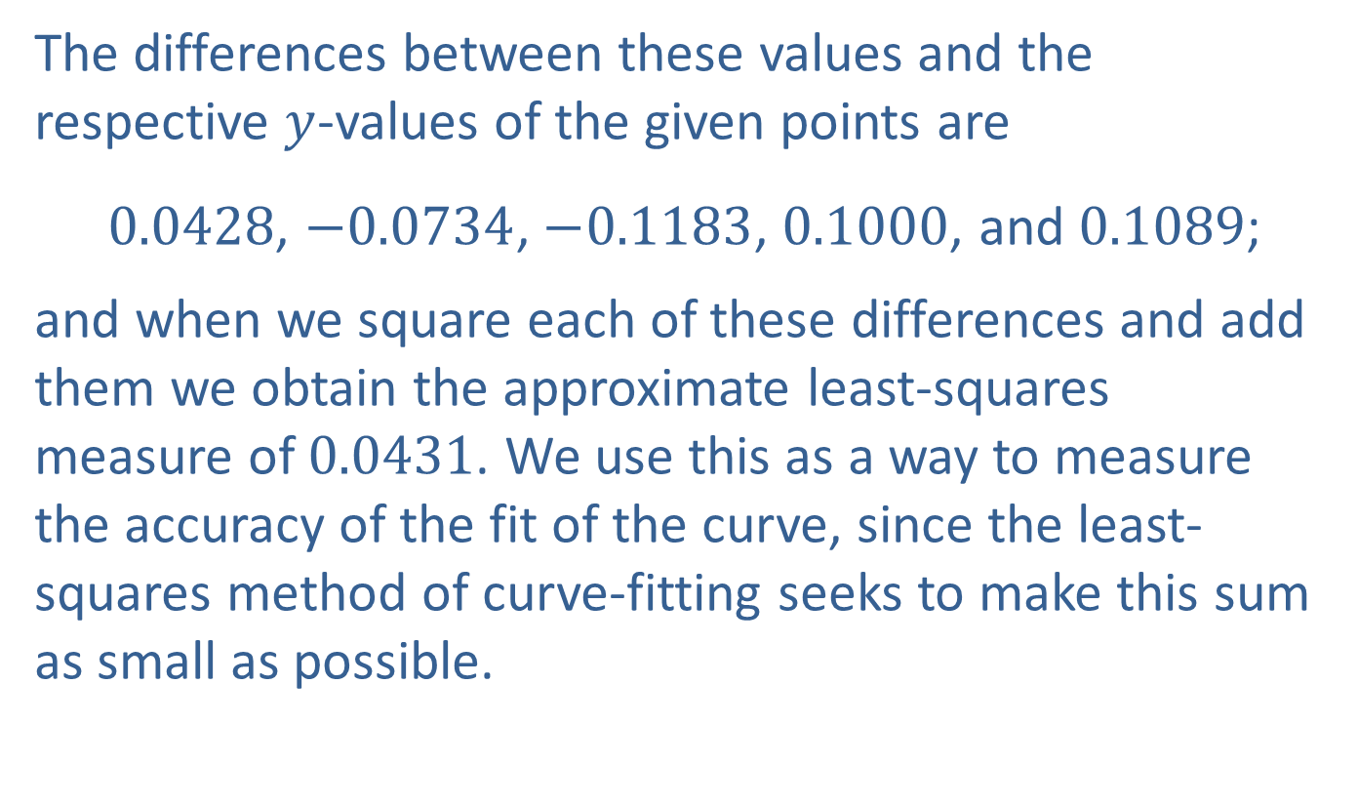
Example 6: Exponential Regression (cont.)
​The differences between these values and the respective $y$-values of the given points are
​ 0.0428, $−0.0734$, $−0.1183$, 0.1000, and 0.1089;
​and when we square each of these differences and add them we obtain the approximate least-squares measure of 0.0431. We use this as a way to measure the accuracy of the fit of the curve, since the least-squares method of curve-fitting seeks to make this sum as small as possible.

Slide 32
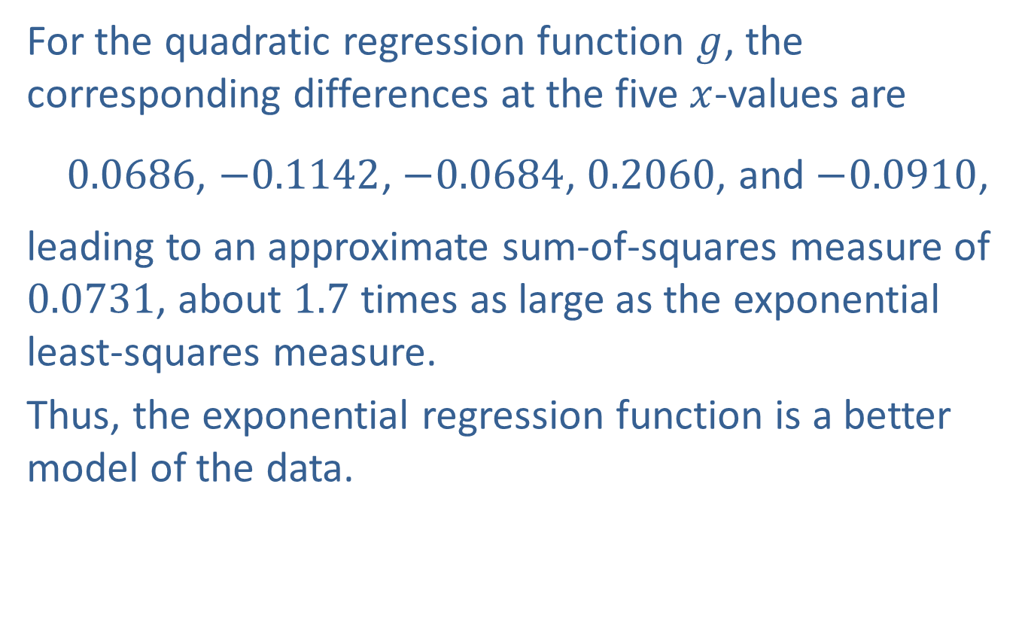
Example 6: Exponential Regression (cont.)
​For the quadratic regression function $g$, the corresponding differences at the five $x$-values are
​ 0.0686, $−0.1142$, $−0.0684$, 0.2060, and $−0.0910$,
​leading to an approximate sum-of-squares measure of 0.0731, about 1.7 times as large as the exponential least-squares measure.
​Thus, the exponential regression function is a better model of the data.

Slide 33
Example 7: Logistic Regression
Table 4 shows the weight of a puppy at the end of each of its first 12 months of life. Karen, the puppy's owner, had been told to expect the dog to have an adult weight somewhere between 40 and 45 pounds. Use a graphing utility to fit a logistic curve to the recorded weights and use the result to predict the dog's weight at the end of the second year. Compare the logistic curve to the best-fitting line and best-fitting parabola.

Slide 34
Example 7: Logistic Regression (cont.)
Table 4
End of Month | Weight (in pounds)
1 | 3
2 | 5
3 | 8
4 | 11
5 | 17
6 | 22
7 | 28
8 | 32
9 | 35
10 | 38
11 | 40
12 | 42

Slide 35
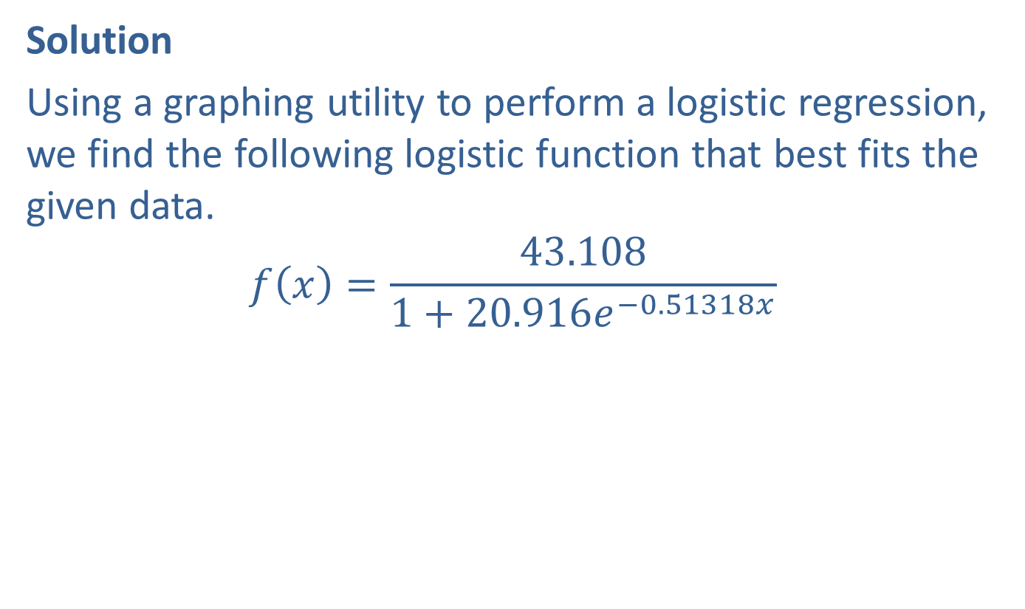
Example 7: Logistic Regression (cont.)
Solution
Using a graphing utility to perform a logistic regression, we find the following logistic function that best fits the given data.
$$f\left(x\right)=\frac{43.108}{1+20.916e^{−0.51318x}}$$

Slide 36
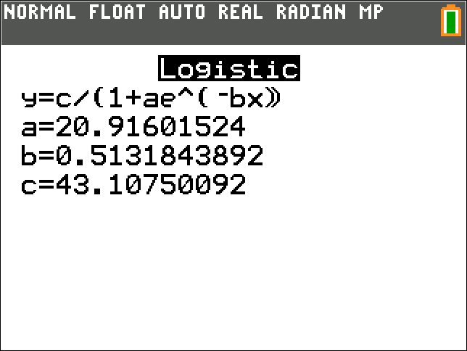
Example 7: Logistic Regression (cont.)
Figure 5

Slide 37

Example 7: Logistic Regression (cont.)
A graph of $f$, along with the given 12 data points, appears in Figure 6.

Slide 38
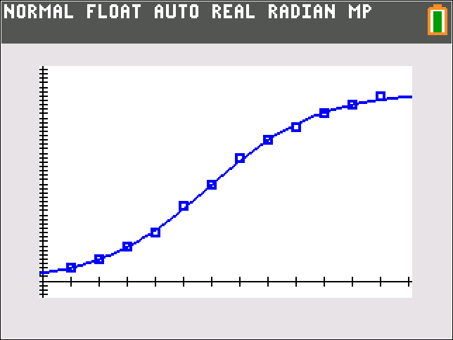
Example 7: Logistic Regression (cont.)
Figure 6

Slide 39
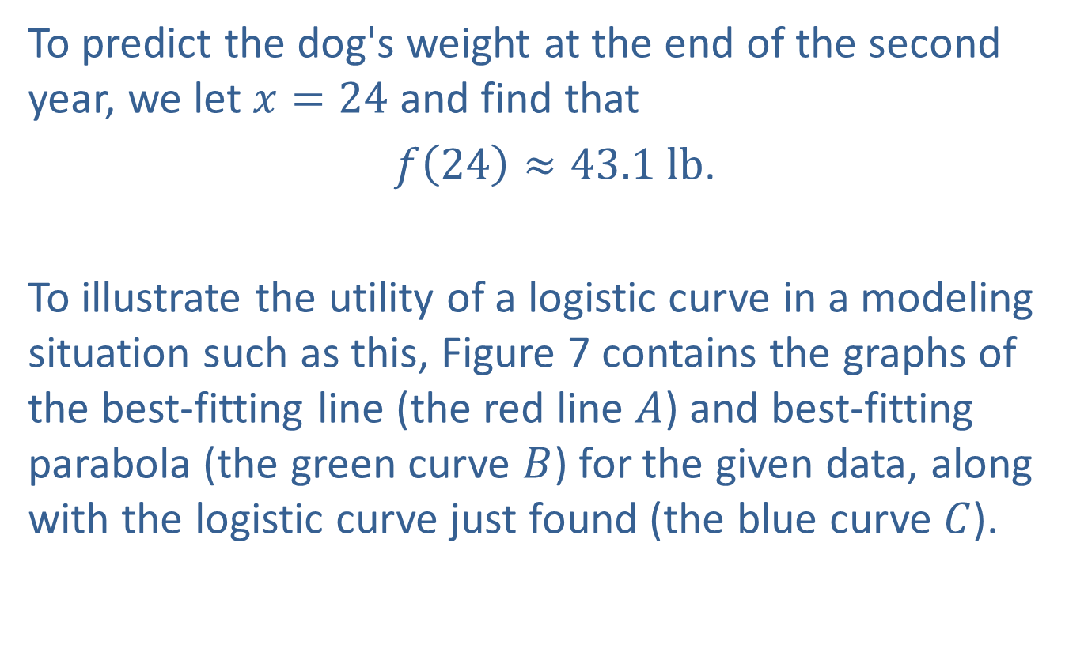
Example 7: Logistic Regression (cont.)
To predict the dog's weight at the end of the second year, we let $x=24$ and find that
$f\left(24\right)≈43.1 lb$.
To illustrate the utility of a logistic curve in a modeling situation such as this, Figure 7 contains the graphs of the best-fitting line (the red line $A$) and best-fitting parabola (the green curve $B$) for the given data, along with the logistic curve just found (the blue curve $C$).

Slide 40
Example 7: Logistic Regression (cont.)
The graphs indicate that both linear and quadratic regression are inappropriate tools in this case, while the logistic regression function appears to be much more realistic. As a particular point of comparison, the weights predicted by the linear and quadratic models at the end of month 24 are, respectively, 92 pounds and 68 pounds, far outside the expected range of 40 to 45 pounds.

Slide 41
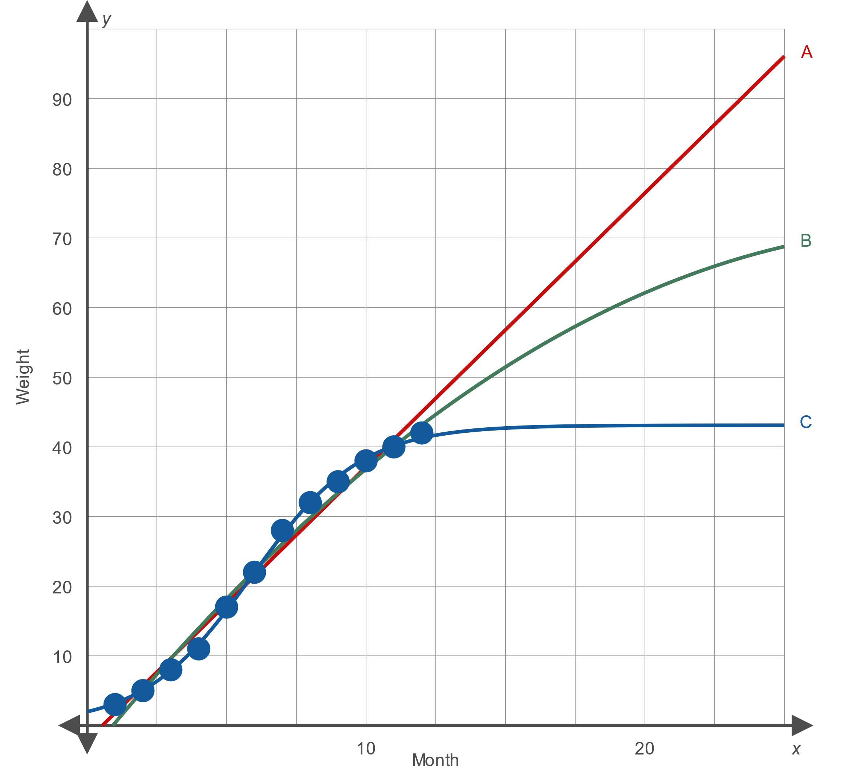
Example 7: Logistic Regression (cont.)
Figure 7

