Slide 1
Section 7.1
Radian and Degree Measure

Slide 2
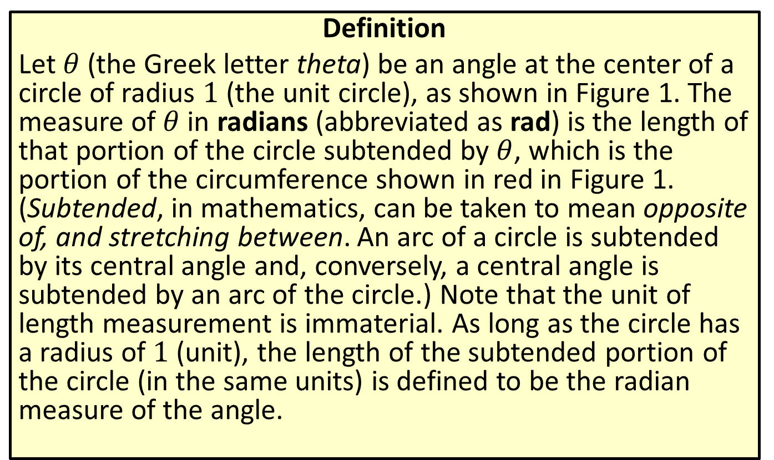
Radian Measure
Definition
Let $θ$ (the Greek letter theta) be an angle at the center of a circle of radius 1 (the unit circle), as shown in Figure 1. The measure of $θ$ in radians (abbreviated as rad) is the length of that portion of the circle subtended by $θ$, which is the portion of the circumference shown in red in Figure 1. (Subtended, in mathematics, can be taken to mean opposite of, and stretching between. An arc of a circle is subtended by its central angle and, conversely, a central angle is subtended by an arc of the circle.) Note that the unit of length measurement is immaterial. As long as the circle has a radius of 1 (unit), the length of the subtended portion of the circle (in the same units) is defined to be the radian measure of the angle.

Slide 3
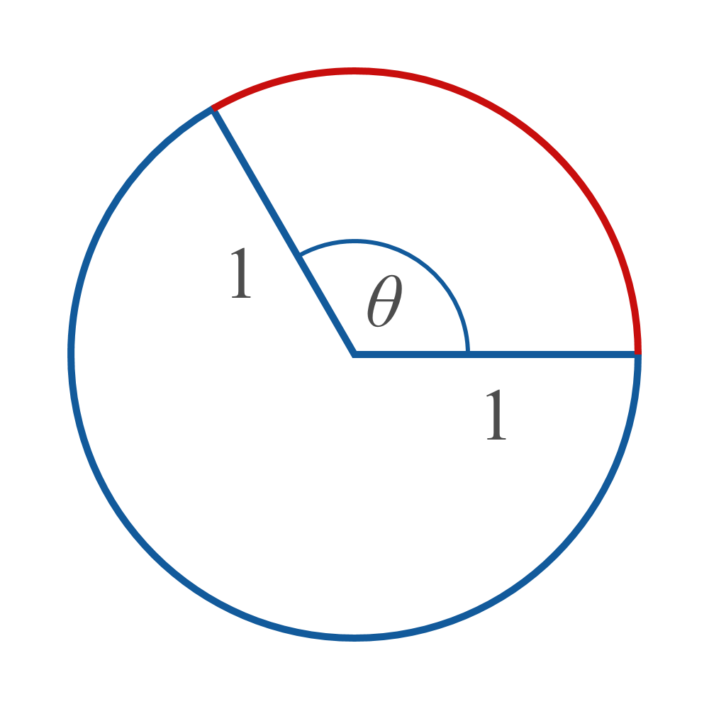
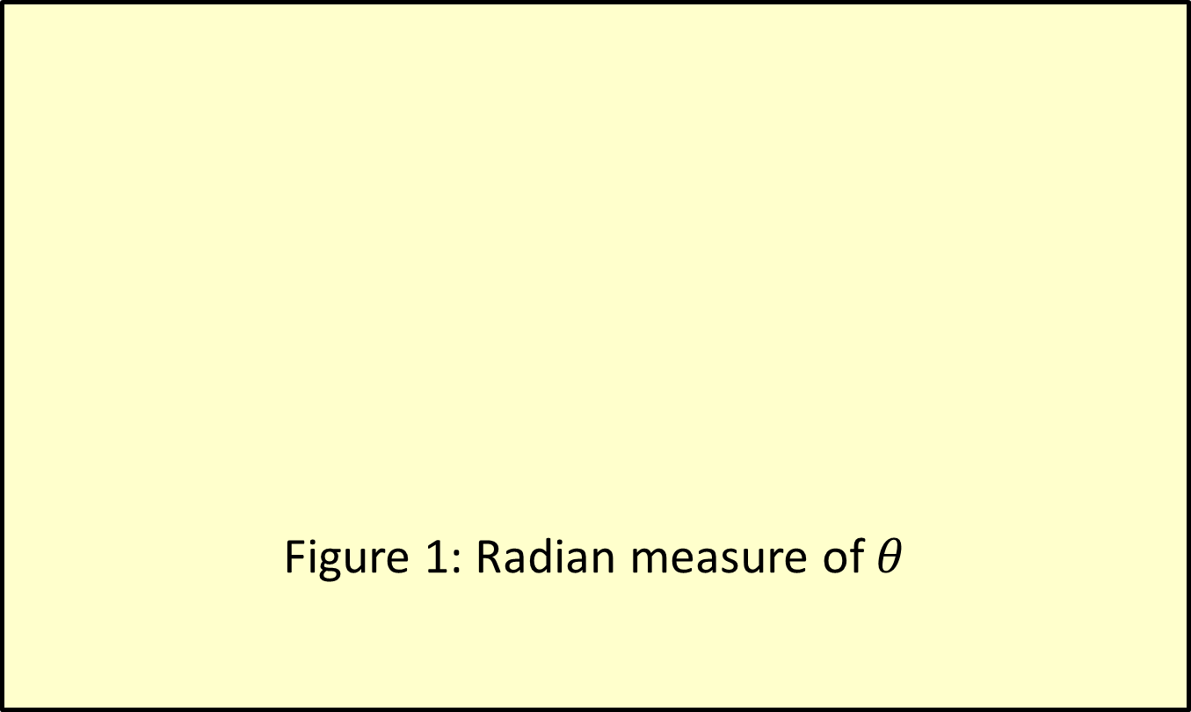
Radian Measure (cont.)
Figure 1: Radian measure of $θ$

Slide 4
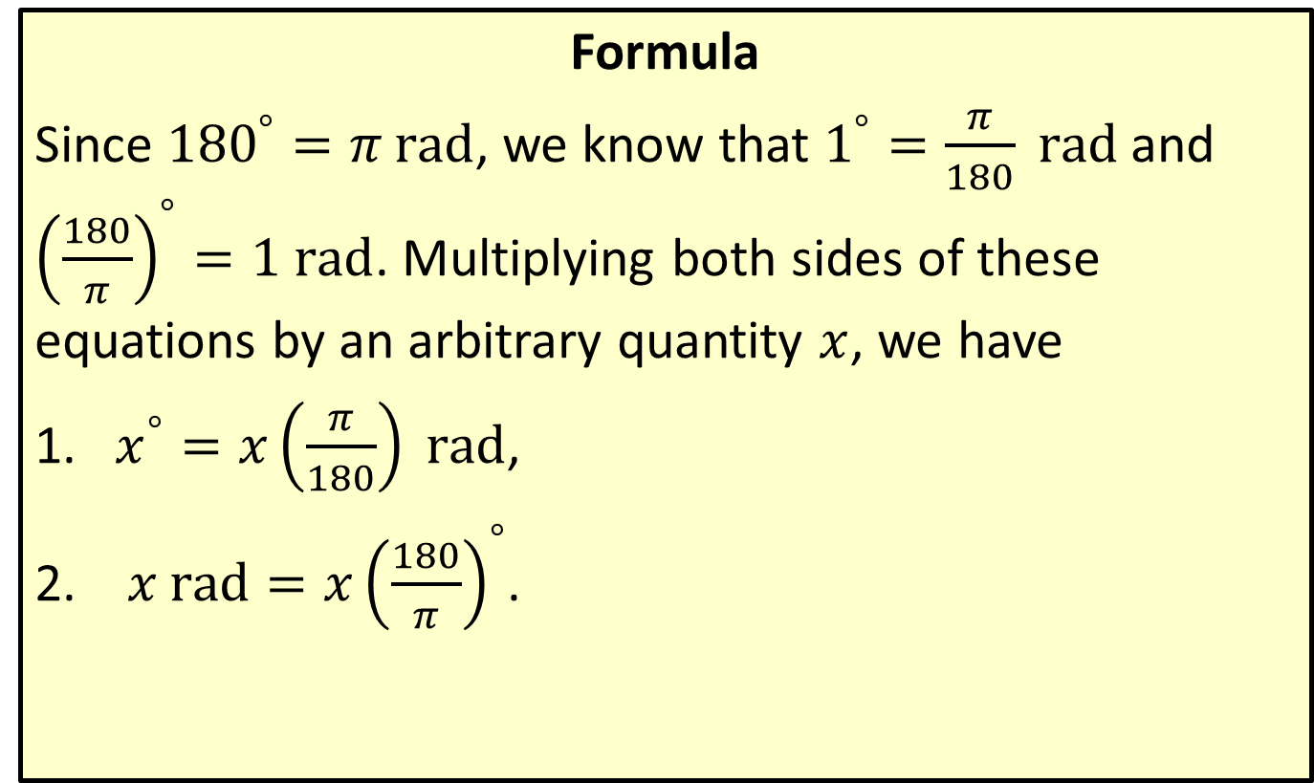
Angle Measurement Conversion
Formula
Since ${180}^{°}=π \text{rad}$, we know that $1^{°}=\frac{π}{180} \text{rad}$ and ${\left(\frac{180}{π}\right)}^{°}=1 \text{rad}$. Multiplying both sides of these equations by an arbitrary quantity $x$, we have
​$x^{°}=x\left(\frac{π}{180}\right) \text{rad}$,
​ $x rad=x{\left(\frac{180}{π}\right)}^{°}$.

Slide 5

Example 1: Converting between Degrees and Radians
Convert the following angle measures as directed.
​Express $\frac{π}{3} \text{rad}$ in degrees.
​Express ${270}^{°}$ in radians.
​Express $−2 \text{rad}$ in degrees.

Slide 6

Example 1: Converting between Degrees and Radians (cont.)
Solution
​$\frac{π}{3} \text{rad}=\left(\frac{π}{3}\right){\left(\frac{180}{π}\right)}^{°}={60}^{°}$
​${270}^{°}=\left(270\right)\left(\frac{π}{180}\right) \text{rad}=\frac{3π}{2} \text{rad}$
​$−2 \text{rad}=\left(−2\right){\left(\frac{180}{π}\right)}^{°}≈{−114.592}^{°}$

Slide 7
Example 2: Determining the Measure of an Angle
Use the information in each diagram to determine the radian measure of the indicated angle.

Slide 8
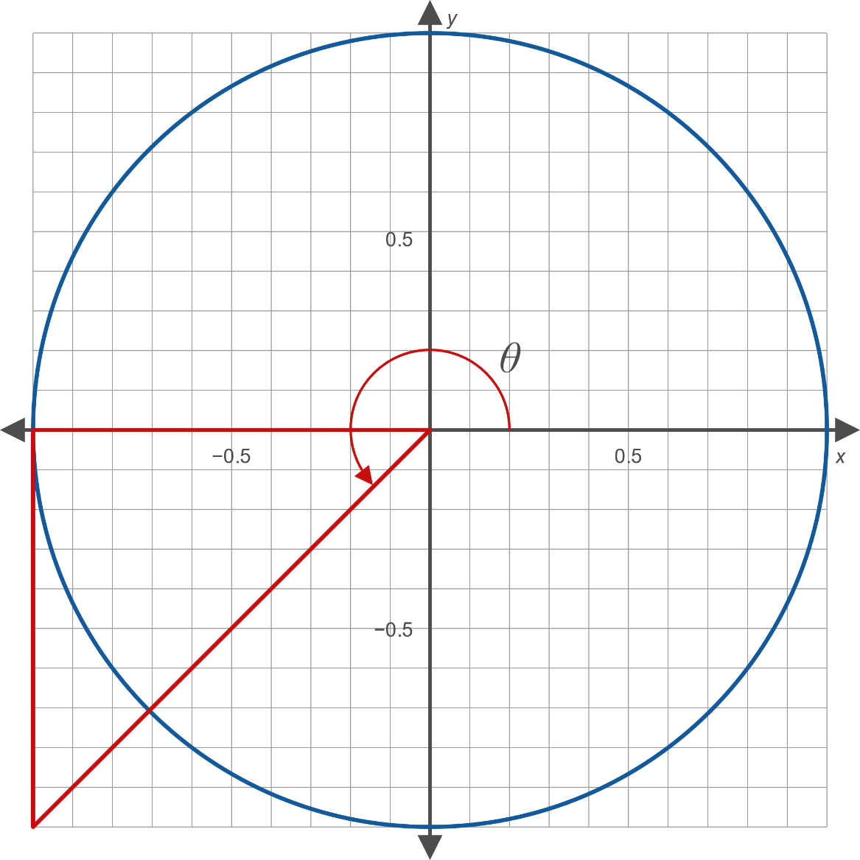
Example 2: Determining the Measure of an Angle (cont.)
​
Figure 7

Slide 9
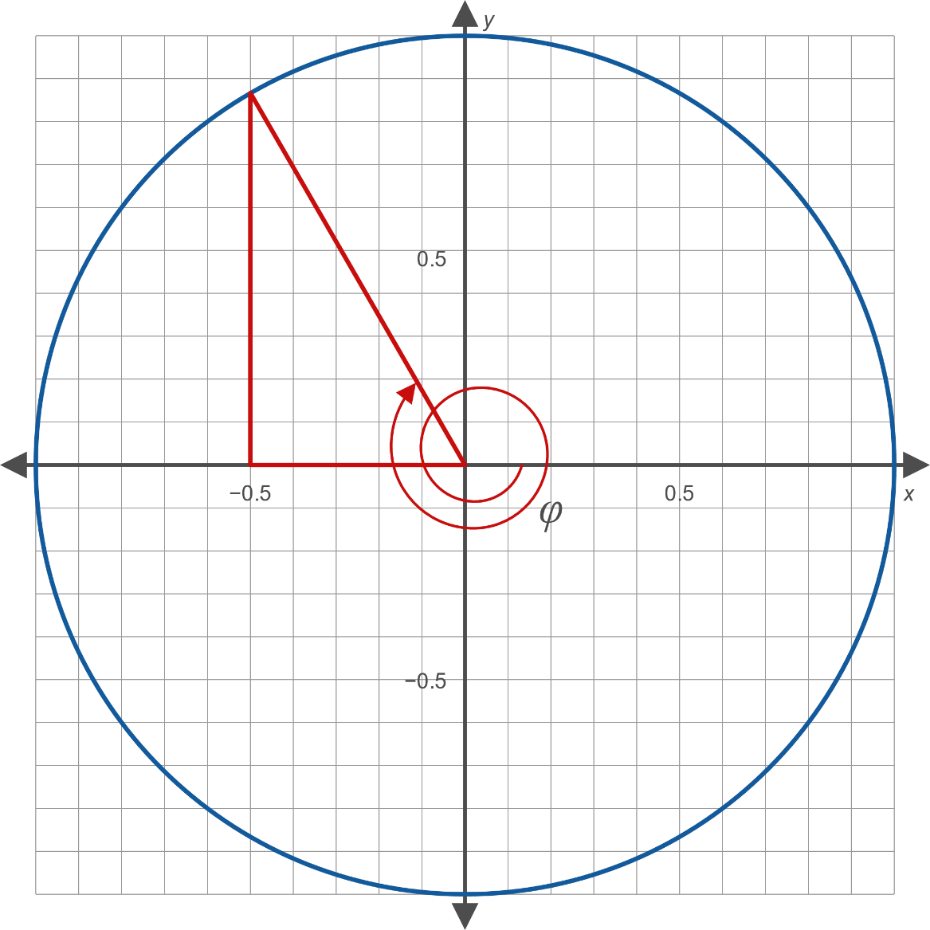
Example 2: Determining the Measure of an Angle (cont.)
​
Figure 8

Slide 10
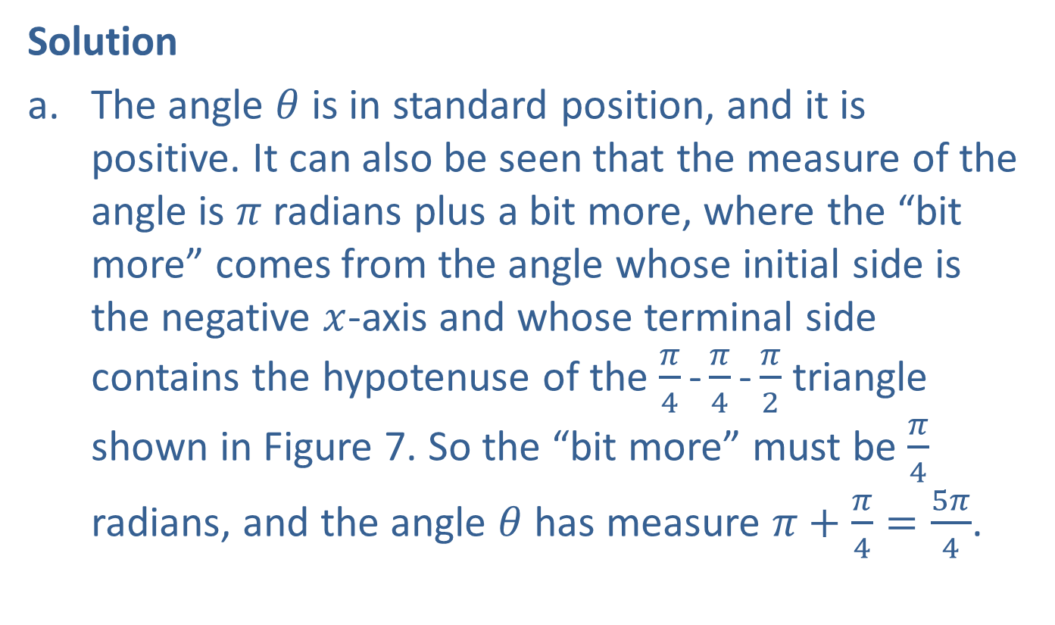
Example 2: Determining the Measure of an Angle (cont.)
Solution
​The angle $θ$ is in standard position, and it is positive. It can also be seen that the measure of the angle is $π$ radians plus a bit more, where the “bit more” comes from the angle whose initial side is the negative $x$-axis and whose terminal side contains the hypotenuse of the $\frac{π}{4}\text{−}\frac{π}{4}\text{−}\frac{π}{2}$ triangle shown in Figure 7. So the “bit more” must be $\frac{π}{4}$ radians, and the angle $θ$ has measure $π+\frac{π}{4}=\frac{5π}{4}$.

Slide 11
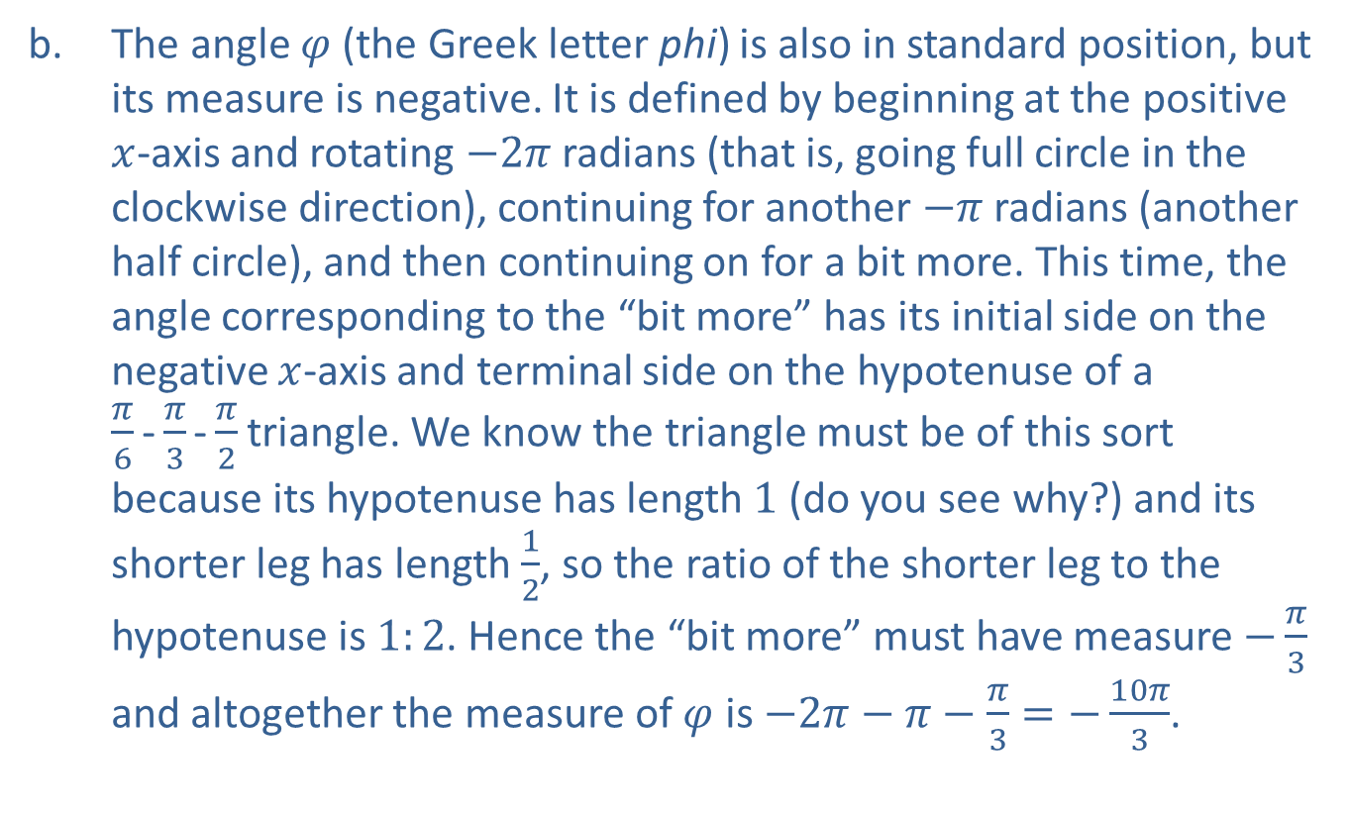
Example 2: Determining the Measure of an Angle (cont.)
​The angle $φ$ (the Greek letter phi) is also in standard position, but its measure is negative. It is defined by beginning at the positive $x$-axis and rotating $−2π$ radians (that is, going full circle in the clockwise direction), continuing for another $−π$ radians (another half circle), and then continuing on for a bit more. This time, the angle corresponding to the “bit more” has its initial side on the negative $x$-axis and terminal side on the hypotenuse of a
$\frac{π}{6}\text{−}\frac{π}{3}\text{−}\frac{π}{2}$ triangle. We know the triangle must be of this sort because its hypotenuse has length 1 (do you see why?) and its shorter leg has length $\frac{1}{2}$, so the ratio of the shorter leg to the hypotenuse is $1:2$. Hence the “bit more” must have measure $−\frac{π}{3}$ and altogether the measure of $φ$ is $−2π−π−\frac{π}{3}=−\frac{10π}{3}$.

Slide 12
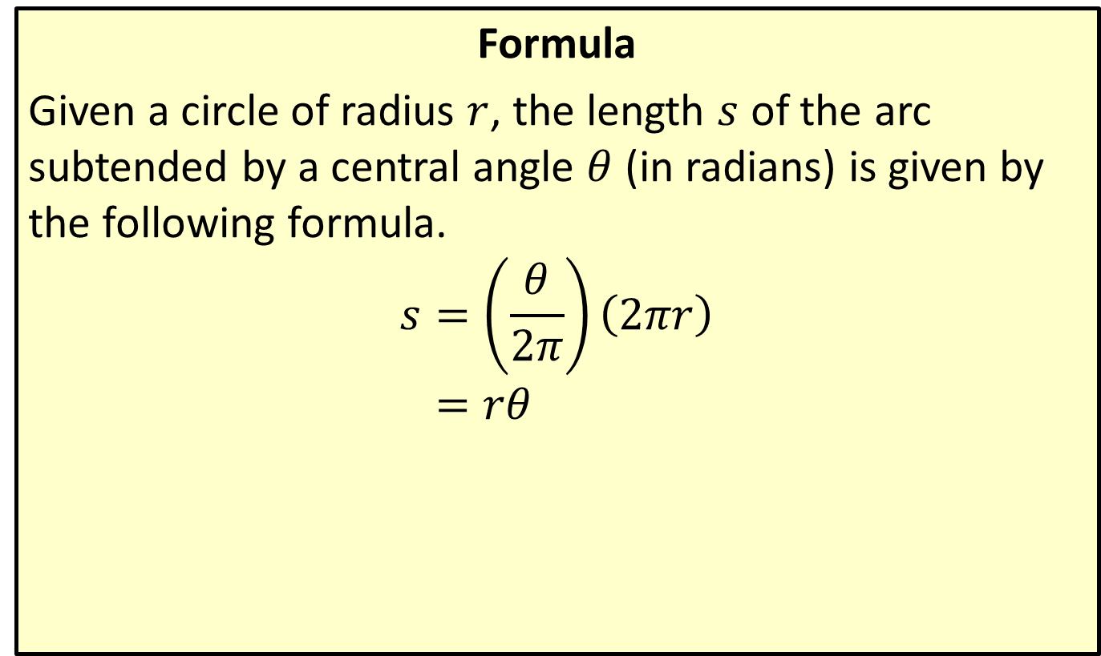
Arc Length
Formula
Given a circle of radius $r$, the length $s$ of the arc subtended by a central angle $θ$ (in radians) is given by the following formula.
𝑠=𝜃2𝜋2𝜋𝑟𝑠=𝑟𝜃

Slide 13
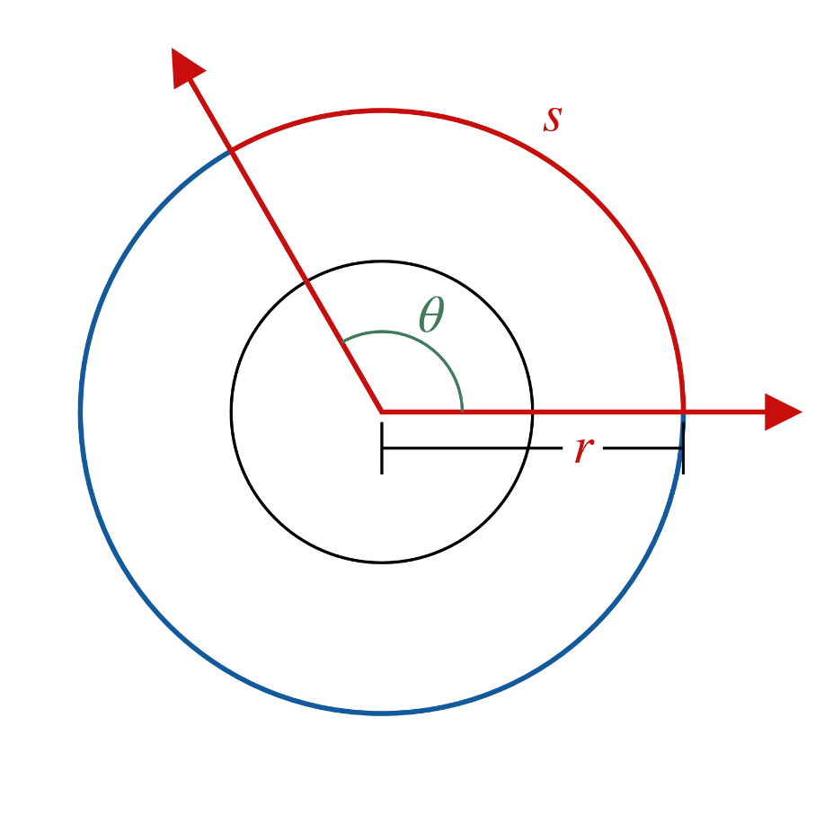

Arc Length (cont.)
Figure 9
(In Figure 9, the smaller circle is the unit circle, while the larger circle has radius $r$.)

Slide 14
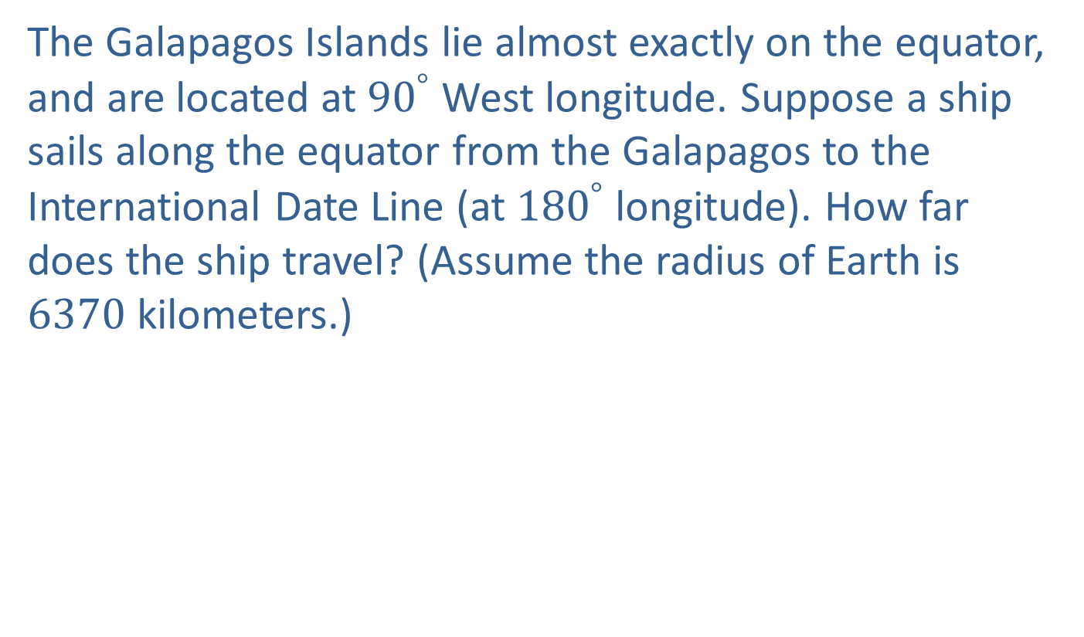
Example 3: Applying the Arc Length Formula
The Galapagos Islands lie almost exactly on the equator, and are located at ${90}^{°}$ West longitude. Suppose a ship sails along the equator from the Galapagos to the International Date Line (at ${180}^{°}$ longitude). How far does the ship travel? (Assume the radius of Earth is 6370 kilometers.)

Slide 15
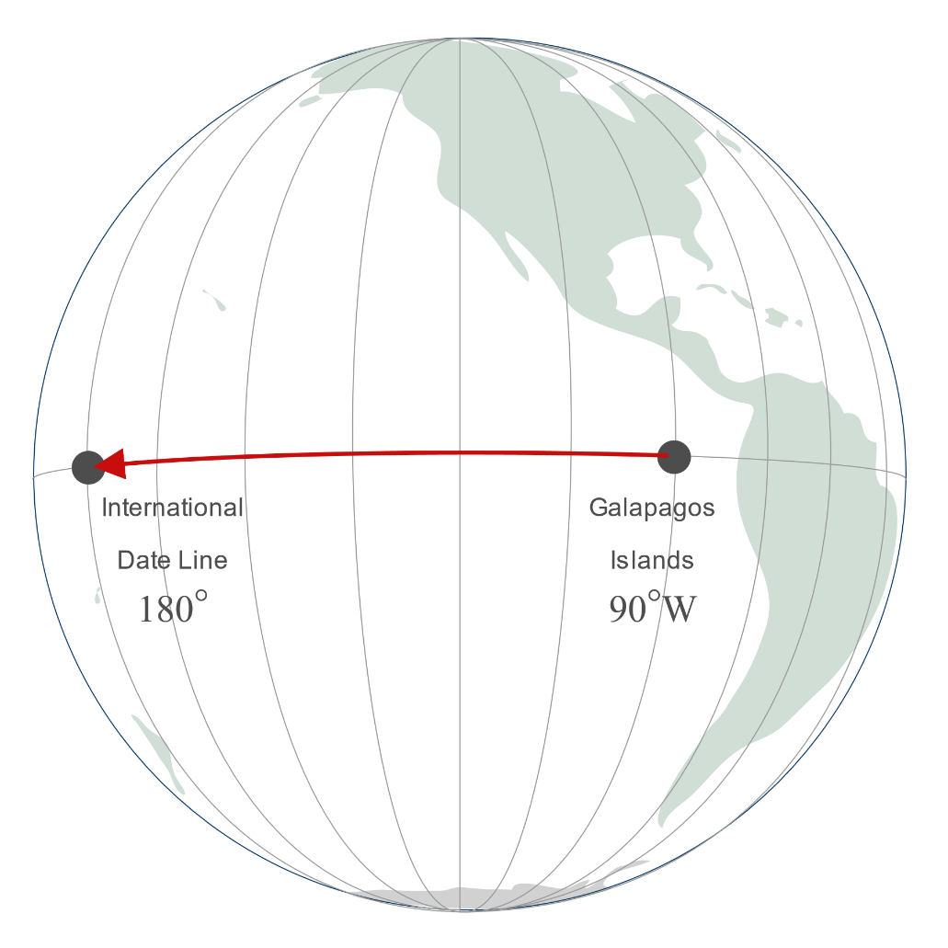
Example 3: Applying the Arc Length Formula (cont.)
Figure 10

Slide 16
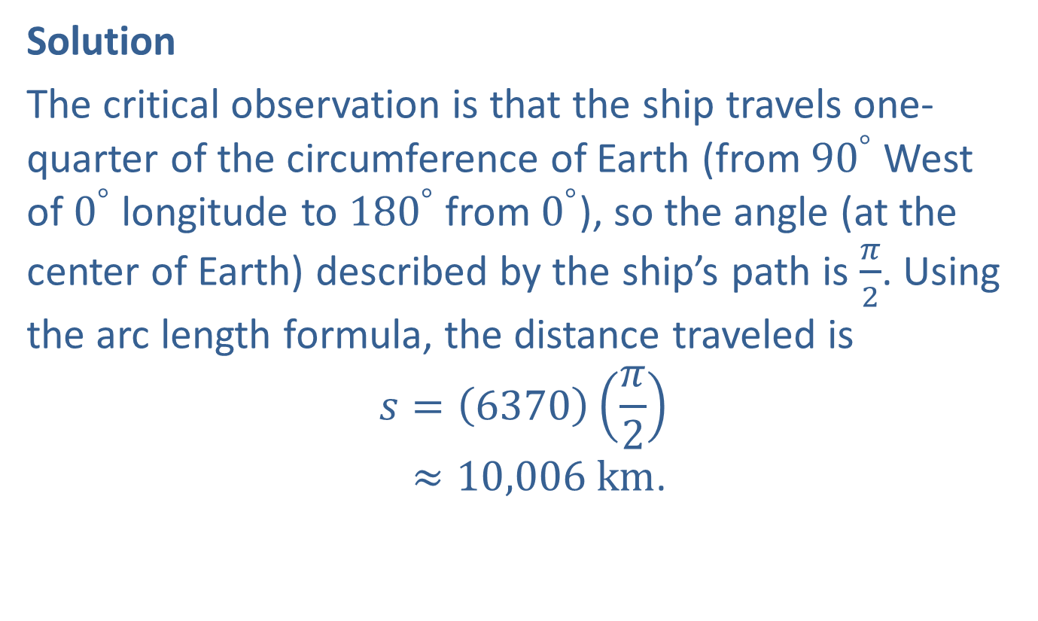
Example 3: Applying the Arc Length Formula (cont.)
Solution
The critical observation is that the ship travels one-quarter of the circumference of Earth (from ${90}^{°}$ West of $0^{°}$ longitude to ${180}^{°}$ from $0^{°}$), so the angle (at the center of Earth) described by the ship’s path is $\frac{π}{2}$. Using the arc length formula, the distance traveled is
𝑠=6370𝜋2𝑠≈10,006 km.

Slide 17
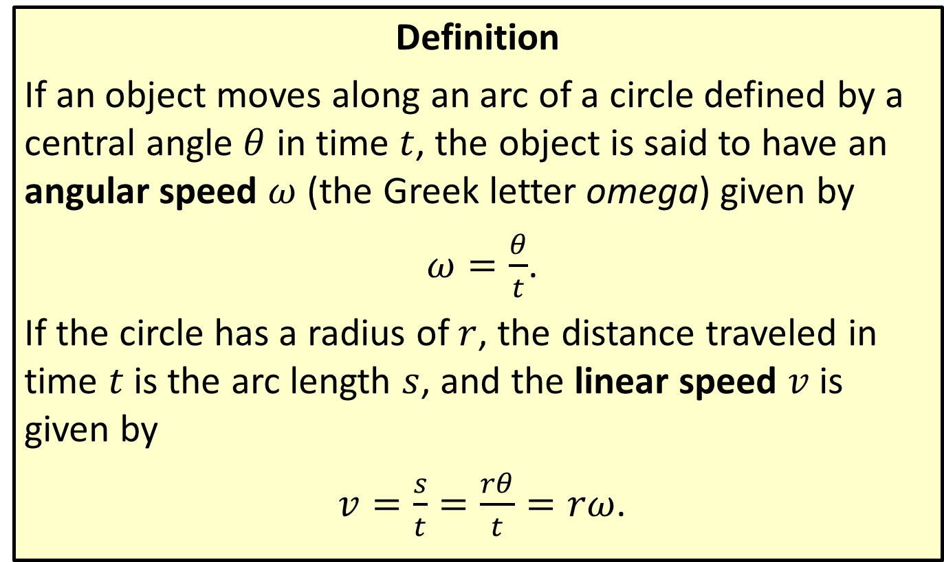
Angular Speed and Linear Speed
Definition
If an object moves along an arc of a circle defined by a central angle $θ$ in time $t$, the object is said to have an angular speed $ω$ (the Greek letter omega) given by
$ω=\frac{θ}{t}$.
If the circle has a radius of $r$, the distance traveled in time $t$ is the arc length $s$, and the linear speed $v$ is given by
$v=\frac{s}{t}=\frac{rθ}{t}=rω$.

Slide 18
Example 4: Finding the Angular and Linear Speeds
Suppose an ant crawls along the rim of a circular glass with radius 2 inches, and traverses the arc indicated in Figure 11 in 20 seconds. What are the angular and linear speeds of the ant, and how far does it travel?

Slide 19
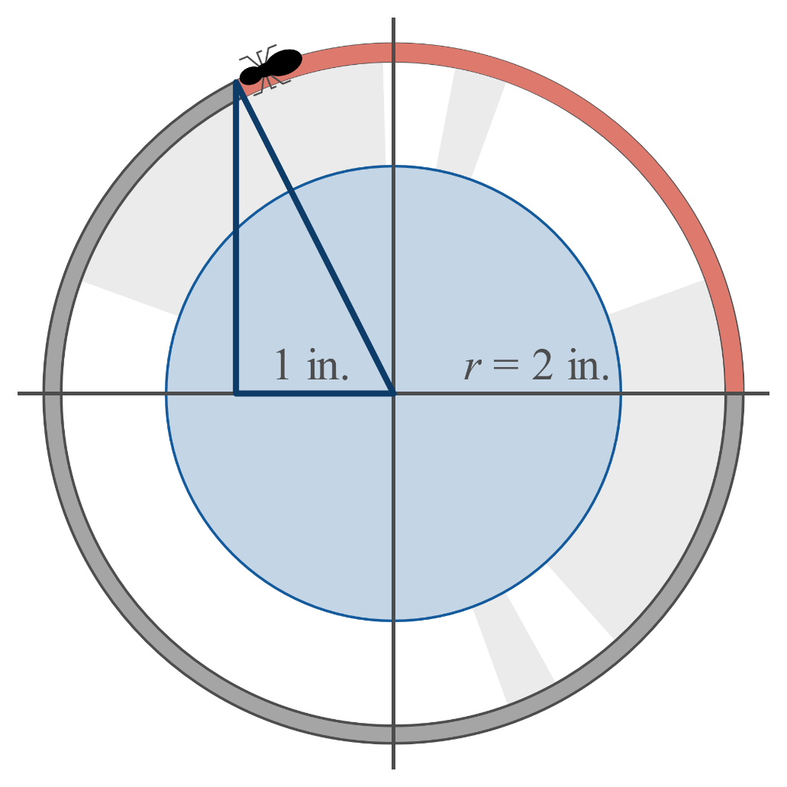
Example 4: Finding the Angular and Linear Speeds (cont.)
Figure 11

Slide 20
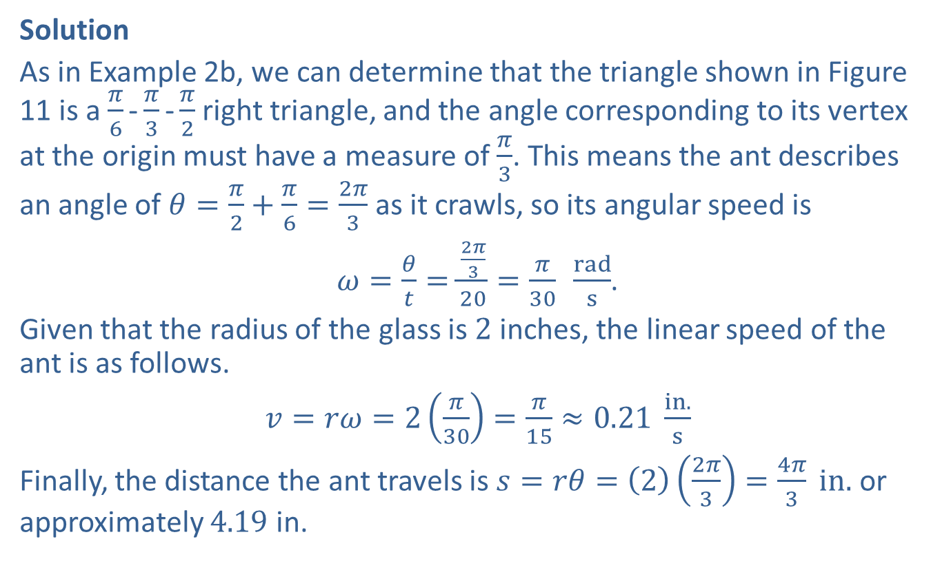
Example 4: Finding the Angular and Linear Speeds (cont.)
Solution
As in Example 2b, we can determine that the triangle shown in Figure 11 is a $\frac{π}{6}\text{-}\frac{π}{3}\text{-}\frac{π}{2}$ right triangle, and the angle corresponding to its vertex at the origin must have a measure of $\frac{π}{3}$. This means the ant describes an angle of $θ=\frac{π}{2}+\frac{π}{6}=\frac{2π}{3}$ as it crawls, so its angular speed is
$ω=\frac{θ}{t}=\frac{\frac{2π}{3}}{20}=\frac{π}{30} \frac{rad}{s}$.
Given that the radius of the glass is 2 inches, the linear speed of the ant is as follows.
$v=rω=2\left(\frac{π}{30}\right)=\frac{π}{15}≈0.21 \frac{in.}{s}$
Finally, the distance the ant travels is $s=rθ=\left(2\right)\left(\frac{2π}{3}\right)=\frac{4π}{3} in.$ or approximately 4.19 in.

Slide 21
CAUTION!
The arc length and angular speed formulas, as well as the area formula that follows, are only true for angles measured in radians. Equivalent but less convenient formulas can be derived for angles measured in terms of degrees.

Slide 22
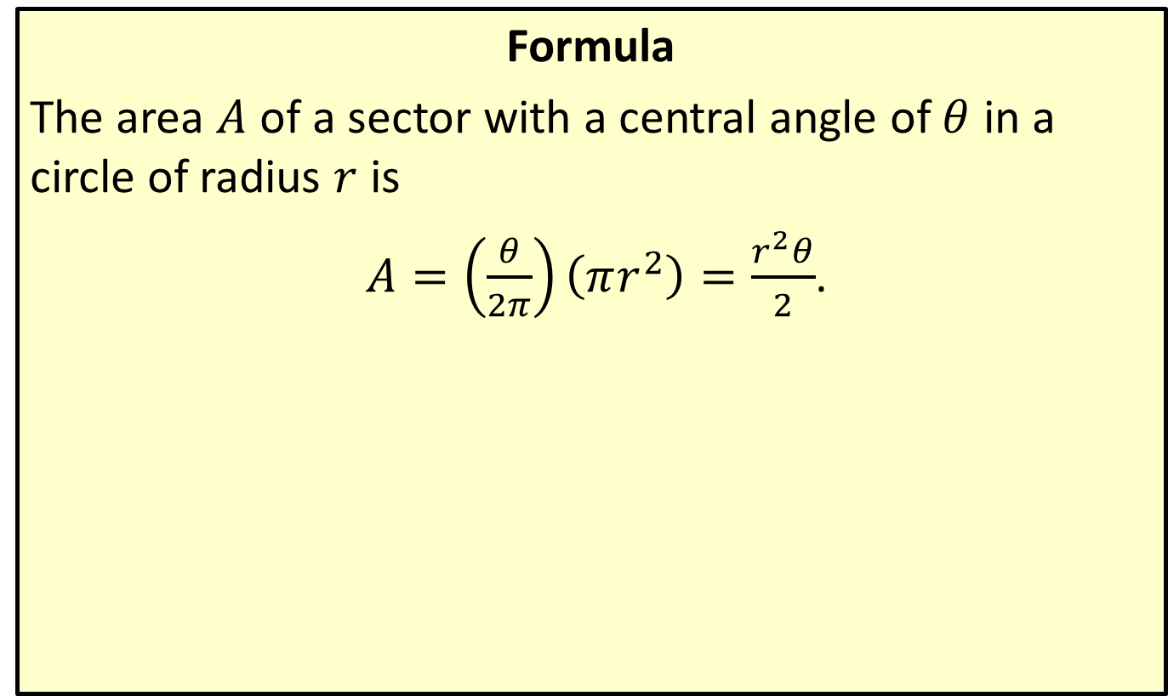
Sector Area
Formula
The area $A$ of a sector with a central angle of $θ$ in a circle of radius $r$ is
$A=\left(\frac{θ}{2π}\right)\left(πr^{2}\right)=\frac{r^{2}θ}{2}$.

Slide 23

Example 5: Finding the Area of a Sector
Determine the areas of the sectors defined by the given radii and angles.
​Circle of radius 3 cm, central angle of ${52}^{°}$
​Circle of radius $\frac{1}{2}$ ft, central angle of $\frac{4π}{3}$

Slide 24
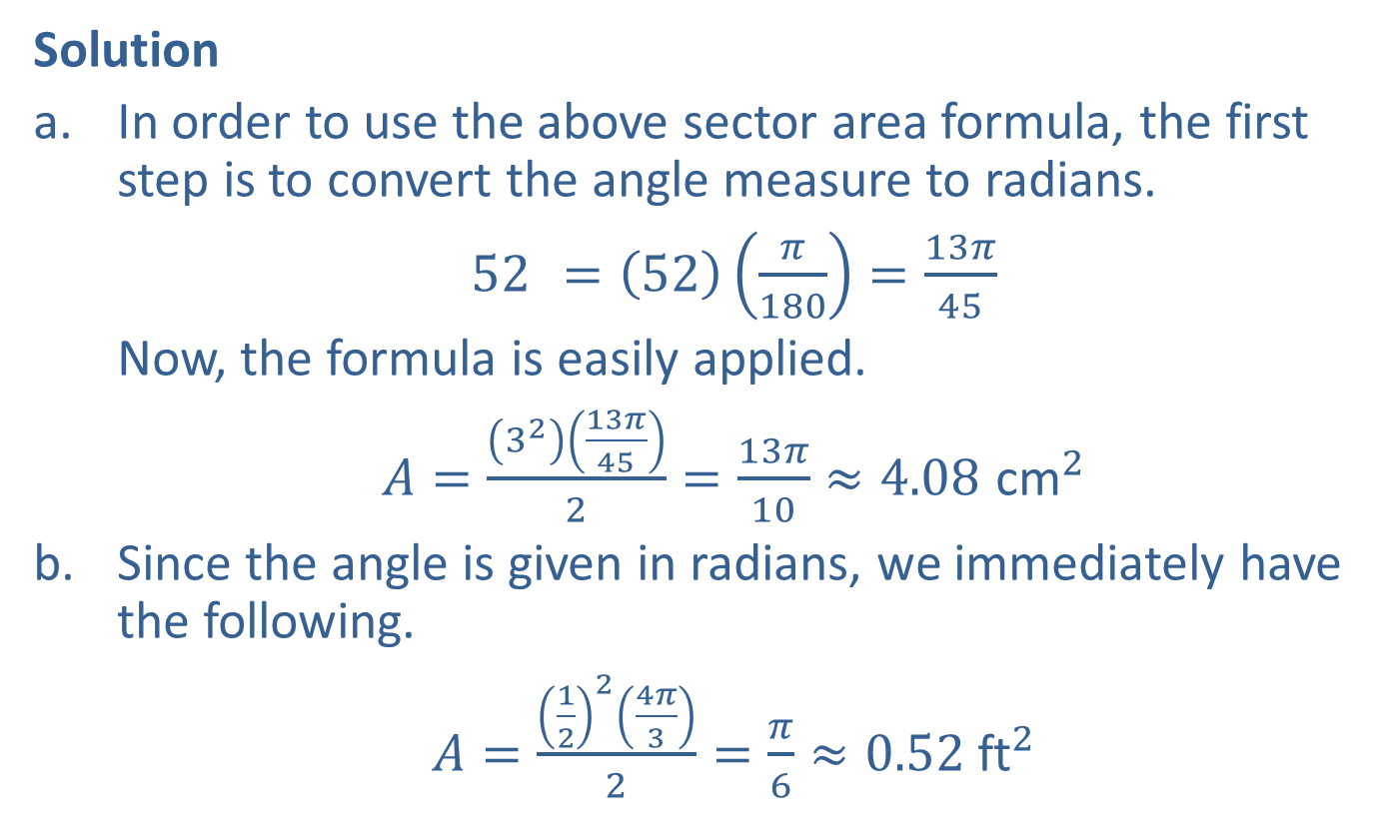
Example 5: Finding the Area of a Sector (cont.)
Solution
​In order to use the above sector area formula, the first step is to convert the angle measure to radians.
​${52}^{ }=\left(52\right)\left(\frac{π}{180}\right)=\frac{13π}{45}$
​Now, the formula is easily applied.
​$A=\frac{\left(3^{2}\right)\left(\frac{13π}{45}\right)}{2}=\frac{13π}{10}≈4.08 {\text{cm}}^{2}$
​Since the angle is given in radians, we immediately have the following.
​$A=\frac{{\left(\frac{1}{2}\right)}^{2}\left(\frac{4π}{3}\right)}{2}=\frac{π}{6}≈0.52 {\text{ft}}^{2}$

