Slide 1
Section 7.3
Trigonometric Functions and the Unit Circle

Slide 2

Example 1: Finding the Point on the Unit Circle Associated with a Real Number
Determine the point $\left(x\text{, }y\right)$ on the unit circle associated with each real number $s$.
​$s=\frac{π}{3}$
​$s=−\frac{5π}{2}$

Slide 3
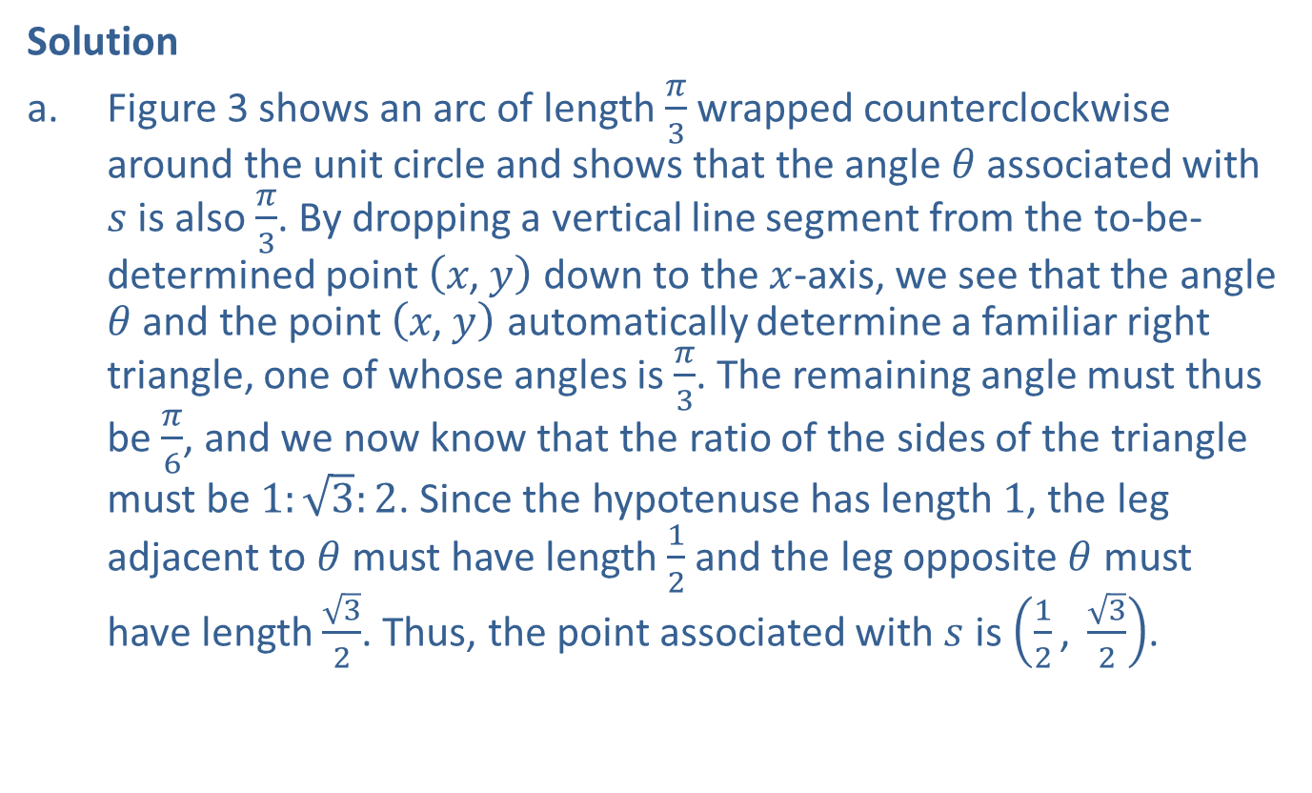
Example 1: Finding the Point on the Unit Circle Associated with a Real Number (cont.)
Solution
​Figure 3 shows an arc of length $\frac{π}{3}$ wrapped counterclockwise around the unit circle and shows that the angle $θ$ associated with $s$ is also $\frac{π}{3}$. By dropping a vertical line segment from the to-be-determined point $\left(x\text{, }y\right)$ down to the $x$-axis, we see that the angle $θ$ and the point $\left(x\text{, }y\right)$ automatically determine a familiar right triangle, one of whose angles is $\frac{π}{3}$. The remaining angle must thus be $\frac{π}{6}$, and we now know that the ratio of the sides of the triangle must be $1:\sqrt{3}:2$. Since the hypotenuse has length 1, the leg adjacent to $θ$ must have length $\frac{1}{2}$ and the leg opposite $θ$ must have length $\frac{\sqrt{3}}{2}$. Thus, the point associated with $s$ is $\left(\frac{1}{2}\text{, }\frac{\sqrt{3}}{2}\right)$.

Slide 4
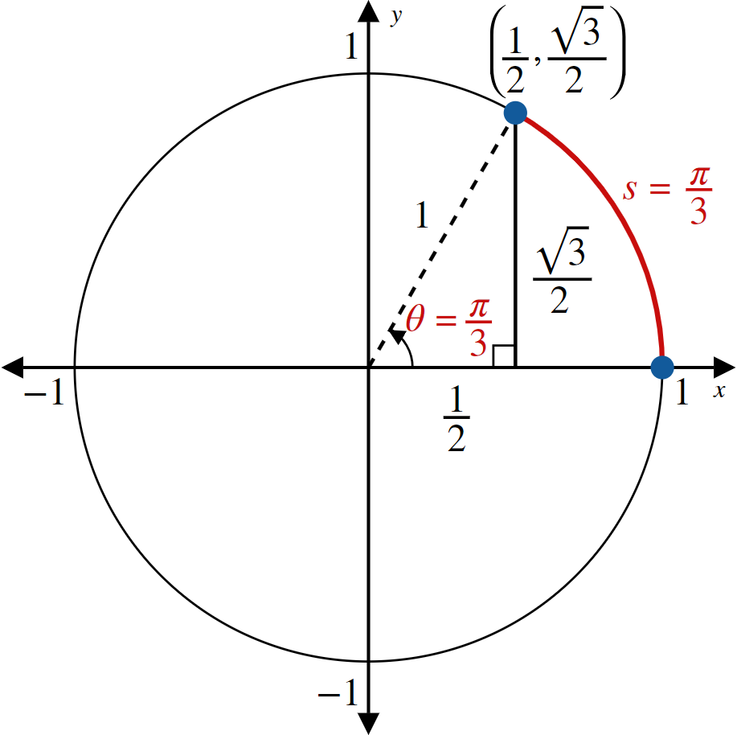
Example 1: Finding the Point on the Unit Circle Associated with a Real Number (cont.)
Figure 3

Slide 5
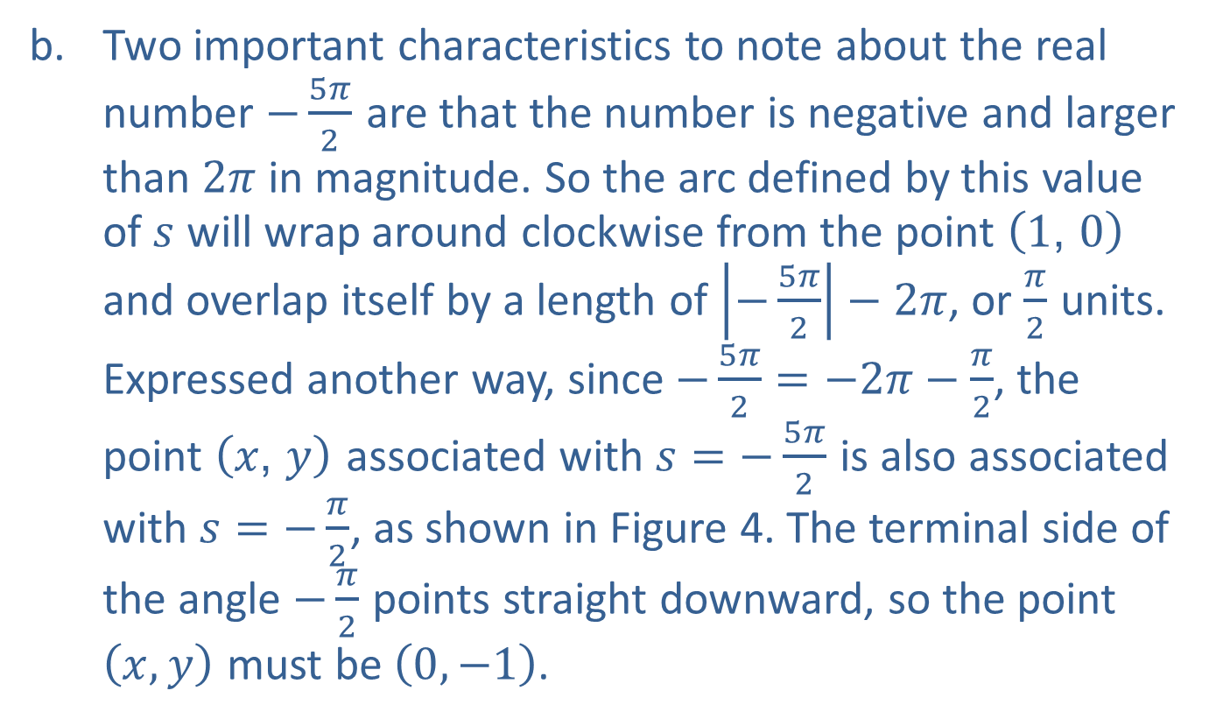
Example 1: Finding the Point on the Unit Circle Associated with a Real Number (cont.)
​Two important characteristics to note about the real number $−\frac{5π}{2}$ are that the number is negative and larger than $2π$ in magnitude. So the arc defined by this value of $s$ will wrap around clockwise from the point $\left(1\text{, }0\right)$ and overlap itself by a length of $\left|−\frac{5π}{2}\right|−2π$, or $\frac{π}{2}$ units. Expressed another way, since $−\frac{5π}{2}=−2π−\frac{π}{2}$, the point $\left(x\text{, }y\right)$ associated with $s=−\frac{5π}{2}$ is also associated with $s=−\frac{π}{2}$, as shown in Figure 4. The terminal side of the angle $−\frac{π}{2}$ points straight downward, so the point $\left(x,y\right)$ must be $\left(0,−1\right)$.

Slide 6
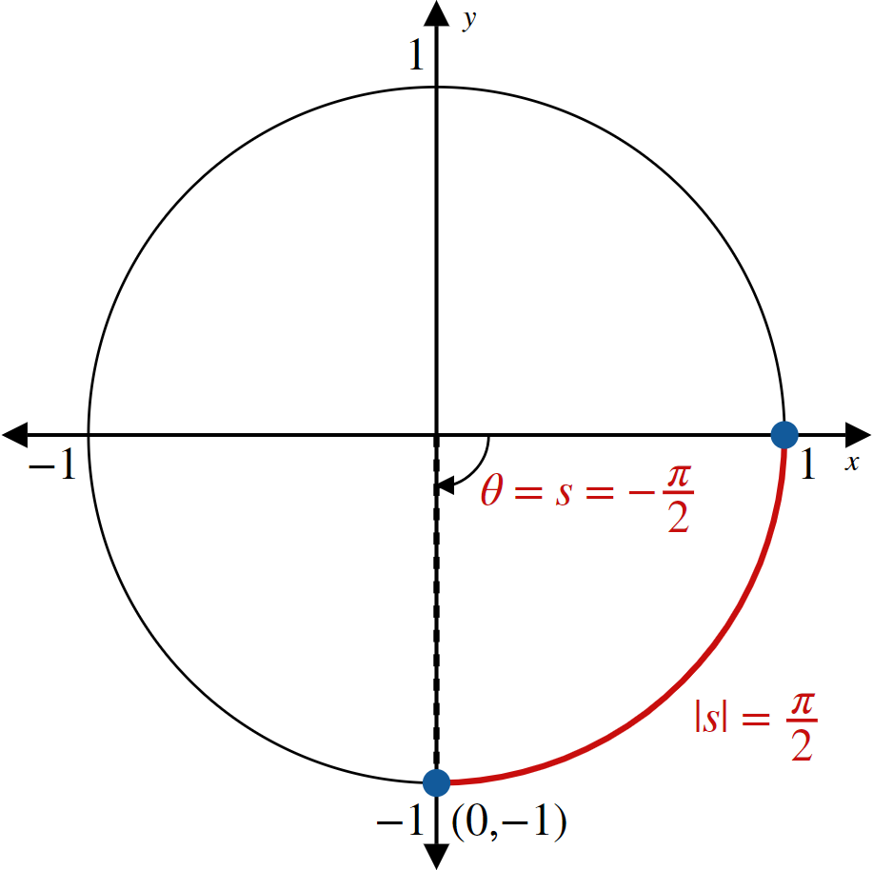
Example 1: Finding the Point on the Unit Circle Associated with a Real Number (cont.)
Figure 4

Slide 7

Example 2: Finding All Real Numbers Associated with a Point on the Unit Circle
Determine all real numbers $s$ associated with the point $\left(x,y\right)=\left(−\frac{1}{\sqrt{2}},\frac{1}{\sqrt{2}}\right)$ on the unit circle.

Slide 8
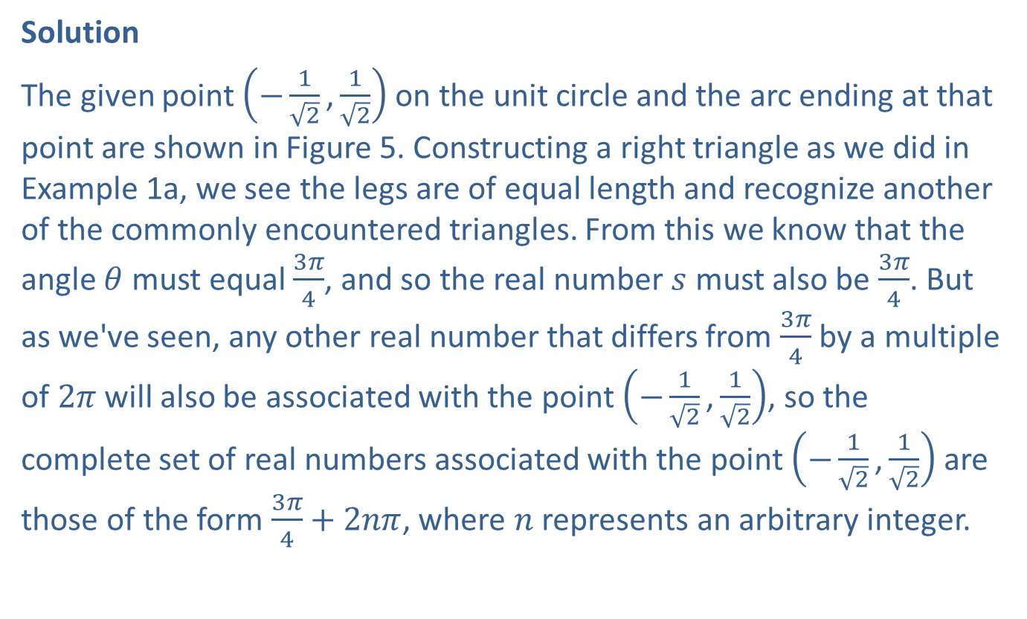
Example 2: Finding All Real Numbers Associated with a Point on the Unit Circle (cont.)
Solution
The given point $\left(−\frac{1}{\sqrt{2}}\text{,}\frac{1}{\sqrt{2}}\right)$ on the unit circle and the arc ending at that point are shown in Figure 5. Constructing a right triangle as we did in Example 1a, we see the legs are of equal length and recognize another of the commonly encountered triangles. From this we know that the angle $θ$ must equal $\frac{3π}{4}$, and so the real number $s$ must also be $\frac{3π}{4}$. But as we've seen, any other real number that differs from $\frac{3π}{4}$ by a multiple of $2π$ will also be associated with the point $\left(−\frac{1}{\sqrt{2}}\text{,}\frac{1}{\sqrt{2}}\right)$, so the complete set of real numbers associated with the point $\left(−\frac{1}{\sqrt{2}}\text{,}\frac{1}{\sqrt{2}}\right)$ are those of the form $\frac{3π}{4}+2nπ$, where $n$ represents an arbitrary integer.

Slide 9
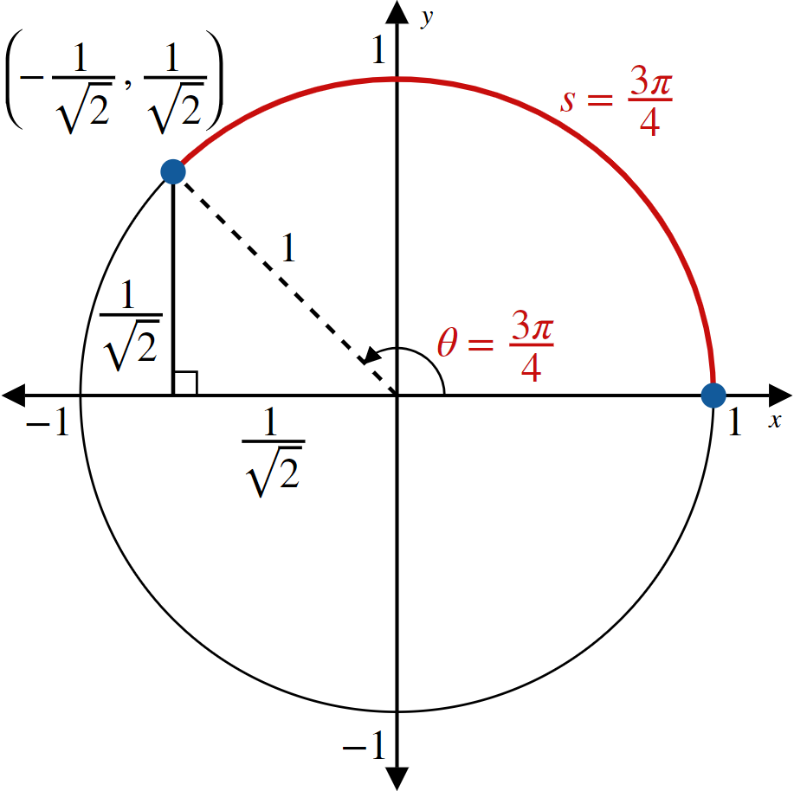
Example 2: Finding All Real Numbers Associated with a Point on the Unit Circle (cont.)
Figure 5

Slide 10
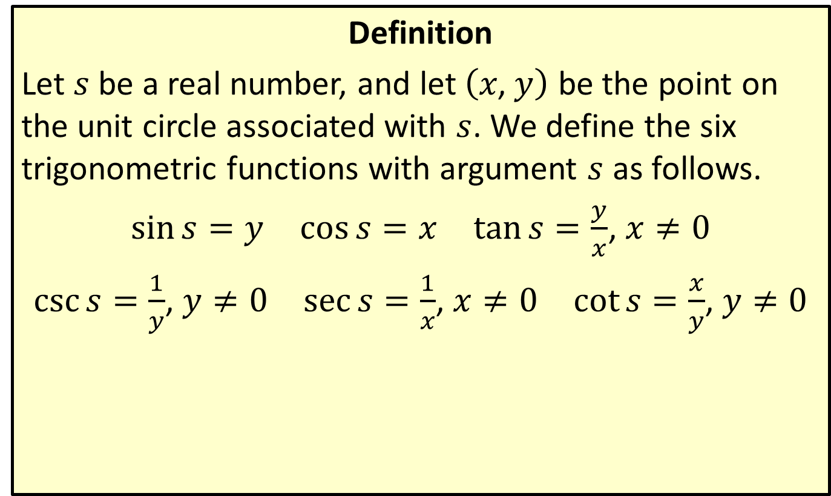
Extending the Domains of the Trigonometric Functions
Definition
Let $s$ be a real number, and let $\left(x\text{, }y\right)$ be the point on the unit circle associated with $s$. We define the six trigonometric functions with argument $s$ as follows.
$\sin{s}=y$ $\cos{s}=x$ $\tan{s}=\frac{y}{x}$, $x≠0$
$\csc{s}=\frac{1}{y}$, $y≠0$ $\sec{s}=\frac{1}{x}$, $x≠0$ $\cot{s}=\frac{x}{y}$, $y≠0$

Slide 11

Example 3: Finding the Values of the Six Trigonometric Functions
Determine the values of the six trigonometric functions of each angle $θ$.
​$θ=−\frac{5π}{2}$
​$θ={210}^{°}$

Slide 12
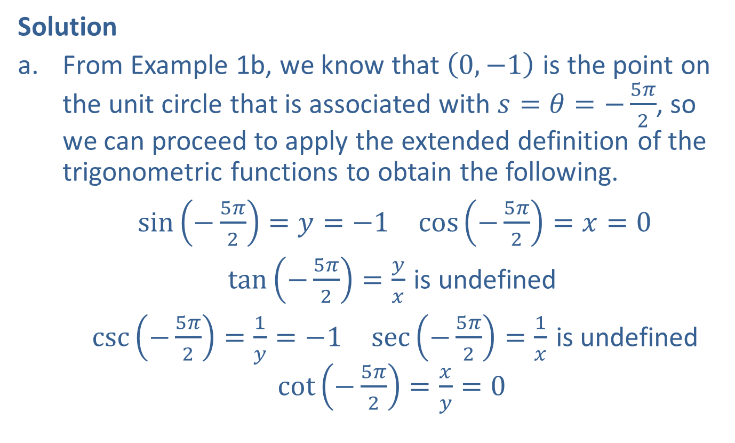
Example 3: Finding the Values of the Six Trigonometric Functions (cont.)
Solution
​From Example 1b, we know that $\left(0,−1\right)$ is the point on the unit circle that is associated with $s=θ=−\frac{5π}{2}$, so we can proceed to apply the extended definition of the trigonometric functions to obtain the following.
​ $\sin\left(−\frac{5π}{2}\right)=y=−1$ $\cos\left(−\frac{5π}{2}\right)=x=0$
$\tan\left(−\frac{5π}{2}\right)=\frac{y}{x}$ is undefined
​ $\csc\left(−\frac{5π}{2}\right)=\frac{1}{y}=−1$ $\sec\left(−\frac{5π}{2}\right)=\frac{1}{x}$ is undefined $\cot\left(−\frac{5π}{2}\right)=\frac{x}{y}=0$

Slide 13
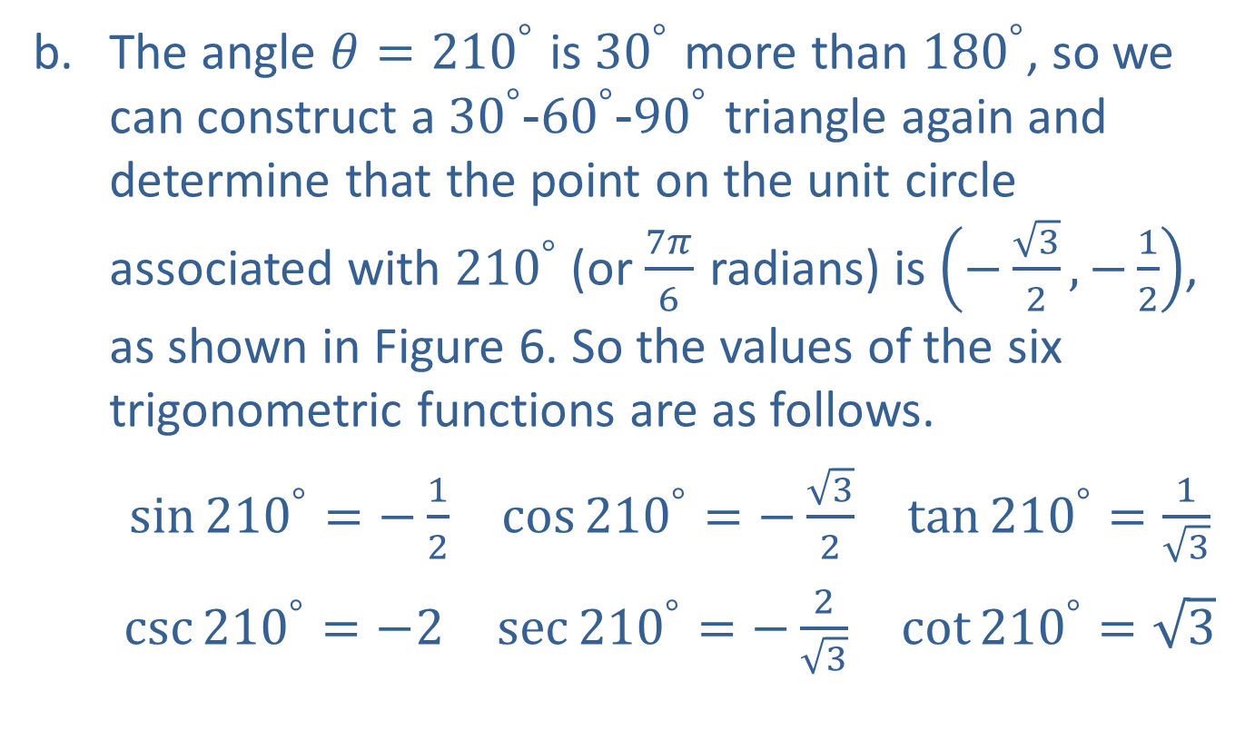
Example 3: Finding the Values of the Six Trigonometric Functions (cont.)
​The angle $θ={210}^{°}$ is ${30}^{°}$ more than ${180}^{°}$, so we can construct a ${30}^{°}$-${60}^{°}$-${90}^{°}$ triangle again and determine that the point on the unit circle associated with ${210}^{°}$ (or $\frac{7π}{6}$ radians) is $\left(−\frac{\sqrt{3}}{2},−\frac{1}{2}\right)$, as shown in Figure 6. So the values of the six trigonometric functions are as follows.
$\sin{{210}^{°}}=−\frac{1}{2}$ $\cos{{210}^{°}}=−\frac{\sqrt{3}}{2}$ $\tan{{210}^{°}}=\frac{1}{\sqrt{3}}$
​$\csc{{210}^{°}}=−2$ $\sec{{210}^{°}}=−\frac{2}{\sqrt{3}}$ $\cot{{210}^{°}}=\sqrt{3}$

Slide 14
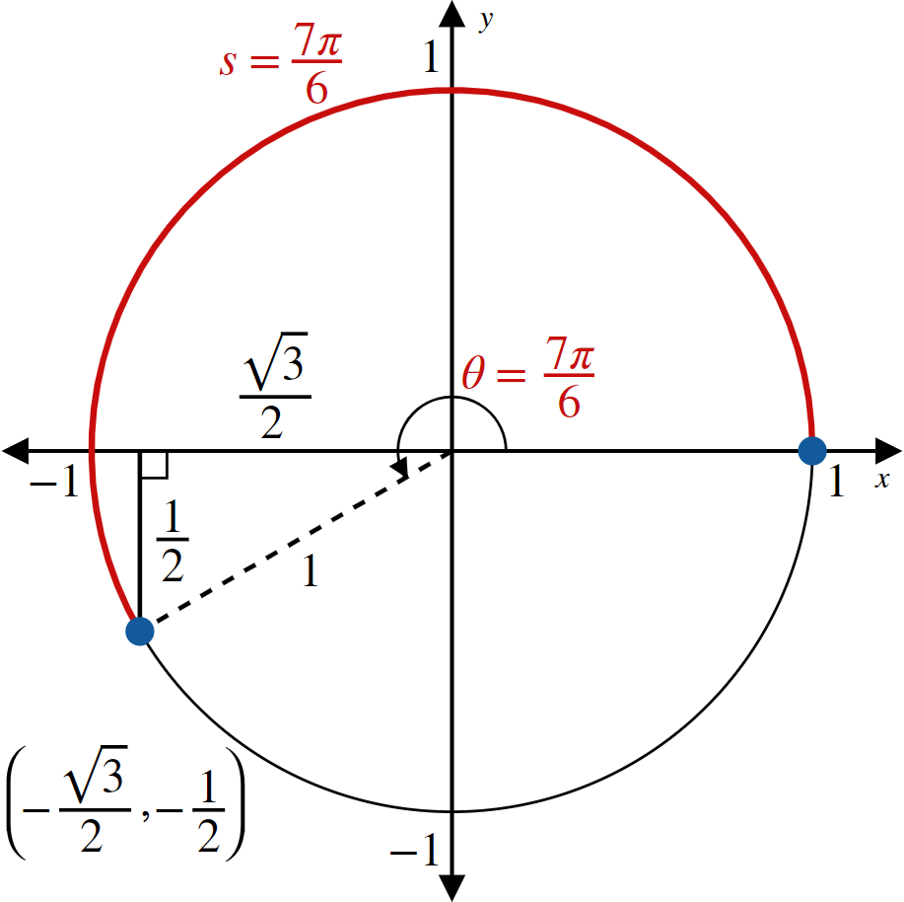
Example 3: Finding the Values of the Six Trigonometric Functions (cont.)
Figure 6

Slide 15
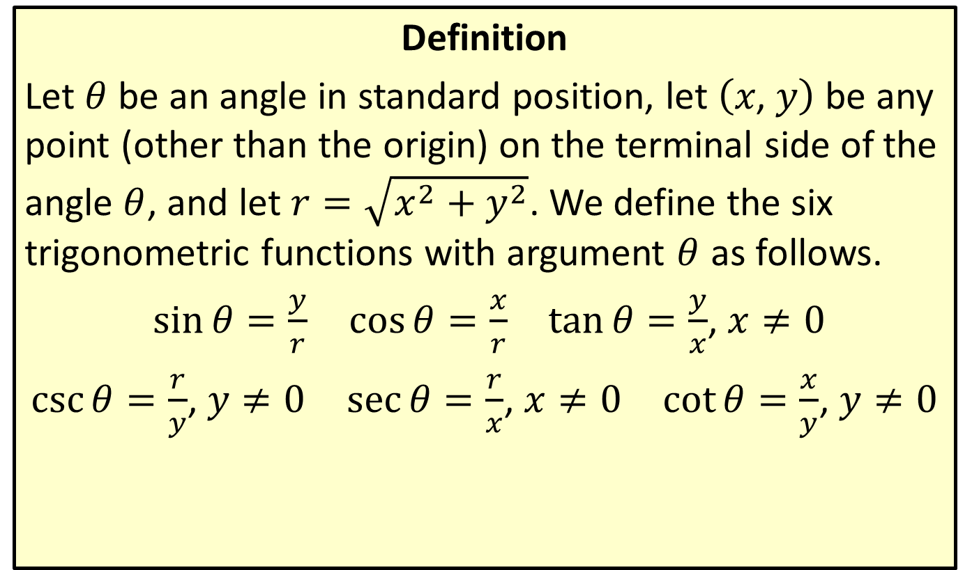
Trigonometric Functions Defined for an Arbitrary Angle
Definition
Let $θ$ be an angle in standard position, let $\left(x\text{, }y\right)$ be any point (other than the origin) on the terminal side of the angle $θ$, and let $r=\sqrt{x^{2}+y^{2}}$. We define the six trigonometric functions with argument $θ$ as follows.
$\sin{θ}=\frac{y}{r}$ $\cos{θ}=\frac{x}{r}$ $\tan{θ}=\frac{y}{x}$, $x≠0$
$\csc{θ}=\frac{r}{y}$, $y≠0$ $\sec{θ}=\frac{r}{x}$, $x≠0$ $\cot{θ}=\frac{x}{y}$, $y≠0$

Slide 16
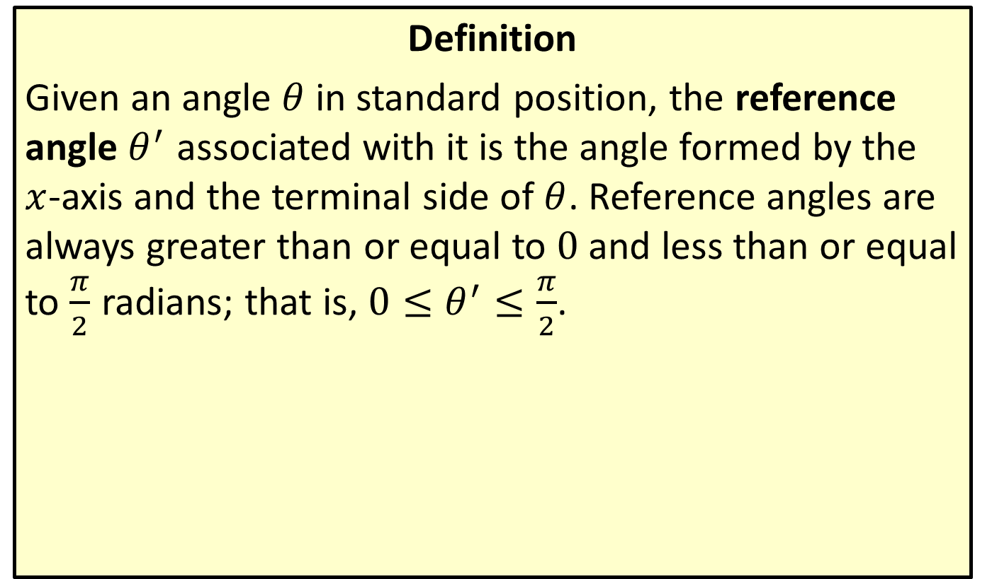
Reference Angle
Definition
Given an angle $θ$ in standard position, the reference angle $θ^{′}$ associated with it is the angle formed by the $x$-axis and the terminal side of $θ$. Reference angles are always greater than or equal to 0 and less than or equal to $\frac{π}{2}$ radians; that is, $0≤θ^{′}≤\frac{π}{2}$.

Slide 17

Example 4: Finding the Reference Angle
Find the reference angle associated with each of the following angles.
​$θ=\frac{9π}{8}$
​$φ=−{655}^{°}$

Slide 18
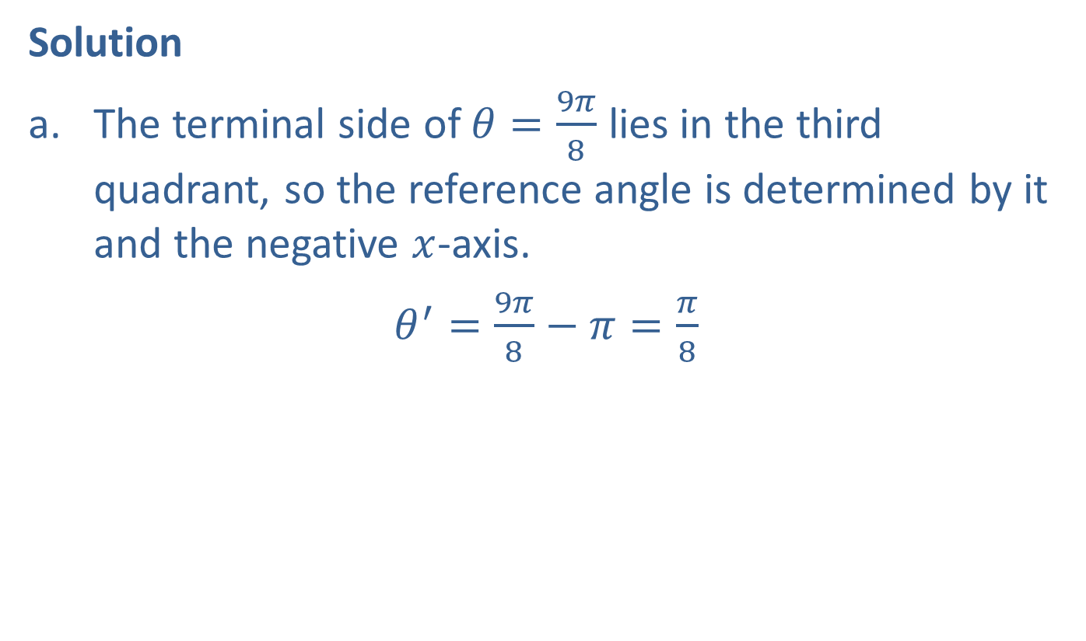
Example 4: Finding the Reference Angle (cont.)
Solution
​The terminal side of $θ=\frac{9π}{8}$ lies in the third quadrant, so the reference angle is determined by it and the negative $x$-axis.
​ $θ^{′}=\frac{9π}{8}−π=\frac{π}{8}$

Slide 19
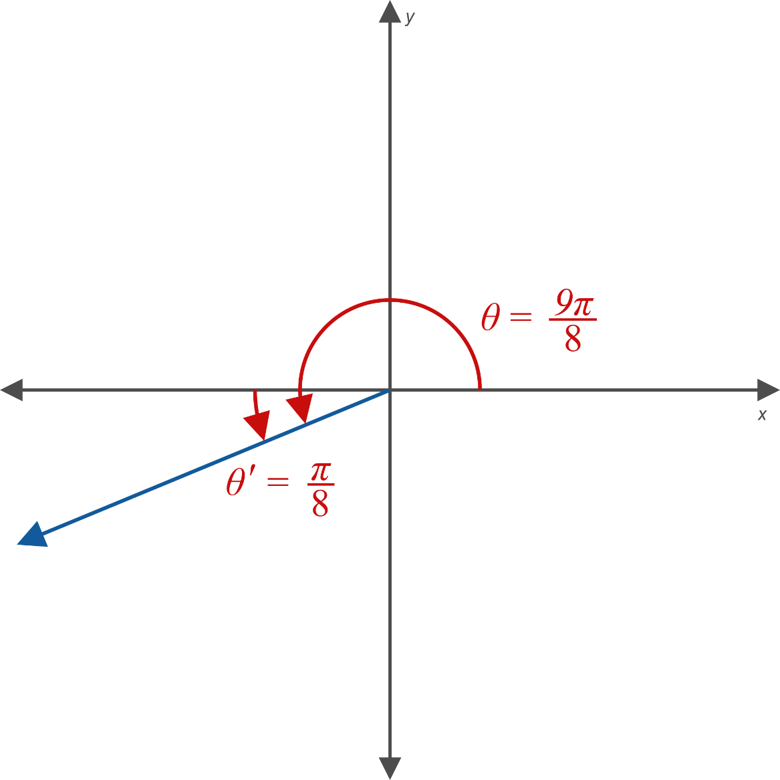
Example 4: Finding the Reference Angle (cont.)
Figure 9

Slide 20
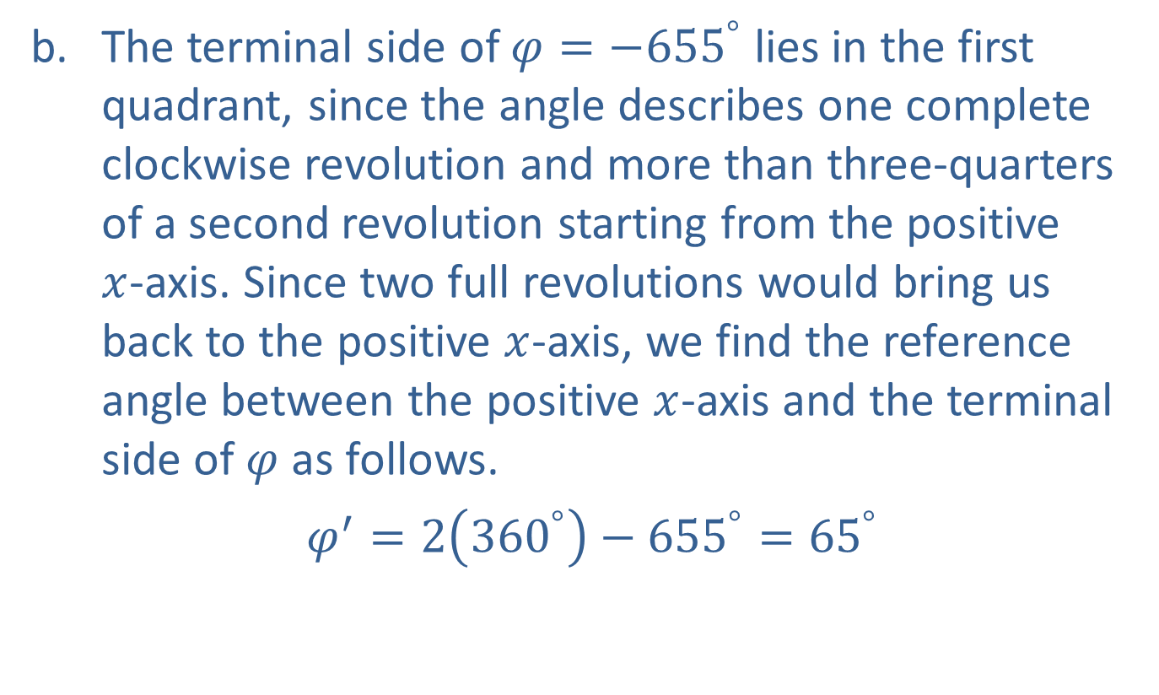
Example 4: Finding the Reference Angle (cont.)
​The terminal side of $φ=−{655}^{°}$ lies in the first quadrant, since the angle describes one complete clockwise revolution and more than three-quarters of a second revolution starting from the positive
$x$-axis. Since two full revolutions would bring us back to the positive $x$-axis, we find the reference angle between the positive $x$-axis and the terminal side of $φ$ as follows.
​ $φ^{′}=2\left({360}^{°}\right)−{655}^{°}={65}^{°}$

Slide 21
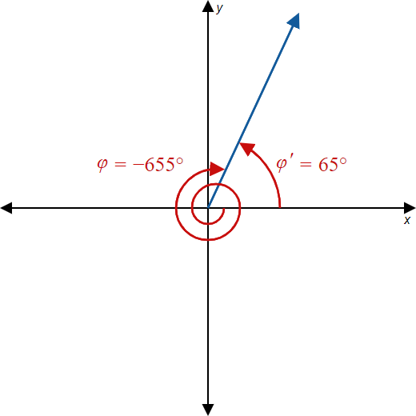
Example 4: Finding the Reference Angle (cont.)
Figure 10

Slide 22

Example 5: Evaluating Trigonometric Functions
Evaluate the following.
​$cos⁡\left(\frac{4π}{3}\right)$
​$tan⁡\left(−{225}^{°}\right)$

Slide 23
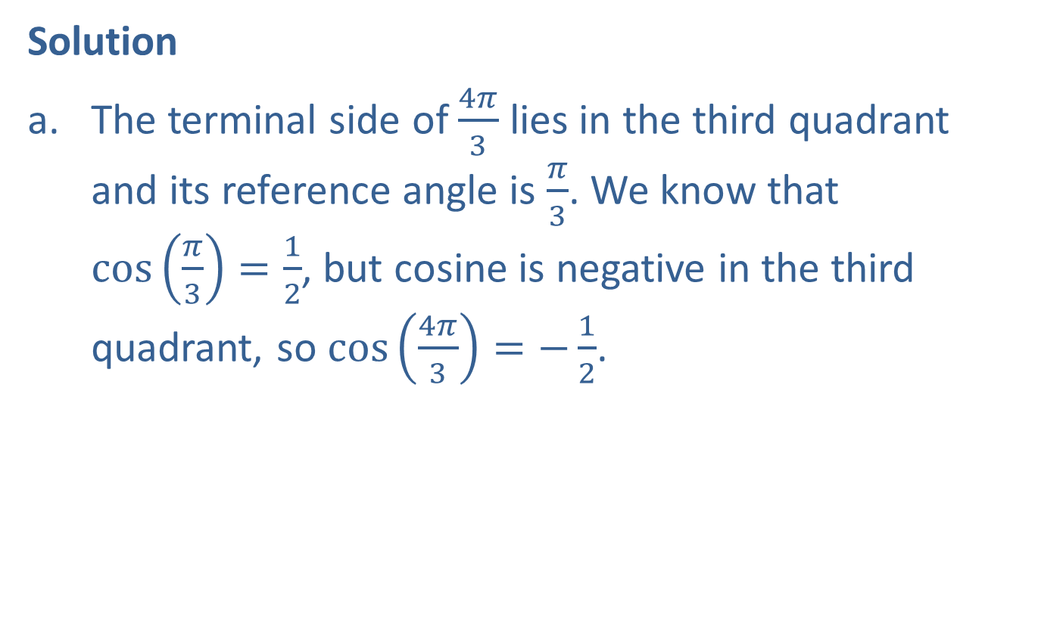
Example 5: Evaluating Trigonometric Functions (cont.)
Solution
​The terminal side of $\frac{4π}{3}$ lies in the third quadrant and its reference angle is $\frac{π}{3}$. We know that
$\cos\left(\frac{π}{3}\right)=\frac{1}{2}$, but cosine is negative in the third quadrant, so $\cos\left(\frac{4π}{3}\right)=−\frac{1}{2}$.

Slide 24
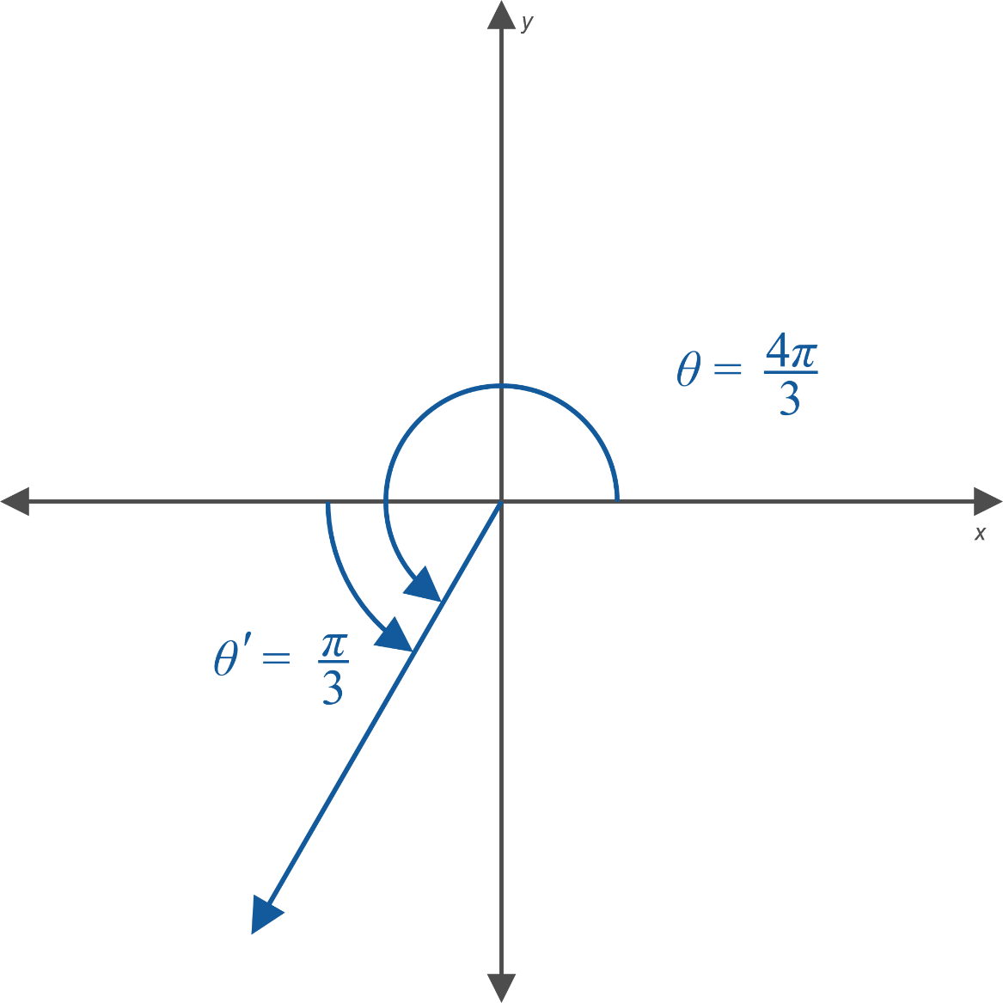
Example 5: Evaluating Trigonometric Functions (cont.)
Figure 12

Slide 25

Example 5: Evaluating Trigonometric Functions (cont.)
​The terminal side of $−{225}^{°}$ lies in the second quadrant and its reference angle is ${45}^{°}$. Since tangent is negative in the second quadrant, $\tan\left(−{225}^{°}\right)=−\tan{{45}^{°}}=−1$.​

Slide 26
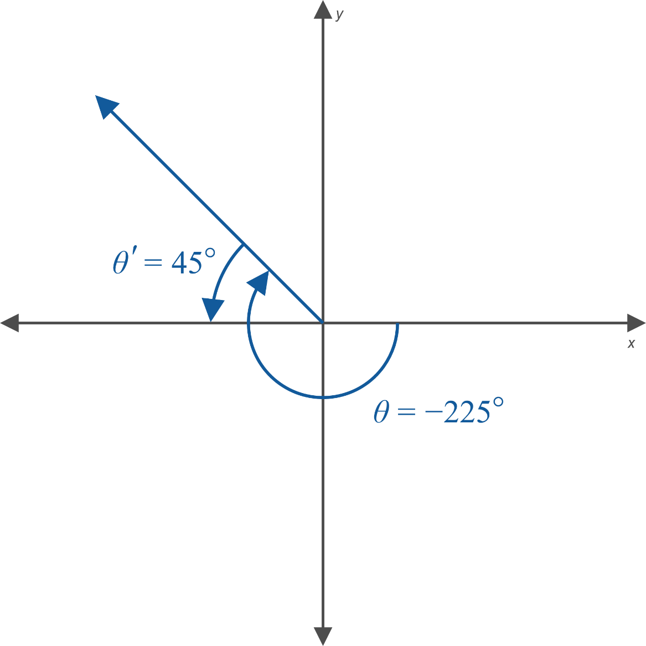
Example 5: Evaluating Trigonometric Functions (cont.)
Figure 13

Slide 27
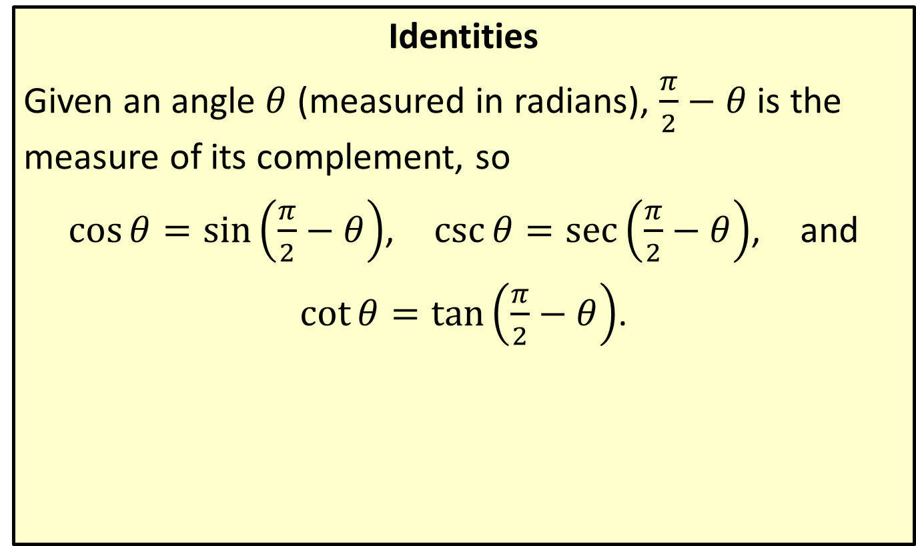
Cofunction Identities
Identities
Given an angle $θ$ (measured in radians), $\frac{π}{2}−θ$ is the measure of its complement, so
$\cos{θ}=\sin\left(\frac{π}{2}−θ\right)$, $\csc{θ}=\sec\left(\frac{π}{2}−θ\right)$, and
$\cot{θ}=\tan\left(\frac{π}{2}−θ\right)$.

Slide 28
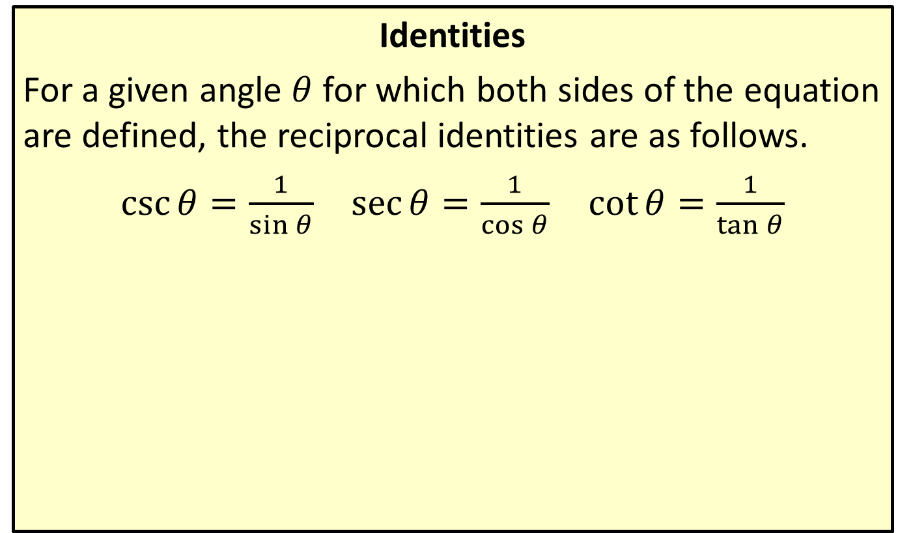
Reciprocal Identities
Identities
For a given angle $θ$ for which both sides of the equation are defined, the reciprocal identities are as follows.
$\csc{θ}=\frac{1}{\sin{θ}}$ $\sec{θ}=\frac{1}{\cos{θ}}$ $\cot{θ}=\frac{1}{\tan{θ}}$

Slide 29
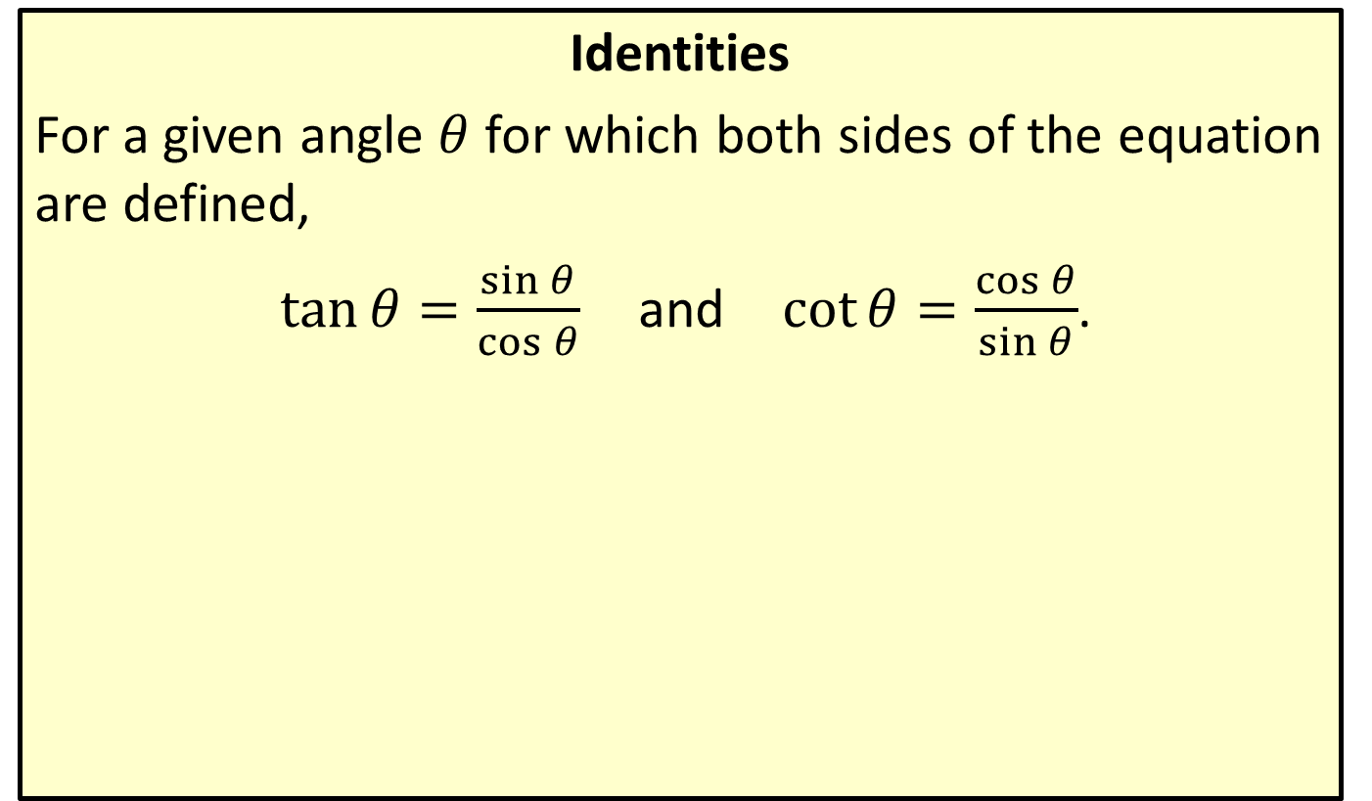
Quotient Identities
Identities
For a given angle $θ$ for which both sides of the equation are defined,
$\tan{θ}=\frac{\sin{θ}}{\cos{θ}}$ and $\cot{θ}=\frac{\cos{θ}}{\sin{θ}}$.

Slide 30
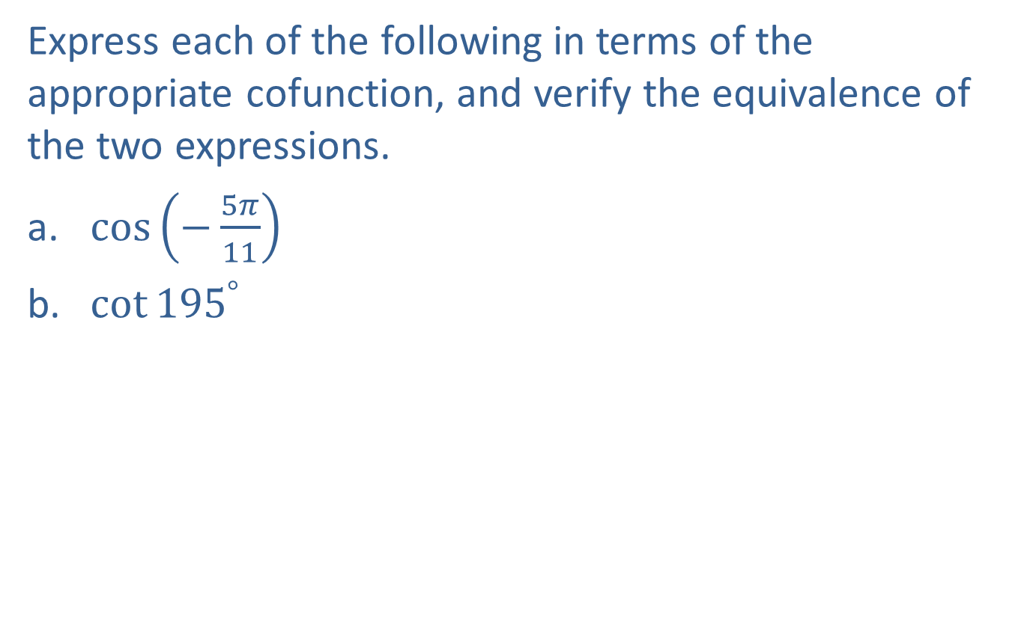
Example 6: Using Cofunction Identities
Express each of the following in terms of the appropriate cofunction, and verify the equivalence of the two expressions.
​$cos⁡\left(−\frac{5π}{11}\right)$
​$\cot{{195}^{°}}$

Slide 31
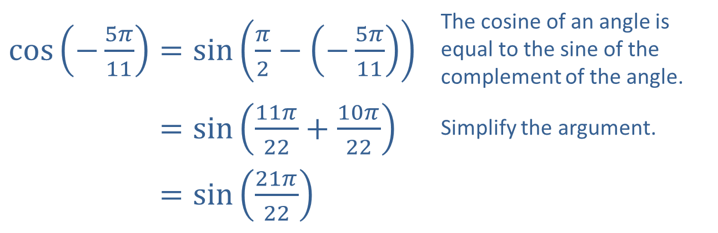

Example 6: Using Cofunction Identities (cont.)
Solution
​
Now use a calculator to verify that $cos⁡\left(−\frac{5π}{11}\right)$ and $sin⁡\left(\frac{21π}{22}\right)$ are both approximately 0.1423.
​$\cos\left(−\frac{5π}{11}\right)=\sin\left(\frac{π}{2}−\left(−\frac{5π}{11}\right)\right)$ | The cosine of an angle is equal to the sine of the complement of the angle.
​cos⁡−5𝜋11=sin11𝜋22+10𝜋22 | Simplify the argument.
​cos⁡−5𝜋11=sin21𝜋22

Slide 32
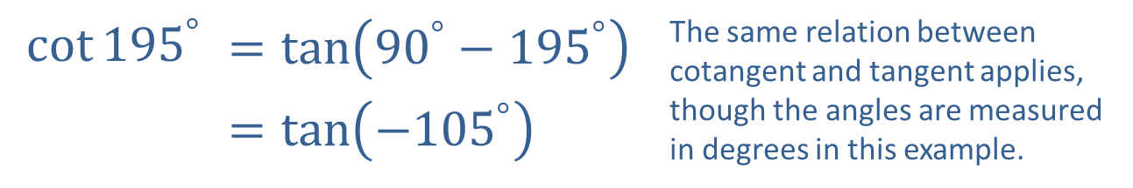
Example 6: Using Cofunction Identities (cont.)
​$\cot{{195}^{°}}$ | $$=\tan\left({90}^{°}−{195}^{°}\right)$$ | The same relation between cotangent and tangent applies, though the angles are measured in degrees in this example.
​ | $$=\tan\left(−{105}^{°}\right)$$
Verify that both sides are approximately 3.7321.​

Slide 33

Example 7: Using the Relationships between Trigonometric Functions
Given that $\cos{θ}=−\frac{\sqrt{3}}{2}$ and $tan⁡θ$ is negative, determine $θ$ and $tan⁡θ$.

Slide 34
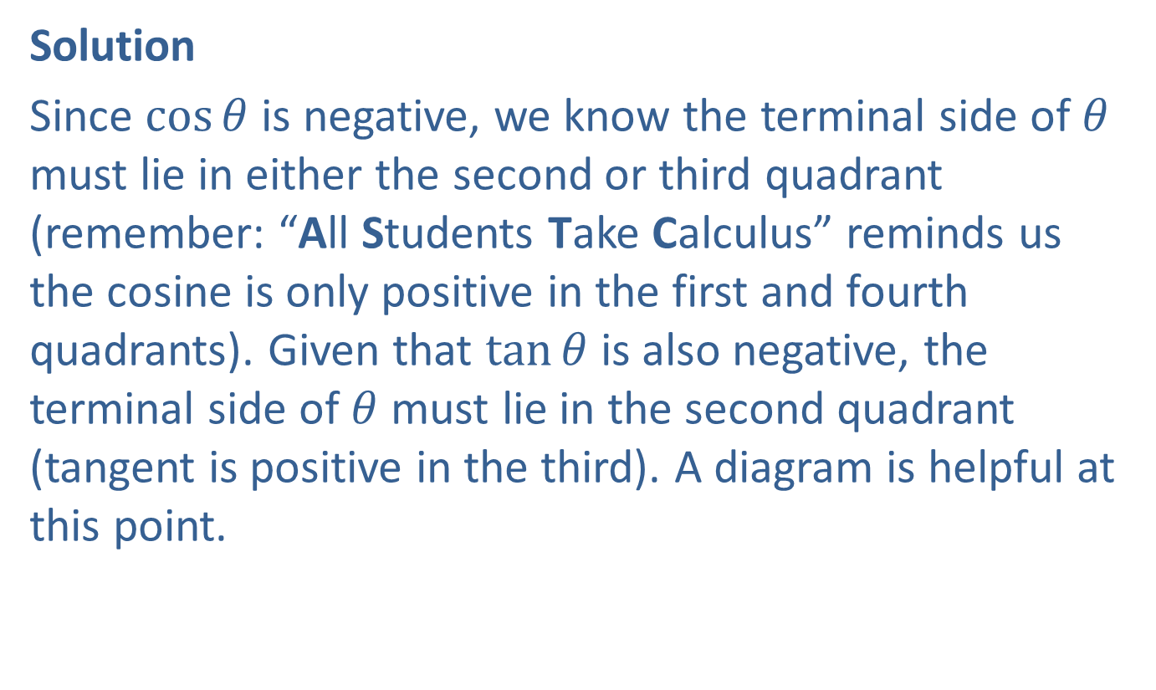
Example 7: Using the Relationships between Trigonometric Functions (cont.)
Solution
Since $cos⁡θ$ is negative, we know the terminal side of $θ$ must lie in either the second or third quadrant (remember: “All Students Take Calculus” reminds us the cosine is only positive in the first and fourth quadrants). Given that $tan⁡θ$ is also negative, the terminal side of $θ$ must lie in the second quadrant (tangent is positive in the third). A diagram is helpful at this point.

Slide 35
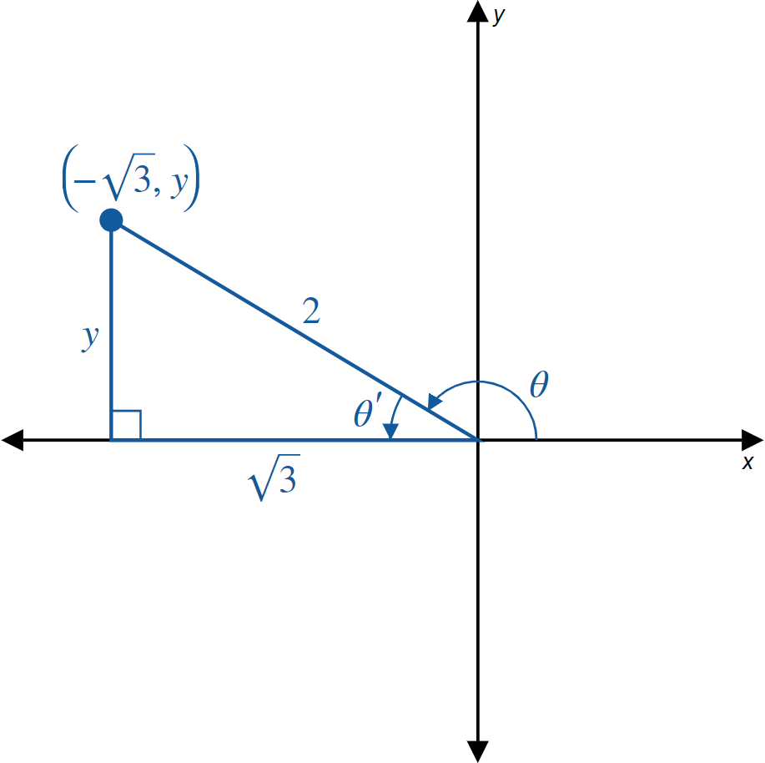
Example 7: Using the Relationships Between Trigonometric Functions (cont.)
Figure 16

Slide 36
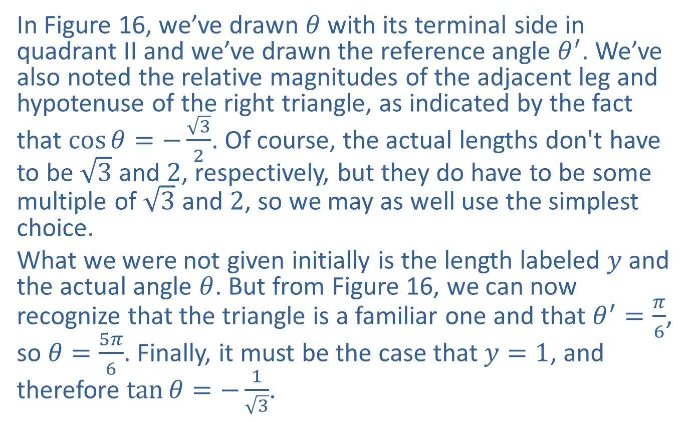
Example 7: Using the Relationships Between Trigonometric Functions (cont.)
In Figure 16, we’ve drawn $θ$ with its terminal side in quadrant II and we’ve drawn the reference angle $θ^{′}$. We’ve also noted the relative magnitudes of the adjacent leg and hypotenuse of the right triangle, as indicated by the fact that $\cos{θ}=−\frac{\sqrt{3}}{2}$. Of course, the actual lengths don't have to be $\sqrt{3}$ and 2, respectively, but they do have to be some multiple of $\sqrt{3}$ and 2, so we may as well use the simplest choice.
What we were not given initially is the length labeled $y$ and the actual angle $θ$. But from Figure 16, we can now recognize that the triangle is a familiar one and that $θ^{′}=\frac{π}{6}$, so $θ=\frac{5π}{6}$. Finally, it must be the case that $y=1$, and therefore $\tan{θ}=−\frac{1}{\sqrt{3}}$.

Slide 37

Example 8: Using the Relationships between Trigonometric Functions
Given that $\cot{θ}=0.4$ and $θ$ lies in the first quadrant, determine $sin⁡θ$.

Slide 38
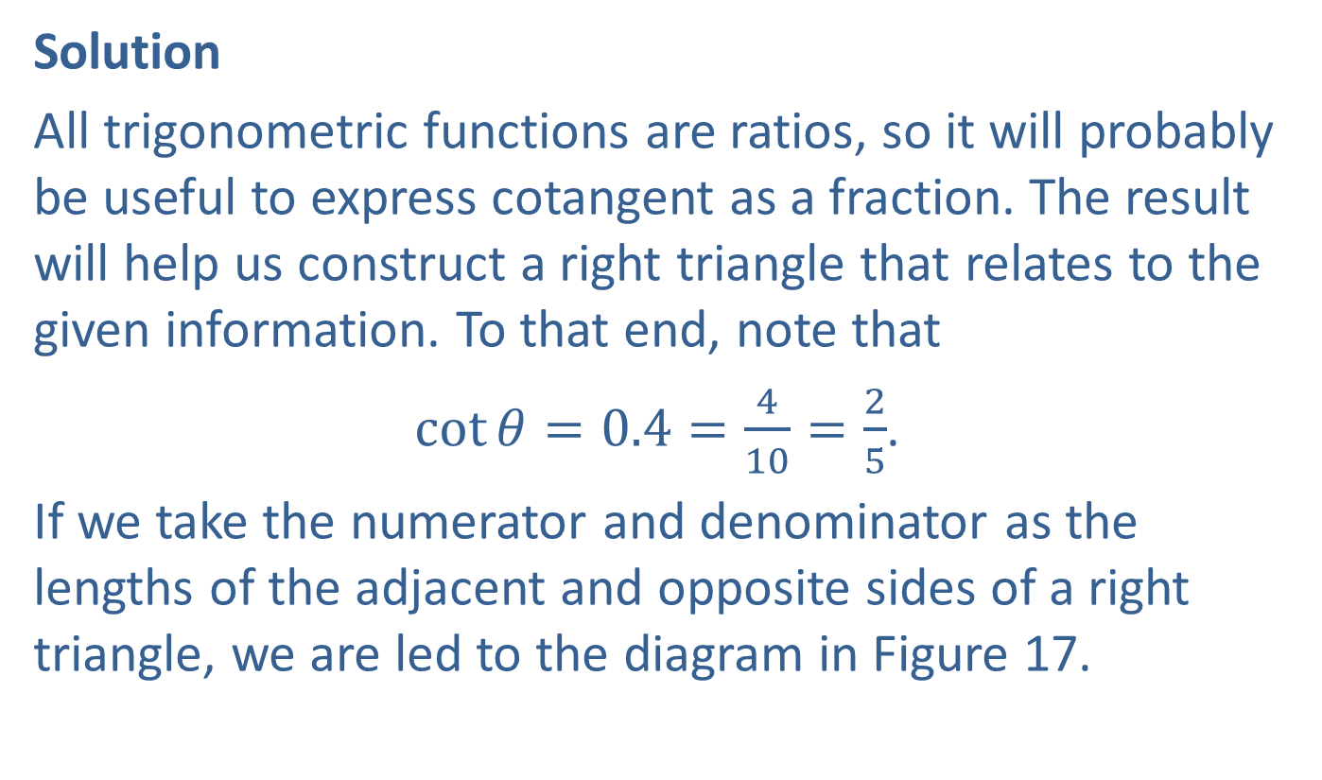
Example 8: Using the Relationships Between Trigonometric Functions (cont.)
Solution
All trigonometric functions are ratios, so it will probably be useful to express cotangent as a fraction. The result will help us construct a right triangle that relates to the given information. To that end, note that
$\cot{θ}=0.4=\frac{4}{10}=\frac{2}{5}$.
If we take the numerator and denominator as the lengths of the adjacent and opposite sides of a right triangle, we are led to the diagram in Figure 17.

Slide 39
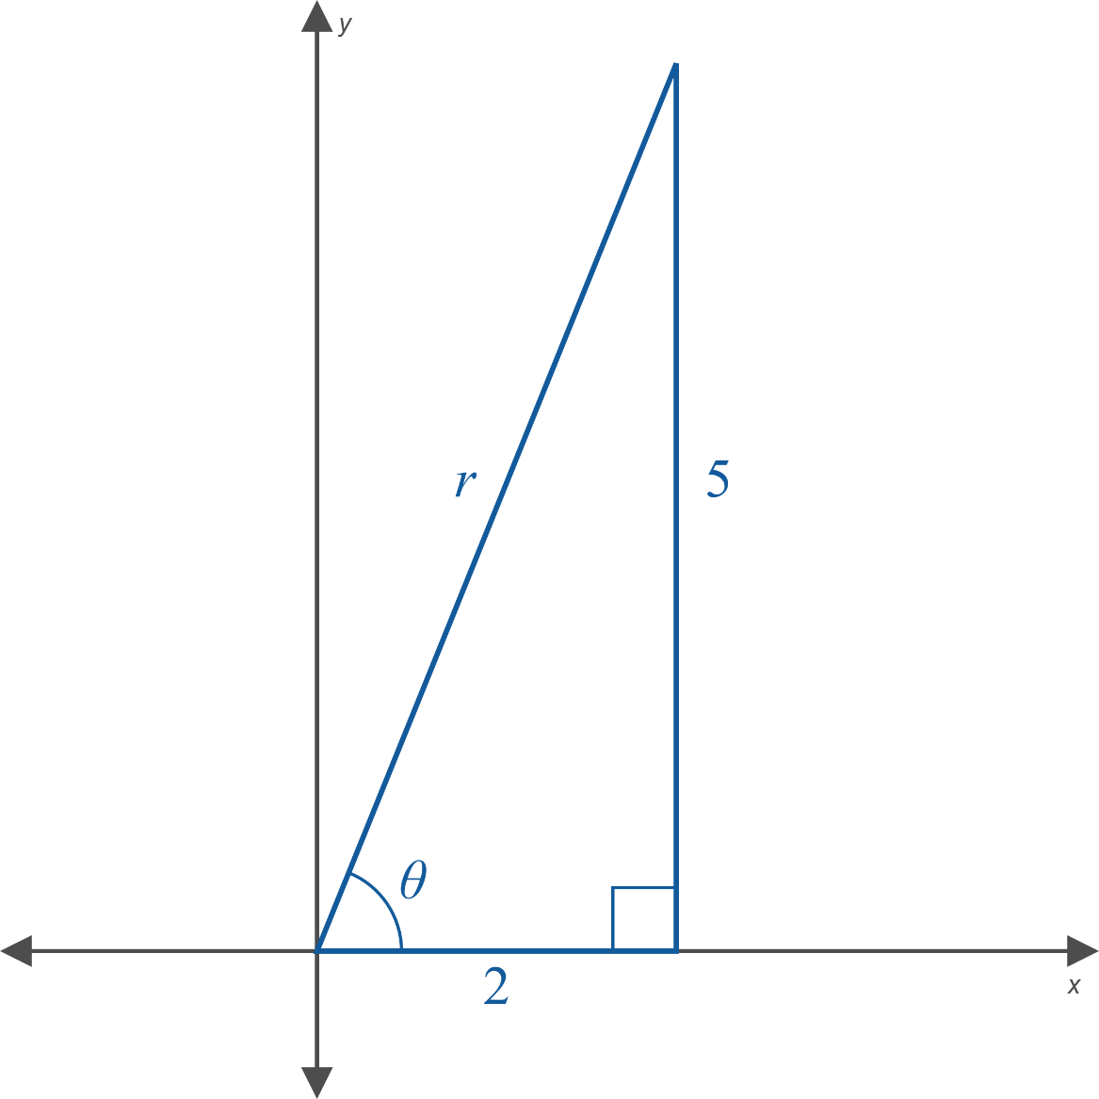
Example 8: Using the Relationships Between Trigonometric Functions (cont.)
Figure 17

Slide 40

Example 8: Using the Relationships Between Trigonometric Functions (cont.)
Now we can use the Pythagorean Theorem to determine that $r=\sqrt{4+25}=\sqrt{29}$, and so
$\sin{θ}=\frac{5}{\sqrt{29}}$.

