Slide 1
Section 7.4
Graphs of Sine and Cosine Functions

Slide 2
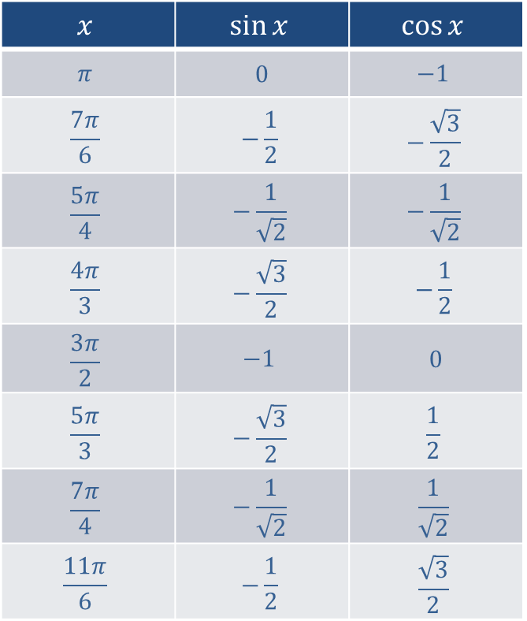
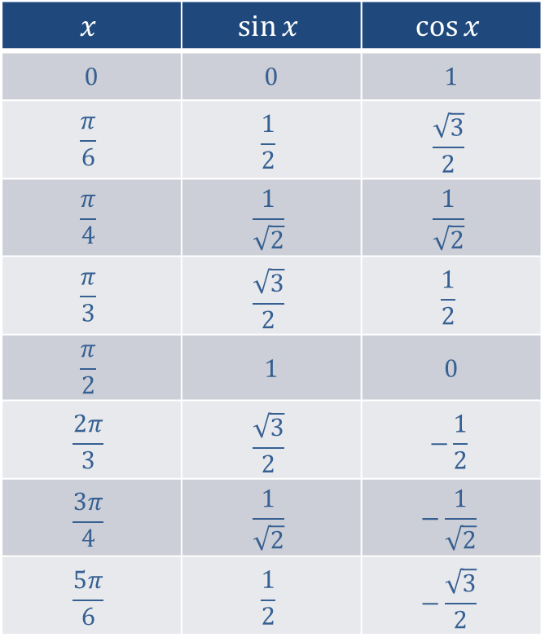
Table 1: Selected Values of Sine and Cosine
$$x$$ | $$sin⁡x$$ | $$cos⁡x$$
0 | 0 | 1
$$\frac{π}{6}$$ | $$\frac{1}{2}$$ | $$\frac{\sqrt{3}}{2}$$
$$\frac{π}{4}$$ | $$\frac{1}{\sqrt{2}}$$ | $$\frac{1}{\sqrt{2}}$$
$$\frac{π}{3}$$ | $$\frac{\sqrt{3}}{2}$$ | $$\frac{1}{2}$$
$$\frac{π}{2}$$ | 1 | 0
$$\frac{2π}{3}$$ | $$\frac{\sqrt{3}}{2}$$ | $$−\frac{1}{2}$$
$$\frac{3π}{4}$$ | $$\frac{1}{\sqrt{2}}$$ | $$−\frac{1}{\sqrt{2}}$$
$$\frac{5π}{6}$$ | $$\frac{1}{2}$$ | $$−\frac{\sqrt{3}}{2}$$
$$x$$ | $$sin⁡x$$ | $$cos⁡x$$
$$π$$ | 0 | $$−1$$
$$\frac{7π}{6}$$ | $$−\frac{1}{2}$$ | $$−\frac{\sqrt{3}}{2}$$
$$\frac{5π}{4}$$ | $$−\frac{1}{\sqrt{2}}$$ | $$−\frac{1}{\sqrt{2}}$$
$$\frac{4π}{3}$$ | $$−\frac{\sqrt{3}}{2}$$ | $$−\frac{1}{2}$$
$$\frac{3π}{2}$$ | $$−1$$ | 0
$$\frac{5π}{3}$$ | $$−\frac{\sqrt{3}}{2}$$ | $$\frac{1}{2}$$
$$\frac{7π}{4}$$ | $$−\frac{1}{\sqrt{2}}$$ | $$\frac{1}{\sqrt{2}}$$
$$\frac{11π}{6}$$ | $$−\frac{1}{2}$$ | $$\frac{\sqrt{3}}{2}$$

Slide 3
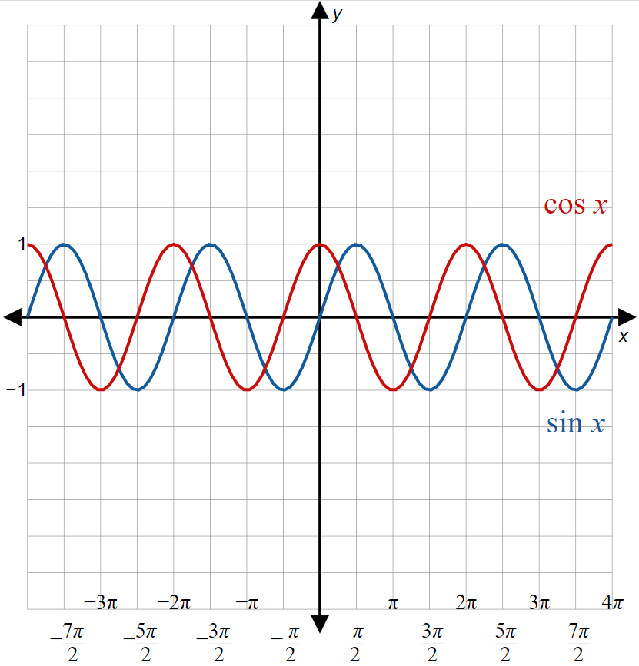
Figure 5: Graphs of Sine and Cosine

Slide 4

Note:
The domain of both sine and cosine is $(−∞,∞)$ and the range of both sine and cosine is $[−1,1]$.

Slide 5
Example 1: Transformation of Cosine, Part 1
Based on the graphs of sine and cosine in Figure 5 and the values of sine and cosine shown in Table 1, construct a transformation of cosine that is equal to sine.

Slide 6
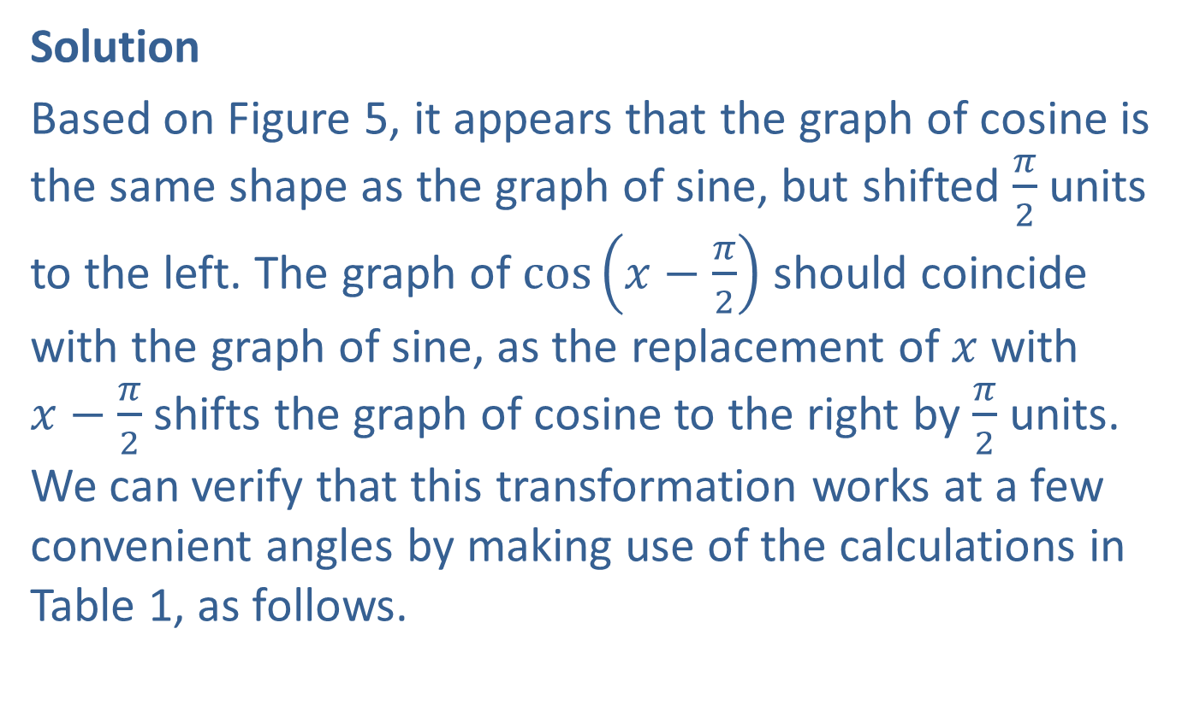
Example 1: Transformation of Cosine, Part 1 (cont.)
Solution
Based on Figure 5, it appears that the graph of cosine is the same shape as the graph of sine, but shifted $\frac{π}{2}$ units to the left. The graph of $cos⁡\left(x−\frac{π}{2}\right)$ should coincide with the graph of sine, as the replacement of $x$ with
$x−\frac{π}{2}$ shifts the graph of cosine to the right by $\frac{π}{2}$ units. We can verify that this transformation works at a few convenient angles by making use of the calculations in Table 1, as follows.

Slide 7
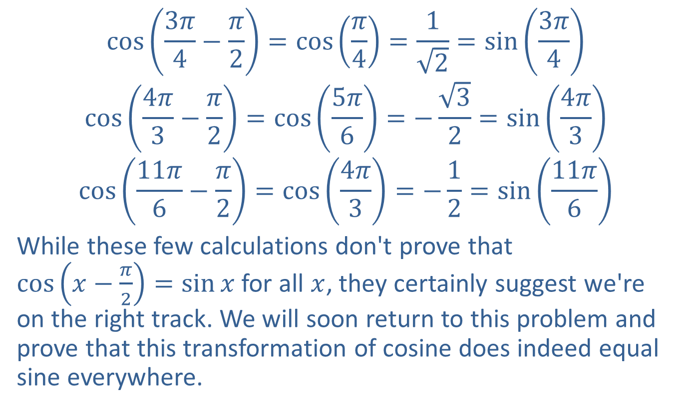
Example 1: Transformation of Cosine, Part 1 (cont.)
$$\cos\left(\frac{3π}{4}−\frac{π}{2}\right)=\cos\left(\frac{π}{4}\right)=\frac{1}{\sqrt{2}}=\sin\left(\frac{3π}{4}\right)$$
$$\cos\left(\frac{4π}{3}−\frac{π}{2}\right)=\cos\left(\frac{5π}{6}\right)=−\frac{\sqrt{3}}{2}=\sin\left(\frac{4π}{3}\right)$$
$$\cos\left(\frac{11π}{6}−\frac{π}{2}\right)=\cos\left(\frac{4π}{3}\right)=−\frac{1}{2}=\sin\left(\frac{11π}{6}\right)$$
While these few calculations don't prove that
$cos⁡\left(x−\frac{π}{2}\right)=\sin{x}$ for all $x$, they certainly suggest we're on the right track. We will soon return to this problem and prove that this transformation of cosine does indeed equal sine everywhere.

Slide 8
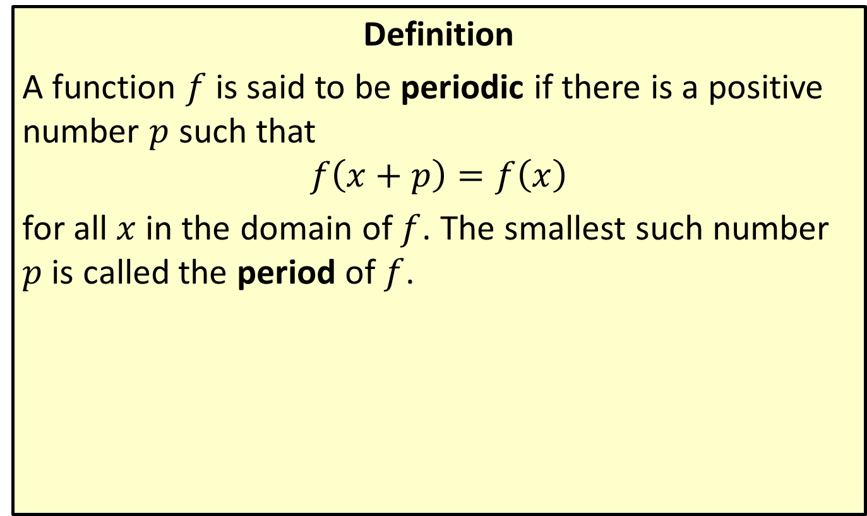
Period of a Function
Definition
A function $f$ is said to be periodic if there is a positive number $p$ such that
$$f\left(x+p\right)=f\left(x\right)$$
for all $x$ in the domain of $f$. The smallest such number $p$ is called the period of $f$.

Slide 9
Example 2: Finding the Period of Trigonometric Functions
Determine the periods of the secant, cosecant, tangent, and cotangent functions.

Slide 10
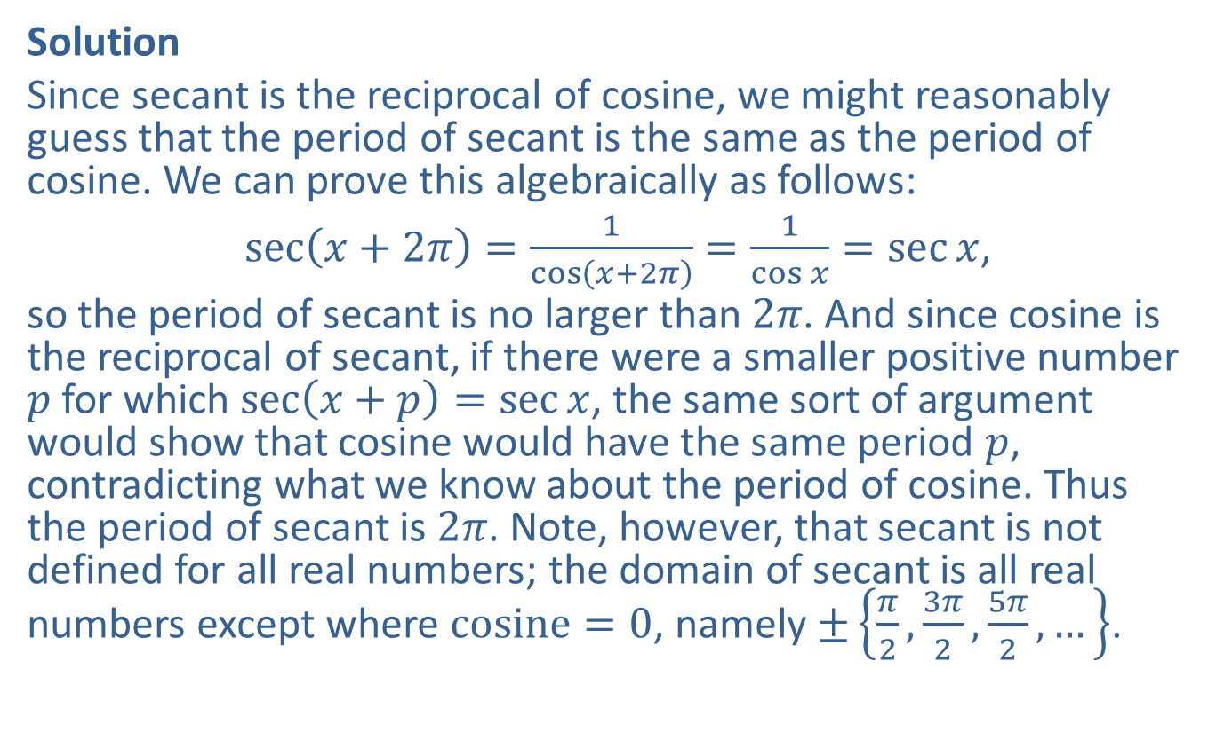
Example 2: Finding the Period of Trigonometric Functions (cont.)
Solution
Since secant is the reciprocal of cosine, we might reasonably guess that the period of secant is the same as the period of cosine. We can prove this algebraically as follows:
$\sec\left(x+2π\right)=\frac{1}{\cos\left(x+2π\right)}=\frac{1}{\cos{x}}=\sec{x}$,
so the period of secant is no larger than $2π$. And since cosine is the reciprocal of secant, if there were a smaller positive number $p$ for which $\sec\left(x+p\right)=\sec{x}$, the same sort of argument would show that cosine would have the same period $p$, contradicting what we know about the period of cosine. Thus the period of secant is $2π$. Note, however, that secant is not defined for all real numbers; the domain of secant is all real numbers except where $cosine=0$, namely $±\left\{\frac{π}{2},\frac{3π}{2},\frac{5π}{2},…\right\}$.

Slide 11

Example 2: Finding the Period of Trigonometric Functions (cont.)
The same reasoning shows that the period of cosecant, being the reciprocal of sine, is also $2π$.
We'll have to work a bit harder to determine the period of tangent. A reasonable guess might again be $2π$, since four of the trigonometric functions have period $2π$, but we'll see that this time the guess is wrong.

Slide 12
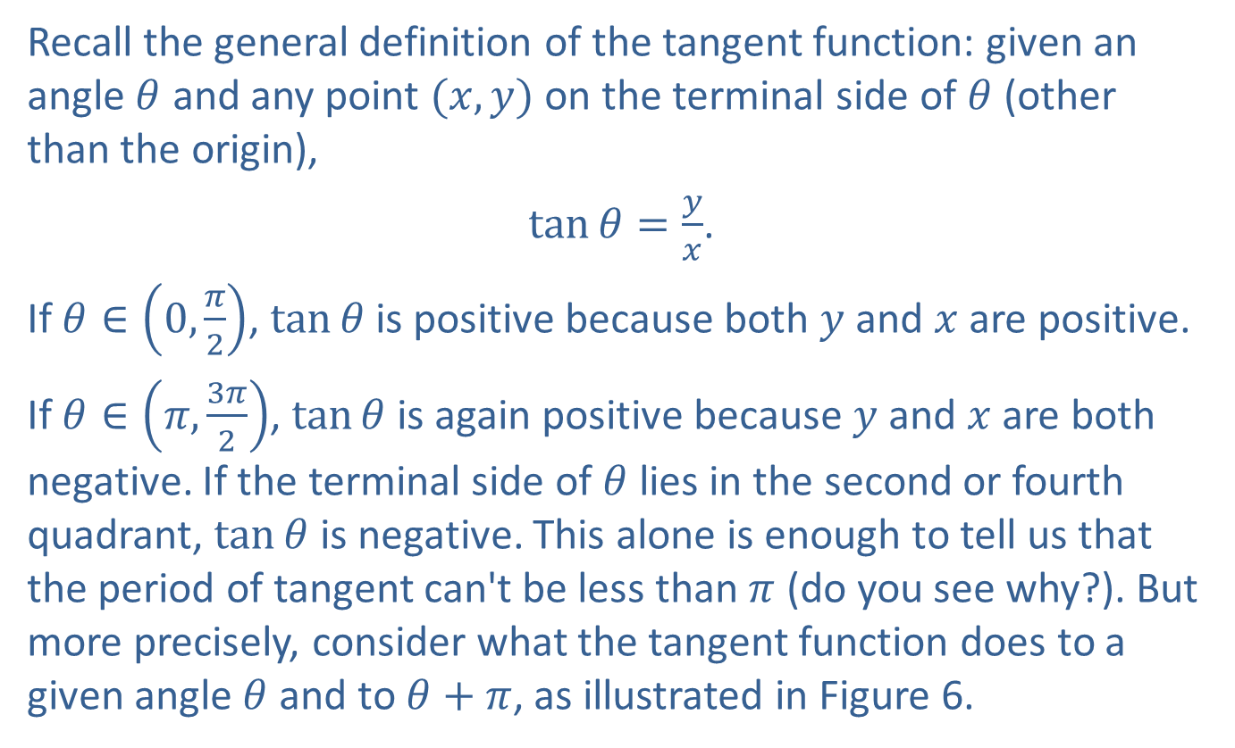
Example 2: Finding the Period of Trigonometric Functions (cont.)
Recall the general definition of the tangent function: given an angle $θ$ and any point $(x,y)$ on the terminal side of $θ$ (other than the origin),
$\tan{θ}=\frac{y}{x}$.
If $θ∈\left(0,\frac{π}{2}\right)$, $tan⁡θ$ is positive because both $y$ and $x$ are positive.
If $θ∈\left(π,\frac{3π}{2}\right)$, $tan⁡θ$ is again positive because $y$ and $x$ are both negative. If the terminal side of $θ$ lies in the second or fourth quadrant, $tan⁡θ$ is negative. This alone is enough to tell us that the period of tangent can't be less than $π$ (do you see why?). But more precisely, consider what the tangent function does to a given angle $θ$ and to $θ+π$, as illustrated in Figure 6.

Slide 13
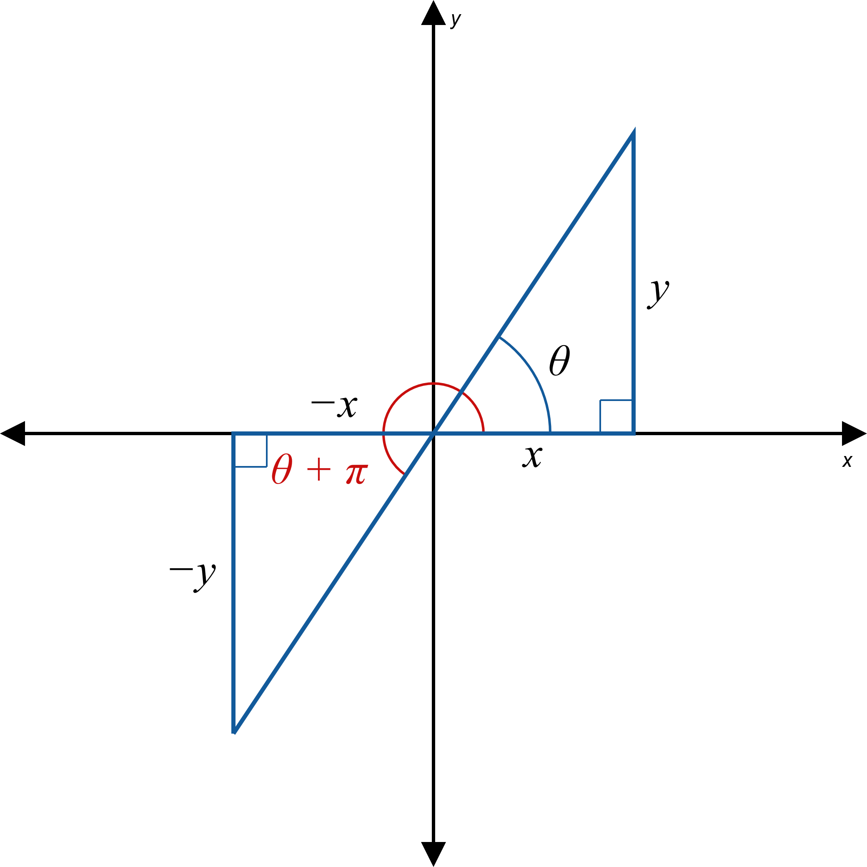
Example 2: Finding the Period of Trigonometric Functions (cont.)

Slide 14
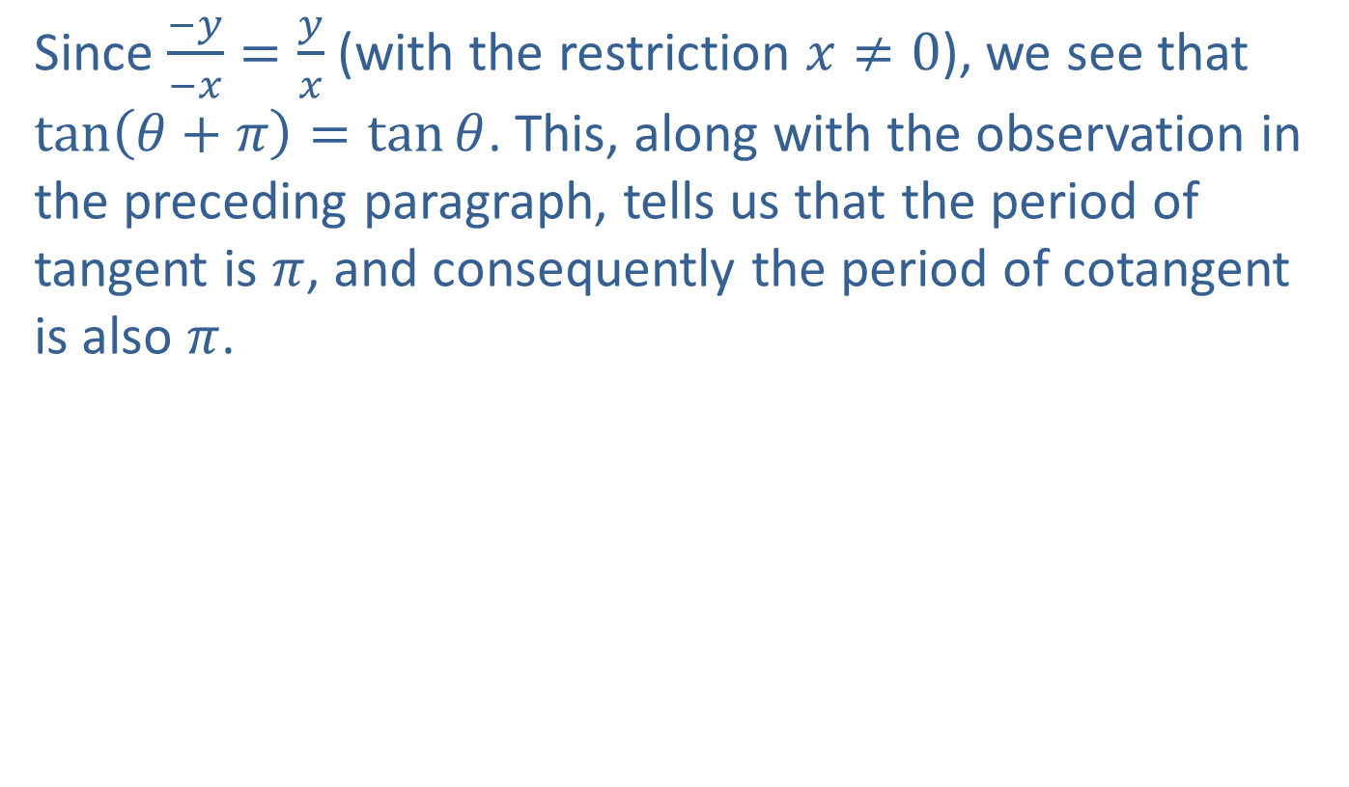
Example 2: Finding the Period of Trigonometric Functions (cont.)
Since $\frac{−y}{−x}=\frac{y}{x}$ (with the restriction $x≠0$), we see that $\tan\left(θ+π\right)=\tan{θ}$. This, along with the observation in the preceding paragraph, tells us that the period of tangent is $π$, and consequently the period of cotangent is also $π$.

Slide 15
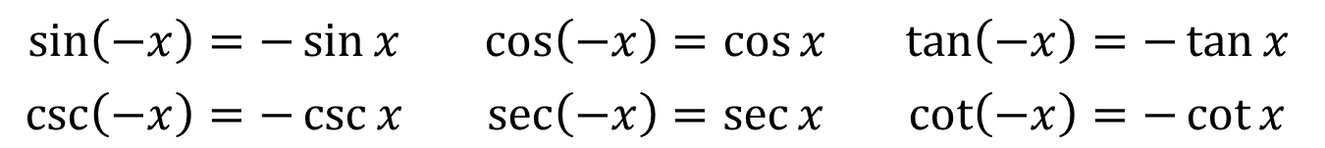
Even/Odd Identities
Identities
$$\sin\left(−x\right)=−\sin{x}$$ | $$\cos\left(−x\right)=\cos{x}$$ | $$\tan\left(−x\right)=−\tan{x}$$
$$\csc\left(−x\right)=−\csc{x}$$ | $$\sec\left(−x\right)=\sec{x}$$ | $$\cot\left(−x\right)=−\cot{x}$$

Slide 16

Example 3: Transformation of Cosine, Part 2
Use a cofunction identity and an even/odd identity to prove the transformation statement $\cos\left(x−\frac{π}{2}\right)=\sin{x}$ for all $x$.

Slide 17
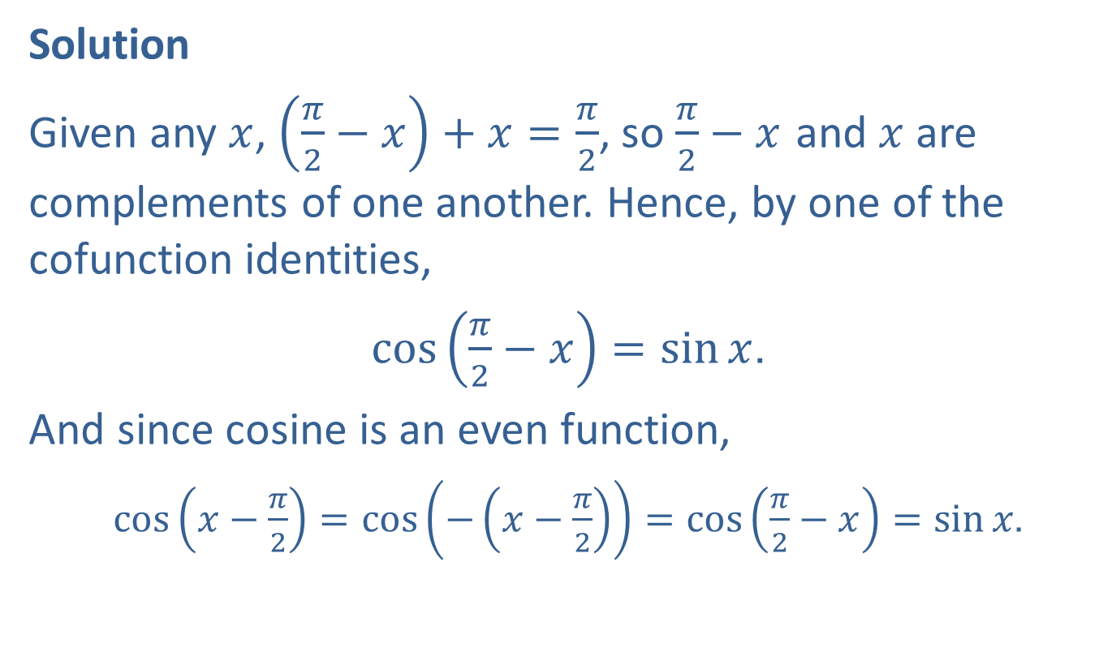
Example 3: Transformation of Cosine, Part 2 (cont.)
Solution
Given any $x$, $\left(\frac{π}{2}−x\right)+x=\frac{π}{2}$, so $\frac{π}{2}−x$ and $x$ are complements of one another. Hence, by one of the cofunction identities,
$\cos\left(\frac{π}{2}−x\right)=\sin{x}$.
And since cosine is an even function,
$\cos\left(x−\frac{π}{2}\right)=\cos\left(−\left(x−\frac{π}{2}\right)\right)=cos\left(\frac{π}{2}−x\right)=\sin{x}$.

Slide 18
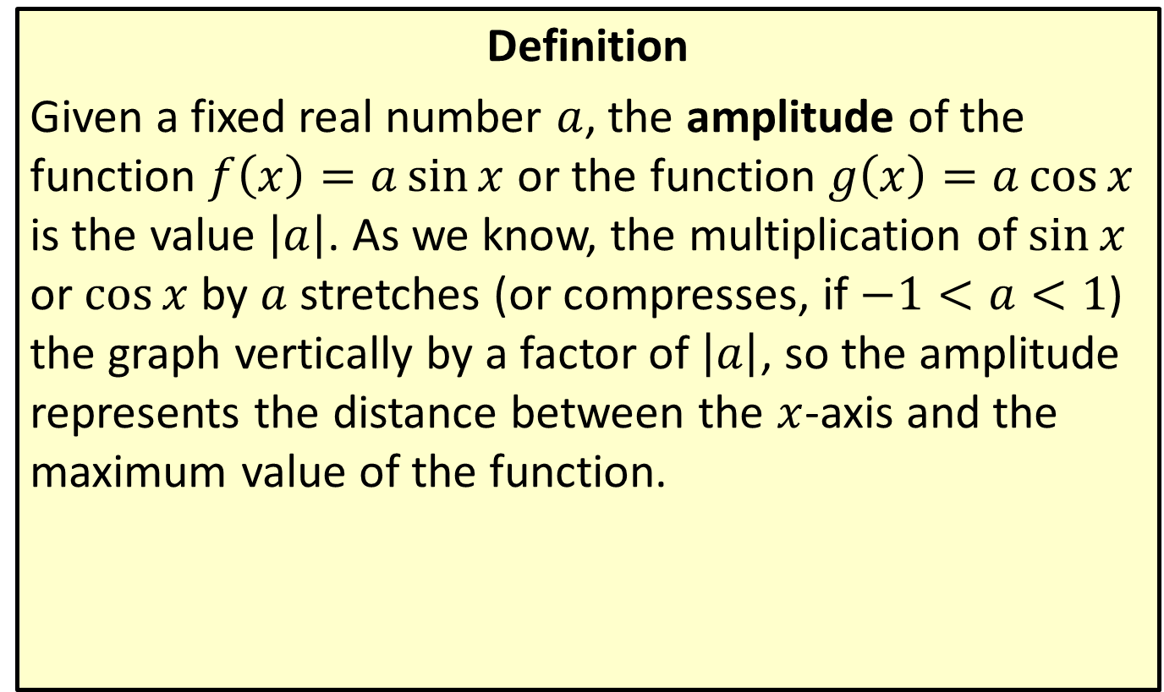
Amplitude of Sine and Cosine Curves
Definition
Given a fixed real number $a$, the amplitude of the function $f\left(x\right)=a\sin{x}$ or the function $g\left(x\right)=a\cos{x}$ is the value $\left|a\right|$. As we know, the multiplication of $sin⁡x$ or $cos⁡x$ by $a$ stretches (or compresses, if $−1<a<1$) the graph vertically by a factor of $\left|a\right|$, so the amplitude represents the distance between the $x$-axis and the maximum value of the function.

Slide 19
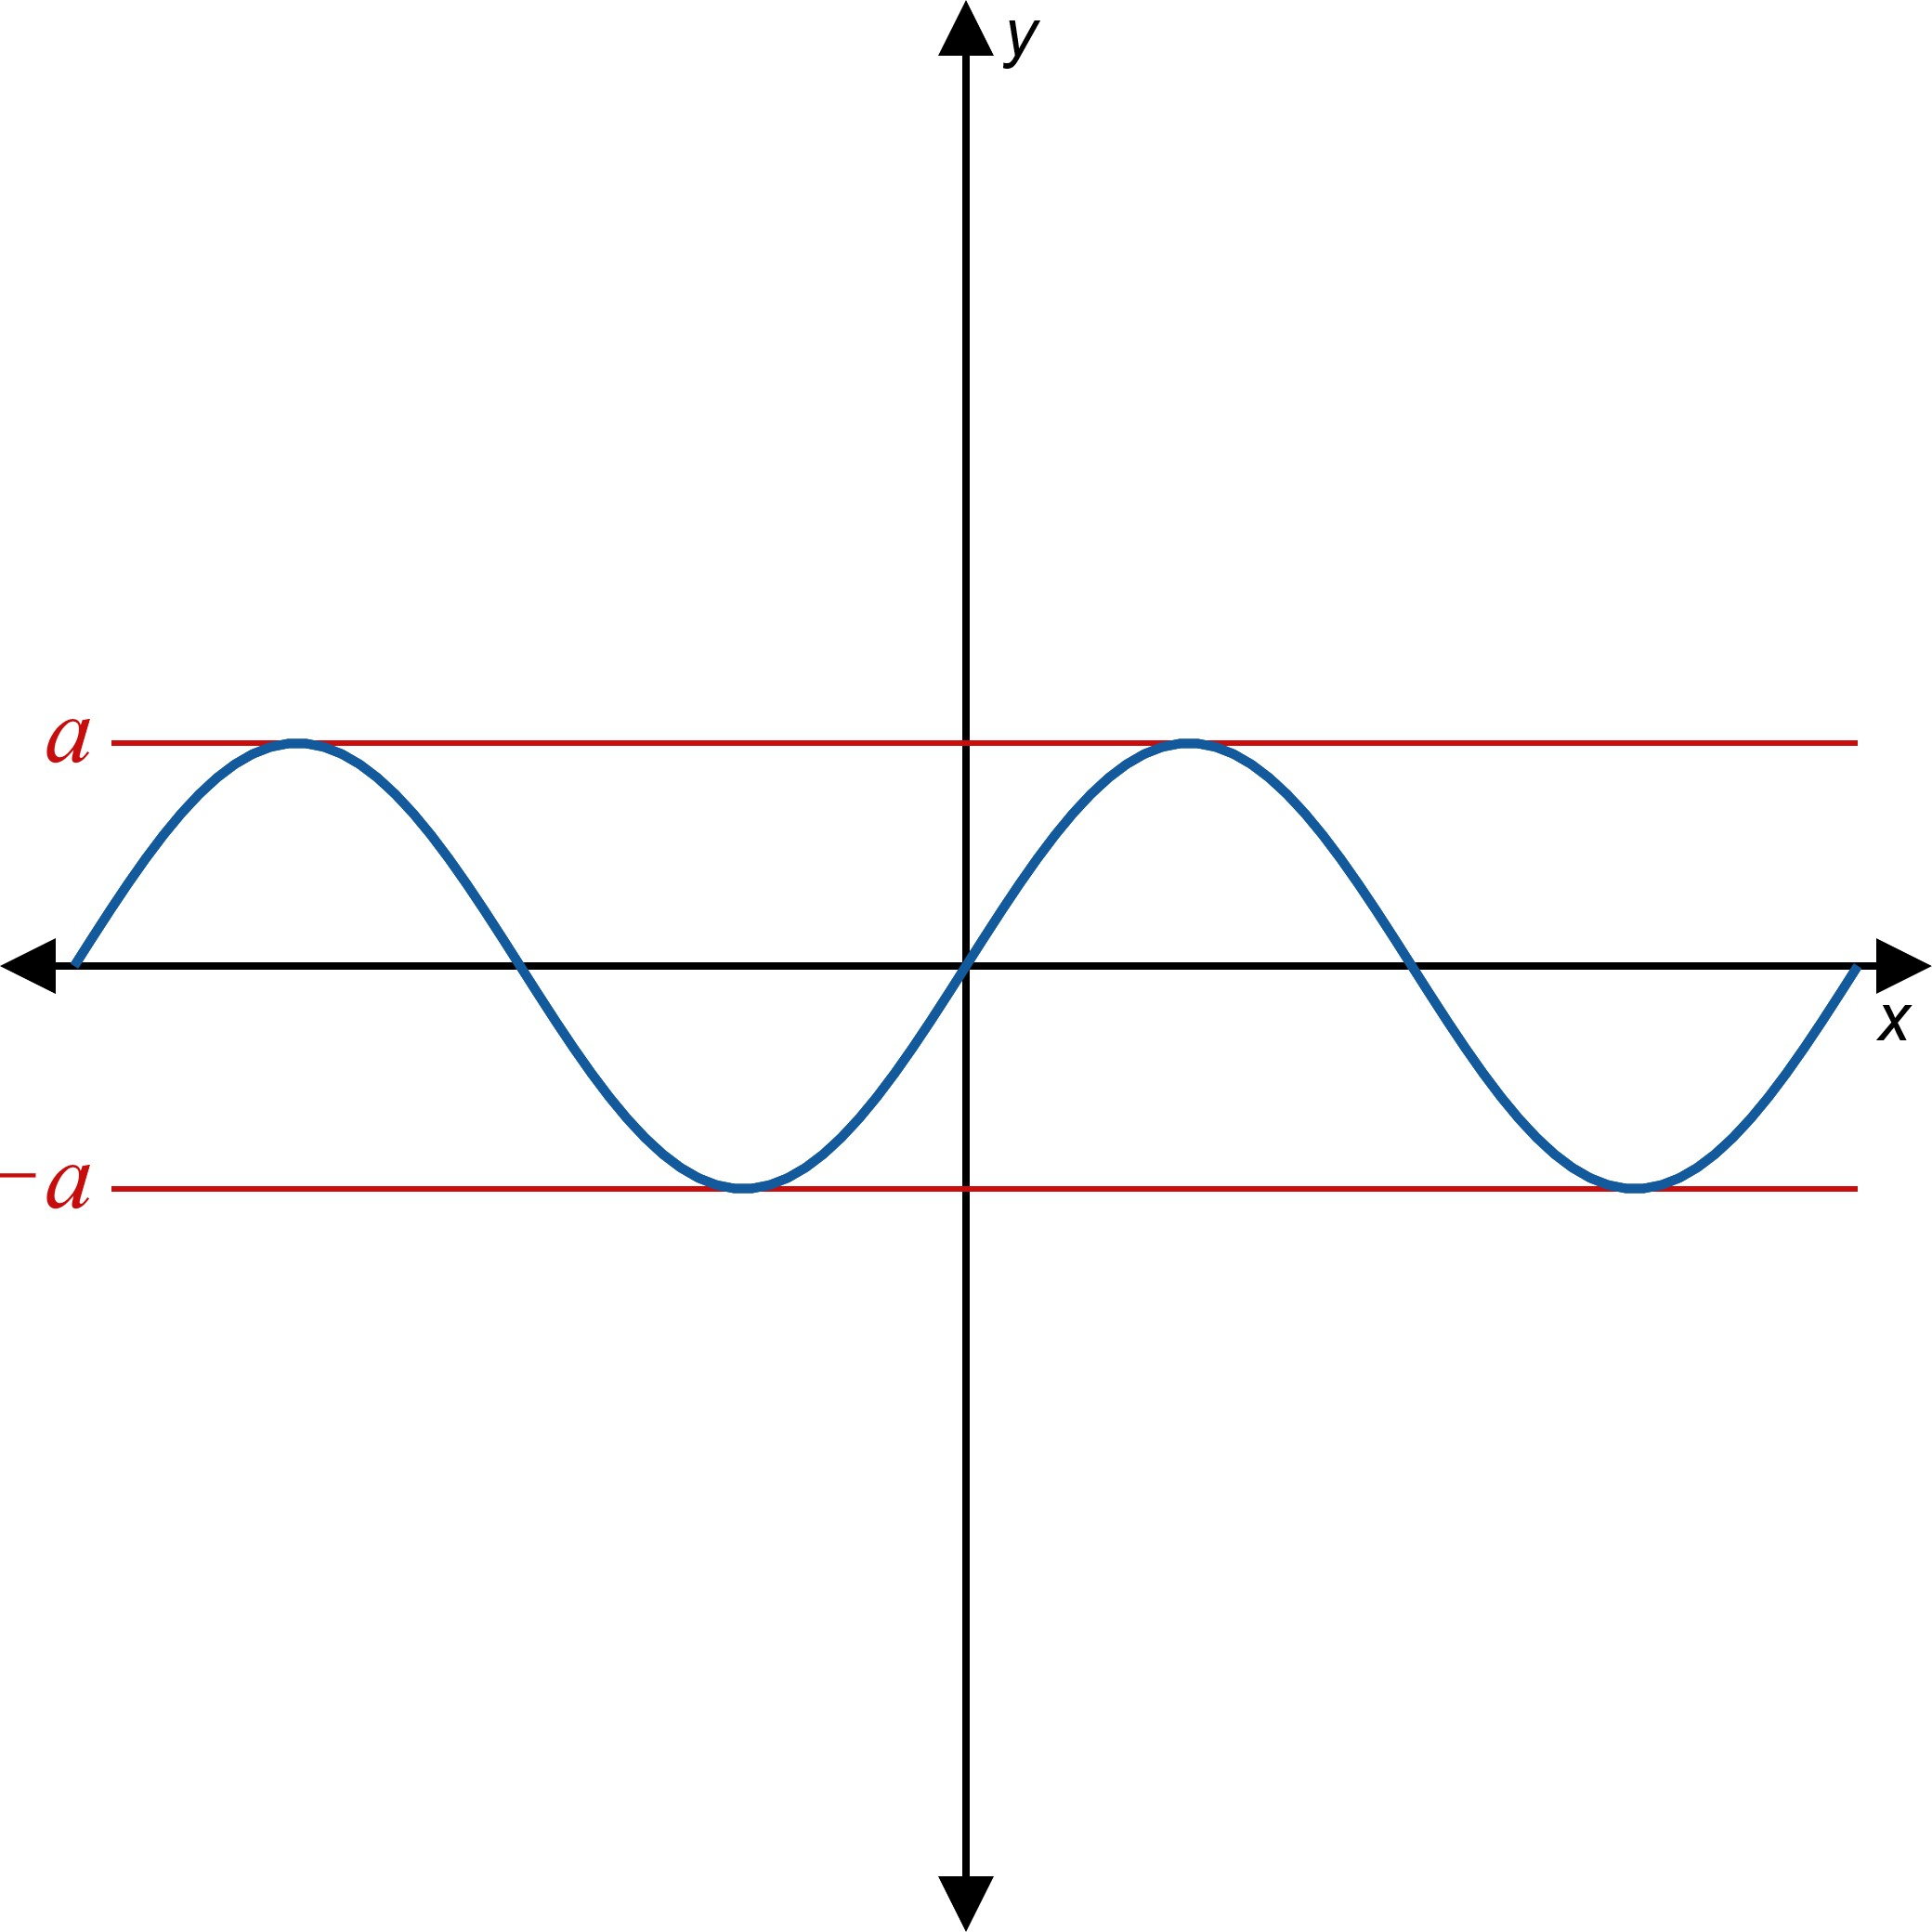
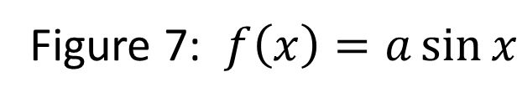
Amplitude of Sine and Cosine Curves (cont.)

Slide 20
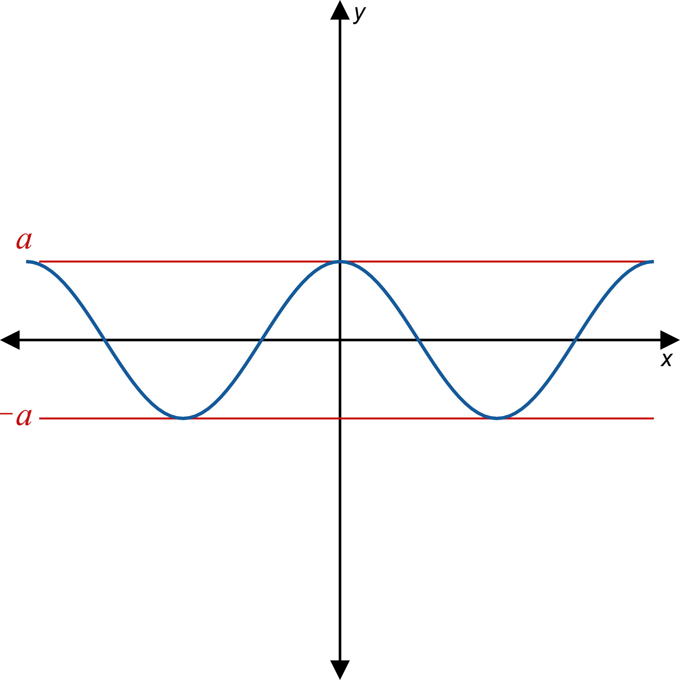
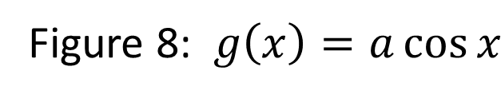
Amplitude of Sine and Cosine Curves (cont.)

Slide 21
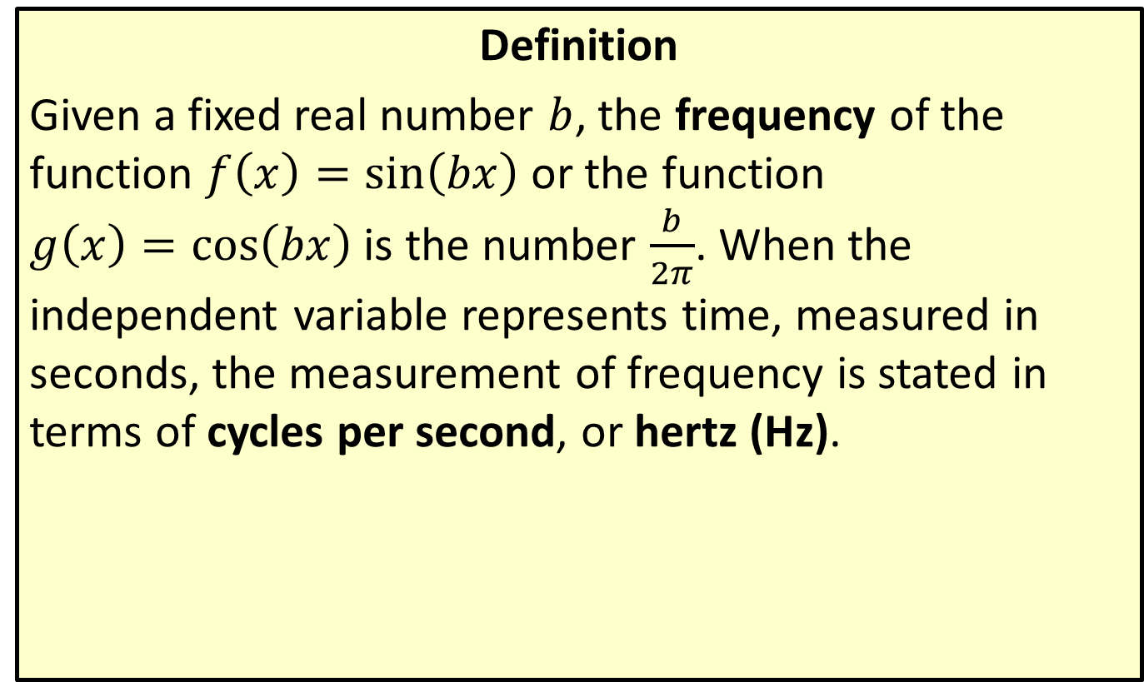
Frequency of Sine and Cosine Curves
Definition
Given a fixed real number $b$, the frequency of the function $f\left(x\right)=\sin\left(bx\right)$ or the function
$g\left(x\right)=\cos\left(bx\right)$ is the number $\frac{b}{2π}$. When the independent variable represents time, measured in seconds, the measurement of frequency is stated in terms of cycles per second, or hertz (Hz).

Slide 22
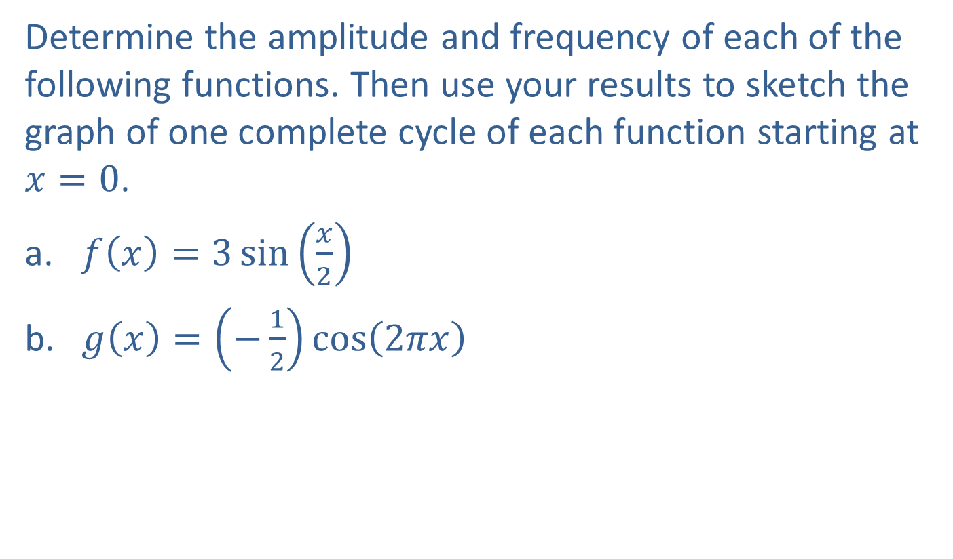
Example 4: Finding Amplitude and Frequency
Determine the amplitude and frequency of each of the following functions. Then use your results to sketch the graph of one complete cycle of each function starting at $x=0$.
​$f\left(x\right)=3\sin\left(\frac{x}{2}\right)$
​$g\left(x\right)=\left(−\frac{1}{2}\right)\cos\left(2πx\right)$

Slide 23
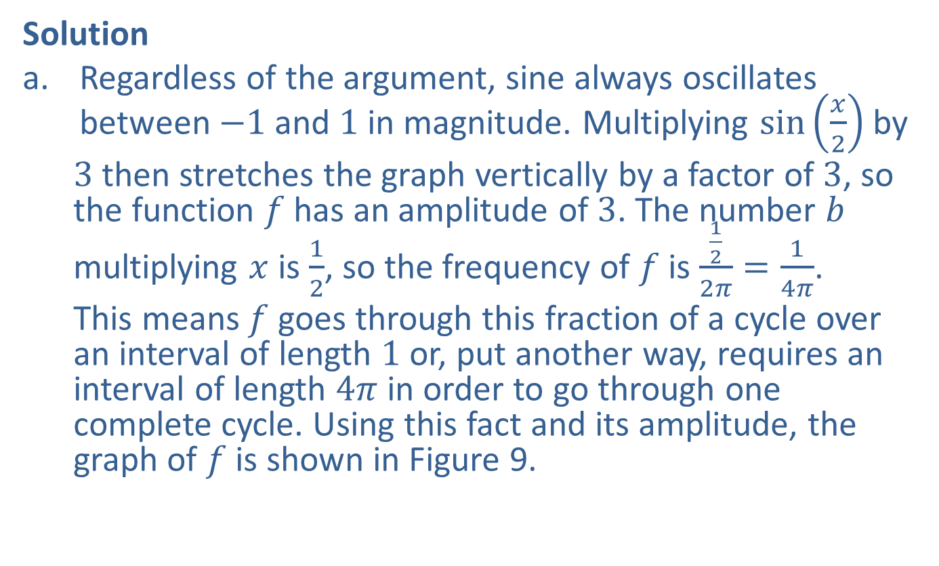
Example 4: Finding Amplitude and Frequency (cont.)
Solution
​Regardless of the argument, sine always oscillates between $−1$ and 1 in magnitude. Multiplying $sin⁡\left(\frac{x}{2}\right)$ by
  3 then stretches the graph vertically by a factor of 3, so the function $f$ has an amplitude of 3. The number $b$ multiplying $x$ is $\frac{1}{2}$, so the frequency of $f$ is $\frac{\frac{1}{2}}{2π}=\frac{1}{4π}$.
  This means $f$ goes through this fraction of a cycle over an interval of length 1 or, put another way, requires an interval of length $4π$ in order to go through one complete cycle. Using this fact and its amplitude, the graph of $f$ is shown in Figure 9.
​

Slide 24
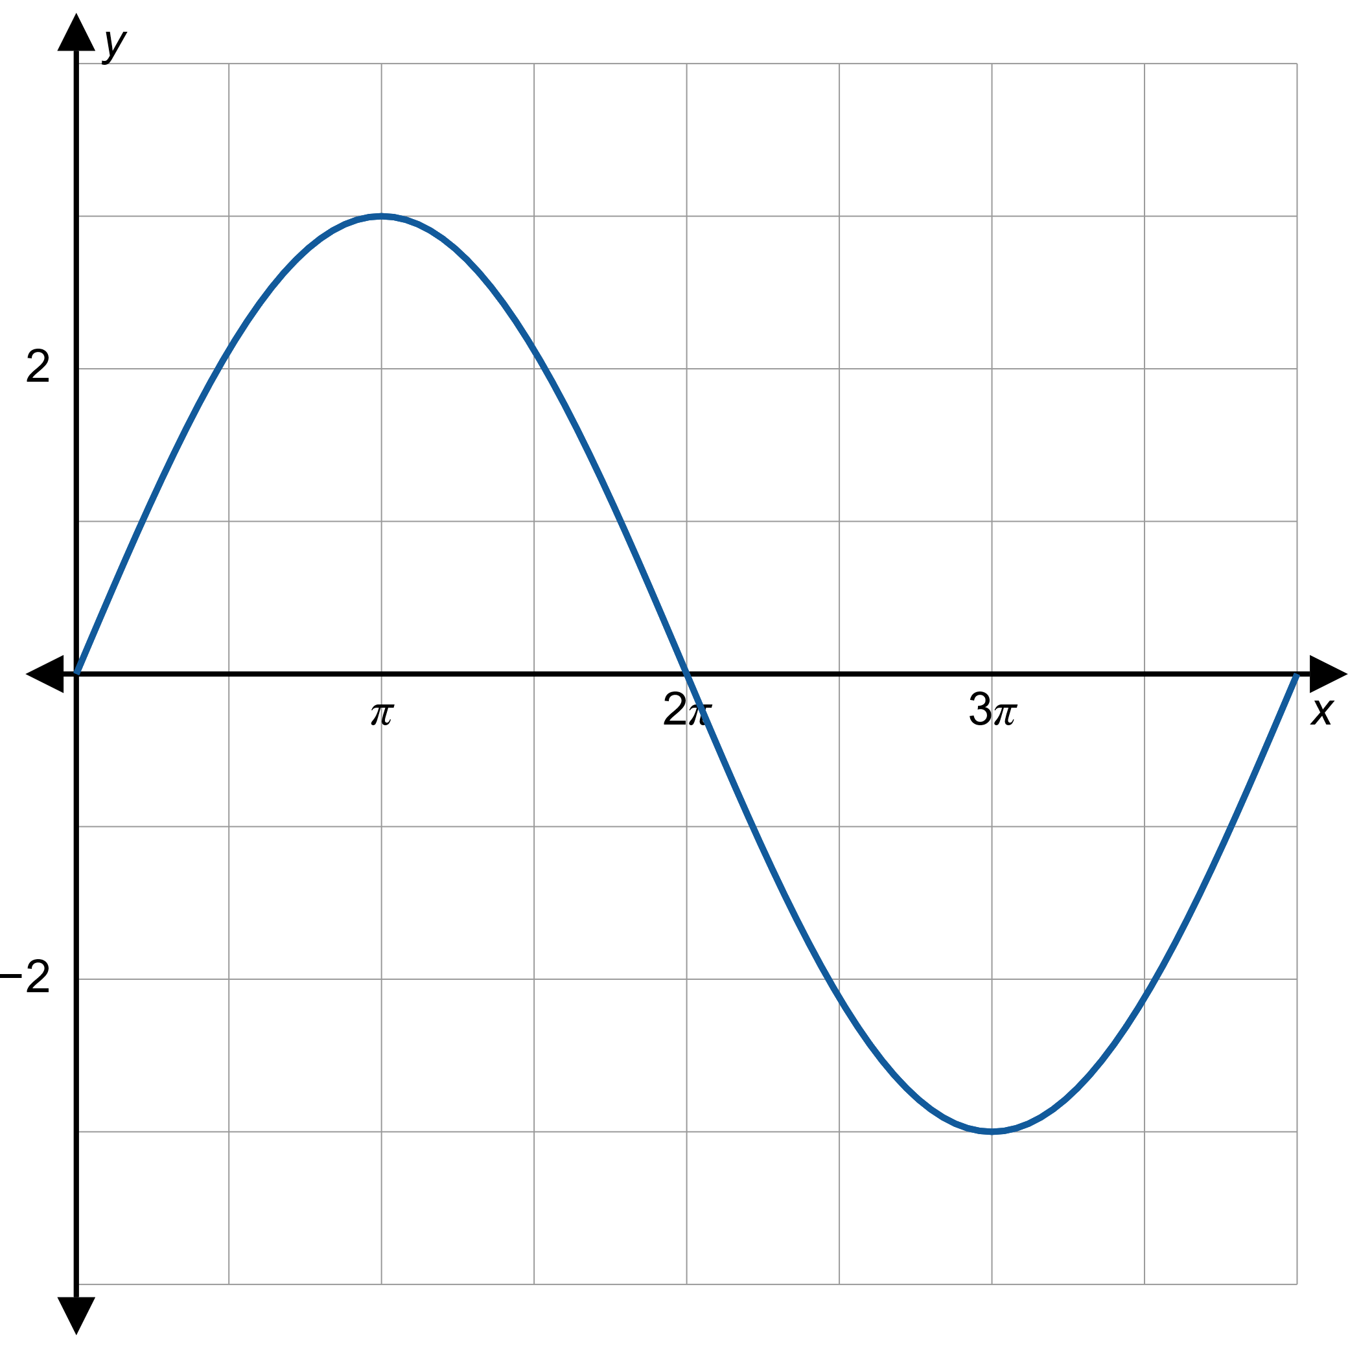
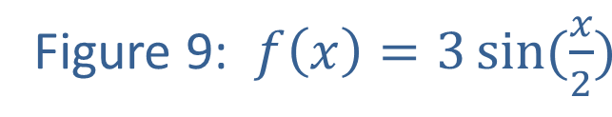
Example 4: Finding Amplitude and Frequency (cont.)

Slide 25
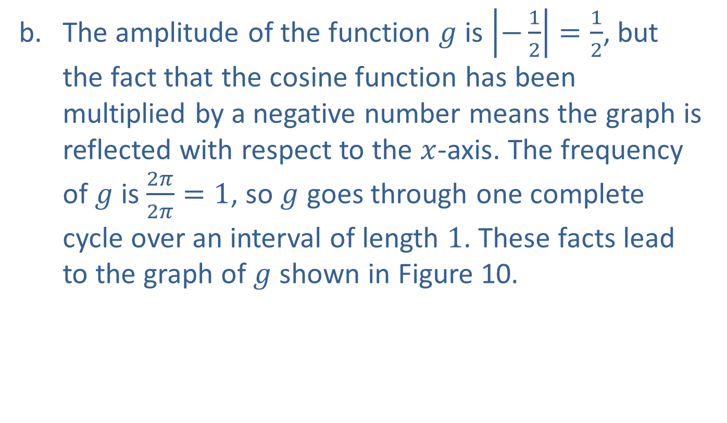
Example 4: Finding Amplitude and Frequency (cont.)
​The amplitude of the function $g$ is $\left|−\frac{1}{2}\right|=\frac{1}{2}$, but the fact that the cosine function has been multiplied by a negative number means the graph is reflected with respect to the $x$-axis. The frequency of $g$ is $\frac{2π}{2π}=1$, so $g$ goes through one complete cycle over an interval of length 1. These facts lead to the graph of $g$ shown in Figure 10.
​

Slide 26
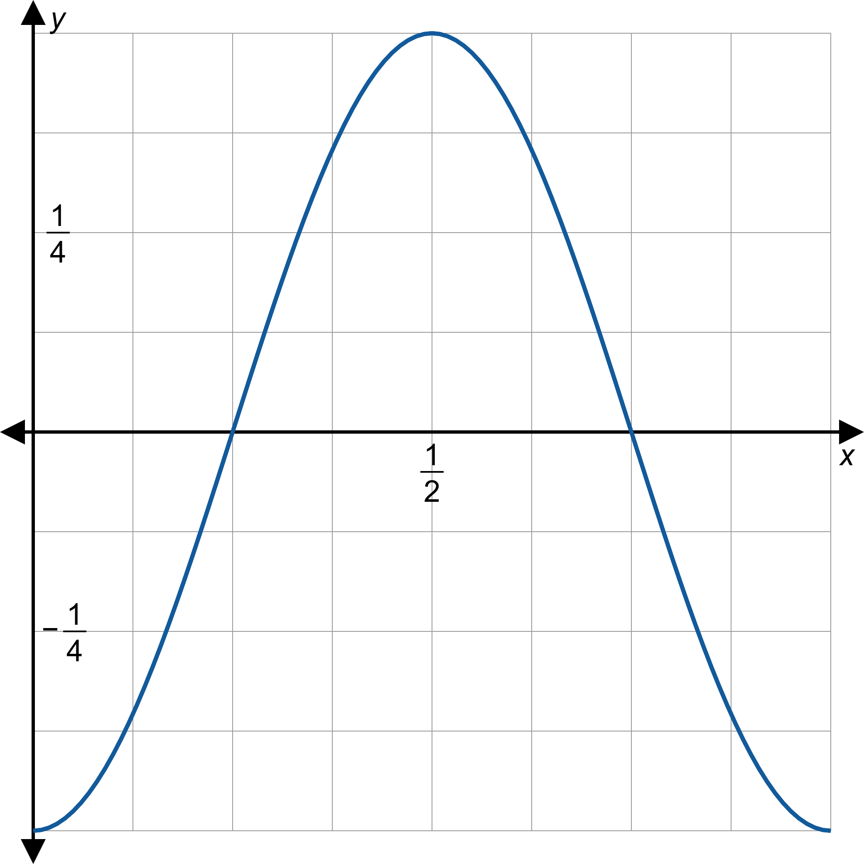
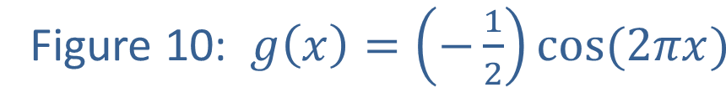
Example 4: Finding Amplitude and Frequency (cont.)

Slide 27
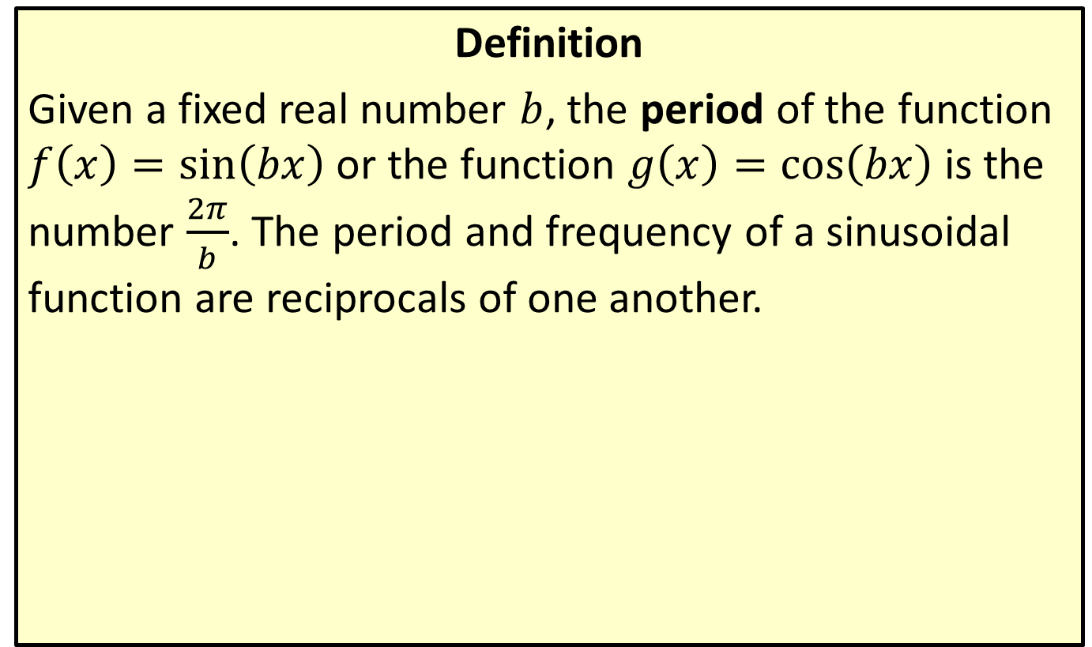
Period Revisited
Definition
Given a fixed real number $b$, the period of the function $f\left(x\right)=\sin\left(bx\right)$ or the function $g\left(x\right)=\cos\left(bx\right)$ is the number $\frac{2π}{b}$. The period and frequency of a sinusoidal function are reciprocals of one another.

Slide 28
Example 5: Finding the Period Using Frequency
The A and D strings of a cello are tuned to vibrate at frequencies of 220 Hz and 146.8 Hz, respectively. What are the periods of the waves that these two strings produce?

Slide 29
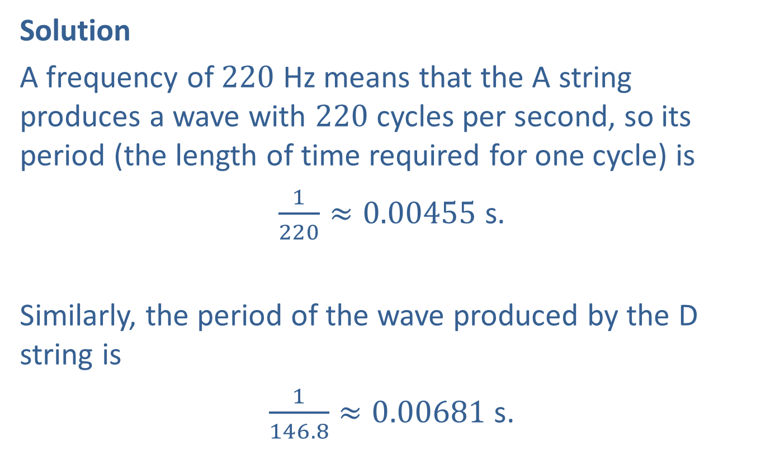
Example 5: Finding the Period Using Frequency (cont.)
Solution
A frequency of 220 Hz means that the A string produces a wave with 220 cycles per second, so its period (the length of time required for one cycle) is
$\frac{1}{220}≈0.00455 \text{s}$.
Similarly, the period of the wave produced by the D string is
$\frac{1}{146.8}≈0.00681 \text{s}$.

Slide 30
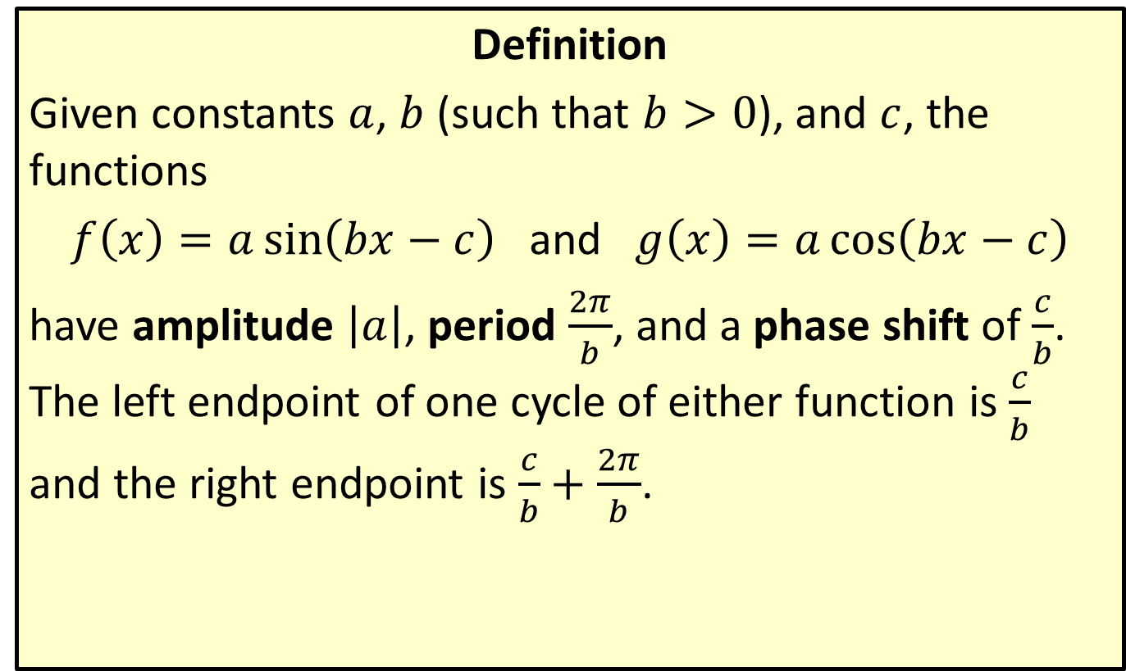
Amplitude, Period, and Phase Shift Combined
Definition
Given constants $a$, $b$ (such that $b>0$), and $c$, the functions
$f\left(x\right)=a\sin\left(bx−c\right)$ and $g\left(x\right)=a\cos\left(bx−c\right)$
have amplitude $\left|a\right|$, period $\frac{2π}{b}$, and a phase shift of $\frac{c}{b}$. The left endpoint of one cycle of either function is $\frac{c}{b}$ and the right endpoint is $\frac{c}{b}+\frac{2π}{b}$.

Slide 31
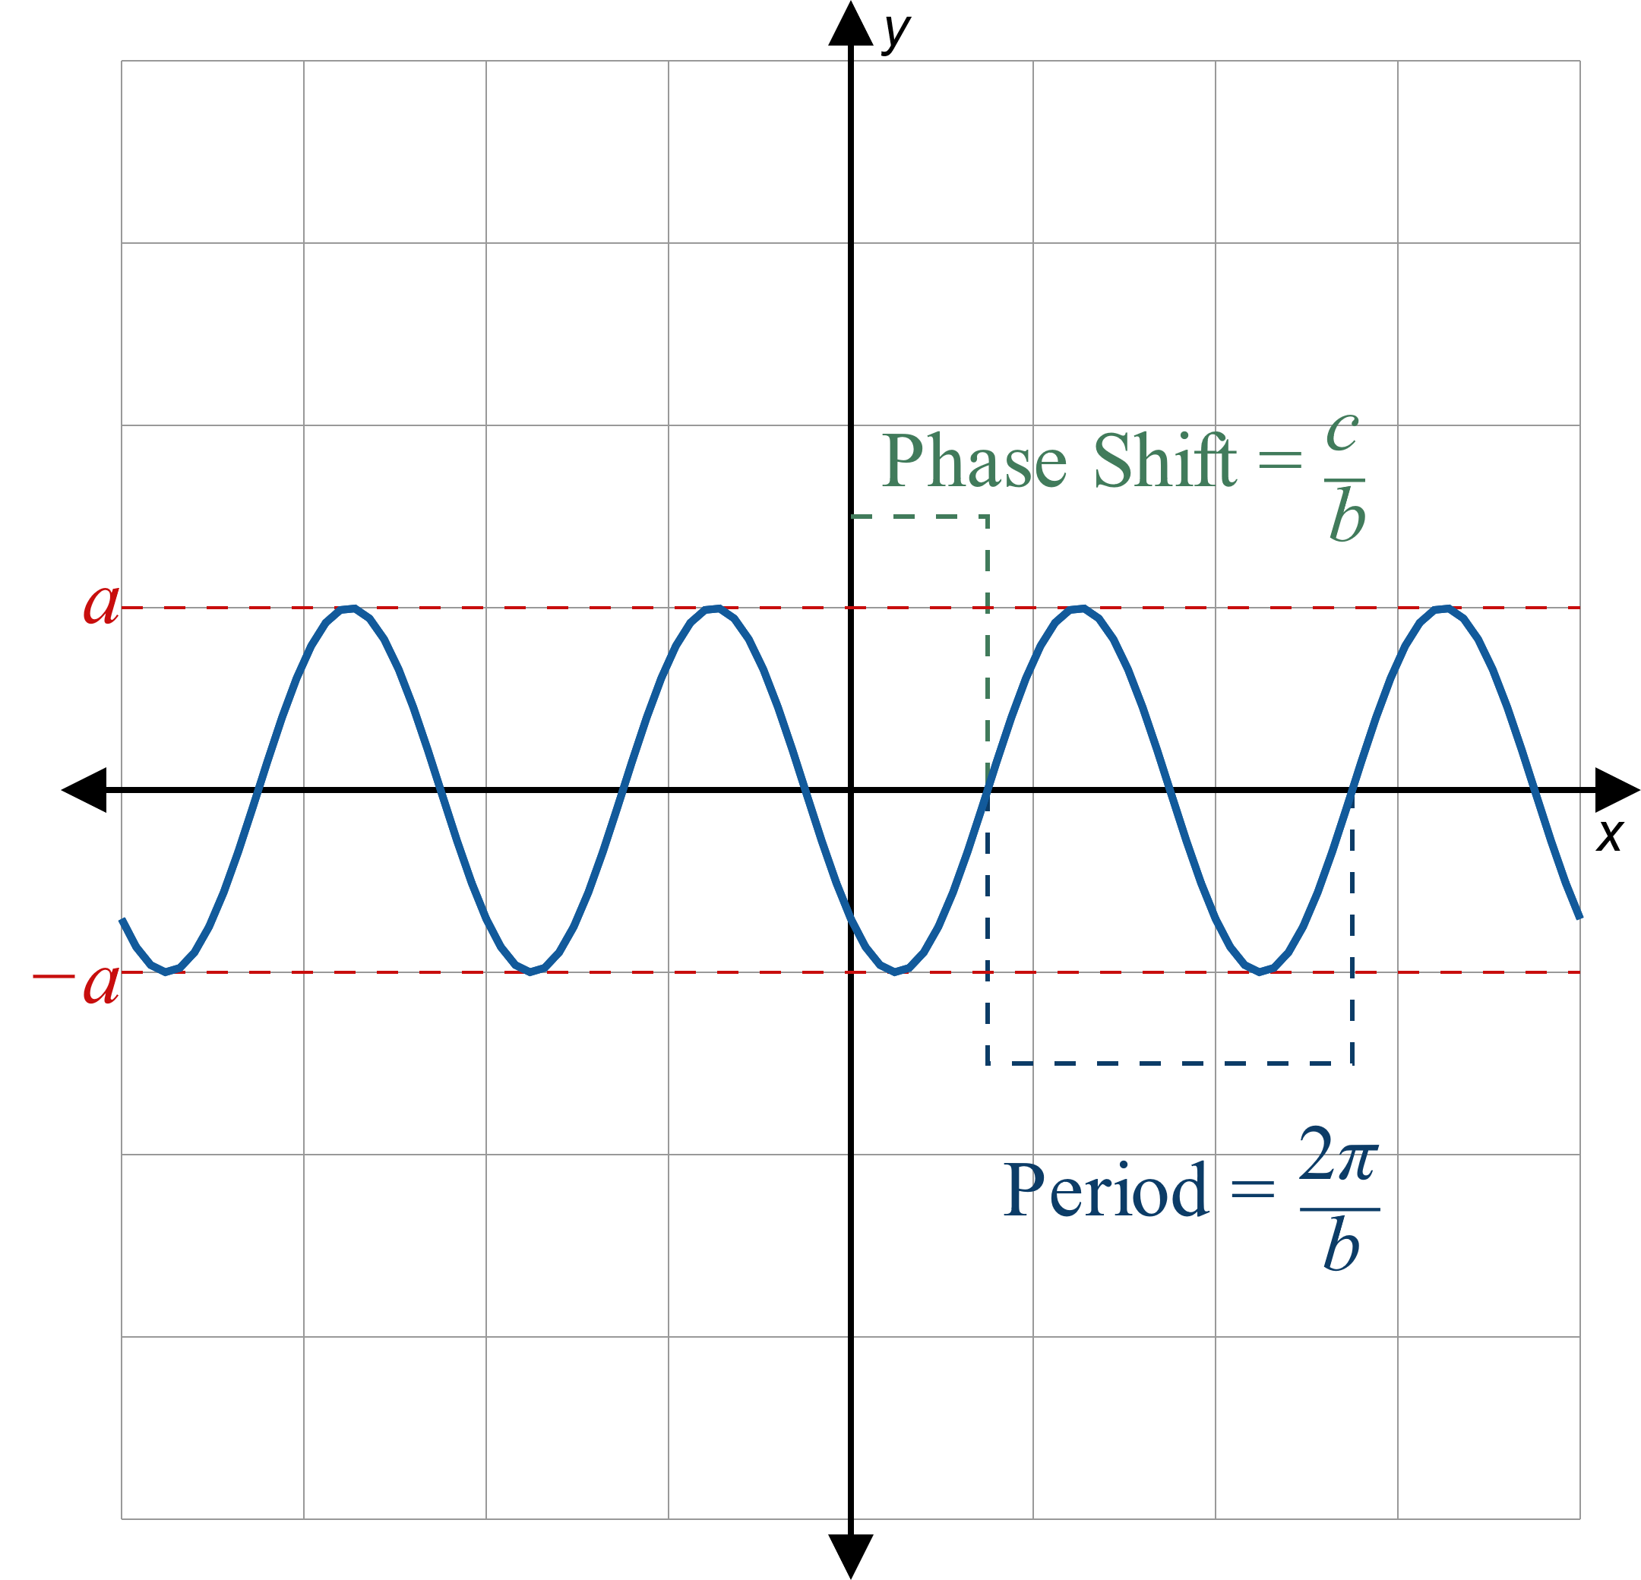
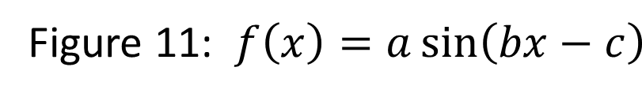
Amplitude, Period, and Phase Shift Combined (cont.)

Slide 32
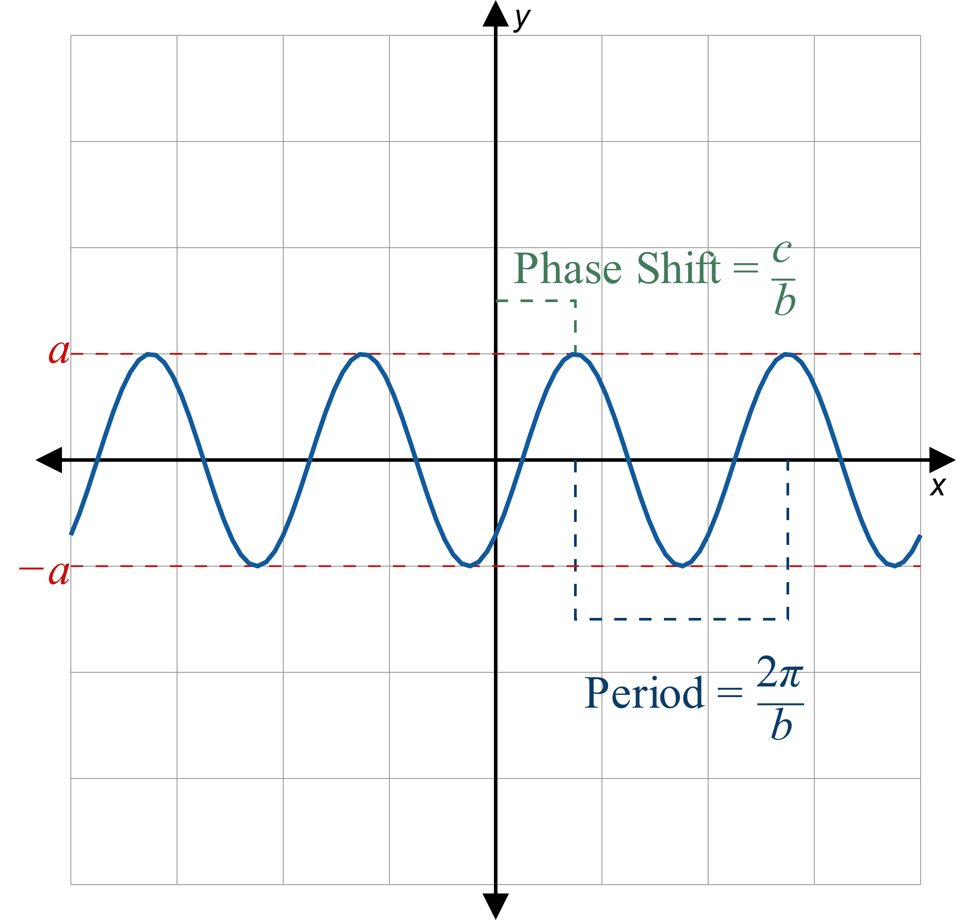
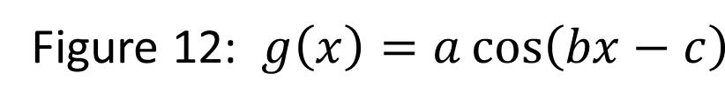
Amplitude, Period, and Phase Shift Combined (cont.)

Slide 33

Example 6: Graphing Transformed Trigonometric Functions
Sketch the graph of $f\left(x\right)=−2\cos\left(πx−π\right)$.

Slide 34
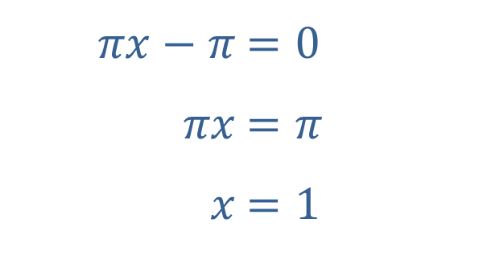

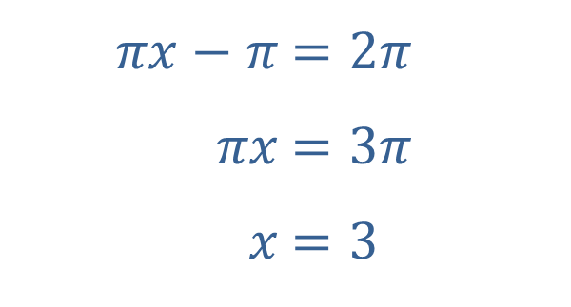
Example 6: Graphing Transformed Trigonometric Functions (cont.)
Solution
The graph of the basic cosine function completes one cycle over an interval of length $2π$, so we can determine the left and right endpoints of one cycle of $f$ by solving $πx−π=0$ and $πx−π=2π$.
​
​$πx−π$ | ​$=0$
​$πx$ | ​$=π$
​$x$ | ​$=1$
​$πx−π$ | ​$=2π$
​$πx$ | ​$=3π$
​$x$ | ​$=3$

Slide 35
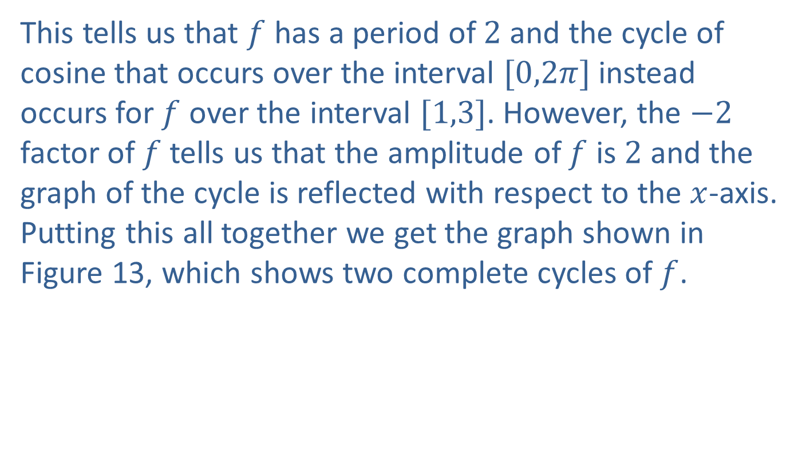
Example 6: Graphing Transformed Trigonometric Functions (cont.)
This tells us that $f$ has a period of 2 and the cycle of cosine that occurs over the interval $[0,2π]$ instead occurs for $f$ over the interval $[1,3]$. However, the $−2$ factor of $f$ tells us that the amplitude of $f$ is 2 and the graph of the cycle is reflected with respect to the $x$-axis. Putting this all together we get the graph shown in Figure 13, which shows two complete cycles of $f$.

Slide 36
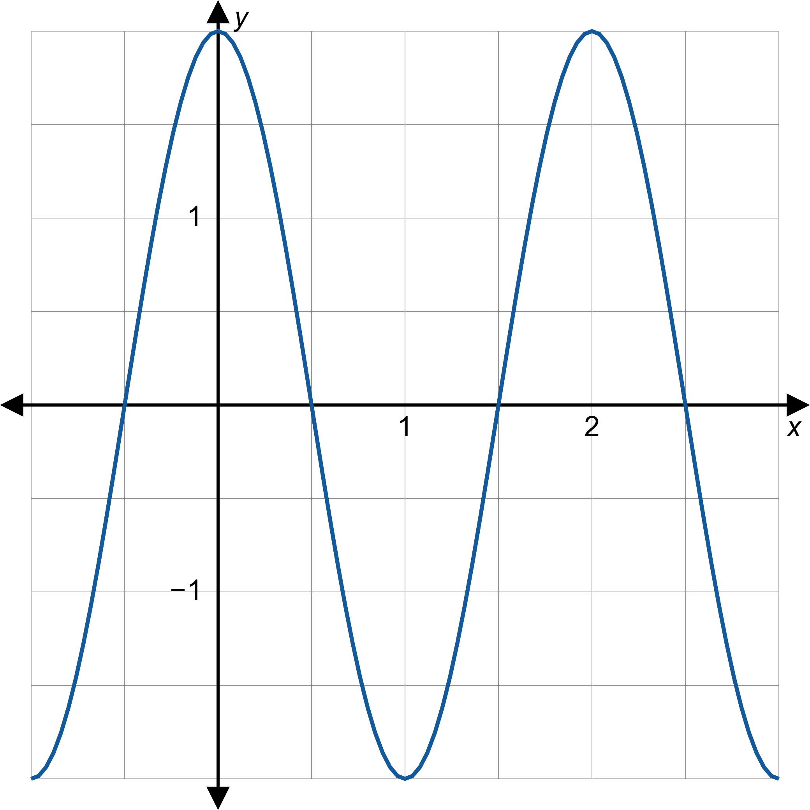

Example 6: Graphing Transformed Trigonometric Functions (cont.)

Slide 37

Example 7: Graphing Transformed Trigonometric Functions
Sketch the graph of $g\left(x\right)=1+\sin\left(x−\frac{π}{4}\right)$.

Slide 38
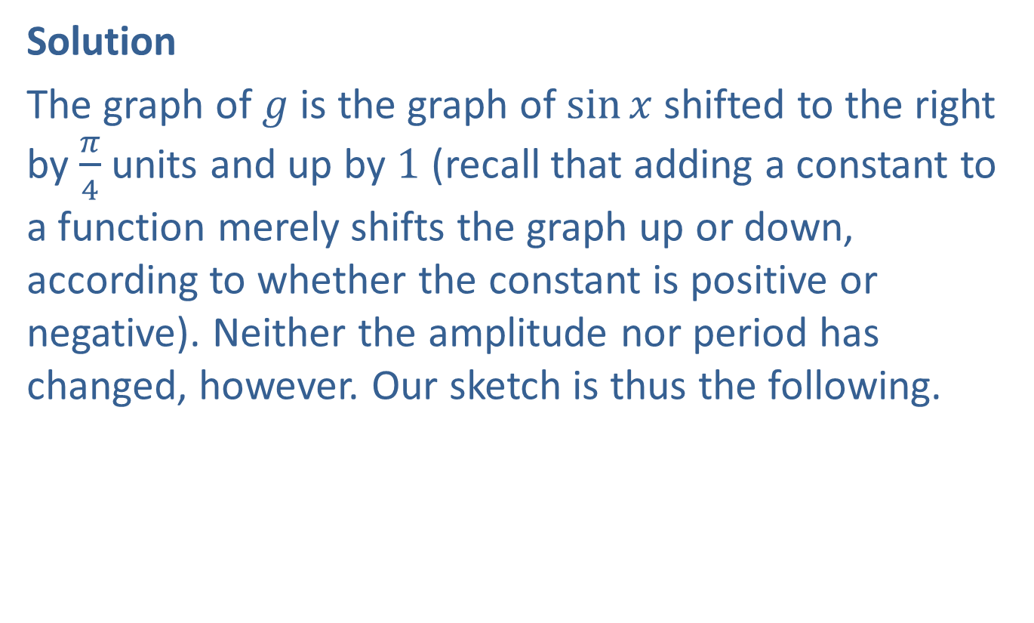
Example 7: Graphing Transformed Trigonometric Functions (cont.)
Solution
The graph of $g$ is the graph of $sin⁡x$ shifted to the right by $\frac{π}{4}$ units and up by 1 (recall that adding a constant to a function merely shifts the graph up or down, according to whether the constant is positive or negative). Neither the amplitude nor period has changed, however. Our sketch is thus the following.

Slide 39
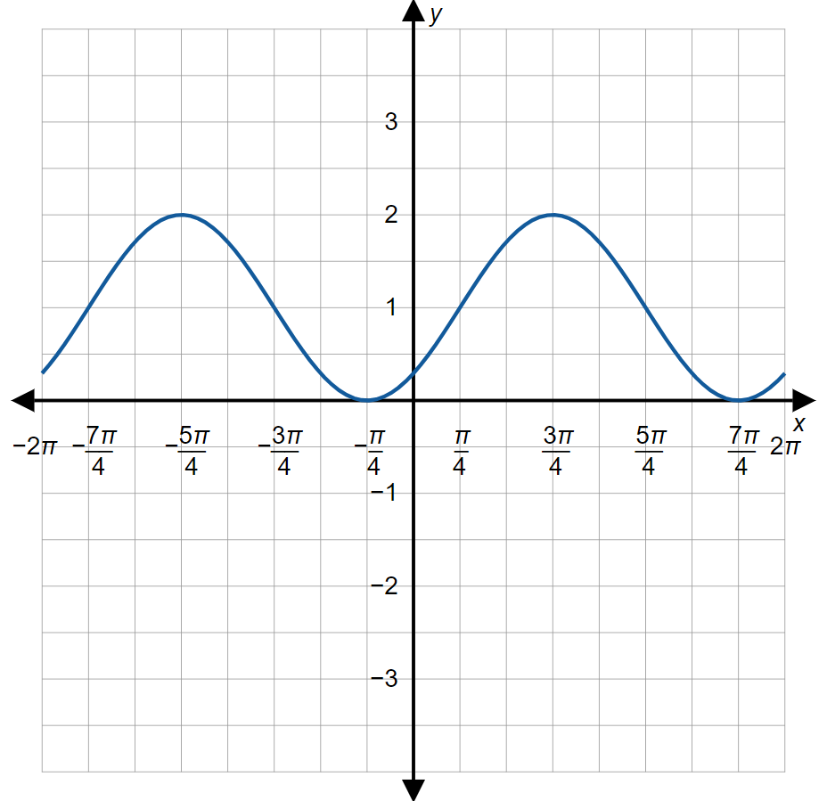

Example 7: Graphing Transformed Trigonometric Functions (cont.)

Slide 40
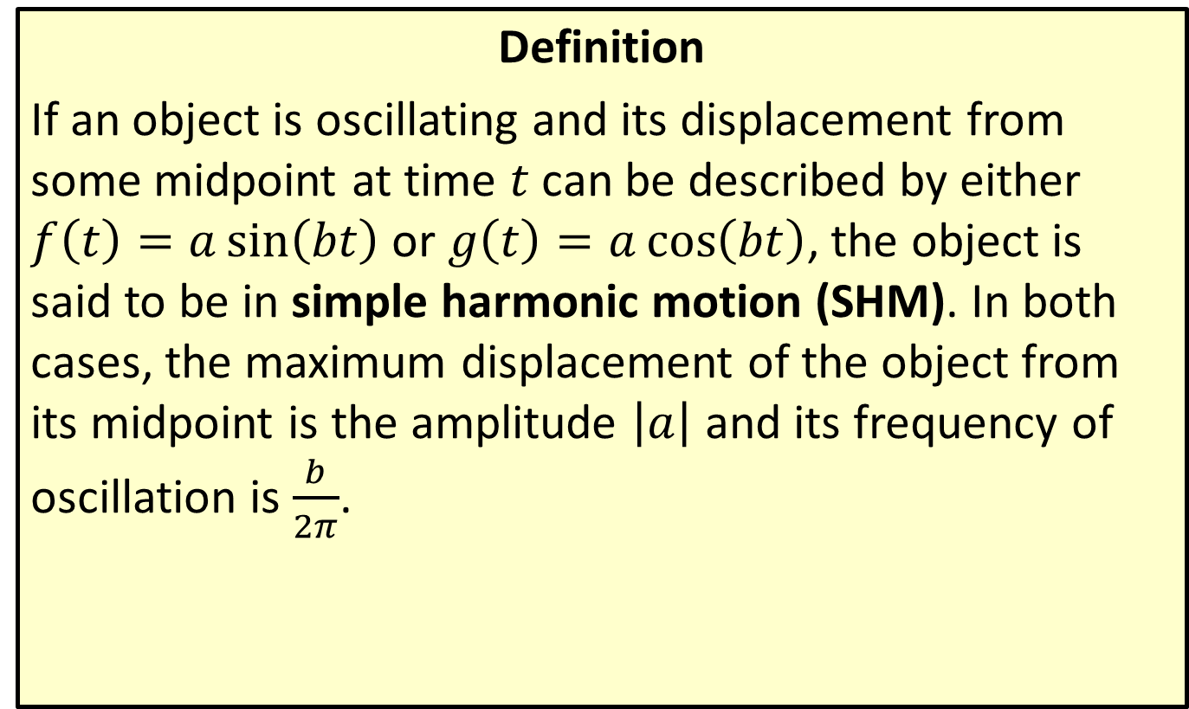
Simple Harmonic Motion
Definition
If an object is oscillating and its displacement from some midpoint at time $t$ can be described by either $f\left(t\right)=a\sin\left(bt\right)$ or $g\left(t\right)=a\cos\left(bt\right)$, the object is said to be in simple harmonic motion (SHM). In both cases, the maximum displacement of the object from its midpoint is the amplitude $\left|a\right|$ and its frequency of oscillation is $\frac{b}{2π}$.

Slide 41
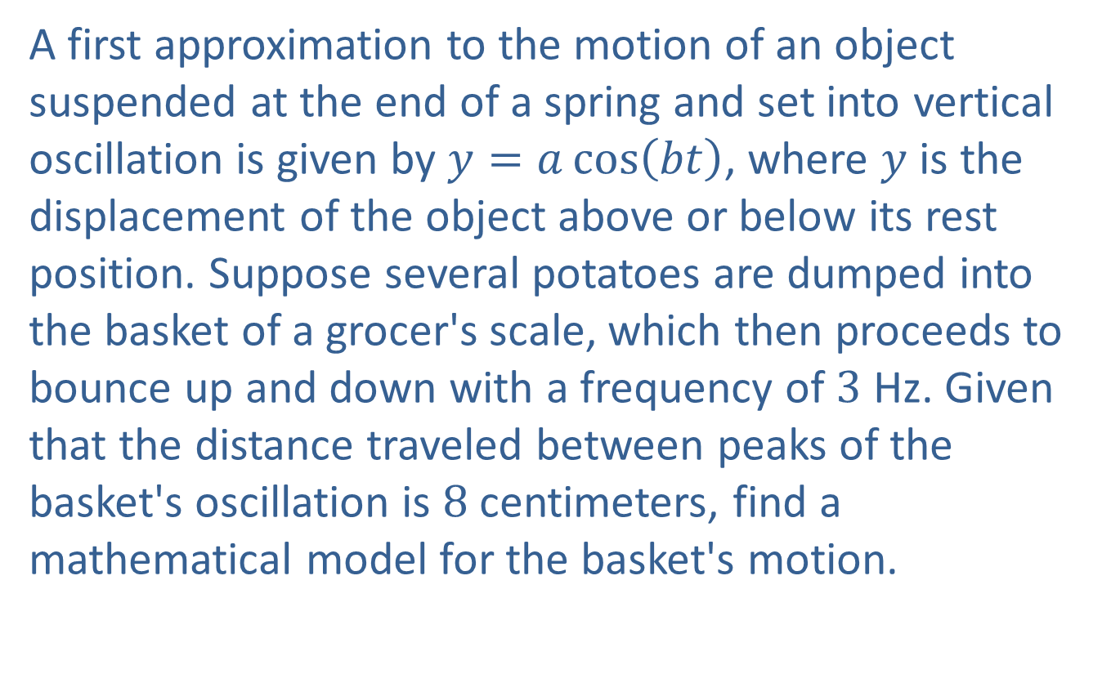
Example 8: Using Simple Harmonic Motion
A first approximation to the motion of an object suspended at the end of a spring and set into vertical oscillation is given by $y=a\cos\left(bt\right)$, where $y$ is the displacement of the object above or below its rest position. Suppose several potatoes are dumped into the basket of a grocer's scale, which then proceeds to bounce up and down with a frequency of 3 Hz. Given that the distance traveled between peaks of the basket's oscillation is 8 centimeters, find a mathematical model for the basket's motion.

Slide 42
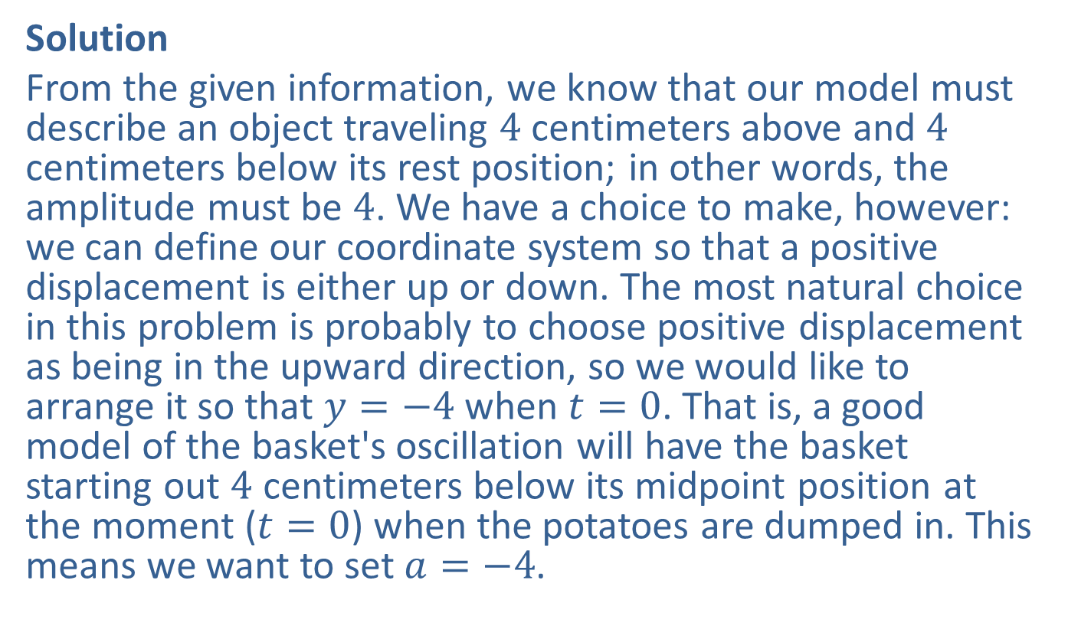
Example 8: Using Simple Harmonic Motion (cont.)
Solution
From the given information, we know that our model must describe an object traveling 4 centimeters above and 4 centimeters below its rest position; in other words, the amplitude must be 4. We have a choice to make, however: we can define our coordinate system so that a positive displacement is either up or down. The most natural choice in this problem is probably to choose positive displacement as being in the upward direction, so we would like to arrange it so that $y=−4$ when $t=0$. That is, a good model of the basket's oscillation will have the basket starting out 4 centimeters below its midpoint position at the moment ($t=0$) when the potatoes are dumped in. This means we want to set $a=−4$.

Slide 43

Example 8: Using Simple Harmonic Motion (cont.)
A frequency of 3 Hz means that the basket makes 3 complete up-and-down cycles every second. This means that $b=6π$, and so our model is
$y=−4\cos\left(6πt\right)$. To see how our model relates to the physical situation, consider the following graph.

Slide 44
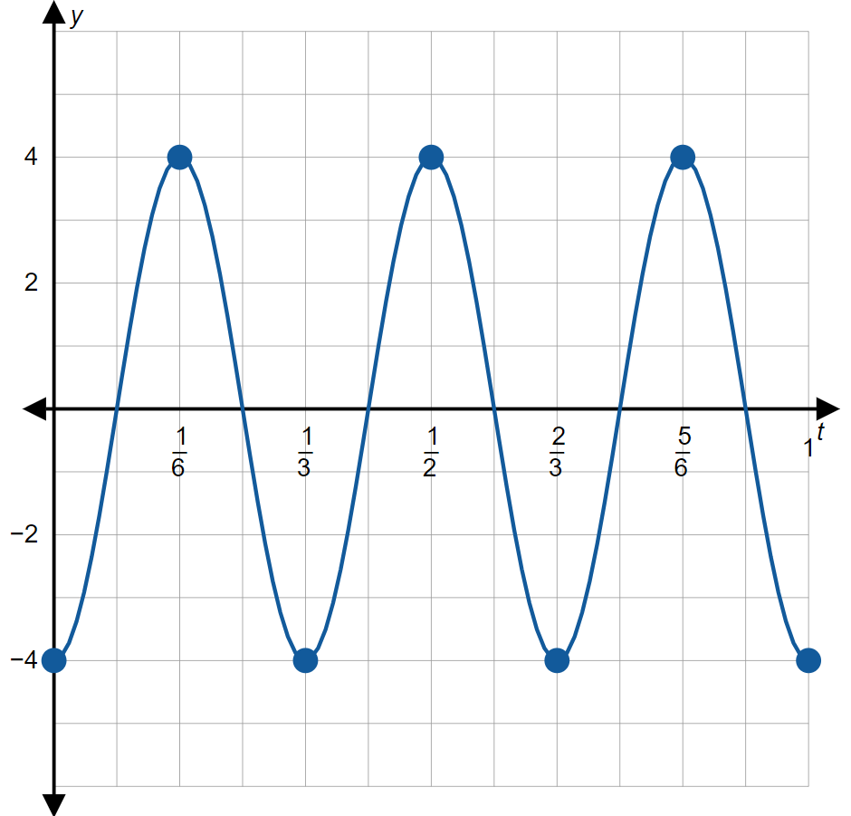

Example 8: Using Simple Harmonic Motion (cont.)

Slide 45
Example 8: Using Simple Harmonic Motion (cont.)
From the graph, it's clear that the basket really does make 3 complete cycles during the course of the first second, that it starts out 4 centimeters below the midpoint position, and that its maximum displacement above midpoint is also 4 centimeters.

Slide 46

Example 9: Modeling Damped Harmonic Motion
Sketch the graph of $f\left(t\right)=−4e^{−t}\cos\left(6πt\right)$.

Slide 47

Example 9: Modeling Damped Harmonic Motion (cont.)
Solution
We've already graphed the function $f\left(t\right)=−4\cos\left(6πt\right)$ (this function was our simple model for the motion of the grocer's basket in Example 8). The factor of $e^{−t}$ provides the desired damping effect. In Figure 17, the graphs of $4e^{−t}$ and $−4e^{−t}$ are included to show how they describe the "envelope" of amplitude modulation. The result is that the magnitude of the displacement of the grocer's basket decreases over time. Notice, however, the period is unaffected.

Slide 48


Example 9: Modeling Damped Harmonic Motion (cont.)

