Slide 1
Section 7.5
Graphs of Other Trigonometric Functions

Slide 2

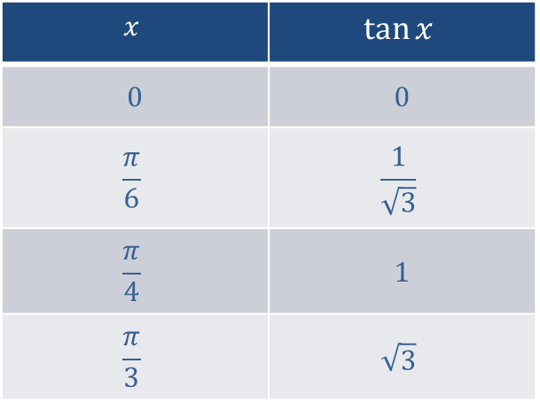

Tangent Function
Tangent is defined for all real numbers except for odd multiples of $\frac{π}{2}$. Using the fact that $\tan{x}=\frac{\sin{x}}{\cos{x}}$, we evaluate tangent at 0, $\frac{π}{6}$, $\frac{π}{4}$, and $\frac{π}{3}$ to obtain Table 1.
$$x$$ | $$tan⁡x$$
0 | 0
$$\frac{π}{6}$$ | $$\frac{1}{\sqrt{3}}$$
$$\frac{π}{4}$$ | 1
$$\frac{π}{3}$$ | $$\sqrt{3}$$

Slide 3
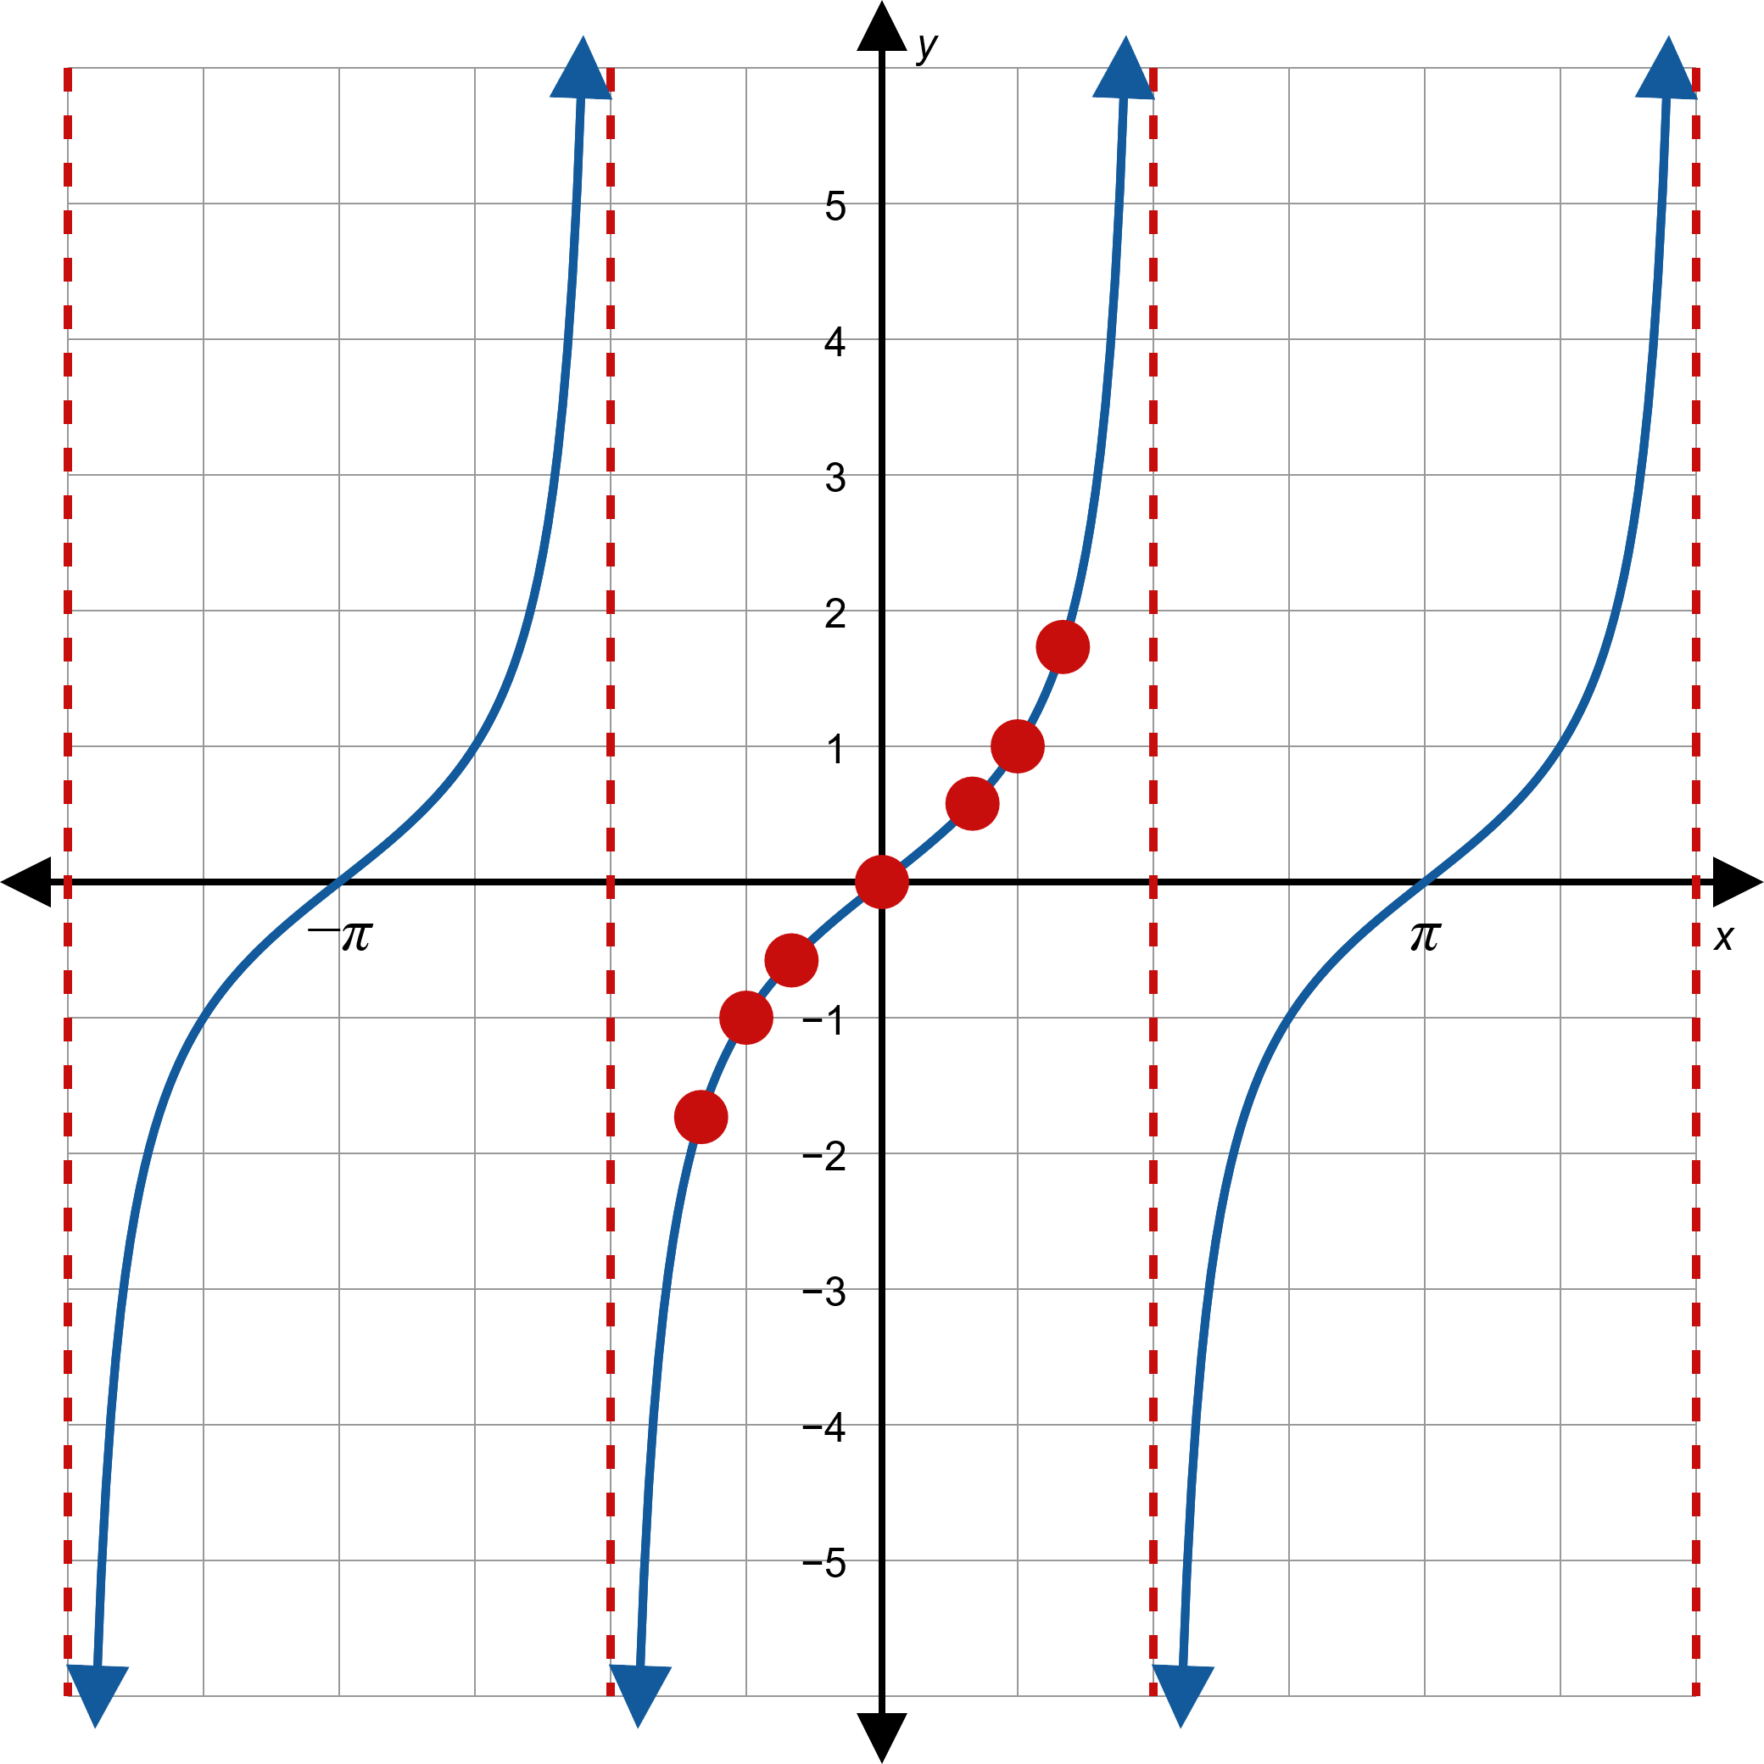
Figure 1: Graph of Tangent

Slide 4
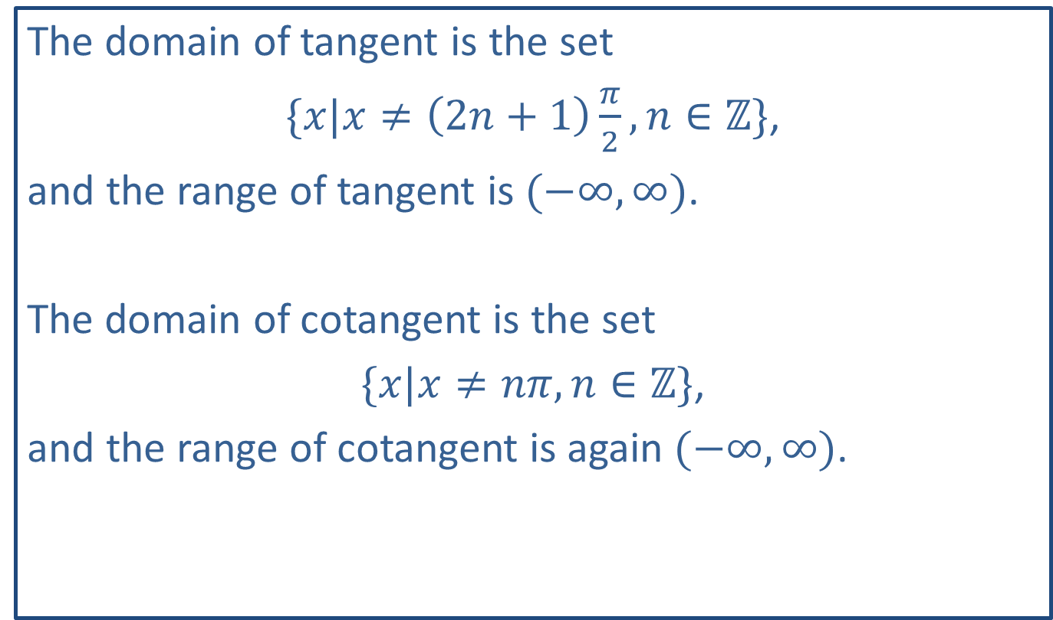
Note:
The domain of tangent is the set
$\{x|x≠\left(2n+1\right)\frac{π}{2},n∈ℤ\}$,
and the range of tangent is $(−∞,∞)$.
The domain of cotangent is the set
$\{x|x≠nπ,n∈ℤ\}$,
and the range of cotangent is again $(−∞,∞)$.

Slide 5

Example 1: Graphing Transformed Trigonometric Functions
Sketch the graph of $f\left(x\right)=1+3 tan⁡x$.

Slide 6
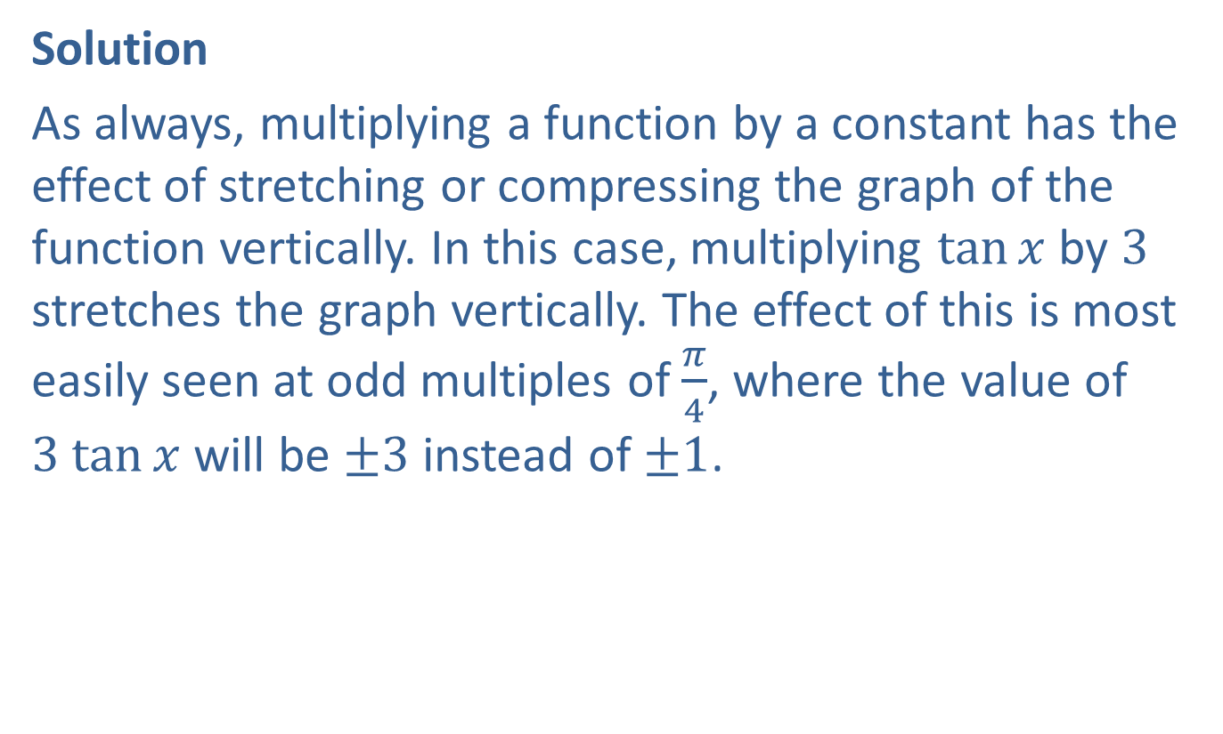
Example 1: Graphing Transformed Trigonometric Functions (cont.)
Solution
As always, multiplying a function by a constant has the effect of stretching or compressing the graph of the function vertically. In this case, multiplying $tan⁡x$ by 3 stretches the graph vertically. The effect of this is most easily seen at odd multiples of $\frac{π}{4}$, where the value of $3 tan⁡x$ will be $±3$ instead of $±1$.

Slide 7
Example 1: Graphing Transformed Trigonometric Functions (cont.)
The effect of adding a constant, in this case 1, to a function simply shifts the entire graph upward by 1 unit. Incorporating these two transformations into the graph of the basic tangent function, we are led to the graph in Figure 2.

Slide 8
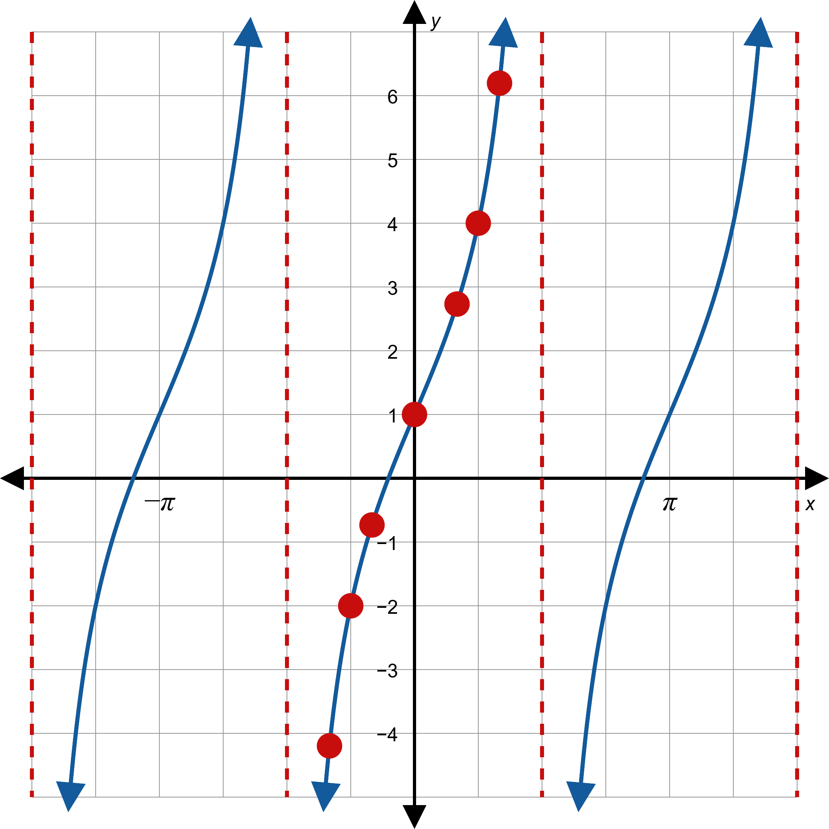

Example 1: Graphing Transformed Trigonometric Functions (cont.)

Slide 9

Example 2: Graphing Transformed Trigonometric Functions
Sketch the graph of $f\left(x\right)=\tan\left(\frac{πx}{4}−\frac{π}{2}\right)$.

Slide 10
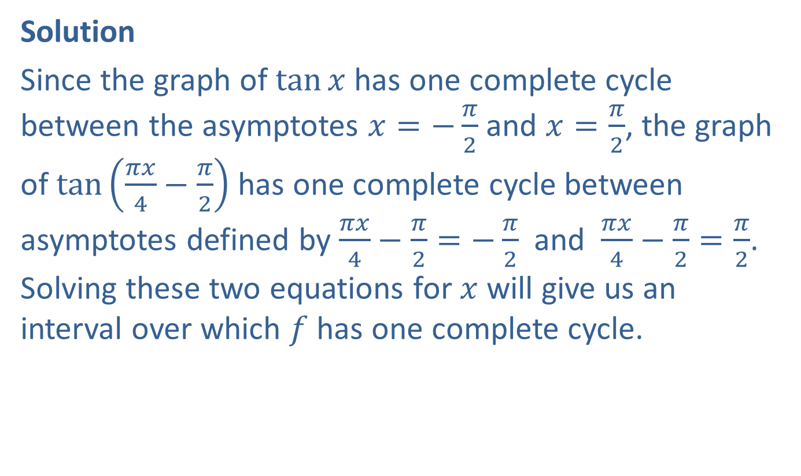
Example 2: Graphing Transformed Trigonometric Functions (cont.)
Solution
Since the graph of $tan⁡x$ has one complete cycle between the asymptotes $x=−\frac{π}{2}$ and $x=\frac{π}{2}$, the graph of $tan⁡\left(\frac{πx}{4}−\frac{π}{2}\right)$ has one complete cycle between asymptotes defined by $\frac{πx}{4}−\frac{π}{2}=−\frac{π}{2}$ and $\frac{πx}{4}−\frac{π}{2}=\frac{π}{2}$. Solving these two equations for $x$ will give us an interval over which $f$ has one complete cycle.
​

Slide 11
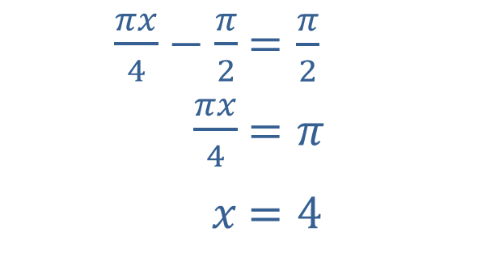
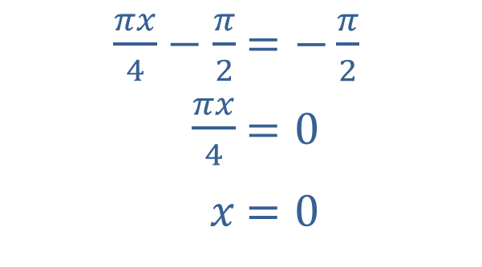
Example 2: Graphing Transformed Trigonometric Functions (cont.)
​
​$\frac{πx}{4}−\frac{π}{2}$ | ​$=−\frac{π}{2}$
​$\frac{πx}{4}$ | ​$=0$
​$x$ | ​$=0$
​$\frac{πx}{4}−\frac{π}{2}$ | ​$=\frac{π}{2}$
​$\frac{πx}{4}$ | ​$=π$
​$x$ | ​$=4$

Slide 12

Example 2: Graphing Transformed Trigonometric Functions (cont.)
This tells us that $f$ has a period of 4 and vertical asymptotes at multiples of 4, with the graph of tangent being stretched out a bit horizontally accordingly. The graph appears in Figure 3, with values of $f$ at $x=1$, $x=2$, and $x=3$ highlighted.

Slide 13
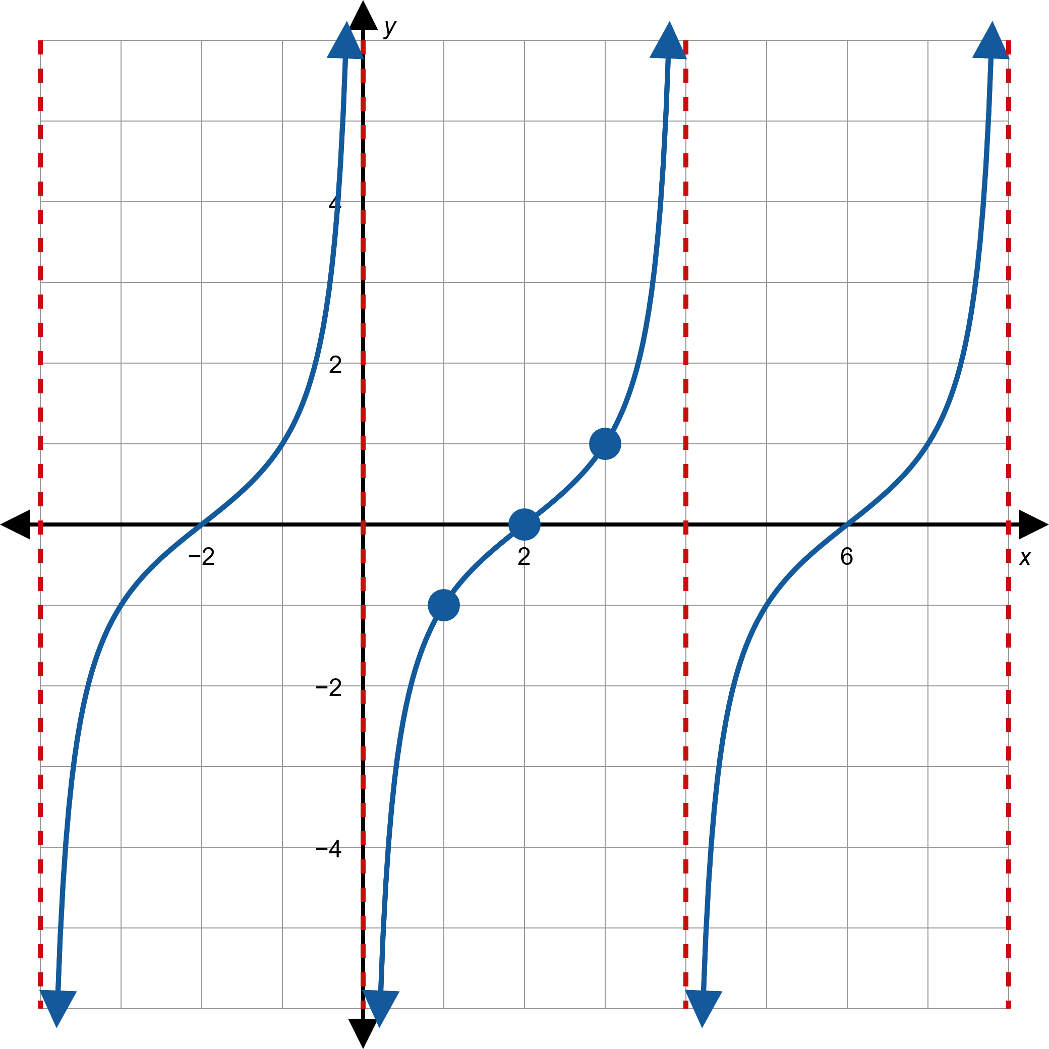
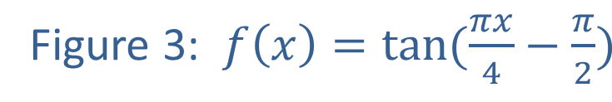
Example 2: Graphing Transformed Trigonometric Functions (cont.)

Slide 14
Example 3: Graphing the Cosecant Function
Sketch the graph of the cosecant function.

Slide 15
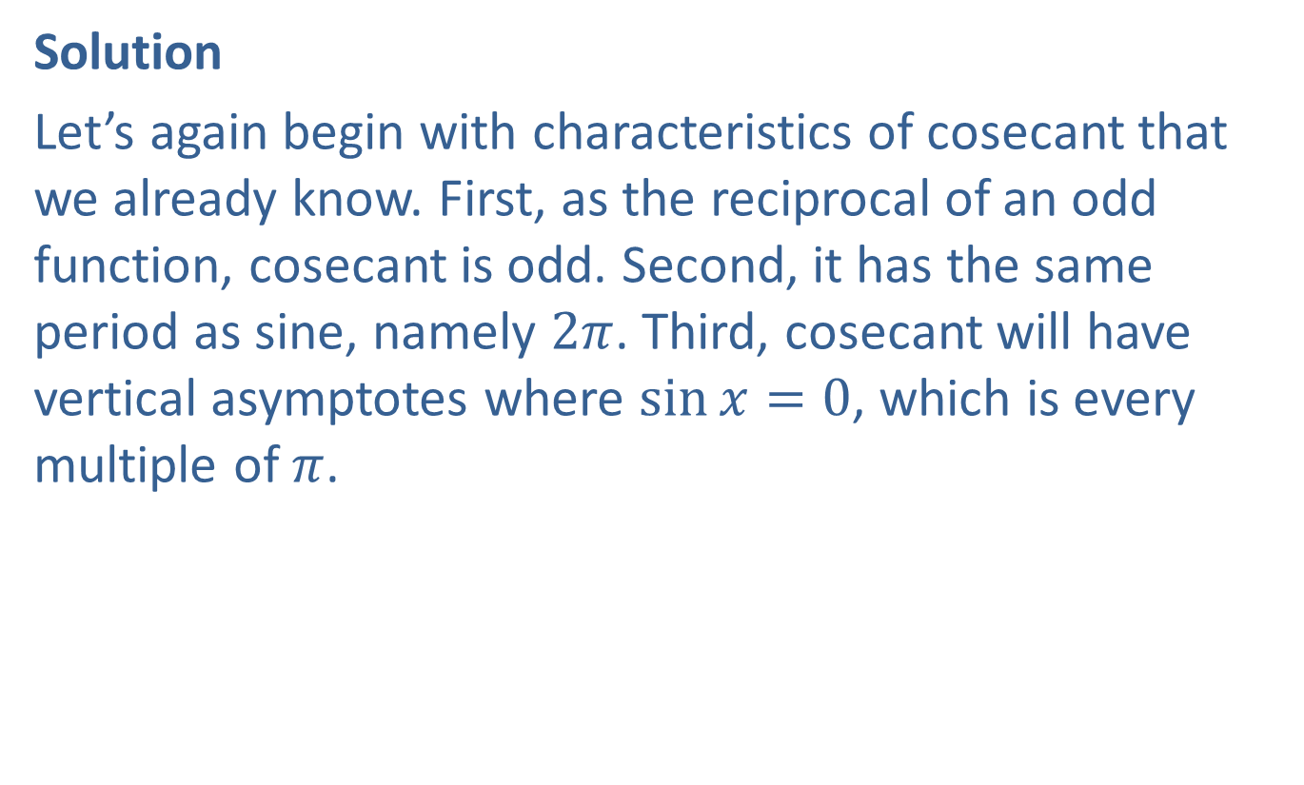
Example 3: Graphing the Cosecant Function (cont.)
Solution
Let’s again begin with characteristics of cosecant that we already know. First, as the reciprocal of an odd function, cosecant is odd. Second, it has the same period as sine, namely $2π$. Third, cosecant will have vertical asymptotes where $\sin{x}=0$, which is every multiple of $π$.

Slide 16
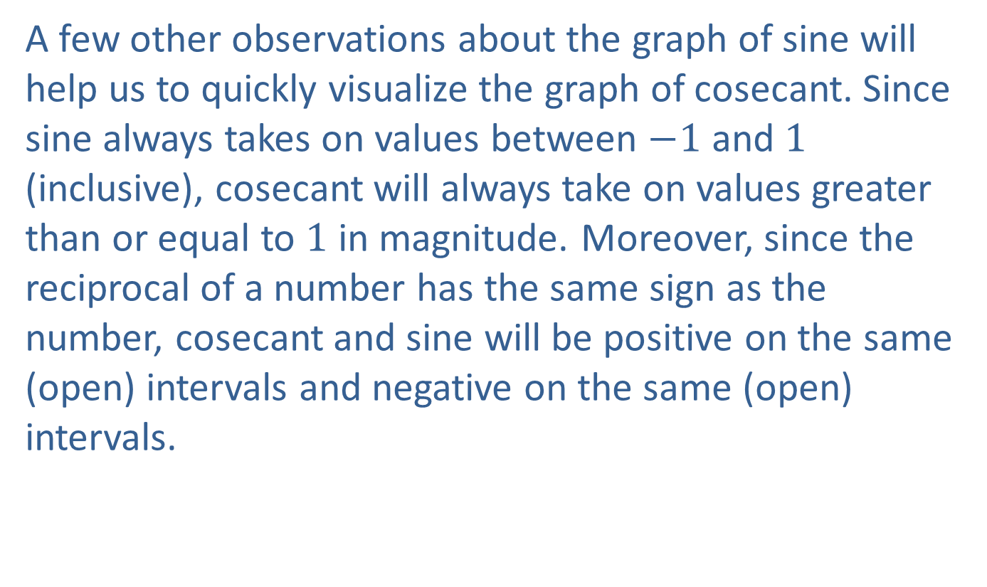
Example 3: Graphing the Cosecant Function (cont.)
A few other observations about the graph of sine will help us to quickly visualize the graph of cosecant. Since sine always takes on values between $−1$ and 1 (inclusive), cosecant will always take on values greater than or equal to 1 in magnitude. Moreover, since the reciprocal of a number has the same sign as the number, cosecant and sine will be positive on the same (open) intervals and negative on the same (open) intervals.

Slide 17
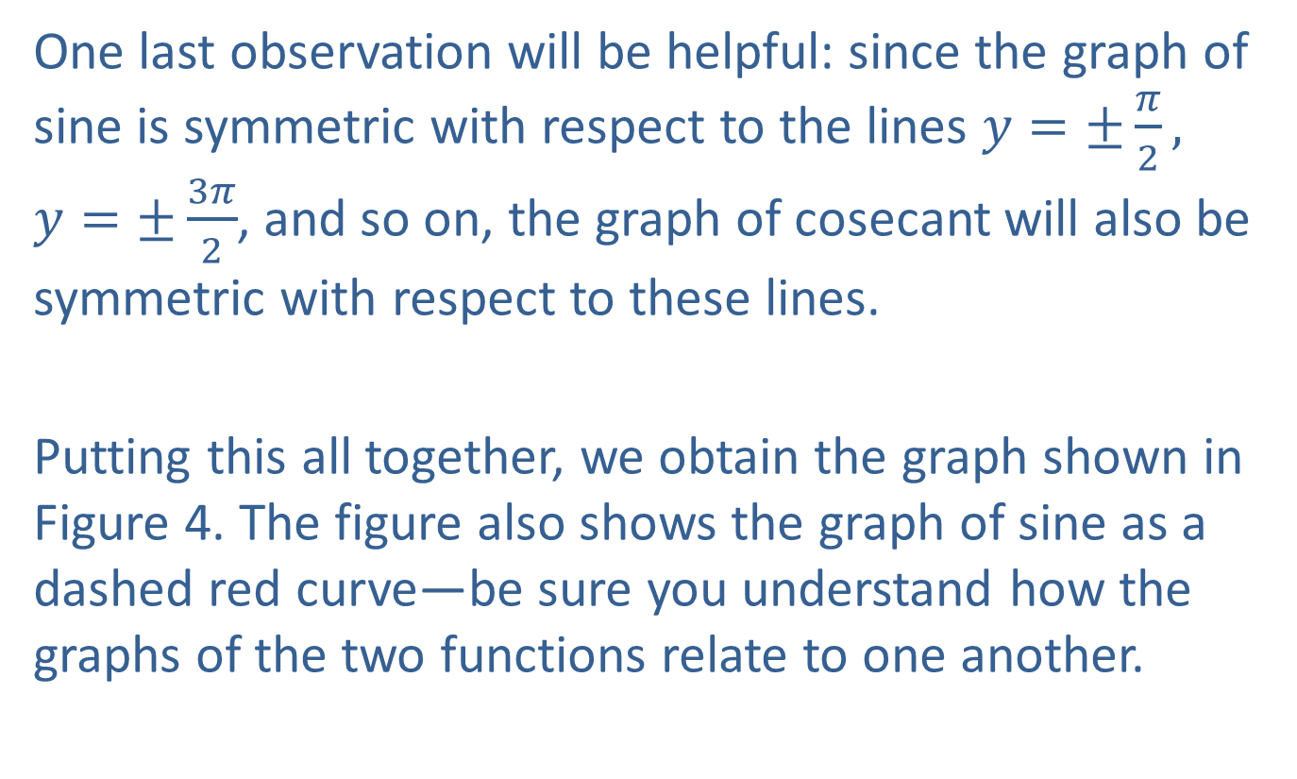
Example 3: Graphing the Cosecant Function (cont.)
One last observation will be helpful: since the graph of sine is symmetric with respect to the lines $y=±\frac{π}{2},$
$y=±\frac{3π}{2}$, and so on, the graph of cosecant will also be symmetric with respect to these lines.
Putting this all together, we obtain the graph shown in Figure 4. The figure also shows the graph of sine as a dashed red curve—be sure you understand how the graphs of the two functions relate to one another.

Slide 18
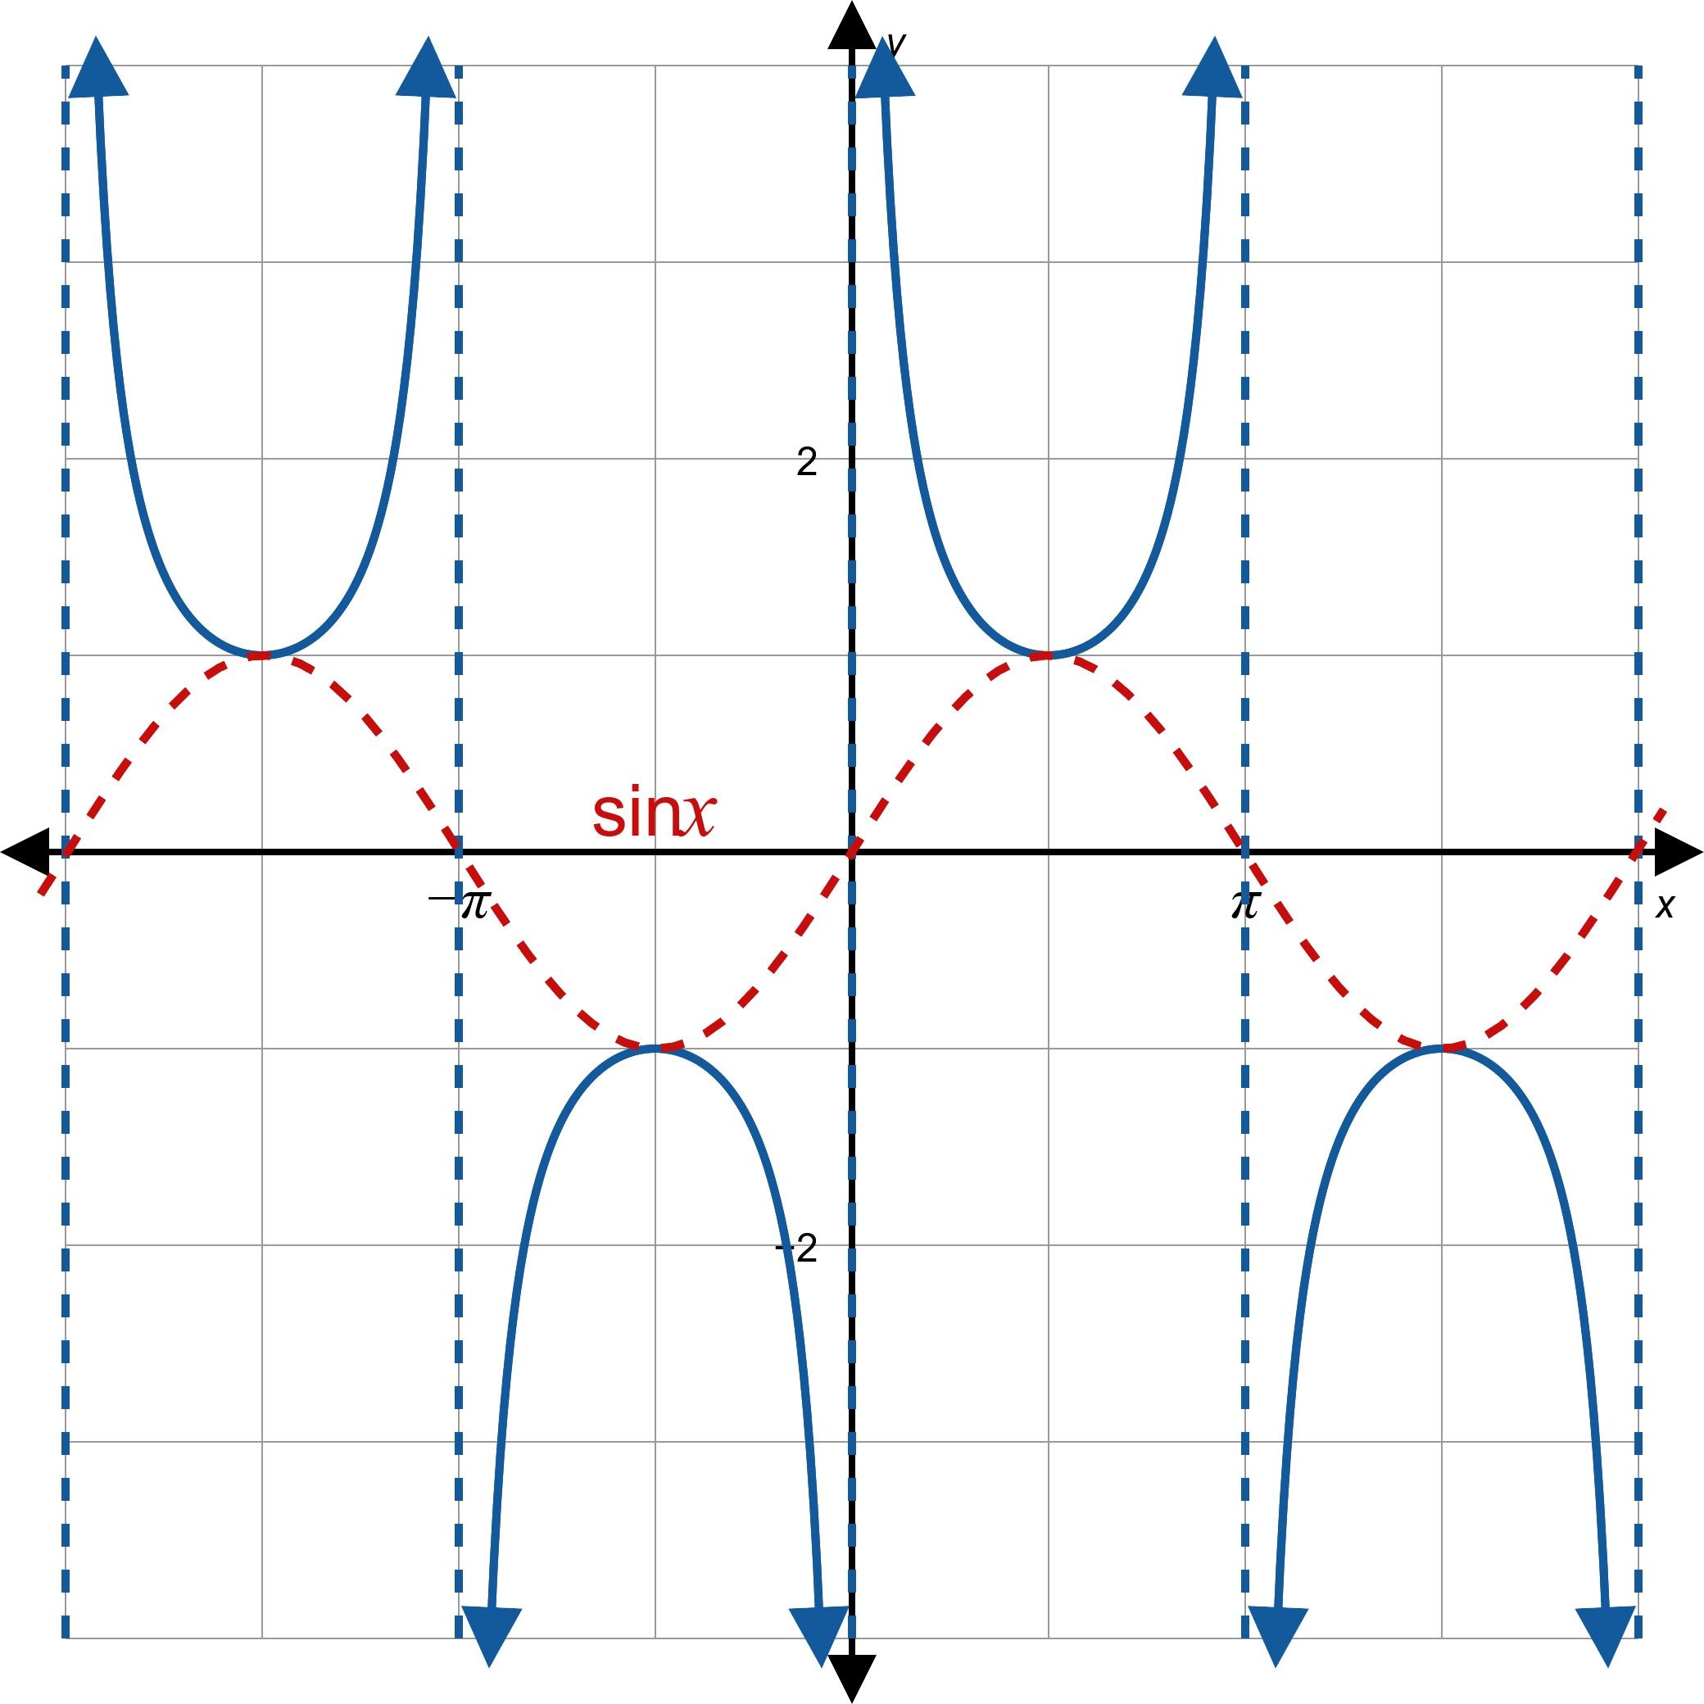

Example 3: Graphing the Cosecant Function (cont.)

Slide 19
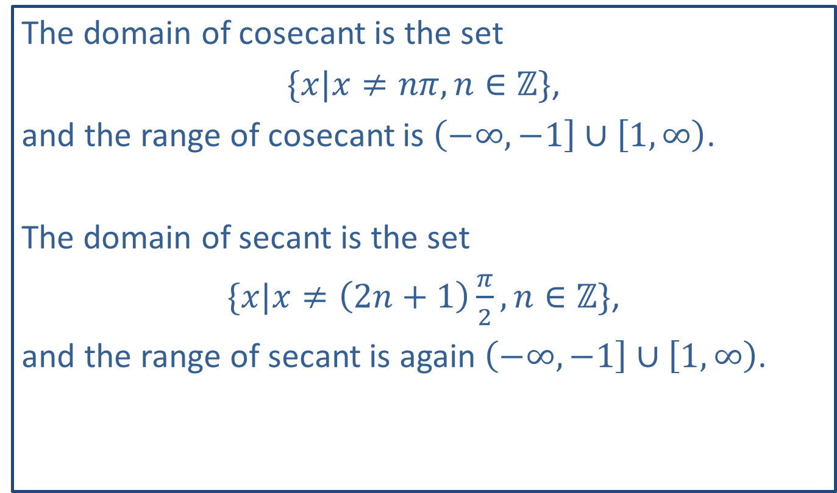
Note:
The domain of cosecant is the set
$\{x|x≠nπ,n∈ℤ\}$,
and the range of cosecant is $\left(−∞,−1\right]∪\left[1,∞\right)$.
The domain of secant is the set
$\{x|x≠\left(2n+1\right)\frac{π}{2},n∈ℤ\}$,
and the range of secant is again $\left(−∞,−1\right]∪\left[1,∞\right)$.

Slide 20

Example 4: Graphing Transformed Trigonometric Functions
Sketch the graph of $f\left(x\right)=−2 csc⁡\left(πx+\frac{π}{2}\right)$.

Slide 21
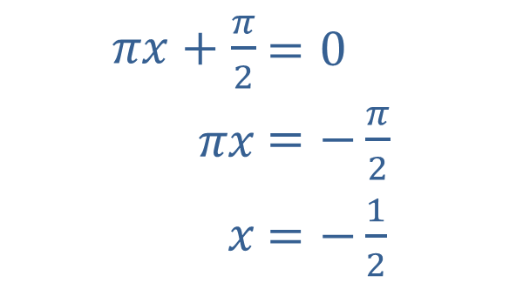
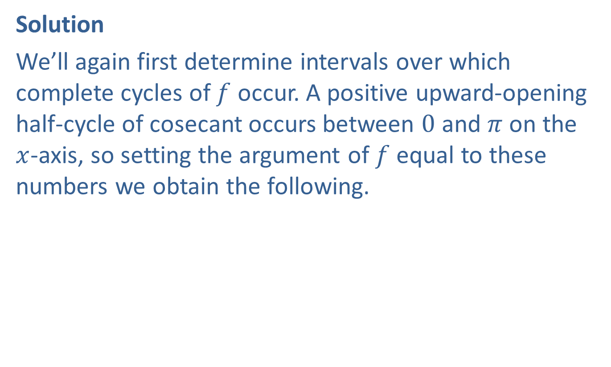
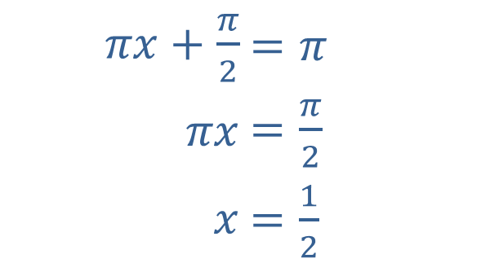
Example 4: Graphing Transformed Trigonometric Functions (cont.)
Solution
We’ll again first determine intervals over which complete cycles of $f$ occur. A positive upward-opening half-cycle of cosecant occurs between 0 and $π$ on the $x$-axis, so setting the argument of $f$ equal to these numbers we obtain the following.
​
​$πx+\frac{π}{2}$ | ​$=0$
​$πx$ | ​$=−\frac{π}{2}$
​$x$ | ​$=−\frac{1}{2}$
​$πx+\frac{π}{2}$ | ​$=π$
​$πx$ | ​$=\frac{π}{2}$
​$x$ | ​$=\frac{1}{2}$

Slide 22
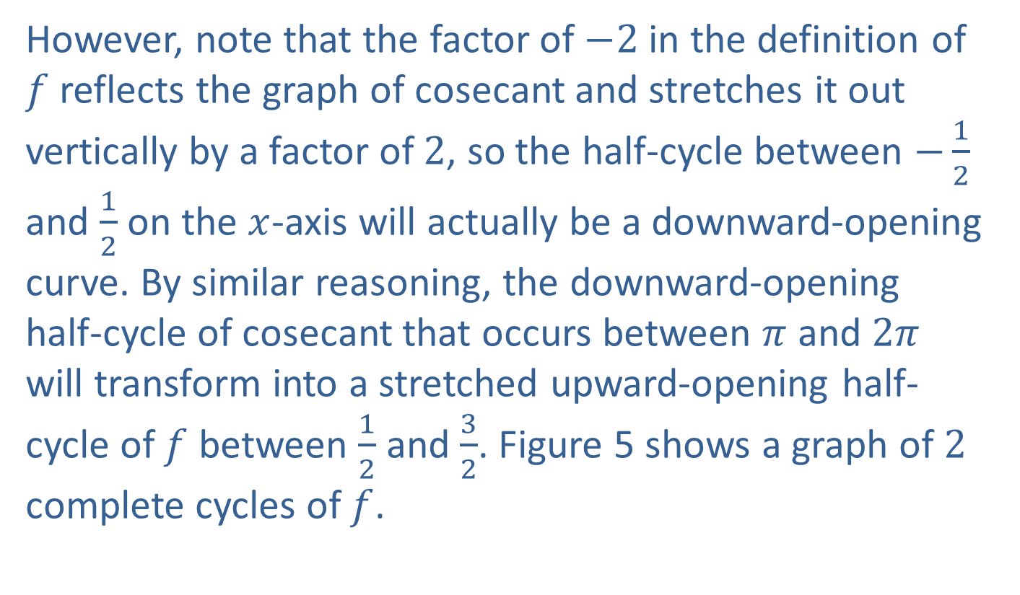
Example 4: Graphing Transformed Trigonometric Functions (cont.)
However, note that the factor of $−2$ in the definition of $f$ reflects the graph of cosecant and stretches it out vertically by a factor of 2, so the half-cycle between $−\frac{1}{2}$ and $\frac{1}{2}$ on the $x$-axis will actually be a downward-opening curve. By similar reasoning, the downward-opening half-cycle of cosecant that occurs between $π$ and $2π$ will transform into a stretched upward-opening half-cycle of $f$ between $\frac{1}{2}$ and $\frac{3}{2}$. Figure 5 shows a graph of 2 complete cycles of $f$.

Slide 23
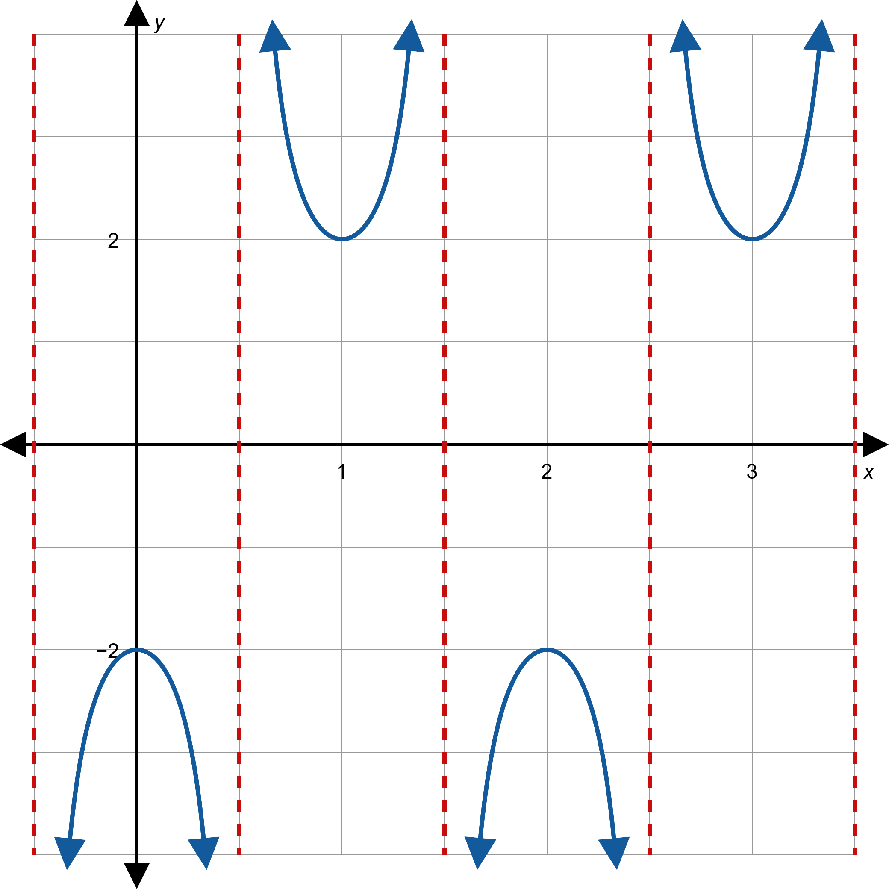
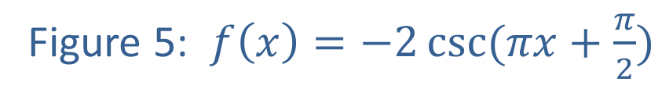
Example 4: Graphing Transformed Trigonometric Functions (cont.)

Slide 24
Example 5: Identifying a Trigonometric Graph
Find a function corresponding to the graph shown in Figure 6.

Slide 25
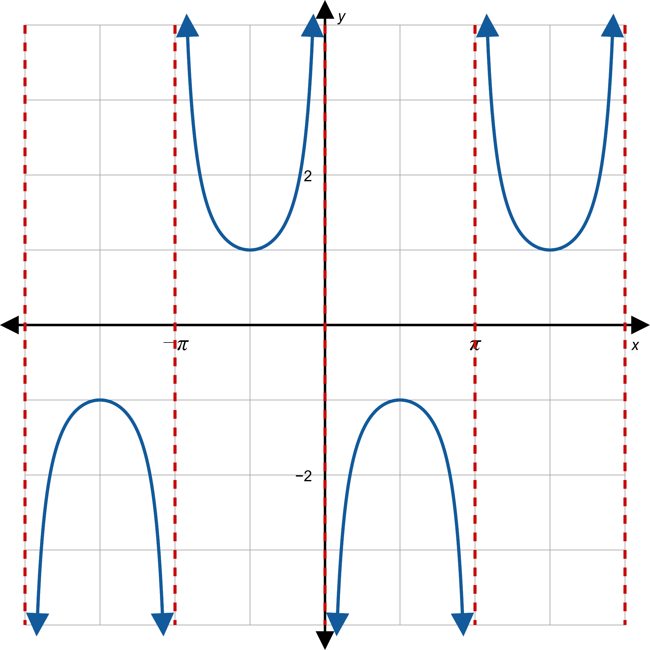

Example 5: Identifying a Trigonometric Graph (cont.)

Slide 26
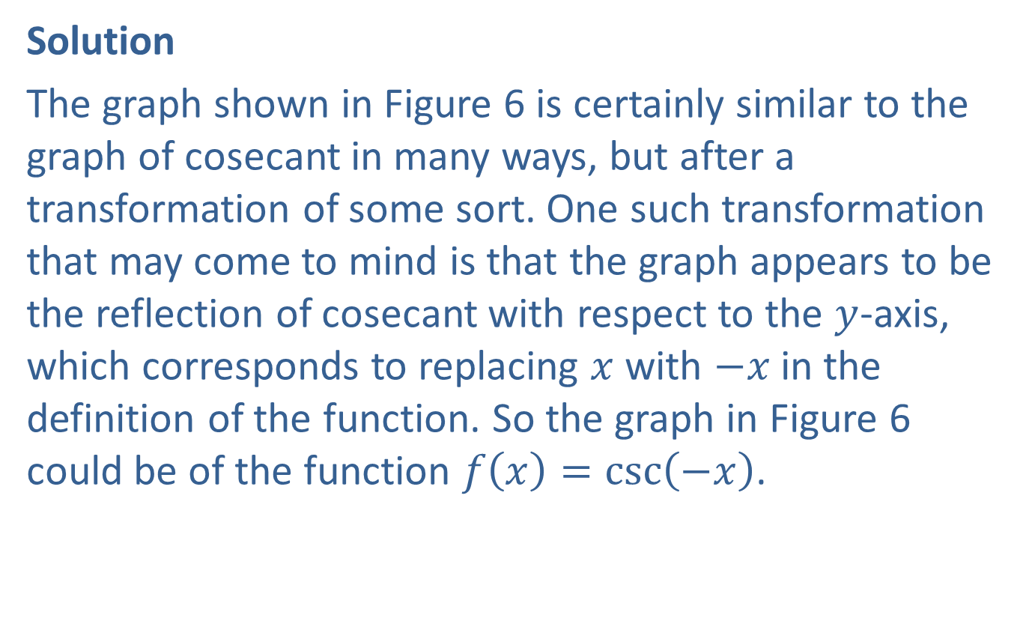
Example 5: Identifying a Trigonometric Graph (cont.)
Solution
The graph shown in Figure 6 is certainly similar to the graph of cosecant in many ways, but after a transformation of some sort. One such transformation that may come to mind is that the graph appears to be the reflection of cosecant with respect to the $y$-axis, which corresponds to replacing $x$ with $−x$ in the definition of the function. So the graph in Figure 6 could be of the function $f\left(x\right)=\csc\left(−x\right)$.

Slide 27
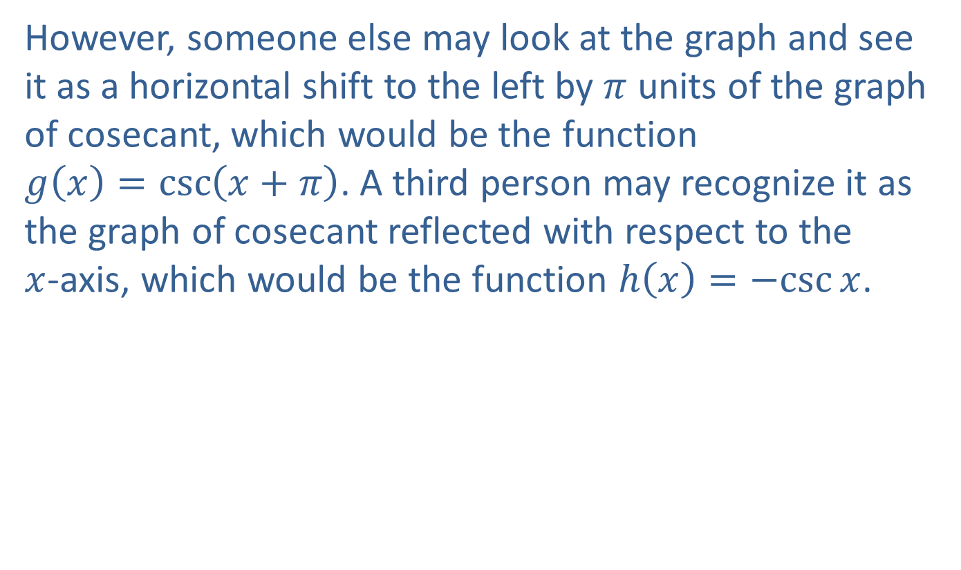
Example 5: Identifying a Trigonometric Graph (cont.)
However, someone else may look at the graph and see it as a horizontal shift to the left by $π$ units of the graph of cosecant, which would be the function
$g\left(x\right)=\csc\left(x+π\right)$. A third person may recognize it as the graph of cosecant reflected with respect to the
$x$-axis, which would be the function $h\left(x\right)=−csc{x}$.

Slide 28
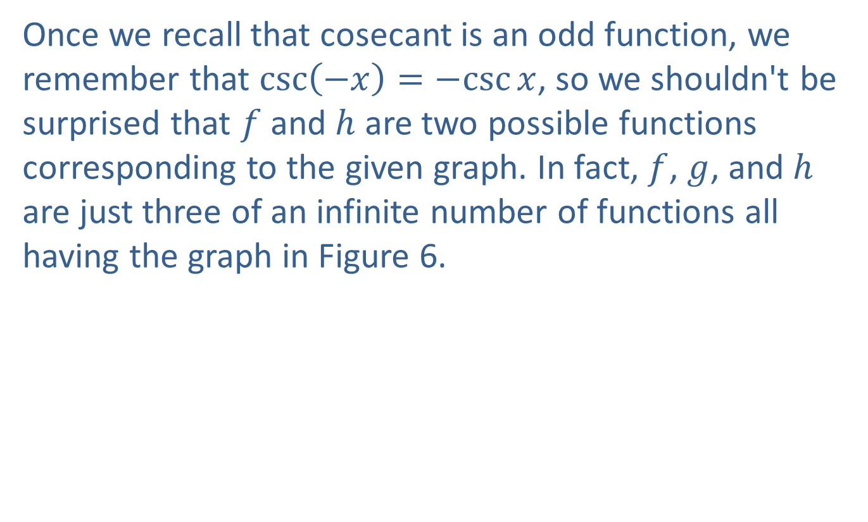
Example 5: Identifying a Trigonometric Graph (cont.)
Once we recall that cosecant is an odd function, we remember that $\csc\left(−x\right)=−csc{x}$, so we shouldn't be surprised that $f$ and $h$ are two possible functions corresponding to the given graph. In fact, $f$, $g$, and $h$ are just three of an infinite number of functions all having the graph in Figure 6.

