Slide 1
Section 7.6
Inverse Trigonometric Functions

Slide 2
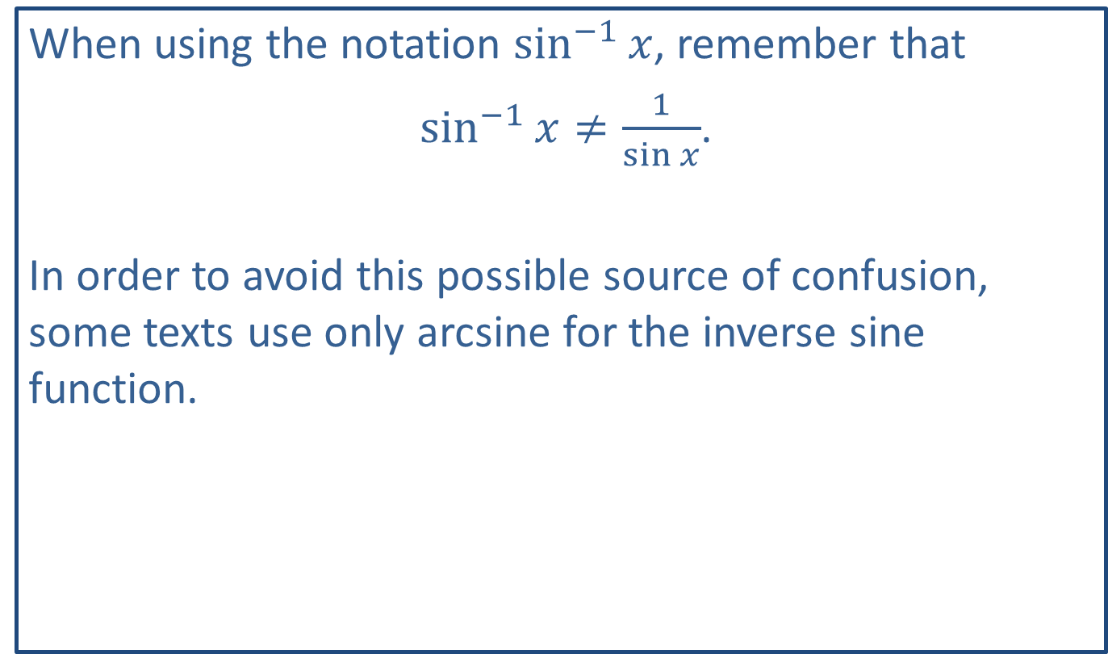
CAUTION!
When using the notation $\sin^{−1}⁡x$, remember that
$\sin^{−1}{x}≠\frac{1}{\sin{x}}$.
In order to avoid this possible source of confusion, some texts use only arcsine for the inverse sine function.

Slide 3
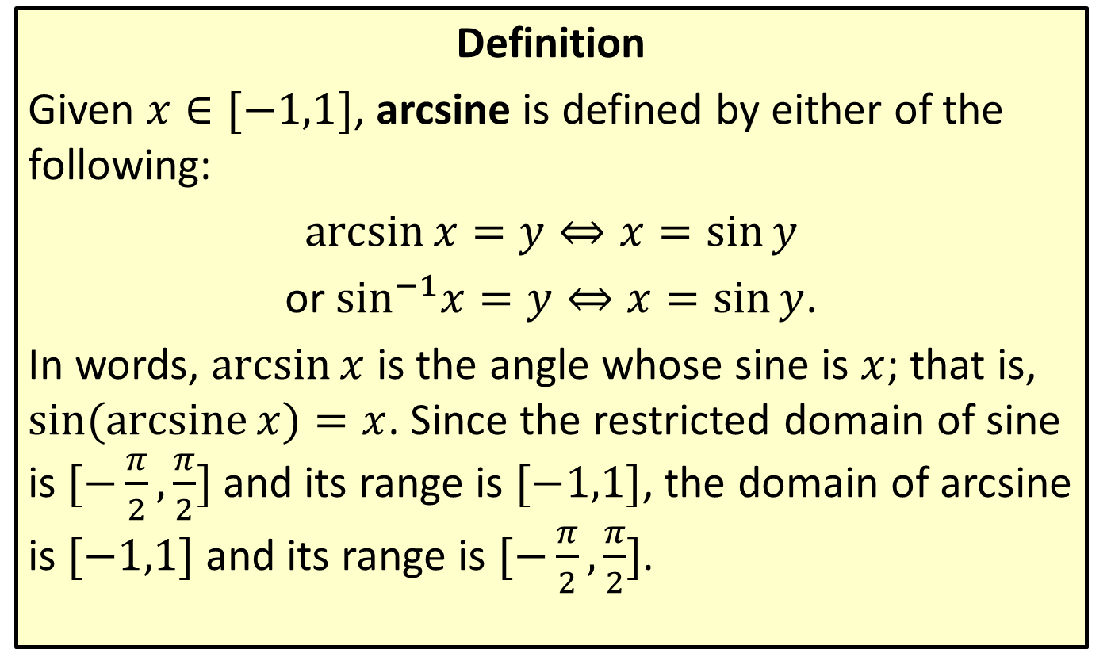
Arcsine
Definition
Given $x∈[−1,1]$, arcsine is defined by either of the following:
$\arcsin{x}=y⇔x=\sin{y}$
or $\sin^{−1}x=y⇔x=\sin{y}$.
In words, $arcsin⁡x$ is the angle whose sine is $x$; that is, $sin⁡(\operatorname{arcsine}{x})=x$. Since the restricted domain of sine is $[−\frac{π}{2},\frac{π}{2}]$ and its range is $[−1,1]$, the domain of arcsine is $[−1,1]$ and its range is $[−\frac{π}{2},\frac{π}{2}]$.

Slide 4
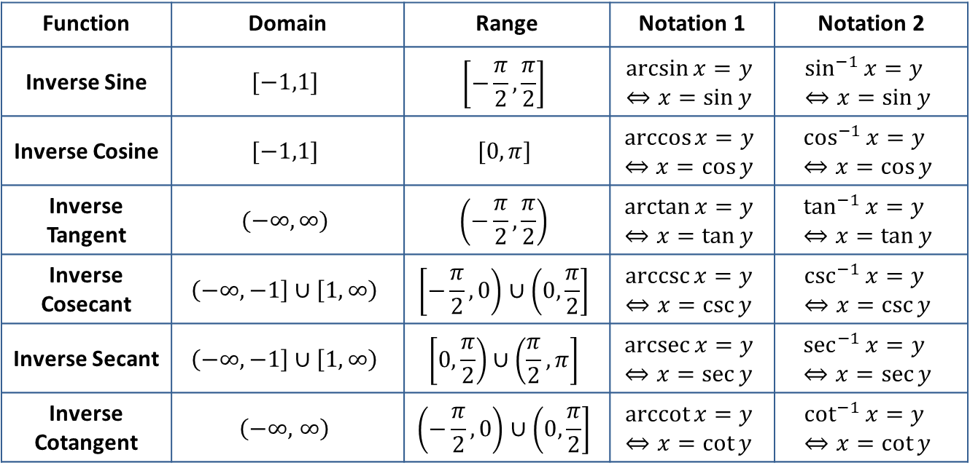
Inverse Trigonometric Functions
Definition
Function | Domain | Range | Notation 1 | Notation 2
Inverse Sine | $$[−1,1]$$ | $$\left[−\frac{π}{2},\frac{π}{2}\right]$$ | $$\arcsin{x}=y⇔x=\sin{y}$$ | $$\sin^{−1}{x}=y \\ ⇔x=\sin{y}$$
Inverse Cosine | $$[−1,1]$$ | $$[0,π]$$ | $$\arccos{x}=y⇔x=\cos{y}$$ | $$\cos^{−1}{x}=y \\ ⇔x=\cos{y}$$
Inverse Tangent | $$(−∞,∞)$$ | $$\left(−\frac{π}{2},\frac{π}{2}\right)$$ | $$\arctan{x}=y⇔x=\tan{y}$$ | $$\tan^{−1}{x}=y \\ ⇔x=\tan{y}$$
Inverse Cosecant | $$\left(−∞,−1\right]∪\left[1,∞\right)$$ | $$\left[−\frac{π}{2},0\right)∪\left(0,\frac{π}{2}\right]$$ | $$\operatorname{arccsc}{x}=y⇔x=\csc{y}$$ | $$\csc^{−1}{x}=y \\ ⇔x=\csc{y}$$
Inverse Secant | $$\left(−∞,−1\right]∪\left[1,∞\right)$$ | $$\left[0,\frac{π}{2}\right)∪\left(\frac{π}{2},π\right]$$ | $$\operatorname{arcsec}{x}=y⇔x=\sec{y}$$ | $$\sec^{−1}{x}=y \\ ⇔x=\sec{y}$$
Inverse Cotangent | $$\left(−∞\text{,} ∞\right)$$ | $$\left(−\frac{π}{2},0\right)∪\left(0,\frac{π}{2}\right]$$ | $$\operatorname{arccot}{x}=y⇔x=\cot{y}$$ | $$\cot^{−1}{x}=y \\ ⇔x=\cot{y}$$

Slide 5
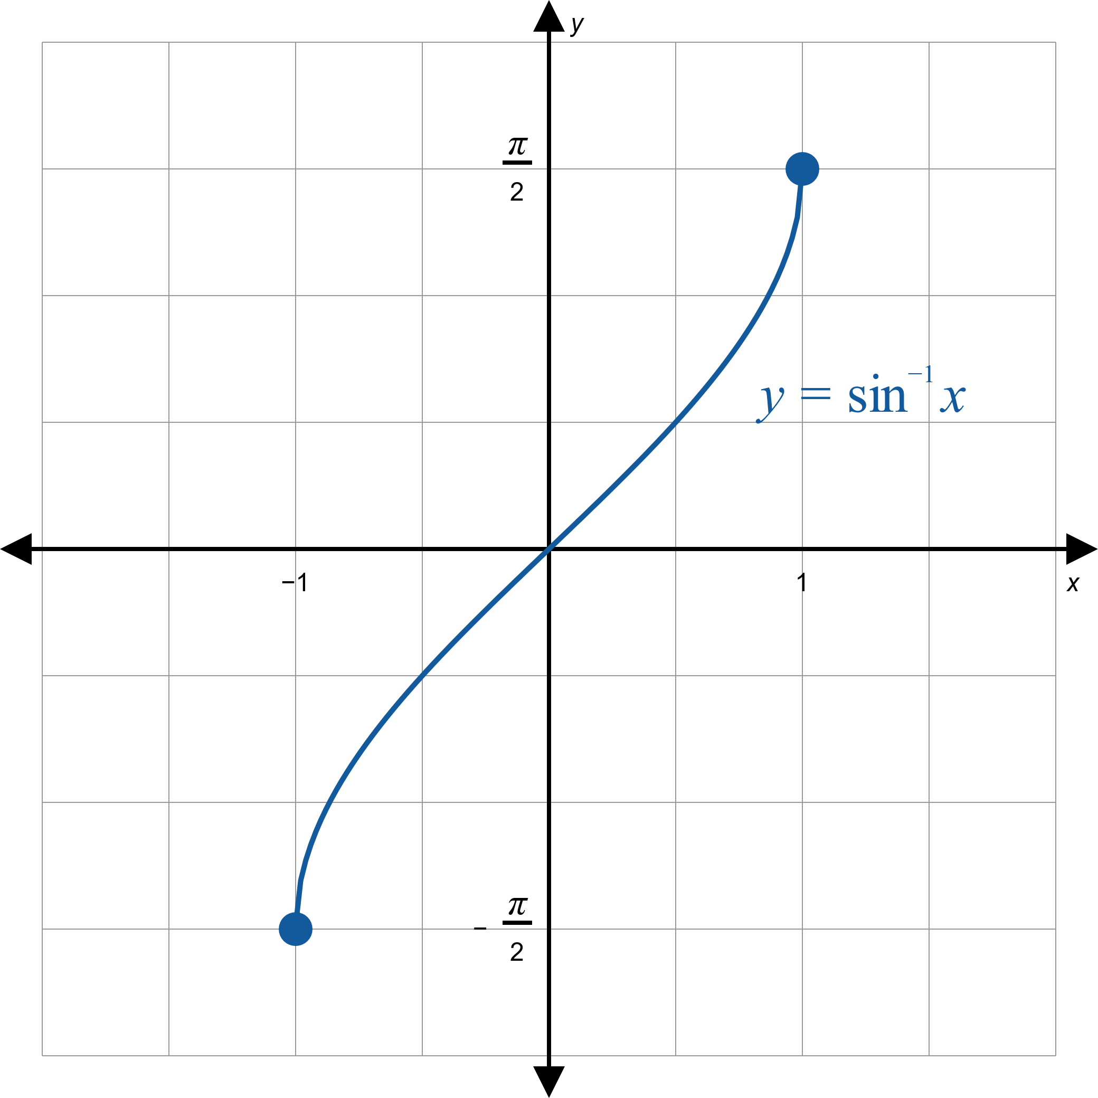
Inverse Sine Graph

Slide 6
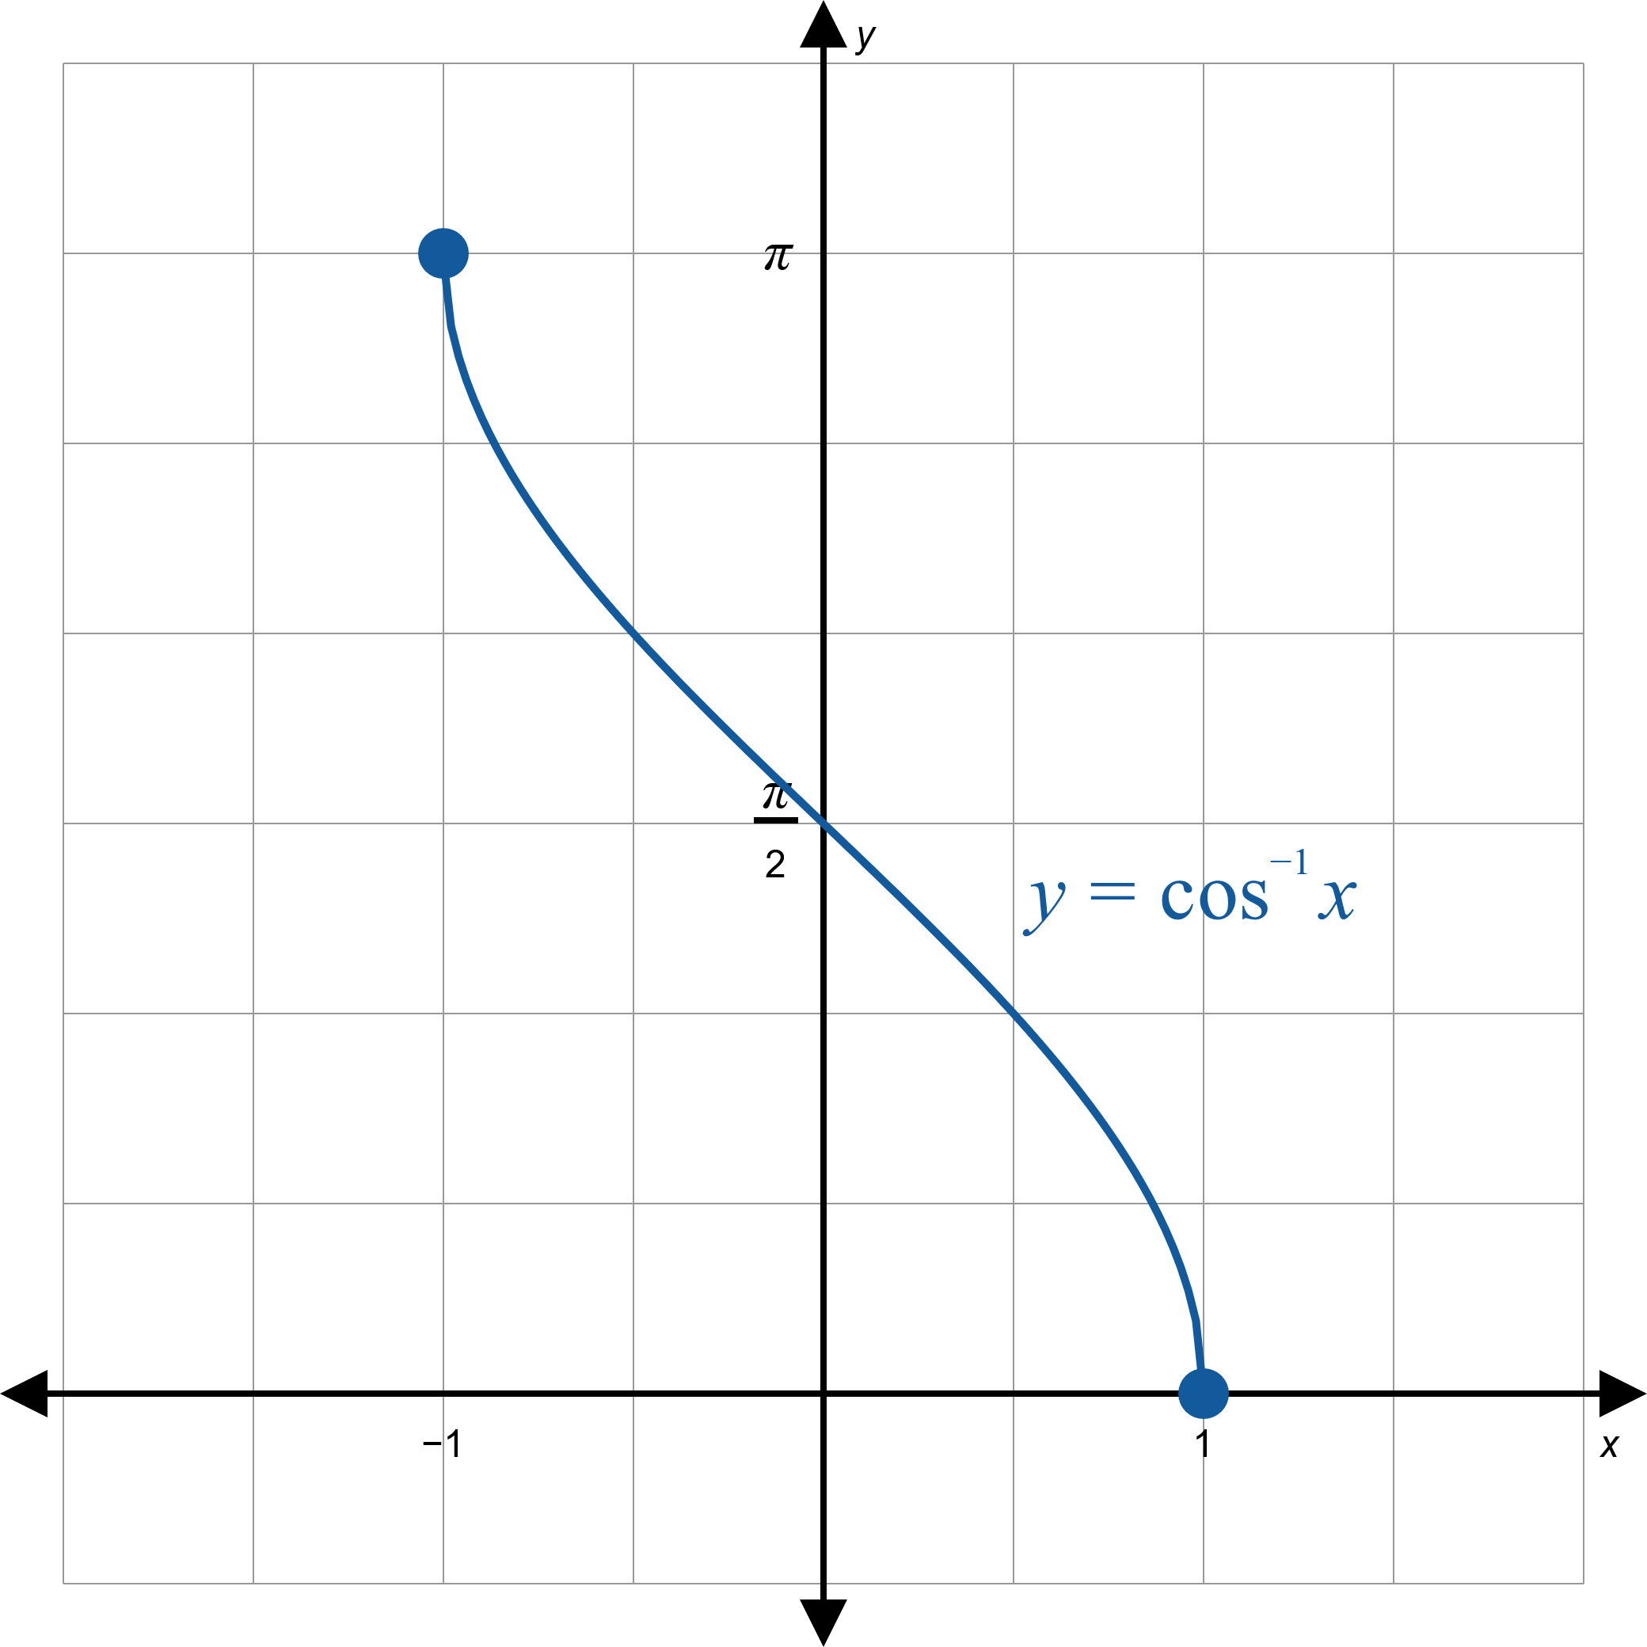
Inverse Cosine Graph

Slide 7
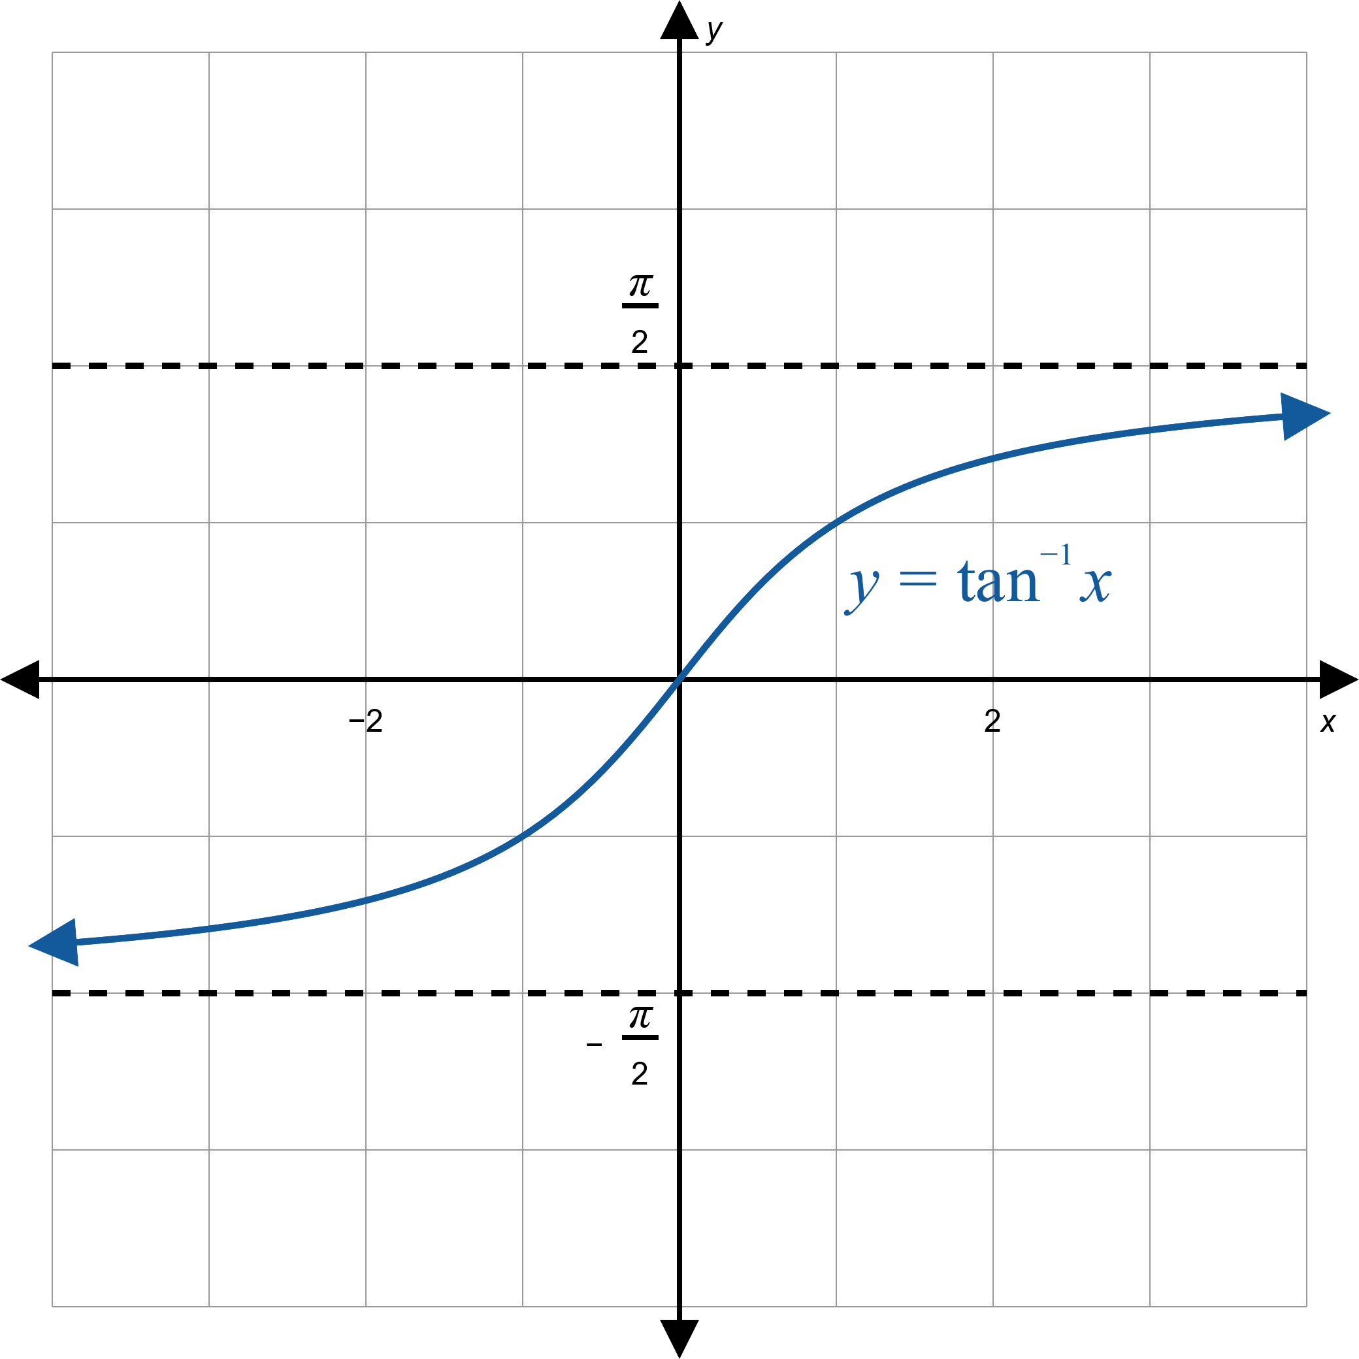
Inverse Tangent Graph

Slide 8
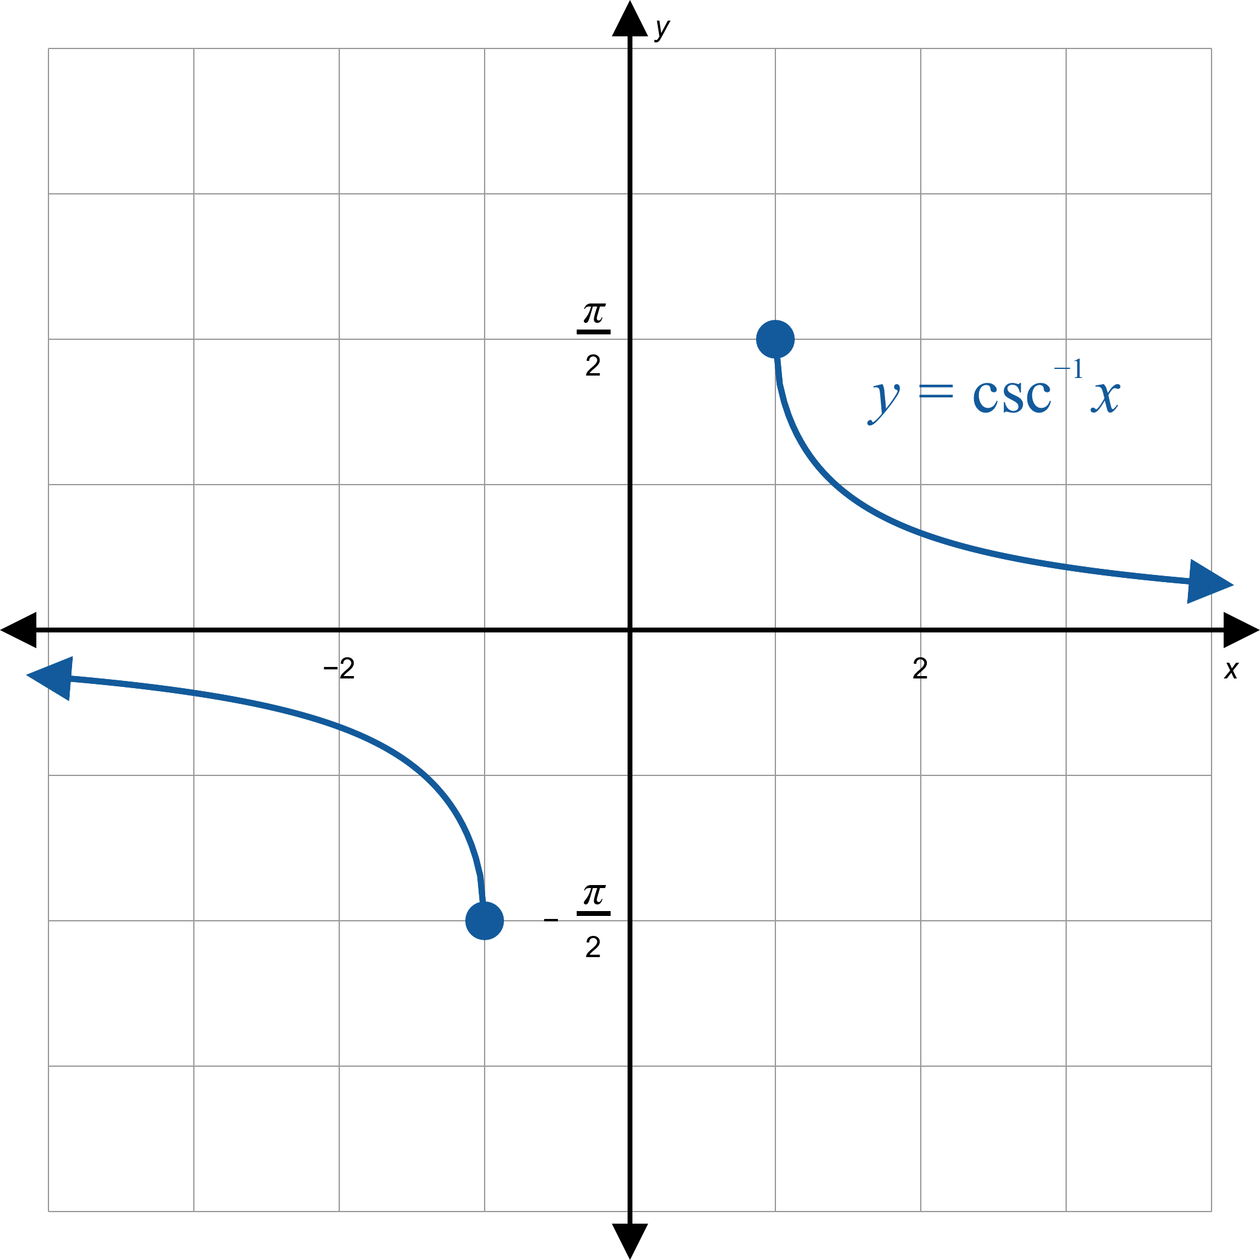
Inverse Cosecant Graph

Slide 9
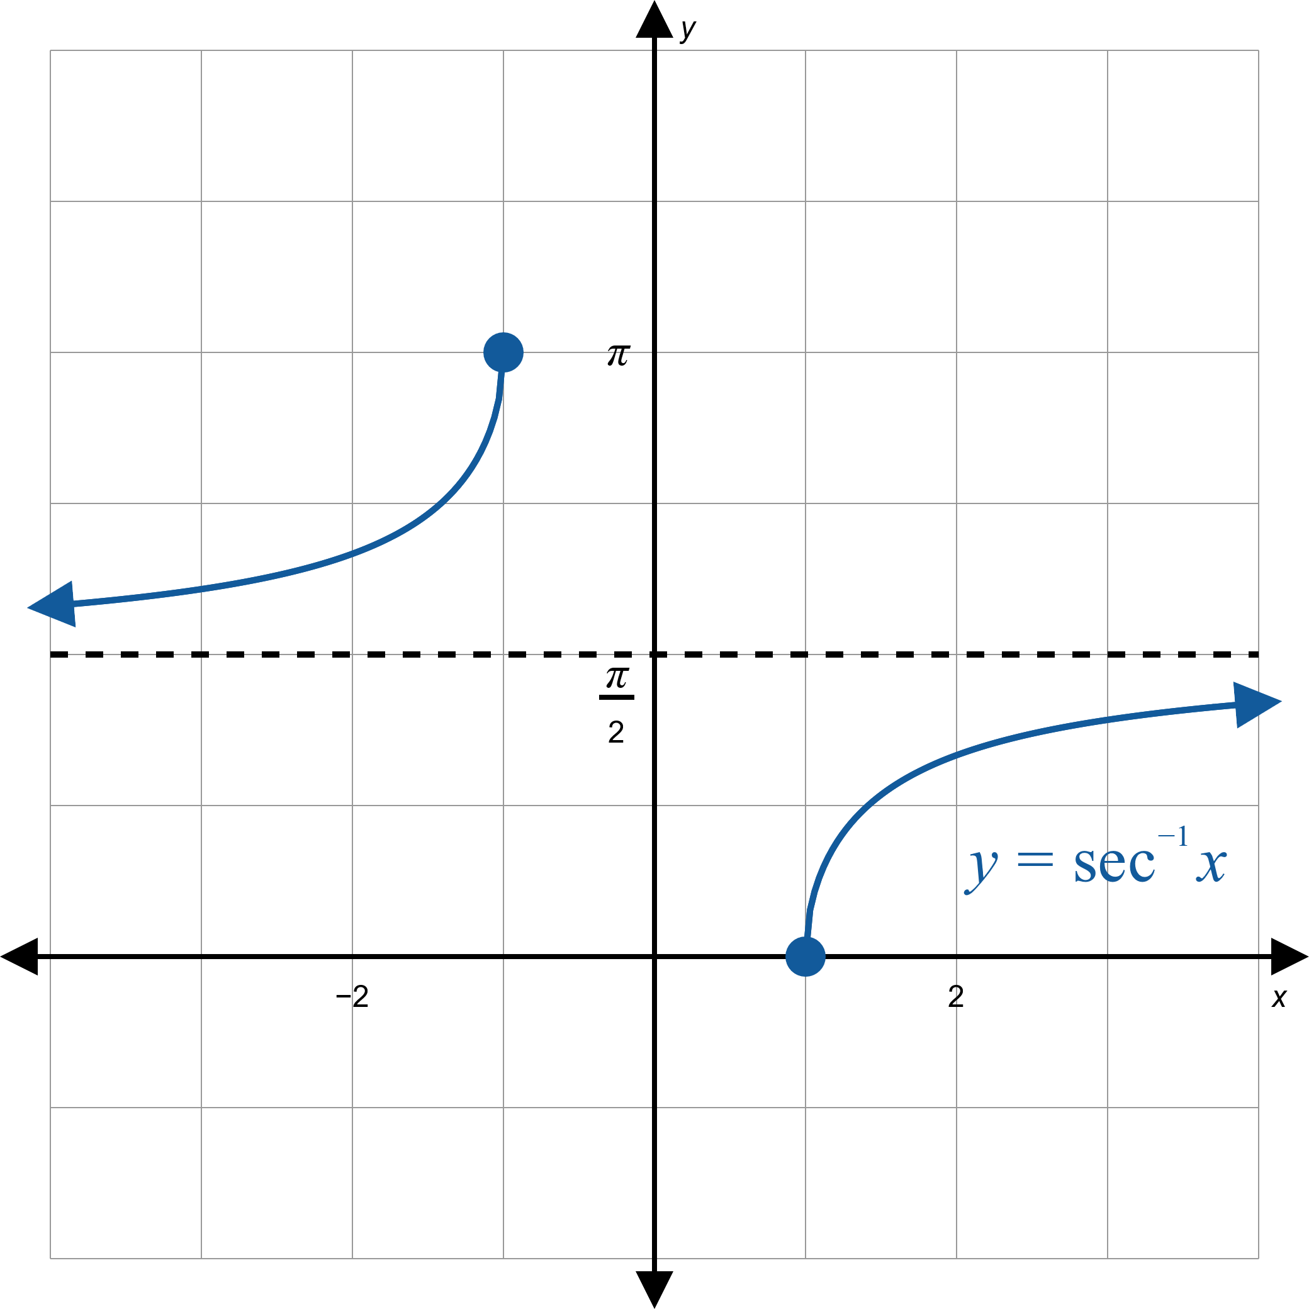
Inverse Secant Graph

Slide 10
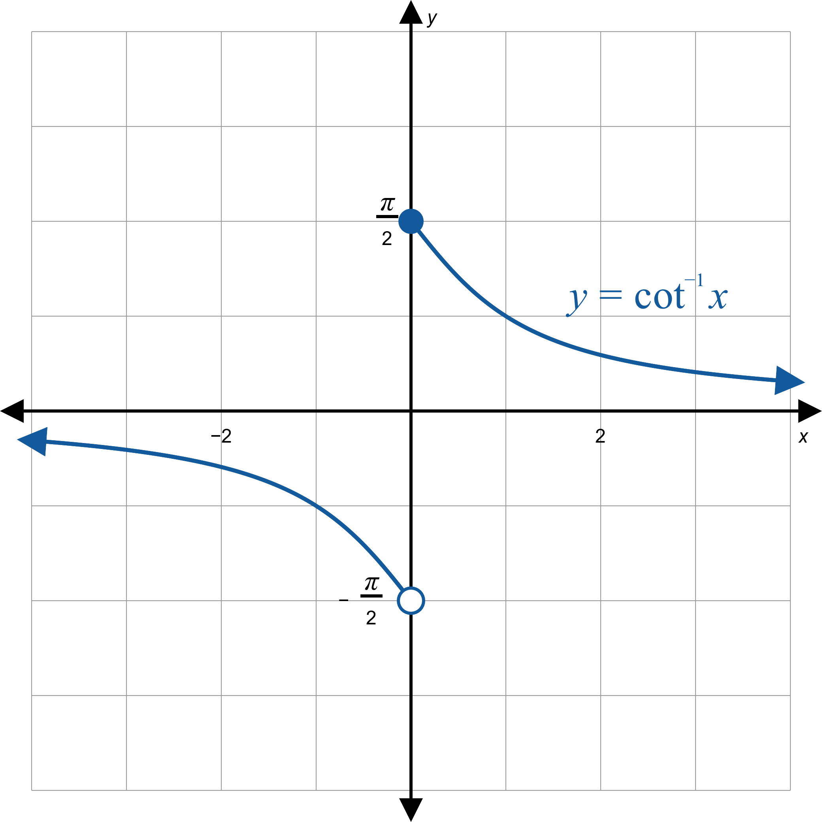
Inverse Cotangent Graph

Slide 11

Example 1: Evaluating Inverse Trigonometric Functions
Evaluate the following expressions.
​$arctan⁡\left(−1\right)$
​$\csc^{−1}⁡2$
​$\sin^{−1}⁡(2.3)$

Slide 12
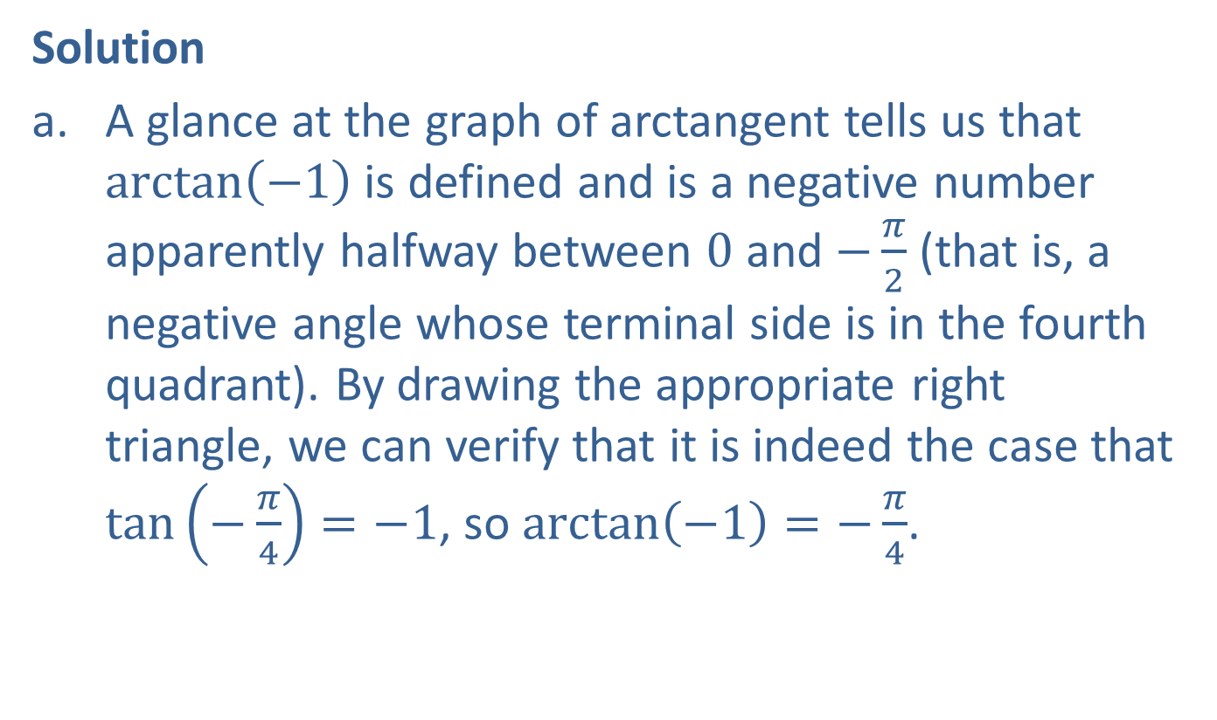
Example 1: Evaluating Inverse Trigonometric Functions (cont.)
Solution
​A glance at the graph of arctangent tells us that $arctan⁡\left(−1\right)$ is defined and is a negative number apparently halfway between 0 and $−\frac{π}{2}$ (that is, a negative angle whose terminal side is in the fourth quadrant). By drawing the appropriate right triangle, we can verify that it is indeed the case that $\tan\left(−\frac{π}{4}\right)=−1$, so $\arctan\left(−1\right)=−\frac{π}{4}$.
​

Slide 13
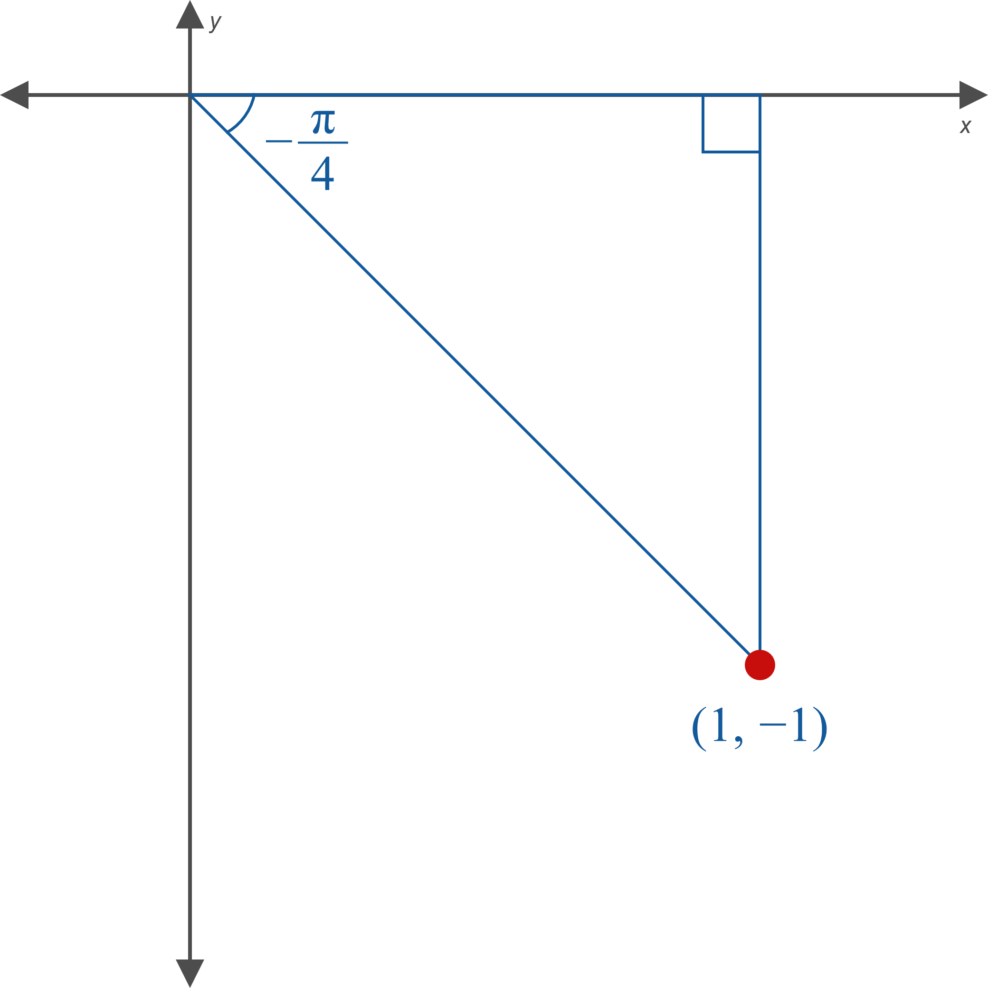

Example 1: Evaluating Inverse Trigonometric Functions (cont.)

Slide 14
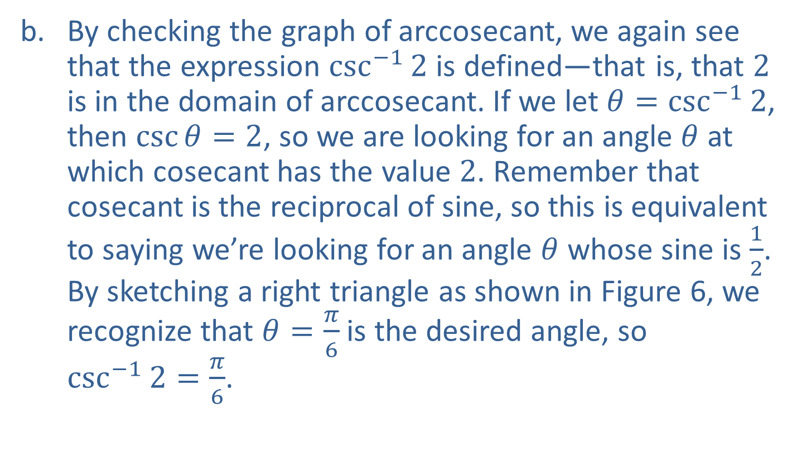
Example 1: Evaluating Inverse Trigonometric Functions (cont.)
​By checking the graph of arccosecant, we again see that the expression $\csc^{−1}⁡2$ is defined—that is, that 2 is in the domain of arccosecant. If we let $θ=\csc^{−1}⁡2$, then $\csc{θ}=2$, so we are looking for an angle $θ$ at which cosecant has the value 2. Remember that cosecant is the reciprocal of sine, so this is equivalent to saying we’re looking for an angle $θ$ whose sine is $\frac{1}{2}$. By sketching a right triangle as shown in Figure 6, we recognize that $θ=\frac{π}{6}$ is the desired angle, so
$\csc^{−1}{2}=\frac{π}{6}$.
​

Slide 15
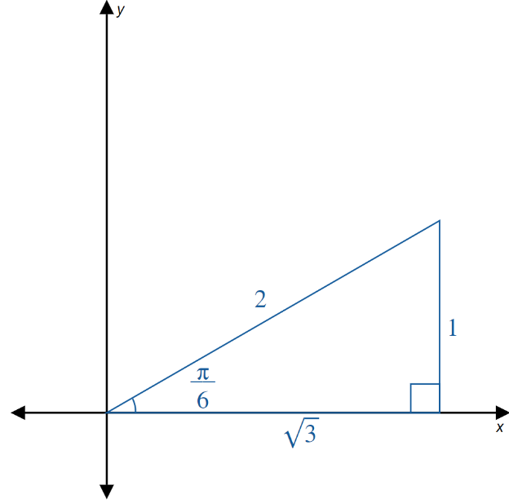
Example 1: Evaluating Inverse Trigonometric Functions (cont.)

Slide 16
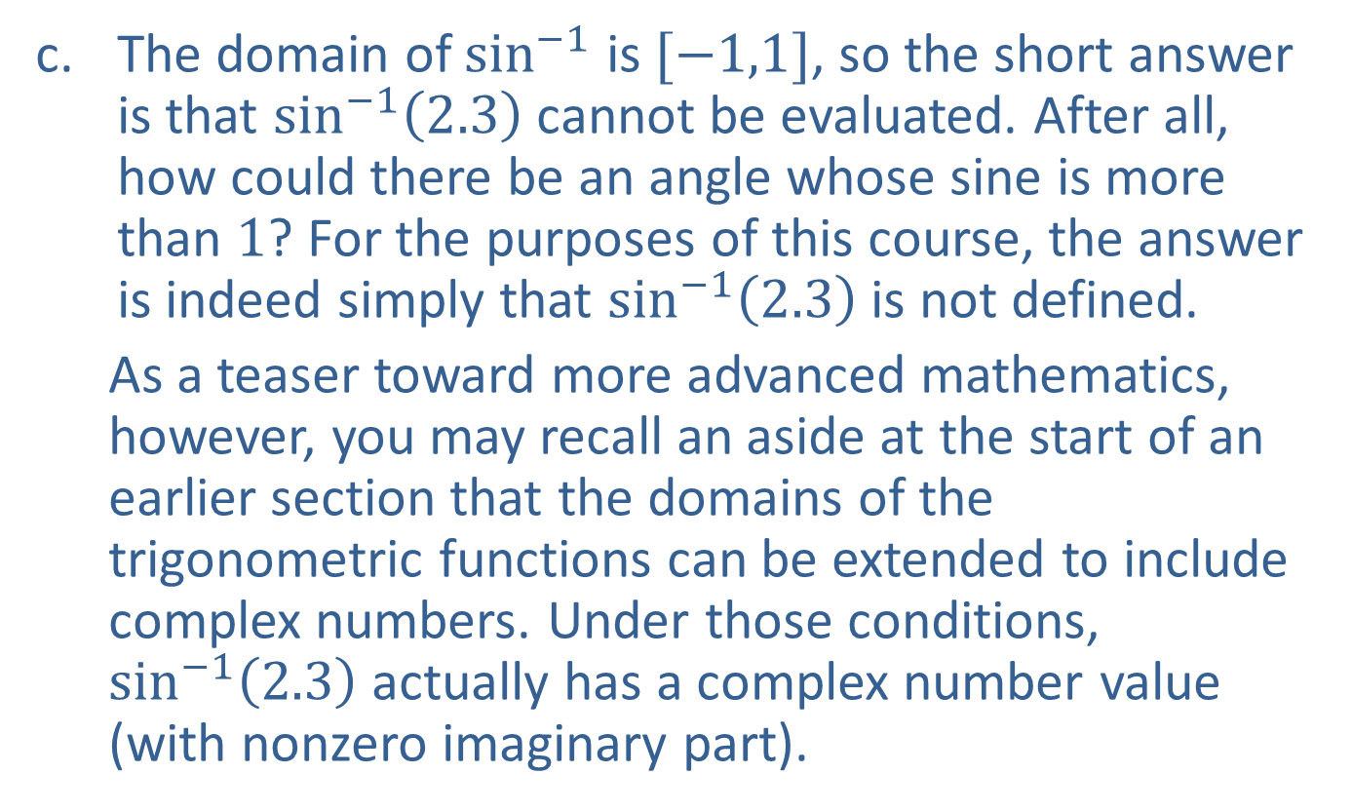
Example 1: Evaluating Inverse Trigonometric Functions (cont.)
​The domain of $\sin^{−1}$ is $[−1,1]$, so the short answer is that $\sin^{−1}⁡\left(2.3\right)$ cannot be evaluated. After all, how could there be an angle whose sine is more than 1? For the purposes of this course, the answer is indeed simply that $\sin^{−1}⁡\left(2.3\right)$ is not defined.
  As a teaser toward more advanced mathematics, however, you may recall an aside at the start of an earlier section that the domains of the trigonometric functions can be extended to include complex numbers. Under those conditions, $\sin^{−1}⁡\left(2.3\right)$ actually has a complex number value (with nonzero imaginary part).

Slide 17

Example 2: Evaluating Compositions of Trigonometric Functions
Evaluate the following expressions, if possible.
​$arcsin⁡\left(\sin\left(\frac{3π}{4}\right)\right)$
​$cos⁡\left(\cos^{−1}\left(−0.2\right)\right)$
​$\tan^{−1}⁡\left(\tan\left(\frac{7π}{6}\right)\right)$

Slide 18
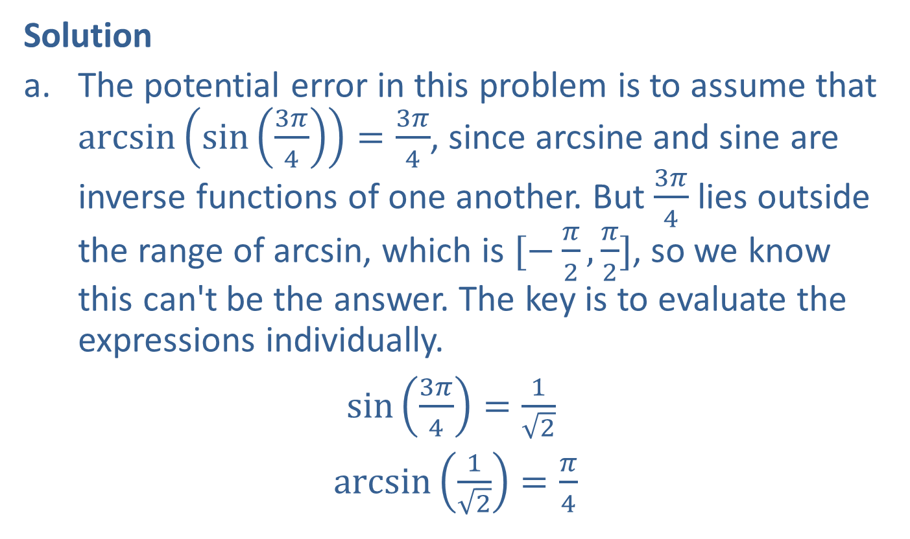
Example 2: Evaluating Compositions of Trigonometric Functions (cont.)
Solution
​The potential error in this problem is to assume that $\arcsin\left(\sin\left(\frac{3π}{4}\right)\right)=\frac{3π}{4}$, since arcsine and sine are inverse functions of one another. But $\frac{3π}{4}$ lies outside the range of arcsin, which is $[−\frac{π}{2},\frac{π}{2}]$, so we know this can't be the answer. The key is to evaluate the expressions individually.
​$\sin\left(\frac{3π}{4}\right)=\frac{1}{\sqrt{2}}$
​ $\arcsin\left(\frac{1}{\sqrt{2}}\right)=\frac{π}{4}$

Slide 19
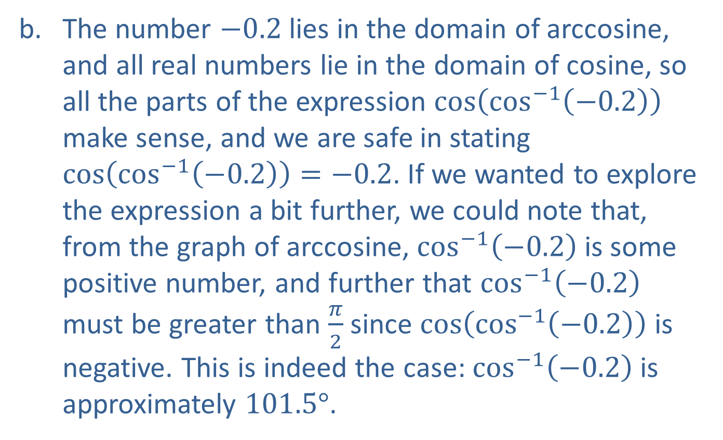
Example 2: Evaluating Compositions of Trigonometric Functions (cont.)
​The number $−0.2$ lies in the domain of arccosine, and all real numbers lie in the domain of cosine, so all the parts of the expression $cos⁡\left(\cos^{−1}\left(−0.2\right)\right)$ make sense, and we are safe in stating $\cos\left(\cos^{−1}\left(−0.2\right)\right)=−0.2$. If we wanted to explore the expression a bit further, we could note that, from the graph of arccosine, $\cos^{−1}⁡\left(−0.2\right)$ is some positive number, and further that $\cos^{−1}⁡\left(−0.2\right)$ must be greater than $\frac{π}{2}$ since $cos⁡\left({cos⁡}^{−1}\left(−0.2\right)\right)$ is negative. This is indeed the case: $\cos^{−1}⁡\left(−0.2\right)$ is approximately $101.5°$.

Slide 20
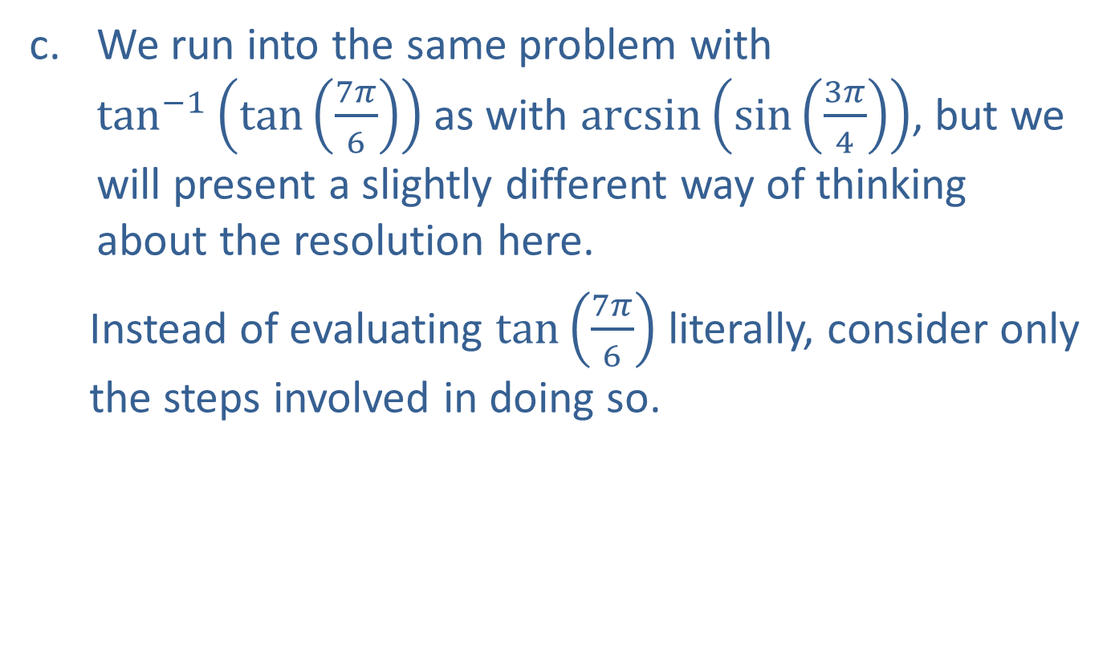
Example 2: Evaluating Compositions of Trigonometric Functions (cont.)
​We run into the same problem with $\tan^{−1}⁡\left(\tan\left(\frac{7π}{6}\right)\right)$ as with $arcsin⁡\left(\sin\left(\frac{3π}{4}\right)\right)$, but we will present a slightly different way of thinking about the resolution here.
  Instead of evaluating $tan⁡\left(\frac{7π}{6}\right)$ literally, consider only the steps involved in doing so.

Slide 21
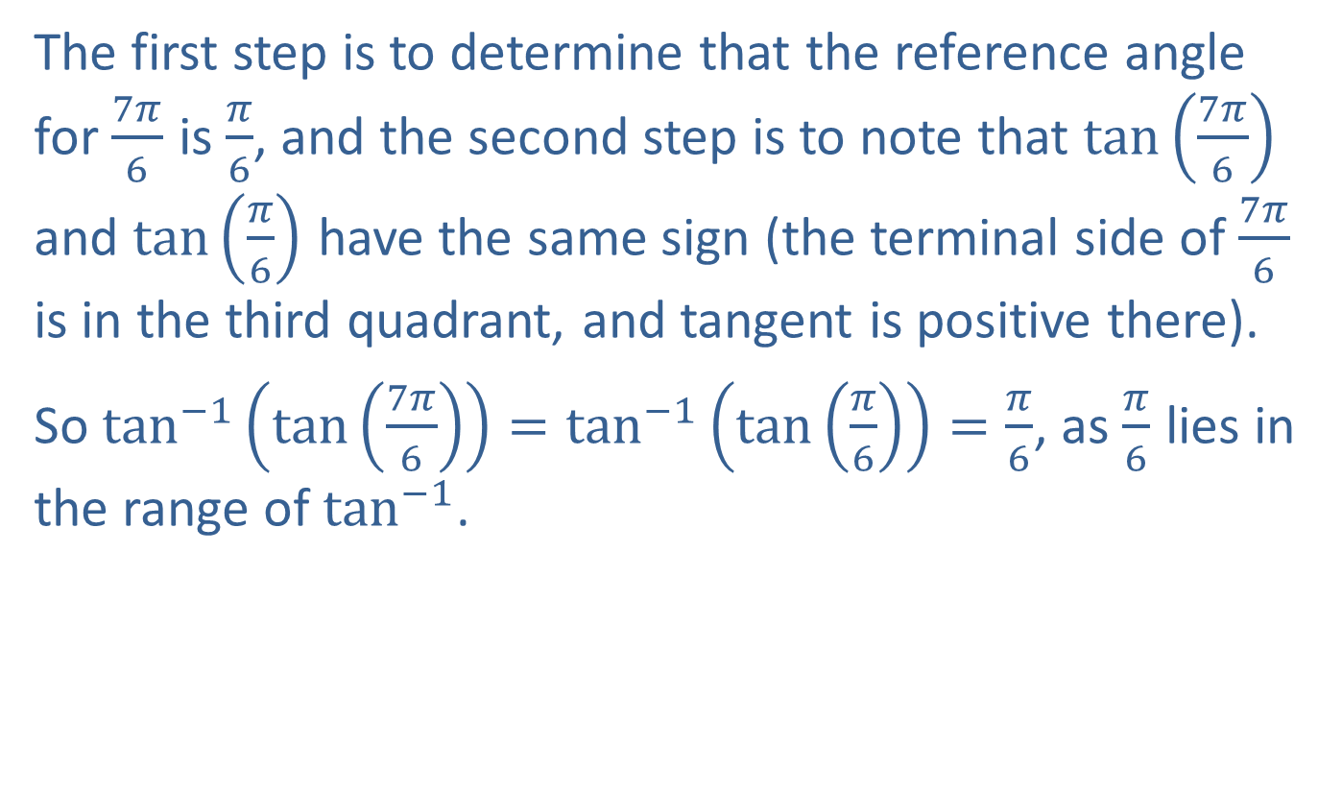
Example 2: Evaluating Compositions of Trigonometric Functions (cont.)
The first step is to determine that the reference angle for $\frac{7π}{6}$ is $\frac{π}{6}$, and the second step is to note that $tan⁡\left(\frac{7π}{6}\right)$ and $tan⁡\left(\frac{π}{6}\right)$ have the same sign (the terminal side of $\frac{7π}{6}$ is in the third quadrant, and tangent is positive there).
So $\tan^{−1}\left(\tan\left(\frac{7π}{6}\right)\right)=\tan^{−1}\left(\tan\left(\frac{π}{6}\right)\right)=\frac{π}{6}$, as $\frac{π}{6}$ lies in the range of $\tan^{−1}$.

Slide 22

Example 3: Evaluating Compositions of Trigonometric Functions
Evaluate the following expressions.
​$tan⁡\left(\sin^{−1}\left(−\frac{4}{5}\right)\right)$
​$cos⁡\left(\arctan{(0.4)}\right)$

Slide 23
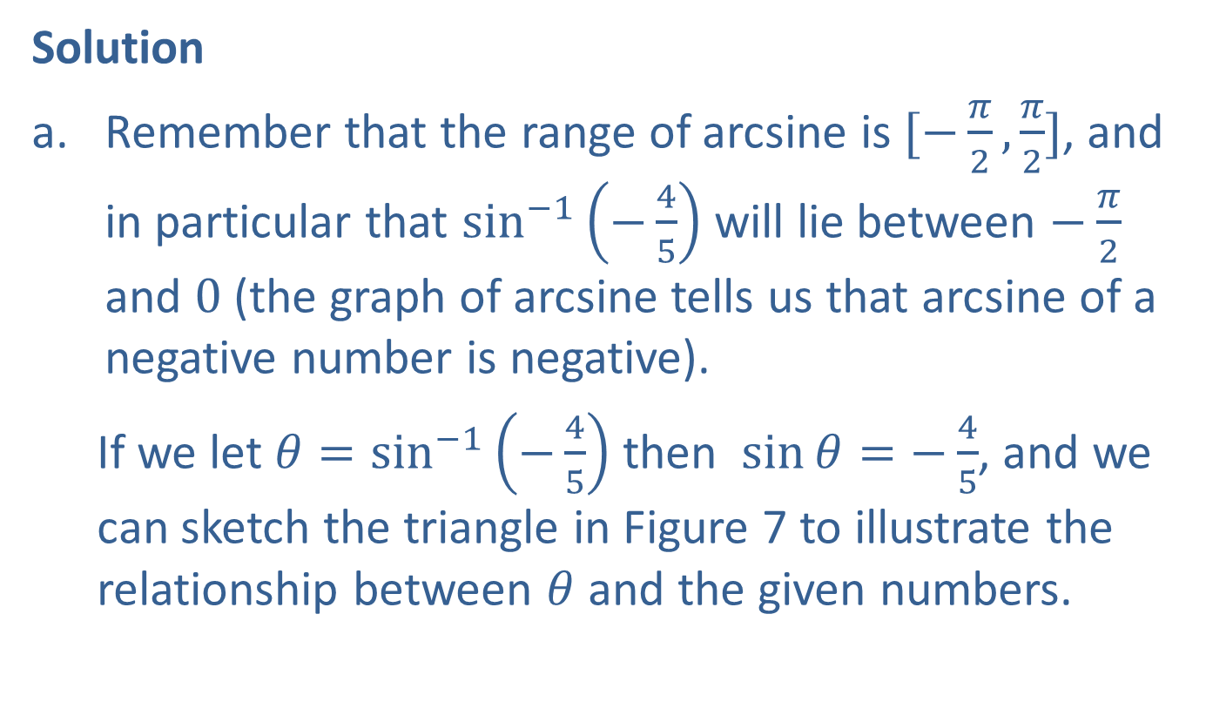
Example 3: Evaluating Compositions of Trigonometric Functions (cont.)
Solution
​Remember that the range of arcsine is $[−\frac{π}{2},\frac{π}{2}]$, and in particular that $\sin^{−1}⁡\left(−\frac{4}{5}\right)$ will lie between $−\frac{π}{2}$ and 0 (the graph of arcsine tells us that arcsine of a negative number is negative).
  If we let $θ=\sin^{−1}\left(−\frac{4}{5}\right)$ then $\sin{θ}=−\frac{4}{5}$, and we can sketch the triangle in Figure 7 to illustrate the relationship between $θ$ and the given numbers.
​

Slide 24
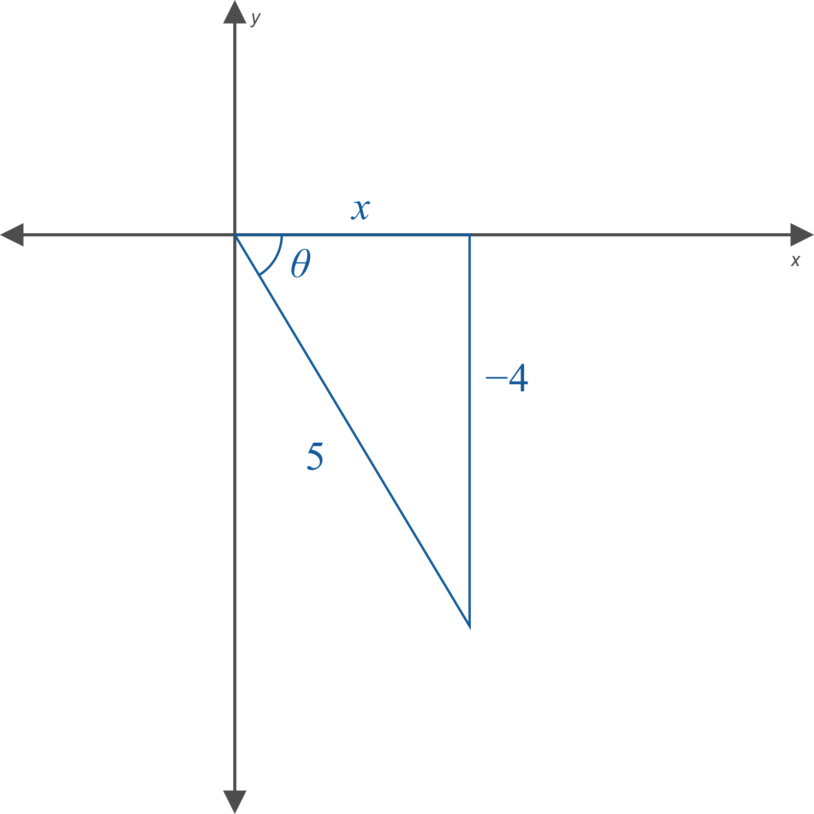

Example 3: Evaluating Compositions of Trigonometric Functions (cont.)

Slide 25
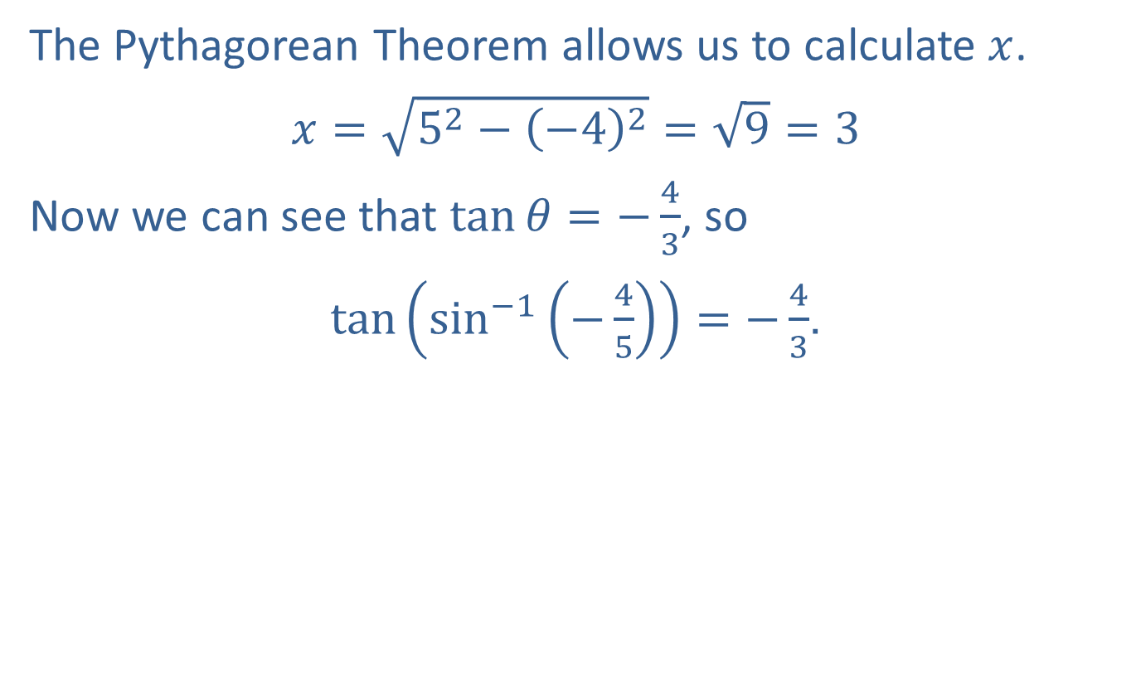
Example 3: Evaluating Compositions of Trigonometric Functions (cont.)
The Pythagorean Theorem allows us to calculate $x$.
​$x=\sqrt{5^{2}−{\left(−4\right)}^{2}}=\sqrt{9}=3$
​Now we can see that $\tan{θ}=−\frac{4}{3}$, so
​$\tan\left(\sin^{−1}\left(−\frac{4}{5}\right)\right)=−\frac{4}{3}$.

Slide 26

Example 3: Evaluating Compositions of Trigonometric Functions (cont.)
​We can employ the same method and let
$θ=\arctan{(0.4)}$. This leads to
​$\tan{θ}=0.4=\frac{4}{10}=\frac{2}{5}$
  and then to the triangle in Figure 8.
​

Slide 27
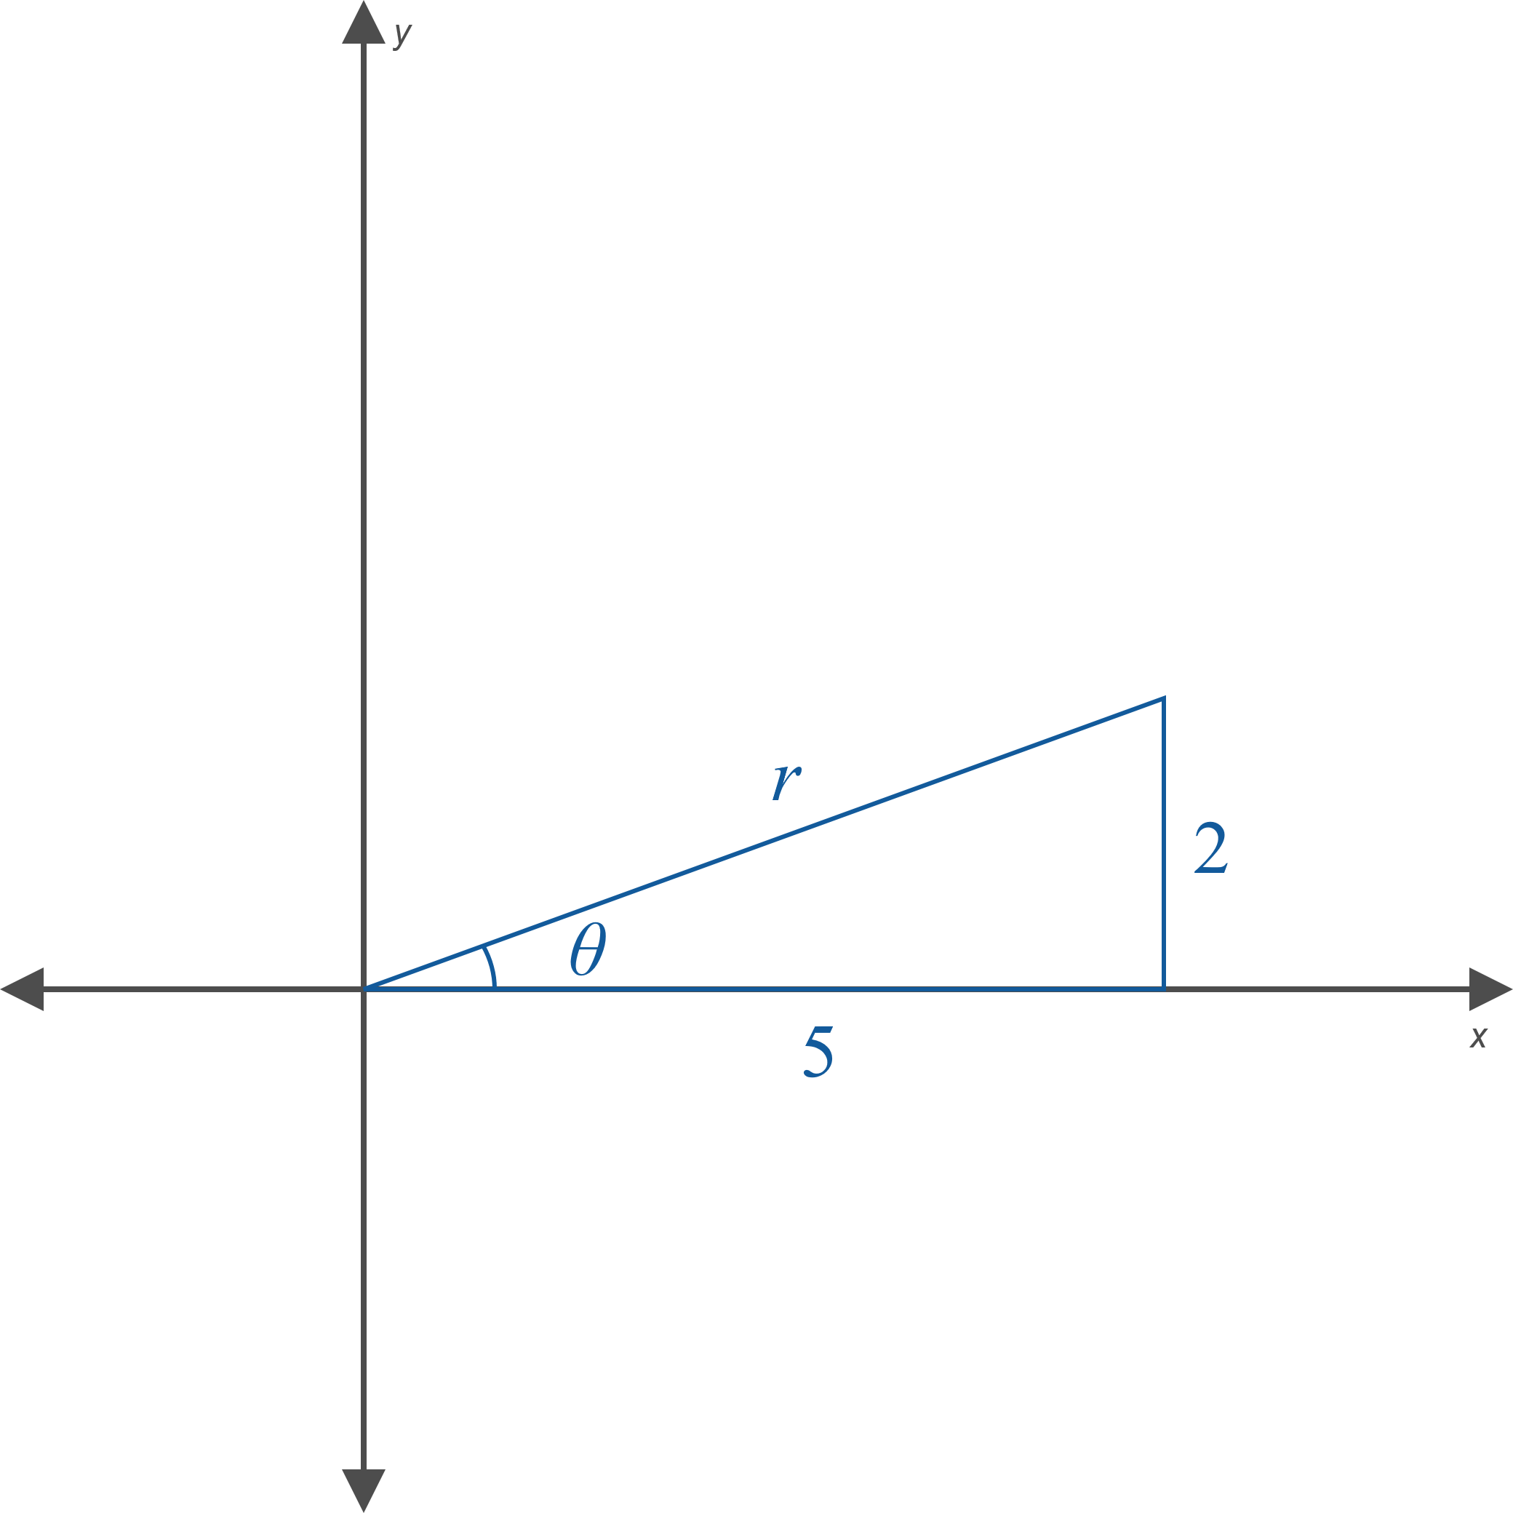

Example 3: Evaluating Compositions of Trigonometric Functions (cont.)

Slide 28

Example 3: Evaluating Compositions of Trigonometric Functions (cont.)
​The Pythagorean Theorem gives us
$r=\sqrt{5^{2}+2^{2}}=\sqrt{29}$, and so $\cos\left(\arctan{(0.4)}\right)=\frac{5}{\sqrt{29}}$.

Slide 29
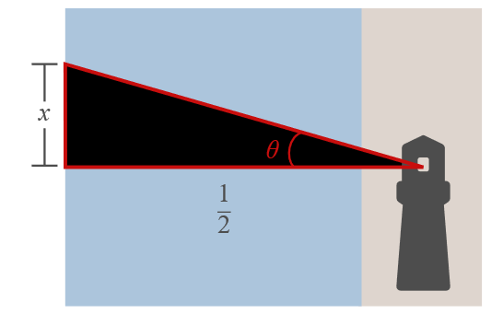


Example 4: Using Inverse Trigonometric Functions
A lighthouse is to be constructed half a mile from a long, straight reef, as shown in Figure 9. In order to ensure the light illuminates certain portions of the reef within specified lengths of time, the engineer needs a formula for $θ$ in terms of $x$. Find such a formula.

Slide 30

Example 4: Using Inverse Trigonometric Functions (cont.)
Solution
From Figure 9, we see that $\tan{θ}=\frac{x}{\frac{1}{2}}=2x$, so the formula for $θ$ is
$θ=\tan^{−1}\left(2x\right)$.

Slide 31

Example 5: Using Inverse Trigonometric Functions
Express $sin⁡\left(\cos^{−1}\left(2x\right)\right)$ as an algebraic function of $x$, assuming $−\frac{1}{2}≤x≤\frac{1}{2}$.

Slide 32

Example 5: Using Inverse Trigonometric Functions (cont.)
Solution
Let $θ=\cos^{−1}\left(2x\right)$. Then $\cos{θ}=2x$, and we are led to consider a sketch like the one in Figure 10.

Slide 33
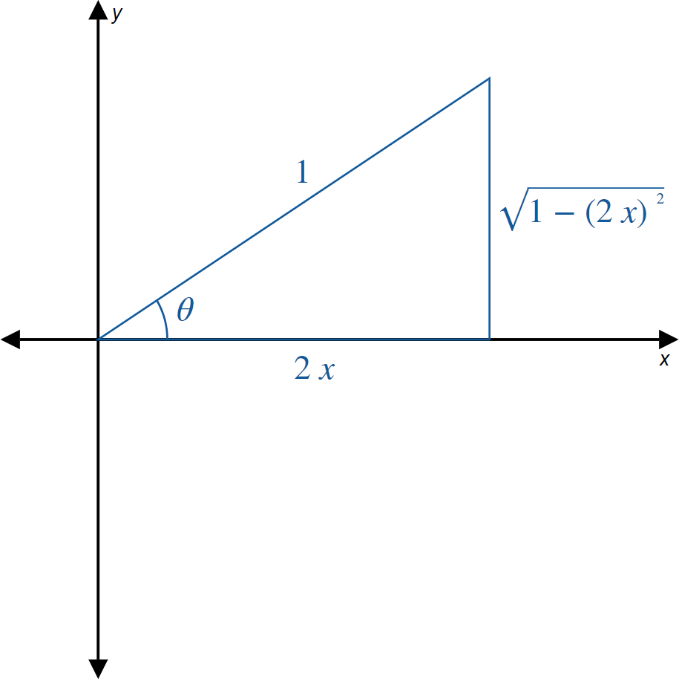

Example 5: Using Inverse Trigonometric Functions (cont.)

Slide 34
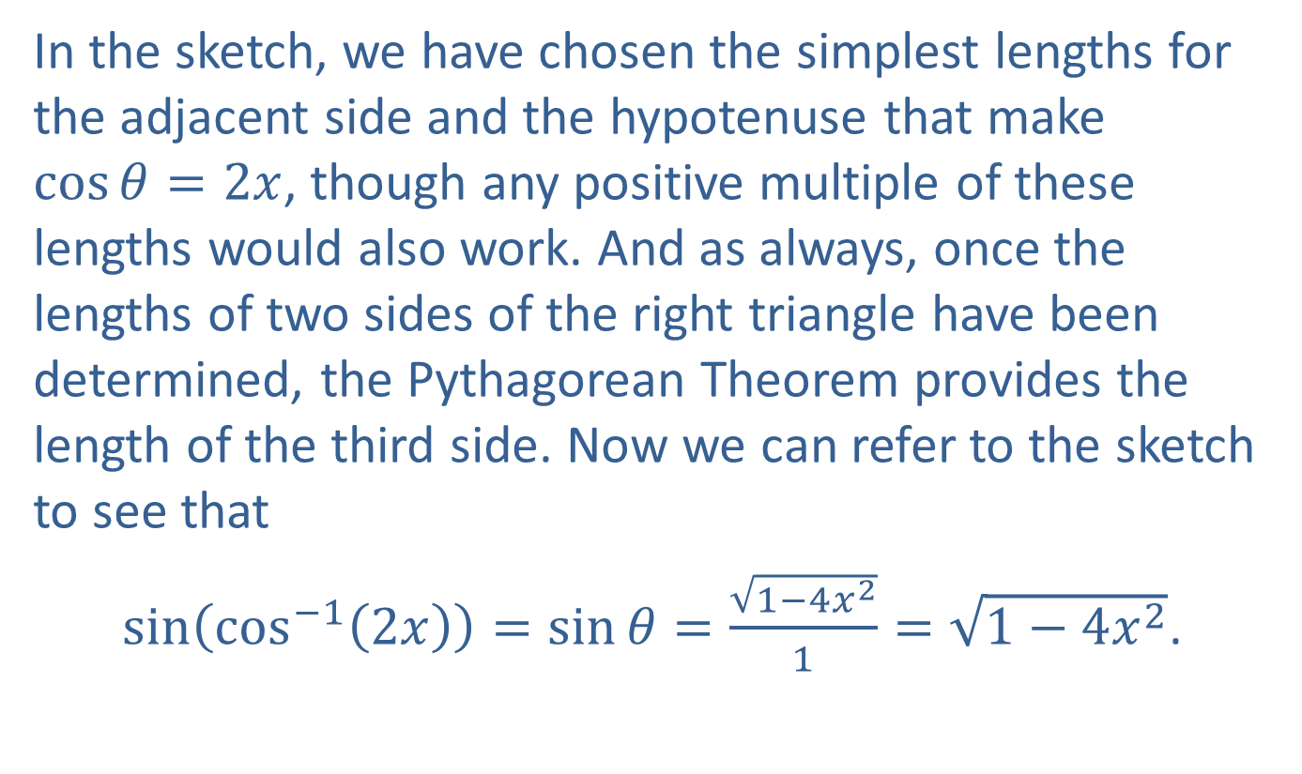
Example 5: Using Inverse Trigonometric Functions (cont.)
In the sketch, we have chosen the simplest lengths for the adjacent side and the hypotenuse that make
$\cos{θ}=2x$, though any positive multiple of these lengths would also work. And as always, once the lengths of two sides of the right triangle have been determined, the Pythagorean Theorem provides the length of the third side. Now we can refer to the sketch to see that
$\sin\left(\cos^{−1}\left(2x\right)\right)=\sin{θ}=\frac{\sqrt{1−4x^{2}}}{1}=\sqrt{1−4x^{2}}$.

