Slide 1
Section 8.1
Fundamental Trigonometric Identities

Slide 2

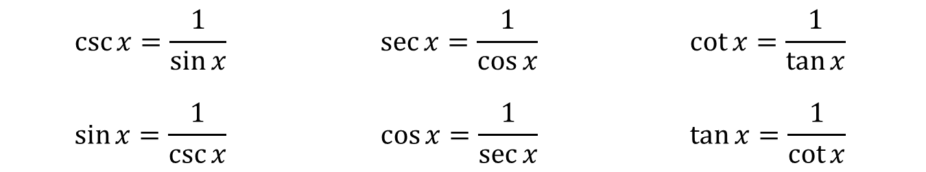
Identities Already Seen
Reciprocal Identities
Quotient Identities
$$\csc{x}=\frac{1}{\sin{x}}$$ | $$\sec{x}=\frac{1}{\cos{x}}$$ | $$\cot{x}=\frac{1}{\tan{x}}$$
$$\sin{x}=\frac{1}{\csc{x}}$$ | $$\cos{x}=\frac{1}{\sec{x}}$$ | $$\tan{x}=\frac{1}{\cot{x}}$$
$$\tan{x}=\frac{\sin{x}}{\cos{x}}$$ | $$\cot{x}=\frac{\cos{x}}{\sin{x}}$$

Slide 3
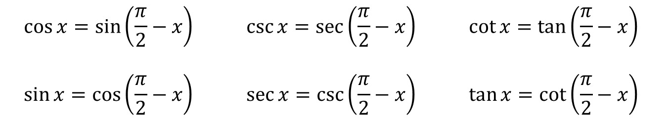
Identities Already Seen (cont.)
Cofunction Identities
$$\cos{x}=\sin\left(\frac{π}{2}−x\right)$$ | $$\csc{x}=\sec\left(\frac{π}{2}−x\right)$$ | $$\cot{x}=\tan\left(\frac{π}{2}−x\right)$$
$$\sin{x}=\cos\left(\frac{π}{2}−x\right)$$ | $$\sec{x}=\csc\left(\frac{π}{2}−x\right)$$ | $$\tan{x}=\cot\left(\frac{π}{2}−x\right)$$

Slide 4
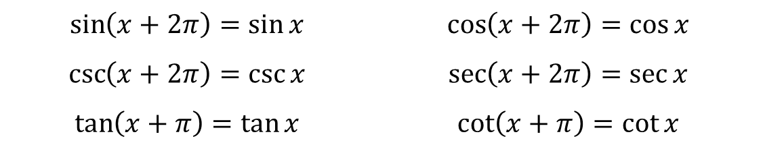
Identities Already Seen (cont.)
Period Identities
$$\sin\left(x+2π\right)=\sin{x}$$ | $$\cos\left(x+2π\right)=\cos{x}$$
$$\csc\left(x+2π\right)=\csc{x}$$ | $$\sec\left(x+2π\right)=\sec{x}$$
$$\tan\left(x+π\right)=\tan{x}$$ | $$\cot\left(x+π\right)=\cot{x}$$

Slide 5
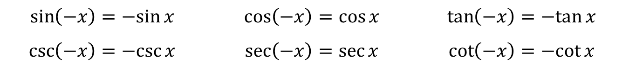
Identities Already Seen (cont.)
Even/Odd Identities
Pythagorean Identities
$$\sin\left(−x\right)=−sin{x}$$ | $$\cos\left(−x\right)=\cos{x}$$ | $$\tan\left(−x\right)=−tan{x}$$
$$\csc\left(−x\right)=−csc{x}$$ | $$\sec\left(−x\right)=\sec{x}$$ | $$\cot\left(−x\right)=−cot{x}$$
$$\sin^{2}{x}+\cos^{2}{x}=1$$ | $$\tan^{2}{x}+1=\sec^{2}{x}$$ | $$1+\cot^{2}{x}=\csc^{2}{x}$$

Slide 6

Example 1: Simplifying Trigonometric Expressions
Simplify the expression $\cos{θ}+\sin{θ}\tan{θ}$.

Slide 7
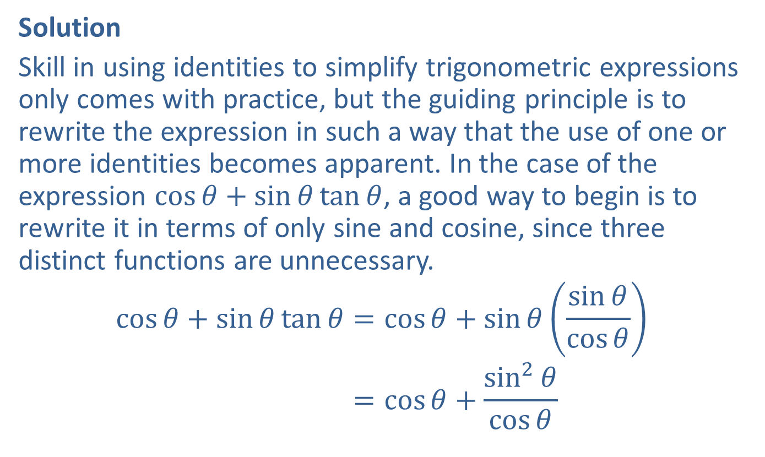
Example 1: Simplifying Trigonometric Expressions (cont.)
Solution
Skill in using identities to simplify trigonometric expressions only comes with practice, but the guiding principle is to rewrite the expression in such a way that the use of one or more identities becomes apparent. In the case of the expression $\cos{θ}+\sin{θ}\tan{θ}$, a good way to begin is to rewrite it in terms of only sine and cosine, since three distinct functions are unnecessary.
cos𝜃+sin𝜃tan𝜃=cos𝜃+sin𝜃sin𝜃cos𝜃cos𝜃+sin𝜃tan𝜃=cos𝜃+sin2𝜃cos𝜃

Slide 8
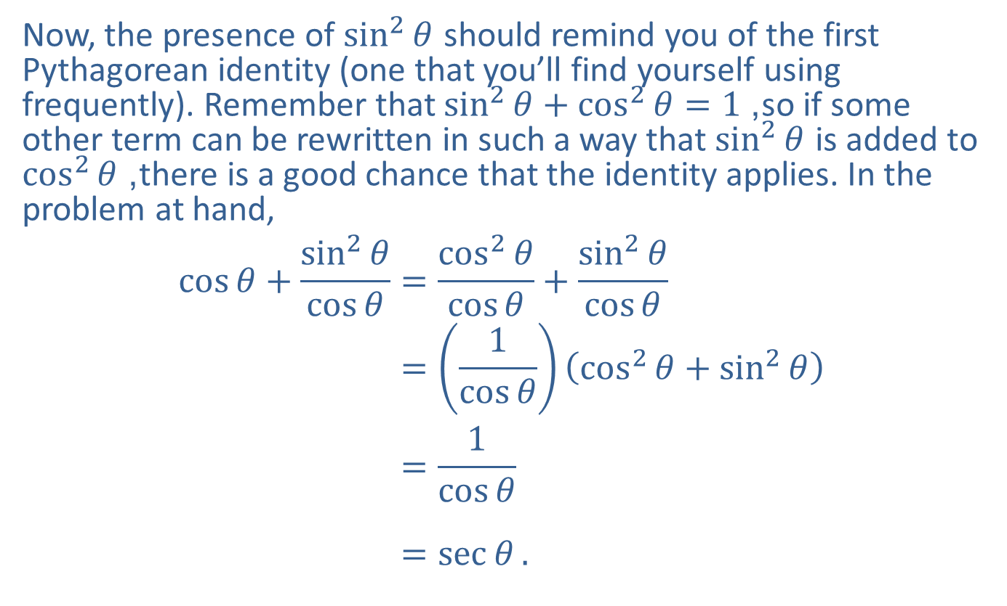
Example 1: Simplifying Trigonometric Expressions (cont.)
Now, the presence of $\sin^{2}⁡θ$ should remind you of the first Pythagorean identity (one that you’ll find yourself using frequently). Remember that $\sin^{2}{θ}+\cos^{2}{θ}=1$, so if some other term can be rewritten in such a way that $\sin^{2}⁡θ$ is added to $\cos^{2}⁡θ$, there is a good chance that the identity applies. In the problem at hand,
cos𝜃+sin2𝜃cos𝜃=cos2𝜃cos𝜃+sin2𝜃cos𝜃cos𝜃+sin2𝜃cos𝜃=1cos𝜃cos2𝜃+sin2𝜃cos𝜃+sin2𝜃cos𝜃=1cos𝜃cos𝜃+sin2𝜃cos𝜃=sec𝜃.

Slide 9

Example 2: Simplifying Trigonometric Expressions
Simplify the expression $\cot{α}+\frac{\sin{α}}{1+\cos{α}}$.

Slide 10
Example 2: Simplifying Trigonometric Expressions (cont.)
Solution
As in Example 1, rewriting the expression in terms of only sine and cosine is a good way to start. And as in so many problems, finding a common denominator and combining the resulting fractions is a promising way to proceed. After that, the remaining steps suggest themselves clearly.

Slide 11
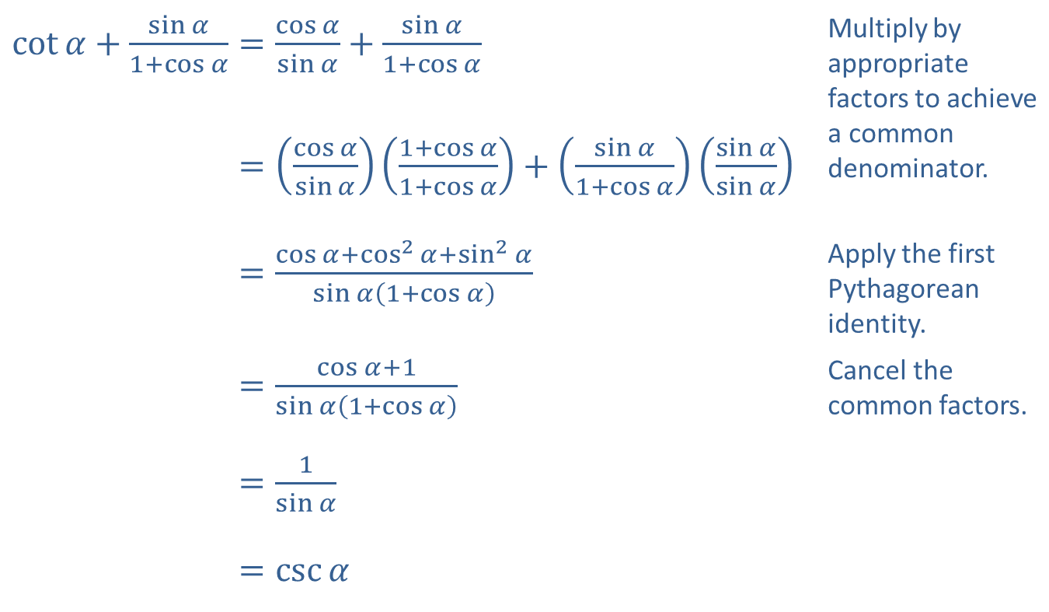
Example 2: Simplifying Trigonometric Expressions (cont.)
​$\cot{α}+\frac{\sin{α}}{1+\cos{α}}=\frac{\cos{α}}{\sin{α}}+\frac{\sin{α}}{1+\cos{α}}$ | Multiply by appropriate factors to achieve a common denominator.
​cot𝛼+sin𝛼1+cos𝛼=cos𝛼sin𝛼1+cos𝛼1+cos𝛼+sin𝛼1+cos𝛼sin𝛼sin𝛼
​cot𝛼+sin𝛼1+cos𝛼=cos𝛼+cos2𝛼+sin2𝛼sin𝛼1+cos𝛼 | Apply the first Pythagorean identity.
​cot𝛼+sin𝛼1+cos𝛼=cos𝛼+1sin𝛼1+cos𝛼 | Cancel the common factors.
​cot𝛼+sin𝛼1+cos𝛼=1sin𝛼
​cot𝛼+sin𝛼1+cos𝛼=csc𝛼

Slide 12
Guidelines for Verifying Trigonometric Identities
Procedure
​Work with one side at a time. Choose one side of the equation to work with and simplify it. The more complicated side is usually the best choice. The goal is to transform it into the other side.
​Apply trigonometric identities as appropriate. To do so, it will probably be necessary to combine fractions, add or subtract terms, factor expressions, or use other algebraic manipulations.
​Rewrite in terms of sine and cosine if necessary. If you are stuck, expressing everything in terms of sine and cosine often leads to inspiration.

Slide 13

Example 3: Verifying Trigonometric Identities
Verify the identity $2\csc^{2}{x}=\frac{1}{1−\cos{x}}+\frac{1}{1+\cos{x}}$.

Slide 14

Example 3: Verifying Trigonometric Identities (cont.)
Solution
The right-hand side is more complicated, so we'll begin with it. Combining the two fractions is a good way to begin, especially if we notice that a denominator of $1−\cos^{2}{x}$ will eventually appear.

Slide 15
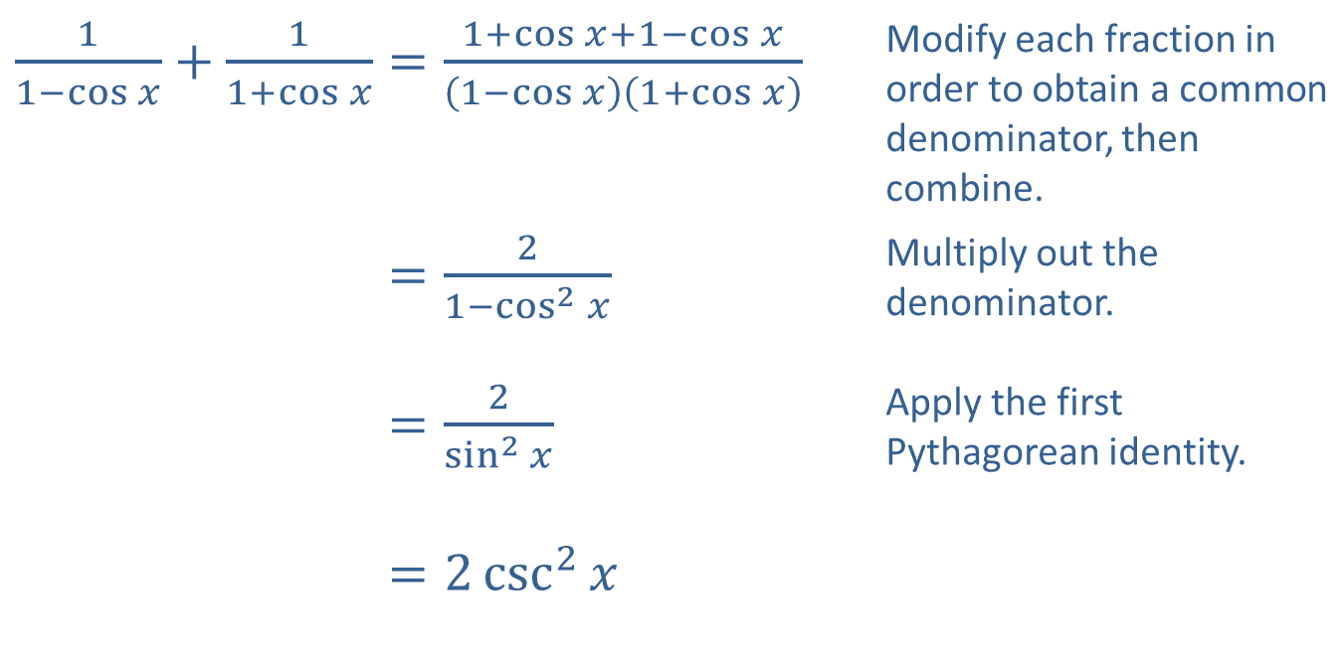
Example 3: Verifying Trigonometric Identities (cont.)
​$\frac{1}{1−\cos{x}}+\frac{1}{1+\cos{x}}=\frac{1+\cos{x}+1−\cos{x}}{\left(1−\cos{x}\right)\left(1+\cos{x}\right)}$ | Modify each fraction in order to obtain a common denominator, then combine.
​11−cos𝑥+11+cos𝑥=21−cos2𝑥 | Multiply out the denominator.
​11−cos𝑥+11+cos𝑥=2sin2𝑥 | Apply the first Pythagorean identity.
​11−cos𝑥+11+cos𝑥=2csc2𝑥

Slide 16

Example 4: Verifying Trigonometric Identities
Verify the identity $\frac{\tan^{2}{x}}{1+\sec{x}}=\frac{1−\cos{x}}{\cos{x}}$.

Slide 17
Example 4: Verifying Trigonometric Identities (cont.)
Solution
It's not immediately clear that either side is more complicated than the other, so we can try simplifying both. Beginning with the left-hand side, we can use another of the Pythagorean identities as follows.

Slide 18
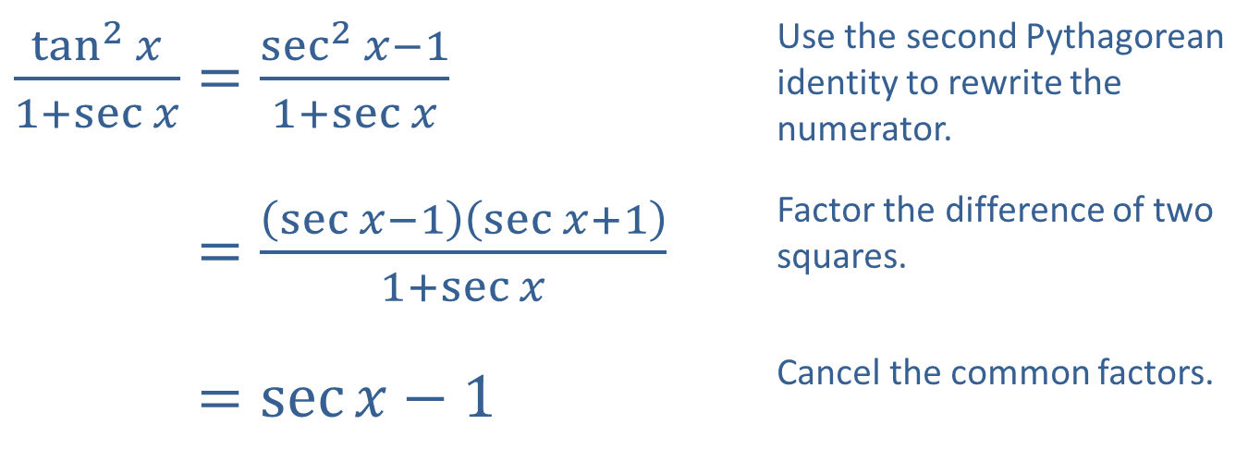
Example 4: Verifying Trigonometric Identities (cont.)
​$\frac{\tan^{2}{x}}{1+\sec{x}}=\frac{\sec^{2}{x}−1}{1+\sec{x}}$ | Use the second Pythagorean identity to rewrite the numerator.
​tan2𝑥1+sec𝑥=sec𝑥−1sec𝑥+11+sec𝑥 | Factor the difference of two squares.
​tan2𝑥1+sec𝑥=sec𝑥−1 | Cancel the common factors.

Slide 19
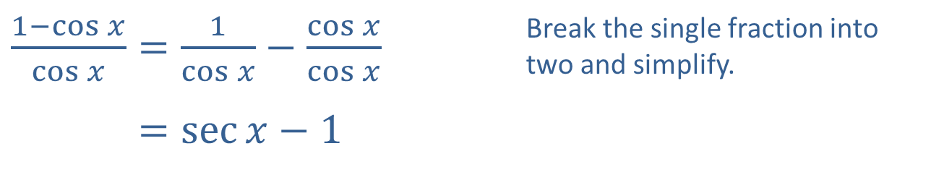
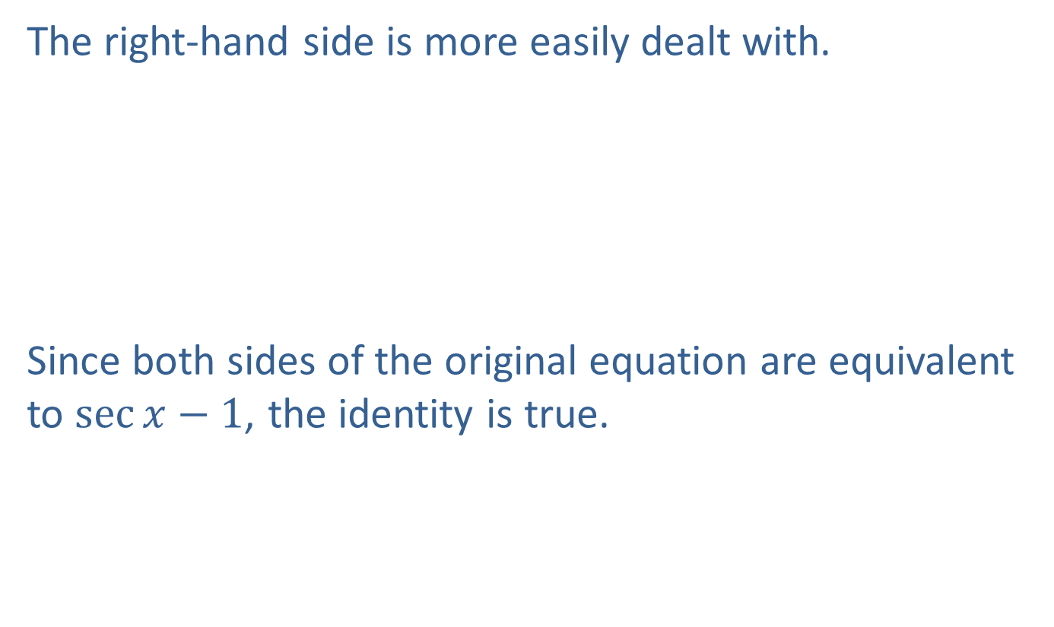
Example 4: Verifying Trigonometric Identities (cont.)
The right-hand side is more easily dealt with.
Since both sides of the original equation are equivalent to $\sec{x}−1$, the identity is true.
​$\frac{1−\cos{x}}{\cos{x}}=\frac{1}{\cos{x}}−\frac{\cos{x}}{\cos{x}}$ | Break the single fraction into two and simplify.
​1−cos𝑥cos𝑥=sec𝑥−1

Slide 20

Example 5: Verifying Trigonometric Identities
Verify the identity $\frac{\cos{φ}\cot{φ}}{1−\sin{φ}}−1=\csc{φ}$.

Slide 21
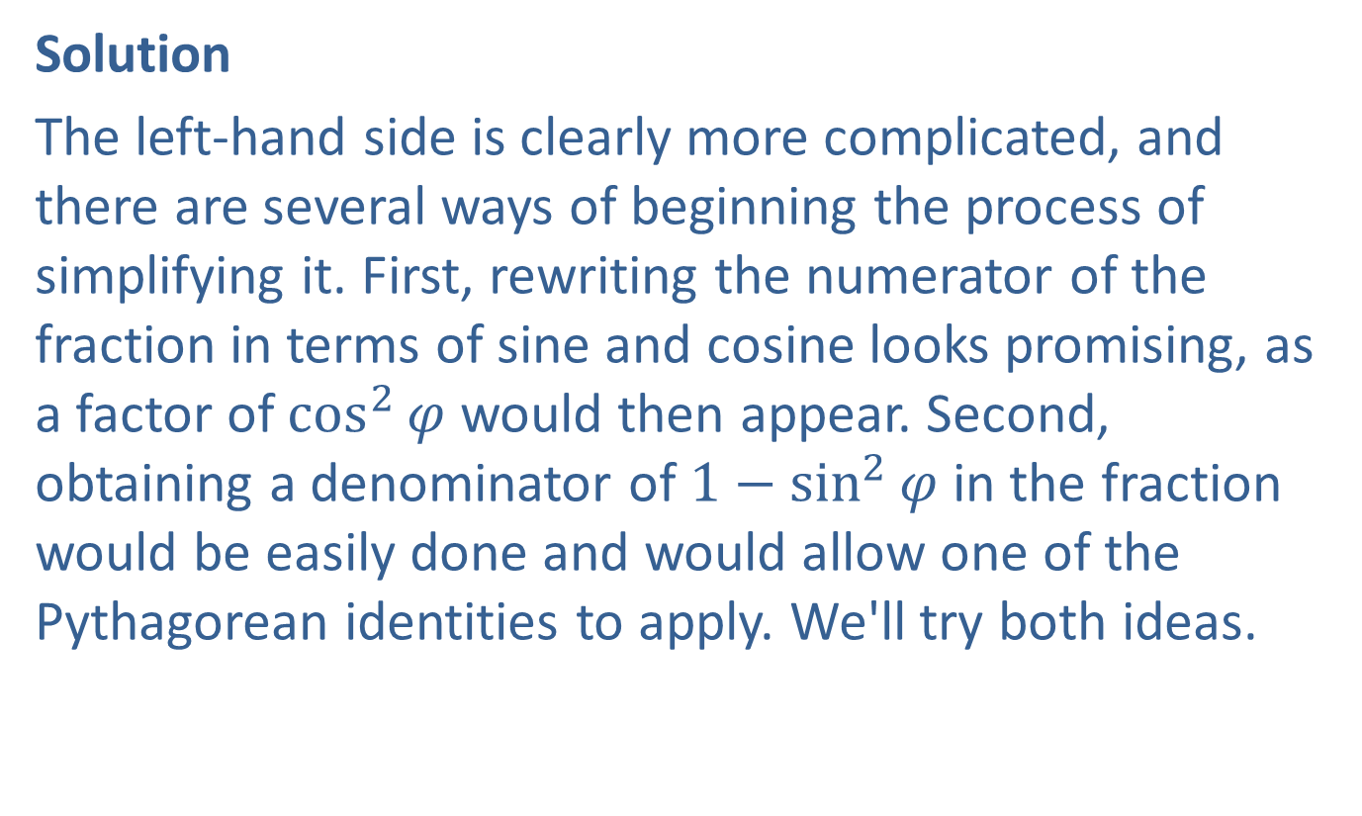
Example 5: Verifying Trigonometric Identities (cont.)
Solution
The left-hand side is clearly more complicated, and there are several ways of beginning the process of simplifying it. First, rewriting the numerator of the fraction in terms of sine and cosine looks promising, as a factor of $\cos^{2}⁡φ$ would then appear. Second, obtaining a denominator of $1−\sin^{2}{φ}$ in the fraction would be easily done and would allow one of the Pythagorean identities to apply. We'll try both ideas.

Slide 22
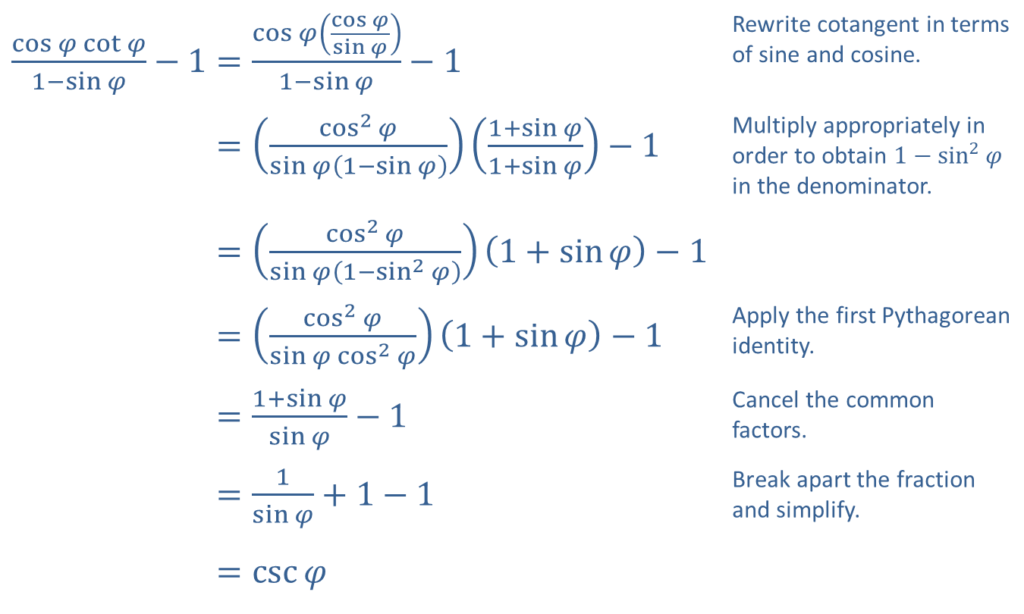
Example 5: Verifying Trigonometric Identities (cont.)
​$\frac{\cos{φ}\cot{φ}}{1−\sin{φ}}−1=\frac{\cos{φ}\left(\frac{\cos{φ}}{\sin{φ}}\right)}{1−\sin{φ}}−1$ | Rewrite cotangent in terms of sine and cosine.
​cos𝜑cot𝜑1−sin𝜑−1=cos2𝜑sin𝜑1−sin𝜑1+sin𝜑1+sin𝜑−1 | Multiply appropriately in order to obtain $1−\sin^{2}{φ}$ in the denominator.
​cos𝜑cot𝜑1−sin𝜑−1=cos2𝜑sin𝜑1−sin2𝜑1+sin𝜑−1
​cos𝜑cot𝜑1−sin𝜑−1=cos2𝜑sin𝜑cos2𝜑1+sin𝜑−1 | Apply the first Pythagorean identity.
​cos𝜑cot𝜑1−sin𝜑−1=1+sin𝜑sin𝜑−1 | Cancel the common factors.
​cos𝜑cot𝜑1−sin𝜑−1=1sin𝜑+1−1 | Break apart the fraction and simplify.
​cos𝜑cot𝜑1−sin𝜑−1=csc𝜑

Slide 23

Example 6: Using Trigonometric Substitutions
Use the substitution $\sin{θ}=\frac{x}{2}$ to write $\sqrt{4−x^{2}}$ as a trigonometric expression. Assume $0≤θ≤\frac{π}{2}$.

Slide 24
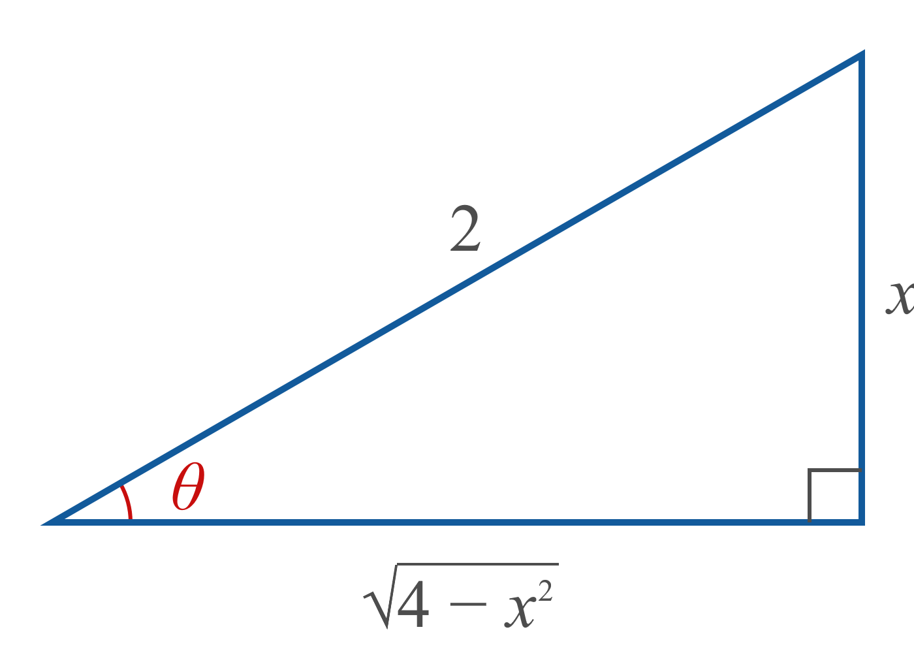

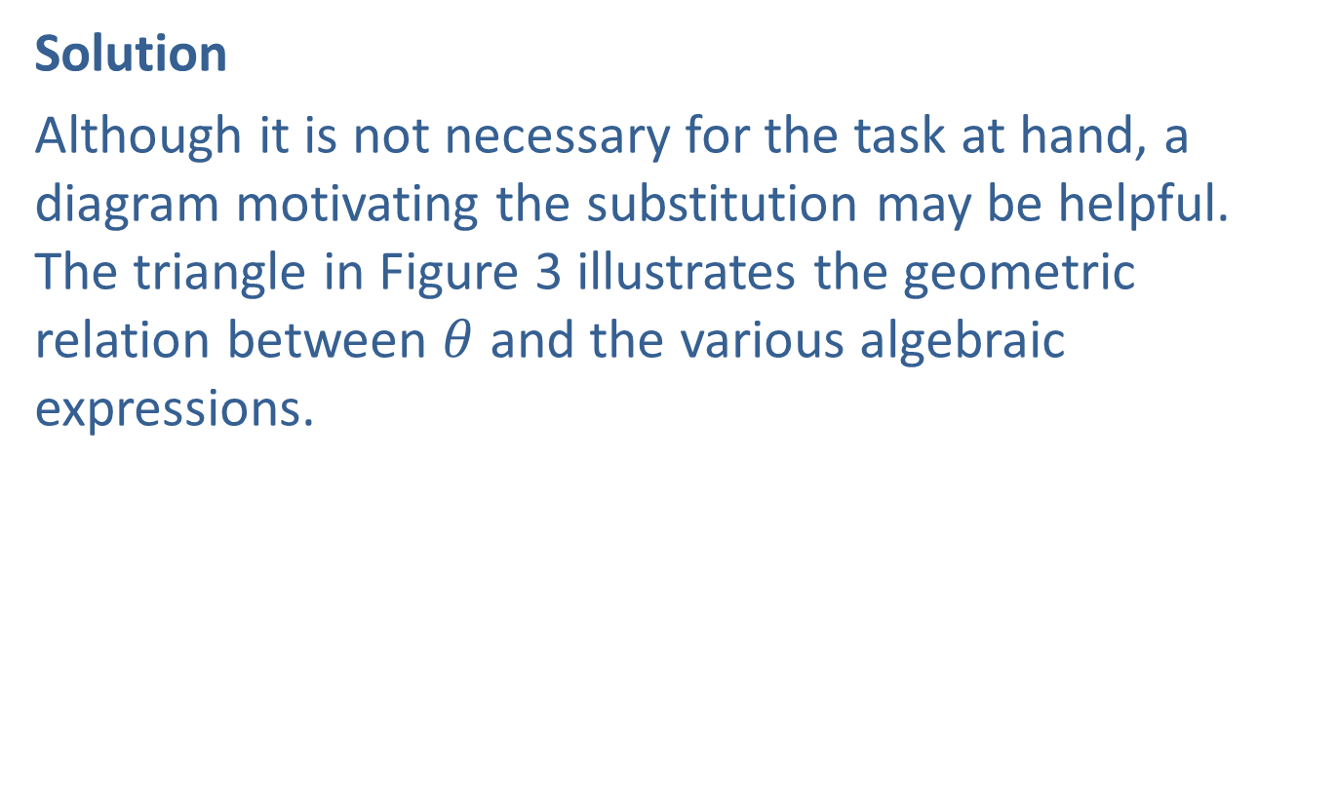
Example 6: Using Trigonometric Substitutions (cont.)
Solution
Although it is not necessary for the task at hand, a diagram motivating the substitution may be helpful. The triangle in Figure 3 illustrates the geometric relation between $θ$ and the various algebraic expressions.

Slide 25
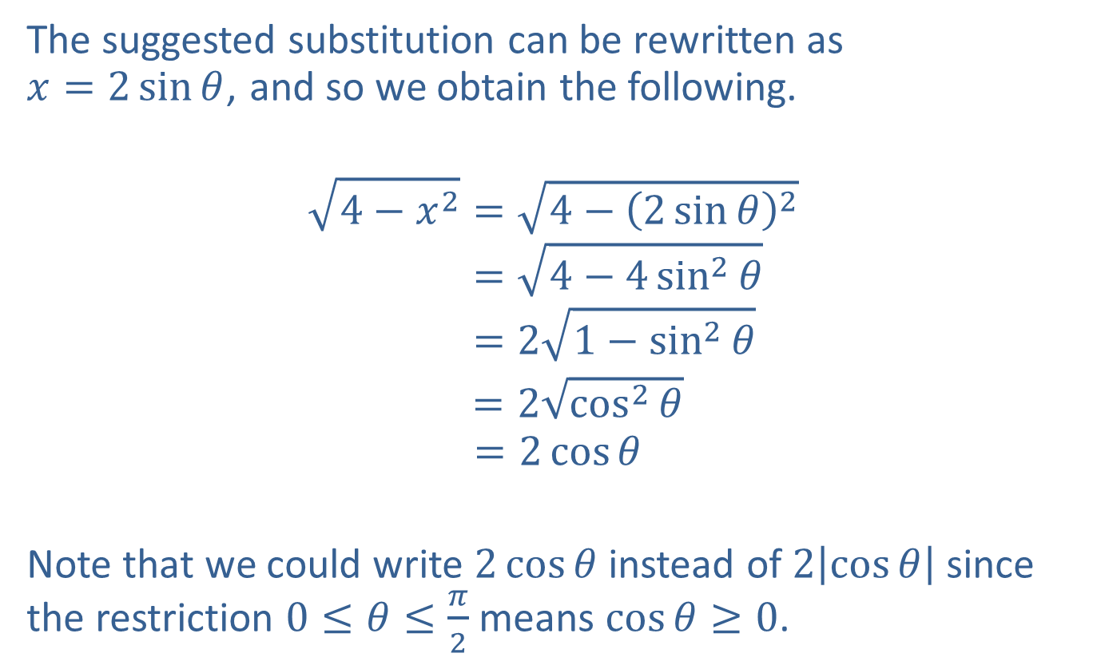
Example 6: Using Trigonometric Substitutions (cont.)
The suggested substitution can be rewritten as $x=2\sin{θ}$, and so we obtain the following.
4−𝑥2=4−2sin𝜃24−𝑥2=4−4sin2𝜃4−𝑥2=21−sin2𝜃
$=2\sqrt{\cos^{2}⁡θ}$ $$=2\cos{θ}$$
Note that we could write $2\cos{θ}$ instead of $2\left|\cos{θ}\right|$ since the restriction $0≤θ≤\frac{π}{2}$ means $\cos{θ}≥0$.

