Slide 1
Section 8.2
Sum and Difference Identities

Slide 2
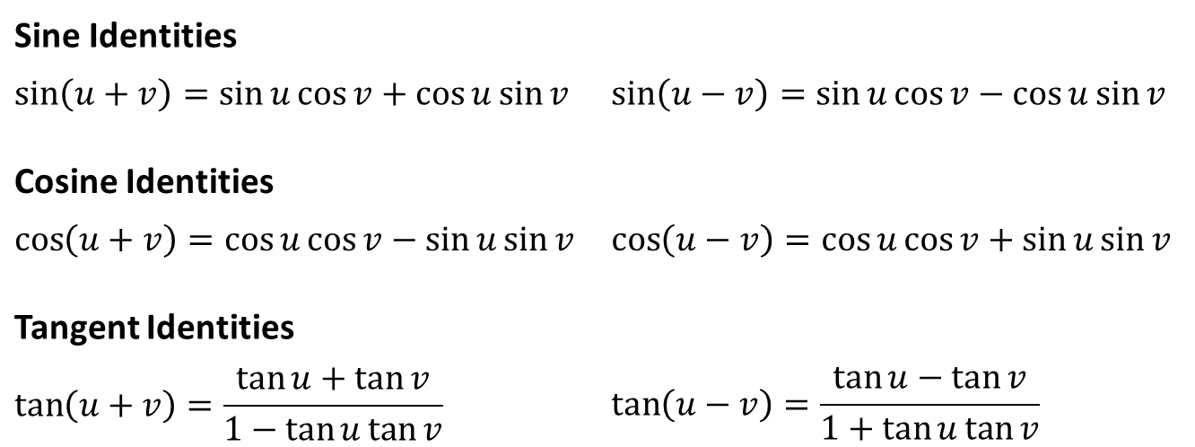
Sum and Difference Identities
Identities
Sine Identities
$$\sin\left(u+v\right)=\sin{u}\cos{v}+\cos{u}\sin{v}$$ | $$\sin\left(u−v\right)=\sin{u}\cos{v}−\cos{u}\sin{v}$$
Cosine Identities
$$\cos\left(u+v\right)=\cos{u}\cos{v}−\sin{u}\sin{v}$$ | $$\cos\left(u−v\right)=\cos{u}\cos{v}+\sin{u}\sin{v}$$
Tangent Identities
$$\tan\left(u+v\right)=\frac{\tan{u}+\tan{v}}{1−\tan{u}\tan{v}}$$ | $$\tan\left(u−v\right)=\frac{\tan{u}−\tan{v}}{1+\tan{u}\tan{v}}$$

Slide 3

Example 1: Using the Sum and Difference Identities for Exact Evaluation
Determine the exact value of $sin⁡{75}^{°}$.

Slide 4
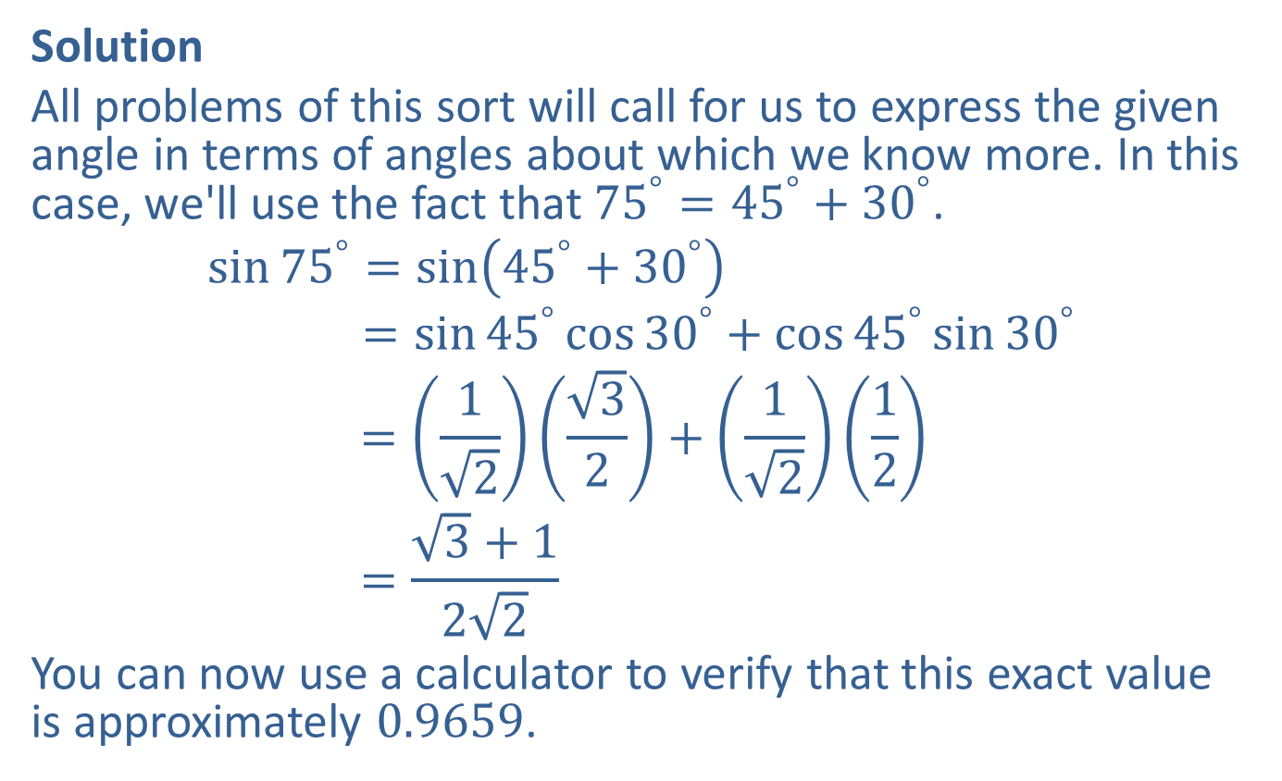
Example 1: Using the Sum and Difference Identities for Exact Evaluation (cont.)
Solution
All problems of this sort will call for us to express the given angle in terms of angles about which we know more. In this case, we'll use the fact that ${75}^{°}={45}^{°}+{30}^{°}$.
sin75°=sin45°+30°sin⁡75 =sin45°cos30°+cos45°sin30°sin⁡75 =1232+1212sin⁡75 =3+122
You can now use a calculator to verify that this exact value is approximately 0.9659.

Slide 5

Example 2: Using the Sum and Difference Identities for Exact Evaluation
Determine the exact value of $cos⁡{75}^{°}$.

Slide 6
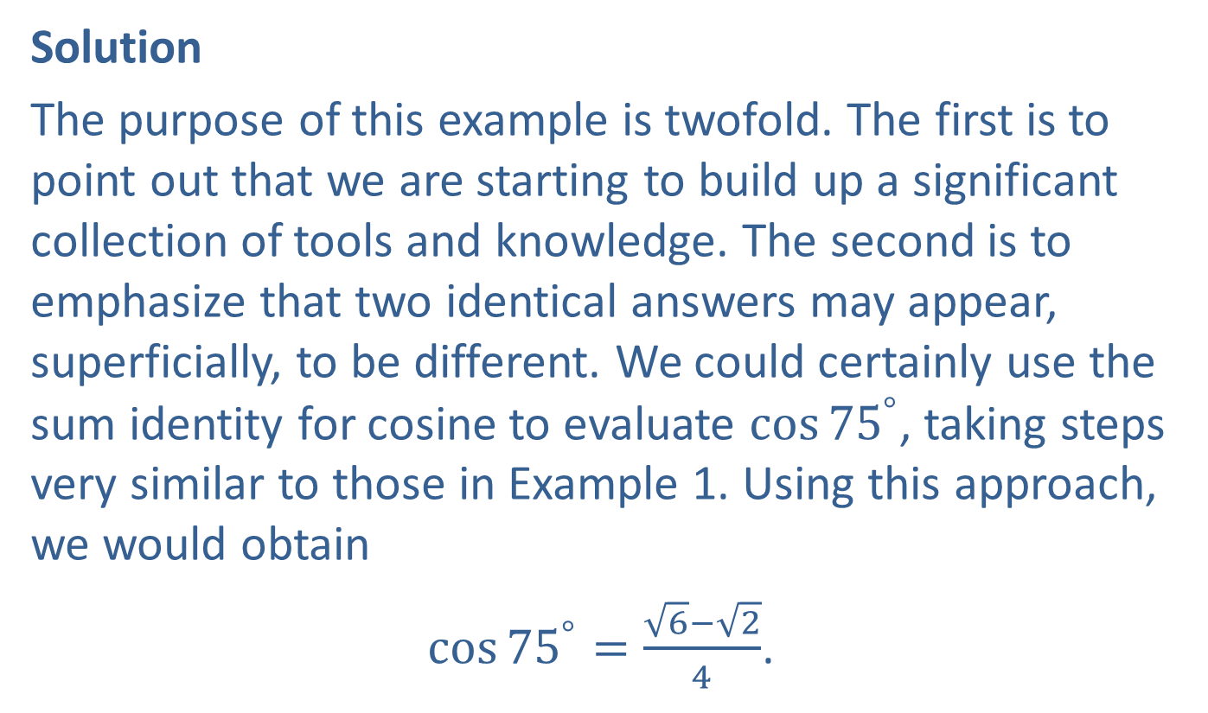
Example 2: Using the Sum and Difference Identities for Exact Evaluation (cont.)
Solution
The purpose of this example is twofold. The first is to point out that we are starting to build up a significant collection of tools and knowledge. The second is to emphasize that two identical answers may appear, superficially, to be different. We could certainly use the sum identity for cosine to evaluate $cos⁡{75}^{°}$, taking steps very similar to those in Example 1. Using this approach, we would obtain
$\cos{{75}^{°}}=\frac{\sqrt{6}−\sqrt{2}}{4}$.

Slide 7
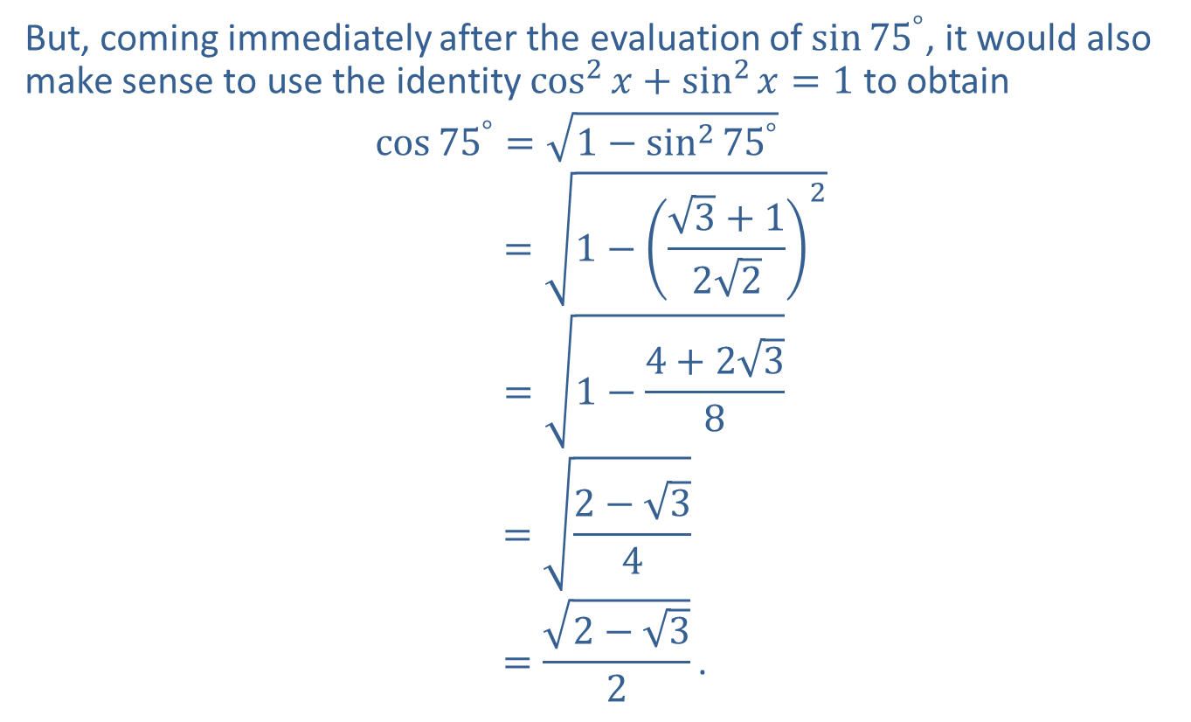
Example 2: Using the Sum and Difference Identities for Exact Evaluation (cont.)
But, coming immediately after the evaluation of $sin⁡{75}^{°}$, it would also make sense to use the identity ${cos⁡}^{2}{x}+{sin⁡}^{2}{x}=1$ to obtain
cos75°=1−sin⁡275°cos⁡75 =1−3+1222cos⁡75 =1−4+238cos⁡75 =2−34cos⁡75 =2−32.

Slide 8
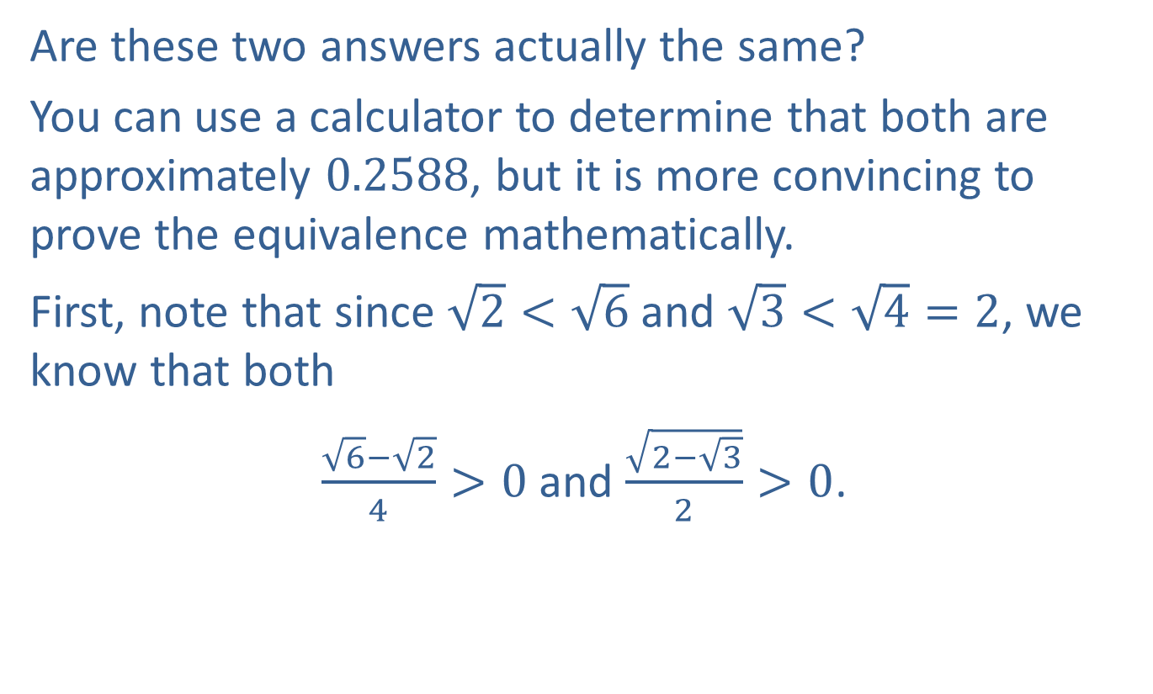
Example 2: Using the Sum and Difference Identities for Exact Evaluation (cont.)
Are these two answers actually the same?
You can use a calculator to determine that both are approximately 0.2588, but it is more convincing to prove the equivalence mathematically.
First, note that since $\sqrt{2}<\sqrt{6}$ and $\sqrt{3}<\sqrt{4}=2$, we know that both
$\frac{\sqrt{6}−\sqrt{2}}{4}>0$ and $\frac{\sqrt{2−\sqrt{3}}}{2}>0$.

Slide 9
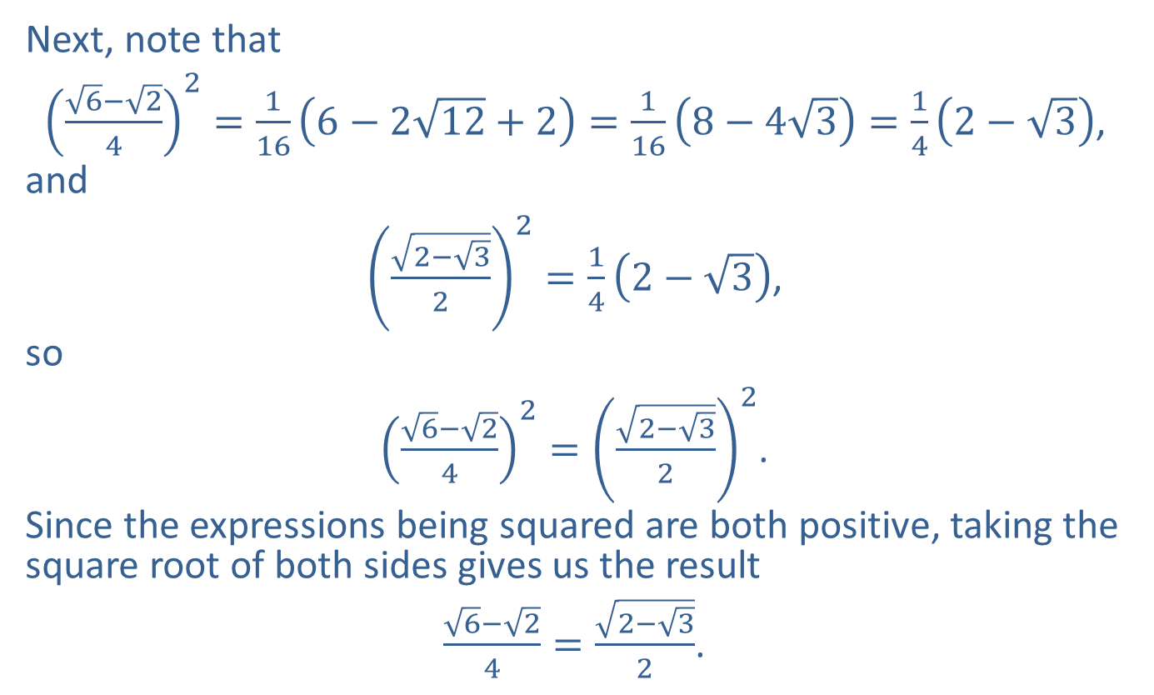
Example 2: Using the Sum and Difference Identities for Exact Evaluation (cont.)
Next, note that
${\left(\frac{\sqrt{6}−\sqrt{2}}{4}\right)}^{2}=\frac{1}{16}\left(6−2\sqrt{12}+2\right)=\frac{1}{16}\left(8−4\sqrt{3}\right)=\frac{1}{4}\left(2−\sqrt{3}\right)$,
and
${\left(\frac{\sqrt{2−\sqrt{3}}}{2}\right)}^{2}=\frac{1}{4}\left(2−\sqrt{3}\right)$,
so
${\left(\frac{\sqrt{6}−\sqrt{2}}{4}\right)}^{2}={\left(\frac{\sqrt{2−\sqrt{3}}}{2}\right)}^{2}$.
Since the expressions being squared are both positive, taking the square root of both sides gives us the result
$\frac{\sqrt{6}−\sqrt{2}}{4}=\frac{\sqrt{2−\sqrt{3}}}{2}$.

Slide 10

Example 3: Using the Sum and Difference Identities for Exact Evaluation
Determine the exact value of $tan⁡\left(\frac{π}{12}\right)$.

Slide 11
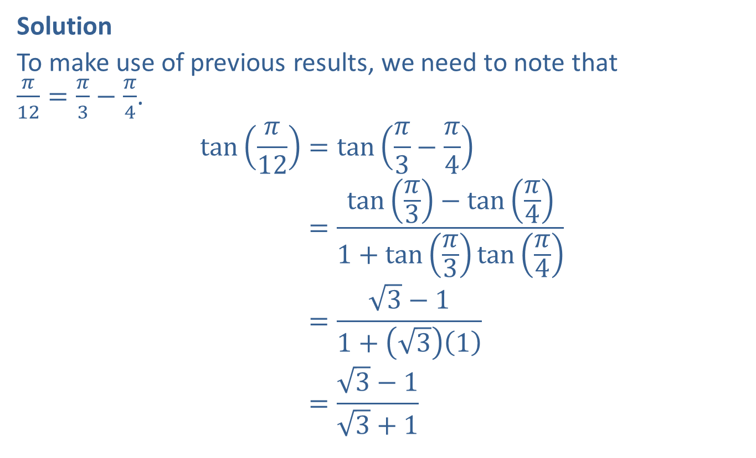
Example 3: Using the Sum and Difference Identities for Exact Evaluation (cont.)
Solution
To make use of previous results, we need to note that $\frac{π}{12}=\frac{π}{3}−\frac{π}{4}$.
tan𝜋12=tan𝜋3−𝜋4tan𝜋12=tan𝜋3−tan𝜋41+tan𝜋3tan𝜋4tan𝜋12=3−11+31tan𝜋12=3−13+1

Slide 12

Example 4: Using the Sum and Difference Identities for Exact Evaluation
Determine the exact value of
$\sin{{80}^{°}}\cos{{20}^{°}}−\cos{{80}^{°}}\sin{{20}^{°}}$.

Slide 13
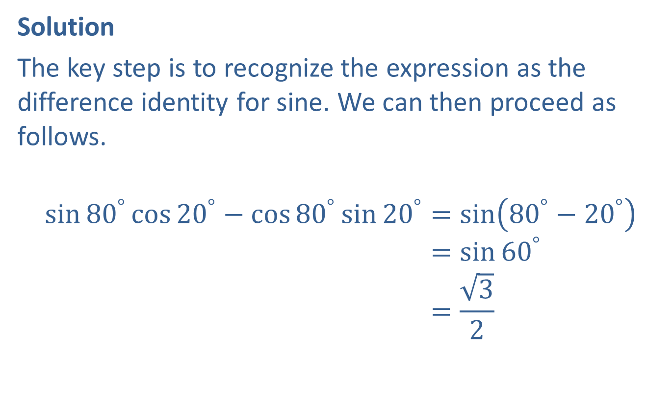
Example 4: Using the Sum and Difference Identities for Exact Evaluation (cont.)
Solution
The key step is to recognize the expression as the difference identity for sine. We can then proceed as follows.
sin80°cos20°−cos80°sin20°=sin80°−20°sin80°cos20°−cos80°sin20°=sin60°sin80°cos20°−cos80°sin20°=32

Slide 14

Example 5: Using the Sum and Difference Identities
Use a difference identity to verify that
$\sin\left(\frac{π}{2}−x\right)=\cos{x}$.

Slide 15
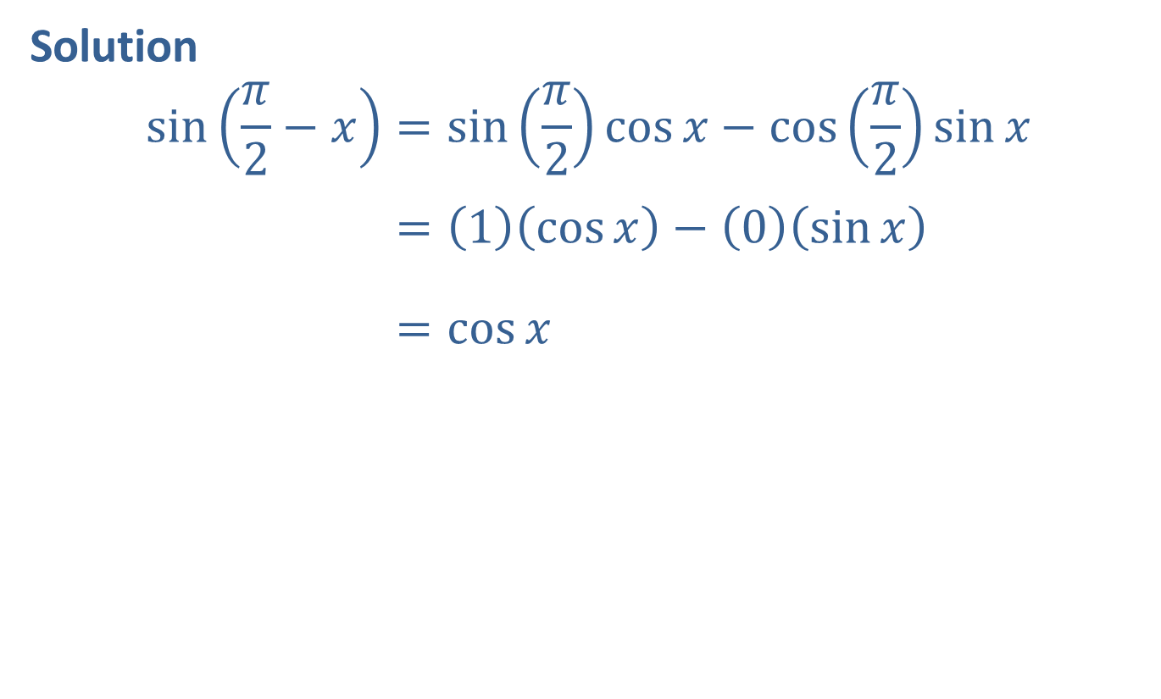
Example 5: Using the Sum and Difference Identities (cont.)
Solution
sin𝜋2−𝑥=sin𝜋2cos𝑥−cos𝜋2sin𝑥sin⁡𝜋2−𝑥=1cos𝑥−0sin𝑥sin⁡𝜋2−𝑥=cos𝑥

Slide 16

Example 6: Using the Sum and Difference Identities
Evaluate the expression $sin⁡\left(\cos^{−1}\left(\frac{3}{5}\right)−\tan^{−1}\left(\frac{12}{5}\right)\right)$.

Slide 17
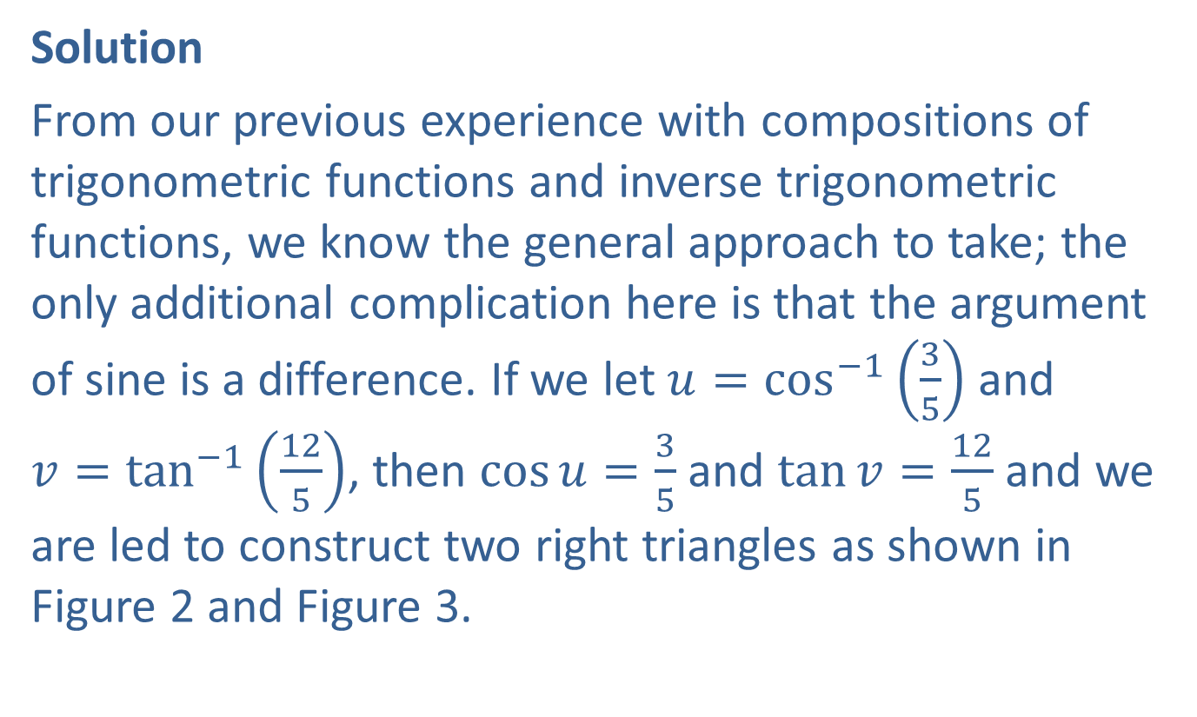
Example 6: Using the Sum and Difference Identities (cont.)
Solution
From our previous experience with compositions of trigonometric functions and inverse trigonometric functions, we know the general approach to take; the only additional complication here is that the argument of sine is a difference. If we let $u=\cos^{−1}\left(\frac{3}{5}\right)$ and $v=\tan^{−1}\left(\frac{12}{5}\right)$, then $\cos{u}=\frac{3}{5}$ and $\tan{v}=\frac{12}{5}$ and we are led to construct two right triangles as shown in Figure 2 and Figure 3.

Slide 18
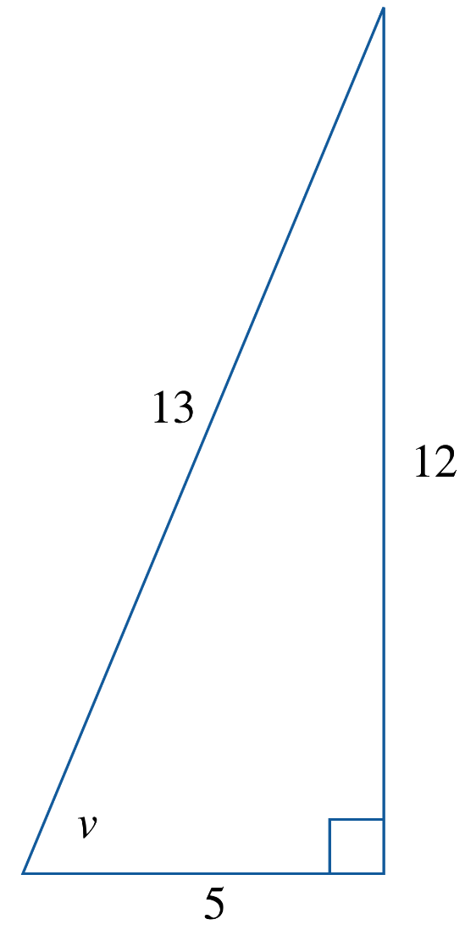
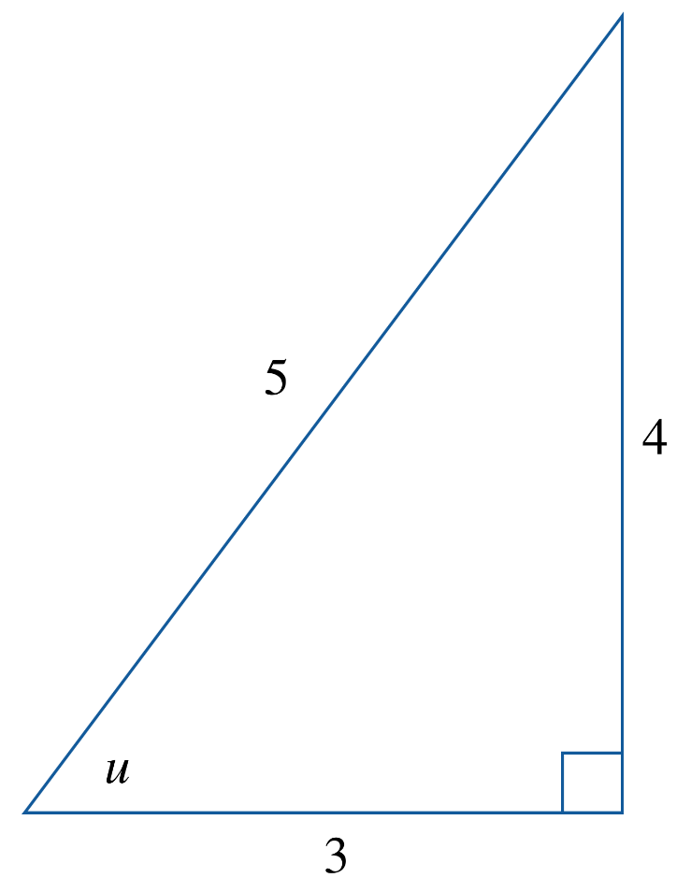
Example 6: Using the Sum and Difference Identities (cont.)
Figure 2
Figure 3

Slide 19
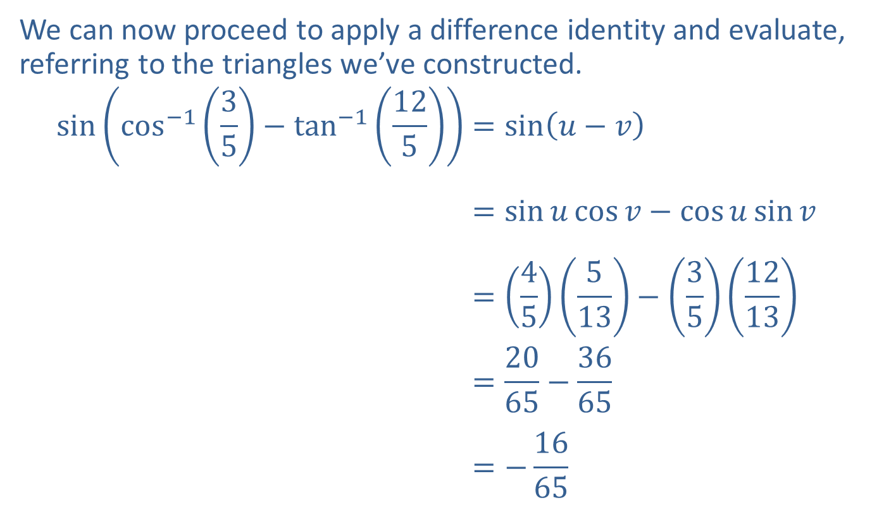
Example 6: Using the Sum and Difference Identities (cont.)
We can now proceed to apply a difference identity and evaluate, referring to the triangles we’ve constructed.
sincos−135−tan−1125=sin𝑢−𝑣sin⁡cos−135−tan−1125=sin𝑢cos𝑣−cos𝑢sin𝑣sin⁡cos−135−tan−1125=45513−351213sin⁡cos−135−tan−1125=2065−3665sin⁡cos−135−tan−1125=−1665

Slide 20

Example 7: Using the Sum and Difference Identities
Express $sin⁡\left({tan⁡}^{−1}{x}+{cos⁡}^{−1}{x}\right)$ as an algebraic function of $x$.

Slide 21
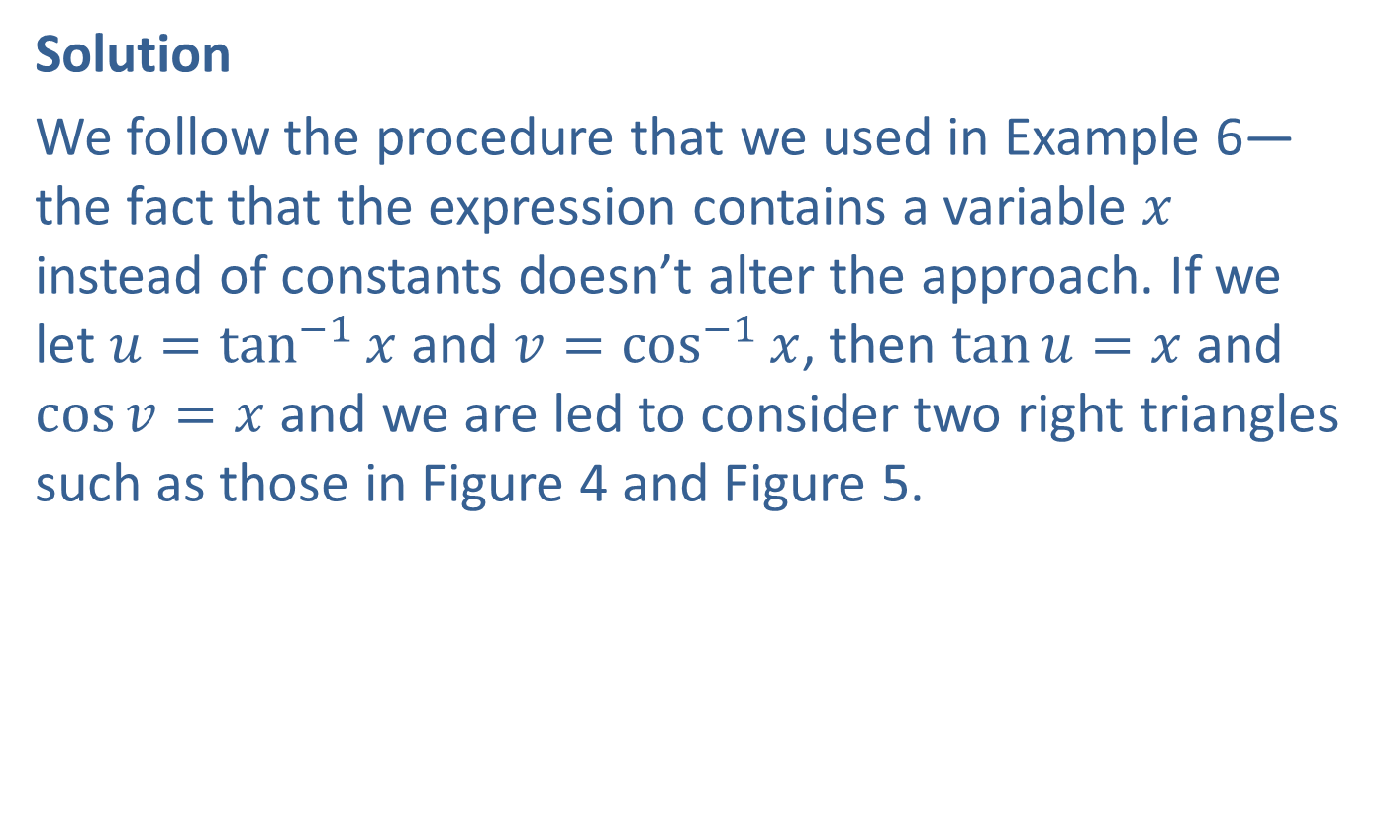
Example 7: Using the Sum and Difference Identities (cont.)
Solution
We follow the procedure that we used in Example 6—the fact that the expression contains a variable $x$ instead of constants doesn’t alter the approach. If we let $u={tan⁡}^{−1}{x}$ and $v={cos⁡}^{−1}{x}$, then $\tan{u}=x$ and $\cos{v}=x$ and we are led to consider two right triangles such as those in Figure 4 and Figure 5.

Slide 22
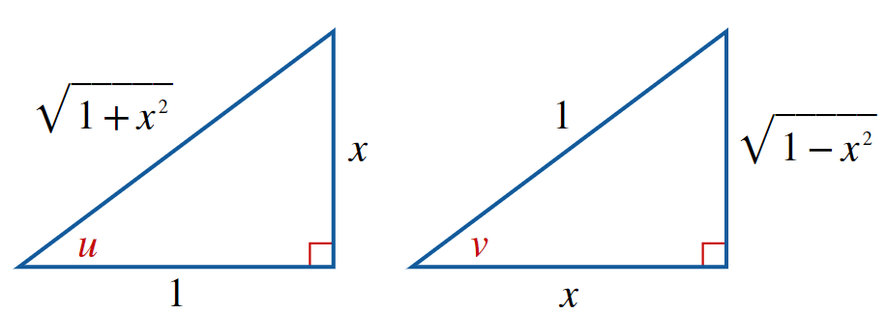
Example 7: Using the Sum and Difference Identities (cont.)
Figure 4
Figure 5

Slide 23
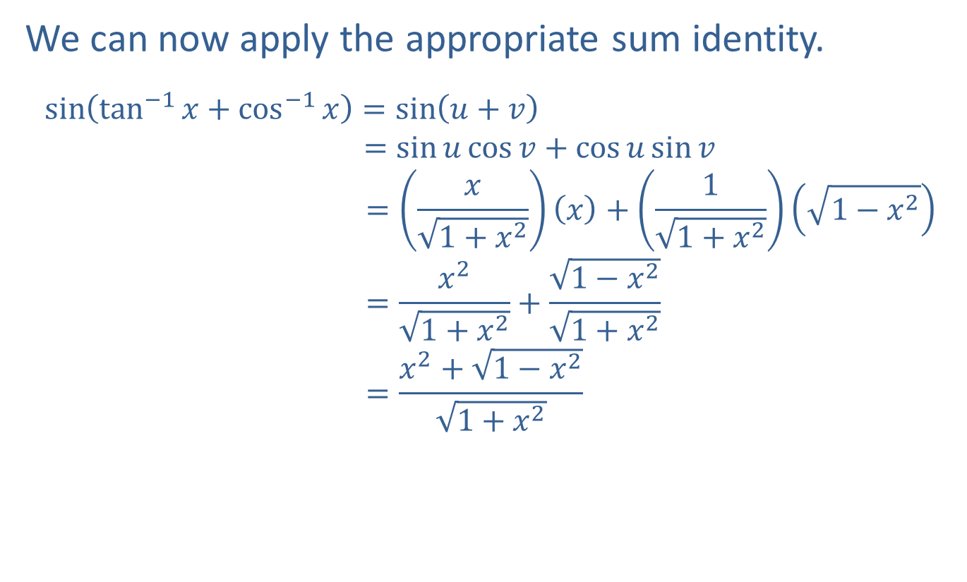
Example 7: Using the Sum and Difference Identities (cont.)
We can now apply the appropriate sum identity.
sintan−1𝑥+cos−1𝑥=sin𝑢+𝑣sin⁡tan−1𝑥+cos−1x =sin𝑢cos𝑣+cos𝑢sin𝑣sin⁡tan−1𝑥+cos−1𝑥 =𝑥1+𝑥2𝑥+11+𝑥21−𝑥2sin⁡tan−1𝑥+cos−1𝑥 =𝑥21+𝑥2+1−𝑥21+𝑥2sin⁡tan−1𝑥+cos−1𝑥 =𝑥2+1−𝑥21+𝑥2

Slide 24

Example 8: Using the Sum and Difference Identities
Show that
$\frac{\sin\left(x+h\right)−\sin{x}}{h}=\sin{x}\left(\frac{\cos{h}−1}{h}\right)+\cos{x}\left(\frac{\sin{h}}{h}\right)$.

Slide 25
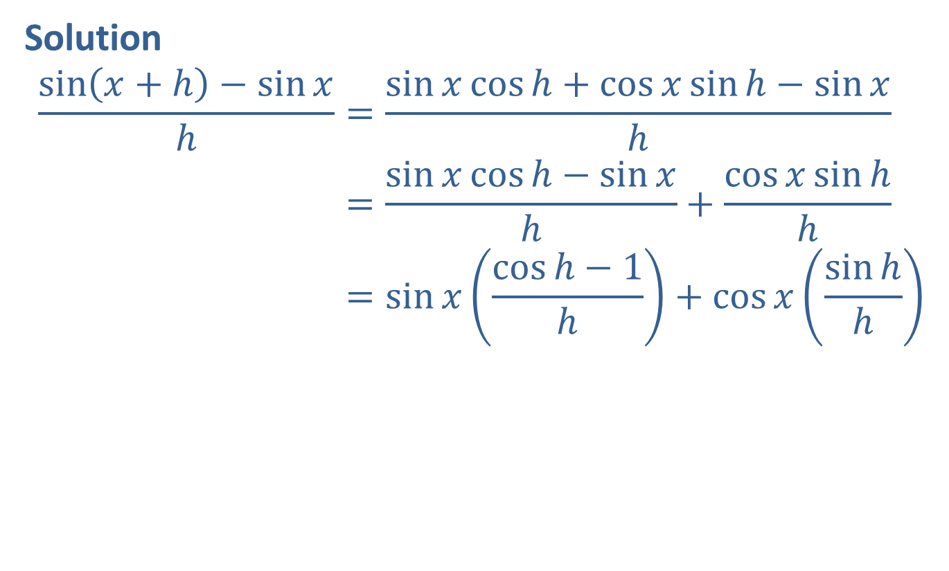
Example 8: Using the Sum and Difference Identities (cont.)
Solution
sin𝑥+h−sin𝑥h=sin𝑥cosh+cos𝑥sinh−sin𝑥hsin𝑥+h−sin𝑥h=sin𝑥cosh−sin𝑥h+cos𝑥sinhhsin𝑥+h−sin𝑥h=sin𝑥cosh−1h+cos𝑥sinhh

Slide 26
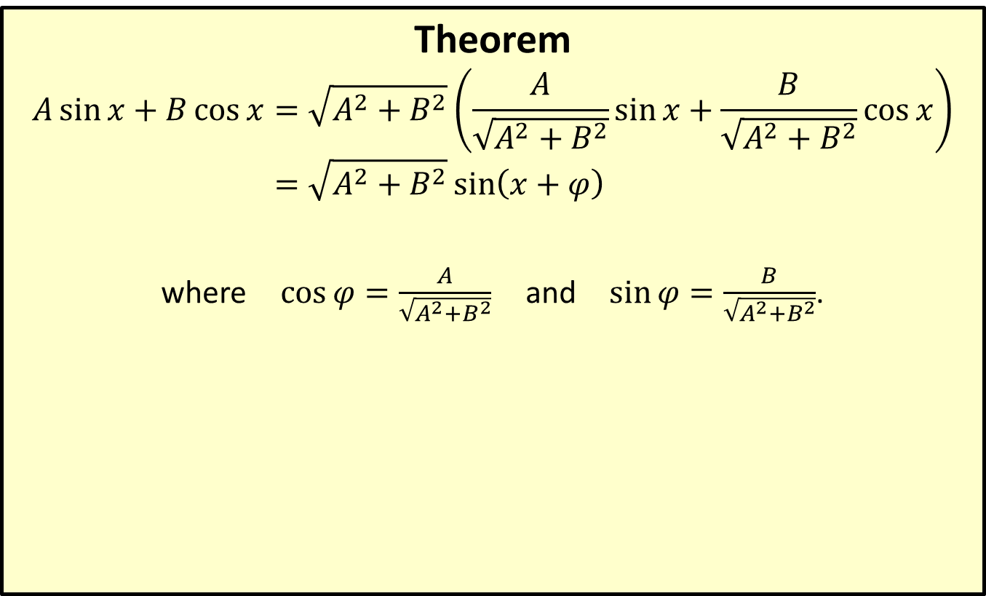
Sum of Sines and Cosines
Theorem
𝐴sin𝑥+𝐵cos𝑥=𝐴2+𝐵2𝐴𝐴2+𝐵2sin𝑥+𝐵𝐴2+𝐵2cos𝑥𝐴sin𝑥+𝐵cos𝑥=𝐴2+𝐵2sin𝑥+𝜑
where $\cos{φ}=\frac{A}{\sqrt{A^{2}+B^{2}}}$ and $\sin{φ}=\frac{B}{\sqrt{A^{2}+B^{2}}}$.

Slide 27

Example 9: Using the Sum of Sines and Cosines Theorem
Express the function $f\left(x\right)=\sin{x}−\sqrt{3}\cos{x}$ in terms of a single sine function, and graph the result.

Slide 28
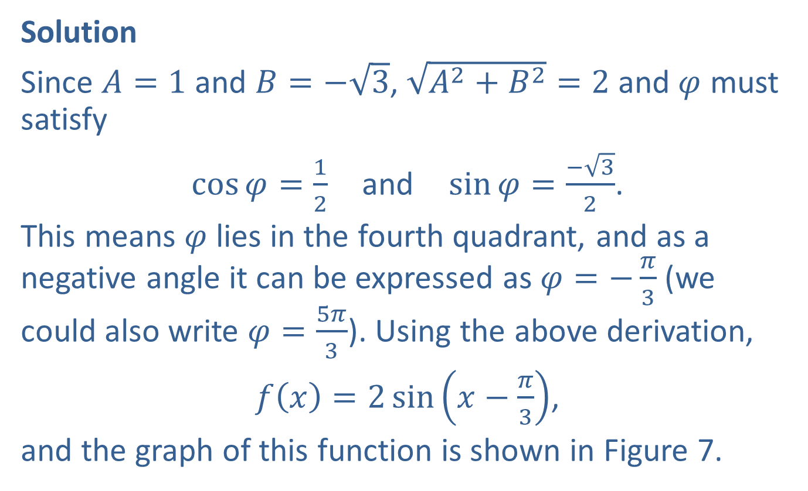
Example 9: Using the Sum of Sines and Cosines Identity (cont.)
Solution
Since $A=1$ and $B=−\sqrt{3}$, $\sqrt{A^{2}+B^{2}}=2$ and $φ$ must satisfy
$\cos{φ}=\frac{1}{2}$ and $\sin{φ}=\frac{−\sqrt{3}}{2}$.
This means $φ$ lies in the fourth quadrant, and as a negative angle it can be expressed as $φ=−\frac{π}{3}$ (we could also write $φ=\frac{5π}{3}$). Using the above derivation,
$f\left(x\right)=2\sin\left(x−\frac{π}{3}\right)$,
and the graph of this function is shown in Figure 7.

Slide 29
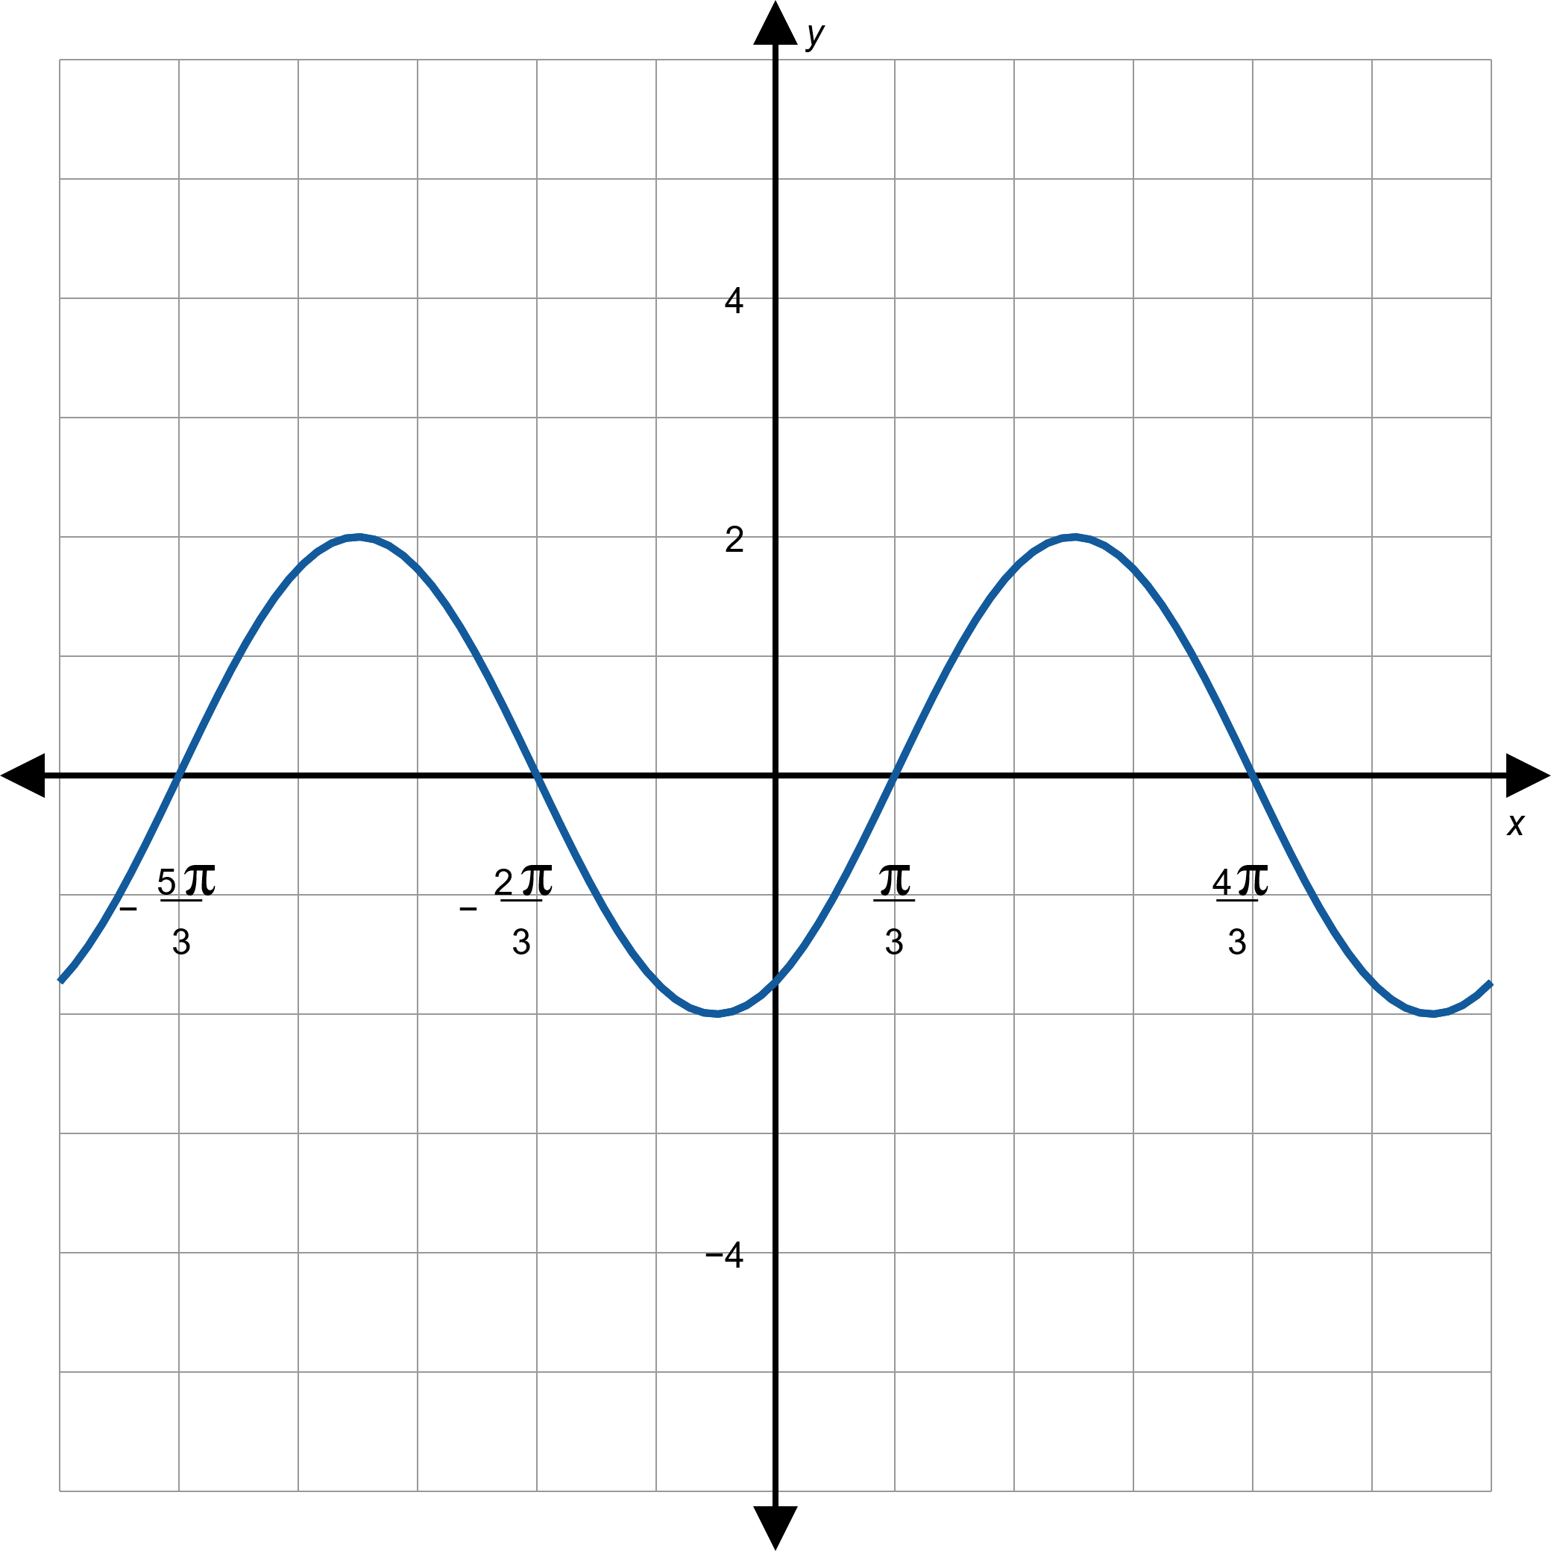
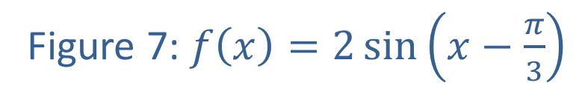
Example 9: Using the Sum of Sines and Cosines Identity (cont.)
Figure 7: $f\left(x\right)=2\sin\left(x−\frac{π}{3}\right)$

