Slide 1
Section 9.1
The Law of Sines

Slide 2
Use of the Law of Sines and the Law of Cosines
Law of Sines | Law of Cosines
Two angles and a side (AAS or ASA) | Two sides and the included angle (SAS)
Two sides and a nonincluded angle (SSA) | Three sides (SSS)
Table 1

Slide 3
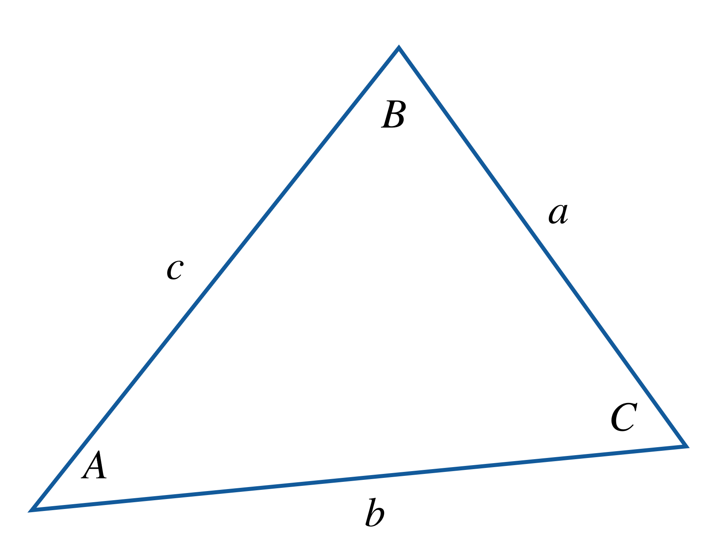

The Law of Sines
Theorem
Given a triangle with sides and angles labeled according to the convention in Figure 1, the following equation represents the Law of Sines.
$$\frac{\sin{A}}{a}=\frac{\sin{B}}{b}=\frac{\sin{C}}{c}$$
Figure 1: Oblique Triangle with
Sides and Angles Labeled

Slide 4
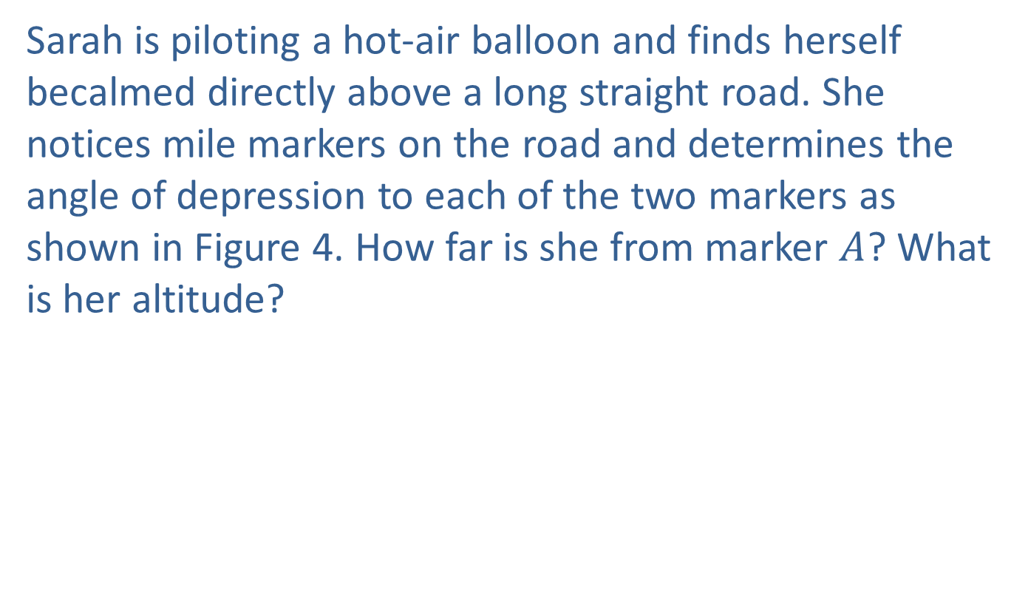
Example 1: Using the Law of Sines in an AAS Situation
Sarah is piloting a hot-air balloon and finds herself becalmed directly above a long straight road. She notices mile markers on the road and determines the angle of depression to each of the two markers as shown in Figure 4. How far is she from marker $A$? What is her altitude?

Slide 5
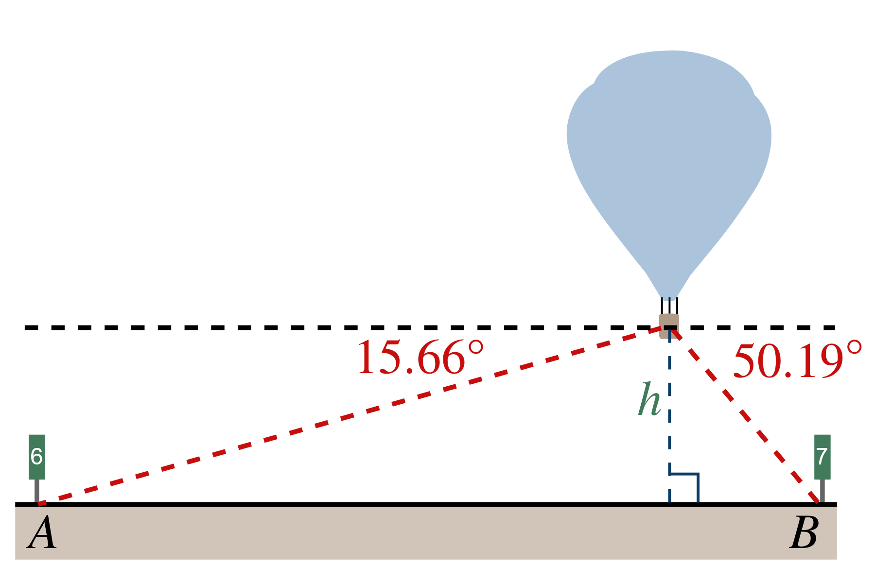
Example 1: Using the Law of Sines in an AAS Situation (cont.)
Figure 4

Slide 6
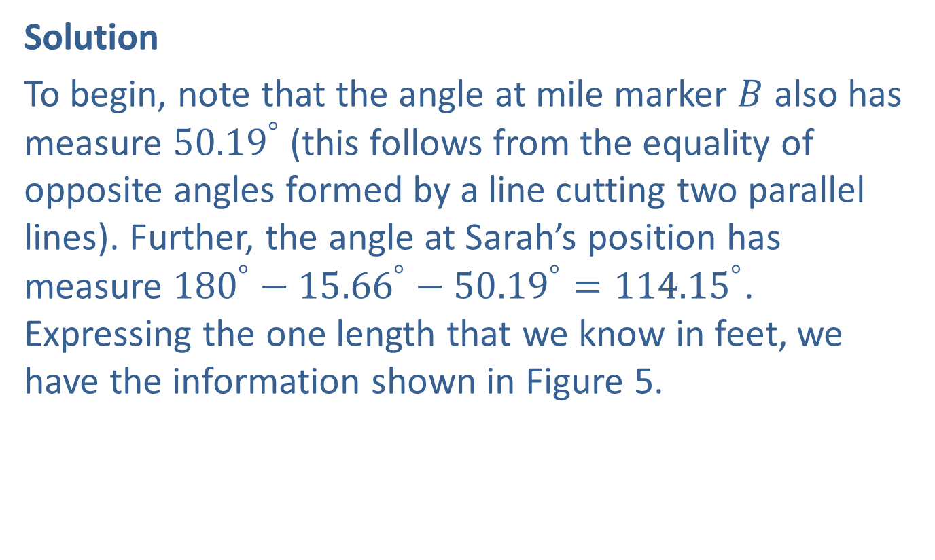
Example 1: Using the Law of Sines in an AAS Situation (cont.)
Solution
To begin, note that the angle at mile marker $B$ also has measure ${50.19}^{°}$ (this follows from the equality of opposite angles formed by a line cutting two parallel lines). Further, the angle at Sarah’s position has measure ${180}^{°}−{15.66}^{°}−{50.19}^{°}={114.15}^{°}$. Expressing the one length that we know in feet, we have the information shown in Figure 5.

Slide 7
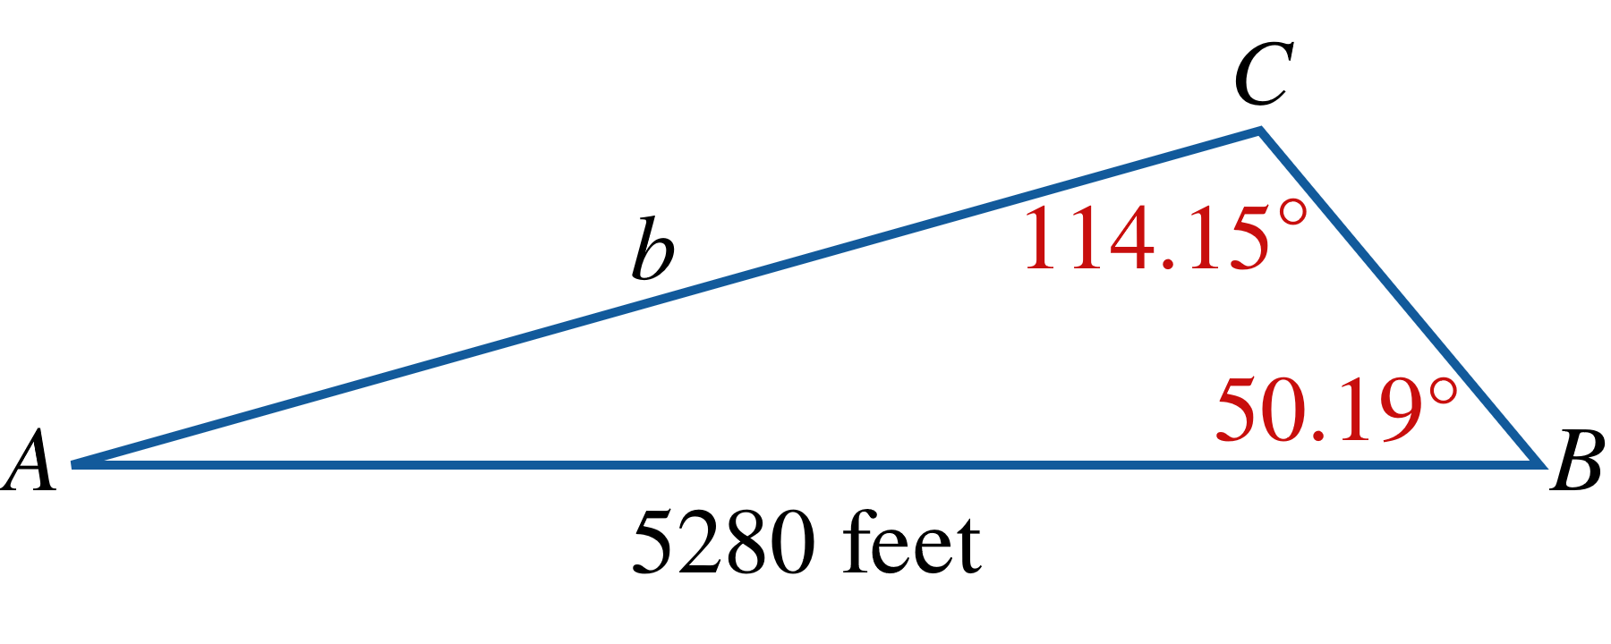
Example 1: Using the Law of Sines in an AAS Situation (cont.)
Figure 5

Slide 8
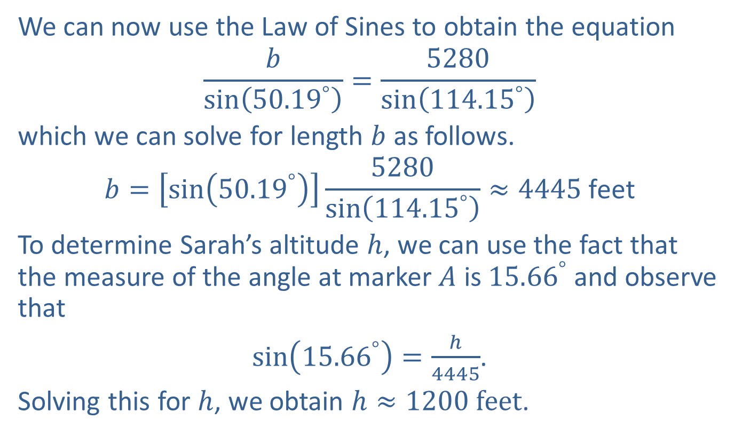
Example 1: Using the Law of Sines in an AAS Situation (cont.)
We can now use the Law of Sines to obtain the equation
$$\frac{b}{\sin\left({50.19}^{°}\right)}=\frac{5280}{\sin\left({114.15}^{°}\right)}$$
which we can solve for length $b$ as follows.
$$b=\left[\sin\left({50.19}^{°}\right)\right]\frac{5280}{\sin\left({114.15}^{°}\right)}≈4445 \text{feet}$$
To determine Sarah’s altitude $h$, we can use the fact that the measure of the angle at marker $A$ is ${15.66}^{°}$ and observe that
$\sin\left({15.66}^{°}\right)=\frac{h}{4445}$.
Solving this for $h$, we obtain $h≈1200 feet$.

Slide 9
Example 2: Using the Law of Sines in an ASA Situation
A surveyor has the task of determining the dimensions of the triangular plot of land shown in Figure 6. He has already measured the length of the short side of the plot and has also determined the measure of two of the angles. What are the lengths of the other two sides?

Slide 10
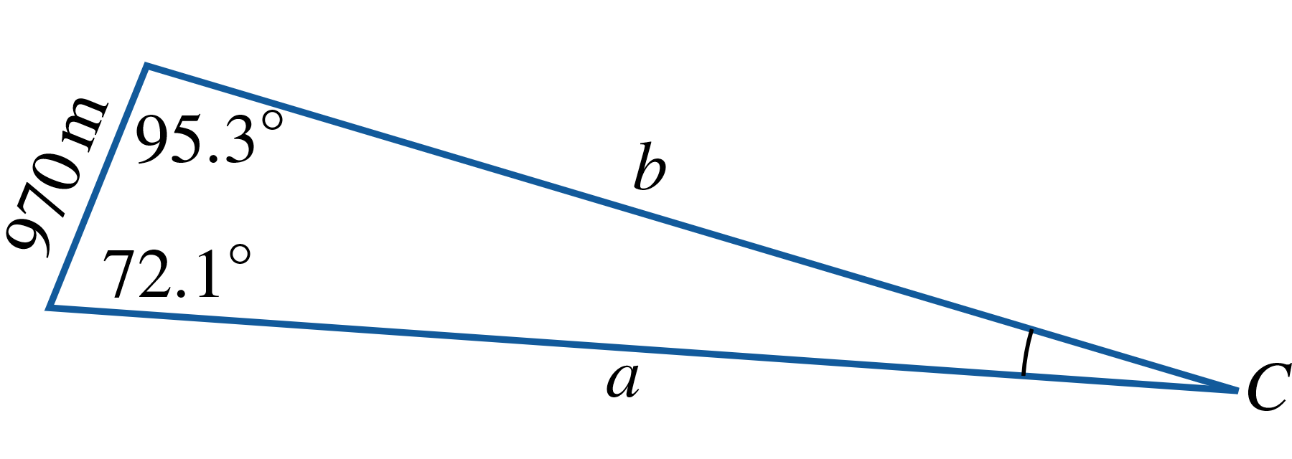
Example 2: Using the Law of Sines in an ASA Situation (cont.)
Figure 6

Slide 11
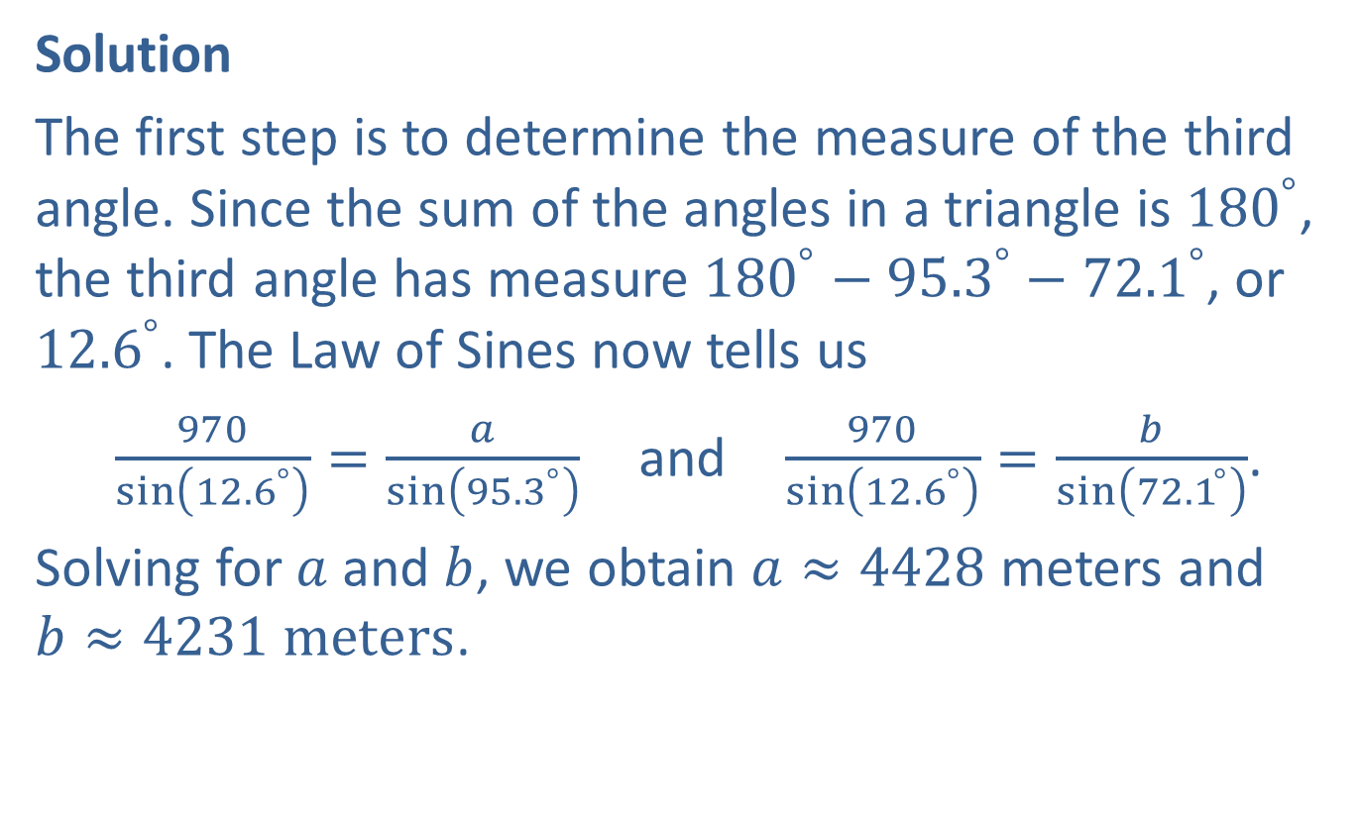
Example 2: Using the Law of Sines in an ASA Situation (cont.)
Solution
The first step is to determine the measure of the third angle. Since the sum of the angles in a triangle is ${180}^{°}$, the third angle has measure ${180}^{°}−{95.3}^{°}−{72.1}^{°}$, or ${12.6}^{°}$. The Law of Sines now tells us
$\frac{970}{\sin\left({12.6}^{°}\right)}=\frac{a}{\sin\left({95.3}^{°}\right)}$ and $\frac{970}{\sin\left({12.6}^{°}\right)}=\frac{b}{\sin\left({72.1}^{°}\right)}$.
Solving for $a$ and $b$, we obtain $a≈4428$ meters and $b≈4231 meters$.

Slide 12

Example 3: Using the Law of Sines in an SSA Situation with Two Solutions
Construct a triangle, if possible, for which $A=\frac{π}{6}$,
$b=12 cm$, and $a=7 cm$.

Slide 13
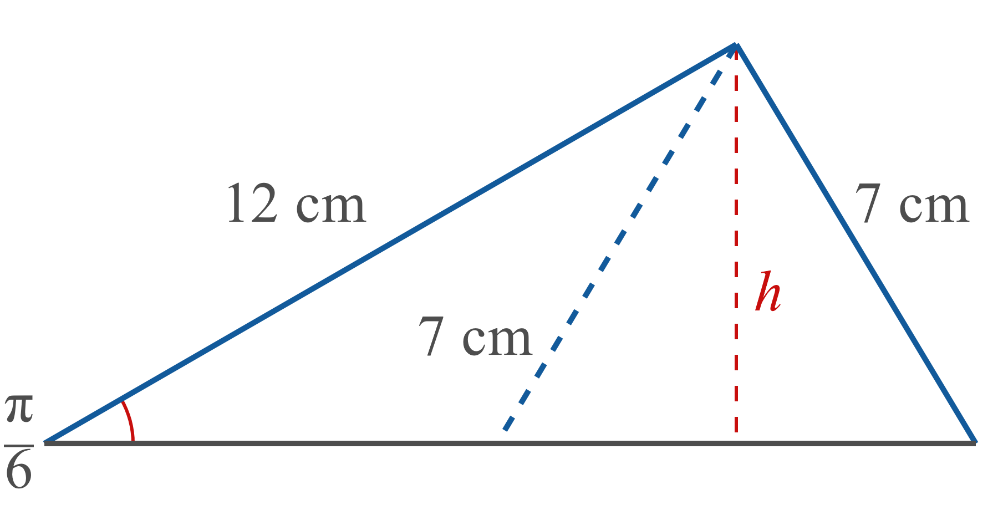
Example 3: Using the Law of Sines in an SSA Situation with Two Solutions (cont.)
Solution
A sketch is often useful in order to get an initial idea of whether such a triangle is possible. In this case, a rough sketch might look something like Figure 9.
Figure 9

Slide 14
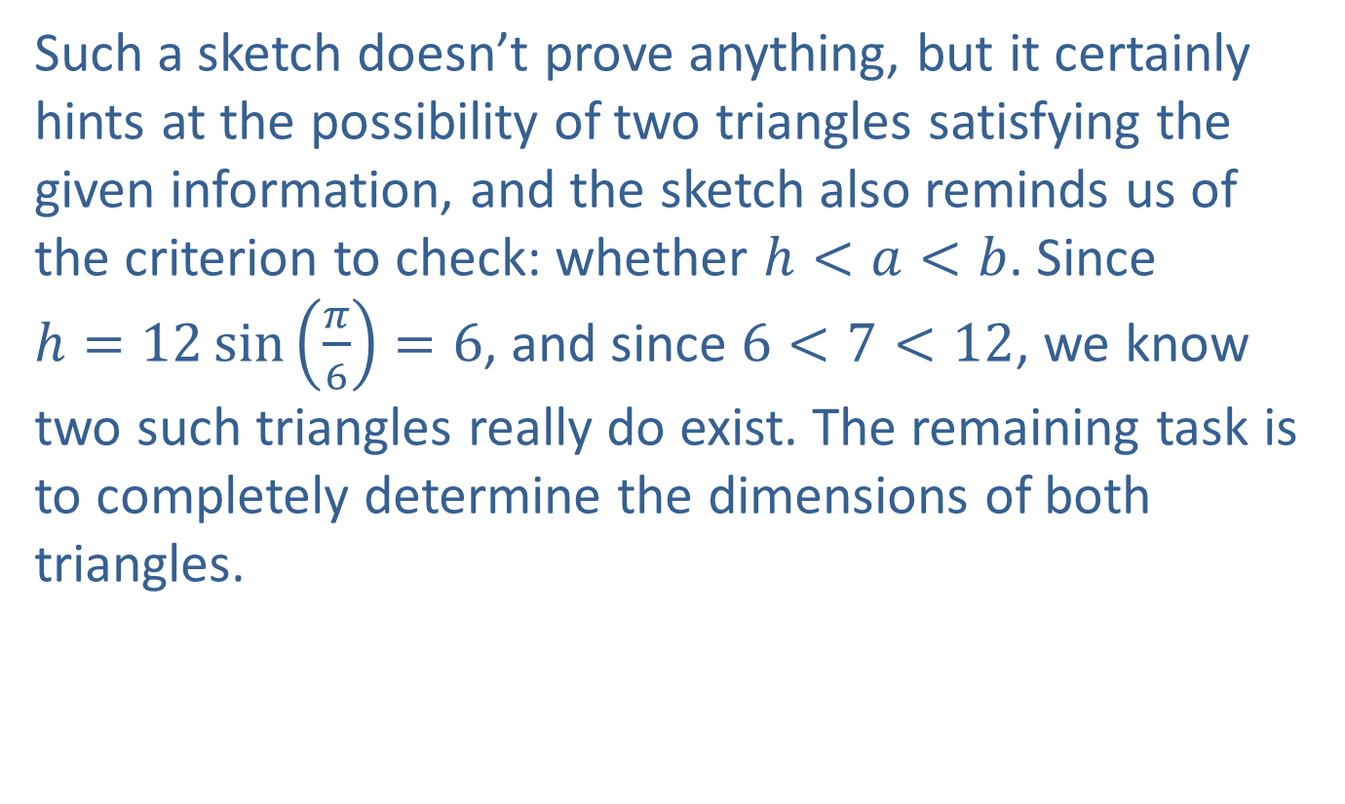
Example 3: Using the Law of Sines in an SSA Situation with Two Solutions (cont.)
Such a sketch doesn’t prove anything, but it certainly hints at the possibility of two triangles satisfying the given information, and the sketch also reminds us of the criterion to check: whether $h<a<b$. Since
$h=12\sin\left(\frac{π}{6}\right)=6$, and since $6<7<12$, we know two such triangles really do exist. The remaining task is to completely determine the dimensions of both triangles.

Slide 15
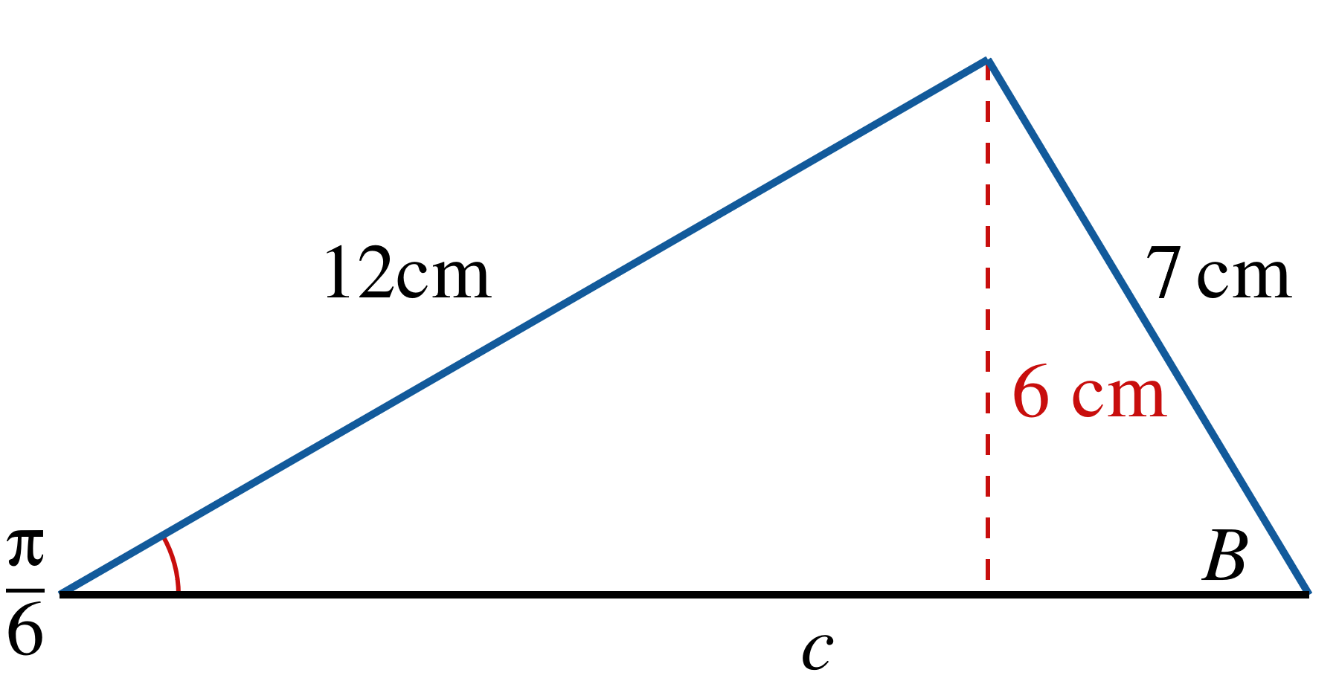

Example 3: Using the Law of Sines in an SSA Situation with Two Solutions (cont.)
Triangle 1: We will arbitrarily designate the triangle in which $B$ is acute as Triangle 1.
Figure 10: Triangle 1

Slide 16
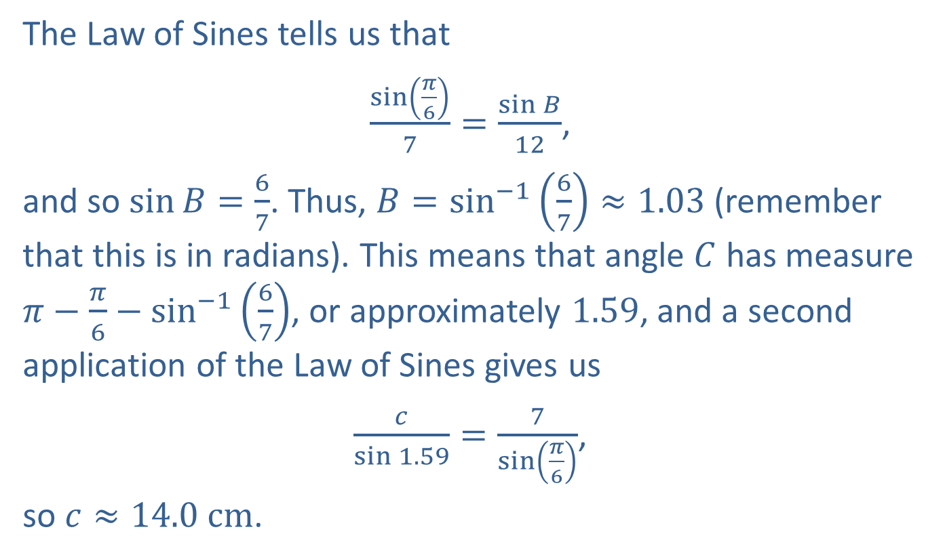
Example 3: Using the Law of Sines in an SSA Situation with Two Solutions (cont.)
The Law of Sines tells us that
$\frac{\sin\left(\frac{π}{6}\right)}{7}=\frac{\sin{B}}{12}$,
and so $\sin{B}=\frac{6}{7}$. Thus, $B=\sin^{−1}\left(\frac{6}{7}\right)≈1.03$ (remember that this is in radians). This means that angle $C$ has measure $π−\frac{π}{6}−\sin^{−1}\left(\frac{6}{7}\right)$, or approximately 1.59, and a second application of the Law of Sines gives us
$\frac{c}{\sin{1.59}}=\frac{7}{\sin\left(\frac{π}{6}\right)}$,
so $c≈14.0 cm$.

Slide 17
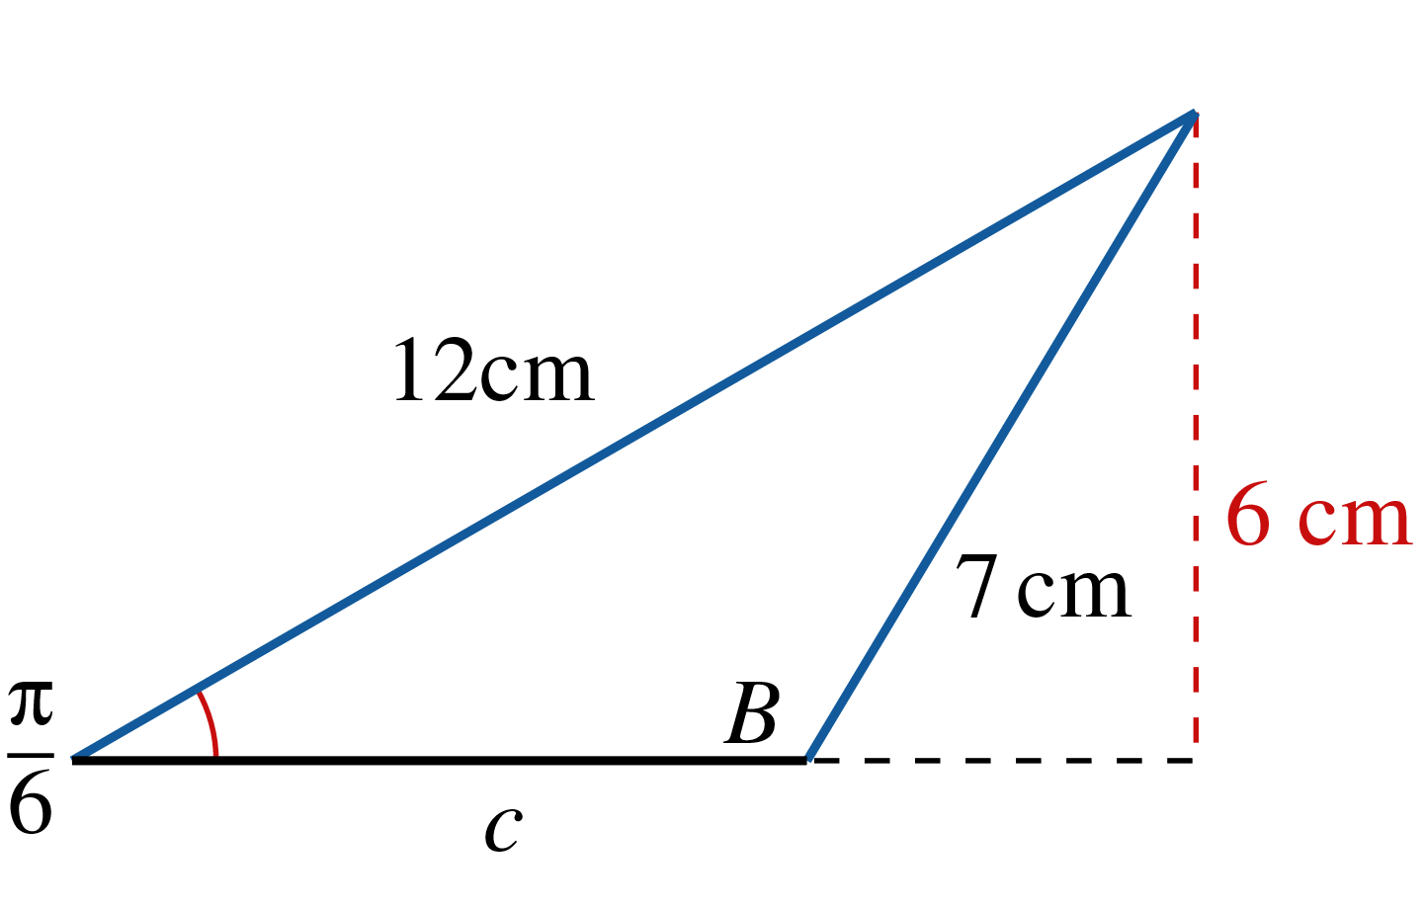

Example 3: Using the Law of Sines in an SSA Situation with Two Solutions (cont.)
Triangle 2: In the second triangle, $B$ is obtuse and we have $\sin{B}=sin\left(π−B\right)=\frac{6}{7}$.
Figure 11: Triangle 2

Slide 18
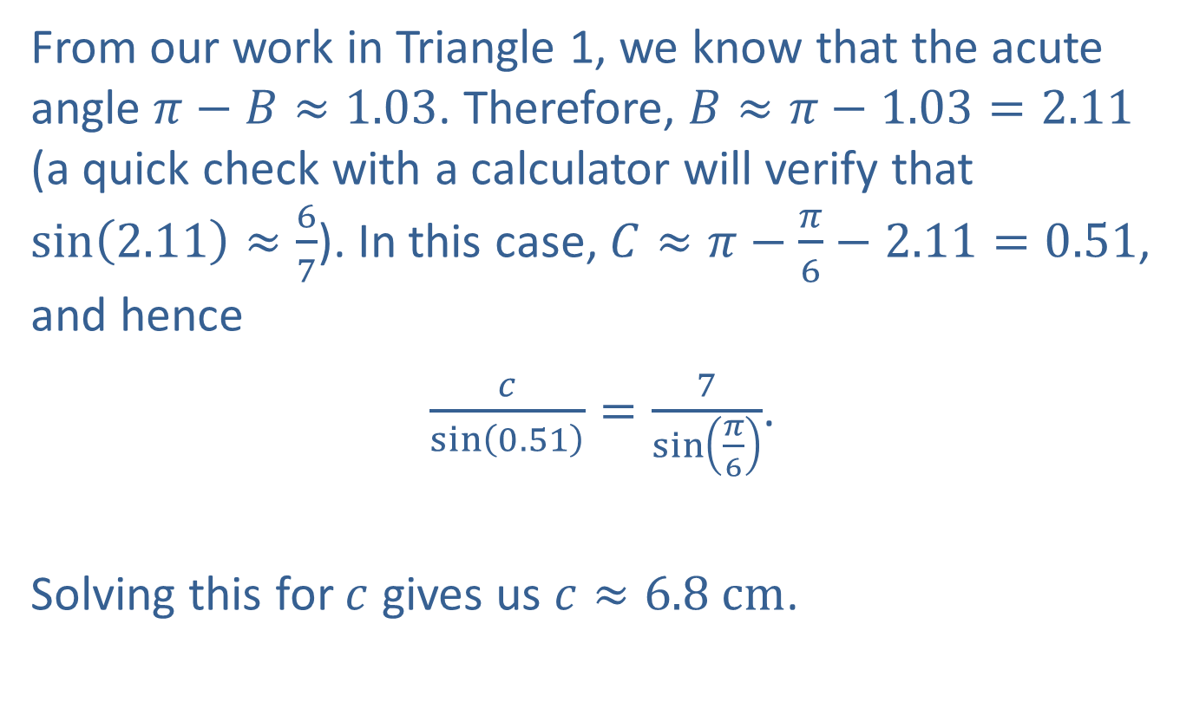
Example 3: Using the Law of Sines in an SSA Situation with Two Solutions (cont.)
From our work in Triangle 1, we know that the acute angle $π−B≈1.03$. Therefore, $B≈π−1.03=2.11$ (a quick check with a calculator will verify that $\sin\left(2.11\right)≈\frac{6}{7}$). In this case, $C≈π−\frac{π}{6}−2.11=0.51$, and hence
$\frac{c}{\sin\left(0.51\right)}=\frac{7}{\sin\left(\frac{π}{6}\right)}$.
Solving this for $c$ gives us $c≈6.8 cm$.

Slide 19

Example 4: Using the Law of Sines in an SSA Situation with No Solution
Construct a triangle, if possible, for which $A={75}^{°}$,
$b=15 units$, and $a=10$.

Slide 20
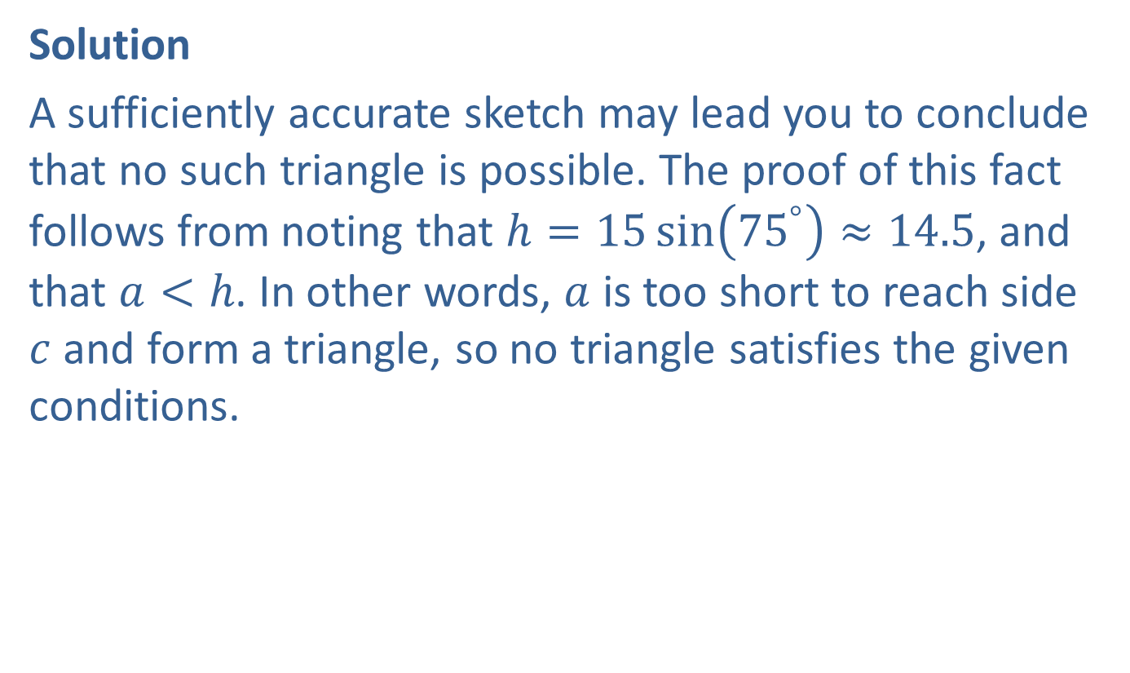
Example 4: Using the Law of Sines in an SSA Situation with No Solution (cont.)
Solution
A sufficiently accurate sketch may lead you to conclude that no such triangle is possible. The proof of this fact follows from noting that $h=15\sin\left({75}^{°}\right)≈14.5$, and that $a<h$. In other words, $a$ is too short to reach side $c$ and form a triangle, so no triangle satisfies the given conditions.

Slide 21
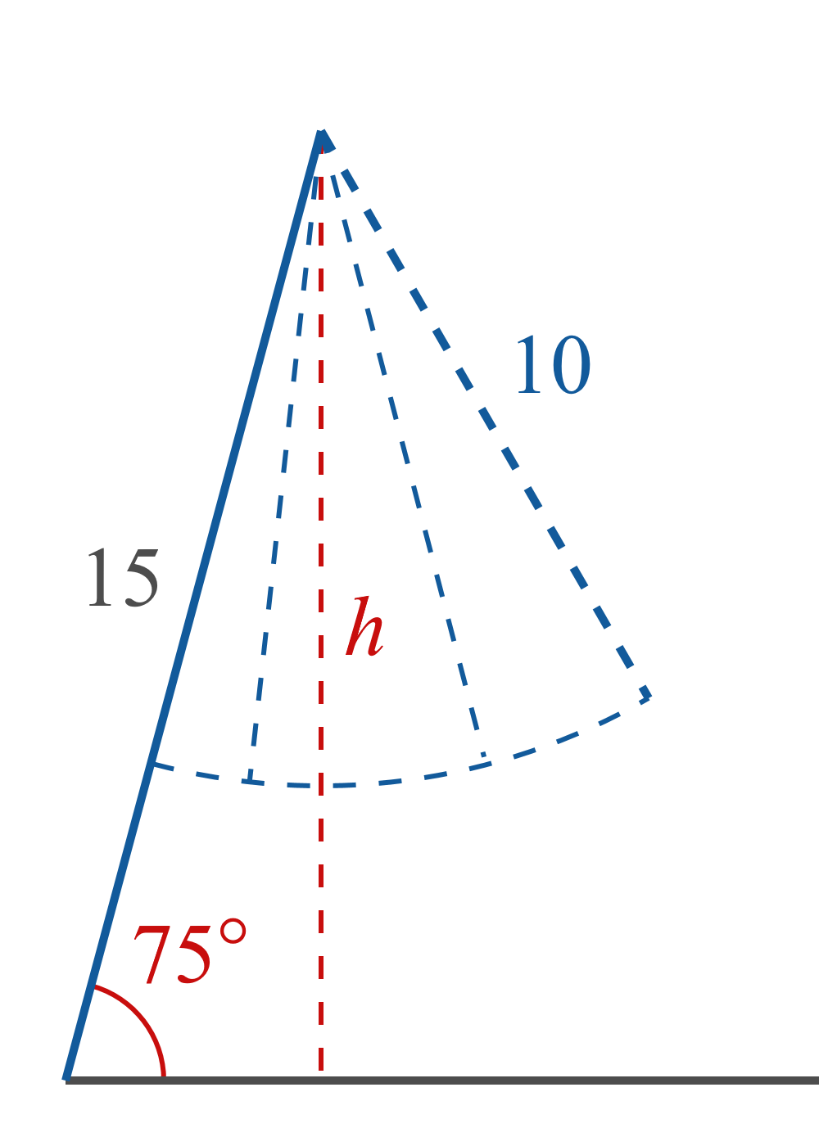
Example 4: Using the Law of Sines in an SSA Situation with No Solution (cont.)
Figure 12

Slide 22
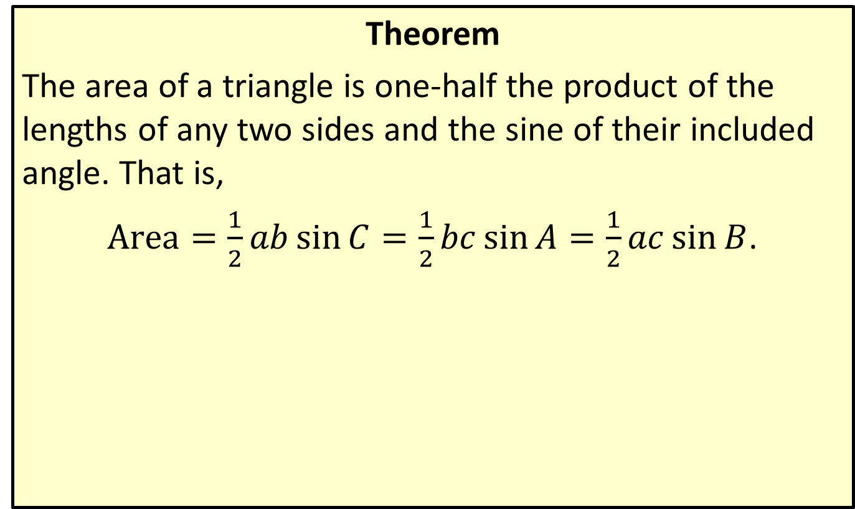
Area of a Triangle (Sine Formula)
Theorem
The area of a triangle is one-half the product of the lengths of any two sides and the sine of their included angle. That is,
$Area=\frac{1}{2}ab\sin{C}=\frac{1}{2}bc\sin{A}=\frac{1}{2}ac\sin{B}$.

Slide 23
Example 5: Using the Sine Formula to Find the Area of a Triangle
A businessman has an opportunity to buy a triangular plot of land in a part of town known colloquially as “Five Points,” as five roads intersect there to form five equal angles. The property has 147 feet of frontage on one road and 207 feet of frontage on the other. What is the square footage of the property?

Slide 24
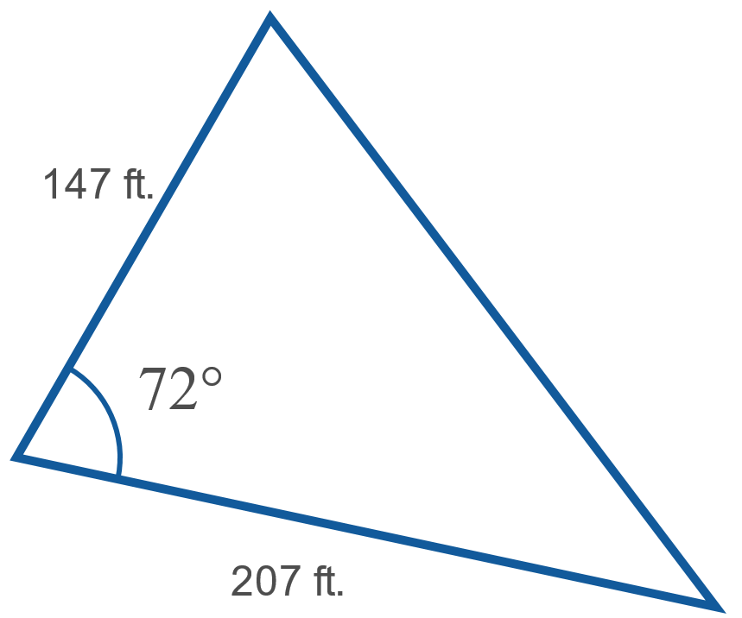

Example 5: Using the Sine Formula to Find the Area of a Triangle (cont.)
Solution
Since the roads intersect to form five equal angles, the included angle of the plot must be ${{360}^{°}÷5=72}^{°}$.
Figure 14

Slide 25
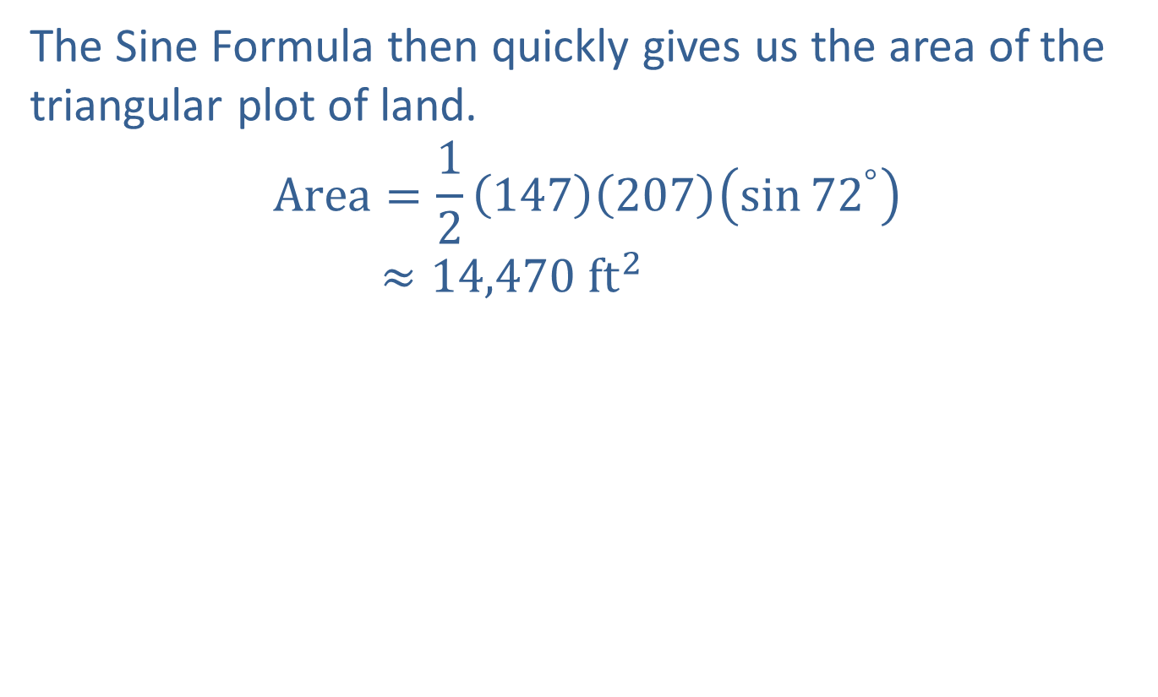
Example 5: Using the Sine Formula to Find the Area of a Triangle (cont.)
The Sine Formula then quickly gives us the area of the triangular plot of land.
Area=12147207sin72°Area≈14,470 ft2

