Slide 1
Section 9.8
Hyperbolic Functions

Slide 2
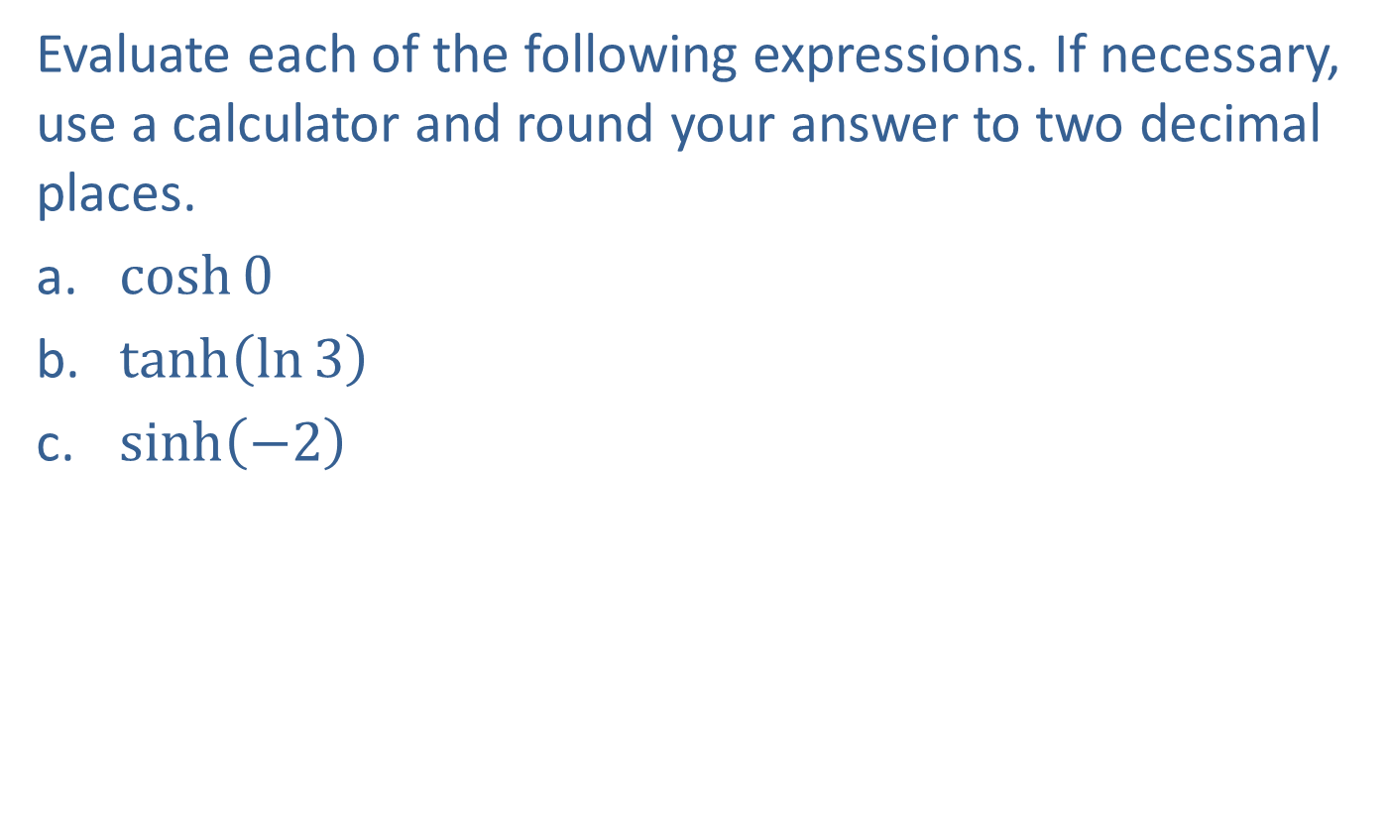
Example 1: Evaluating Hyperbolic Functions
Evaluate each of the following expressions. If necessary, use a calculator and round your answer to two decimal places.
​$cosh⁡0$
​$tanh⁡\left(\ln{3}\right)$
​$sinh⁡\left(−2\right)$

Slide 3
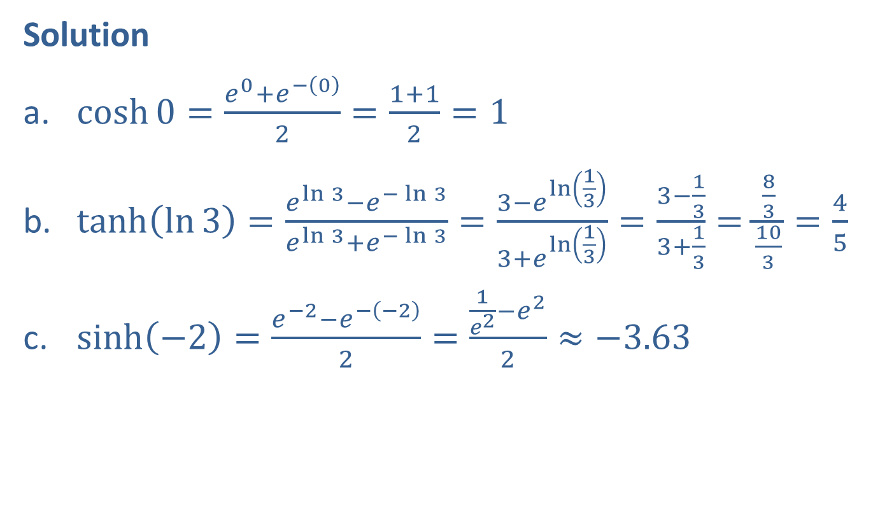
Example 1: Evaluating Hyperbolic Functions (cont.)
Solution
​$\cosh{0}=\frac{e^{0}+e^{−\left(0\right)}}{2}=\frac{1+1}{2}=1$
​$\tanh\left(\ln{3}\right)=\frac{e^{\ln{3}}−e^{−\ln{3}}}{e^{\ln{3}}+e^{−\ln{3}}}=\frac{3−e^{\ln\left(\frac{1}{3}\right)}}{3+e^{\ln\left(\frac{1}{3}\right)}}=\frac{3−\frac{1}{3}}{3+\frac{1}{3}}=\frac{\frac{8}{3}}{\frac{10}{3}}=\frac{4}{5}$
​$\sinh\left(−2\right)=\frac{e^{−2}−e^{−\left(−2\right)}}{2}=\frac{\frac{1}{e^{2}}−e^{2}}{2}≈−3.63$

Slide 4
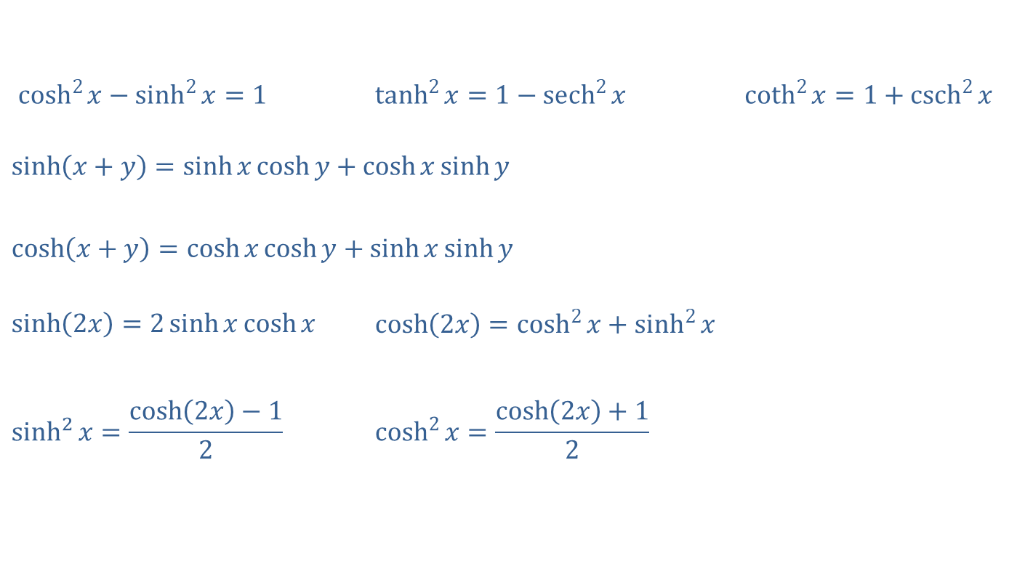
Elementary Hyperbolic Identities
$\cosh^{2}{x}−\sinh^{2}{x}=1$ | $\tanh^{2}{x}=1−{sech}^{2}{x}$ | $\coth^{2}{x}=1+{csch}^{2}{x}$
$$\sinh\left(x+y\right)=\sinh{x}\cosh{y}+\cosh{x}\sinh{y}$$
$$\cosh\left(x+y\right)=\cosh{x}\cosh{y}+\sinh{x}\sinh{y}$$
$\sinh\left(2x\right)=2\sinh{x}\cosh{x}$ | $\cosh\left(2x\right)=\cosh^{2}{x}+\sinh^{2}{x}$
$$\sinh^{2}{x}=\frac{\cosh\left(2x\right)−1}{2}$$ | $$\cosh^{2}{x}=\frac{\cosh\left(2x\right)+1}{2}$$

Slide 5

Example 2: Verification of Identities
Verify each of the following identities.
​$\tanh^{2}{x}=1−{sech}^{2}{x}$
​$\sinh^{2}{x}=\frac{\cosh\left(2x\right)−1}{2}$

Slide 6
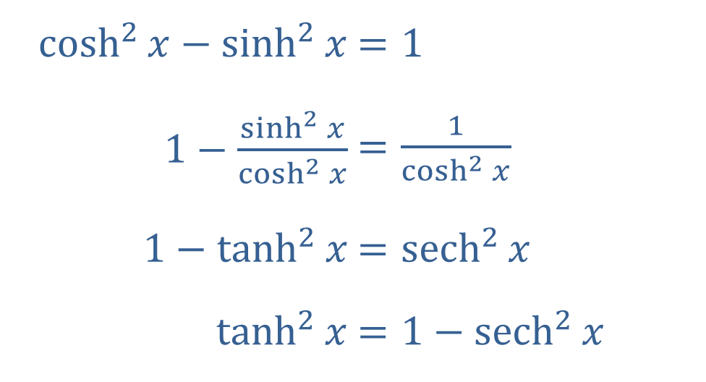
Example 2: Verification of Identities (cont.)
Solution
a.​
​$\cosh^{2}{x}−\sinh^{2}{x}$ | ​$=1$
​$1−\frac{\sinh^{2}{x}}{\cosh^{2}{x}}$ | ​$=\frac{1}{\cosh^{2}{x}}$
​$1−\tanh^{2}{x}$ | ​$={sech}^{2}{x}$
​$\tanh^{2}⁡x$ | ​$=1−{sech}^{2}{x}$

Slide 7

Example 2: Verification of Identities (cont.)
b. ​$\sinh^{2}{x}=\left(\frac{e^{x}−e^{−x}}{2}\right)\left(\frac{e^{x}−e^{−x}}{2}\right)$
sinh2⁡𝑥=14𝑒2𝑥−2+𝑒−2𝑥
sinh2⁡𝑥=12𝑒2𝑥+𝑒−2𝑥2−1
sinh2⁡𝑥=cosh2𝑥−12

Slide 8

Example 3: Evaluating Inverse Hyperbolic Functions
Evaluate $\sinh^{−1}⁡0$.

Slide 9
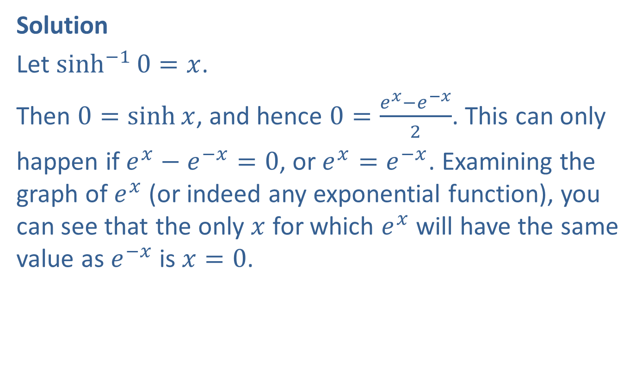
Example 3: Evaluating Inverse Hyperbolic Functions (cont.)
Solution
Let $\sinh^{−1}{0}=x$.
Then $0=\sinh{x}$, and hence $0=\frac{e^{x}−e^{−x}}{2}$. This can only
happen if $e^{x}−e^{−x}=0$, or $e^{x}=e^{−x}$. Examining the graph of $e^{x}$ (or indeed any exponential function), you can see that the only $x$ for which $e^{x}$ will have the same value as $e^{−x}$ is $x=0$.

Slide 10

Example 3: Evaluating Inverse Hyperbolic Functions (cont.)
Alternatively, multiplying the equation $e^{x}=e^{−x}$ through by $e^{x}$ results in the equation $e^{2x}=1$, which has the single solution $2x=0$, and hence $x=0$. By either argument, $x=0$ and so $\sinh^{−1}{0}=0$.

