Slide 1
Section 1.2
Addition and Subtraction of Whole Numbers (Calculators Included)

Slide 2
Objectives
Be able to add with whole numbers and understand the terms addend and sum.
Learn the meaning of the term variable.
Know the following properties of addition: commutative, associative, and additive identity.
Understand the concept of perimeter.
Be able to subtract with whole numbers and understand the meaning of the term difference.

Slide 3
Objectives (cont.)
Learn how to estimate sums and differences with rounded numbers.
Learn how to add and subtract with a calculator.

Slide 4
Example 1
To add the following numbers, we note the combinations that total 10 to find the sums quickly.
Solution
add 7 + 9 + 4 + 6 = 7 + 9 + 10
= 26
Carry the 2 from the 26.

Slide 5
Example 1 (cont.)
Add 2 + 1 + 8 + 3 + 3 = 10 + 1 + 3 + 3 = 17
10
Carry the 1 from the 17.
Add 1 + 2 + 3 + 6 + 5 = 10 + 2 + 5
= 17
10

Slide 6
Properties of Addition
Variable
A variable is a symbol (generally a letter of the alphabet) that is used to represent an unknown number or any one of several numbers.

Slide 7
Properties of Addition
Commutative Property of Addition
For any whole numbers a and b, a + b = b + a.
For example, 33 + 14 = 14 + 33.
(The order of the numbers in addition can be reversed.)

Slide 8
Properties of Addition
Associative Property of Addition
For any whole numbers a, b and c,
(a + b) + c = a + (b + c).
For example, (6 + 12) + 5 = 6 + (12 + 5).
(The grouping of the numbers can be changed.)

Slide 9
Properties of Addition
Additive Identity Property
For any whole number a, a + 0 = a.
For example, 8 + 0 = 8.
(The sum of a number and 0 is that same number.)
The number 0 is called the additive identity.

Slide 10
Example 2
Each of the properties of addition is illustrated.
40 + 3 = 3 + 40
As a check, we see that 40 + 3 = 43 and 3 + 40 = 43.
b. 2 + (5 + 9) = (2 + 5) + 9
As a check, we see that 2 + (14) = (7) + 9 = 16.
c. 86 + 0 = 86
commutative property of addition
associative property of addition
additive identity property

Slide 11
Completion Example 3
Use your knowledge of the properties of addition to find the value of the variable that will make each statement true. State the name of the property used.
Solution
a. 14 + n = 14 n = __ ________________
b. 3 + x = 5 + 3 x = __ ________________
c. (1+ y) + 2 = 1 + (7 + 2) y = __ ________________
Value
Property
0
additive identity
commutative property of addition
5
associative property
of addition
7

Slide 12
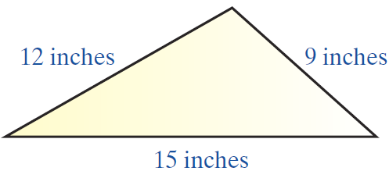
Example 4
To find the perimeter, find the sum of the lengths of the sides:
perimeter

Slide 13
Example 5
Find the difference.
Solution
Step 1: Since 2 is smaller than 9, borrow 10 from 40 and add this 10 to 2 to get 12. This leaves 30 in the tens place; cross out 4 and write 3.
10 borrowed from 40

Slide 14
Example 5 (cont.)
Step 2: Since 3 is smaller than 5, borrow 100 from 700. This leaves 600, so cross out 7 and write 6.
Step 3: Now subtract.

Slide 15
Example 5 (cont.)
Check: Add the difference to subtrahend. The sum should be the minuend.

Slide 16
Example 6
In pricing a new car, Jason found that he would have to pay a base price of $15,200 plus $1025 in taxes and $575 for license fees. If the bank loaned him $10,640, how much cash would Jason need to buy the car?
Solution
The solution involves both addition and subtraction. First, we add Jason’s expenses and then we subtract the amount of the bank loan.

Slide 17
Example 6 (cont.)
Jason would need $6160 in cash to buy the car.
Expenses
Cash Needed
base price
total expenses
taxes
bank loan
license fees
cash
total expenses

Slide 18
Estimating Sums and Differences with Whole Numbers
To Estimate an Answer
1. Round each number to the place of the leftmost digit.
2. Perform the indicated operation with these rounded numbers.

Slide 19
Example 7
Estimate the sum; then find the sum.
Solution
Note that in this example numbers are rounded to different places because they are of different sizes. That is, the leftmost digit is not in the same place for all numbers.

Slide 20
Example 7 (cont.)
Another method might be to round each number to the tens place (or hundreds place). This other method might give a more accurate estimate. However, the method chosen here is relatively fast and easy to follow and will be used in the discussions throughout the text.

Slide 21
Example 7 (cont.)
a. Estimate the sum by first rounding each number to the place of the leftmost digit and then adding. In actual practice, many of these steps can be done mentally.
rounded value of 68
rounded value of 925
rounded value of 487
estimated sum

Slide 22
Example 7 (cont.)
b. Now we find the sum, knowing that the answer should be close to 1470.
This sum is very close to 1470.

Slide 23
Example 8
Estimate the difference; then find the difference.
Solution
a. Round each number to the place of the leftmost digit and subtract using these rounded numbers.
rounded value of 2783
rounded value of 975
estimated difference

Slide 24
Example 8 (cont.)
b. Now we find the difference, knowing that the difference should be close to 2000.
The difference is close to 2000.

Slide 25
Estimating Sums and Differences with Whole Numbers
Caution
The use of rounded numbers to approximate answers demands some understanding of numbers in general and some judgement as to how “close” an estimate can be to be acceptable. In particular, when all numbers are rounded up or all numbers are rounded down, the estimate might not be “close enough” to detect a large error. Still, the process is worthwhile and can give “quick” and useful estimates in many cases.

Slide 26
Addition and Subtraction with Calculators
A Special Note On Calculators
The use of calculators is discussed throughout this text. However, you should be aware that a calculator cannot take the place of understanding mathematical concepts. A calculator is a useful aid for speed and accuracy, but it is limited to doing only what you command it to do.
A calculator does not think!

Slide 27
Example 9
Find the following sum with the use of a calculator.
Solution with a TI-84 Plus Graphing Calculator

Slide 28


Example 9 (cont.)
Follow these steps to find the answer on a TI-84 Plus graphing calculator.
enter
press
enter
press
enter
press
enter
press
899
743
625
592

Slide 29
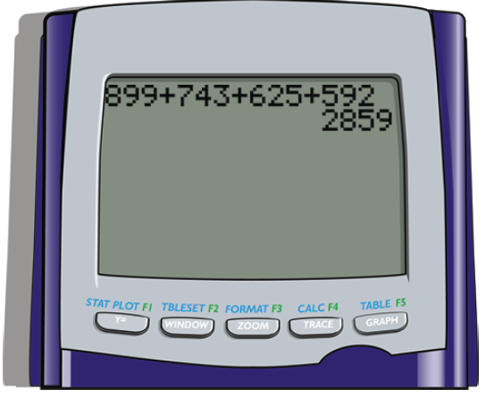
Example 9 (cont.)
The display screen is large and you will see all the numbers you enter and all the operations and the answer.

Slide 30
Example 10
Use your calculator to find the following difference.
Solution with a TI-84 Plus graphing calculator:
Follow these steps to find the answer on a TI-84 Plus graphing calculator.
enter
press
enter
press
678025
483975

Slide 31
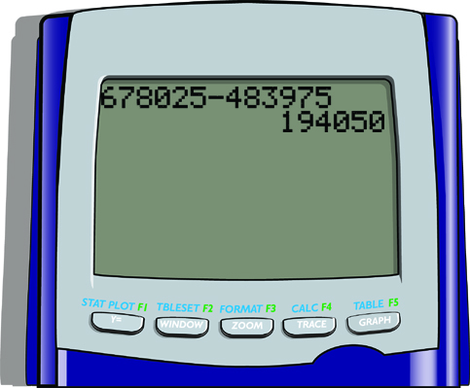
Example 10 (cont.)
The display screen is large and you will see all the numbers you enter and all the operations and the answer. Note that the commas are not entered with the numbers and are not shown in the displayed answer.

