Slide 1
Section 1.3
Multiplication and Division with Whole Numbers
(Calculators Included)

Slide 2
Objectives
Be able to multiply and understand the following terms: factor and product.
Know the following properties of multiplication: commutative property, associative property, multiplicative identity, zero factor law, and distributive property.
Understand the concept of area.
Be able to divide and understand the following terms: divisor, dividend, quotient, and remainder.

Slide 3
Objectives (cont.)
Learn that division by 0 is undefined. (That is, division by 0 is not possible.)
Learn how to estimate products and quotients with rounded numbers.
Learn how to multiply and divide with a calculator.

Slide 4
Multiplication with Whole Numbers
Symbols for Multiplication
Symbol Example
⋅ raised dot
( ) numbers inside or
next to parentheses
× cross sign

Slide 5
Properties of Multiplication
Commutative Property of Multiplication
For any whole number a and b, a ⋅ b = b ⋅ a.
For example, 3 ⋅ 4 = 4 ⋅ 3.
(The order of multiplication can be reversed.)

Slide 6
Properties of Multiplication
Associative Property of Multiplication
For any whole number a, b, and c, (a ⋅ b) ⋅ c = a ⋅(b ⋅ c)
For example, (7 ⋅ 2) ⋅ 5 = 7 ⋅(2 ⋅ 5).
(The grouping of the numbers can be changed.)

Slide 7
Properties of Multiplication
Multiplicative Identity Property
For any whole number a, a ⋅ 1 = a.
For example, 6 ⋅ 1 = 6.
(The product of any number and 1 is that same number.)
The number 1 is called the multiplicative identity.

Slide 8
Properties of Multiplication
Zero Factor Law
For any whole number a, a ⋅ 0 = 0.
For example, 63 ⋅ 0 = 0.
(The product of a number and 0 is always 0.)

Slide 9
Example 1: Properties of Multiplication
Each of the properties of multiplication is illustrated.
  a. 5 × 6 = 6 × 5
  As a check, we see that 5 × 6 = 30 and 6 × 5 = 30.
  b. 2 ⋅ (5 ⋅ 9) = (2 ⋅ 5) ⋅ 9
  As a check, we see that
  c. 8 ⋅ 1 = 8
  d. 196 ⋅ 0 = 0
commutative property of multiplication
associative property of multiplication
multiplicative identity property
zero factor law

Slide 10
Completion Example 2
Use your knowledge of the properties of multiplication to find the value of the variable that will make each statement true. State the name of the property used. Value Property
  a. 24 ⋅ n = 24 n = __ ___________
  b. 3 ⋅ x = 5 ⋅ 3 x = __ ___________
  c. (7 ⋅ y) ⋅ 2 = 7 ⋅ (5 ⋅ 2) y = __ ___________
  d. 82 ⋅ t = 0 t = __ ___________
multiplicative
identity property
1
commutative property
of multiplication
5
associative property
of multiplication
5
0
zero factor law

Slide 11
Example 3
The following products illustrate how the commutative and associative properties of multiplication are related to the method of multiplication of numbers that end with 0’s.
a. 7 ⋅ 90

Slide 12
Example 3 (cont.)
c. 50 ⋅ 700
d. 200 ⋅ 4000

Slide 13
The Distributive Property
Distributive Property of Multiplication Over Addition
If a, b, and c are whole numbers, then

Slide 14
Example 4
The steps in multiplication are shown in finding the product 37 ⋅ 27.
Step 1:
Step 2:
4 carried from 49.
Multiply: 7 ⋅ 7 = 49.
Now multiply: 7 ⋅ 3 = 21.
And add the 4: 4 + 21 = 25

Slide 15
Example 4 (cont.)
Step 3:
1 carried from the 14.
Next multiply : 2 ⋅ 7 = 14.
Write the 4 in the tens column
because you are actually multiplying
20 ⋅ 7 = 140. Generally, the 0 is not written.

Slide 16
Example 4 (cont.)
Step 4:
Step 5:
Now multiply : 2 ⋅ 3 = 6.
Then add 1: 6 + 1 =7.
Add to find the final product.

Slide 17
Example 5
The standard form of multiplication is used here to find the product 93⋅ 46.
6⋅3 = 18. Write 8, carry 1. 6⋅9 = 54. Add 1: 54 + 1 = 55.
4 ⋅3 = 12. Write 2, carry 1. 4 ⋅9 = 36. Add 1: 36 + 1 = 37.
product.

Slide 18
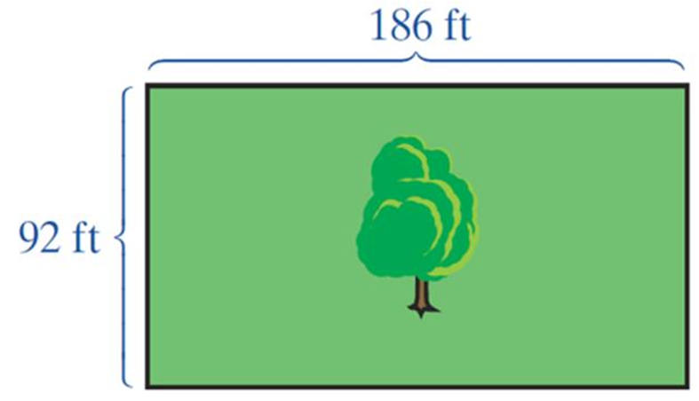
Example 6
The area of a rectangle (measured in square units) is found by multiplying its length by its width. Find the area of a rectangular plot of land with dimensions as shown here.

Slide 19
Example 6 (cont.)
Solution
To find the area, we multiply 186 ⋅ 92.
square feet

Slide 20
Example 7
Find the quotient and remainder for 9385 ÷ 45.
Solution
Step 1:
By trial, divide 40 into 90 or 4 into 9.
Write the result, 2, in the hundreds position of the quotient.
Multiply this result by the divisor and subtract.

Slide 21
Example 7 (cont.)
Step 2:
45 will not divide into 38. So, write
0 in the tens column and multiply 0 ⋅ 45 = 0.
Do not forget to write the 0 in the quotient.

Slide 22
Example 7 (cont.)
Step 3:
quotient
dividend
Choose a trial divisor of 8 for the ones digit. Since 8⋅ 45 = 360 and 360 is smaller than 385, 8 is the desired number.
remainder

Slide 23
Example 7 (cont.)
Check:
Multiply the quotient by the divisor and then add the remainder. This sum should equal the dividend.
quotient
divisor
remainder
dividend

Slide 24
Example 8
Show that 19 and 43 are factors (or divisors) of 817.
Solution
In order to show that 19 and 43 are factors of 817, we divide. Both 817 ÷ 19 and 817 ÷ 43 will give a remainder of 0 if indeed these numbers are
factors of 817. We only need to
try one of them to find out if the
remainder is 0.

Slide 25
Example 8 (cont.)
Check:
Thus 19 and 43 are indeed factors of 817.

Slide 26
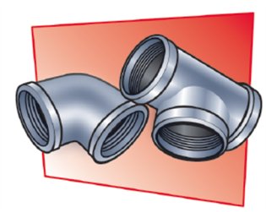
Example 9
A plumber purchased 32 pipe fittings. What was the price of one fitting if the bill was $512 before taxes?

Slide 27
Example 9 (cont.)
Solution
We need to know how many times 32 is contained in 512.
The price for one fitting was $16.

Slide 28
Division with Whole Numbers
Division with 0
Case 1: If a is any nonzero whole number, then
Case 2: If a is any whole number, then

Slide 29
Example 10
Find the product 63⋅ 49, but first estimate the product.
Solution
a. Estimate:
rounded value of 63
rounded value of 49
estimated product

Slide 30
Example 10 (cont.)
b. Notice that, in rounding, 63 was rounded down and 49 was rounded up. Thus, we can expect the actual product to be reasonably close to 3000.
The actual product is close to 3000.

Slide 31
Estimating Products and Quotients
Adjustment to the Procedure of Estimating Answers
As was stated earlier in Section 1.2, the “rule” of using numbers rounded to the leftmost digit is flexible. There are times when adjusting to using two digits instead of one gives simpler calculations and more accurate estimates. This adjustment is generally more applicable with division than with addition, subtraction, or multiplication.

Slide 32
Estimating Products and Quotients
Adjustment to the Procedure of Estimating Answers (cont.)
In general, estimating answers involves basic understanding of numbers and intuitive judgment, and there is no one best way to estimate answers.

Slide 33
Example 11
Estimate the quotient 148,062 ÷ 26; then find the quotient.
Solution
a. Estimation:
In this case, we rounded using the two leftmost digits for 148,062 because 150,000 can be divided evenly by 30.

Slide 34
Example 11 (cont.)
approximate quotient
remainder

Slide 35
Example 11 (cont.)
b. The quotient should be near 5000.
actual quotient
remainder

Slide 36
Completion Example 12
Find the quotient and remainder.
___
___
___
___
remainder

Slide 37
Completion Example 12 (cont.)
Now estimate the quotient by mentally dividing
rounded numbers: ___________
Is your estimate close to the actual quotient? ______________
What is the difference? _______________

Slide 38
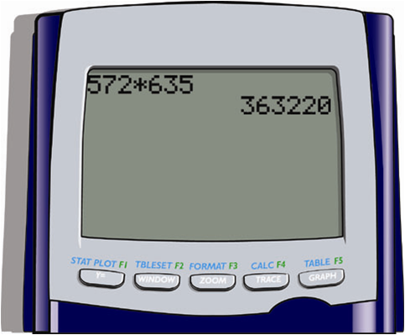
Example 13: Multiplication with a Calculator
Use your calculator to find the product:
Solution with a TI-84 Plus graphing calculator
Thus 572 × 635 = 363,220

Slide 39
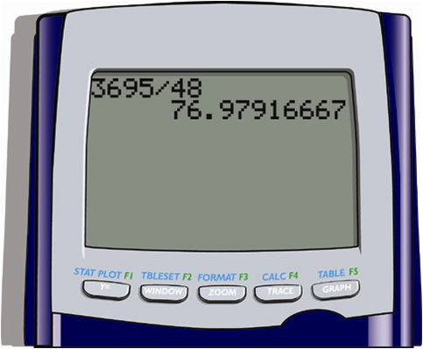
Example 14: Division with a Calculator
Use your calculator to find the quotient:
Solution with a TI-84 Plus graphing calculator

Slide 40
Example 14: Division with a Calculator (cont.)
If the quotient is not a whole number (as is the case here), the calculator gives rounded decimal answers. (These decimal numbers will be discussed in Chapter 5.) Thus calculators do have some limitations in terms of whole numbers. The whole number part of the display (76) is the correct whole number part of the quotient, but we do not know the remainder R.
Thus 3695 ÷ 48 = 76 with an undetermined remainder.

Slide 41
Example 15
Use a calculator to divide 1857 ÷17, and then find the quotient and remainder as whole numbers.
Solution
With a calculator, 1857 ÷17 = 109.2352941. Multiply the whole number part of the quotient (109) by the divisor (17):
109 ⋅ 17 = 1853

Slide 42
Example 15 (cont.)
To find the remainder, subtract this product from the dividend:
1857 − 1853 = 4
Thus the quotient is 109 and the remainder is 4.

Slide 43
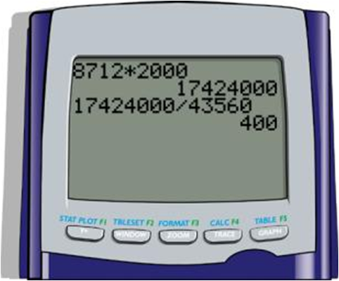
Example 16
One acre of land is equal to 43,560 square feet. How many acres are in a piece of land in the shape of a rectangle 8712 feet by 2000 feet?
Solution
Step 1:
8712 ⋅ 2000 = 17,424,000 sq. ft
Step 2:
17,424,000 ÷ 43,560 = 400 acres
Thus the land has a measure of 400 acres.
The calculator method is also shown.

