Slide 1
Section 1.4
Applications: Number Problems, Consumer Items, Checking, Geometry, and Reading Graphs

Slide 2
Objectives
Learn the basic strategy for solving word problems.
Be able to identify key words that indicate operations.
Be able to solve application word problems.

Slide 3
Basic Strategy for Solving Word Problems
Basic Strategy for Solving Word Problems
1. Read each problem carefully until you understand the problem and know what is being asked. Discard any irrelevant information.
2. Draw any type of figure or diagram that might be helpful, and decide what operations are needed.

Slide 4
Basic Strategy for Solving Word Problems
Basic Strategy for Solving Word Problems (cont.)
3. Perform these operations to find the unknown value(s).
4. Mentally check to see if your answer is reasonable and see if you can think of another more efficient or more interesting way to do the same problem.

Slide 5
Basic Strategy for Solving Word Problems
Key Words that Indicate Operations
Addition | Subtraction | Multiplication | Division
add | subtract (from) | multiply | divide
sum | difference | product | quotient
plus | minus | times | ratio
more than | less than | twice
increased by | decreased by

Slide 6
Example 1: Number Problems
Find the sum of the product of 78 and 32 and the difference between 7600 and 2200.
Solution
As an aid, rewrite the problem emphasizing the key words by printing them in boldface. (You might want to do the same by underlining the key words on your paper.)
Find the sum of the product of 78 and 32 and the difference between 7600 and 2200.

Slide 7
Example 1: Number Problems (cont.)
After reading the problem carefully, note that the sum cannot be found until both the product and the difference are found.
Product
Difference

Slide 8
Example 1: Number Problems (cont.)
Now we find the sum:
Thus the requested sum is 7896.
(As a quick mental check, use rounded numbers:
80 ⋅ 30 = 2400 and 8000 − 2000 = 6000 and the sum 2400 + 6000 = 8400 seems reasonably close to the result 7896.)
Sum

Slide 9
Example 1: Number Problems (cont.)
[Note that the word and does not indicate any operation. And is used twice in this problem as a grammatical connector (a conjunction).]

Slide 10
Example 2: Number Problems
If the quotient of 1265 and 5 is decreased by the sum of 120 and 37, what is the difference?
Solution
Again, we rewrite the problem emphasize the key words by printing them in boldface.
If the quotient of 1265 and 5 is decreased by the sum of 120 and 37, what is the difference?
To find the difference, first find the quotient and sum:

Slide 11
Example 2: Number Problems (cont.)
Quotient
Sum
Difference
The difference between the quotient and the sum is 96.

Slide 12
Example 3: Consumer Items
Mr. Fujimoto bought a used car for $15,000 for his son. The salesperson included $1050 for taxes and $480 for license fees. If he made a down payment of $3500 and financed the rest through his credit union, how much did he finance?
Solution
First, find the total cost by adding the expenses. Then subtract the down payment.

Slide 13
Example 3: Consumer Items (cont.)
(Note that the words add and subtract do not appear in the statement of the problem. Only real-life experience tells us that these are the operations to be performed.)
Mr. Fujimoto financed $13,030.
Add Expenses
Subtract Down Payment
total expenses
down payment
total expenses
to be financed

Slide 14
Example 4: Checking Account
In June, Ms. Maxwell opened a checking account and deposited $5280. During the month, she made another deposit of $800 and wrote checks for $135, $450, $775,
and $72. What was the balance in her account at the end of the month?
Solution
To find the balance, we find the difference between the sum of the deposit amounts and the sum of the check amounts.

Slide 15
Example 4: Checking Account (cont.)
sum of deposits
sum of checks
balance
The balance in the account was $4648 at the end of the month.

Slide 16
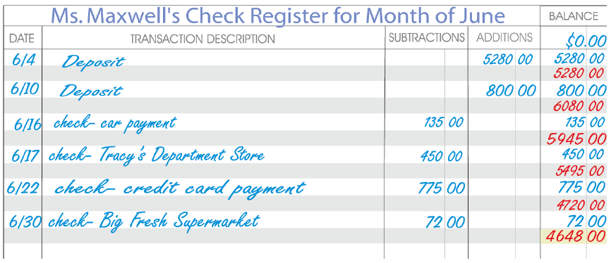
Example 4: Checking Account (cont.)
(Mental check: Using rounded numbers, we find that a balance of about $4500 is close.)

Slide 17
Example 5: Geometry
A rectangular picture is mounted in a rectangular frame with a border (called a mat). (A rectangle is a four-sided figure with opposite sides equal and all four angles equal, 90° each.) If the picture is 14 inches by
20 inches, the frame is 18 inches by 24 inches, and the width of the frame is 1 inch, what is the area of the mat?
Solution
In this case, a figure is very helpful. Also, remember that the area of a rectangle is found by multiplying length and width.

Slide 18
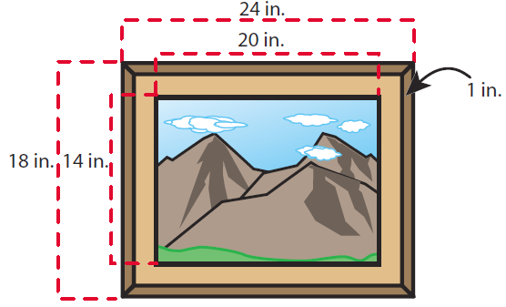
Example 5: Geometry (cont.)
The area of the mat will be the difference between the areas of the two inner rectangles. Since the frame is one inch thick on each edge, we must subtract 2 from the length and width of the frame to get the dimensions of the mat.
Therefore, the mat is
16 inches by 22 inches.

Slide 19
Example 5: Geometry (cont.)
The area of the mat is 72 square inches.
Larger Area
Smaller Area
Area of Mat
square inches
square inches
square inches

Slide 20
Example 6: Reading Graphs
The graph shown here indicates Dr. Wright’s water usage for four billing periods. Use the graph to answer the following questions.
a. During which billing period did he use the most water?
b. How many gallons of water did he use during the January billing period?
c. What total number of units of water did he use for these four billing periods?

Slide 21
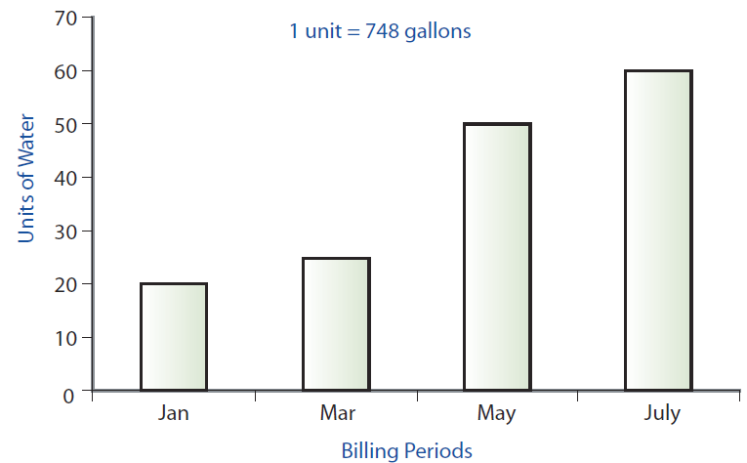
Example 6: Reading Graphs (cont.)
d. How many gallons of water did he use over all of these periods?

Slide 22
Example 6: Reading Graphs (cont.)
Solutions
a. The graph shows that Dr. Wright used the most amount of water during the July billing period. (That is, when lawns are watered in southern California.)
b. The graph indicates 1 unit = 748 gallons of water and 20 units were used in the January billing period.
So, we multiply:
gallons per unit
units
gallons of water

Slide 23
Example 6: Reading Graphs (cont.)
c. Adding the units for each billing period gives:
20 + 25 + 50 + 60 = 155 total units
d. Multiplying the total units used by 748 gives the result:
total units
gallons per unit
total gallons

