Slide 1
Section 1.6
Exponents and Order of Operations

Slide 2
Objectives
Understand the terms base, exponent, and power.
Know how to evaluate expressions with exponents, including 1 and 0 as exponents.
Learn how to use a calculator to evaluate exponential expressions.
Know the rules for order of operations and be able to apply these rules when evaluating numerical expressions.

Slide 3
Example 1
With Repeated Multiplication
a.
b.
c.
d.
With Exponents

Slide 4
Terminology of Exponents
Exponent and Base
A whole number n is an exponent if it is used to tell how many times another whole number a is used as a factor. The repeated factor a is called the base of the exponent. Symbolically,
n factors

Slide 5
Terminology of Exponents
Common Error
Do not multiply the
base and the exponent.
Do multiply the base by itself.
INCORRECT
CORRECT
INCORRECT
CORRECT

Slide 6
Example 2
a. 8² = 64
b. 5³ = 125
Expressions with exponents other than 2 or 3 are read as the base “to the ___ power.” For example,
2⁵ = 32 is read “two to the fifth power is equal to thirty-two.”
is read “eight squared is equal to sixty-four.”
is read “five cubed is equal to one hundred twenty-five.”

Slide 7
Terminology of Exponents
Special Note: There is usually some confusion about the use of the word “power.” Since 2⁵ is read “two to the fifth power,” it is natural to think of 5 as the power. This is not true. A power is not an exponent. A power is the product indicated by a base raised to an exponent. Thus, for the equation 2⁵ = 32 , think of the phrase “two to the fifth power” in its entirety. The corresponding power is the product, 32.

Slide 8
One and Zero as Exponents
The Exponent 1
For any whole number a, a = a¹.

Slide 9
One and Zero as Exponents
The Exponent 0
If a is any nonzero whole number, then
a⁰ = 1.
(Note: The expression 0⁰ is undefined.)

Slide 10


Example 3
Use a TI-84 Plus graphing calculator to find the value of each of the following exponential expressions.
a. 9⁵ b. 41⁴ c. 250²
Solutions for a TI-84 Plus Calculator
a. Step 1: Enter 9. (This is the base.)
Step 2: Press the caret key .
Step 3: Enter 5. (This is the exponent.)
Step 4: Press the key .
The display should read 59049.

Slide 11
Example 3 (cont.)
b. Step 1: Enter 41.
Step 2: Press the caret key .
Step 3: Enter 4.
Step 4: Press the key .
The display should read 2825761.

Slide 12

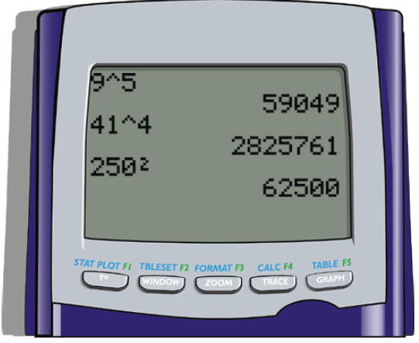
Example 3 (cont.)
c. Step 1: Enter 250.
Step 2: Press the caret key .
Step 3: Press the key .
The display should read 62500.
Here we show the display screen
for all these calculations.

Slide 13
Rules for Order of Operations
Special Note about the Difference between Evaluating Expressions and Solving Equations
Some students seem to have difficulty distinguishing between evaluating expressions and solving equations. In evaluating expressions, we are simply trying to find the numerical value of an expression. In solving equations, we are trying to find the value of some unknown number represented by a variable in an equation.

Slide 14
Rules for Order of Operations
Special Note about the Difference between Evaluating Expressions and Solving Equations (cont.)
These two concepts are not the same. In solving equations, we use the Addition Principle, the Subtraction Principle, and the Division Principle. In evaluating expressions, we use the Rules for Order of Operations. These rules are programmed into nearly every calculator.

Slide 15
Rules for Order of Operations
Rules for Order of Operations
1. First, simplify within grouping symbols, such as parentheses ( ), brackets [ ], or braces { }. Start with the innermost grouping.
2. Second, evaluate any numbers or expressions with exponents.

Slide 16
Rules for Order of Operations
Rules for Order of Operations (cont.)
3. Third, moving from left to right, perform any multiplications or divisions in the order in which they appear.
4. Fourth, moving from left to right, perform any additions or subtractions in the order in which they appear.

Slide 17
Rules for Order of Operations
Note
Even though the mnemonic PEMDAS is helpful, remember that multiplication and division are performed as they appear, left to right. Also, addition and subtraction are performed as they appear, left to right.

Slide 18
Example 4
Evaluate the expression
Solution
Divide before multiplying in this case.
Remember to move left to right.
Multiply before adding or subtracting.
Add before subtracting in this case.
Remember to move left to right.
Subtract.

Slide 19
Example 5
Evaluate the expression
Solution
Divide.
Multiply.
Multiply.
Subtract.
Add.

Slide 20
Example 6
Evaluate the expression
Solution
Operate within parentheses.
Find the power.
Divide.
Multiply in each part separated by +.
Add.

Slide 21
Completion Example 7
Evaluate the expression
Solution
Operate within parentheses and find the power.
4
9
= ( _____ )[(5 + _____ ) ÷ 2 + 5]
Operate within parentheses.
4
14
Divide within brackets.
= ( _____ )[( _____ ) ÷ 2 + 5]
4
7
Add within brackets.
= ( _____ )[ _____ + 5]
4
12
Multiply.
= ( _____ )[ _____ ]
= _____
48

Slide 22
Completion Example 8
Evaluate the expression
Solution
4
4
= 9( _____ − 1 ) − 17 + 6 ⋅ _____
3
4
= 9( _____ ) − 17 + 6 ⋅ _____
27
24
= _____ − 17 + _____
10
= _____ + _____
24
34
= _____

