Slide 1
Section 10.1
Angles and Triangles

Slide 2
Objectives
Recognize the terms point, line, and plane, and know that they are undefined terms.
Know the definition of an angle.
Learn how to classify an angle by its measure as acute, right, obtuse, or straight.
Know the meanings of the terms complementary angles and supplementary angles.

Slide 3
Objectives
Learn how to classify a triangle by its sides: scalene, isosceles, or equilateral.
Learn how to classify a triangle by its angles: acute, right, or obtuse.
Know that for any triangle:
a. The sum of the measures of its angles is 180°.
b. The sum of the lengths of any two sides must be greater than the length of the third side.

Slide 4
Introduction to Geometry
Undefined Term Representation Discussion
1. Point
2. Line
A dot represents a point. Points are labeled with capital letters.
A line has no beginning or end. Lines are labeled with small letters or by two points on the line.

Slide 5
Introduction to Geometry
Undefined Term Representation Discussion
3. Plane
Flat surfaces, such as table tops or walls, represent planes. Planes are labeled with capital letters.

Slide 6
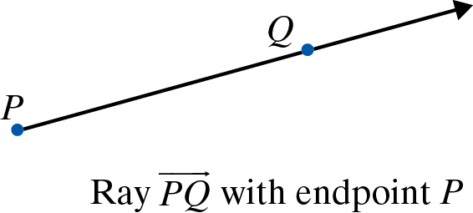
Angles
Ray, Angle, Vertex, Sides
A ray consists of a point (called the endpoint) and all the points on a line on one side of that point.

Slide 7
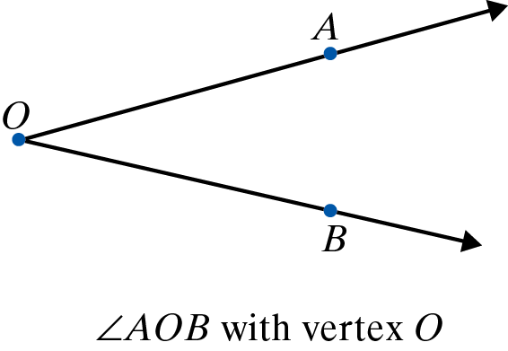
Angles
Ray, Angle, Vertex, Sides (cont.)
An angle consists of two rays
with a common endpoint.
The common endpoint is
called the vertex of the angle.
In an angle, the two rays are called the sides of the angle. Thus, as shown in the above figure,

Slide 8
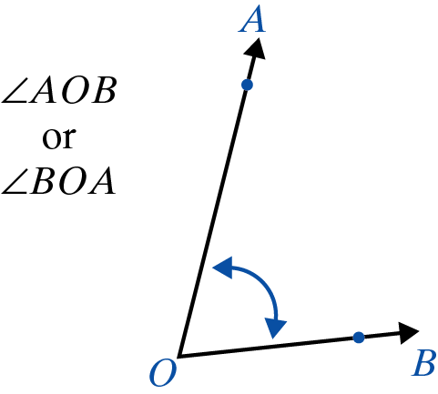
Angles
Three Common Ways of Labeling Angles
1. Using three capital letters with the vertex as the middle letter.

Slide 9
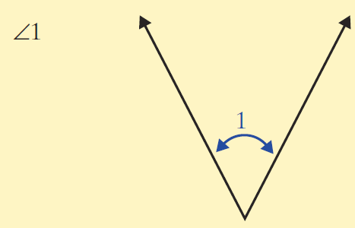
Angles
Three Common Ways of Labeling Angles (cont.)
2. Using single numbers such as 1, 2, 3.

Slide 10
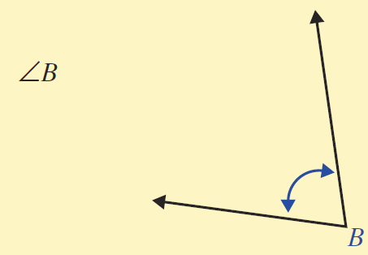
Angles
Three Common Ways of Labeling Angles (cont.)
3. Using the single capital letter at the vertex when the meaning is clear.

Slide 11
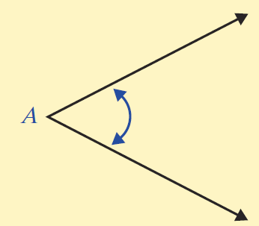
Angles
Types of Angles
Name Measure Illustration
1. Acute

Slide 12
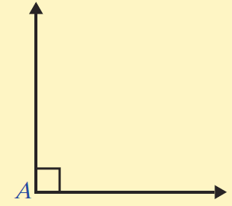
Angles
Types of Angles
Name Measure Illustration
2. Right

Slide 13
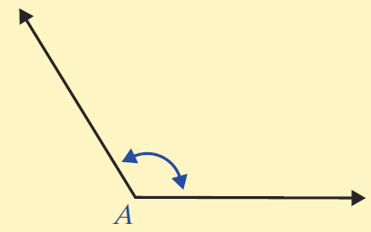
Angles
Types of Angles
Name Measure Illustration
3. Obtuse

Slide 14

Angles
Types of Angles
Name Measure Illustration
4. Straight

Slide 15
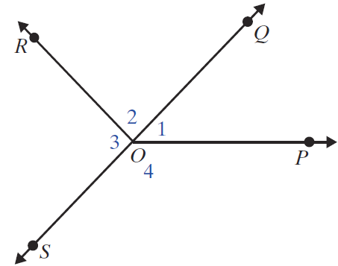
Example 1
Use a protractor to check that the measures of the angles.
Solution

Slide 16
Example 2
Tell whether each of the following angles is acute, right, obtuse, or straight.
Solution

Slide 17
Angles
Complementary, Supplementary, Equal Angles
1. Two angles are complementary if the sum of their measures is 90º.
2. Two angles are supplementary if the sum of their measures is 180º.
3. Two angles are equal if they have the same measure.

Slide 18
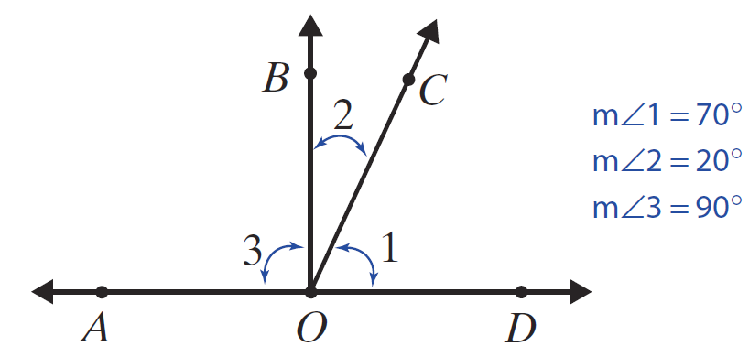
Example 3
In the following figure,
a. ∠1 and ∠2 are complementary because
m∠1 + m∠2 = 90°;

Slide 19
Example 3 (cont.)
b. ∠COD and ∠COA are supplementary because
m∠COD + m∠COA = 70° + 110° = 180°;
c. ∠AOD is a straight angle because m∠AOD = 180°;
d. ∠BOA and ∠BOD are supplementary; and in this case m∠BOA = m∠BOD = 90°.

Slide 20
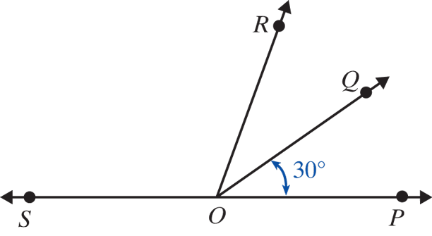
Example 4
In the figure below, is a straight line and
m∠QOP = 30° and m∠QOR = 30°. Find the measures of
a. ∠QOS and b. ∠SOP.
c. Are any pairs complementary?
d. Are any pairs supplementary?

Slide 21
Example 4 (cont.)
Solution
a. m∠QOS = 150°.
b. m∠SOP = 180°.
c. No pairs are complementary. No two angles have a total measure of 90°.
d. Yes, ∠QOP and ∠QOS are supplementary and ∠ROP and ∠ROS are supplementary. The sum of the measures of each pair is 180°.

Slide 22
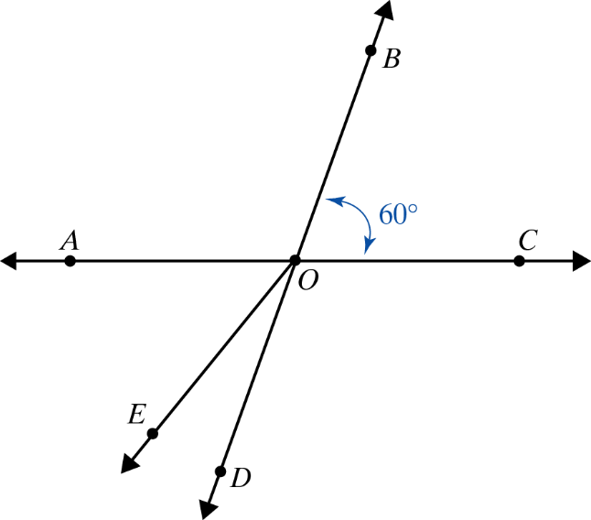
Example 5
In the figure below are straight lines.
a. Name an angle adjacent to ∠EOD.
b. What is m∠AOD?

Slide 23
Example 5 (cont.)
Solutions
a. Four angles adjacent to ∠EOD are ∠AOE, ∠BOE, ∠BOD, and ∠COD.
b. Since ∠BOC and ∠AOD are vertical angles, they have the same measure. So m∠AOD = 60°.

Slide 24
Triangles
Triangles are classified in two ways:
1. According to the lengths of their sides, and
2. According to the measures of their angles.

Slide 25
Triangles
Special Note
The line segment with endpoints A and B is indicated by placing a bar over the letters, as in The length of the segment is indicated by writing only the letters, as in AB.

Slide 26
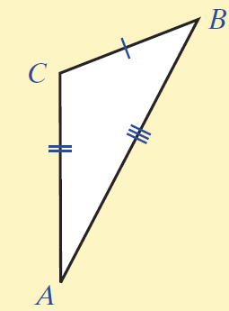
Triangles
Triangles Classified by Sides
Name Property Illustration
1. Scalene No two sides
are equal.

Slide 27
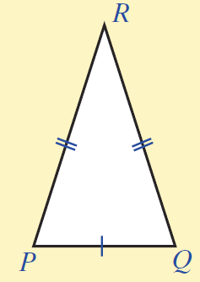
Triangles
Triangles Classified by Sides (cont.)
Name Property Illustration
2. Isosceles Two sides
are equal.

Slide 28
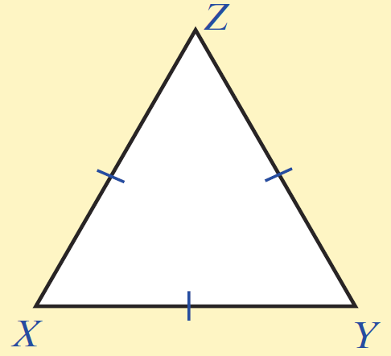
Triangles
Triangles Classified by Sides (cont.)
Name Property Illustration
3. Equilateral All three sides
are equal

Slide 29
Triangles
Triangles Classified by Sides (cont.)
[NOTE: The different number of tick marks on more than one side of a triangle indicate unequal sides, while the same amount of tick marks on more than one side indicate equal sides. For example, on the scalene triangle, each side has a different number of tick marks, indicating no sides are equal, while the equilateral triangle has a single tick mark on each side, indicating all sides are equal.]

Slide 30
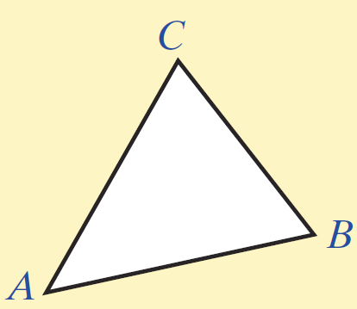
Triangles
Triangles Classified by Angles
Name Property Illustration
1. Acute All three angles
are acute.

Slide 31
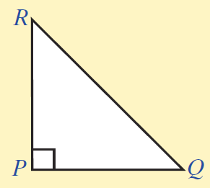
Triangles
Triangles Classified by Angles (cont.)
Name Property Illustration
2. Right One angle is
a right angle.

Slide 32
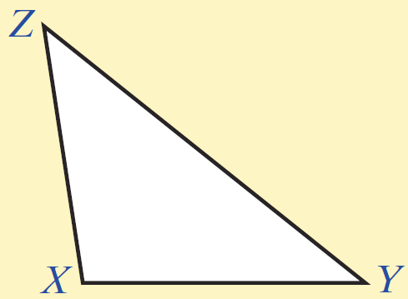
Triangles
Triangles Classified by Angles (cont.)
Name Property Illustration
3. Obtuse One angle is
an obtuse angle.

Slide 33
Triangle
Two Important Properties of Any Triangle
1. The sum of the measures of its angles is 180º.
2. The sum of the lengths of any two sides must be greater than the length of the third side.

Slide 34
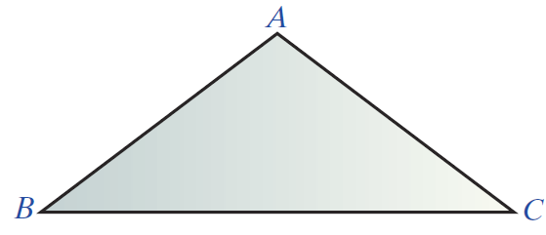
Example 6
In ΔABC below, AB = AC. What kind of triangle is ΔABC?
Solution
ΔABC can be classified in two ways. ΔABC is isosceles because two sides are equal. ΔABC is also obtuse because m∠A > 90°.

Slide 35
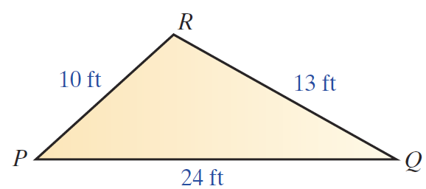
Example 7
Suppose the lengths of the sides of ΔPQR are as shown in the figure below. Is this possible?

Slide 36
Example 7 (cont.)
Solution
This is not possible. PR + QR = 10 ft + 13 ft = 23ft and PQ = 24 ft, which is longer than the sum of the other two sides. In a triangle, the sum of the lengths of any two sides must be greater than the length of the third side.

Slide 37
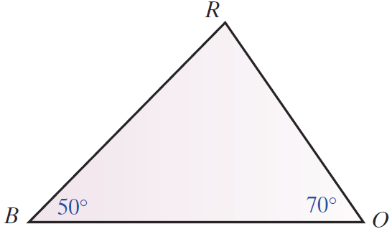
Example 8
In ΔBOR below, m∠B = 50° and m∠O = 70°.
a. What is m∠R?
b. What kind of triangle is ΔBOR?
c. Which side is opposite ∠R?
d. Which sides include ∠R?
e. Is ΔBOR a right triangle?
Why or why not?

Slide 38
Example 8 (cont.)
Solutions
a. The sum of the measures of the angles must be 180°. Since 50° + 70° = 120°, m∠R = 180°−120° = 60°.
b. ΔBOR is an acute triangle because all the angles are acute. Also, ΔBOR is a scalene triangle because no two sides are equal.
c. is opposite ∠R.
d. include ∠R.

Slide 39
Example 8 (cont.)
e. ΔBOR is not a right triangle because none of the angles are right angles.

