Slide 1
Section 10.2
Length and Perimeter

Slide 2
Objectives
Recognize the measures of length in the metric system.
Be able to change metric measures of length within the metric system.
Know how to use tables to convert units of length between the metric system and U.S. customary system.
Know the formulas for the perimeter of several geometric figures.

Slide 3
Metric Units of Length
Metric Measures of Length
1 millimeter (mm) | = 0.001 meter | 1 m = 10 dm
1 centimeter (cm) | = 0.01 meter | 1 m = 100 cm
1 decimeter (dm) | = 0.1 meter | 1 m = 1000 mm
1 meter (m) | = 1.0 meter (basic unit)
1 decameter (dam) | = 10 meters
1 hectometer (hm) | = 100 meters
1 kilometer (km) | = 1000 meters

Slide 4
Metric Units of Length
Changing Metric Measures of Length
Procedure Example
To change to a measure of length that is: Larger to Smaller
one unit smaller, multiply by 10,
two units smaller, multiply by 100,
three units smaller, multiply by 1000,
and so on.
To change to a measure of length that is: Smaller to Larger
one unit larger, divide by 10,
two units larger, divide by 100,
three units larger, divide by 1000,
and so on.

Slide 5
Example 1
The following examples illustrate how to change from larger to smaller units of length in the metric system.
a. 5.6 m
b. 5.6 m
c. 23.5 cm
d. 1.42 km
= 100(5.6) cm
= 560 cm
= 1000(5.6) mm
= 5600 mm
= 10 (23.5) mm
= 235 mm
= 1000(1.42) m
= 1420 m

Slide 6
Example 2
The following examples illustrate how to change from smaller to larger units of length in the metric system.
a. 375 cm
b. 375 mm
c. 1055 m
= 3.75 m
= 0.375 m
= 1.055 km

Slide 7
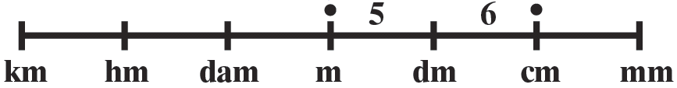
Example 3
Change 56 cm to the equivalent measure in meters.
Solution
Thus, 56 cm
2 units to the left
New
Position
Original
Position
= 0.56 m.

Slide 8
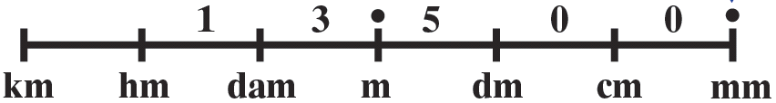
Example 4
Change 13.5 m to the equivalent measure in millimeters.
Solution
Thus, 13.5 m
3 units to the right
Original
Position
New
Position
= 13 500 mm.

Slide 9
Metric Units of Length
Note
In the metric system,
1. A 0 is written to the left of the decimal point if there is no whole number part (0.287 m).
2. No commas are used in writing numbers. If a number has more than four digits (left or right of the decimal point), the digits are grouped in threes from the decimal point with a space between the groups (25 000 m or 0.000 34 m).

Slide 10
U.S. Customary and Metric Equivalent Units of Length
U.S. Customary Units of Length
1 foot (ft) | = 12 inches (in.)
1 yard (yd) | = 3 ft
1 mile (mi) | = 5280 ft

Slide 11
U.S. Customary and Metric Equivalent Units of Length
U.S. – Metric Length Equivalents
U.S. to Metric | Metric to U.S.
1 in = 2.54 cm (exact) | 1 cm = 0.394 in.
1 ft = 0.305 m | 1 m = 3.28 ft
1 yd = 0.914 m | 1 m = 1.09 yd
1 mi = 1.61 km | 1 km = 0.62 mi

Slide 12
U.S. Customary and Metric Equivalent Units of Length
Important Note About Conversions between U.S. and Metric Equivalents
Most of the conversion units are not exact and slightly different answers are possible, depending on the conversion units used. Generally, the conversions will be accurate to at least the first three digits. Therefore, we will give conversions rounded to the place of the first three digits only.

Slide 13
Example 5
Convert the following measures of length as indicated.
a. 6 ft = ________ cm
b. How many kilometers is the same as 25 miles?
Solution
a. 6 ft
b. 25 mi
= 6(12 in.)
= 72 in.
= 72(1 in.)
= 72(2.54 cm)
= 183 cm (rounded)
= 25(1 mi)
= 25(1.61 km)
= 40.25 km
= 40.3 km (rounded)

Slide 14
Example 6
Convert the following measures of length as indicated.
a. How many feet are there in 30 m?
b. Convert 10 km to miles.
Solution
a. 30 m
b. 10 km
= 30(1 m)
= 30(3.28 ft)
= 98.4 ft
= 10(1 km)
= 10(0.62 mi)
= 6.2 mi

Slide 15
Geometry: Formulas for Perimeter
Important Terms
Perimeter: Total distance around a plane geometric figure
Circumference : Perimeter of a circle
Radius: Distance from the center of a circle to a point on the circle
Diameter: Distance from one point on a circle to another point on the circle measured through the center

Slide 16
Geometry: Formulas for Perimeter
Note
We will use π = 3.14, but you should remember that 3.14 is only an approximation to π.

Slide 17
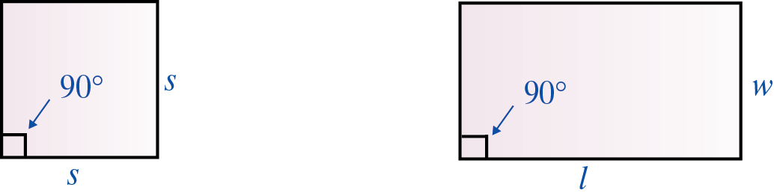
Geometry: Formulas for Perimeter
Geometric Figures and the Formulas for Finding Their Perimeters

Slide 18
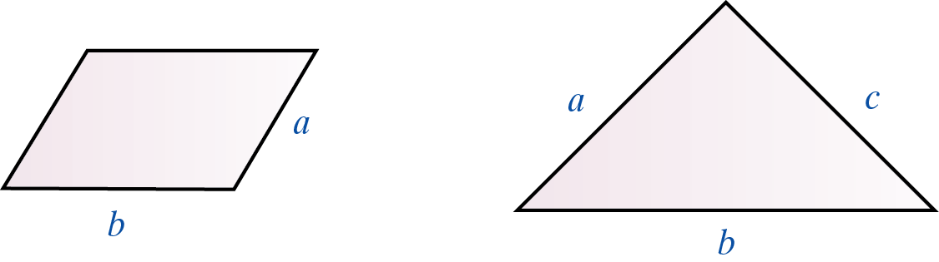
Geometry: Formulas for Perimeter
Geometric Figures and the Formulas for Finding Their Perimeters (cont.)

Slide 19
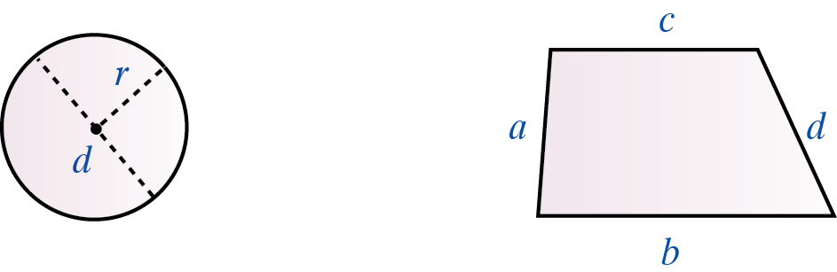
Geometry: Formulas for Perimeter
Geometric Figures and the Formulas for Finding Their Perimeters (cont.)

Slide 20
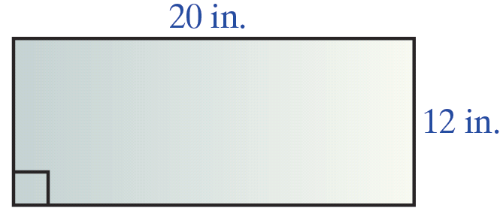
Example 7
Find the perimeter of a rectangle with length 20 inches and width 12 inches. Write the answer in both inches and centimeters.
Solution
The perimeter is 64 in., or 162.56 cm.

Slide 21
Example 8
Find the perimeter of a triangle with sides of 4 cm,
80 mm, and 0.6 dm. Find the perimeter in both millimeters and centimeters.
Solution
Sketch the figure carefully so that your drawing shows how the lengths of the sides are related. (That is, the longest side must be labeled as 80 mm.) Change all the units to the same unit of measure. In this case, any of the three units of measure will do. Millimeters have been chosen.

Slide 22
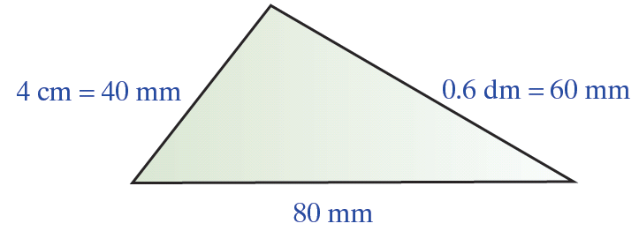
Example 8 (cont.)
4 cm = 40 mm, 80 mm = 80 mm, 0.6 dm = 60 mm
So, the perimeter is 180 mm, or 18 cm.

Slide 23
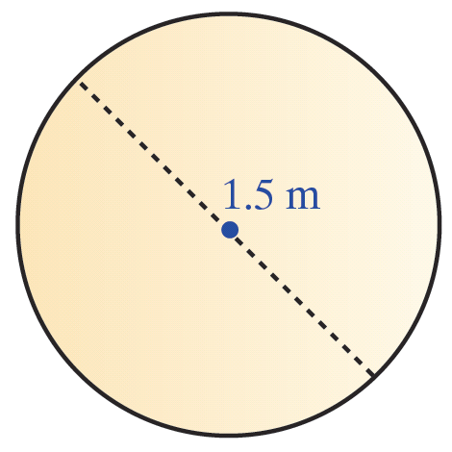
Example 9
Find the circumference of a circle with a diameter of 1.5 meters. Write the answer in both meters and feet.
Solution
Sketch the circle and label a diameter.

Slide 24
Example 9 (cont.)
The circumference is 4.71 m, or 15.4 ft.

Slide 25
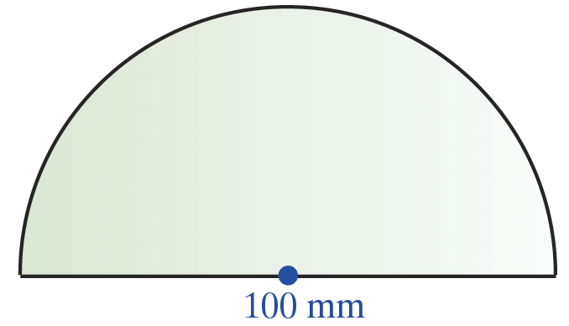
Example 10
Find the perimeter of a figure that is a semicircle (half of a circle) with a diameter of 100 mm. Find the perimeter in both millimeters and meters.
Solution
A sketch of the figure will help.

Slide 26
Example 10 (cont.)
Find the perimeter of the figure by adding the length of the diameter (100 mm) to the length of the arc of the semicircle.
So, the perimeter of the figure is 257 mm, or 0.257 m.

