Slide 1
Section 10.3
Area

Slide 2
Objectives
Recognize measures of area in the metric system.
Be able to change metric measures of area within the metric system.
Know how to use tables to convert units of area between the metric system and U.S. customary system.
Know the formulas for the area of several geometric figures.

Slide 3
Metric Units of Area
Metric Measures of Small Areas
1 cm² | = 100 mm²
1 dm² = 100 cm² | = 10 000 mm²
1 m² = 100 dm² = 10 000 cm² | = 1 000 000 mm²

Slide 4
Metric Units of Area
Changing Metric Measures of Area
Procedure Example
To change to a measure of area that is:
one unit smaller, multiply by 100,
two units smaller, multiply by 10 000,
three units smaller, multiply by 1 000 000,
and so on.
To change to a measure of area that is:
one unit larger, divide by 100,
two units larger, divide by 10 000,
three units larger, divide by 1 000 000,
and so on.

Slide 5
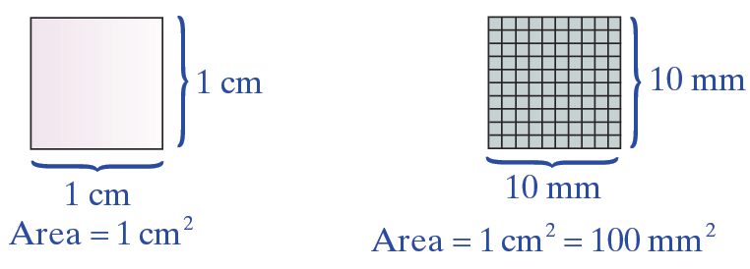
Example 1
a. A square 1 centimeter on each side encloses 100 square millimeters: 1 cm² = 100 mm²

Slide 6
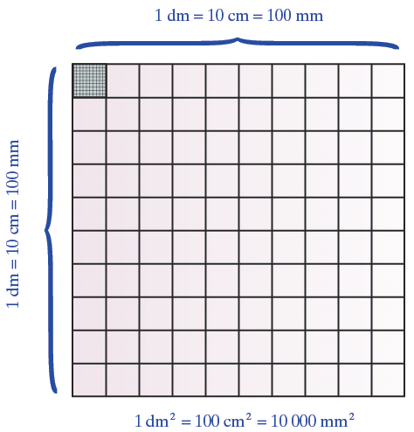
Example 1 (cont.)
b. A square 1 decimeter (10 cm) on a side encloses 1 square decimeter: 1 dm² = 100 cm² = 10 000 mm²

Slide 7
Example 2
The following examples illustrate how to change from larger to smaller units of area in the metric system.
a. 5 cm²
= 5(100 mm²)
= 500 mm²
(Note: mm² is one unit smaller than cm².)
= 5(1 cm²)

Slide 8
Example 2 (cont.)
b. 3 dm²
= 3(10 000 mm²)
= 30 000 mm²
(Note: mm² is two units smaller than dm².)
c. 9.8 km²
= 9.8(1 000 000 m²)
= 9 800 000 m²
(Note: m² is three units smaller than km².)
= 3(1 dm²)
= 9.8(1 km²)

Slide 9
Example 3
These examples illustrate how to change from smaller to larger units of area in the metric system.
a. 1.4 m²
(Note: dam² is one unit larger than m².)
b. 3500 mm²
(Note: cm² is one unit larger than mm².)
= 0.014 dam²
= 35 cm²

Slide 10
Example 3 (cont.)
c. 3500 mm²
(Note: m² is three units larger than mm².)
= 0.0035 m²

Slide 11
Metric Units of Area
Metric Measures of Land Area
1 a | = 100 m²
1 ha | = 100 a = 10 000 m²

Slide 12
Example 4
How many ares are in 1 km²? (Note: For comparison, 1 km is about 0.6 mile, so 1 km² is about 0.6 mi × 0.6 mi = 0.36 mi².)
Solution
Remember that 1 km = 1000 m, so
Divide m² by 100 to get ares.

Slide 13
U.S. Customary and Metric Equivalent Units of Area
U.S. Customary Units of Area
1 ft² | = 144 in²
1 yd² | = 9 ft²
1 acre | = 4840 yd² = 43,560 ft²

Slide 14
U.S. Customary and Metric Equivalent Units of Area
U.S. Customary and Metric Area Equivalents
U.S. to Metric |  | Metric to U.S.
1 in² | = 6.45 cm² | 1 cm² | = 0.155 in²
1 ft² | = 0.093 m² | 1 m² | = 10.764 ft²
1 yd² | = 0.836 m² | 1 m² | = 1.196 yd²
1 acre | = 0.405 ha | 1 ha | = 2.47 acres

Slide 15
U.S. Customary and Metric Equivalent Units of Area
Important Note About Conversions between U.S. and Metric Equivalents
As stated in Section 10.2, most of the conversion units are not exact and slightly different answers are possible, depending on the conversion units used. We will give area conversions rounded to the place of the first four digits only.

Slide 16
Example 5
a. 40 yd² = ____ m²
b. How many hectares are there in 5 acres?
Solutions
a. 40 yd²
= 40(0.836 m²)
= 33.44 m²
b. 5 acres
= 5(0.405 ha)
= 2.025 ha
= 40(1 yd²)
= 5(1 acre)

Slide 17
Example 6
a. Convert 5 hectares to acres.
b. Change 100 cm² to square inches.
Solutions
a. 5 ha
= 5(2.47 acres)
= 12.35 acres
b. 100 cm²
= 100(0.155 in.²)
= 15.5 in.²
= 5(1 ha)
= 100(1 cm²)

Slide 18
Geometry: Formulas for Area
Note
In triangles and other figures, the letter h is used to represent the height of the figure. The height is also called the altitude.

Slide 19
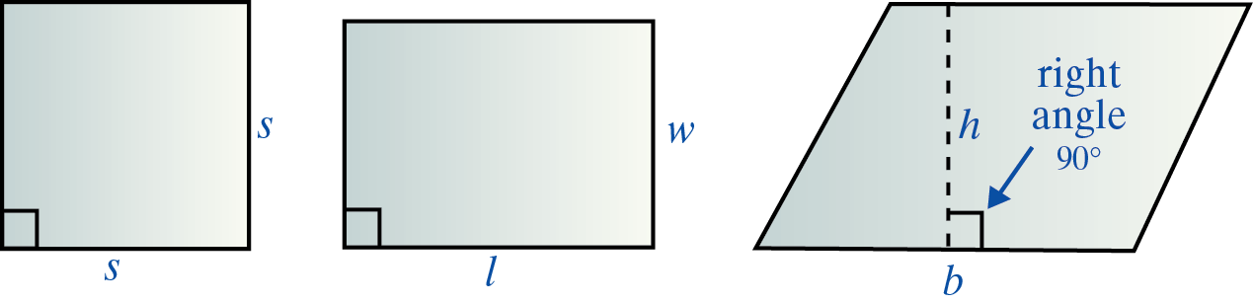
Geometry: Formulas for Area
Six Geometric Figures and the Formulas for Finding Their Areas

Slide 20
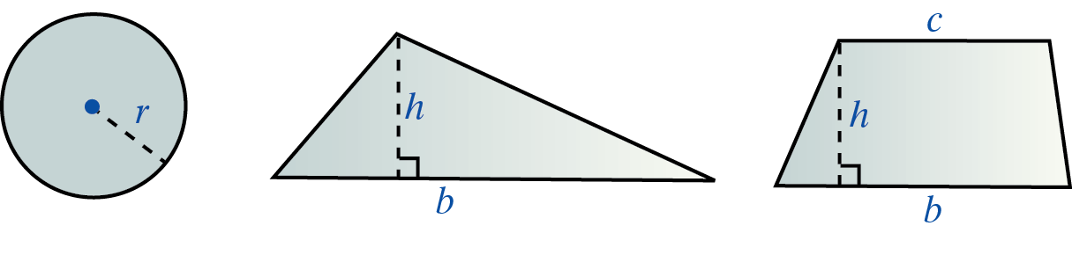
Geometry: Formulas for Area
Six Geometric Figures and the Formulas for Finding Their Areas (cont.)

Slide 21
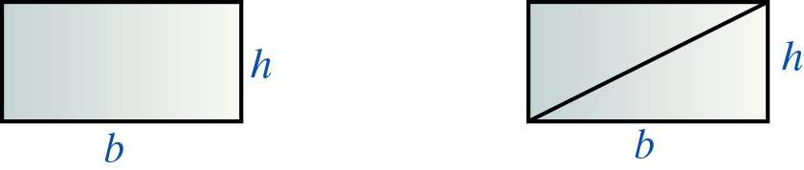
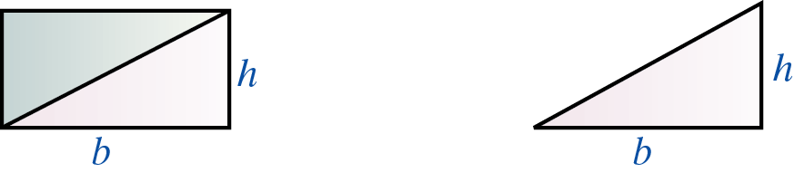
Geometry: Formulas for Area
Relationship of Area of a Triangle to the Area of a Rectangle

Slide 22
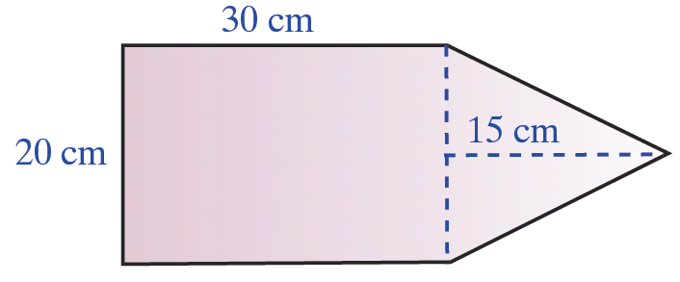
Example 7
Find the area of the figure shown here with the indicated dimensions. Write the answer in both square centimeters and square inches.
Solution
Find the area of the rectangle and the area of the triangle, and then add the two areas.

Slide 23
Example 7 (cont.)
Rectangle
Triangle
In square inches:

Slide 24
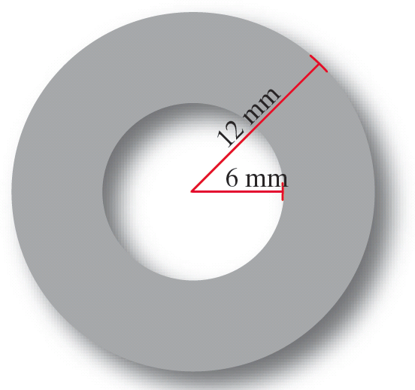
Example 8
Find the area of the washer (shaded portion) with dimensions as shown. Write the answer in both square millimeters and square centimeters.
Solution
Subtract the area of the inside (smaller) circle from the area of the outside (larger) circle. This difference will be the area of the washer (shaded portion).

Slide 25
Example 8 (cont.)
Larger Circle
Smaller Circle
In square centimeters:

Slide 26
Example 8 (cont.)
An alternate approach is to leave π in the first answers and substitute later as follows:
This approach is more algebraic in nature.
and

Slide 27
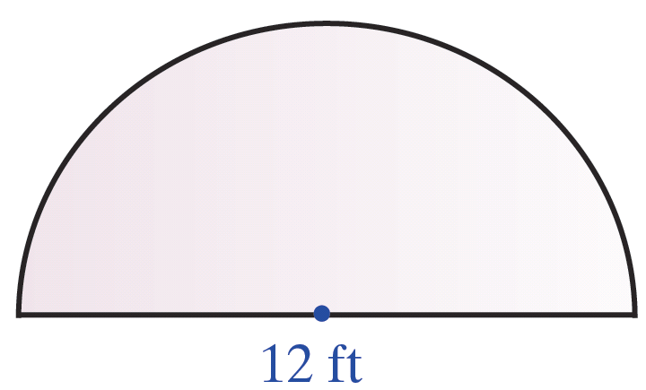
Example 9
Find the area enclosed by a semicircle and diameter if the diameter is 12 feet long. Write the answer in both square feet and square meters.
Solution
First, sketch the figure. (A semicircle is half of a circle.)

Slide 28
Example 9 (cont.)
For a circle, A = πr². So, for a semicircle,
For this semicircle, d = 12 ft, so r = 6 ft.
In square meters:

