Slide 1
Section 10.4
Volume

Slide 2
Objectives
Recognize measures of volume in the metric system.
Be able to change metric measures of volume within the metric system.
Know how to use tables to convert units of volume between the metric system and U.S. customary systems.
Know the formulas for the volume of several geometric figures.

Slide 3
Metric Units of Volume
Metric Measures of Volume
1 cm³ | = 1000 mm³
1 dm³ = 1000 cm³ | = 1 000 000 mm³
1 m³ = 1000 dm³ = 1 000 000 cm³ | = 1 000 000 000 mm³

Slide 4
Metric Units of Volume
Changing Metric Measures of Volume
Procedure Example
To change to a measure of volume that is
one unit smaller, multiply by 1000,
two units smaller, multiply by 1 000 000,
three units smaller, multiply
by 1 000 000 000,
and so on.
To change to a measure of volume that is
one unit larger, divide by 1000,
two units larger, divide by 1 000 000,
three units larger, divide
by 1 000 000 000,
and so on.

Slide 5
Example 1
The following examples illustrate how to change from larger to smaller units of volume in the metric system.
a. 15 cm³
= 15(1000 mm³)
= 15 000 mm³
b. 4.1 dm³
= 4.1(1000 cm³)
= 4100 cm³
= 15(1 cm³)
= 4.1(1 dm³)

Slide 6
Example 1 (cont.)
c. 22.6 m³
= (22.6)(1 000 000 cm³)
= 22 600 000 cm³
d. 4 m³
= 4(1000 dm³)
= 4000 dm³
= 4000(1000 cm³)
= 4 000 000 cm³
= 22.6(1 m³)
= 4(1 m³)

Slide 7
Example 2
The following examples illustrate how to change from smaller to larger units of volume in the metric system.

Slide 8
U.S. Customary and Metric Equivalent Units of Volume
Metric Units of Liquid Volume and Equivalents
Metric Units |  | Equivalents
1 milliliter (mL) | = 0.001 liter | 1 L | = 1000 mL
1 liter (L) | = 1.0 liter | 1 kL | = 1000 L
1 hectoliter (hL) | = 100 liters | 1 kL | = 10 hL
1 kiloliter (kL) | = 1000 liters | 1 L | = 1 dm³
 |  | 1 kL | = 1 m³
 |  | 1 mL | = 1 cm³

Slide 9
U.S. Customary and Metric Equivalent Units of Volume
U.S. Customary Units of Liquid Volume
1 pint (pt) | = 16 fluid ounces (fl oz)
1 quart (qt) | = 2 pt = 32 fl oz
1 gallon (gal) | = 4 qt

Slide 10
U.S. Customary and Metric Equivalent Units of Volume
U.S. Customary and Metric Volume Equivalents
U.S. to Metric |  | Metric to U.S.
1 in.³ | = 16.387 cm³ | 1 cm³ | = 0.06 in.³
1 ft.³ | = 0.028 m³ | 1 m³ | = 35.315 ft.³
1 qt | = 0.946 L | 1 L | = 1.06 qt
1 gal | = 3.785 L | 1 L | = 0.264 gal

Slide 11
U.S. Customary and Metric Equivalent Units of Volume
Important Note About Conversions between U.S. Customary and Metric
As stated in Sections 10.2 and 10.3, most of the conversion units are not exact and slightly different answers are possible, depending on the conversion units used. We will give volume conversions rounded to the place of the first three digits only.

Slide 12
Example 3
a. 20 gal = ___ L
b. How many liters are there in 6 qt?
Solutions
a. 20 gal
= 20(3.785 L)
= 75.7 L
b. 6 qt
= 6 (0.946 L)
= 5.676 L
= 20(1 gal)
= 6 (1 qt)

Slide 13
Example 4
a. Change 42 L to gallons.
b. Express 10 cm³ in cubic inches.
Solutions
a. 42 L
= 11.088 gal
= 11.09 gal (rounded)
b. 10 cm³
= 10(0.06 in.³ )
= 0.6 in.³
= 42(1 L)
= 42(0.264 gal)
= 10(1 cm³ )

Slide 14
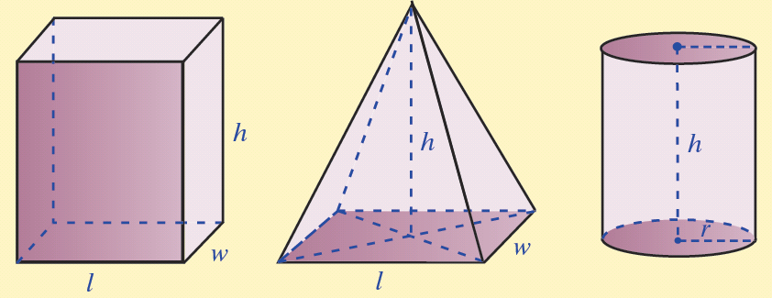
Geometry: Formulas for Volume
Five Geometric Solids and the Formulas for Their Volumes

Slide 15
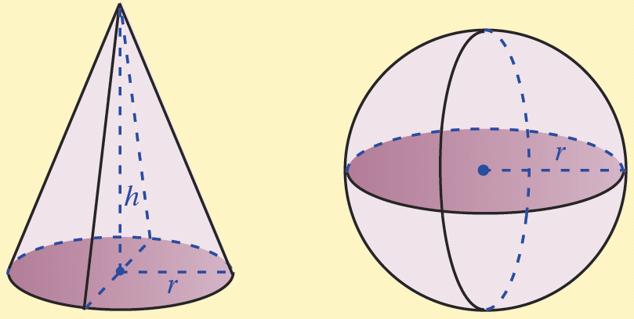
Geometry: Formulas for Volume
Five Geometric Solids and the Formulas for Their Volumes (cont.)

Slide 16
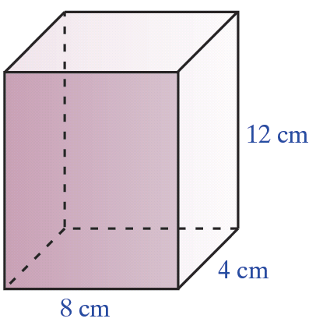
Example 5
Find the volume of the rectangular
solid with length 8 cm, width
4 cm, and height 12 cm. Write
the answer in both cubic
centimeters and milliliters.
Solution

Slide 17
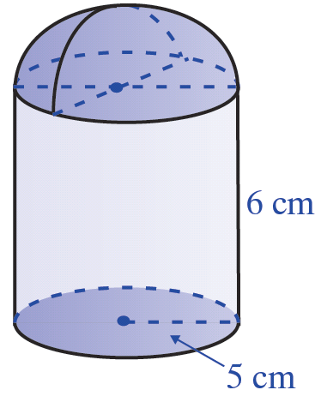
Example 6
Find the volume of the solid with
the dimensions indicated. Write
the answer in both cubic
centimeters and liters.
Solution
From the illustration, the solid is a hemisphere resting on top of a cylinder. Thus, the volume of the solid will be the sum of the volumes of these two figures.

Slide 18
Example 6: Volume (cont.)
Cylinder
Hemisphere
Total Volume
cylinder
hemisphere
total volume

