Slide 1
Section 2.5
Applications: Change in Value and Average

Slide 2
Objectives
Understand how the change between two integer values can be found by subtracting the beginning value from the end value.
Be able to find the average of several integers.

Slide 3
Example 1
On a cold day at a ski resort, the temperature dropped from a high of 25°F at 1 p.m. to a low of –10°F at 2 a.m.
What was the change in temperature?
Solution
–10° – (25°)
–
The temperature dropped 35°,
so the change was –35° F.
= –35°
end temperature
beginning temperature
= change

Slide 4
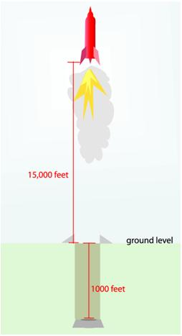
Example 2
A rocket was fired from a silo 1000 feet below ground level. If the rocket attained a height of 15,000 feet what was its change in altitude?
Solution
The end value was +15,000 feet.
The beginning value was –1000 feet since
the rocket was below ground level.

Slide 5
Example 2 (cont.)
Change = 15,000 – (–1000 )
= 15000 + 1000
= 16,000 feet
The change in altitude was 16,000 feet.

Slide 6
Average
Average
The average of a set of numbers is the value found by adding the numbers in the set, then dividing this sum by the number of numbers in the set.

Slide 7
Example 3
Find the average noonday temperature for the 5 days on which the temperature at noon was 10°F, –2°F, 5°F, –7°F, and –11°F.
Solution
Find the sum of the temperatures and then divide the sum by 5.

Slide 8
Example 3 (cont.)
The average noonday temperature was –1°F (or 1°F below 0).
average
sum

Slide 9
Example 4
On an art history exam, two students scored 95, five scored 86, one scored 78, and six scored 75. What is the mean score for the class on this exam?
Solution

Slide 10
Example 4 (cont.)
We multiplied rather than wrote down all 14 scores. Thus the sum of the four products represents the sum of 14 exam scores, and the sum is divided by 14.
The class mean is 82 points.
mean score

Slide 11
Example 5
Below is a bar graph showing the number of hybrid cars sold in the U.S. from the year 2000 to 2004. a. What year had the highest number of hybrid car sales?
b. What year had the lowest number of hybrid car sales? c. Find the average number of car sales per year over the five year period.

Slide 12
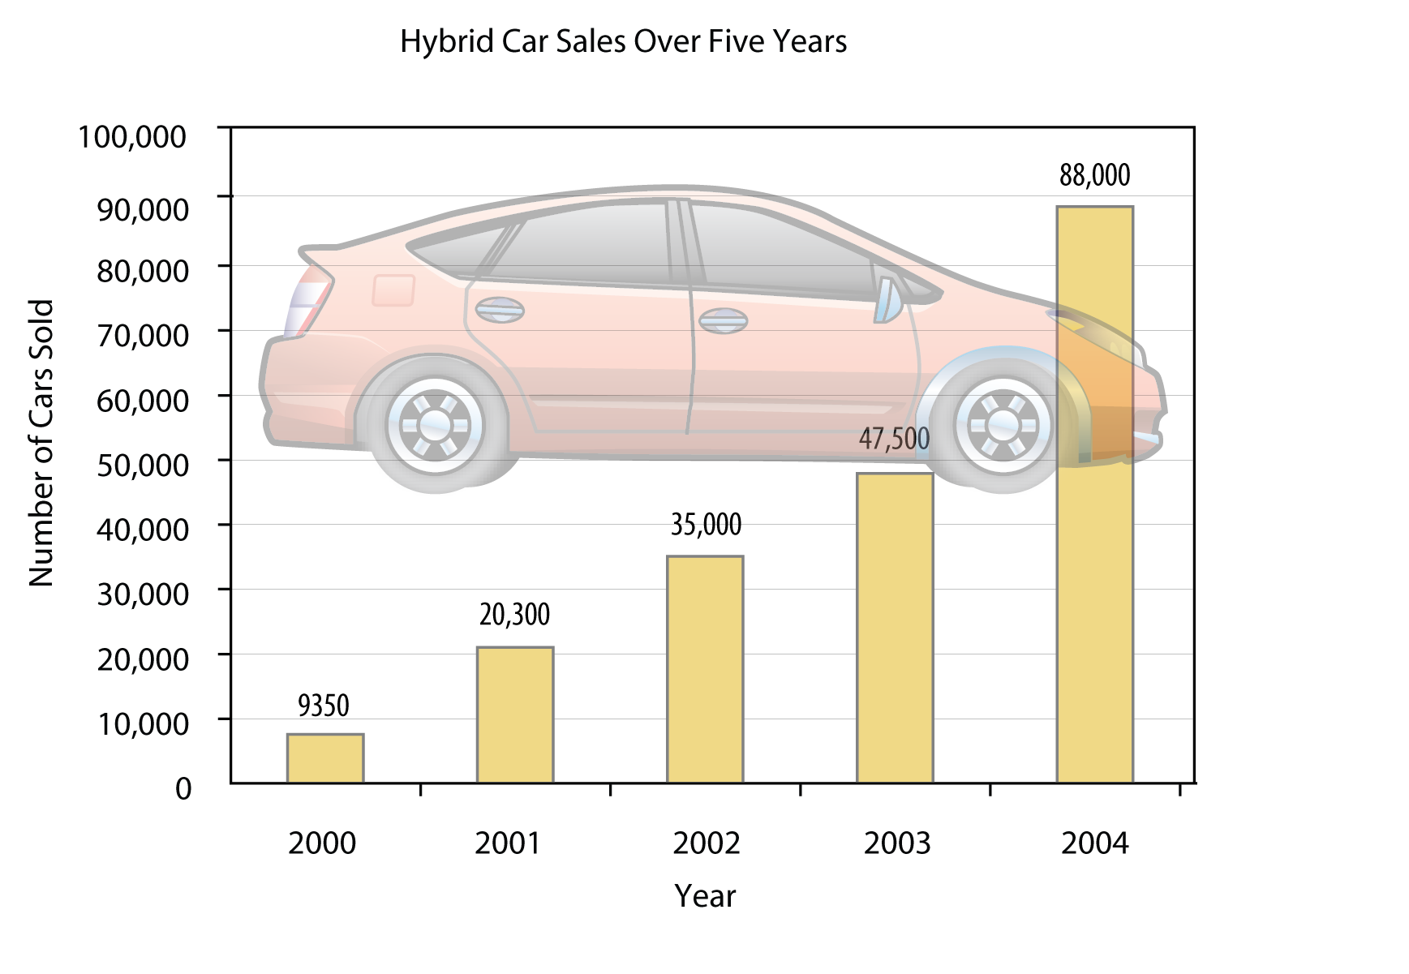
Example 5 (cont.)

Slide 13
Example 5 (cont.)
Solutions
a. From the bar graph, we can see that 2004 had the highest number of hybrid car sales with 88,000 cars sold.
b. From the bar graph, we can see that 2000 had the lowest number of hybrid car sales with 9350 cars sold.

Slide 14
Example 5 (cont.)
c. In order to find the average number of cars sold per year over five years, find the sum of yearly sales and divide the sum by 5.
The average hybrid sales per year over the last five years is 40,030 cars.
mean score

