Slide 1
Section 3.4
Least Common Multiple (LCM)

Slide 2
Objectives
Understand the meaning of the term least common multiple.
Be able to use prime factorizations to find the least common multiple of a set of numbers and a set of algebraic terms.
Recognize the application of the LCM concept in a word problem.

Slide 3
Finding the LCM of a Set of Counting (or Natural) Numbers
To Find the LCM of a Set of Counting Numbers
1. Find the prime factorization of each number.
2. Identify the prime factors that appear in any one of the prime factorizations.
3. Form the product of these primes using each prime the most number of times it appears in any one of the prime factorizations.

Slide 4
Example 1
Find the least common multiple (LCM) of 8, 10, and 30.
Solution
a. Prime factorizations:
8 = 2 ⋅ 2 ⋅ 2 three 2’s
10 = 2 ⋅ 5 one 2, one 5
30 = 2 ⋅ 3 ⋅ 5 one 2, one 3, one 5
b. Prime factors that are present are 2, 3, and 5.

Slide 5
Example 1 (cont.)
c. The most of each prime factor in any one factorization:
Three 2’s (in 8)
One 3 (in 30)
One 5 (in 10 and in 30)
LCM = 2 ⋅ 2 ⋅ 2 ⋅ 3 ⋅ 5 = 2³ ⋅ 3 ⋅ 5
= 120
120 is the LCM and therefore, the smallest number divisible by 8, 10, and 30.

Slide 6
Example 2
Find the LCM of 27, 30, 35, and 42.
Solution
a. Prime factorizations:
27 = 3 ⋅ 3 ⋅ 3 three 3’s
30 = 2 ⋅ 3 ⋅ 5 one 2, one 3, one 5
35 = 5 ⋅ 7 one 5, one 7
42 = 2 ⋅ 3 ⋅ 7 one 2, one 3, one 7
b. Prime factors present are 2, 3, 5, and 7.

Slide 7
Example 2 (cont.)
c. The most of each prime factor in any one factorization:
One 2 (in 30 and in 42)
Three 3’s (in 27)
One 5 (in 30 and in 35)
One 7 (in 35 and in 42)
LCM = 2 ⋅ 3 ⋅ 3 ⋅ 3 ⋅ 5 ⋅ 7 = 2 ⋅ 3³ ⋅ 5 ⋅ 7
= 1890
1890 is the smallest number divisible by all four of the numbers 27, 30, 35, and 42.

Slide 8
Completion Example 3
Find the LCM for 15, 24, and 36.
Solution
a. Prime factorizations:
15 = _____________
24 = _____________
36 = _____________
b. The only prime factors are ________, _________, and ________.
3 ⋅ 5
2 ⋅ 2 ⋅ 2 ⋅ 3
2 ⋅ 2 ⋅ 3 ⋅ 3
2
3
5

Slide 9
Completion Example 3 (cont.)
c. The most of each prime factor in any one factorization:
___________ (in 24)
___________ (in 36)
___________ (in 15)
LCM = ______________ = __________ (using exponents)
= __________
Three 2’s
Two 3’s
One 5
2 ⋅ 2 ⋅ 2 ⋅ 3 ⋅ 3 ⋅ 5
2³ ⋅ 3² ⋅ 5
360

Slide 10
Completion Example 4
a. Find the LCM for 18, 36, and 66, and
b. Tell how many times each number divides into the LCM.
Solutions
a.

Slide 11
Completion Example 4 (cont.)
2 ⋅ 2 ⋅ 3 ⋅ 3 ⋅ 11
b. 396 = _____________
= ( 2 ⋅ 3 ⋅ 3 ) ⋅ _______
= 18 ⋅ ___
396 = _____________
= ( 2 ⋅ 2 ⋅ 3 ⋅ 3 ) ⋅ ______
= 36 ⋅ ___
396 = _____________
= ( 2 ⋅ 3 ⋅ 11 ) ⋅ _______
= 66 ⋅ ______
( 2 ⋅ 11)
22
2 ⋅ 2 ⋅ 3 ⋅ 3 ⋅ 11
( 11 )
11
2 ⋅ 2 ⋅ 3 ⋅ 3 ⋅ 11
( 2 ⋅ 3 )
6

Slide 12
Example 5
Find the LCM of the terms 6a, a²b, 4a², and 18b³.
Solution
Write each prime factorization in exponential form (including variables) and multiply the largest powers of each prime factor, including variables.

Slide 13
Example 6
Find the LCM of the terms 16x, 25xy³, 30x²y.
Solution
Write each prime factorization in exponential form (including variables) and multiply the largest powers of each prime factor, including variables.

Slide 14
Completion Example 7
Find the LCM of the terms 8xy, 10x², and 20y.
Solution

Slide 15
Example 8
Suppose three weather satellites − A, B, and C − are orbiting the earth at different times. Satellite A takes 24 hours, B takes 18 hours, and C takes 12 hours. If they are directly above each other now, as shown in part (a) of the figure, in how many hours will they again be directly above each other in the position shown in part (a) ? How many orbits will each satellite have made in that time?

Slide 16
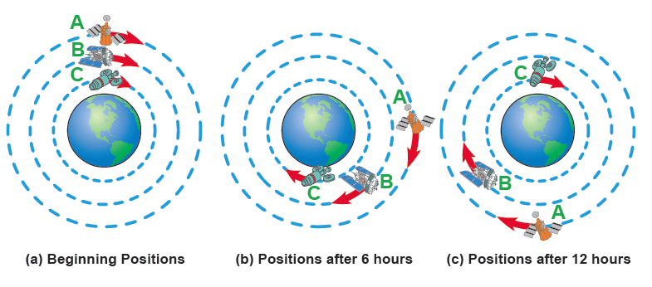
Example 8 (cont.)

Slide 17
Example 8 (cont.)
Solution
Study the diagrams shown. When the three satellites are again in the position shown, each will have made some number of complete orbits. Since A takes 24 hours to make one complete orbit, the solution must be a multiple of 24. Similarly, the solution must be a multiple of 18 and a multiple of 12 to allow for complete orbits of satellites B and C.

Slide 18
Example 8 (cont.)
The solution is the LCM of 24, 18, and 12.
Thus, the satellites will align again at the position shown in 72 hours (or 3 days).
Note that: Satellite A will have made 3 orbits: 24 ⋅ 3 = 72
Satellite B will have made 4 orbits: 18 ⋅ 4 = 72
Satellite C will have made 6 orbits: 12 ⋅ 6 = 72.

