Slide 1
Section 3.5
Reducing and Multiplication with Fractions

Slide 2
Objectives
Know that the term rational number is the technical term for fraction.
Know how to multiply fractions.
Be able to determine what to multiply by in order to build a fraction to higher terms.
Know how to reduce a fraction to lowest terms.
Be able to multiply fractions and reduce at the same time.

Slide 3
Rational Numbers
Rational Number
A rational number is a number that can be written in
the form where

Slide 4
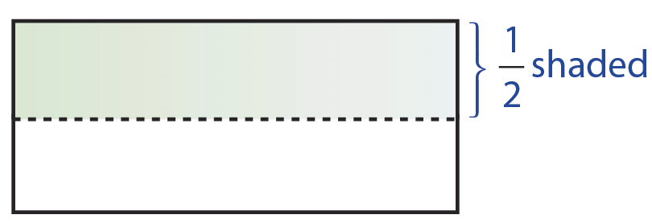
Example 1
a. can mean 1 of 2 equal parts.

Slide 5
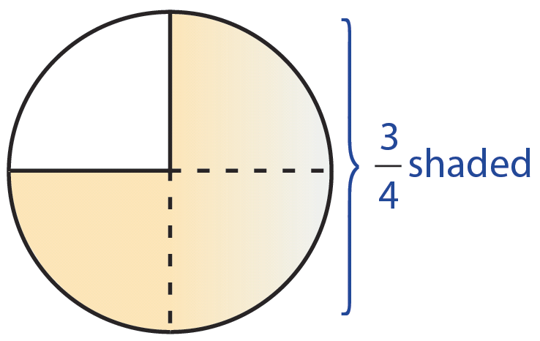
Example 1 (cont.)
b. can mean 3 of 4 equal parts.

Slide 6
Example 1 (cont.)
c. In chapter 2, we used the fraction form of a number to indicate division. For example,

Slide 7
Rational Numbers
Proper Fraction, Improper Fraction
A proper fraction is a fraction in which the numerator is less than the denominator.
An improper fraction is a fraction in which the numerator is greater than the denominator.

Slide 8
Rational Numbers
Rules for Placement of Negative Signs

Slide 9
Example 2

Slide 10
Multiplying Rational Numbers (or Fractions)
To Multiply Fractions
1. Multiply the numerators.
2. Multiply the denominators.

Slide 11
Example 3
Find the product of
Solution

Slide 12
Example 4
Find
Solution

Slide 13
Example 5

Slide 14
Multiplying Rational Numbers (or Fractions)
Commutative Property of Multiplication

Slide 15
Example 6
Illustrates the commutative
property of multiplication.

Slide 16
Multiplying Rational Numbers (or Fractions)
Associative Property of Multiplication

Slide 17
Example 7
Illustrates the associative
property of multiplication.

Slide 18
Raising Fractions to Higher Terms and Reducing Fractions
Multiplicative Identity

Slide 19
Example 8
Raise to higher terms as indicated:
Solution
We know that

Slide 20
Example 9
Raise to higher terms as indicated:
Solution
We know that

Slide 21
Raising Fractions to Higher Terms and Reducing Fractions
To Reduce a Fraction to Lowest Terms
1. Factor the numerator and denominator into prime factorizations.
2. Use the fact that and “divide out” all common factors.
Note: Reduced fractions might be improper fractions.

Slide 22
Example 10
Reduce
Solution
If both the numerator and denominator have a factor of –1, then we “divide out” –1 and treat the fraction
as positive, since

Slide 23
Example 11
Reduce
Solution

Slide 24
Example 12
Reduce
Solution
a. Using prime factors, we have
b. Larger common factors can be divided out, but we must be sure that we have the largest common factor.
Note that the answer is a reduced improper fraction.

Slide 25
Completion Example 13
Reduce
Solution

Slide 26
Example 14
Multiply and reduce to lowest terms.

Slide 27
Example 15
Multiply and reduce to lowest terms.
In this example, 25 is a common factor that is not a prime number.

Slide 28
Example 16
Multiply and reduce to lowest terms.

Slide 29
Completion Example 17
Multiply and reduce to lowest terms.

Slide 30
Example 18
3
3
6 divides into both 18 and 12.
7 divides into both 21 and 35.
5
2

Slide 31
Example 19
2
1
1
4
17 divides into both 17 and 34.
25 divides into both 25 and 50.
2 divides into both 8 and 2.
2 divides into both 4 and 2.
2
2

Slide 32
Example 20
If you had $25 and you spent $15 to buy computer disks, what fraction of your money did you spend for computer disks? What fraction do you still have?
Solution
a. The fraction you spent is
b. Since you still have $10, the fraction you still have is

