Slide 1
Section 3.7
Addition and Subtraction with Fractions

Slide 2
Objectives
Be able to add fractions with the same denominator.
Be able to add fractions with different denominators.
Be able to subtract fractions with the same denominator.
Be able to subtract fractions with different denominators.
Learn how to add and subtract fractions with variables in the numerators or denominators.

Slide 3
Addition with Fractions
To Add Two (or More) Fractions with the Same Denominator
1. Add the numerators.
2. Keep the common denominator.
3. Reduce, if possible.

Slide 4
Example 1

Slide 5
Example 2

Slide 6
Addition with Fractions
To Add Two Fractions with Different Denominators
1. Find the least common denominator (LCD).
2. Change each fraction into an equivalent fraction with that denominator.
3. Add the new fractions.
4. Reduce, if possible.

Slide 7
Example 3
Find the sum:
Solution
a. Find the LCD. Remember that the least common denominator (LCD) is the least common multiple (LCM) of the denominators.

Slide 8
Example 3 (cont.)
Note: You might not need to use prime factorizations to find the LCD. If the denominators are numbers that are familiar to you, then you might be able to find the LCD simply by inspection.

Slide 9
Example 3 (cont.)
b. Find fractions equal to with denominator 24.

Slide 10
Example 3 (cont.)
c. Add
d. The fraction is in lowest terms because 35 and
24 have only +1 and –1 as common factors.

Slide 11
Example 4
Find the sum:
Solution
a. Find the LCD.

Slide 12
Example 4 (cont.)
b. Steps b, c, and d from Example 3 can be written together in one step.

Slide 13
Example 4 (cont.)
Note that, in adding fractions, we also may choose to write them vertically. The process is the same.

Slide 14
Example 5
Find the sum:
Solution
a. LCD = 1000. All the denominators are powers of 10,
and 1000 is the largest. Write 6 as

Slide 15
Example 5 (cont.)
Note: The only prime factors of 1000 are 2’s and 5’s. And since neither 2 nor 5 is a factor of 6903, the answer will not reduce.

Slide 16
Addition with Fractions
Common Error
The following common error must be avoided:
Find the sum
Incorrect Solution
You cannot cancel across the + sign.

Slide 17
Addition with Fractions
Common Error (cont.)
Correct Solution
Use LCD = 6.
NOW reduce.
2 is a factor in both the numerator and the denominator.

Slide 18
Addition with Fractions
Commutative Property of Addition

Slide 19
Addition with Fractions
Associative Property of Addition

Slide 20
Subtraction with Fractions
To Subtract Two Fractions with the Same Denominator
1. Subtract the numerators.
2. Keep the common denominator
3. Reduce if possible.

Slide 21
Example 6
Find the difference:
Solution
The difference is reduced just as any fraction is reduced.

Slide 22
Example 7
Find the difference:
Solution
The difference is negative because a larger number is subtracted from a smaller number.

Slide 23
Subtraction with Fractions
To Subtract Two Fractions with Different Denominators
1. Find the least common denominator (LCD).
2. Change each fraction to an equal fraction with that denominator.
3. Subtract the new fractions.
4. Reduce, if possible.

Slide 24
Example 8
Find the difference:
Solution
a. Find the LCD.

Slide 25
Example 8 (cont.)
b. Find equivalent fractions with denominator 165, subtract, and reduce.
The answer does not reduce because there are no
common prime factors in the numerator and denominator.

Slide 26
Example 9
Subtract:
Solution
a. Since 1 can be written the LCD is 15.

Slide 27
Completion Example 10
Find the algebraic difference as indicated:
Solution
a. Find the LCD.

Slide 28
Completion Example 10 (cont.)

Slide 29
Example 11
Find the sum:
Solution
The fractions all have the same denominator, so we simply add the numerators and keep the common denominator.

Slide 30
Example 12
Find the sum:
Solution
The two fractions have different denominators. The LCD is the product of the two denominators: 8x.

Slide 31
Subtraction with Fractions
Caution
Do not try to reduce the answer in Example 12.
In the fraction neither 8 nor x is a factor of
the numerator.
We will see in Chapter 8, and in later courses in mathematics, how to factor and reduce algebraic fractions when there is a common factor in the numerator and denominator. For example, by using the distributive property we can find factors and reduce each of the following fractions:

Slide 32
Subtraction with Fractions
Caution (cont.)
Notice that, while 8 is a common factor here, x is not.
3 is a common factor and y is not a common factor.

Slide 33
Example 13
Find the difference:
Solution
The LCD is 18.
Notice that this fraction cannot be reduced because there are no common factors in the numerator and denominator.

Slide 34
Example 14
Simplify the following expression:
Solution
The LCD is 12.

Slide 35
Example 14 (cont.)
Notice that this fraction cannot be reduced because there are no common factors in the numerator and denominator.

Slide 36
Completion Example 15
Subtract:
Solution
The LCD is ____.

Slide 37
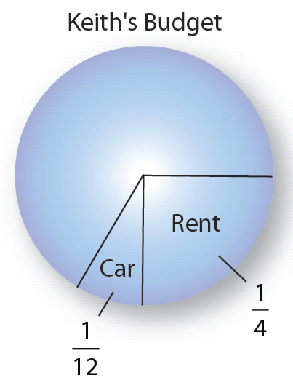
Example 16
If Keith’s total income for the year
was $36,000 and he spent of
his income on rent and of
his income on his car, what total amount did he spend on these two items?

Slide 38
Example 16 (cont.)
Solution
We can add the two fractions, and multiply the sum by $36,000. (Or we can multiply each fraction by $36,000, and then add the results. We will get the same answer either way.) The LCD is 12.

Slide 39
Example 16 (cont.)
Now multiply times $36,000.
Keith spent a total of $12,000 on rent and his car.
12,000
1

