Slide 1
Section 4.2
Multiplication and Division with Mixed Numbers

Slide 2
Objectives
Learn how to multiply with mixed numbers.
Know how to find the area of a rectangle and the area of a triangle.
Know how to find the volume of a three‑dimensional rectangular solid.
Learn how to divide with mixed numbers.

Slide 3
Multiplication with Mixed Numbers
To Multiply Mixed Numbers
1. Change each number to fraction form.
2. Factor the numerator and denominator of each improper fraction, and then reduce and multiply.
3. Change the answer to a mixed number or leave it in fraction form. (The choice sometimes depends on what use is to be made of the answer.)

Slide 4
Example 1
Find the product:
Solution
Change each mixed number to fraction form, then multiply the fractions.

Slide 5
Example 2
Multiply and reduce to lowest terms:
Solution

Slide 6
Example 3
Find the product of
Solution

Slide 7
Multiplication with Mixed Numbers
Note
Because most calculators work with rounded decimal numbers, they are not designed to multiply or divide with numbers in the form of fractions or mixed numbers. The answers (in decimal form) (See Chapter 5) may not be exact. However, with the TI-84 Plus there is a process that will allow fractions to be multiplied (or divided) and will give fractional answers (in reduced form).

Slide 8
Multiplication with Mixed Numbers
Note (cont.)
Specifically, the TI-84 Plus has a menu item under the key . This selection is marked as Frac.
When you add, subtract, multiply, or divide with decimal numbers and/or fractions, press the key, and choose the first selection ( Frac ) from the list. Press and Frac will appear on the display.
Press again and the answer will appear in fraction form.

Slide 9
Multiplication with Mixed Numbers
Note (cont.)
If you have a TI-84 Plus or similar graphing calculator, your instructor may want you to use your calculator to help check your work.
Obviously, calculators and computers can operate quickly and accurately. However, remember that calculators and computers do not think for you. To advance in mathematics, you need to understand general concepts, and you should not rely on a calculator or computer to do your thinking for you.

Slide 10
Example 4
Multiply by using a calculator.
Solution
a. Change each mixed number into an improper fraction. Use a calculator or do the work with pencil and paper as shown here.

Slide 11
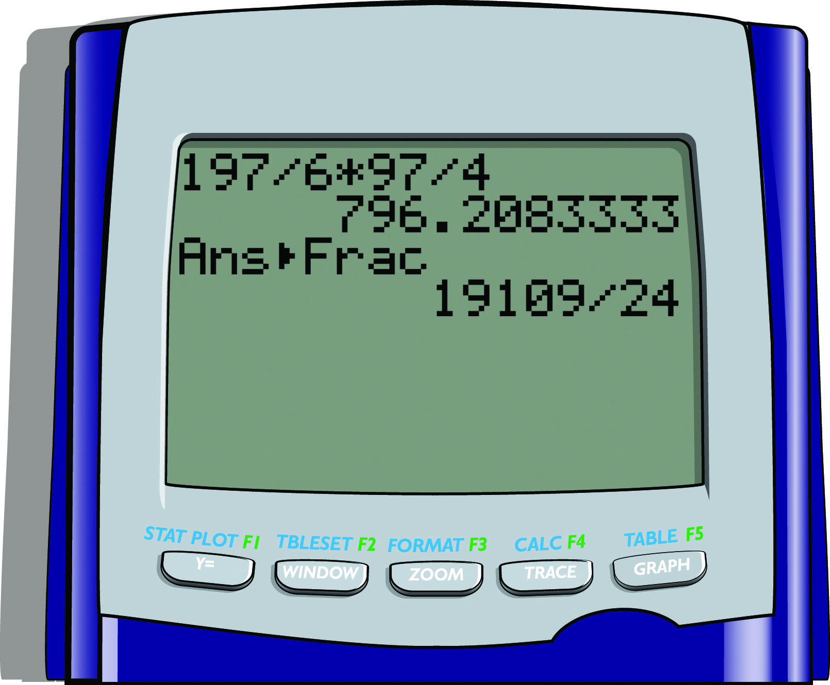
Example 4 (cont.)
b. Now, with your calculator:

Slide 12
Example 4 (cont.)
Divide to get the answer in mixed number form.

Slide 13
Completion Example 5
Find the product and write it as a mixed number with
the fraction part in lowest terms:
Solution

Slide 14
Completion Example 6
Multiply:
Solution

Slide 15
Multiplication with Mixed Numbers
Note
To find a fraction of a number means to multiply the number by the fraction.

Slide 16
Example 7
Find
Solution
8
1

Slide 17
Example 8
Find
Solution

Slide 18
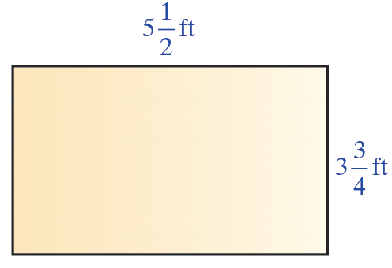
Example 9
Find the area of the rectangle with sides of length
Solution
The area is the product of the length times the width and we can use the formula A = lw.

Slide 19
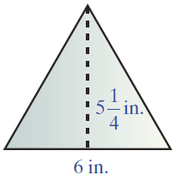
Example 10
Find the area of the triangle with base 6 in. and height
Solution
The area can be found using the
formula

Slide 20
Example 10 (cont.)
The area of the triangle is square inches (or in.²).
3
1

Slide 21
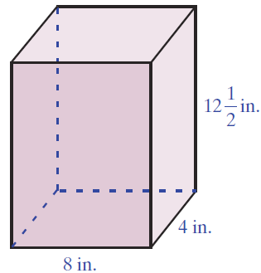
Example 11
Find the volume of the rectangular solid with
dimensions 8 inches by 4 inches by
Solution

Slide 22
Division With Mixed Numbers
To Divide with Mixed Numbers
1. Change each number to fraction form.
2. Multiply by the reciprocal of the divisor.
3. Reduce, if possible.

Slide 23
Example 12
Divide:
Solution
First, change the mixed number to the improper
fraction and then multiply by its reciprocal.

Slide 24
Completion Example 13
Find the quotient:
Solution

Slide 25
Example 14
The product of two numbers is One of the numbers is What is the other number?
Solution
Reasoning that is to be multiplied by some unknown number, we can write

Slide 26
Example 14 (cont.)
To find the missing number, divide Do not multiply.

Slide 27
Example 14 (cont.)
The other number is OR, reasoning again that
is to be multiplied by some unknown number, we can write an equation and solve the equation. If x is the unknown number, then
Multiply both sides by the
reciprocal of the coefficient.
Note that this is the same as
dividing by

Slide 28
Example 14 (cont.)
CHECK:

