Slide 1
Section 4.6
Solving Equations: Ratios and Proportions

Slide 2
Objectives
Understand the meaning of the term ratio.
Become familiar with the basic concepts related to probability.
Understand that a proportion is an equation.
Know the meanings of the terms means and extremes.
Know how to solve for the unknown term in a proportion.

Slide 3
Objectives (cont.)
Learn how to solve word problems and problems in geometry by setting up and solving proportions with unknown terms.

Slide 4
Understanding Ratios
Ratio
A ratio is a comparison of two quantities by division. The ratio of a to b can be written as
or a : b or a to b.

Slide 5
Example 1
Major league baseball players’ batting averages are a rate (a ratio) of the number of hits to the number of times at bat. (Newspapers report these numbers in decimal form. See Chapter 5.) Suppose a player has a batting average indicating he gets 320 hits for every 1000 times he is at bat. What is this player’s rate of hits to times at bat in reduced form?

Slide 6
Example 1 (cont.)
Solution
In fraction form, his batting average is the ratio:
Reducing gives
This means that we can expect this player to hit safely at a rate of 8 hits for every 25 times he comes to bat.

Slide 7
Example 2
What is the reduced ratio of 250 centimeters (cm) to 2 meters (m)? Centimeters and meters are units of measure in the metric system. (See Chapter 10 for more details.)
Solution
Here we change the units so that they are the same. There are 100 centimeters in 1 meter. Therefore, 2 m = 200 cm, and the ratio is
The reduced ratio can also be written as 5 : 4 or 5 to 4.

Slide 8
Example 3
If two fair coins are tossed, find the probability of the following events:
a. exactly one heads occurs
b. at least one heads occurs
Solutions
We know that the possible outcomes are {HH,HT,TH,TT}.
a. Of all possible outcomes, there are two outcomes with exactly one heads: HT, TH.

Slide 9
Example 3 (cont.)
Each of these outcomes is considered a success. Thus
b. There are three outcomes with at least one heads: HH, HT, TH.
Each of these outcomes is considered a success. The probability is the ratio of 3 to 4:

Slide 10
Example 4
If one die is rolled, the set of possible outcomes can be indicated as {1, 2, 3, 4, 5, 6}. Find the probability that the number showing on top is an odd number.
Solution
Of the six possibilities there are three odd numbers: namely, 1, 3, 5.
Any of these three numbers is considered a success and

Slide 11
Understanding Proportions
Proportion
A proportion is a statement that two ratios are equal.
In symbols, is a proportion.

Slide 12
Understanding Proportions
Means and Extremes
In a true proportion, the product of the extremes is equal to the product of the means. In symbols,
if and only if a ⋅ d = b ⋅ c (where b ≠ 0 and
d ≠ 0).

Slide 13
Example 5
Determine whether each of the following proportions is true or false.

Slide 14
Example 5 (cont.)
Solutions
a. For the proportion
the product of the extremes is 6 × 20 = 120, and
the product of the means is 8 × 15 = 120.
Since the product of the extremes is equal to the
product of the means, the proportion
is true.

Slide 15
Example 5 (cont.)
b. For the proportion the calculations
shown here could easily be performed with a calculator.
The product of the extremes:

Slide 16
Example 5 (cont.)
The product of the means:
Since the product of the extremes is equal to the product of the means, the proportion is true.

Slide 17
Example 5 (cont.)
c. For the proportion change the means
and extremes to improper fraction form and multiply:
The product of the means is

Slide 18
Example 5 (cont.)
and the product of the extremes is
Since the product of the extremes is equal to the product of the means, the proportion is true.

Slide 19
Applications
Solving for the Unknown Term in a Proportion
1. If the unknown term is in a denominator, solve by setting the product of the means equal to the product of the extremes and then solving the resulting equation.
2. If the unknown term is in a numerator, solve the proportion directly by multiplying both sides by the reciprocal of the denominator as in Section 3.6.

Slide 20
Example 6
Find the unknown term in the following proportion:
(In this case, the unknown term is in the
denominator.)
Solution
Write the proportion.
Write the product of the extremes equal to the product of the means.
Solve the equation.

Slide 21
Completion Example 7
Find the value of x if (In this case the
unknown term is in the numerator.)
Solution
Since the unknown term is in the numerator, multiply both sides by 100 and solve the proportion in one step.

Slide 22
Completion Example 7 (cont.)
Write the proportion.
Multiply both sides by _________.
Simplify.

Slide 23
Applications
Setting Up a Proportion
Suppose that a car will travel 500 miles on 20 gallons of gas. How far would you expect to travel on 30 gallons of gas?
Pattern A: Each ratio has different units, but they are in the same order. For example,

Slide 24
Applications
Setting Up a Proportion (cont.)
Pattern B: Each ratio has the same units, the numerators correspond, and the denominators correspond. For example,

Slide 25
Applications
Setting Up a Proportion (cont.)
With every one of the four equations illustrated in Pattern A and Pattern B, setting the product of the extremes equal to the product of the means will give the same equation to be solved, namely,
20x = 500 × 30.
So you may use the form that occurs to you first. The solution will be the same regardless of the form chosen.

Slide 26
Example 8
An architect draws the plans for a building using a scale
of inch to represent 10 feet. How many feet would
6 inches represent?
Solution
Step 1: Let y represent the number of unknown feet.
Step 2: Set up a proportion and label the numerators and denominators to be sure that the pattern is correct.

Slide 27
Example 8 (cont.)
Step 3: One such proportion (following Pattern B) is
Any of the proportions following Pattern A or Pattern B will give the same solution.

Slide 28
Example 8 (cont.)
Step 4: Solve the proportion:
Multiply both sides by
the reciprocal of

Slide 29
Example 8 (cont.)
Therefore, on the architect’s drawing, 6 inches represents 80 feet.

Slide 30
Applications
Two Triangles are Similar if
1. Their corresponding angles are equal. (The corresponding angles have the same measure.)
2. Their corresponding sides are proportional.

Slide 31
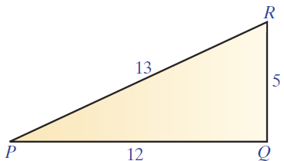
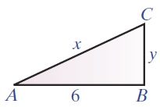
Example 9
Given that ΔABC ∼ ΔPQR, use the fact that corresponding sides are proportional and find the values of x and y.

Slide 32
Example 9 (cont.)
Solution
Set up two proportions and solve for the unknown terms.

Slide 33
Example 9 (cont.)
OR: Reducing first may lead to equations that are easier to solve. The answers will be the same.

Slide 34
Example 10
A very tall magnificently decorated tree was on display in an outside patio area at the mall during the month before Christmas. Joann knew that the height of a nearby lamppost was 10 feet. At 2 p.m. on a Tuesday afternoon, she measured the shadow of the lamppost
to be feet long and the shadow of the tree to be 21
feet long and the shadow of the tree to be 21 feet long.
With her understanding of similar triangles, Joann was able to calculate the height of the tree. What was the height of the tree?

Slide 35
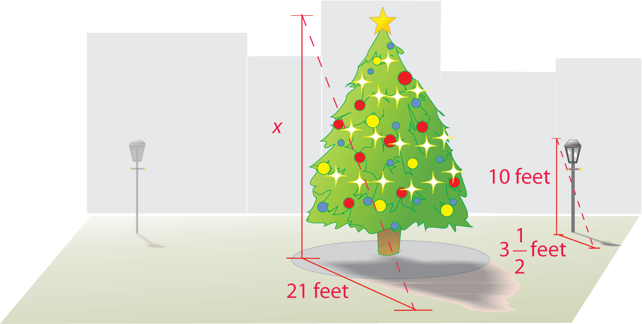
Example 10 (cont.)

Slide 36
Example 10 (cont.)
Solution
By letting x represent the height of the tree, Joann set up and solved the following proportion.

Slide 37
Example 10 (cont.)
The tree was 60 feet tall.

Slide 38
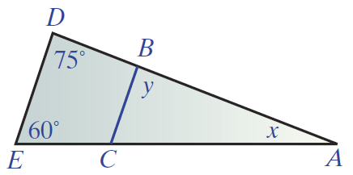
Example 11
Find the values of x and y in triangles ΔABC and ΔADE where ΔABC ∼ ΔADE.

Slide 39
Example 11 (cont.)
Solution
Let x be the measure of ∠A and y be the measure of ∠B in ΔABC as illustrated. Since y is in the same relative position as 75° in ΔADE (∠B and ∠D are corresponding angles ), we have y = 75°. In ΔADE, using the fact that the sum of the measures of the angles of a triangle must be 180° gives the equation x + 75 + 60 = 180. Solving for x gives x = 45°.

