Slide 1
Section 5.2
Addition and Subtraction with Decimal Numbers

Slide 2
Objectives
Know how to add with decimal numbers.
Know how to subtract with decimal numbers.
Learn how to add and subtract with positive and negative decimal numbers.
Be able to estimate sums and differences with rounded decimal numbers.

Slide 3
Addition With Decimal Numbers
To Add Decimal Numbers
1. Write the addends in a vertical column.
2. Keep the decimal points aligned vertically.
3. Keep digits with the same position value aligned. (Zeros may be filled in as aids.)
4. Add the numbers, just as with whole numbers, keeping the decimal point in the sum aligned with the other decimal points.

Slide 4
Example 1
Find the sum:
Solution
Align decimal points vertically.
The decimal point is understood to be to the right of 17, as 17.0.
0’s are filled in to help keep the digits in line.
sum

Slide 5
Example 2
Simplify by combining like terms:
Solution
The method for combining like terms is to use the distributive property with decimal coefficients just as with integer coefficients.

Slide 6
Subtraction With Decimal Numbers
To Subtract Decimal Numbers
1. Write the numbers in a vertical column.
2. Keep the decimal points aligned vertically.
3. Keep digits with the same position value aligned. (Zeros may be filled in as aids.)
4. Subtract, just as with whole numbers, keeping the decimal point in the difference aligned with the other decimal points.

Slide 7
Example 3
Find the difference:
Solution
difference

Slide 8
Example 4
At the bookstore, Mrs. Gonzalez bought a text for $55, art supplies for $32.50, and computer supplies for $29.25. If tax was $9.34, how much change did she receive from a gift certificate worth $150?
Solution
a. Find the total of her expenses including tax.
total

Slide 9
Example 4 (cont.)
b. Subtract the answer in part a. from $150.
She received $23.91 in change.

Slide 10
Example 5
Find the difference:
Solution
We find the difference between the absolute values and use the negative sign.

Slide 11
Example 6
Solve the equation:
Solution
Write the equation.
Simplify.
Add 25.67 to both sides.
Simplify.

Slide 12
Example 7
First estimate the sum then find the sum.
Solution
a. Estimate by adding rounded numbers.
Actual value
Rounded value
(Each number is rounded to the place of the leftmost nonzero digit in that number.)
estimate

Slide 13
Example 7 (cont.)
b. Find the actual sum.

Slide 14
Completion Example 8
Estimate the difference then find the difference.
Solution
a. Estimate: b. Actual difference:
estimate
actual difference

Slide 15
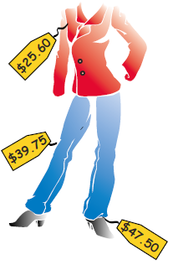
Completion Example 9
Samantha bought a pair of shoes for $47.50, a jacket for $25.60 (on sale), and a pair of slacks for $39.75.

Slide 16
Completion Example 9 (cont.)
a. How much did she spend? (Tax was included in the prices.)
b. What was her change from $120?
[Mentally estimate both answers before you actually calculate them.]

Slide 17
Completion Example 9 (cont.)
Solutions
a. b.
Did you estimate her expenses as $120 and her change as $0?
expenses
change
expenses

Slide 18
Example 10
Use a TI-84 Plus graphing calculator to perform the following operations:
b.
Solution
After entering the values and operations into the calculator, the display will be as follows:

Slide 19
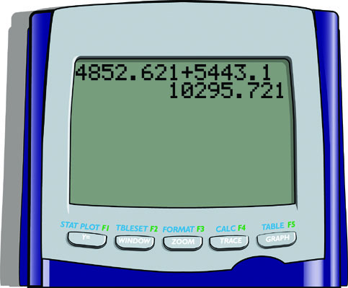

Example 10 (cont.)
a. b.
The answer to part a. is 10,295.721 and the answer to part b. is 37.3813.

