Slide 1
Section 5.3
Multiplication and Division with Decimal Numbers

Slide 2
Objectives
Know how to multiply decimal numbers and place the decimal point correctly in the product.
Learn how to multiply decimal numbers mentally by powers of 10.
Know how to divide decimal numbers and place the decimal point correctly in the quotient.
Learn how to divide decimal numbers mentally by powers of 10.

Slide 3
Objectives (cont.)
Be able to estimate products and quotients with rounded numbers.
Understand how to solve word problems involving decimal numbers.

Slide 4
Multiplication with Decimal Numbers
To Multiply Positive Decimal Numbers
1. Multiply the two numbers as if they were whole numbers.
2. Count the total number of places to the right of the decimal points in both numbers being multiplied.
3. Place the decimal point in the product so that the number of places to the right is the same as that found in step 2.

Slide 5
Example 1
Multiply:
Solution
3 places
1 place
total of 4 places (ten-thousandths)
4 places in the product

Slide 6
Example 2
Find the product:
Solution
Since the signs are not alike, the product will be negative.
Note that three 0’s had to be inserted between the 3 and the decimal point in the product to get a total of 6 decimal places.
3 places
3 places
total of 6 places
6 places in the product

Slide 7
Multiplication by Powers of 10
To Multiply a Decimal Number by a Power of 10
1. Move the decimal point to the right.
2. Move it the same number of places as the number of 0’s in the power of 10.
Multiplication by 10 moves the decimal point one place to the right;
Multiplication by 100 moves the decimal point two places to the right;
Multiplication by 1000 moves the decimal point three places to the right; and so on.

Slide 8
Example 3
The following products illustrate multiplication by powers of 10.
Move decimal point 1 place to the right.
Move decimal point 2 places to the right.
Move decimal point 2 places to the right.
Move decimal point 3 places to the right.

Slide 9
Example 3 (cont.)
Exponent tells how many places to move the decimal point. Move decimal point 2 places.
Move decimal point 3 places to the right.

Slide 10
Division with Decimal Numbers
To Divide Decimal Numbers
1. Move the decimal point in the divisor to the right so that the divisor is a whole number.
2. Move the decimal point in the dividend the same number of places to the right.
3. Place the decimal point in the quotient directly above the new decimal point in the dividend.
4. Divide just as with whole numbers.

Slide 11
Division with Decimal Numbers
Note
1. In moving the decimal point, you are multiplying by a power of 10.
2. Be sure to place the decimal point in the quotient before actually dividing.

Slide 12
Example 4
Find the quotient:
Solution
a. Write down the numbers.
b. Move both decimal points one place to the right so that the divisor becomes a whole number. Then place the decimal point in the quotient.
Decimal point in quotient

Slide 13
Example 4 (cont.)
c. Proceed to divide as with whole numbers.

Slide 14
Example 5
Find the quotient:
Solution
a. Write down the numbers.
b. Move two decimal points two places to the right so that the divisor becomes a whole number. Then place the decimal point in the quotient.
decimal point in quotient

Slide 15
Example 5 (cont.)
c. Proceed to divide as with whole numbers.

Slide 16
Divide Decimal Numbers
When the Remainder is Not Zero
1. Decide first how many decimal places are to be in the quotient.
2. Divide until the quotient is one digit past the place of desired accuracy.
3. Using this last digit, round the quotient to the desired place of accuracy.

Slide 17
Example 6
Find the quotient to the nearest tenth.
Solution
Divide until the quotient is in the hundredths (one
place more than the tenths); then round to tenths.

Slide 18
Example 6 (cont.)
hundredths
read approximately
Add 0’s as needed.
accurate to the nearest tenth

Slide 19
Example 7
Find the quotient to the nearest hundredth.
Solution
thousandths
accurate to the nearest hundredth

Slide 20
Divide by Powers of 10
To Divide a Decimal Number by a Power of 10
1. Move the decimal point to the left.
2. Move it the same number of places as the number of 0’s in the power of 10.
Division by 10 moves the decimal point one place to the left;
Division by 100 moves the decimal point two places to the left;
Division by 1000 moves the decimal point three places to the left; and so on.

Slide 21
Example 8
The following quotients illustrate division by powers of 10.
Move decimal point 2 places to the left.
Move decimal point 1 place to the left.
Move decimal point 3 places to the left. The exponent tells how many places to move the decimal point.
Move decimal point 2 places to the left.

Slide 22
Example 9
For the product
a. First, estimate the product. Then,
b. find the product.
Solutions
a. Estimate by multiplying rounded numbers
0.358 rounded
6.2 rounded
estimate

Slide 23
Example 9 (cont.)
b. Find the actual product.
actual product

Slide 24
Example 9 (cont.)
The estimated product 2.4 helps place the decimal point correctly in the product 2.2196. Thus an answer of 0.22196 or 22.196 would indicate an error in the placement of the decimal point, since the answer should be near 2.4 (or between 2 and 3).

Slide 25
Example 10
First estimate the quotient then find the quotient to the nearest tenth.
Solution
a. Using 6.1 ≈ 6 and 0.312 ≈ 0.3, estimate the quotient.
estimate

Slide 26
Example 10 (cont.)
b. Find the quotient to the nearest tenth.

Slide 27
Example 11
You can buy a car for $8500 cash, or you can make a down payment of $1700 and then pay $616.67 each month for 12 months. How much can you save by paying cash?
Solution
a. Find the amount paid in monthly payments by multiplying the amount of each payment by 12. In this case, judgment dictates that we do not want to lose two full monthly payments in our estimate, so we use 12 and do not round to 10.

Slide 28
Example 11 (cont.)
Estimate
Actual Amount
paid in monthly payments

Slide 29
Example 11 (cont.)
b. Find the total amount paid by adding the down payment to the answer in part a.
Estimate
Actual Amount
down payment
down payment
monthly payments
monthly payments
total paid
total paid

Slide 30
Example 11 (cont.)
c. Find the savings by subtracting $8500 from the answer in part b.
Estimate
The $700 estimate is very close to the actual savings.
Actual Amount
savings by paying cash

Slide 31
Example 12
The gas tank of a car holds 18 gallons of gasoline. Approximately how many miles per gallon does the car average if it will go 470 miles on one tank of gas?
Solution
Miles per gallon means miles divided by gallons. Since the question calls only for an approximate answer, rounded values can be used.
18 ≈ 20 gal and 470 ≈ 500 miles.

Slide 32
Example 12 (cont.)
The car averages about 25 miles per gallon.
miles per gallon

Slide 33
Example 13
If you jog at an average speed of 4.8 miles per hour, how far will you jog in 3.2 hours?
Solution
Multiply the average speed by the number of hours.
You will jog 15.36 miles in 3.2 hours.
miles per hour
hours
miles

Slide 34
Example 14
Suppose that the price of a gallon of gas is stated as $3.15 at the pump and the station owner tells you that the taxes you are paying are figured at 0.45 times the price he is actually charging for a gallon of gas. What price (to the nearest penny) is he actually charging for a gallon of gas?
Solution
To find the actual price of a gallon of gas, before taxes, divide the total price by 1.45.

Slide 35
Example 14 (cont.)
So, the actual cost of the gas is about $2.17 per gallon before taxes.

Slide 36
Example 15
Use a TI-84 Plus graphing calculator to perform the following operations and write the answer accurate to 4 decimal places:
a. 4.631(0.235)(2.3) b. 19.36 ÷ 5.4
Solution
After entering the values and operations into the calculator, the display will be as follows:

Slide 37
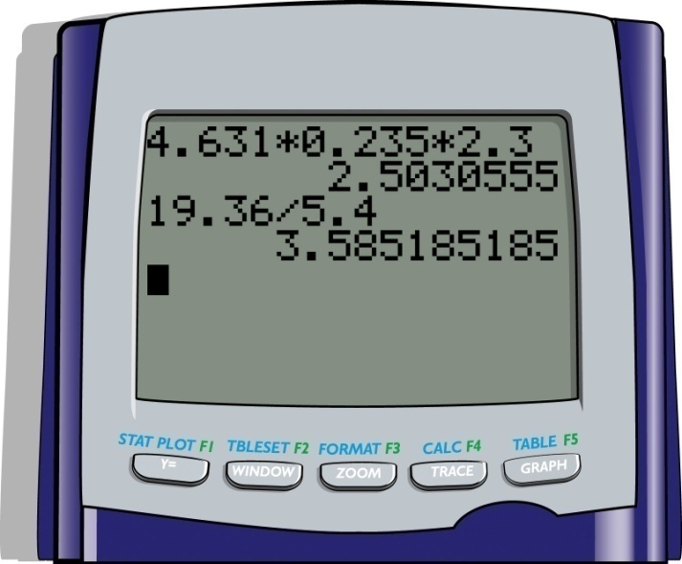
Example 15 (cont.)
The answers accurate to 4 decimal places:
a. 2.5031
b. 3.5852

