Slide 1
Section 5.4
Applications in Statistics (Mean, Median, Mode, and Range)

Slide 2
Objectives
Understand the meaning of the terms mean, median, mode, and range.
Learn how to find the mean, median, mode, and range of a set of data items.

Slide 3
Statistical Terms
Terms used in the Study of Statistics
Data: Value(s) measuring some information of interest (We will consider only numerical data.)
Statistics: A single number describing some characteristic of the data
Mean: The arithmetic average of the data
(Find the sum of all the data and divide by the number of data items)

Slide 4
Statistical Terms
Terms used in the Study of Statistics (cont.)
Median: The middle of the data after the data have been arranged in order (The median may or may not be one of the data items.)
Mode: The single data item that appears most frequently (A set of data may have more than one mode. The data sets in this text, however, will have either one mode or no mode.)

Slide 5
Statistical Terms
Terms used in the Study of Statistics (cont.)
Range: The difference between the largest and smallest data items

Slide 6
Example 1
Find the mean temperature for the 8 people in
Group A.
Solution
The mean is the arithmetic average of the data. Therefore, we add the 8 temperatures and divide the sum by 8. (You can, of course, perform these calculations with a calculator.)
Group A: Body Temperature (in Fahrenheit degrees) of 8 People
96.4° 98.6° 98.7° 99.8° 99.2° 101.2° 98.6° 97.1°

Slide 7
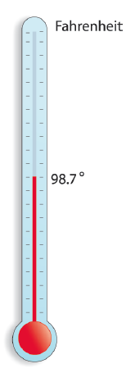
Example 1 (cont.)
mean temperature
The mean temperature is 98.7°F.

Slide 8
Finding Statistical Measures
To Find the Median
1. Rank the data. (Arrange the data in order, either from smallest to largest or largest to smallest.)
2. The median can be found by counting from the top
down (or from the bottom up) to the position
where n represents the number of data items.
a. If there are an odd number of items, the median is the middle number.

Slide 9
Finding Statistical Measures
To Find the Median (cont.)
b. If there are an even number of items, the median is the value found by averaging the two middle terms. (Note: This value may or may not be in the data.)

Slide 10
Example 2
Find the median temperature for the 8 people in Group A and the median time for the movies in Group B.
Solution
First, we rank both sets of data in order from smallest to largest.
Group A: Body Temperature (in Fahrenheit degrees) of 8 People
96.4° 98.6° 98.7° 99.8° 99.2° 101.2° 98.6° 97.1°
Group B: The Time (in minutes) of 11 Movies
100 min 90 min 113 min 110 min 88 min 90 min 155 min 88 min 105 min 93 min 90 min

Slide 11
Example 2 (cont.)
Group B (Movie Times)
Group A (Temperatures)
1. 96.4
2. 97.1
3. 98.6
4. 98.6
5. 98.7
6. 99.2
7. 99.8
8. 101.2
1. 88
2. 88
3. 90
4. 90
5. 90
6. 93
7. 100
8. 105
9. 110
10. 113
11. 155
The median is between
98.6 and 98.7.
The median is 93.

Slide 12
Example 2 (cont.)
Group A has 8 items. With the formula for the position
the median is the average of
the items in the fourth and fifth positions.
Median temperature
(Note that 8 is an even number and the median is the average of the two middle items.)

Slide 13
Example 2 (cont.)
Group B has 11 items. With the formula for the position
the median is the item in the sixth position.
Median movie time
(Note that 11 is an odd number and the median is the middle item.)
(Comment: Note that in Group A the median is not one of the data items, while in Group B the median is one of the data items.)
= 93 minutes

Slide 14
Example 3
For both Group A and Group B, find
a. the mode and
b. the range
Solutions
a. From the ranked data in Example 2, we can see the most frequent item in each group:
For Group A, the mode is 98.6°. (98.6° occurs twice and no other item occurs more than once.)

Slide 15
Example 3 (cont.)
For Group B, the mode is 90 minutes. (90 min. occurs three times and no other item occurs more than twice.)
b. Again referring to the ranked data in Example 2, we can calculate each range as follows:
Range = (Largest value) − (Smallest value)
Group A range = 101.2° − 96.4° = 4.8°
Group B range = 155 − 88 = 67 minutes

Slide 16
Completion Example 4
Suppose that your grade in this class is based on 5 exam scores: 4 sectional exams and 1 comprehensive final exam, with each exam scored on a basis of 100 points. On the first 4 exams you have scores of 85, 78, 82, and 70. What is the lowest score you can get on the final exam and still earn a grade of B in the course? (Assume that to get a B you must average between 80 and 89.)

Slide 17
Completion Example 4 (cont.)
Solution
Solve the problem by first finding the total number of points needed to average 80 on 5 exams. Then calculate the number of points accumulated on the first four exams. Finally, subtract the number of points accumulated from the total needed. This will give the number of points needed on the final exam.

Slide 18
Completion Example 4 (cont.)
ARITHMETIC APPROACH
a. Find the total number of points needed for a B, since 5 exams are to average to 80 (or more), then the total number of points must be at least:
Total points (or more) needed for a B.

Slide 19
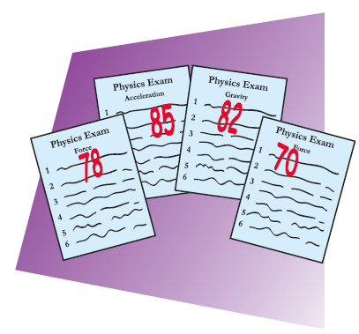
Completion Example 4 (cont.)
b. On the first 4 exams you have accumulated
Points accumulated

Slide 20
Completion Example 4 (cont.)
c. To average 80 (or more) on your 5 exams, you need
Thus you need at least a score of ____ on your final exam to earn a grade of B for the course. (Note: We will see an algebraic approach to solving problems of this type in Section 7.6.)
Total Points needed
Points accumulated
Points needed on the final exam

Slide 21
Finding the Mean, Median, Mode, and Range of a Set of Data
Note
Of the four statistics mentioned in this section, the mean and median are most commonly used. Many people who use statistics professionally believe that the mean (or arithmetic average) is relied on too much in reporting central tendencies for data such as income,
housing costs, and taxes, because a few very high or very low items can distort the picture of a central tendency. For example, the median of 93 minutes for the movies in Group B is probably more representative
than the mean, which is 102 minutes.

Slide 22
Finding the Mean, Median, Mode, and Range of a Set of Data
Note (cont.)
This is so because the one high time of 155 minutes raises the mean considerably, whereas the median is not affected by this one extreme outer value. When you read an article in a magazine or newspaper that reports means or medians, you should now have a better understanding of the implications of these statistical measures.

