Slide 1
Section 5.5
Decimals, Fractions, and Scientific Notation

Slide 2
Objectives
Learn how to change decimal numbers to fraction and/or mixed number form.
Learn how to change fractions and mixed numbers to decimal form.
Understand that working with decimals and fractions in the same problem may involve rounded numbers and approximate answers.
Know how to read and write decimal numbers in scientific notation.
Be able to read results written in scientific notation on a calculator.

Slide 3
Decimals and Fractions
Changing from Decimal Form to Fraction Form
A decimal number with digits to the right of the decimal point can be written in fraction form by writing a fraction with
1. A numerator that consists of the whole number formed by all the digits of the decimal number and
2. A denominator that is the power of 10 that corresponds to the rightmost digit. (For example, a denominator of 100 corresponds to hundredths.)

Slide 4
Example 1
hundredths
hundredths
thousandths

Slide 5
Example 1 (cont.)
or, as a mixed number,
tenths

Slide 6
Decimals and Fractions
Changing from Fraction Form to Decimal Form
A fraction can be written in decimal form by dividing the numerator by the denominator.
1. If the remainder is 0, the decimal is said to be terminating.
2. If the remainder is not 0, the decimal is said to be nonterminating.

Slide 7
Example 2
Change to a decimal.
Solution

Slide 8
Example 3
Change to a decimal.
Solution
also can be written In any case, the result
of the division will be negative. For convenience, we
simply divide 4 by 5 and then write the negative sign in
the quotient.

Slide 9
Example 3 (cont.)
Thus, which is a terminating decimal.

Slide 10
Example 4
Change to a decimal.
Solution
We write
The 3 will repeat without end.
Continuing to divide will give a remainder of 1 each time.
The ellipsis (. . . ) means “and so on” or that the digits continue without stopping.

Slide 11
Example 5
The six digits will repeat in the same pattern without end.
Change to a decimal.
Solution
We can write
The remainders will repeat in sequence: 3, 2, 6, 4, 5, 1, 3, and so on. Therefore, the digits in the quotient will also repeat.

Slide 12
Example 6
Find the sum
a. in decimal form and
b. in fraction form.
Solutions
a. Change each fraction to decimal form and then add. In this example, each fraction has a terminating decimal form.

Slide 13
Example 6 (cont.)

Slide 14
Example 6 (cont.)
b. Change the decimal to a fraction; then find a
common denominator and add.

Slide 15
Example 6 (cont.)
The answers for parts a. and b. must be equal, and they are:

Slide 16
Example 7
Find the quotient in decimal form.
Solution
Since we can divide mentally as

Slide 17
Example 8
Find the difference
a. in fraction form, and
b. in decimal form.
Solutions
a. Both numbers are already in fraction form and the LCD = 21. We can proceed as follows:

Slide 18
Example 8 (cont.)
b. As we have seen earlier in this section, both numbers are nonterminating decimals. Therefore, to subtract in decimal form, we agree beforehand to round each decimal to a certain place and accept an approximate answer. In this example we write each decimal accurate to thousandths and subtract.
(rounded to thousandths) and
(rounded to thousandths)

Slide 19
Example 8 (cont.)
Subtraction gives:
Note that, as anticipated, 0.096 is an approximation of

Slide 20
Example 9
Evaluate the expression
Solution
Changing to decimal form and substituting
and we have

Slide 21
Example 9 (cont.)
Changing 4.2 to fraction form and substituting
and
we have

Slide 22
Example 9 (cont.)
Because the decimals in this example were all terminating decimals, we get exactly the same answer whether we use the fraction form or the decimal form of each number.

Slide 23
Example 9 (cont.)
In this case,
If rounded decimals are used, then the answers will not be exactly the same (only close).

Slide 24
Absolute Value
Absolute Value
The absolute value of a decimal number is its distance from 0. The absolute value of a decimal number is nonnegative. We can express the definition symbolically, for any decimal number a, as follows:
If is positive or 0, then
If is negative, then

Slide 25
Example 10
Find the absolute value of each of the following expressions.

Slide 26
Absolute Value
Special Note
We have seen that fractions can be changed to terminating or repeating decimal forms and vice versa. These decimal forms and fractions are technically known as rational numbers, and the three terms fractions, repeating decimals, and rational numbers are used interchangeably.
(Terminating decimals can be considered to repeat 0’s and therefore are classified as repeating decimals.)

Slide 27
Example 11
Each of the following numbers is written in both decimal notation and scientific notation.
Decimal Notation
Scientific Notation (One digit to the left of the decimal point)

Slide 28
Example 12
With a calculator set in the mode for scientific notation, perform the following operations.
a. 6.3 ÷ 360
b. 82,000 × 75,000

Slide 29
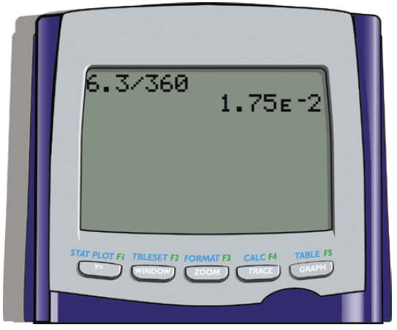
Example 12
Solutions
a. 6.3 ÷ 360 = 1.75 Ε −02
This answer is the same as 1.75 × 10⁻² (or 0.0175).

Slide 30
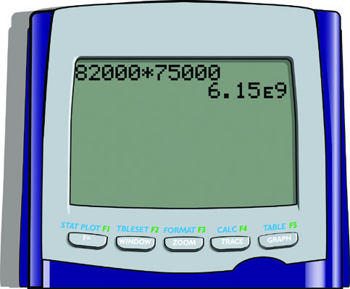
Example 12 (cont.)
b. 82,000 × 75,000 = 6.15 Ε 09
This answer is the same as 6.15 × 10⁹ (or 6,150,000,000).

