Slide 1
Section 5.6
Solving Equations with Decimal Numbers and Circumference and Area of Circles

Slide 2
Objectives
Learn how to solve equations with decimals.
Know how to find the circumference of a circle.
Know how to find the area of a circle.

Slide 3
Example 1
Solve the equation
Solution
Write the equation.
Use the distributive property.
Add –18.5 to both sides.
Simplify.
Multiply both sides by
Simplify.

Slide 4
Completion Example 2
Supply the reasons for each step in the following solution of the equation:
Solution
Write the equation.
Add –18.4 to both sides.
Simplify.
Add –1.5y to both sides.
Simplify.
Divide both sides by –0.9.
Simplify.

Slide 5
Completion Example 3
Solve the equation:
Solution

Slide 6
Example 4
A student bought a textbook and a calculator for a total of $184.90 (including tax). If the calculator cost $15.50 more than the book, what was the cost of each item?
Solution
Let x = the cost of the book.
Then x + 15.50 = the cost of the calculator.
The equation to be solved is:

Slide 7
Example 4 (cont.)
cost of
calculator
cost of
book
total
spent
The textbook costs $84.70 and the calculator costs $100.20, with tax included in each price.
cost of textbook
cost of calculator

Slide 8
Example 5
A car rental agency charges $14.50 per day plus $0.15 per mile. How many miles was the car driven if the charge for one day was $48.25?
Solution
Let x = the number of miles driven.
Then 0.15x = the charge for the miles driven.

Slide 9
Example 5 (cont.)
The related equation is:
The car was driven 225 miles.

Slide 10
Circumference and Area of Circles
Important Terms and Definitions for Circles
Circle: The set of all points in a plane that are some fixed distance from a fixed point called the center of the circle.
Radius: The fixed distance from the center of a circle to any point on the circle. (The letter r is used to represent the radius of a circle.)
Diameter: The distance from one point on a circle to another point on the circle measured through the center. (The letter d is used to represent the diameter of a circle.)

Slide 11
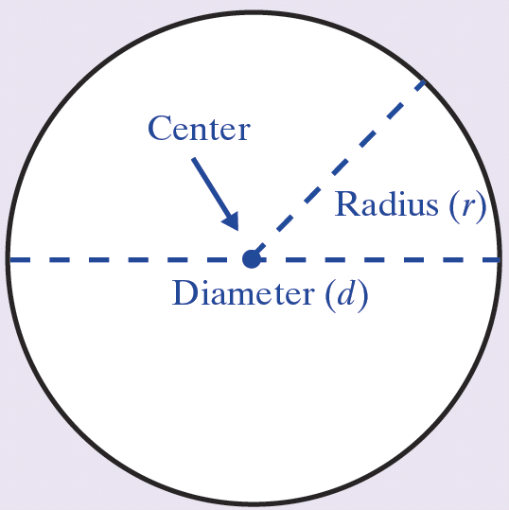
Circumference and Area of Circles
Terms and Definitions for Circles (cont.)
Circumference: Perimeter of (or distance around)
a circle.

Slide 12
Circumference and Area of Circles
Note
π is the symbol used for the constant 3.1415926535…. This number is an infinite nonrepeating decimal (an irrational number). For our purposes, we will use π = 3.14 (accurate to hundredths). However, you
should always be aware that 3.14 is only an approximation for π and that the related answers are only approximations.

Slide 13
Circumference and Area of Circles
Formulas for Circles
For circumference:
For area:

Slide 14
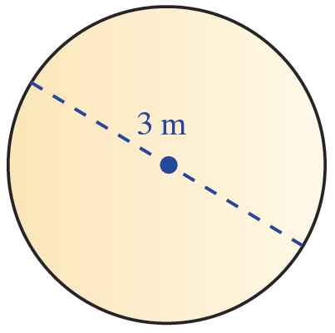
Example 6
Find the circumference of a circle with a diameter of 3 meters.
Solution
Sketch the circle and label a diameter.
The circumference is 9.42 meters. (Remember that 9.42 m is only an approximate answer because 3.14 is only an approximation for π.)

Slide 15
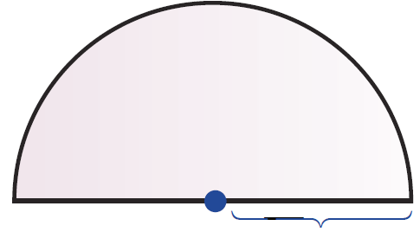

Example 7
Find the perimeter of a semicircle with a radius of 6 feet.
Solution
Sketch the semicircle and label a radius. In order to find the perimeter of the semicircle, find the perimeter of half a circle (which we will call the arclength) and then add the diameter.

Slide 16
Example 7 (cont.)
The perimeter is 30.84 ft.

Slide 17
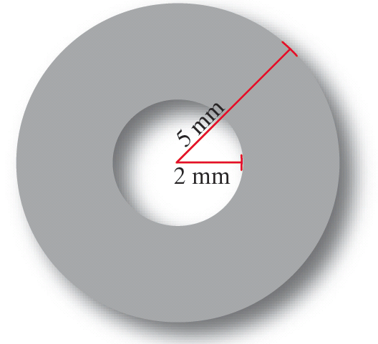
Example 8
Find the area of the washer (shaded portion) with dimensions as shown.
Solution
Subtract the area of the inside (smaller) circle from the area of the outside (larger) circle. This difference will be the area of the washer (shaded portion).

Slide 18
Example 8 (cont.)
Area of Larger Circle
Area of Smaller Circle
Difference:
area of outer circle
area of inner circle
area of washer
The area of the washer is 65.94 mm².

Slide 19
Example 8 (cont.)
Alternate Approach
In this approach, we leave π in the calculations and evaluate at the end.
For the larger circle:
For the smaller circle:
The difference is:

Slide 20
Example 9
Find the radius of a circle with circumference 31.4 inches.
Solution
Use the formula substitute 31.4 for C, and solve for r.
The radius is 5 inches.

