Slide 1
Section 5.7
Square Roots and the Pythagorean Theorem

Slide 2
Objectives
Understand the terms perfect square, square root, radical sign, radicand, and radical.
Learn how to use a calculator to find square roots.
Understand the terms right triangle, hypotenuse, and leg.
Know and be able to use the Pythagorean Theorem.

Slide 3
Square Roots and Real Numbers
Table 5.1 Square Roots of Perfect Squares from 1 to 400

Slide 4
Example 1
Refer to Table 5.1 to find the following square roots.
Solutions

Slide 5
Square Roots and Real Numbers
Square Root
For any real number a and any nonnegative real number b, a is a square root of b if a² = b. If a is
positive, then we write Thus

Slide 6
Example 2
Find the value of each of the following expressions.
Solutions
c. Even though we do not know the exact decimal
value of its square must be 3.

Slide 7
Example 3
Use a calculator and show by squaring 2.44 and 2.45 that is between these two numbers.
Solution

Slide 8
Example 4
Since
what can be said about
Solution
Calculators can be used to approximate square roots accurate to several decimal places. To find, or approximate, a square root with a calculator, use the key labeled Example 5 illustrates the technique using a TI-84 Plus graphing calculator. Note that the sequence of steps depends on the calculator.

Slide 9






Example 5
Use a TI-84 Plus calculator to find the following square roots accurate to eight or nine decimal places.
Solution
Step 1: Press the key and then the key. This
will display the symbol
Step 2: Enter the number, say ,and the right
parenthesis This will display .

Slide 10

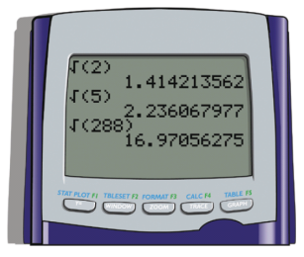
Example 5 (cont.)
Step 3: Press and the display will show the square
root of 2 accurate to nine places. The three results are shown in the figure. (For larger numbers the accuracy may be less than 9 decimal places because of the space allowed for the answers.)

Slide 11
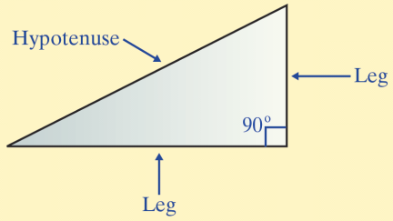
The Pythagorean Theorem
Terms Related to Right Triangles
Right Triangle: A triangle with a right angle (90°)
Hypotenuse: The longest side of a right triangle: the side opposite the right angle.
Leg: Each of the other
two sides of a
right triangle.

Slide 12
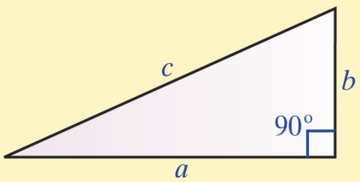
The Pythagorean Theorem
The Pythagorean Theorem
In a right triangle, the square of the hypotenuse is equal to the sum of the square of the two legs:

Slide 13
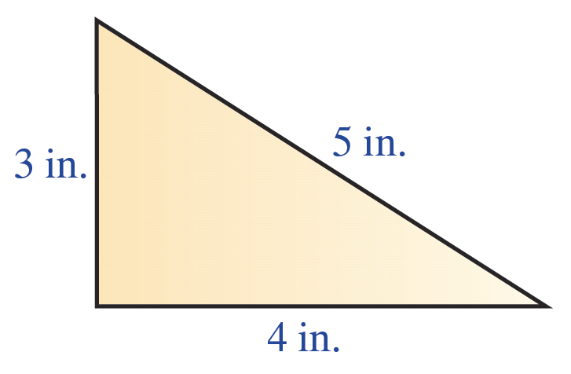
Example 6
Show that a triangle with sides of 3 inches, 4 inches, and 5 inches must be a right triangle.

Slide 14
Example 6 (cont.)
Solution
If the triangle is a right triangle, then the longest side (5 inches) must be the hypotenuse, and the relationship
Since 25 = 9 + 16, the triangle is a right triangle. That is, the square of the hypotenuse is equal to the sum of the squares of the legs.

Slide 15
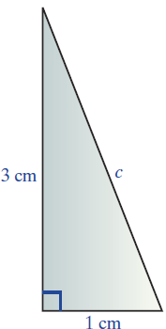
Example 7
Use a calculator and the Pythagorean Theorem to find the length of the hypotenuse (accurate to two decimal places) of a right triangle with legs 1 centimeter long and 3 centimeter long.
Solution
Let c = the length of the hypotenuse.
Then, by the Pythagorean Theorem,

Slide 16
Example 7 (cont.)
The length of the hypotenuse is about 3.16 cm long.

Slide 17
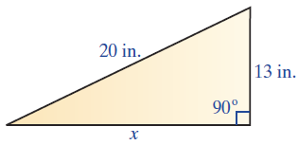
Example 8
Use a calculator and the Pythagorean Theorem to find the length of a leg (accurate to two decimal places) of a right triangle with hypotenuse 20 inches long and the other leg 13 inches long.
Solution
In this case, the length of the hypotenuse is known and the unknown is one of the legs.
Let x = the length of the unknown leg.

Slide 18
Example 8 (cont.)
Then, by the Pythagorean Theorem,
So the leg is 15.20 inches long (accurate to two decimal places).
accurate to hundredths

Slide 19
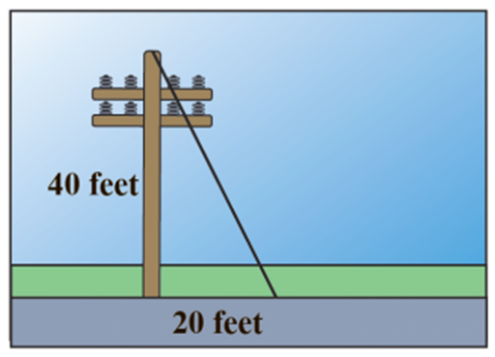
Example 9
A guy wire is attached to the top of a telephone pole and anchored in the ground 20 feet from the base of the pole. If the pole is 40 feet high, what is the length of the guy wire (accurate to one decimal place)?
Solution
Let x = the length of the guy wire.
Then, by the Pythagorean Theorem,

Slide 20
Example 9 (cont.)
The length of the guy wire is about 44.7 ft long.
accurate to one decimal place

