Slide 1
Section 6.5
Applications: Buying a Car and Buying a Home

Slide 2
Objectives
Become aware of and learn how to calculate the expenses involved in buying a car.
Become aware of and learn how to calculate the expenses involved in buying a house.

Slide 3
Buying a Car
Expenses in Buying a Car
Purchase Price: The selling price agreed on by the seller and buyer.
Sales Tax: A fixed percent that varies from state to state.
License Fee: Fixed by the state, often based on the type of car and its value.

Slide 4
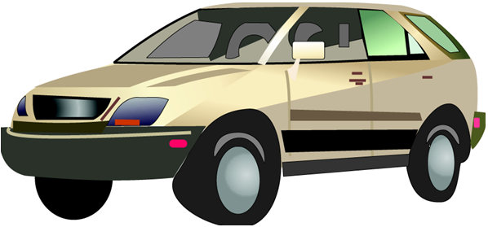
Example 1
You are going to buy a used car for $8500. The bank will loan you 70% of the purchase price. But you must pay a 6% sales tax and a $150 license fee. How much cash do you need to buy the car?

Slide 5
Example 1 (cont.)
Solution
a. Calculate the down payment (30% of $8500, since the bank will loan you 70%).
b. Calculate the sales tax (6% of $8500).
Down payment
Sales tax

Slide 6
Example 1 (cont.)
c. Add all the cash expenses.
You need $3210 cash to buy the car.
Down payment
Sales tax
License tax
Total cash needed

Slide 7
Buying a Home
Expenses in Buying a Home
Purchase Price: The selling price (what you have agreed to pay).
Down Payment: Cash you pay to the seller (usually 20% to 30% of the purchase price).
Mortgage Loan (first trust deed): Loan to you by a bank or a savings and loan (difference between purchase price and down payment).
Mortgage Fee (or points): Loan fee charged by the lender (usually 1% to 3% of the mortgage loan).

Slide 8
Buying a Home
Expenses in Buying a Home (cont.)
Fire Insurance: Insurance against the loss of your home by fire (required by almost all lenders).
Recording Fees: Local and state fees for recording you as the legal owner.
Property Taxes: Taxes that must be prepaid before the lender will give you the loan (usually 6 months in advance).

Slide 9
Buying a Home
Expenses in Buying a Home (cont.)
Legal Fees: Fees charged by a lawyer or escrow company and/or title search company for completing all forms in a legal manner.

Slide 10
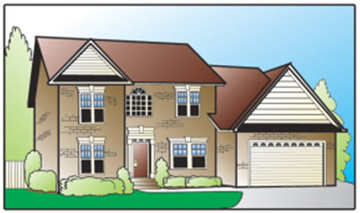
Example 2
You buy a home for $150,000. Your down payment is 20% of the selling price, and the mortgage fee is 2% of the new mortgage. You also have to pay $500 for fire insurance, $350 for taxes, $50 for recording fees, and $310 for legal fees. What is the amount of your mortgage? How much cash must you provide to complete the purchase?

Slide 11
Example 2 (cont.)
Solution
a. Find the down payment
b. Find the mortgage and mortgage fee (2% of mortgage).
Selling price
Down payment
Selling price
Mortgage
Down payment
Mortgage
Mortgage fee

Slide 12
Example 2 (cont.)
c. Add all cash expenses.
The mortgage will be $120,000, and you will need $33,610 in cash.
Down payment
Mortgage fee (loan fee)
Fire insurance
Taxes
Recording fees
Legal Fees
Cash to complete purchase

