Slide 1
Section 6.6
Simple Interest and Compound Interest

Slide 2
Objectives
Know how to find simple interest by using the formula I = Prt.
Know how to find compound interest by using the
formula
Understand the concepts of inflation and depreciation and be able to use the related formulas.

Slide 3
Understanding Simple Interest ( I = Prt )
Formula for Calculating Simple Interest
I = Prt
where
I = Interest (earned or paid)
P = Principal (the amount invested or borrowed)
r = Rate of interest (stated as an annual or yearly rate)
t = Time (in years or fraction of a year)

Slide 4
Understanding Simple Interest ( I = Prt )
Formula for Calculating Simple Interest (cont.)
Note: For the purpose of calculations, we will use 360 days in one year (30 days a month). This is a common practice in business and banking. However, with the advent of computers, many lending institutions now base their calculations on 365 days per year and pay or charge interest on a daily basis.

Slide 5
Example 1
You want to borrow $2000 at 12% interest for only 90 days. How much interest would you pay?
Solution

Slide 6
Example 1 (cont.)
Now, using the formula,
You would pay $60 in interest if you borrowed $2000 for 90 days at 12%.
0.03

Slide 7
Example 2
Carmen loaned $500 to a friend for 6 months at an interest rate of 8%. How much will her friend pay her at the end of the 6 months?
Solution

Slide 8
Example 2 (cont.)
The interest is found by using the formula:
The interest is $20 and the total amount to be paid at the end of 6 months is
Principal + Interest = $500 + $20 = $520.
0.04

Slide 9
Example 3
What principal would you need to invest to earn $450 in interest in 6 months if the rate of interest was 9%?
Solution
In this problem we know the interest, rate, and time, and want to find the principal P.

Slide 10
Example 3 (cont.)
Substitute into the formula I = Prt and solve for P.
You would need a principal amount of $10,000 invested at 9% to make $450 in 6 months.
Multiply both sides by 2.
Divide both sides by 0.09.

Slide 11
Completion Example 4
Find the rate of interest that would be paid if $50 interest was to be earned on $2000 in 3 months.
Solution
The unknown quantity is _____________.
I = $_________.
P = $_________.
t = 3 months = _____ year.

Slide 12
Completion Example 4 (cont.)
Substituting into the formula I = Prt gives
The interest rate would be _____%.
Simplify the right-hand side.
Divide both sides by 500, the coefficient of r.

Slide 13
Example 5
If an account is compounded monthly (n = 12) at 6%, how much interest will a principal of $5500 earn in 3 months?
Solution
Since the compounding is monthly, use in the formula I = Prt.
And, since the period is three months, calculate the interest three times. Calculate each time with a new principal.

Slide 14
Example 5 (cont.)
a. First period: the principal is P = $5500.
b. Second period: the new principal is P = $5500 + $27.50 = $5527.50.
interest for first period
interest for second period

Slide 15
Example 5 (cont.)
c. Third period: the new principal is
P = $5527.50 + $27.64 = $5555.14.
The new principal is P = $5555.14 + $27.78 = $5582.92.
interest for third period

Slide 16
Example 5 (cont.)
To find the total interest earned in three months, find the sum of the interest for each period, or subtract the original principal from the final principal as follows:
interest
interest
interest
final principal
original principal
OR
Total interest earned
Total interest earned

Slide 17
Calculating Compound Interest with the Formula
Compound Interest Formula
When interest is compounded, the total amount A accumulated (including principal and interest) is given by the formula
where
P = the principal
r = the annual interest rate
t = the length of time in years
n = the number of compounding periods in 1 year

Slide 18
Example 6
Max invested $4500 at 9% to be compounded monthly. What will be the amount in his account in 5 years?
Solution
P = $4500, r = 9% = 0.09
n = 12 times per year, t = 5 years
Substituting into the formula gives

Slide 19
Example 6 (cont.)
A TI-84 Plus graphing calculator automatically follows the rules for order of operations. Therefore, you can enter all of the numbers and parentheses just as you see them placed in the formula. You can enter the exponent at 60 or enter it as the product of 12 times 5.
The product must be in parentheses as (12 * 5).

Slide 20

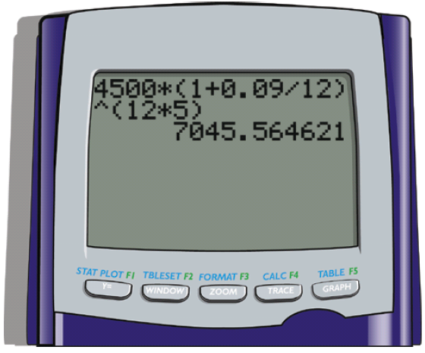
Example 6 (cont.)
Step 1: Enter the numbers and parentheses so that the display appears as follows:
Step 2: Press .
The display should now read:

Slide 21
Example 6 (cont.)
Whether we do the calculations step-by-step or let the calculator do all the steps internally, we find that the amount in Max’s account in 5 years will be $7045.56.

Slide 22
Calculating Compound Interest with the Formula
Total Interest Earned
To find the total interest earned on an investment that has earned interest by compounding, subtract the initial principal from the accumulated amount:
I = A − P

Slide 23
Example 7
How much interest did Max earn in the investment described in Example 6?
Solution
Max earned $2545.56 in interest.

Slide 24
Completion Example 8
a. Use the compound interest formula to find the value of $6000 invested for 4 years if it is compounded daily at 12%.
b. Find the amount of interest earned.
Solutions
a. With a TI-84 Plus calculator, follow the steps outlined in the first part of Example 6 with
P = $6000, r = 12% = 0.12, n = 360, t = 4
Each step will show the same final answer.

Slide 25
Completion Example 8 (cont.)
Substituting into the formula gives
The value (or amount) will be $__________.
9695.67

Slide 26
Completion Example 8 (cont.)
b. The interest earned will be
I = $__________ − $6000.00
= $ __________.

Slide 27
Inflation and Depreciation
Formula for Inflation
The formula for the accumulated amount A due to inflation is the same as the formula for compound interest with n = 1:

Slide 28
Example 9
Suppose that your income is $2400 per month (or $28,800 per year) and that you will receive a cost-of-living raise each year. If inflation is steady at 6%, find your income in:
a. 5 years b. 10 years c. 20 years
Solutions
We answer this question by using the formula A = 28,800(1 + 0.06)^{t} and let t = 5, t = 10, and t = 20 and round to the nearest cent.

Slide 29
Example 9 (cont.)
Thus, if you stay on the same job (or a similar job) for 20 years and inflation is at 6%, you will need an income of $92,365.50 to have the same buying power you have today if your annual income is $28,800.

Slide 30
Example 9 (cont.)
[Try this based on different cost-of-living indexes and with different base salaries. You will probably be very surprised. This will help you to understand the effect of compound interest.]

Slide 31
Inflation and Depreciation
Formula for Depreciation
The current value V of an item due to depreciation can be determined from the formula.
where
P = the original value
r = the annual rate of depreciation (in decimal form)
t = the time in years

Slide 32
Example 10
Suppose that a certain make of automobile depreciates 15% each year. Find the current market value of one of these automobiles if it is 5 years old and its original cost was $40,000.
Solution
Using the formula for depreciation, we have:

Slide 33
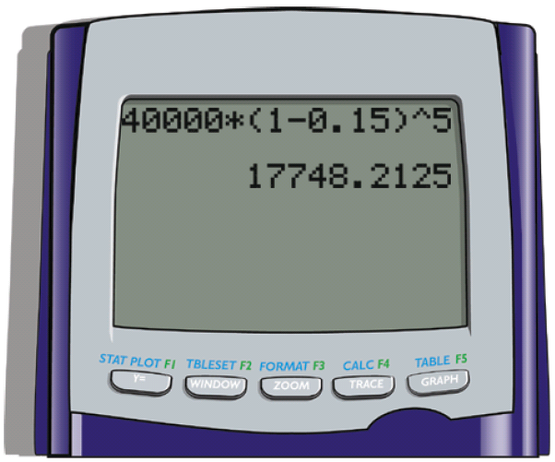
Example 10 (cont.)
Putting this in the TI-84 Plus calculator gives:
The current market value of the automobile is $17,748.21.

