Slide 1
Section 7.4
Applications: Numbers and Consecutive Integers

Slide 2
Objectives
Be able to solve number problems.
Be able to solve consecutive integer problems.

Slide 3
The Problem-Solving Process
Pòlya’s Four-Step Process for Solving Problems
1. Understand the problem. (Read it carefully and be sure that you understand all the terms used.)
2. Devise a plan. (Set up an equation or a table or chart relating the information.)
3. Carry out the plan. (Perform any indicated operations in Step 2.)
4. Look back over the results. (Ask yourself if the answer seems reasonable and if you could solve similar problems in the future.)

Slide 4
Example 1
Seven less than four times a number is equal to twice the number increased by three. Find the number.
Solution
Let n = the unknown number.
Translate “seven less than four times a number” to
4n – 7. (Remember that “7 less than” means to subtract 7.)
Translate “twice the number increased by three” to
2n + 3.

Slide 5
Example 1 (cont.)
Form the equation: 4n – 7 = 2n + 3.
Solve the equation:
CHECK:
The number is 5.

Slide 6
Completion Example 2
Fifteen plus a number is equal to times the number.
What is the number?
Solution
Let x = the number.
Translate “fifteen plus a number” to ______.
Translate “ times the number” to______.
Form the equation: ____________

Slide 7
Completion Example 2 (cont.)
Solve the equation:

Slide 8
Completion Example 2 (cont.)
Check:
“Fifteen plus the number” translates to 15 + 30 = 45, and
“ times the number” translates to
So _____ is the correct number.
30

Slide 9
Example 3 (Perimeter)
The perimeter of a triangle is 35 feet. If one side is 3 feet more than another side and the third side is 5 feet more than the sum of the other two, what are the lengths of the sides of the triangle?
Solution
Let

Slide 10
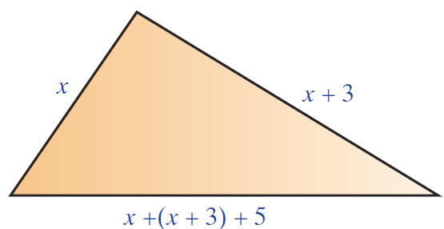
Example 3: Perimeter (cont.)
Since the perimeter is 35 feet, the sum of the three sides must be 35.

Slide 11
Example 3: Perimeter (cont.)
First Side + Second Side + Third Side = Perimeter

Slide 12
Example 3: Perimeter (cont.)
Thus the sides are
x = length of first side = 6 ft.
x + 3 = length of second side = 9 ft.
x + (x + 3) + 5 = length of third side = 20 ft.
Check: The perimeter is 6 ft + 9 ft + 20 ft = 35 ft.

Slide 13
Solving Consecutive Integer Problems
Consecutive Integers, Odd Integers, and Even Integers
Consecutive Integers:
Integers are consecutive if each is 1 more than the previous integer. Three consecutive integers can be represented as

Slide 14
Solving Consecutive Integer Problems
Consecutive Integers, Odd Integers, and Even Integers (cont.)
Consecutive Odd Integers:
Odd integers are consecutive if each is 2 more than the previous odd integer. Three consecutive odd integers can be represented as
Where n is an odd integer

Slide 15
Solving Consecutive Integer Problems
Consecutive Integers, Odd Integers, and Even Integers (cont.)
Consecutive Even Integers:
Even integers are consecutive if each is 2 more than the previous even integer. Three consecutive even integers can be represented as
Where n is an even integer

Slide 16
Example 4
Find three consecutive integers whose sum is –27.
Solution
Let
The equation to be solved is

Slide 17
Example 4 (cont.)
the first integer
the second integer
Check:
the third integer

Slide 18
Example 5
Find three consecutive odd integers such that the sum of the first and third is 23 more than the second.
Solution
Let
The equation to be solved is

Slide 19
Example 5 (cont.)
the first odd integer
the second consecutive odd integer
the third consecutive odd integer

Slide 20
Example 5 (cont.)
Check:
first
+
third
second
+
23
21
25
23
+
23
46
=
46

Slide 21
Completion Example 6
Find three consecutive even integers such that three times the first is 10 more than the sum of the second and third.
Solution
Let n = the first even integer,
______ = the second consecutive even integer, and
______ = the third consecutive even integer.

Slide 22
Completion Example 6 (cont.)
Solve the equation:
The three consecutive even integers are ___, and ___, and ___.

