Slide 1
Section 7.5
Working with Formulas

Slide 2
Objectives
Be able to substitute given values into a formula and solve for the unknown variable.
Learn how to solve a formula for an indicated variable in terms of the remaining variables.

Slide 3
Example 1
Given the formula find the Fahrenheit
temperature that corresponds to a Celsius temperature of 100°.
Solution
Substitute 100 for C in the formula and solve the resulting equation for F.
Multiply both sides by 9.

Slide 4
Example 1 (cont.)
Simplify.
Use the distributive property.
Add 160 to both sides.
Divide both sides by 5.
Thus 100°C is equal to 212°F, the boiling point of water at sea level.

Slide 5
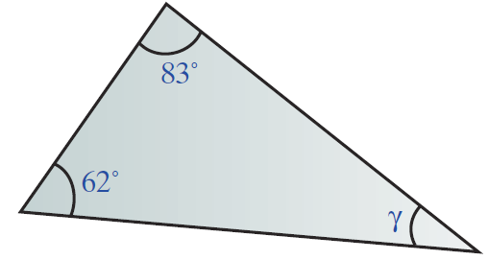
Completion Example 2
Two angles of a triangle are measured at 62° and 83°. What is the measure of the third angle?

Slide 6
Completion Example 2 (cont.)
Solution
Use the formula α + β + γ = 180°.
Substitute α = 62 and β = 83, and solve for γ.
The measure of the third angle is ______.

Slide 7
Example 3
Given the formula solve for t in terms of d and r.
Solution
The formula now indicates that time is equal to distance divided by rate. (Note that the relationship among distance, rate, and time is not changed. Only the form of the formula is changed.)
Treat d and r as if they were constants.
Divide both sides by r.
Simplify.

Slide 8
Completion Example 4
Given the equation 3x + 4y = 12,
a. solve for x in terms of y, and
b. solve for y in terms of x. (We will see in Chapter 8 that such an equation represents the graph of a straight line.)

Slide 9
Completion Example 4 (cont.)
Solutions
a. Solving for x:
Subtract 4y from both sides.
Simplify.
Divide both sides by 3.

Slide 10
Completion Example 4 (cont.)
b. Solving for y:

