Slide 1
Section 9.1
Graphing Ordered Pairs of Real Numbers

Slide 2
Objectives
Become familiar with the following terms related to graphing: ordered pairs, first coordinate, second coordinate, x-axis, y-axis, and quadrant.
Be able to list the set of ordered pairs corresponding to points on a graph.
Know how to graph the points corresponding to a set of ordered pairs of real numbers.

Slide 3
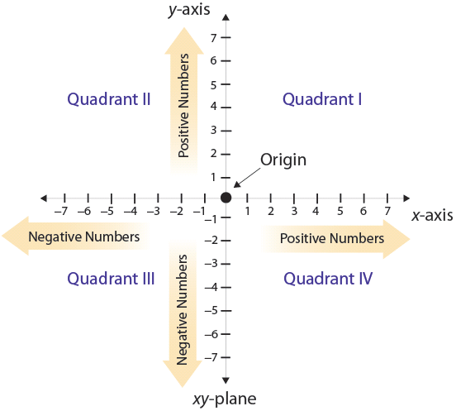
Graphing Ordered Pairs

Slide 4
Graphing Ordered Pairs
There is a one-to-one correspondence between the points in a plane and ordered pairs of real numbers. That is, each point in a plane corresponds to one ordered pair of real numbers, and each ordered pair of real numbers corresponds to one point in a plane. (See Figure 9.2.)

Slide 5
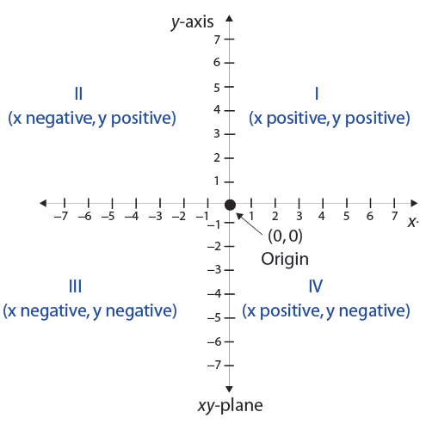
Graphing Ordered Pairs
Figure 9.2

Slide 6
Graphing Ordered Pairs
Note
Unless a scale is labeled on the x-axis or on the y-axis, the grid lines are assumed to be one unit apart in both the horizontal and vertical directions.

Slide 7
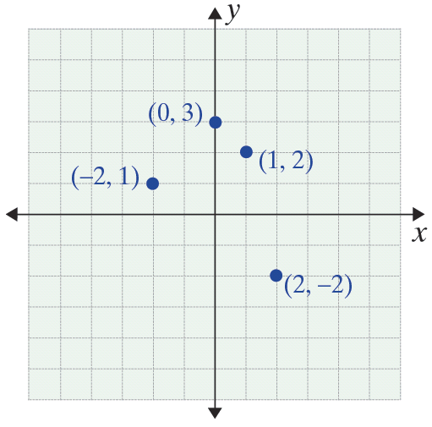
Example 1
Graph the following set of ordered pairs.
Solution

Slide 8
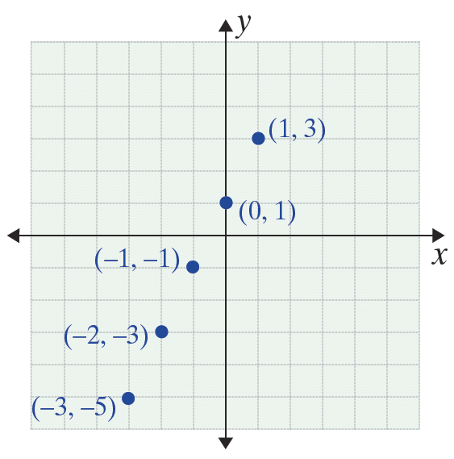
Example 2
Graph the following set of ordered pairs.
x | y
−3 | −5
−2 | −3
−1 | −1
0 | 1
1 | 3
Solution

Slide 9
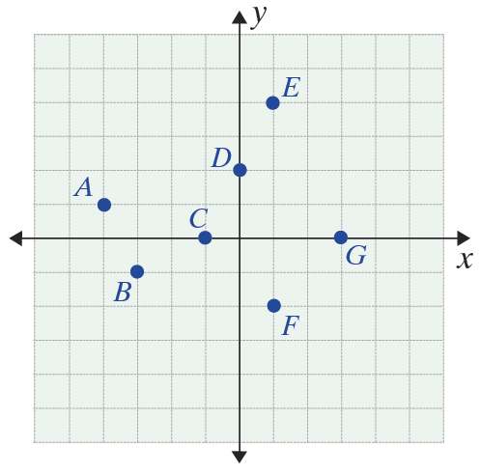
Example 3
The graph of a set of points is given. List the set of ordered pairs that correspond to the points in the graph.

Slide 10
Example 3 (cont.)
Solution
or, in table form,
 | x | y
A | −4 | 1
B | −3 | −1
C | −1 | 0
D | 0 | 2
E | 1 | 4
F | 1 | −2
G | 3 | 0

Slide 11
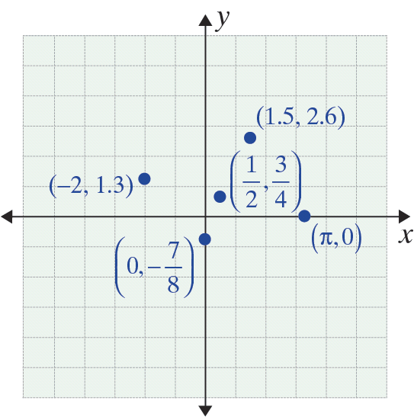
Example 4
Graph the following set of ordered pairs.
Solution

