Slide 1
Section 9.2
Graphing Linear Equations I:
Ax + By = C

Slide 2
Objectives
Know how to plot points that satisfy a linear equation and draw the graph of the corresponding line.
Be able to recognize the standard form of a linear equation in two variables: Ax + By = C.
Learn how to find ordered pairs of real numbers that satisfy a linear equation in two variables.
Know how to find the x-intercept and y-intercept of a line.

Slide 3
Linear Equations in Standard Form: Ax + By = C
The points (ordered pairs of real numbers) that satisfy any equation of the form
where A and B are not both 0, will lie on a straight line. The equation is called a linear equation in two variables and is in the standard form for the equation of a line. Any point not on the line will not satisfy the equation.

Slide 4
Example 1
Write the linear equation y = –2x + 5 in standard form.
Solution
By adding 2x to both sides, we get the standard form:

Slide 5
Example 2
Draw the graph of the linear equation x + 2y = 6.
Solution
We find and plot three ordered pairs that satisfy the equation and then sketch the graph. (Note: The values for x are purely arbitrary. Other values could have been chosen. The result would still be the same graph. That is, locating different points on the graph will not change the position of the line.)

Slide 6
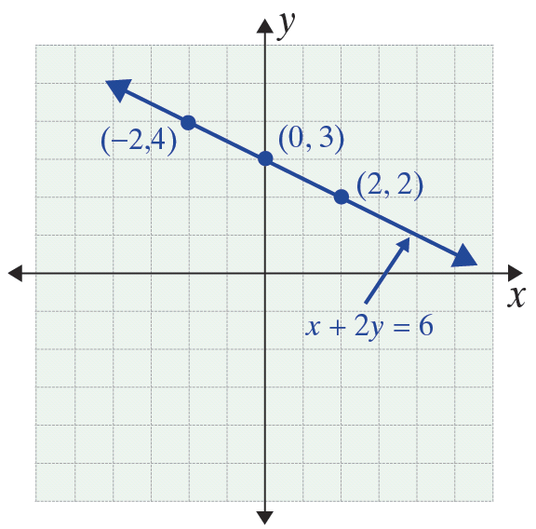
Example 2 (cont.)
x | y
−2 | 4
0 | 3
2 | 2
(Locating three points helps in avoiding errors. Avoid choosing points close together.)

Slide 7
Example 3
Draw the graph of the linear equation x + 2y = 4.
Solution
The process of substituting values for x and finding the corresponding values for y can be made easier by first solving the equation for y as follows:

Slide 8
Example 3 (cont.)
We can now substitute values for x in this form of the equation:

Slide 9
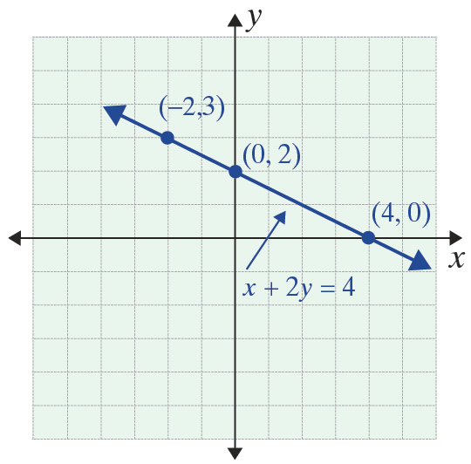
Example 3 (cont.)
x | y
–2 | 3
0 | 2
4 | 0

Slide 10
Graphing Linear Equations
x- and y- Intercept
The y-intercept of a line is the point where the line crosses the y-axis. This point can be located by letting x = 0. Similarly, the x-intercept is the point where the line crosses the x-axis and is found by letting y = 0. When the line is not vertical or horizontal, the y‑intercept and the x-intercept are generally easy to locate and are frequently used for drawing the graph of a linear equation.

Slide 11
Example 4
Draw the graph of the linear equation x – 2y = 8 by locating the y-intercept and the x-intercept.
Solution
Find the y-intercept
Find the x-intercept

Slide 12
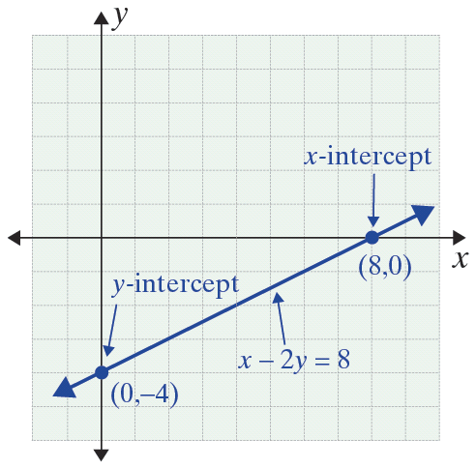
Example 4 (cont.)
Choice
x | y
0 | –4
8 | 0
Calculated
value
Calculated
value
Choice

Slide 13
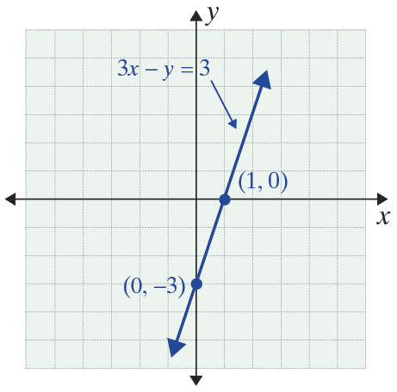
Example 5
Locate the y-intercept and the x-intercept, and draw the graph of the linear equation 3x – y = 3.
Solution
Find the y-intercept
Find the x-intercept
x | y
0 | –3
1 | 0

