Slide 1
Section 9.3
Graphing Linear Equations II: Horizontal and Vertical Lines, Calculators

Slide 2
Objectives
Be able to recognize equations of the form x = a and y = b as the forms for vertical and horizontal lines, respectively.
Learn how to use a TI-84 Plus graphing calculator to graph straight lines.

Slide 3
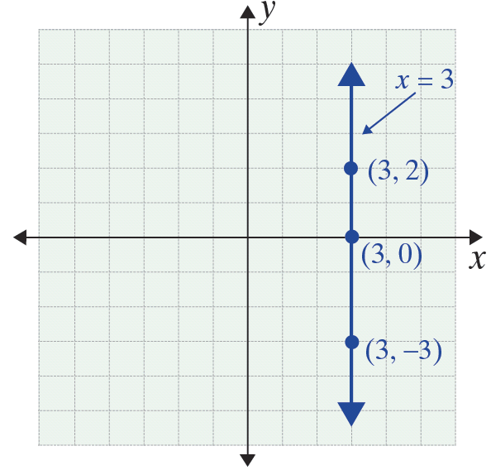
Example 1
Graph the vertical line x = 3 and label three points on the line.
Solution

Slide 4
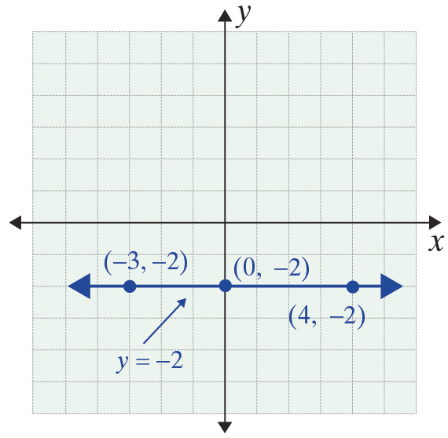
Example 2
Graph the horizontal line y + 2 = 0 and label three points on the line.
Solution
First solve for y:

Slide 5
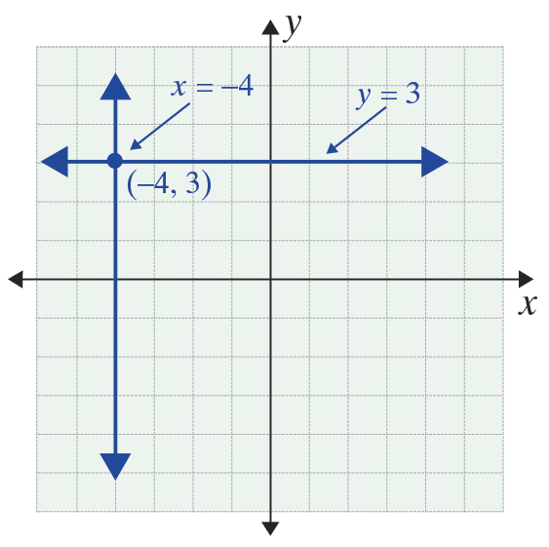
Example 3
Graph both the vertical line x = – 4 and the horizontal line y = 3 and label the point where the lines intersect.
Solution

Slide 6
Example 4
Use a TI-84 Plus graphing calculator to graph the line corresponding to the equation 2x + 3y = 6.
Solution
Solve for y:

Slide 7


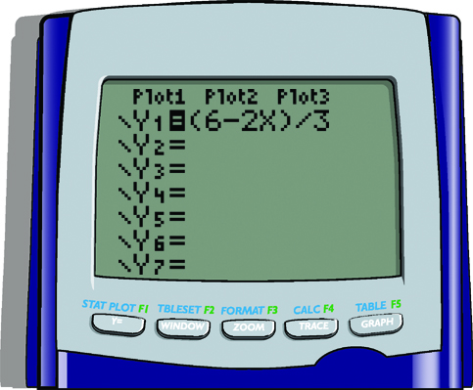
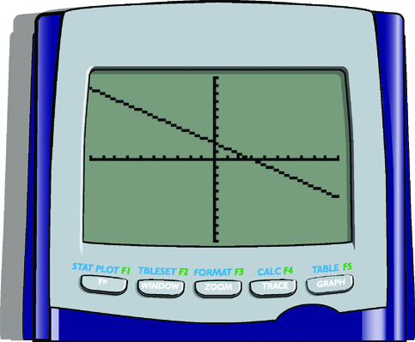
Example 4 (cont.)
Press and enter the expression for y using parentheses in the numerator.
Press and the graph will appear as shown:

