Slide 1
Section 9.4
Constructing Graphs from Databases

Slide 2
Objectives
Be able to organize and represent given data in the appropriate form of a bar graph or circle graph.

Slide 3
Constructing Graphs from Databases
Important Note
All of the graphs discussed here can be easily done with a computer and a spreadsheet program such as Excel. If you have access to a computer, your instructor may choose to have you work the problems in this section with a spreadsheet program.

Slide 4
Constructing a Bar Graph
Steps to Follow in Constructing a Vertical Bar Graph
1. Draw a vertical axis and horizontal axis.
2. Mark an appropriate scale on the vertical axis to represent the frequency of each category. (The scale must be uniform. That is, the distance between consecutive marks must represent the same amount.)
3. Mark the categories of data along the horizontal axis.

Slide 5
Constructing a Bar Graph
Steps to Follow in Constructing a Vertical Bar Graph (cont.)
4. Draw the vertical bar for each category so that the height of the bar reaches the frequency of the data in that category.

Slide 6
Example 1
Construct a bar graph that represents the following population data.
1. | New York, NY | 8,143,000
2. | Los Angeles, CA | 3,845,000
3. | Chicago, IL | 2,843,000
4. | Houston, TX | 2,017,000
5. | Philadelphia, PA | 1,463,000
6. | Phoenix, AZ | 1,462,000
7. | San Antonio, TX | 1,257,000
8. | San Diego, CA | 1,256,000
Source: U.S. Census Bureau

Slide 7
Example 1 (cont.)
Steps 1 and 2: Draw the vertical axis and horizontal axis and mark a scale on the vertical axis that will encompass the numbers from 0 to 7.3 million people. (On this graph, we have chosen to mark the numbers from 1.0 to 8.0 in a scale of 1 unit.)
Steps 3 and 4: The horizontal axis marks are labeled with the names of the cities represented. The height of each vertical bar corresponds to the population (in millions) of each city as given.

Slide 8
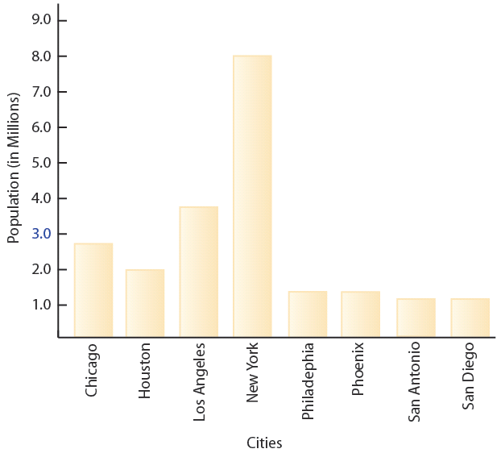
Example 1 (cont.)
Population of 8 Largest U.S. Cities

Slide 9
Constructing a Circle Graph (or Pie Chart)
Steps to Follow in Constructing a Circle Graph
1. Find the central angle (angle at the center of the circle) for each category by multiplying the corresponding percent (in decimal form) by 360°.
2. Draw a circle.
3. Draw each central angle (use a protractor), and label each sector with the name and corresponding percent of each category.

Slide 10
Example 2
Construct a circle graph (pie chart) that represents the following data.
Ethnic Breakdown of Students Who Took the SAT (Scholastic Aptitude Test), Nationwide, 2005
Ethnicity | Percent
African-American | 12%
Asian-American | 10%
Hispanic | 11%
Native American | 1%
White | 62%
Other | 4%
Source: CollegeBoard.com

Slide 11
Example 2 (cont.)
Step 1: Find the percent of 360°.

Slide 12
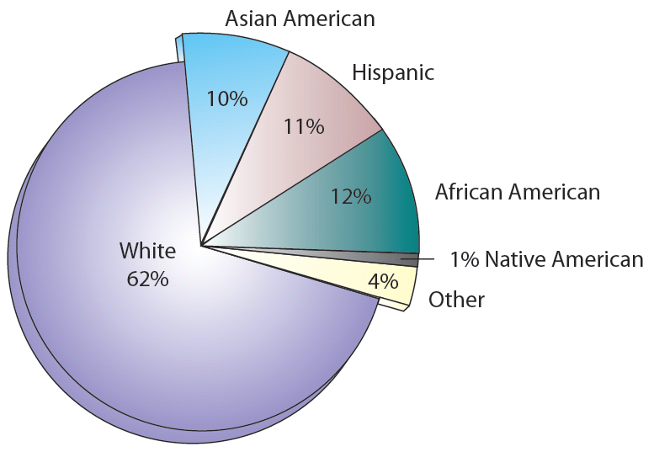
Example 2 (cont.)
Steps 2 and 3: Draw a circle, mark the central angles as close to the actual degrees as is practical, and label each sector. Note that the order of the wedges (pie slices) is not important.
Ethnic Breakdown for SAT,
Nationwide, 2005

