Slide 1
Chapter 11
Personality

Slide 2

Lesson 11.1 Figure 1

Slide 3
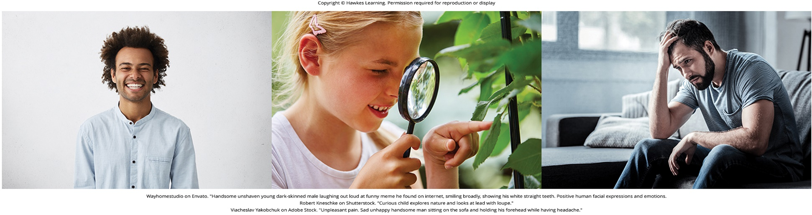
Lesson 11.1 Figure 2

Slide 4
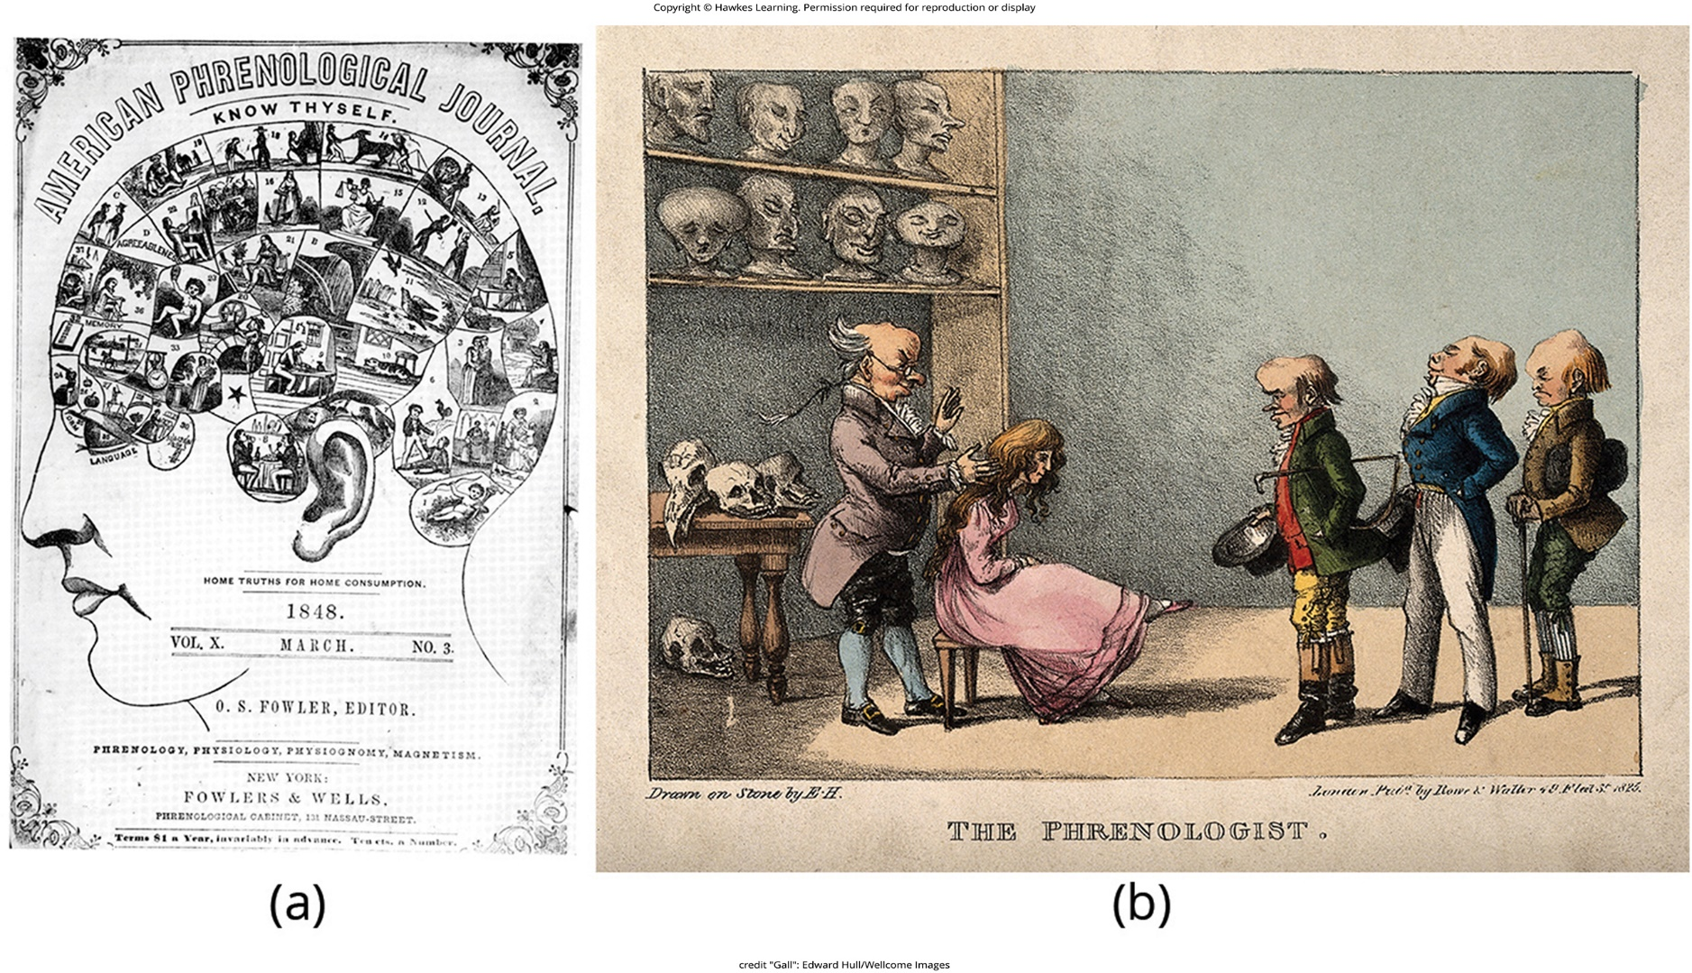
Lesson 11.1 Figure 3

Slide 5
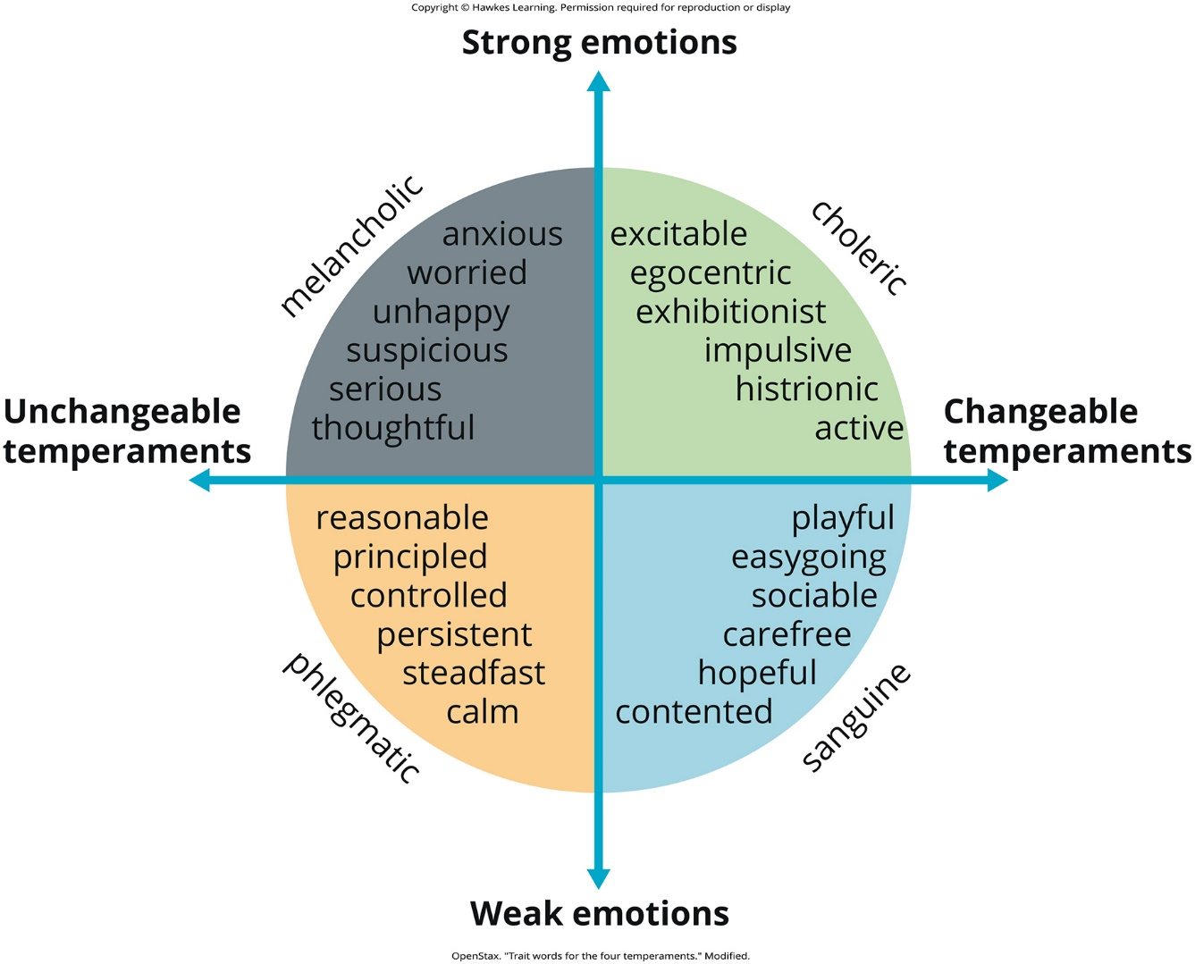
Lesson 11.1 Figure 4

Slide 6
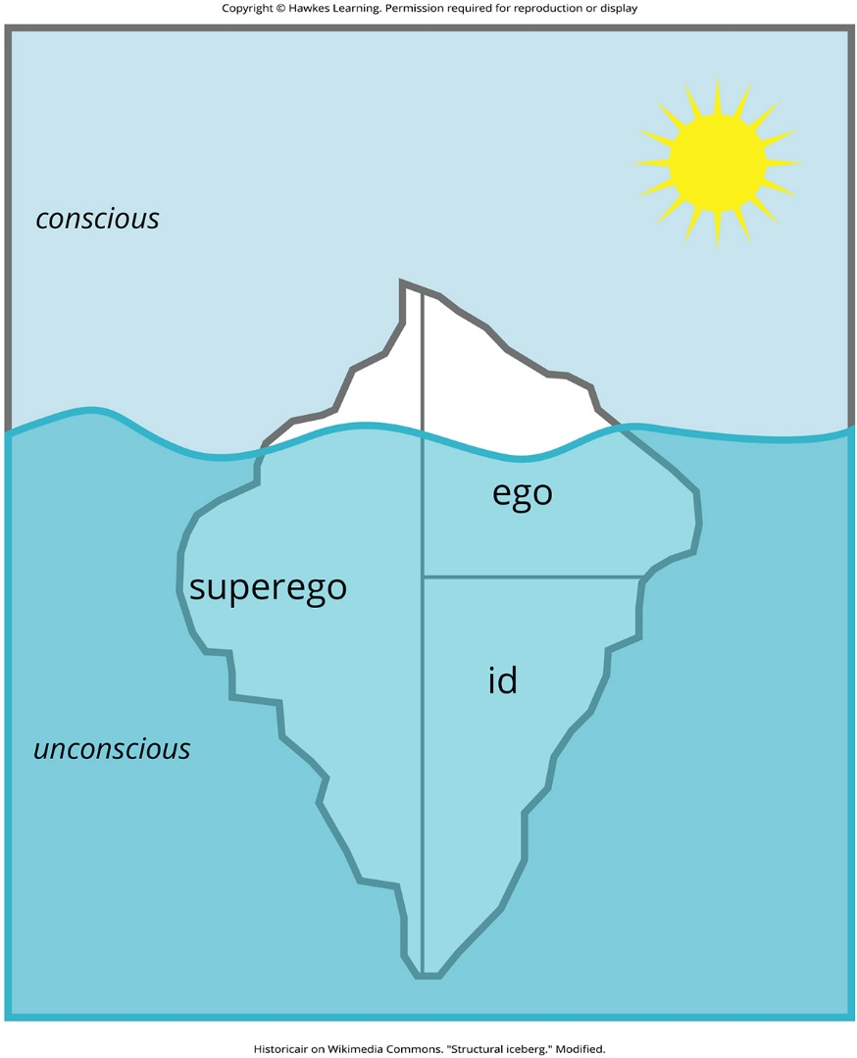
Lesson 11.2 Figure 1

Slide 7
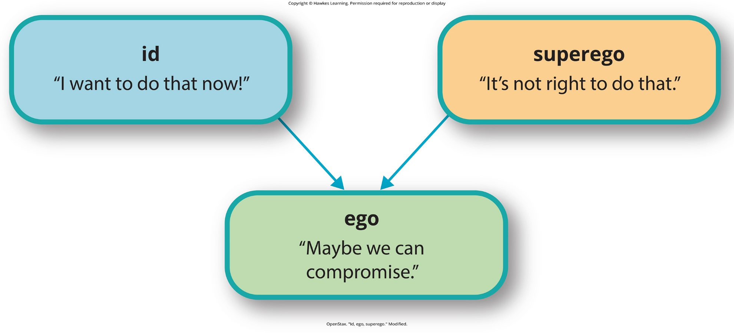
Lesson 11.2 Figure 2

Slide 8
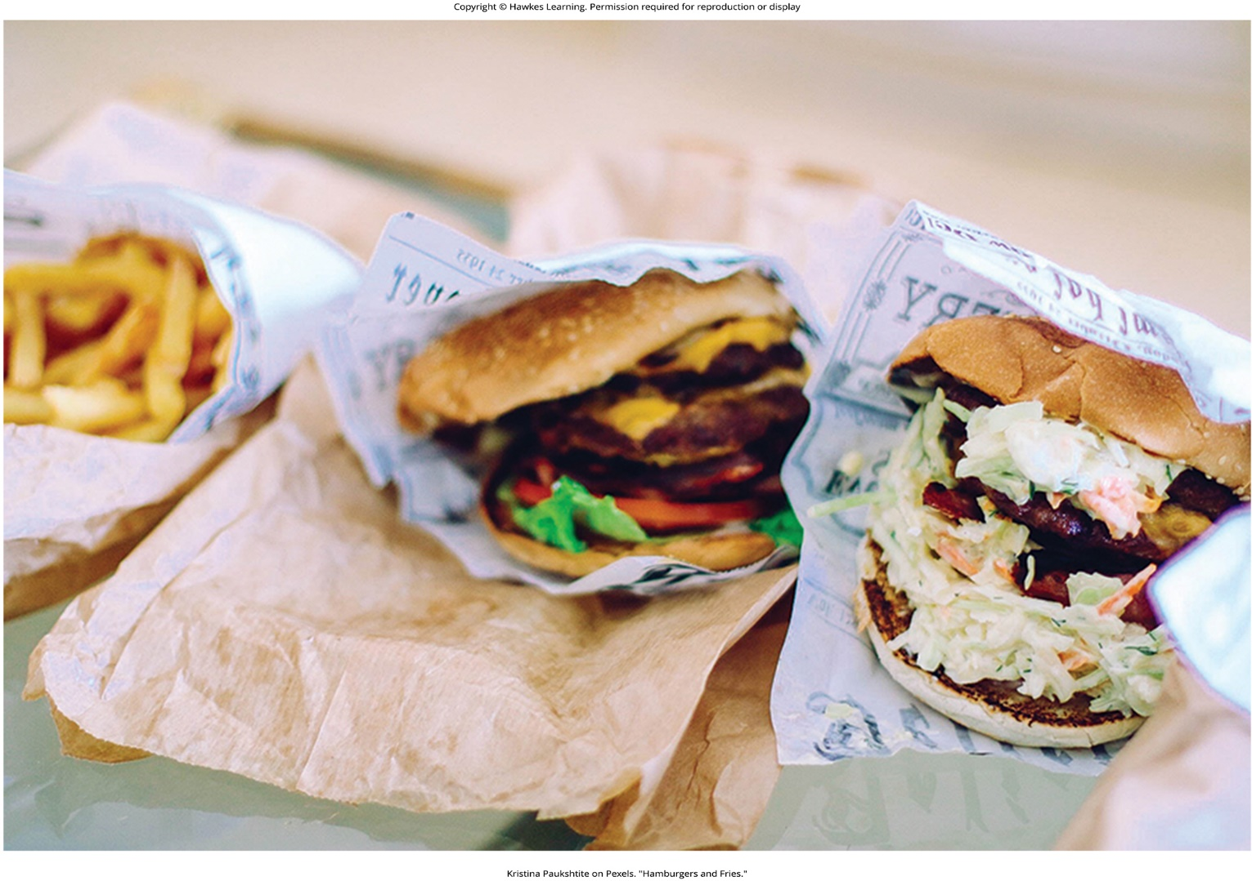
Lesson 11.2 Figure 3

Slide 9
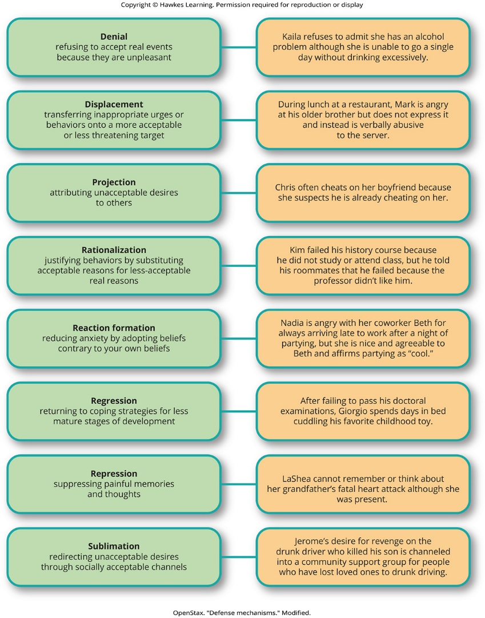
Lesson 11.2 Figure 4

Slide 10
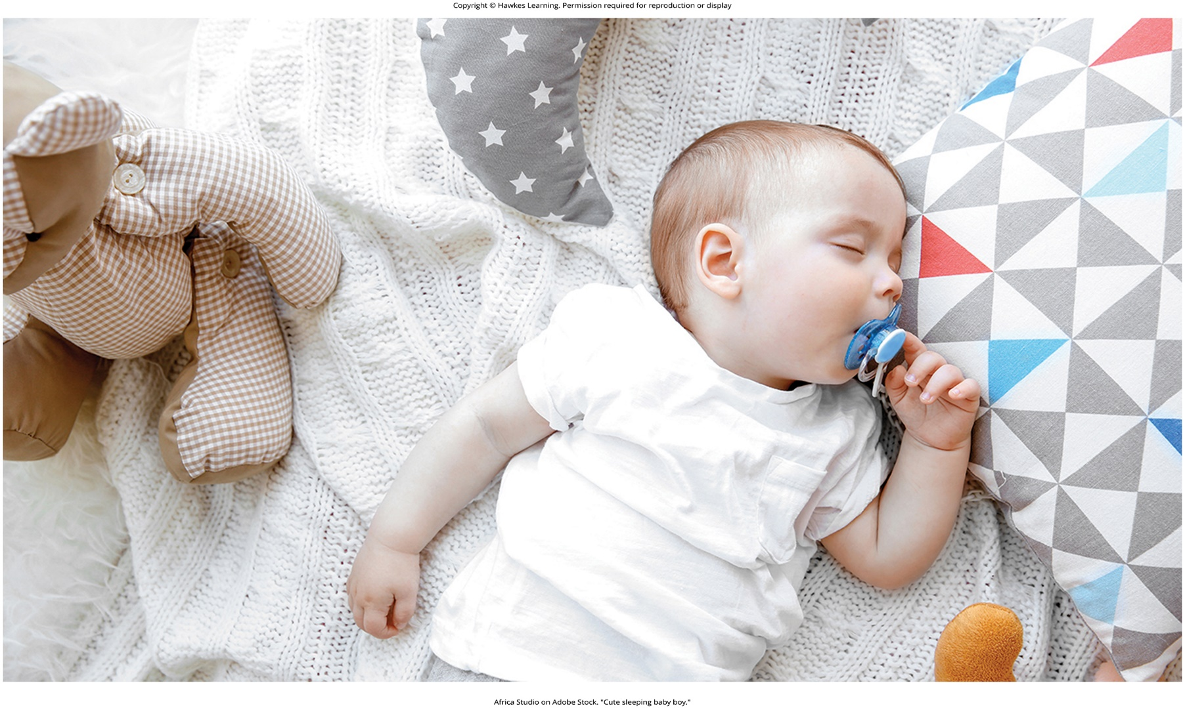
Lesson 11.2 Figure 5

Slide 11
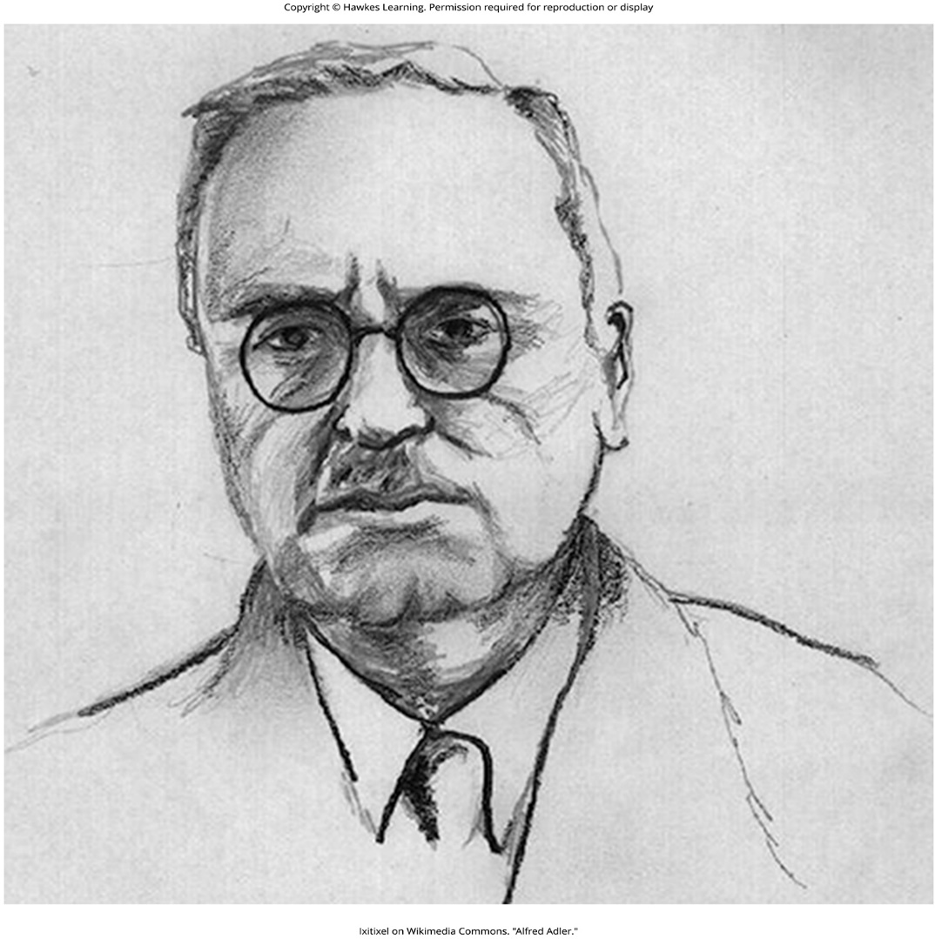
Lesson 11.3 Figure 1

Slide 12
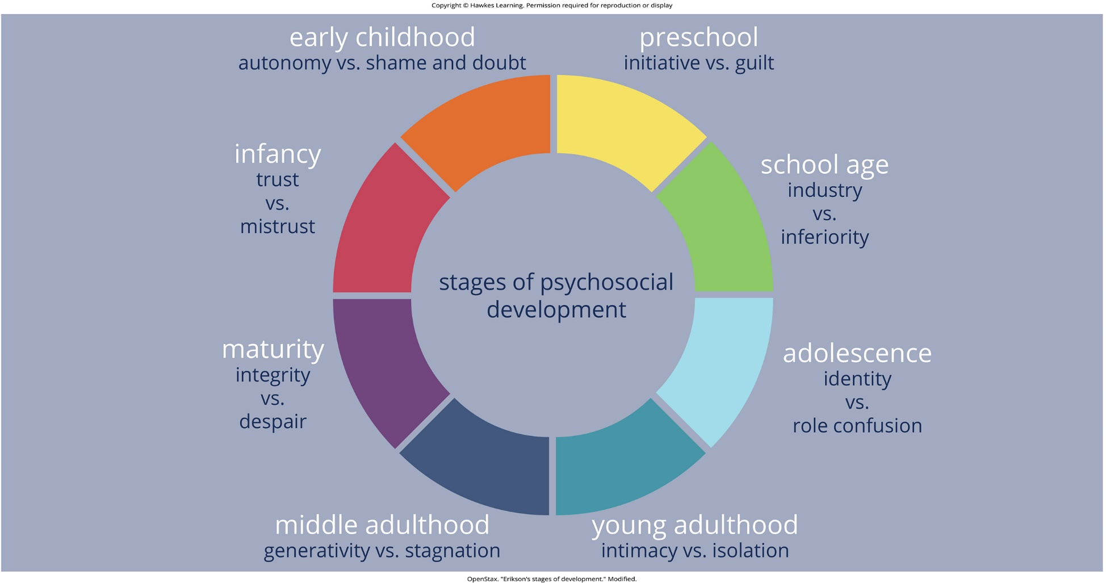
Lesson 11.3 Figure 2

Slide 13
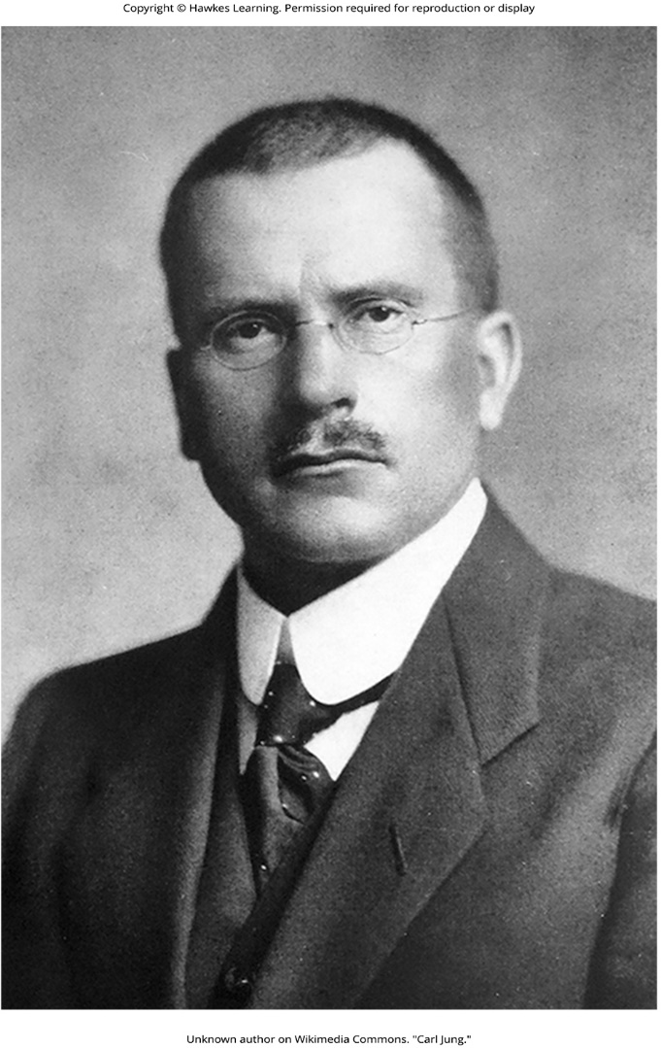
Lesson 11.3 Figure 3

Slide 14

Lesson 11.3 Figure 4

Slide 15
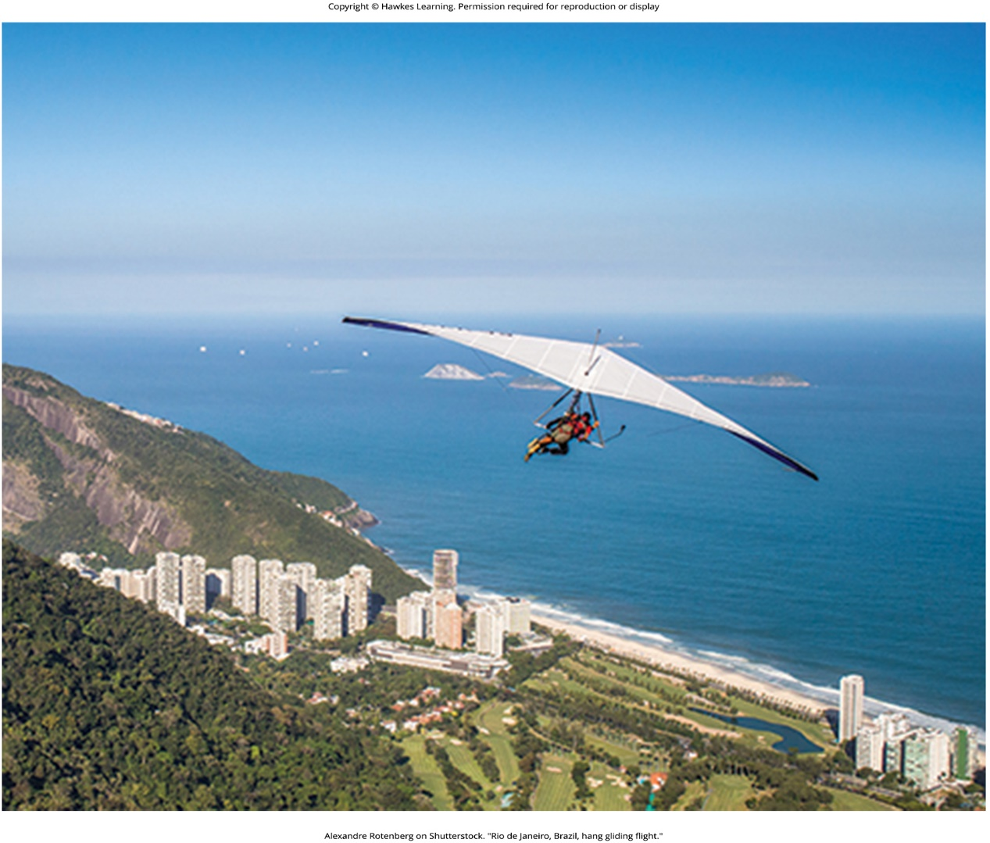
Lesson 11.4 Figure 1

Slide 16
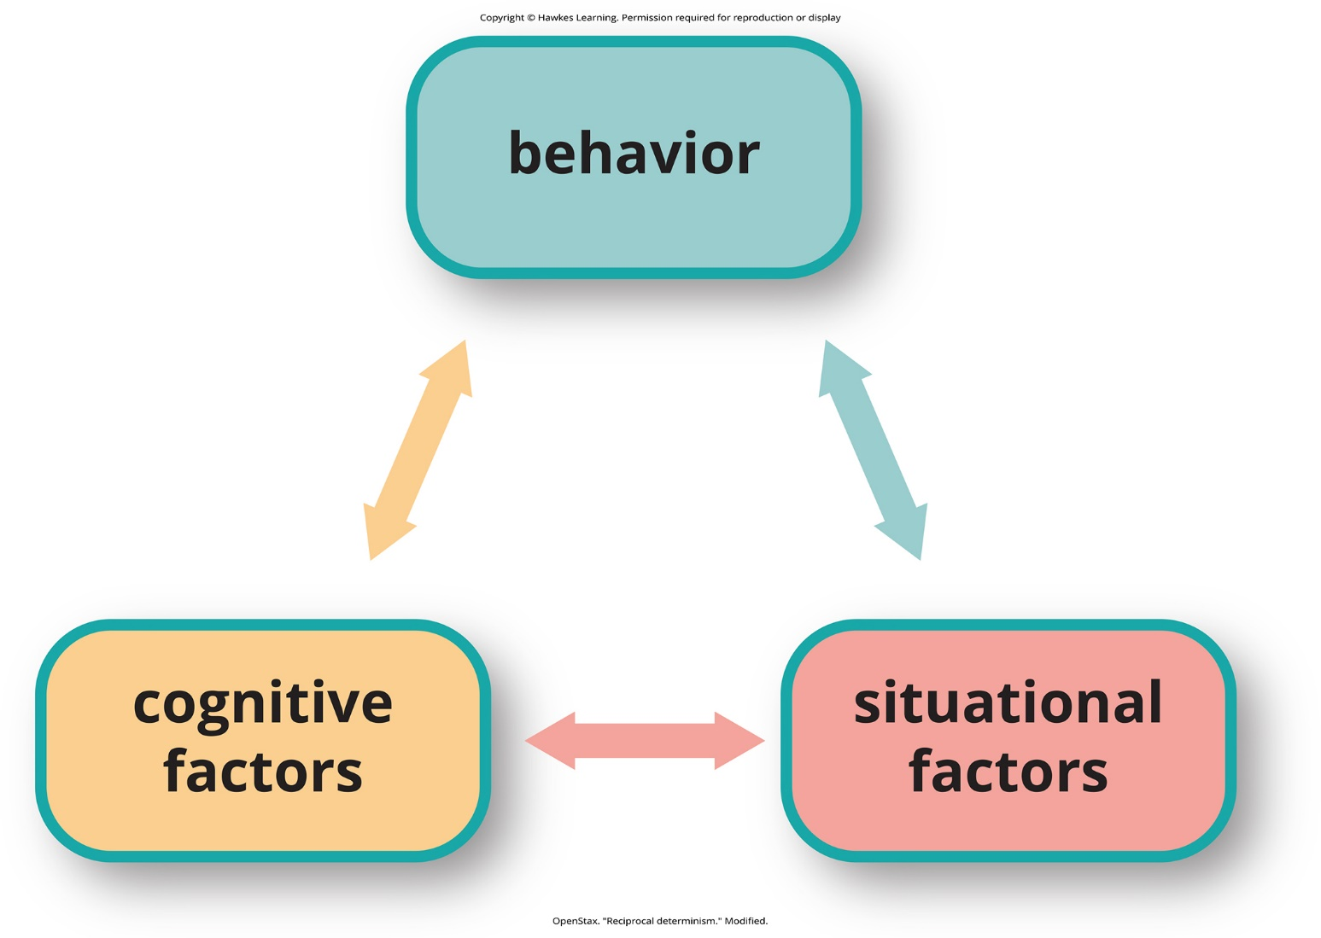
Lesson 11.4 Figure 2

Slide 17
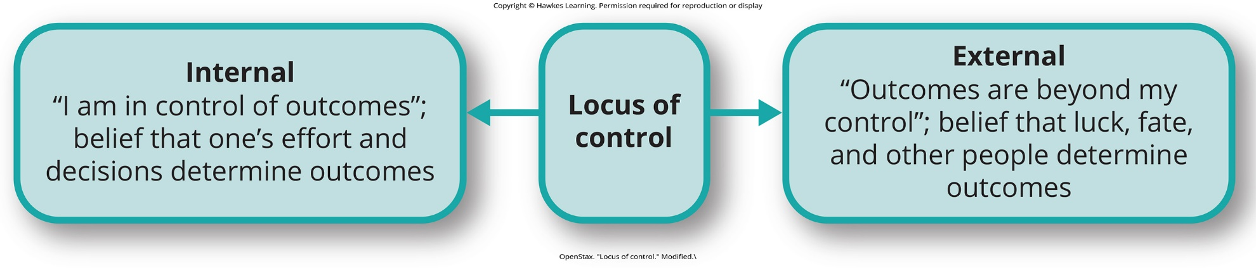
Lesson 11.4 Figure 3

Slide 18
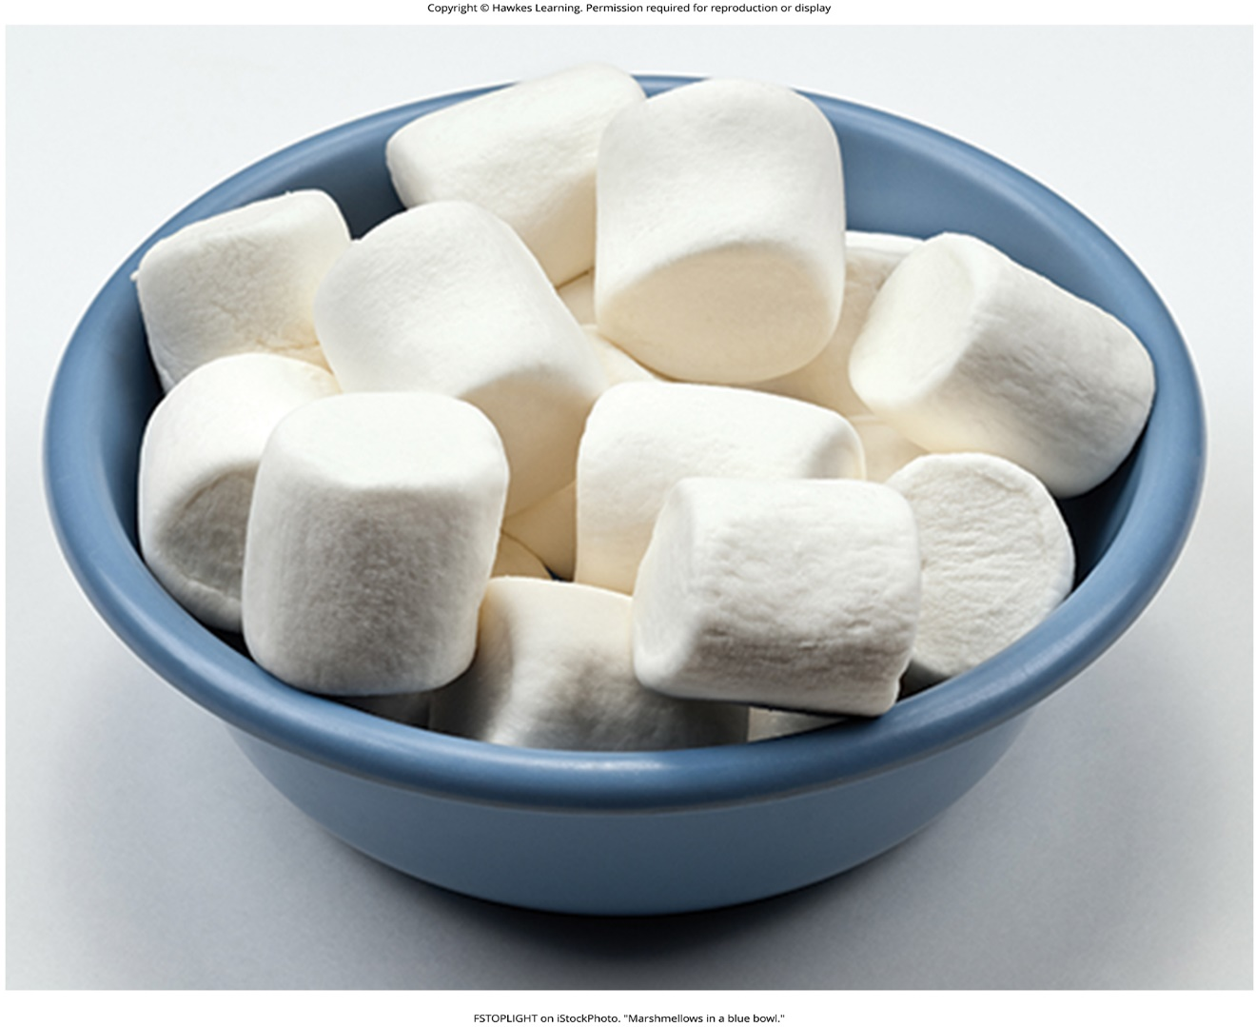
Lesson 11.4 Figure 4

Slide 19
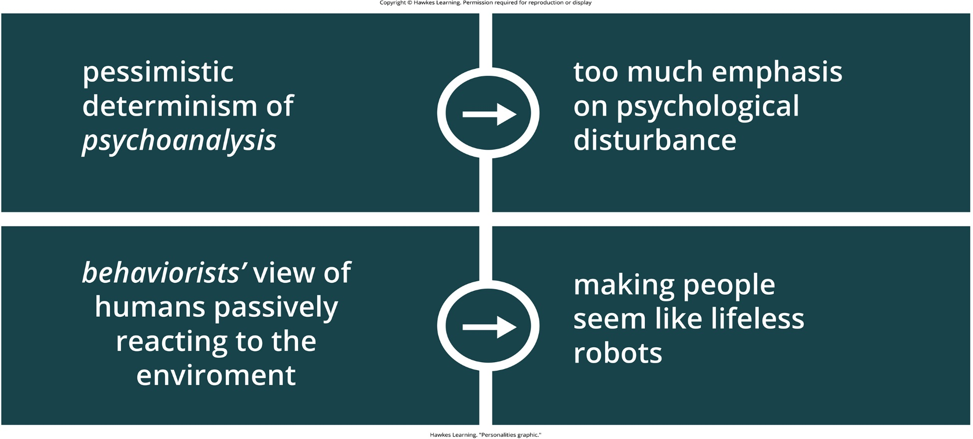
Lesson 11.5 Figure 1

Slide 20
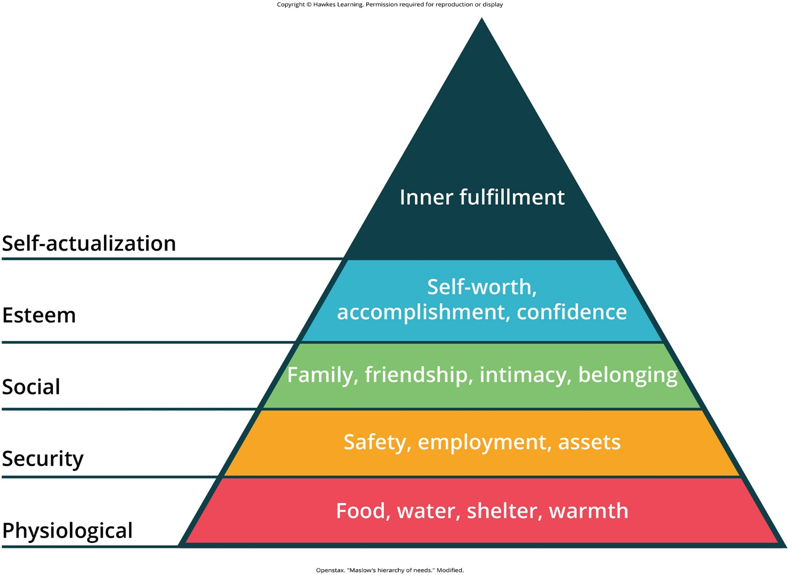
Lesson 11.5 Figure 2

Slide 21
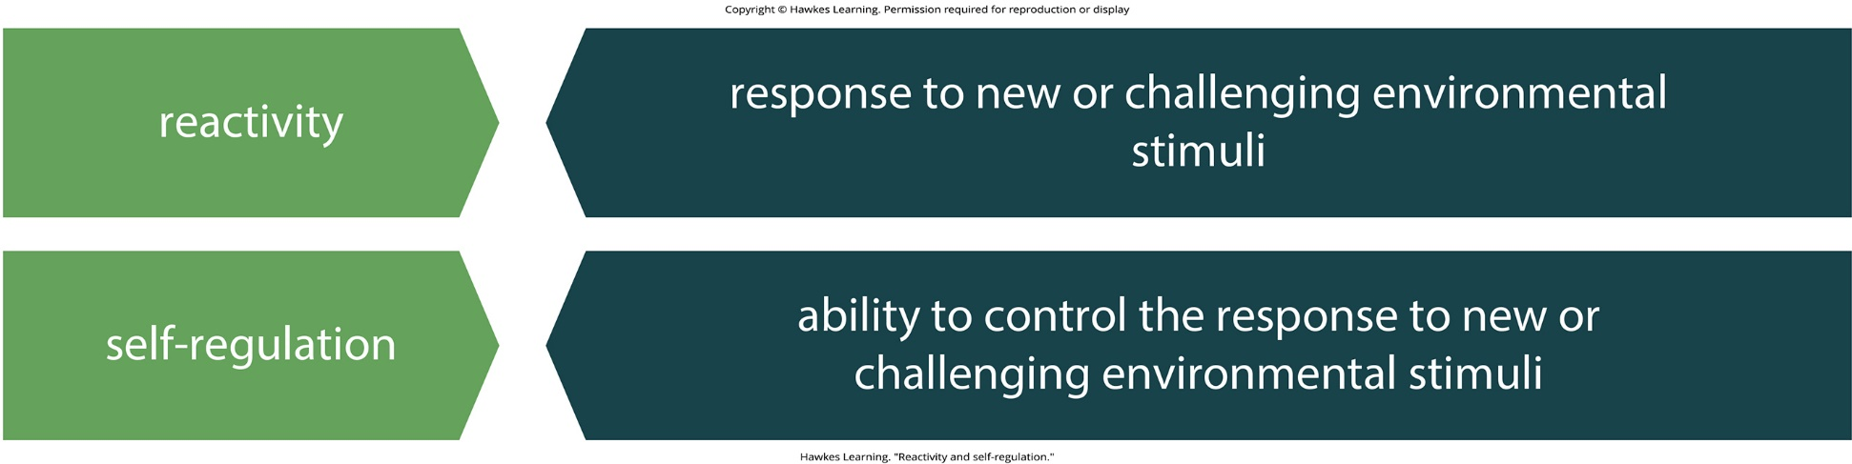
Lesson 11.6 Figure 1

Slide 22
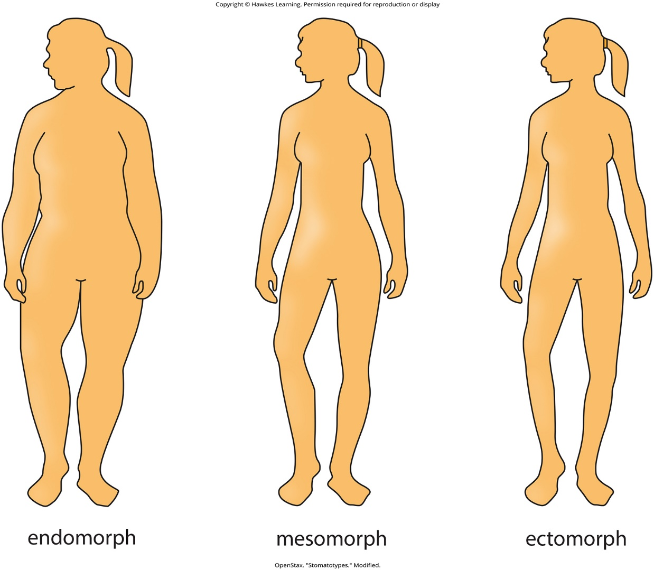
Lesson 11.6 Figure 2

Slide 23
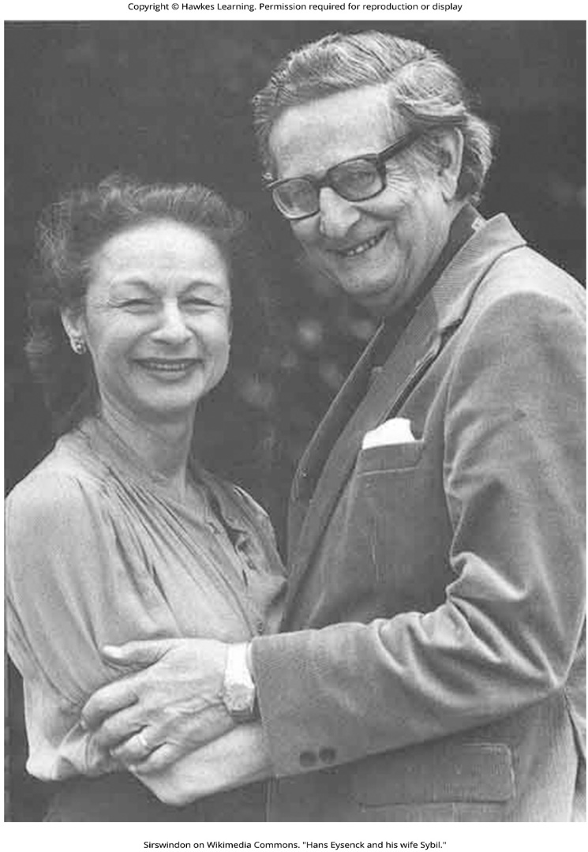
Lesson 11.7 Figure 1

Slide 24
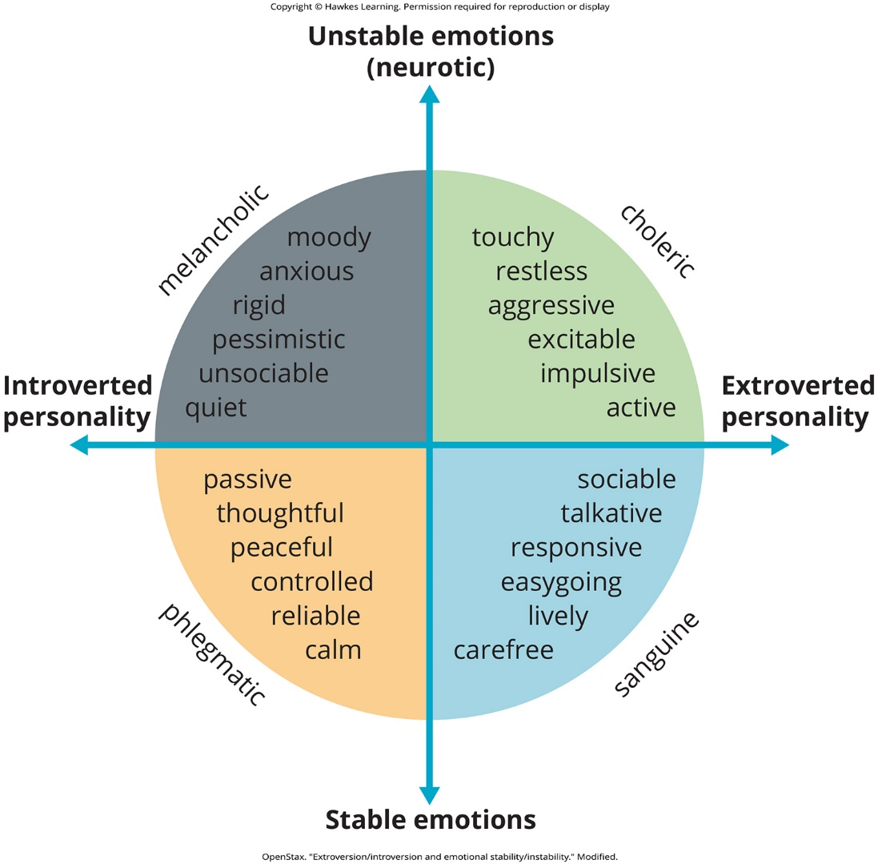
Lesson 11.7 Figure 2

Slide 25
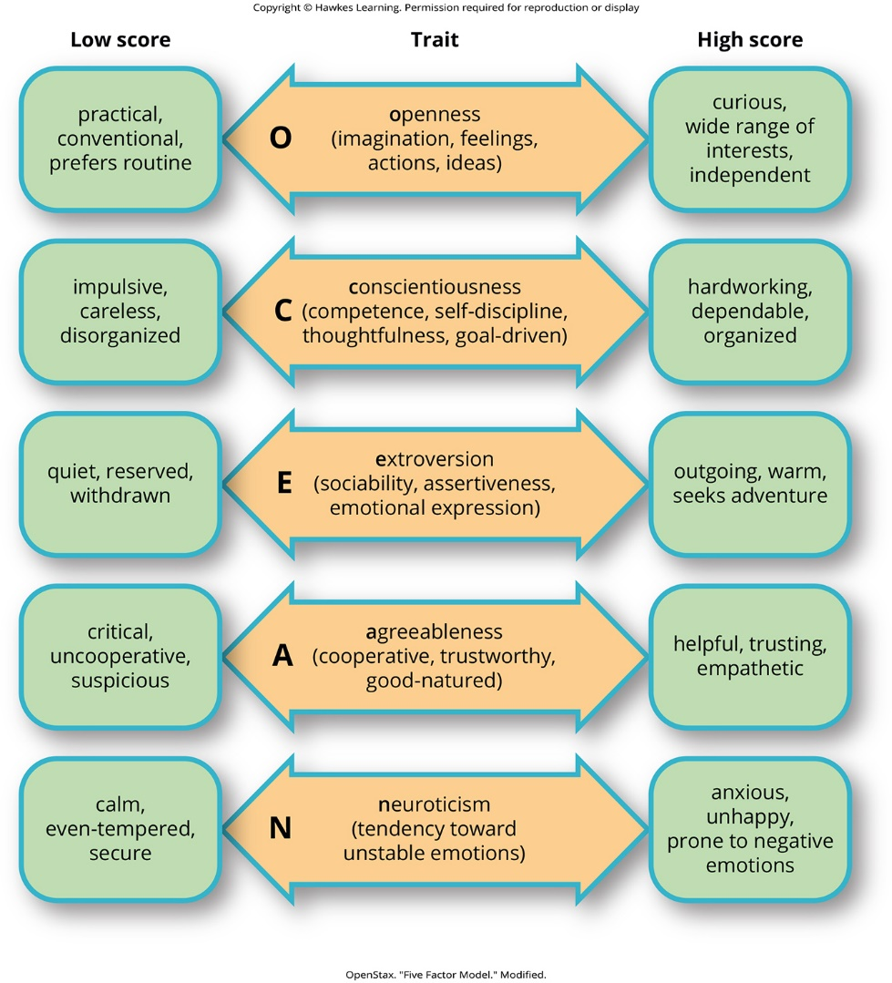
Lesson 11.7 Figure 3

Slide 26

Lesson 11.8 Figure 1

Slide 27
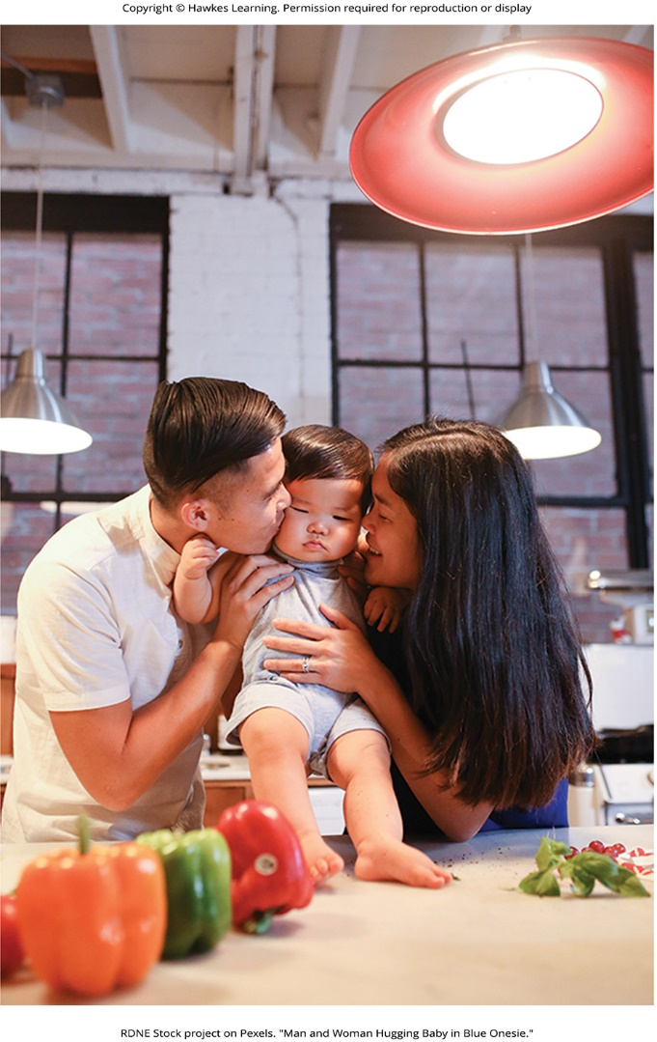
Lesson 11.8 Figure 2

Slide 28
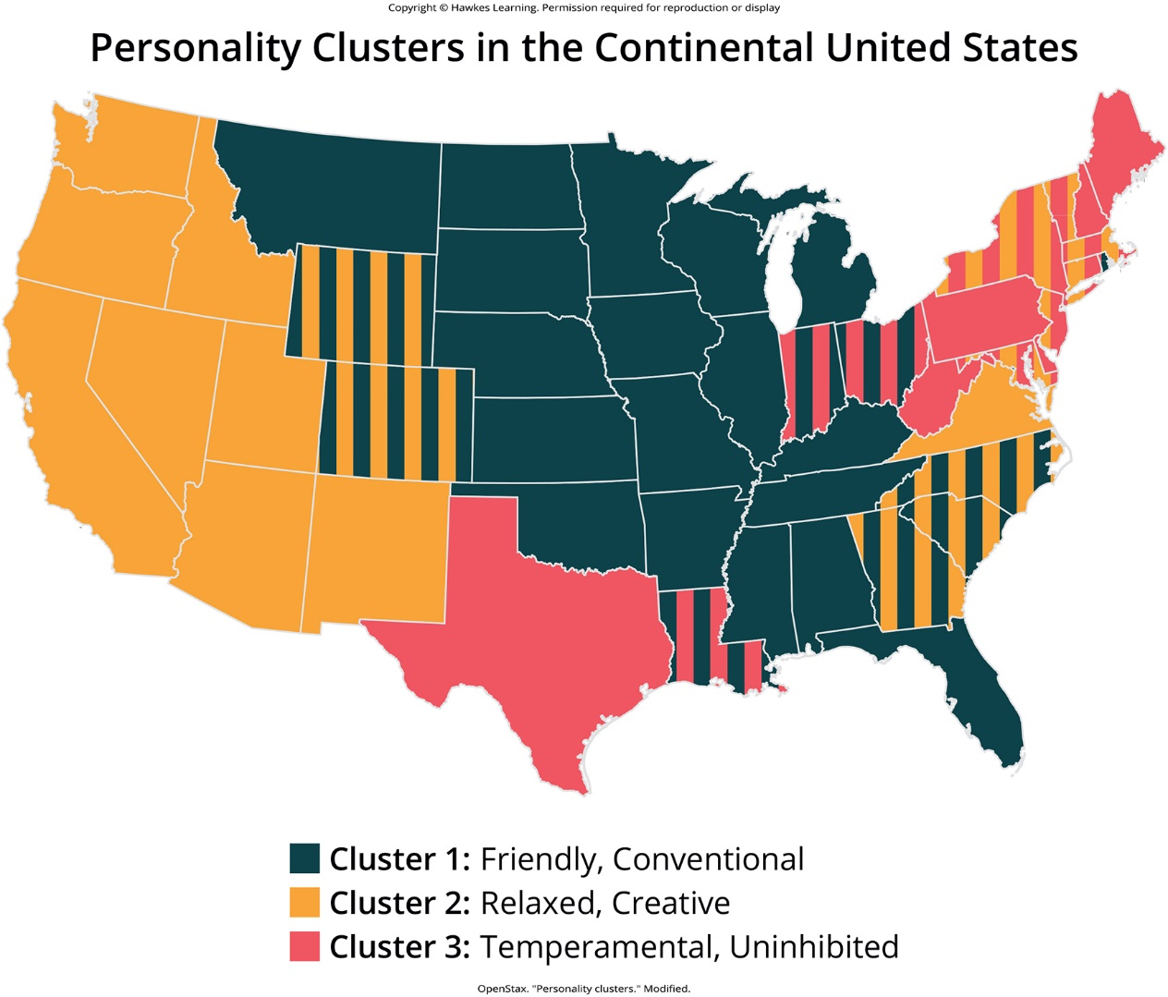
Lesson 11.8 Figure 3

Slide 29
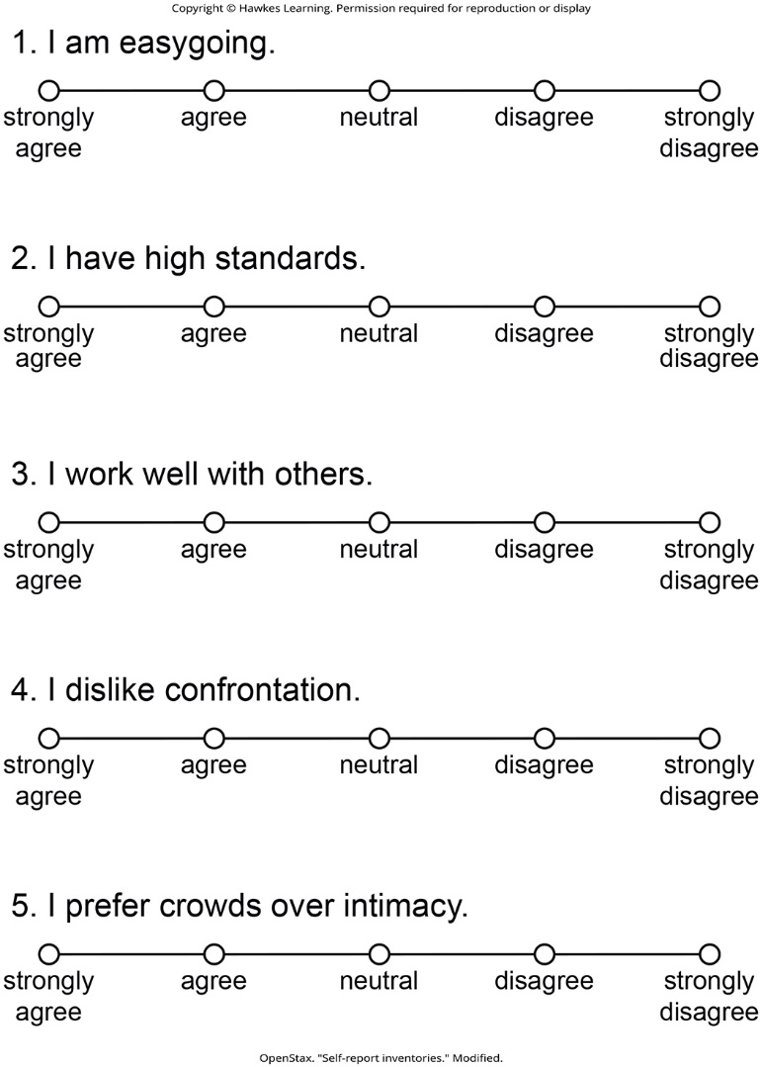
Lesson 11.9 Figure 1

Slide 30
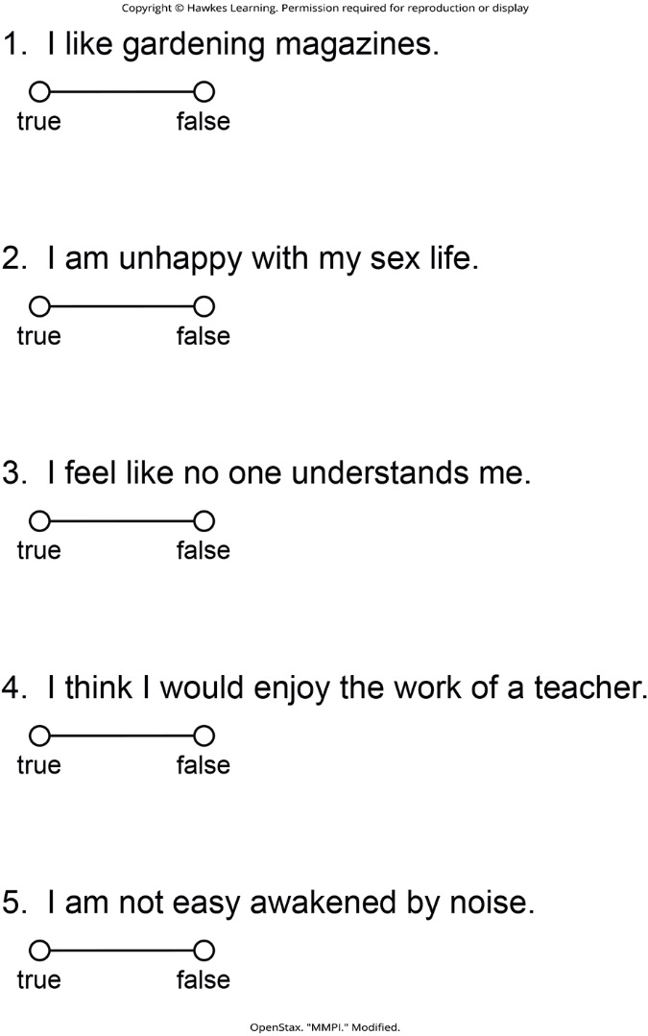
Lesson 11.9 Figure 2

Slide 31
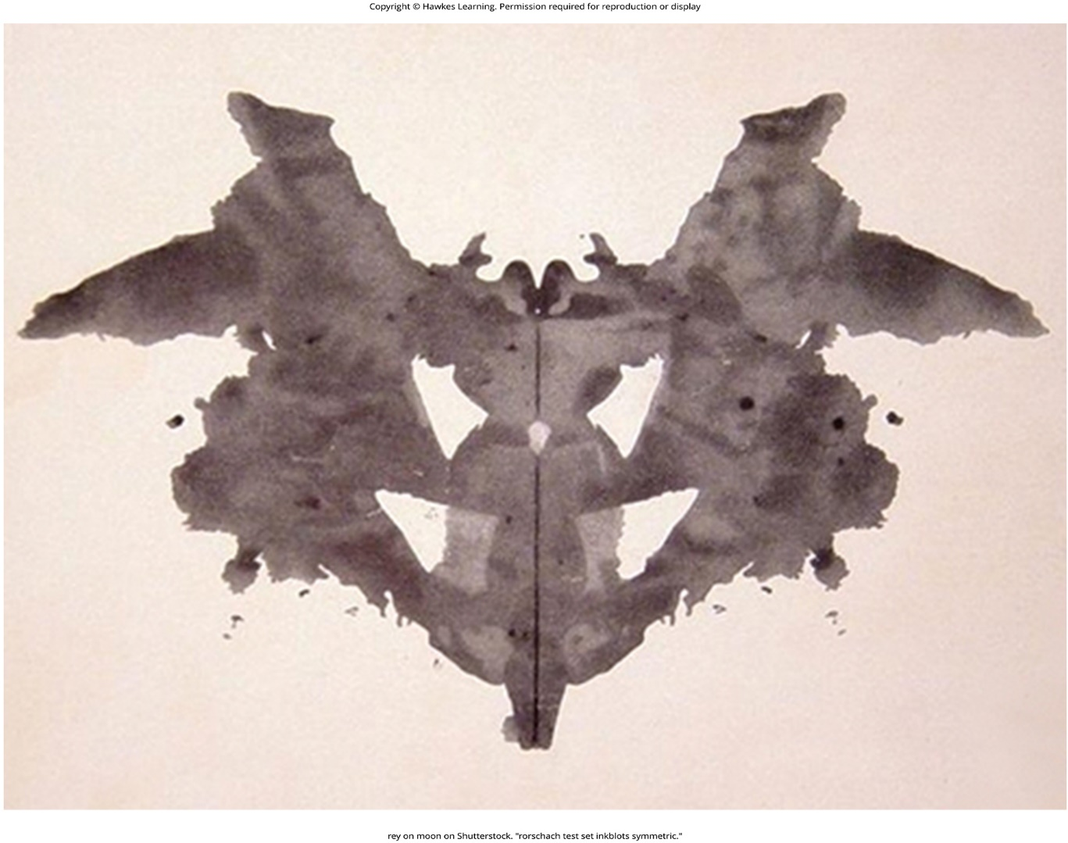
Lesson 11.9 Figure 3

Slide 32
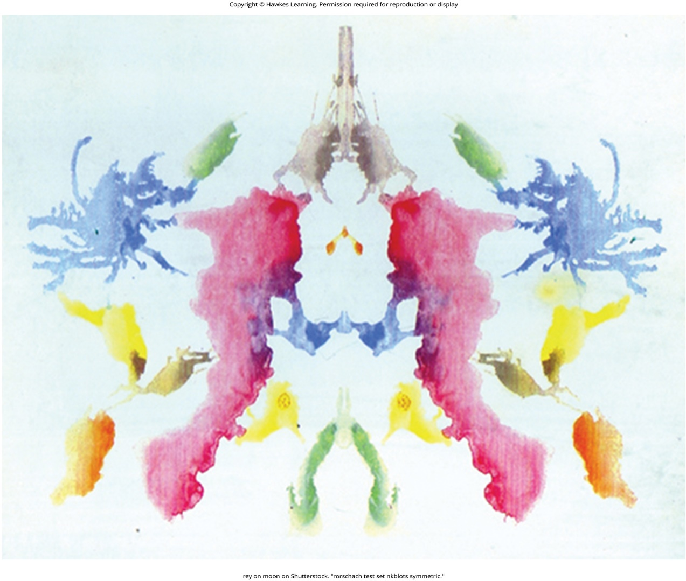
Lesson 11.9 Figure 4

Slide 33
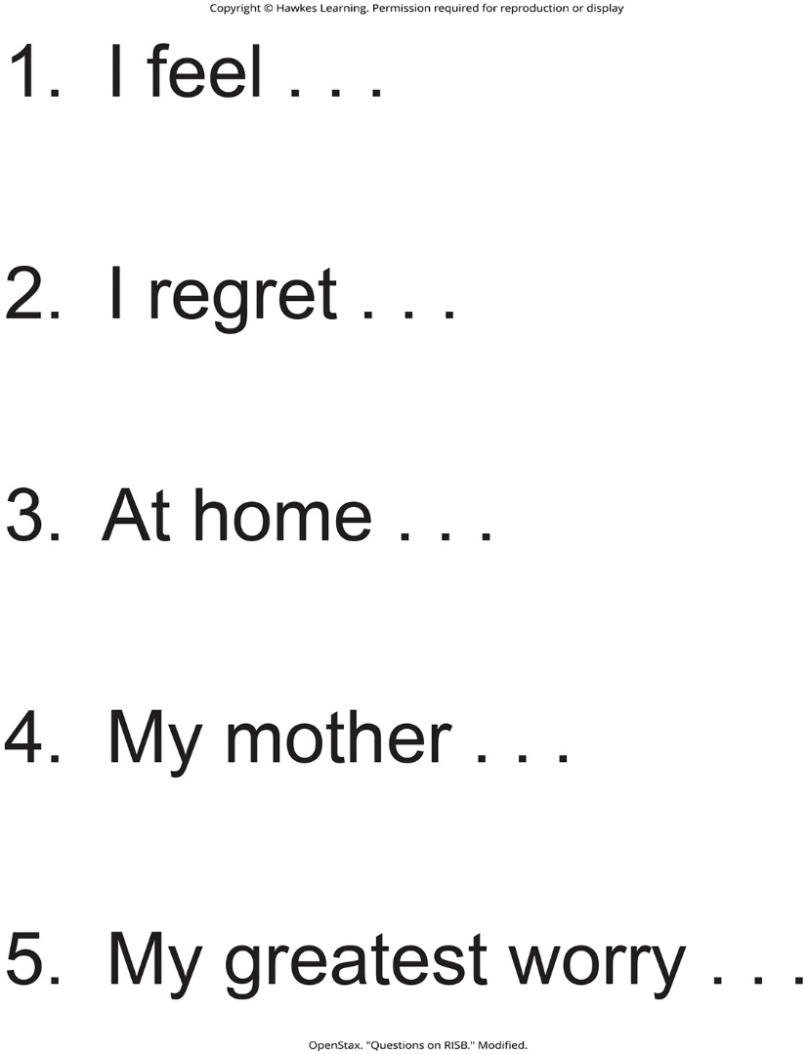
Lesson 11.9 Figure 5

Slide 34
Hawkes Learning – End of PowerPoint

