Slide 1
Chapter 12
Social Psychology

Slide 2

Lesson 12.1 Figure 1

Slide 3
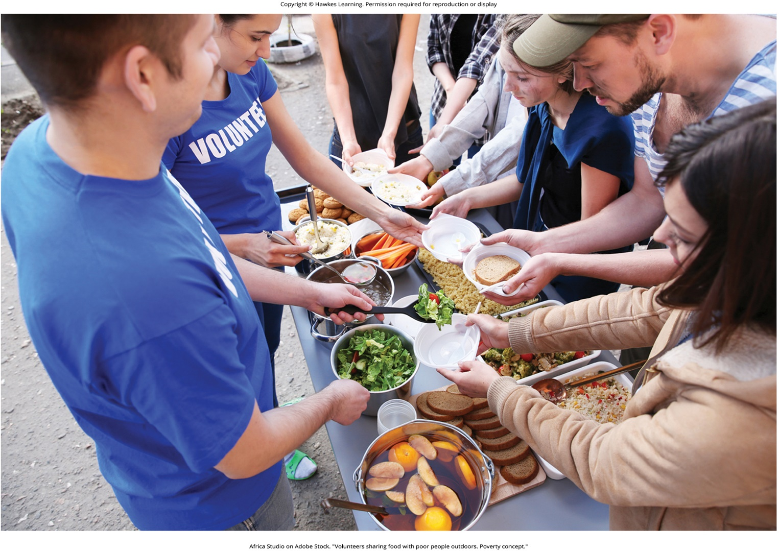
Lesson 12.1 Figure 2

Slide 4

Lesson 12.1 Figure 3

Slide 5
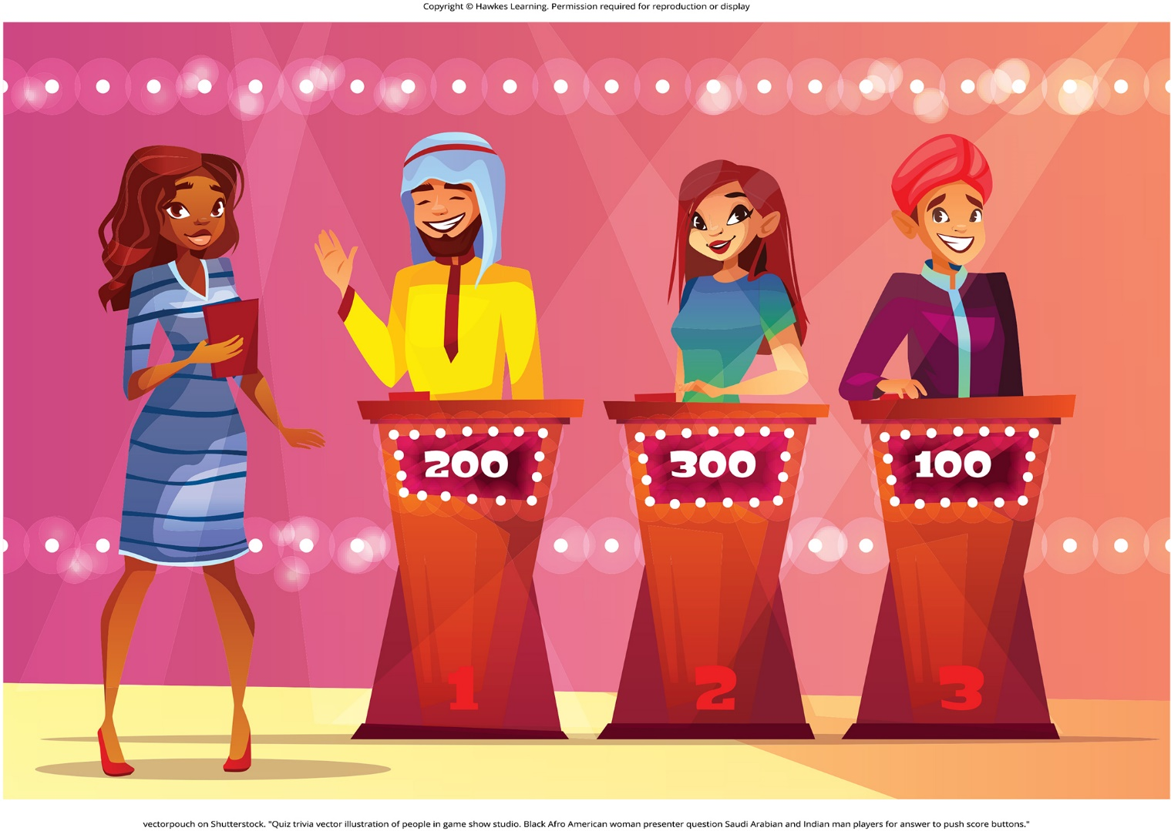
Lesson 12.1 Figure 4

Slide 6
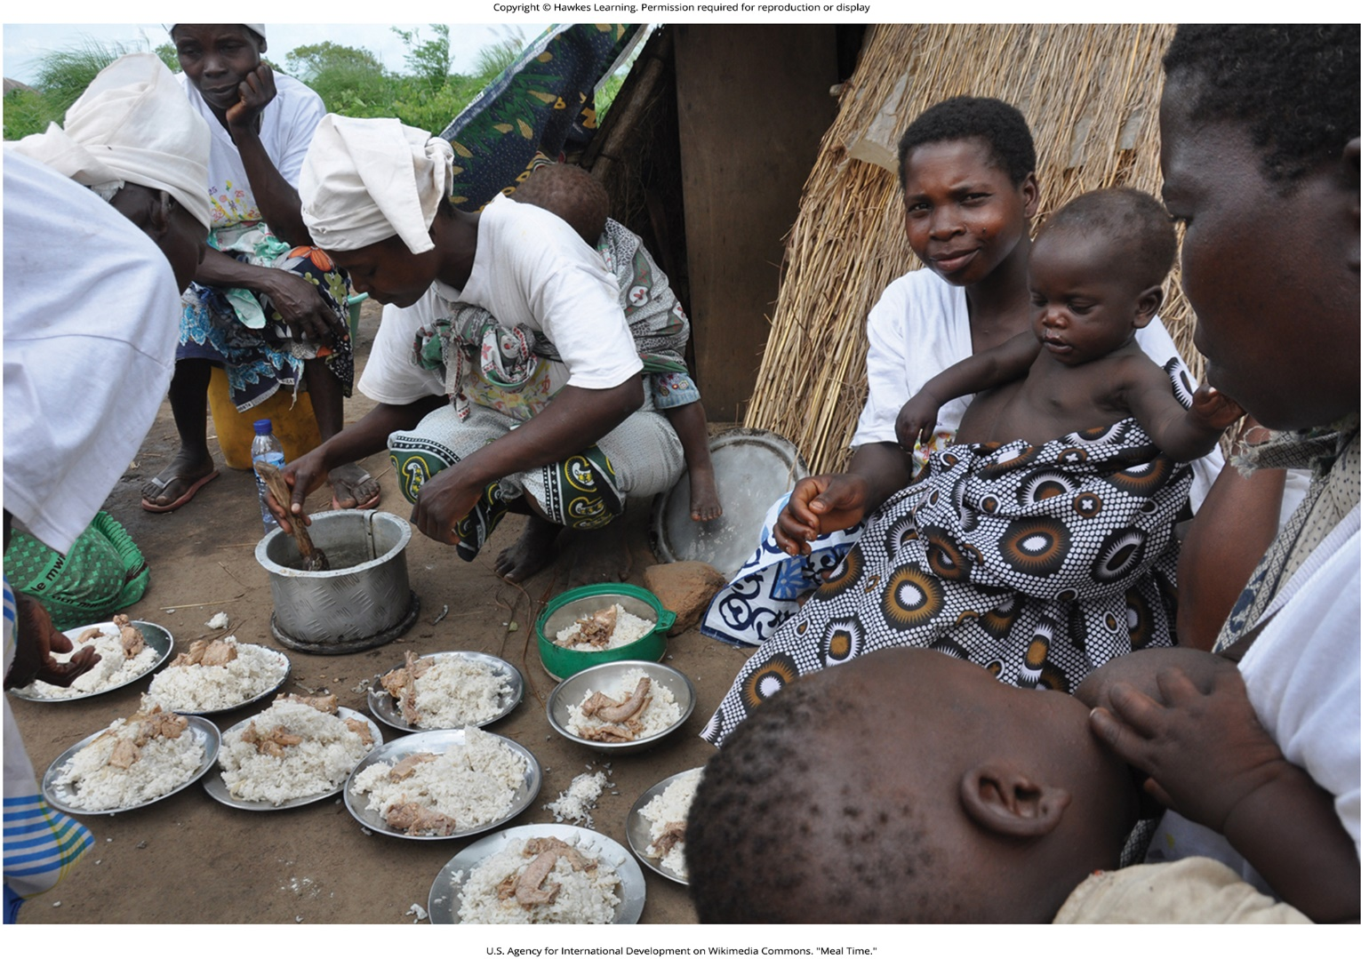
Lesson 12.1 Figure 5

Slide 7
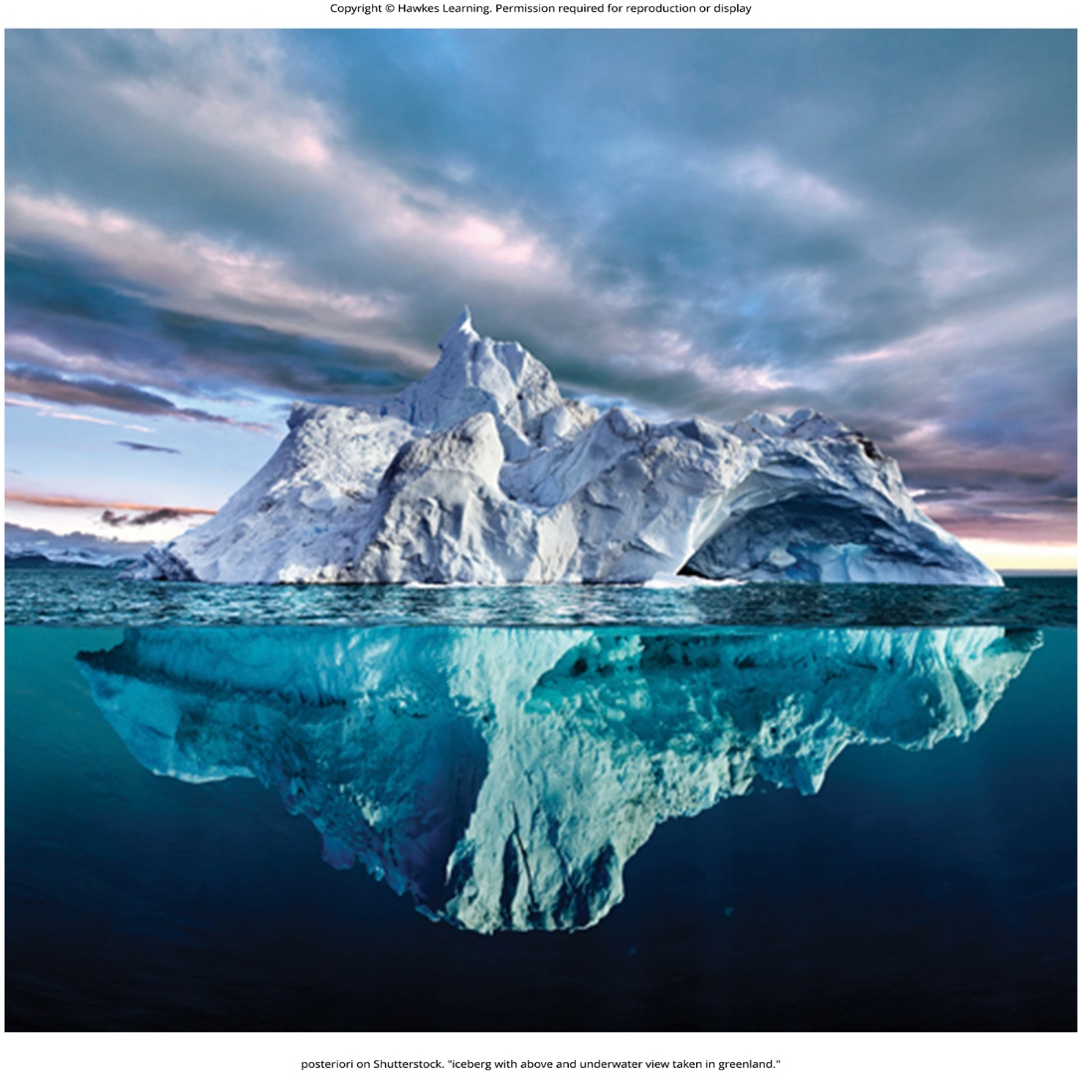
Lesson 12.1 Figure 6

Slide 8
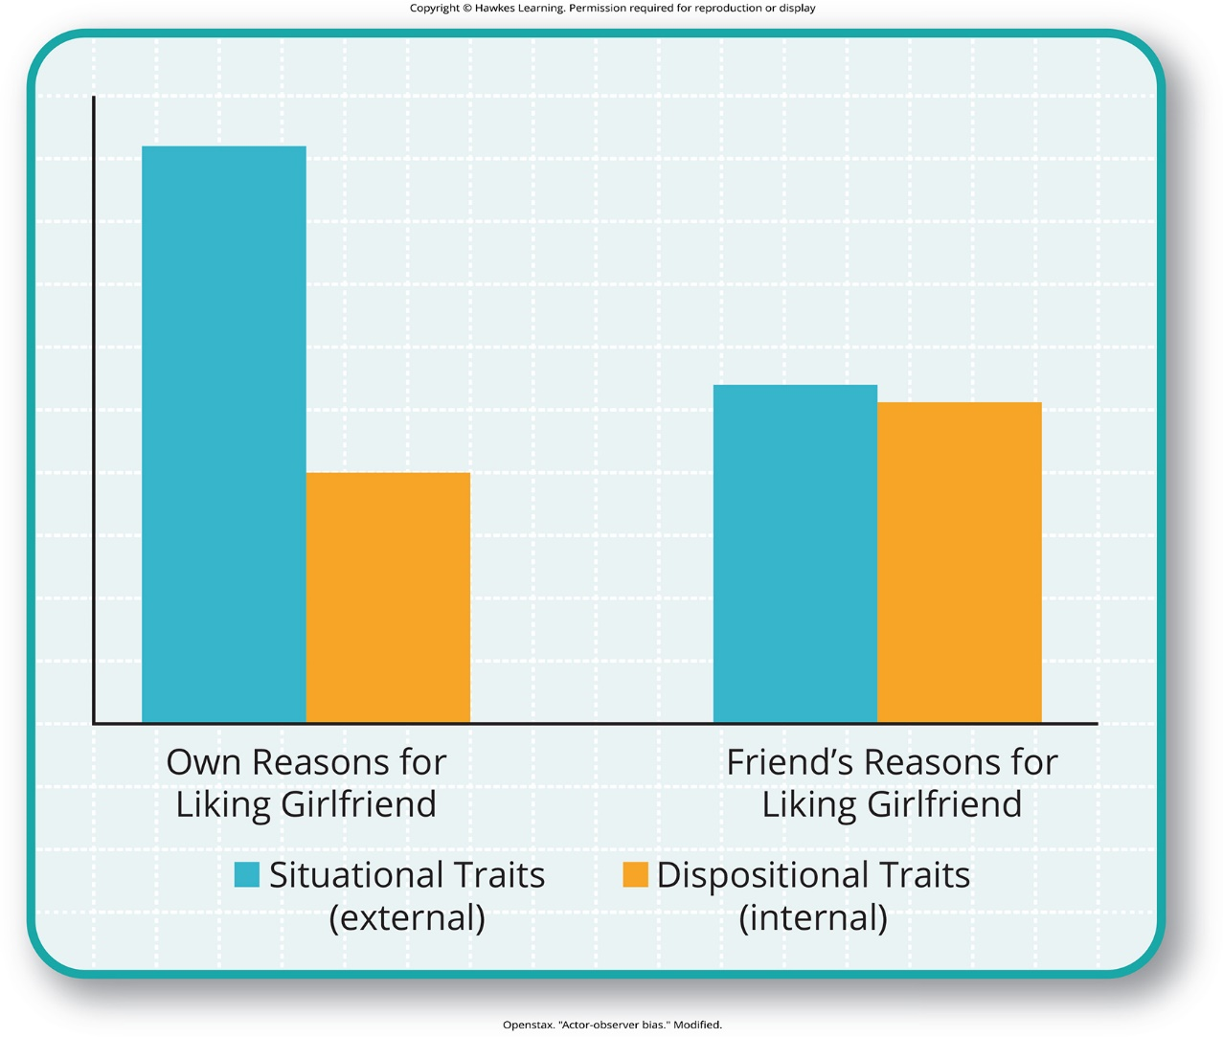
Lesson 12.1 Figure 7

Slide 9

Lesson 12.1 Figure 8

Slide 10
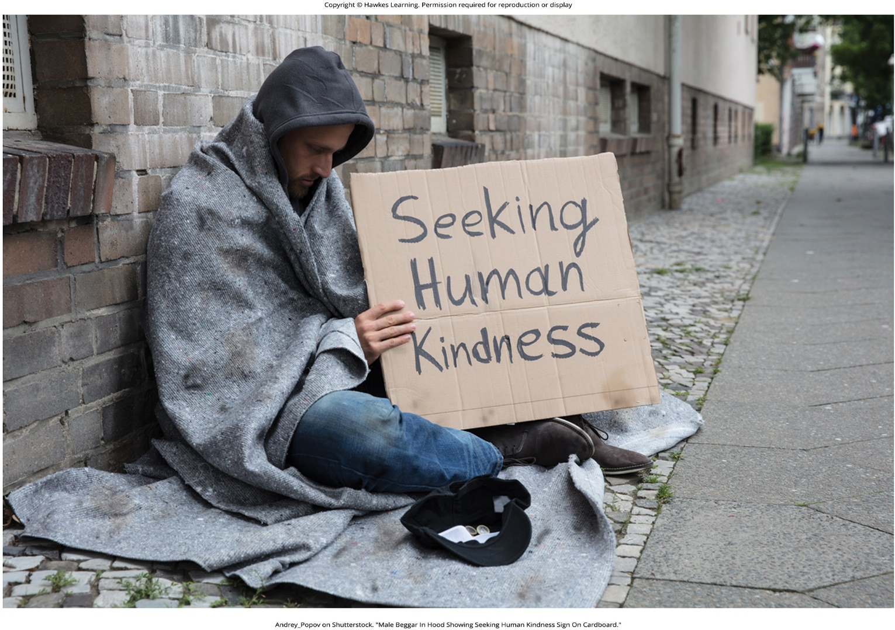
Lesson 12.1 Figure 9

Slide 11
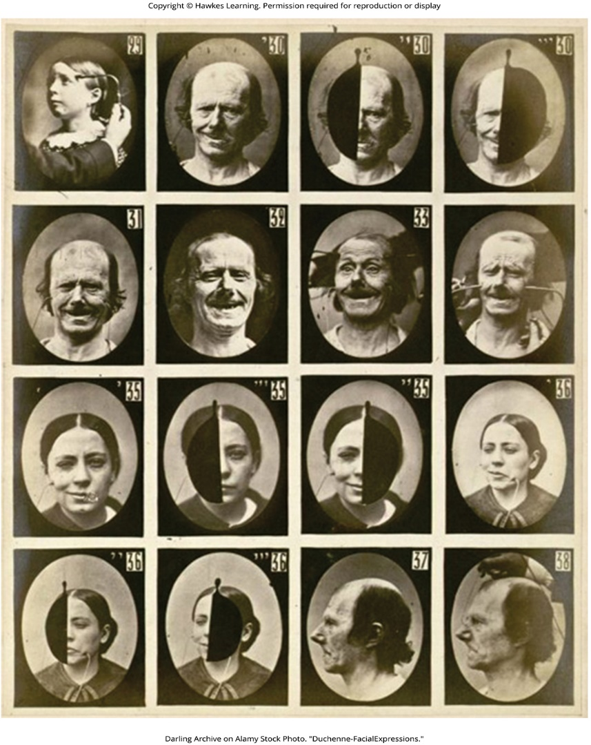
Lesson 12.2 Figure 1

Slide 12

Lesson 12.2 Figure 2

Slide 13

Lesson 12.2 Figure 3

Slide 14

Lesson 12.2 Figure 4

Slide 15
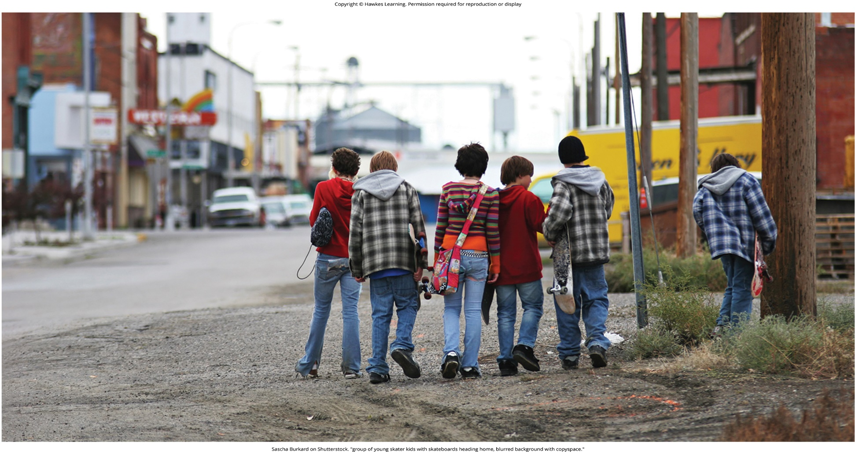
Lesson 12.2 Figure 5

Slide 16
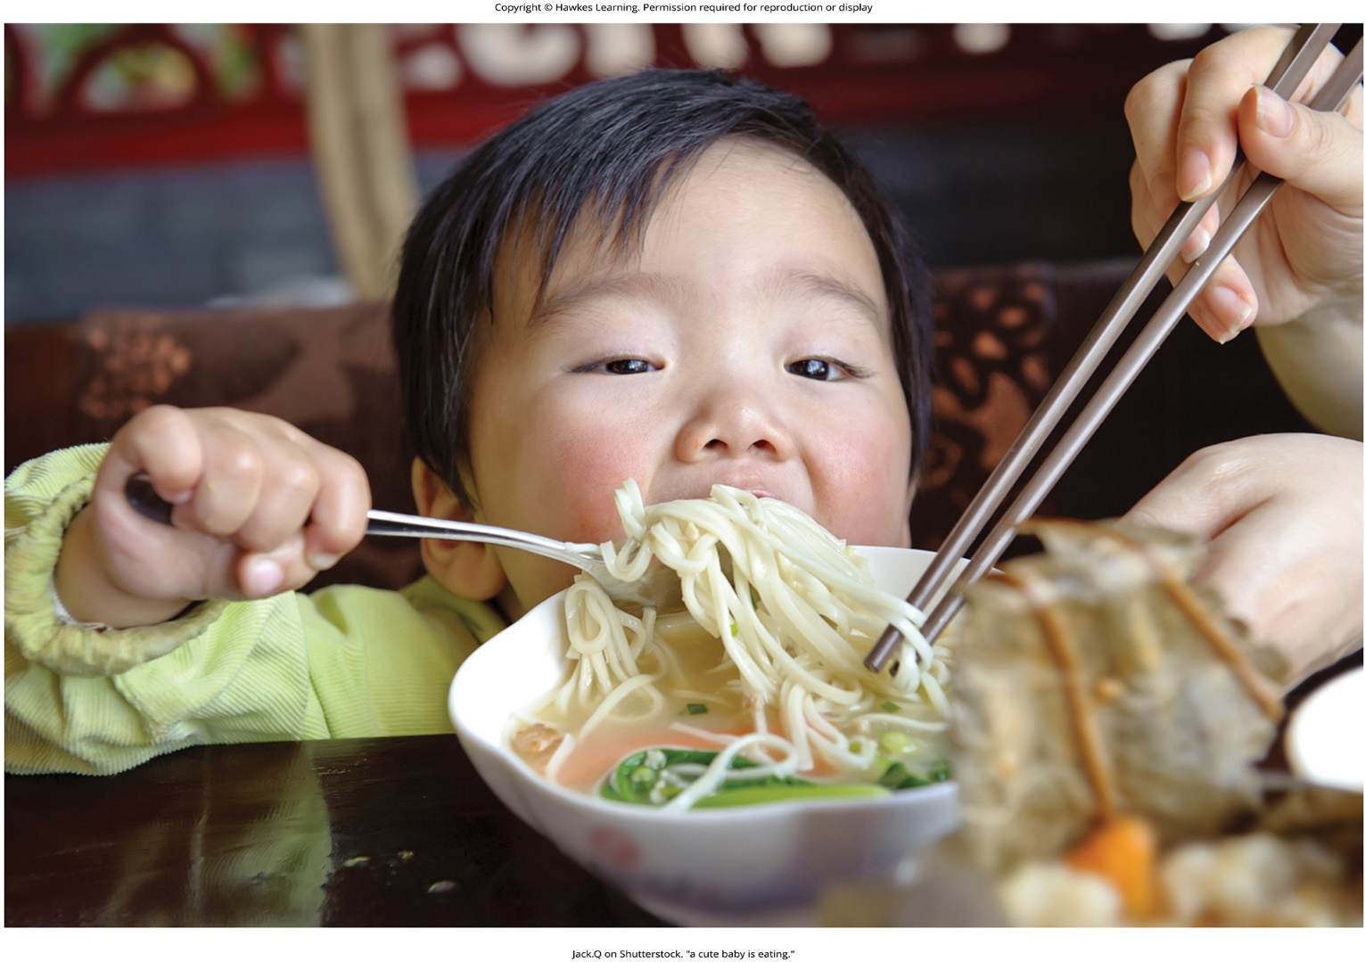
Lesson 12.2 Figure 6

Slide 17
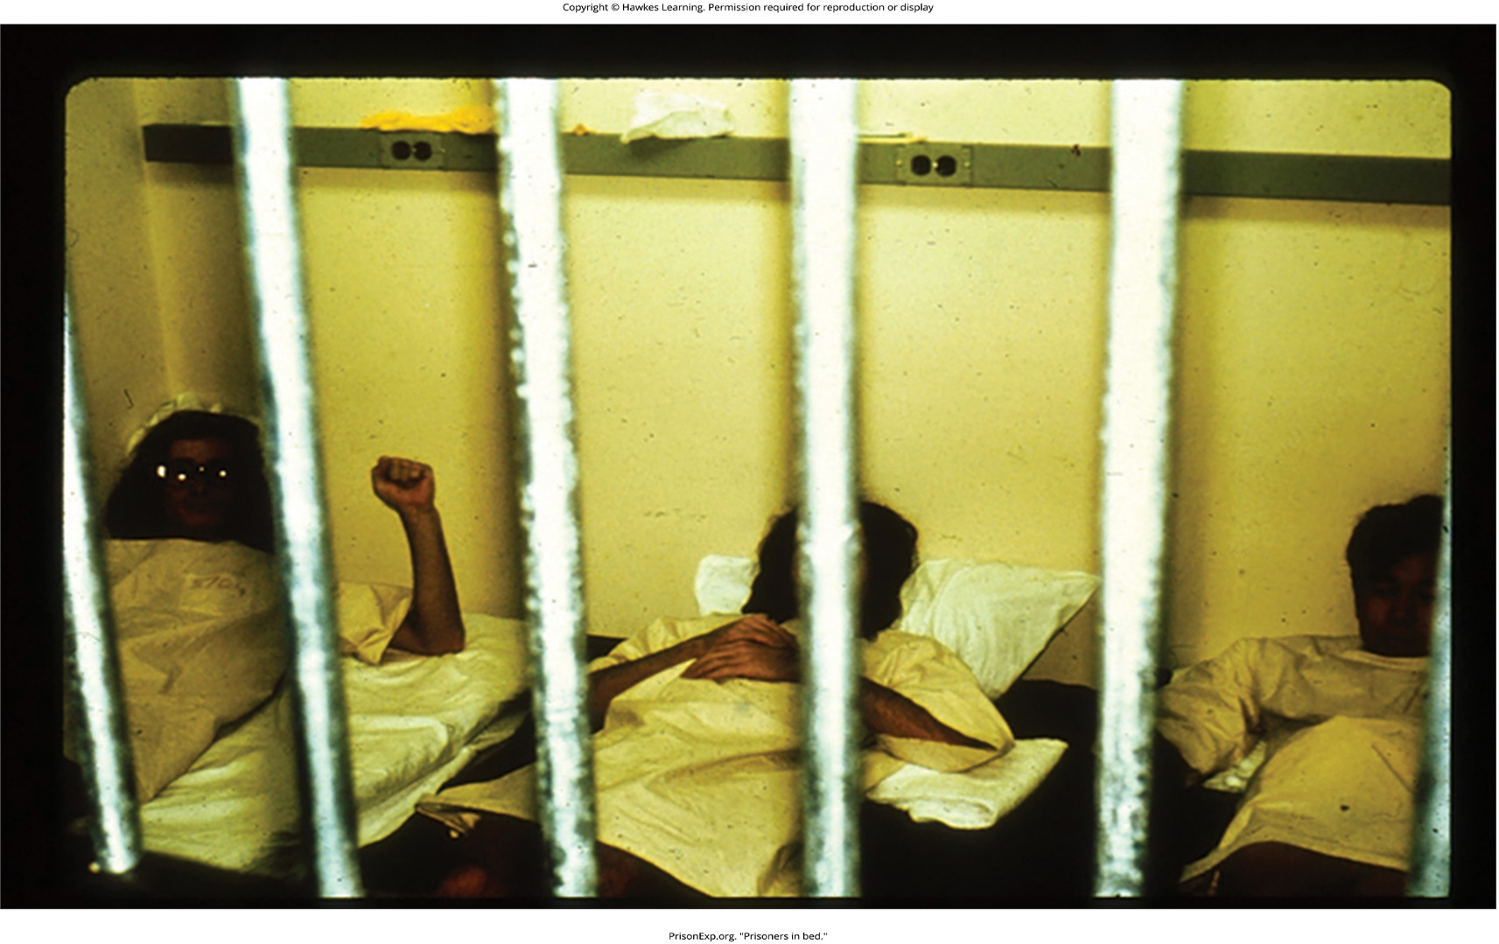
Lesson 12.2 Figure 7

Slide 18
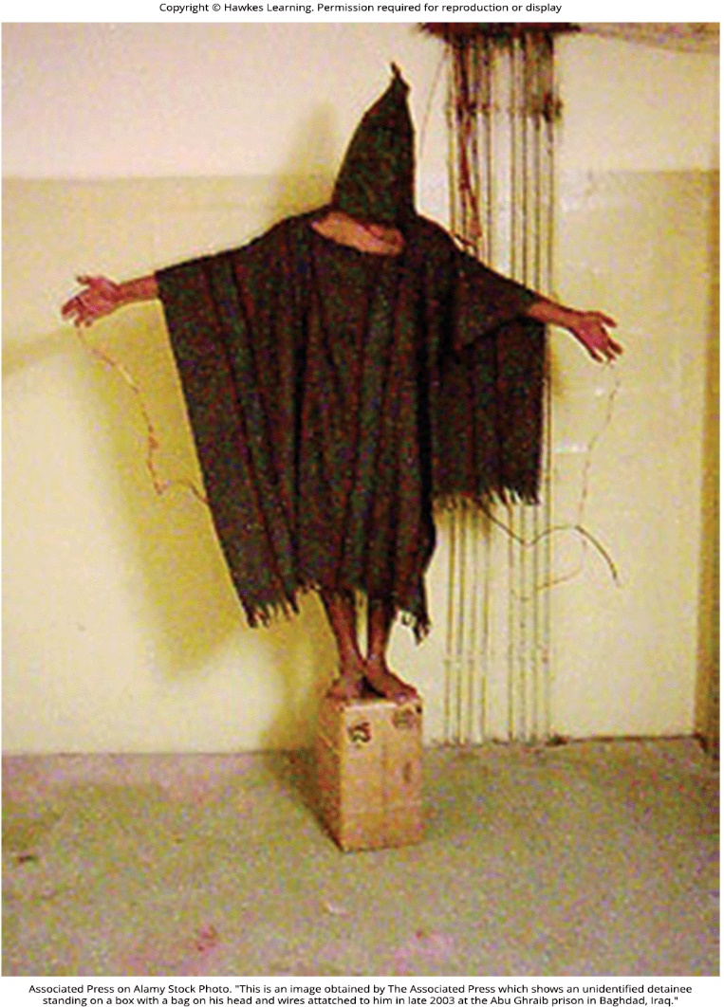
Lesson 12.2 Figure 8

Slide 19
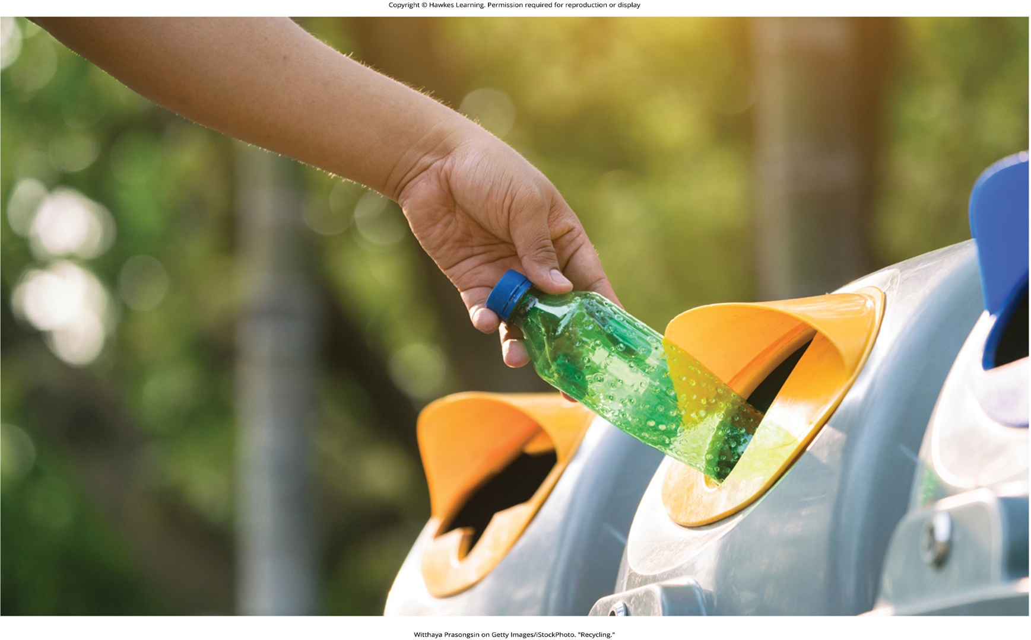
Lesson 12.3 Figure 1

Slide 20

Lesson 12.3 Figure 2

Slide 21
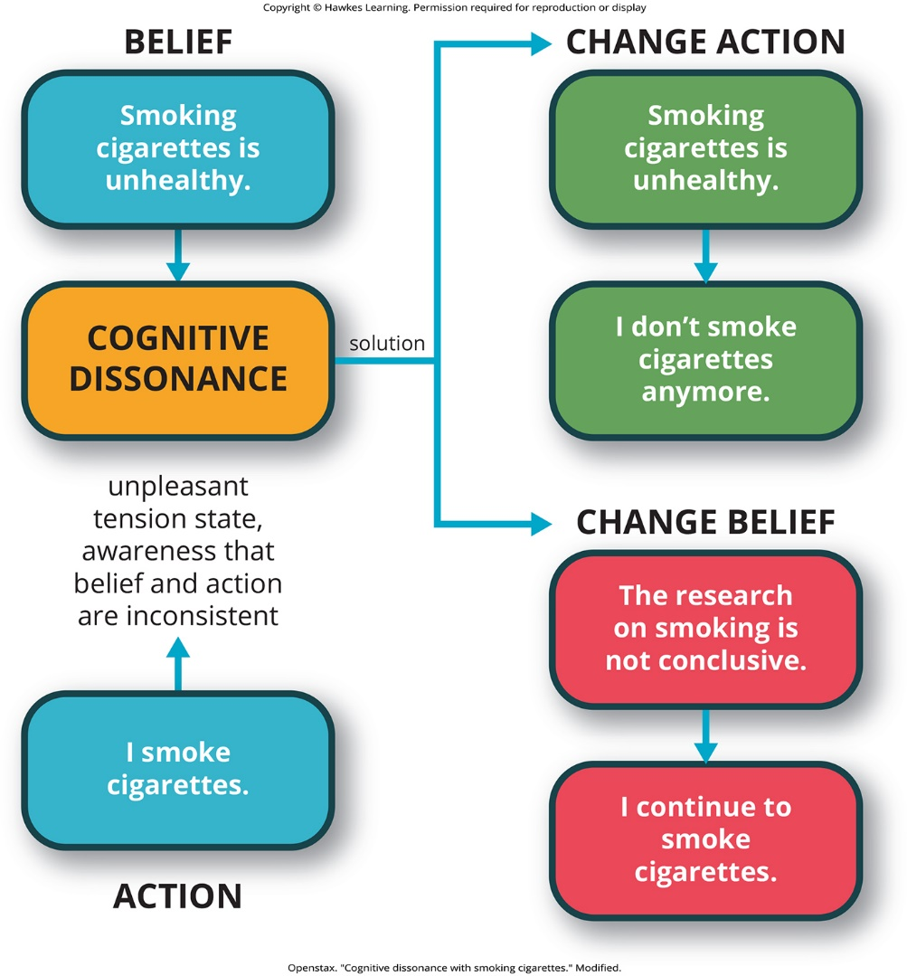
Lesson 12.3 Figure 3

Slide 22

Lesson 12.3 Figure 4

Slide 23
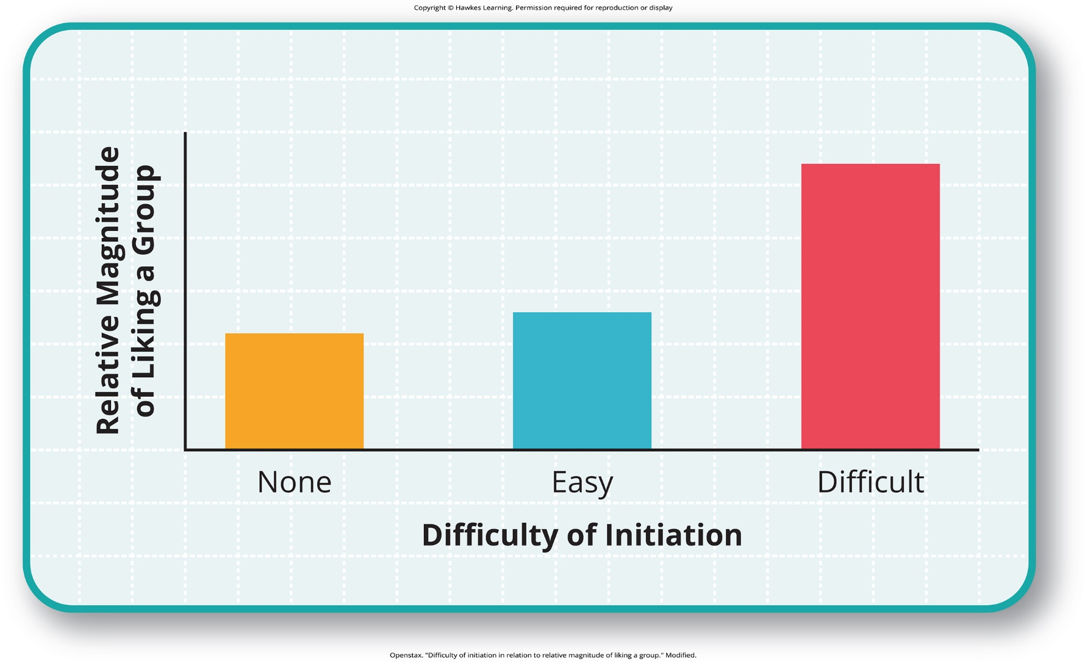
Lesson 12.3 Figure 5

Slide 24
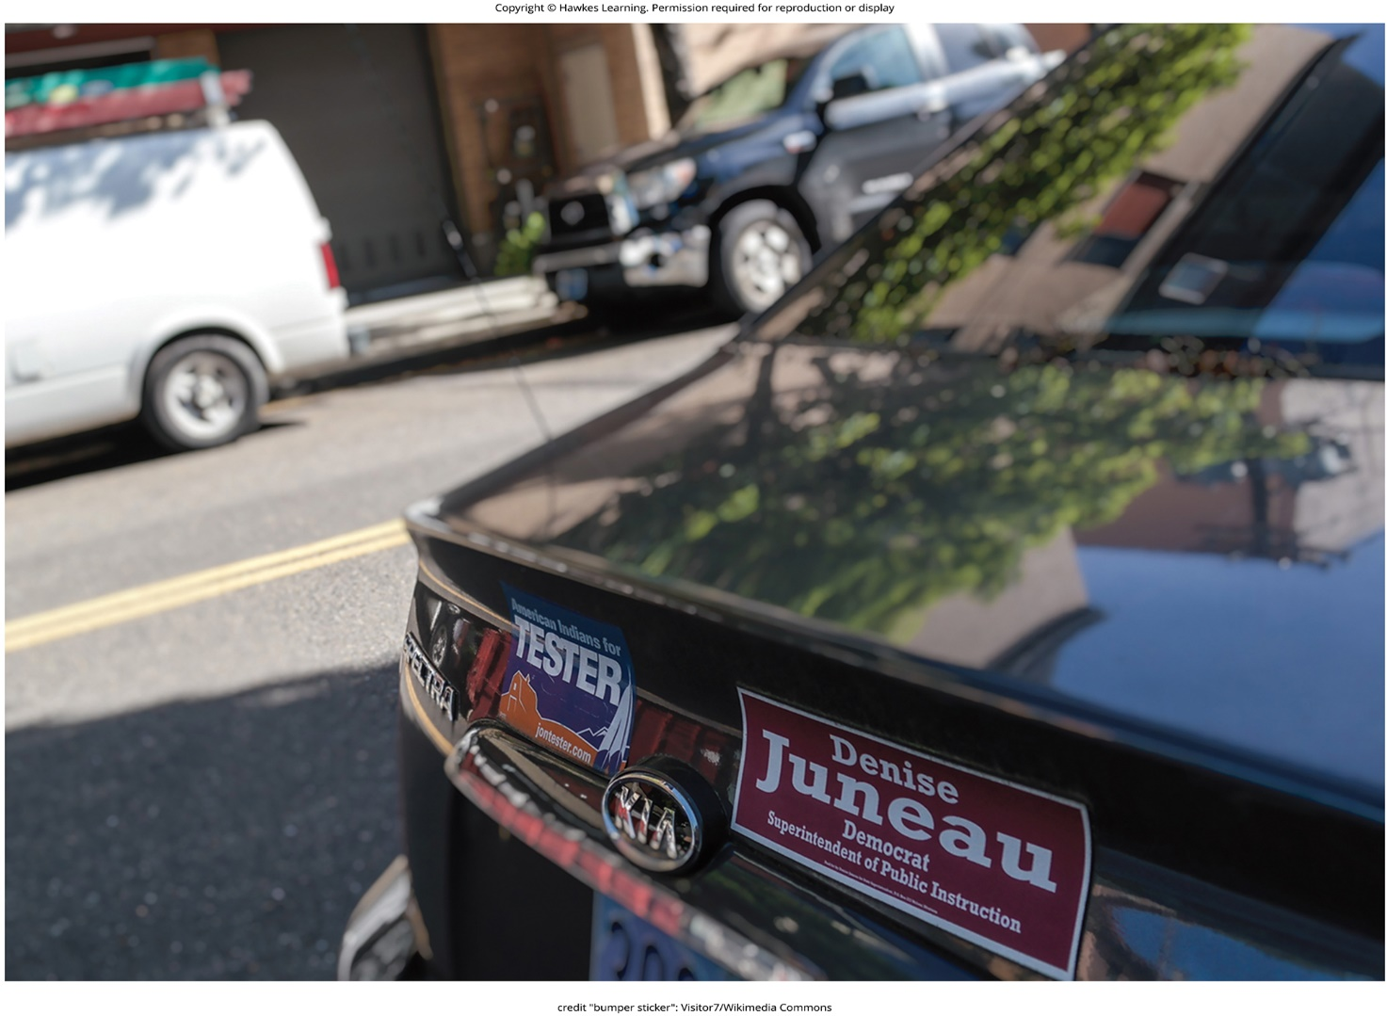
Lesson 12.3 Figure 6

Slide 25
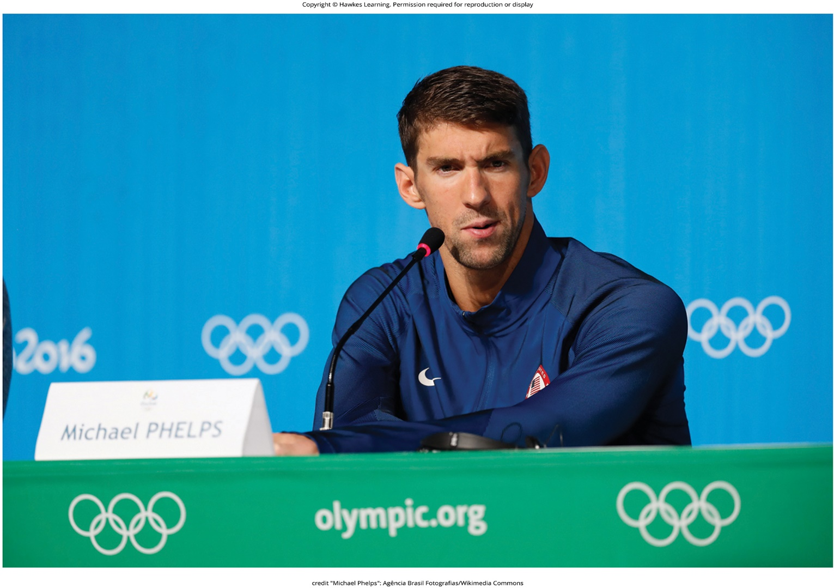
Lesson 12.3 Figure 7

Slide 26
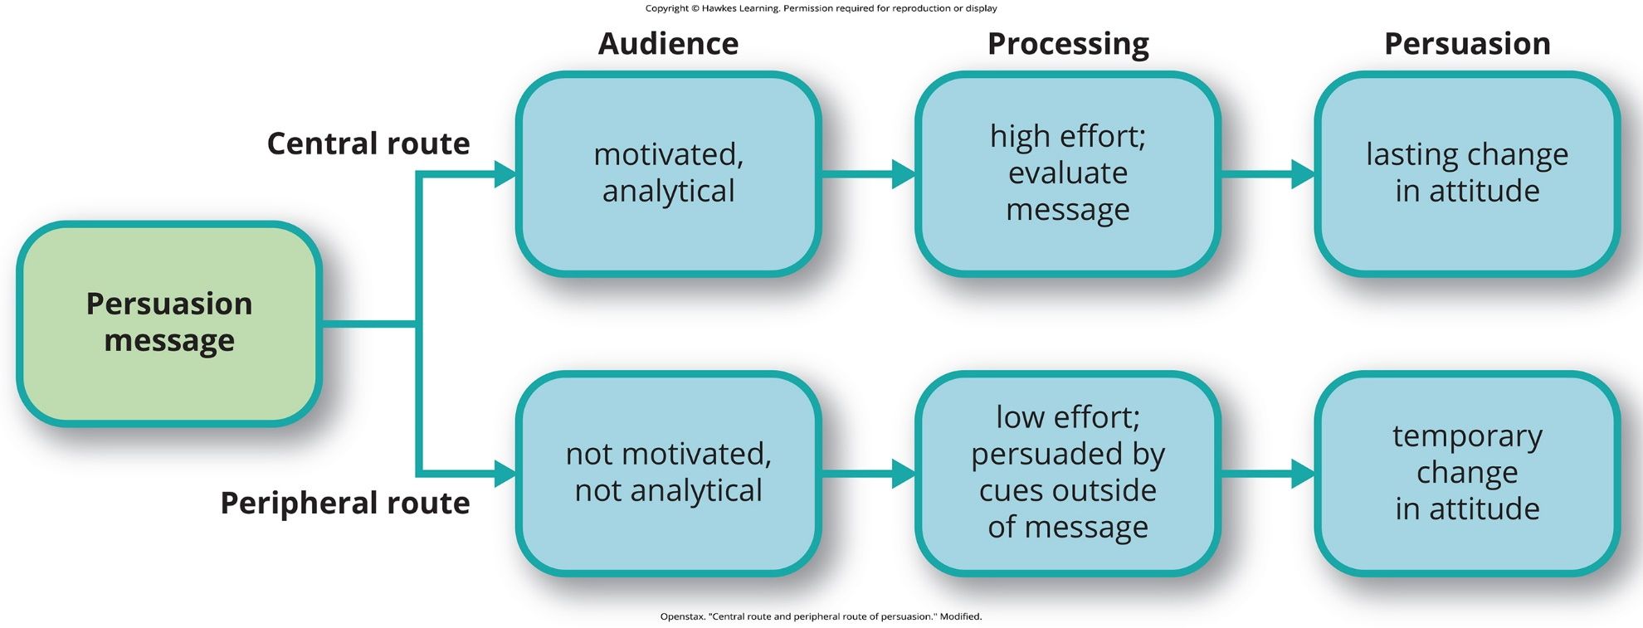
Lesson 12.3 Figure 8

Slide 27
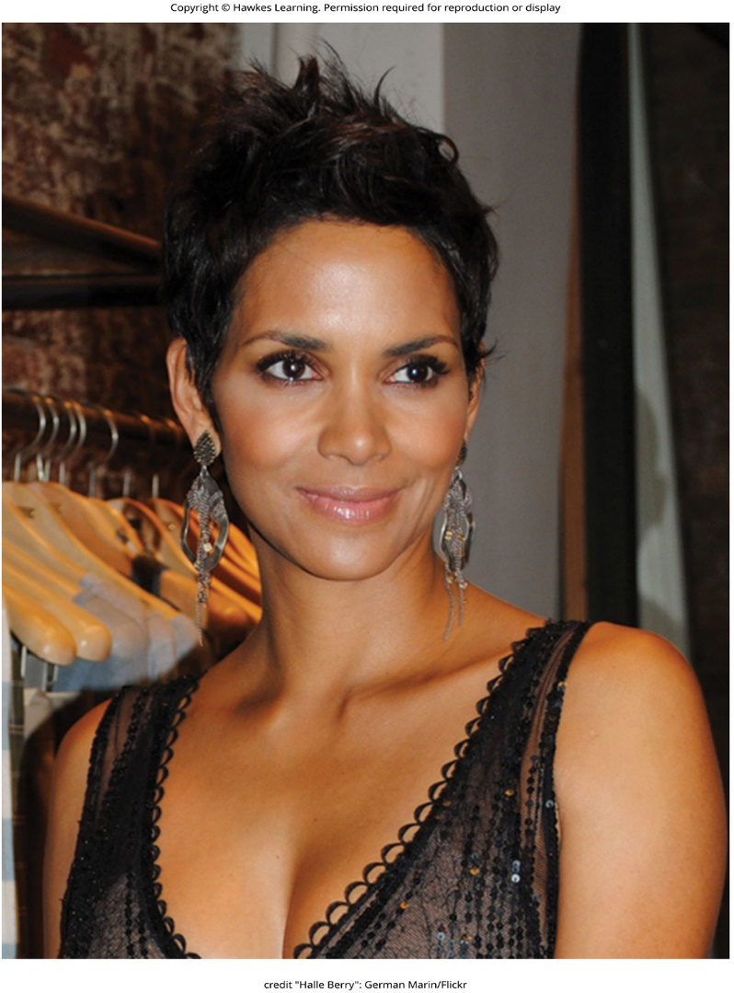
Lesson 12.3 Figure 9

Slide 28

Lesson 12.3 Figure 10

Slide 29
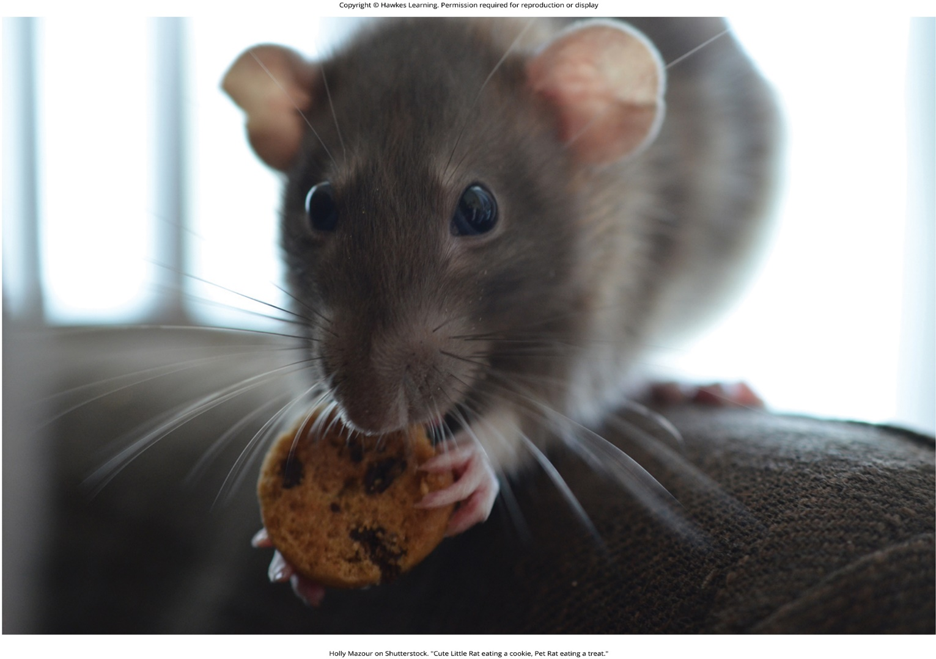
Lesson 12.3 Figure 11

Slide 30
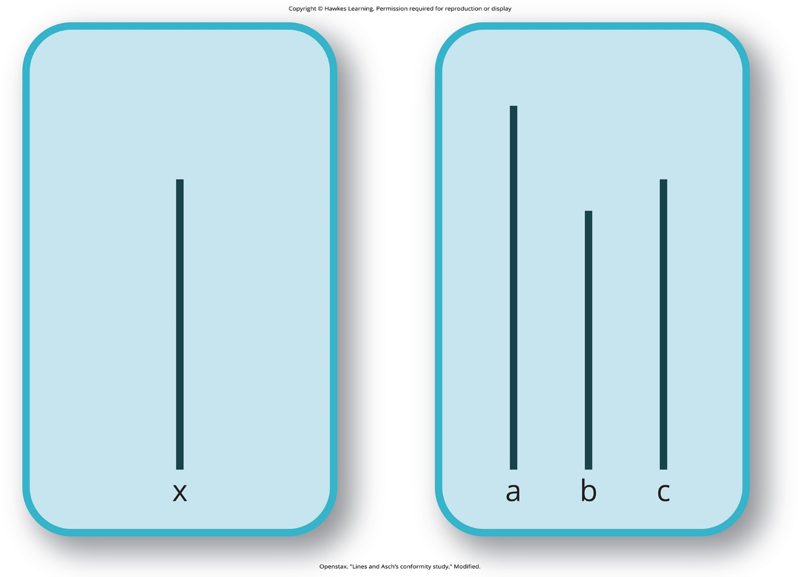
Lesson 12.4 Figure 1

Slide 31
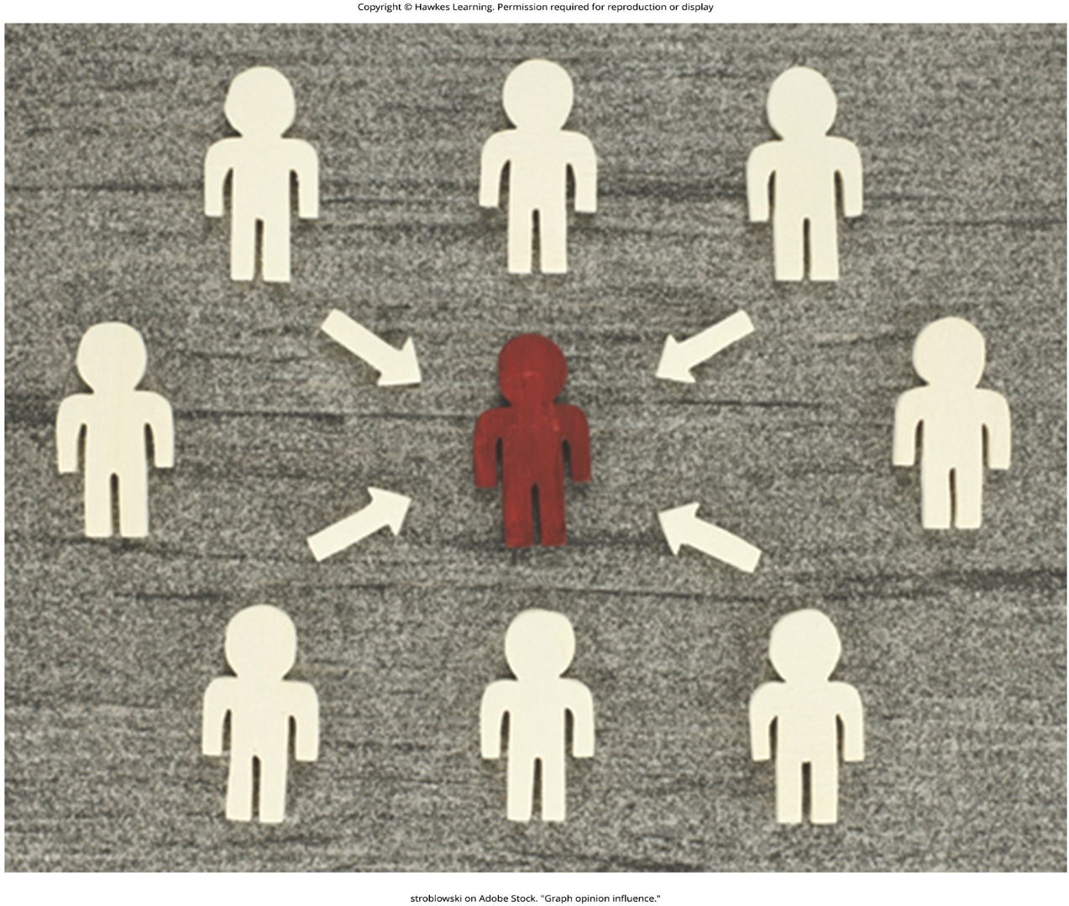
Lesson 12.4 Figure 2

Slide 32
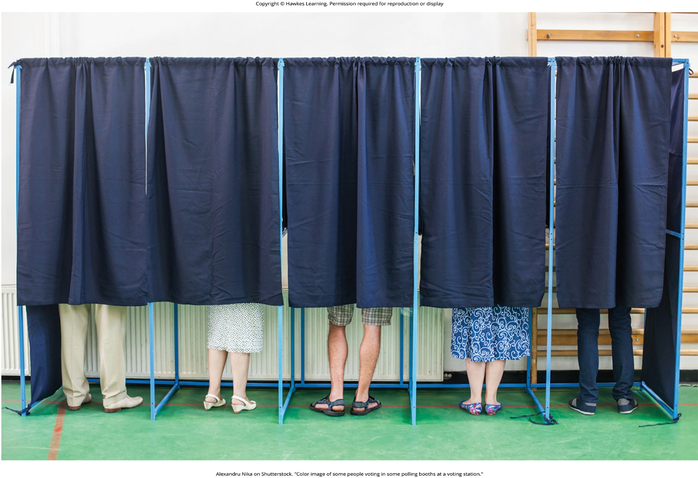
Lesson 12.4 Figure 3

Slide 33
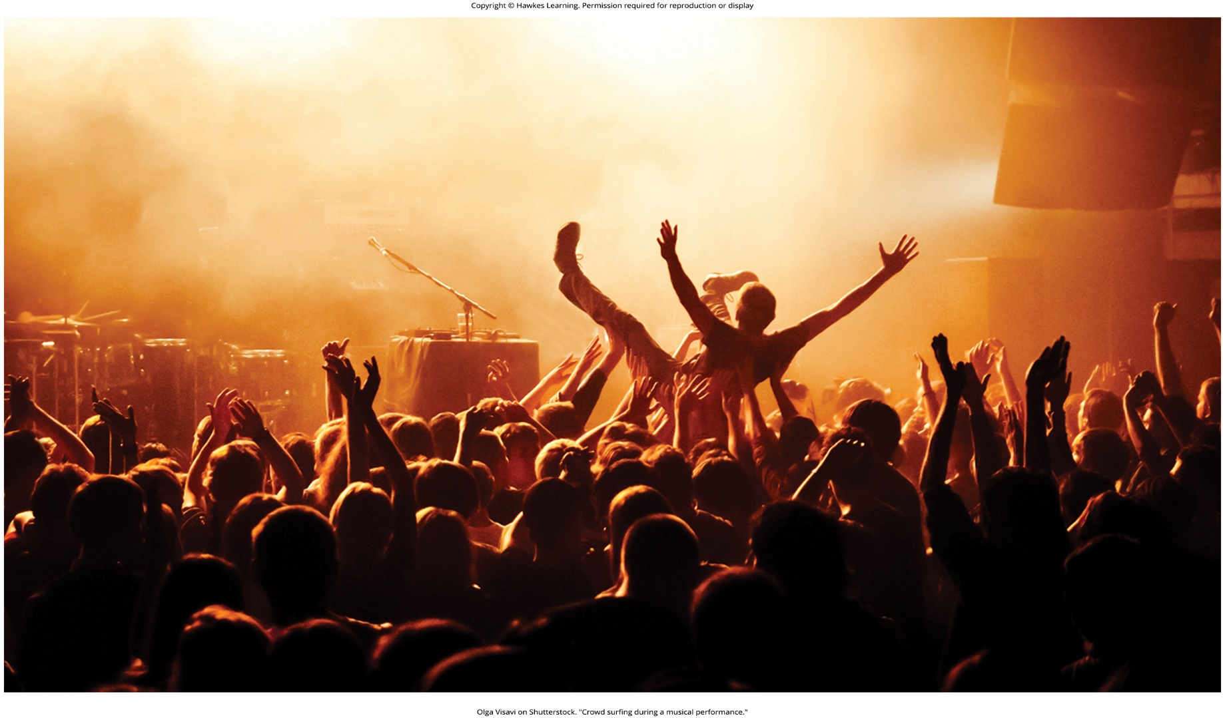
Lesson 12.4 Figure 4

Slide 34

Lesson 12.4 Figure 5

Slide 35

Lesson 12.4 Figure 6

Slide 36
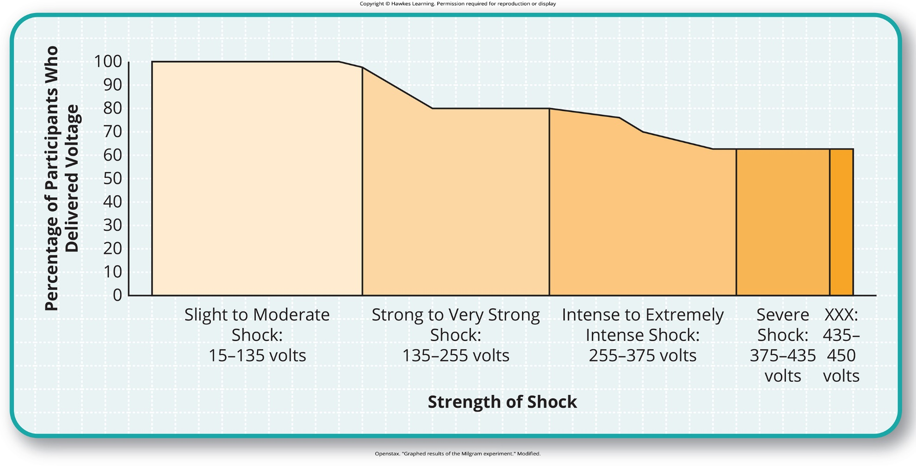
Lesson 12.4 Figure 7

Slide 37

Lesson 12.4 Figure 8

Slide 38
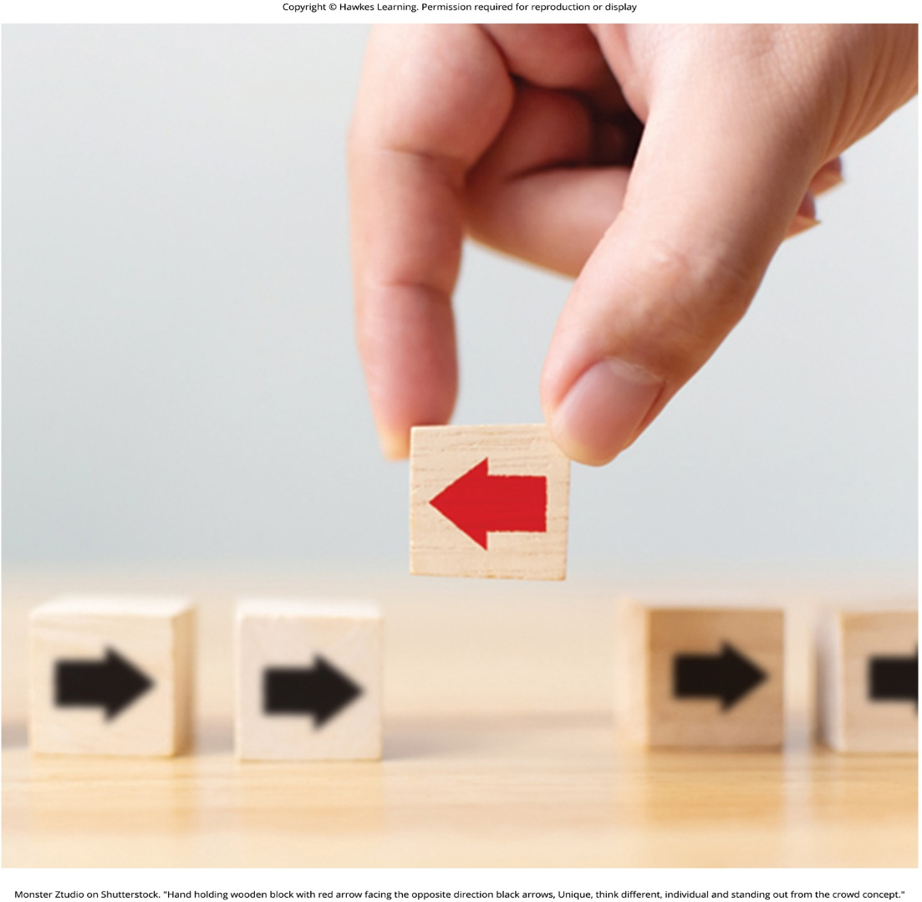
Lesson 12.4 Figure 9

Slide 39

Lesson 12.4 Figure 10

Slide 40

Lesson 12.4 Figure 11

Slide 41
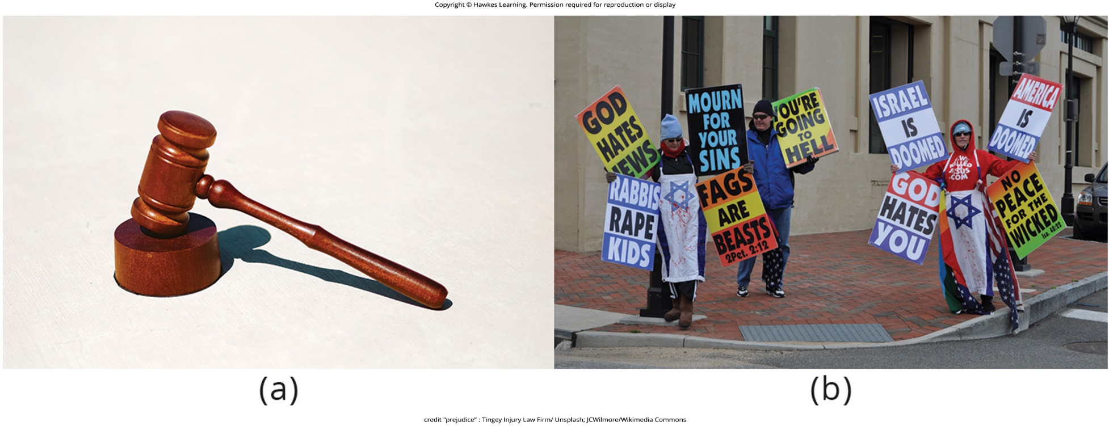
Lesson 12.5 Figure 1

Slide 42
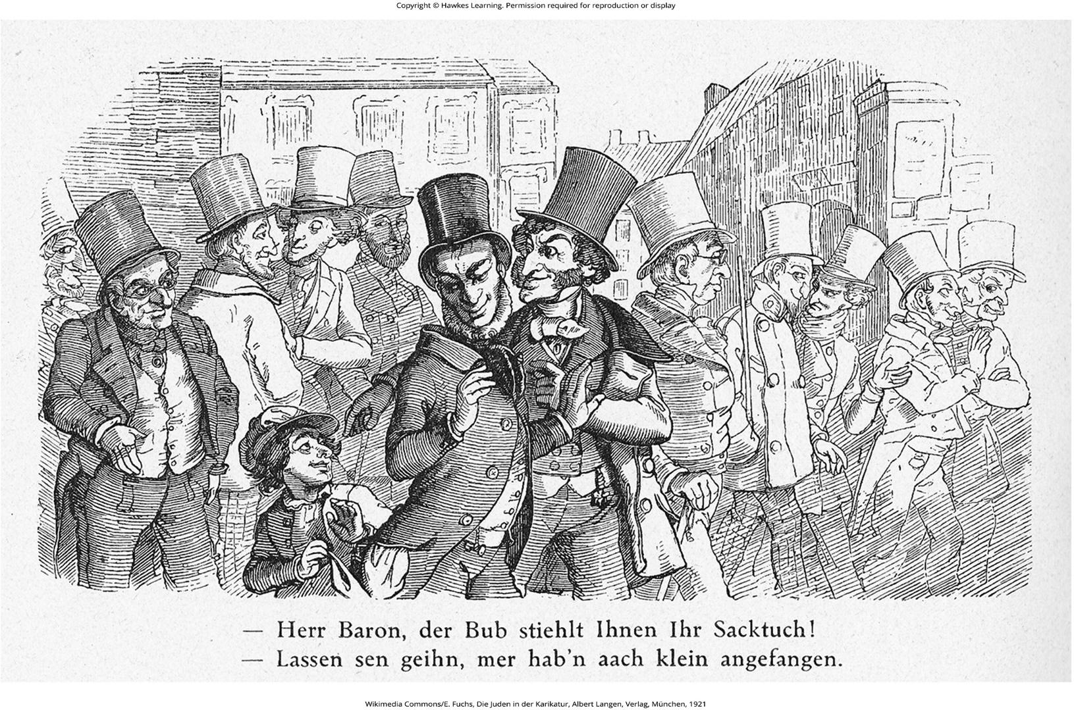
Lesson 12.5 Figure 2

Slide 43
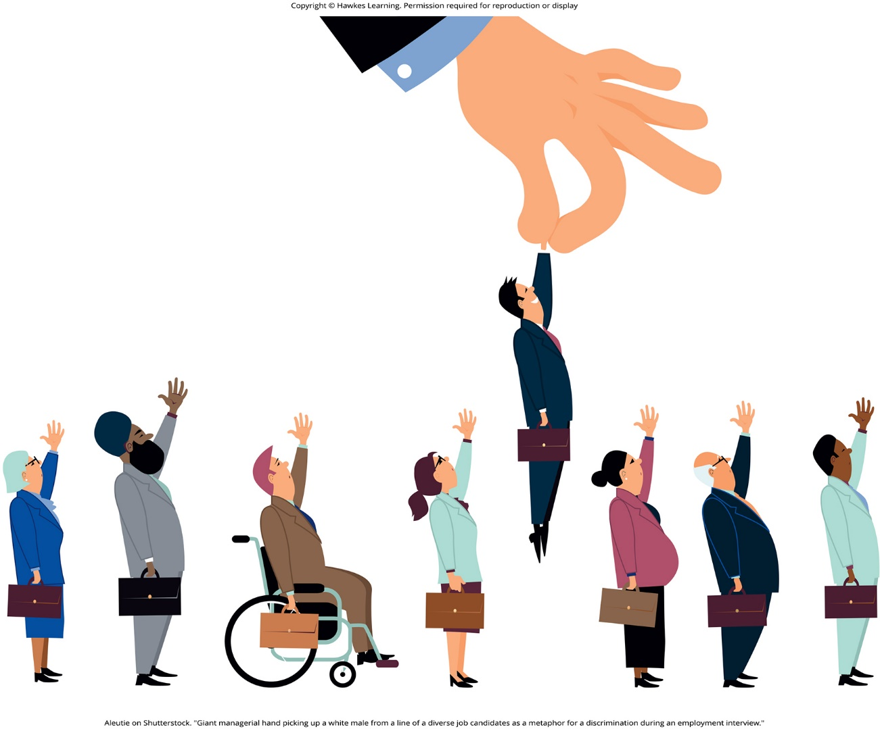
Lesson 12.5 Figure 3

Slide 44
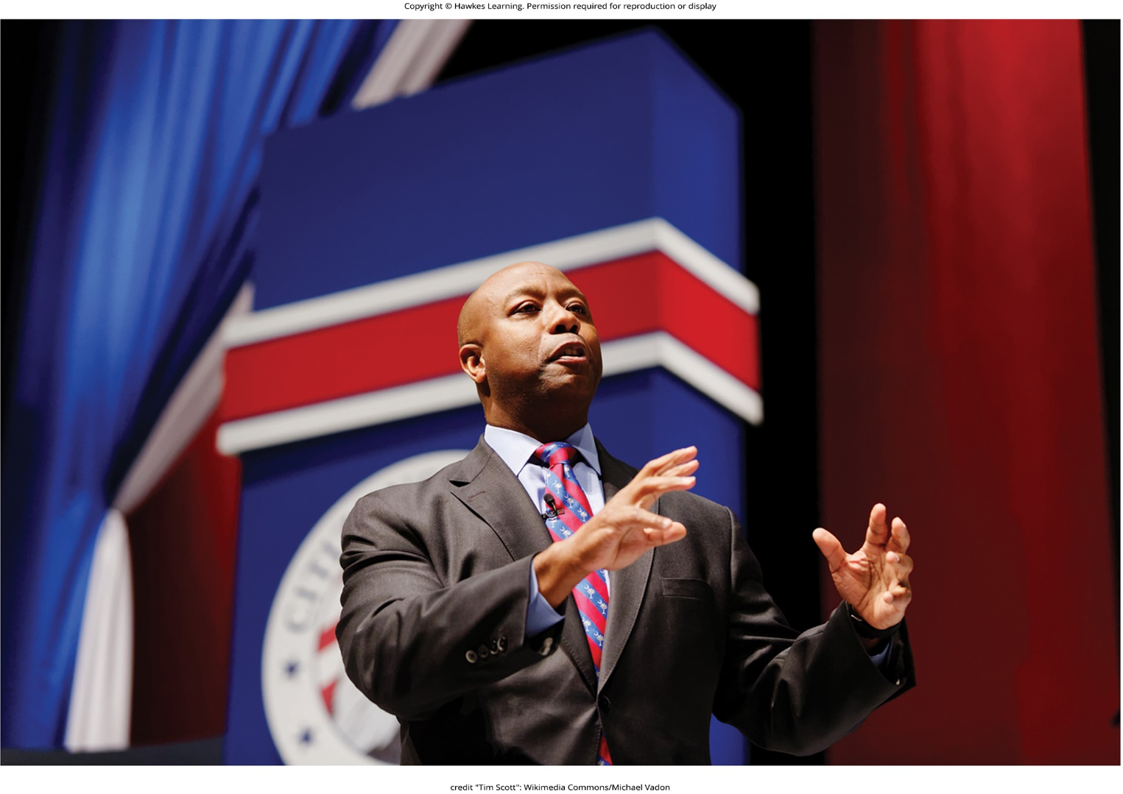
Lesson 12.5 Figure 4

Slide 45

Lesson 12.5 Figure 5

Slide 46
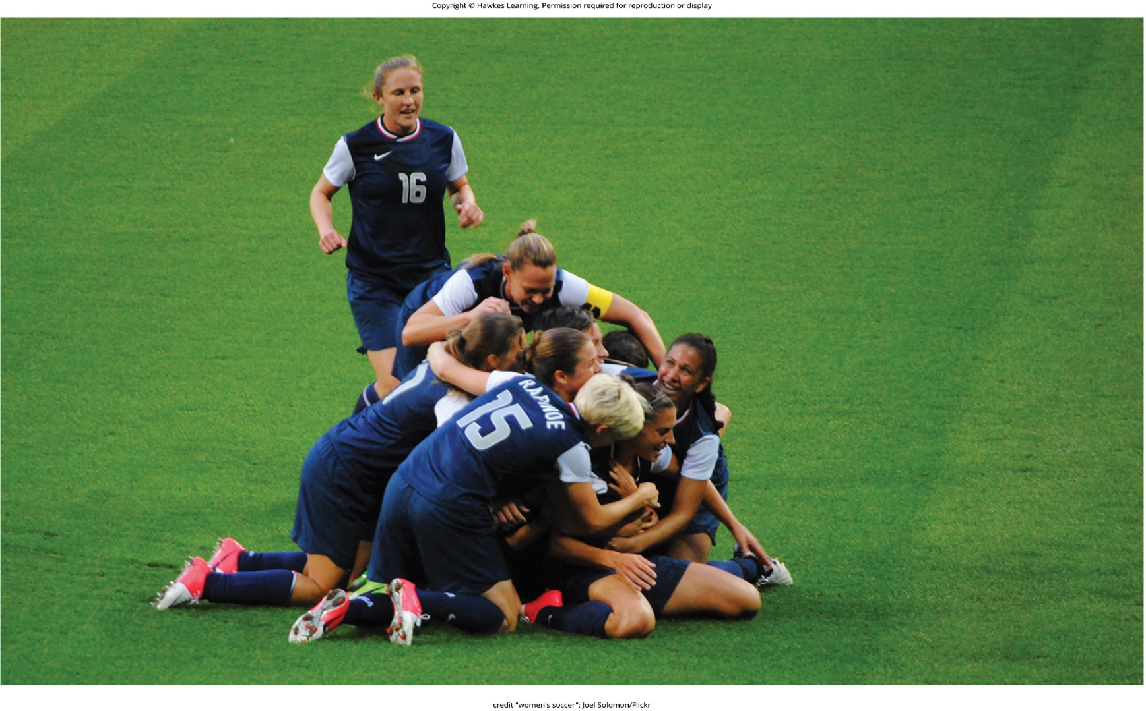
Lesson 12.5 Figure 6

Slide 47

Lesson 12.5 Figure 7

Slide 48

Lesson 12.5 Figure 8

Slide 49

Lesson 12.5 Figure 9

Slide 50

Lesson 12.5 Figure 10

Slide 51
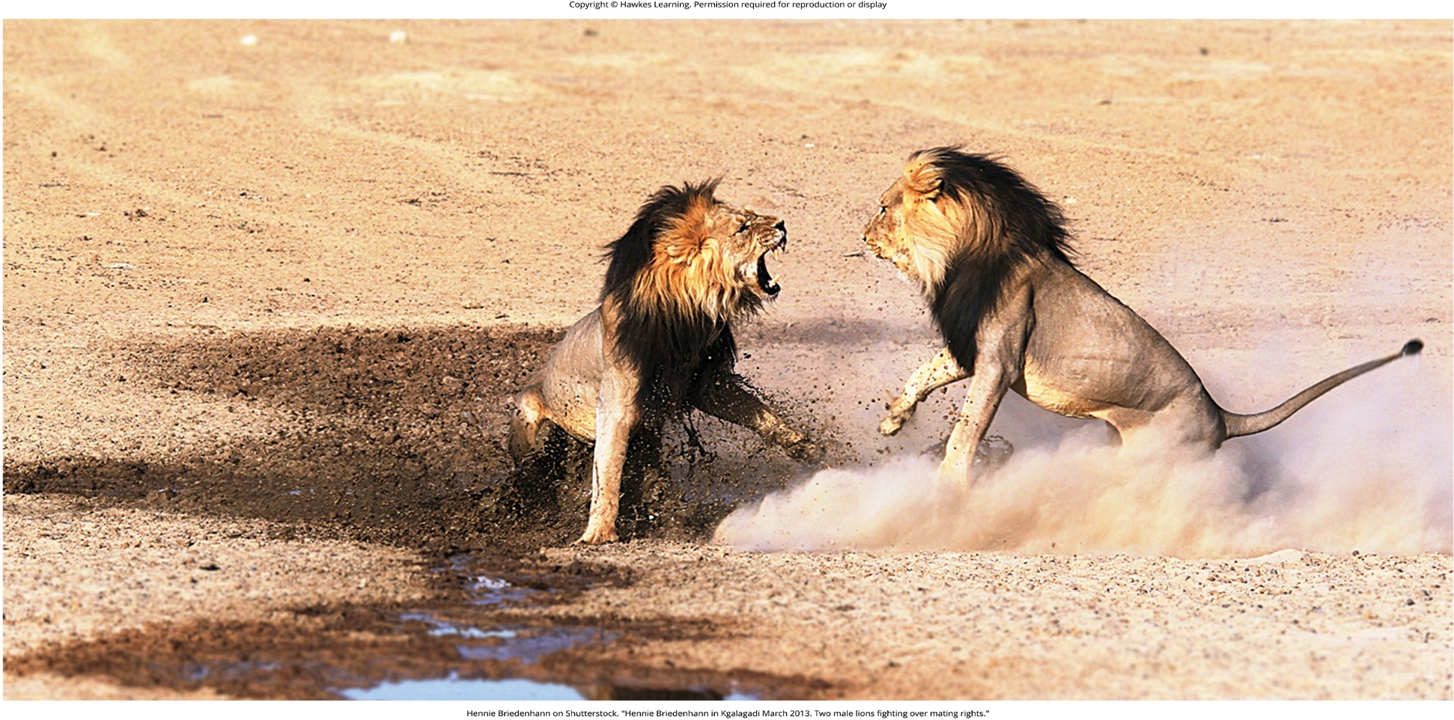
Lesson 12.6 Figure 1

Slide 52
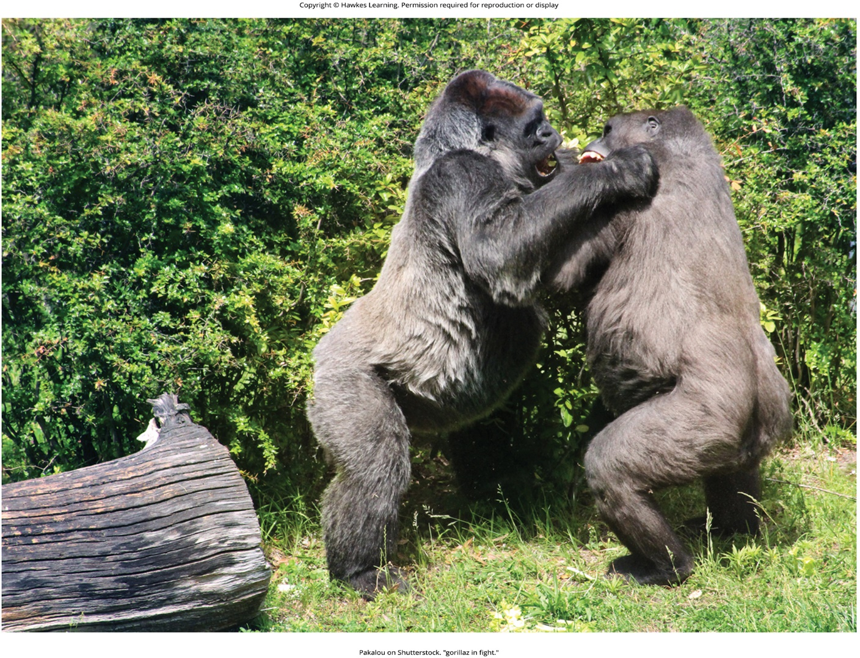
Lesson 12.6 Figure 2

Slide 53
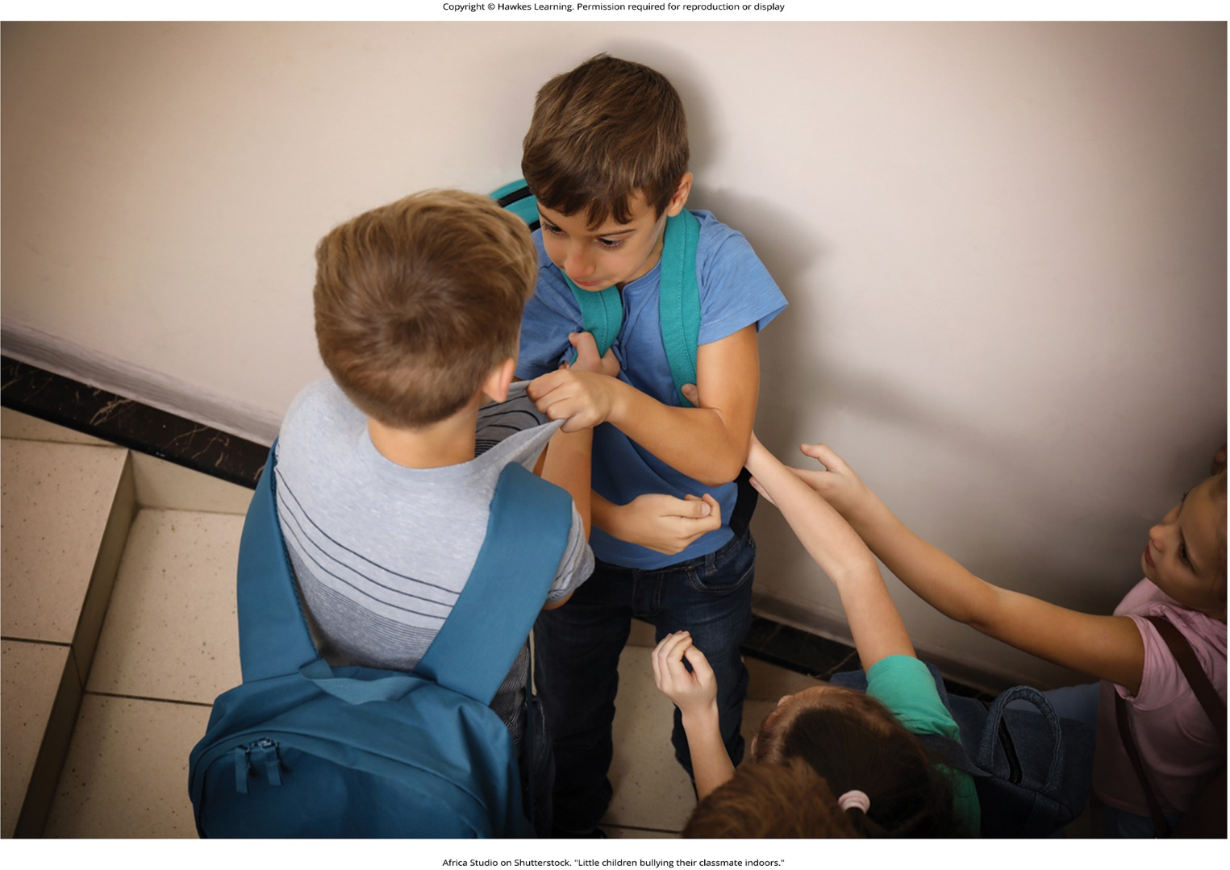
Lesson 12.6 Figure 3

Slide 54

Lesson 12.6 Figure 4

Slide 55

Lesson 12.6 Figure 5

Slide 56
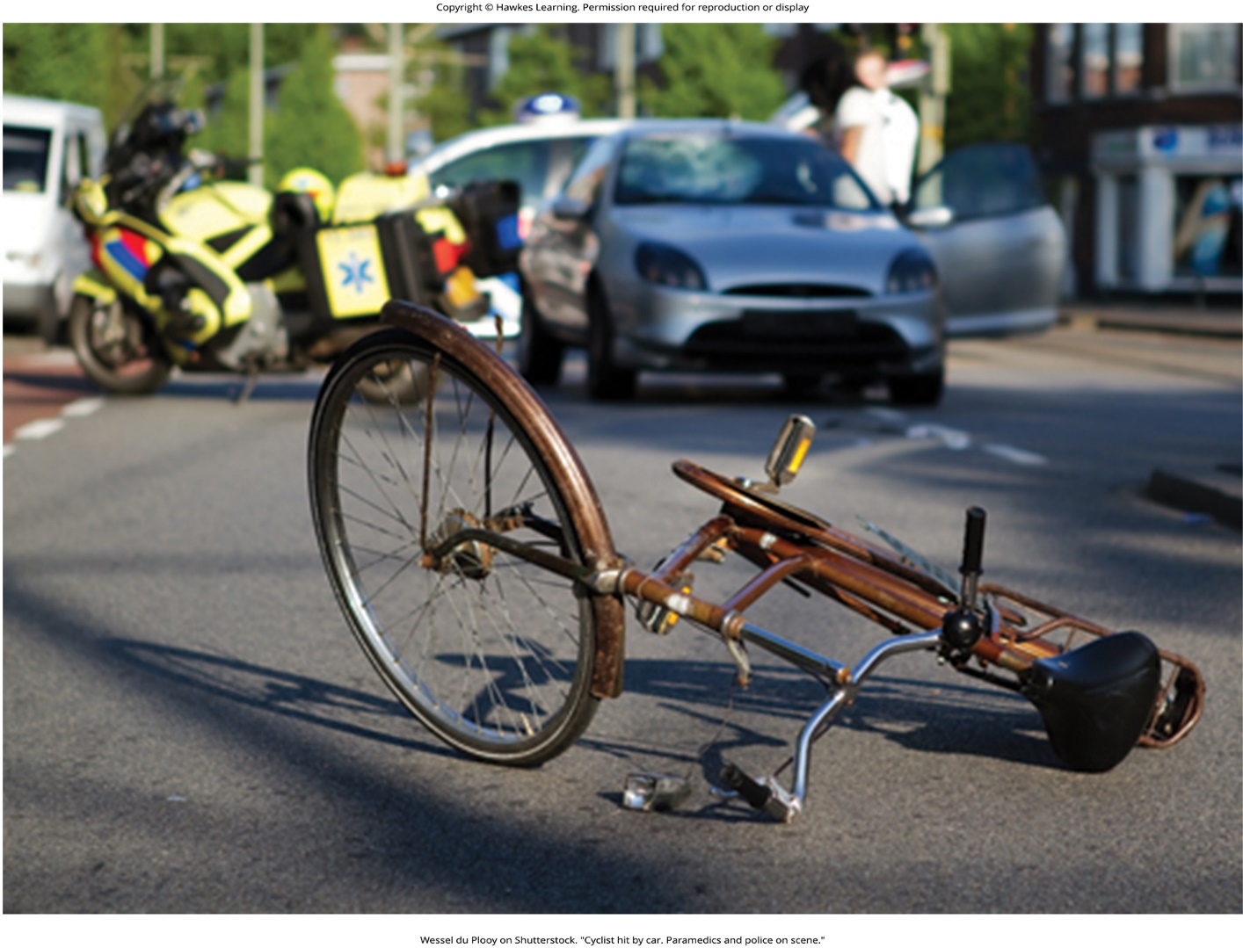
Lesson 12.6 Figure 6

Slide 57
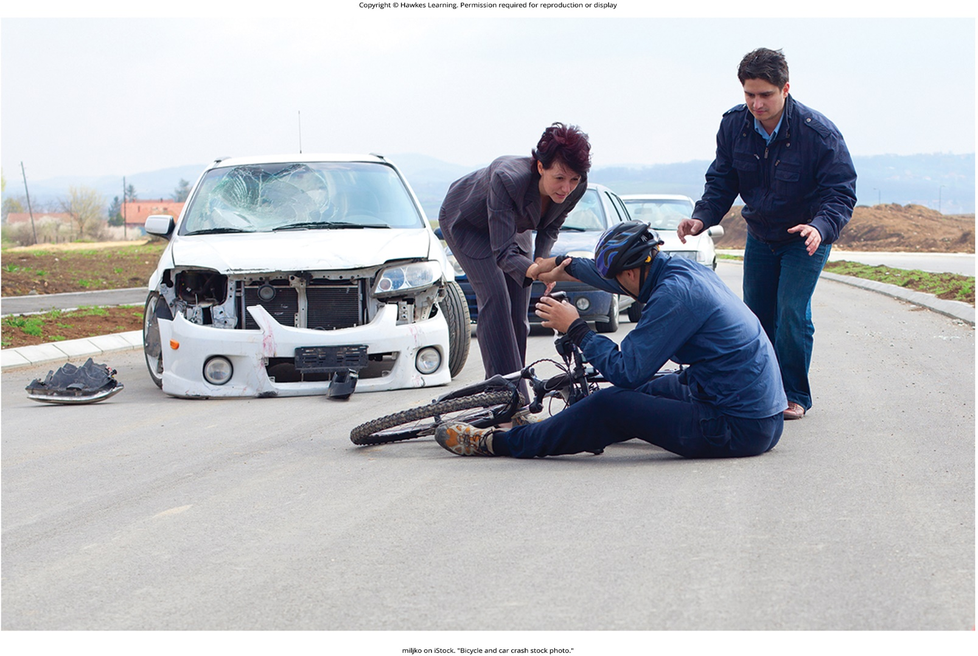
Lesson 12.7 Figure 1

Slide 58

Lesson 12.7 Figure 2

Slide 59
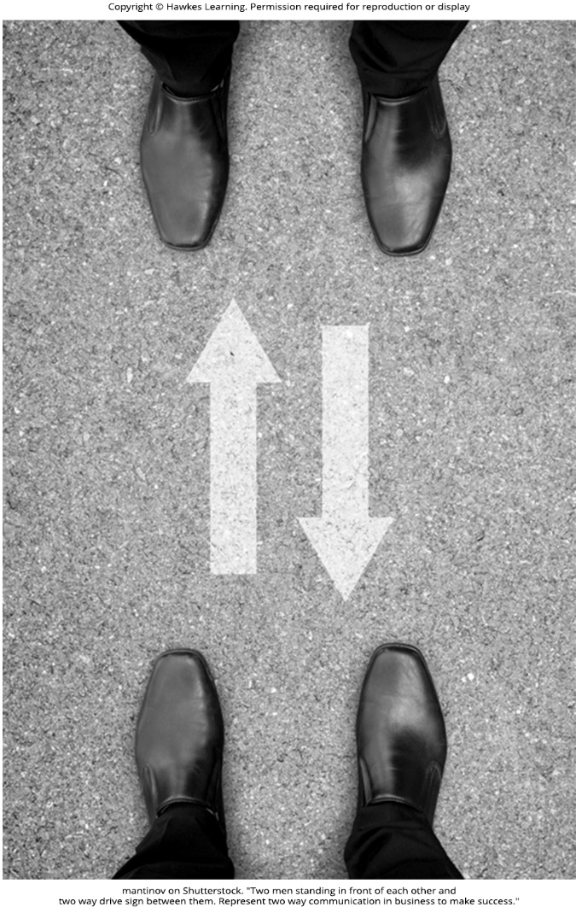
Lesson 12.7 Figure 3

Slide 60
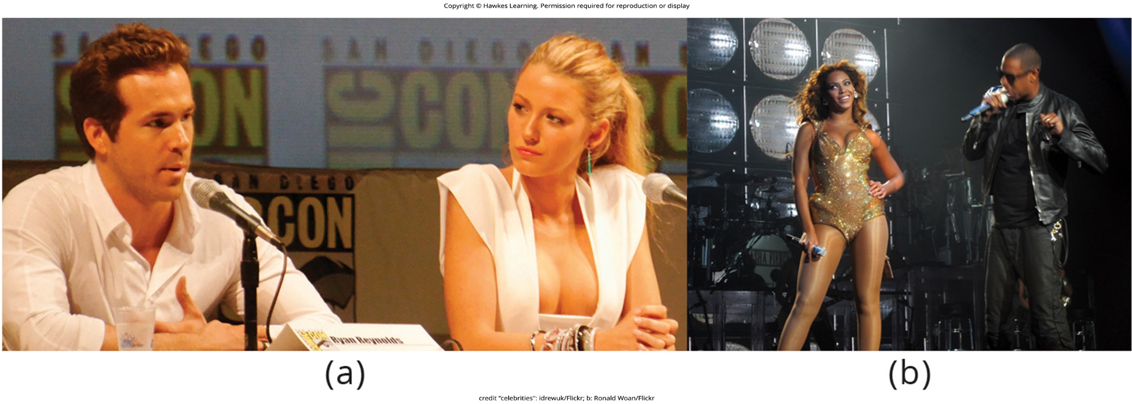
Lesson 12.7 Figure 4

Slide 61
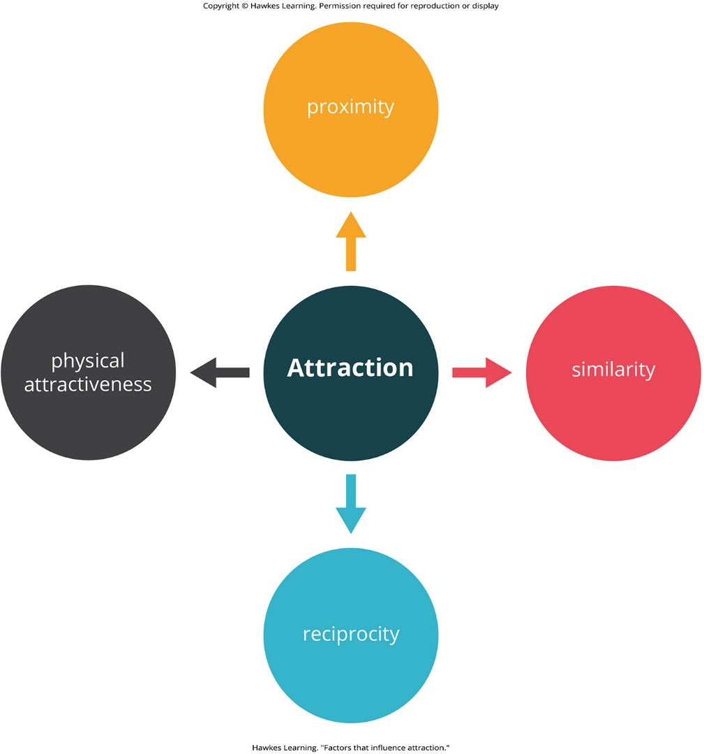
Lesson 12.7 Figure 5

Slide 62
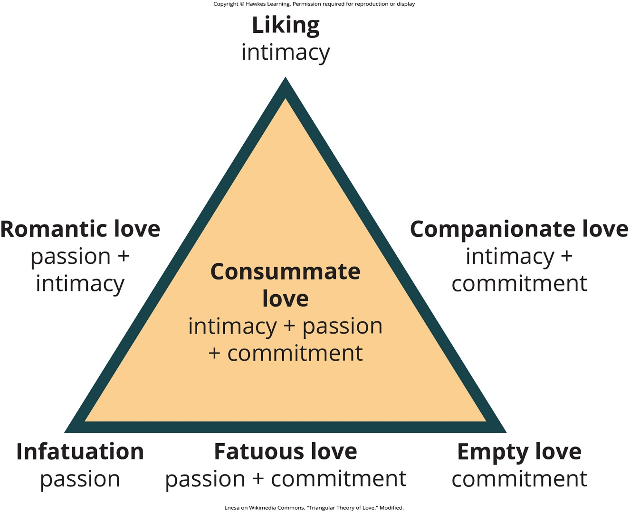
Lesson 12.7 Figure 6

Slide 63

Lesson 12.7 Figure 7

Slide 64
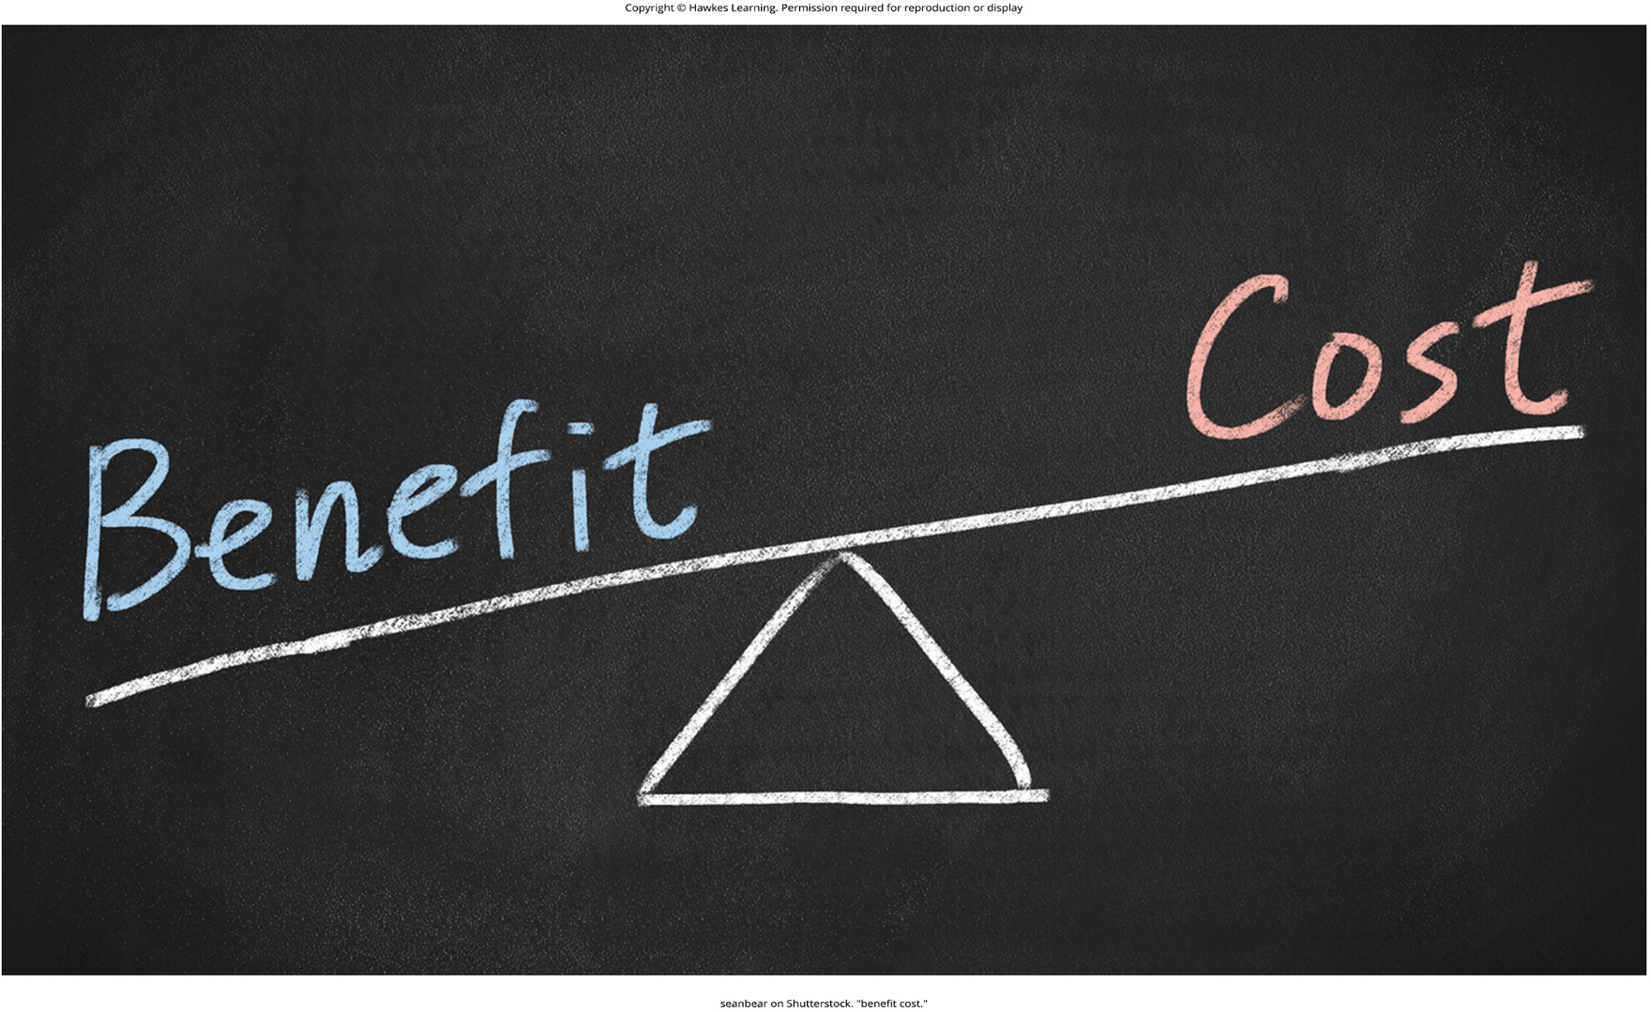
Lesson 12.7 Figure 8

Slide 65
Hawkes Learning – End of PowerPoint

