Slide 1
Chapter 13
Industrial-Organizational Psychology

Slide 2
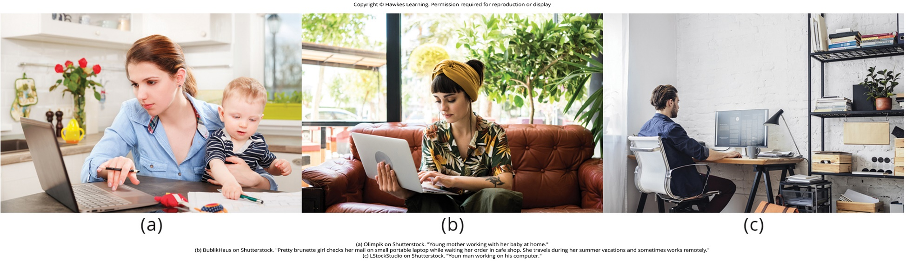
Lesson 13.1 Figure 1

Slide 3
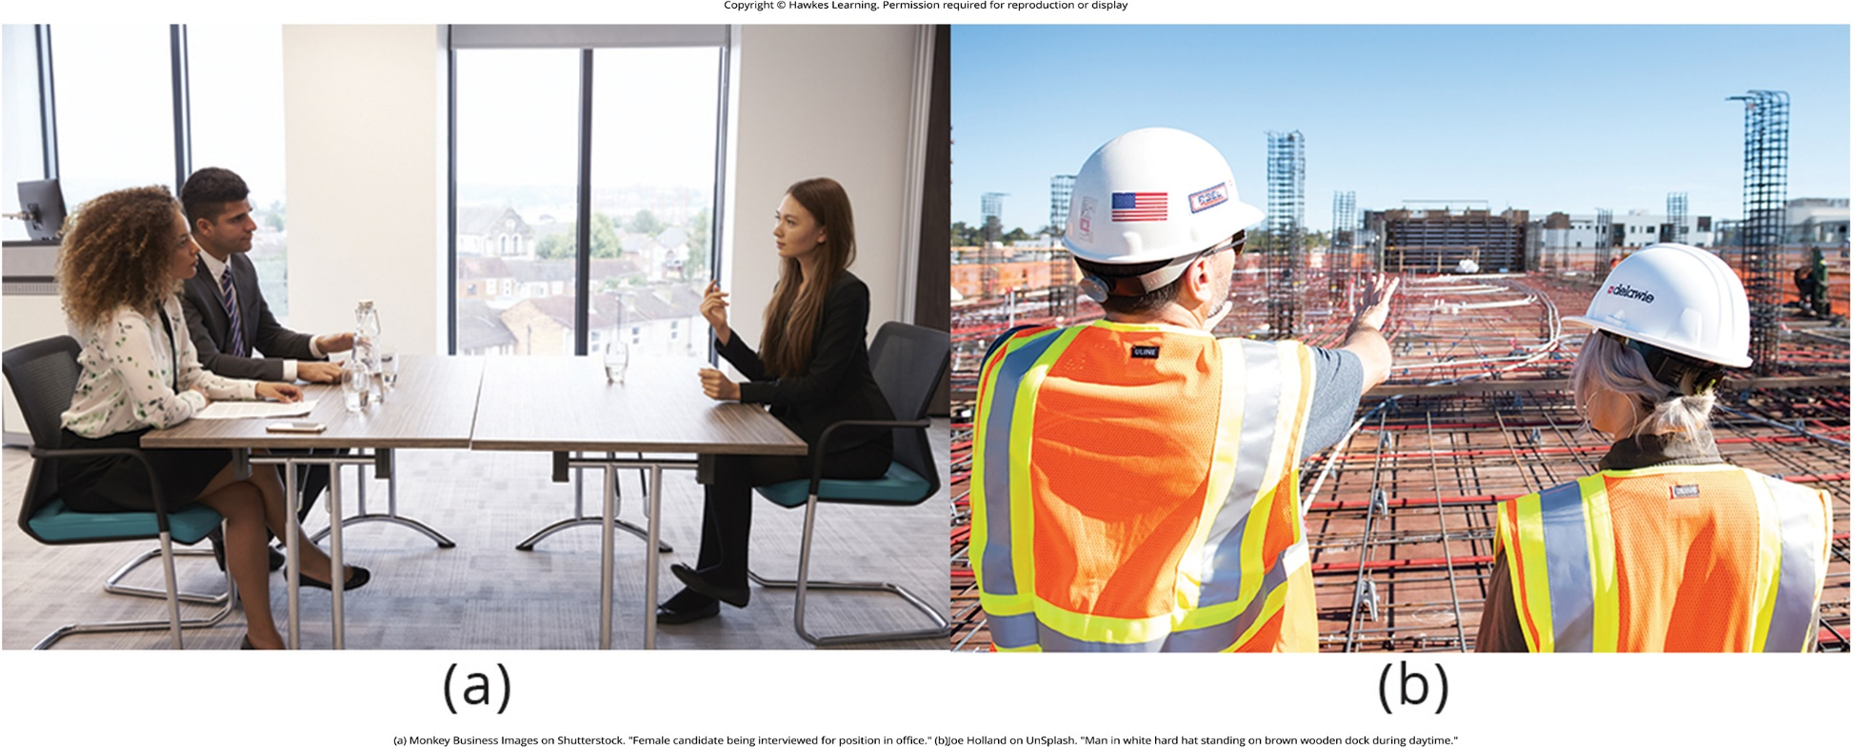
Lesson 13.1 Figure 2

Slide 4
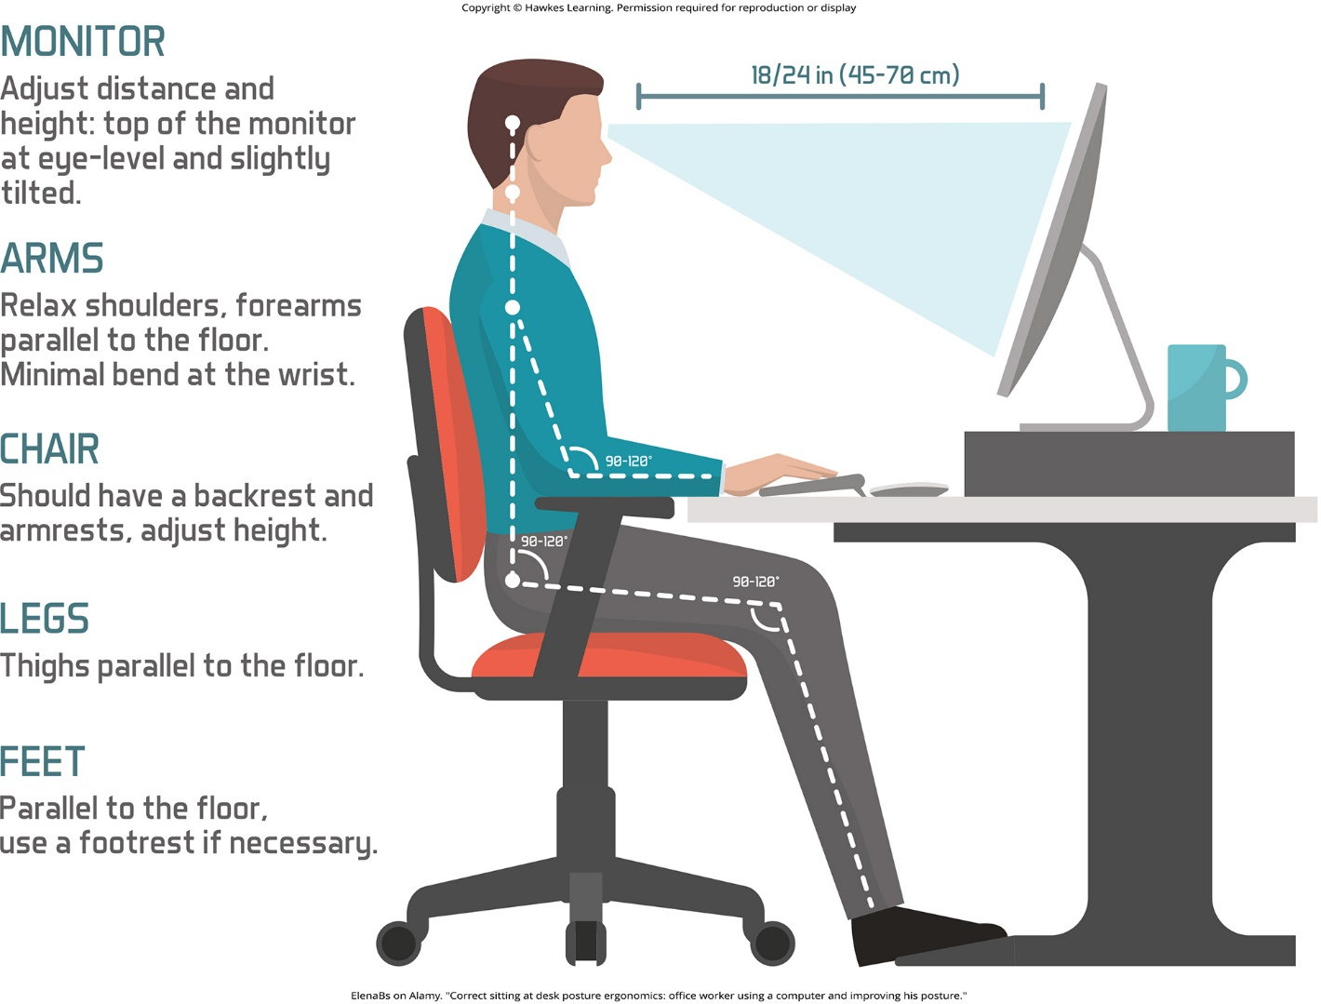
Lesson 13.1 Figure 3

Slide 5

Lesson 13.1 Figure 4

Slide 6

Lesson 13.1 Figure 5

Slide 7

Lesson 13.1 Figure 6

Slide 8
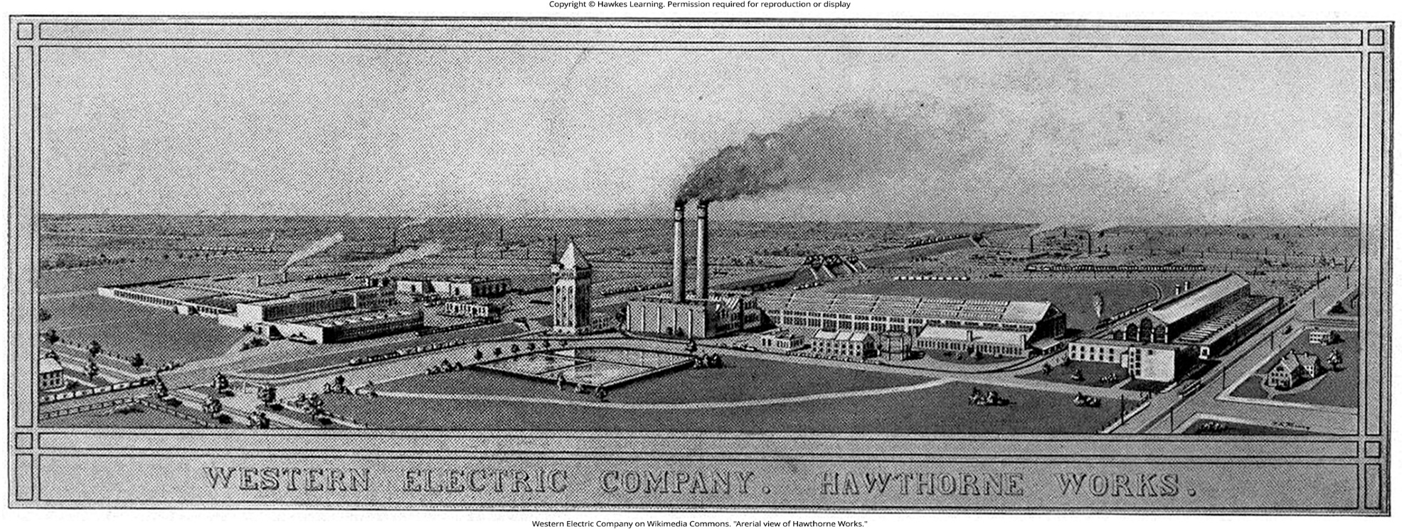
Lesson 13.1 Figure 7

Slide 9
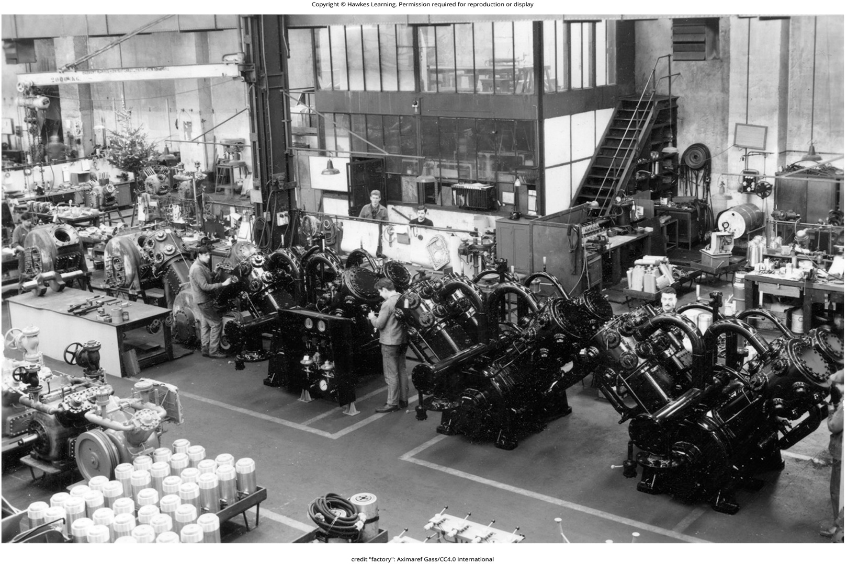
Lesson 13.1 Figure 8

Slide 10
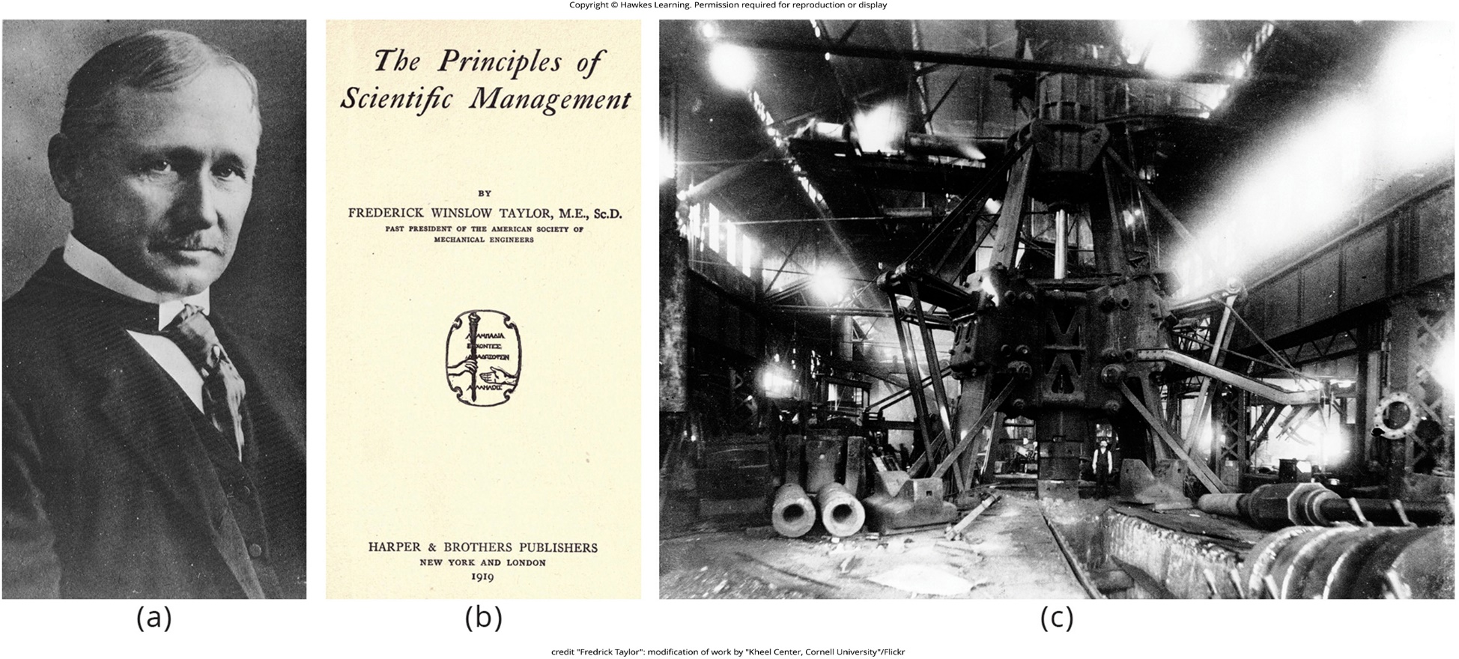
Lesson 13.1 Figure 9

Slide 11
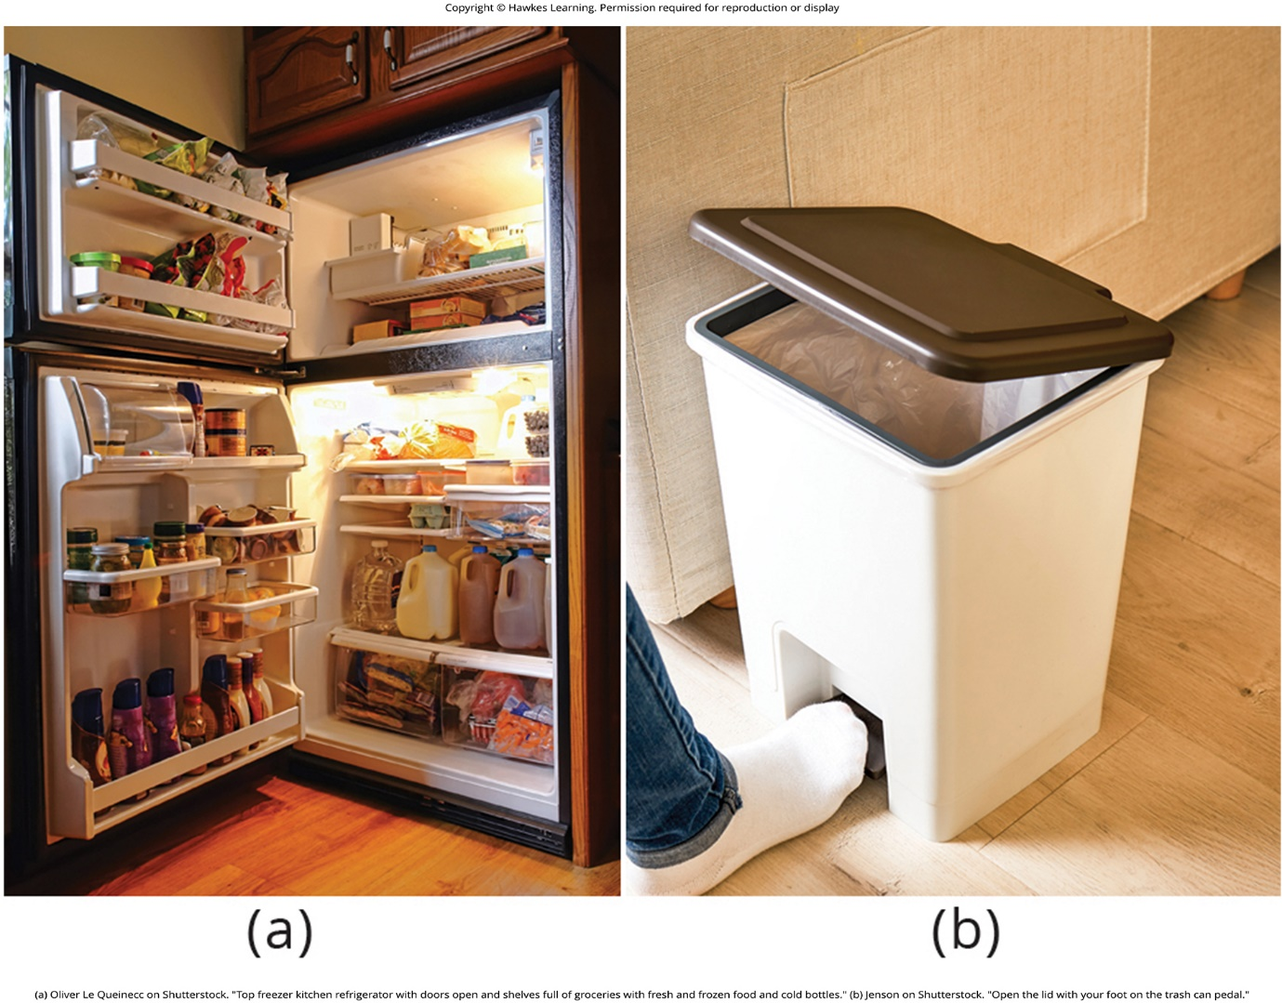
Lesson 13.1 Figure 10

Slide 12

Lesson 13.2 Figure 1

Slide 13

Lesson 13.2 Figure 2

Slide 14

Lesson 13.2 Figure 3

Slide 15
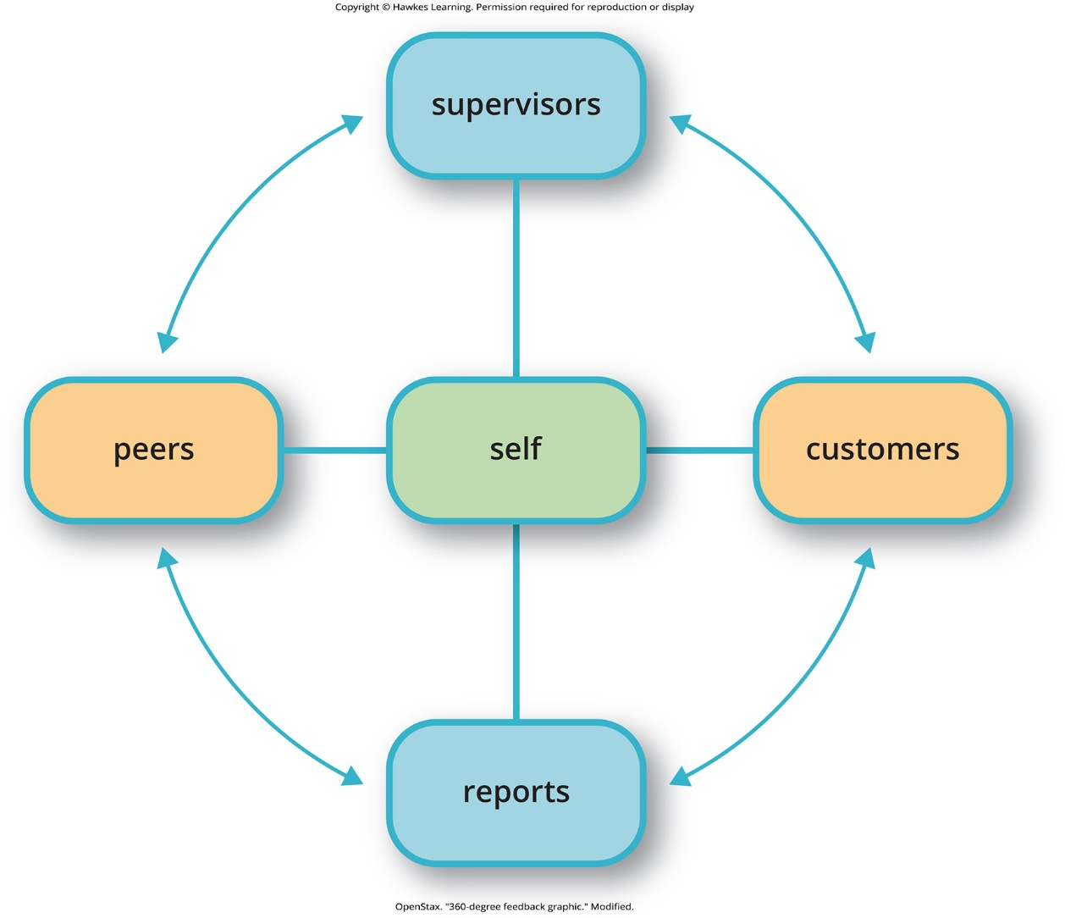
Lesson 13.2 Figure 4

Slide 16
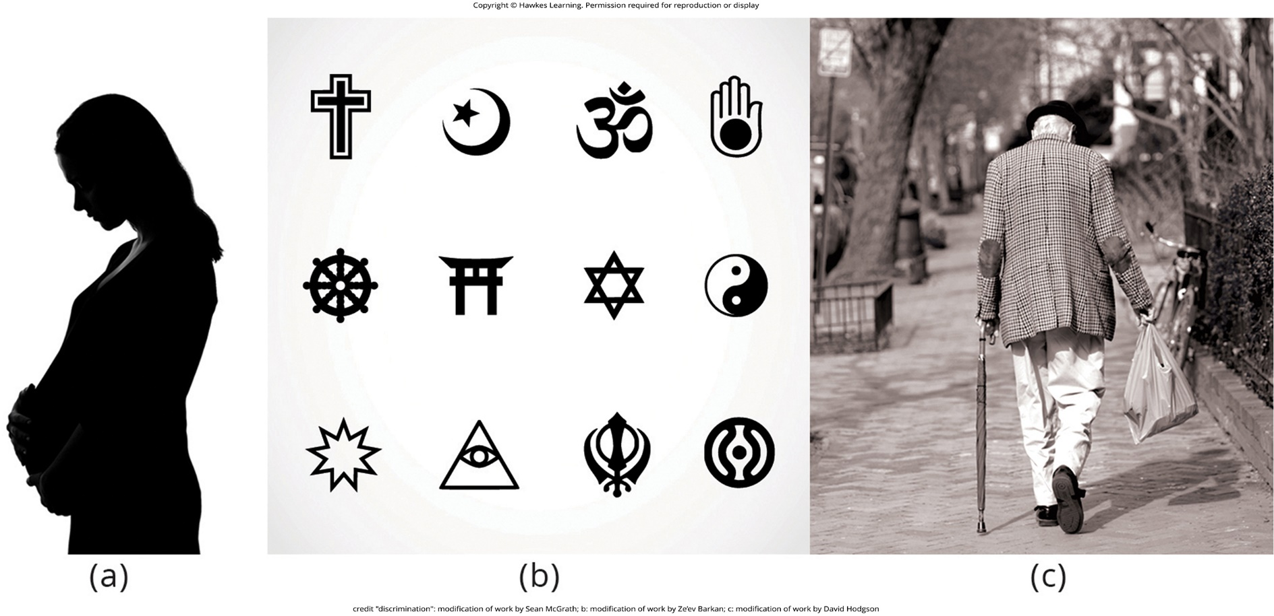
Lesson 13.2 Figure 5

Slide 17
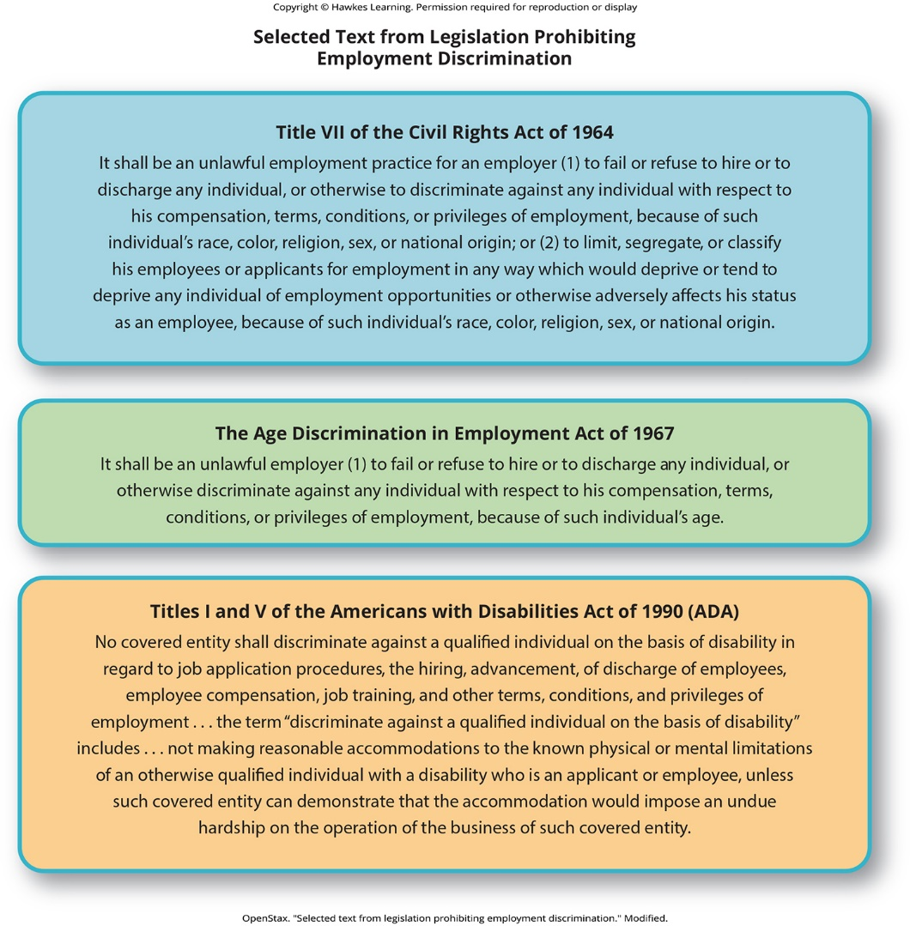
Lesson 13.2 Figure 6

Slide 18
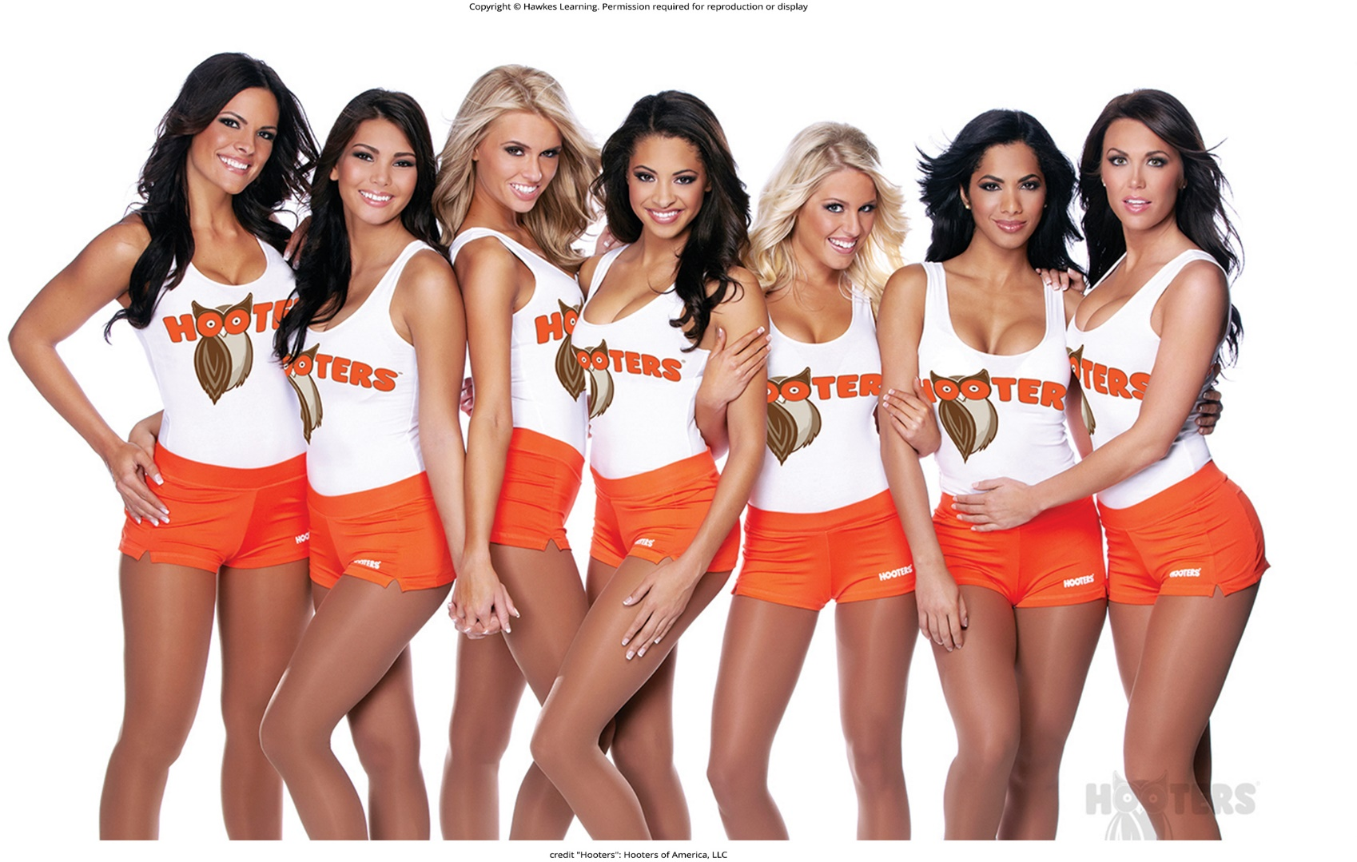
Lesson 13.2 Figure 7

Slide 19
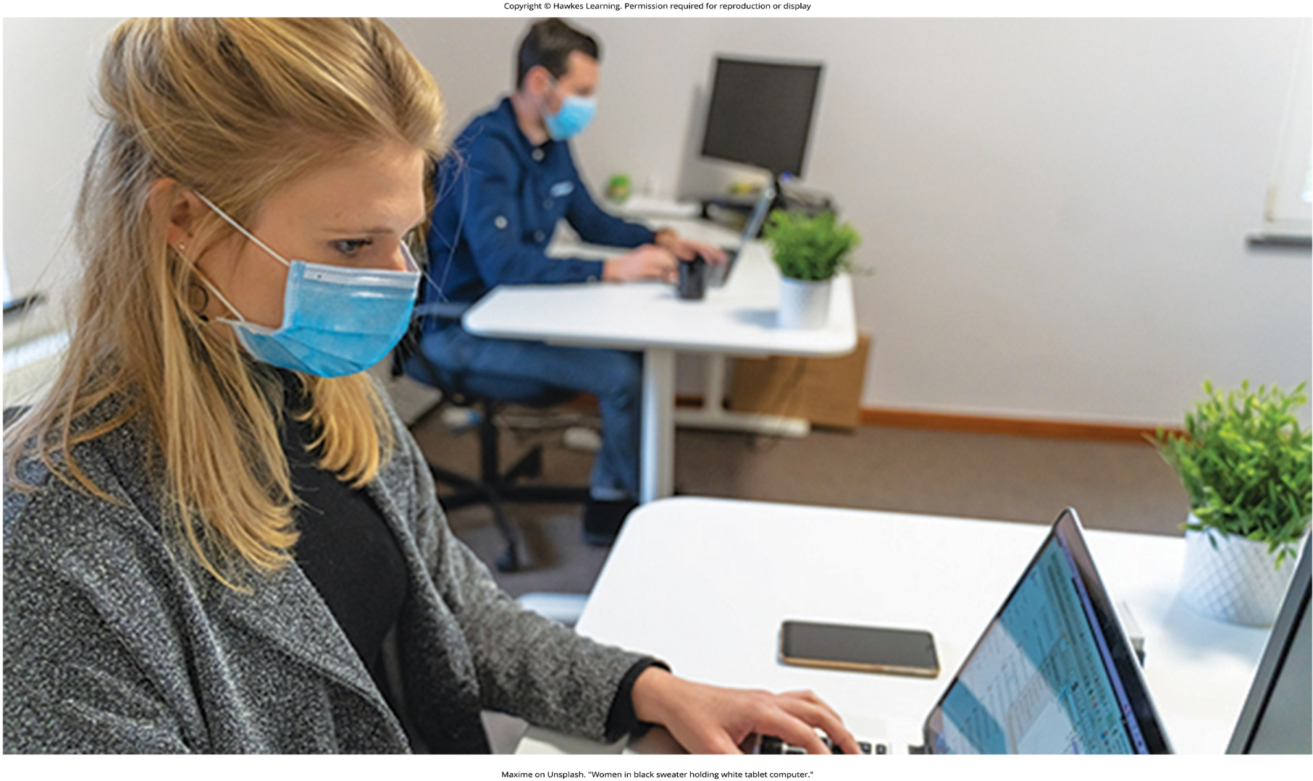
Lesson 13.3 Figure 1

Slide 20
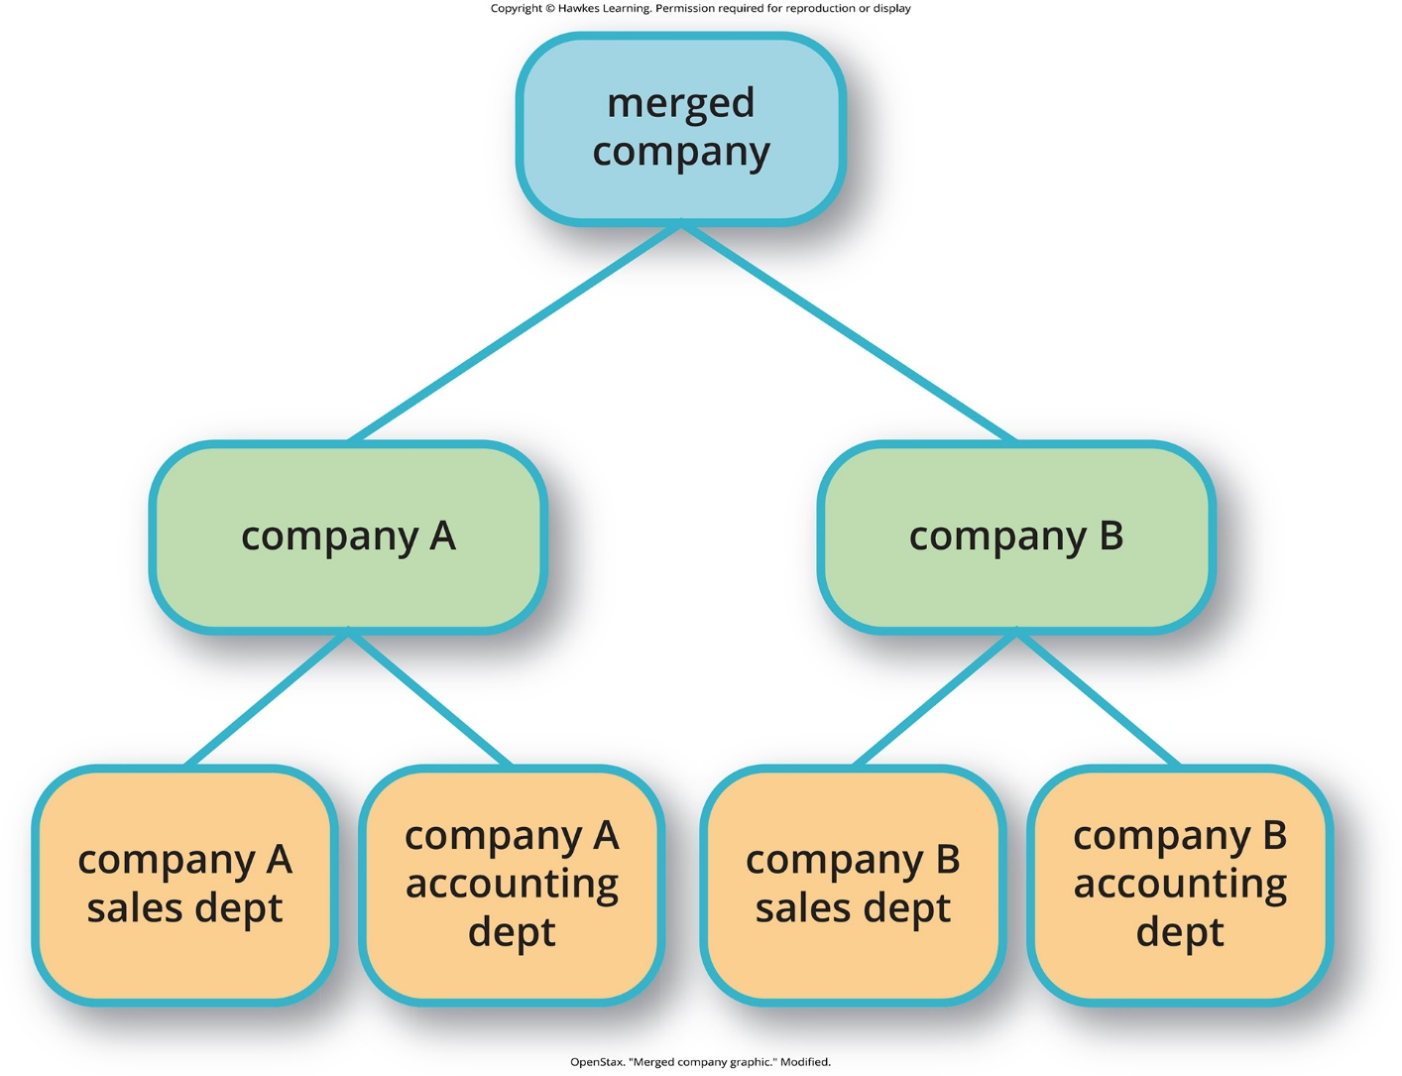
Lesson 13.3 Figure 2

Slide 21

Lesson 13.3 Figure 3

Slide 22

Lesson 13.3 Figure 4

Slide 23

Lesson 13.3 Figure 5

Slide 24
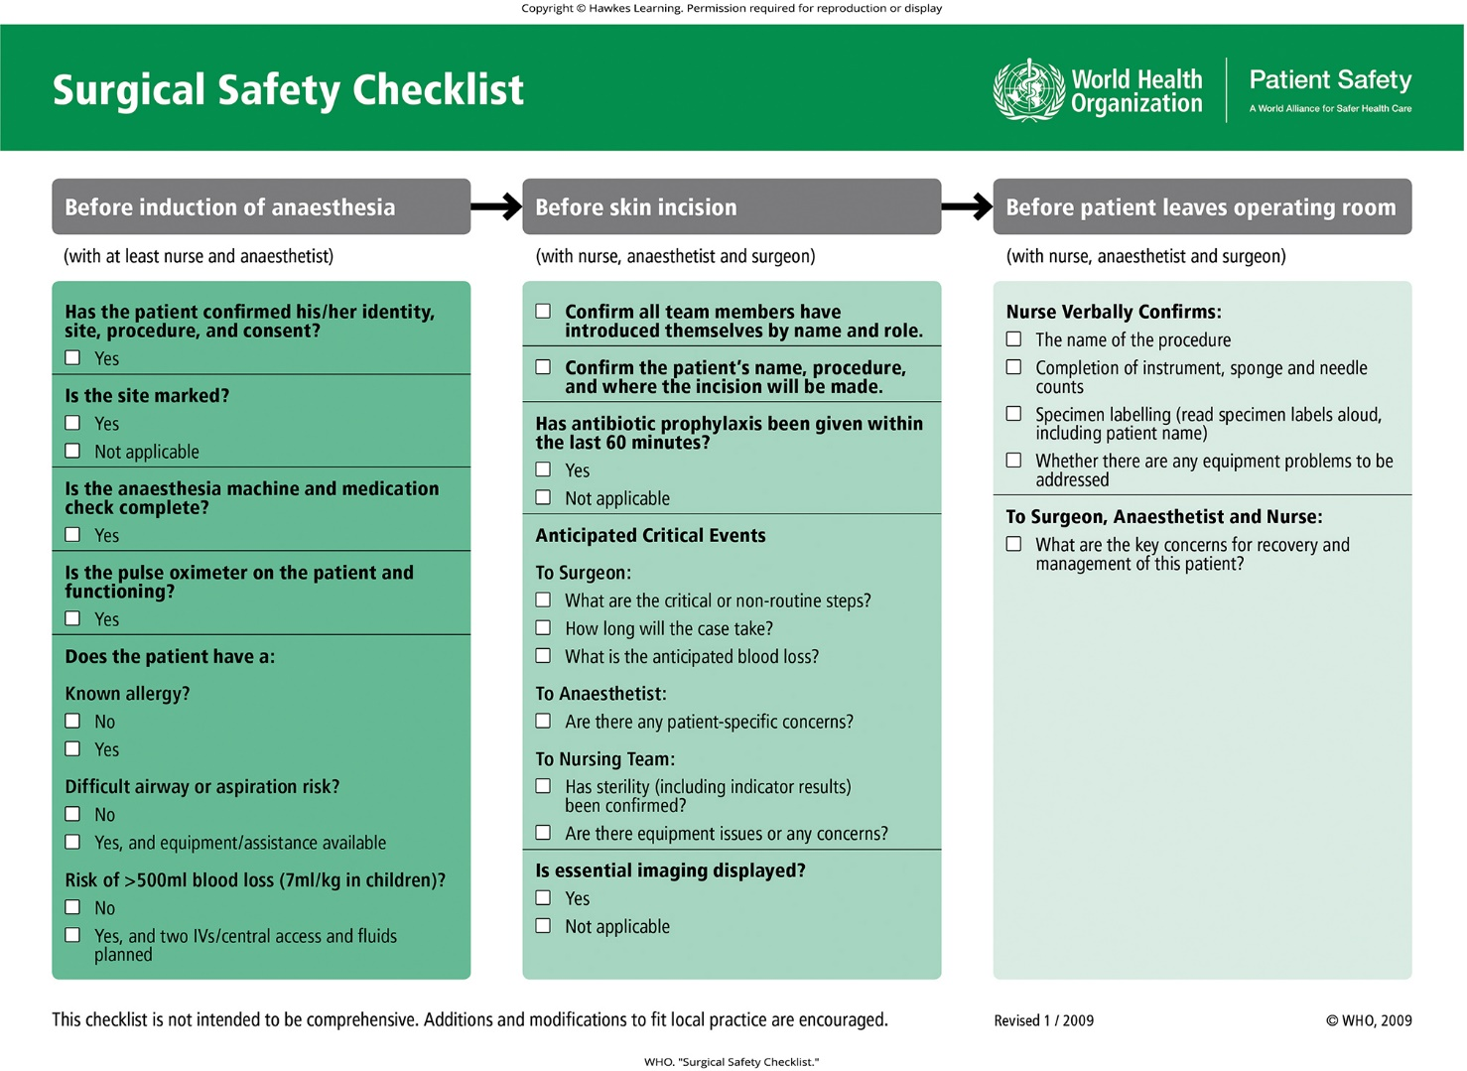
Lesson 13.4 Figure 1

Slide 25
Hawkes Learning – End of PowerPoint

