Slide 1
Chapter 14
Stress, Lifestyle, and Health

Slide 2

Lesson 14.1 Figure 1

Slide 3

Lesson 14.1 Figure 2

Slide 4

Lesson 14.1 Figure 3

Slide 5
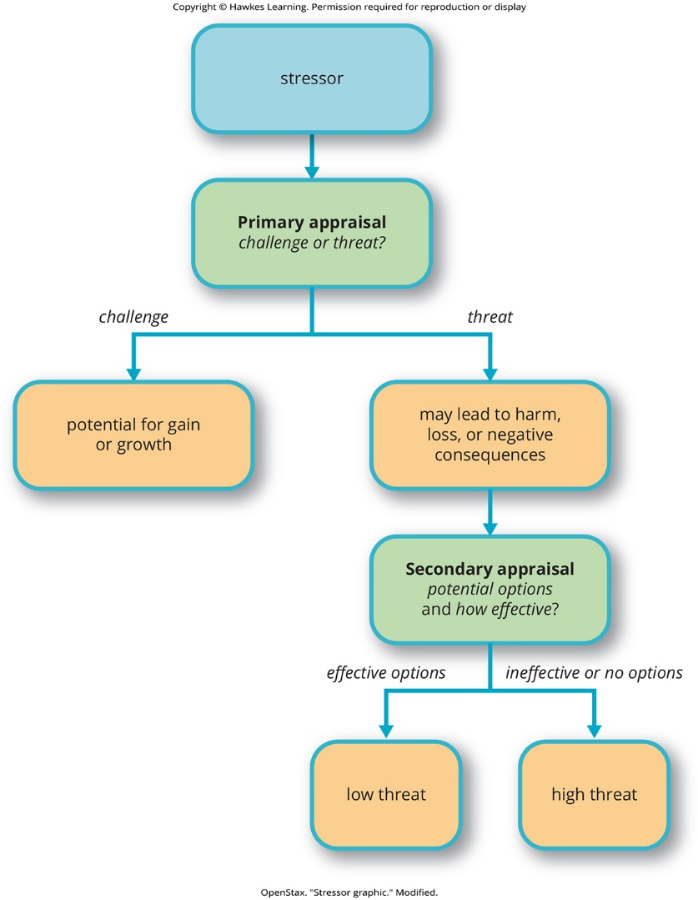
Lesson 14.1 Figure 4

Slide 6

Lesson 14.1 Figure 5

Slide 7
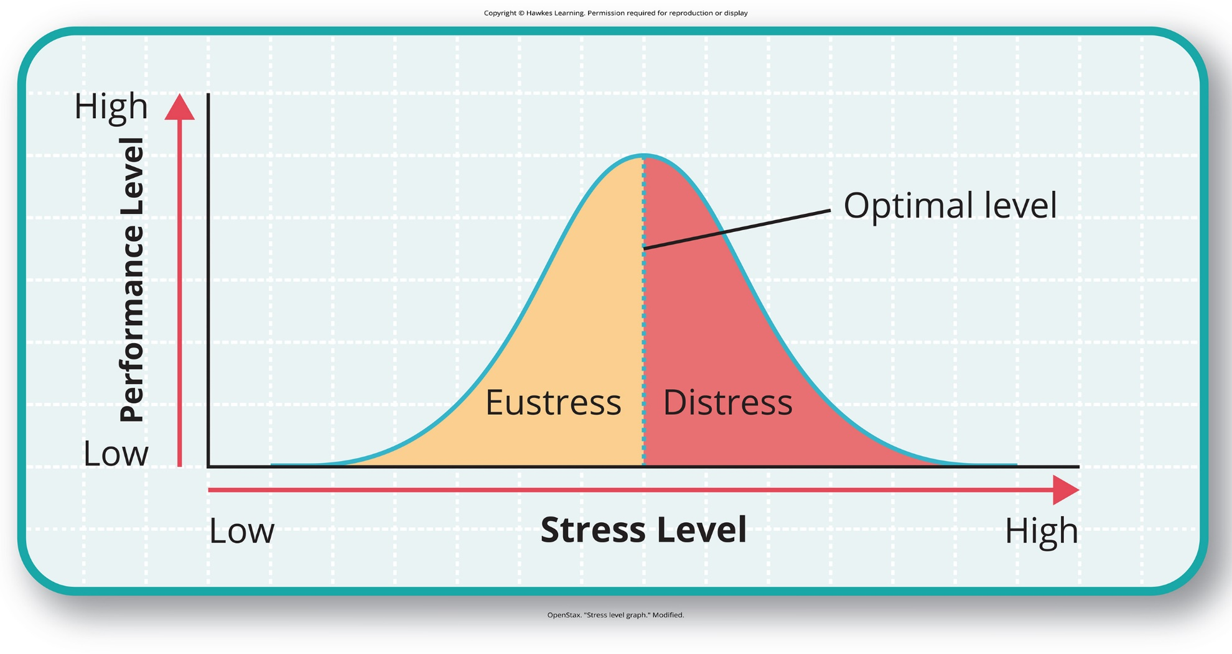
Lesson 14.1 Figure 6

Slide 8
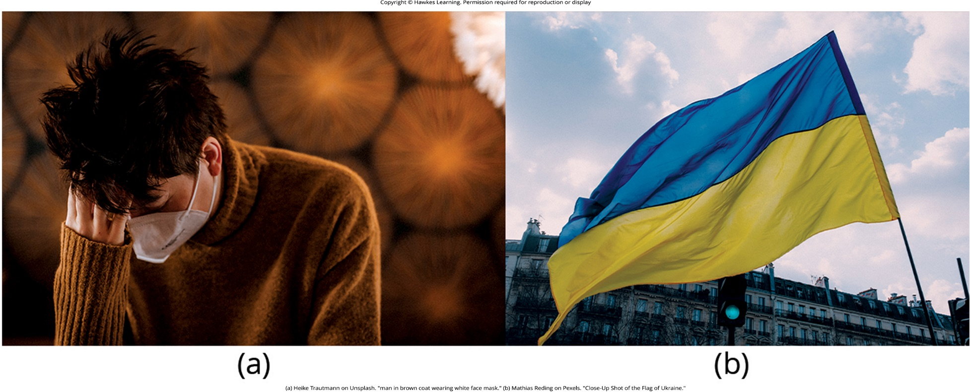
Lesson 14.1 Figure 7

Slide 9
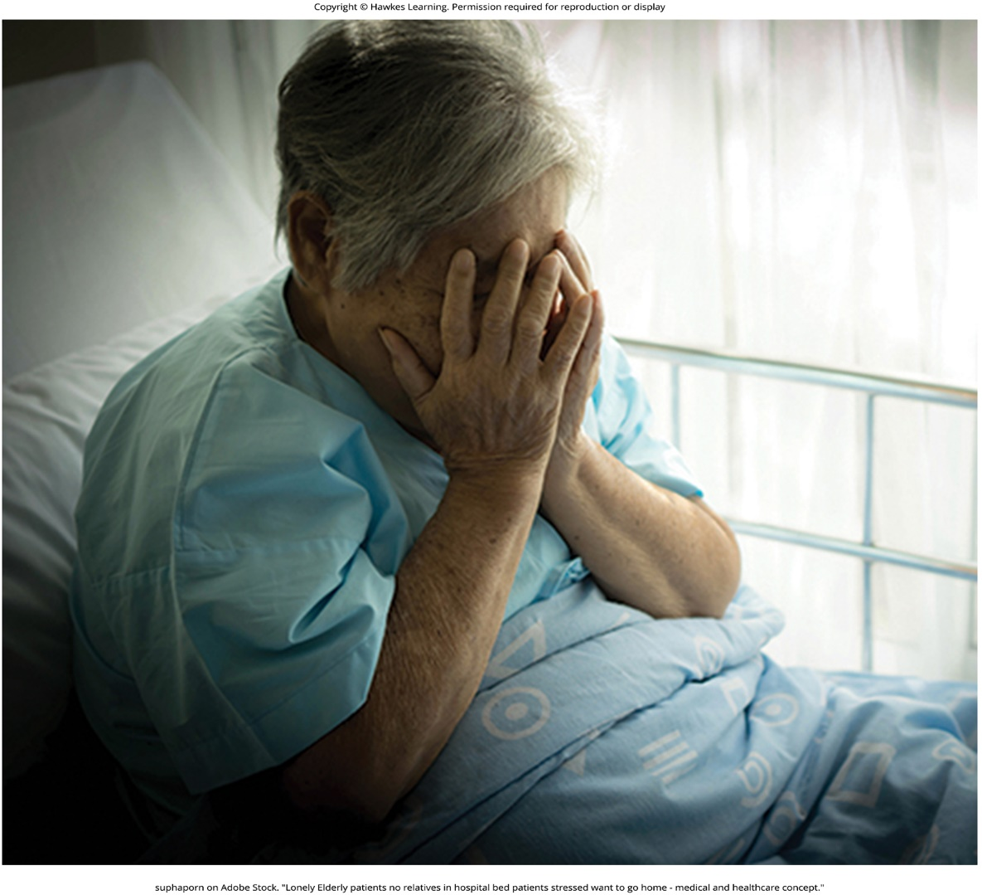
Lesson 14.1 Figure 8

Slide 10

Lesson 14.1 Figure 9

Slide 11
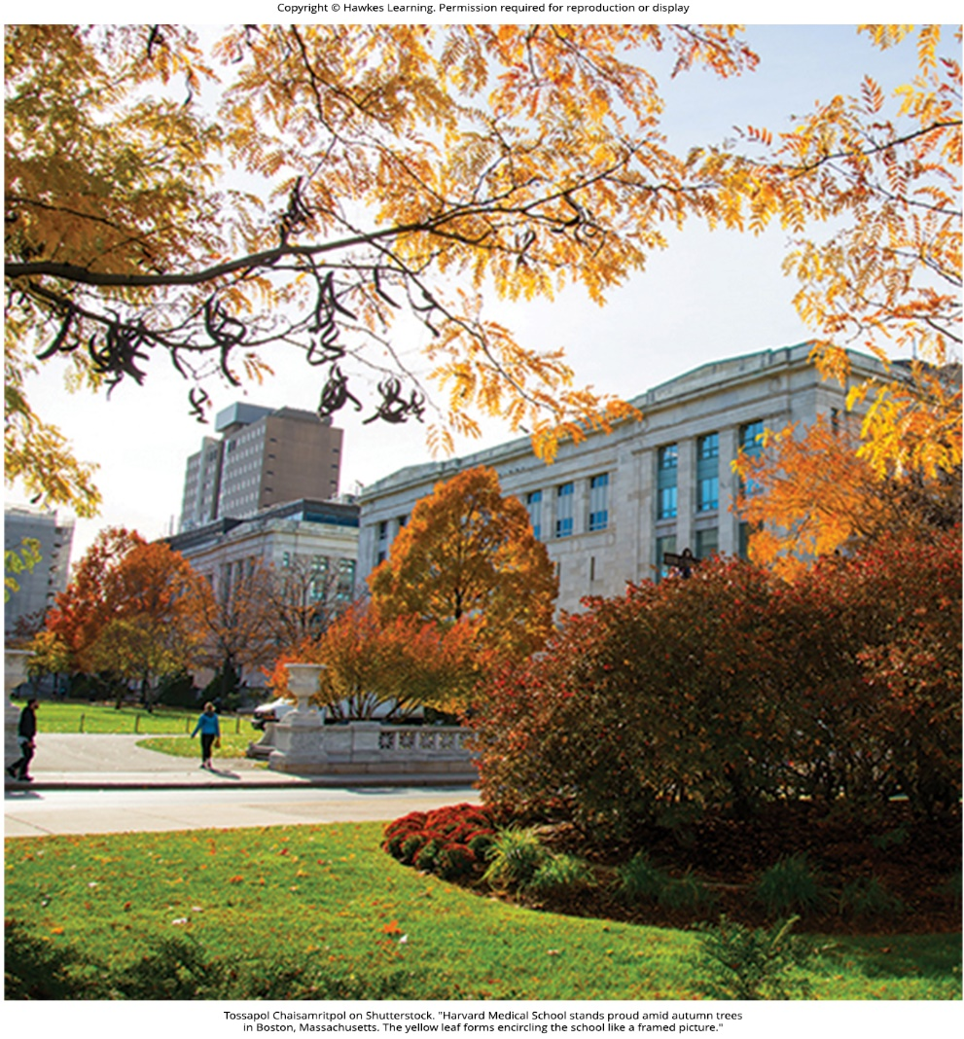
Lesson 14.1 Figure 10

Slide 12
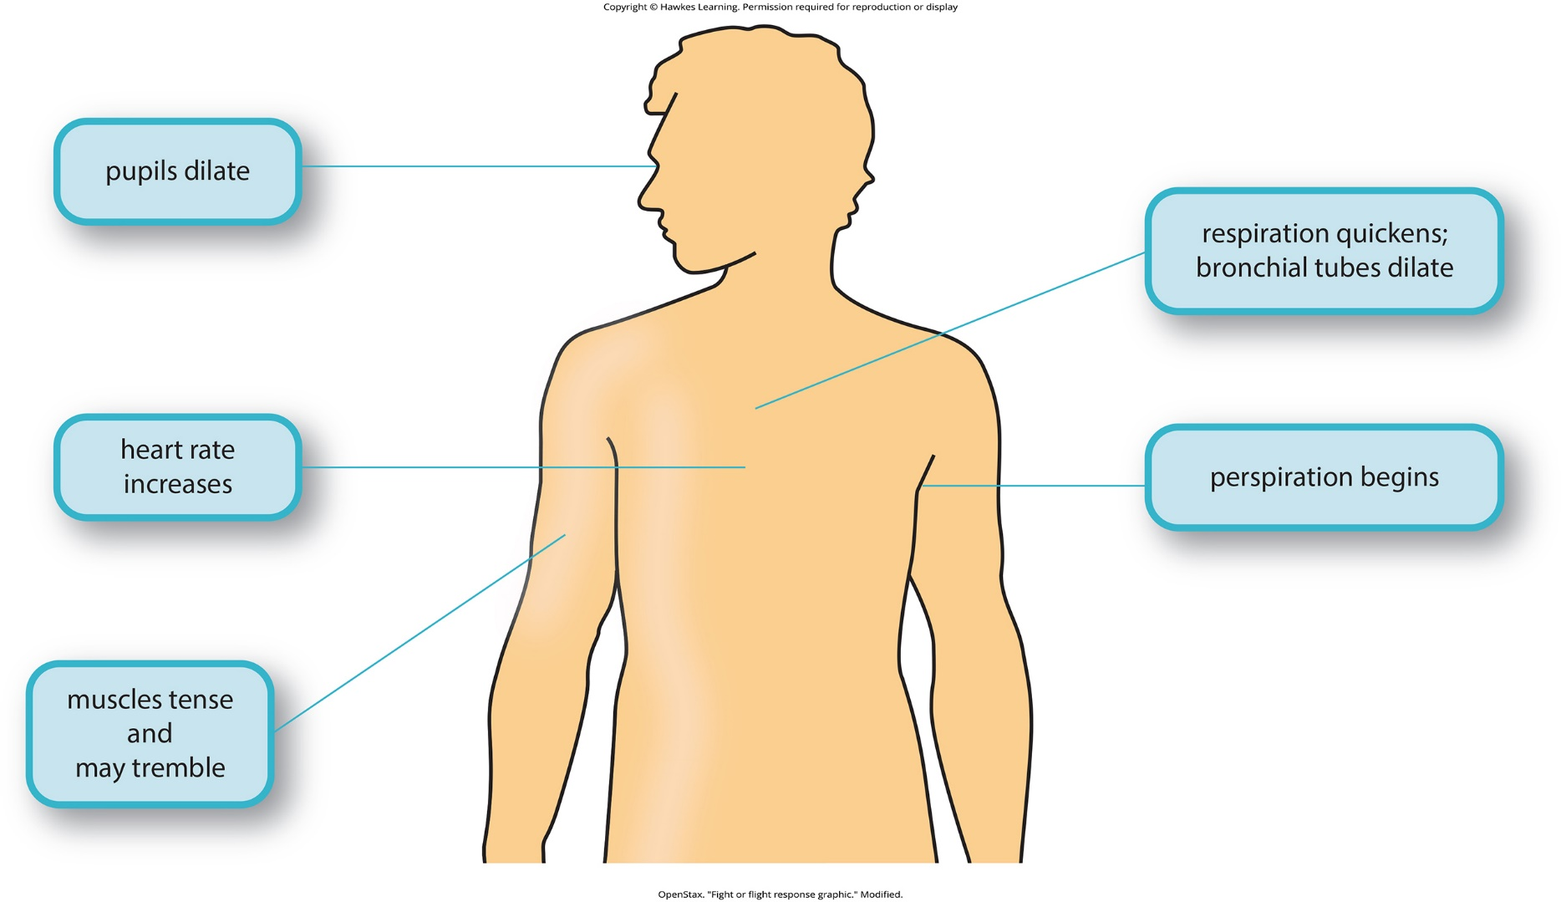
Lesson 14.1 Figure 11

Slide 13
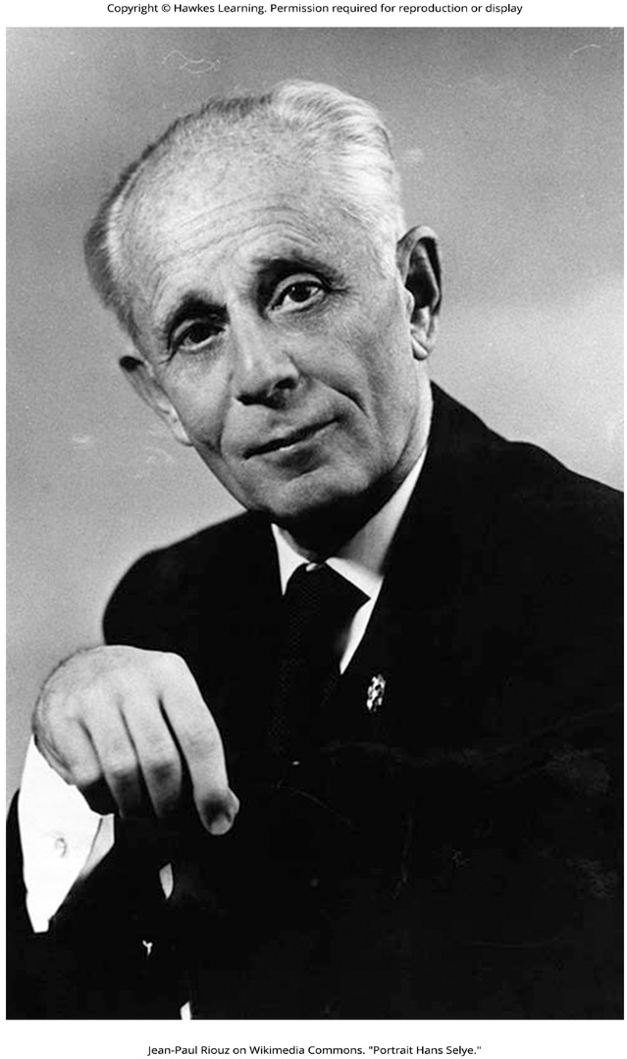
Lesson 14.1 Figure 12

Slide 14
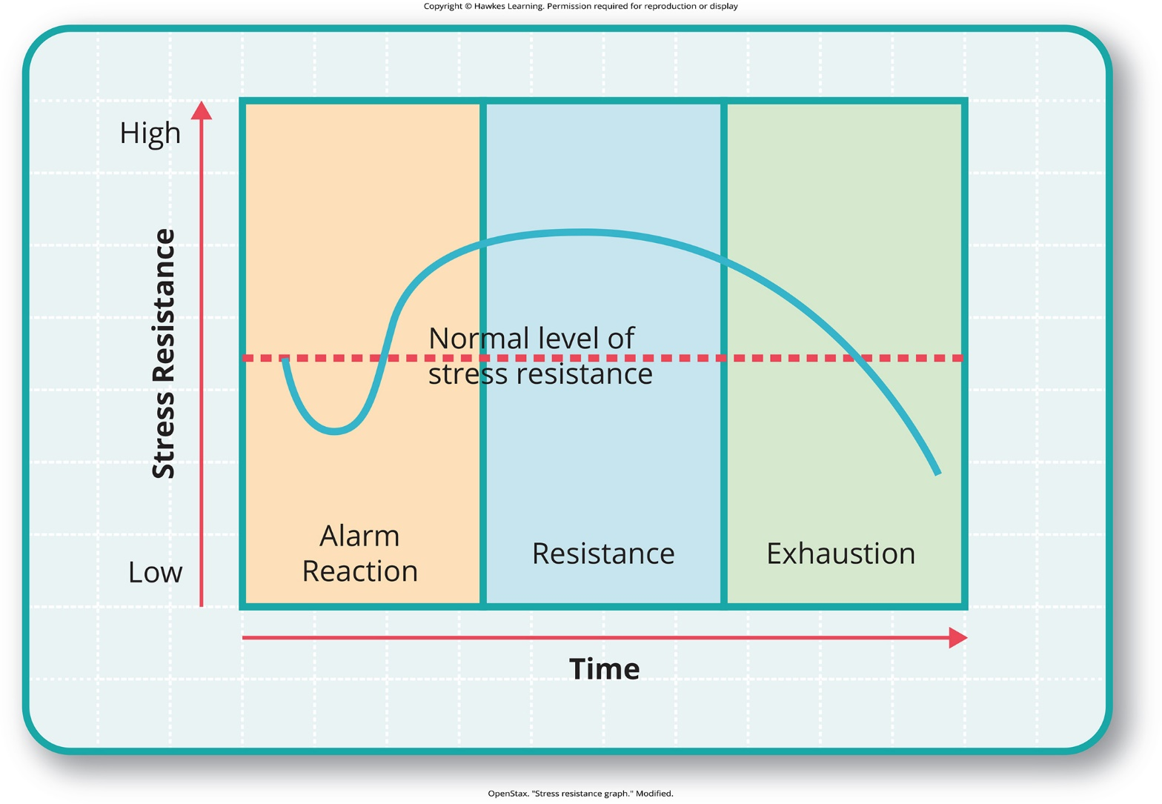
Lesson 14.1 Figure 13

Slide 15
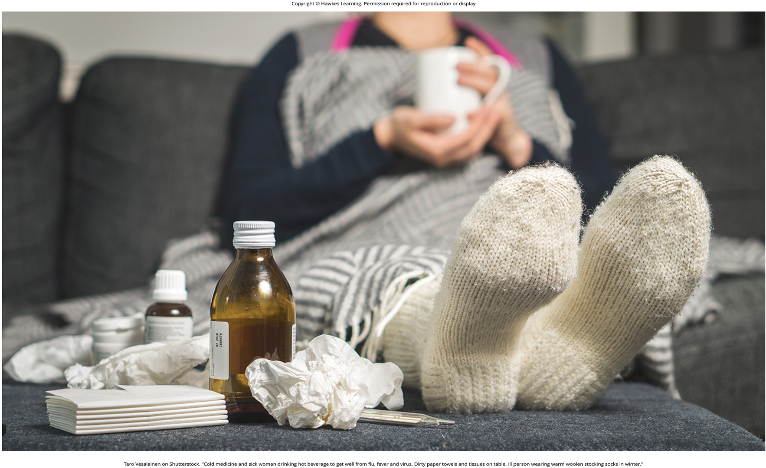
Lesson 14.1 Figure 14

Slide 16
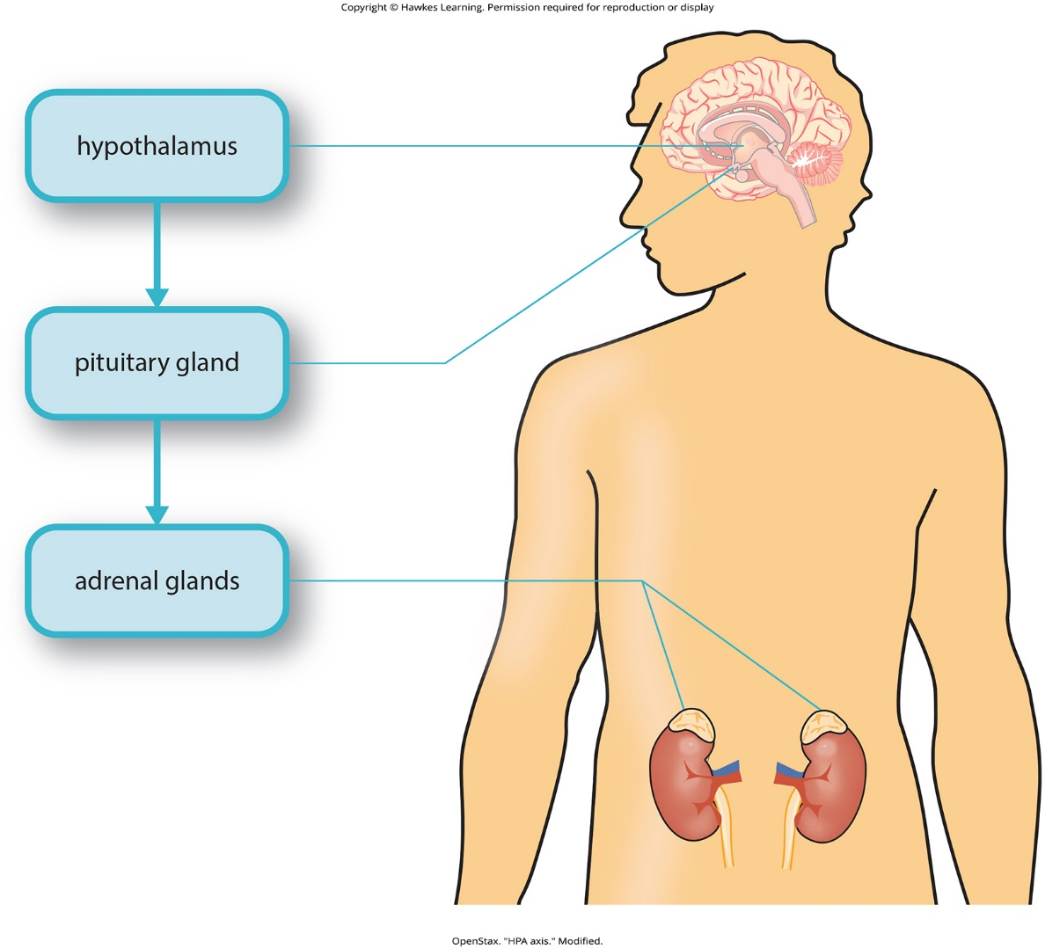
Lesson 14.1 Figure 15

Slide 17
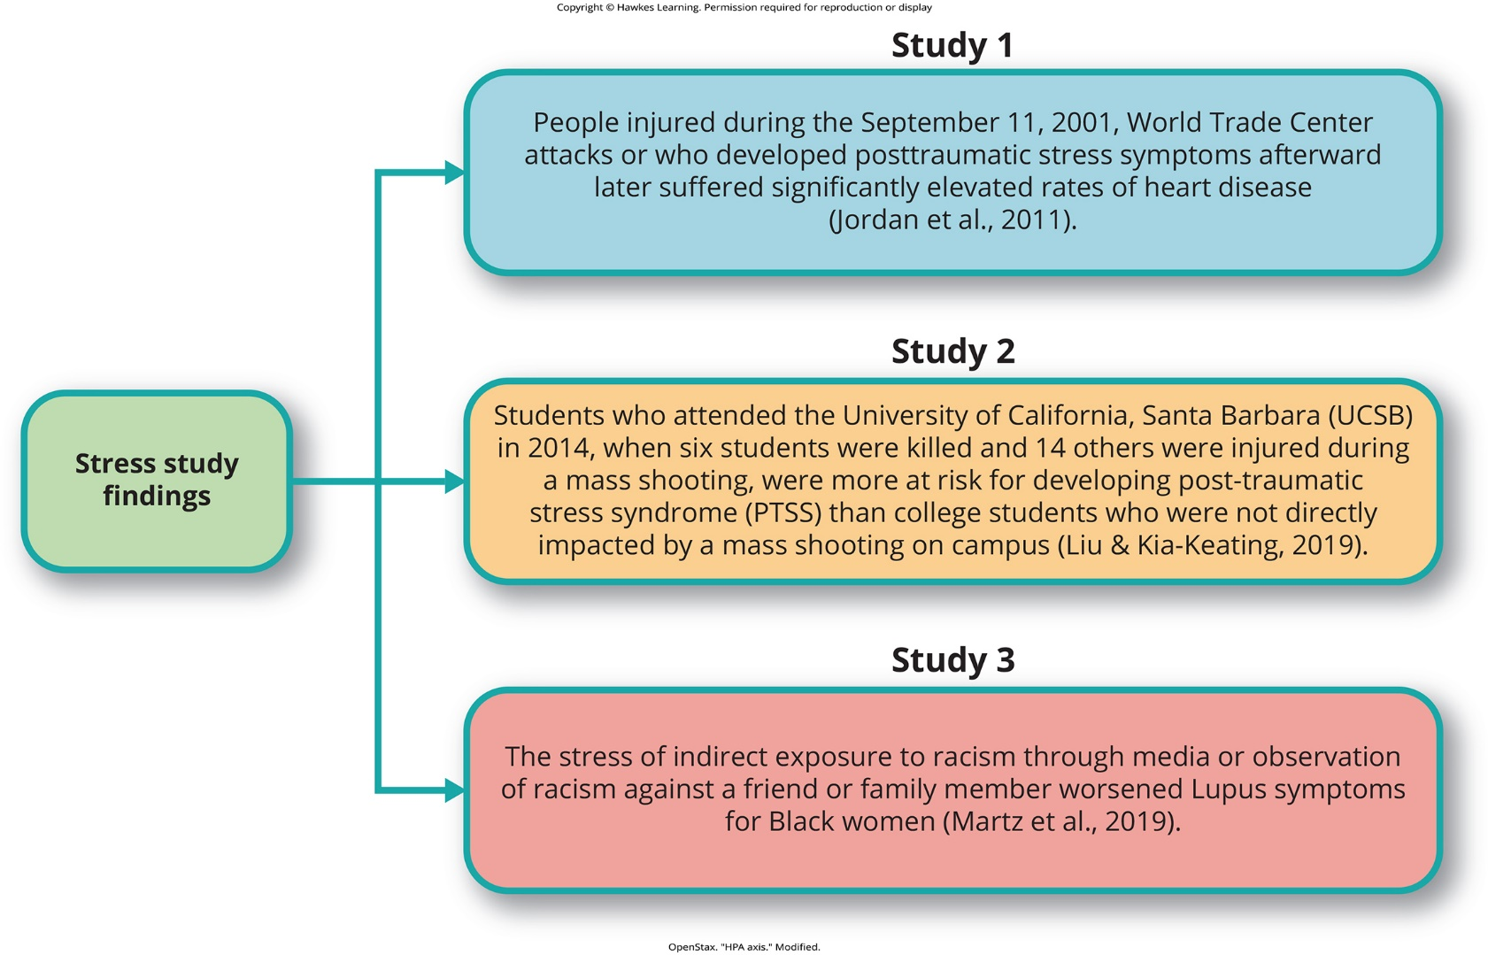
Lesson 14.1 Stress Study

Slide 18
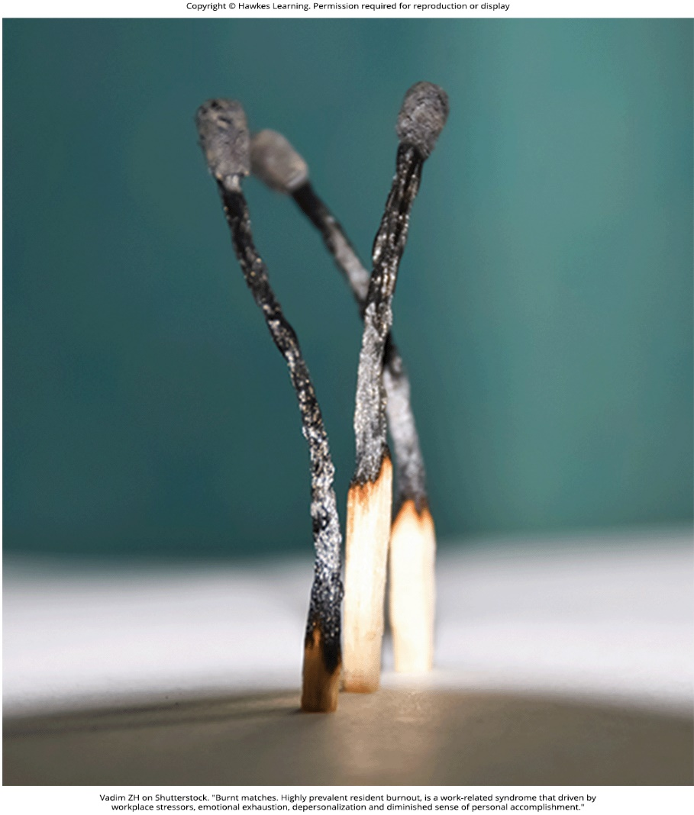
Lesson 14.2 Figure 1

Slide 19
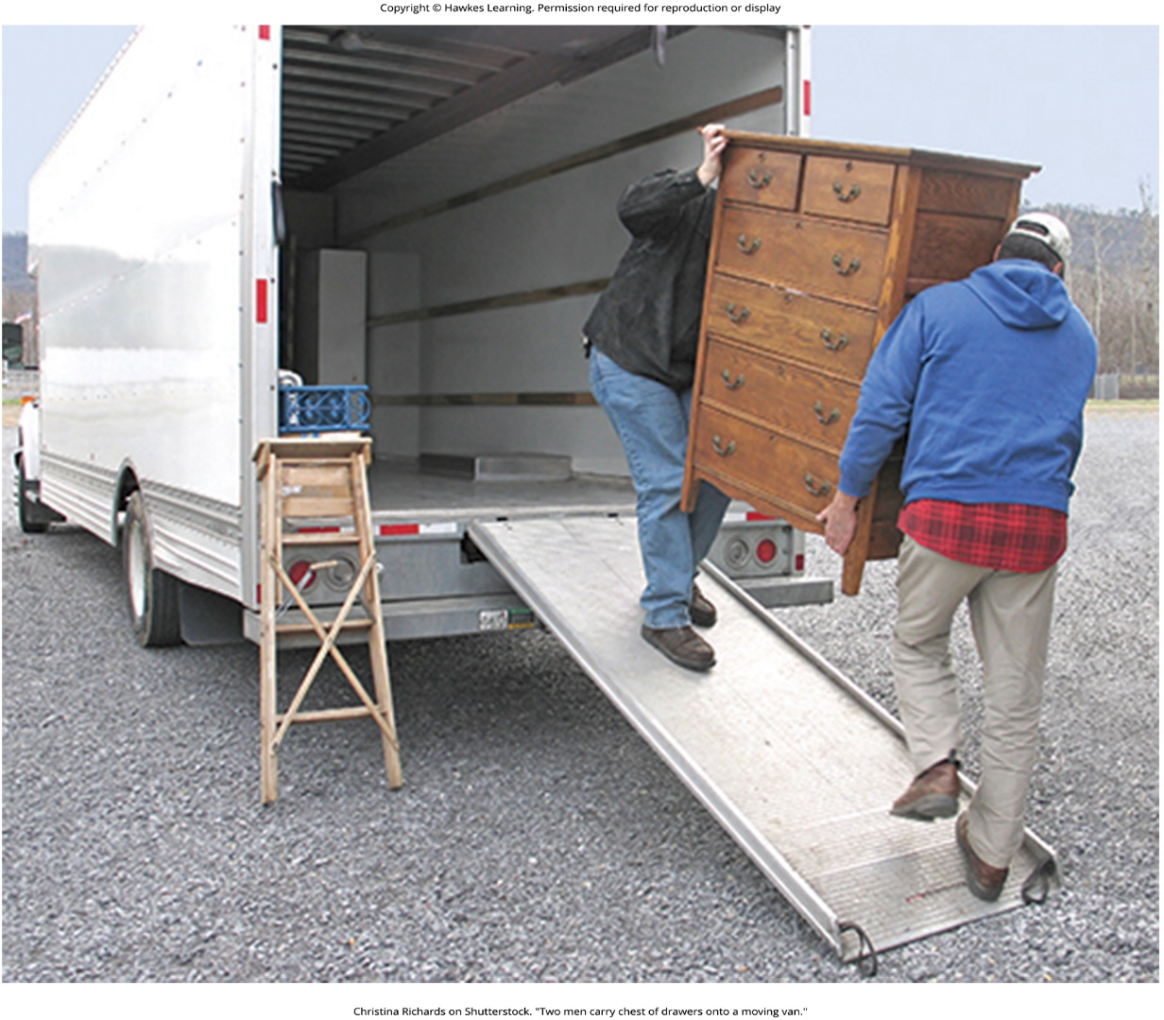
Lesson 14.2 Figure 2

Slide 20
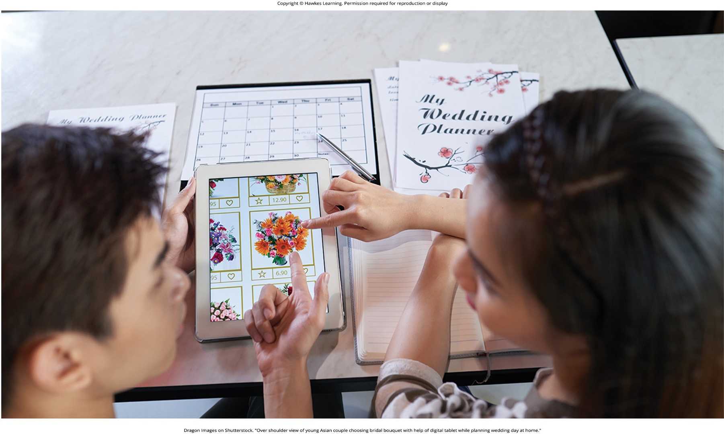
Lesson 14.2 Figure 3

Slide 21

Lesson 14.2 Figure 4

Slide 22
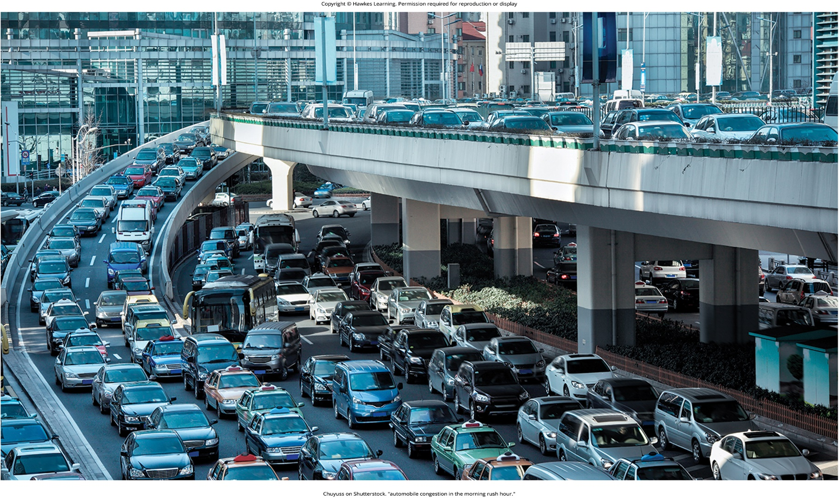
Lesson 14.2 Figure 5

Slide 23
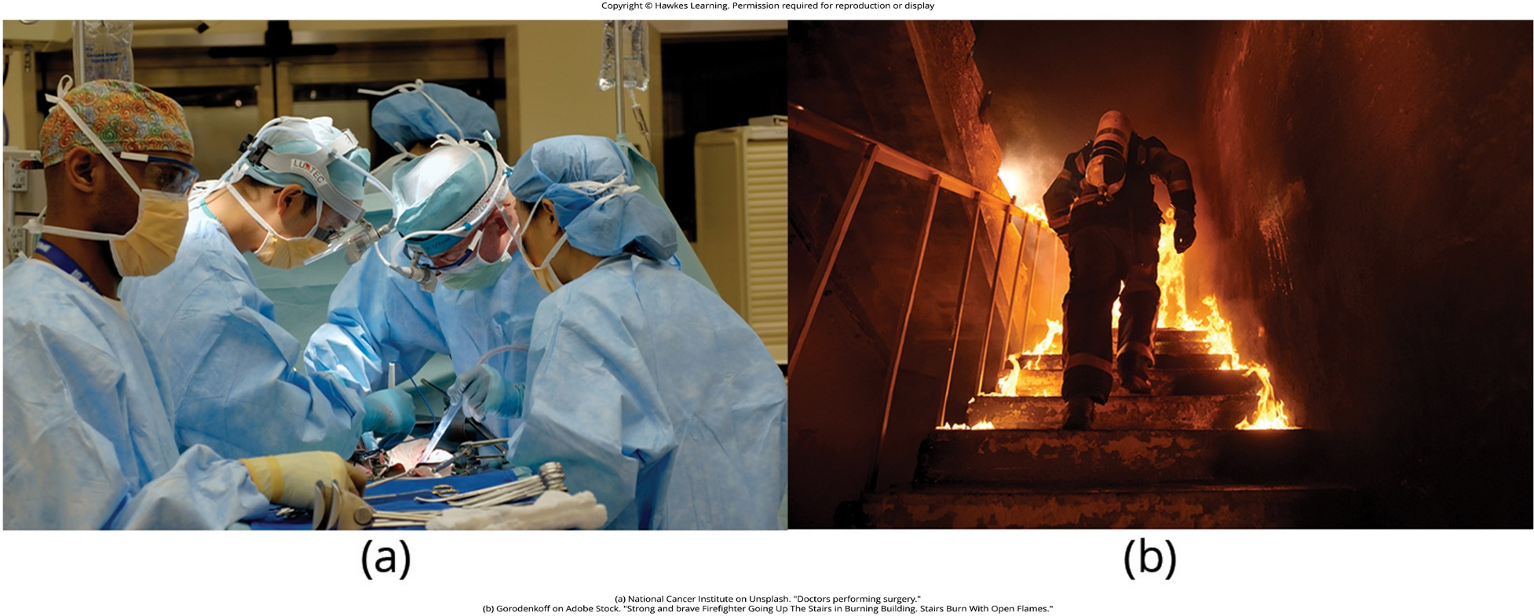
Lesson 14.2 Figure 6

Slide 24

Lesson 14.2 Figure 7

Slide 25
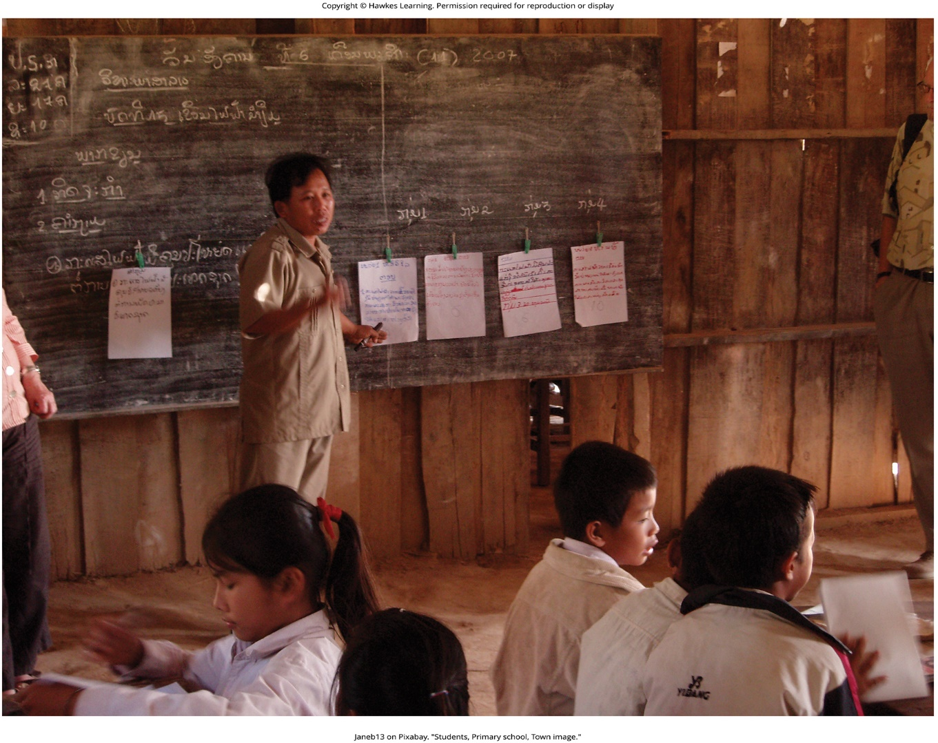
Lesson 14.2 Figure 8

Slide 26
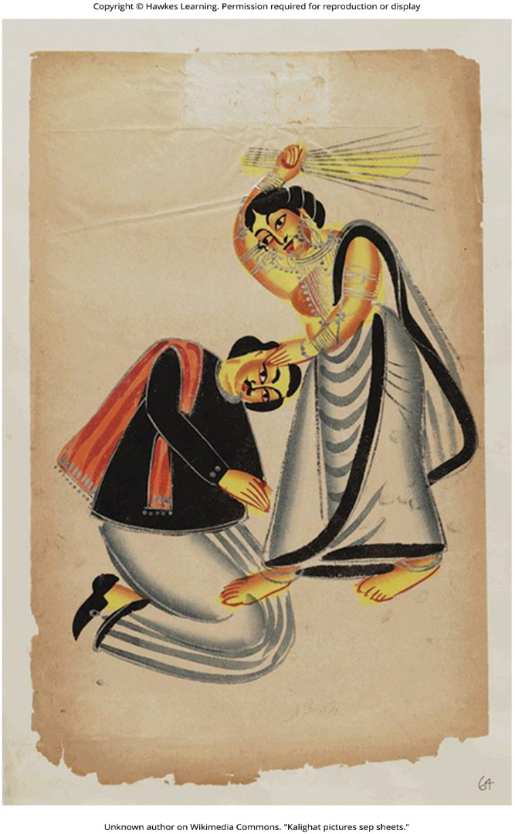
Lesson 14.2 Figure 9

Slide 27
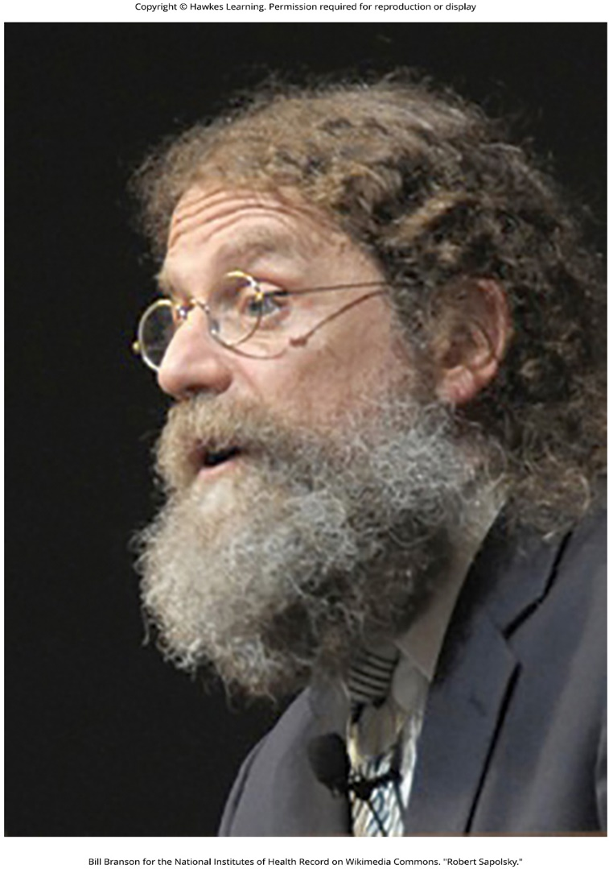
Lesson 14.3 Figure 1

Slide 28
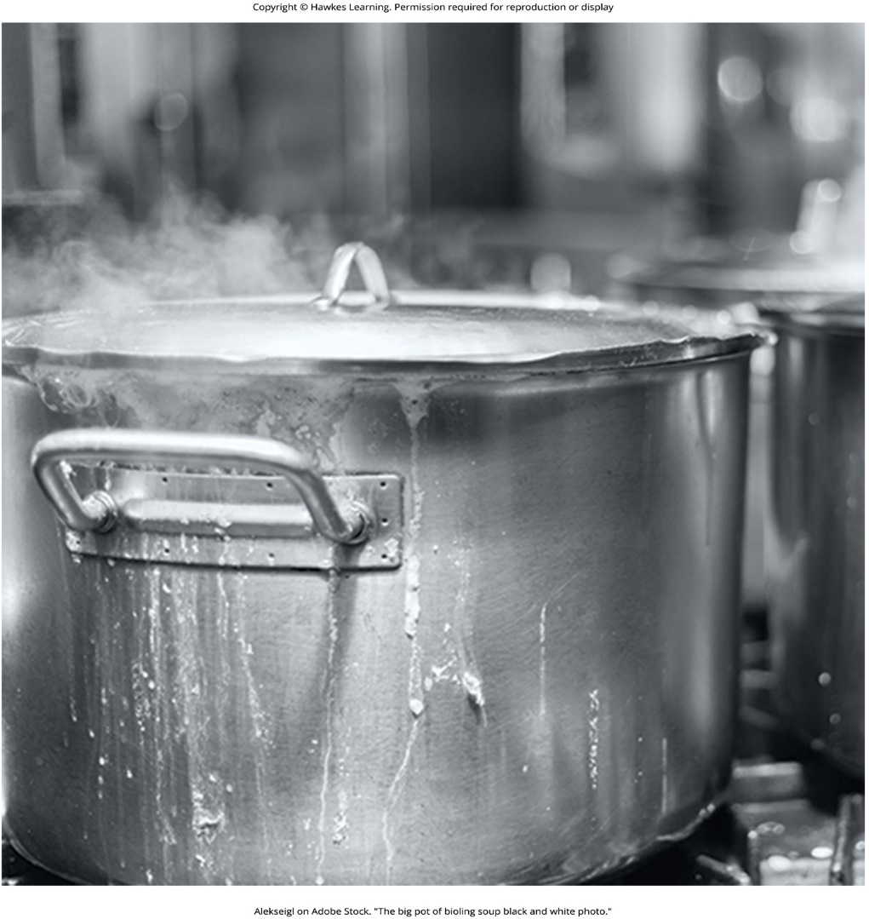
Lesson 14.3 Figure 2

Slide 29
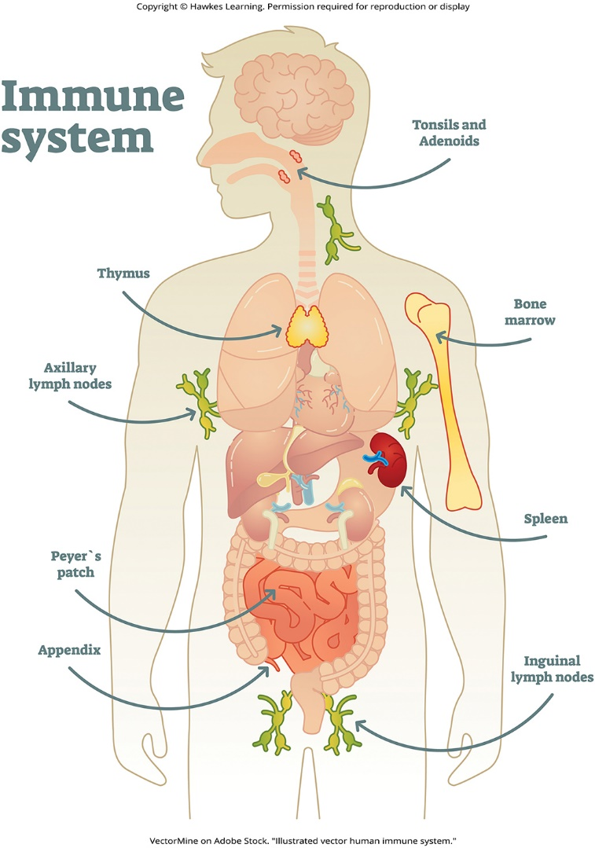
Lesson 14.3 Figure 3

Slide 30
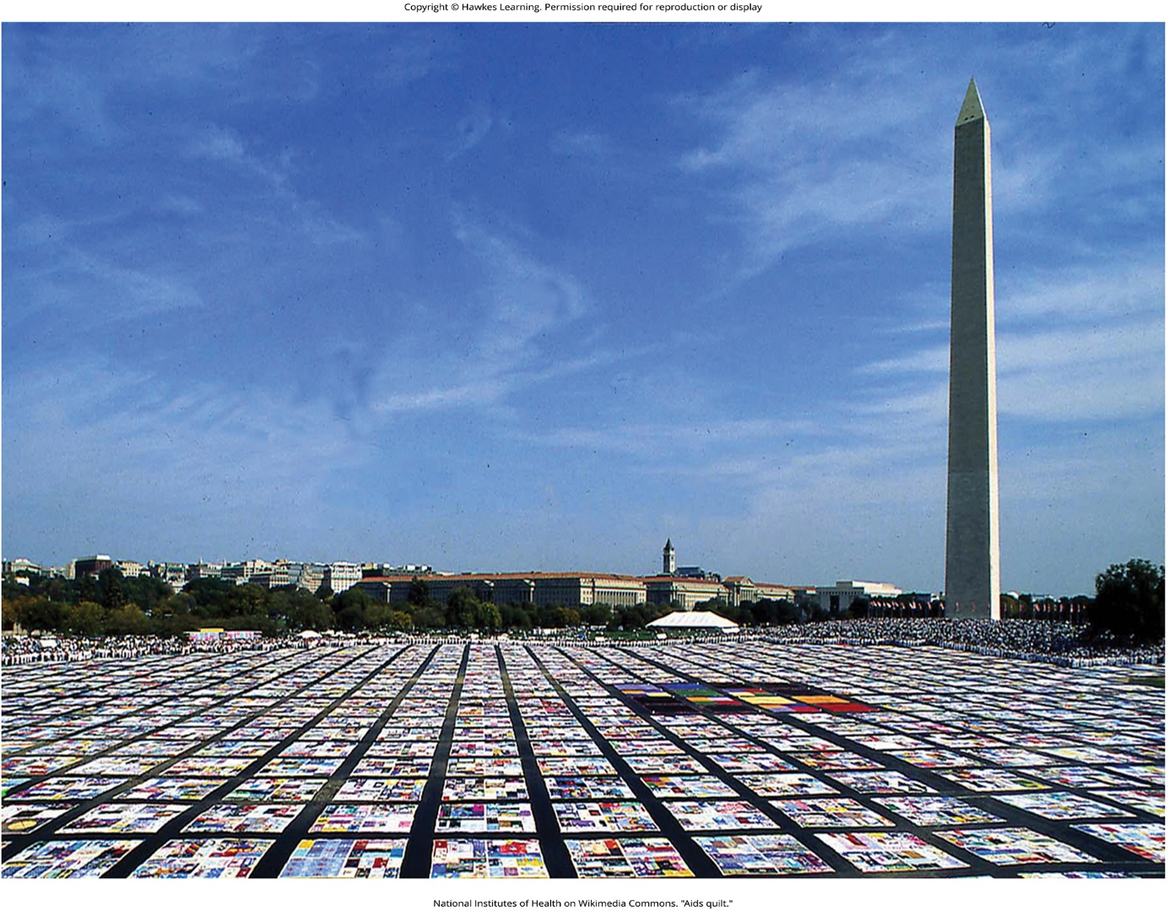
Lesson 14.3 Figure 4

Slide 31
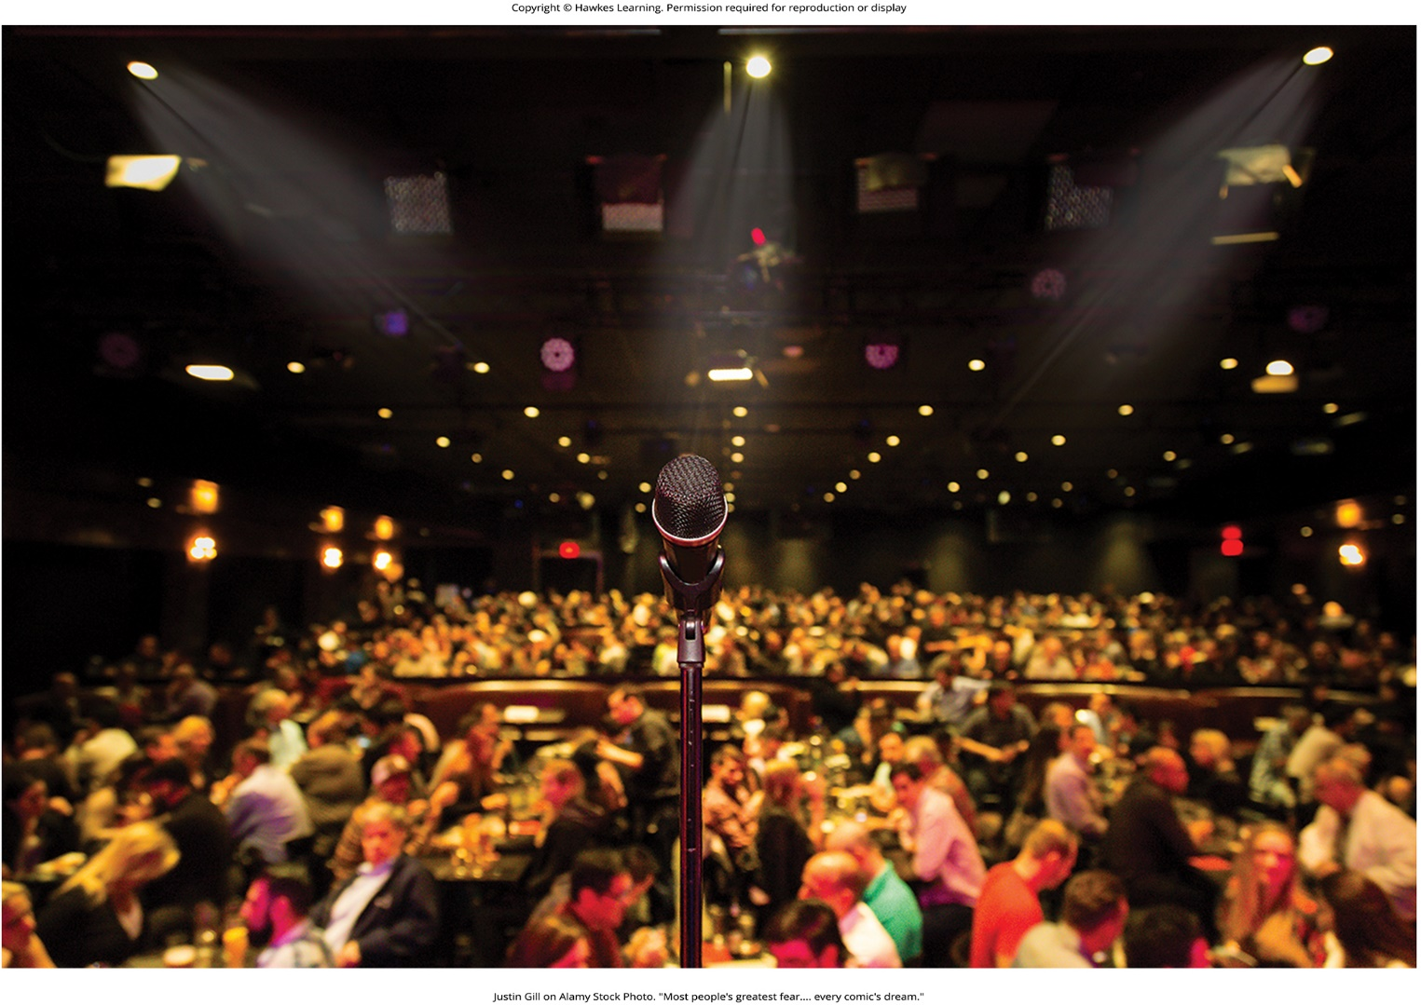
Lesson 14.3 Figure 5

Slide 32
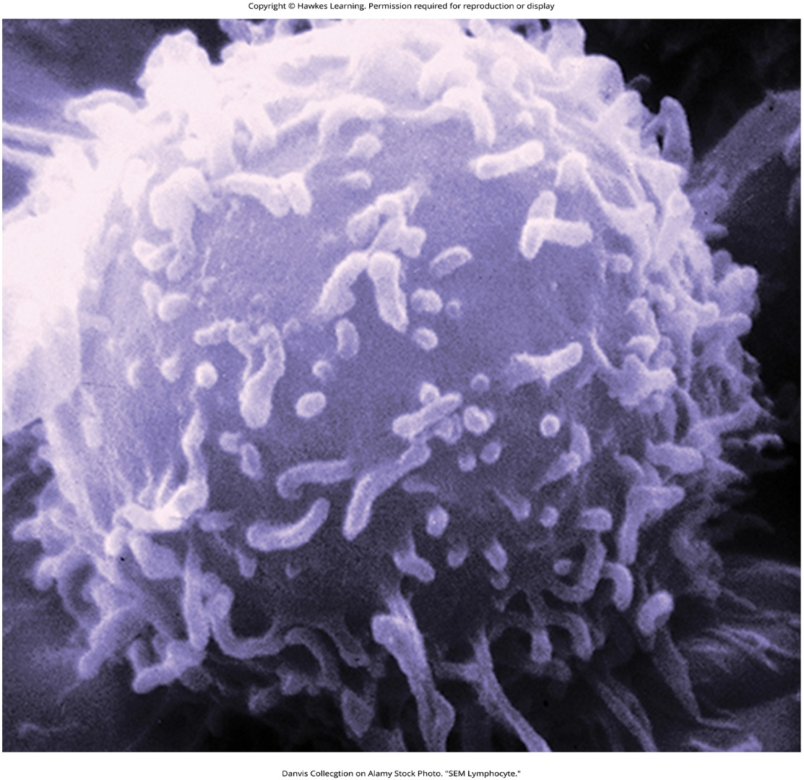
Lesson 14.3 Figure 6

Slide 33
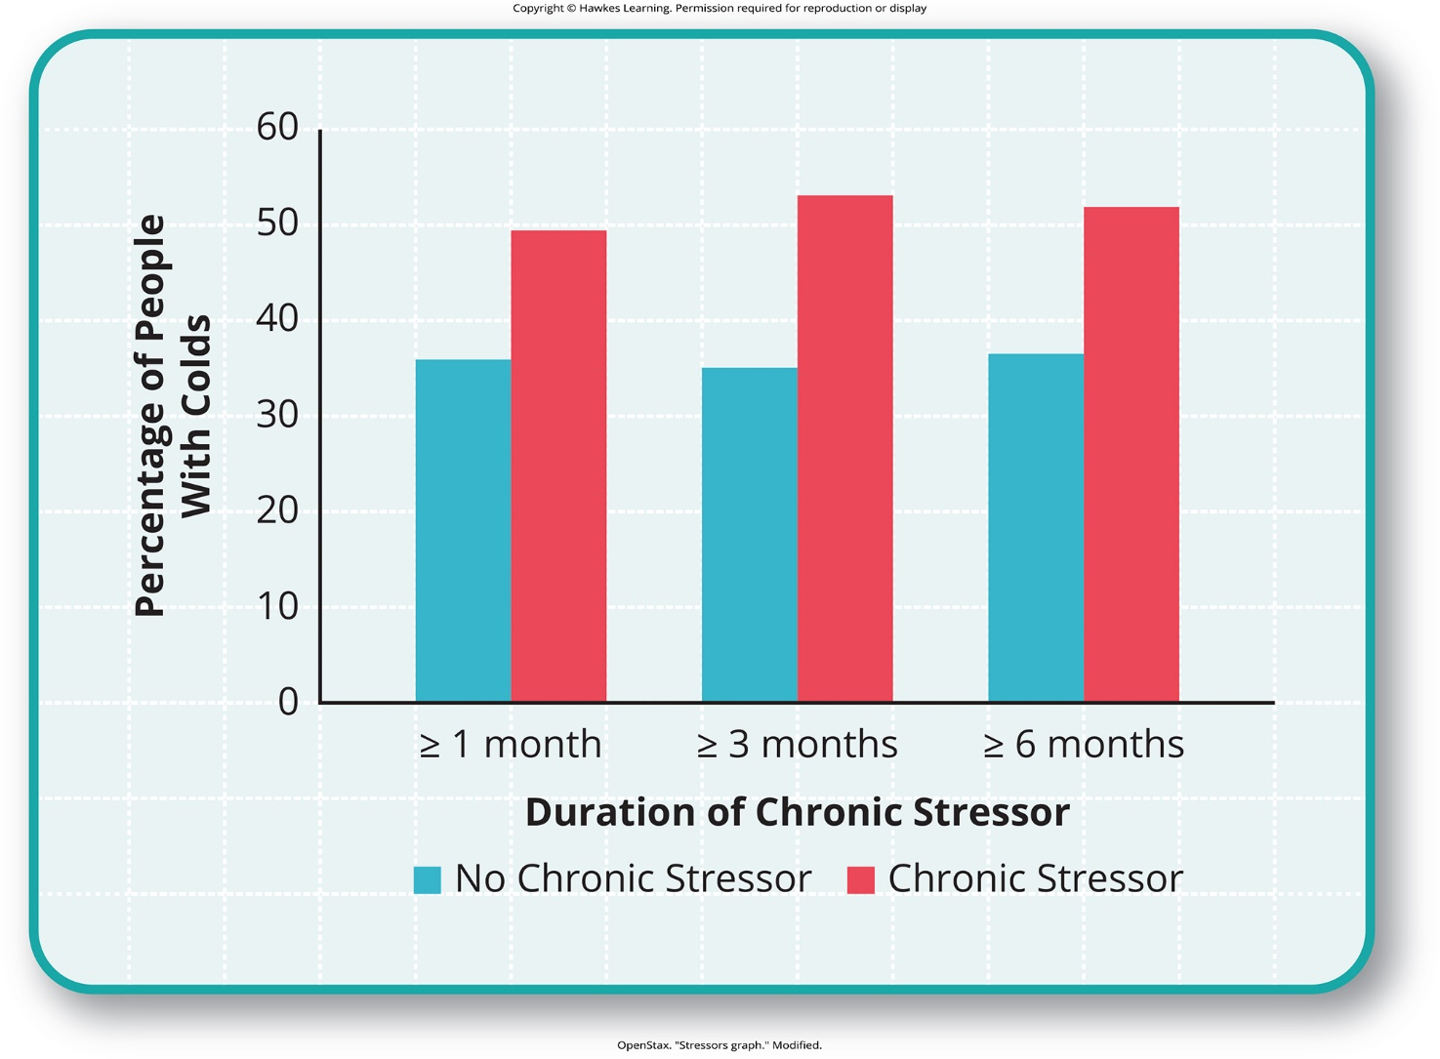
Lesson 14.3 Figure 7

Slide 34
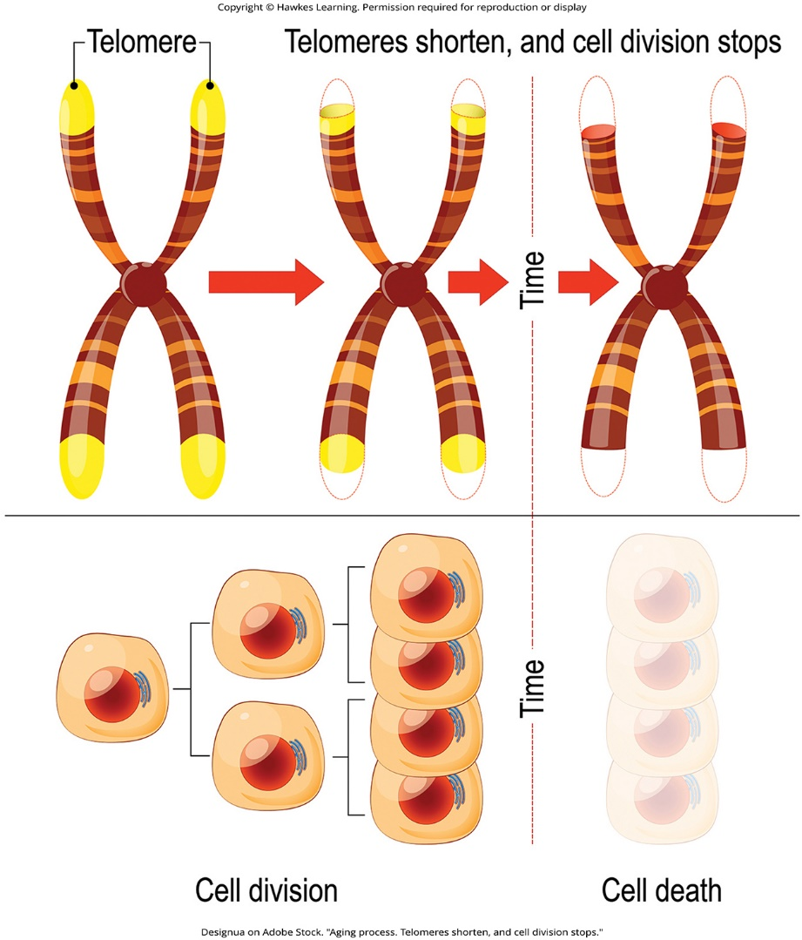
Lesson 14.3 Figure 8

Slide 35
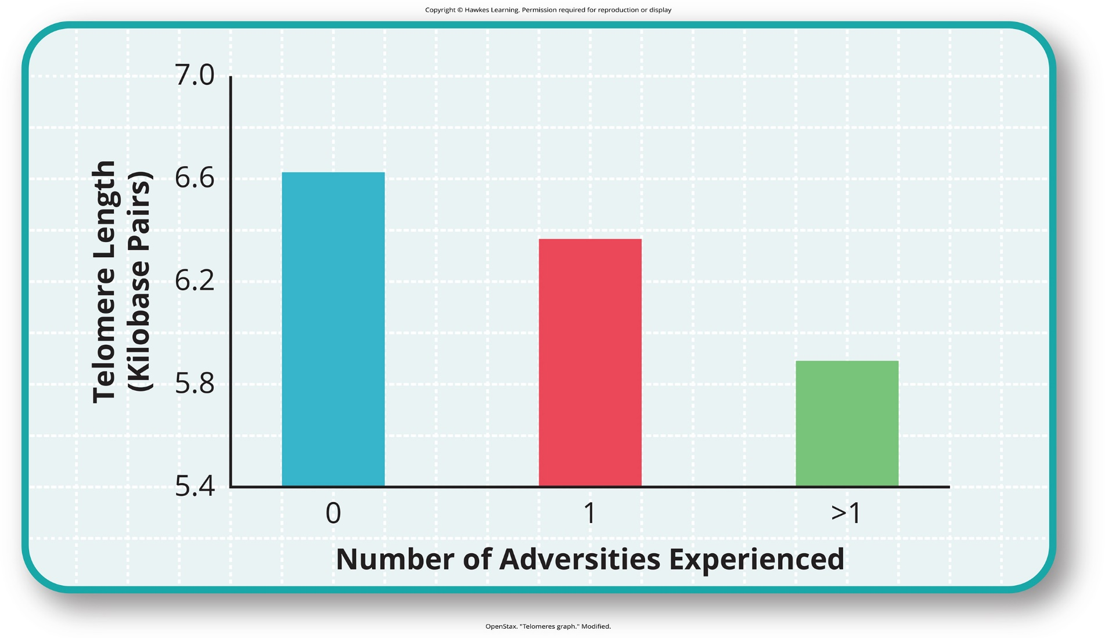
Lesson 14.3 Figure 9

Slide 36
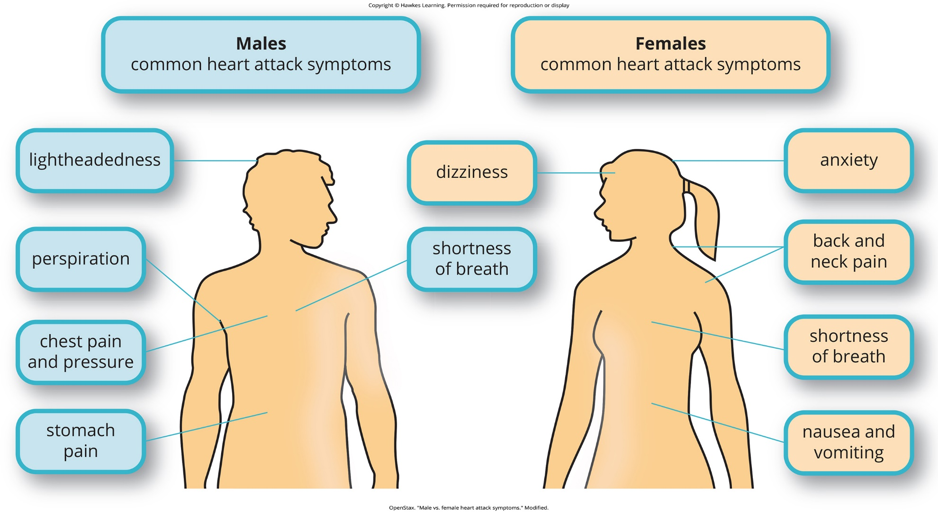
Lesson 14.3 Figure 10

Slide 37
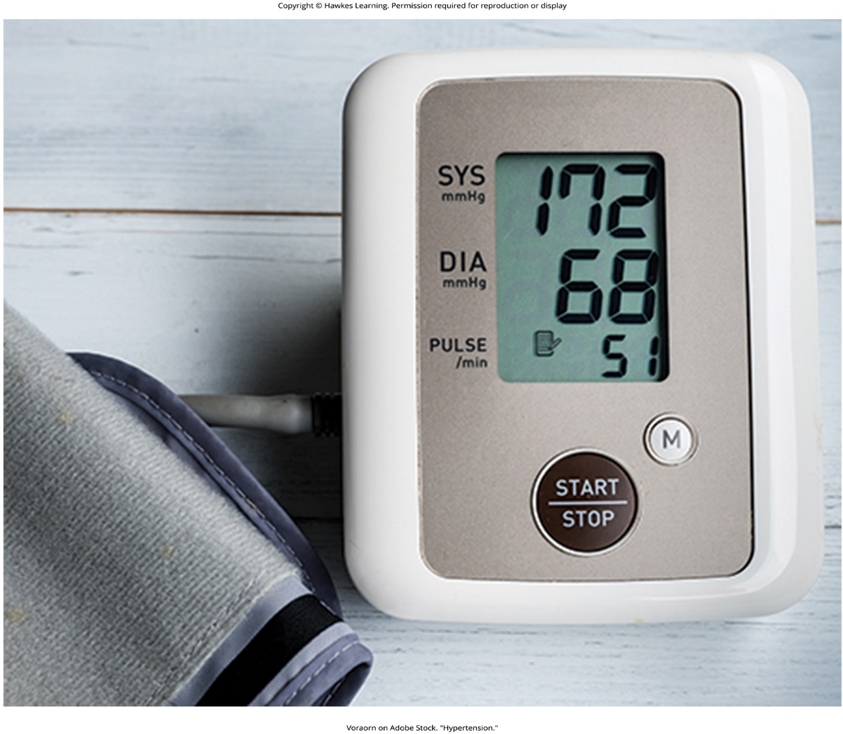
Lesson 14.3 Figure 11

Slide 38
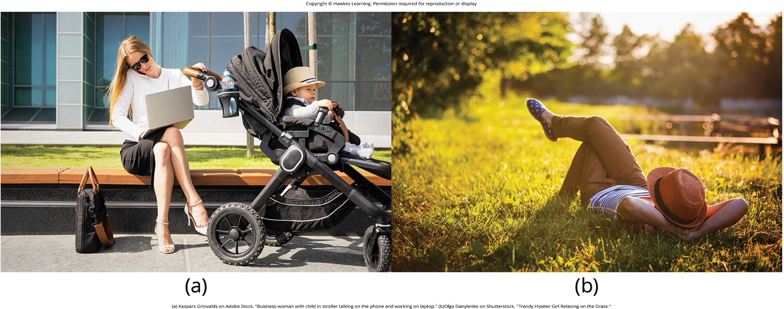
Lesson 14.3 Figure 12

Slide 39
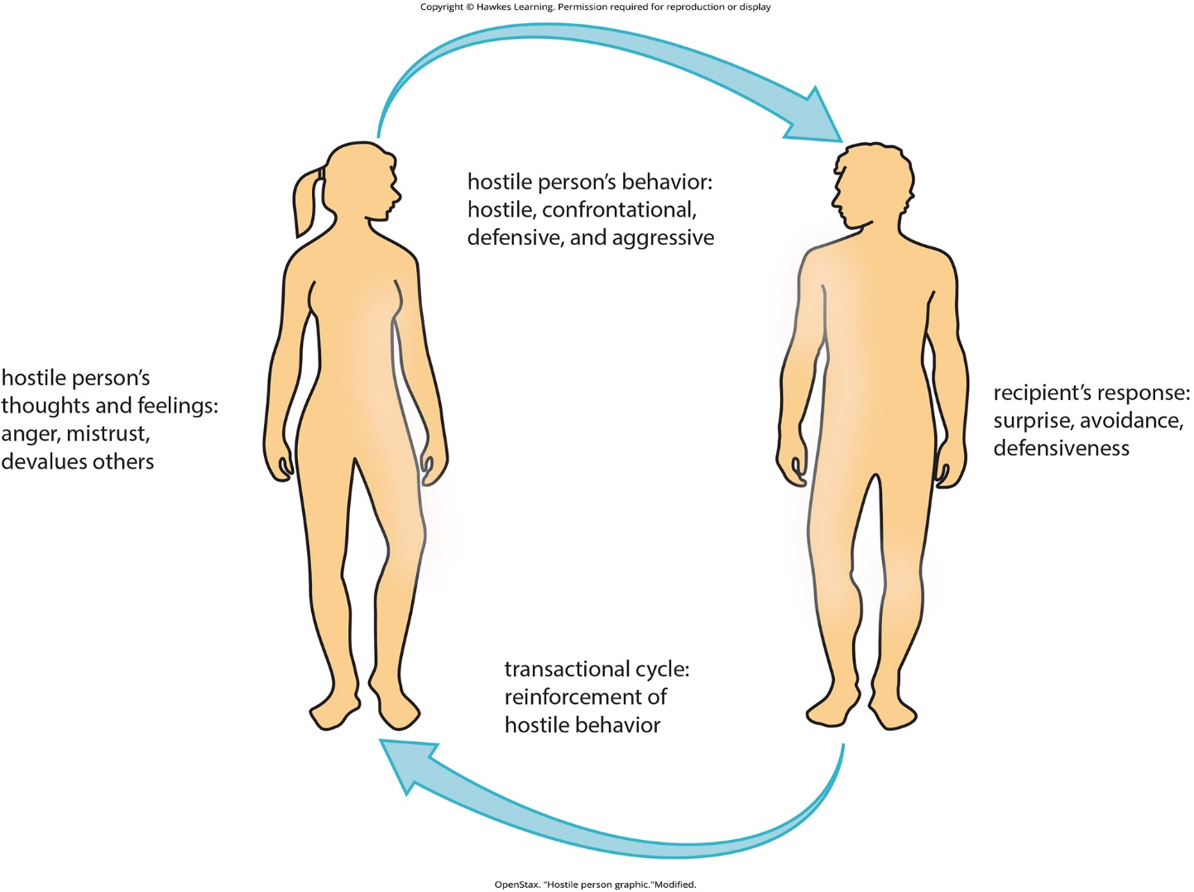
Lesson 14.3 Figure 13

Slide 40
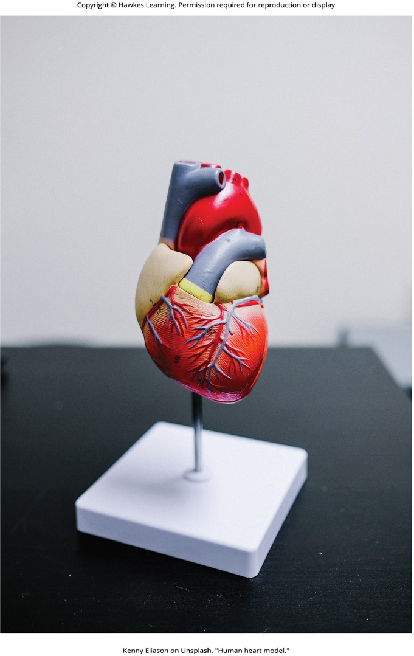
Lesson 14.3 Figure 14

Slide 41
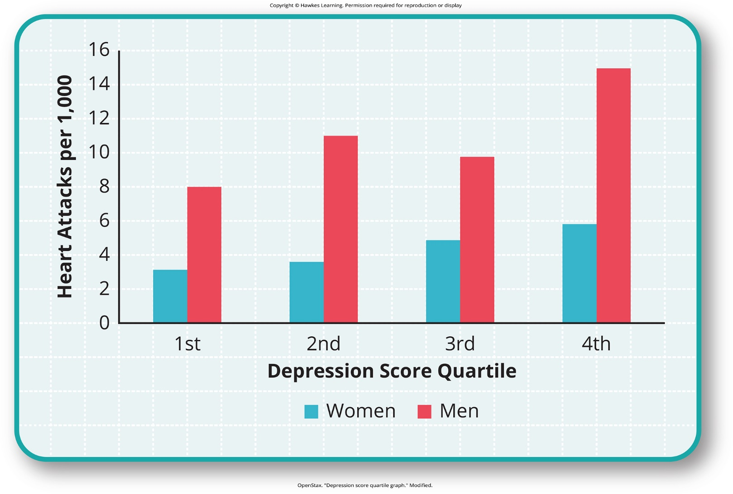
Lesson 14.3 Figure 15

Slide 42
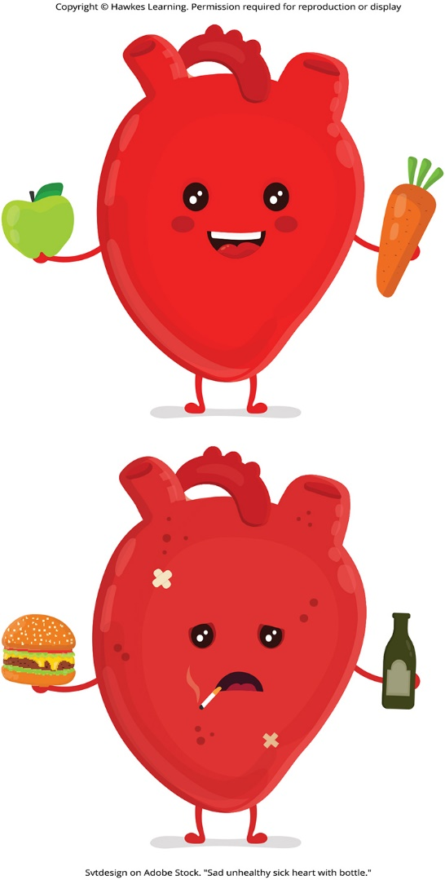
Lesson 14.3 Figure 16

Slide 43
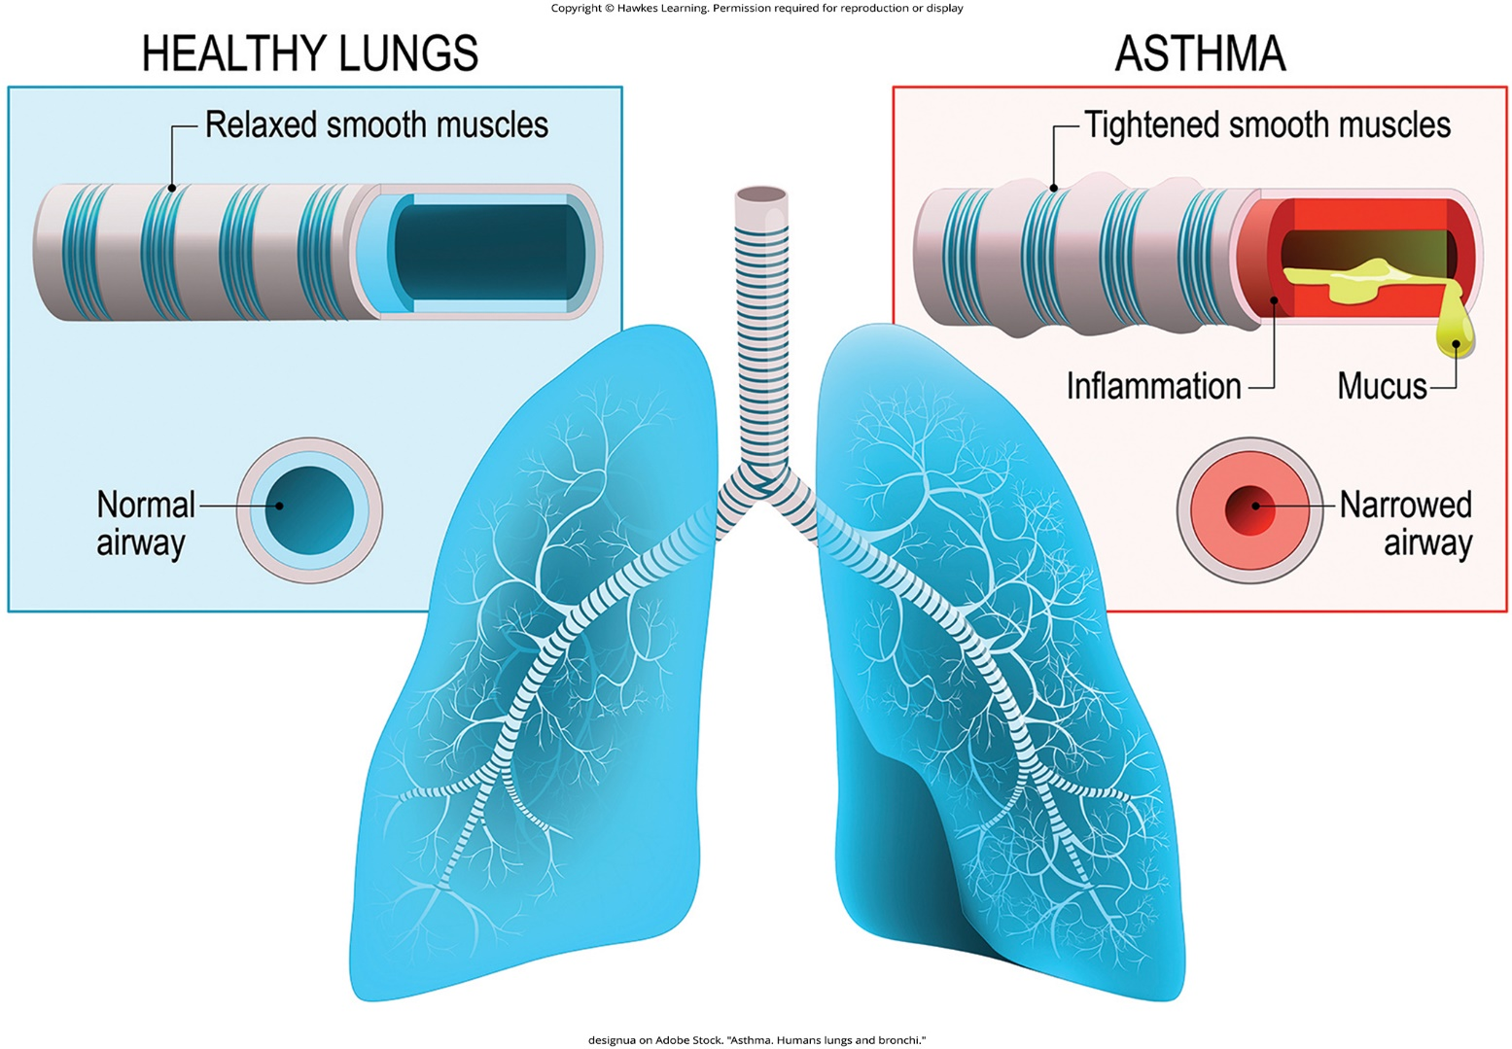
Lesson 14.3 Figure 17

Slide 44
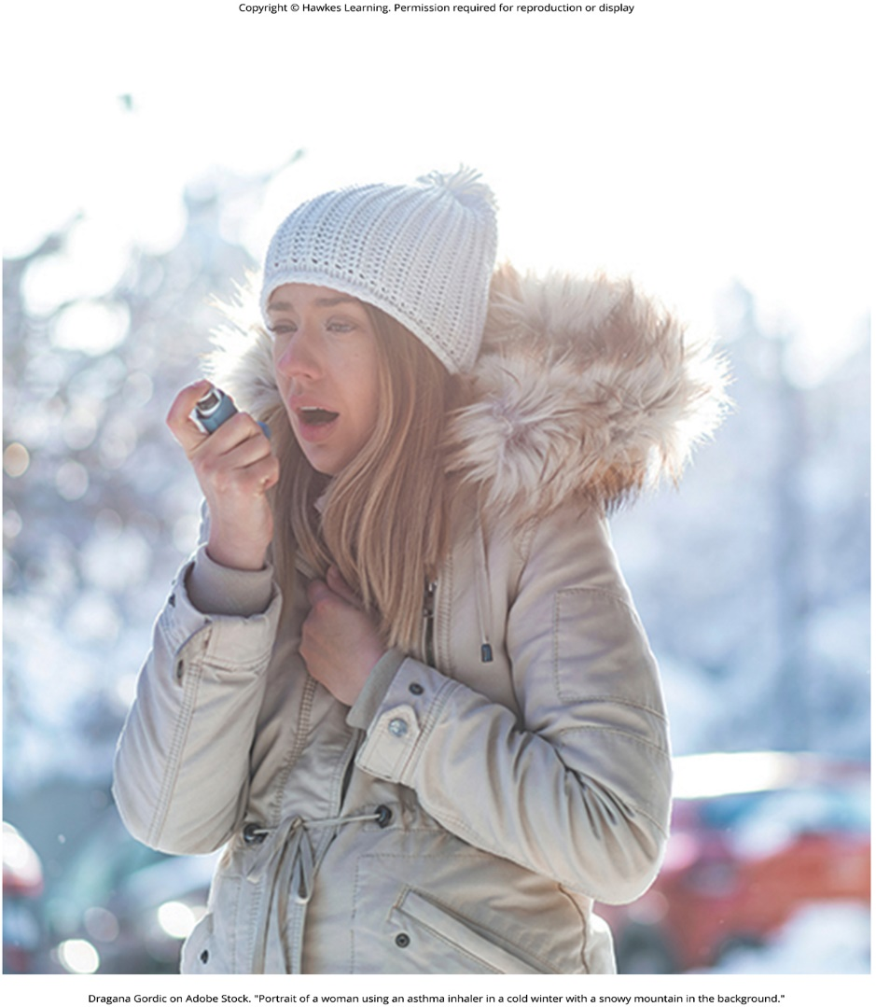
Lesson 14.3 Figure 18

Slide 45
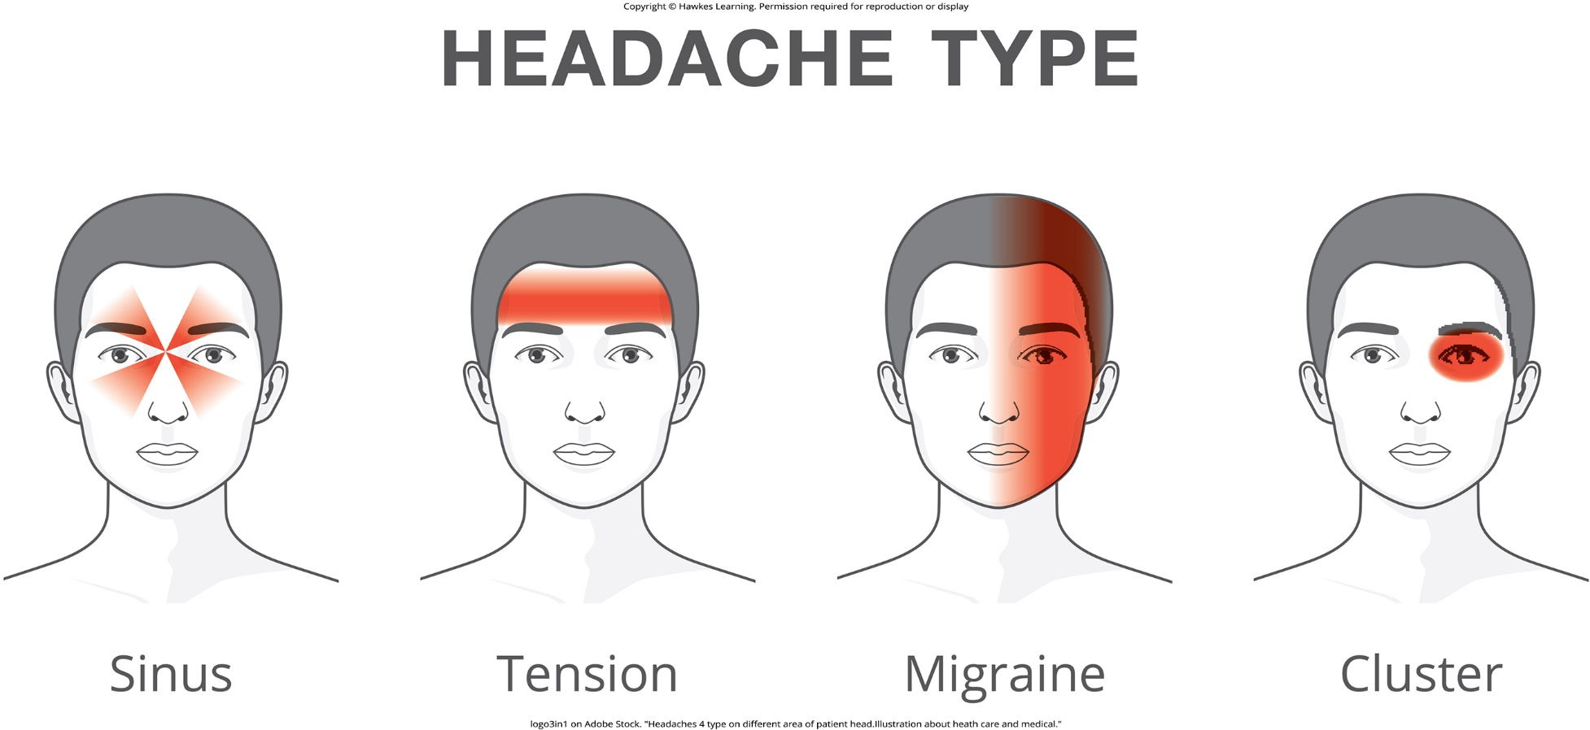
Lesson 14.3 Figure 19

Slide 46

Lesson 14.4 Figure 1

Slide 47
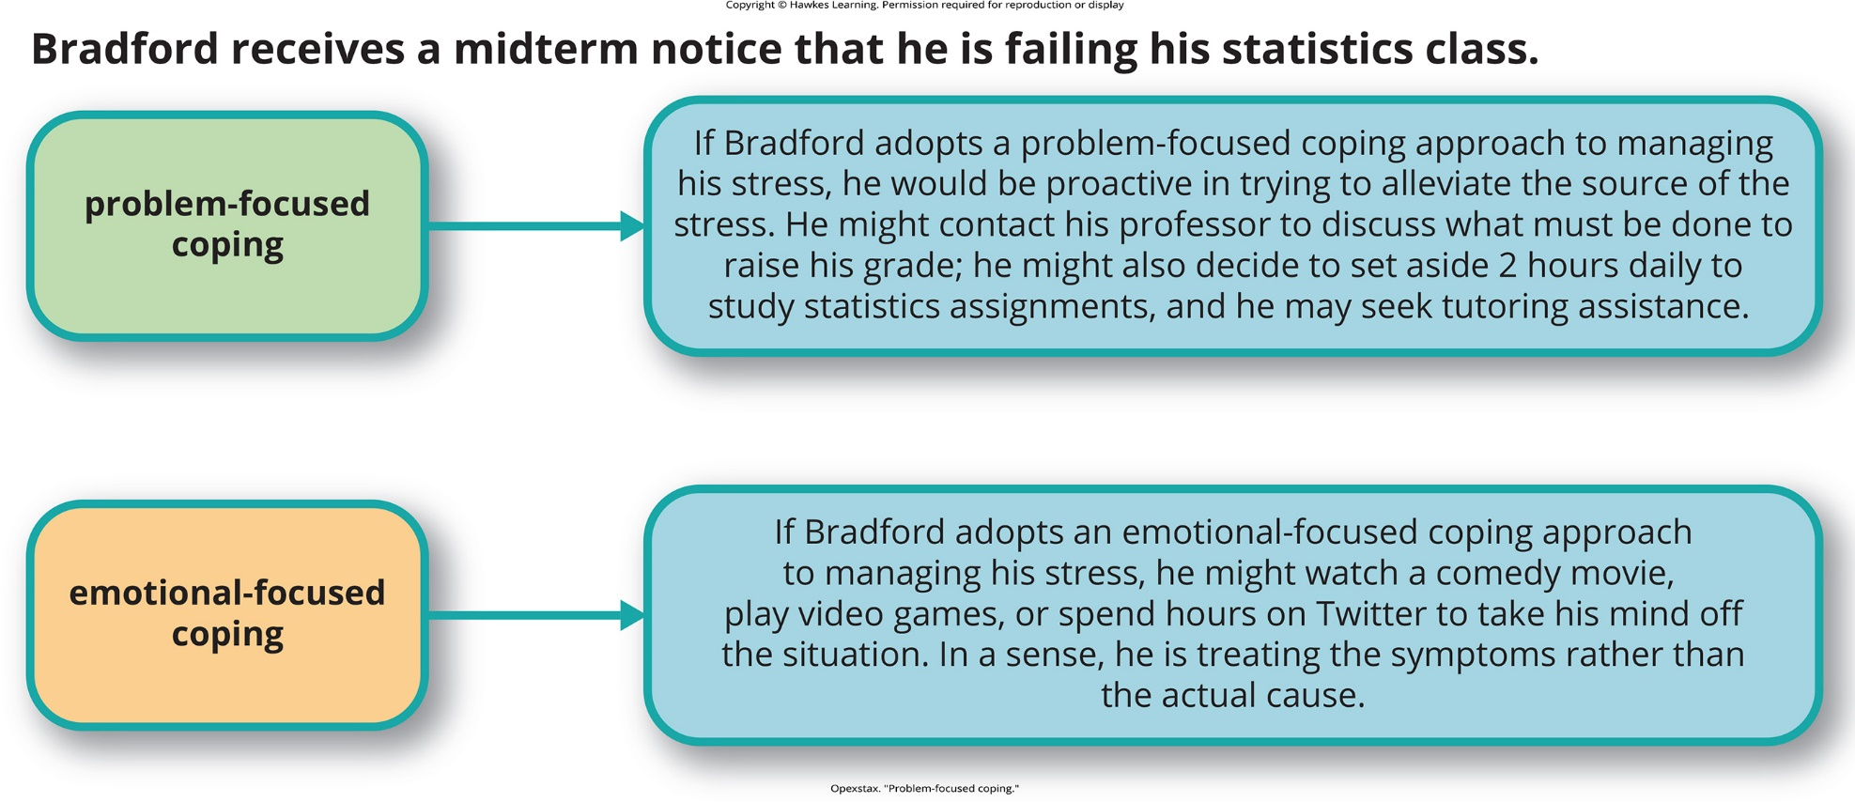
Lesson 14.4 Problem-focused coping

Slide 48

Lesson 14.4 Figure 2

Slide 49
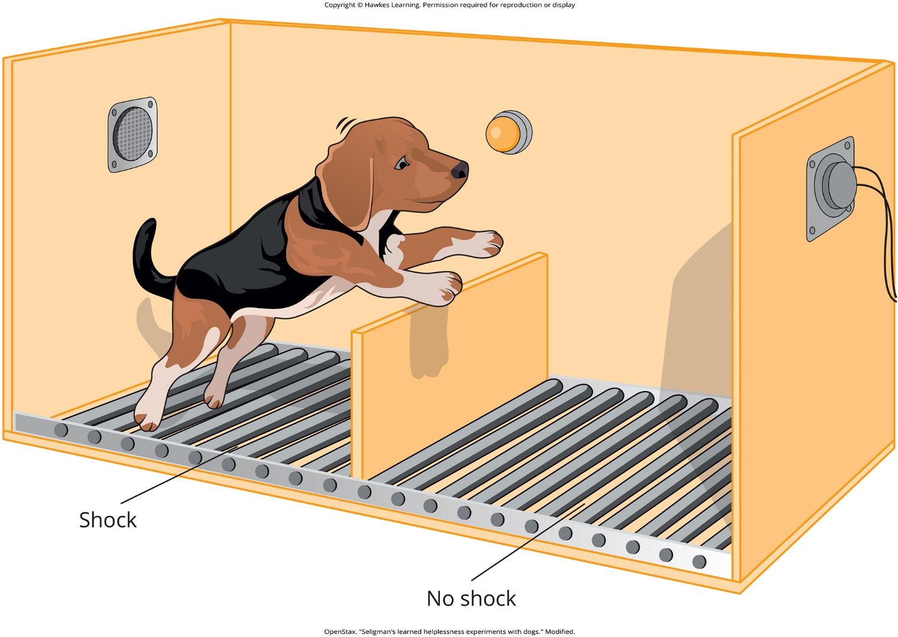
Lesson 14.4 Figure 3

Slide 50

Lesson 14.4 Figure 4

Slide 51

Lesson 14.4 Figure 5

Slide 52

Lesson 14.4 Figure 6

Slide 53

Lesson 14.4 Figure 7

Slide 54

Lesson 14.4 Figure 8

Slide 55
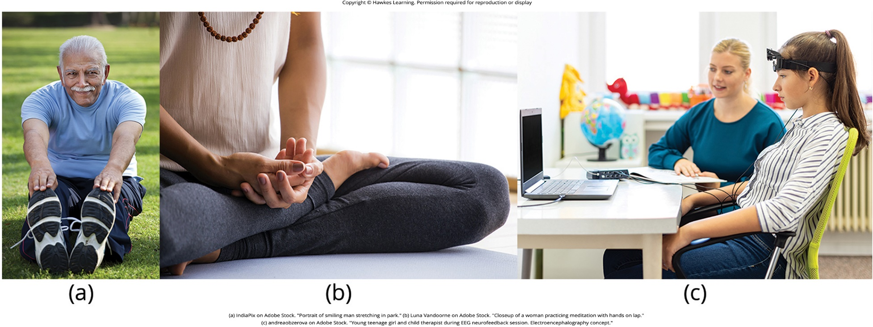
Lesson 14.4 Figure 9

Slide 56
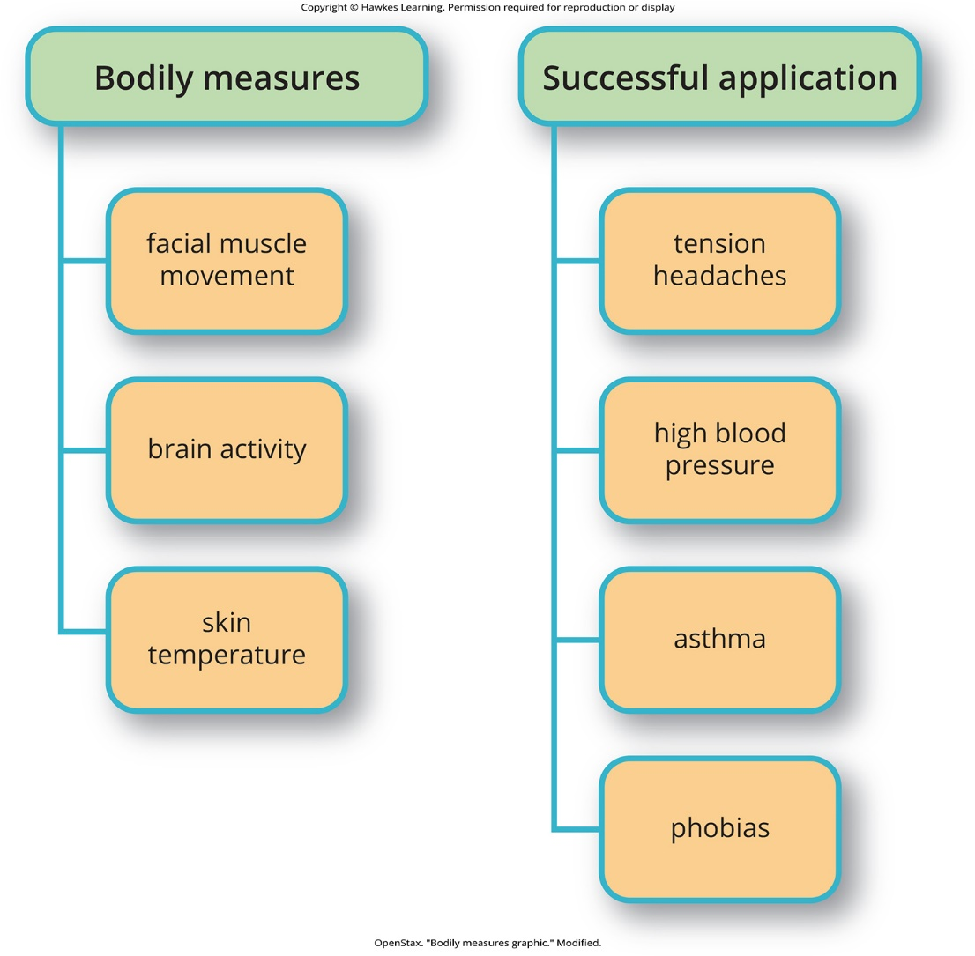
Lesson 14.4 Figure 10

Slide 57

Lesson 14.5 Figure 1

Slide 58
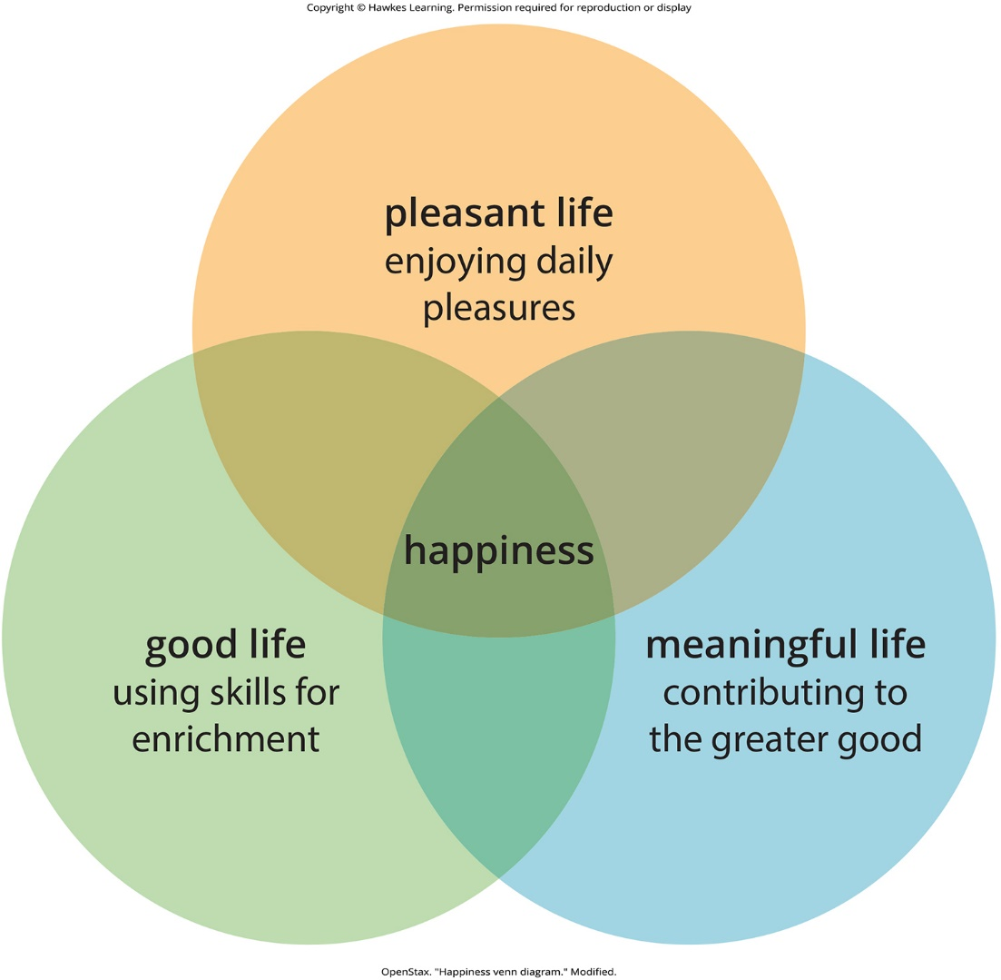
Lesson 14.5 Figure 2

Slide 59
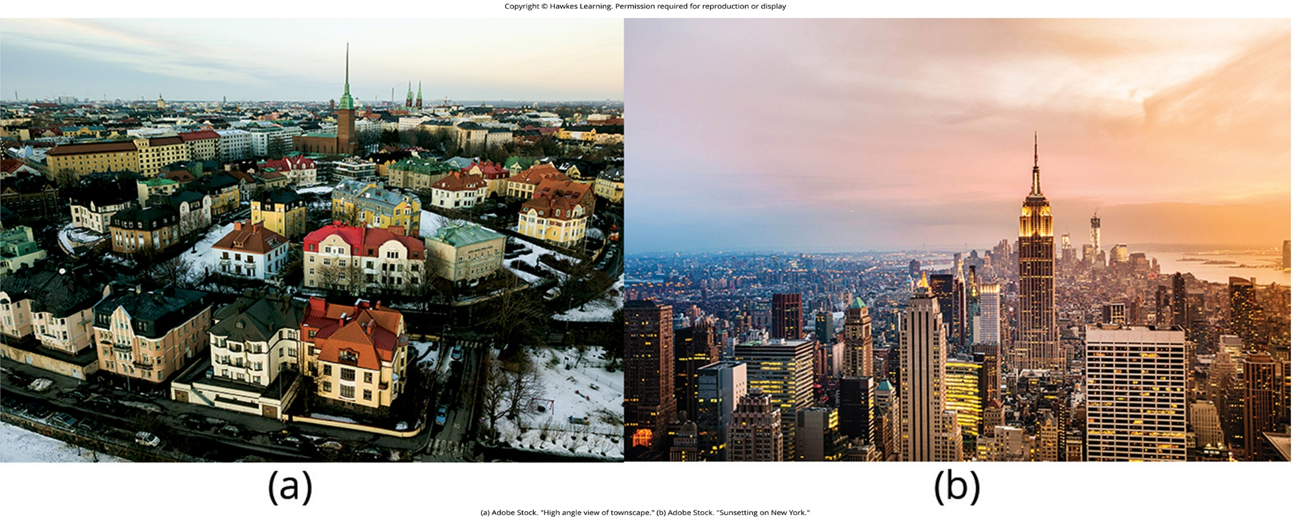
Lesson 14.5 Figure 3

Slide 60
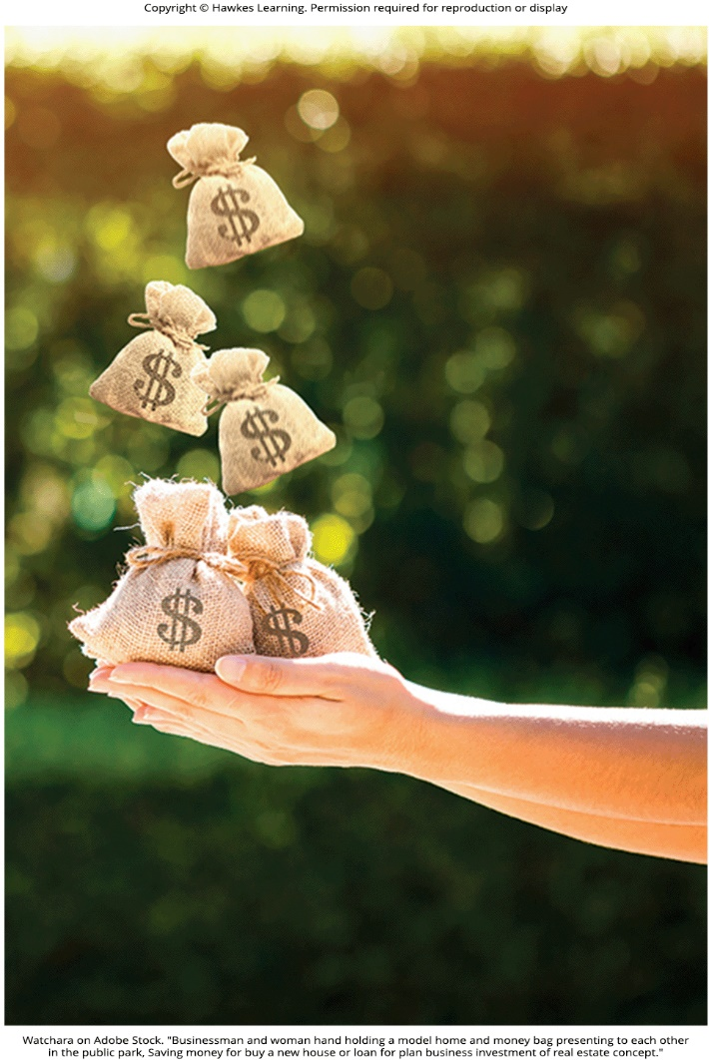
Lesson 14.5 Figure 4

Slide 61

Lesson 14.5 Figure 5

Slide 62
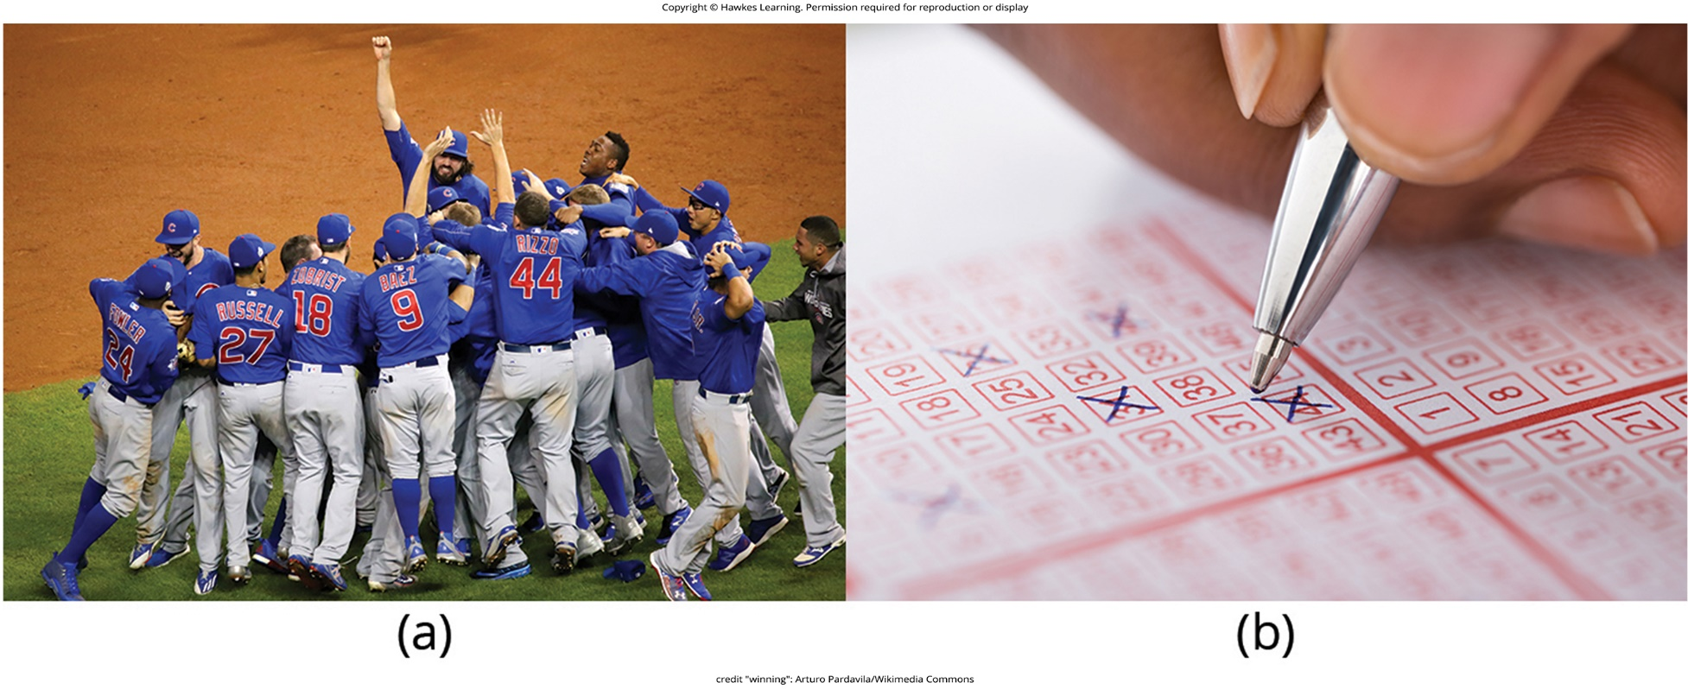
Lesson 14.5 Figure 6

Slide 63
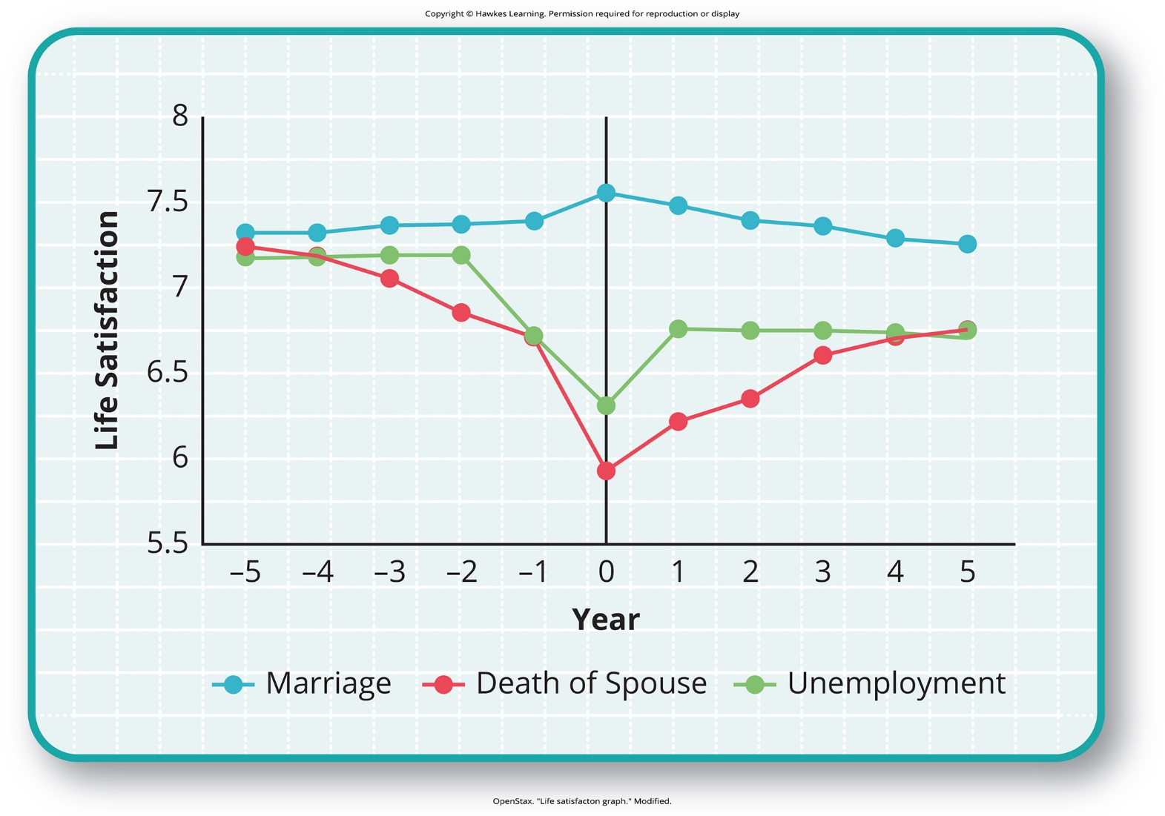
Lesson 14.5 Figure 7

Slide 64

Lesson 14.5 Figure 8

Slide 65

Lesson 14.5 Figure 9

Slide 66

Lesson 14.5 Figure 10

Slide 67
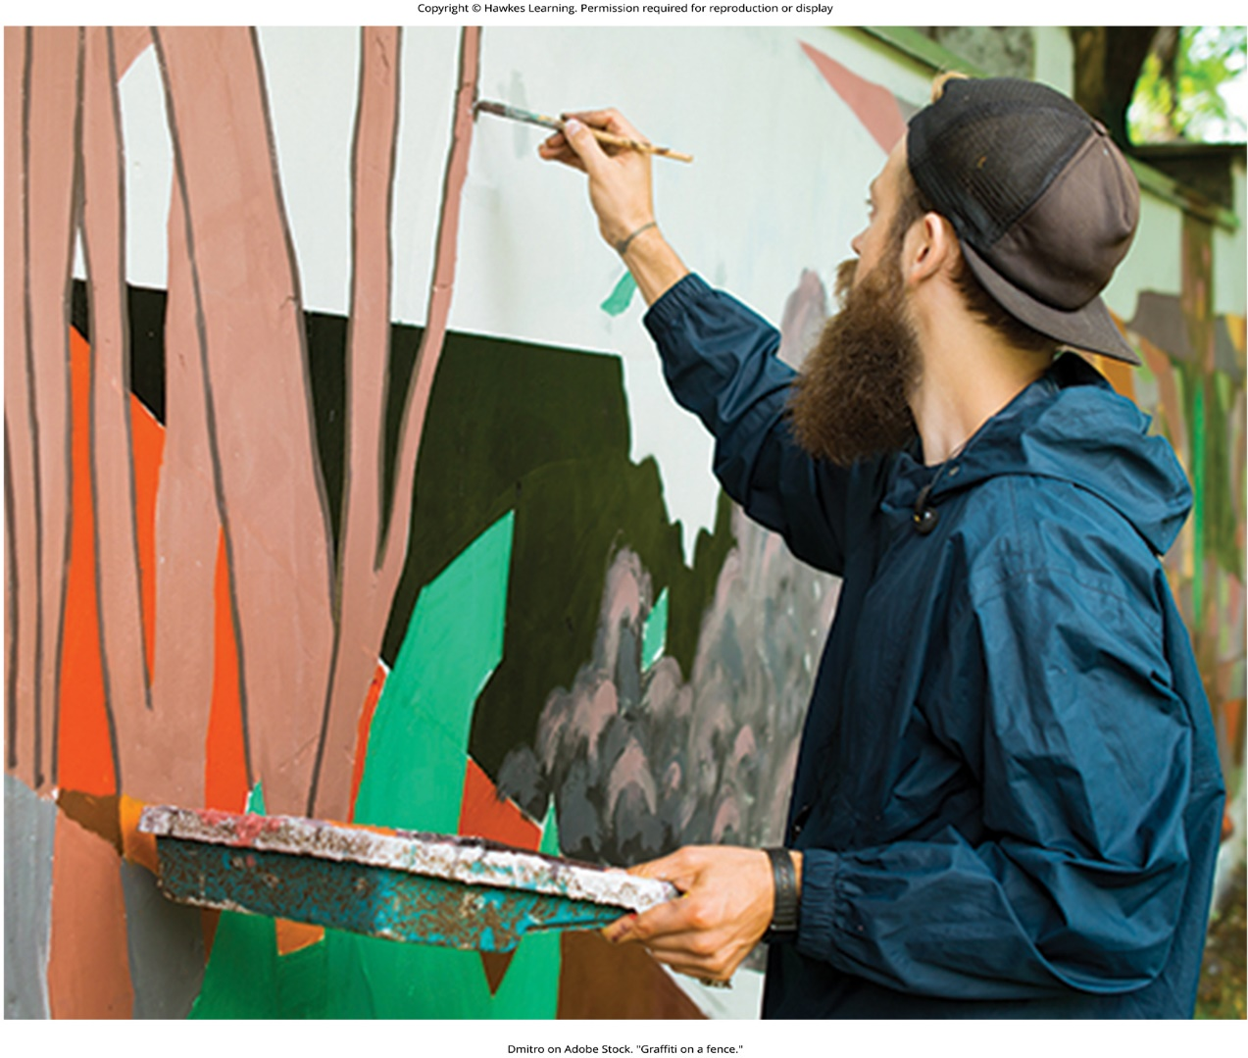
Lesson 14.5 Figure 11

Slide 68
Hawkes Learning – End of PowerPoint

