Slide 1
Chapter 15
Psychological Disorders

Slide 2
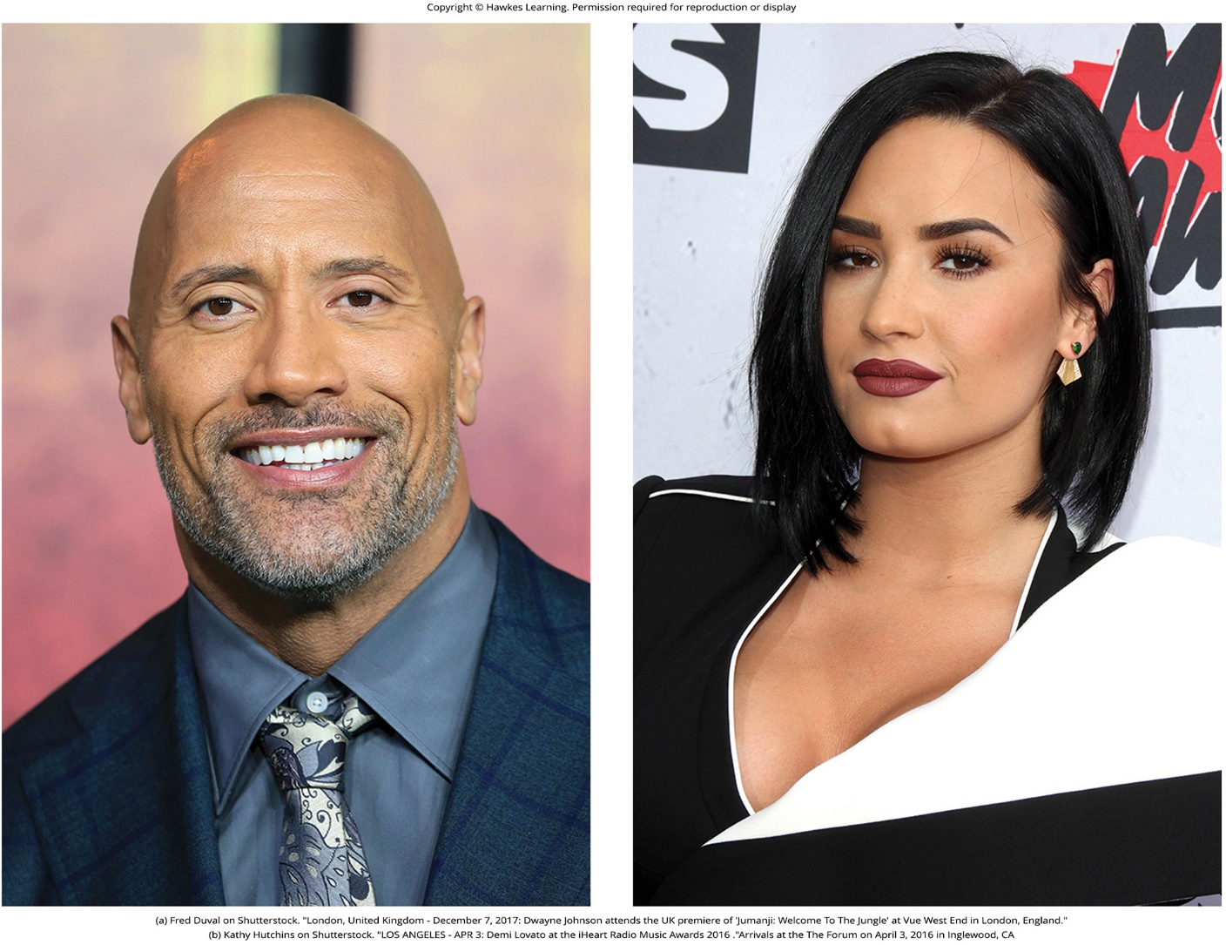
Lesson 15.1 Figure 1

Slide 3
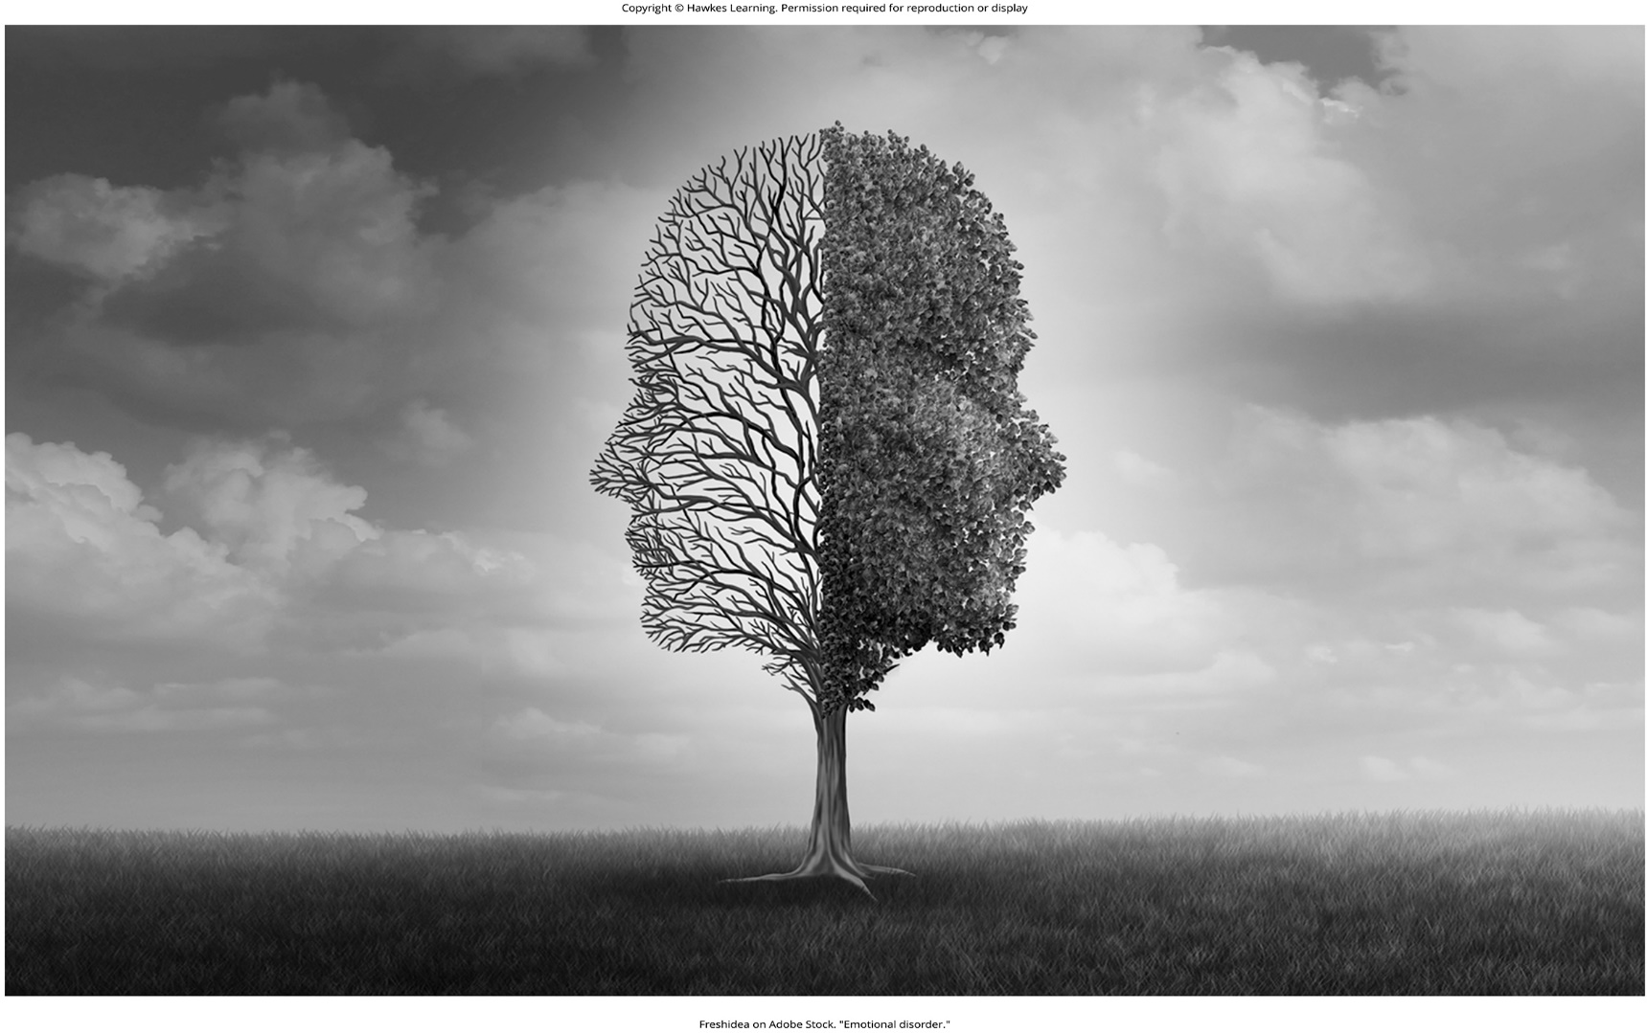
Lesson 15.1 Figure 2

Slide 4

Lesson 15.1 Figure 3

Slide 5

Lesson 15.1 Figure 4

Slide 6
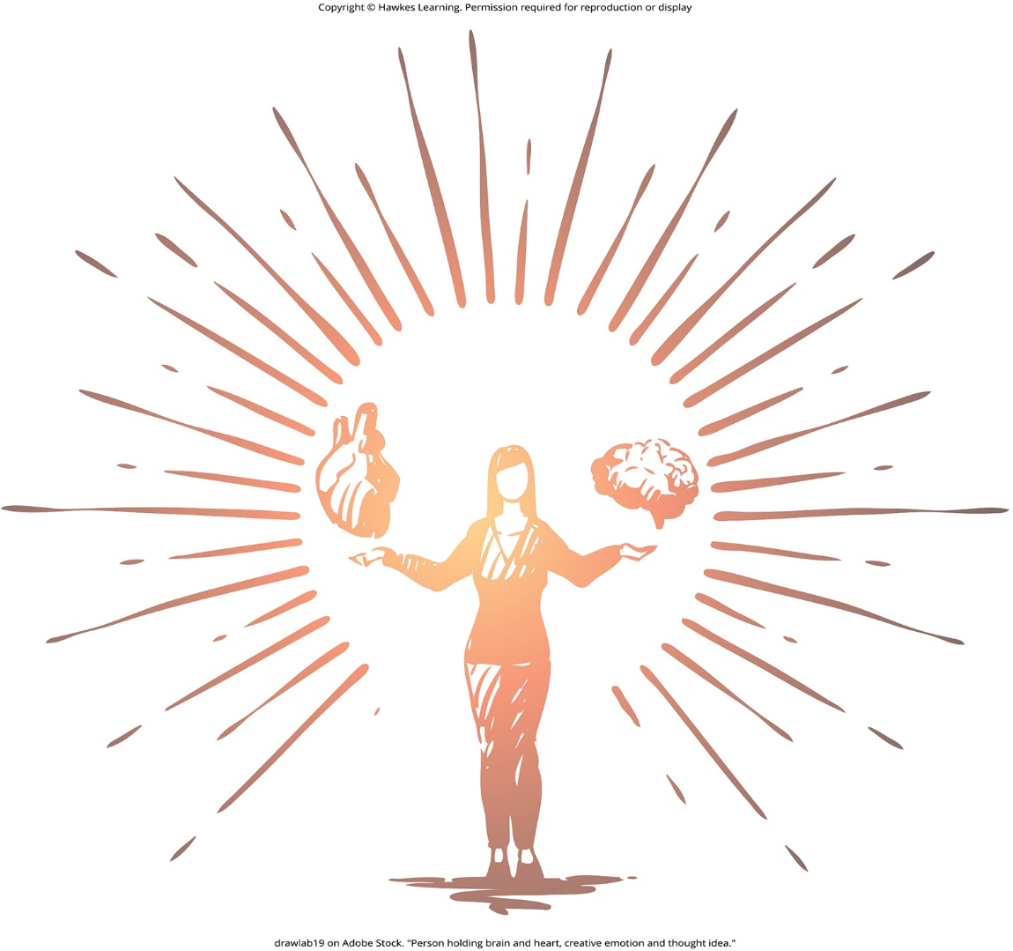
Lesson 15.1 Figure 5

Slide 7
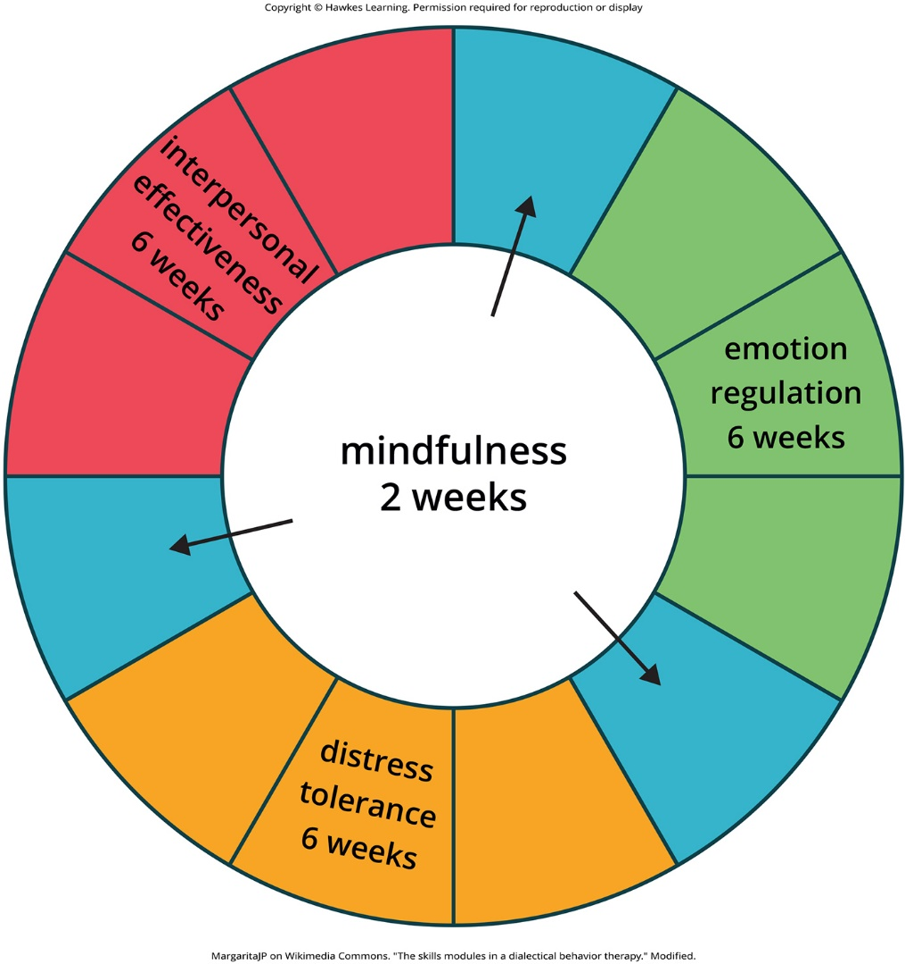
Lesson 15.1 Figure 6

Slide 8
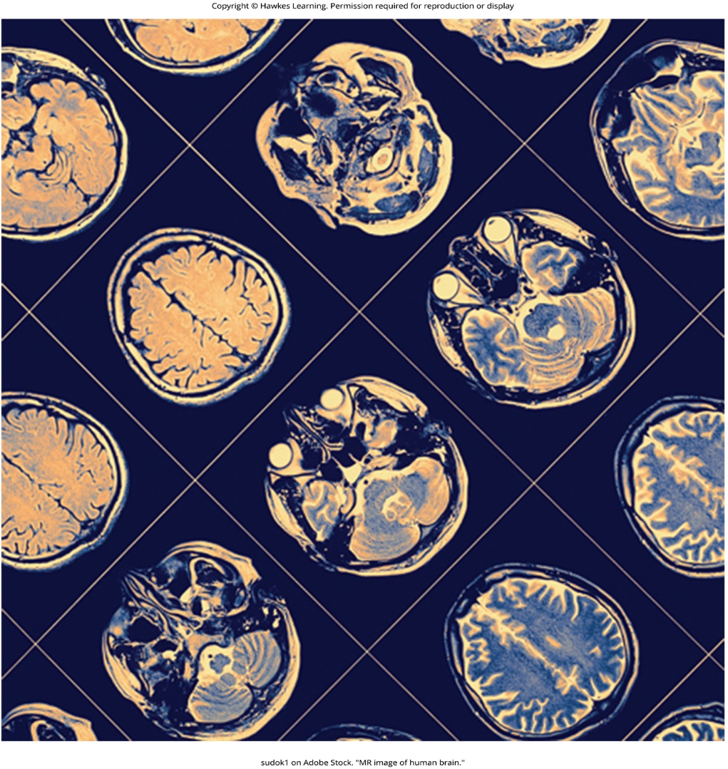
Lesson 15.1 Figure 7

Slide 9
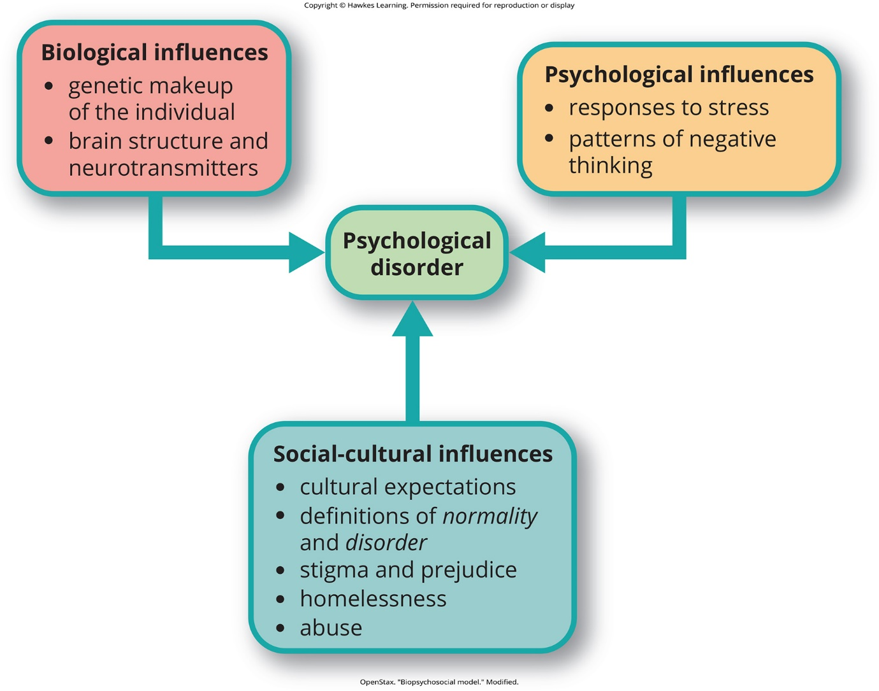
Lesson 15.1 Figure 8

Slide 10
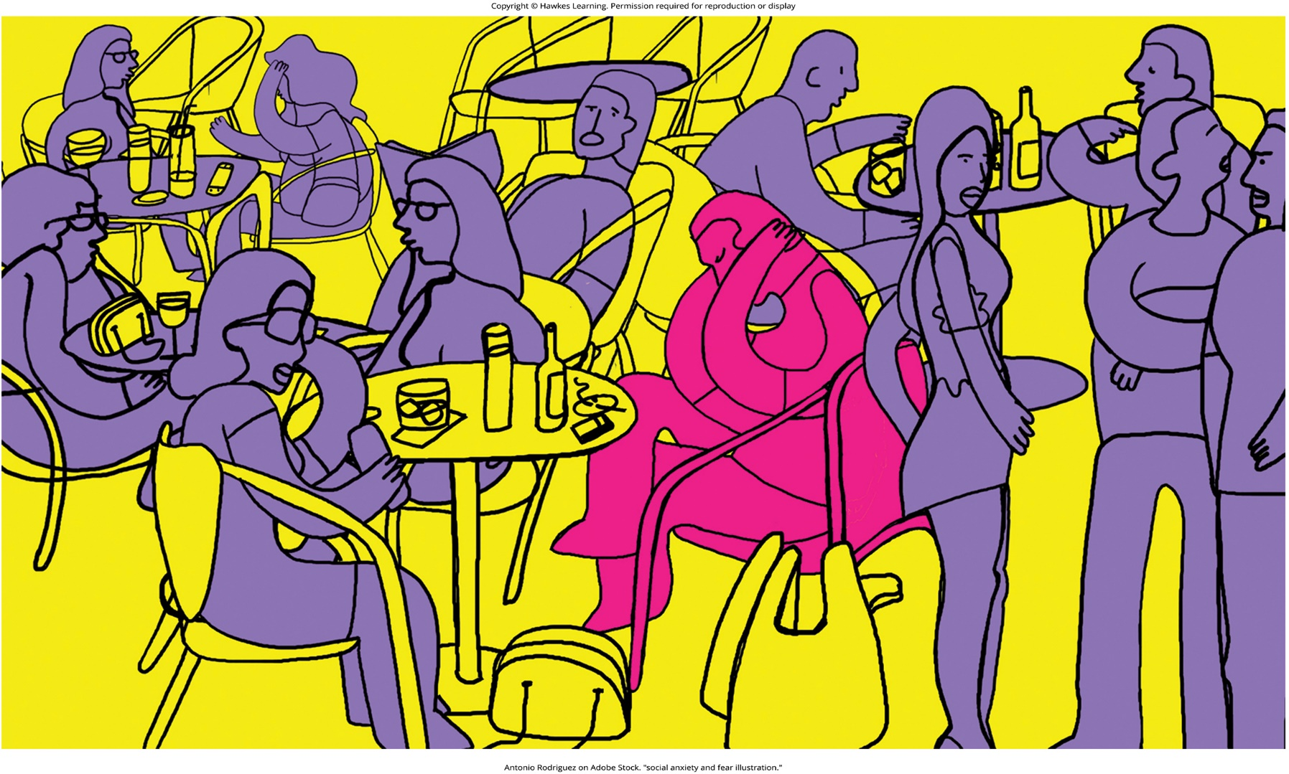
Lesson 15.1 Figure 9

Slide 11
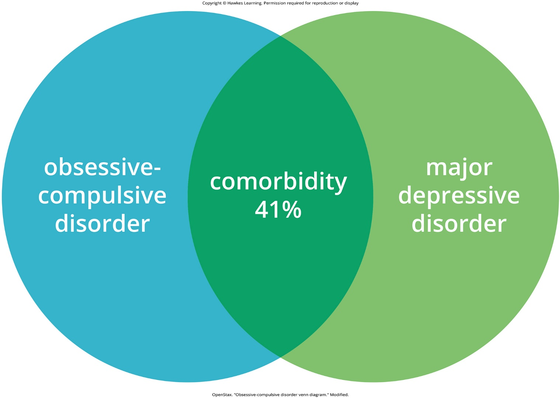
Lesson 15.2 Figure 1

Slide 12

Lesson 15.2 Figure 2

Slide 13

Lesson 15.2 Figure 3

Slide 14
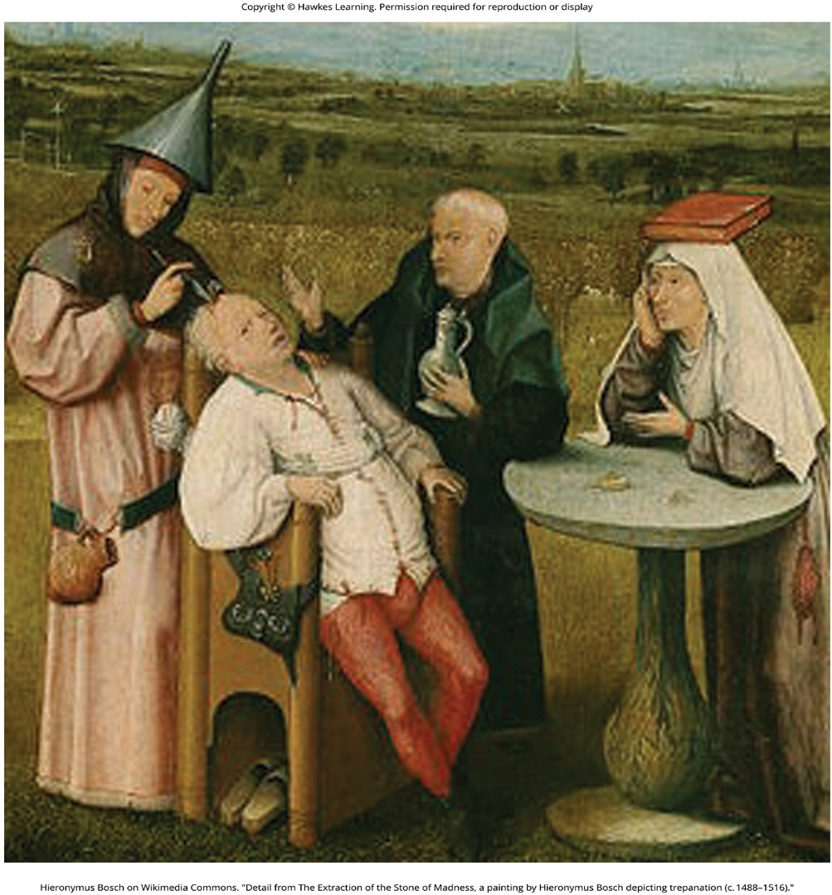
Lesson 15.3 Figure 1

Slide 15
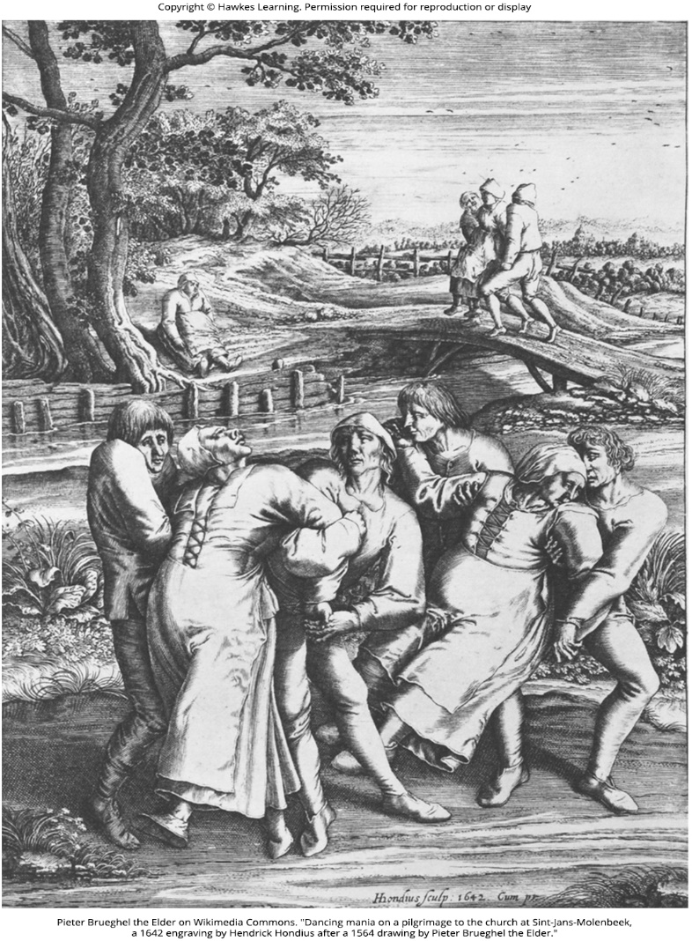
Lesson 15.3 Figure 2

Slide 16
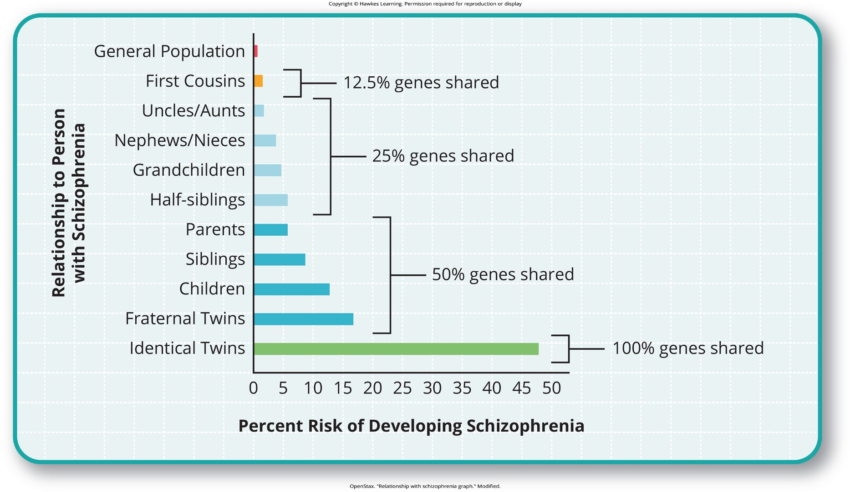
Lesson 15.3 Figure 3

Slide 17
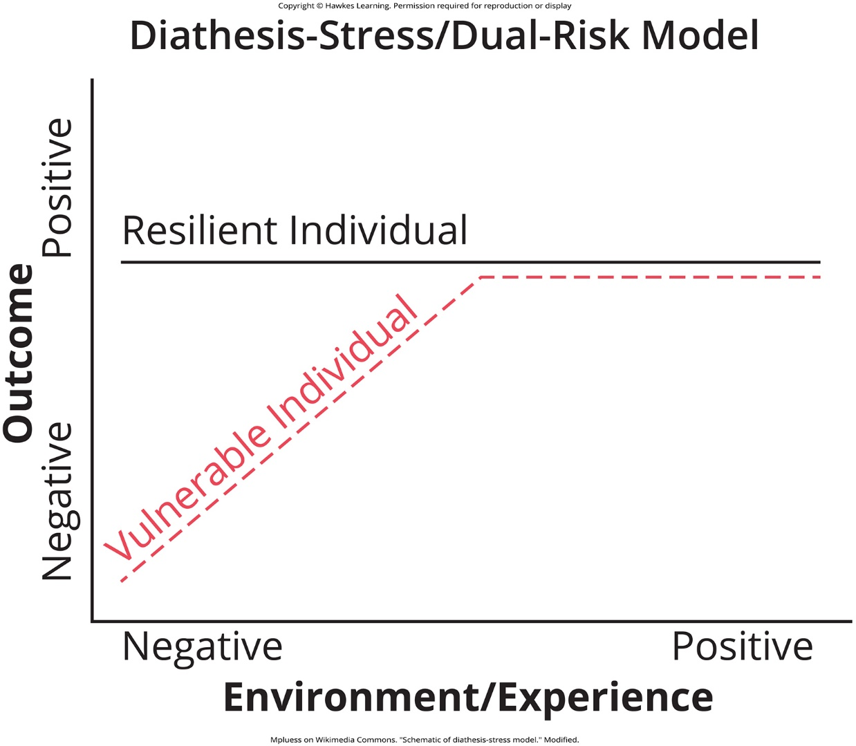
Lesson 15.3 Figure 4

Slide 18
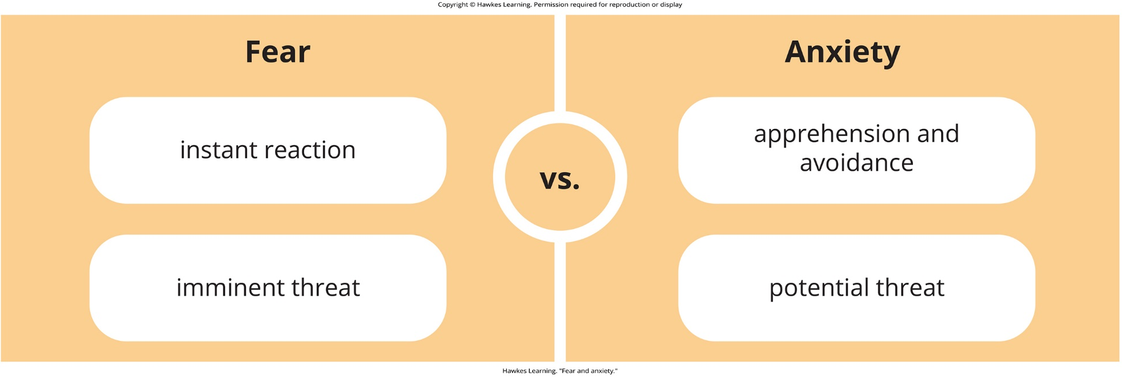
Lesson 15.4 Figure 1

Slide 19
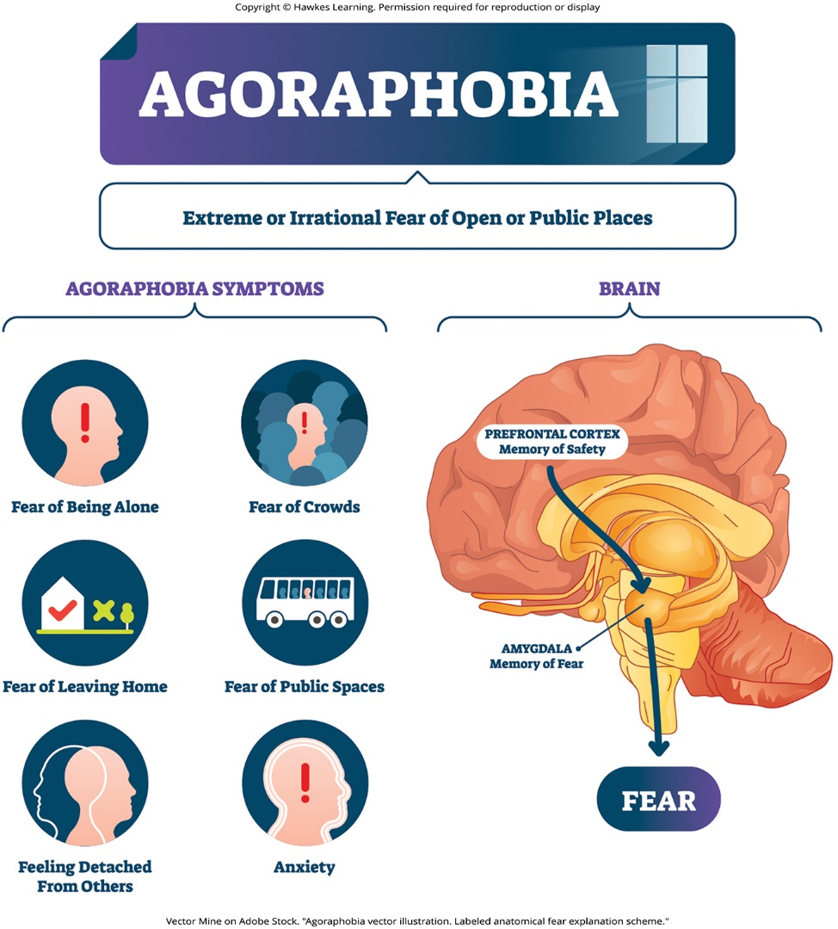
Lesson 15.4 Figure 2

Slide 20
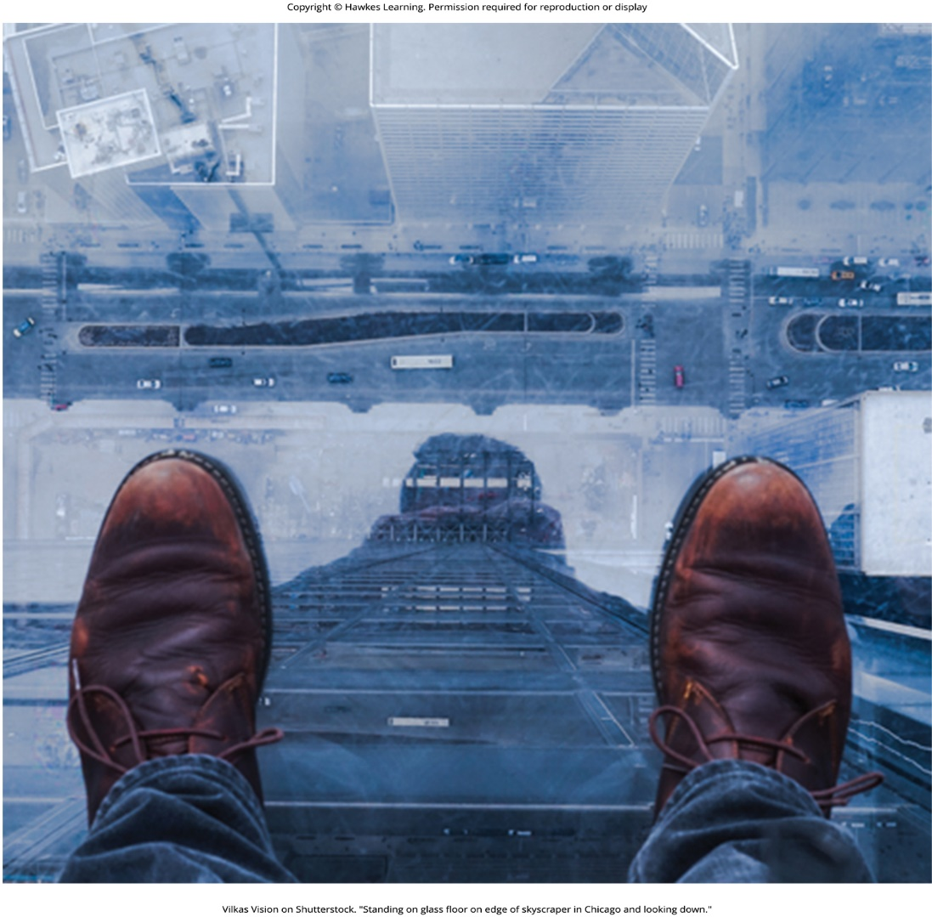
Lesson 15.4 Figure 3

Slide 21
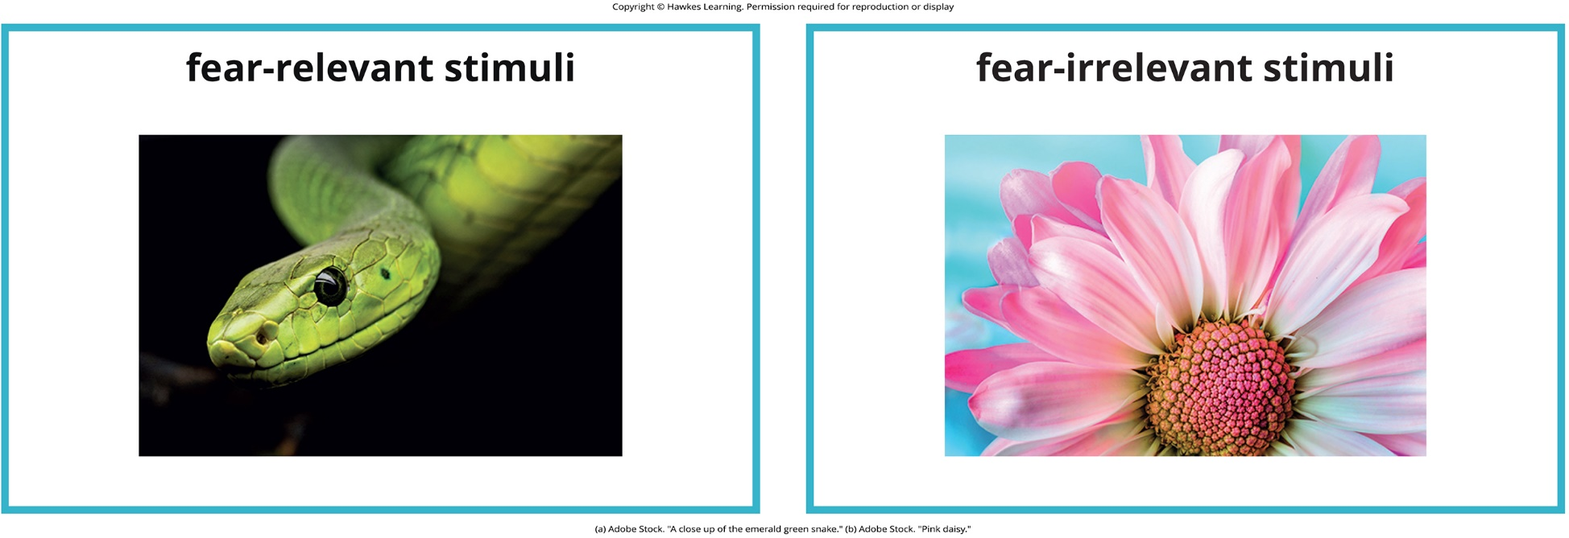
Lesson 15.4 Figure 4

Slide 22
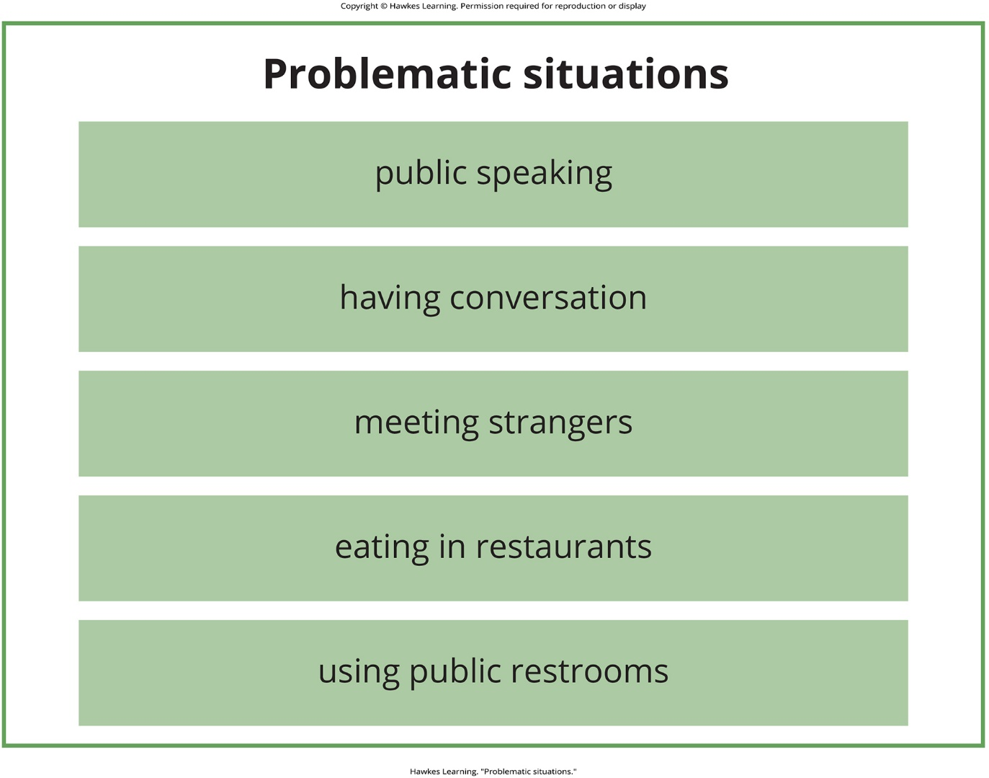
Lesson 15.4 Figure 5

Slide 23
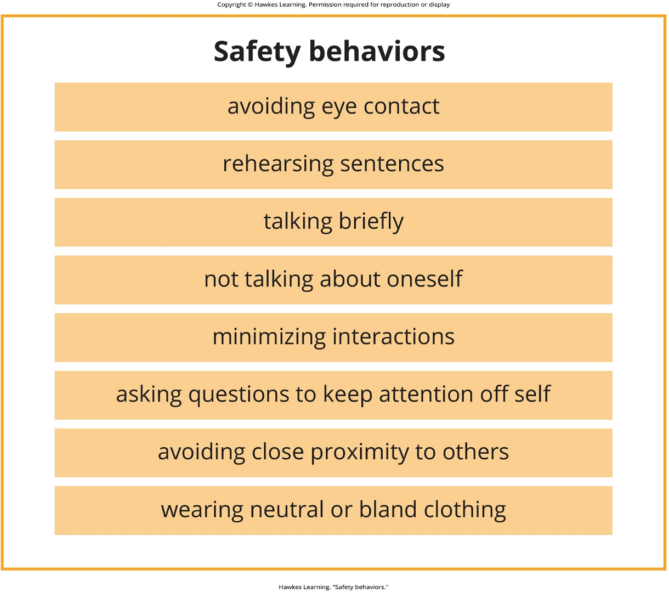
Lesson 15.4 Figure 6

Slide 24

Lesson 15.4 Figure 7

Slide 25
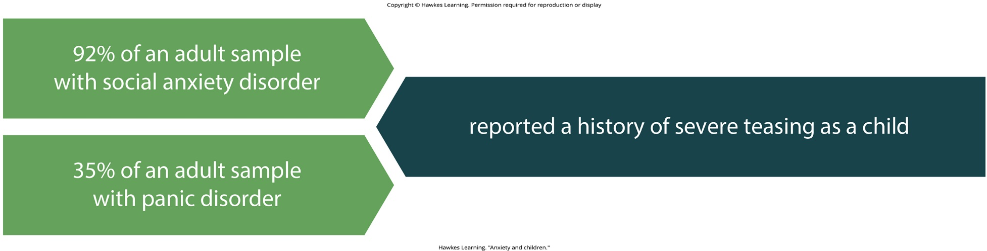
Lesson 15.4 Figure 8

Slide 26
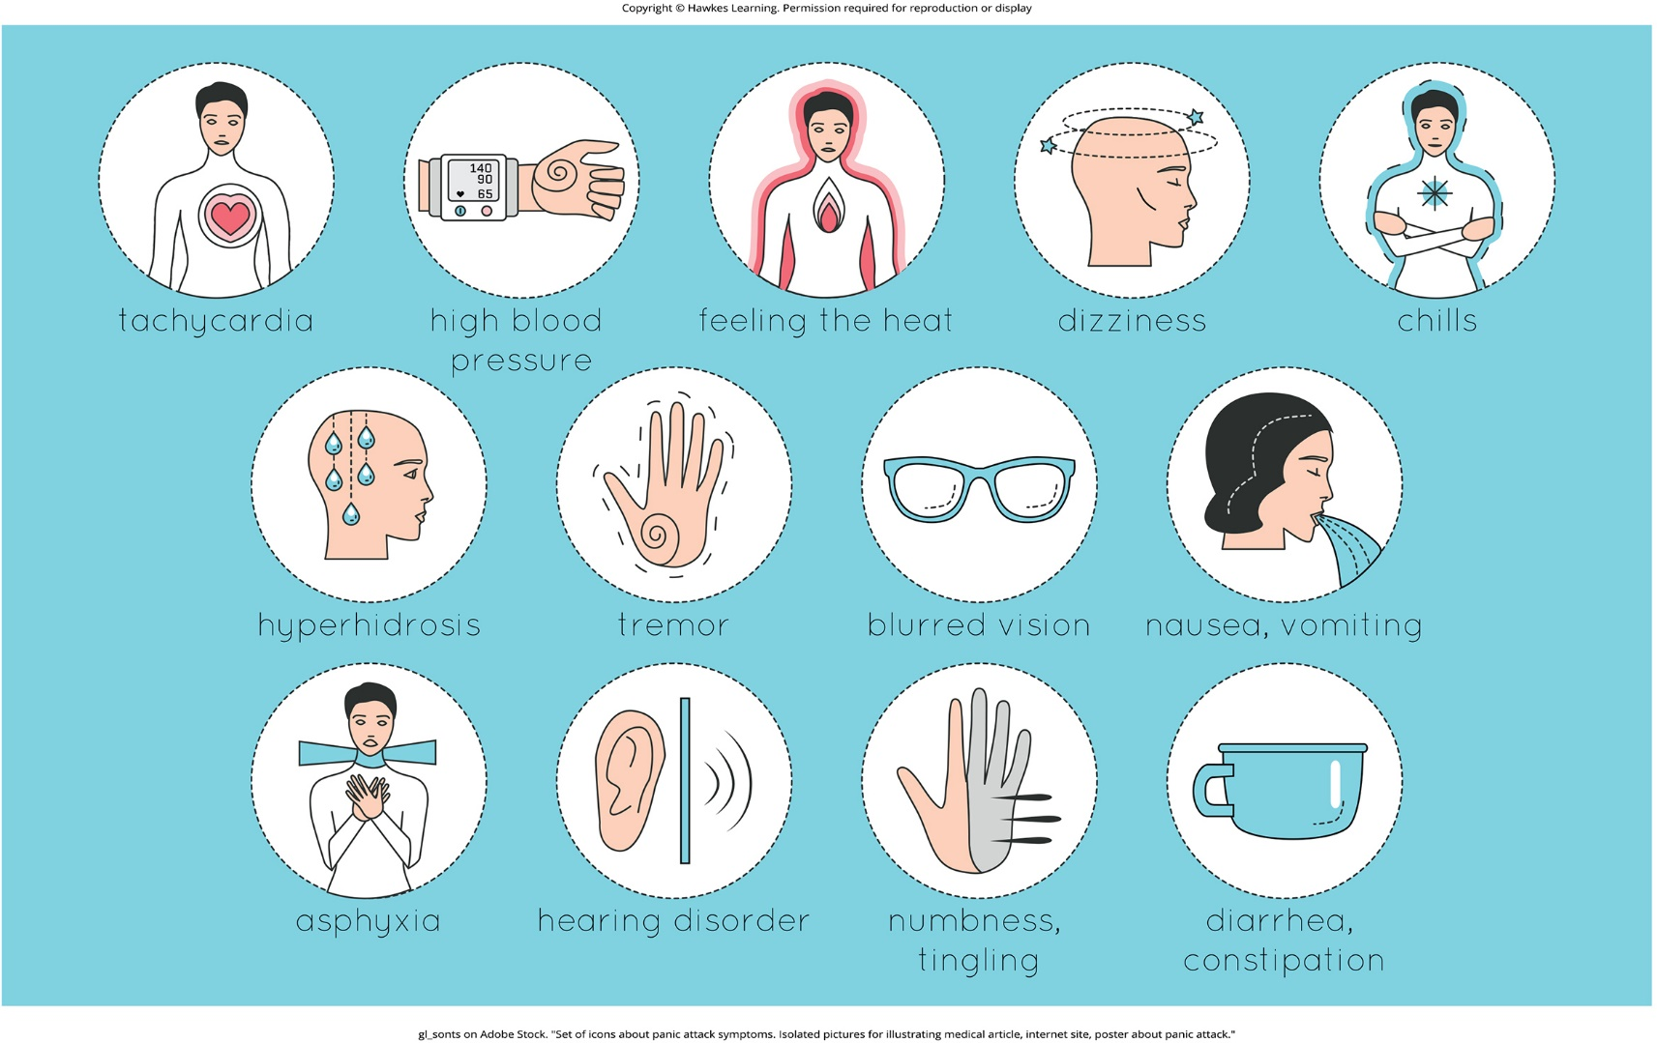
Lesson 15.4 Figure 9

Slide 27
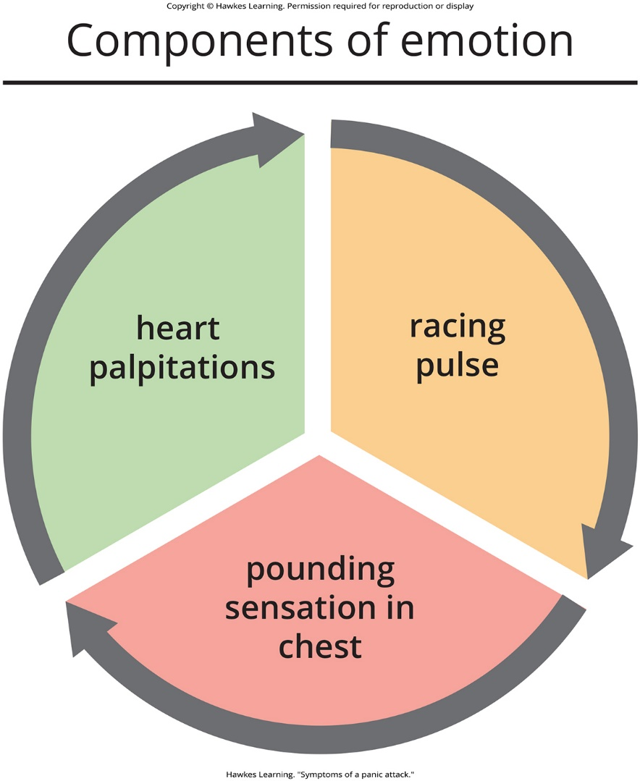
Lesson 15.4 Figure 10

Slide 28
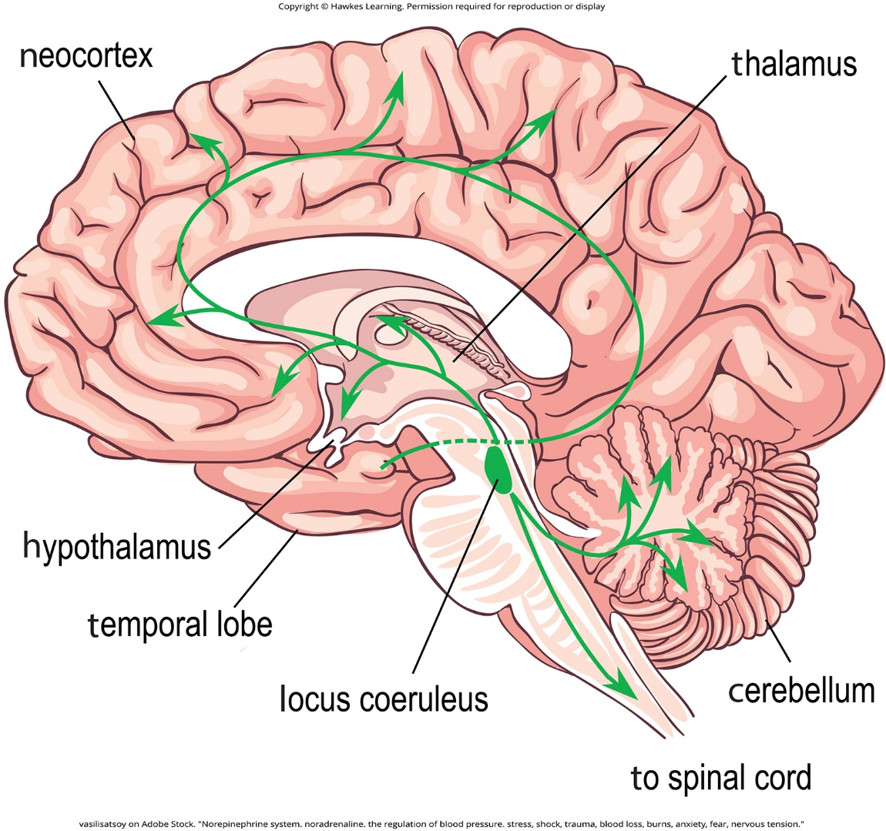
Lesson 15.4 Figure 11

Slide 29
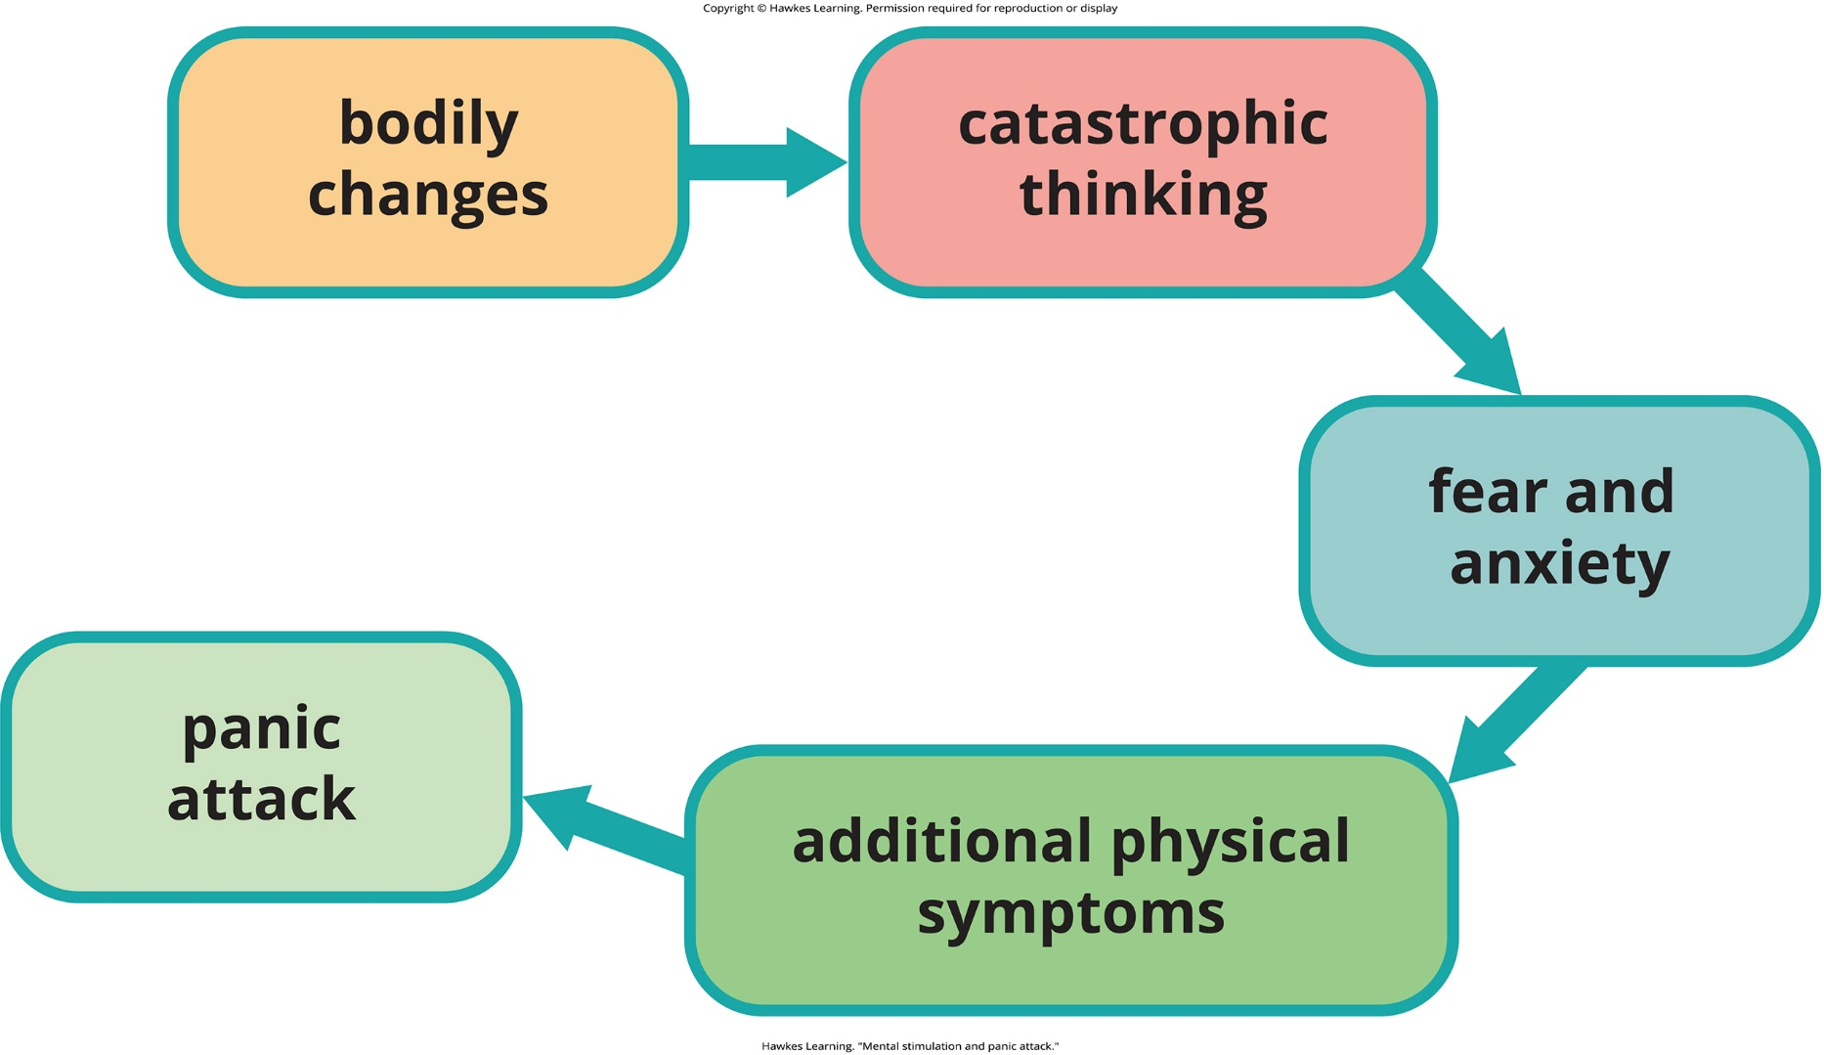
Lesson 15.4 Figure 12

Slide 30

Lesson 15.4 Figure 13

Slide 31
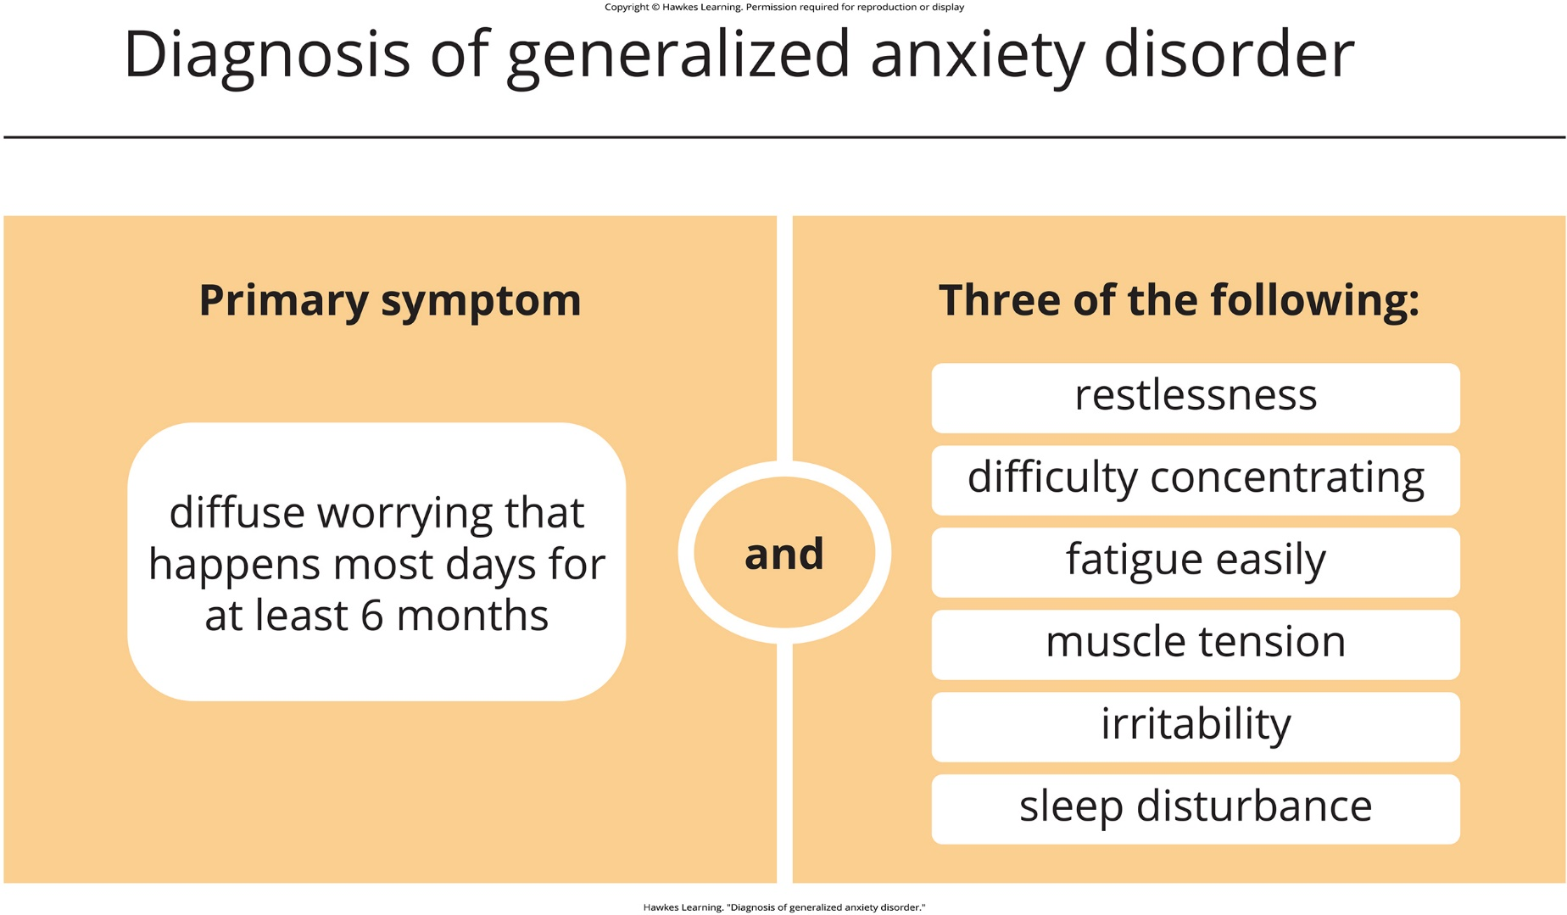
Lesson 15.4 Figure 14

Slide 32
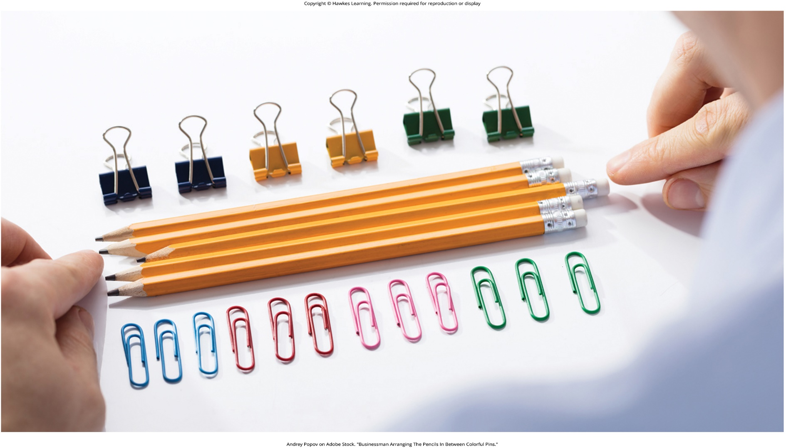
Lesson 15.4 Figure 15

Slide 33
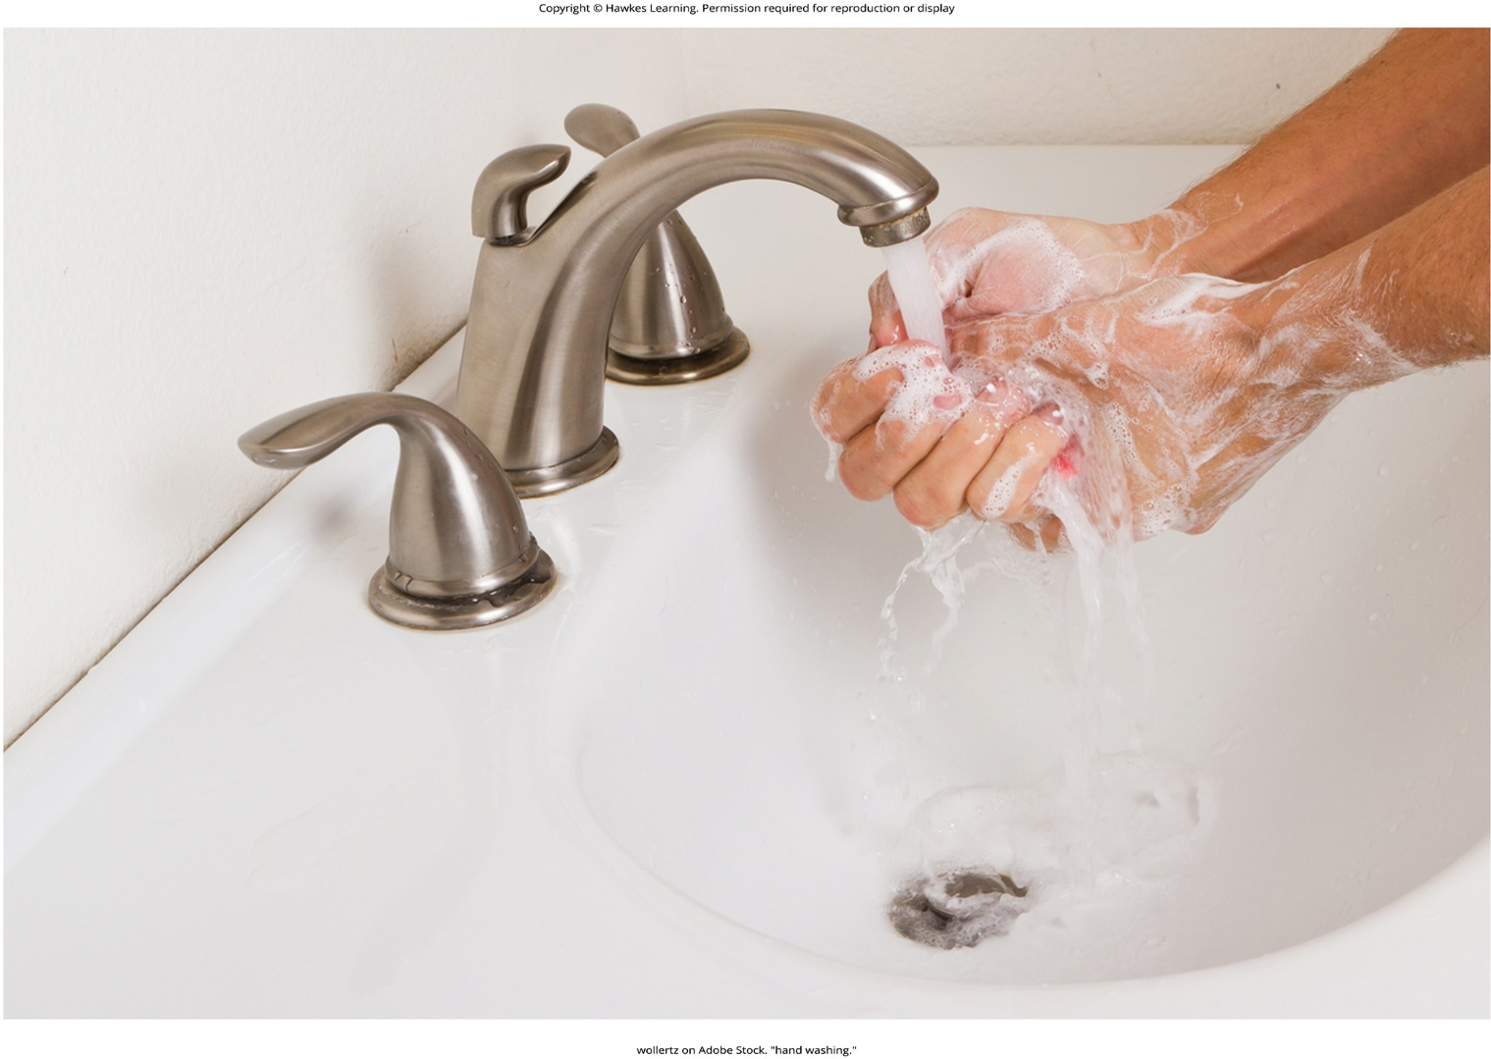
Lesson 15.4 Figure 16

Slide 34
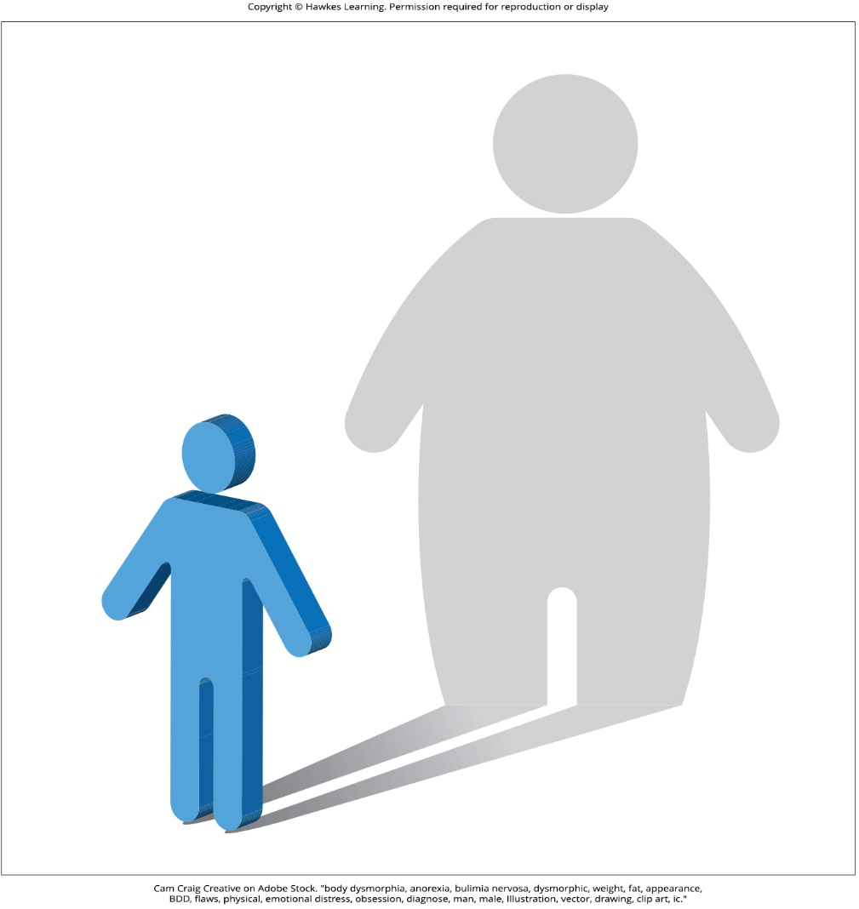
Lesson 15.4 Figure 17

Slide 35
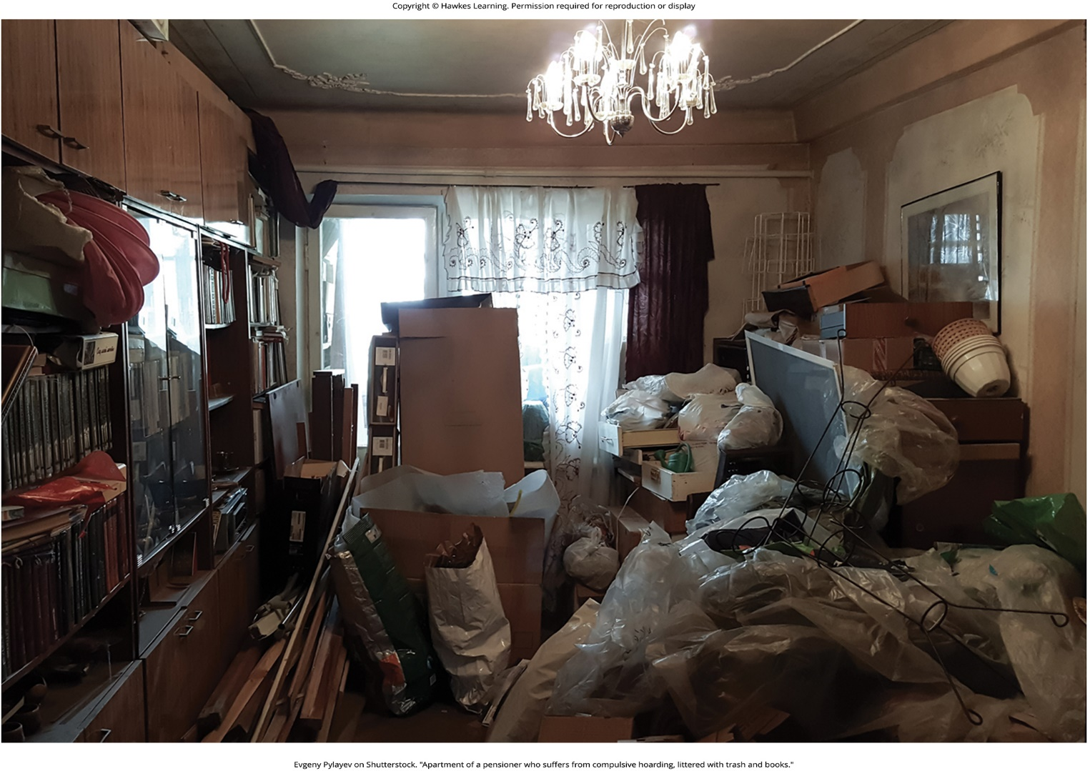
Lesson 15.4 Figure 18

Slide 36
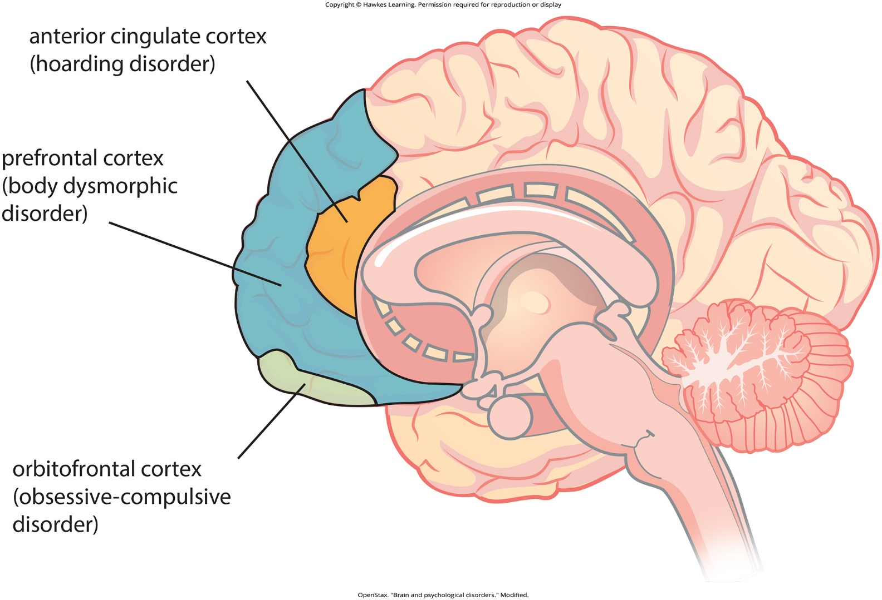
Lesson 15.4 Figure 19

Slide 37

Lesson 15.4 Figure 20

Slide 38
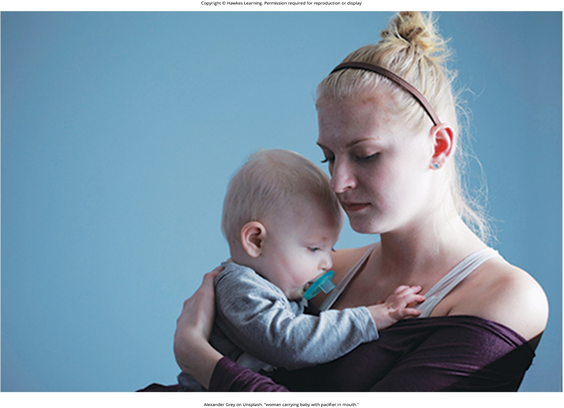
Lesson 15.4 Figure 21

Slide 39
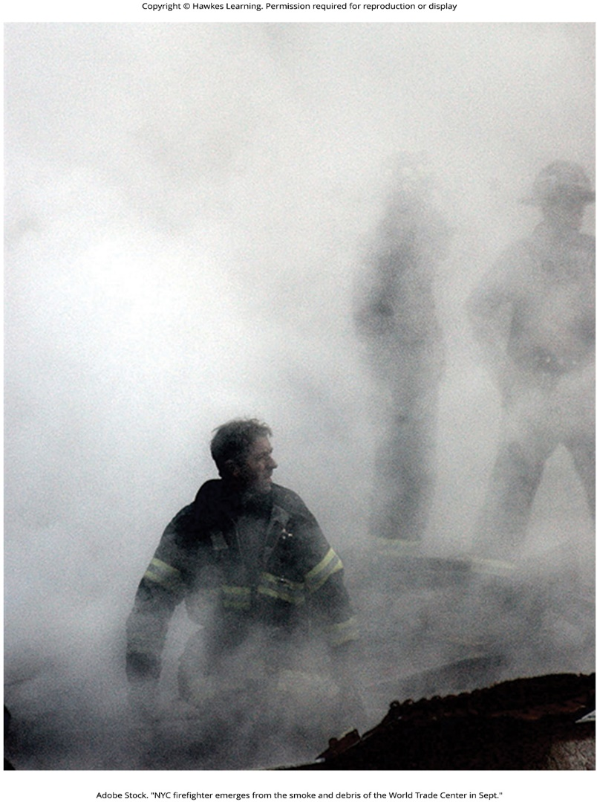
Lesson 15.4 Figure 22

Slide 40

Lesson 15.4 Figure 23

Slide 41
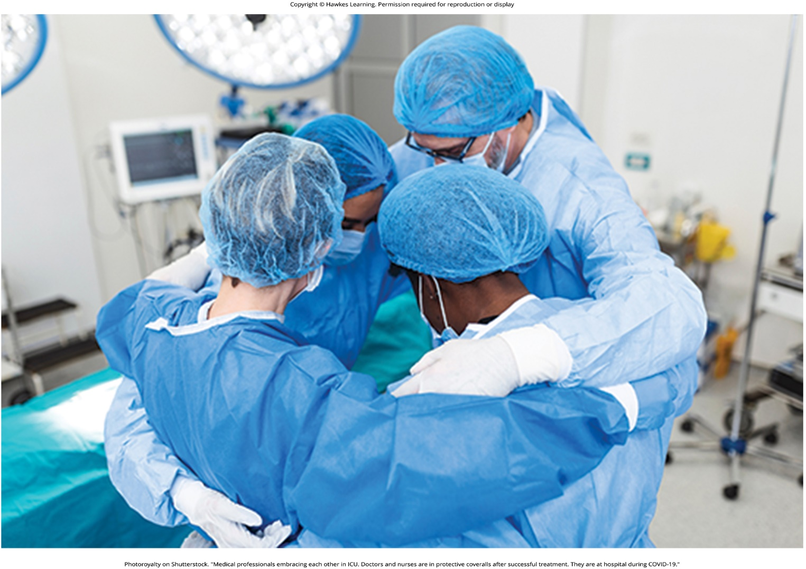
Lesson 15.4 Figure 24

Slide 42

Lesson 15.5 Figure 1

Slide 43
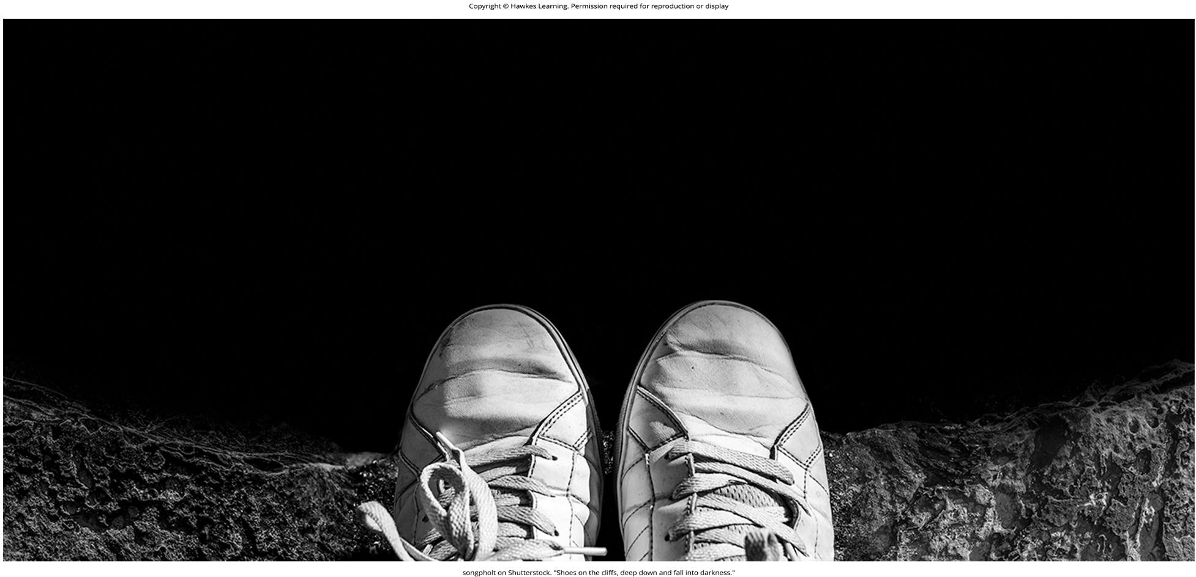
Lesson 15.5 Figure 2

Slide 44
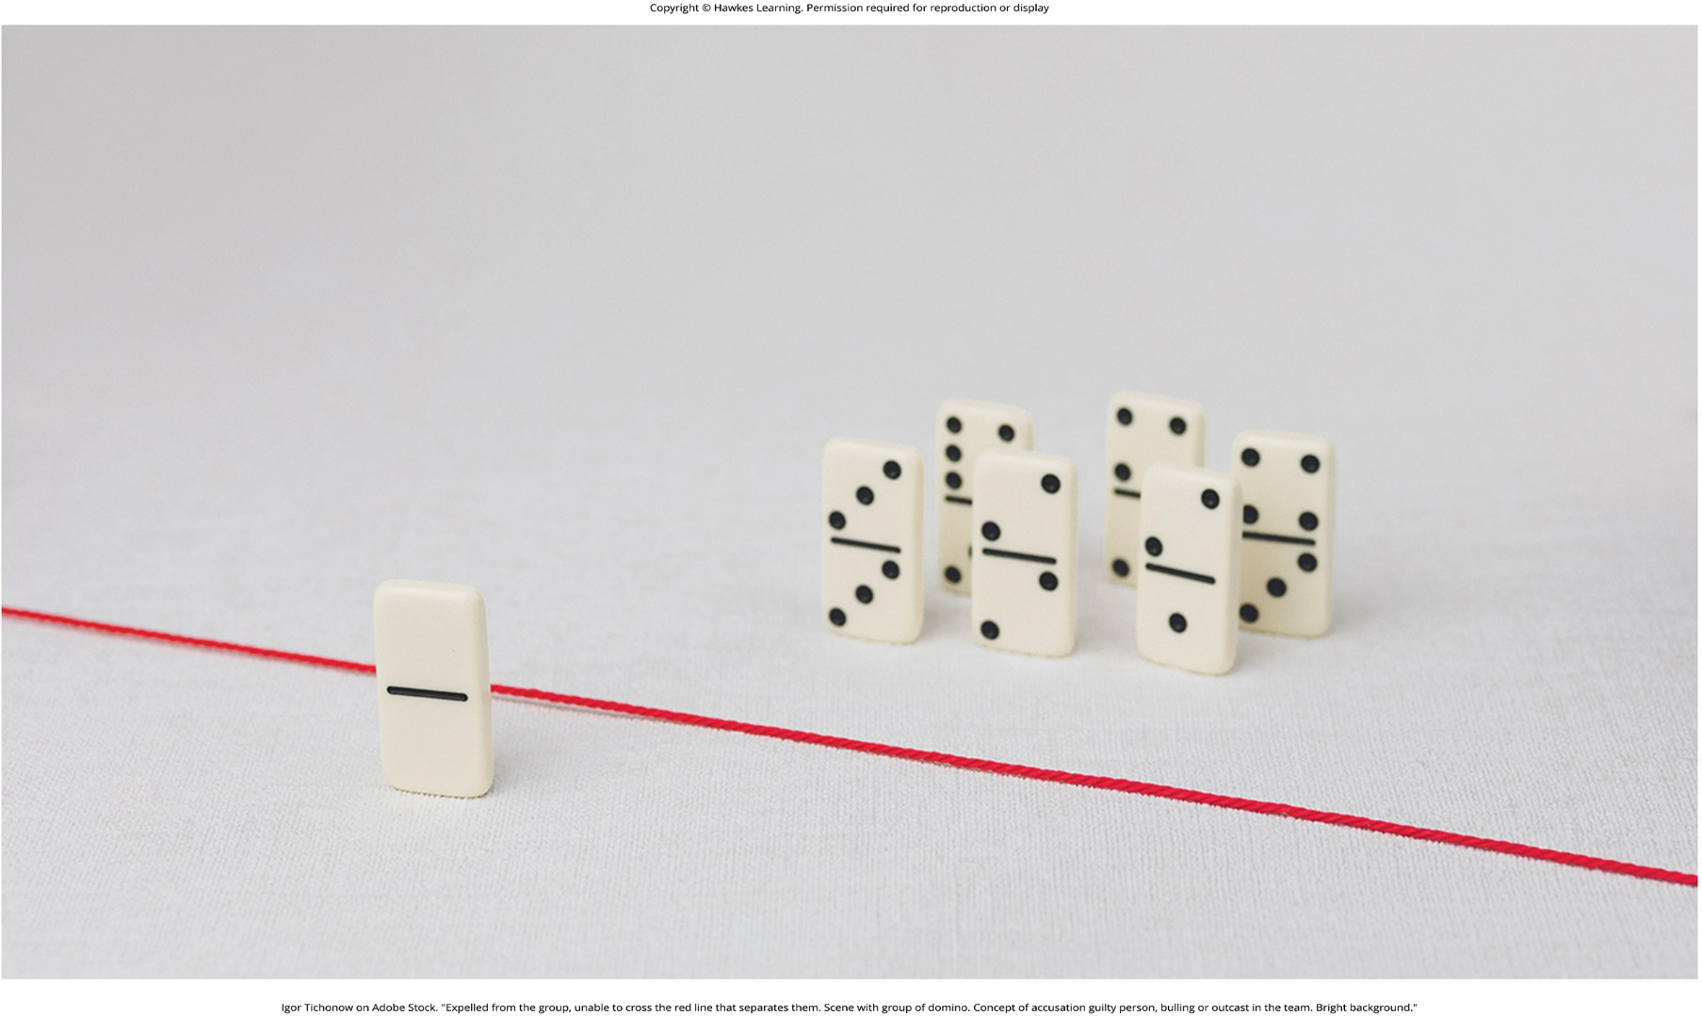
Lesson 15.5 Figure 3

Slide 45
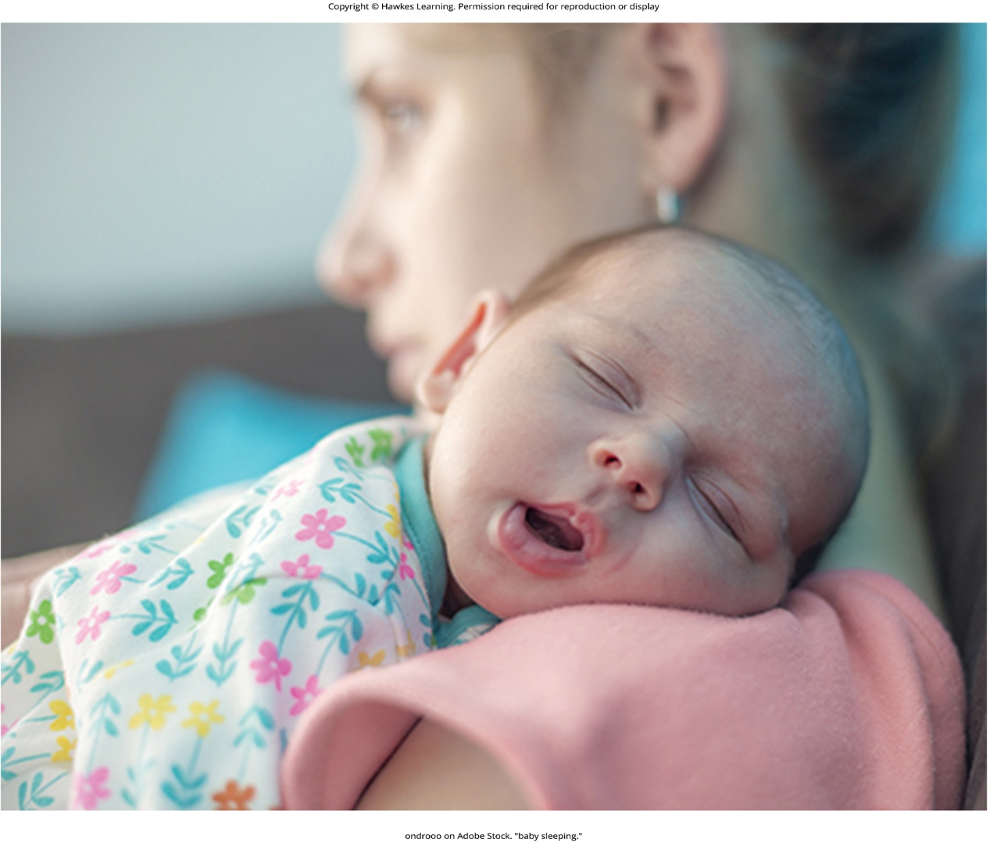
Lesson 15.5 Figure 4

Slide 46

Lesson 15.5 Figure 5

Slide 47
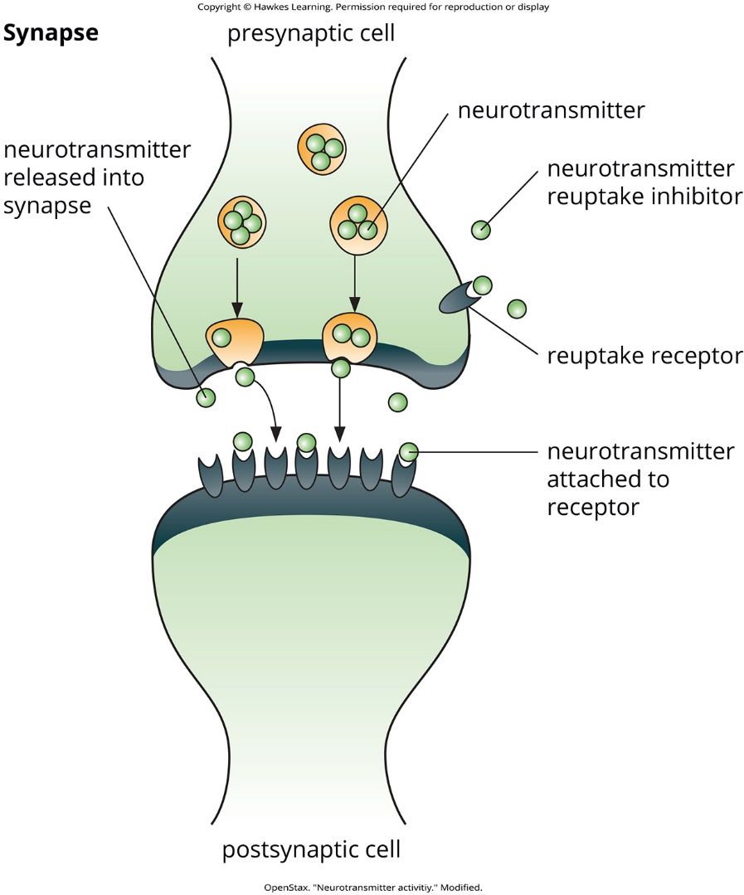
Lesson 15.5 Figure 6

Slide 48
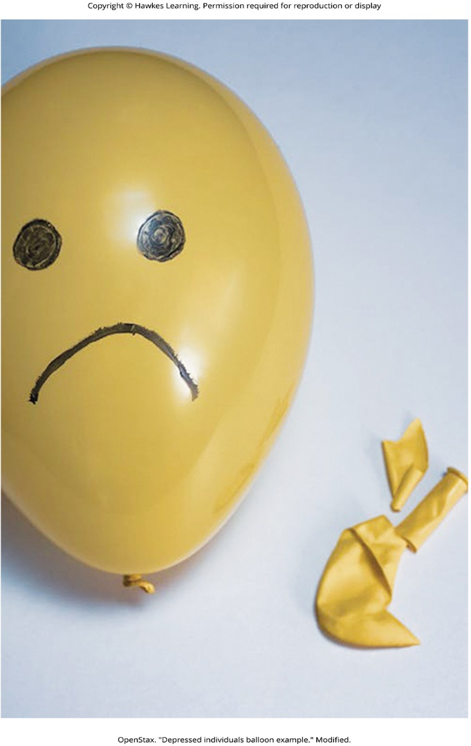
Lesson 15.5 Figure 7

Slide 49
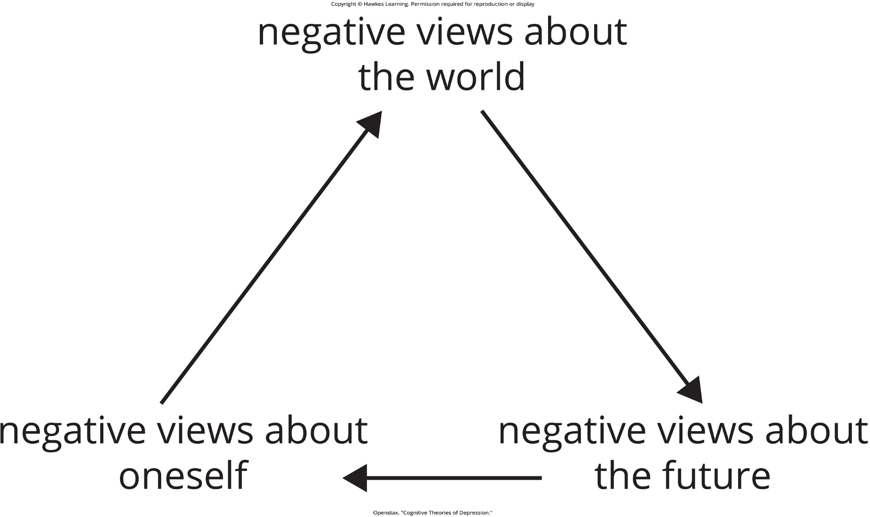
Lesson 15.5 Cognitive Theories of Depression

Slide 50

Lesson 15.5 Figure 8

Slide 51
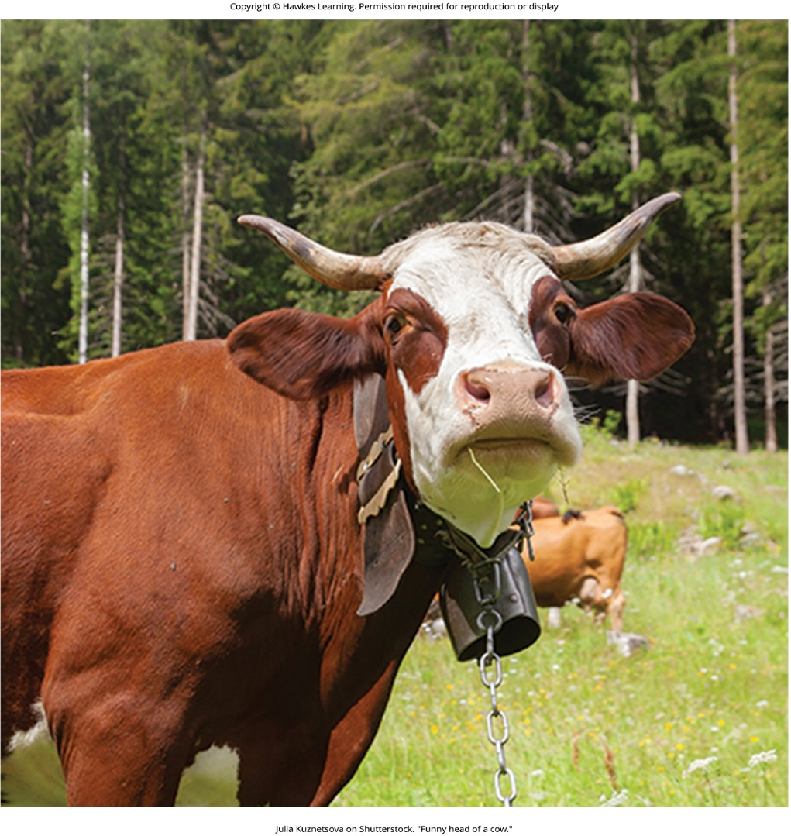
Lesson 15.5 Figure 9

Slide 52
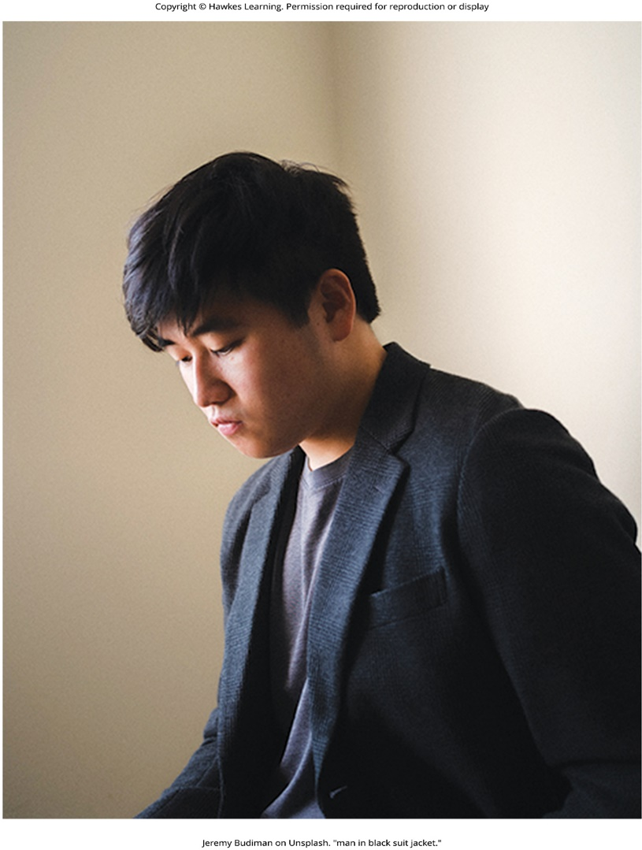
Lesson 15.5 Figure 10

Slide 53
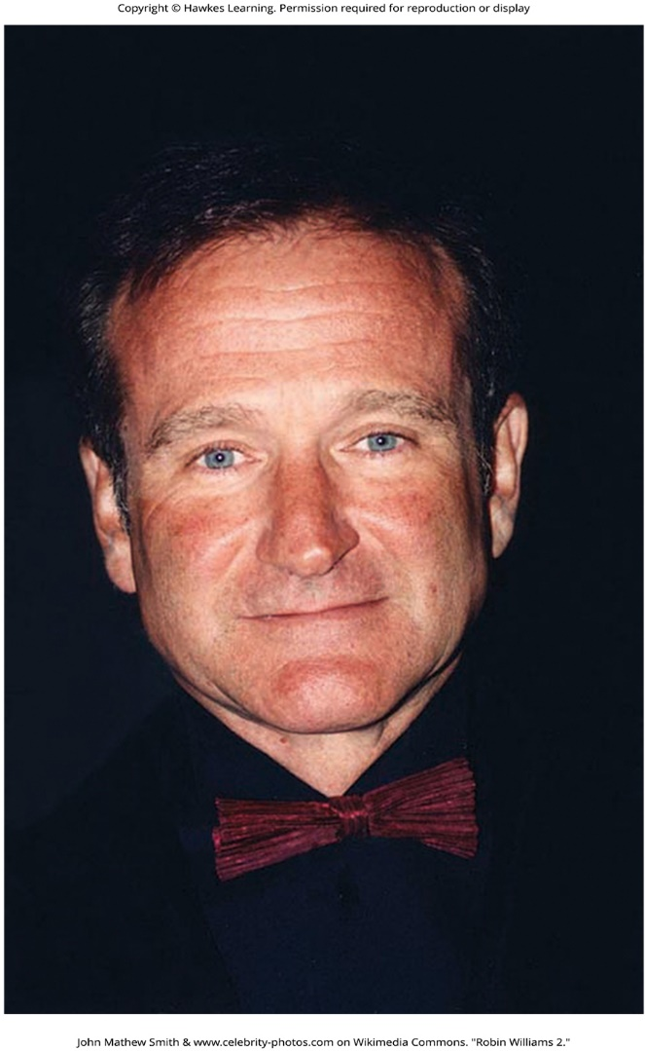
Lesson 15.5 Figure 11

Slide 54

Lesson 15.5 Figure 12

Slide 55

Lesson 15.6 Figure 1

Slide 56
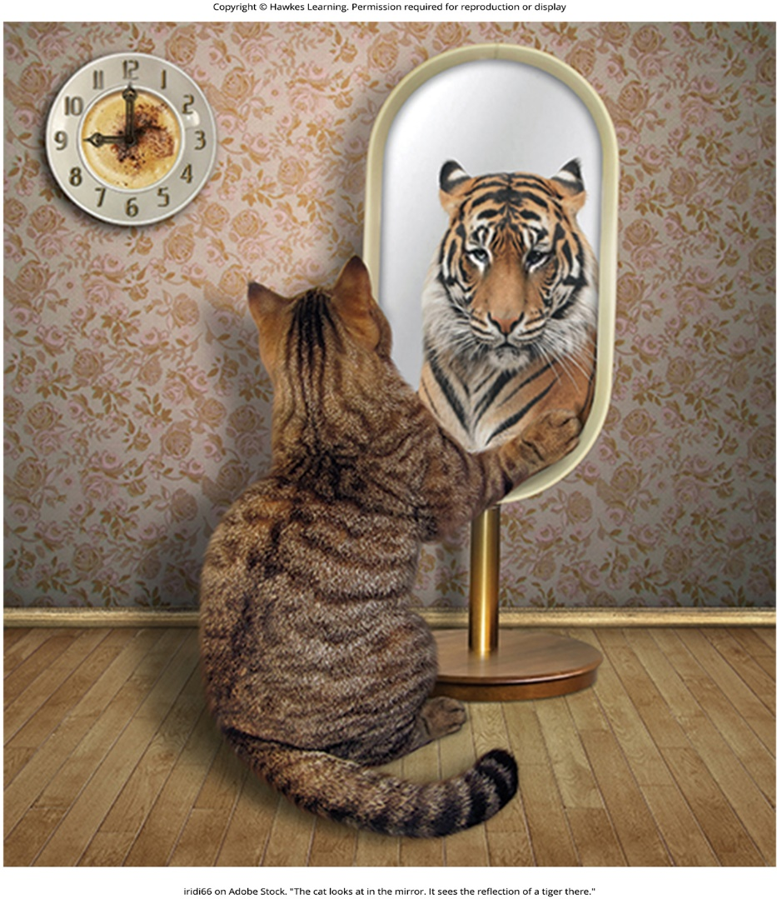
Lesson 15.6 Figure 2

Slide 57
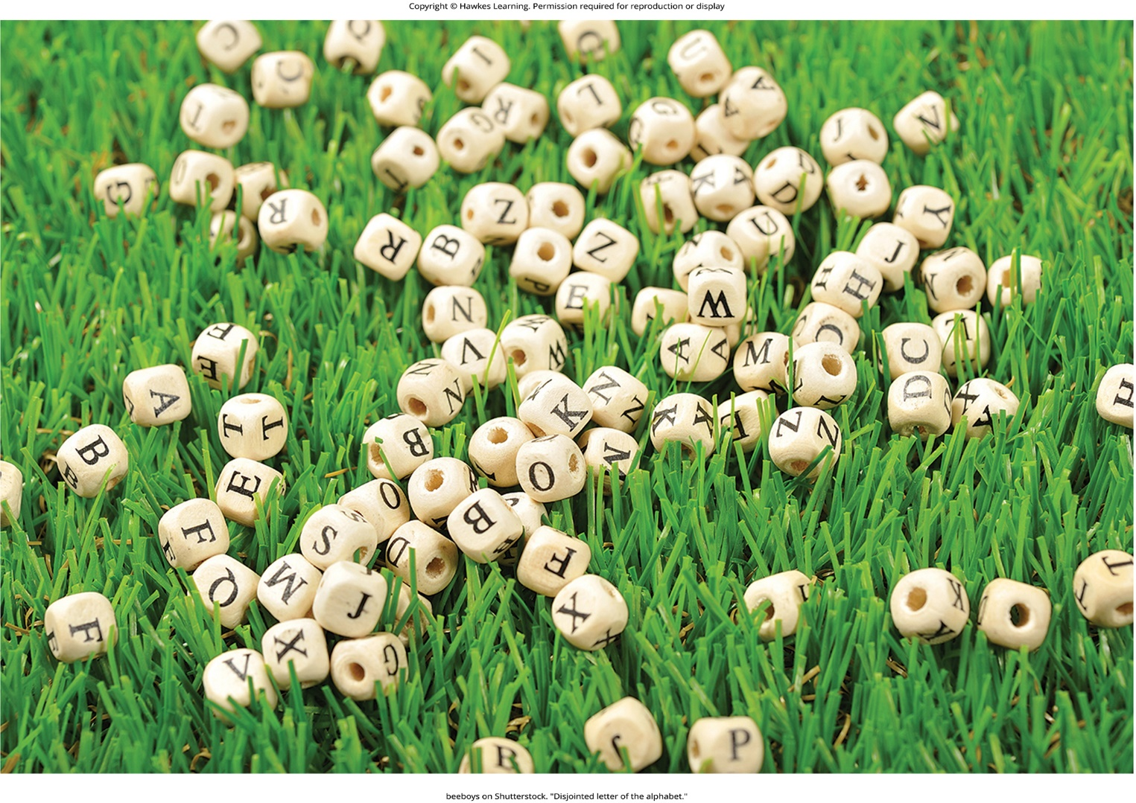
Lesson 15.6 Figure 3

Slide 58
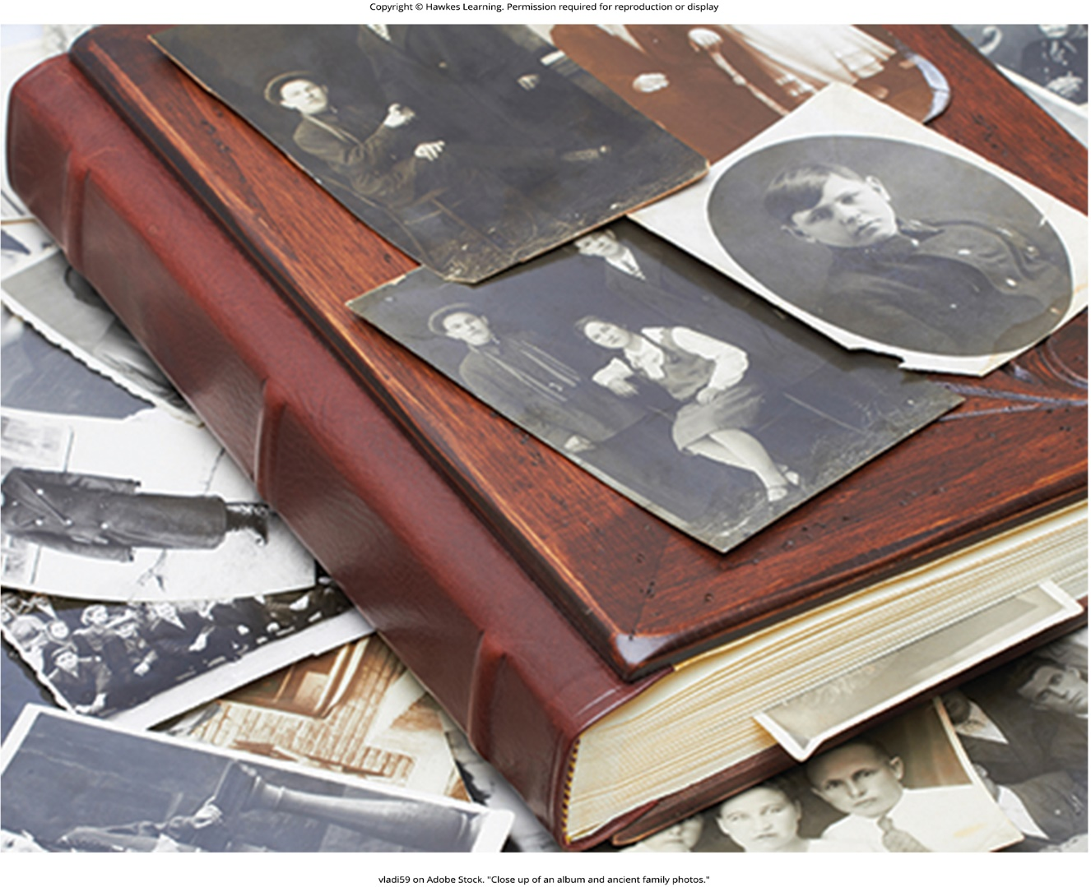
Lesson 15.6 Figure 4

Slide 59
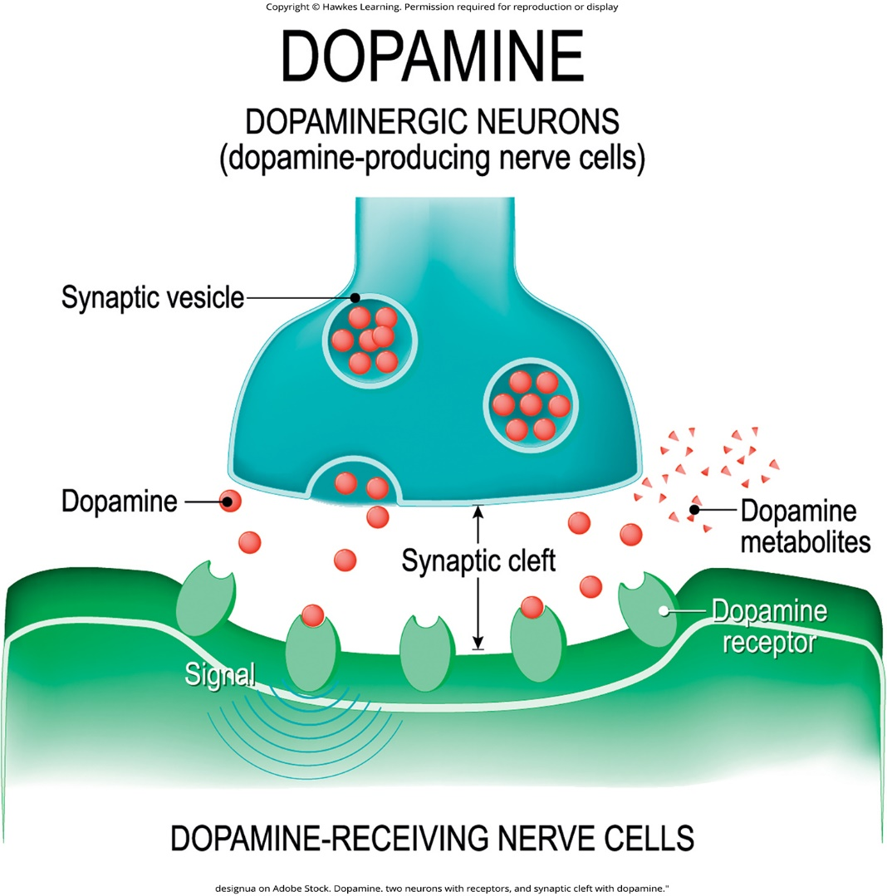
Lesson 15.6 Figure 5

Slide 60
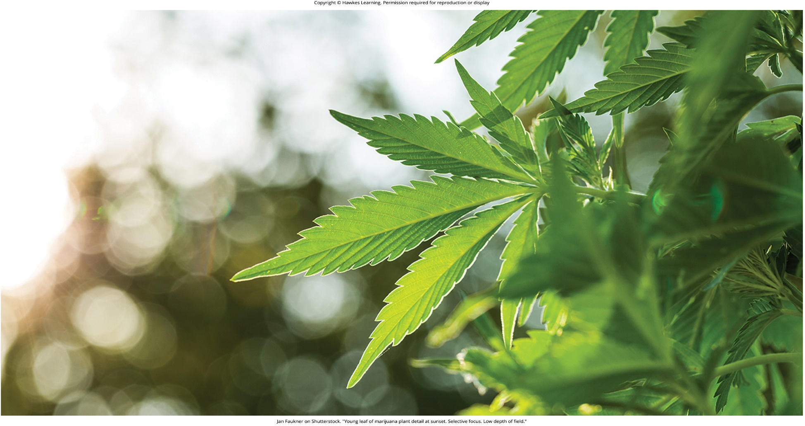
Lesson 15.6 Figure 6

Slide 61
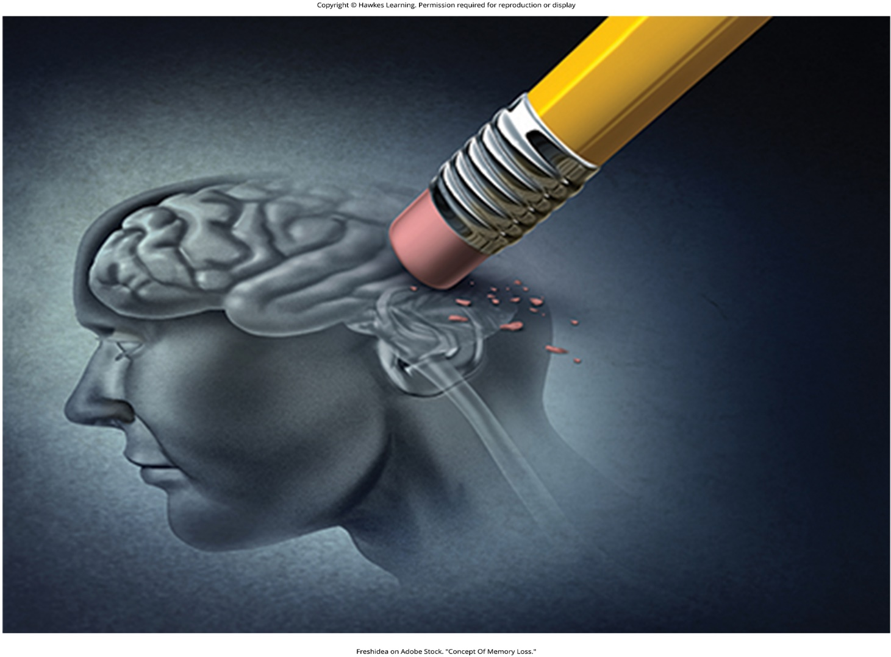
Lesson 15.7 Figure 1

Slide 62
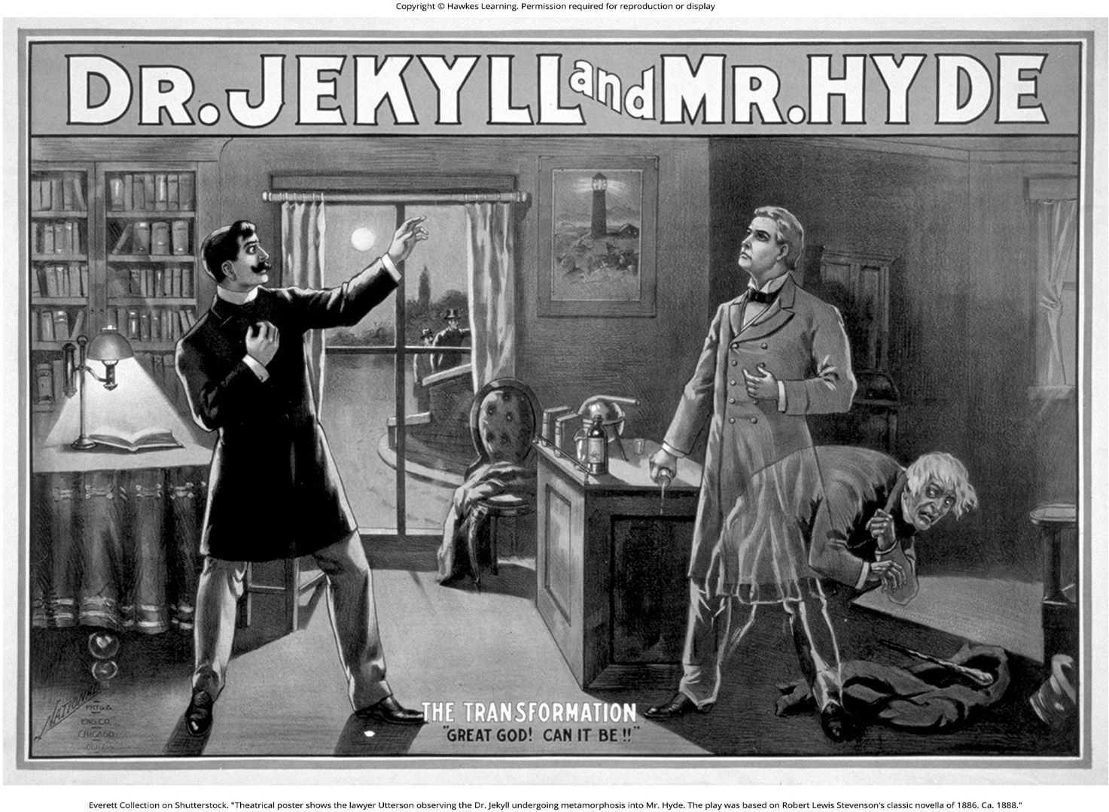
Lesson 15.7 Figure 2

Slide 63
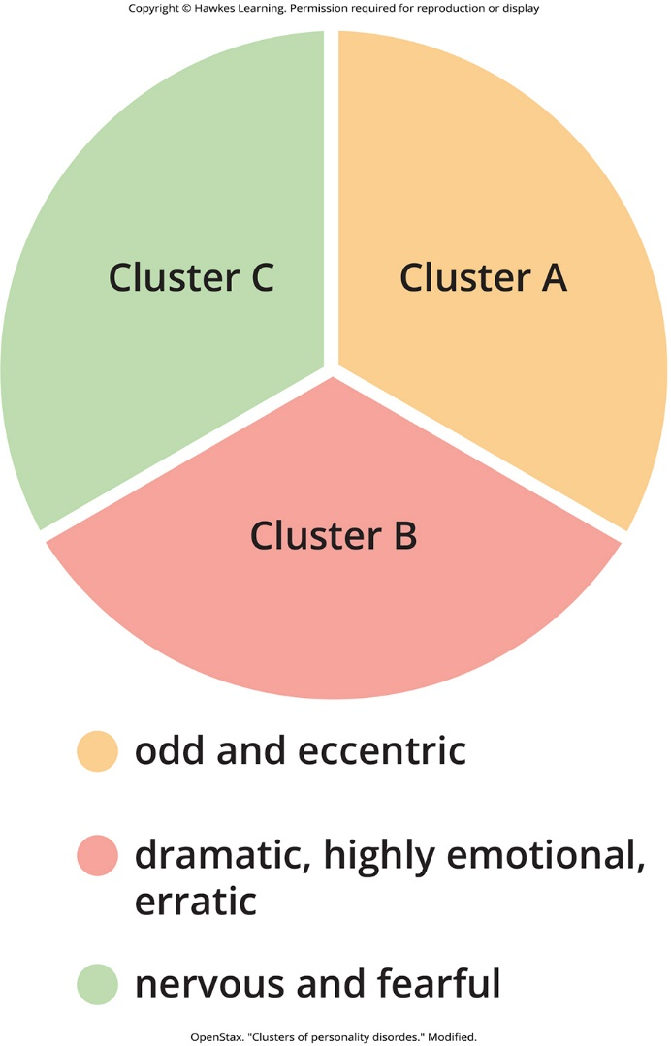
Lesson 15.8 Figure 1

Slide 64
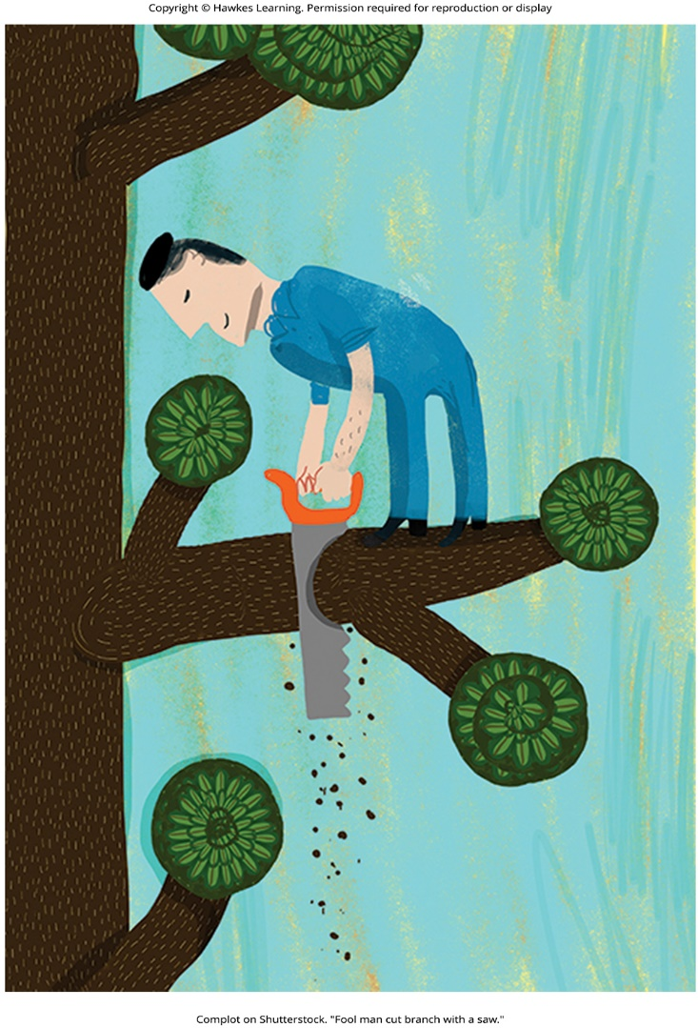
Lesson 15.8 Figure 2

Slide 65

Lesson 15.8 Figure 3

Slide 66

Lesson 15.8 Figure 4

Slide 67

Lesson 15.8 Figure 5

Slide 68

Lesson 15.9 Figure 1

Slide 69

Lesson 15.9 Figure 2

Slide 70

Lesson 15.9 Figure 3

Slide 71

Lesson 15.9 Figure 4

Slide 72

Lesson 15.9 Figure 5

Slide 73

Lesson 15.9 Figure 6

Slide 74

Lesson 15.9 Figure 7

Slide 75

Lesson 15.9 Figure 8

Slide 76

Lesson 15.9 Figure 9

Slide 77
Hawkes Learning – End of PowerPoint

