Slide 1
Chapter 16
Therapy and Treatment

Slide 2
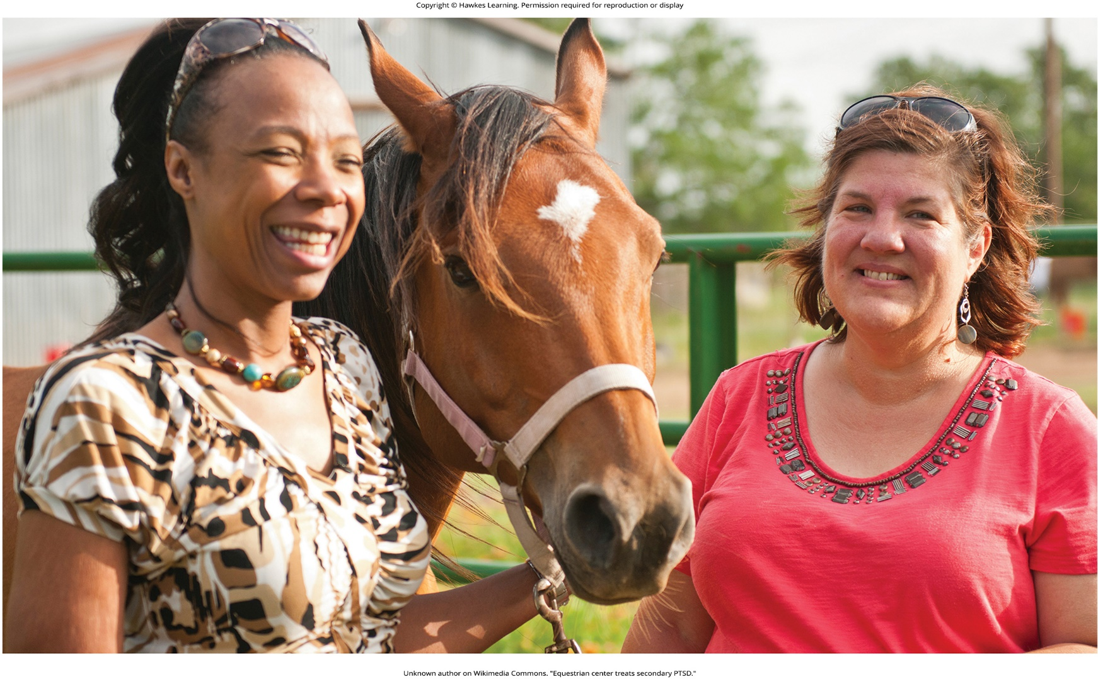
Lesson 16.1 Figure 1

Slide 3
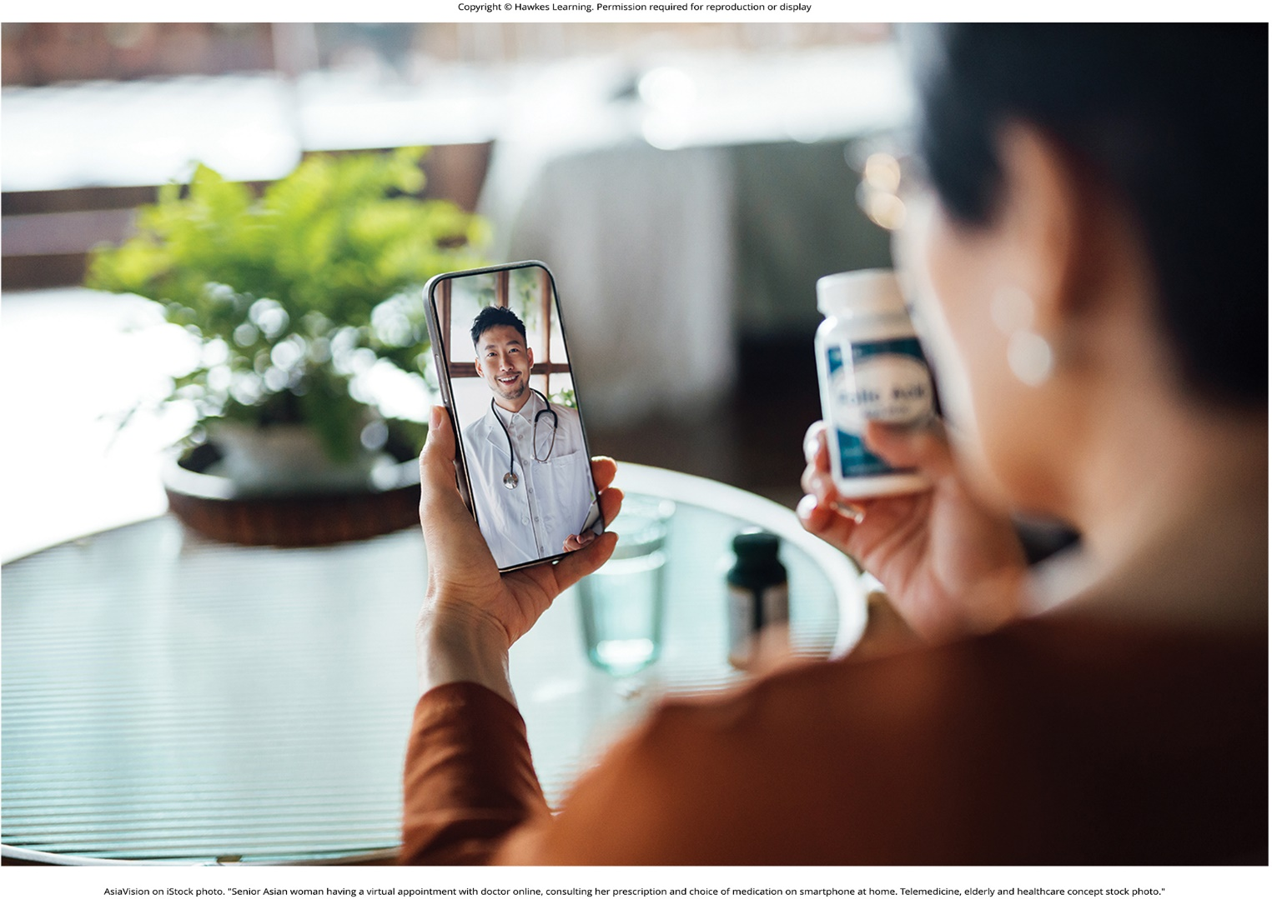
Lesson 16.1 Figure 2

Slide 4
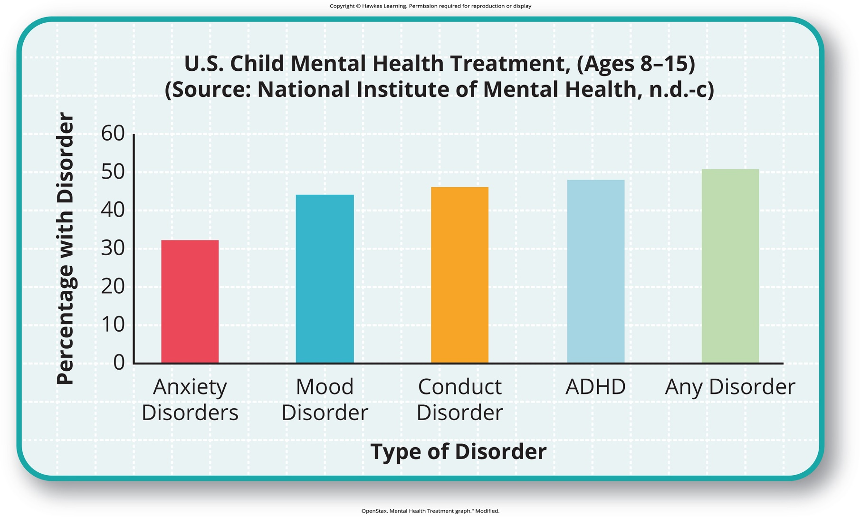
Lesson 16.1 Figure 3

Slide 5
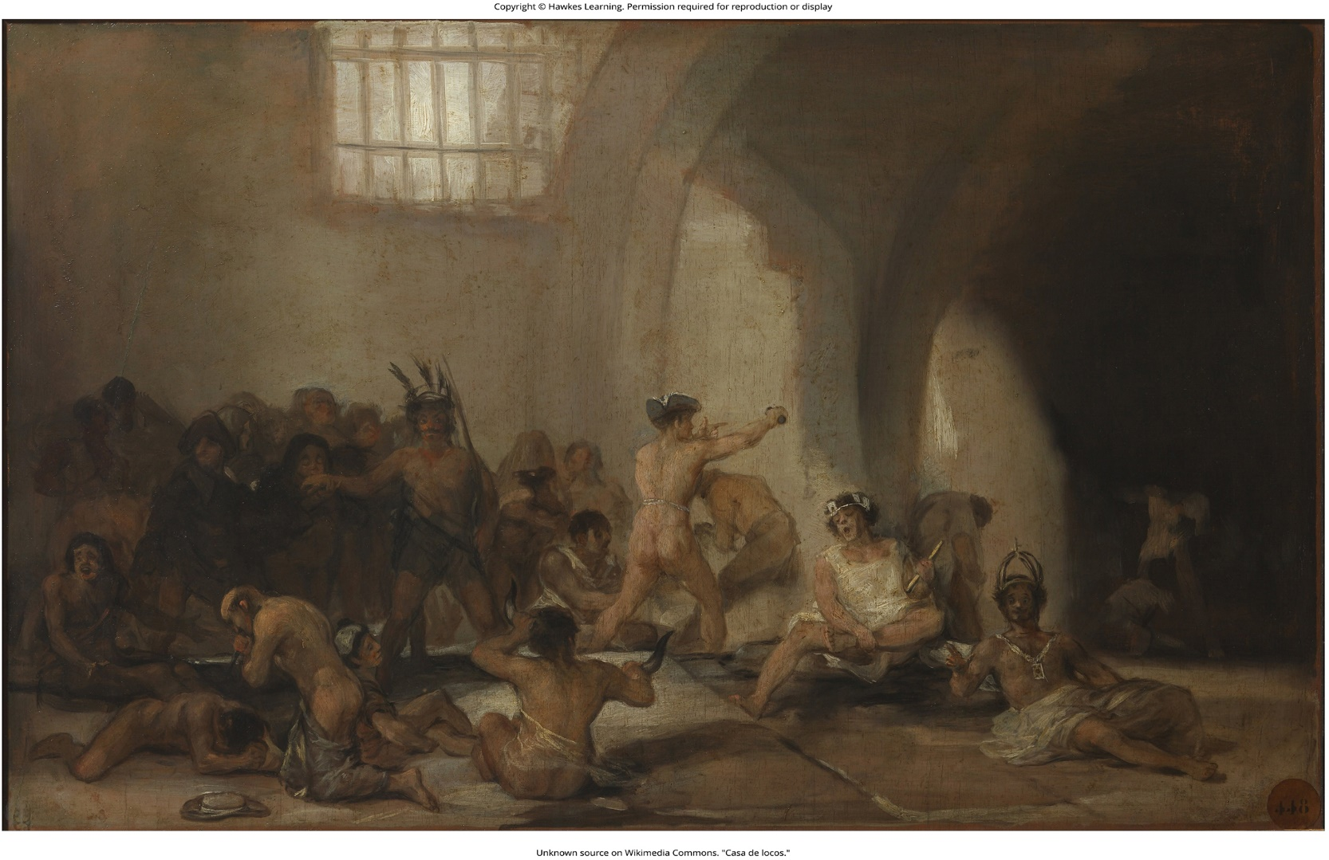
Lesson 16.1 Figure 4

Slide 6
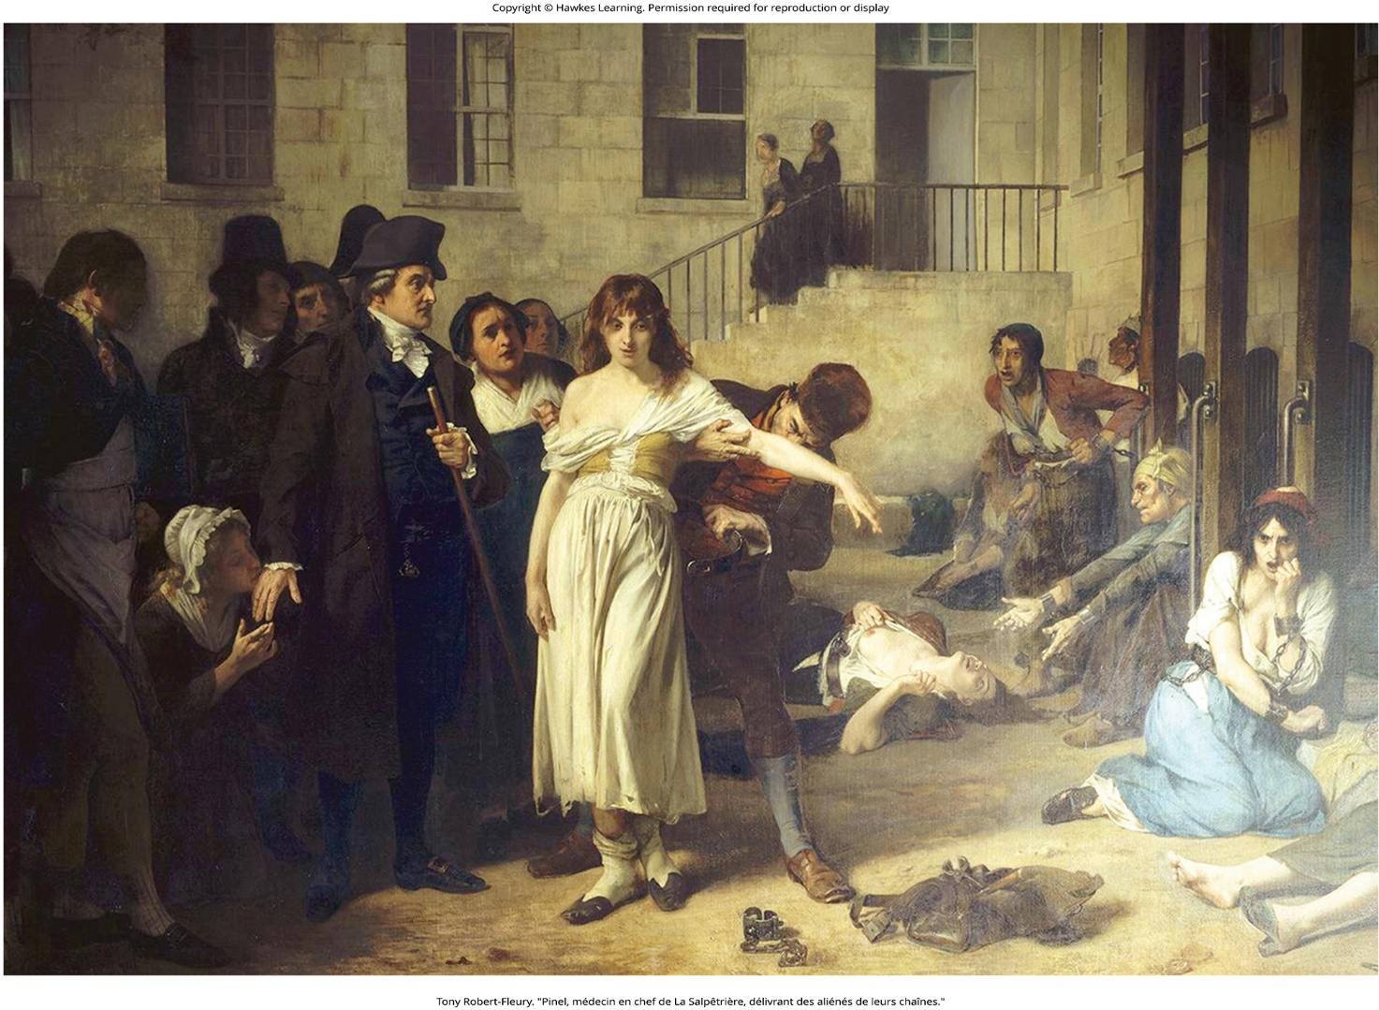
Lesson 16.1 Figure 5

Slide 7
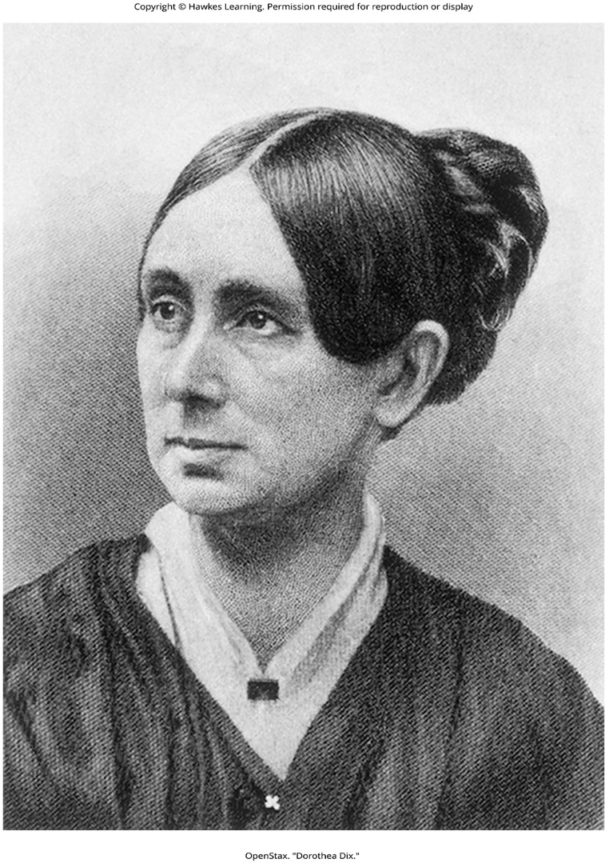
Lesson 16.1 Figure 6

Slide 8
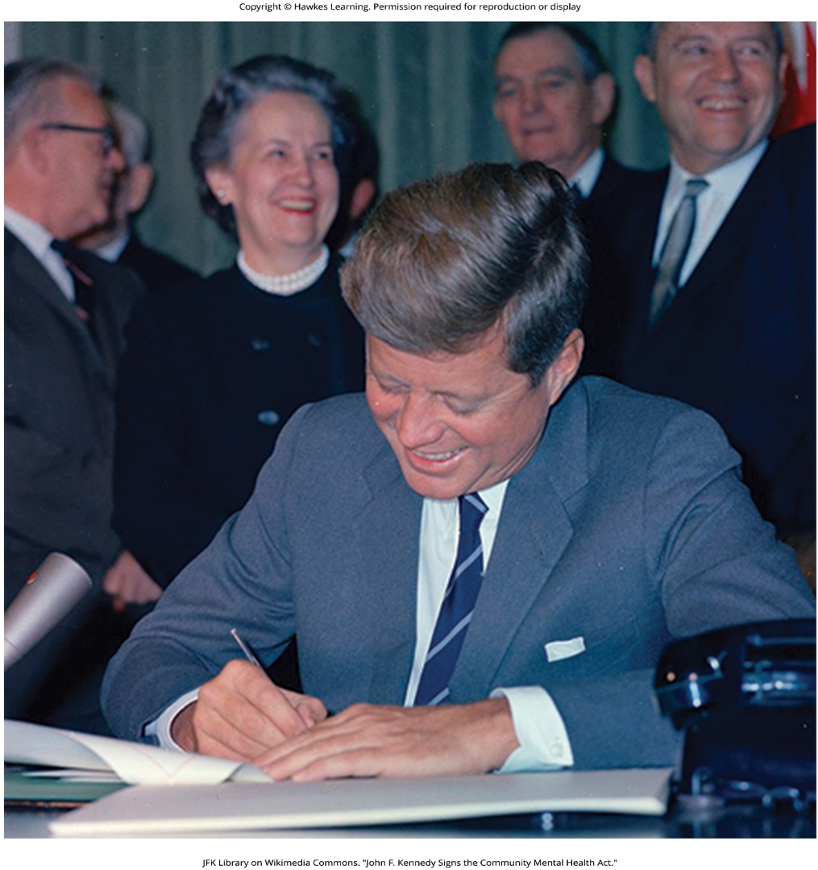
Lesson 16.1 Figure 7

Slide 9
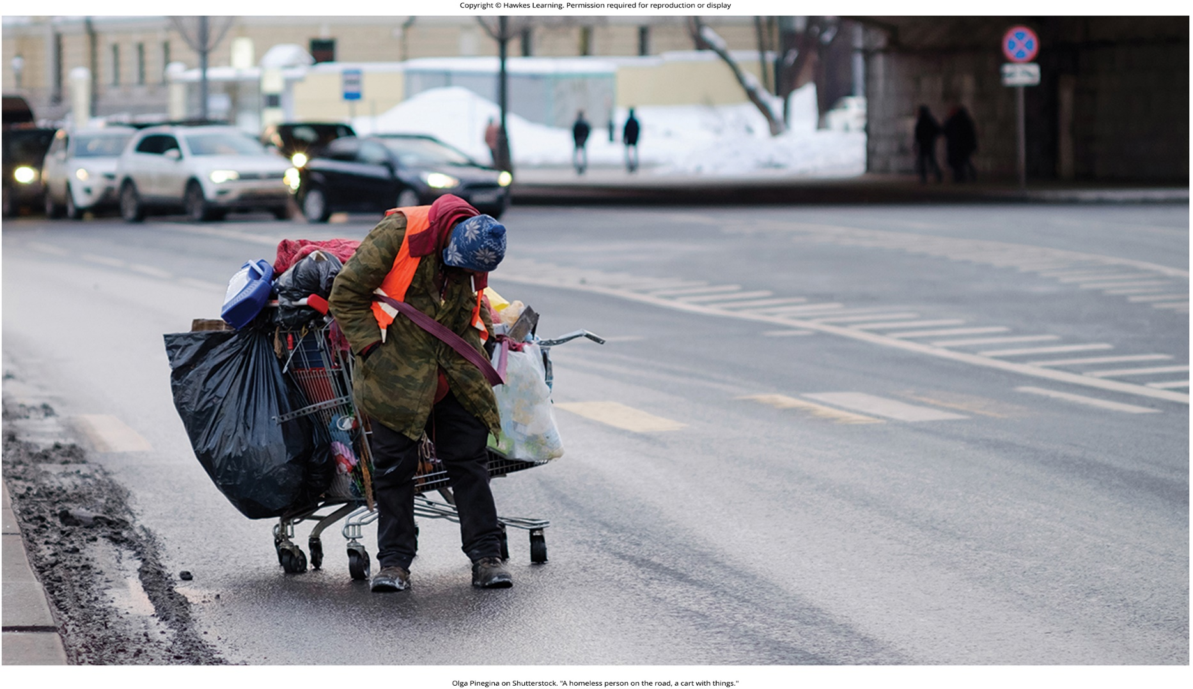
Lesson 16.1 Figure 8

Slide 10
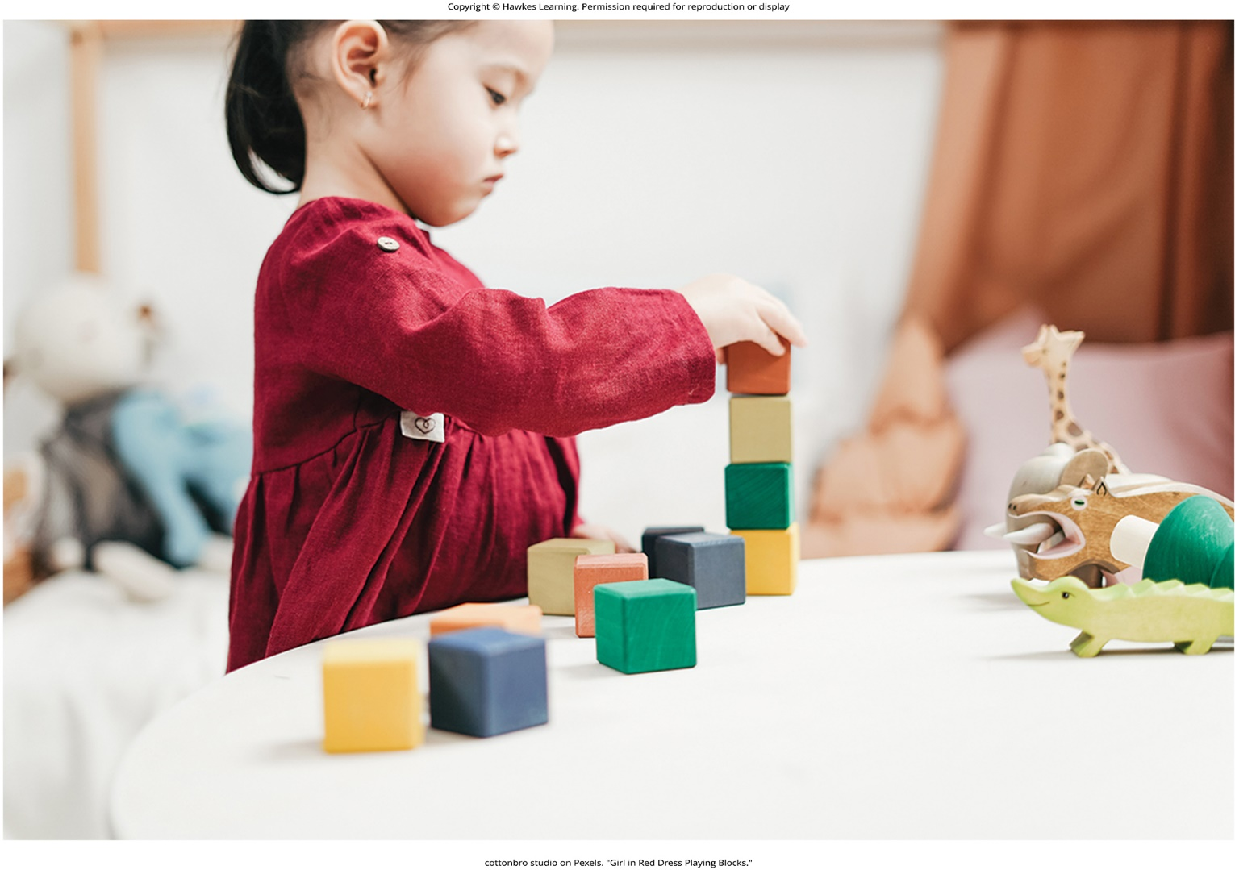
Lesson 16.1 Figure 9

Slide 11
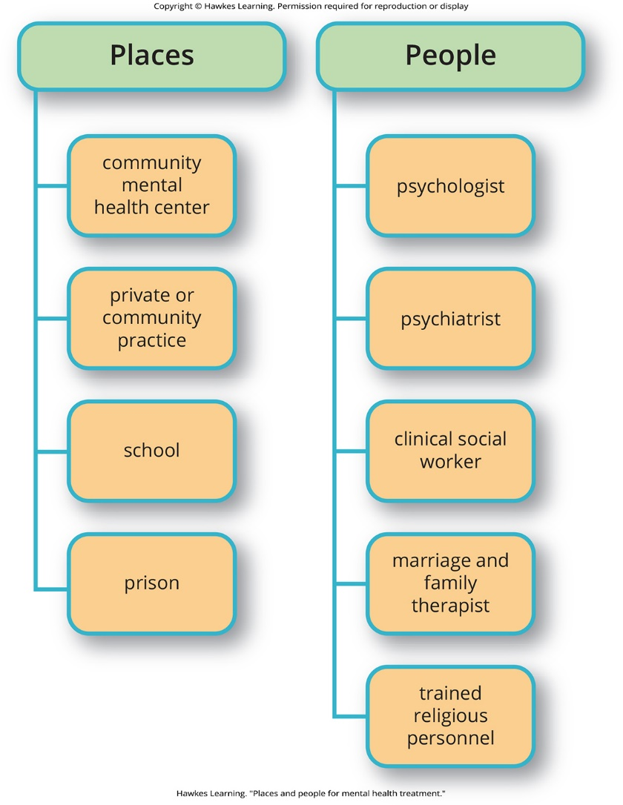
Lesson 16.1 Figure 10

Slide 12
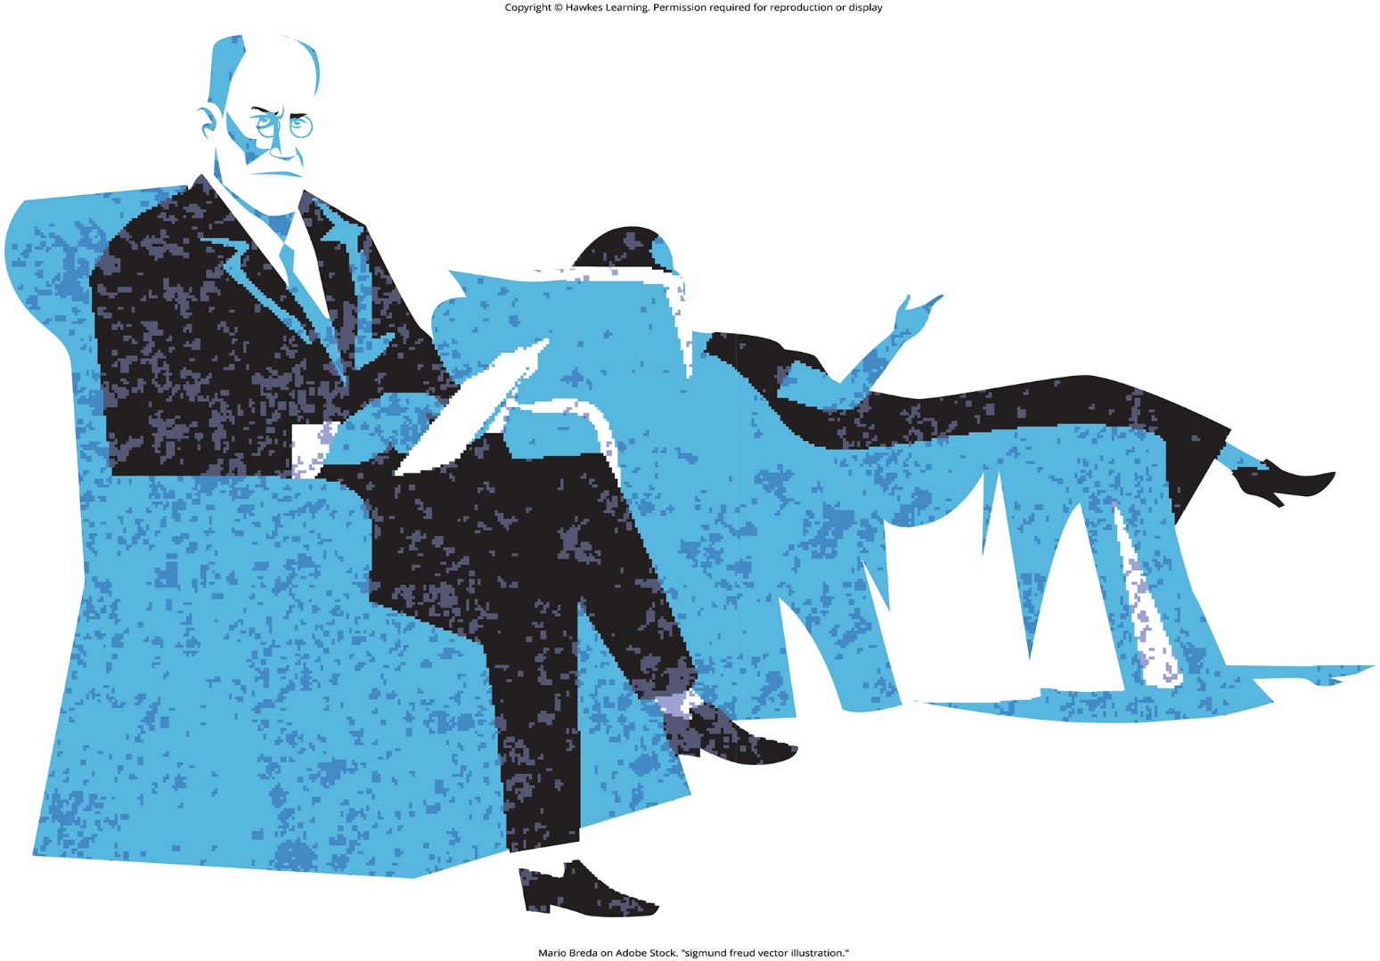
Lesson 16.2 Figure 1

Slide 13
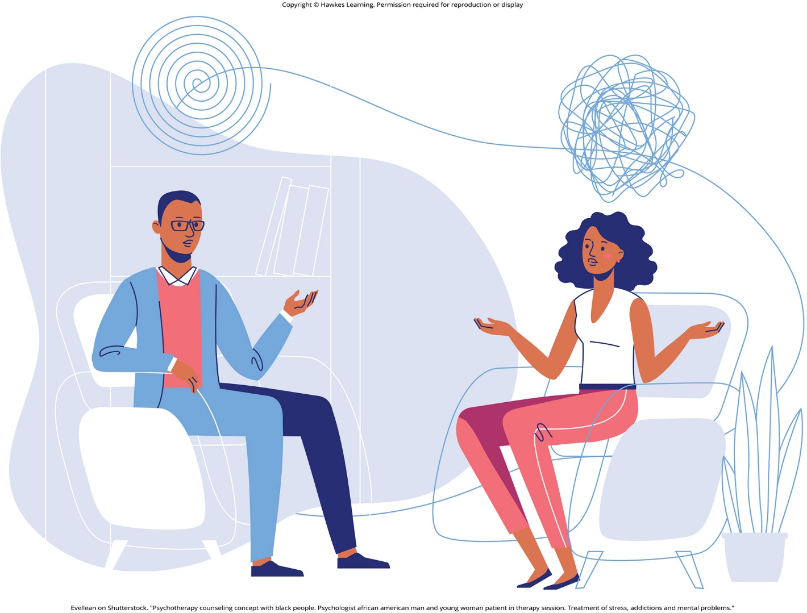
Lesson 16.2 Figure 2

Slide 14
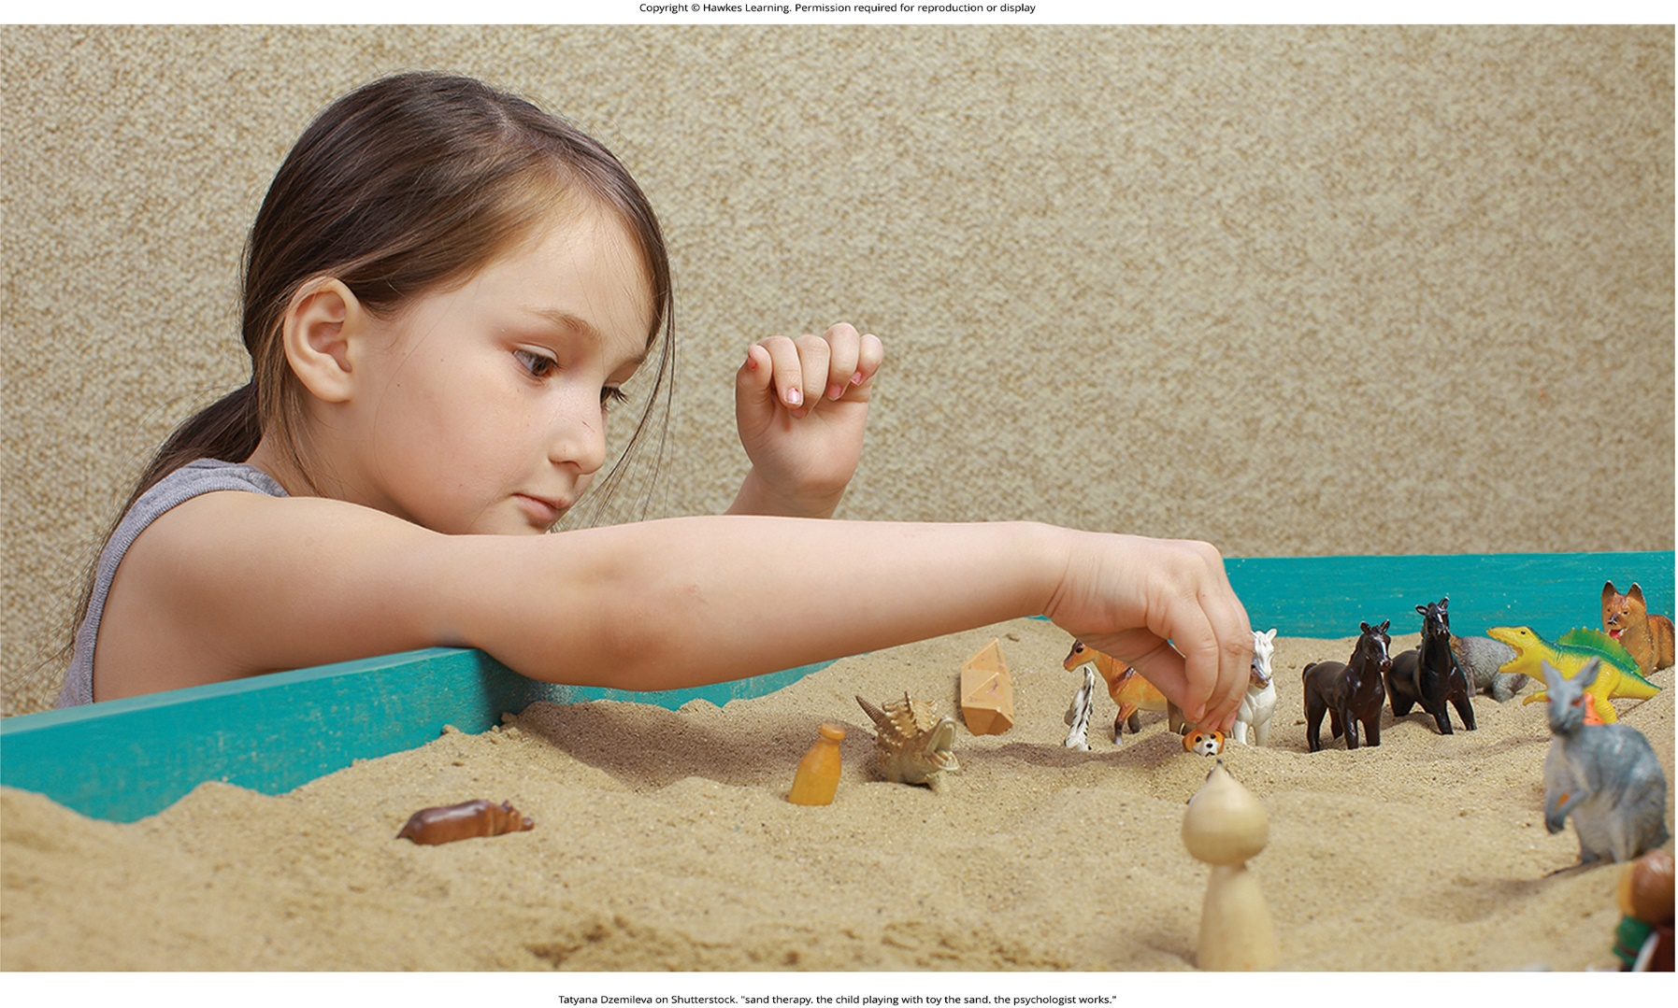
Lesson 16.2 Figure 3

Slide 15
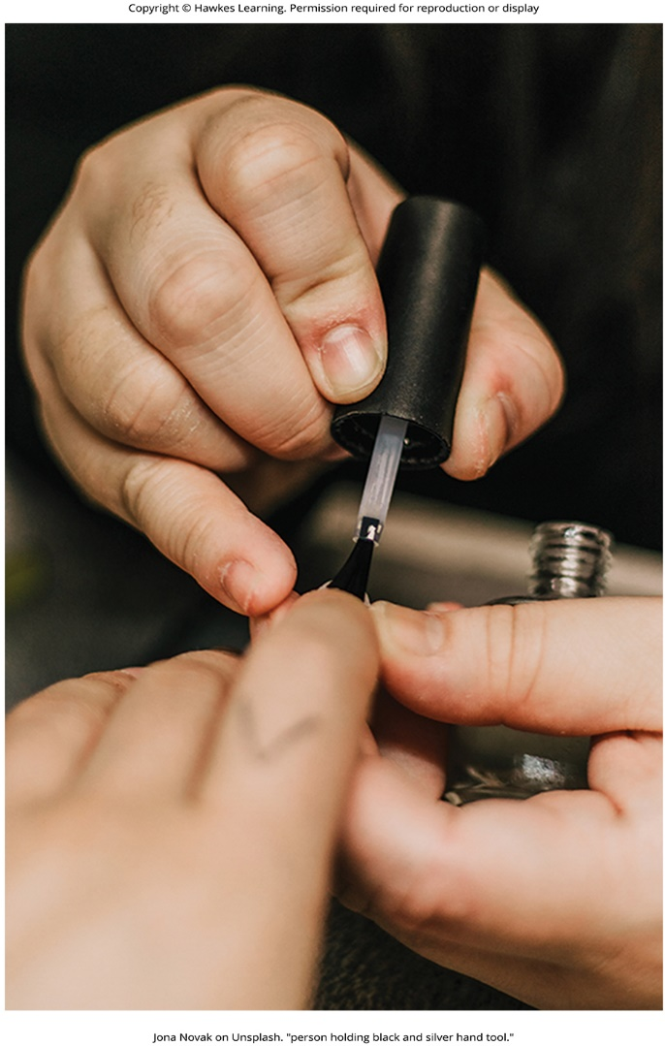
Lesson 16.2 Figure 4

Slide 16
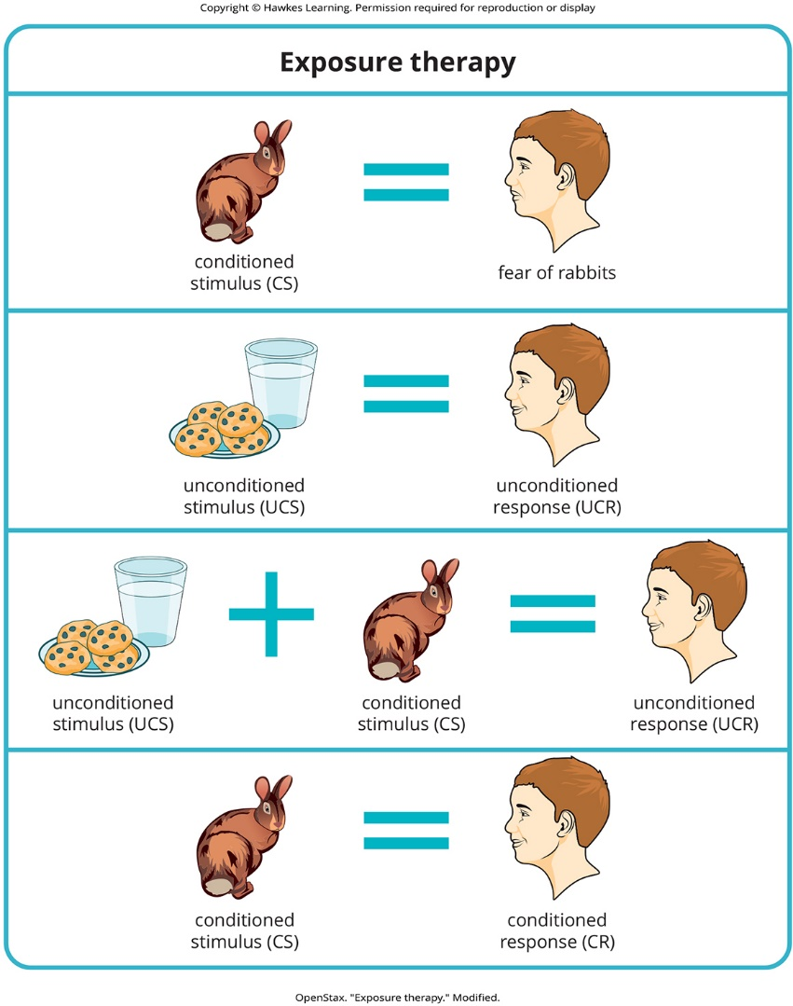
Lesson 16.2 Figure 5

Slide 17
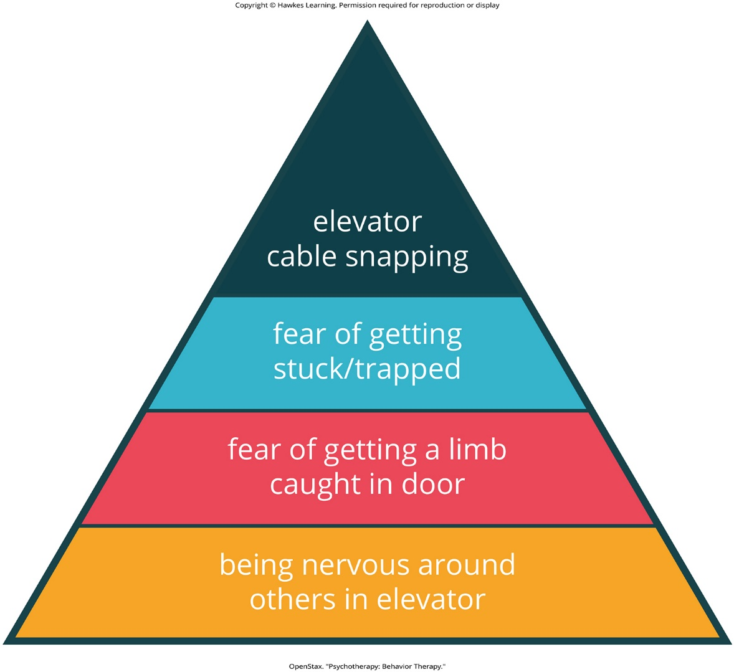
Lesson 16.2 Psychotherapy: Behavior Therapy

Slide 18
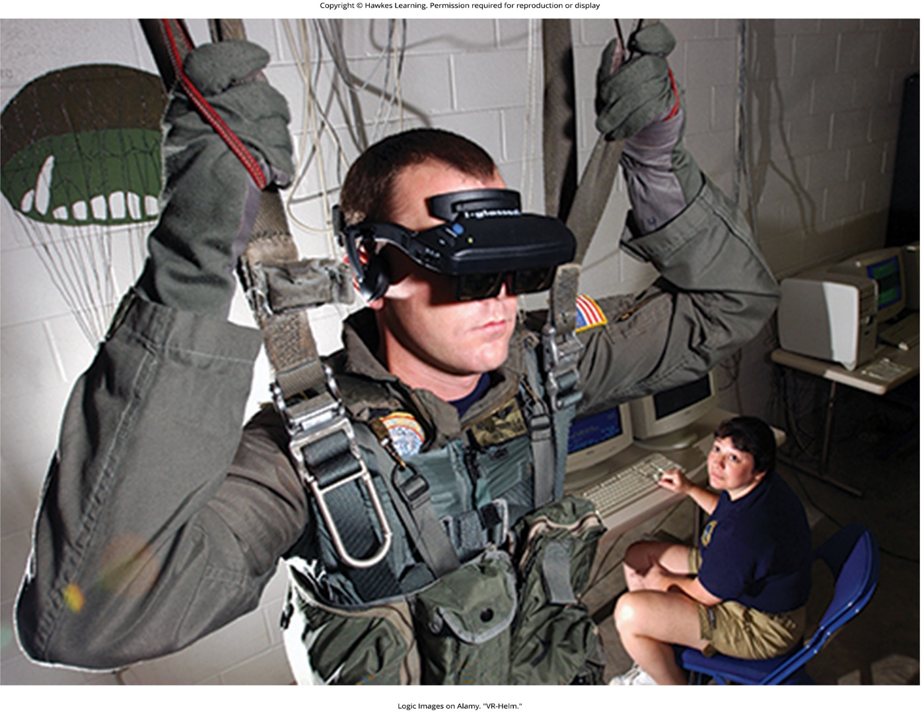
Lesson 16.2 Figure 6

Slide 19
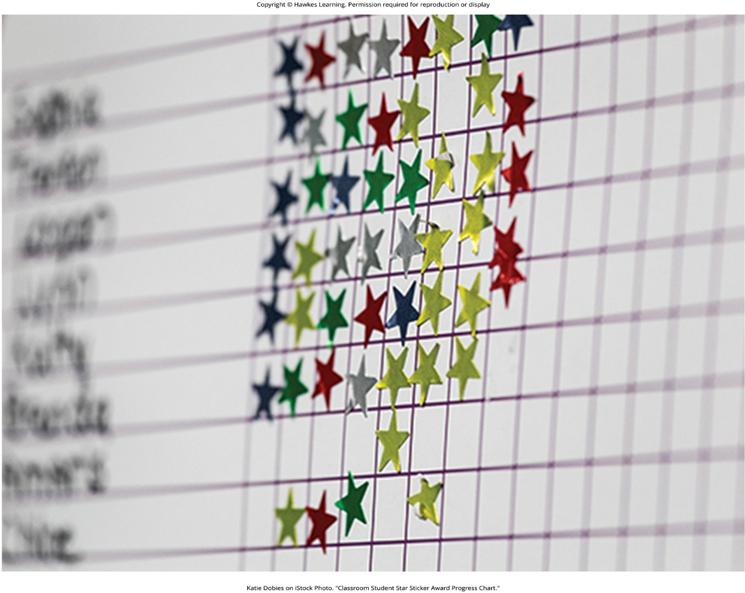
Lesson 16.2 Figure 7

Slide 20
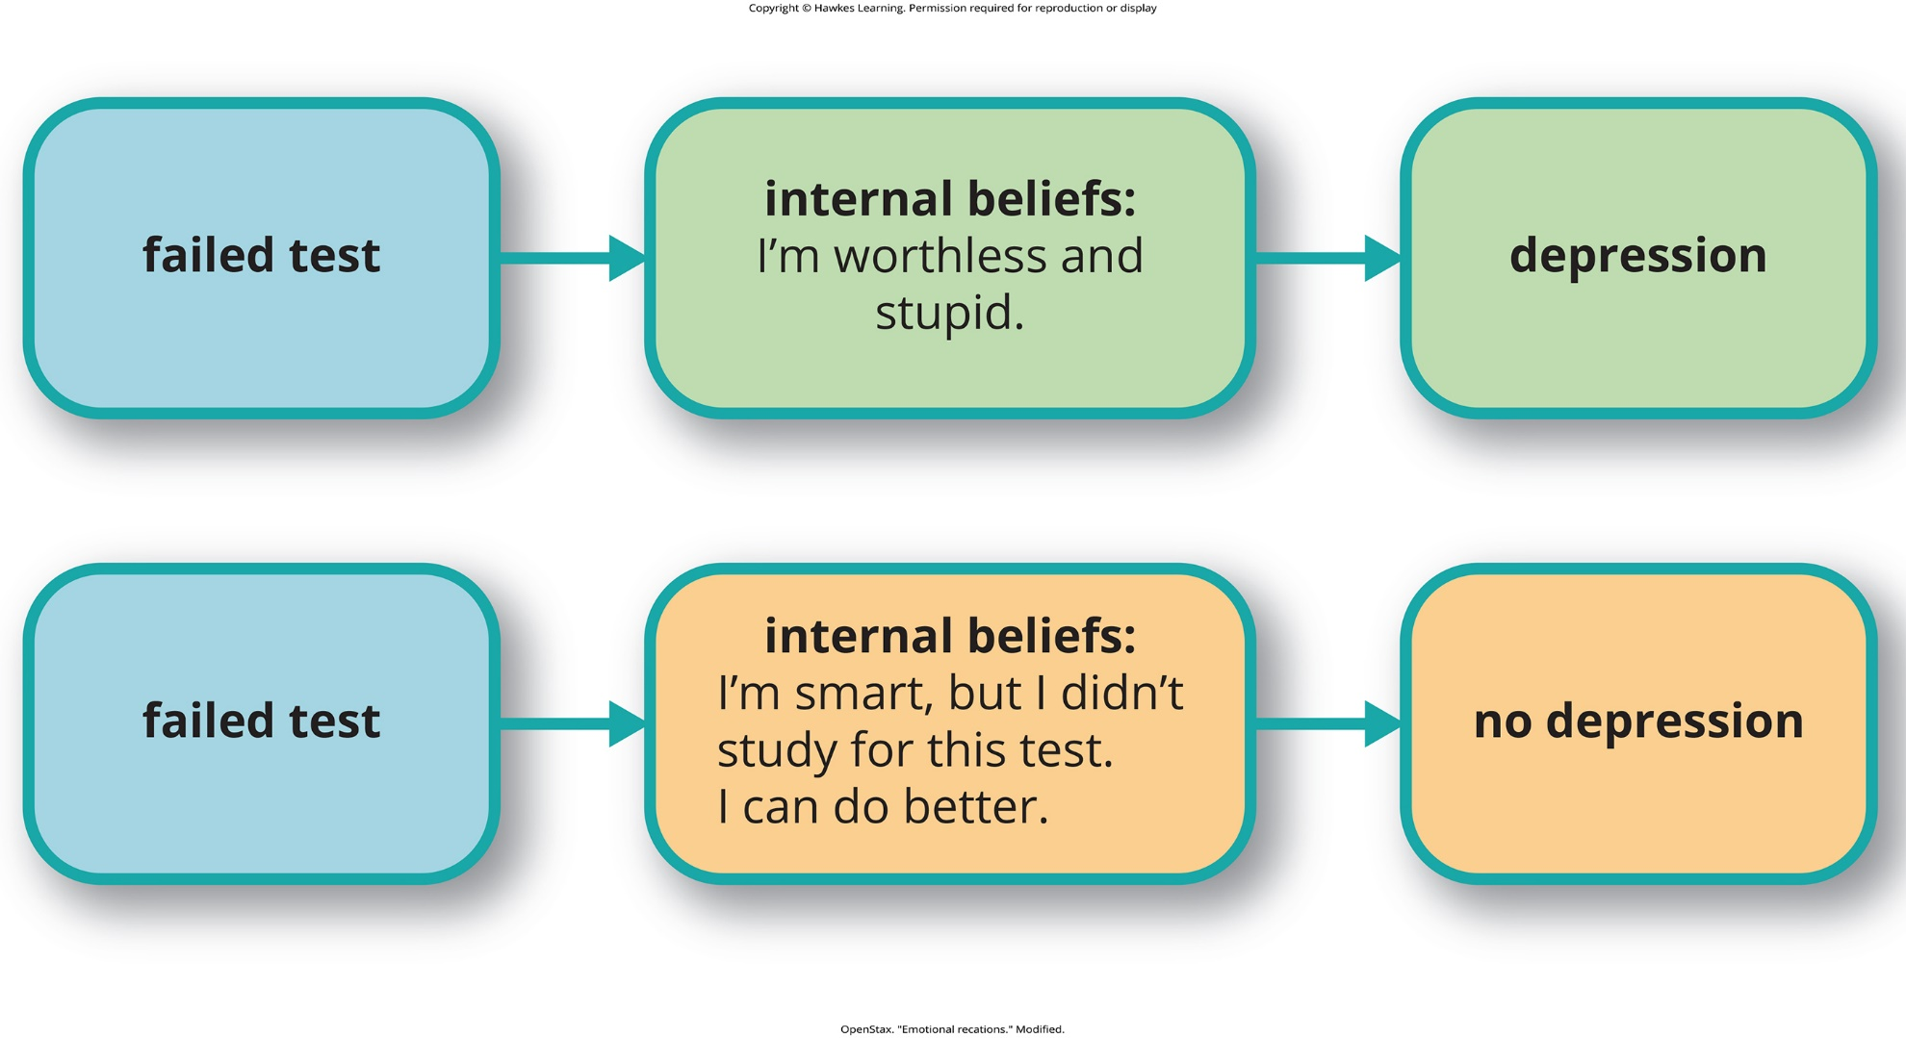
Lesson 16.2 Figure 8

Slide 21
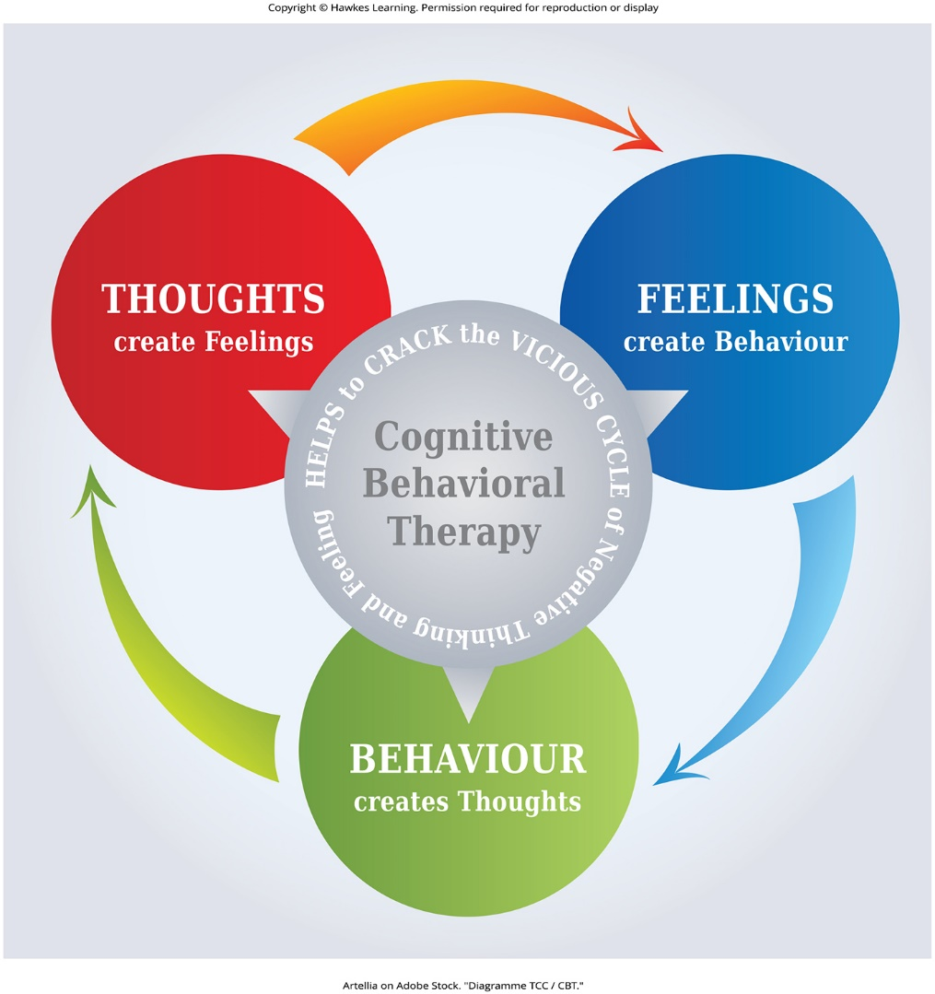
Lesson 16.2 Figure 9

Slide 22
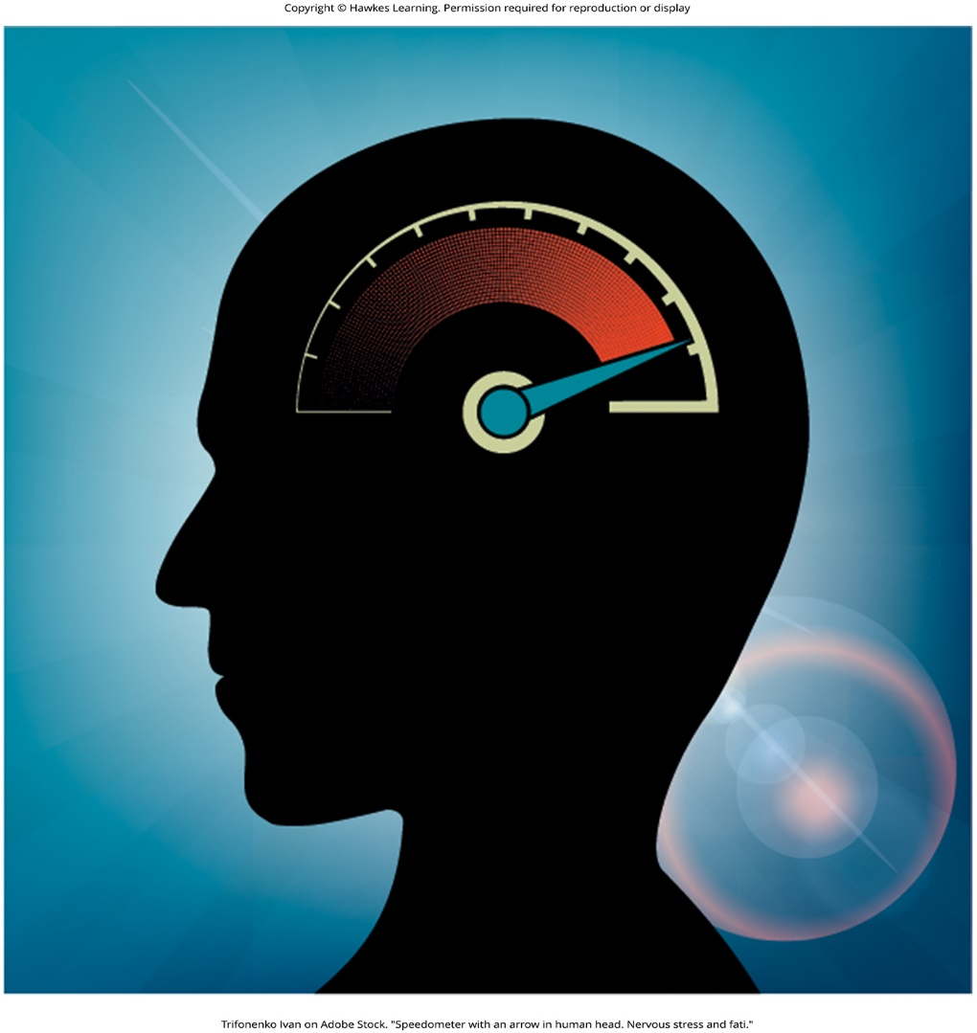
Lesson 16.2 Figure 10

Slide 23
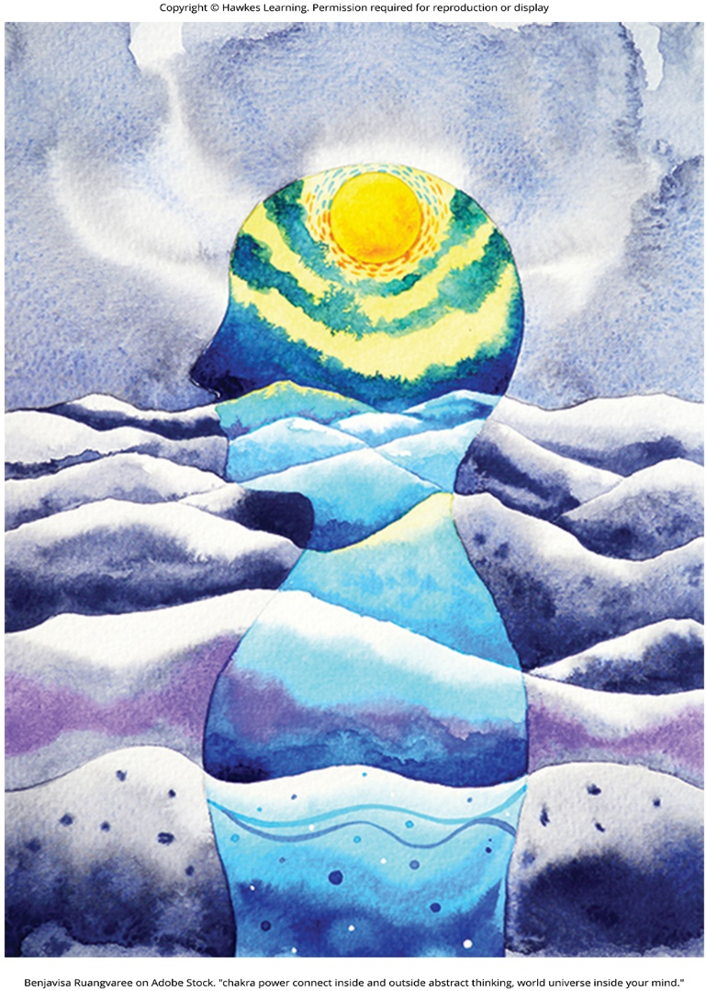
Lesson 16.2 Figure 11

Slide 24
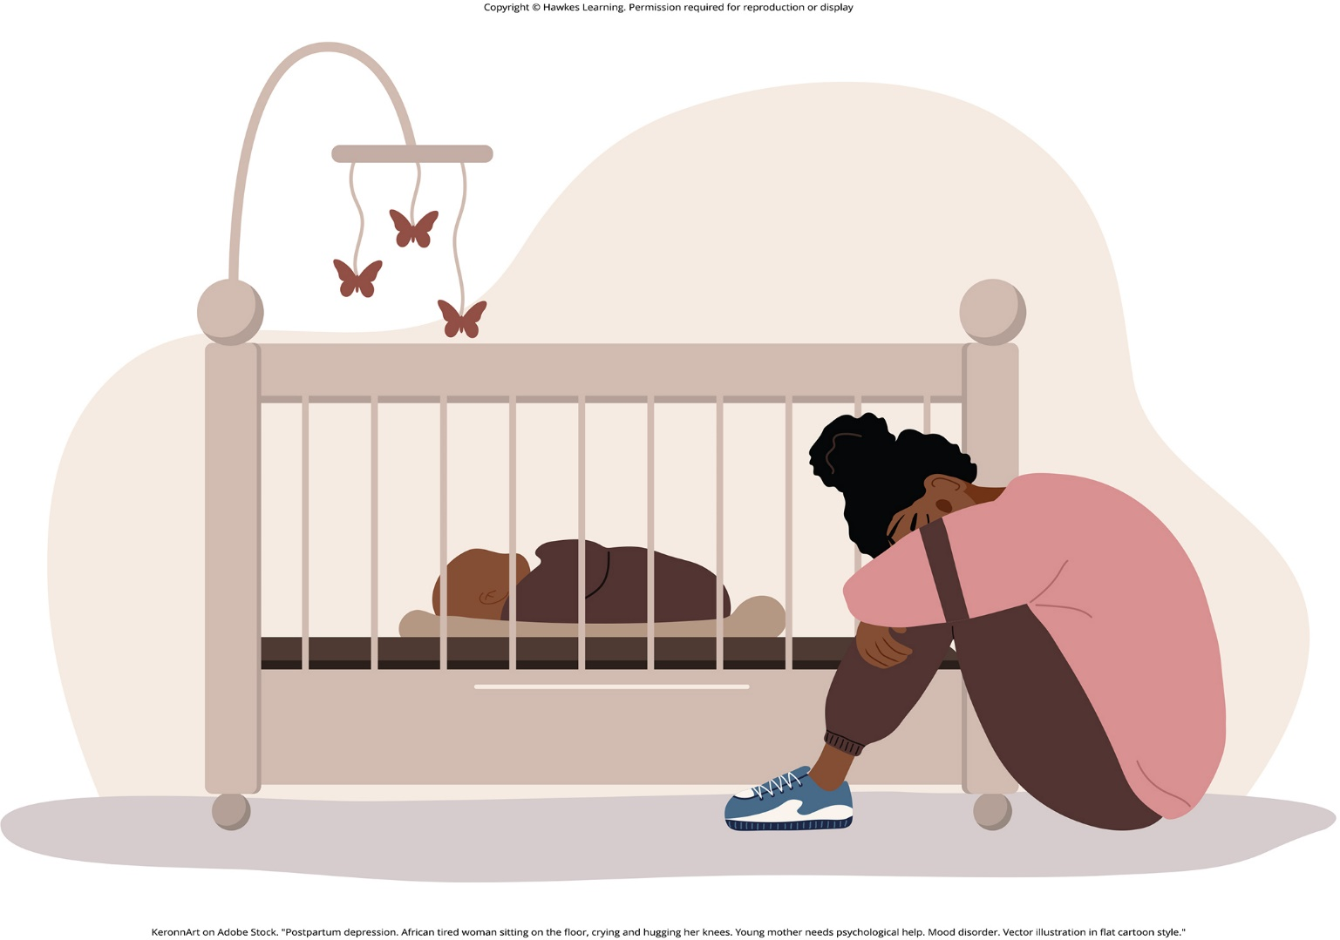
Lesson 16.2 Figure 12

Slide 25
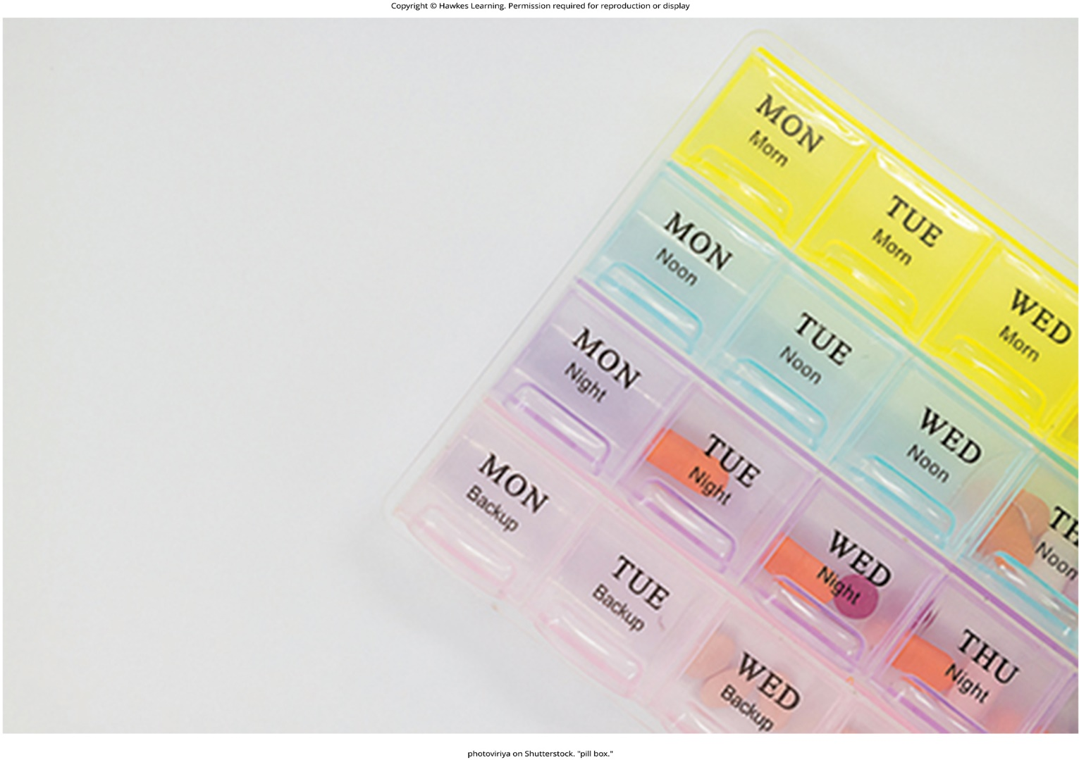
Lesson 16.2 Figure 13

Slide 26
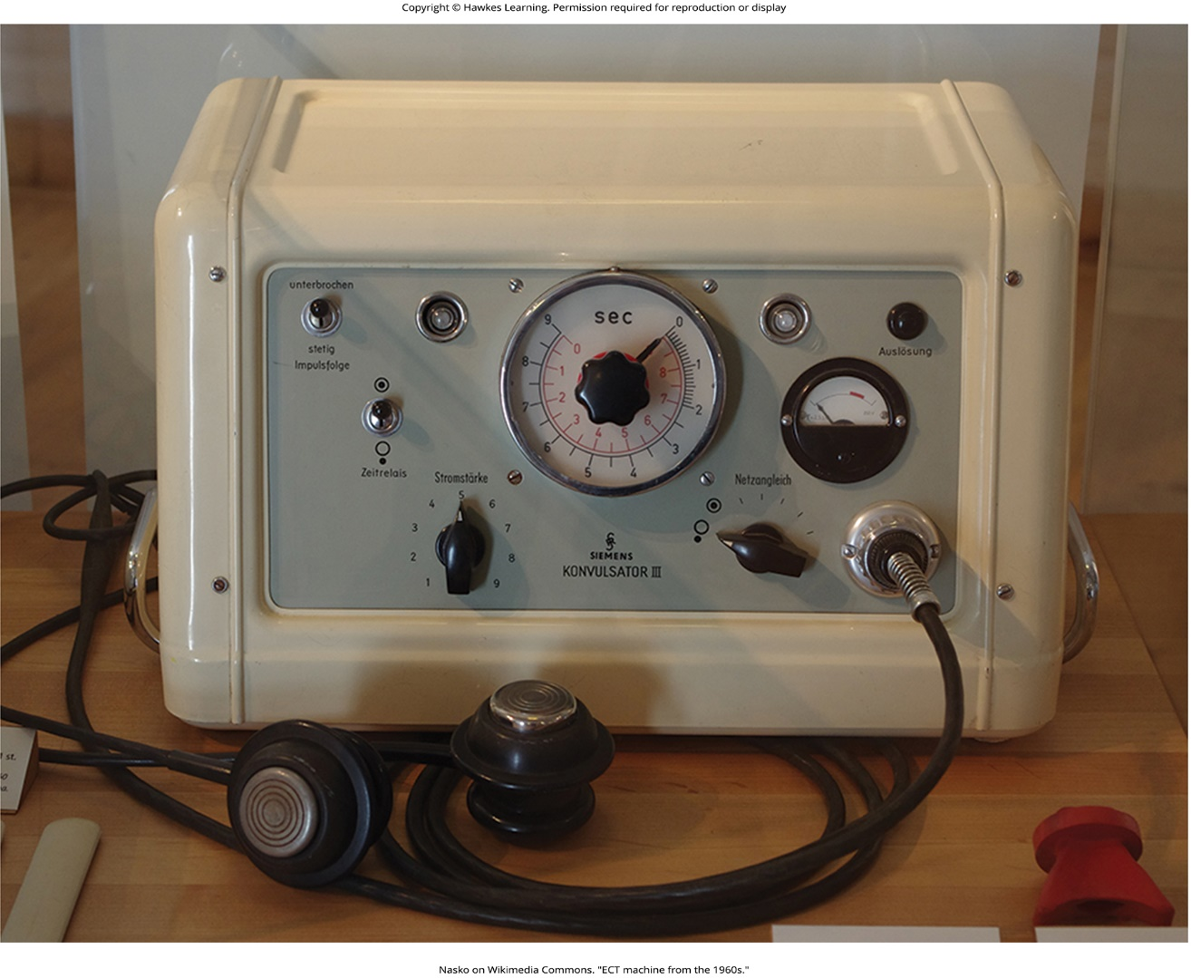
Lesson 16.2 Figure 14

Slide 27
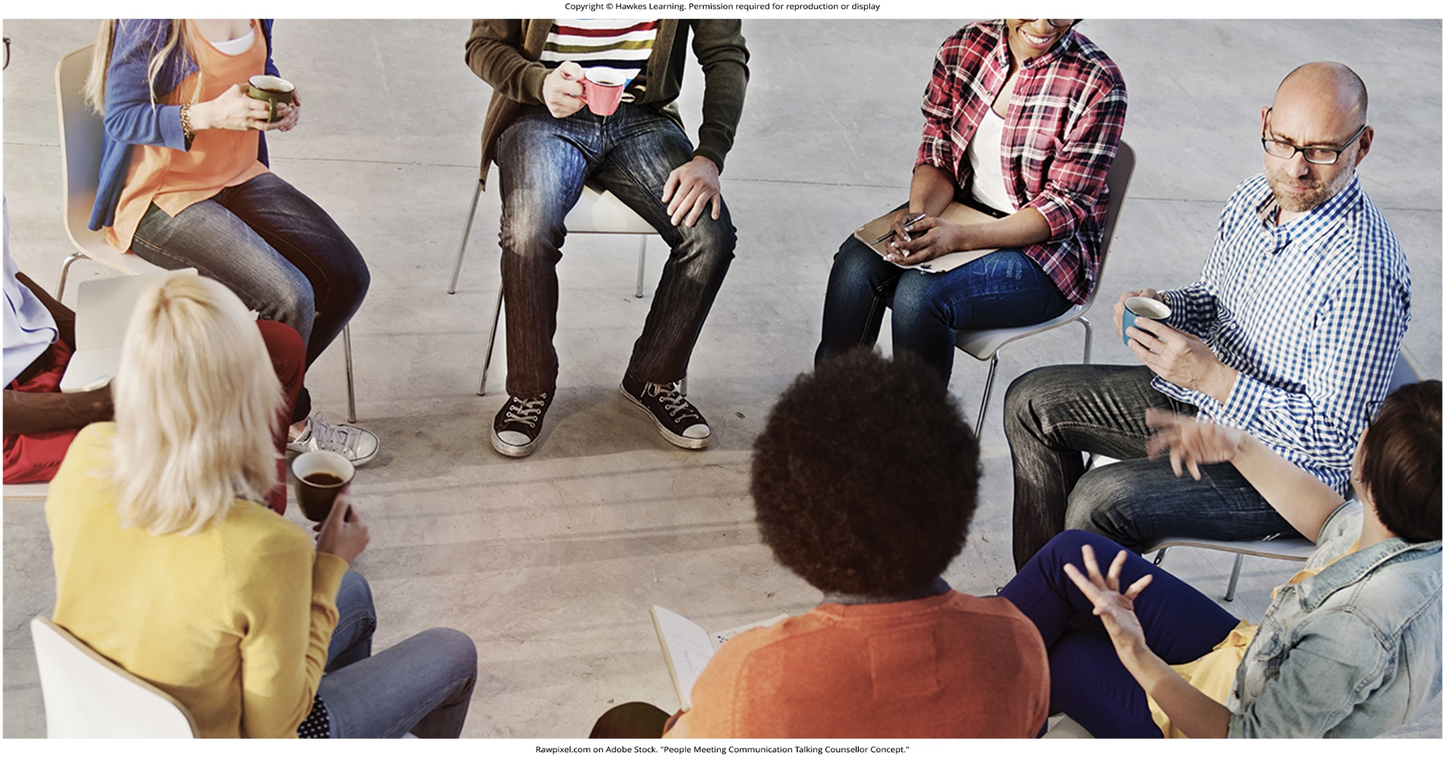
Lesson 16.3 Figure 1

Slide 28
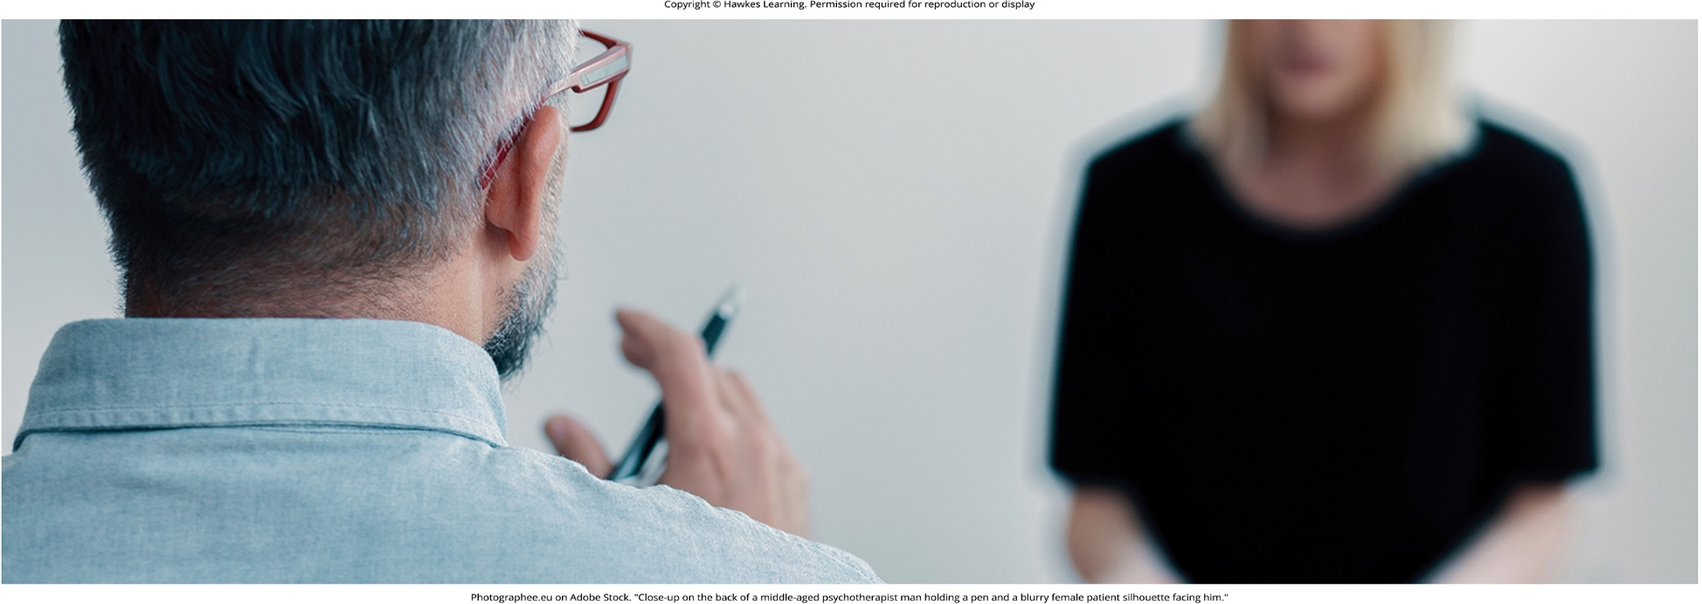
Lesson 16.3 Figure 2

Slide 29
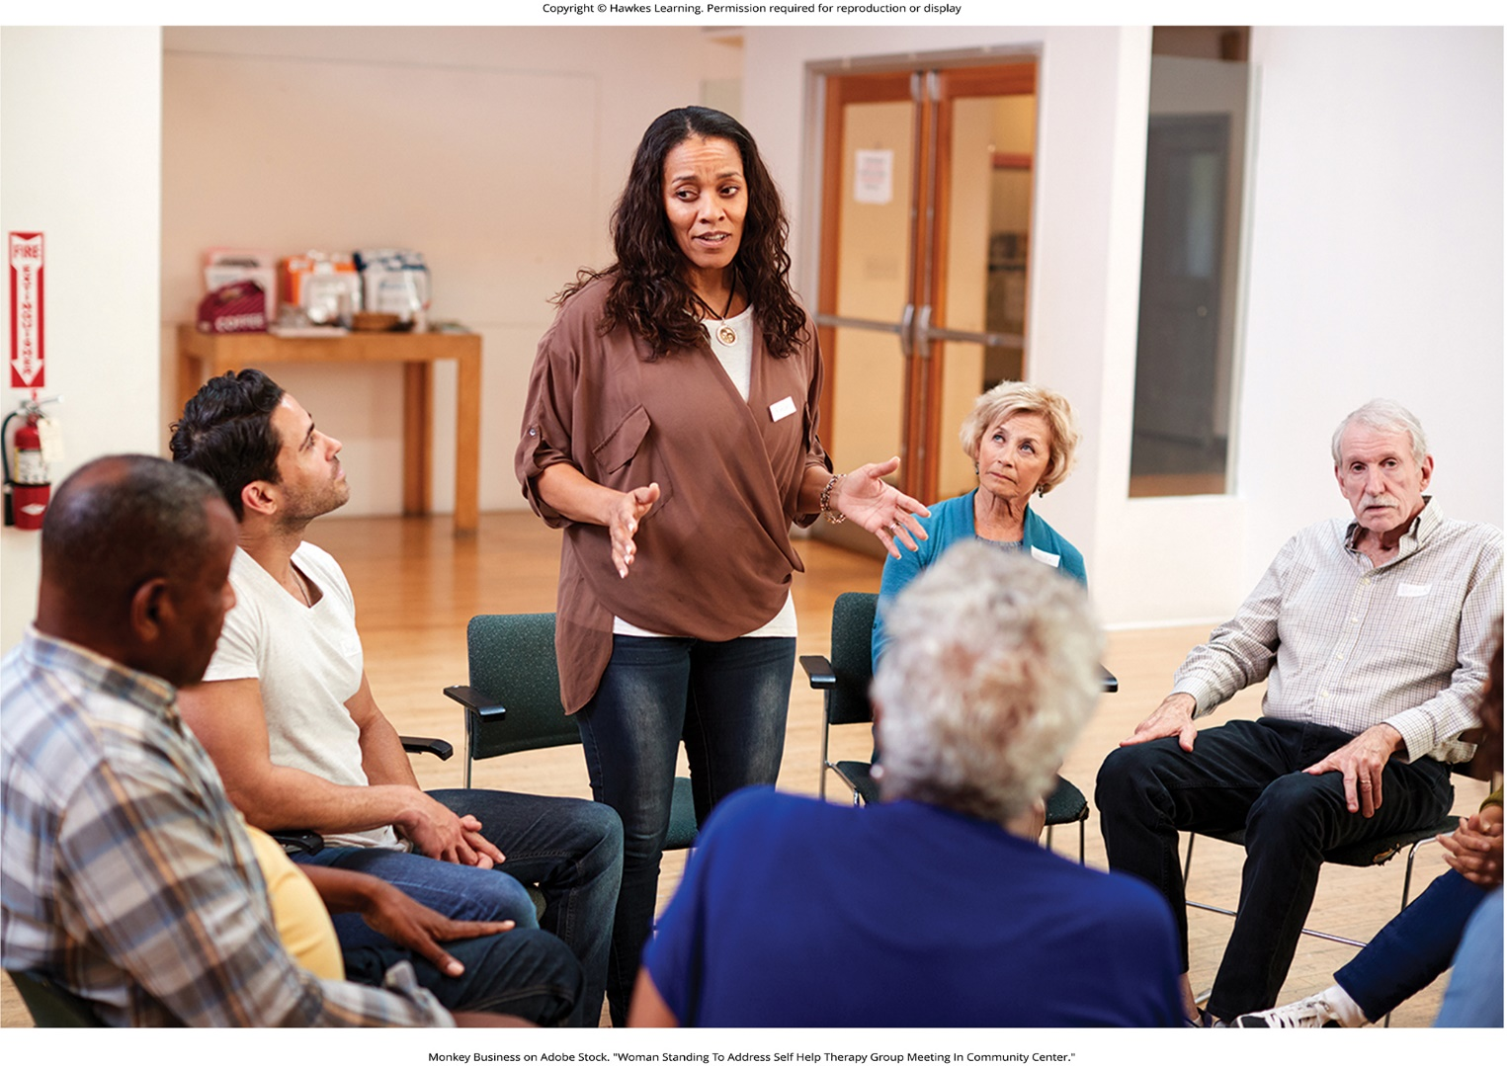
Lesson 16.3 Figure 3

Slide 30

Lesson 16.3 Figure 4

Slide 31

Lesson 16.3 Figure 5

Slide 32
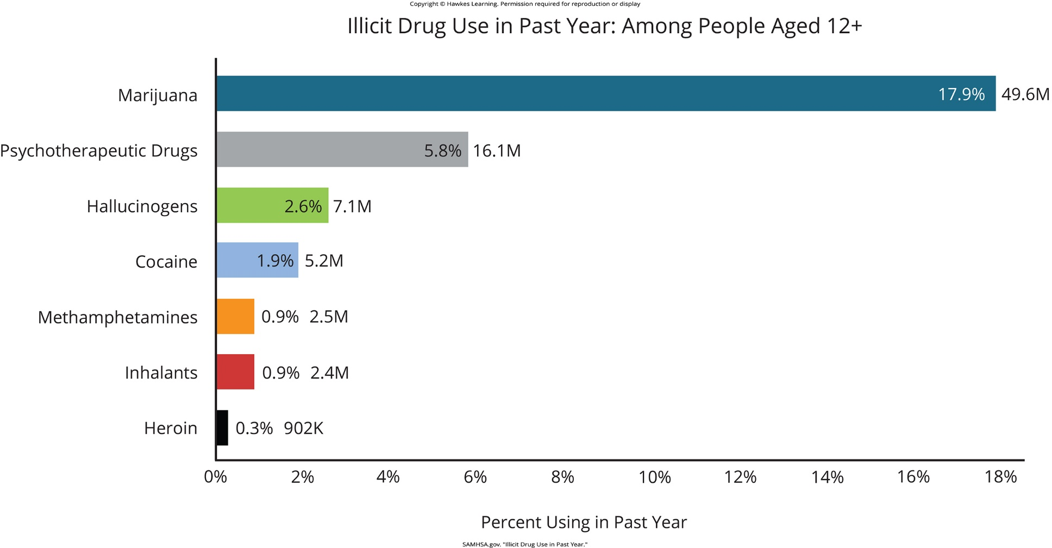
Lesson 16.4 Figure 1

Slide 33
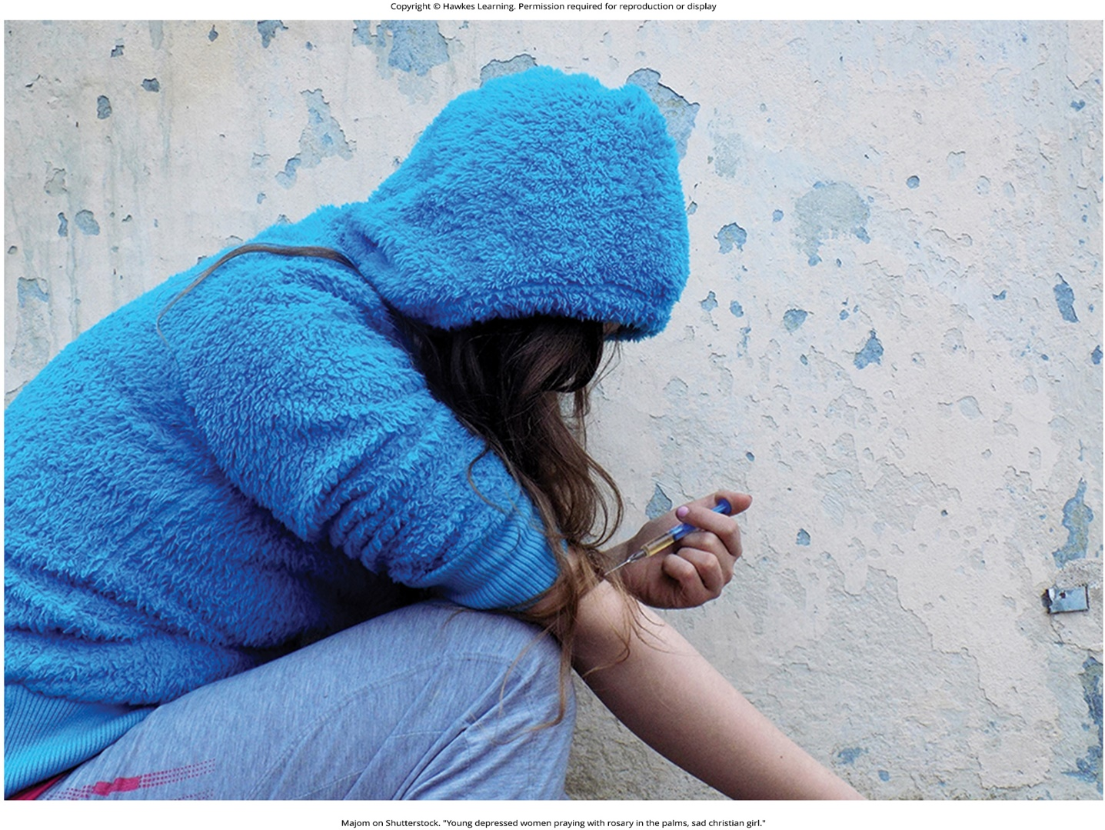
Lesson 16.4 Figure 2

Slide 34

Lesson 16.5 Figure 1

Slide 35
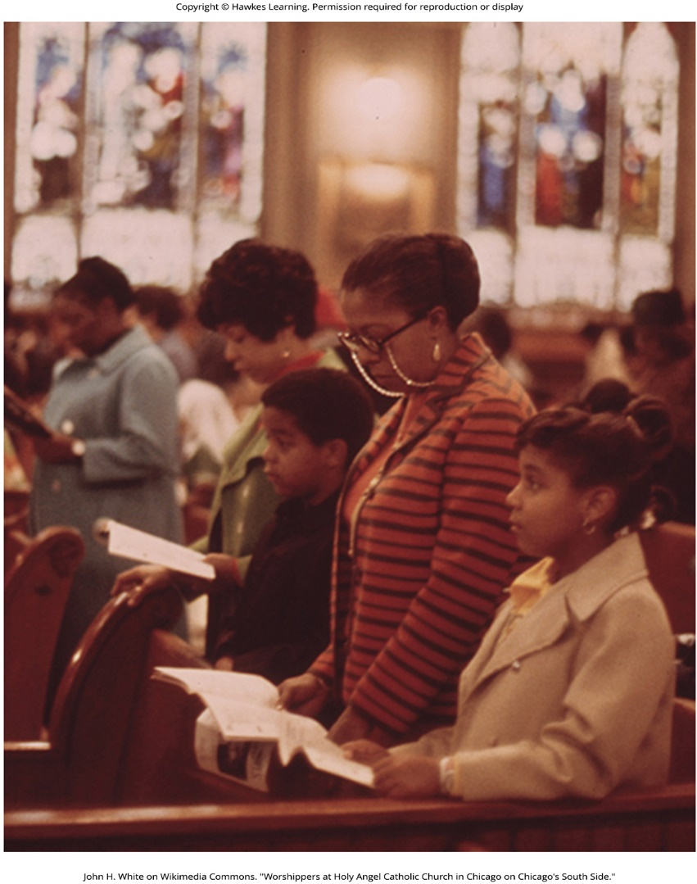
Lesson 16.5 Figure 2

Slide 36

Lesson 16.5 Figure 3

Slide 37
Hawkes Learning – End of PowerPoint

